Slide 1
CEPC High luminosity Higgs lattice impacts on the hardwares
Yiwei Wang
for the CEPC Accelerator Physics Group
CEPC day, 25 Nov. 2020

Slide 2
Outline
Design of the high luminosity Higgs lattice
Impacts on hardwares

Slide 3
The way to a high luminosity Higgs lattice
The high luminosity lattice (comparing with CDR) is mainly achieved by squeezing the beam size at IP while keep adequate beam lifetime.
Squeezing the beta function at IP
Reduction of the emittance
get enough transverse dynamic aperture and momentum acceptance

Slide 4
Overall parameters for Higgs mode
Parameters design by D. Wang et al
 | Higgs (CDR) | Higgs (high)
Number of IPs | 2 | 2
Beam energy (GeV) | 120 | 120
Circumference (km) | 100 | 100
Synchrotron radiation loss/turn (GeV) | 1.73 | 1.8
Crossing angle at IP (mrad) | 16.5×2 | 16.5
Piwinski angle | 3.48 | 4.87
Number of particles/bunch N_{e} (10¹⁰) | 15.0 | 16.3
Bunch number (bunch spacing) | 242 (0.68μs) | 214
Beam current (mA) | 17.4 | 16.8
Synchrotron radiation power /beam (MW) | 30 | 30
Bending radius (km) | 10.7 | 10.2
Momentum compact (10⁻⁵) | 1.11 | 7.34
β function at IP β_{x}* / β_{y}* (m) | 0.36/0.0015 | 0.33/0.001
Emittance e_{x}/e_{y} (nm) | 1.21/0.0024 | 0.68/0.0014
Beam size at IP s_{x} /s_{y} (μm) | 20.9/0.06 | 15.0/0.037
Beam-beam parameters ξ_{x}/ξ_{y} | 0.018/0.109 | 0.018/0.115
RF voltage V_{RF} (GV) | 2.17 | 2.27
RF frequency f _{RF} (MHz) (harmonic) | 650 (216816) | 650 (217500)
Natural bunch length σ_{z} (mm) | 2.72 | 2.25
Bunch length σ_{z} (mm) | 4.4 | 4.42
HOM power/cavity (2 cell) (kw) | 0.46 | 0.48
Energy spread (%) | 0.134 | 0.19
Energy acceptance requirement (%) | 1.35 | 1.7
Energy acceptance by RF (%) | 2.06 | 2.5
Beamstruhlung lifetime (min) | 80 | 41
Lifetime (hour) | 0.43 | 0.34
F (hour glass) | 0.89 | 0.88
Luminosity/IP L (10³⁴cm⁻²s⁻¹) | 2.93 | 5.0

Slide 5
Design of high luminosity lattice
Optimization of the quadrupole radiation effect
Interaction region: longer QD0/QF1
ARC region: longer quadrupoles
Reduction of dynamic aperture requirement from injection
Straight section region: larger βx at injection point
Maximization of bend filling factor to minimize the synchrotron radiation loss per turn
ARC region: sextupoles in two rings changed from staggered to parallel; The left drifts are used for the bends.
RF region: shorter phase tuning sections
Optimization of high order chromaticity for arc region
ARC region: new sextupole layout
To make the lattice robust and provide good start point for DA
Interaction region: reduction of L* without changing the front-end position of the FD cryo-module

Slide 6
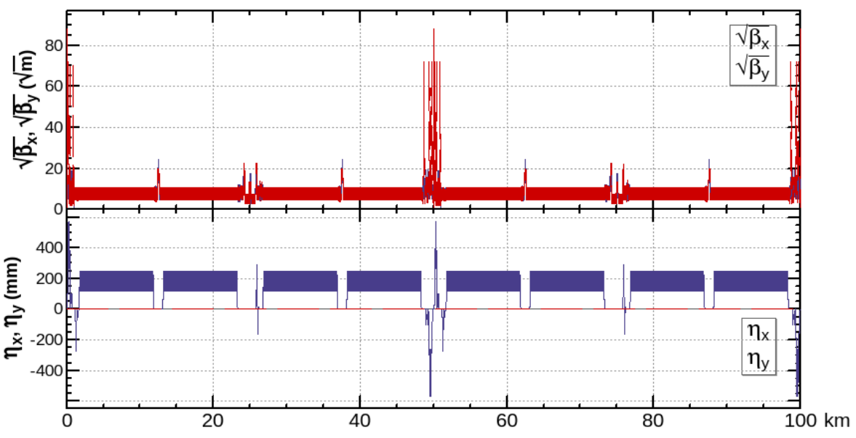
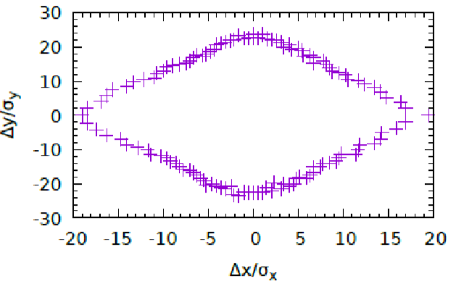
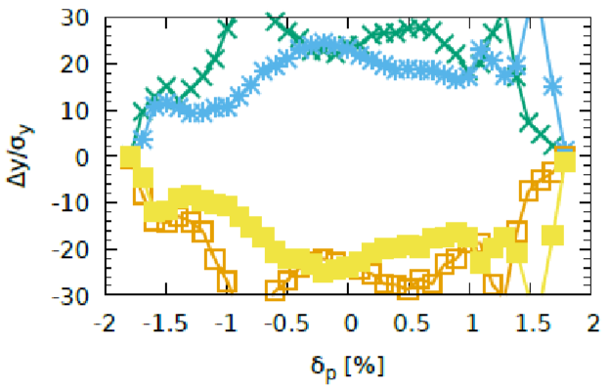
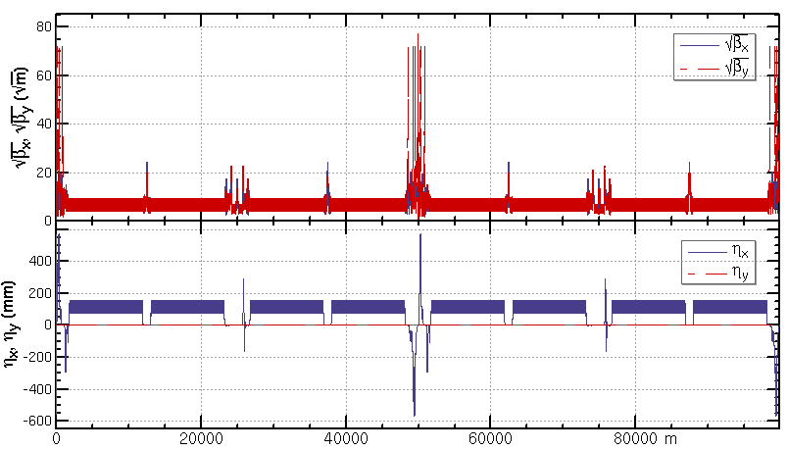
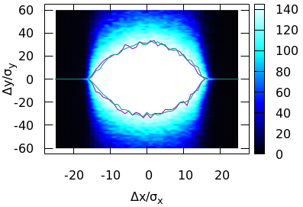
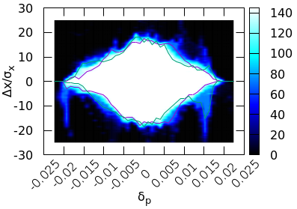
High luminosity lattice
CDR: L=$3.0×{10}^{34}/{cm}^{2}/s$
βy*=1.5mm, εx=1.2nm, L*=2.2m, 1024 FODO cells
Achieved (w/o error): $20σ_{x}×24σ_{y}×1.8\%$
Goal (w/ error): $8σ_{x}×15σ_{y}×1.35\%$
CDR: L=$5.0×{10}^{34}/{cm}^{2}/s$
βy*=1mm, εx=0.64nm, L*=1.9m, 1160 FODO cells
Achieved (w/o error): $16σ_{x}×32σ_{y}×1.9\%$
J. Wu,
Y. Zhang,
Y. W. Wang
Goal (w/ error): $8σ_{x}×15σ_{y}×1.7\%$
Notes:
$11?σ_{x}×15σ_{y}×1.7\%(booster 3.6nm)$

Slide 7
Superconducting magnets
in the interaction region
 | Higgs (CDR) | Higgs (high lumi.)
SC QD0 and QF1 | L*=2.2m, d=0.6m, QD0: 2.0m, 136T/m QF1: 1.48m, 111T/m | L*=1.9m, d=0.3m, QD0: 2.5m, 142T/m, 96T/m QF1=1.5m, 56T/m
SC anti-solenoids | maximum 7.2T | maximum 7.2T
SC sextupoles | VSIRD: 0.6m, 1635 T/m^2 HSIRD: 0.8m, 1882 T/m^2 VSIRU: 0.6m, 1562 T/m^2 HSIRU: 0.6m, 1999 T/m^2 | VSIRD: 0.6m, 1511 T/m^2 HSIRD: 0.8m, 2099T/m^2 VSIRU: 0.6m, 1935 T/m^2 HSIRU: 0.6m, 1413 T/m^2 (safety factor 50% for strength )

Slide 8
Normal conducting magnets
Main magnets in the ARC | Higgs (CDR) Quantity, length and field | Higgs (high lumi.) Quantity, length and field
Dipoles (dual aperture) | 2320, 28.686 m, 373 Gs | 2944, 21.7 m, 390 Gs (Quant +27%, total length -4%)
Quadpoles (dual aperture) | 2320, 2 m, 8.4 T/m | 2944, 3 m, 10.6 T/m (Quant +27%, total length 90%)
Sextupoles (single aperture) | SF: 896, 0.7 m, 506 T/m^2 SD: 896, 0.7 m*2, 506 T/m^2 | SF: 1024, 0.7 m, 1100 T/m^2 SD: 1024, 0.7 m*2, 1129 T/m^2 (Quant +14%, total length 14%)

Slide 9
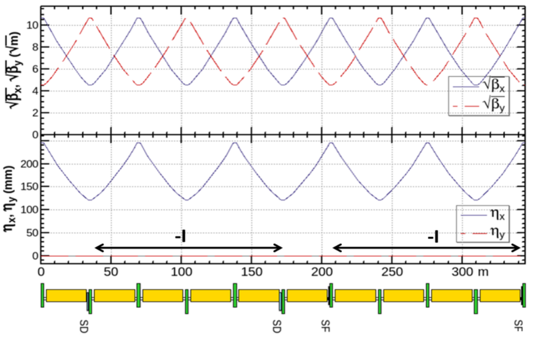
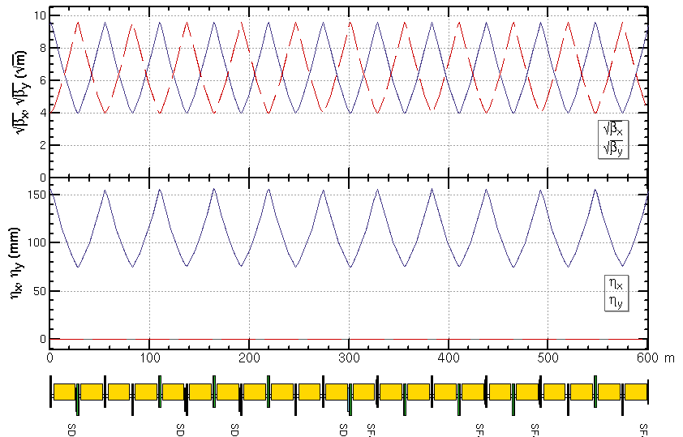
Mechanical systems
ARC period (CDR)
345m, 5cells, 10bends, 10 quads, 4 sextupoles,
staggered sextupoles in two rings
ARC period (High lumi)
600m, 11cells, 22bends, 22 quads, 8 sextupoles,
parallel sextupoles in two rings, more sensitive to alignment error

Slide 10
Other systems
Beam instrumentation: Quantity of BPMs increased with 27%
SC RF system: voltage from 2.17 GV to 2.27 GV
Separating system(bend + static separator, or kicker + septum)
Magnet Power supply: Quantity of sextupoles power supply increased with 14%
Vacuum system: aperture need to be check
Injection and extraction
civil construction
Synchrotron radiation lines
Beam dump system
…

Slide 11
Summary
The high luminosity lattice (comparing with CDR) is mainly achieved by squeezing the beam size at IP while keep adequate beam lifetime.
The impacts on the technical systems are estimated for several systems which are most impacted.

Slide 12
Backup

Slide 13
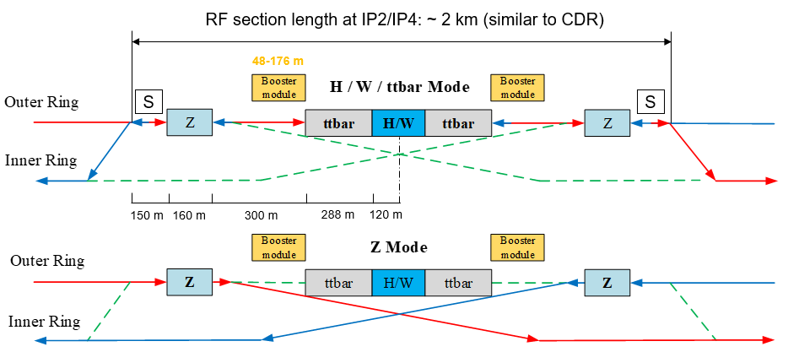
A possible scheme of the RF region*
*talk of Jiyuan ZHAI, CEPC SCRF system and R&D, 14:00 Accelerator section, october 26, 2020

Slide 14
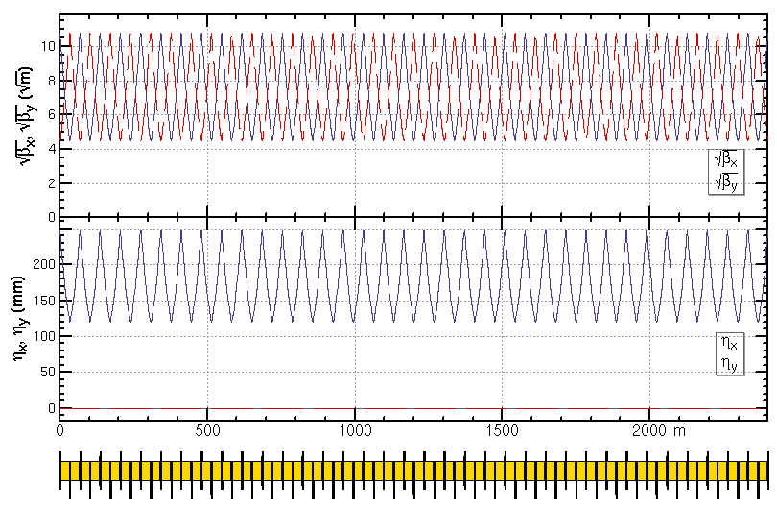
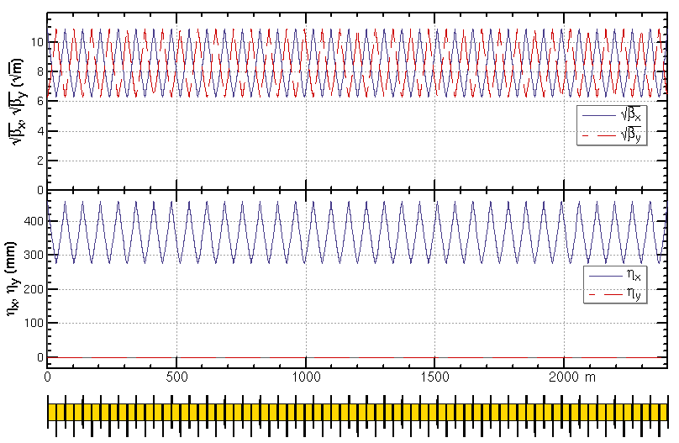
ARC region for other modes
For the arc region, the phase advance of each cell will be changed from 90/90 to 60/60 and the additional sextupoles need to be installed for the Z mode (Ref: FCC-ee CDR).
H/W/tt modes: 5 cells/period, 42 sextupoles in 35 cells
Z mode: 7 cells/period, 12 additional sextupoles (+29%) in 35 cells
SF
SD
SD
SF
SD
35 cells of H/W/tt mode
35 cells of Z mode

