Slide 1
Optical data transmission for silicon pixel detector readout
Xiaoting Li
Electronics Group of Experimental physics Center
11 Nov. 2020

Slide 2
Outline
Introduction of optical data link
Research status and development
My research status
Summary

Slide 3
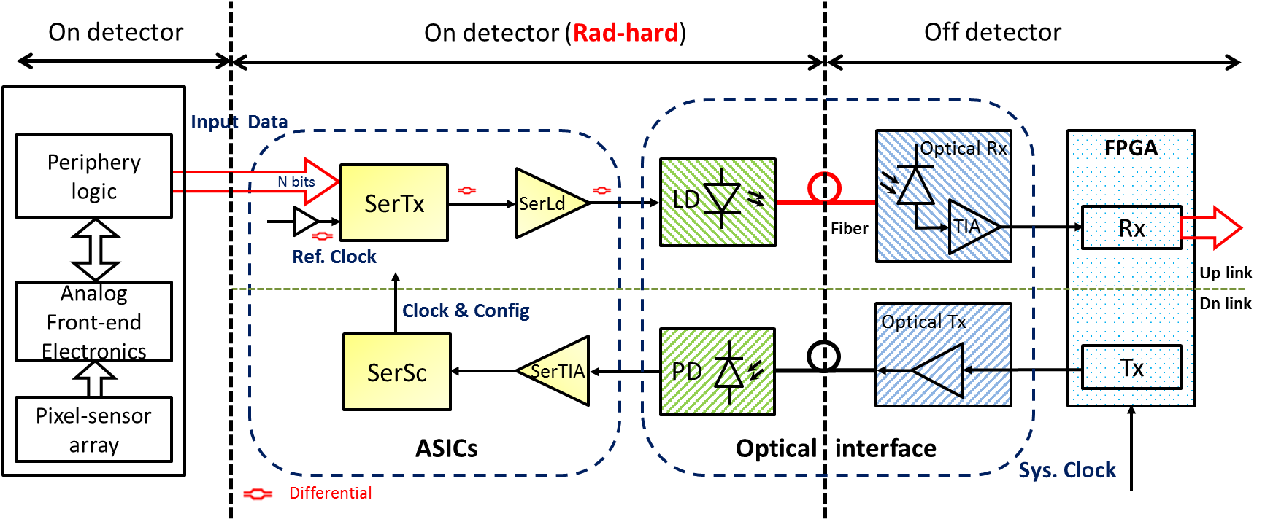
Optical data link
Communications between detector (pixel-array chips) and counting room (FPGAs)
Up link (data link):
Transmitter: (on detector)
Receive parallel data from a pixel array
Serialize (SerTx) and drive (SerLd) the high-speed data to a laser diode (LD)
Receiver: (off detector)
Receive and transfer optical signals to electrical
An FPGA receives and processes the electrical signals
Down link (control link):
Similar to the up link but with different direction
Reference clock and slow control
Custom ASICs (rad-hard requirement):
SerTx (GBTX)
SerSc
SerLd (GBLD)
SerTIA (GBTIA)
Up link
Dn link

Slide 4
Outline
Introduction of optical data link
Research status and development
My research status
Summary

Slide 5
Research status and development – Serializer
Transmitter (serializer part) on detector
Name | Year | Designer | Technology | Encoder | TX_DR (Gbps) | Power (mW) | Total Jitter (ps)
GLink | 1992 | CERN | Silicon Bipolar |  | 1.6 | 1900 | --
GOL | 2001 | CERN | 0.25μm CMOS |  | 1.6 | 400 | 107
LOCs1 | 2010 | SMU | 0.25μm CMOS SOS | ---- | 5.0 | 463 | 62
GBT | 2010 2016 | CERN | 0.13μm CMOS | Reed-Solomon | 4.8 | 330 | 52.4
LpGBT | 2014 | CERN | 65nm CMOS | RS | 4.8 | 20 | --
LOCs2 | 2014 | SMU | 0.25μm CMOS SOS | ---- | 8.0×2ch | 1250 | 25
LOCx2 | 2016 | SMU | 0.25μm CMOS SOS | Cyclical Redundancy Check | 5.0×2ch | 950 | 42
LOCx2-130 | 2018 | SMU | 0.13μm CMOS | CRC | 4.8×2ch | 440 | 52
---- | 2018 | SMU | 0.18μm CMOS | RS | 3.2 | 135 | 60.2
New LpGBT | 2019 | CERN | 65nm CMOS | RS | 10
---- | 2018 | RAL | 65nm CMOS | 64b66b | 10 | -- | BER 10⁻¹⁶
DR of a single channel
5 Gbps
130/250 nm
10 Gbps
65 nm
CERN: Conseil Européenn pour la Recherche Nucléaire
SMU: Southern Methodist University
RAL: Rutherford Appleton Laboratory, Harwell Oxford
20 Gbps…
65 or smaller

Slide 6
Research status and development – Laser driver
Laser driver (array driver) on detector
Name | Year | Designer | Technology | Data Rate (Gbps) | Imod （mA） | Ibias （mA） | Power （mW） | Tj （ps） | TID （rad）
GBLD | 2009 2012 | CERN | 0.13 μm CMOS | 5 | 2-24 | 2-48 | ---- | 25 | ----
VDC | 2010 | OSU | 0.13 μm 8RF-DM CMOS | 5×4chA | 12 | 2 | ---- |  | 46M
GBLD | 2013 | CERN | 0.13 μm CMOS | 7.5 | 2-24 | 2-48 | ---- | 22 (best) | 100M
LOCld1 LOCld2 | 2013 2015 | SMU | 0.25 μm CMOS SOS | 8 8×2ch | 7.8-10.6 | 2-15 | 200/ch (Im-Ib: 6.4-6 mA) | ＜30 | pass
GBLD10 | 2015 | CERN | 0.13 μm CMOS | 10 | 0-12 | 0-43 | 85 | E- 13.68 O- 28.42 | 500M
GBLD10+ | 2016 | CERN | 65 nm CMOS | 10 | 0-12 | 0-43 | 31 | E- 22 ---- | ----
LDQ10 | 2017 | SMU | 65 nm CMOS | 10×4chA | 0-8 | 0-12 | 32.5/ch (4-6 mA) | E- 15.47 O- 17.97 | 300M
VLAD/lpVLAD | 2017 | SMU | 65 nm CMOS | 10×4chA | ---- | ---- | 34/ch, 22/ch （6-2 mA） | O- 48, 37 | 350M
VLAD14 | 2019 | SMU | 65 nm CMOS | 14×4chA | ---- | ---- | 55/ch （6-2 mA） | O- 14.8 | ----
---- | 2019.7 | CCNU | GSMC 0.13 μm SOI CMOS | 10 (Sim) | 2-8.6 | 1-3 | 51.2 (5-2 mA) | ---- | ----
Array
OSU: Ohio State University 4chA: 4-channel array
E: Electrical O: Optical
Im-Ib: Imod-Ibias

Slide 7
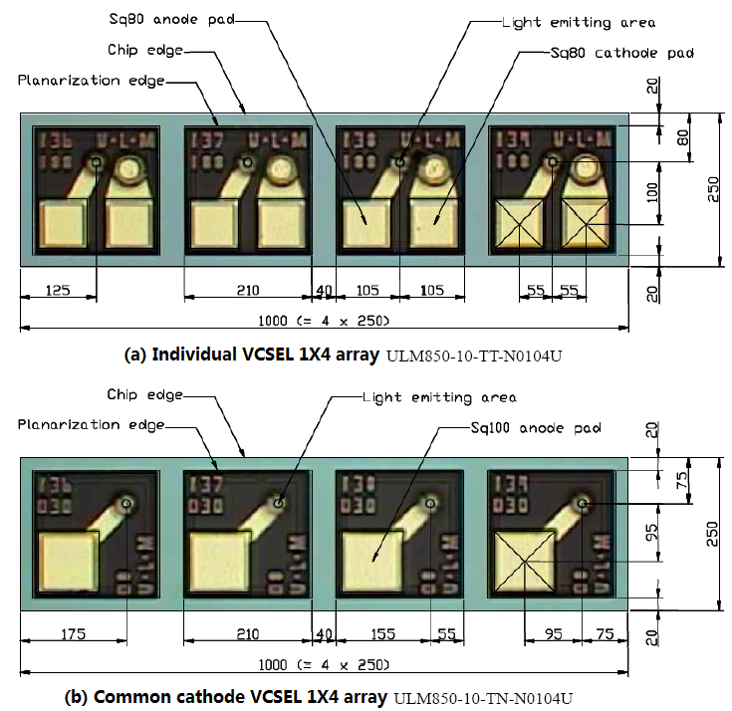
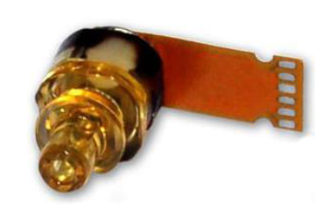
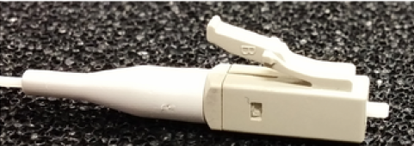
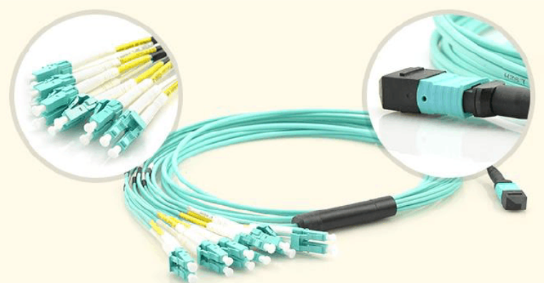
Research status and development – LD & PD
Laser Diode / PIN Diode
VCSEL (Vertical Cavity Surface Emitting Laser)
TOSA/ROSA module
VCSEL array
Fiber connector: FC, SC, ST, LC…
Connections of ASIC chips and LD/PD
TOSA (LC)
LC connector
Bonding wire
PCB #1
Alignment
Optical 90-degree turn
Custom
3D print interface
3D wiring on silicon substrate
…
PCB #2
Connector
array
MTP…
array
PCB #3
MTP-LC connector

Slide 8
Outline
Introduction of optical data link
Research status and development
My research status
Summary

Slide 9
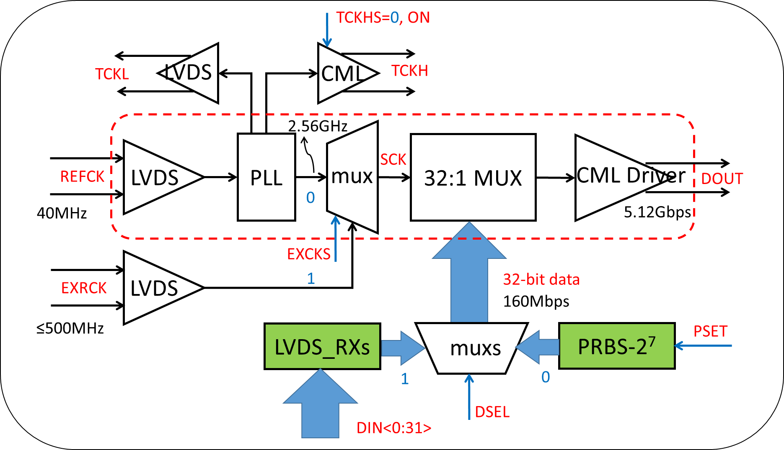
My research status
CEPC MOST2 project (180-nm CIS CMOS technology, Two MPWs: 2019.6, 2020.2)
160 Mbps in trigger mode and 4 Gbps in triggerless mode
Research works (130/55-nm CMOS technology, Two MPWs: 2015, 2017, 2019, 2020)
4 Gbps (upgraded to 5.12Gbps) serializer ASICs in 130 nm
10 Gbps serializer ASIC in 55 nm
Future research
Low power, radiation-tolerant,
high-speed serializer ASIC

Slide 10
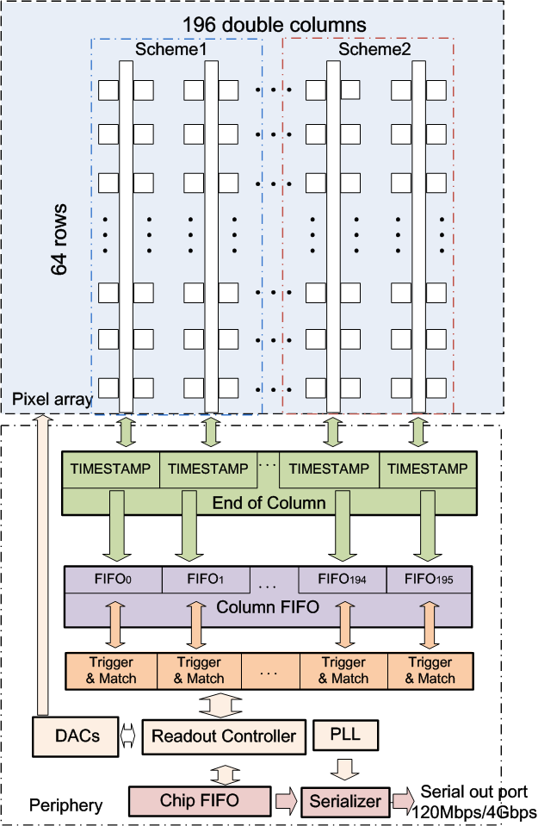
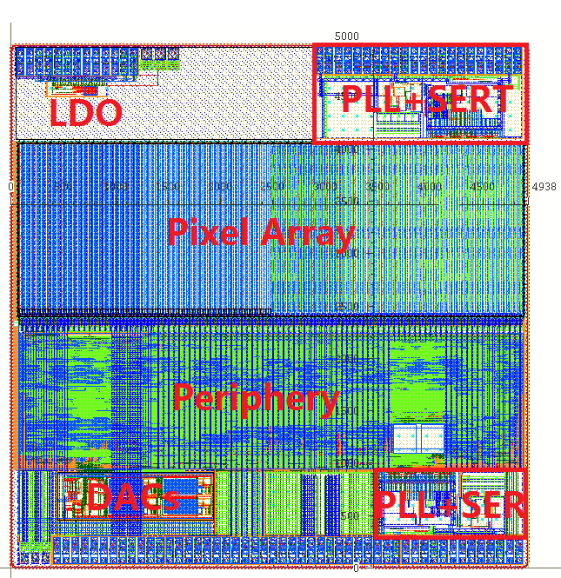
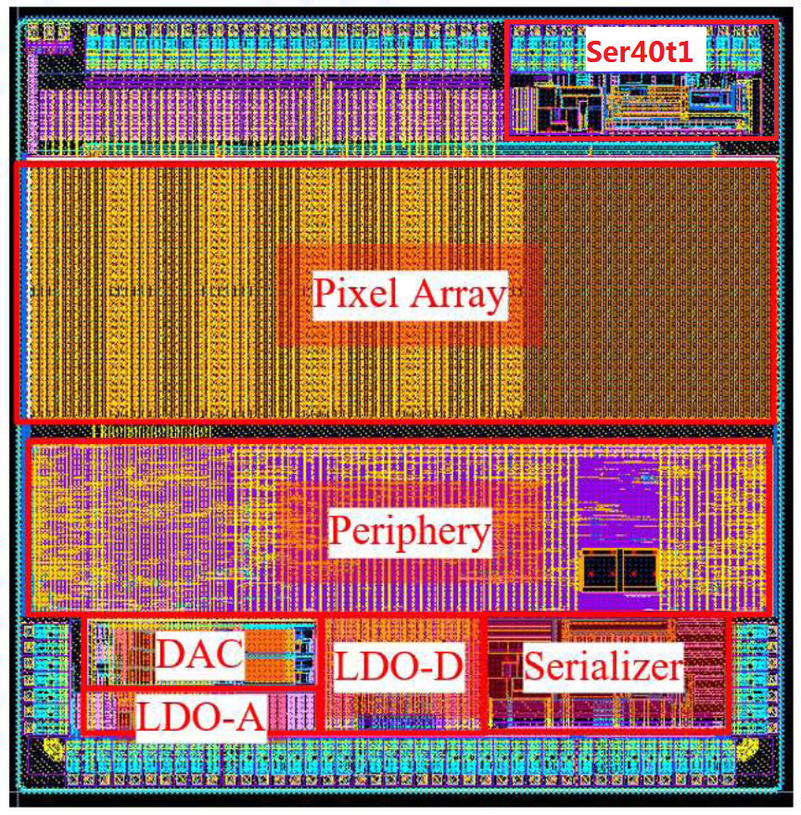
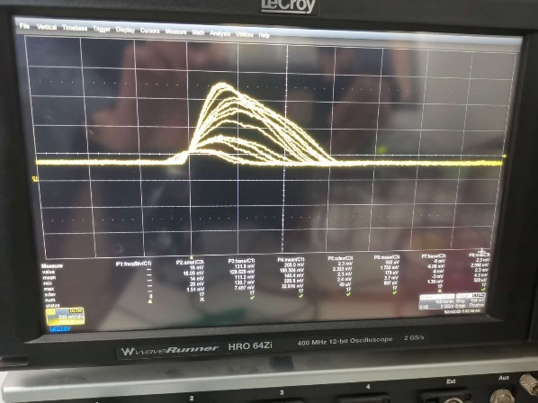
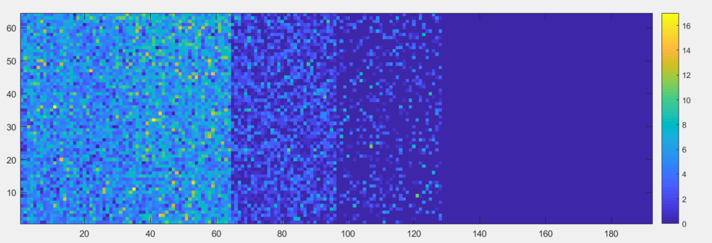
My research status – MOST2 project
CEPC MOST2 project (2019.6, 2020.2)
40-MHz systerm clock, 512R×1024C array, 25μm pitch, 120 MHz/Chip, 32 bits, 8b10b encoder
160 Mbps in trigger mode and 4 Gbps in triggerless mode
A 64-rows×192-cloclums prototype ASIC was fabricated in two MPWs
Chip status
TaiChuPix1:
Pixel analog, Periphery and SER were fully functional proved
Found and located several bugs
TaiChuPix2:
Modified major bugs
Optimized pixel readout
Added 8b10b encoder and chip-to-chip interconnection attempts
A full signal chain (light to PC) was functional proved @ 160Mbps
More detailed tests are ongoing
Beam tests and TID test are preparing
TCP1: 5×5 mm²
TCP2: 5×5 mm²
TCPix2: X-ray tube at 8keV, 50uA

Slide 11
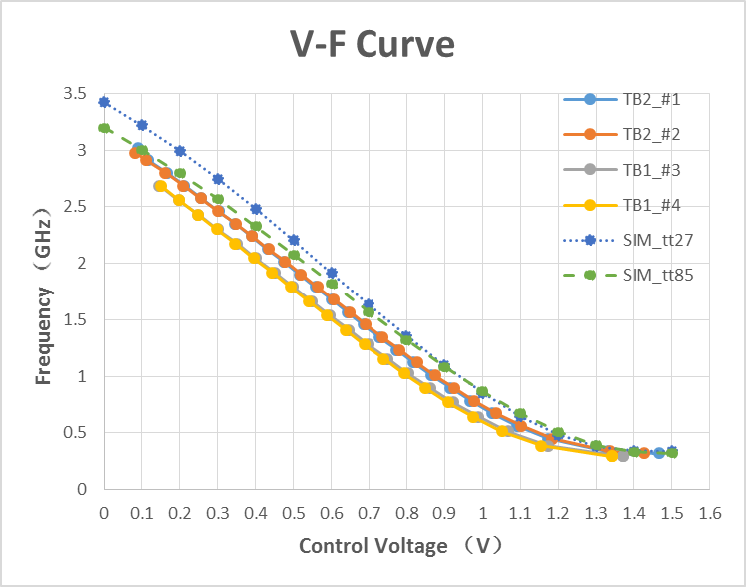
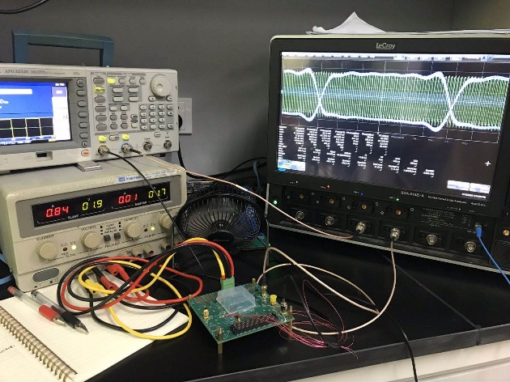
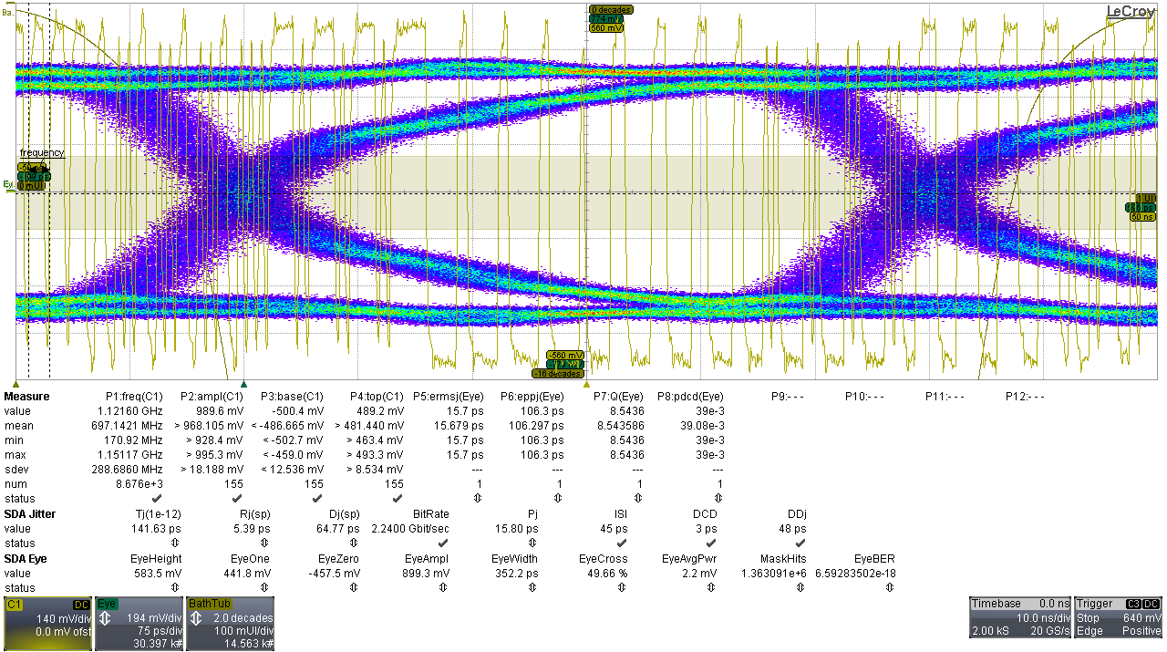
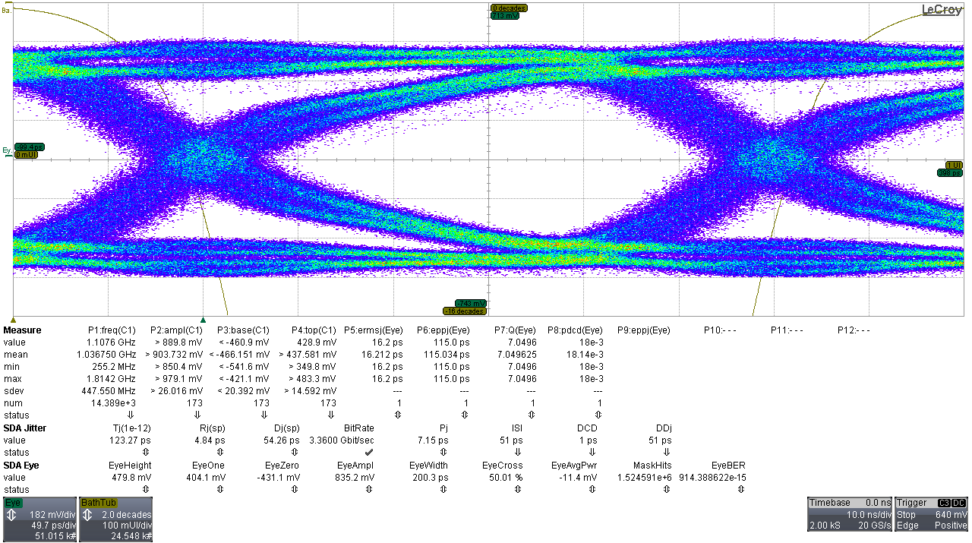
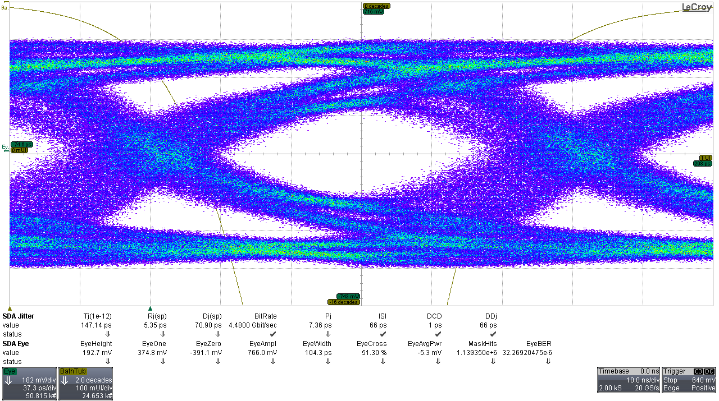
My research status – MOST2 project
Test status of SER block
TaiChuPix1:
Working well at 2.56 Gbps
Large jitter introduced at 4 Gbps
TaiChuPix2:
Will start soon later
PLL test
Tj: 141.63 ps
Rj: 5.39 ps
Dj: 64.77 ps
ISI: 45 ps
Tj: 123.27 ps
Rj: 4.84 ps
Dj: 54.26 ps
ISI: 51 ps
Tj: 147.14 ps
Rj: 5.35 ps
Dj: 70.90 ps
ISI: 66 ps
TCPix1: Eye diagram @ 2.24Gbps (TB2_#1) @ 3.36Gbps @ 4.48Gbps

Slide 12
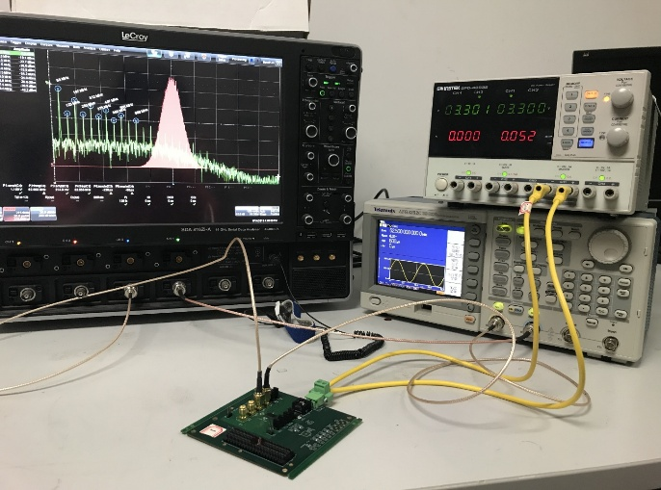
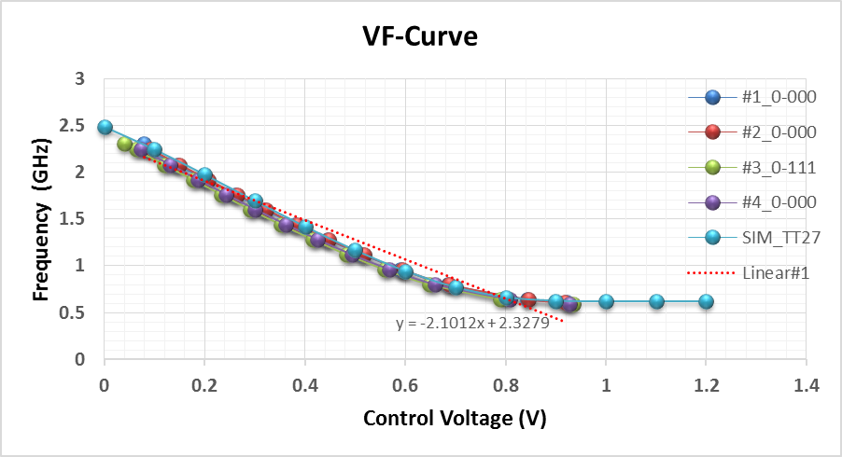
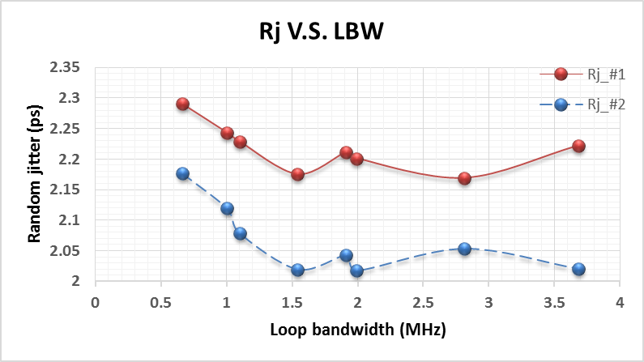
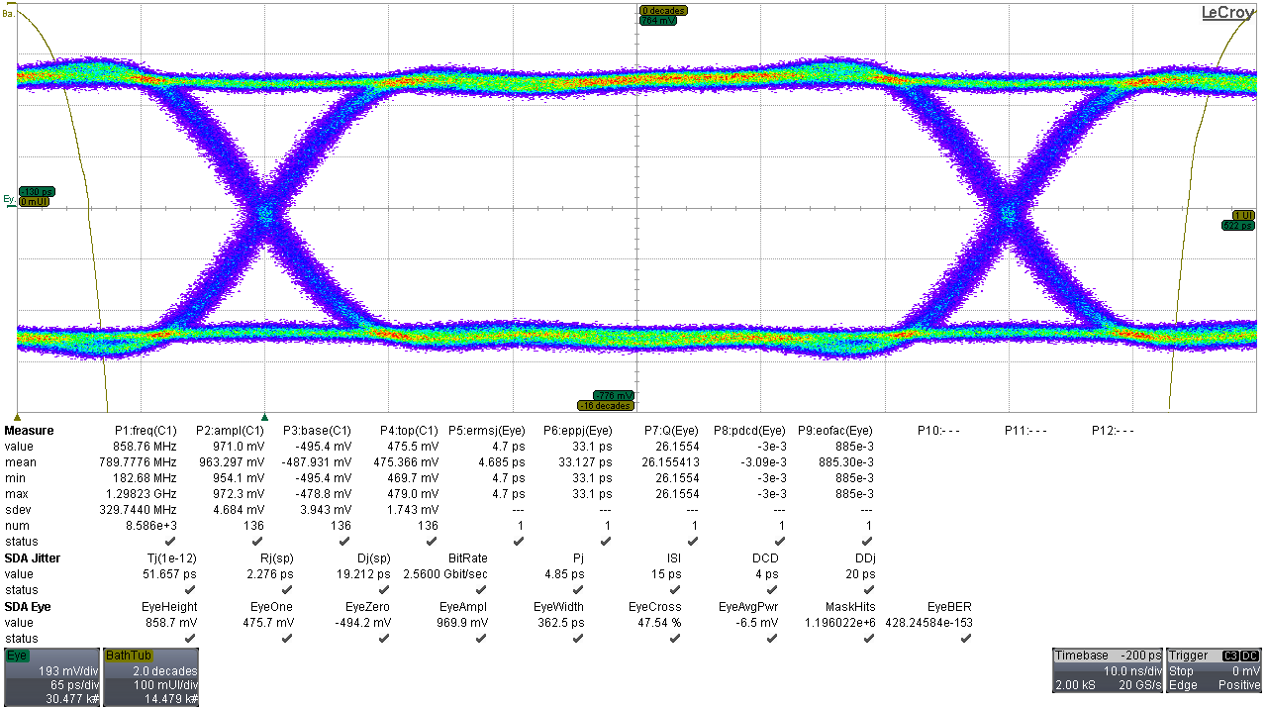
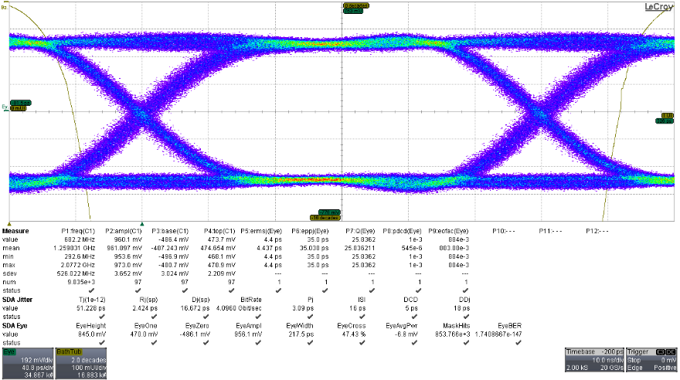
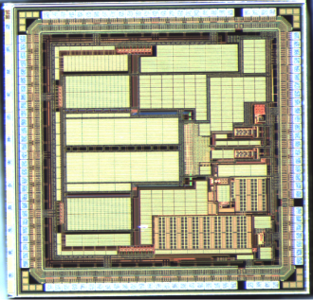
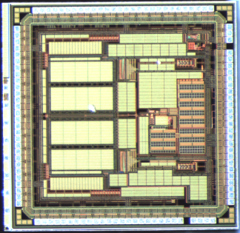
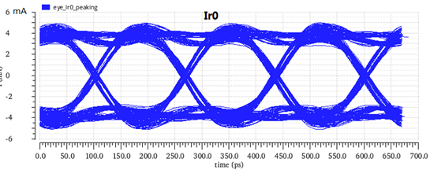
My research status – research works
Research works (2015, 2017, 2019)
4-Gbps 32:1 serializer (without encoder)
Laboratory test was finished, and met the design expectation
Preparing for the radiation tests
Optimize and upgrade to 5.12 Gbps (2.4×2.4 mm²), preparing for test
(Funded by State Key laboratory of Particle Detection and Electronic 2019.1-2019.12)
2.56 Gbps
Tj: 51.66 ps
Rj: 2.28 ps
Dj: 19.22 ps
ISI: 15 ps
PLL tests
4.096 Gbps
LVDS_RX
MUX
PLL
CMLdriver
Tj: 51.23 ps
Rj: 2.43 ps
Dj: 16.68 ps
ISI: 16 ps
32:1 SER 32:2 SER
Simulation @ 6Gbps

Slide 13
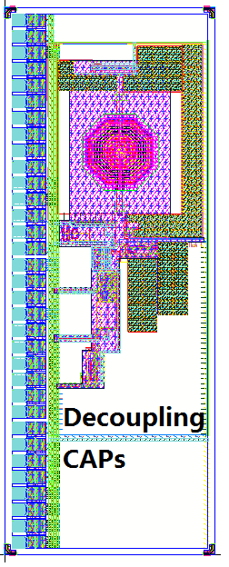
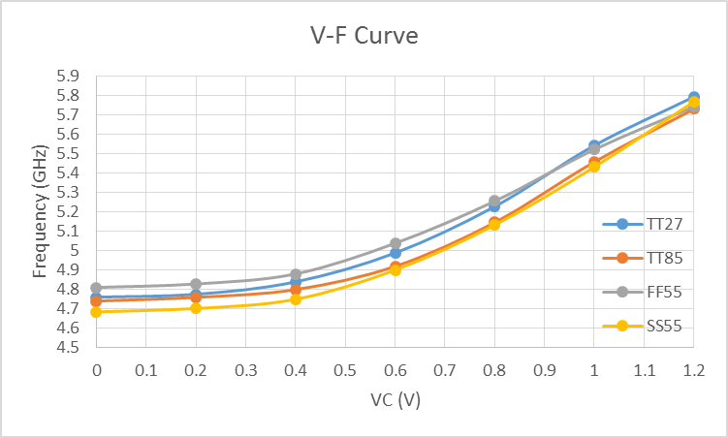
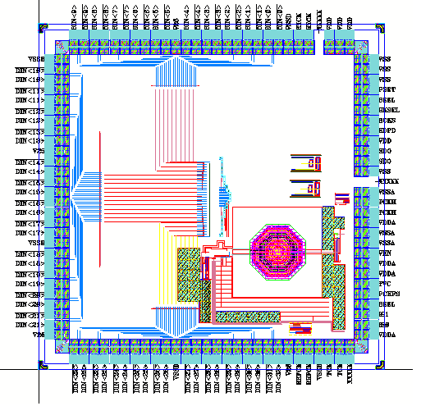
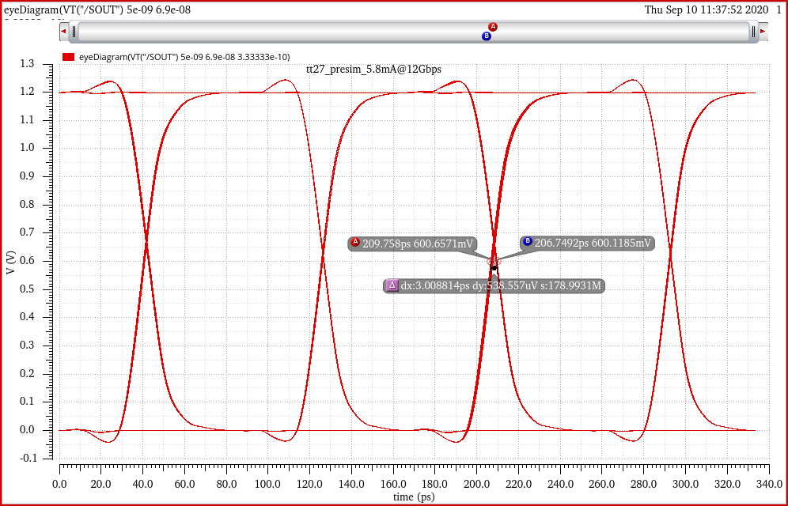
My research status – research works
Research works (2020)
10-Gbps 32:1 serializer in 55 nm
5-GHz PLL was taped-out in July 2020
10-Gbps serializer is under design
Future researches
Low power, radiation tolerant serializer for integrating into pixel array ASIC. (Study on key techniques of high-speed low-power and radiation-tolerant data transmission ASIC for silicon pixel detector, NSFC 2020 of youth)
Related researches in the electronic group
Encoding and decoding techniques based on digital design flow in 130-nm process (Jie Zhang)
LCPLL: 0.9×2.35 mm² Simulations
SER10：about 2×2 mm² A simulation before driver

Slide 14
Outline
Introduction of optical data link
Research status and development
My research status
Summary

Slide 15
Summary
Generally introduced the optical data transmission for silicon pixel detector readout
Collected and compared several researches of serializer and laser driver. Researches trend to higher speed single-channel data rate and smaller size of the process.
Presented some recent works on serializer and future works aiming for low power and rad-hard
Thank you!

Slide 16
3D wiring on silicon substrate
A side view of ASICs and Multi-channel optical interface

