Slide 1
CEPC SR System and BES testbeam facility
CEPC SR study group
2020.11.04
CEPC physics and detection

Slide 2
Outline
CEPC CDR: parameters and baseline layout
SR design in the CEPC CDR
The new design: parameters, baseline and the applications
The vacuum chamber design and the requirement to the bend magnetic
Tunnels, halls and vertical shafts for the SR stations
The challenges and the next works
Summary

Slide 3
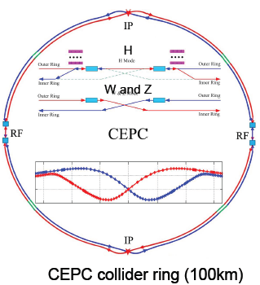
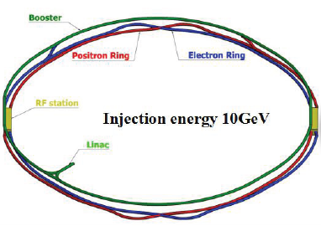
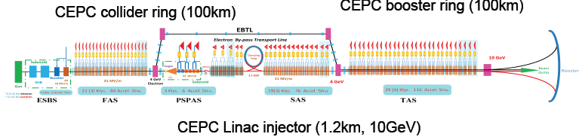
CEPC CDR baselines layout
Notes:
Considering : radiation power, the baseline layout, the cost and the polarization for Z or W mode. If we add wiggler, it maybe useful for polarization, but increase the radiation power also the cost.

Slide 4
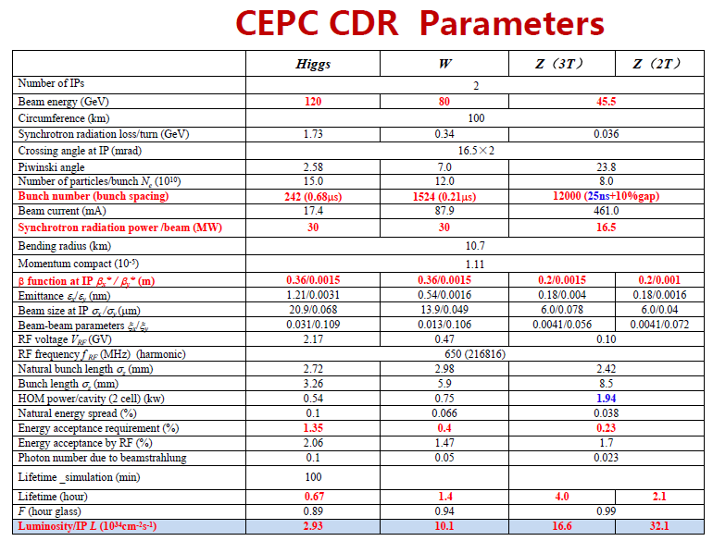
Notes:
The bunch number: 0.68us the dynamic imagination, the time resolution
The bunch length:90ps: 2.72mm

Slide 5
Outline
CEPC CDR: parameters and baseline layout
The design: parameters, baseline and the applications
The vacuum chamber design and the requirement to the bend magnetic
Tunnels, halls and vertical shafts for the SR stations
The challenges and the next works
Summary

Slide 6
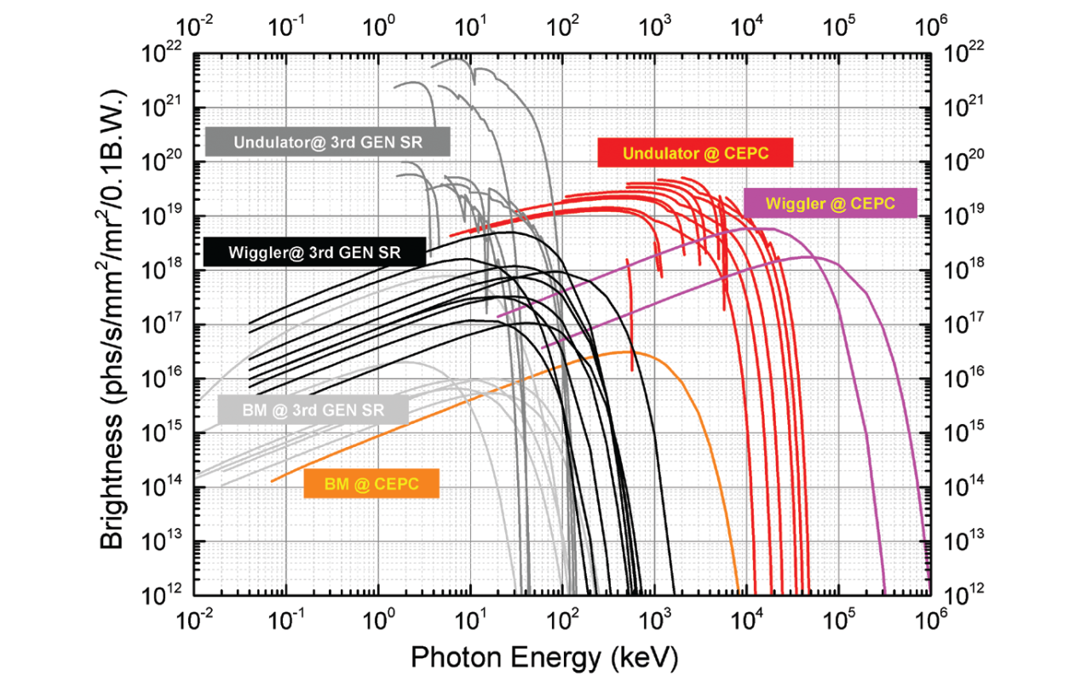
Brightness of the SR from bent iron, torsion, oscillator and low-K undulators in future high-energy particle colliders(CEPC-CDR)
The torsion pendulum has a characteristic gamma energy of 19.2 MeV and a high flux radiant energy of 300 MeV. The gamma light energy produced by the undulator can reach 20 MeV at high flux. Moreover, in the energy region greater than 100 keV, the brightness and flux of the future high energy particle collider synchrotron source are higher than those of the third generation synchrotron radiation source.

Slide 7
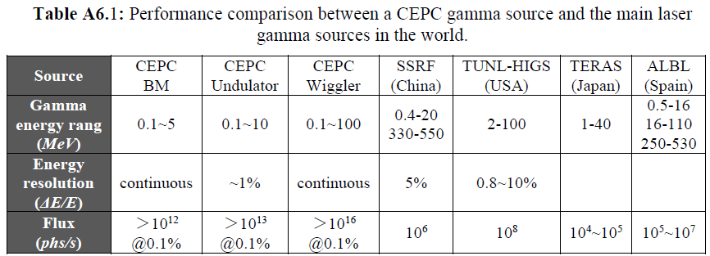
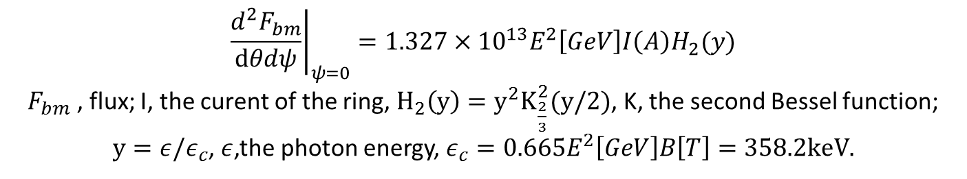
Central intensity of Synchrotron radiation,[photon/s/mrad2/0.1%b.w.]
$${\left.\frac{d^{2}F_{bm}}{dθdψ}\right|}_{ψ=0}=1.327×{10}^{13}E^{2}\left[GeV\right]I\left(A\right)H_{2}(y)$$
$F_{bm}$ , flux; I, the curent of the ring, $H_{2}\left(y\right)=y^{2}K_{\frac{2}{3}}^{2}(y/2)$, K, the second Bessel function;
$y=ε/ε_{c}$, $ε$,the photon energy, $ε_{c}=0.665E^{2}\left[GeV\right]B\left[T\right]=358.2keV.$
Notes:
IN these calculations, the Increment of the radiation power is not considered. It is a big problem. Another problem: do we need undulator and wiggler together? Maybe, just wiggler Is Ok. The gamma energy from the wiggler can cover that from undulator. Also the spectrum from undulator is not monoenergetic too. The another problem is: there are no so many users of the high energy gamma-ray.

Slide 8
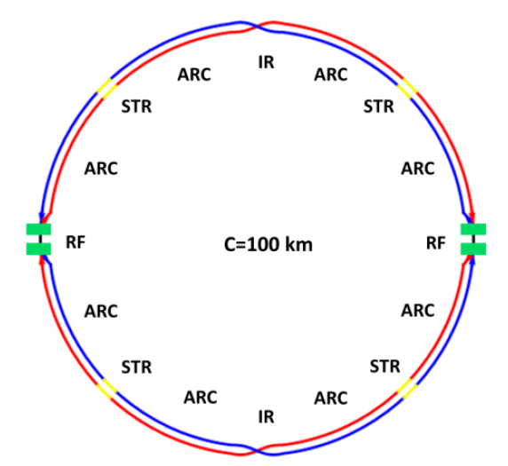
Total design of the SR stations
Four beamlines：
S1+S2
bending magnetic field line：0.1-5MeV, >10^12@0.1%,
High energy X-ray diffraction/scattering/transmission beam line
Hard X-ray micro/nano probe beamline
High voltage extreme condition beam line
wiggler beamline：0.1-100MeV,>10^14@0.1%
Photon-nuclear physics science
Others high energy gamma-ray station, GRB simulations
S1+S2:wiggler+MWCS energy calibration+ Bend

Slide 9
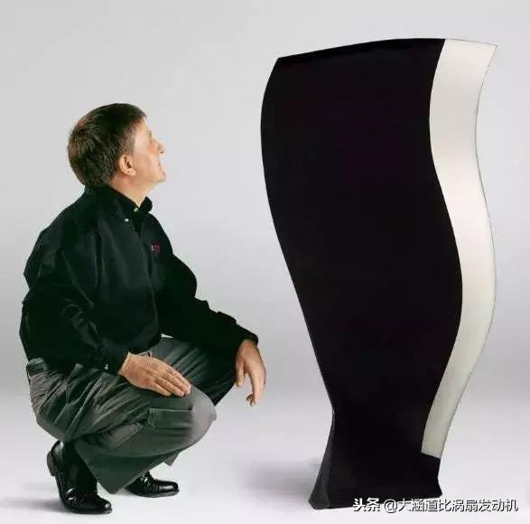
S1 SR from bending magnetic field：0.1-5MeV, >10^12@0.1%
High energy X-ray diffraction/scattering/transmission beam line
In-situ observation and structural analysis of aircraft engine blade growth process
Structural changes of special steel
Observation of special welds
Hard X-ray micro/nano probe beamline
High voltage extreme condition beam line
Structural changes of special materials under dynamic and high pressure conditions of 1000GPa
Study on the equation of state of special materials under static high pressure and high temperature/low temperature

Slide 10
CEPC high-flux γ beamlines
Complementary with the third generations of synchrotron sources, spallation neutron sources, industrial CT, and LCS gamma sources:
7.5cm steel penetration, several micron resolution, high flux fast imagination
Static imaging - engine blade inspection: 6cm thick steel, 1-5 micron resolution
Dynamic imaging---metal phase change process-droplet solidification/seawater corrosion mechanism: us, 6cm thick steel, 1-5 micron resolution
Image reso.
Spallation neutron source
mm
Third generations
Synchrotron radiation source
High energy CT
10um
CEPC-SR γ
（static & dynamic）
LCS γ
um
Micro-nano CT
mm/keV-10keV
cm/100keV
10cm/MeV
penetration/energy

Slide 11
S2: SR from wiggle magnetic field：0.1-100MeV, >10^14@0.1%
Photon-nuclear physics science
Gamma assisted transmutation
Giant resonance,
Nuclear resonance fluorescence
a “mini” giant dipole resonance it is often called pygmy dipole resonance (PDR).
¹²C(α,γ)¹⁶O reaction: the "Holy Grail" of nuclear astrophysics.
Others high energy gamma-ray station, GRB simulations
radio-pharmaceuticals production

Slide 12
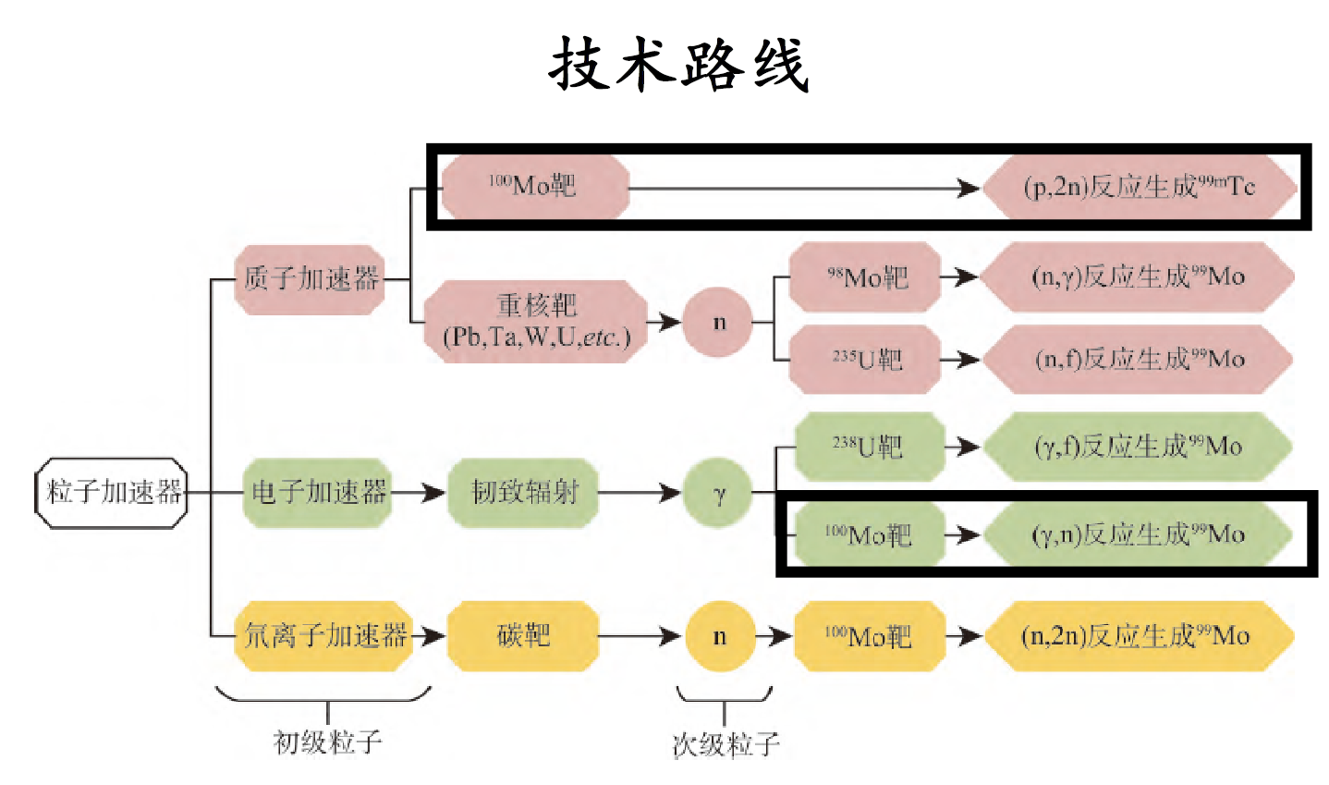
Scarce radioactive medical isotope preparation

Slide 13
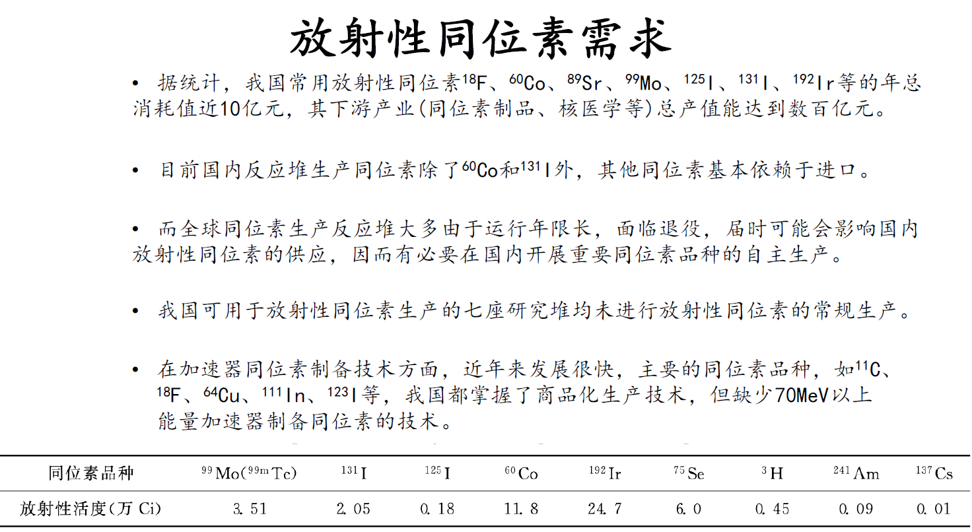
放射性医用同位素需求量大，国内技术迫切需要

Slide 14
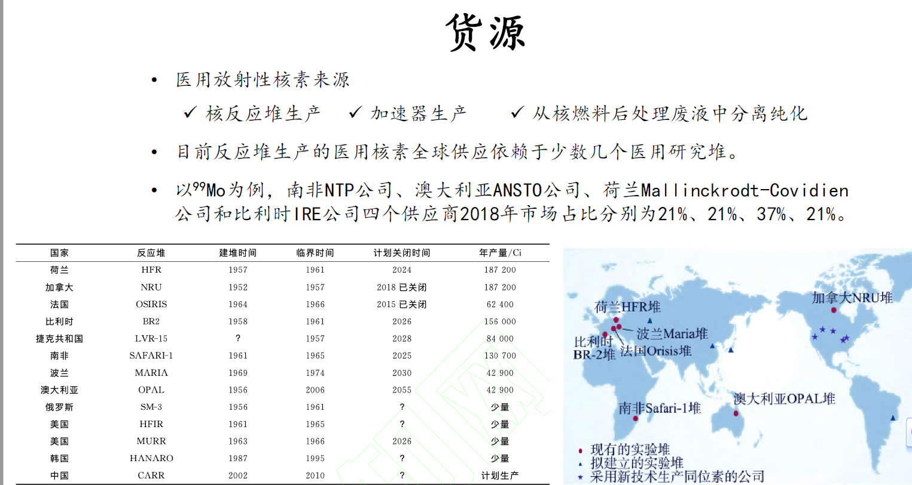
中国目前无法生产Mo99
（1）99mTc发生器的母体核素，反应过程⁹⁸Mo（n，γ）⁹⁹Mo，²³⁵U（n，f）⁹⁹Mo。
（2）制备⁹⁹Tc，用于内脏器官造影。
（3）制造发射γ射线的医用同位素。
（4）作为示踪核素，用于土壤肥料方面科学研究。
钼-99，核素符号⁹⁹Mo，半衰期为65.94h。

Slide 15
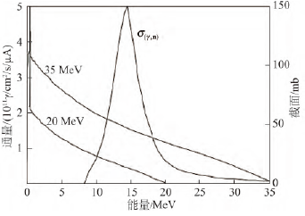
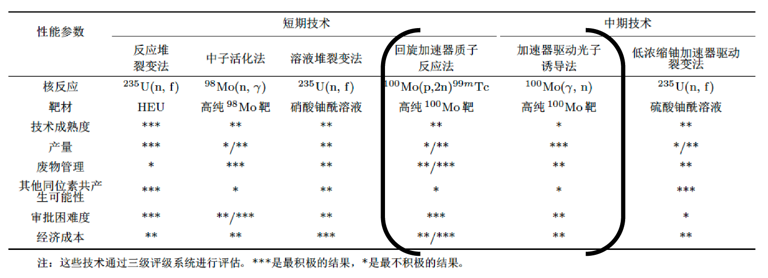

It is very suitable to use wiggler gamma beam energy and flux
𝛾射线诱发100Mo(𝛾,n)反应，反应阈值约为9 MeV；在14.5 MeV 下出现截面最大，约为150 mb。
S=$\frac{N_{A}\left(0.693\right)}{MT}=1.96×10^{13}Bq/mg$
1Mo99=1.66*10^-25kg=1.66*10^-19mg
1mg=6*10^18Mo99
1h 10^14 flux ->1.44mg Mo99
762Ci Molybdenum

Slide 16
Outline
CEPC CDR: parameters and baseline layout
The design: parameters, baseline and the applications
The vacuum chamber design and the requirement to the bend magnetic
Tunnels, halls and vertical shafts for the SR stations
The challenges and the next works
Summary

Slide 17
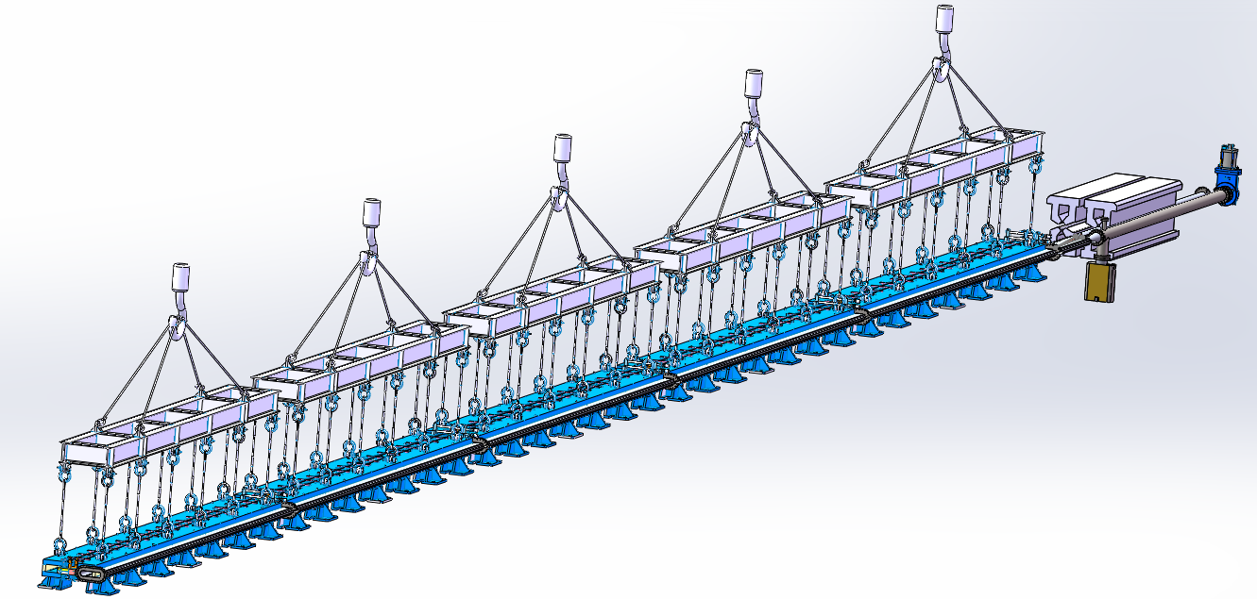
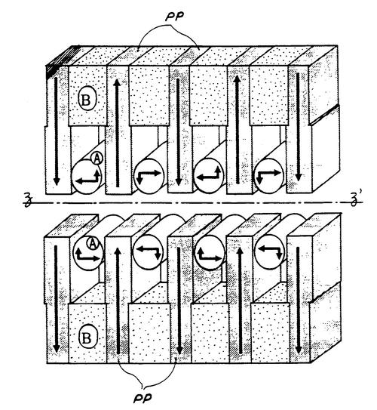
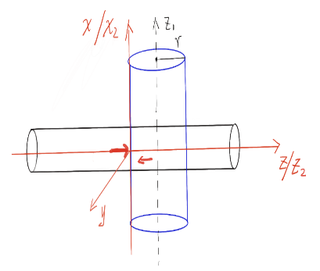
The vacuum chamber design
The first diode vacuum box in the first 28-meter diode vacuum box
The first meter diode vacuum box remains unchanged
The second meter diode vacuum box needs to be extended by 150mm
微波管
束流管
王鹏程，黄永盛，王毅伟，杨梅
电子束团与微波光子180度相互作用

Slide 18
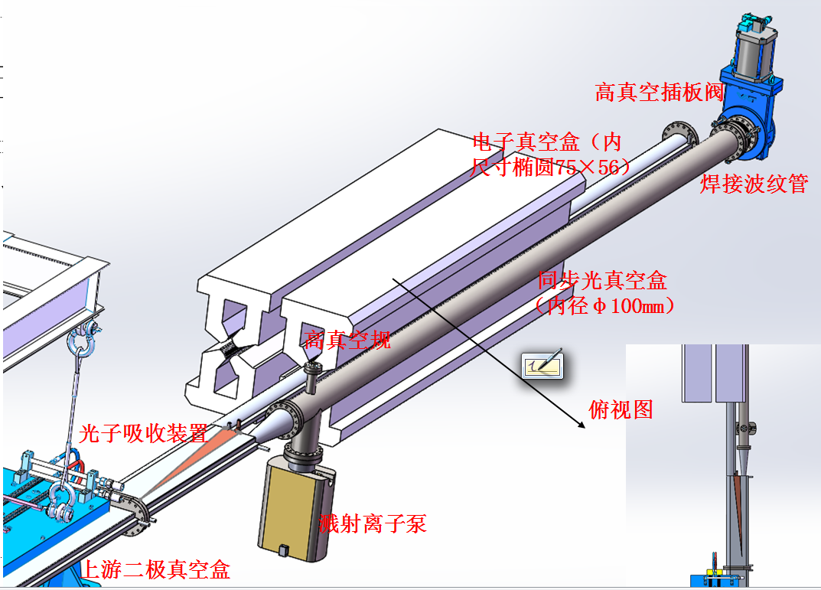
真空管分叉、二级铁末端与四级铁

Slide 19
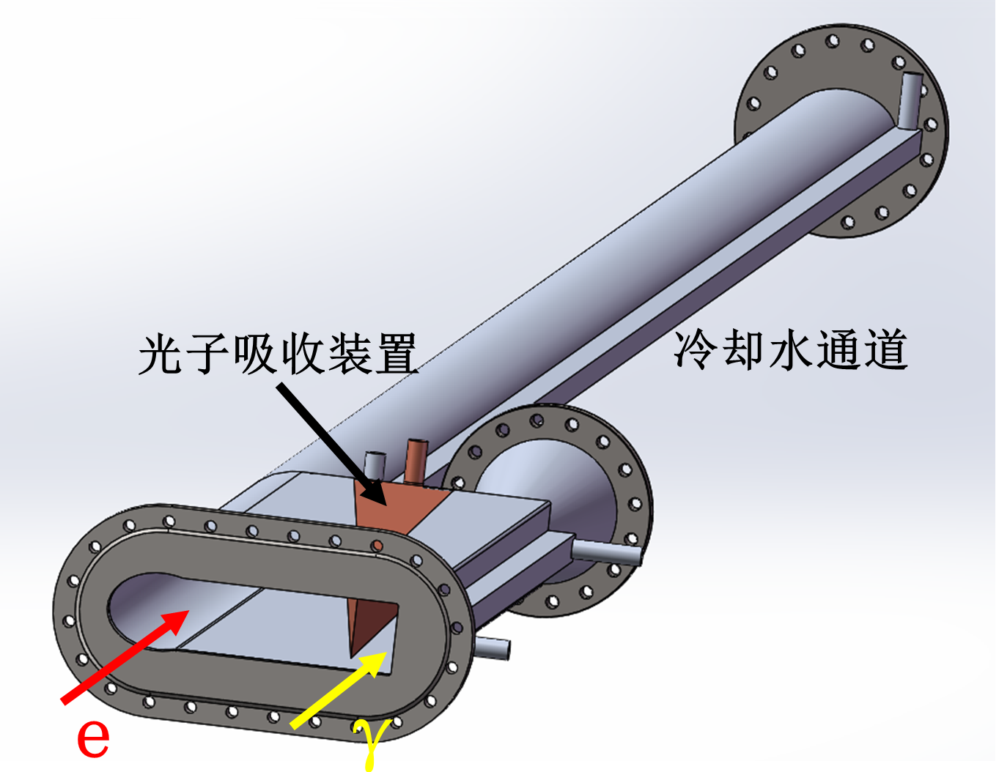
The vacuum chamber design

Slide 20
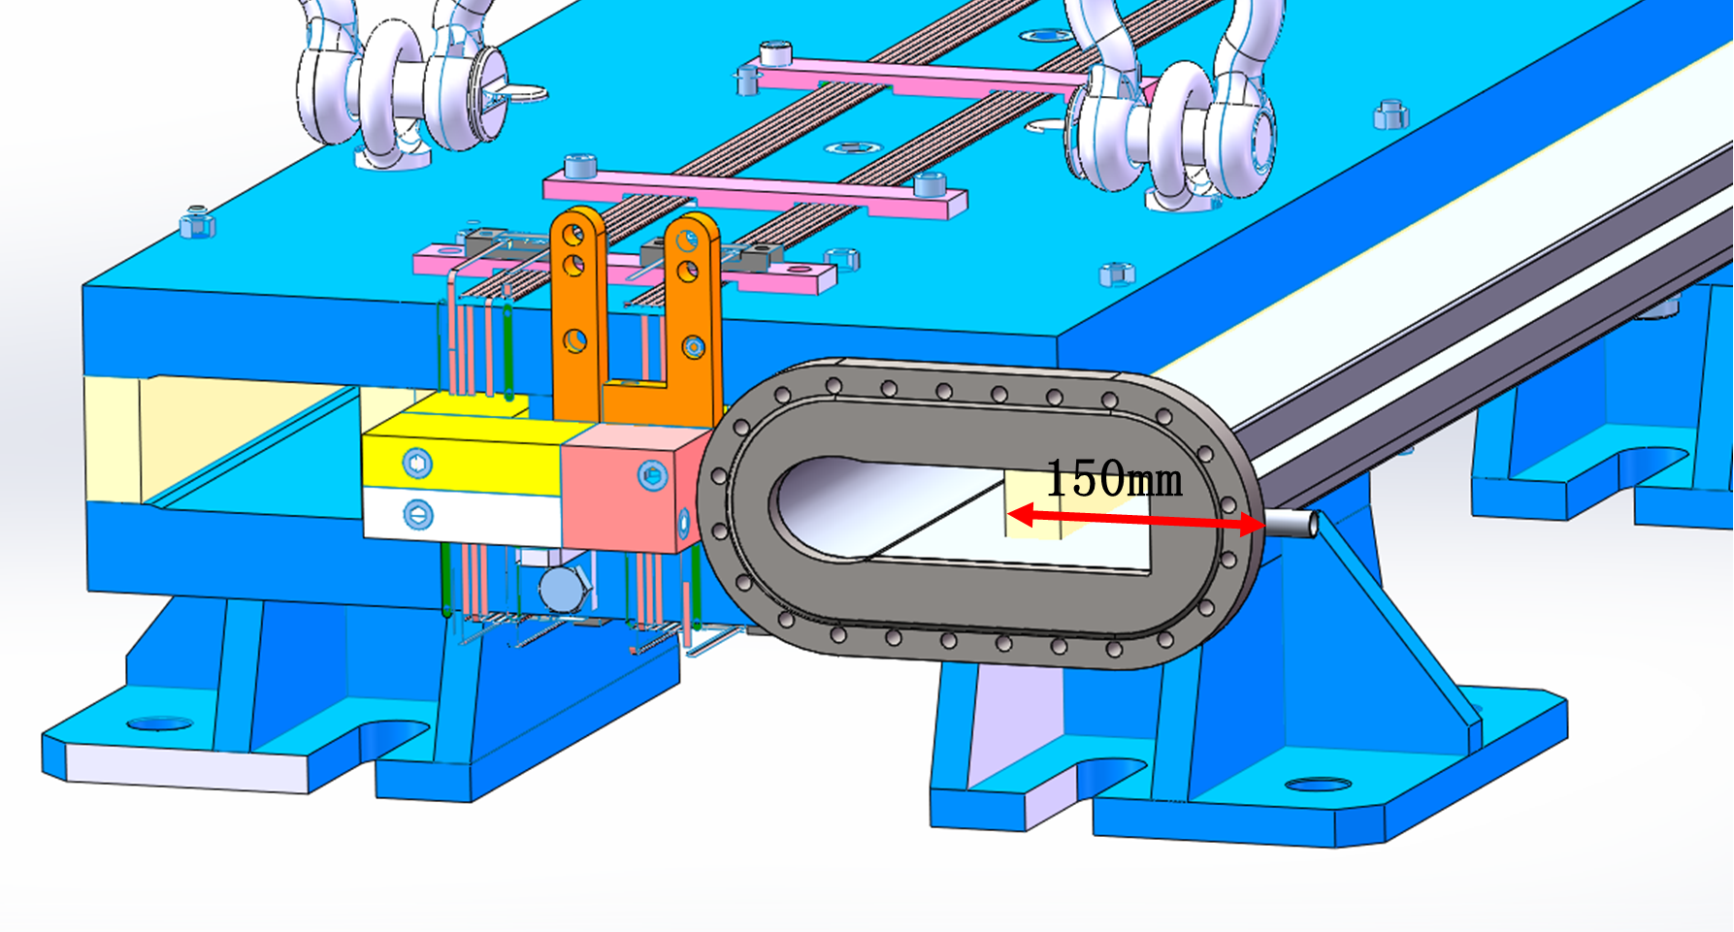
Vacuum piping in dipole iron and requirements for side ends of the iron

Slide 21
The discussions
1. The length of the beam line exceeds 700 meters, and the vacuum system is recommended to be composed of getter films (NEG films) + ion pump.
2. All the beam lines can be divided into 8 sections, each section is separated by all-metal ultra-high vacuum valves (9 valves), and each section has a separate rough suction port and gas filling port, and each section 5-10 ion pumps are uniformly distributed in the section (used to pump out gases that are not easy to pump out of getter films such as CH4), and the inner walls of all vacuum boxes are plated with NEG films.
3. The material of the vacuum box can be 304 stainless steel (the inner size is φ100, the wall thickness is 3mm).
4. Vacuum measurement adopts 2 measurement points in each section, and cold cathode vacuum gauge is used for measurement.
5. In the photon collimation area, it is necessary to arrange temperature measurement points in the nearby vacuum box to monitor the temperature change of the outer wall of the vacuum box.

Slide 22
Outline
CEPC CDR: parameters and baseline layout
The design: parameters, baseline and the applications
The vacuum chamber design and the requirement to the bend magnetic
Tunnels, halls and vertical shafts for the SR stations
The challenges and the next works
Summary

Slide 23


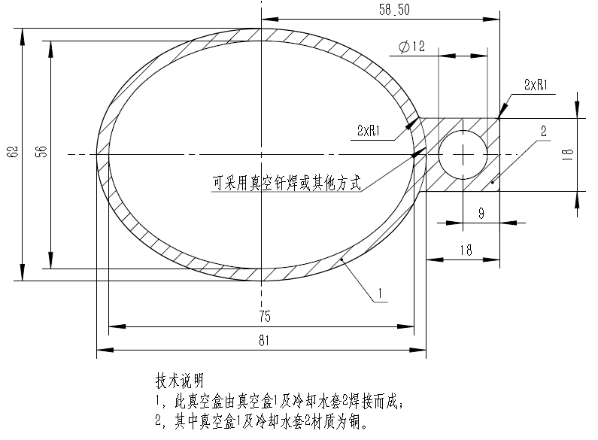
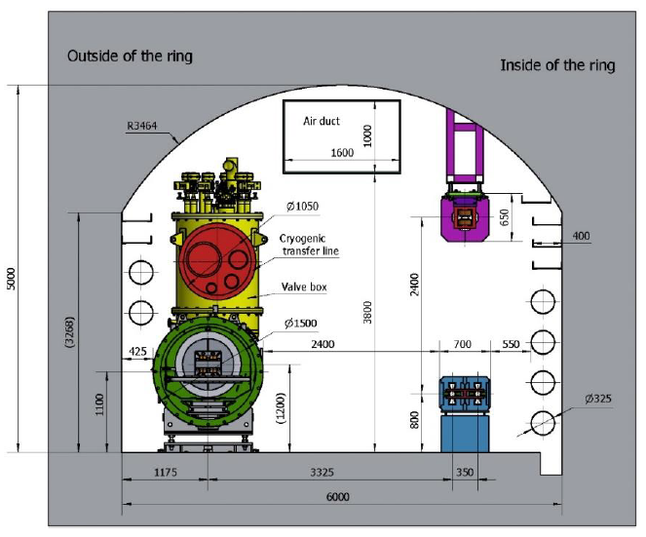
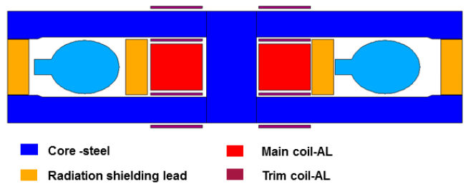
Vacuum chamber, dipole and tunnel
93mm
dvc=0.075/2 m; ! distance from the gamma ray to the inner wall of vacuum chamber
dwall=4.5 m; ! distance from the gamma ray to the wall
4500
Notes:
Synchrotron radiation exits from the tangential direction. Since our radius is so large, the direction is almost the vacuum pipe direction. The pipe of SR need pass through several radiation shielding lead of the magnetic. Maybe we can extend the magnet steel a few centimeters outward

Slide 24
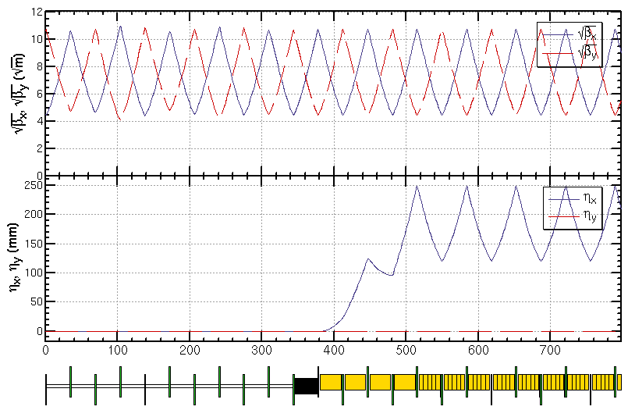
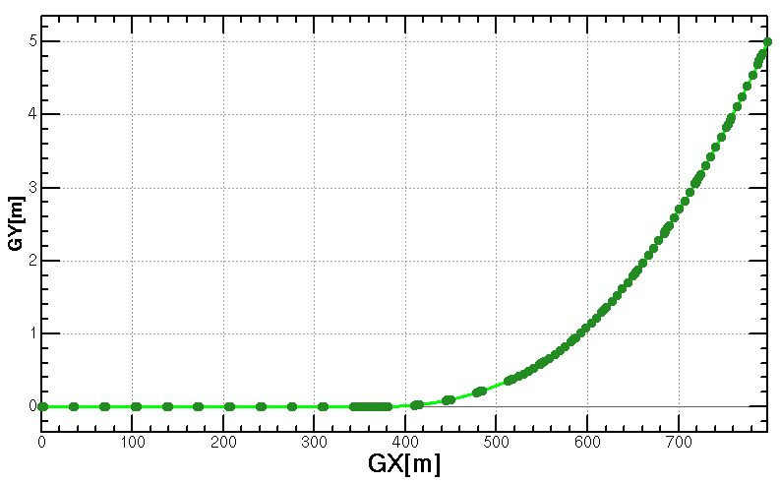
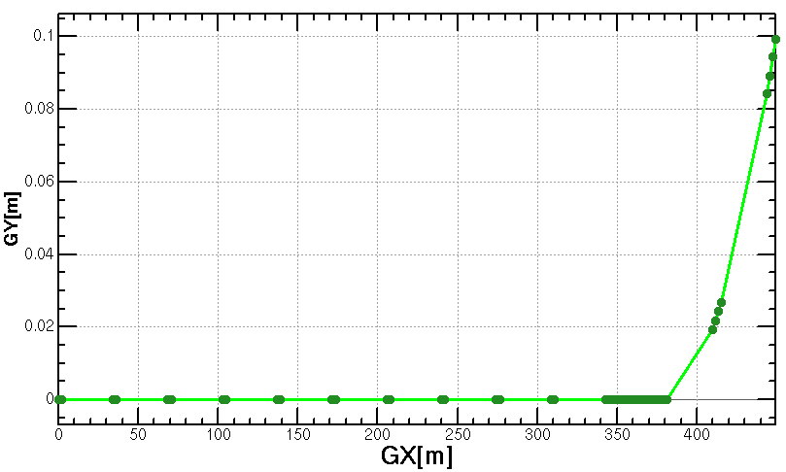
Add Wiggler
Lp=0.32m, Np=4, L=1.28m, B=2.0T
wiggler
dvc=0.075/2 m; ! distance from the gamma ray to the inner wall of vacumn chamber
dwall=4.5 m; ! distance from the gamma ray to the wall
The angle between gamma ray and the vacumn chamber and bend is very small.
The vacumn chamber, bend at these regions need to be carefully design to solve the problem of geometry conflict and impedance.
Notes:
The figures show the properties of the CEPC synchrotron radiation γ-ray source from wiggler. The length of the wiggler is 32m, period length is 320mm, periods number is 100, the minimum Gap is 82mm, the maximum magnet field is 2.0T, the maximum K is 59.7.
The energy can get tens MeV, where the flux is about 10¹⁵ phs/s/0.1% B.W.. the critical energy is 19.2MeV. The maximum power is 20MW, the maximum power density is 428MW/mrad². 2.4times30MW too large

Slide 25
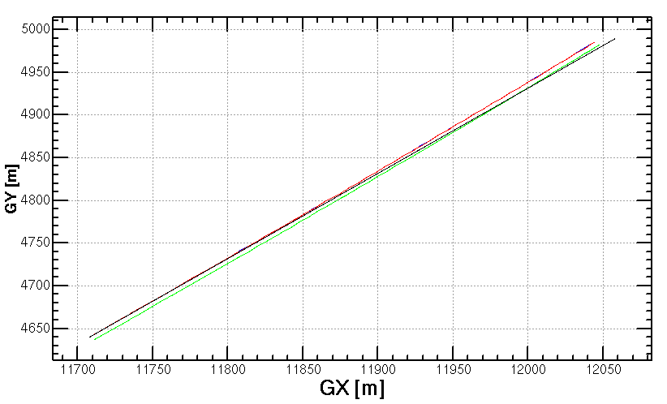
Geometry near S3 and S4 wiggler
Geometry near S4 wiggler
center of outer ring
Inner of vacumn chamber
gamma ray
outer wall
Length from end of the wiggler to the wall: 571.548 m
gamma ray at the end of S4 wiggler:
{11708.067 m, 4640.366 m}
gamma ray at the wall:
{11994.183 m, 4925.771 m}
gamma ray at the end of S3 wiggler:
{-11708.067 m, 4640.366 m}
gamma ray at the wall:
{-11994.183 m, 4925.771 m}

Slide 26
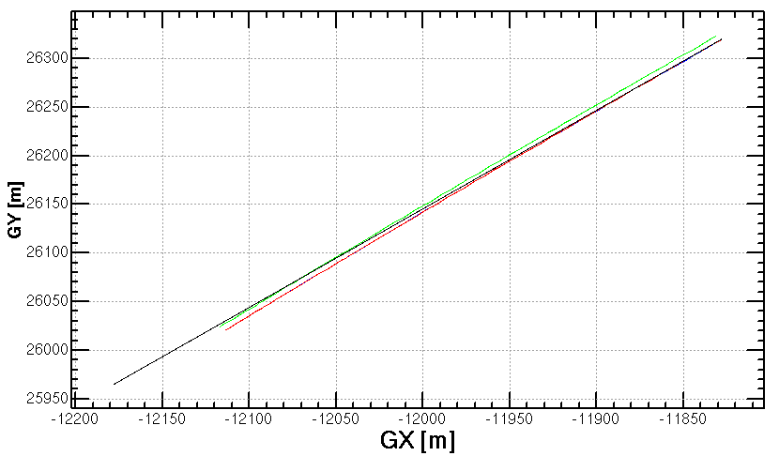
Geometry near S1 and S2 bend
Geometry near S2 bend
center of outer ring
Inner of vacumn chamber
gamma ray
outer wall
Length from end of the bend to the wall: 484.963 m
gamma ray at the end of S2 bend:
{-11827.872 m,26319.878 m}
gamma ray at the wall:
{-12068.740 m,26075.755 m}
gamma ray at the end of S1 bend:
{11827.872 m,26319.878 m}
gamma ray at the wall:
{12068.740 m,26075.755 m}

Slide 27
Tunnels, halls and shafts
Tunnel cross section :3m * 3m
15m
The door on the shield wall:2m*3m
HALL:
15m * 20m * 5m(高)
with overhead crane
300cm
vacuum
pipe
20m
80cm
20cm
8m
100cm
200cm
Shield wall:1m
Door
上一页各束线的终点坐标，从这个点开始，沿着束线方向，向岩石内挖3X3米的隧道，
挖到10米处是防护门，然后是大厅。见右图。
束线S1和S2的大厅处，需分别有吊装竖井和载小货物电梯
电梯：2m*2m*3m，称重>2顿。
Channel
10m

Slide 28
Outline
CEPC CDR: parameters and baseline layout
The design: parameters, baseline and the applications
The vacuum chamber design and the requirement to the bend magnetic
Tunnels, halls and vertical shafts for the SR stations
The challenges and the next works
Summary

Slide 29
The challenges and the next to do
1) The focalization of gamma-ray: larger than MeV
2) The detection of the energy distribution and the spatial distribution of the SR from bending magnetic and wiggler
3) The Mechanical design drawings and equipment, and cost estimates

Slide 30
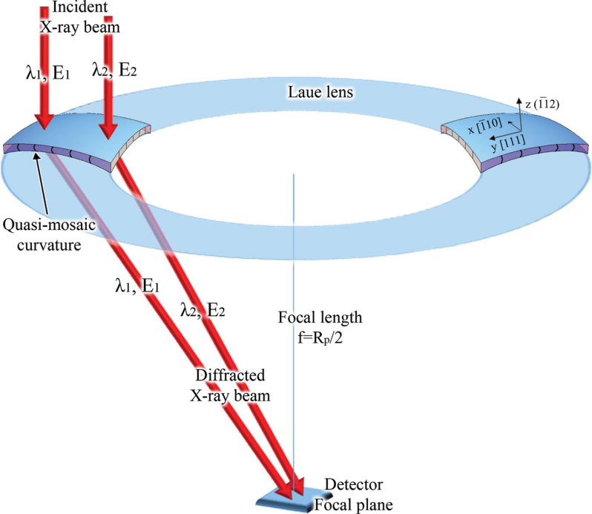
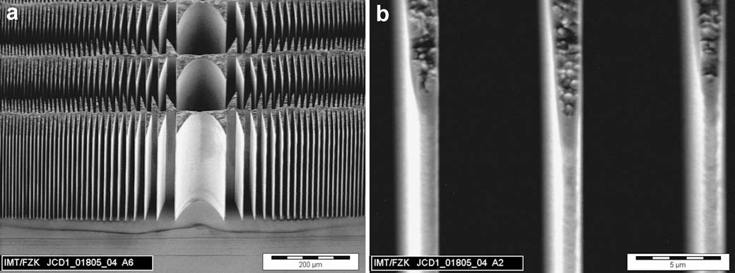
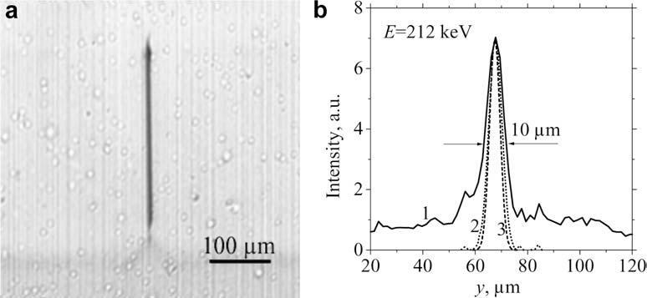
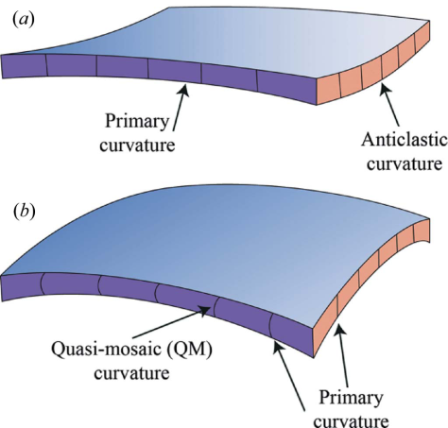
The focalization of hard x-ray
And soft gamma-ray 100keV-1MeV, 1MeV still problem?
LIGA fabrication of X-ray Nickel lenses
100keV-1MeV : Microsystem Technologies 11 (2005) 292–297
Schematic representation of a Laue lens based on QM crystals. J. Appl. Cryst. (2015). 48, 977–989

Slide 31
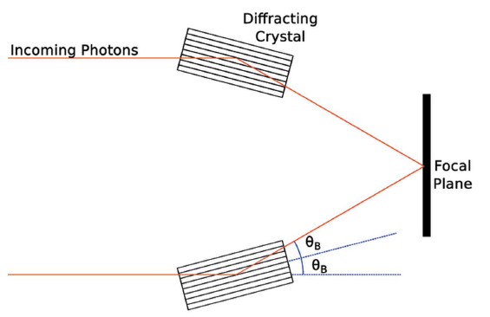

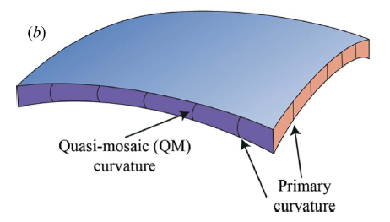
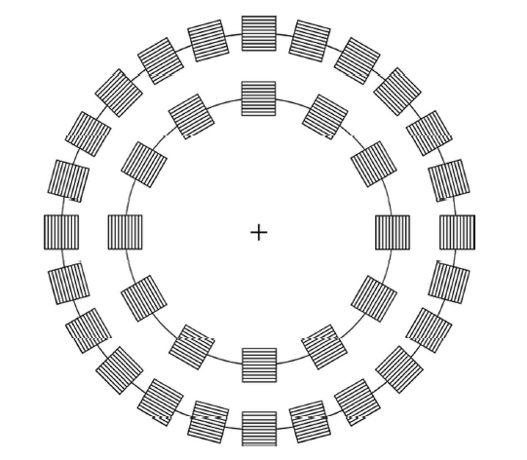
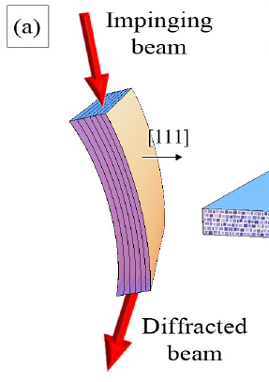
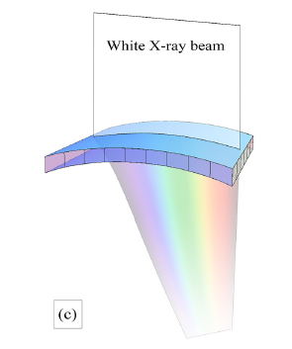
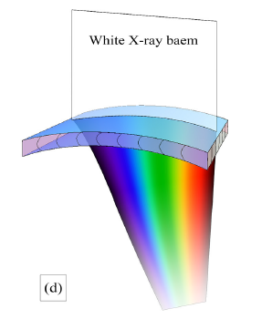
For high-energy photons, the Bragg angle is very small, and even in small beams the crystal must be large to diffract. Therefore, Laue geometry represents a more convenient choice.
Perfect crystal, mosaic crystal,
the maximum reflectivity is 1/2
Curved diffraction plane crystal (CDP), quasi-mosaic (QM) crystal, peak reflectance is not limited by 1/2

Slide 32
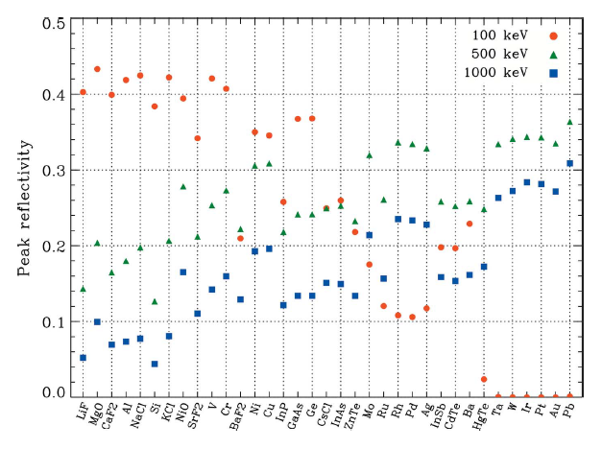
Choice of crystal
For various crystals, the peak reflectance at 100 keV, 500 keV, and 1 MeV energies, Z (atomic number) increases from left to right.
As can be seen from the figure on the right, at high energy, the higher reflectance is a crystal with higher Z; on the other hand, at low energy, the higher reflectance is a crystal with lower Z.

Slide 33
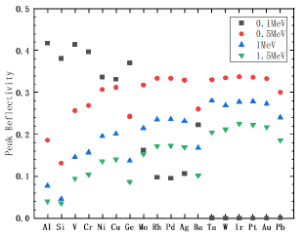
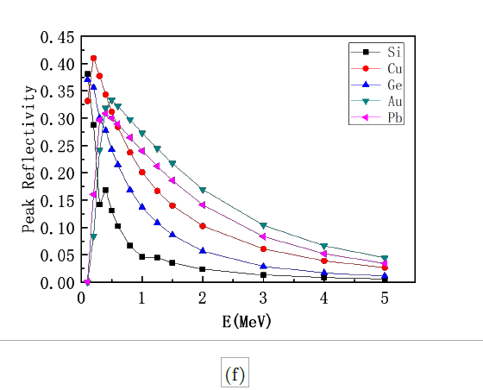
Material selection of MeV focusing lens: Pb, Au
图 : 假设是镶嵌晶体，镶嵌度 Ω 为 30arcsec，微晶厚度 t0 为 5µm，晶体厚度 T0 可由 (3.11)式算出，但被限制在 1 ∼ 25mm 范围内。Si、Ge、Cu、Au 和 Pb 峰值反射率随能量的变化。
图 : 18 种晶体的能量分别在 0.1MeV、0.5 MeV、1 MeV 和 1.5 MeV 时的峰值反射率，按原子序数从左到右逐渐增加排列。假设是镶嵌晶体，镶嵌度 Ω 为 30arcsec，微晶厚度 t0 为 5µm，晶体厚度 T0 可由 (3.11) 式算出，但被限制在 1 ∼ 25mm 范围内。

Slide 34
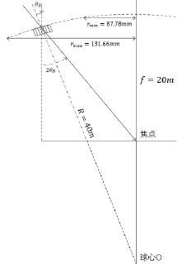
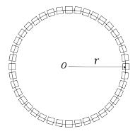

Preliminary scheme of MeV focusing lens
选择劳厄透镜的焦距为 20m，因为 20m 是天体物理学应用中通常会考虑到的焦距。
所以可以算出，当能量为 0.8MeV 时，半径最大为 131.66mm，当能量为 1.2MeV 时，半径最小为 87.78mm。晶体环排列越紧密，相邻环的能量重叠越多，劳厄透镜衍射的能量越平滑，则这个劳厄透镜由 5 个晶体环组成，且每个环上都排列尽可能多的
晶体，这可以使得劳厄透镜的有效面积最大。
估价-100万左右
Figure 2: 0.8-1.2MeV Laue lens geometry
Figure 1: (a) Au Crystal arrangement ，(b)Au Crystal size ，(10×10×3)mm2

Slide 35
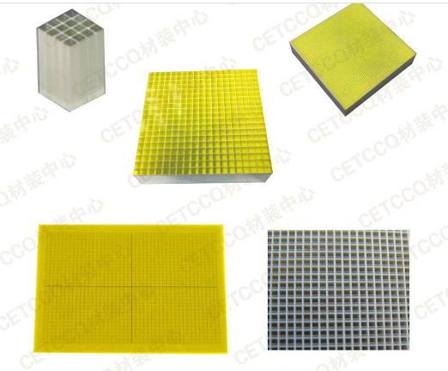
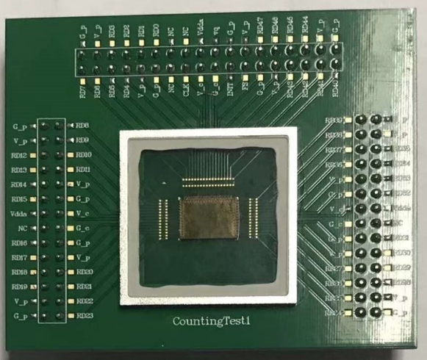
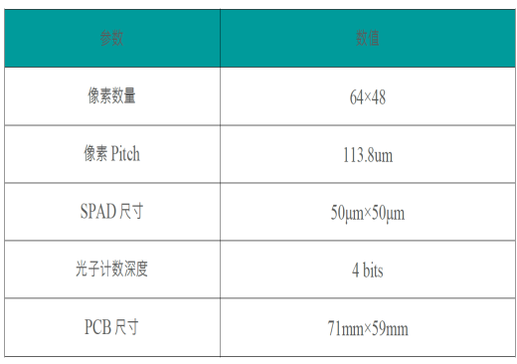
MeV array/imaging gamma detector
Det：Array Cerium-doped gadolinium gallium aluminum multi-component garnet GAGG：150mm*150mm，0.2mm one unit
Elctronics：SiPM array 50um pixel 实现阵列像素4块75mm*75mm的拼接 or 3mm array of SiPM
30-50 Micron plate GAGG Screen
10 Micron particle size GAGG Powder screen

Slide 36
Summary
Considering the layout of CEPC, the radiation power and the possible polarization requirement, four beamlines are designed;
The basic parameters of the wigglers are given;
The possible applications of the beamlines are discussed, especially for the gamma-ray imagination ;
The key challenges need to be study are proposed: the focus of MeV gamma-ray beam and the detection design.

Slide 37
Beijing Test beam- before 2017

Slide 38
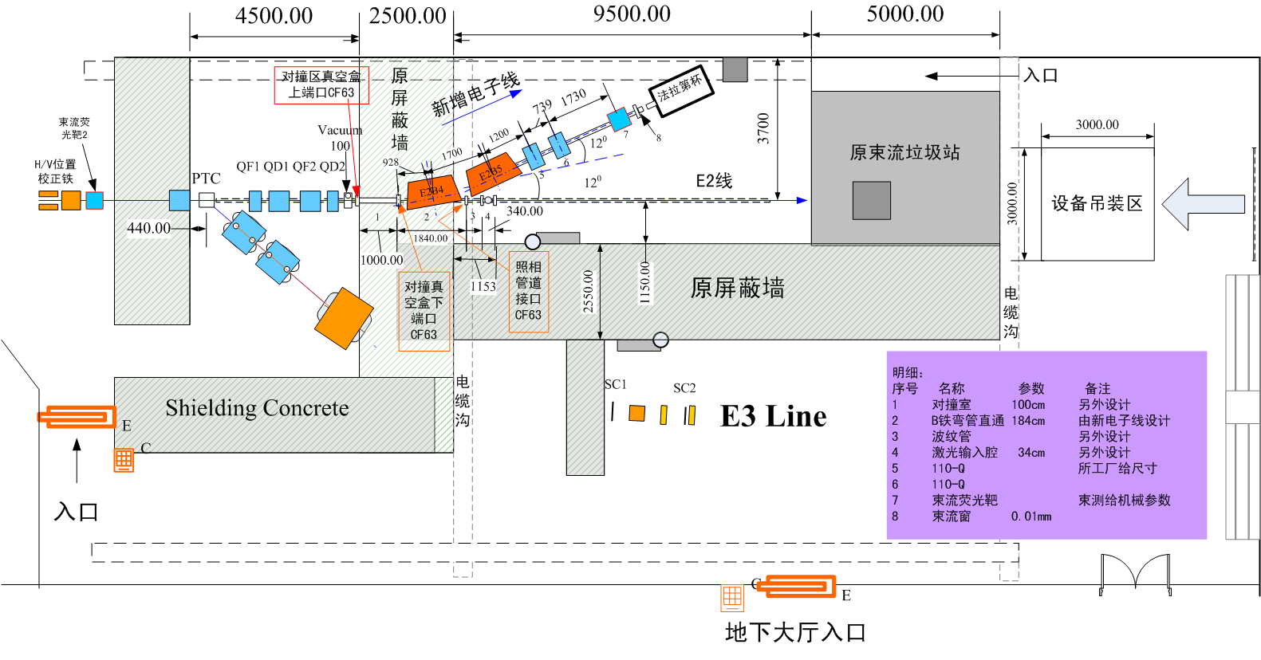
Beijing TestBeam after 2017

Slide 39
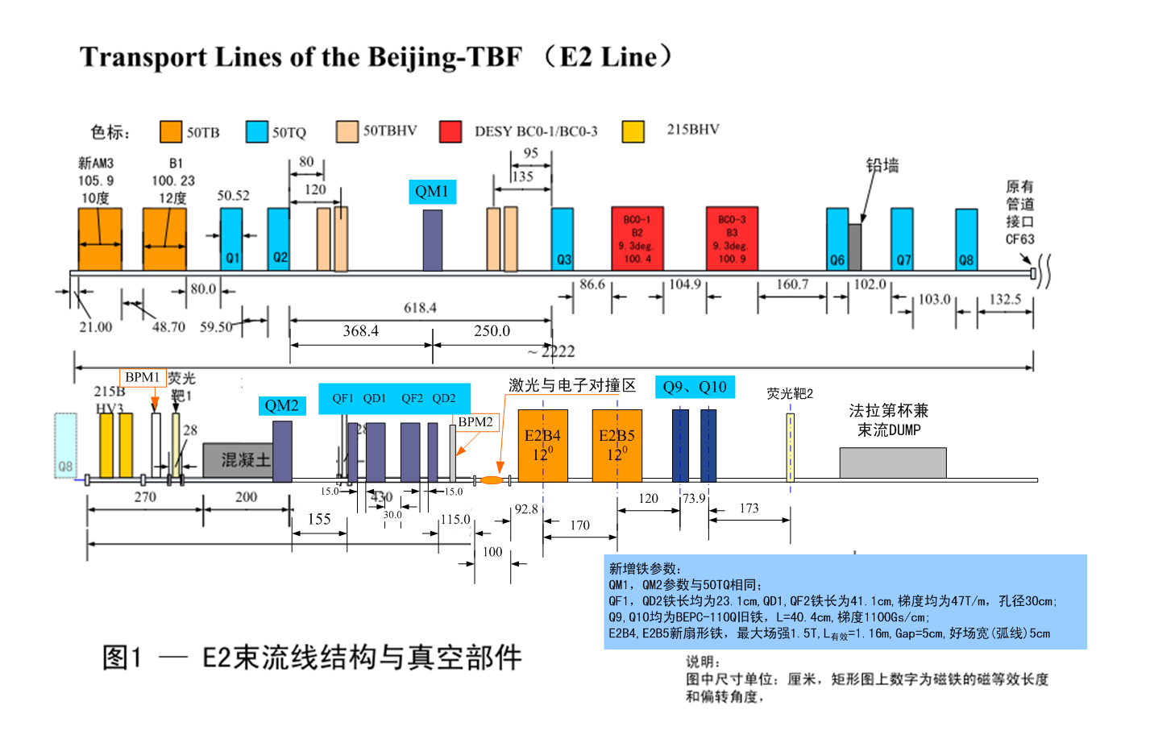
Beijing Test Beam
AM3：10度，B1：12度，B2、B3：9.3度，B4、B5：12度

Slide 40
E2 line :
10-50Hz 2.5GeV 1.89GeV nC 10ps
Electron transmission imaging
Laser-electron inverse Compton scattering
Particle acceleration in the Plasma weakfield driven by electron beams
Neutron source
Multi-particles radiation field
BPM calibration
CMS calibration: linear region
…

Slide 41
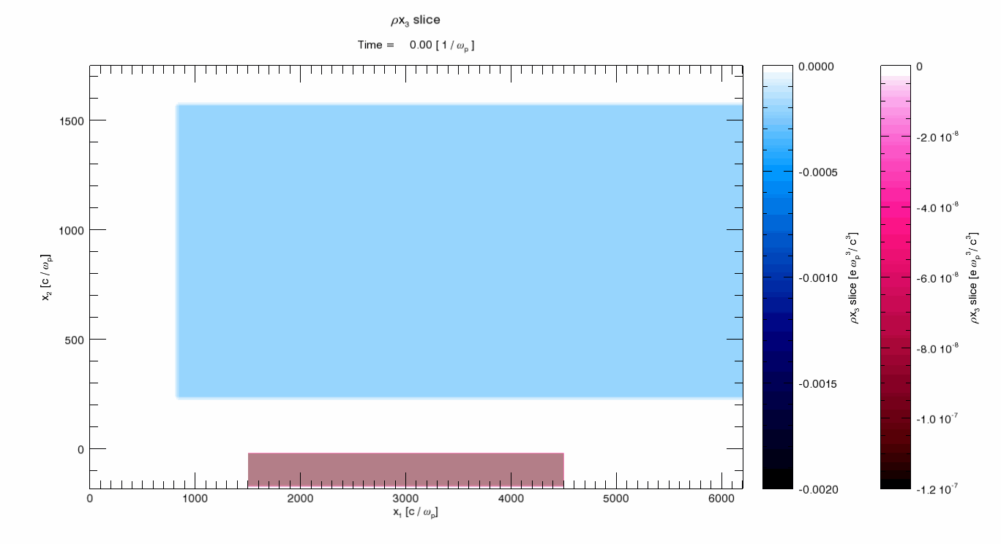

Experimental Study on the plasma wakefield Driven by a High Energy Electron Beam
Beijing test beam:
12.5-50Hz 2G 1nC 10ps; sigma of the beam: mm-cm
Combining the requirements of CEPC and the detection technology of particle physics experiments, we carried out a high charge electron beam-driven wakefield experiments to explore the possibility of experiment landing and provide key experimental data

Slide 42
E3 line:
（1）single particle energy resolution ≤ 1%@300MeV；
（2）spatial positioning accuracy（sigma）≤ 0.15mm；
（3）paritcles（proton、pion介子）number rate，500-700@600MeV/minute （当加速器供束频率25Hz时）。

Slide 43












CEPC energy calibration system
ENT
M1
IP
$$∆\left({E_{IP}−E_{ENT}}/{E_{IP}}\right)<{10}^{−5}$$
END
1） Schemes:
LCS+PD of DE(Laser compton scattering and position detection of the deflected electrons) 1MeV
Micro-wave compton scatter+γDetection 6MeV
2）diamond strip detector and test;
3） Simulation study whether the fiber array-Cerenkov radiation solution can be used to replace diamond detectors, with low cost and large detection area, and can be used for two-dimensional position imaging ；
4）Complete the beam extraction beam line design, determine the beam extraction magnet scheme, including dipole and four-pole magnets, to ensure that the beam parameters can be used for Compton scattering and later measurement.
${\text{E}}_{0}\sim$120GeV
drift
10m, o(BPM)=1mm
extraction line
dipole
0.5T, 3m
$σ_{x}<1$ mm
γ
$σ_{y}<1$ mm
${∆x}_{jitter}<1$mm
$$e^{−}$$
ENDA
$σ_{x}<0.5$ mm
$$e^{−}$$
ENDB
for $σ_{E}<0.1$%
$σ_{y}<0.02$ mm
ENDC
for largest $∆E$

Slide 46
Thanks go to CEPC-SppC team!

Slide 47


