Slide 1
TaichuPix1 Measurement
Tianya Wu
CEPC MOST2 Meeting
twu@ifae.es
16-11-2020

Slide 2
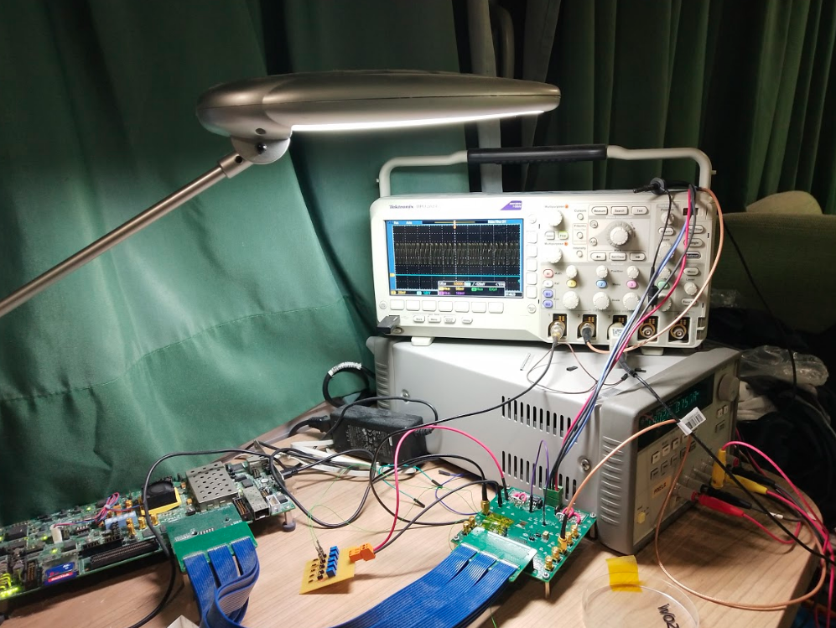
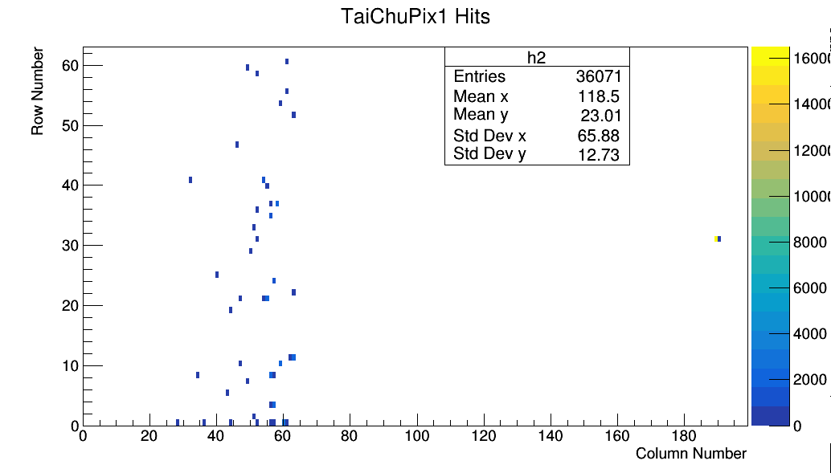
Further test with full chip
Fig1 test platform for TaichuPix1
Fig2 shows the hit map of desk lamp shines to the chip.
It is working at triggerless mode
Do a loop data acquisition via Ethernet.
It throws away the repeating data.
It shields col62~191 with the MASKING and turn on col0~61.(matrix of 192x64)
Fig2 LVDS DATA from exposure to desk lamp.

Slide 3
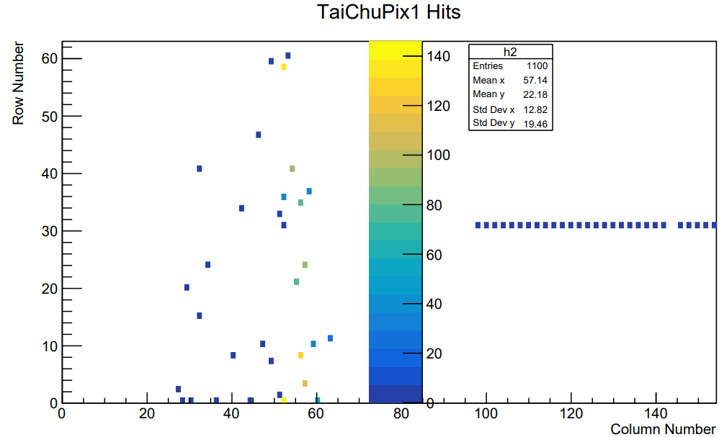
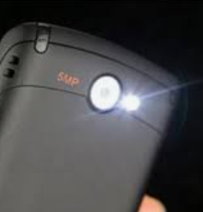
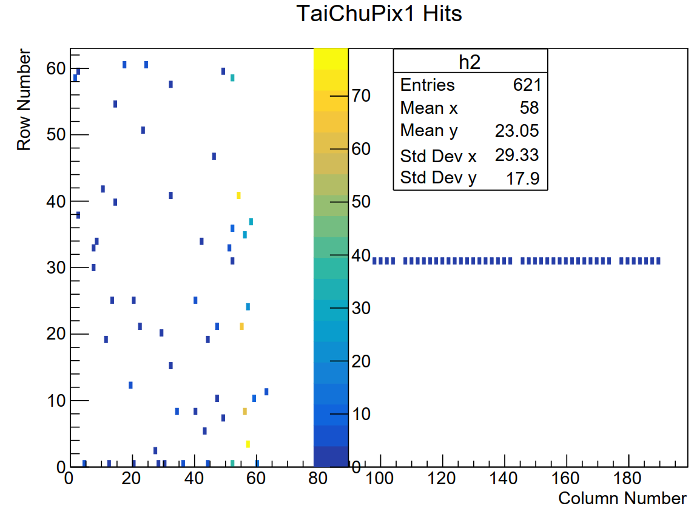
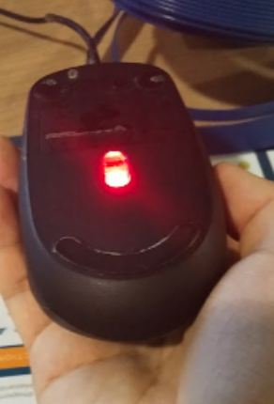
Further test with full chip
With the same system as previous slides, but only read the buffer FIFO for once.
This is the test with two different light source
→The upper hit map is based on cell phone flashlight.
→The bottom one is from the red light injection.
The hit counts of top priority COL61 and COL60 are more than the other columns. And most of the garbage data only count once.
Fig1 With cell phone flash light
Fig2 With mouse red light

Slide 4
Thanks for your attention.

