Slide 1
Higgs CP measurement with EFT model in lepton collider
Qiyu Sha ,Fangyi Guo, Gang Li, Yaquan Fang, Xinchou Lou
Institute of High Energy Physics CAS
2020 International workshop on High Energy CEPC.
Oct. 26-28 2020, Shanghai

Slide 2
Content
Introduction
Theory model
Optimal variable
Higgs CP-mixing measurement
Summary and conclusion

Slide 3
Introduction
Standard Model Higgs: $m_{H}=125.03GeV, J^{PC}=0^{++}$
Related experiments in LHC:
The hypothesis of spin-1 or spin-2 Higgs has been excluded by ATLAS and CMS at >99% CL in $\sqrt{s}=$ 7&8 TeV, 25fb-1 data.
Totally CP-even Higgs also has been excluded, the CL depends on theory model (>95%).
SM+BSM Higgs CP mixing model is still under testing.
All in inclusive Higgs production mode(i.e. ggF dominant), Higgs-gauge vector boson interaction lacks precise measurement.
Any observation of CPV in Higgs would be New Physics!
Eur. Phys. J. C75 (2015) 476

Slide 4
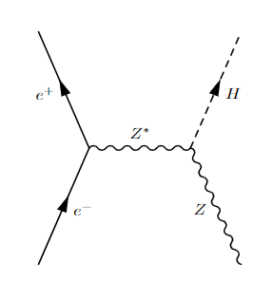
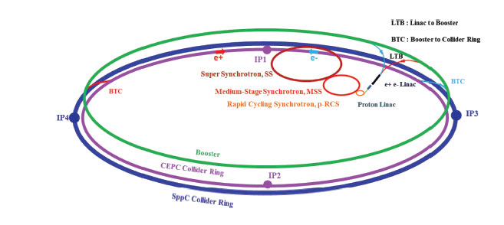
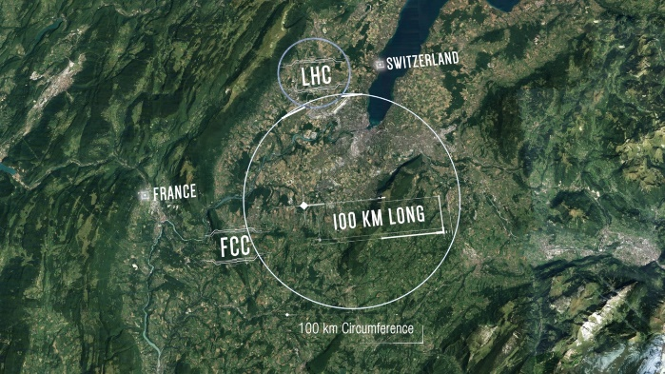
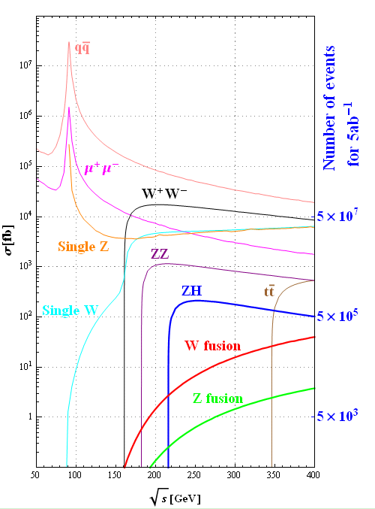
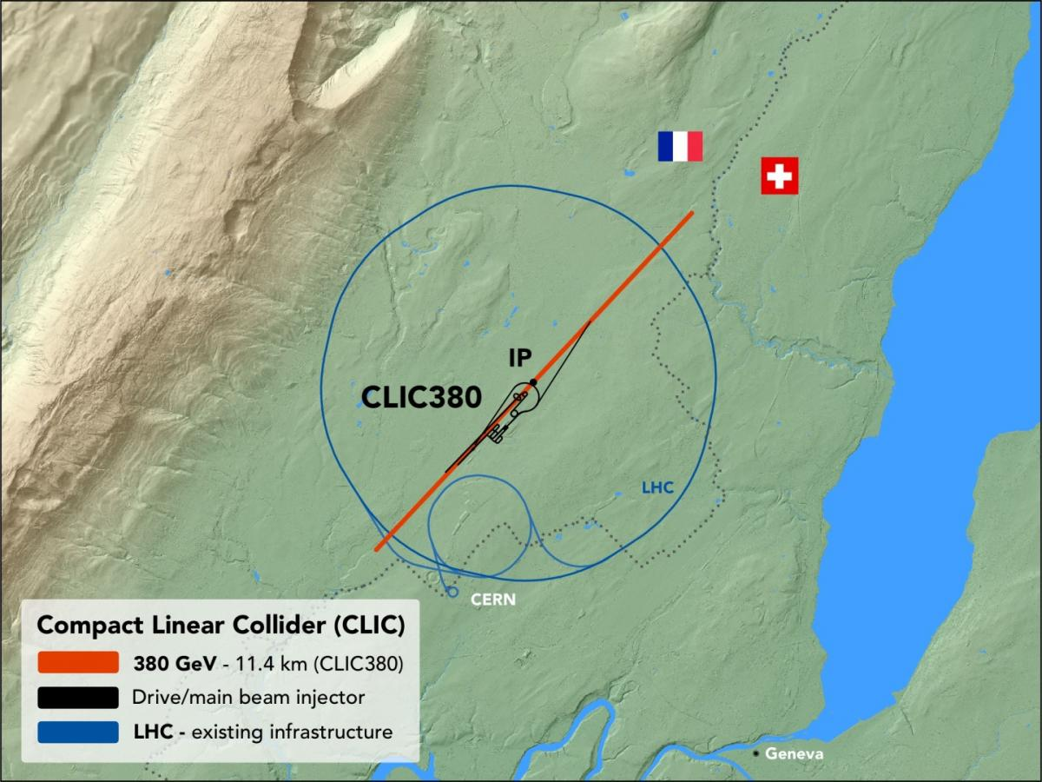
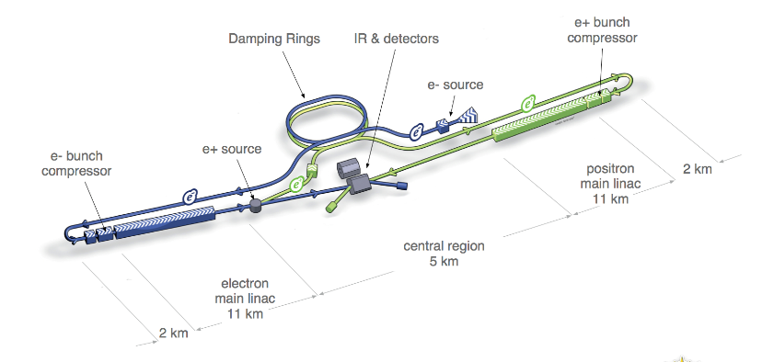
Introduction
Future $e^{+}e^{−}$ collider experiment as Higgs factory
$e^{+}e^{−}→ZH$ process @ $\sqrt{s}\sim 240GeV$
A opportunity for Higgs-gauge boson coupling study.
$$l^{−}$$
$$l^{+}$$
CEPC, 5.6 $ab^{−1}$ @ 240GeV
FCC-ee, 5 $ab^{−1}$ @240GeV
ILC, 2 $ab^{−1}$ @250GeV
CLIC, 380GeV for Higgs & top

Slide 5
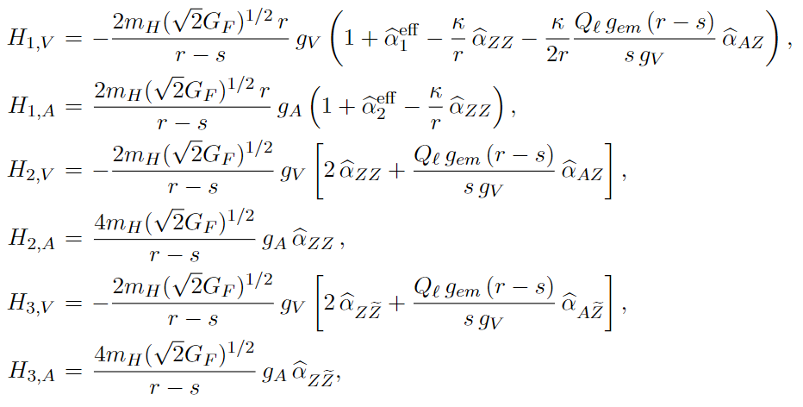
Theory model
JHEP 11(2014) 028
Consider a 6-dimension EFT model: $ℒ_{eff}=ℒ_{SM}^{(4)}+\frac{1}{Λ^{2}}\sum_{k=1}^{59}{α_{k}𝒪_{k}}$
In this base, the experimental observables $G_{F}, m_{z}, α_{em}$ could be presented:
$m_{z}=m_{Z0}\left(1+δ_{Z}\right), G_{F}=G_{F0 }\left(1+δ_{G_{F}}\right), α_{em}=α_{em0}(1+δ_{A})$
where: $δ_{Z}={\hat{α}}_{ZZ}+\frac{1}{4}{\hat{α}}_{ΦD}, δ_{G_{F}}=−{\hat{α}}_{4l}+2{\hat{α}}_{Φl}^{\left(3\right)}, δ_{A}=2{\hat{α}}_{AA}$. etc.
So the $H→Zll$ matrix element:
${\hat{α}}_{1}^{eff}={\hat{α}}_{ZZ}−\frac{m_{H}{\left(\sqrt{2}G_{F}\right)}^{1/2}(r−s)}{2\sqrt{r}}\frac{{\hat{α}}_{φl}^{V} }{g_{V}}$
${\hat{α}}_{2}^{eff}={\hat{α}}_{ZZ}+\frac{m_{H}{\left(\sqrt{2}G_{F}\right)}^{1/2}(r−s)}{2\sqrt{r}}\frac{{\hat{α}}_{φl}^{A} }{g_{A}}$
SM term
Others EFT contribution

Slide 6
Theory model
JHEP 11(2014) 028
Assumption for simplification:
$δ_{G_{F} }={\hat{α}}_{φl}^{V}={\hat{α}}_{φl}^{A}={\hat{α}}_{A\tilde{Z}}={\hat{α}}_{Z\tilde{Z}}={10}^{−3}$,others are set to 0, so $H_{2,V/A}=0$.
Differential cross section for $ee→ZH→llH$
$\frac{dσ}{dcosθ_{1}dcosθ_{2}dφ}=\frac{𝒩_{σ}\left(q^{2}\right)}{m_{H}^{2}}𝒥(q^{2}, θ_{1},θ_{2}, φ)$,
$𝒩_{σ}\left(q^{2}\right)=\frac{1}{2^{10}{\left(2π\right)}^{3}}⋅\frac{1}{\sqrt{r}γ_{Z}}⋅\frac{\sqrt{λ\left(1, s, r\right)}}{s^{2}}$
Variables for studying distribution: $θ_{1}, θ_{2}, φ$

Slide 7
Theory model
JHEP 11(2014) 028
0 in assumption
EFT CP-odd term
Others CP-even contribution
6 of these 9 functions are independent, CP-even and CP-odd terms are fully decoupled: $\frac{dσ}{dcosθ_{1}dcosθ_{2}dφ}=N ×(J_{CP−even}(θ_{1}, θ_{2},φ)+J_{CP−odd}(θ_{1}, θ_{2},φ))$.

Slide 8
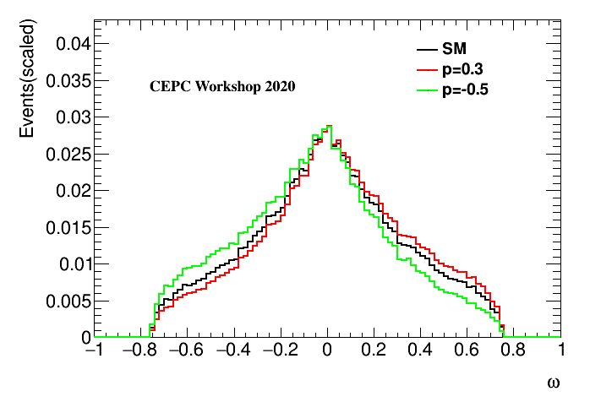
Optimal variable approach
Cross section could be represent as:
$\frac{dσ}{dcosθ_{1}dcosθ_{2}dφ}=N ×(J_{CP−even}(θ_{1}, θ_{2},φ)+p×J_{CP−odd}(θ_{1}, θ_{2},φ))$.
where $p$is an additional global CP-mixing parameter.
In this formation, we could define an Optimal Variable which combines the information from $\{θ_{1}, θ_{2}, φ\}$:
$ω=\frac{J_{CP−odd}\left(θ_{1}, θ_{2},φ\right)}{J_{CP−even}\left(θ_{1}, θ_{2},φ\right)}$ to measure $p$
PLB 306（1993）411-417
Combine the information from 3-dimension phase space
Easier to study

Slide 9
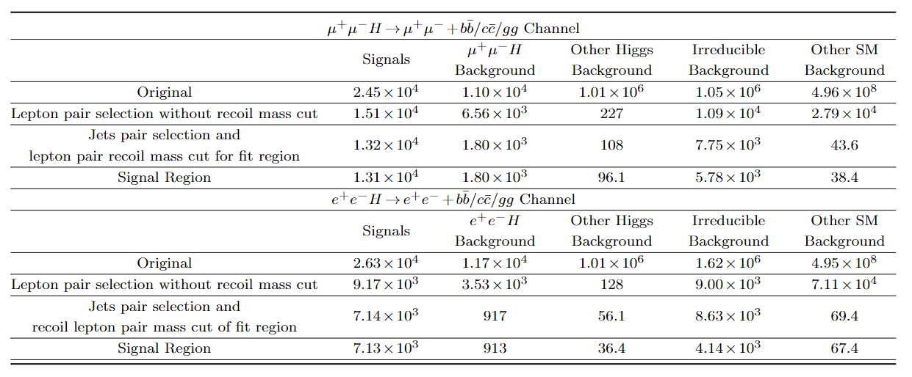
Higgs CP-mixing measurement
https://arxiv.org/abs/1905.12903
Preliminary test in CEPC condition
$\sqrt{s}=240GeV$, $\int{Ldt}=5ab^{−1}$, $ee→ZH→μμbb$ channel.
Irreducible SM background is not considered.
Detector simulation and reconstruction, selection efficiency, flavor tagging efficiency are not considered. Perform this analysis in truth level.
Event yields are not considered, only compare the distribution difference

Slide 10
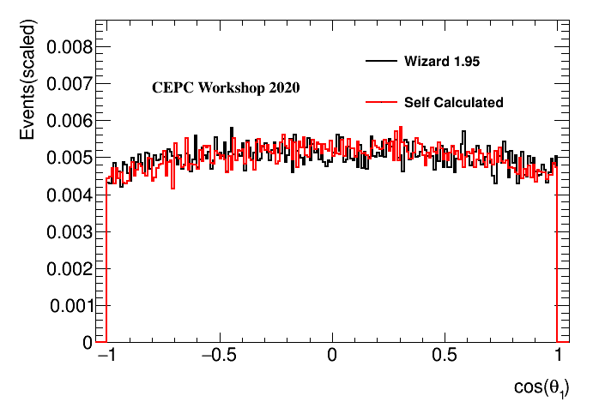
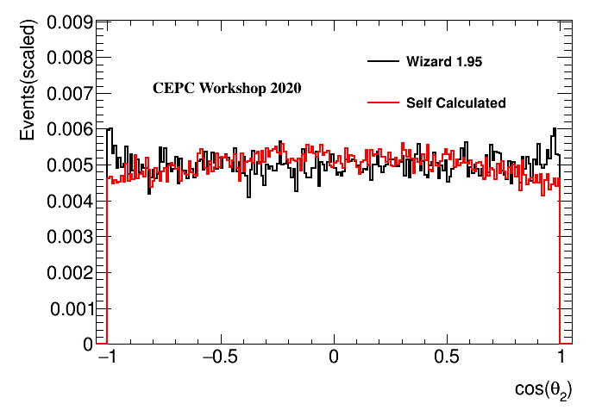
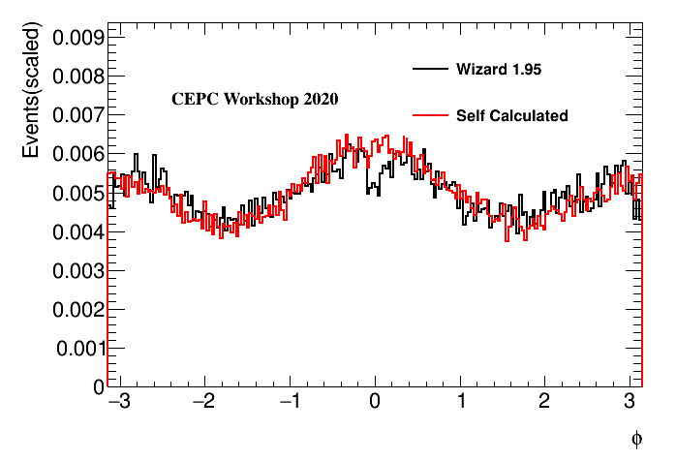
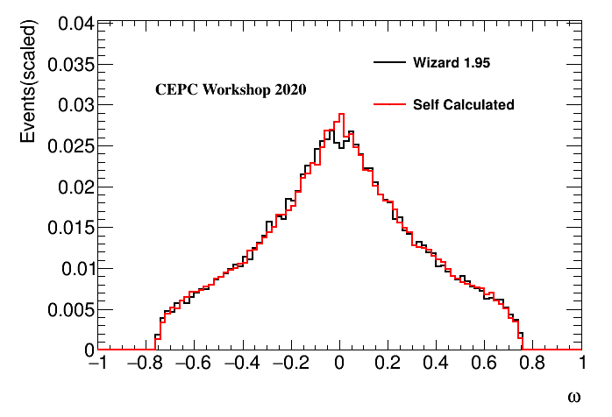
Higgs CP-mixing measurement
Sample simulation
Simulate $ee→ZH→llH$ decay chain in full phase space with TGenPhaseSpace
The joint angular distribution is realized with accept-reject method by calculated differential cross section $\frac{dσ}{dcosθ_{1}dcosθ_{2}dφ}$, and validate with official MC (Whizard 1.95 in CEPC, $ee→ZH→μμH$).
All the parameters in EFT could be easily modified.
Possible to switch to full simulation in future.
Distribution of $\cos{θ_{1}},\cos{θ_{2}}, φ, ω$. $\cos{θ_{2}}$ has some mismatch, but is not used in analysis (next page).

Slide 11
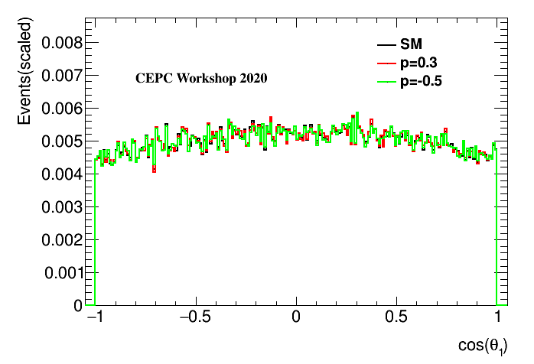
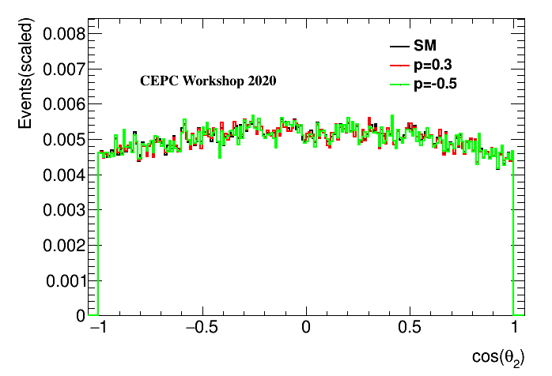
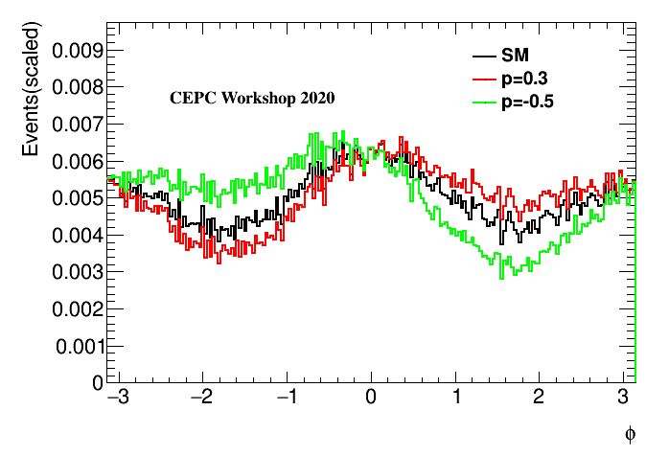
Higgs CP-mixing measurement
The CP-mixing would influence those variables
Parameters chosen for CP-mixing extraction: $φ, ω$. $θ_{1}/θ_{2}$ are not used due to low separation power.
Separation power:
SM vs. p=-0.5:
$cosθ_{1}:1.3×{10}^{−4}$
$cosθ_{2}:1.8×{10}^{−4}$
$φ:0.012$
$ω:0.014$

Slide 12
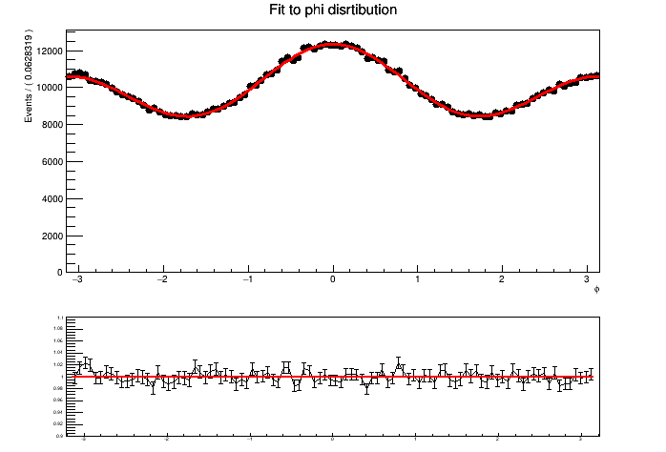
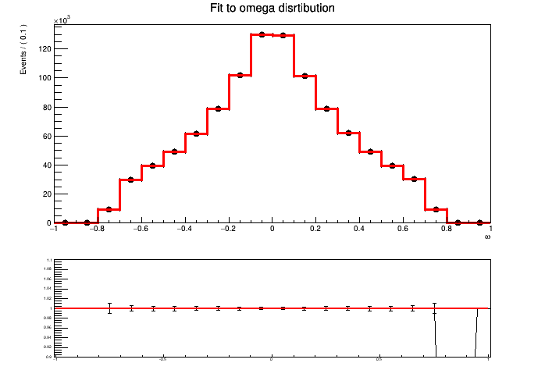
Higgs CP-mixing measurement
Fit strategy: Maximum-likelihood fit
Use high statistic templates to remove statistics fluctuation (1M events).
$φ$ modelling: $f\left(φ| p\right)=\int{\frac{dσ}{dcosθ_{1}dcosθ_{2}dφ}dcosθ_{1}dcosθ_{2}}$
$ω$ modelling: Histogram pdf.
Evaluate likelihood function for each p value hypothesis, and construct a $ΔNLL$ (Negative Log Likelihood) as a function of p.
$f\left(φ\right)=\left(1+c_{1}cosφ+c_{2}\cos\left(2φ\right)+p⋅\left(c_{3}+c_{4}cosφ\right)sinφ\right)⋅N_{norm}$

Slide 13
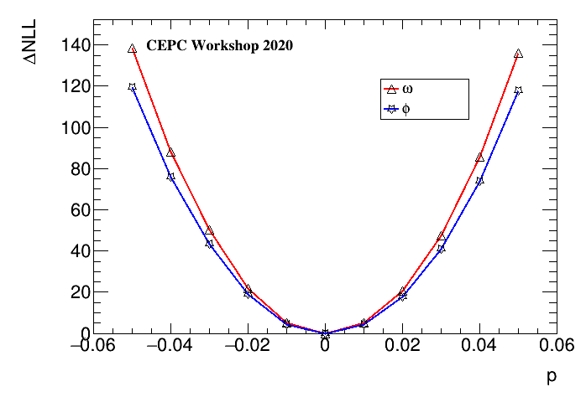
Higgs CP-mixing measurement
Extract maximum-likelihood fit p-value and interval
Fit $ΔNLL$ curve with a quadratic function $ΔNLL\left(p\right)=a⋅{\left(p−p_{0}\right)}^{2}$
68%(95%) CL interval corresponds to $ΔNLL$=0.5(1.96).
Expect limit for SM (no statistics fluctuation in shape).
$ΔNLL\left(p | ω\right)=54164{(p−3×10^{−4})}^{2}$
$ΔNLL\left(p | φ\right)=46779({p−3×10^{−4})}^{2}$
For $ω$:
68% CL: [$−2.72×{10}^{−3}, 3.35×{10}^{−3}$]
95% CL: [$−5.70×{10}^{−3}, 6.33×{10}^{−3}$]
For $φ$:
68% CL: [$−2.97×{10}^{−3}, 3.57×{10}^{−3}$]
95% CL: [$−6.17×{10}^{−3}, 6.78×{10}^{−3}$]

Slide 14
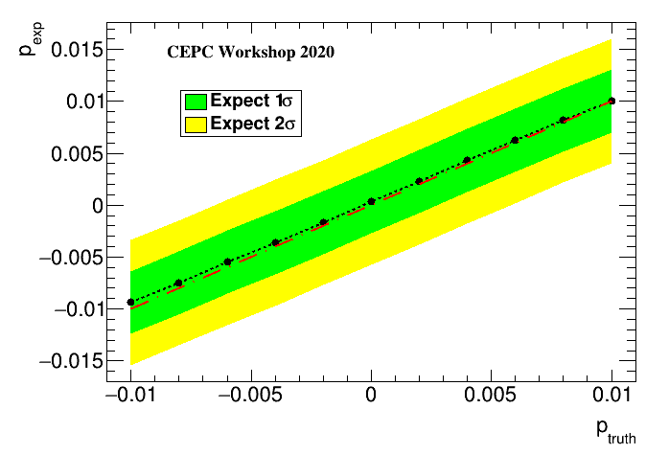
Higgs CP-mixing measurement
For other CP-mixing $p$ hypothesis, a similar result could be derived with $ω$
$1σ$ exceed beyond SM
$2σ$ exceed beyond SM
A bit shift in input truth $p$ and measured $p$.
Needs some further understanding.

Slide 15
Summary and conclusion
A EFT based Higgs CP-mixing test is performed.
Set up some basic assumptions to have a simplest CP-mixing model.
Introduced optimal variable with better performance.
Used ML-fit in $φ$ and $ω$ distribution to extract $p$, while event yield is not considered.
Result: 95% CL $p∈\text{[}−5.70×{10}^{−3}, 6.33×{10}^{−3}\text{]}$, corresponding to $δG_{F},{\hat{α}}_{φl}^{V}, {\hat{α}}_{φl}^{A},{\hat{α}}_{A\tilde{Z}},{\hat{α}}_{Z\tilde{Z}}<{10}^{−6}$.
Remaining problem and next plan:
Fluctuation is not considered. Shape modelling would introduce the dominant uncertainty in the future real high energy $ee$ collider experiment.
Include the background processes, consider full simulation.

Slide 16
Backup

Slide 17
Maximum likelihood fit
Construct a likelihood function
$ℒ(\vec{x}|p,\vec{θ})=\prod_{data}{f\left(x_{i} \right|p,\vec{θ})}$
$\vec{θ}$: nuisance parameter. $p:$POI, CP-mixing parameter. $x_{i}$: dataset ($φ and ω$ here).
When statistics is large enough, we suppose $ℒ\left(\vec{x} | p,\vec{θ}\right)\sim Gaus(\hat{p}, σ_{p}^{2})$, so $lnℒ\left(p\right)=lnℒ_{max}−\frac{1}{2}{\left(\frac{p−\hat{p}}{σ_{p}}\right)}^{2}$
From $ΔNLL=NLL−NLL_{min}$ (negative log likelihood) we can extract maximum likelihood estimate $\hat{p}$ and its CL interval.
$$f(φ|p_{1})$$
$$ℒ(p_{1})$$
$$f(φ|p_{2})$$
$$ℒ(p_{2})$$
dataset
$$f(φ|p_{3})$$
$$ℒ(p_{3})$$
$$f(φ|p_{4})$$
$$ℒ(p_{4})$$
$$f(φ|p_{5})$$
$$ℒ(p_{5})$$

Slide 18
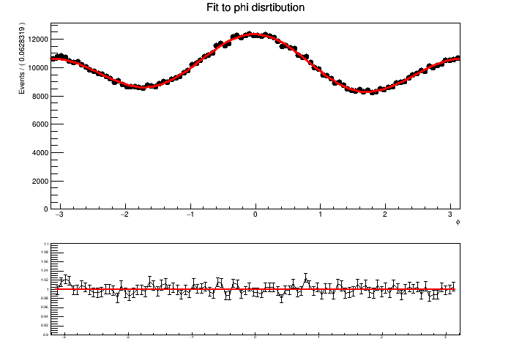
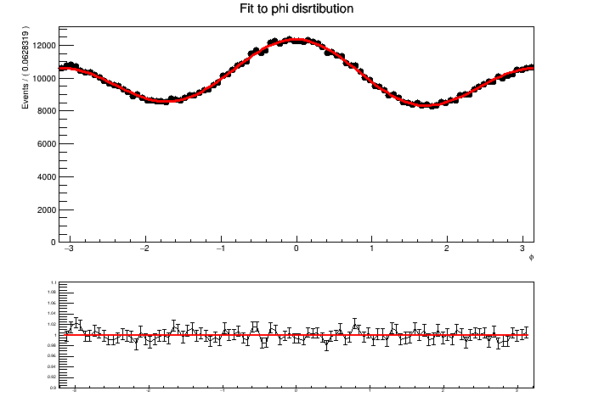
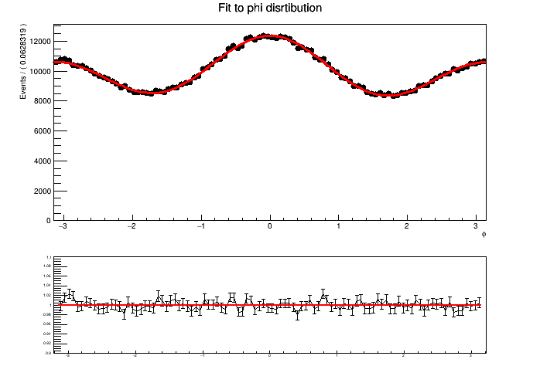
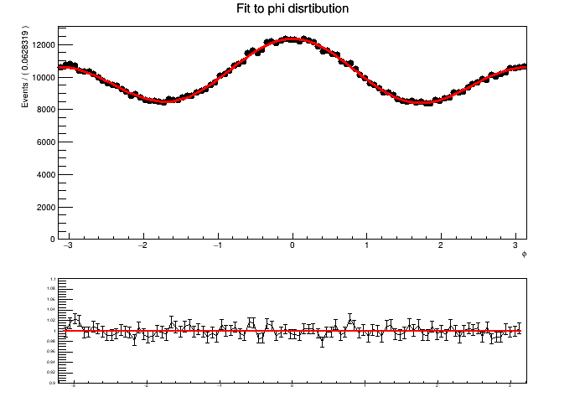
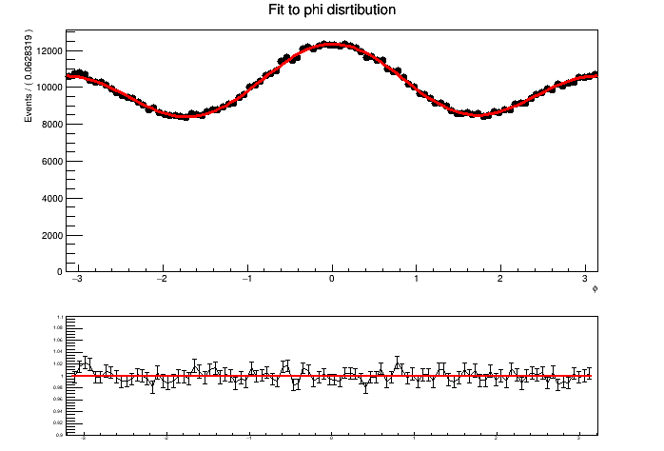
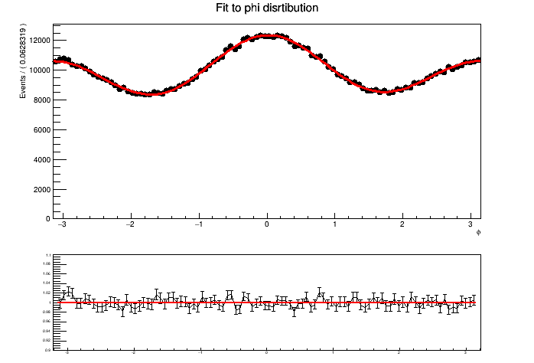
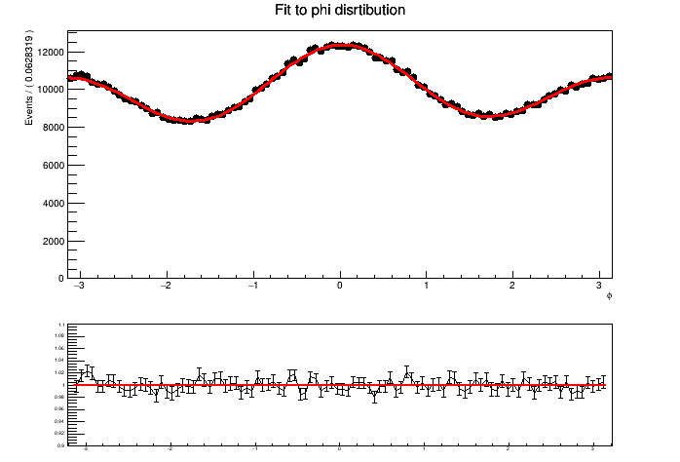
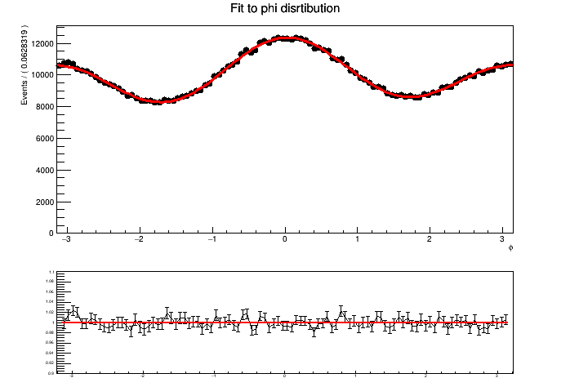
Maximum likelihood fit
Sample modelling
$φ$ modelling: $f\left(φ| p\right)=\int{\frac{dσ}{dcosθ_{1}dcosθ_{2}dφ}dcosθ_{1}dcosθ_{2}}$
p=-0.04
p=-0.03
p=-0.02
p=-0.01
p=0.01
p=0.02
p=0.03
p=0.04

Slide 19
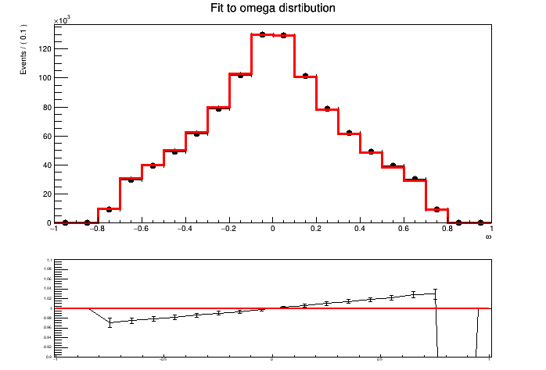
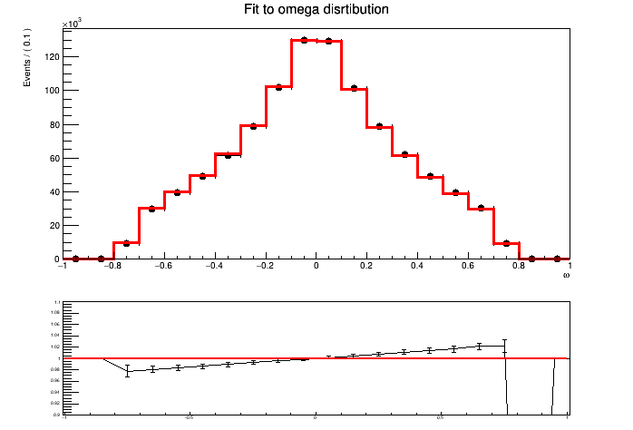
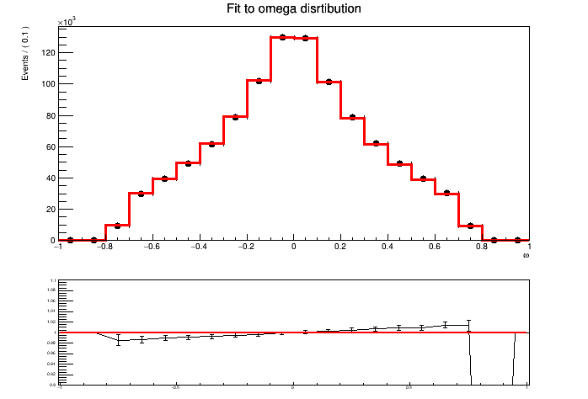
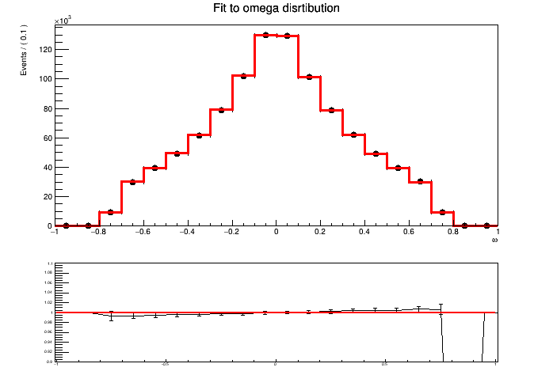
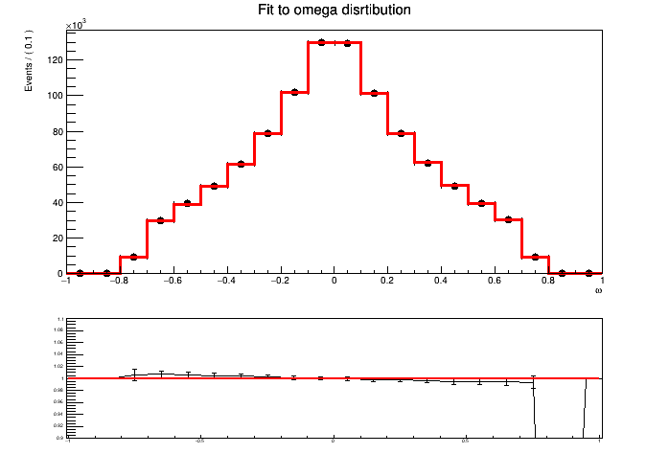
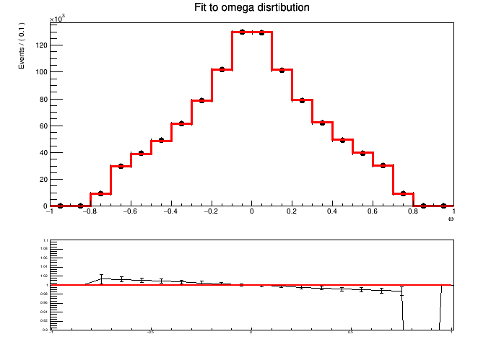
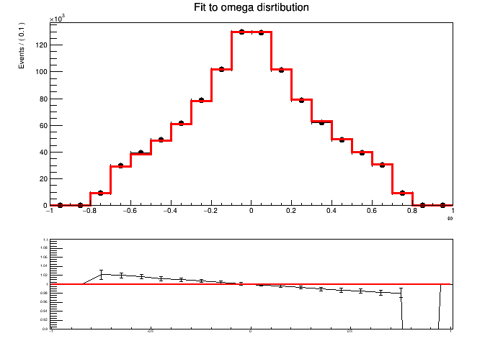
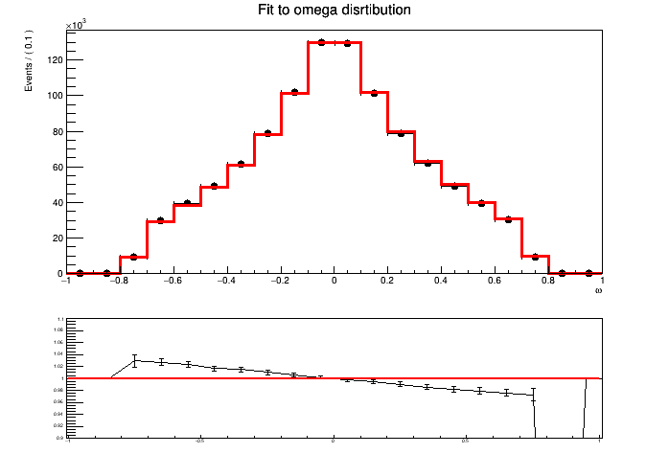
Maximum likelihood fit
Sample modelling
$ω$ modelling: Histogram pdf. Highly depends on the sample statistics used to build histogram and HistPdf.
p=-0.04
p=-0.03
p=-0.02
p=-0.01
p=0.01
p=0.02
p=0.03
p=0.04

Slide 20
Maximum likelihood fit
Precision with real statistics
Central value of best-estimate $p$
Interval width

