Slide 1
JUNO@CNAF
Storage endpoints summary and Use of Resources
JUNO DataCenters Meeting 17/12/2020

Slide 2
SRM based on StoRM
StoRM: Endpoint: storm-fe-ams.cr.cnaf.infn.it (uses 2 gridftp servers) 3 storage areas defined (disk): /juno/storm corresponds to /storage/gpfs_data/juno/junofs/production/storm /juno/data-production corresponds to /storage/gpfs_data/juno/junofs/production/data-production /juno/validation corresponds to /storage/gpfs_data/juno/junofs/production/validation

Slide 3
WebDAV (storm-webdav)
WebDAV: read-write in a new storage area for testing purposes, VOMS authentication. Path on the filesystem: /storage/gpfs_data/juno/junofs/test-webdav Access path: /juno Endpoint: xfer-archive.cr.cnaf.infn.it (4 servers) Example: davix-ls -P grid https://xfer-archive.cr.cnaf.infn.it:8443/juno

Slide 4
XrootD
XrootD: read/write on a new storage area for testing purposes, VOMS authentication. Path on the filesystem: /storage/gpfs_data/juno/junofs/test-xrd Endpoint: xfer-archive-03.cr.cnaf.infn.it Example: xrdfs root://xfer-archive-03.cr.cnaf.infn.it:1094/ ls
xrdcp root://xfer-archive-03.cr.cnaf.infn.it:1094//test.txt test.txt.bak

Slide 5
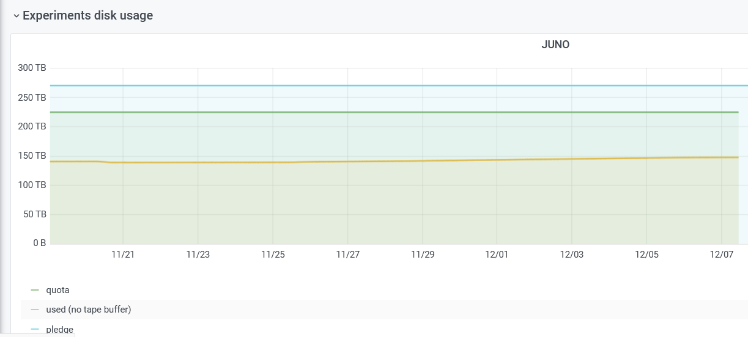
Use of Resources

