Slide 1
Low Energy Muon Beam Facility at PSI
Xiaojie Ni :: Paul Scherrer Institute
2020 EMuS & MOMENT General Meeting

Slide 2
Outline
Low Energy Muon Beam Basics
PSI Overview
Low Energy μ⁺ Beam and Setup
Applications of Low Energy µ⁺
Semiconductors
Magnetism
Superconductivity
Particle Physics Aspects
Improvements of Low Energy µ⁺ Beam

Slide 3
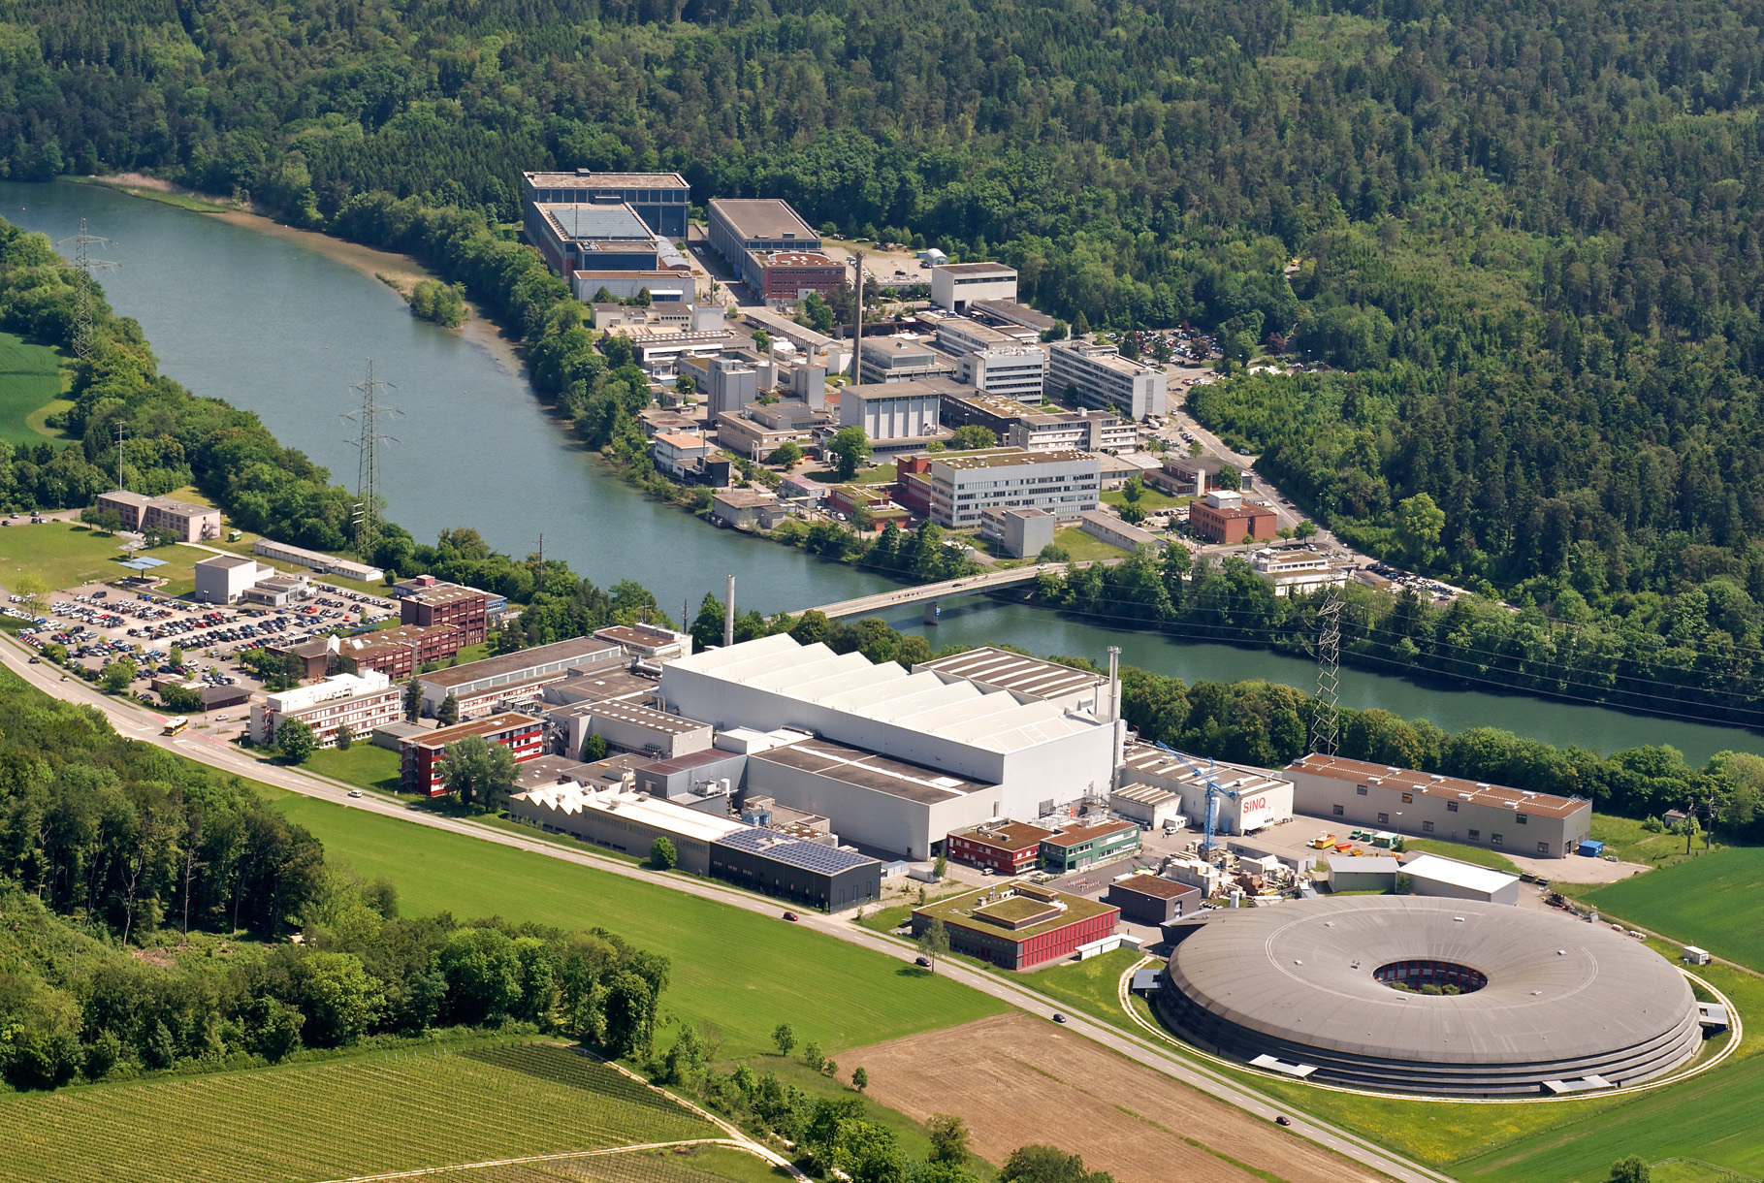
Paul Scherrer Institute
⬅ Basel
Germany ⬆
Aarau/Bern ⬇
Zürich ➔
PSI East
SwissFEL
Neutron Spallation Source
(SINQ)
Proton Accelerator
Muon Source
(SµS)
PSI West
Synchrotron
(SLS)
Notes:
Hier sehen Sie das PSI aus der Vogelperspektive.
Wie Sie sehen, umfassen unsere Forschungsthemen eine sehr breite Palette:
von der Materialforschung über die Energieforschung, der Nanotechnologie bis zur Biologie.
Auf der westlichen Aare-Seite sehen Sie unsere drei bisherigen Grossforschungsanlagen: die Synchrotron Lichtquelle Schweiz SLS, die Neutronenquelle SINQ, und die Myonenquelle SµS (gesprochen: S mü S), dazwischen das Zentrum für Protonentherapie zur Behandlung von bestimmten Krebserkrankungen.
Auf der Ostseite, im Wald, wird derzeit unsere vierte Grossforschungsanlage, der SwissFEL, gebaut. Mehr dazu später.
Diese Anlagen betreibt das PSI nicht nur für sich selbst, sondern für Forscher aus der Schweiz und dem Ausland, aus der Akademie und der Industrie.

Slide 4
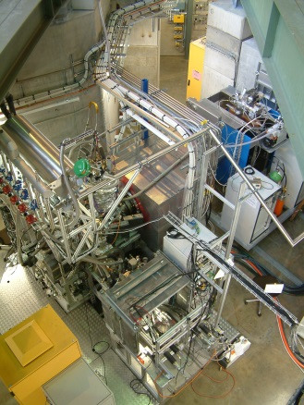
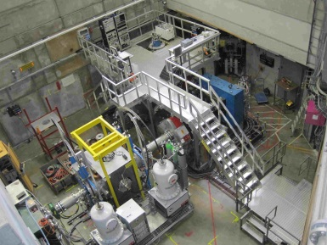
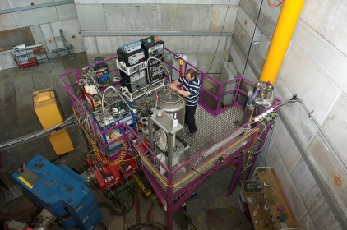
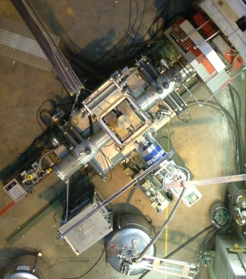
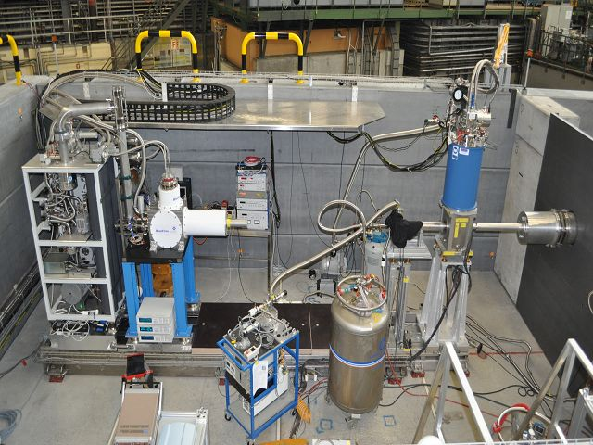
Muon Instruments at PSI: SμS (Swiss Muon Source)
0.3 T
2.5 K
LEM
DOLLY
Low Energy Muon
Instrument
Muon Energy: 4.2 MeV (μ⁺)
0.5 T
0.25 K
GPD
Muon Energy: 0.5-30 keV
General Purpose Decay Channel Instrument (for Pressure Studies)
News:
MIXE (Muon Induced X-ray Emission)
Alex Amato et al.
RF-μSR
Zaher Salman et al.
FLAME
Hubertus Luetkens et al.
Muon Energy: 5-60 MeV (μ⁺/ μ‒)
piE1
μE1
0.5 T
0.3 K
2.8 GPa
μE4
piE3
piM3.2
HAL-9500
piM3.3
High Field and Low Temperature
GPS
3 T
0.02-4 K
LTF
General Purpose Surface Muon Instrument
Low Temperature Facility Retired Dec. 2018 Will be replaced by FLAME in 2021
Shared Surface Muon Beam
Muon on Request (MORE)
Muon Energy: 4.2 MeV (μ⁺)
0.6 T
1.6 K
9.5 T
< 20mK

Slide 5
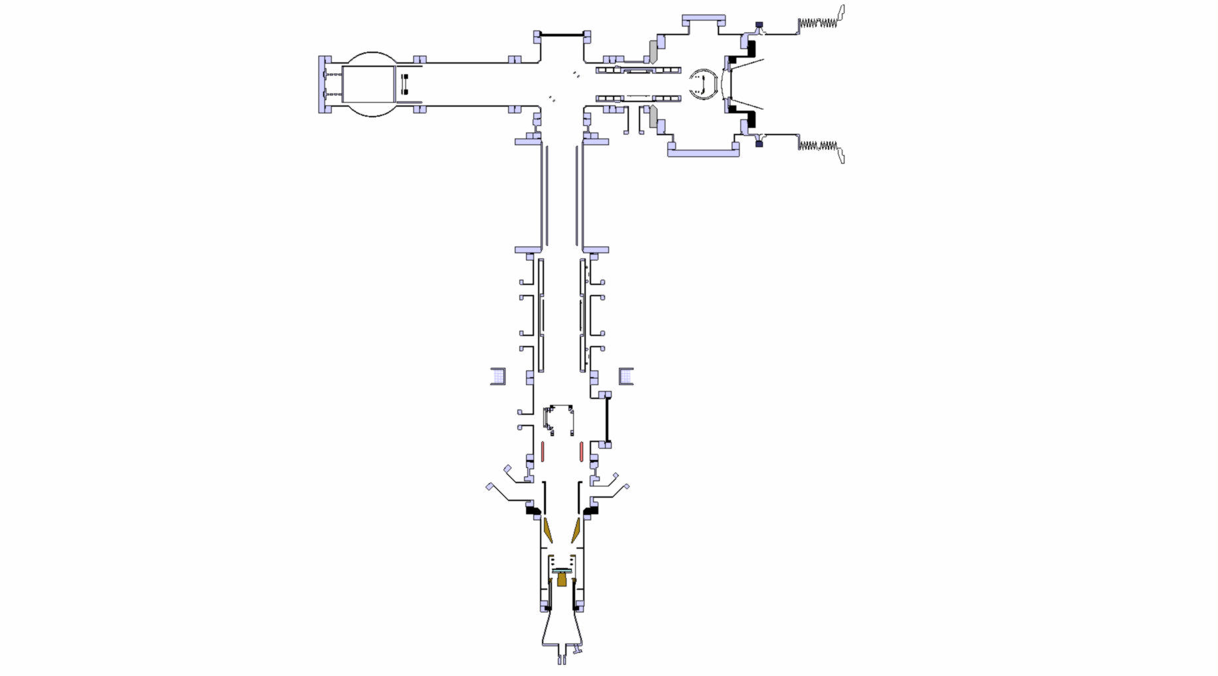
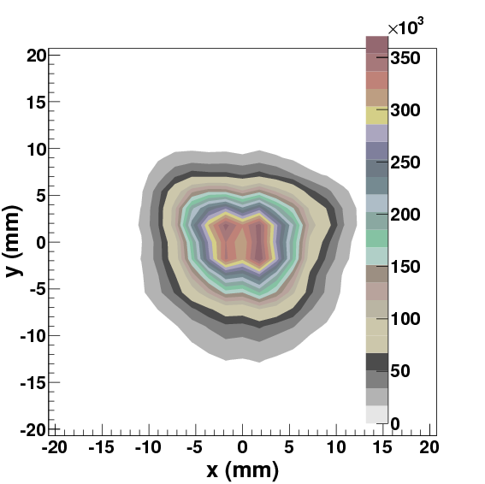
Low Energy μ⁺ Beam and Setup for LE-μSR
Rates are for 6-cm target E and 1.8 mA proton current (2019)
- UHV system, 10⁻¹⁰ mbar
- some parts LN₂ cooled
electrostatic mirror
“surface” μ⁺ beam, ~4 MeV
Spin
~2.2 • 10⁸ μ⁺/s
Polarized Low Energy Muon Beam Energy: 1-30 keV ΔE, Δt: 400 eV, 5 ns Depth: 1 – 300 nm Polarization ~100 % Beam Spot: 12 mm (FWHM)
Spin-rotator (E x B)
Einzel lens
(LN₂ cooled)
moderator
~ 13000 LE-μ⁺/s; accelerate up to 20 keV
Einzel lens
(LN₂ cooled)
Beam spot at sample
Start detector
(10 nm C-foil)
Conical lens
Sample cryostat
e+ detectors
at sample: up to ~ 5200 μ⁺/s

Slide 6
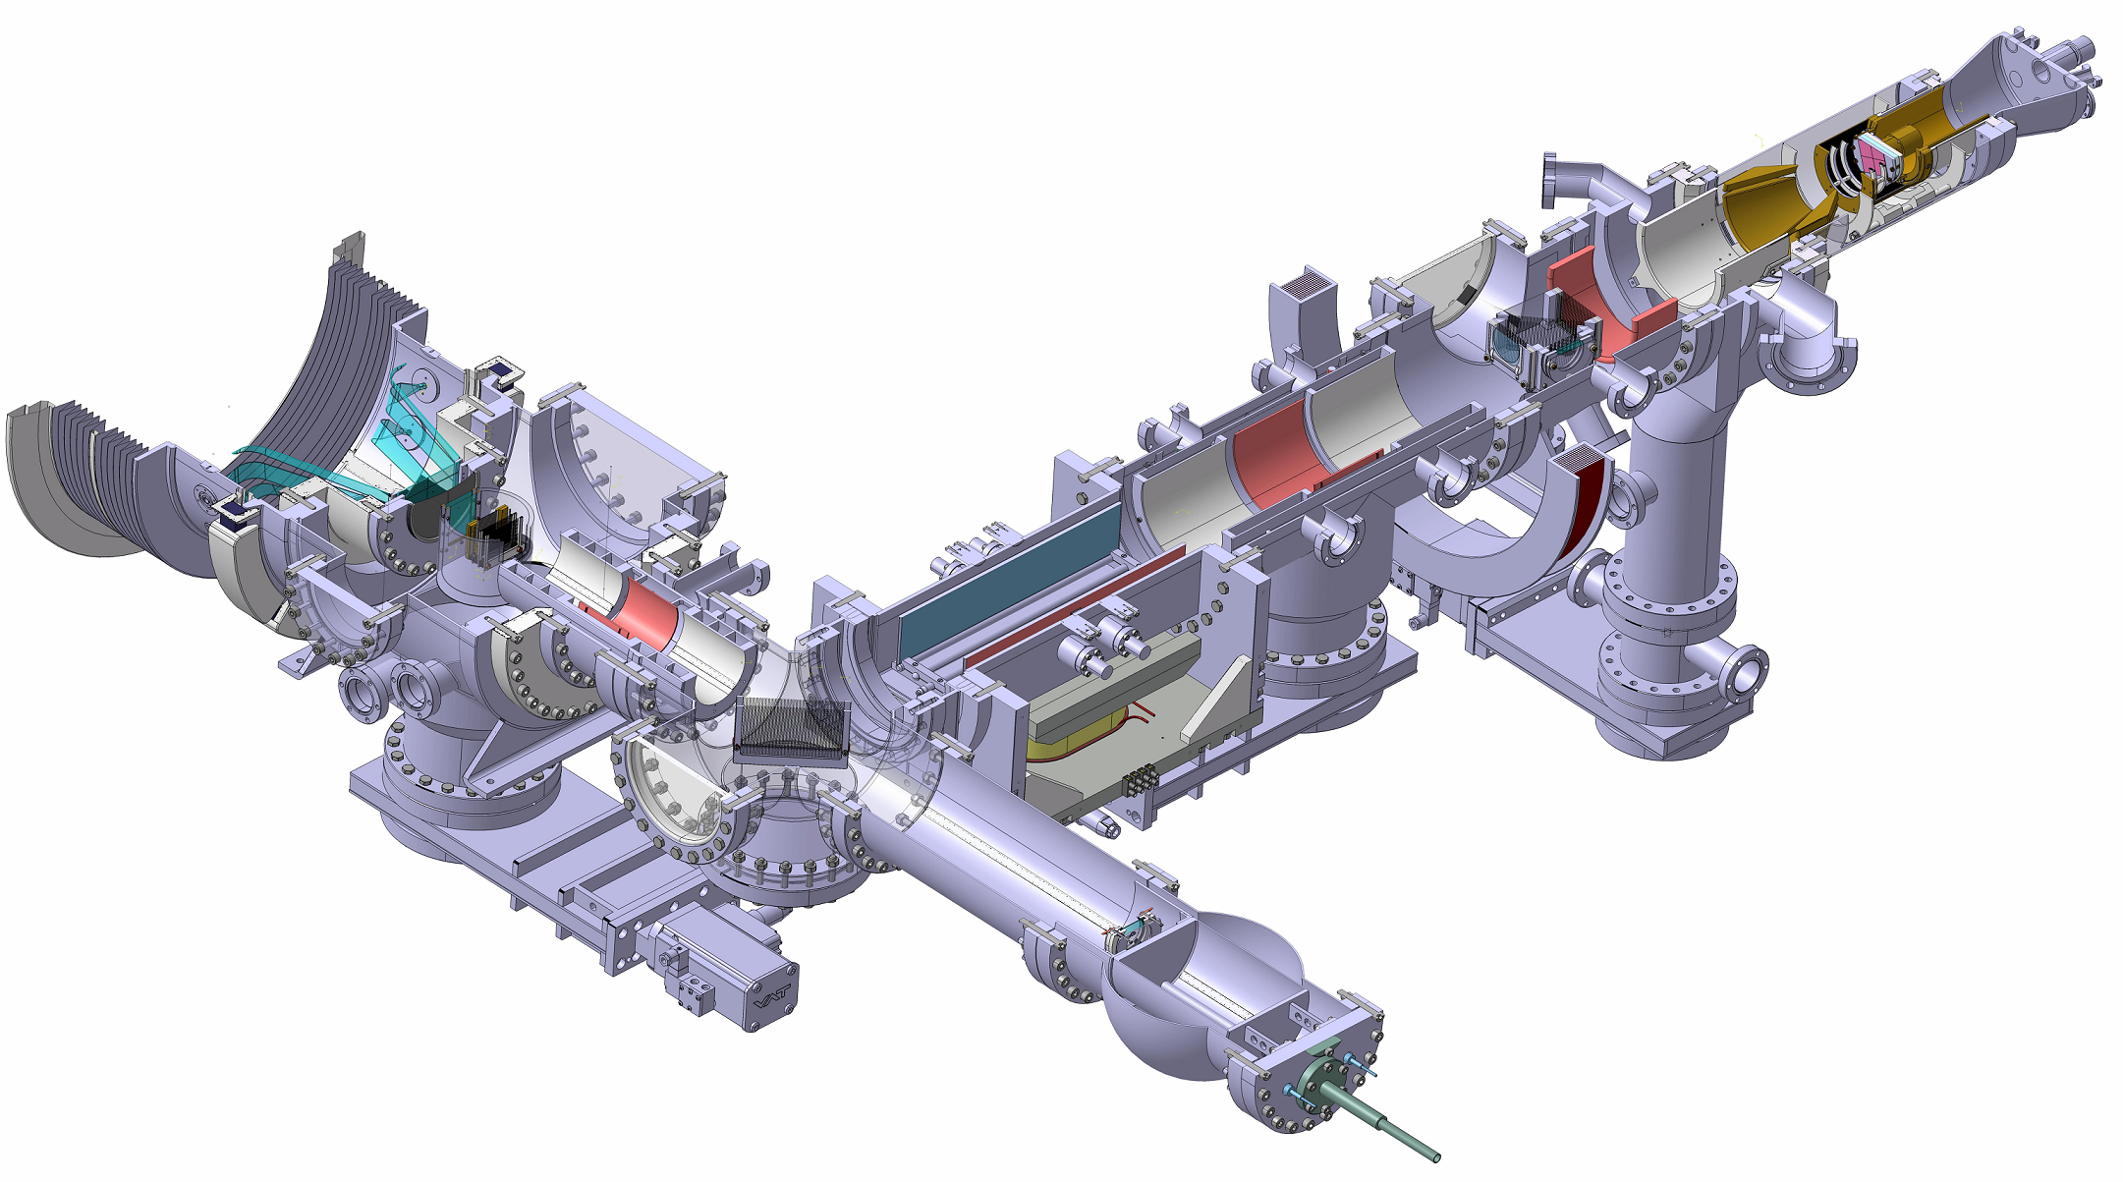
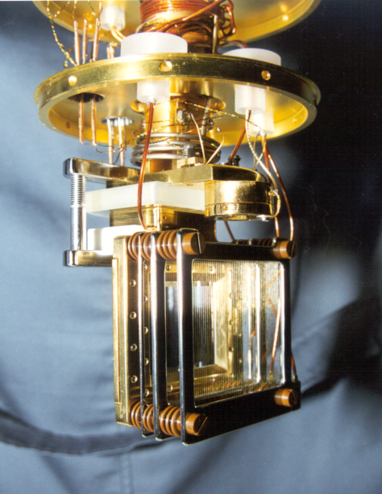
Low Energy μ⁺ Beam and Setup for LE-μSR
Muon Spin
Muon Momentum
Moderator low energy μ⁺
source
Typical re-acceleration voltage at the moderator: 15kV

Slide 7
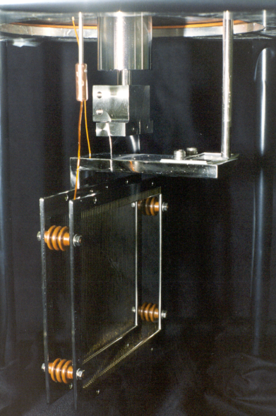
Low Energy μ⁺ Beam and Setup for LE-μSR
Muon Spin
Muon Momentum
Moderated slow µ⁺
Un-moderated fast µ⁺
Mirror
energy filter
Mirror at the same high voltage as the moderator. Typically 15kV

Slide 8
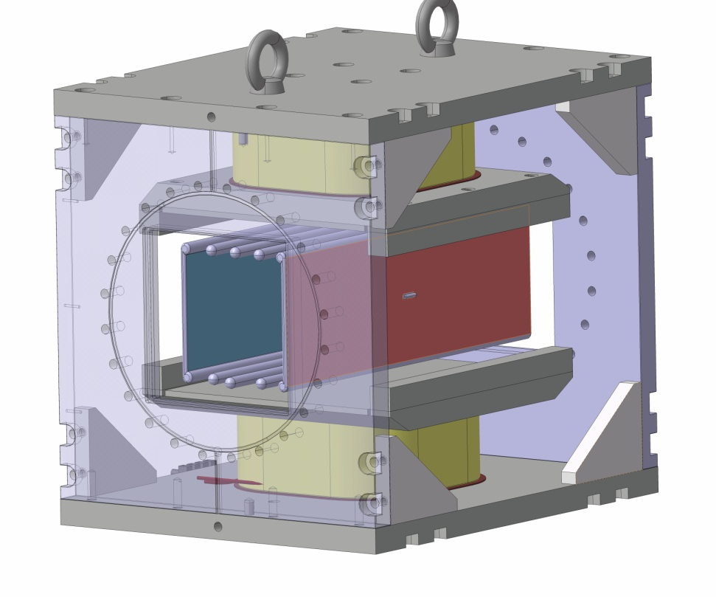
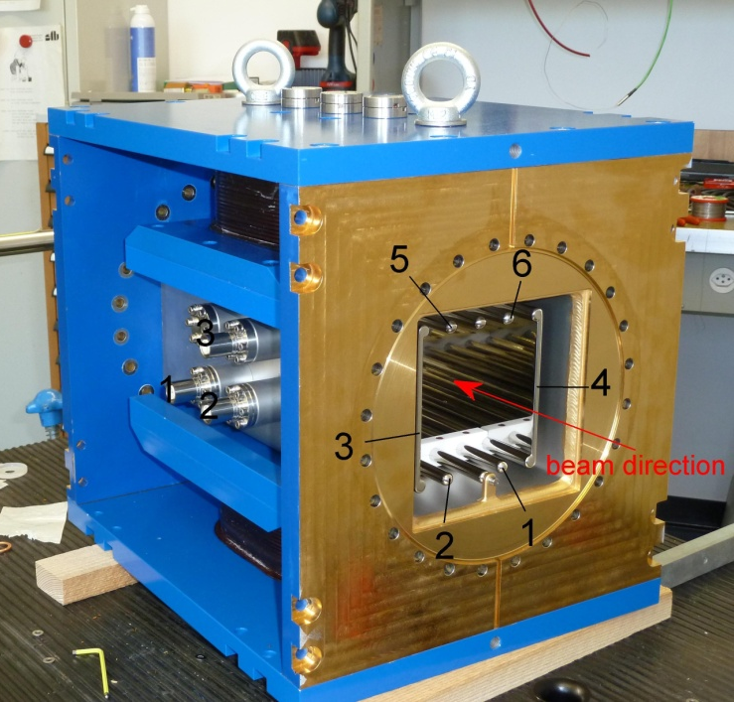
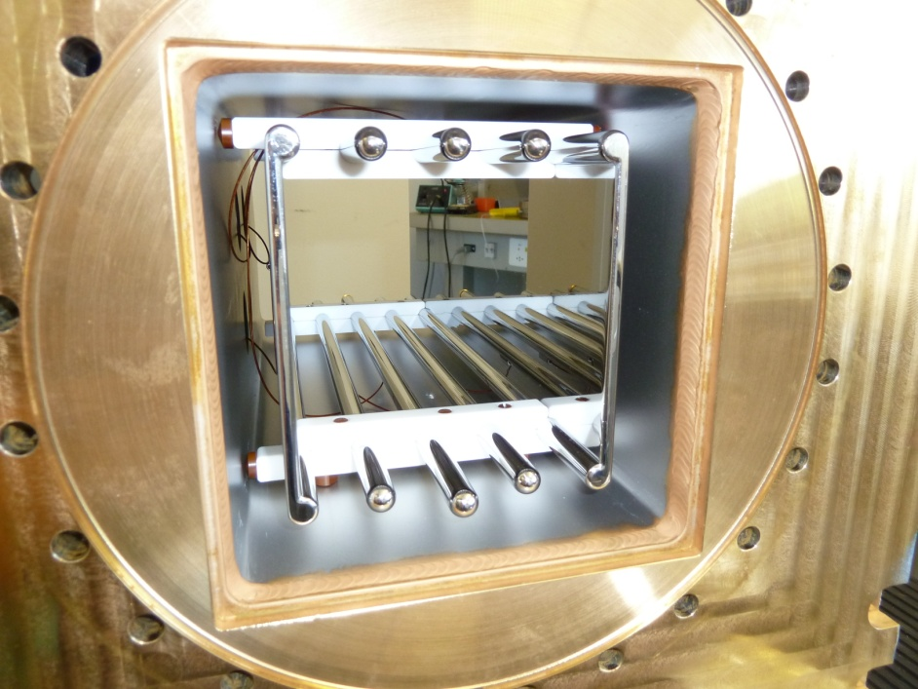
Low Energy μ⁺ Beam and Setup for LE-μSR
Spin-Rotator / Separator
Muon Spin
Muon Momentum
In-plane spin rotation of ± 90° easily possible
E-Field
B-Field

Slide 9
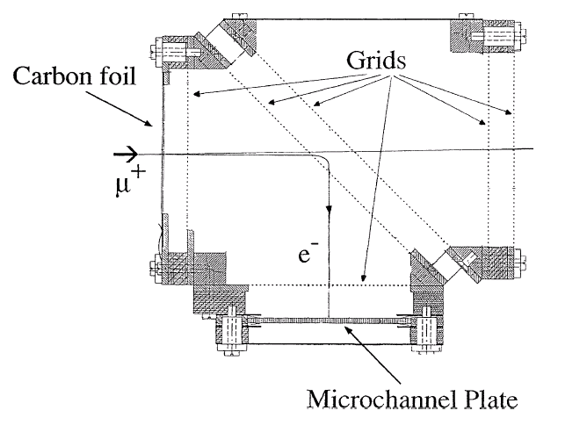
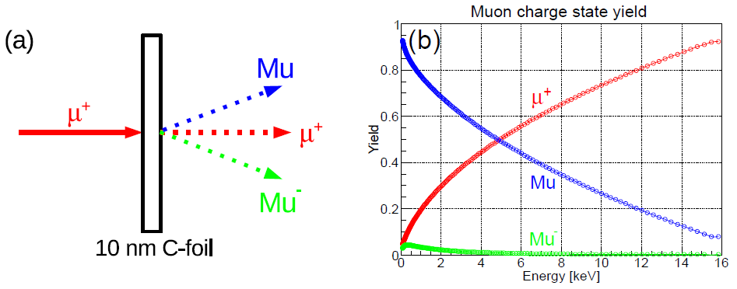
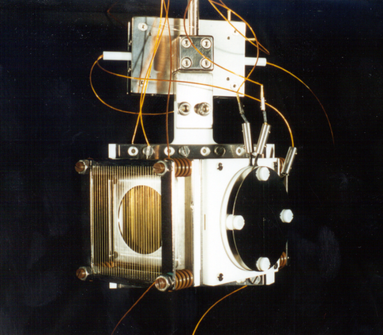
Low Energy μ⁺ Beam and Setup for LE-μSR
Muon Spin
Muon Momentum
Trigger Detector or M-Counter
Trigger
implantation time
A. Hofer, PhD Thesis (98) K.S. Khaw, et al., JINST 10, P10025 (15).

Slide 10
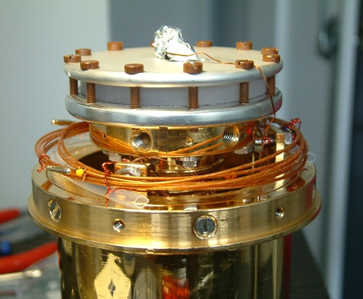
Low Energy μ⁺ Beam and Setup for LE-μSR
Muon Spin
Muon Momentum
Sample Cryostat
Konti flow cryostats: 4 - 320 K at sample plate
LowTemp cryostat: 2.4 - 300 K with sample plate, 2.2 - 300 K without sample plate
Furnace: -50 - 300°C (can be cooled by LN₂)
Sample size: Ideally 25x25 mm² or ∅ = 25 mm, mosaic of four pieces of 10x10²mm

Slide 11
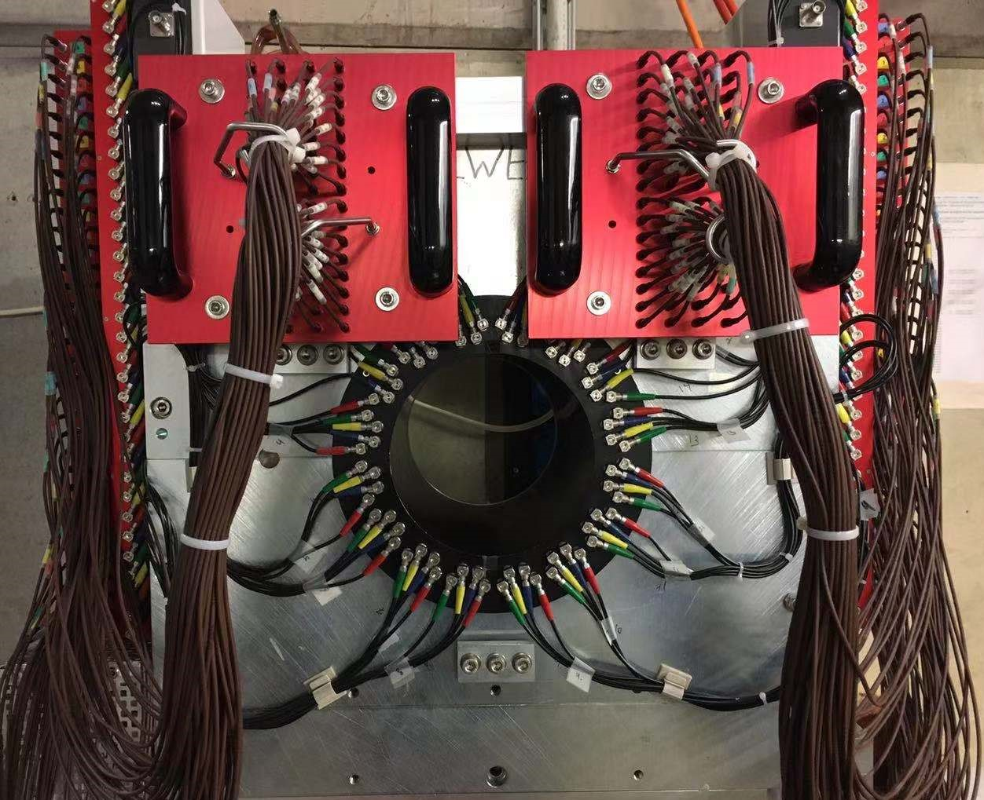
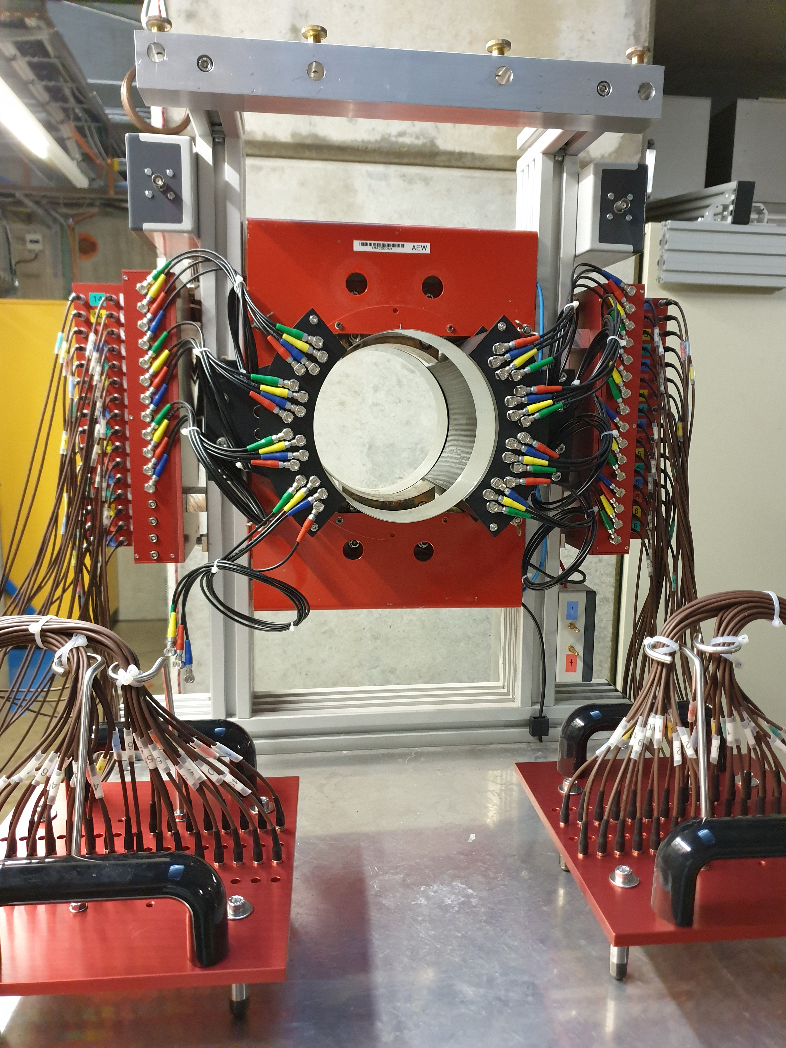
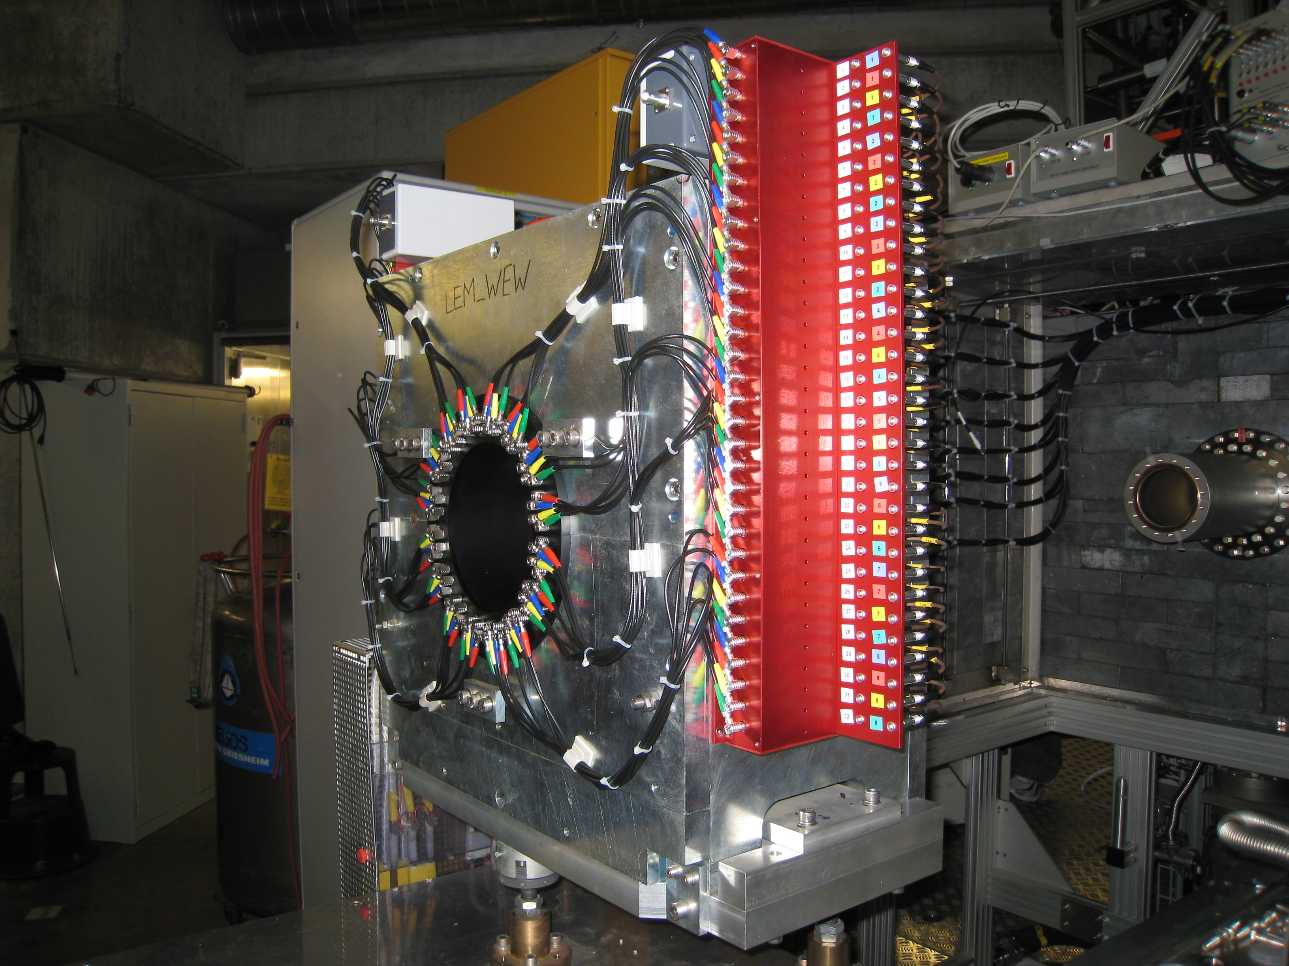
Low Energy μ⁺ Beam and Setup for LE-μSR
Magnets with APD Positron Spectrometer
WEW: 0-0.34 T
AEW: 0-300 G
B
B

Slide 12
Applications of Low Energy µ⁺
Selected Examples

Slide 13
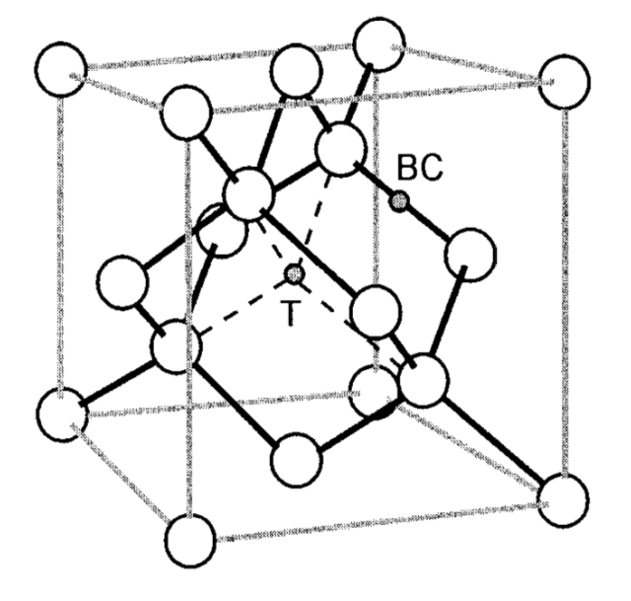
Semiconductors
Possible muon charge states:
“bare” µ⁺ = Mu⁺ (diamagnetic)
µ⁺ + e⁻ = Mu⁰ (paramagnetic)
µ⁺ + 2 e⁻ = Mu⁻ (diamagnetic)
Muon sites:
Bond center (BC): Mu_{BC}^{(+,0)}
Tetrahedral interstitial site (T): Mu_{T}^{(0,-)}
Direct Observation of Hole Carrier-Density Profiles and Their Light-Induced Manipulation at the Surface of Ge
T. Prokscha, et al. Physical Review Applied 14, 014098 (2020)
Measurements performed at T=220K:
Mu_{BC}⁰ fully transformed to Mu_{BC}⁺
Mu_{T} is used as sensor for free hole carriers.
Charge-Exchange Cycles

Slide 14
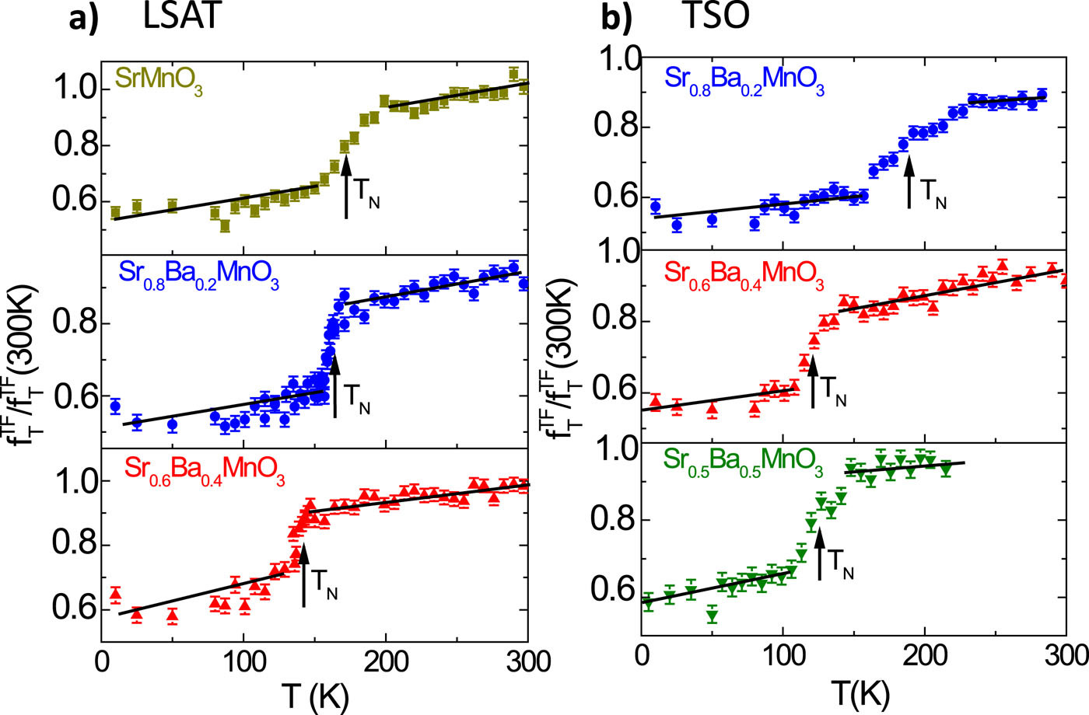
Magnetism
Engineering the magnetic order in epitaxially strained Sr_{1-x}Ba_{x}MnO₃ perovskite thin films
L. Maurel et al., APL Materials 7, 041117 (2019)
FIG. 2. Temperature dependence of the transverse fraction fT^{TF} of the muons normalized to the fraction at 300 K, determined from wTF LE-μSR measurements for 10-nm-thick Sr1-xBaxMnO3 films on (a) LSAT and (b) TSO. The arrows indicate the magnetic order temperature (see text).

Slide 15
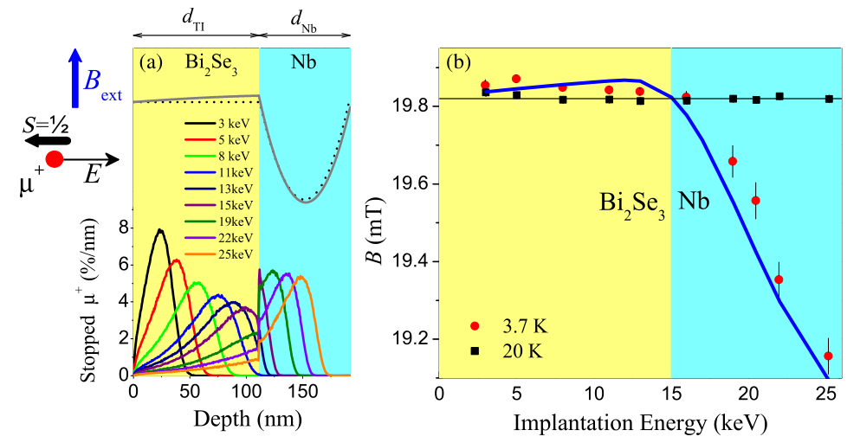
Superconductivity
Proximity-Induced Odd-Frequency Superconductivity in a Topological Insulator
Jonas A. Krieger et al., Physical Review Letters 125, 026802 (2020)
FIG. 1. (a) (top) Schematic showing the μSR geometry where the applied field is parallel to the surface and perpendicular to the muon spin and momentum directions. The lines depict the expected magnetic field depth profile due to screening of the applied field inside the heterostructure with (solid gray) and without (dotted black) proximity induced superconductivity in the Bi₂Se₃layer. (bottom) Calculated muon implantation profiles at different implantation energies using Trim.SP [25]. (b) Measured local mean field as a function of implantation energy above (black squares) and below (red circles) the superconducting transition temperature. The black horizontal line represents the applied field value, B_{ext}, and the blue line is a fit to the theoretical model.

Slide 16
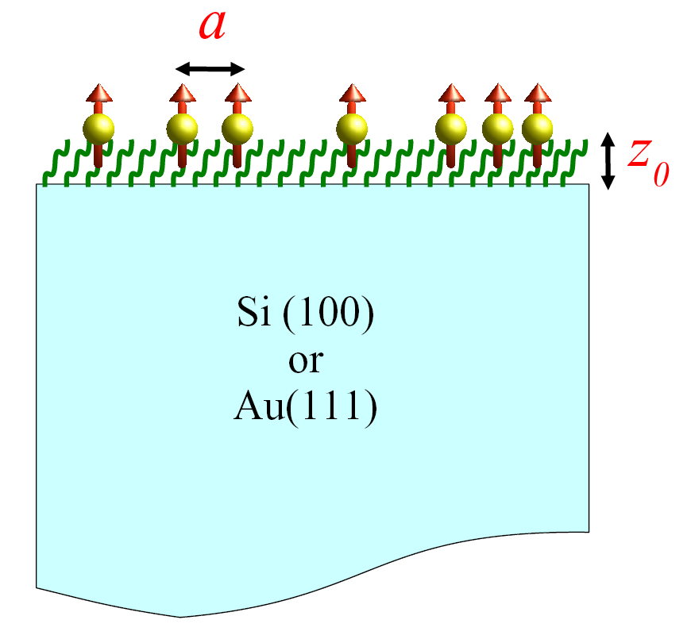
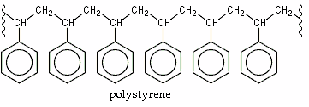
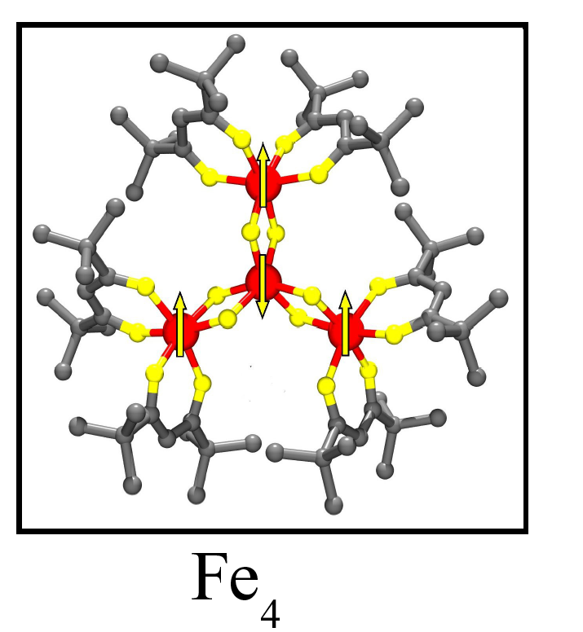
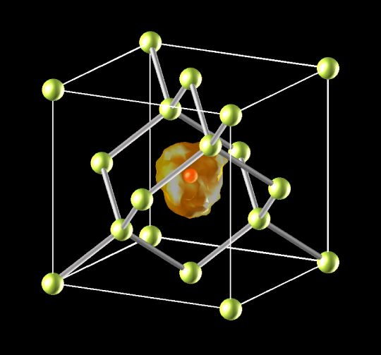
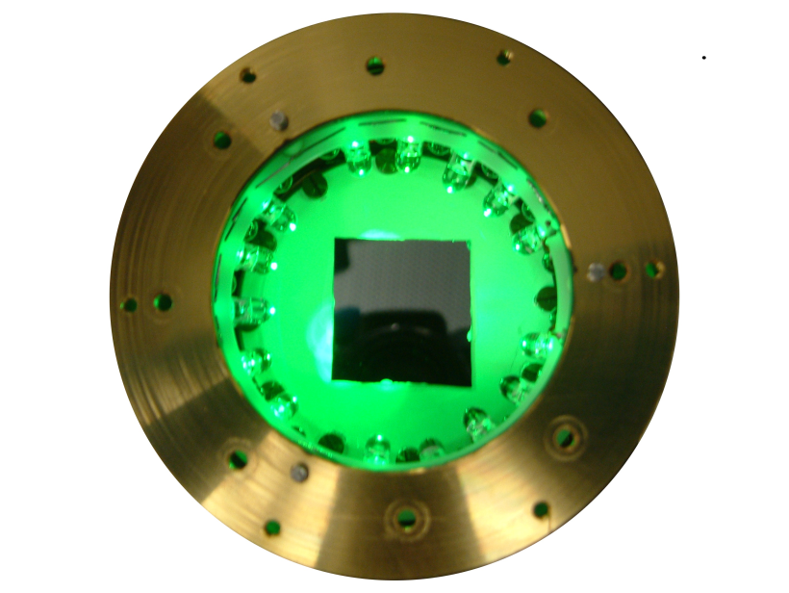
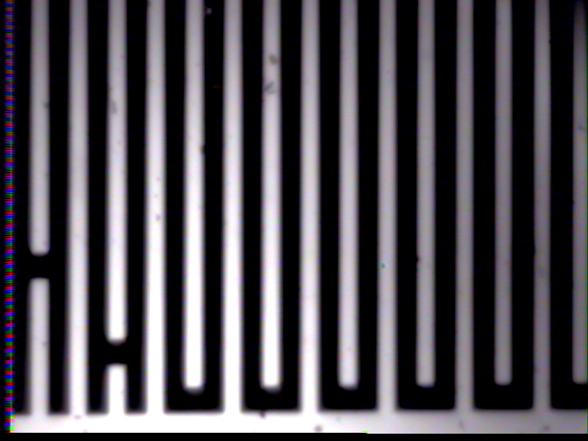
More LE-μSR applications
Surface dynamics of polymers
Magnetic properties of thin films and monolayers of single molecule magnets
Topological Insulators, combination with ARPES
Formation of hydrogen impurities in semiconductors at low energies
http://www.psi.ch/en/low-energy-muons/lem-publications
Photo-induced effects in semiconductors
Superconductivity and Magnetism in LCO/LSCO Superlattices
T_{N}
Proximity effects in normal/superconducting/magnetic heterostructures
T_{c}
doping
Superfluid density in high and low T_{c} heterostructures, superconduc-tivity and magnetism in electron-doped cuprates
Current effects on magnetism and superconductivity in a thin LSCuO wire
300μ
Strain effects on magnetic transition in multi-ferroics

Slide 17
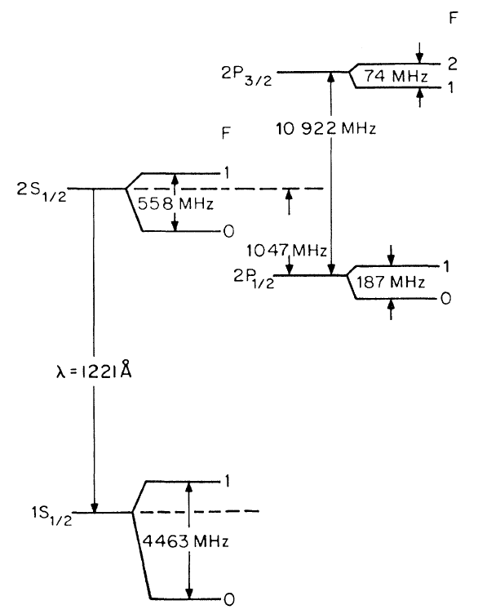
Particle Physics
Atomic Muonium is an ideal system in which to study bound state QED free of finite-size effects and in which hadronic corrections are strongly suppressed compared to hydrogen.
The Muonium 1s-2s transition offers a clean determination of the muon mass, which in turn is required for a precise interpretation of (g-2) and to determine the weak interaction Fermi coupling constant G_{F}, and others.
A. Antognini, et al. PRL 108, 143401 (12).
K.S. Khaw, et al. PRA 94, 022716 (16).

Slide 18
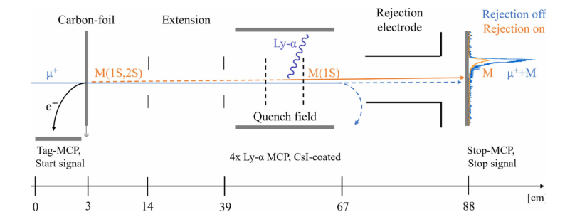
Particle Physics
Intense beam of metastable Muonium
G. Janka et al., Eur. Phys. J. C 80, 804 (2020).
Fig. 1 The experimental setup installed at the end of the LEM beamline, lengths at the bottom are not to scale. To the right there is an example of the time distribution of particles reaching the Stop-MCP in coincidence with the Tag-MCP . The paths of M and μ⁺ are not parallel for visualization reasons

Slide 19
Improvements of Low Energy µ⁺ Beam

Slide 20
Limitation
The insufficient low-energy muon rate at the sample:
Study of subtle proximity effects in magnetic/superconducting heterostructure samples are restricted due to limited statistical precision.
Study of hydrogen-like muonium states in semiconductors needs high statistics to observe the muonium precession frequencies.
Essential for all experiments requiring high statistical precision.
The large beam spot size at the sample:
About 80% of the muons stop in an area of 20×20 mm², and only 40-50% in 10×10 mm², due to the large phase space of the muon beam. Measurements on 5×5 mm² sized samples are currently not possible because of the <10% fraction of the beam stopping in this small area, making the signal-to-background ratio unacceptably low.

Slide 21
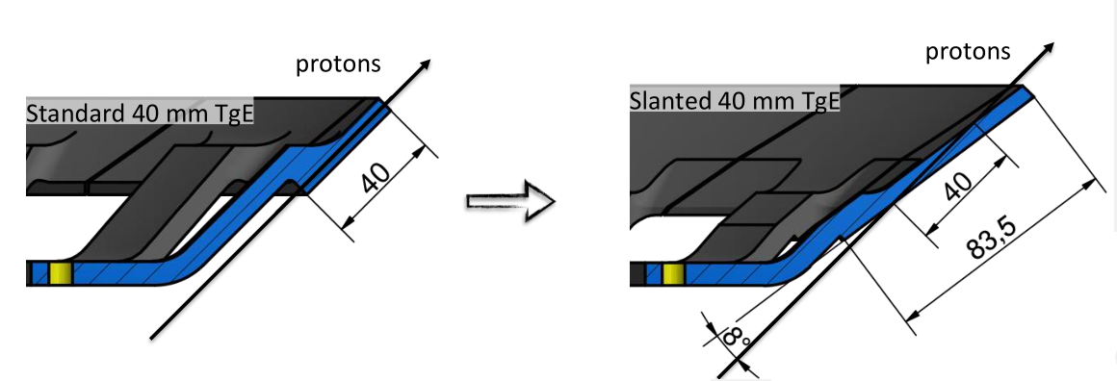
Improvements
Low-energy muon rate
A new target E
30-40 % for μE4
2. To replace the last triplet by a solenoid
 | Current μE4 | After replacing
Standard 40 mm TgE | 5740 | 8772
Slanted 40 mm TgE | 7555 | 10668

Slide 22
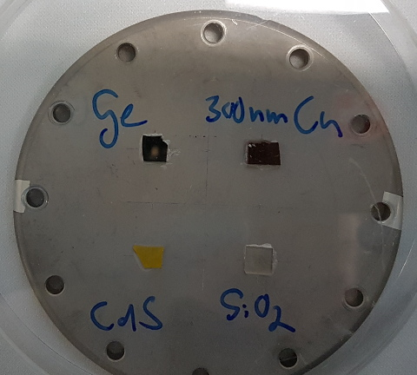
Improvements
Beam spot size
Collimator
1-cm collimator
5×5 mm² Fraction:
< 10 % 30-40%

Slide 23
Improvements
Beam spot size
Collimator
1.5-cm collimator
12 kV transport | LEM rate (mAs) | Asymmetry | FoM (A²×R)
Without collimator | 905 | 0.056 | 2.8
1.5-cm collimator | 390 | 0.092 | 3.3
Sample: 10x5 mm²

Slide 24
Acknowledgments
LEM-Team: Thomas Prokscha (Head) Zaher Salman Andreas Suter Hans-Peter Weber (Technician)
Andrin Doll (Postdoc) Xiaojie Ni (Postdoc)
Maria Inès Mendes Martins (PhD student from 10.2020)
Luping Zhou (Guest PhD student, 09.2019-09.2020)
Jonas A. Krieger (PhD student, graduated 07.2020)

Slide 25
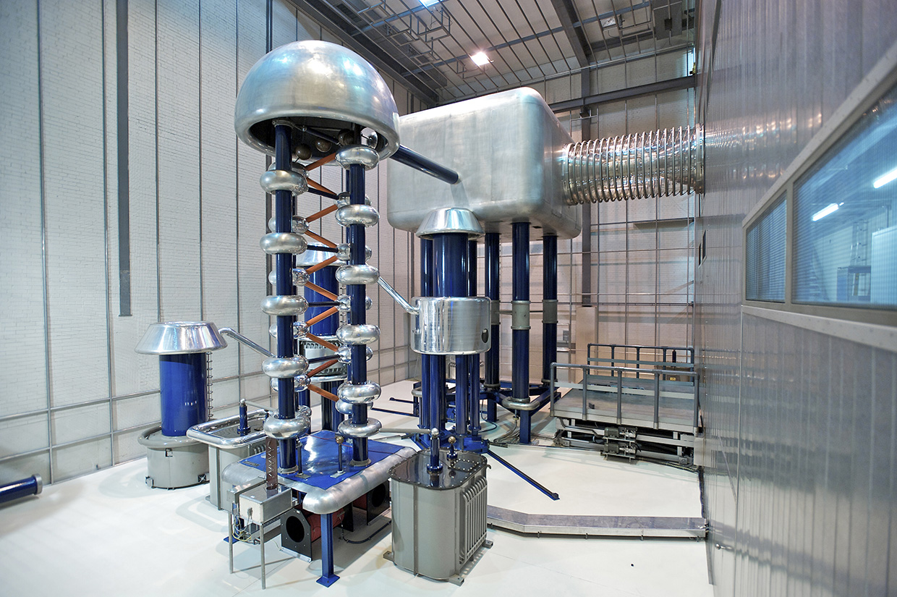
Proton Accelerator (Overview)
Cockcroft-Walton
A proton energy of 870 keV is obtained from the 60 keV extraction voltage at the ion source and the 810 keV DC acceleration of the Cockcroft-Walton accelerator

Slide 26
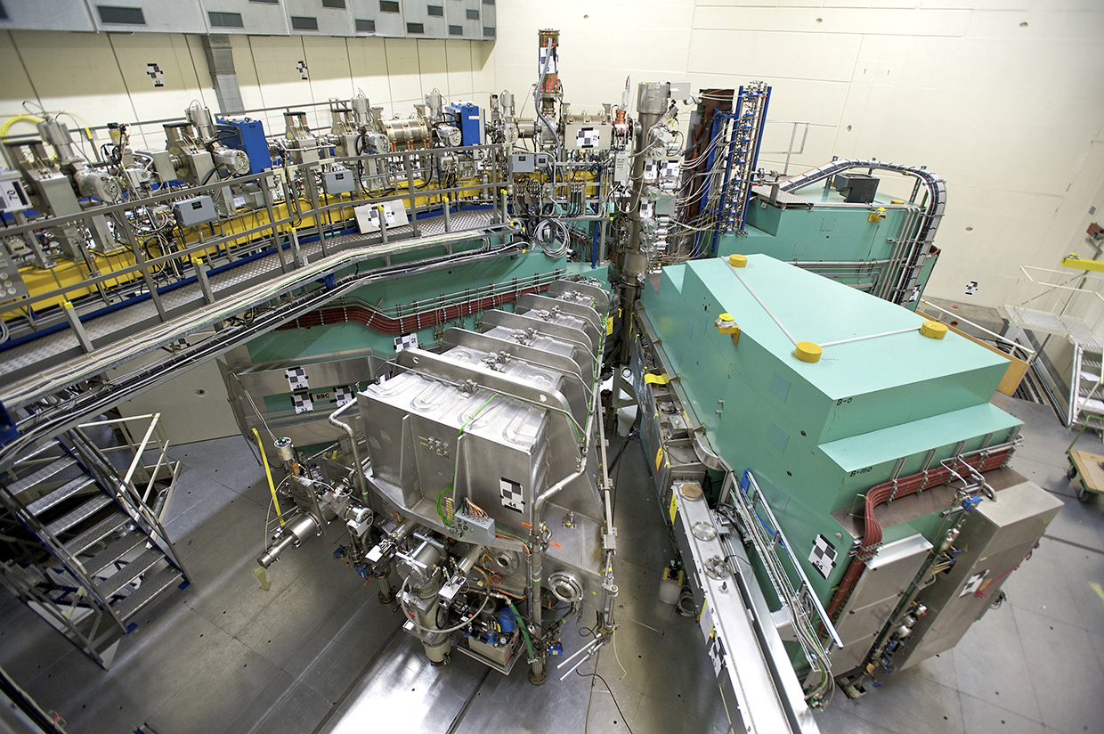
Proton Accelerator (Overview)
Injektor 2 (1st Cyclotron)
Injection Energy 870 keV (4.3% of light speed)
Extraction Energy 72 MeV (37.1% of light speed)
Energy spread (FWHM) ca. 0.2 %
Beam Emittance ca. 2 pi mm x mrad
Beam Current 2.5 mA DC
Accelerator Frequency 50.63 MHz
Time Between Pulses 19.75 ns
Bunch Width ca. 0.3 ns
Magneticfield (Stiffness T x m, middle) 0.36 (1.25, 0.33 T)
Mass of Sektor Magnets 4 x 180.000 kg
Radius at Injection 400 mm
Radius at Extraction 3500 mm
Mass of Resonators 3 x 5.000 kg + 1 x 3.000 kg

Slide 27
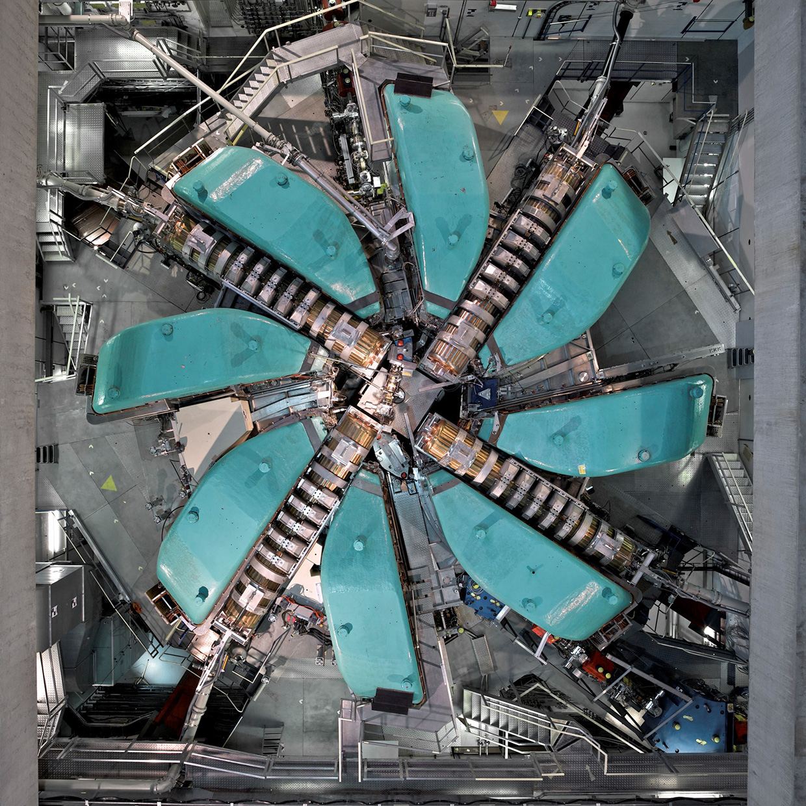
Proton Accelerator (Overview)
Main Cyclotron
Injection Energy 72 MeV
Extraction Energy 590 MeV
Extraction Momentum 1.2 Gev/c
Energy spread (FWHM) ca. 0.2 %
Beam Emittance ca. 2 pi mm x mrad
Beam Current 2.2 mA DC
Accelerator Frequency 50.63 MHz
Time Between Pulses 19.75 ns
Bunch Width ca. 0.3 ns
Extraction Losses ca. 0.03 %

Slide 28
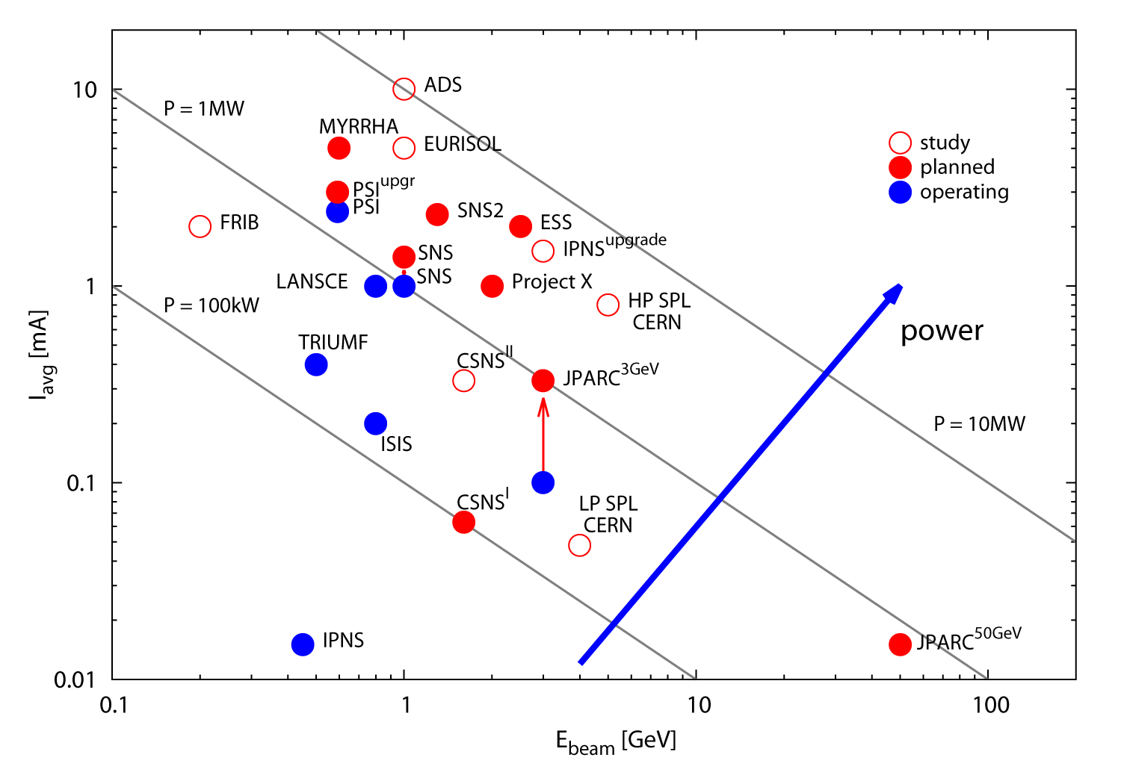
Beam Power of Accelerators World Wide
from M.Seidel, GFA, PSI

Slide 29
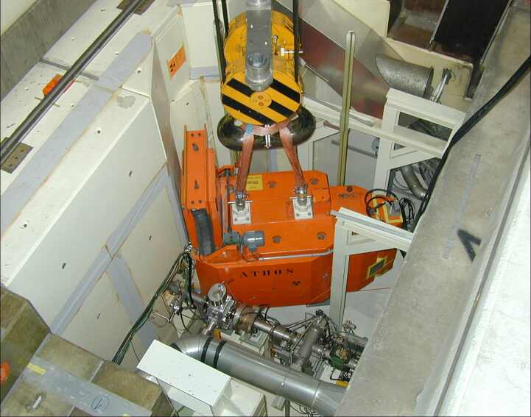
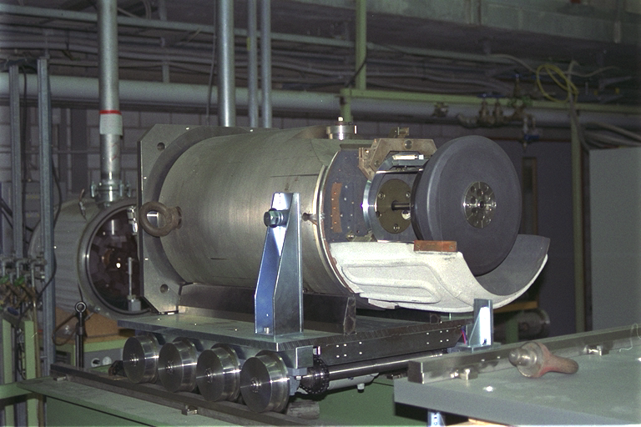
Proton Accelerator (Overview)
Muon Source (Target M)
.

Slide 30
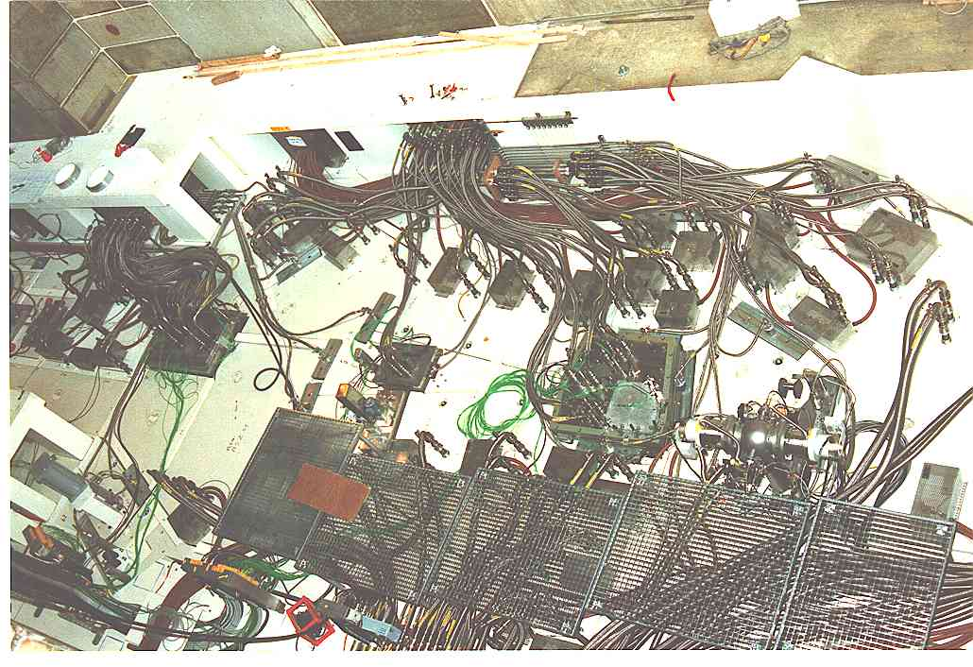
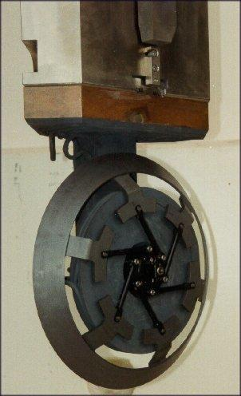
Proton Accelerator (Overview)
Muon Source (Target E)

Slide 31
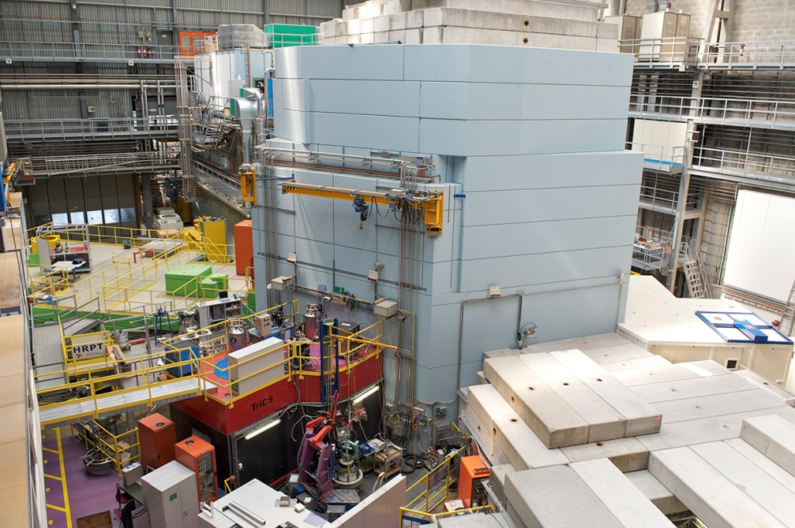
Proton Accelerator (Overview)
Neutron Spalation Source (SINQ)

Slide 32
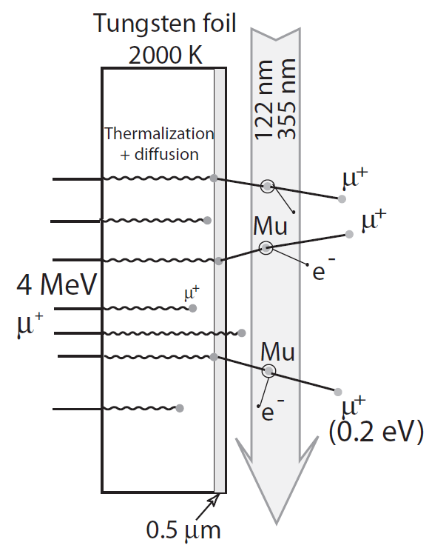
Generation of Thermal μ⁺ at a Pulsed Muon Beam J-PARC (RIKEN-RAL)
Mu
Mu
Mu
K. Nagamine, et al., PRL 74, 4811 (1995). P. Bakule, et al., Nucl. Instr Meth. B 266, 335 (2008).

Slide 33
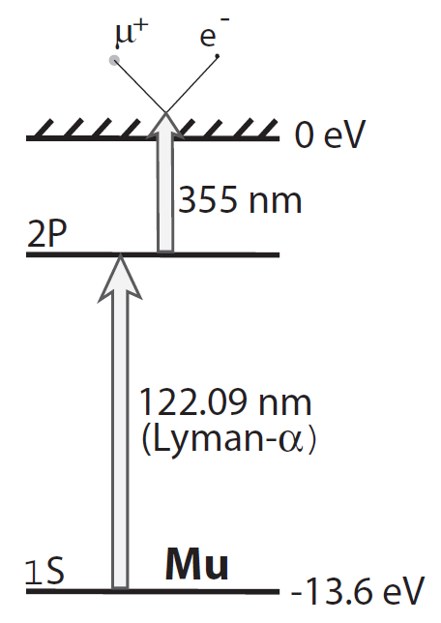
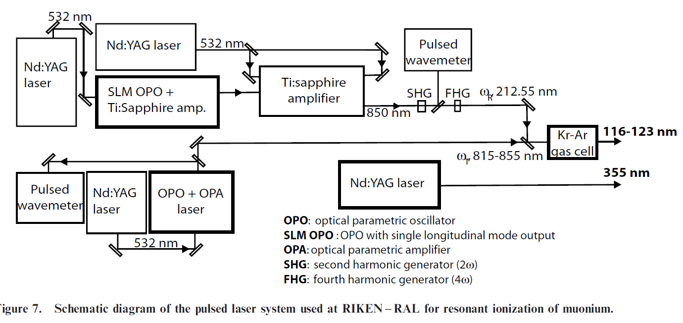
Generation of Thermal μ⁺ at a Pulsed Muon Beam J-PARC (RIKEN-RAL)
Advantage:
high LE-µ⁺ yield
Disadvantage:
Only ½ of the asymmetry
Tricky Laser system
K. Nagamine, et al., PRL 74, 4811 (1995). P. Bakule, et al., Nucl. Instr Meth. B 266, 335 (2008).

Slide 34
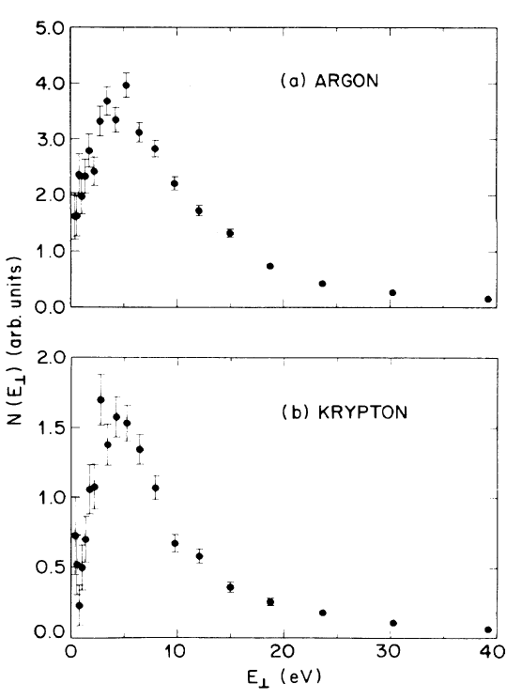
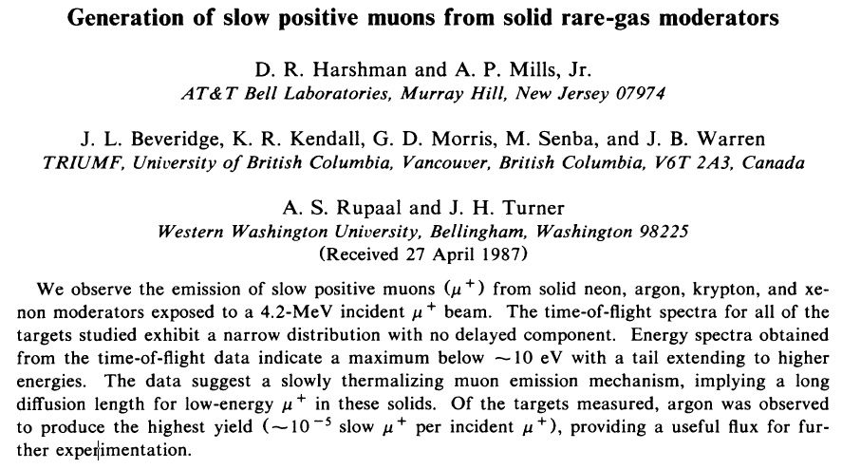
Generation of Slow Positive Muons from Solid Rare-Gas Moderators
PRB 36R, 8850 (87).

Slide 35
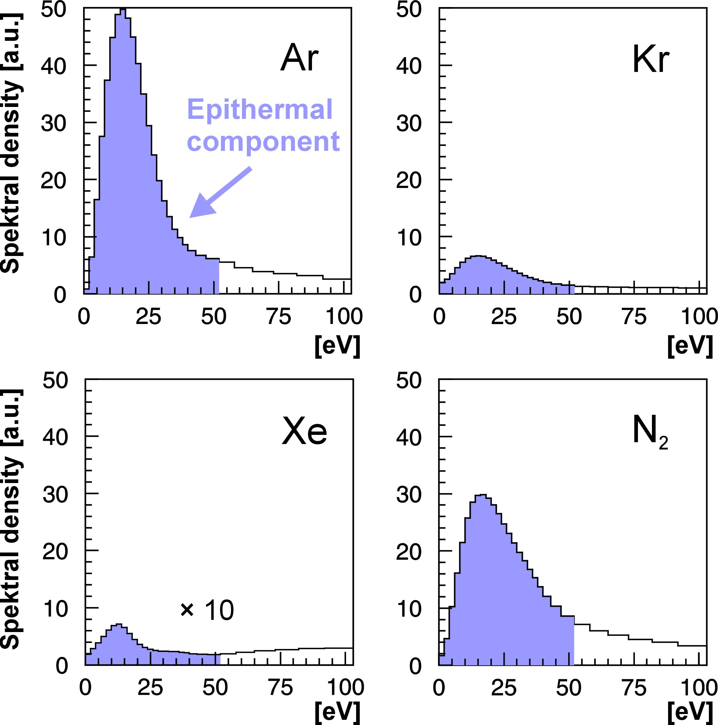
Generation of Polarized Epithermal μ⁺
„Surface“
Muons
∼ 4 MeV
∼ 100% pol.
≈100 μm Ag at T=6K
∼ 500 nm
s-Ne, Ar,
s-N₂
motivated by experiments for positron moderation
T. Prokscha et al., Appl. Surf. Sci. 172, 235 (2001).
T. Prokscha et al., Phys. Rev. A58, 3739 (1998).
E. Morenzoni et al,. J. Appl. Phys. 81, 3340 (1997).
D. Harshmann et al., Phys. Rev. B36, 8850 (1987).

Slide 36
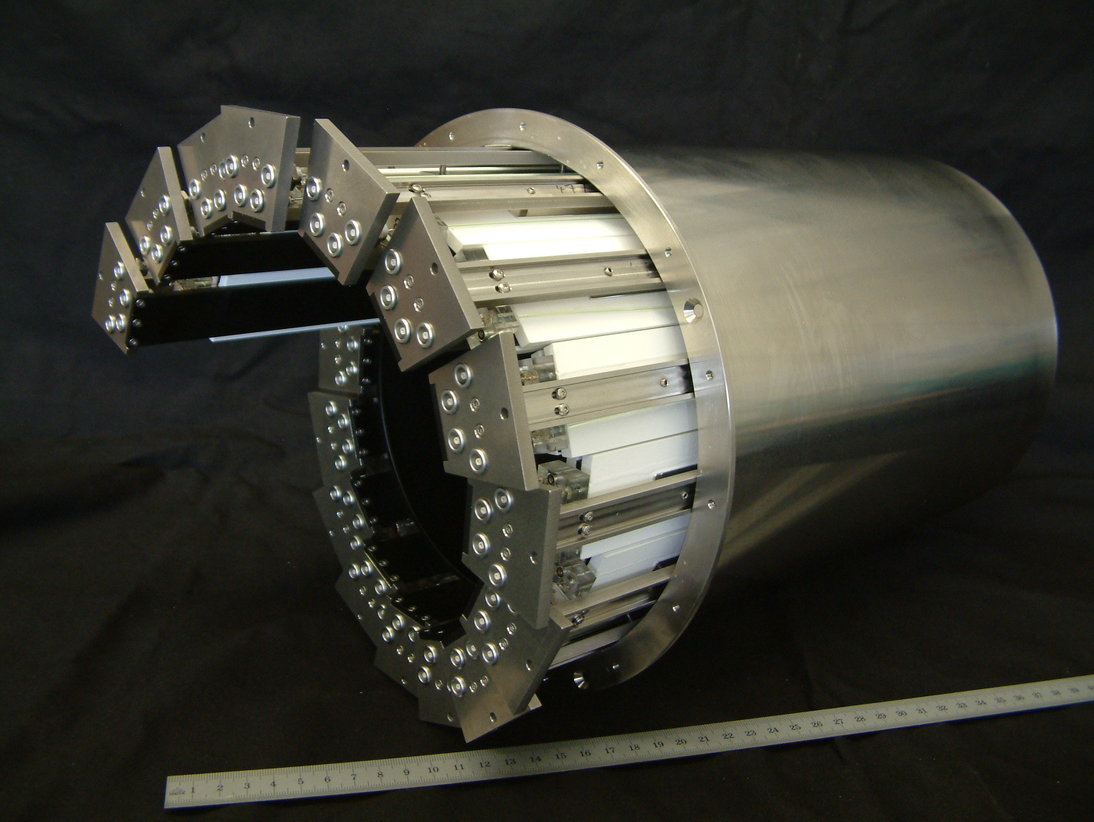
Low Energy μ⁺ Beam and Setup for LE-μSR
Scintilators
APD assembly
Wave length shifting optical fibers
0.6m
A. Stoykov, R. Scheuermann, et al., Physica B 404, 986 (09). See also https://www.psi.ch/en/lmu/position-sensitive-detection-psd-of-muons-and-positrons

Slide 37
Low Energy Muonium Production
SiN membrane 3x3 array 50-nm-thick 5.6 x 5.6 mm²
Cu nose used as e+ absorber to increase the asymmetry
mesoporous
thin film
2 times higher Mu yield at RT
High Mu yield also at low-T, important for the 1s-2s experiment
A. Antognini, et al. PRL 108, 143401 (12).
K.S. Khaw, et al. PRA 94, 022716 (16).

Slide 38
Semiconductors – µ⁺ to Measure Charge Carrier Profiles Example 1: p-doped Ge
Simulation of TF measurements (B=10mT)
Measurements performed at T=220K:
Mu_{BC}⁰ fully transformed to Mu_{BC}⁺
Mu_{T} is used as sensor for free hole carriers.
Charge-Exchange Cylces
“fast” precession
“slow” precession
= γ_{µ} B_{ext}
T. Prokscha, et al. in preparation.

Slide 39
Muon Production – Example: Target E at PSI
Rotating Graphite Target (1 Hz)
Radiation Cooled, T_{avg} = 1700K
Thickness t=40 mm; h=6 mm; ∅ 450 mm
Radiation Losses 30%
h
Pions / Muons
t
590 meV p beam
p + C → π⁺ π⁻ p n …
Graphit
rotation axis
µ+
π⁺ → μ⁺ + ν_{µ}
solenoids
quadrupoles
2200 μA ≈ 1.4∙10¹⁶ p/sec @ 590MeV →
≈ 10⁷ – 10⁸ μ⁺/sec, ≈ 100% polarized
Surface Muons: ≈ 4 MeV
μE4 beamline at PSI: 4 ∙ 10⁸ μ⁺/sec
T.Prokscha et al NIM-A (2008)

