Slide 1
Electronics of the μSR Spectrometer
Hao Liang
Fanshui Deng, Miaoqing Zhuang, Yingge Zhang，Enqi Fu，Xiunan Sun，Changchang Zhao， Xuejian Li
State Key Laboratory of Particle Detection and Electronics, USTC

Slide 2
Content
Introduction of electronics system
Front-end electronics
Multi-channel TDC based on single FPGA
Test Result and Progress
Summary
DAQ software

Slide 3
Introduction of electronics system
01
Pulsed muon beam
Beam monitor
Sample
Electronics system
Front-end electronics（FEE）
Scintillator detector
Discriminator
front-end
Timing discriminator
Start
Stop
TDC module based on FPGA
Multi-channel TDC based on single FPGA
Computer
Data analysis

Slide 4
Introduction of electronics system
01
Requirements
128 channels PMT readout
Count Rate > 40
Time resolution < 1ns
Sturcture
Front-end Electronics(FEE)
8ch in each FEE
Total 16 FEE board
Time to Digital Converter(TDC)
32ch in each TDC
4 TDC Module
1 Fanout & Test Module
DAQ via Ethernet

Slide 5
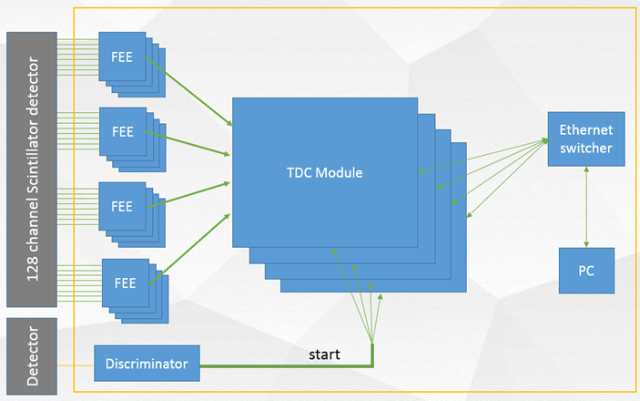
Introduction of electronics system
01

Slide 6
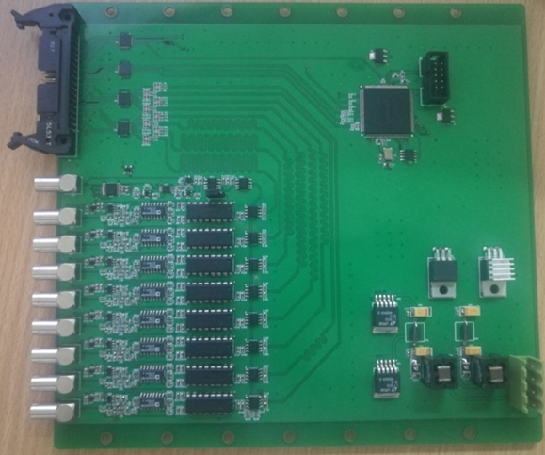
Front-end electronics
02
Features
Timing Discriminator
LVDS signal fanout
Self-test

Slide 7
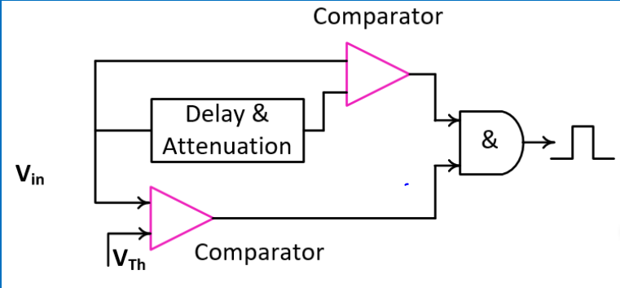
Front-end electronics
02
Timing Discriminator
Change CFD to LED
Non-delayline CFD
Best time resolution
Best integration density
Increased deadtime

Slide 8
Front-end electronics
02
Deadtime reduced to 7ns
Time resolution remains better, ~300ps

Slide 9
Front-end electronics
02
Self-testing circuit
On-board FPGA realize SPI bus, Communicate with TDC module, accept commands and
Generate self-test signal

Slide 10
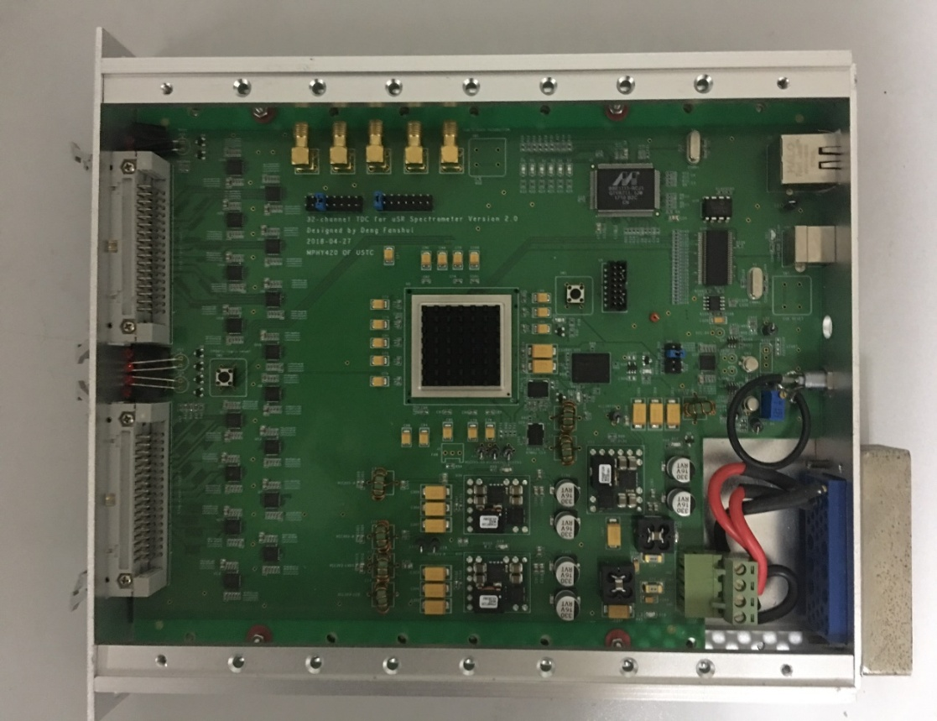
Multi-channel TDC based on single FPGA
03
Work with 4 FEE(LED)
Data transmit via Ethernet or USB
32ch FPGA based TDC
4 modules total

Slide 11
Multi-channel TDC based on single FPGA
03
Start
Trigger
Stop[1]
TDC
(54bit)
Channel coding
(7bit)
FIFO
(61bit)
Stop[2]
Configure
Ethernet
Stop[3]
·
Channel configure
Data packing
(64bit)
Gigabit network
·
·
Time window configure
USB
Stop[N]
USB 2.0
Error’s detector
To front board
Self-checking、calibration、threshold control

Slide 12
Multi-channel TDC based on single FPGA
03
TDC internal structure (1ch)
Start
8flip-flop
(rising edge)+
8flip-flop(falling edge)
Hit arithmetic
(4bit)
Clk0
Clk1
FIFO
(20bit)
Trigger counter
(8bit)
Trigger
Clk2
·
·
·
Enable
Clk7
16bit counter
Time tag
(26bit)
Stop
8flip-flop
(rising edge)+
8flip-flop(falling edge)
Readout FIFO
(54bit)
Clk0
Clk1
Hit arithmetic
(4bit）
Clk2
·
·
·
Clk7

Slide 13
Multi-channel TDC based on single FPGA
03
Features
Number of channels:32
Clock frequency:200Mhz
Resolution:312.5ps
Type:Multi-stop
Counting range:5ns—262us
Counting rate:488Khz
Dead time:5ns

Slide 14
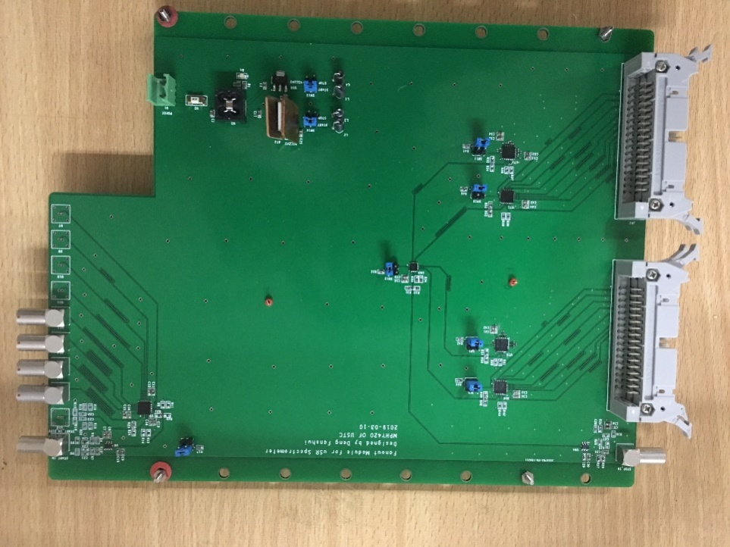
Multi-channel TDC based on single FPGA
03
Fanout & Test Module
Fanout 4 start signal to each TDC
Generate Self-test signal to each TDC

Slide 15
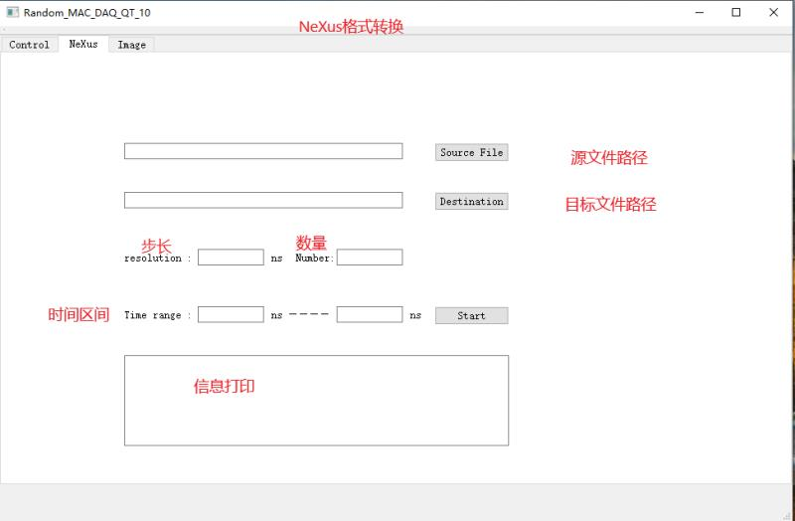
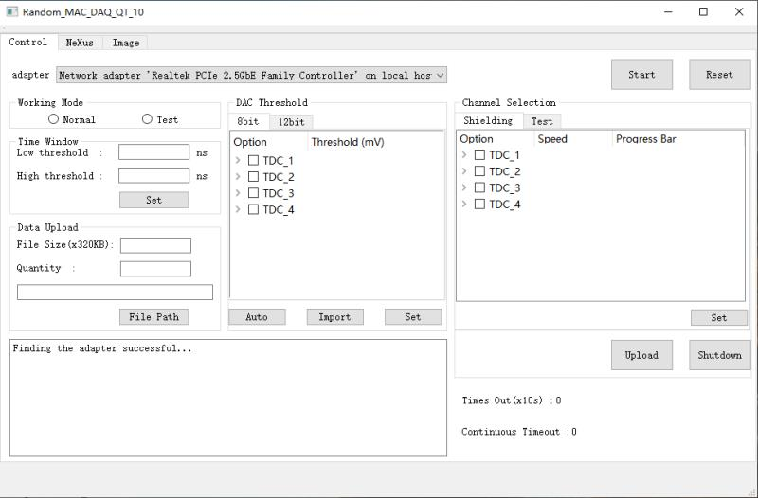
DAQ Software
04
QT based
Data can be saved as Nexus structure
Online monitor

Slide 16
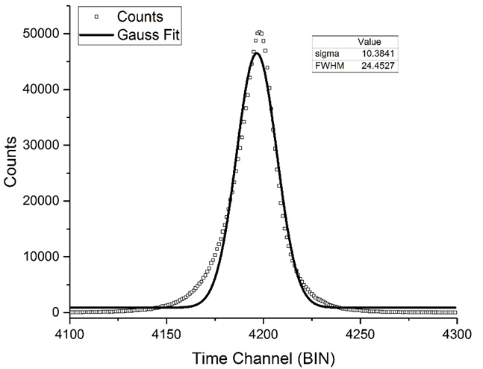
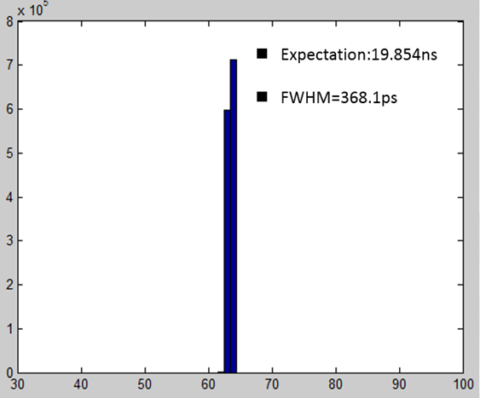
Test Result and Progress
05
Test results
Timing accuracy test results of front end electronics
Timing accuracy test results of TDC

Slide 17
Electronics system test—Precision and linearity
Inc 200ps | 1 | 2 | 3 | 4 | 5 | 6 | 7
Expectation | 25.085ns | 25.273ns | 25.472ns | 25.713ns | 25.894ns | 26.110ns | 26.372ns
FWHM | 356.3ps | 364.8ps | 404.7ps | 404.0ps | 419.4ps | 424.3ps | 425.7ps
Inc 200ps | 8 | 9 | 10 | 11 | 12 | 13 | 14
Expectation | 26.553ns | 26.709ns | 26.946ns | 27.146ns | 27.268ns | 27.461ns | 27.763ns
FWHM | 401.8ps | 404.2ps | 383.1ps | 361.4ps | 365.7ps | 328.6ps | 355.9ps
Inc 200ps | 15 | 16 | 17 | 18 | 19 | 20 | 21
Expectation | 27.931ns | 28.123ns | 28.271ns | 28.461ns | 28.706ns | 28.872ns | 29.125ns
FWHM | 390.3ps | 387.5ps | 411.5ps | 412.5ps | 432.0ps | 428.7ps | 404.3ps
Inc 200ps | 22 | 23 | 24 | 25 | 26 | 27 | 28
Expectation | 29.250ns | 29.401ns | 29.579ns | 29.818ns | 30.090ns | 30.188ns
FWHM | 408.3ps | 381.0ps | 388.1ps | 383.8ps | 364.0ps | 378.7ps
Test result with CFD FEE

Slide 18
Test Result and Progress
05
16FEEs+4TDC modules under testing

Slide 19
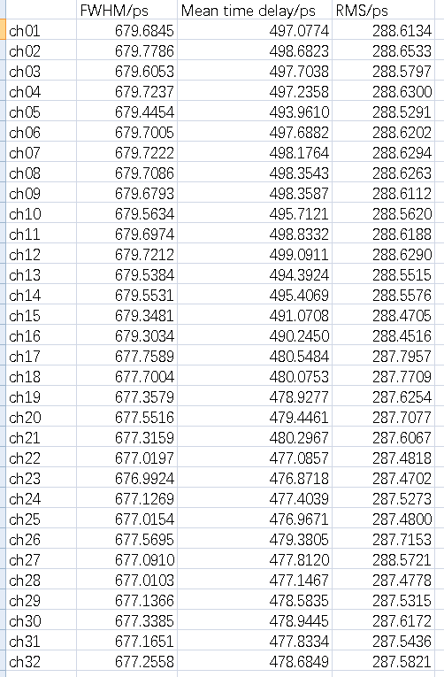
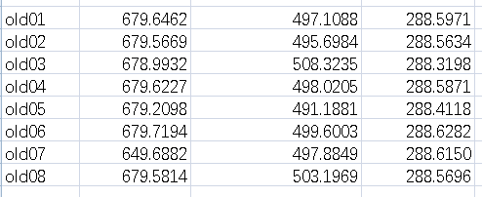
Test result
New Result with LED-FEE

Slide 21
summary
All electronics modules nearly ready
Result of electronics test and beam test shows that Readout Electronics meet the requirements

