Slide 1
Muon Imaging and Muon X-ray Analysis
LI Yang, ZHOU Zhihao
IHEP, CAS
2020.12.12

Slide 2
Muography
    Introduction
    Muon imaging (muography): three modes
    Transmission and absorption muography
    Deviation muography
    Muon CT
Muonic X-Ray Analysis

Slide 3
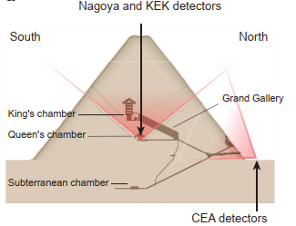
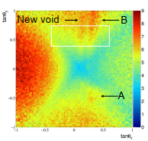
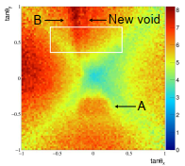
Introduction
Transmission and absorption muography
Muons passing through an object will lose energy due to ionization, bremsstrahlung and other reasons. Therefore, the flux will change when passing through the object, and the density of the material in the path can be determined by the change of muon flux.

Slide 4
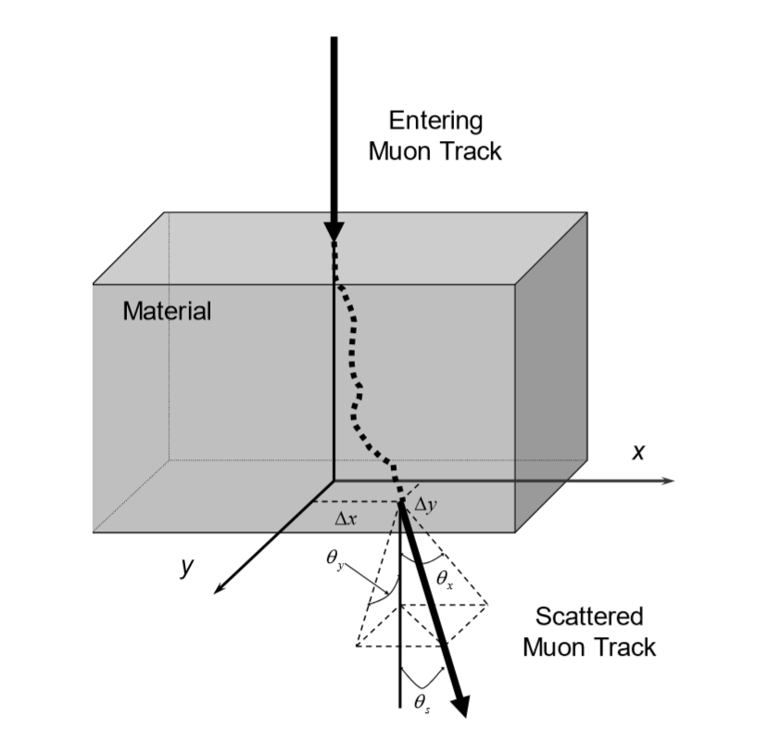
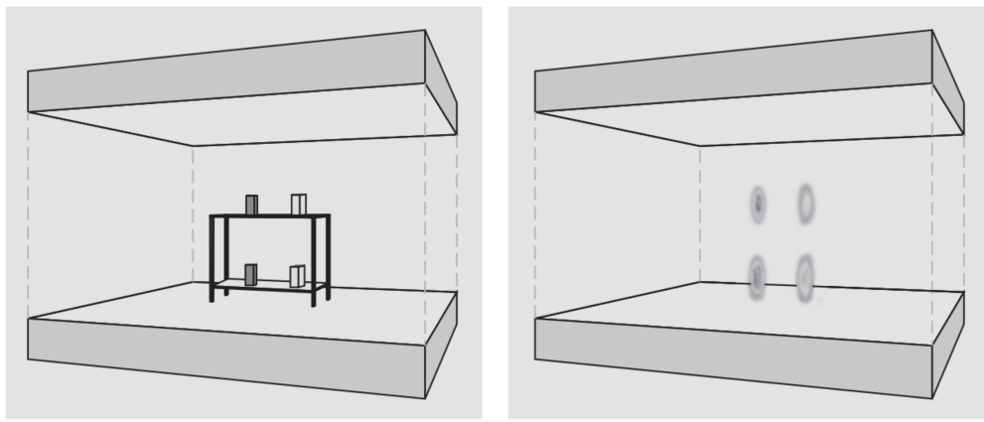
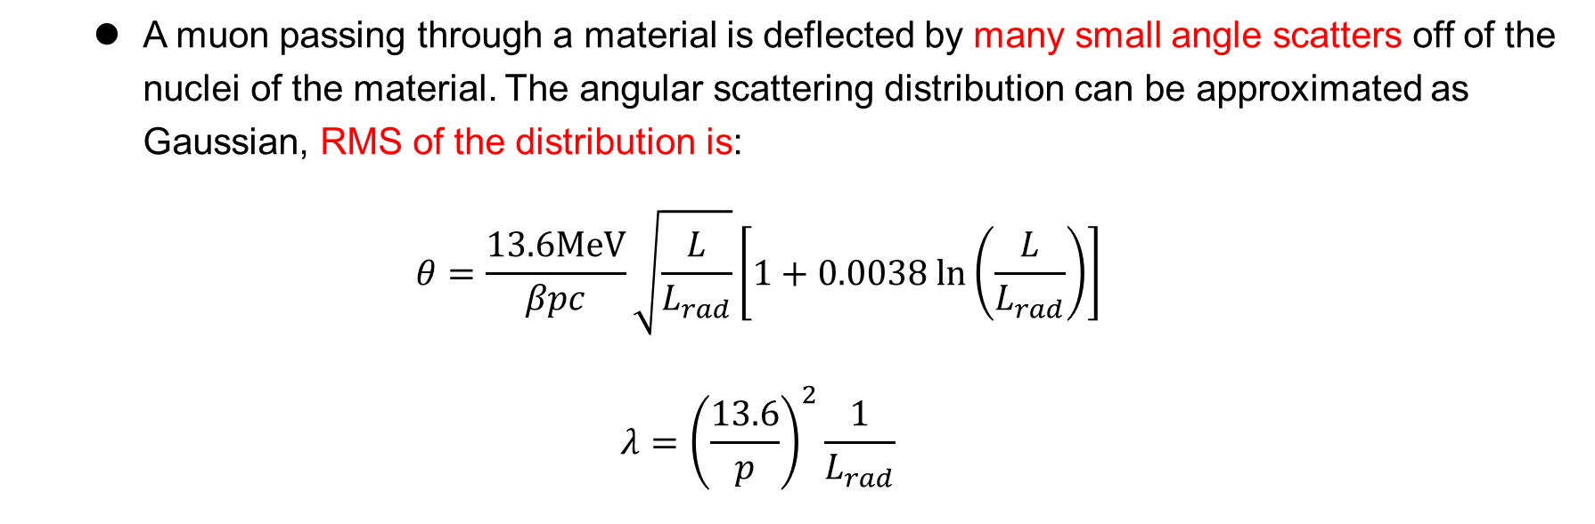
Deviation muography:
A muon passing through a material is deflected by many small angle scatters off of the nuclei of the material. The angular scattering distribution can be approximated as Gaussian, RMS of the distribution is:
$$θ=\frac{13.6MeV}{βpc}\sqrt{\frac{L}{L_{rad}}}\left[1+0.0038 ln\left(\frac{L}{L_{rad}}\right)\right]$$
$$λ={\left(\frac{13.6}{p}\right)}^{2}\frac{1}{L_{rad}}$$

Slide 5
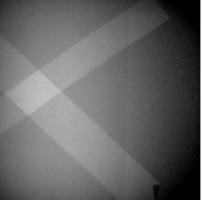
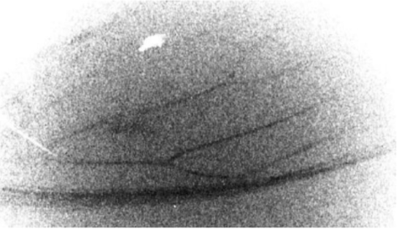
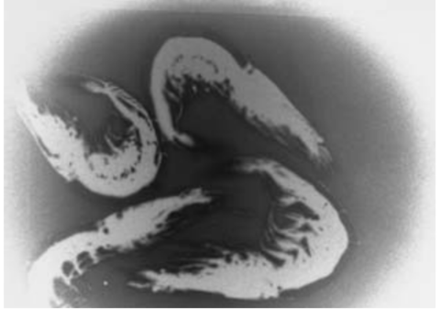
J-PARC
Imaging plates: BaFX:Eu²⁺ (X = Cl, Br)

Slide 6
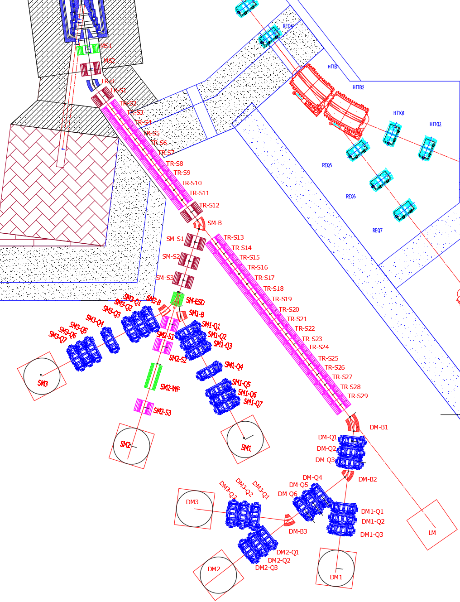
Momentum: up to 450MeV/c
Intensity: 10⁸/s

Slide 7
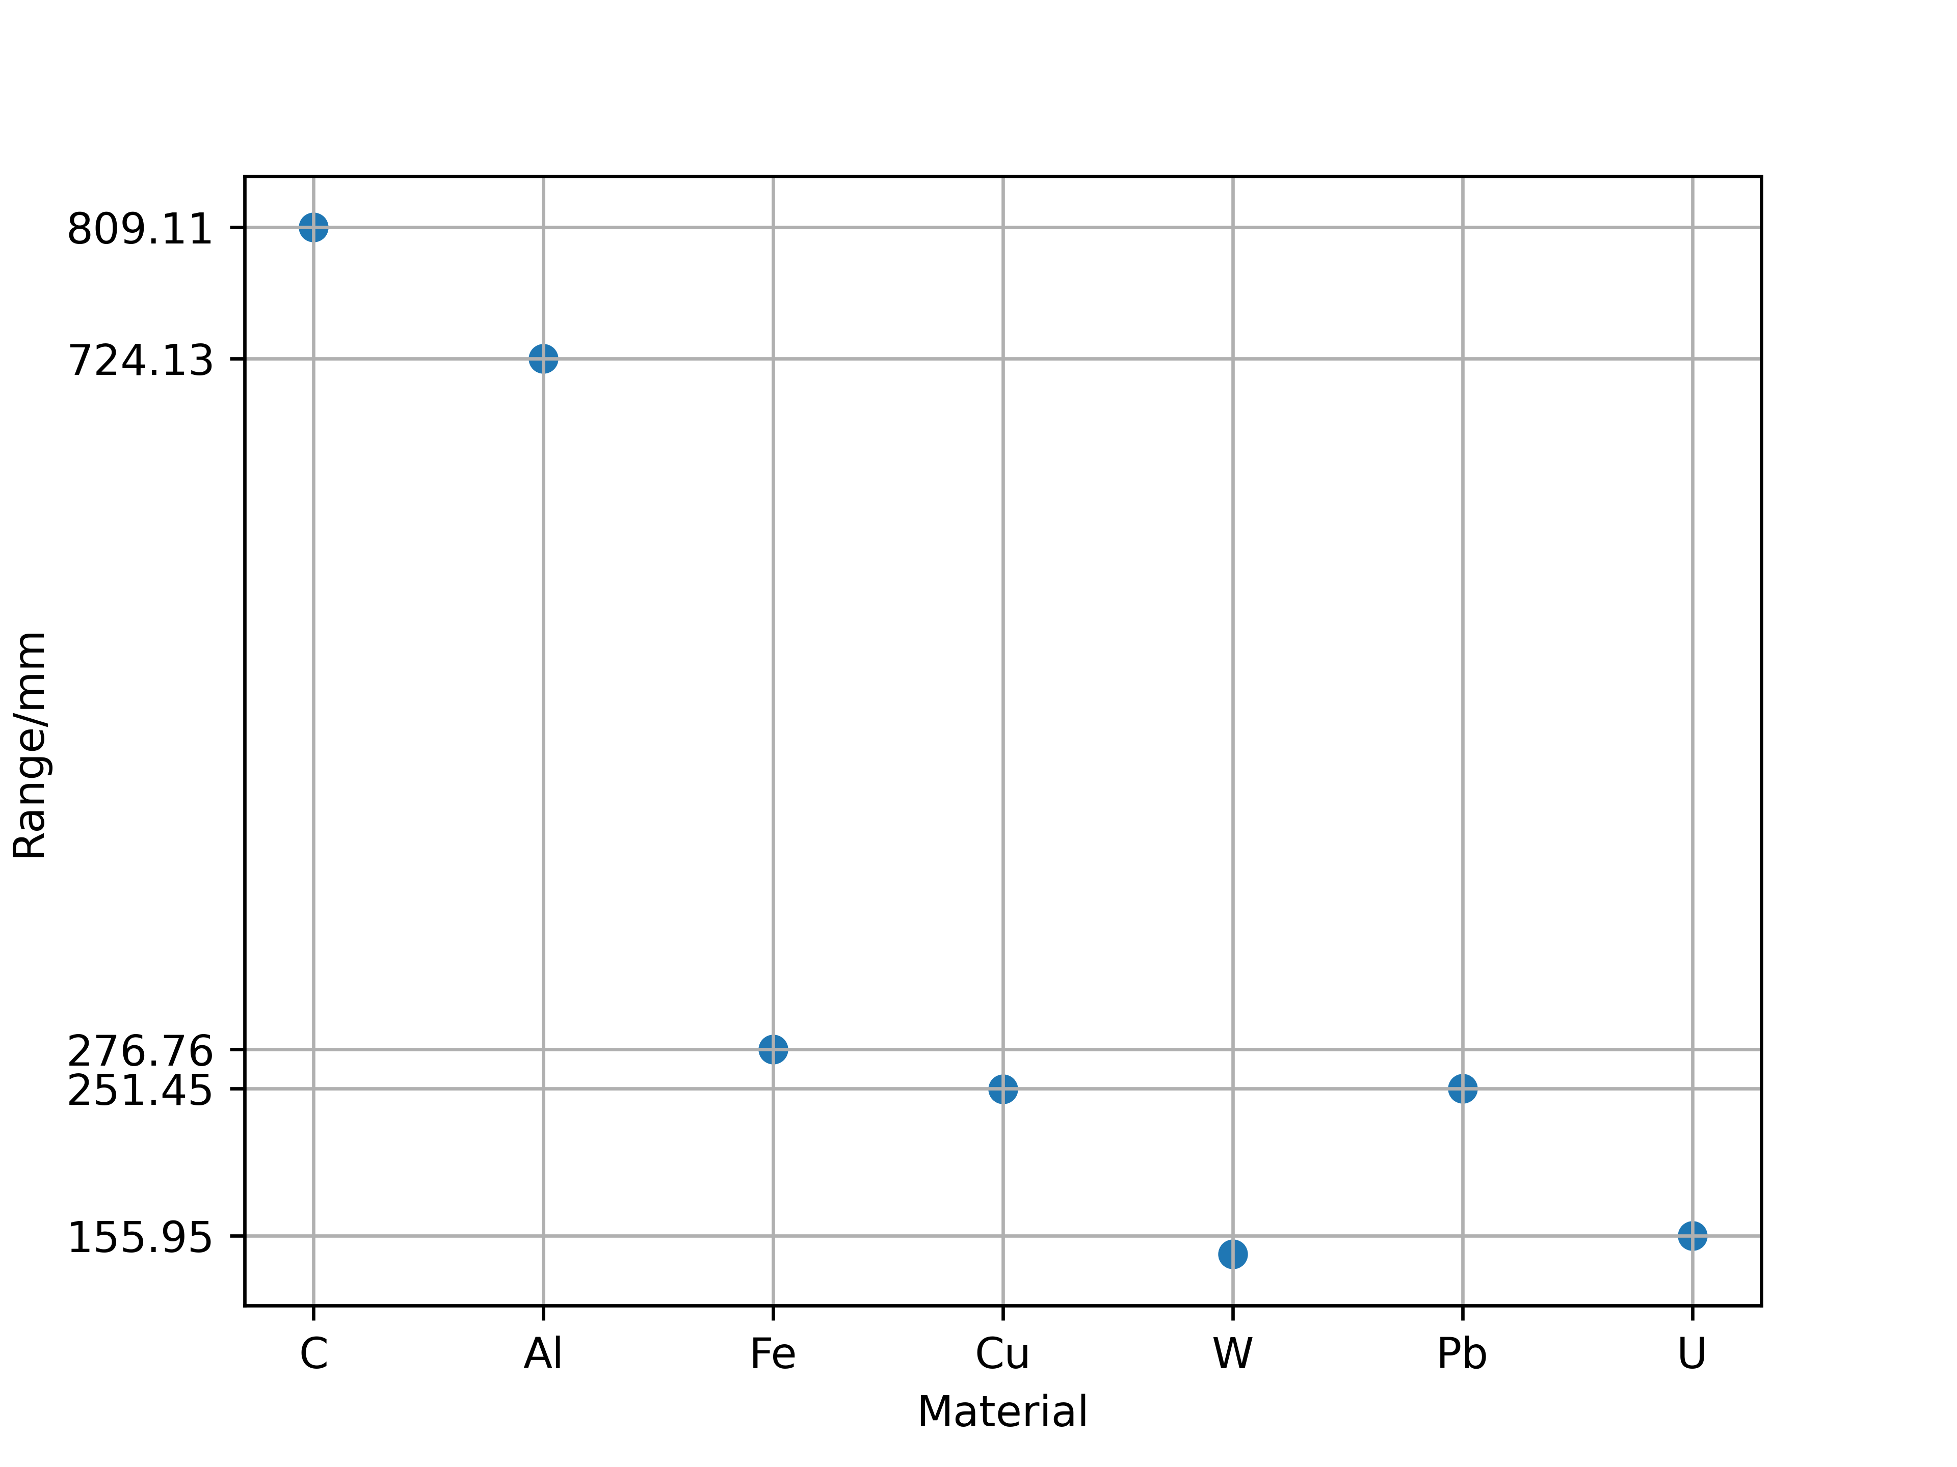
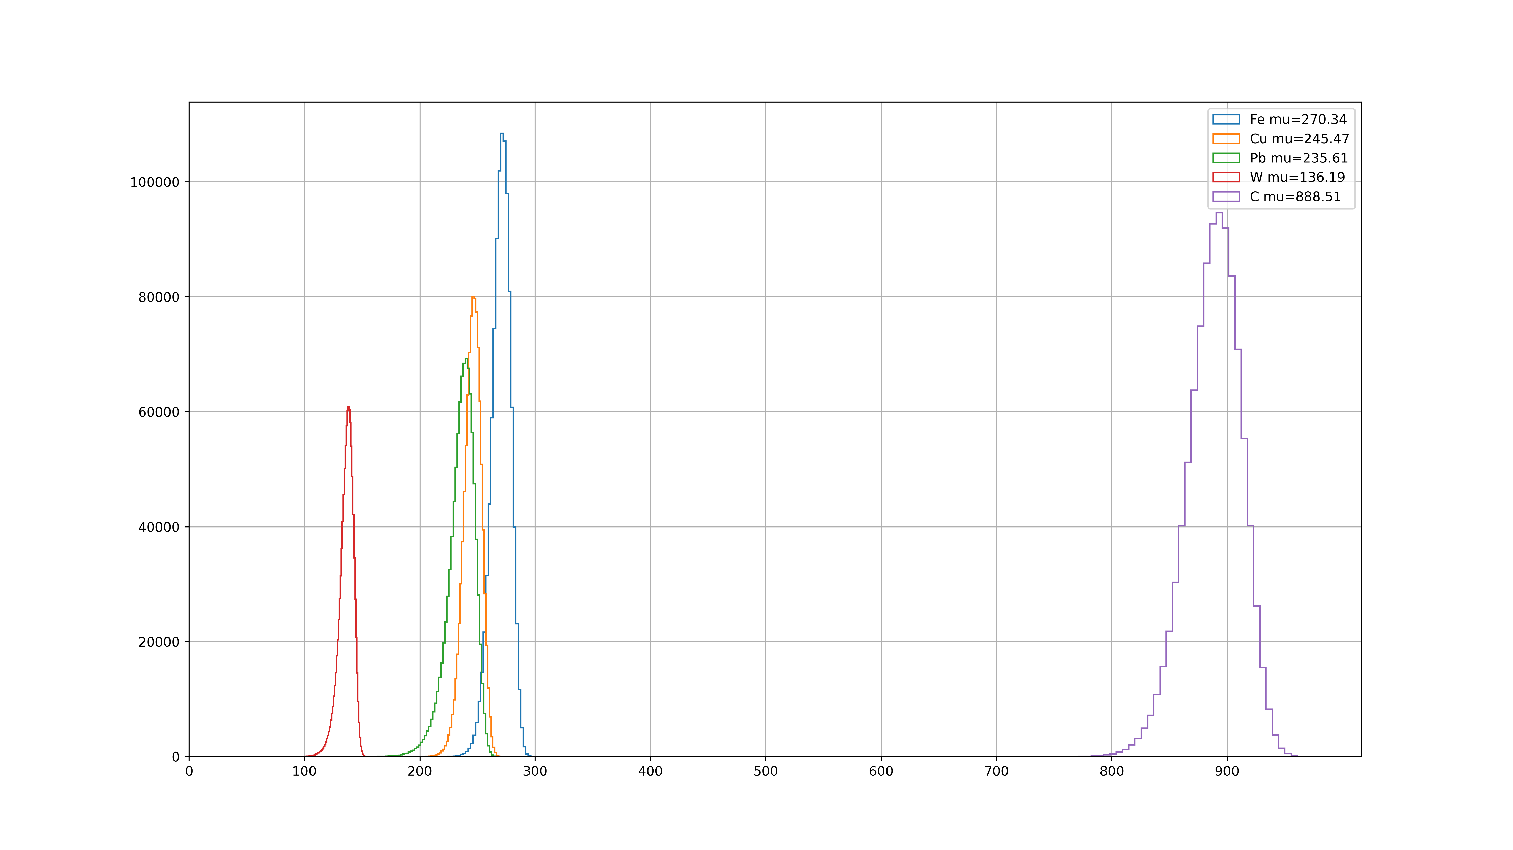
The range of 450MeV/c muon in different materials. The picture on the right shows the result from the Beth-Bloch equation. The image on the left shows the results of the simulation.

Slide 8
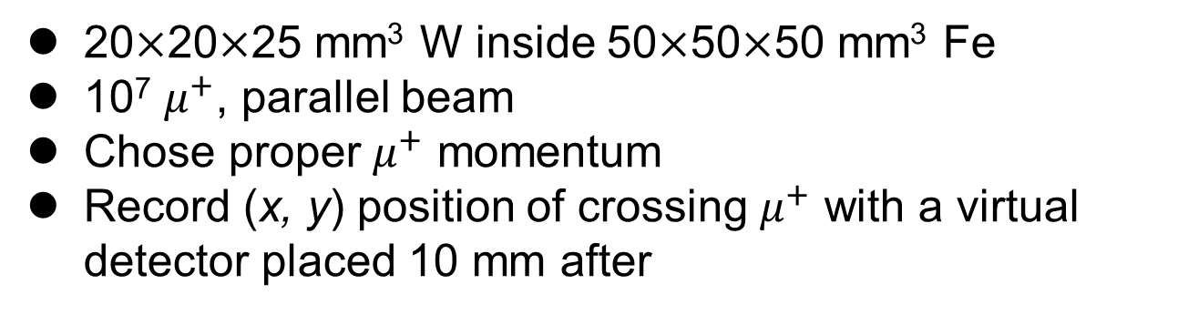
Transmission and Absorption Mode
20$×$20$×$25 mm³ W inside 50$×$50$×$50 mm³ Fe
10⁷ $μ^{+}$, parallel beam
Chose proper $μ^{+}$ momentum
Record (x, y) position of crossing $μ^{+}$ with a virtual detector placed 10 mm after
150 MeV/c
200 MeV/c
300 MeV/c

Slide 9
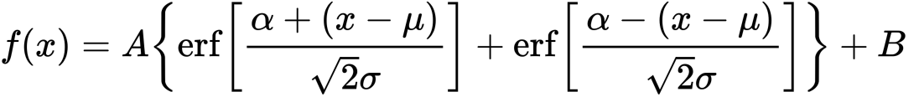
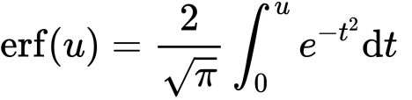
Transmission and Absorption Mode
𝐴: normalization factor.
𝛼: half width of the ‘‘plateau’’.
𝜎 reflects the spatial resolution of the detector convoluted with the beam broadening due to the scattering at the edges.

Slide 10
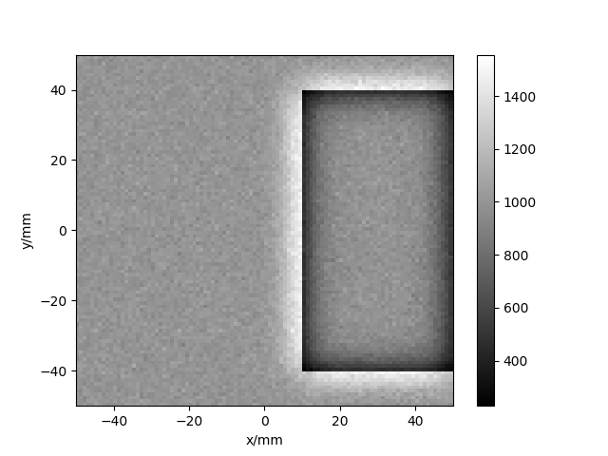
p=200 MeV/c, dp/p=0, parallel beam
50 mm thick Fe
Gaussian fit to the image edge

Slide 11
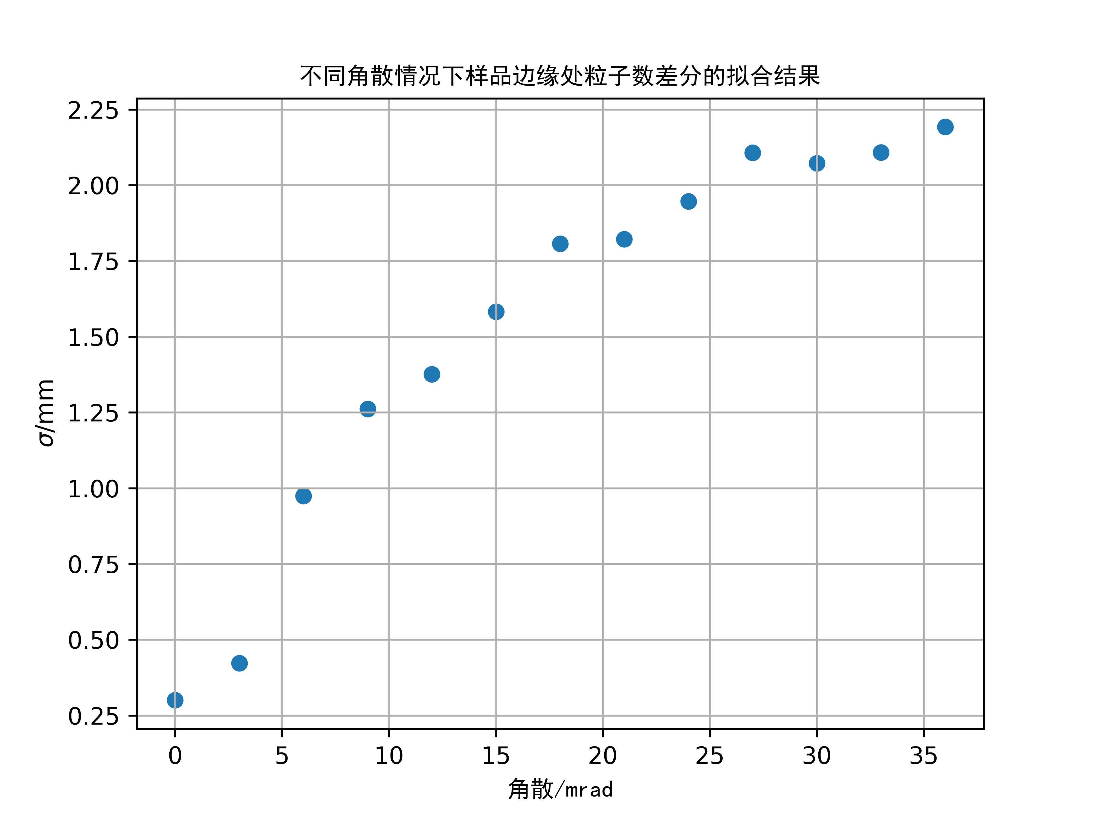
Simulation was performed using beams with different divergence angles, and the results of Gaussian fitting were compared.

Slide 12
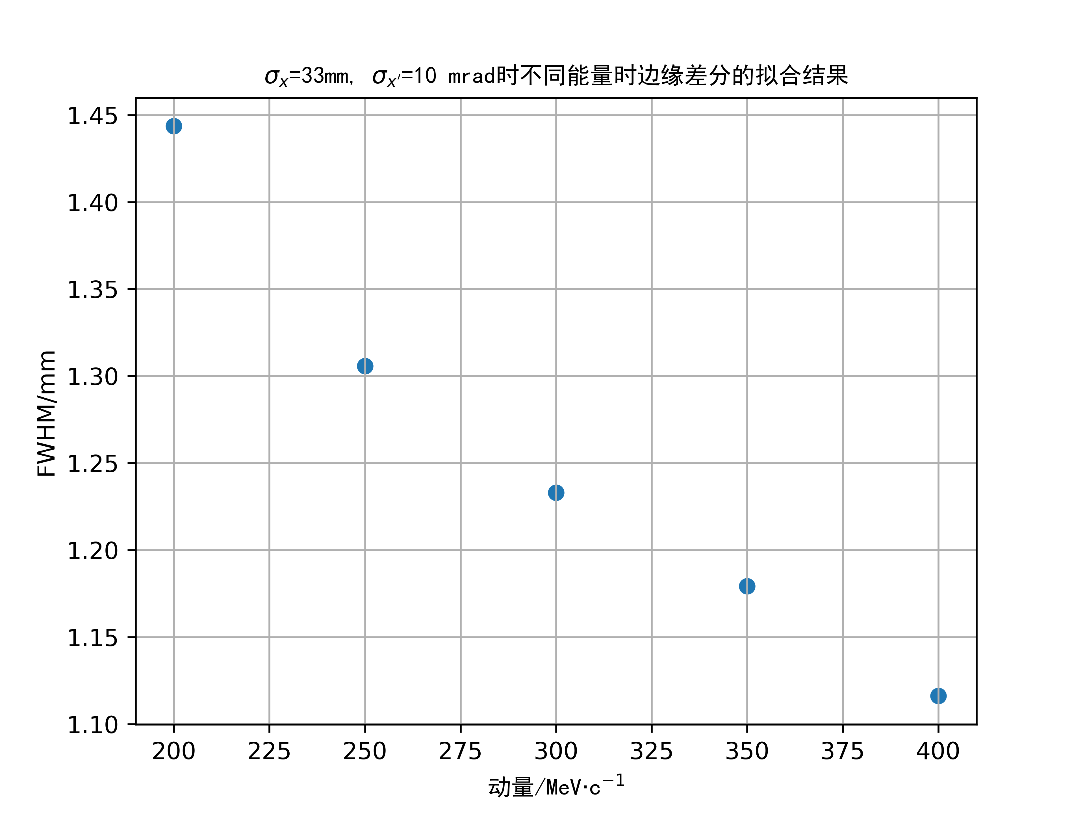
Simulation was performed using beams with different momentum, and the results of Gaussian fitting were compared. As the amount of beam flow increases, so does the sharpness of the edges.

Slide 13
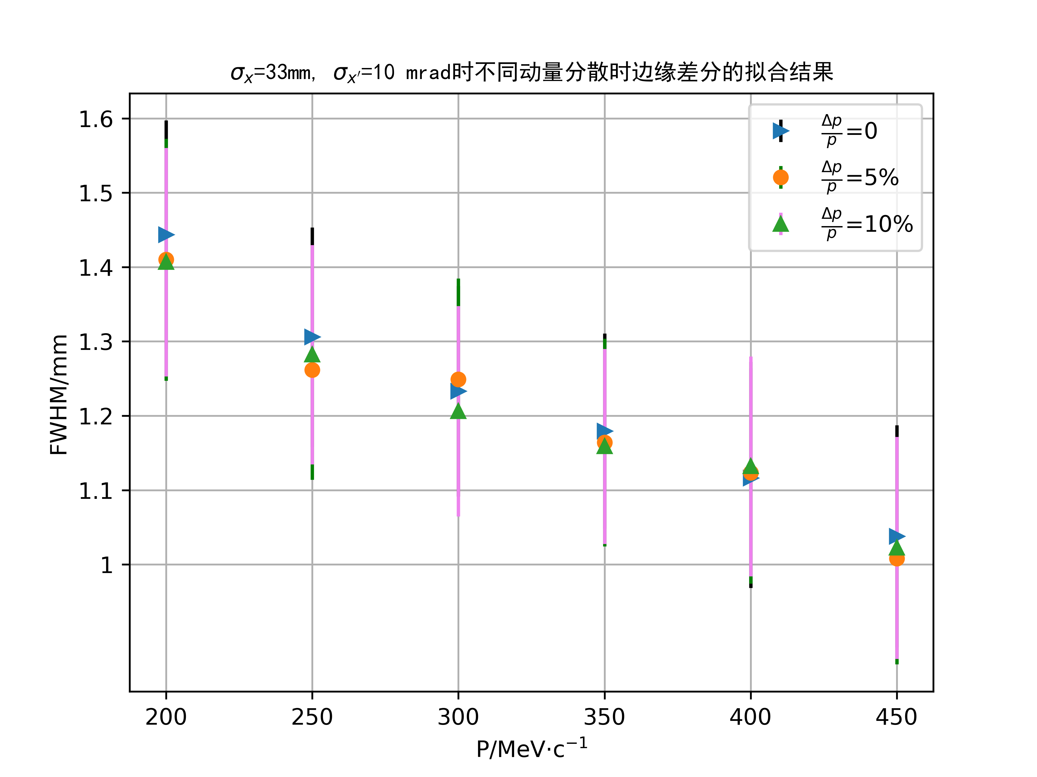
Simulation was performed using beams with different momentum dispersion, and the results of Gaussian fitting were compared. From the results, the momentum dispersion has little effect on the imaging results.

Slide 14
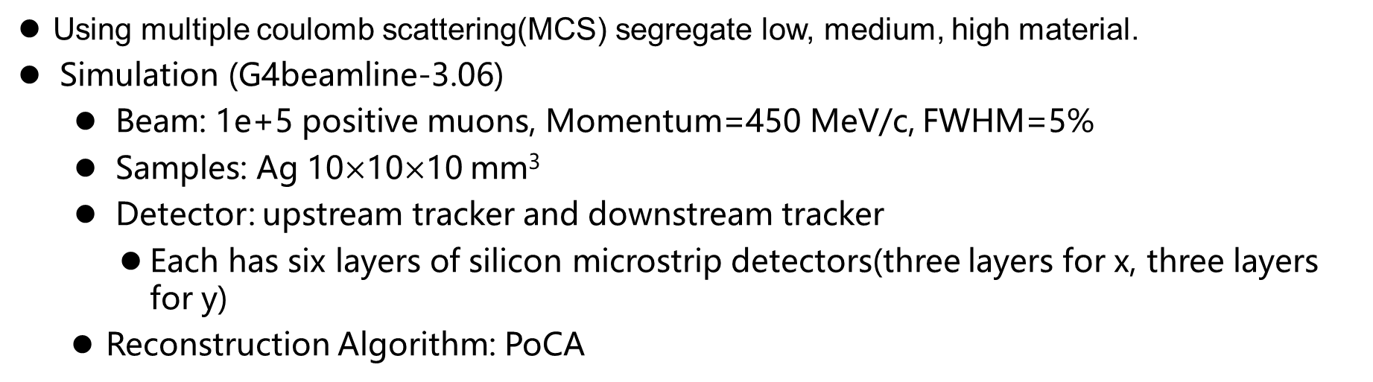
    2. Deviation muography
Using multiple coulomb scattering(MCS) segregate low, medium, high material.
Simulation (G4beamline-3.06)
  Beam: 1e+5 positive muons, Momentum=450 MeV/c, FWHM=5%
  Samples: Ag 10$×$10$×$10 mm³
  Detector: upstream tracker and downstream tracker
  Each has six layers of silicon microstrip detectors(three layers for x, three layers for y)
  Reconstruction Algorithm: PoCA

Slide 15
Result
Multi-layer silicon strip detector (trackerplane in g4bl)
Virtual detector (zntuple in g4bl)

Slide 16
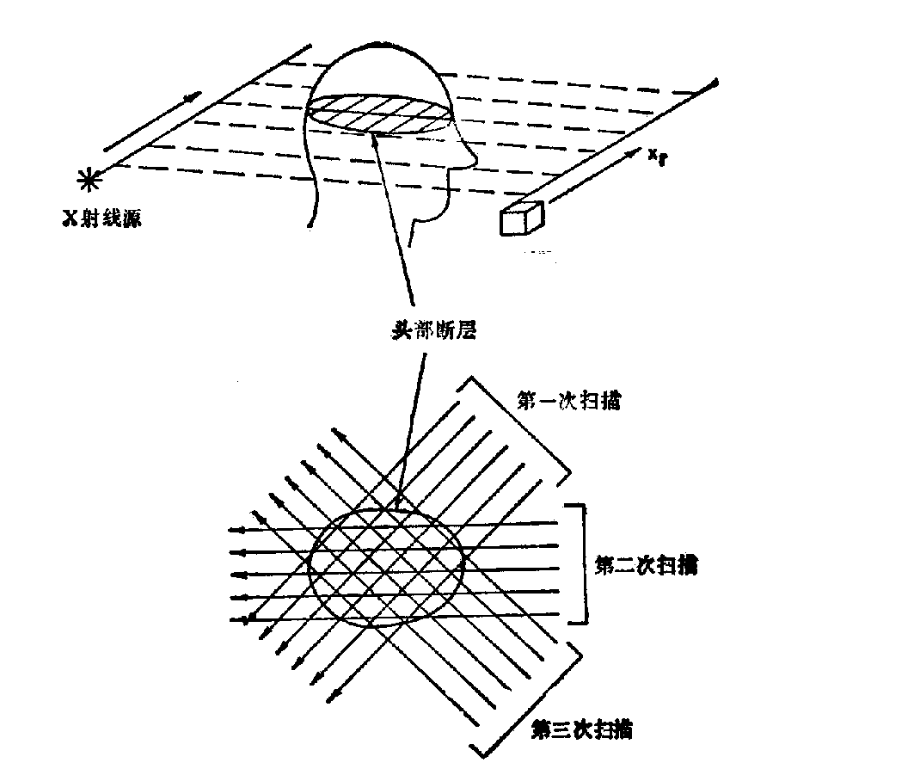
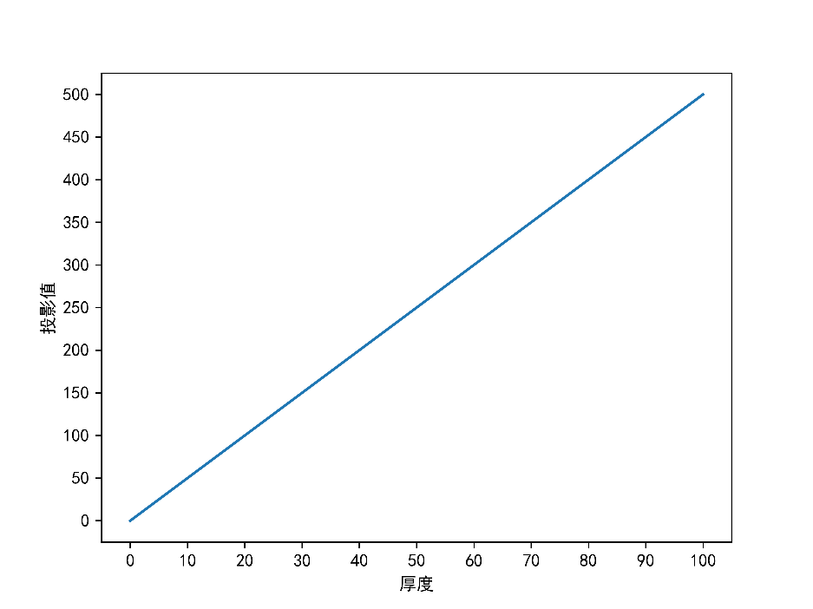
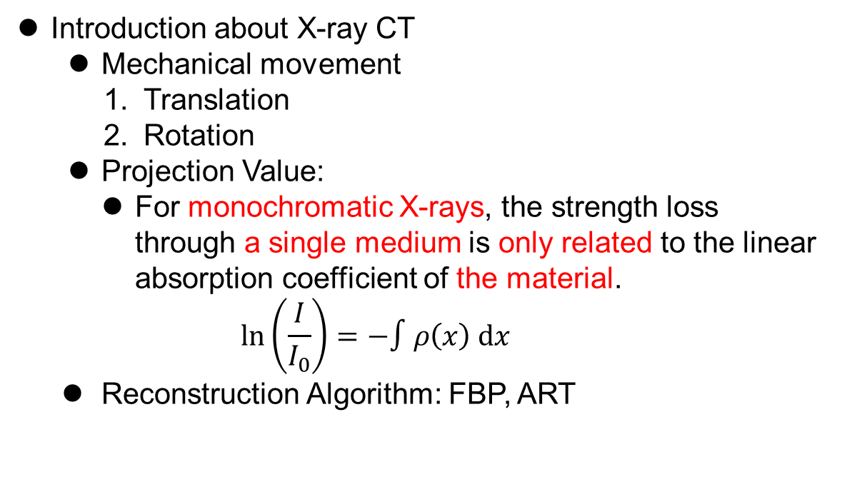
3. Muon CT: Using the information of muon energy-loss
3.1 X-ray CT
Introduction about X-ray CT
Mechanical movement
Translation
Rotation
Projection Value:
For monochromatic X-rays, the strength loss through a single medium is only related to the linear absorption coefficient of the material.
$$\ln\left(\frac{I}{I_{0}}\right)=−∫ρ\left(x\right) dx$$
Reconstruction Algorithm: FBP, ART

Slide 17
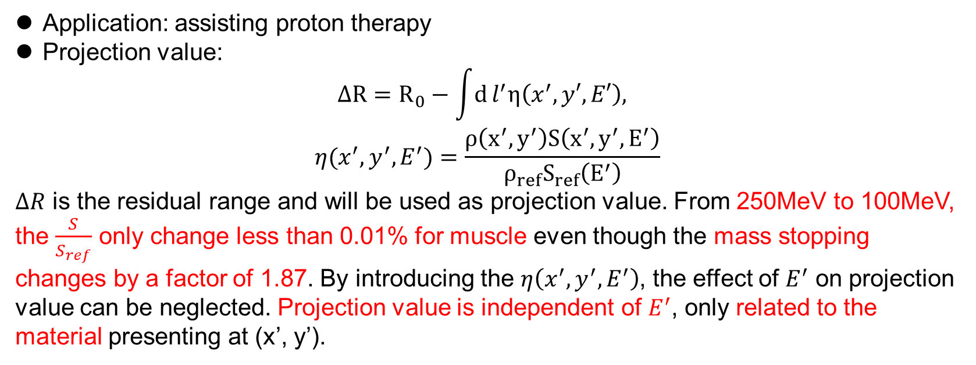
3.2 Proton CT
Application: assisting proton therapy
Projection value:
$$ΔR=R_{0}−\int{d}l^{′}η\left(x^{′}, y′, E′\right),$$
$$η(x^{′}, y^{′},E^{′})=\frac{ρ\left(x^{′},y^{′}\right)S\left(x^{′},y^{′},E^{′}\right)}{ρ_{ref}S_{ref}\left(E^{′}\right)}$$
$ΔR$ is the residual range and will be used as projection value. From 250MeV to 100MeV, the $\frac{S}{S_{ref}}$ only change less than 0.01% for muscle even though the mass stopping changes by a factor of 1.87. By introducing the $η\left(x^{′}, y^{′}, E^{′}\right)$, the effect of $E^{′}$ on projection value can be neglected. Projection value is independent of $E^{′}$, only related to the material presenting at (x’, y’).

Slide 18
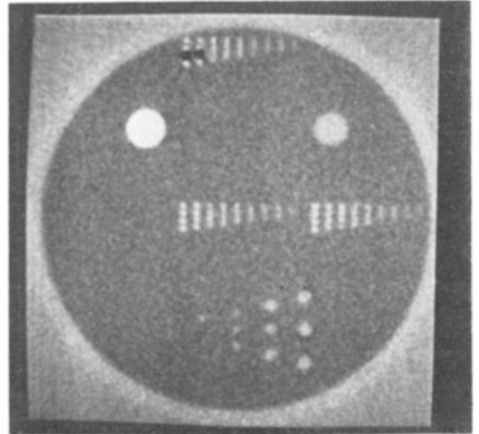
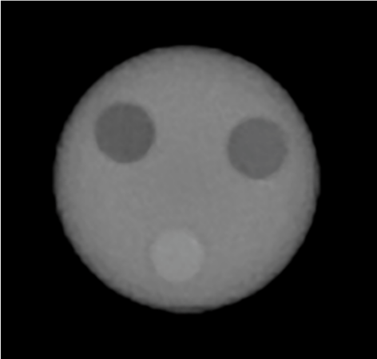
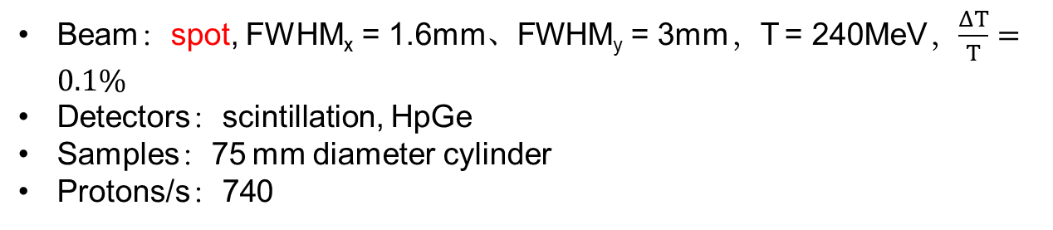
Beam：spot, FWHM_{x} = 1.6mm、FWHM_{y} = 3mm，T = 240MeV，$\frac{ΔT}{T}=0.1\%$
Detectors：scintillation, HpGe
Samples：75 mm diameter cylinder
Protons/s：740
Beam：125MeV、passing through scatterer ；
Detectors： silicon microstrip （两个为一组，分别探测x和y方向）、range relescope(absorbers、pixel sensors)；
Samples： 75 mm diameter PMMA cylinder ， three 15 mm diameter cylinders
Protons/s：10⁶。

Slide 19
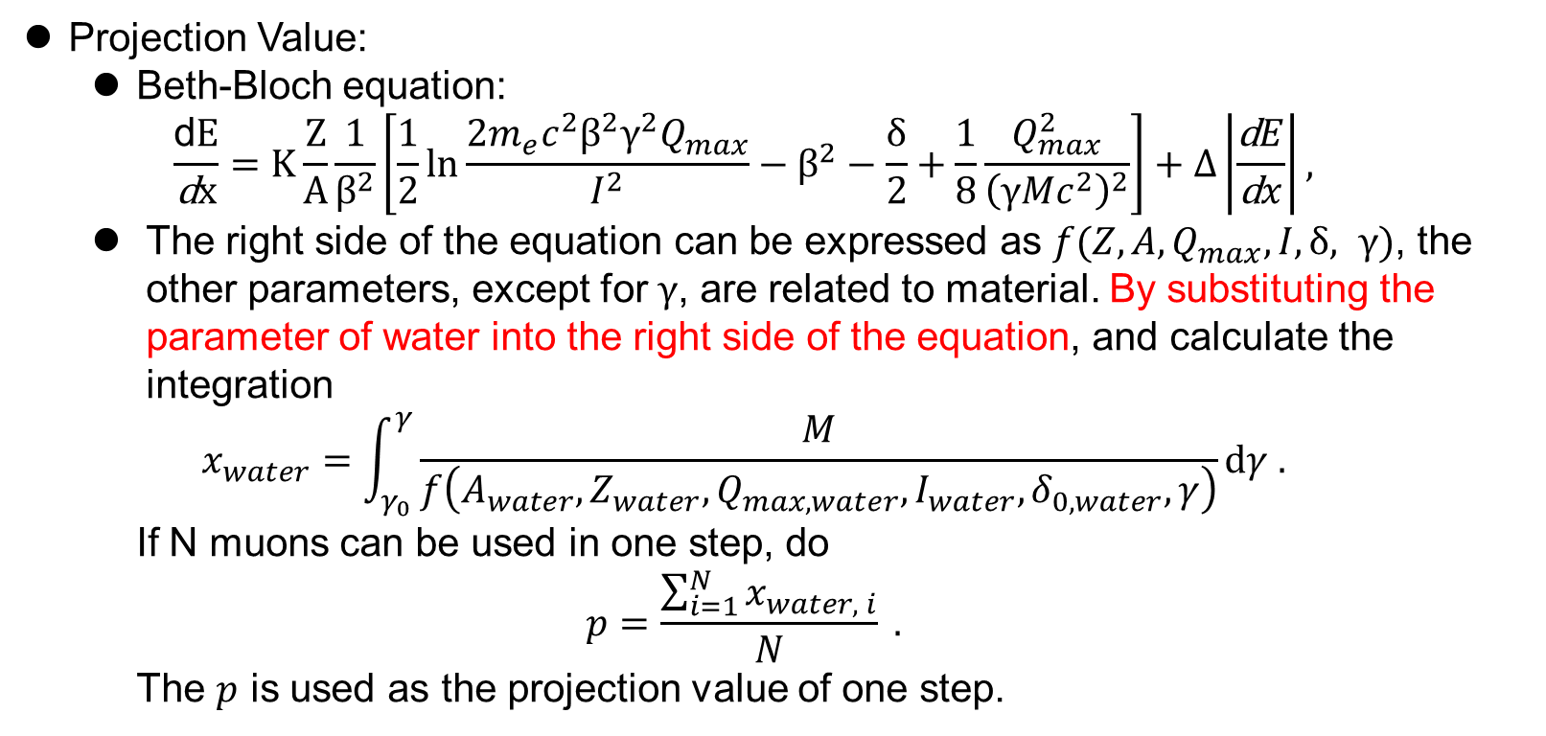
3.3 Muon CT
Projection Value:
Beth-Bloch equation:
$$\frac{\text{d}E}{\text{d}x}=K\frac{Z}{A}\frac{1}{β^{2}}\left[\frac{1}{2}ln\frac{2m_{e}c^{2}β^{2}γ^{2}Q_{max}}{I^{2}}−β^{2}−\frac{δ}{2}+\frac{1}{8}\frac{Q_{max}^{2}}{{\left(γMc^{2}\right)}^{2}}\right]+Δ\left|\frac{\text{d}E}{\text{d}x}\right|,$$
The right side of the equation can be expressed as $f(Z, A, Q_{max}, I, δ, γ)$, the other parameters, except for $γ$, are related to material. By substituting the parameter of water into the right side of the equation, and calculate the integration
$$x_{water}=\int_{γ_{0}}^{γ}{\frac{M}{f\left(A_{water},Z_{water},Q_{max, water},I_{water},δ_{0,water},γ\right)}}dγ .$$
If N muons can be used in one step, do
$$p=\frac{\sum_{i=1}^{N}{x_{water, i}}}{N} .$$
The $p$ is used as the projection value of one step.

Slide 20
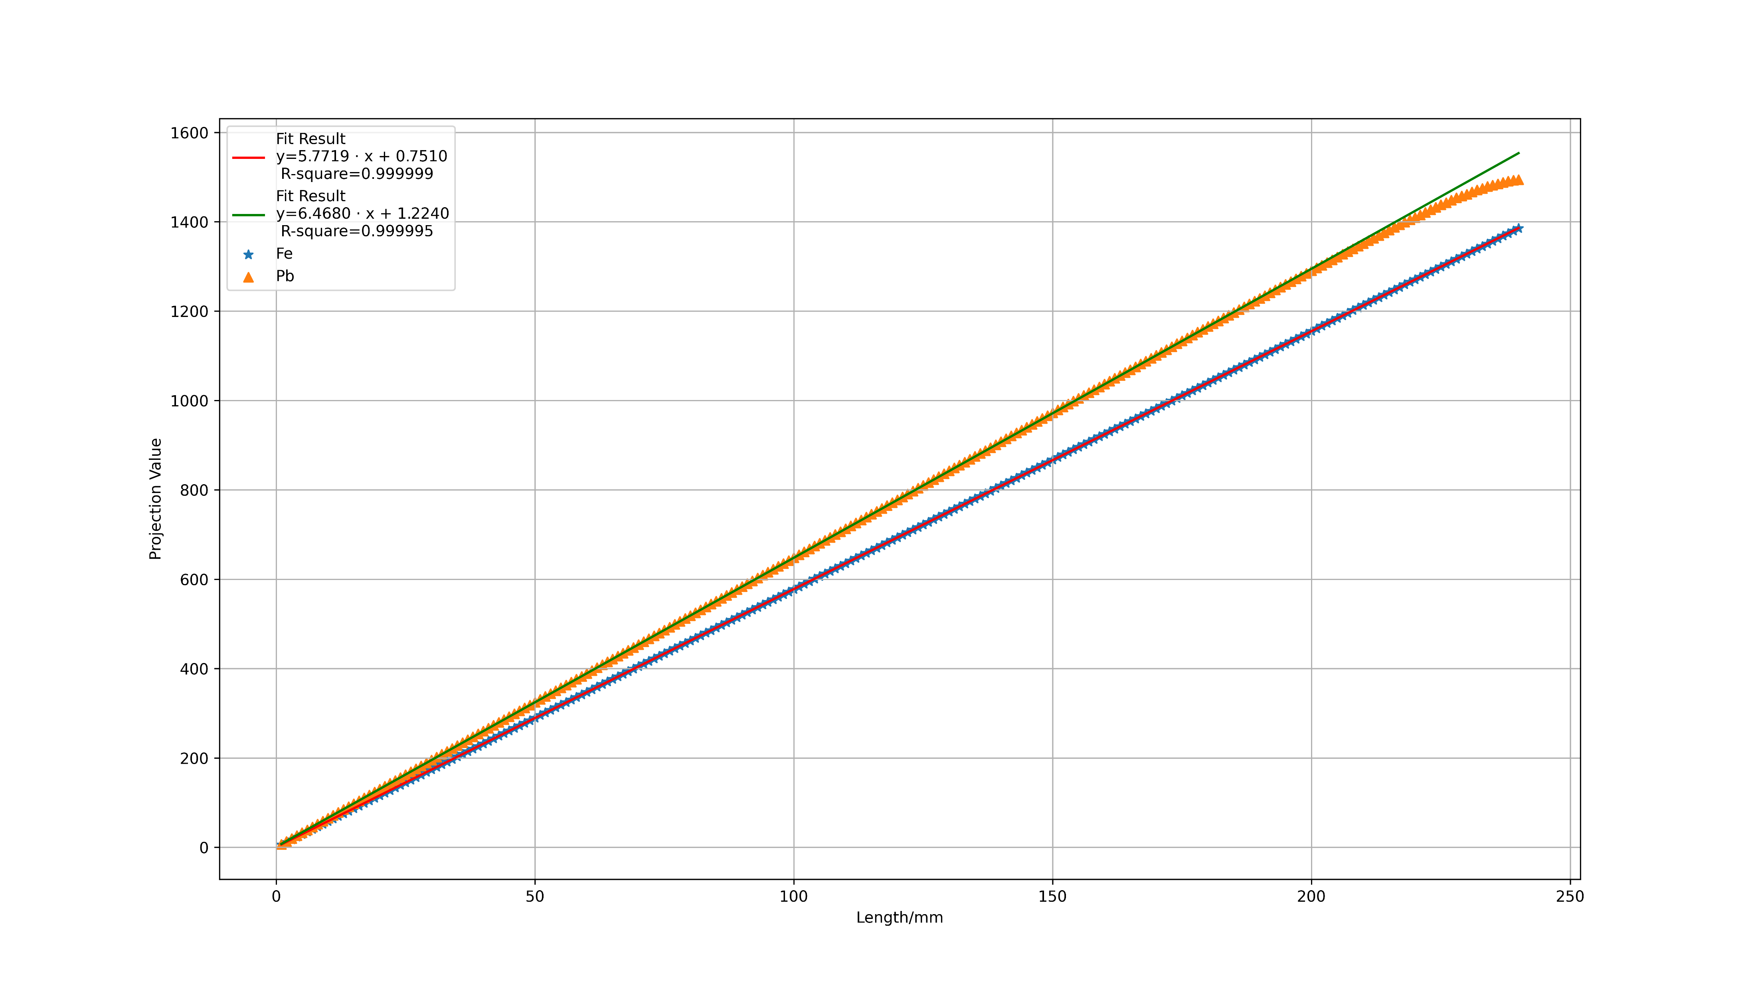
Projection value and fitting curves.

Slide 21
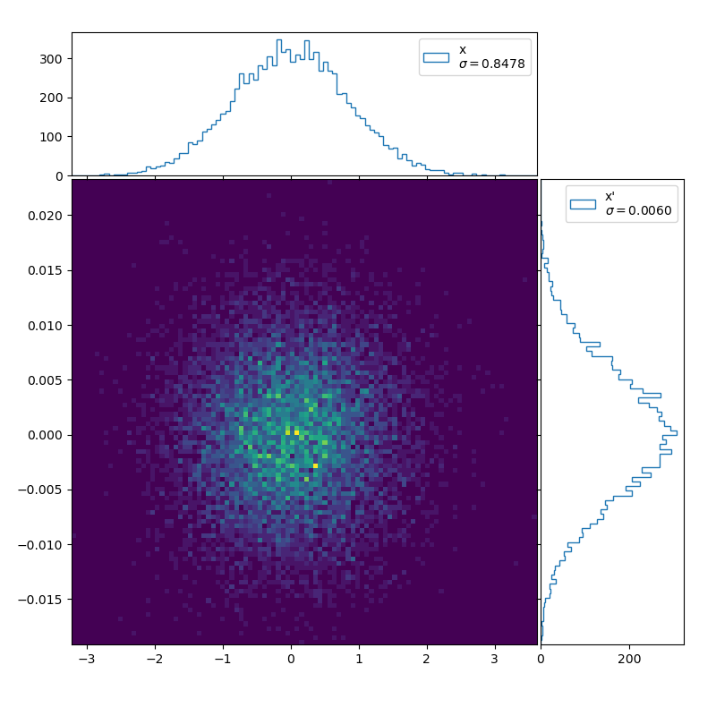
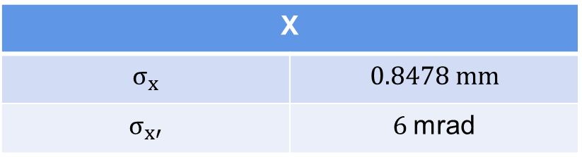
Beam
X

Slide 22
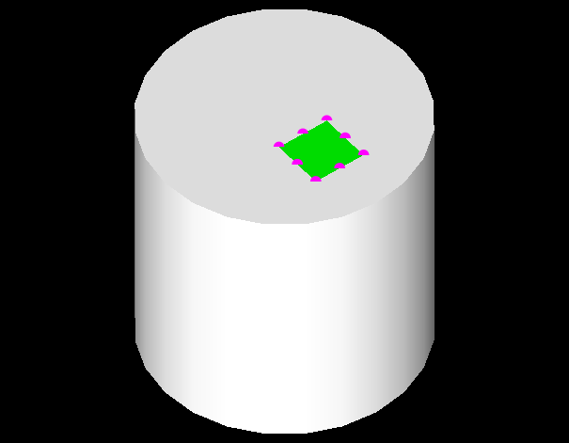
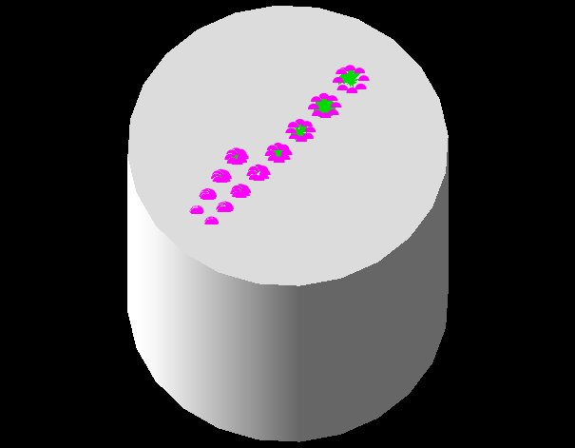
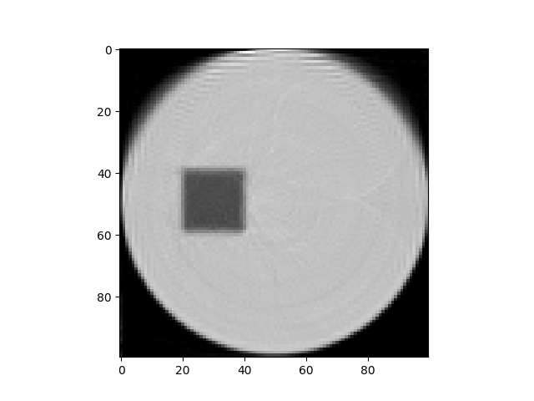
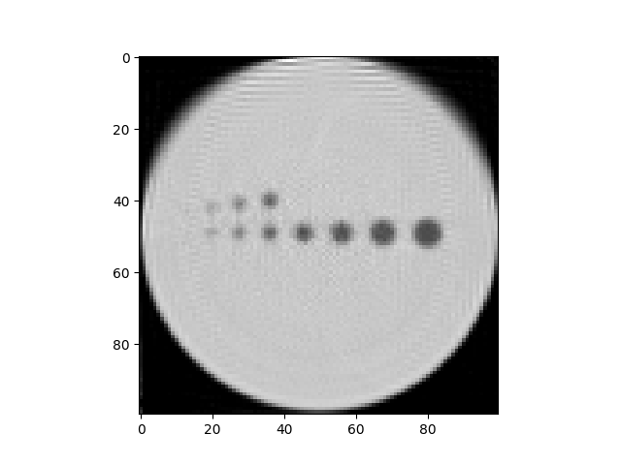
The outer cylinder is made of iron, inner cuboid and cylinders are made of aluminum.

Slide 23
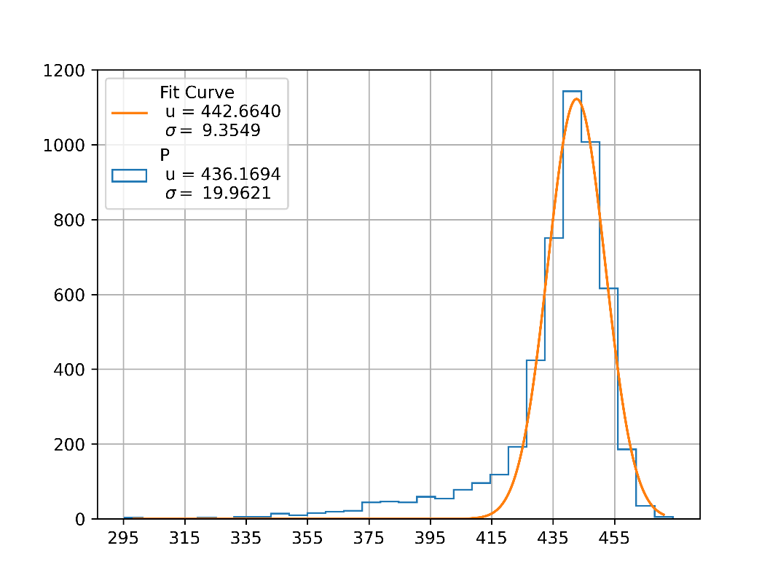
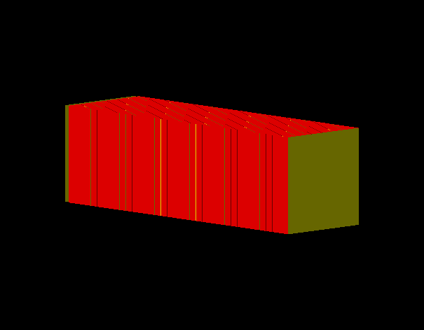
Detector structure and a preliminary result
Absorber: 4mm Cu
Pixel size: 30 * 30 um

Slide 24
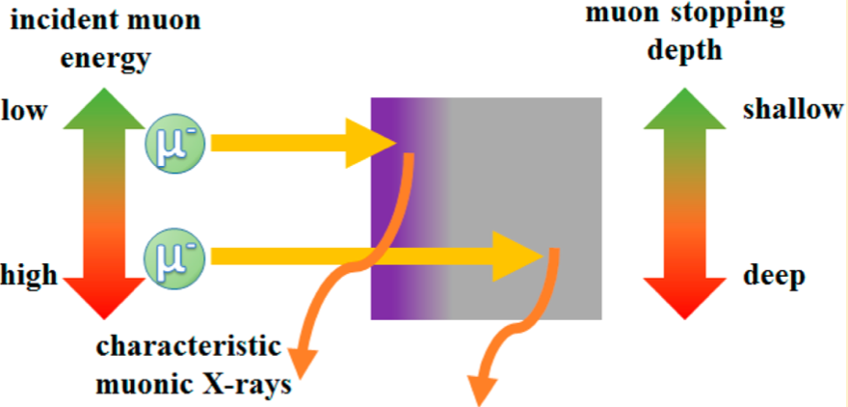
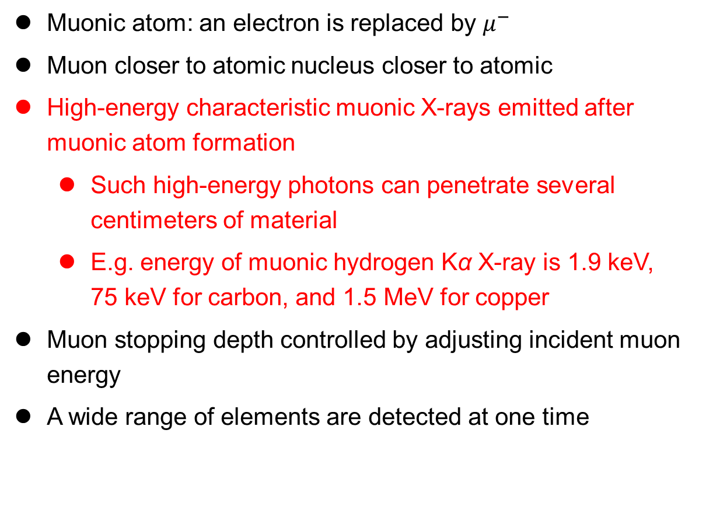
Muonic X-Ray
Introduction
Muonic atom: an electron is replaced by $μ^{−}$
Muon closer to atomic nucleus closer to atomic nucleus
High-energy characteristic muonic X-rays emitted after muonic atom formation
  Such high-energy photons can penetrate several centimeters of material
  E.g. energy of muonic hydrogen Kα X-ray is 1.9 keV, 75 keV for carbon, and 1.5 MeV for copper
Muon stopping depth controlled by adjusting incident muon energy
A wide range of elements are detected at one time

Slide 25
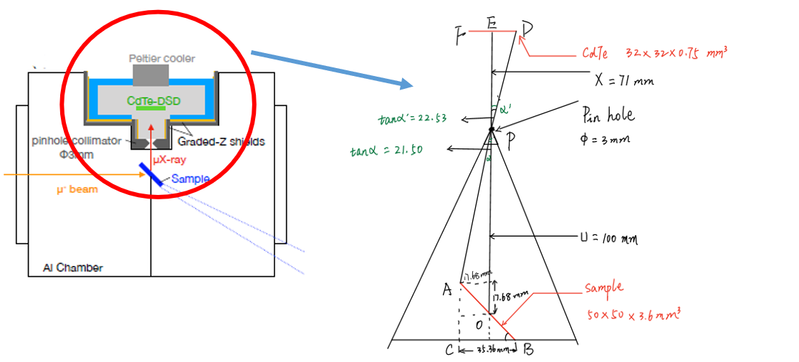
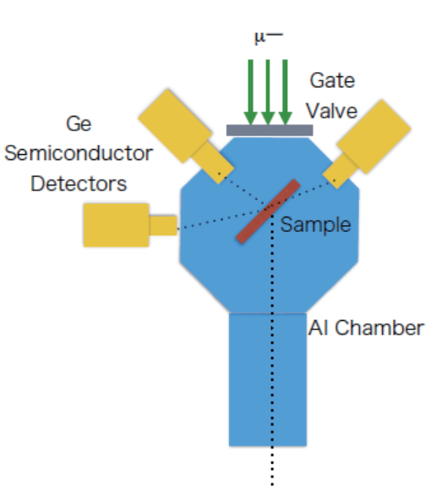
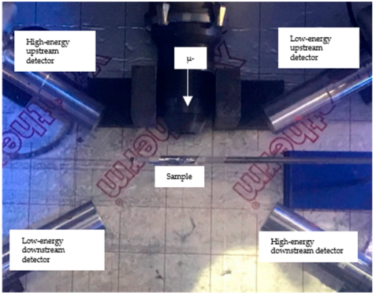
Existing Detector System
(a)
J-PARC
CdTe (2018)
30*30*0.75 mm³
3 – 200 keV
1.6 keV @ 60 keV
Sample: LiF, BN
Ge (2018)
100 mm² *10 mm
0.16 keV @ 5.6 keV, 0.5 keV @ 122 keV
Sample: Li-ion battery
RIKEN-RAL
Ge (2019)
low-energy-high-resolution (3 keV @ 1 MeV)
high-energy-low-resolution (0.1 MeV @ 8 MeV)
Sample: Roman coins (Cu, Ag...)
(c)
(b)

Slide 26
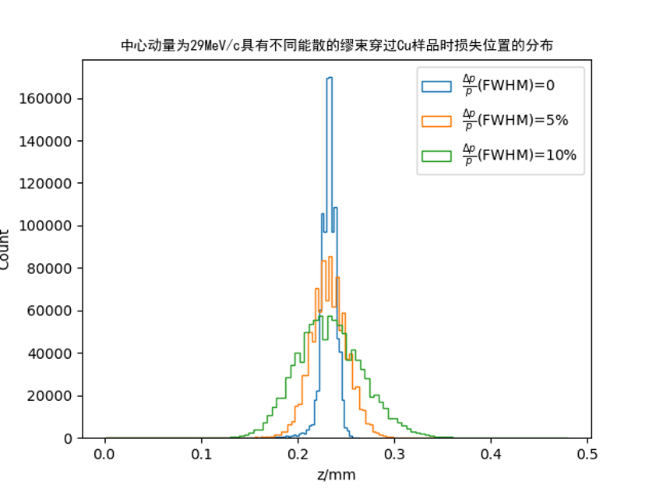
Effect of Beam Momentum Spread
29 MeV/c
 | Momentum spread FWHM [%] | Mean stopping depth [mm] | Depth FWHM [mm] | Depth resolution | Resolution ratio
Li | 0 | 2.841 | 0.252 | 8.9% | 1.0
 | 5 | 2.847 | 0.587 | 20.6% | 2.3
 | 10 | 2.864 | 1.152 | 40.2% | 4.5
Si | 0 | 0.718 | 0.067 | 9.4% | 1.0
 | 5 | 0.719 | 0.139 | 19.3% | 2.1
 | 10 | 0.724 | 0.282 | 38.9% | 4.1
Cu | 0 | 0.231 | 0.018 | 8.0% | 1.0
 | 5 | 0.232 | 0.042 | 18.1% | 2.3
 | 10 | 0.233 | 0.086 | 37.0% | 4.7
Ag | 0 | 0.214 | 0.018 | 8.4% | 1.0
 | 5 | 0.217 | 0.030 | 13.9% | 1.6
 | 10 | 0.220 | 0.056 | 25.4% | 3.0
Au | 0 | 0.120 | 0.003 | 2.5% | 1.0
 | 5 | 0.120 | 0.015 | 12.5% | 5.0
 | 10 | 0.121 | 0.048 | 39.7% | 15.9
Effect on muon stopping depth resolution

Slide 27
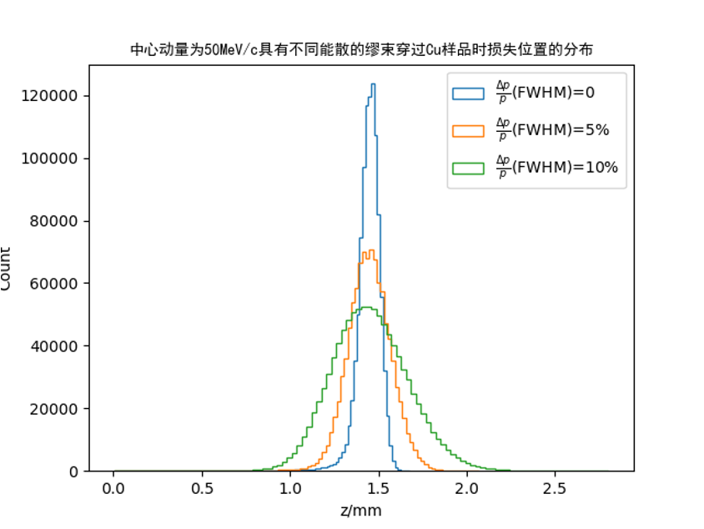
Effect of Beam Momentum Spread
50 MeV/c
 | Momentum spread FWHM [%] | Mean stopping depth [mm] | Depth FWHM [mm] | Depth resolution | Resolution ratio
Li | 0 | 19.17 | 1.71 | 8.9% | 1.0
 | 5 | 19.20 | 3.71 | 19.3% | 2.2
 | 10 | 19.30 | 7.19 | 37.3% | 4.2
Si | 0 | 4.63 | 0.37 | 8.0% | 1.0
 | 5 | 4.64 | 0.93 | 20.1% | 2.5
 | 10 | 4.66 | 1.70 | 36.5% | 4.6
Cu | 0 | 1.44 | 0.13 | 9.3% | 1.0
 | 5 | 1.45 | 0.29 | 20.0% | 2.1
 | 10 | 1.45 | 0.56 | 38.6% | 4.2
Ag | 0 | 1.36 | 0.15 | 10.7% | 1.0
 | 5 | 1.36 | 0.27 | 19.7% | 1.8
 | 10 | 1.37 | 0.50 | 36.6% | 3.4
Au | 0 | 0.84 | 0.10 | 12.4% | 1.0
 | 5 | 0.84 | 0.19 | 22.6% | 1.8
 | 10 | 0.85 | 0.32 | 38.2% | 3.1
Effect on muon stopping depth resolution

Slide 28
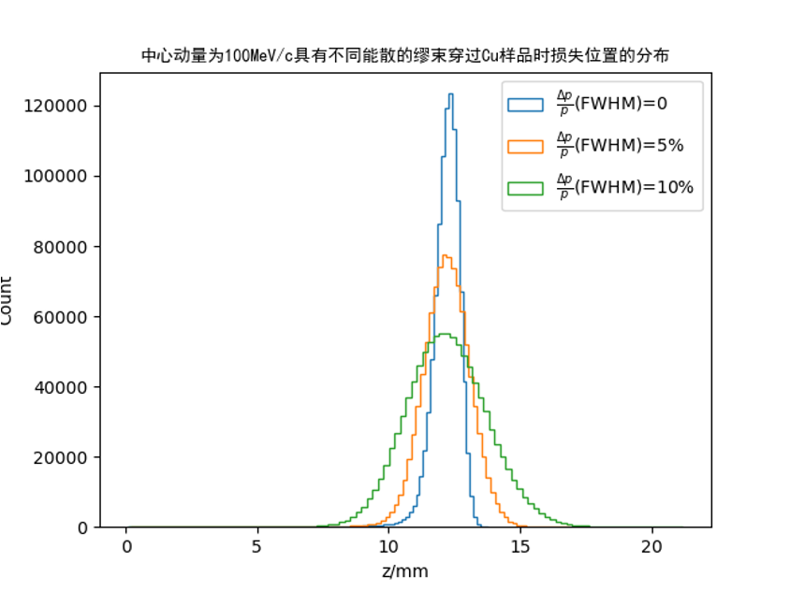
Effect of Beam Momentum Spread
100 MeV/c
 | Momentum spread FWHM [%] | Mean stopping depth [mm] | Depth FWHM [mm] | Depth resolution | Resolution ratio
Li | 0 | 170.1 | 13.2 | 7.7% | 1.0
 | 5 | 170.3 | 28.2 | 16.6% | 2.1
 | 10 | 170.7 | 57.3 | 33.6% | 4.3
Si | 0 | 39.8 | 3.1 | 7.7% | 1.0
 | 5 | 39.9 | 6.6 | 16.6% | 2.1
 | 10 | 40.0 | 13.0 | 32.5% | 4.2
Cu | 0 | 12.2 | 1.2 | 10.1% | 1.0
 | 5 | 12.2 | 2.2 | 17.8% | 1.8
 | 10 | 12.2 | 3.8 | 31.1% | 3.1
Ag | 0 | 11.3 | 1.3 | 11.2% | 1.0
 | 5 | 11.3 | 2.2 | 19.0% | 1.7
 | 10 | 11.4 | 3.8 | 33.6% | 3.0
Au | 0 | 7.0 | 0.9 | 13.0% | 1.0
 | 5 | 7.0 | 1.5 | 21.4% | 1.6
 | 10 | 7.0 | 2.4 | 34.6% | 2.7
Effect on muon stopping depth resolution

Slide 29
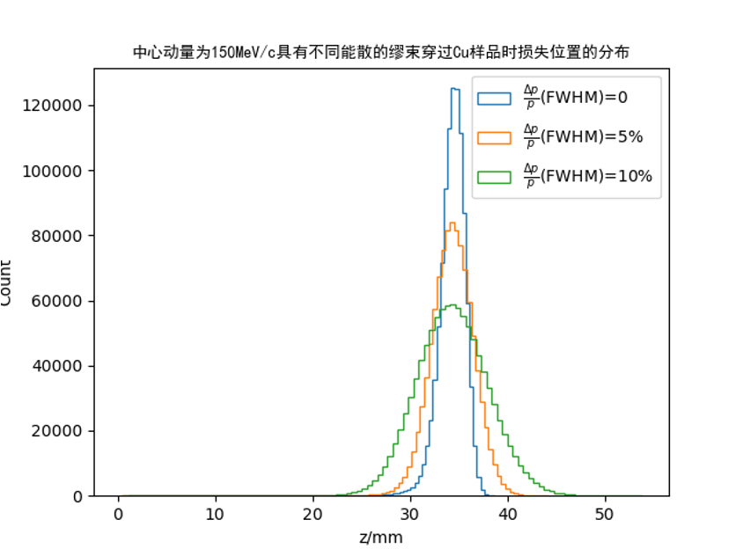
Effect of Beam Momentum Spread
150 MeV/c
 | Momentum spread FWHM [%] | Mean stopping depth [mm] | Depth FWHM [mm] | Depth resolution | Resolution ratio
Li | 0 | 486.2 | 34.3 | 7.1% | 1.0
 | 5 | 486.4 | 74.0 | 15.2% | 2.2
 | 10 | 487.1 | 133.0 | 27.3% | 3.9
Si | 0 | 112.7 | 8.4 | 7.5% | 1.0
 | 5 | 112.7 | 17.7 | 15.7% | 2.1
 | 10 | 112.8 | 30.2 | 26.7% | 3.6
Cu | 0 | 34.3 | 3.0 | 8.8% | 1.0
 | 5 | 34.3 | 5.3 | 15.4% | 1.7
 | 10 | 34.3 | 9.6 | 28.0% | 3.2
Ag | 0 | 31.8 | 3.2 | 10.1% | 1.0
 | 5 | 31.8 | 5.3 | 16.8% | 1.7
 | 10 | 31.8 | 8.9 | 27.9% | 2.8
Au | 0 | 19.5 | 2.4 | 12.5% | 1.0
 | 5 | 19.5 | 3.6 | 18.3% | 1.5
 | 10 | 19.5 | 5.9 | 30.5% | 2.4
Effect on muon stopping depth resolution

Slide 30
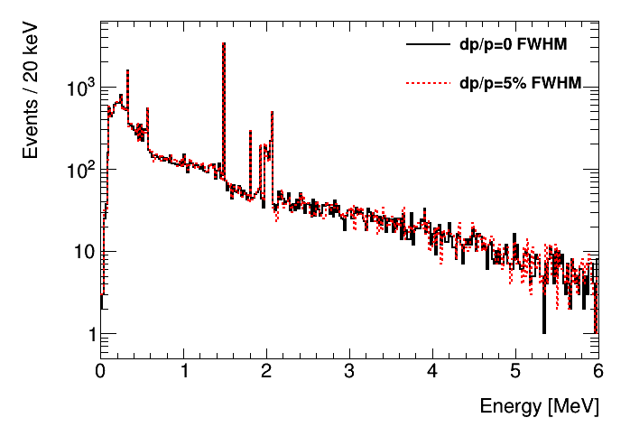
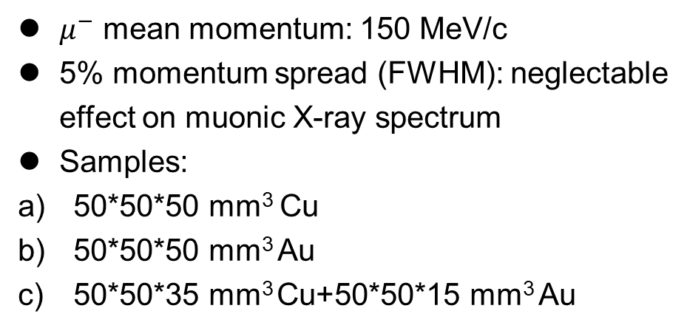
Effect of Beam Momentum Spread
Effect on muonic x-ray spectrum
$μ^{−}$ mean momentum: 150 MeV/c
5% momentum spread (FWHM): neglectable effect on muonic X-ray spectrum
Samples:
50*50*50 mm³ Cu
50*50*50 mm³ Au
50*50*35 mm³ Cu+50*50*15 mm³ Au
Muonic X-ray spectrum of sample a

Slide 31
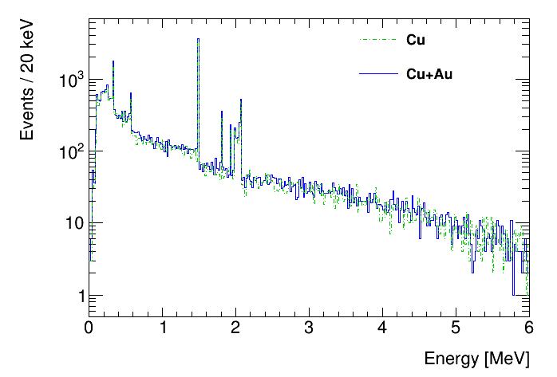
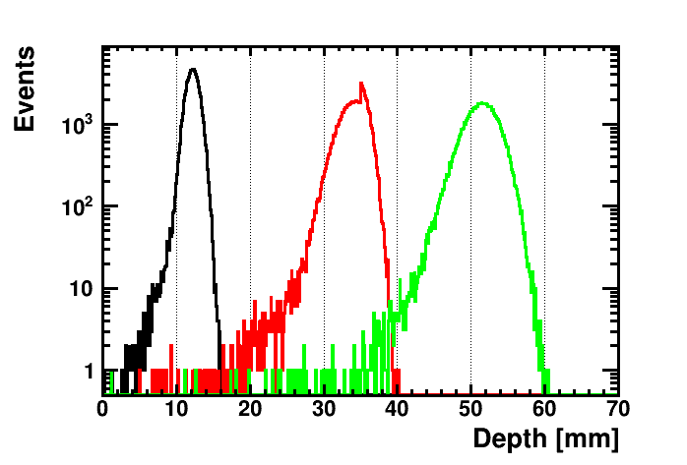



Depth-Controlled Study
$p_{μ^{−}}$ : 100, 150, 200 MeV/c
5% momentum spread (FWHM)
Sample:
50*50*35 mm³ Cu+50*50*35 mm³ Au

Slide 32
Summary
Muon imaging
Whether the Transmission and absorption muography and Deviation muography can be used is tested;
Based on X-ray CT and proton CT, muon CT was discussed;
To-do:
Verify the feasibility of detector structure for CT.
Muonic X-ray analysis
Carried out a survey of Muonic X-ray analysis;
The effects of energy and energy dissipation on the implantation depth and the expansion of the implantation depth are discussed.

Slide 33
Thanks!

