Slide 1
Overview of Neutrino Physics
2020 EMuS & MOMENT General Meeting at CSNS
Liang Zhan (占亮)
Institute of High Energy Physics
2020-12-12

Slide 2
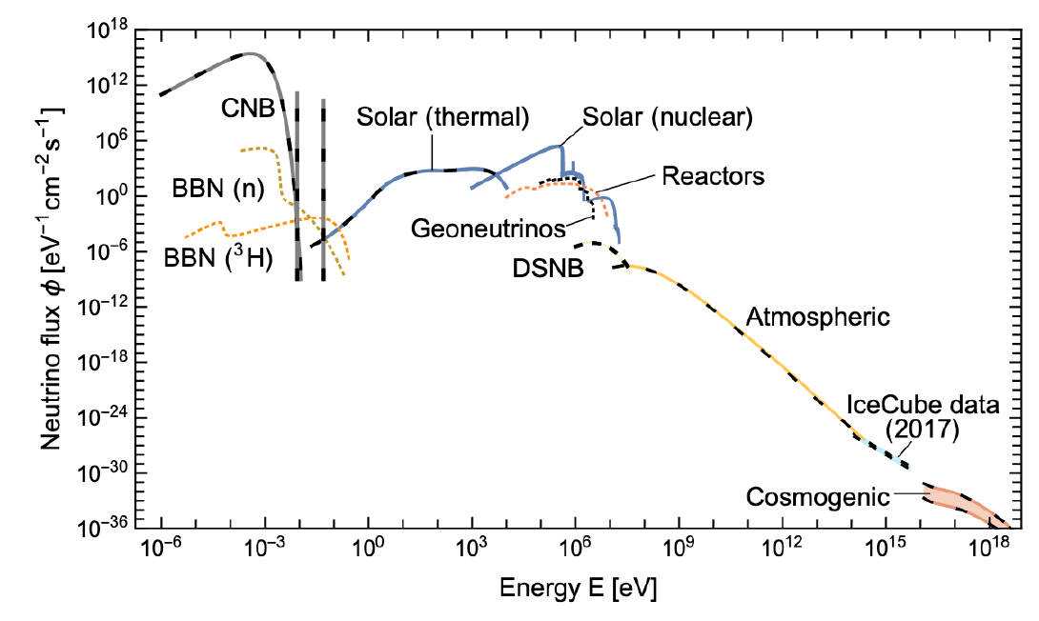
Neutrinos in the universe
arXiv: 1910.11878
Second most abundant particles, ~330/cm³ in universe.
Not observed yet: BBN, CNB, DSNB
BBN: bing bang neutrino
CNB: cosmic neutrino background

Slide 3
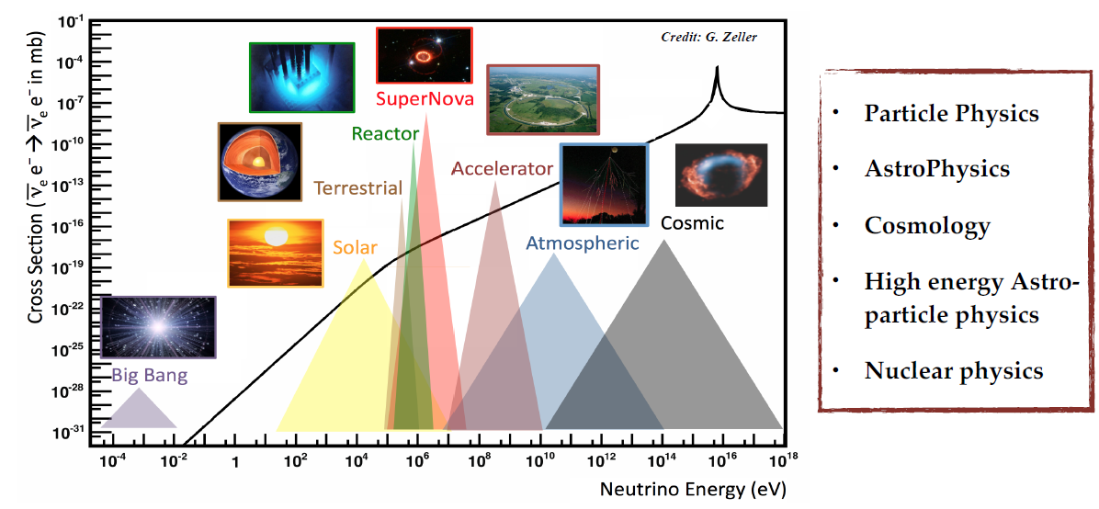

Slide 4
Open questions
Neutrino mass
Absolute mass of neutrinos
Majorana or Dirac particles?
Neutrino oscillation
Oscillation parameters
Mass ordering
CP violation
Beyond 3-flavor framework
Sterile neutrino?

Slide 5
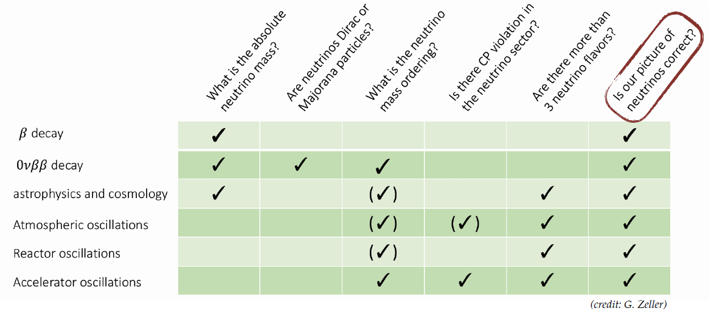
To answer the questions

Slide 6
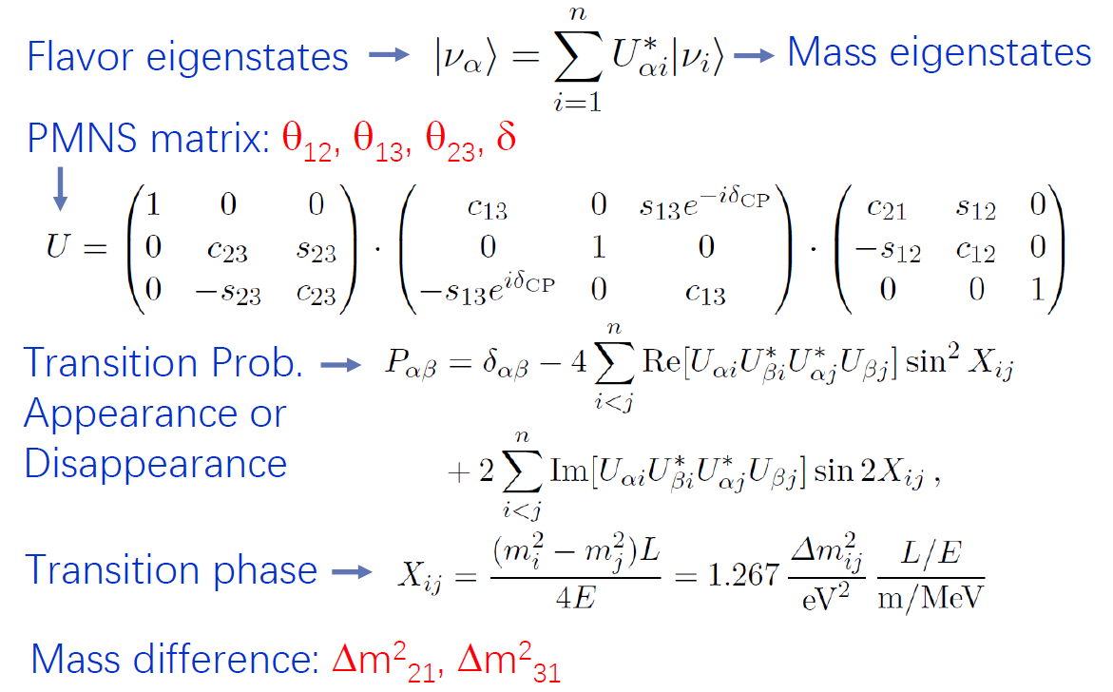
Neutrino oscillation
Zhe Wang @ ICHEP 2020 (a few slides later)

Slide 7
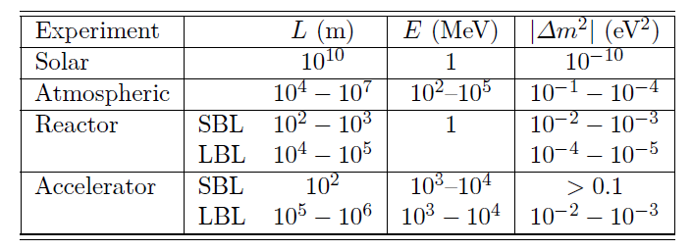
Oscillation experiments

Slide 8
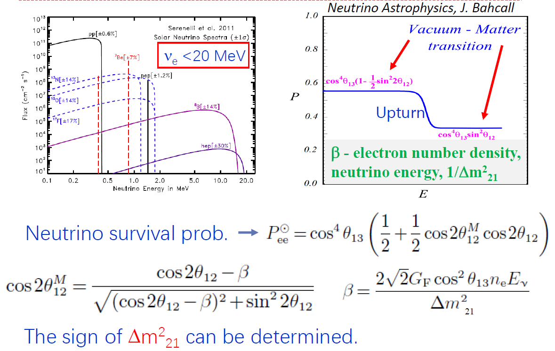
Solar neutrinos

Slide 9
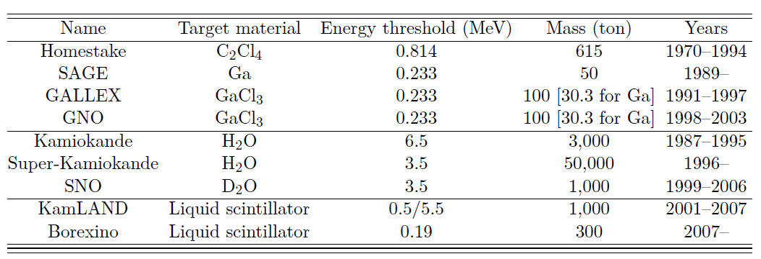
Solar neutrino experiments

Slide 10
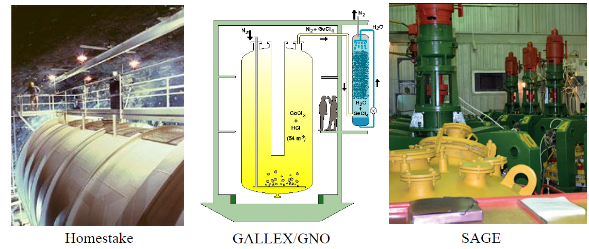
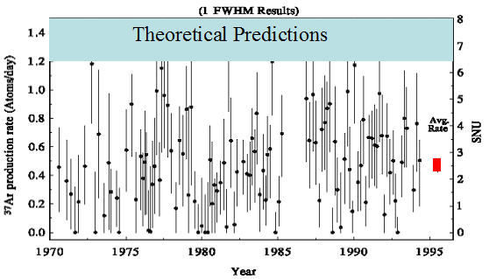
Solar experiment – chemical
Homestake
Solar neutrino puzzle

Slide 11
Solar experiments – real-time counting

Slide 12
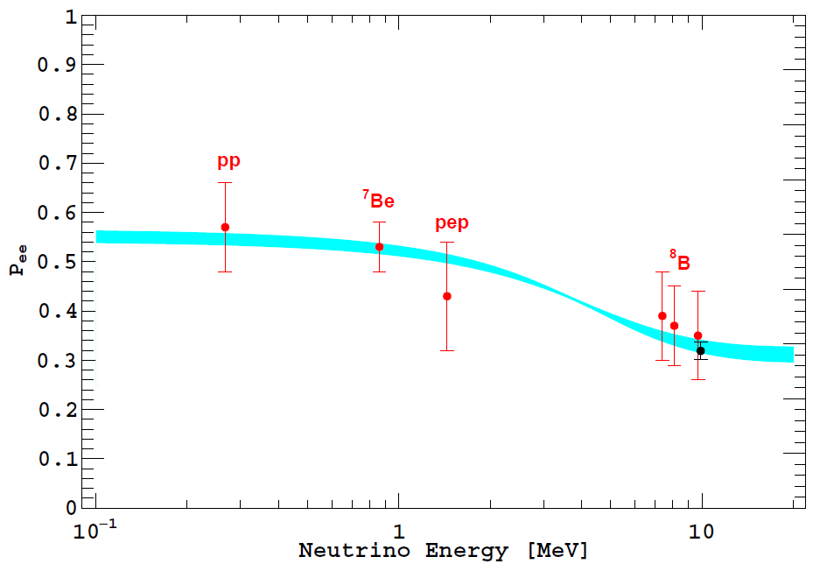
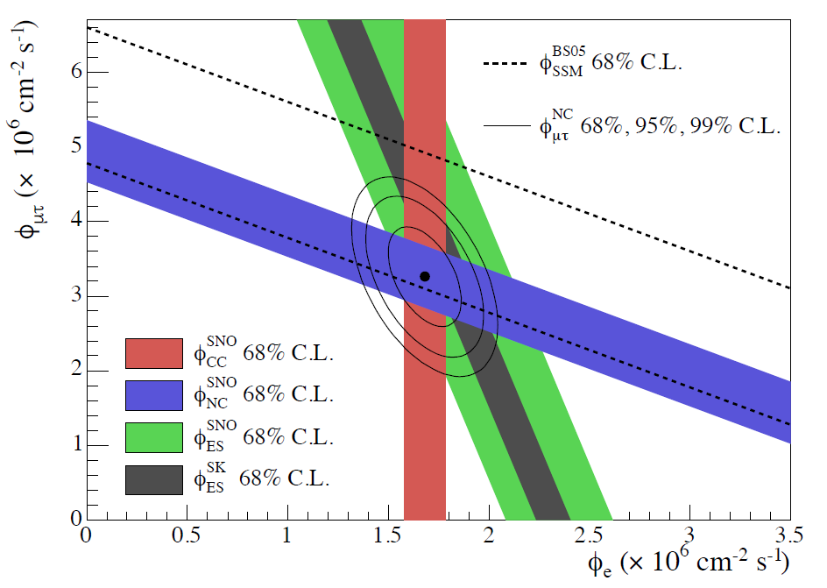
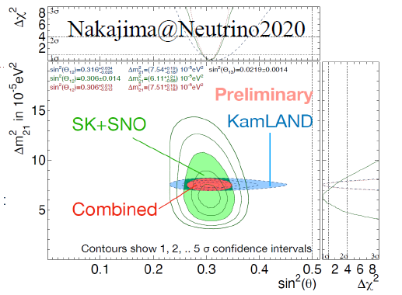
Results
SNO results (2015 Nobel Prize)
Borexino result

Slide 13
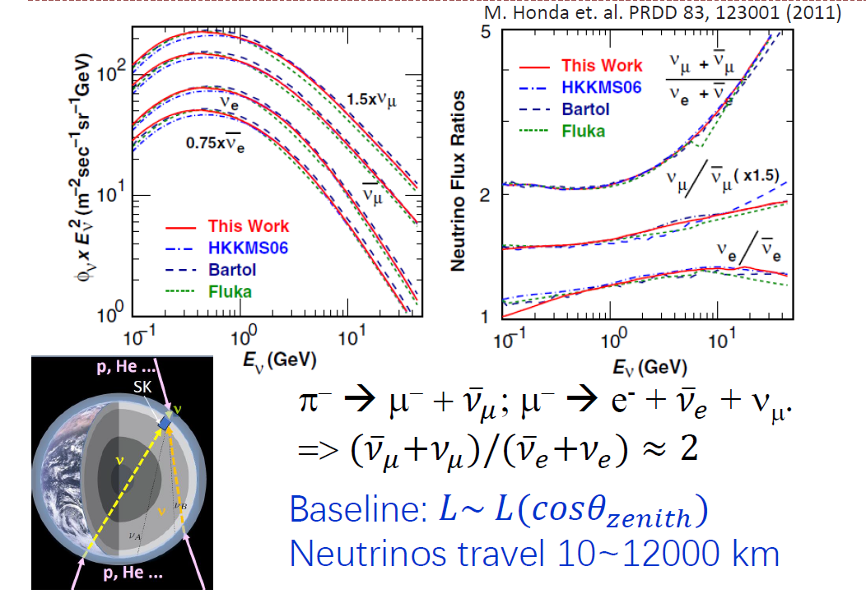
Atmosphere neutrinos

Slide 14
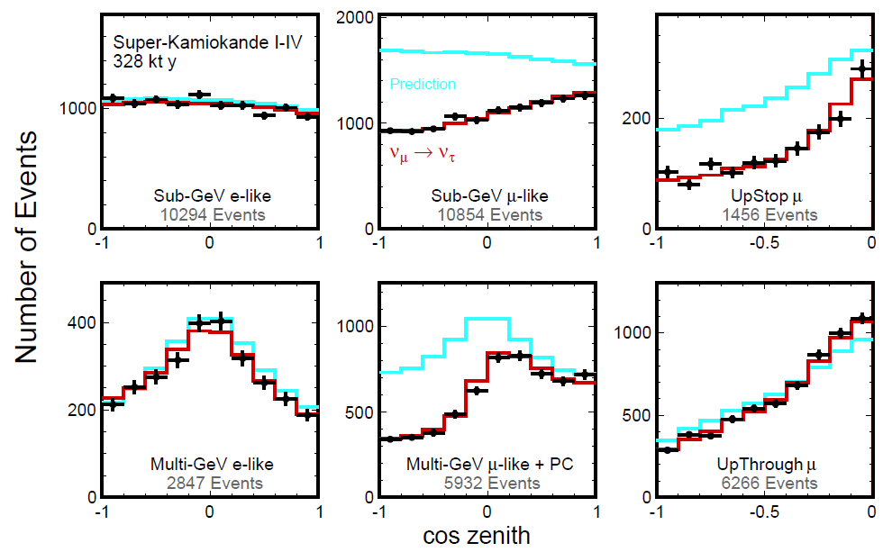
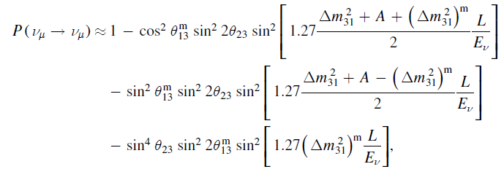
Super-K result
2015 Nobel Prize

Slide 15
Accelerator neutrino experiment
Disappearance
Appearance

Slide 17
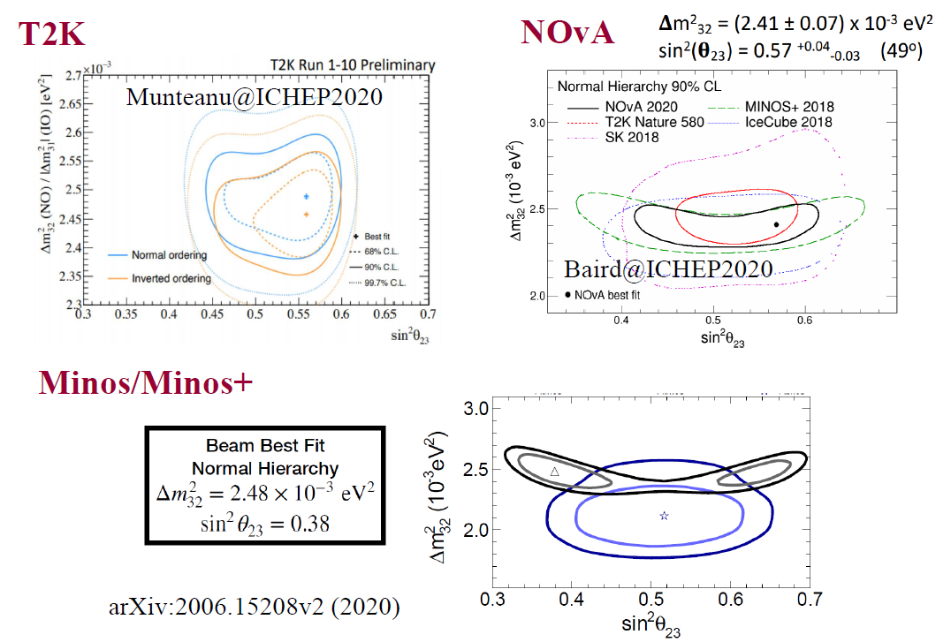
Accelerator Disappearance

Slide 18
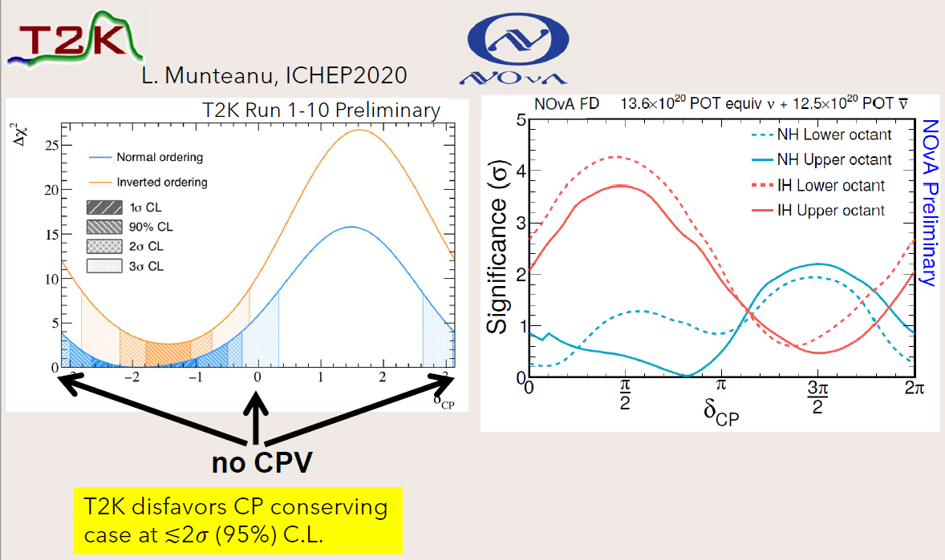
Accelerator Appearance

Slide 19
Sowjanya @ ICHEP 2020

Slide 21
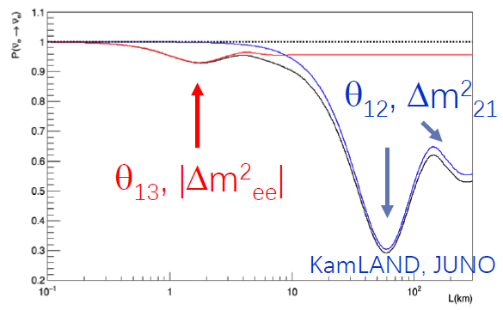
Reactor neutrino experiment

Slide 23
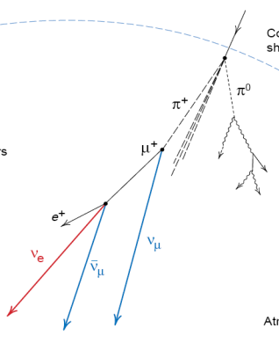
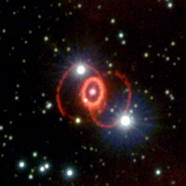
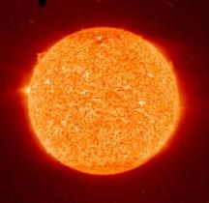
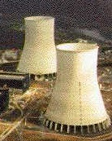
JUNO experiment
Supernova ν 5-7k in 10 s for 10 kpc
Atmospheric ν
several/day
Solar ν
(10s-1000s) /day
700 m
Cosmic-ray
~ 250k /day
0.0037 Hz/m²
215 GeV
10% muon bundles
36 GW_{th}, 53 km
Geo ν
1.1 /day
Reactor ν, 60 /day
20k ton LS
Proton decay

Slide 24
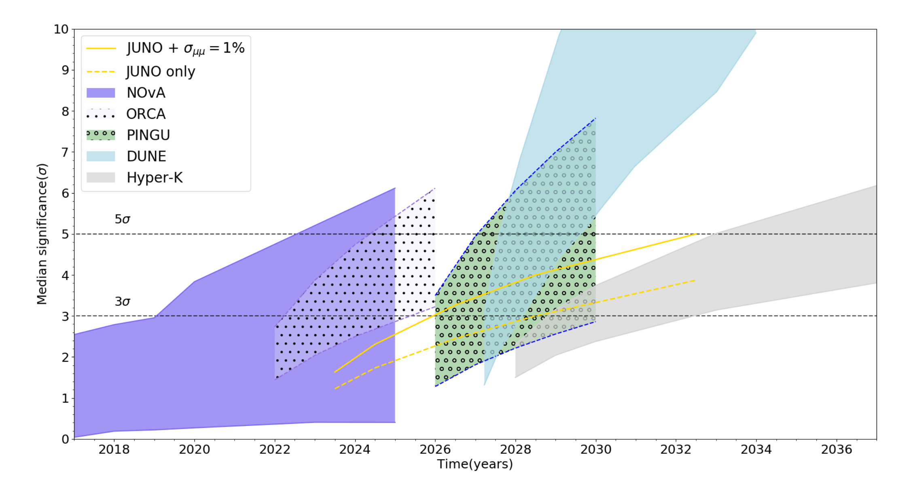
A Global Picture of mass ordering
By Jinnan Zhang
JUNO is unique for MH determination using reactor neutrino
Independent of the θ₂₃, CP phase and matter effect
Complementary to other experiments

Slide 25
Sowjanya @ ICHEP 2020

Slide 26
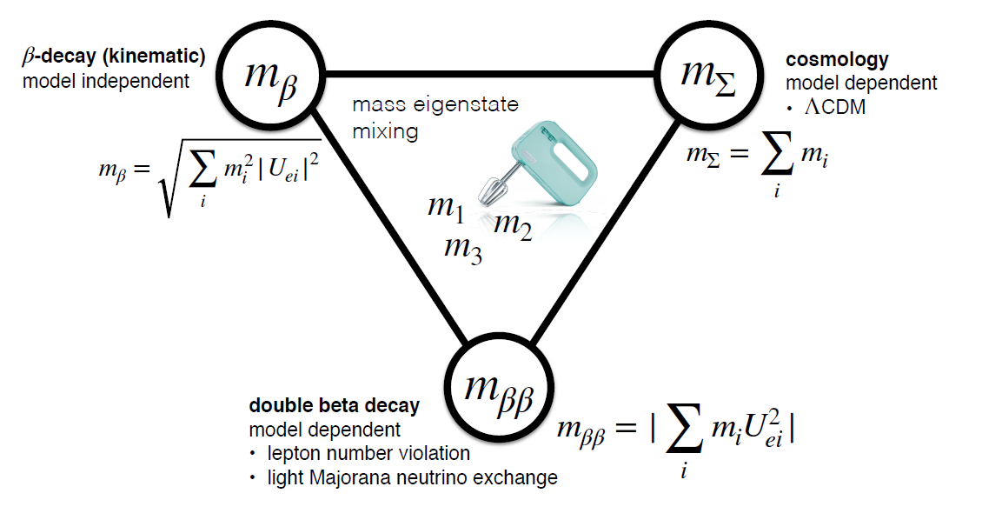
Neutrino mass observables
Björn @ICHEP 2020

Slide 27
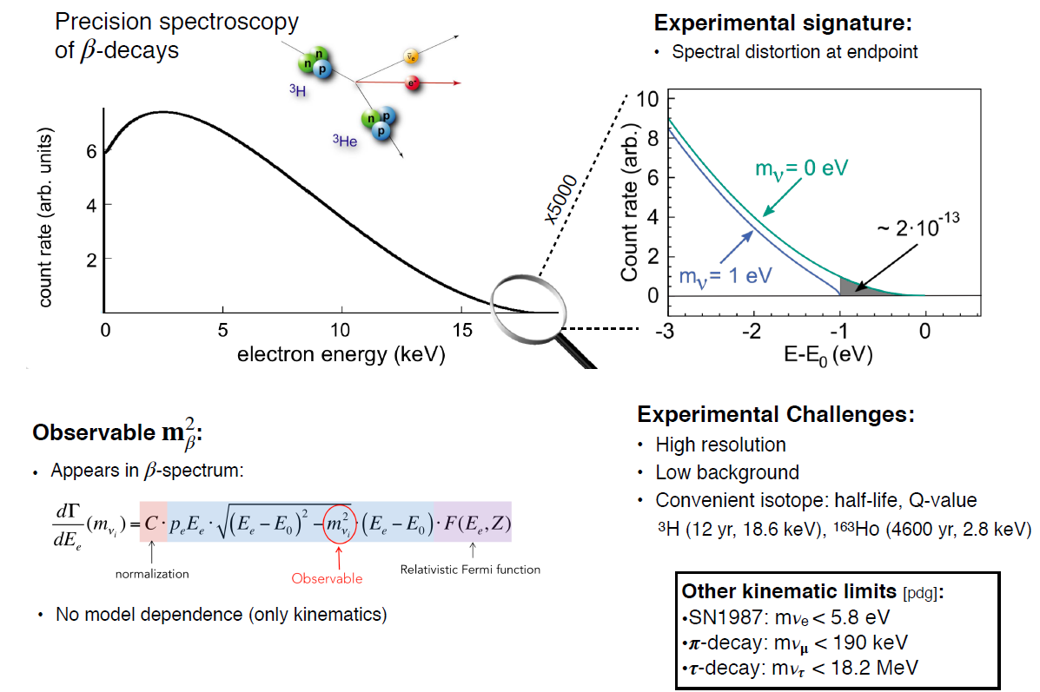
Beta-decay measurements
Björn @ICHEP 2020

Slide 28
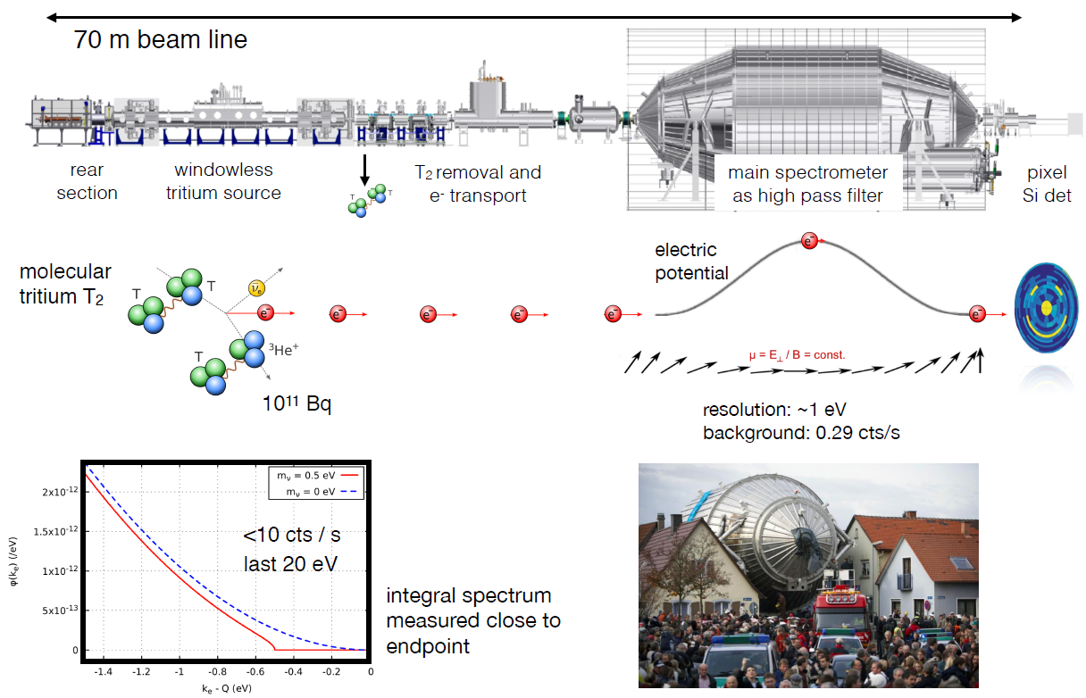
The KATRIN experiment
Björn @ICHEP 2020

Slide 29
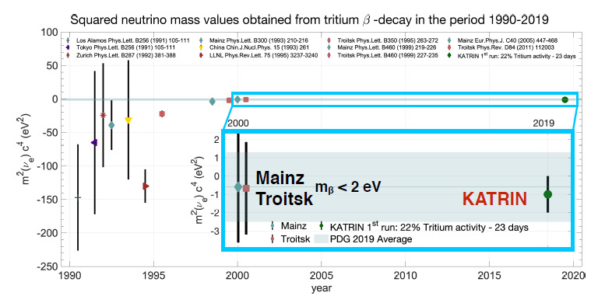
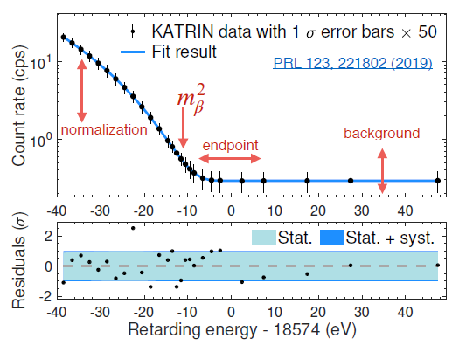
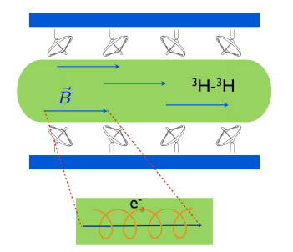
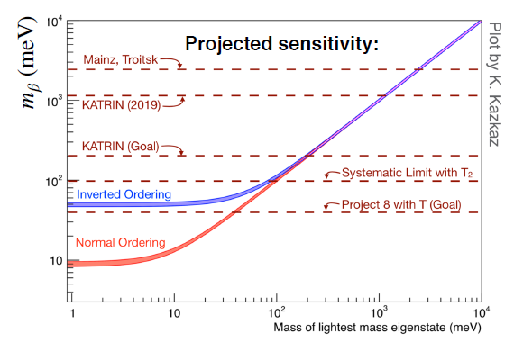
Current results and future
KARTRIN results
Project 8
Cyclotron Radiation Emission Spectroscopy
Lower limit determined by neutrino oscillation
parameters: ∆m²₂₁, ∆m²₃₁

Slide 30
ECHo and HOLMES
Björn @ICHEP 2020

Slide 31
Cosmological signitures

Slide 32
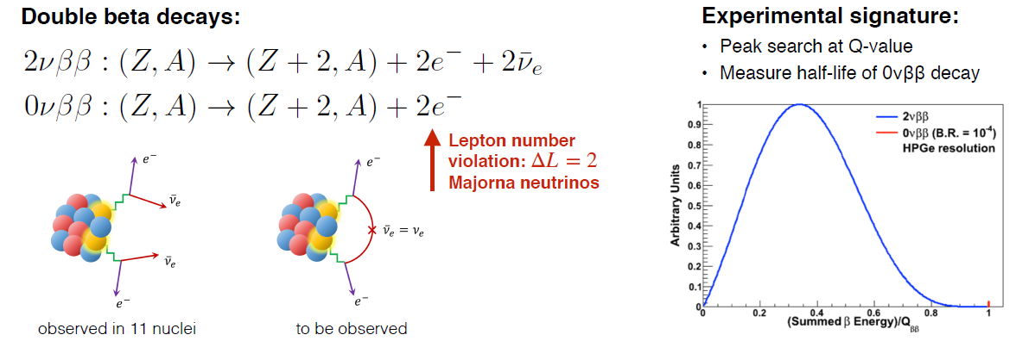
Neutrinoless double beta-decay
Björn @ICHEP 2020

Slide 33
Neutrinoless double beta-decay experiments

Slide 34
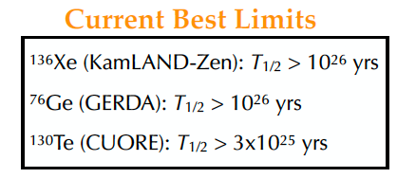
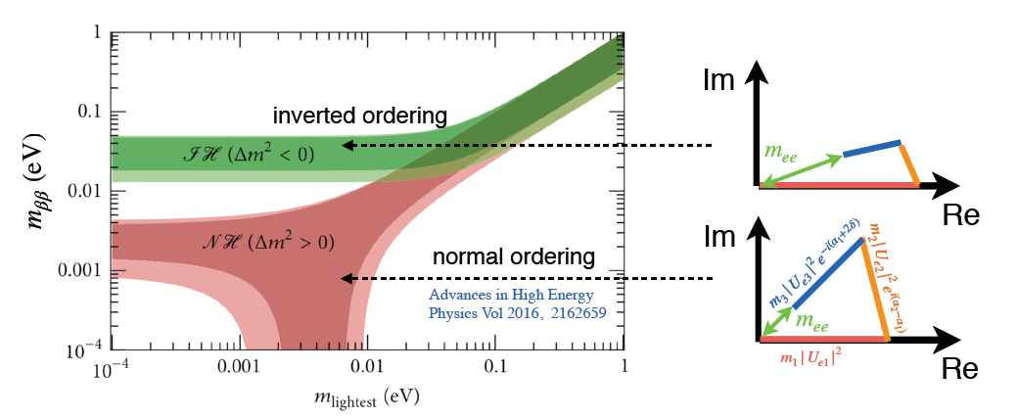
Results

Slide 35
Thanks

