Slide 1
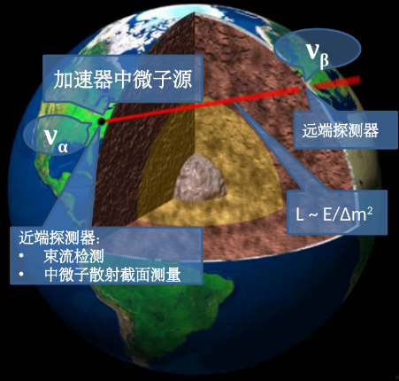
Particle physics potentials of MOMENT&EMuS
Jian Tang (SYSU)
Email: tangjian5@mail.sysu.edu.cn
Many thanks to Yu Chen, Yu-Zhe Mao, Sampsa Vihonen, Tse-Chun Wang and Yibing Zhang…
2020EMuS&MOMENT workshop
Dec. 10th, 2020
?
e⁻
e⁺
μ⁺
μ⁻
Muonium to Antimuonium Conversion Experiment(MACE)

Slide 2
Table of contents
Motivations
Physics performance study of MOMENT
Muonium to Antimuonium Conversion Experiment (MACE)
Summary

Slide 3
Table of contents
Motivations
Physics performance study of MOMENT
Muonium to Antimuonium Conversion Experiment (MACE)
Summary

Slide 4
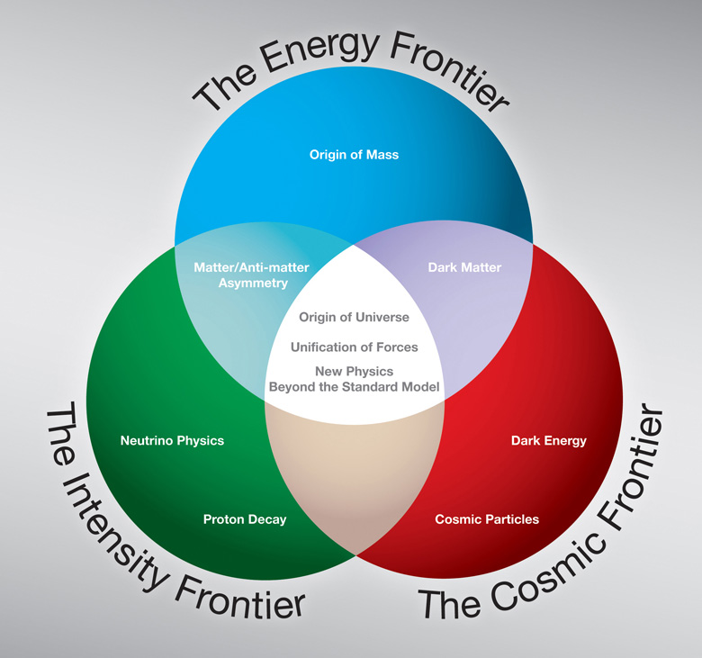
Three frontiers in Particle Physics
High-energy frontier
High-intensity frontier
Cosmic Frontier
Search for new physics beyond SM:
What's the origin of mass?
Any cLFV in Nature?
Matter-antimatter asymmetry?
What is DM?
……

Slide 5
High-intensity frontier
Neutrino experiments
  T2K, NOvA, T2HK, DUNE…
  JUNO, MOMENT…
cLFV：
  Mu2e(FNAL)
  COMET(J-PARC)
  MEG-II(PSI)
  MACE(CSNS)
LNV：
  Mu3e(PSI)
Precision measurements of µ：
  MuLan&FAST at PSI: µ lifetime.
  MuCap at PSI: couplings for µ captures.
  MuSun to measure electroweak interactions and polarizations.
  TWIST at TRIUMF to measure parameters in weak decays.
  g-2 at FNAL to measure magnetic moment.
  MeuSEUM at J-PARC to measure muonium hyper-fine structure.

Slide 6
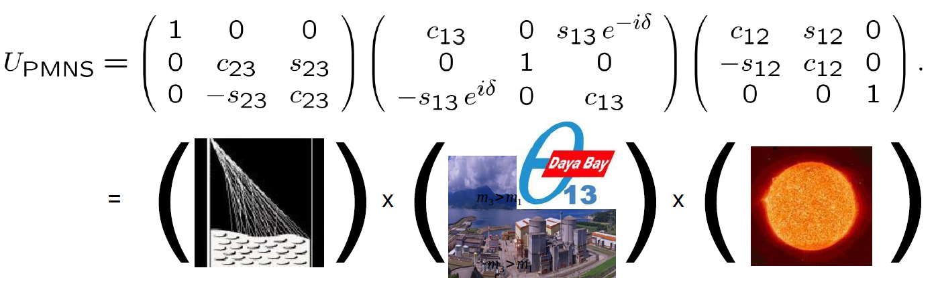
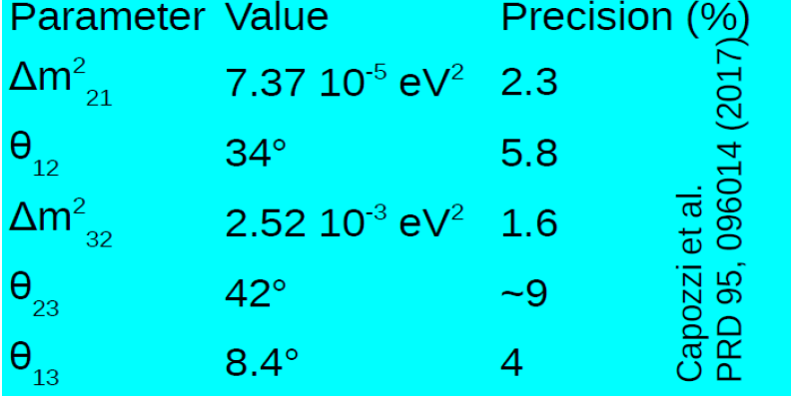
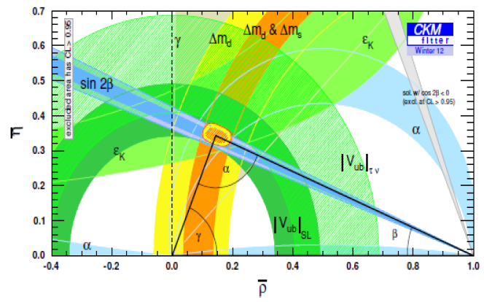
Motivation: Precision measurement and new physics?
PMNS precision ~ O(1) %
New physics might be hidden there
CKM precision ~O(1) ‰
Previous discovery used as a tool to probe new physics

Slide 7
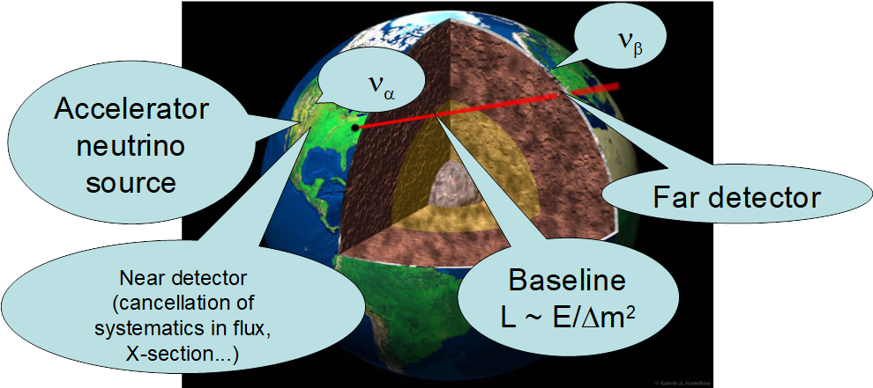
Precision measurement and new physics searches by accelerator neutrino oscillations
Get the neutrino source as clean as possible. Muon decay v.s pion decay beams.
Deploy the best detector to reconstruct the oscillated neutrino spectra: Gd-WC, LAr TPC, scintillator detector with charge identifications…
Data mining: precision measurement & discovery of new physics…

Slide 8





International efforts
$$∼2010$$
$$∼2035$$
$$θ_{12},Δm_{21}^{2},\left|Δm_{31}^{2}\right|$$
$$θ_{13}≠0$$
$$θ_{23},δ,\text{sign}(Δm_{31}^{2})$$
solar e.g. SNO, etc…
atmosphere: SuperK, etc…
reactors: KamLAND, etc…
Reactor and superbeam experiments
DYB, Double Chooz, RENO…
MINOS, NOvA,T2K,
T2HK, DUNE…
Neutrino factory
e.g. NuSTORM
It is important to upgrade the neutrino source:
decrease the statistical uncertainties, i.e. enhance the ν flux intensity;
decrease the systematic uncertainties from the source;
reduce backgrounds from the source…
$$ν$$

Slide 9
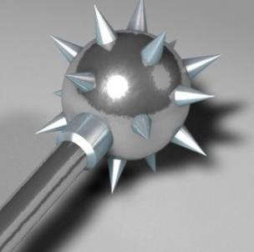
High-intensity frontier
Search for new physics with accelerator muons
  Mu2e in US
  COMET in Japan
  MEG-II/Mu3e in Switzerland
  Muonium to Antimuonium
  Conversion Experiment in China
RF5-RF0-126
MACE
Naively proposed at the international Review of EMuS in November, 2018.
Submit a LOI to Snowmass in 2020. Invited talk at the town hall meeting.
Recently an invitation for a contributed white paper for muonium physics.

Slide 10
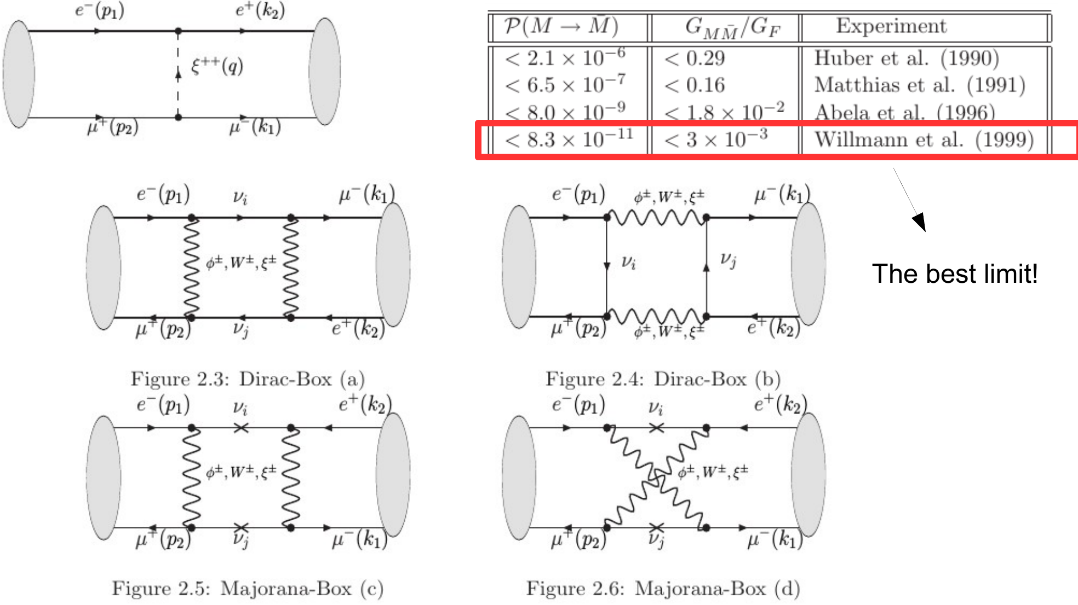
Muonium to antimuonium conversion beyond SM
Lepton flavour violation process beyond SM.
For example, predicted by type-II seesaw model.
Results 20 years ago!!!
EFT study of muonium to antimuonium conversion by R. Conlin and A. Petrov, arXiv: 2005.10276

Slide 11
Table of contents
Motivations
Precision measurements and new physics searches
Muonium to Antimuonium Conversion Experiment (MACE)
Summary

Slide 12
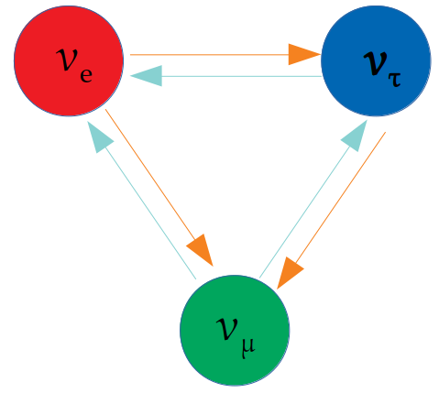
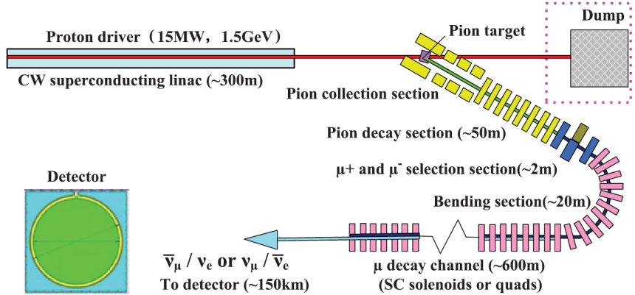
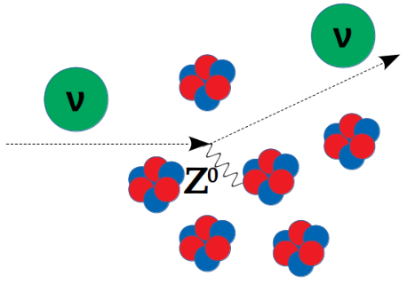
Precision measurements and new physics searches
Precision measurement of δ_{CP}
JHEP 1912 (2019) 130.
MOMENT proposal
Phys.Rev.ST Accel.Beams 17 (2014) 090101
CEvNS at a near detector
Phys.Rev.D97(2018)11,113003.
Constraints on ν mass models
Nucl.Phys. B952 (2020) 114915.
Phys.Rev. D100 (2019) 5, 055022.
+EMuS proposal
Opaque scintillator detector
Phys.Rev.D 102 (2020) 1, 013006.
Unitarity violations
Phys.Lett. B774 (2017) 217-224.
ν Invisible decays
JHEP 1904 (2019) 004.
Neutrino CC-NSI
Phys.Rev. D97 (2018) 3, 035018.

Slide 13
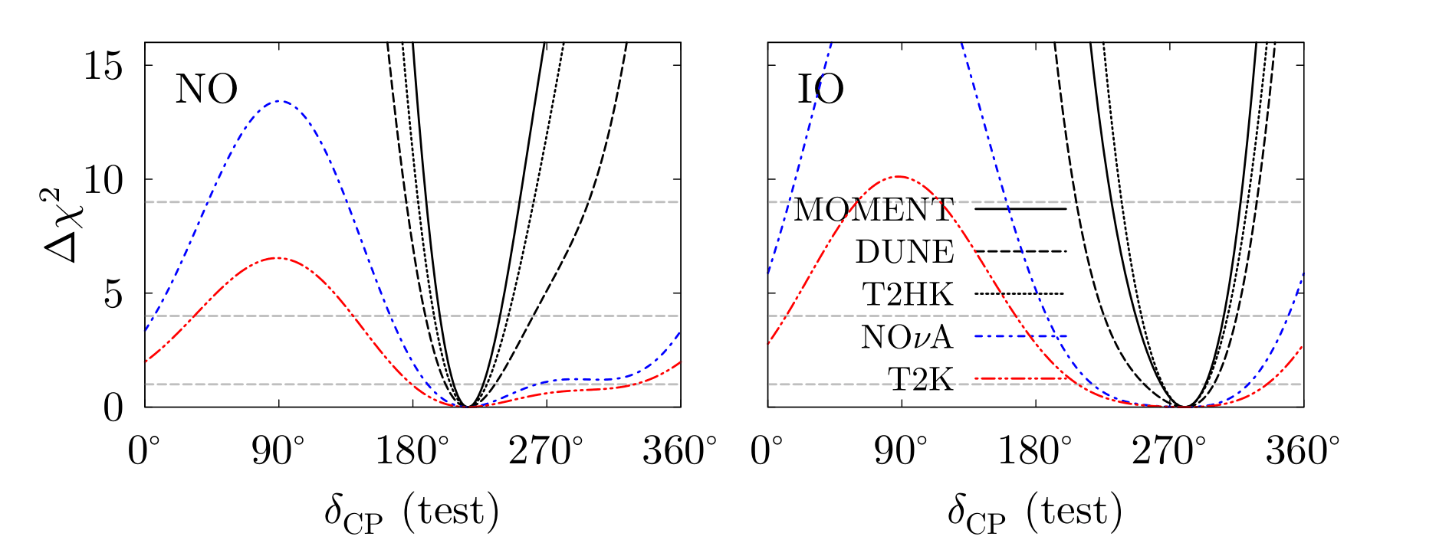
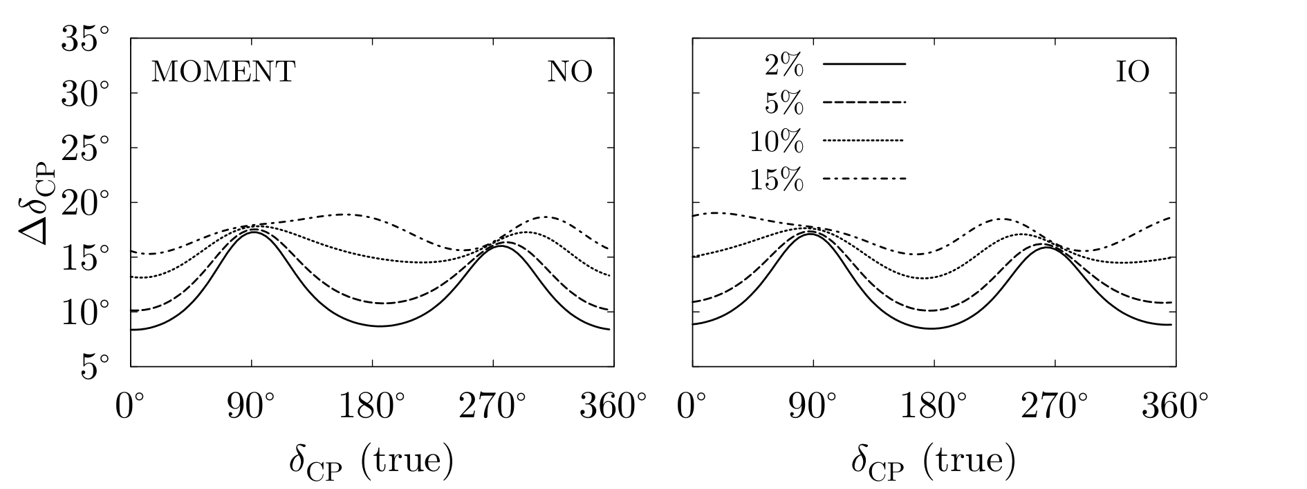
Precision measurement of δ_{CP}
arXiv:1909.01548

Slide 14

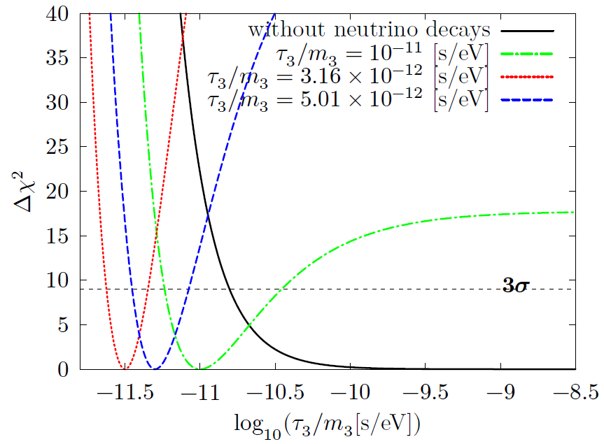
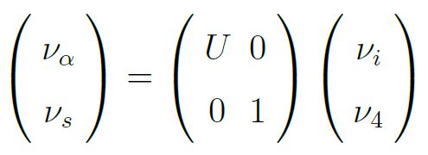
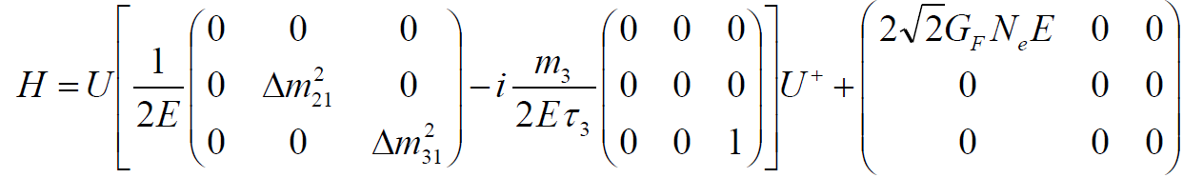
If a neutrino decays?
Visible decays:
If the decay products are active, interact at the detector and give a visible signal.
→ Increase/depletion of event rates.
Invisible decays:
Sterile states, below the detector threshold, depletion of event rates...
Consider the decay mode:
J is a majoron.
arXv:1811.05623

Slide 15
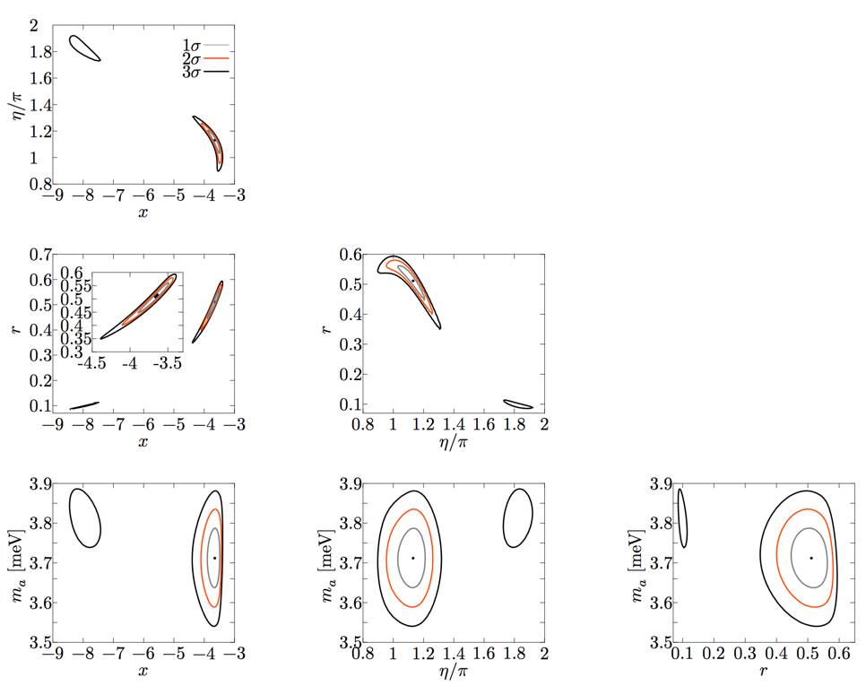
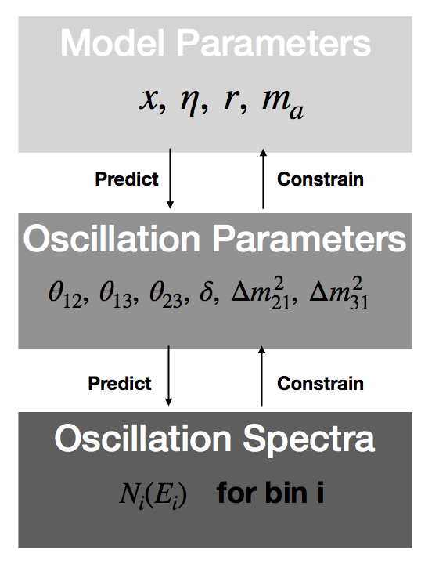

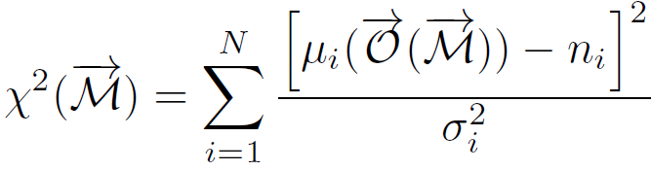
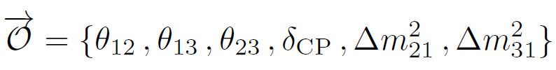
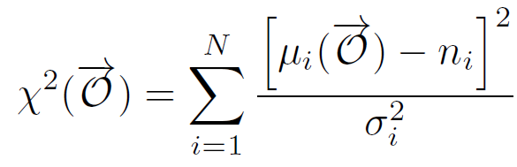
Constraints on flavor-symmetry neutrino models
Flavour Symmetry Embedded -- GLoBES (FaSE-GLoBES) arXiv: 2006.14886
arXv:1907.01371

Slide 16
Table of contents
Motivations
Muonium to Antimuonium Conversion Experiment (MACE)
Precision measurements and new physics searches
Summary

Slide 17
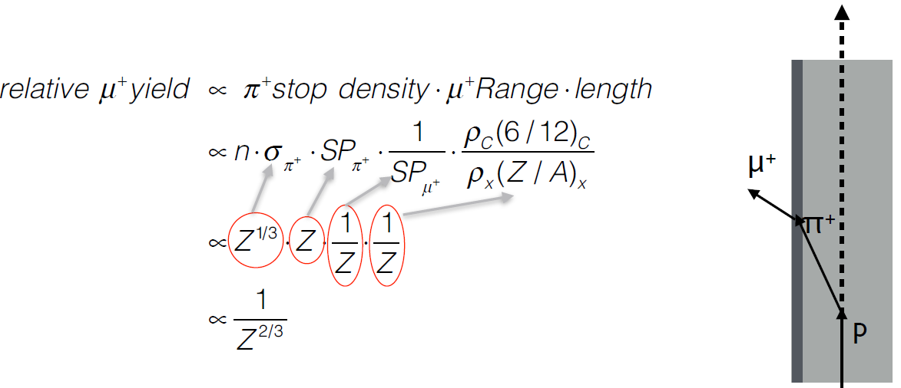
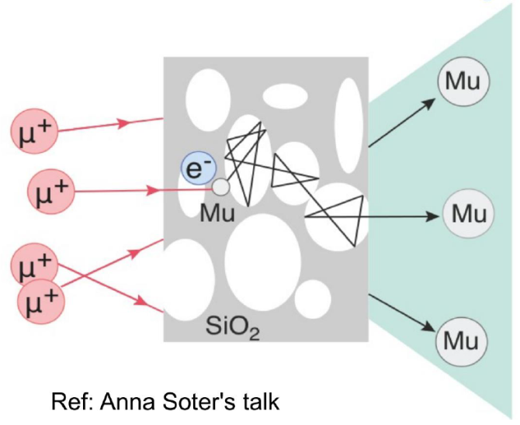
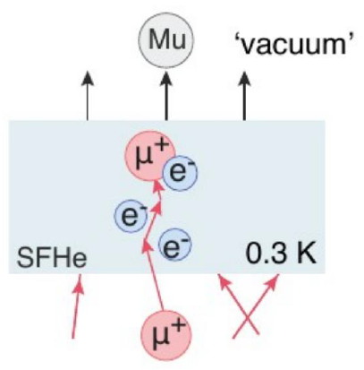
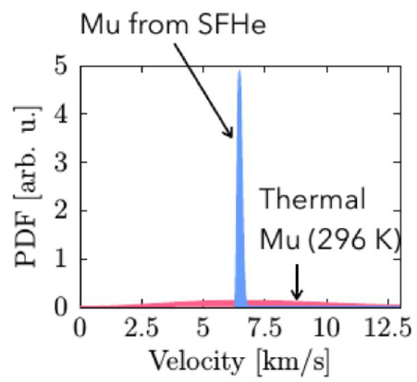
Muon and muonium productions
Previous experience
Hot tungsten in 1986:
4% from 4 MeV μ⁺
SiO₂ powder in 1990:
1%-2% from 4 MeV μ⁺
SiO₂ film(cold) in 2012:
40% from 5 keV μ⁺
Proposed target: aerogel, super fluid helium…
Silica powder
Super Fluid Helium
Increase efficiency

Slide 18
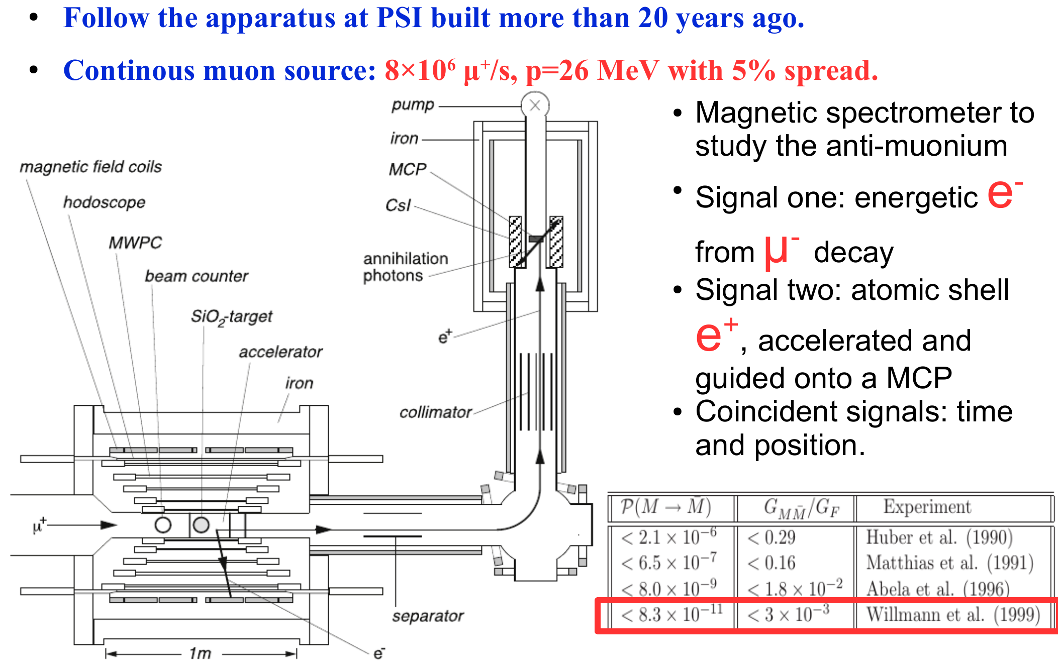
How to detect such a process in 1999?
No progress since then!!!

Slide 19
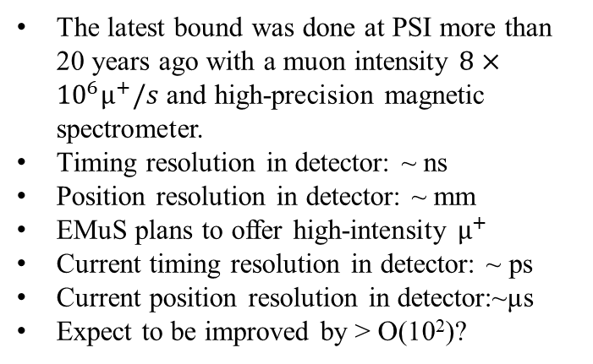
Breakthrough of MACE with EMuS
The latest bound was done at PSI more than 20 years ago with a muon intensity $8×{10}^{6}μ^{+}/s$ and high-precision magnetic spectrometer.
Timing resolution in detector: ~ ns
Position resolution in detector: ~ mm
EMuS plans to offer high-intensity $μ^{+}$
Current timing resolution in detector: ~ ps
Current position resolution in detector:~μs
Expect to be improved by > O(10²)?
Step further with better timing/tracking capability in a magnetic spectrometer?
Without other similar facilities around the world, it is time for us to break through the latest record in 1999.
19

Slide 20
Roadmap and milestones
CDR
TDR
Data taking
MACE

Slide 21
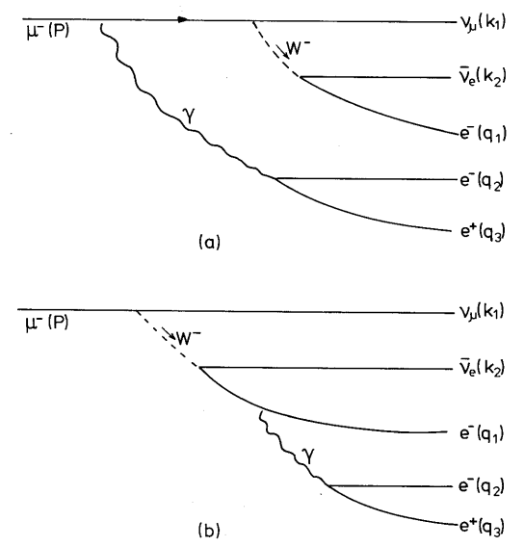
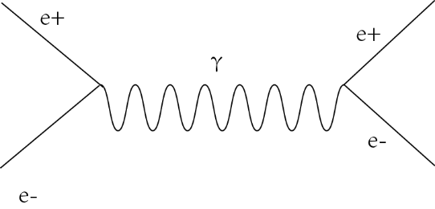
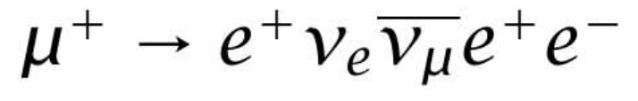
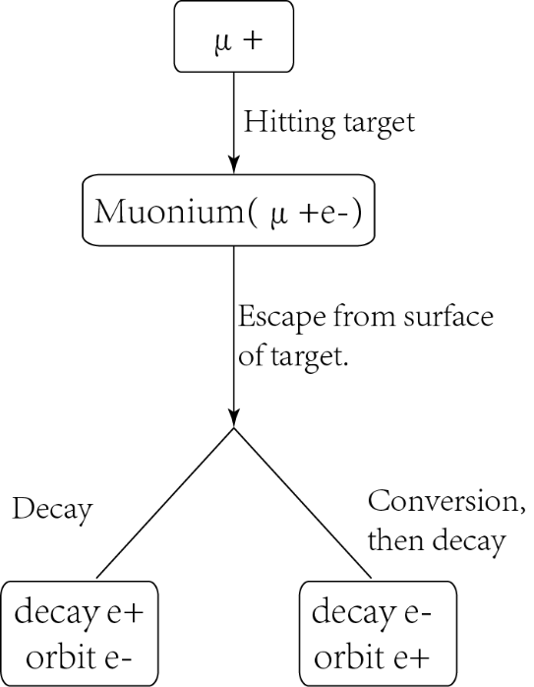
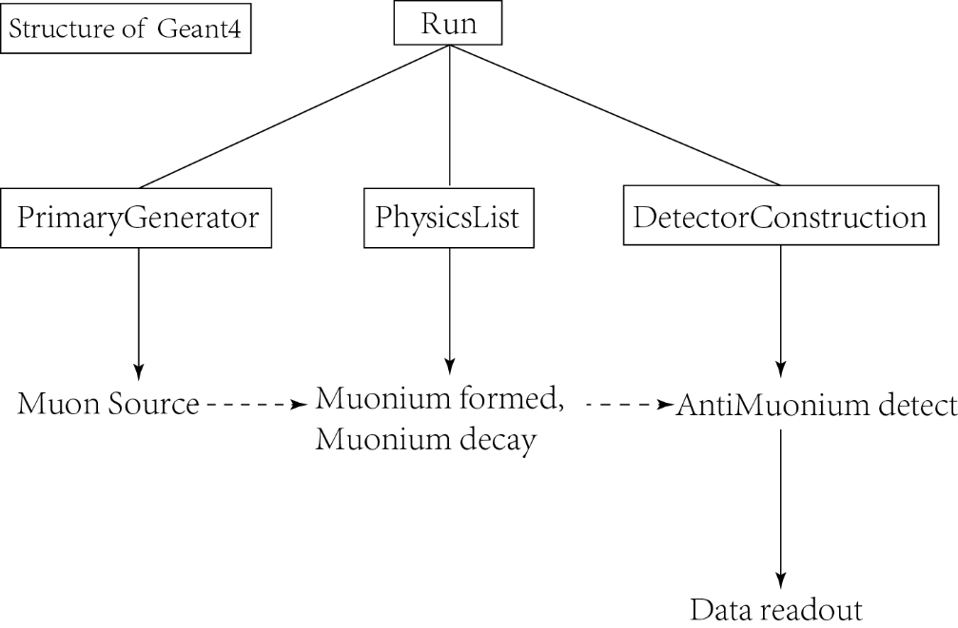
Preliminary MC simulation
Backgrounds:
  μ⁺ decays to e⁺, Bhabha scattering to generate high-energy e⁻ in coincident with low-energy e⁺
  μ⁺ decays:
Antimuonium decay signal by position-time coincidence
  High energy Michael electron ~ O(10) MeV -- TPC
  Low energy orbital positron ~ O(10) eV -- BGO
Courtesy: Yu-Zhe Mao

Slide 22
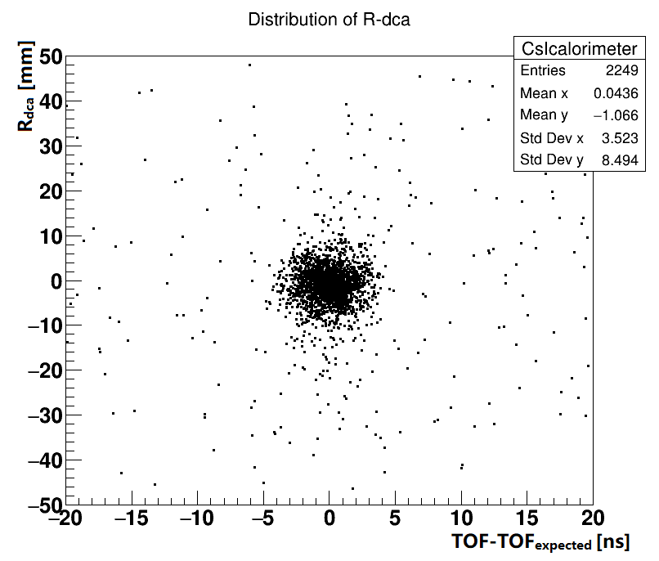
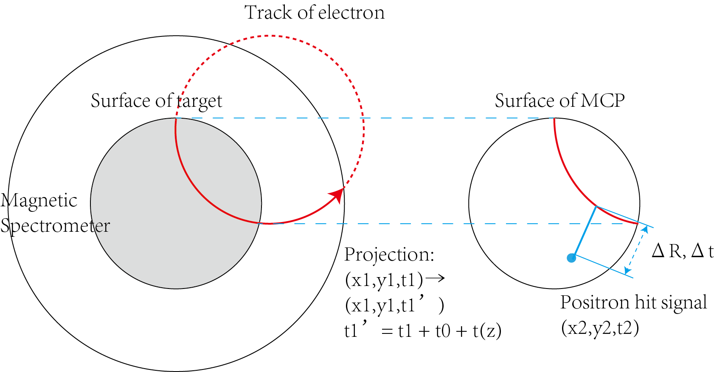
Muonium generators in MC simulation
Injected muons: 1.2×10⁵ of μ⁺
In our simulation, 76% detection efficiency.
Consistent with PSI muonium formation results.
Happen at the same vertex:
|ΔR|~R_{dca} < 12.0 mm
Happen at the same time:
|Δt|~TOF-TOF_{expected} < 4.5 ns:
TOF = t0 + t(z)
Courtesy: Yu-Zhe Mao

Slide 23
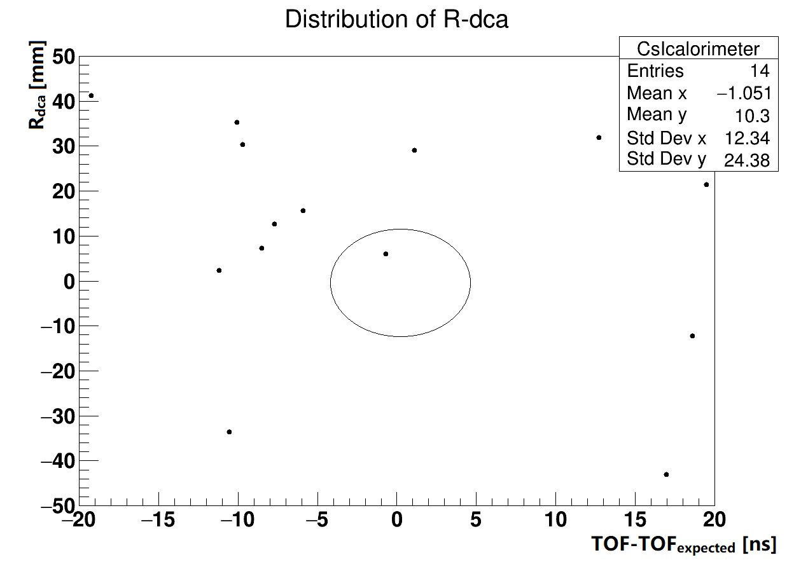
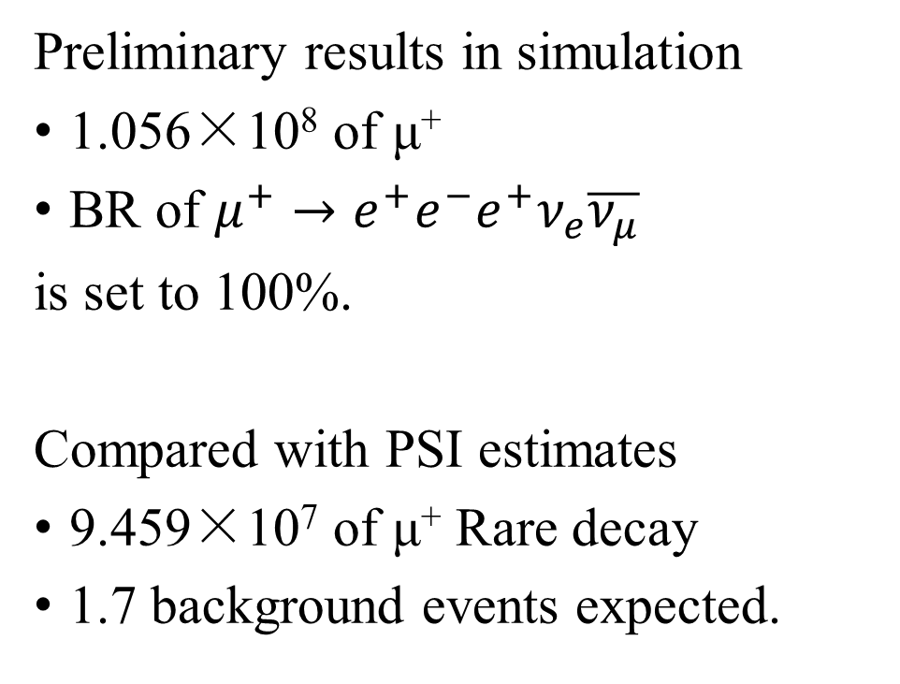
Rare decays in MC simulation
Preliminary results in simulation
1.056×10⁸ of μ⁺
BR of $μ^{+}→e^{+}e^{−}e^{+}ν_{e}\overline{ν_{μ}}$
is set to 100%.
Compared with PSI estimates
9.459×10⁷ of μ⁺ Rare decay
1.7 background events expected.
Happen at the same vertex:
|ΔR|~R_{dca} < 12.0 mm
Happen at the same time:
|Δt|~TOF-TOF_{expected} < 4.5 ns:
TOF = t0 + t(z)
Courtesy: Yu-Zhe Mao

Slide 24
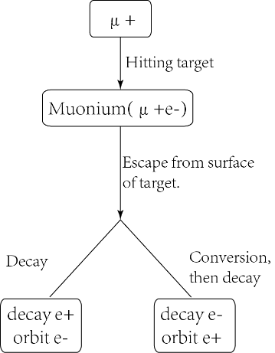
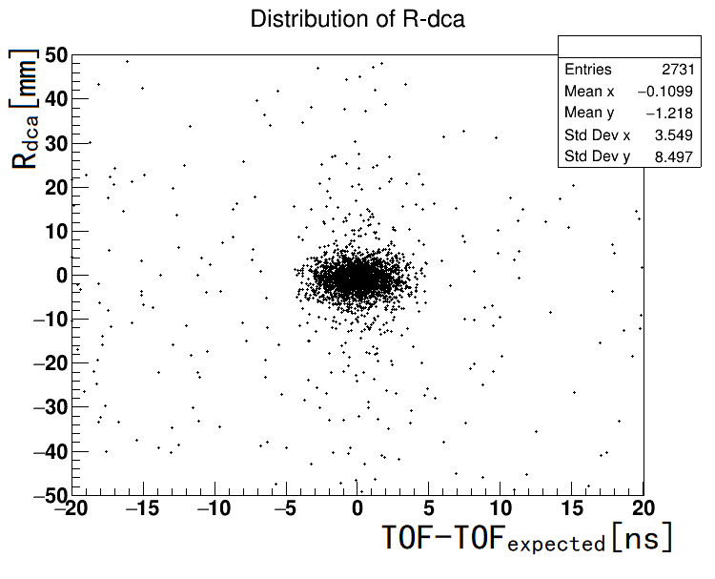
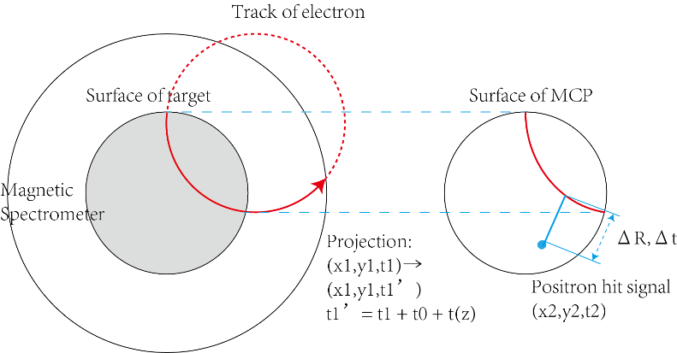
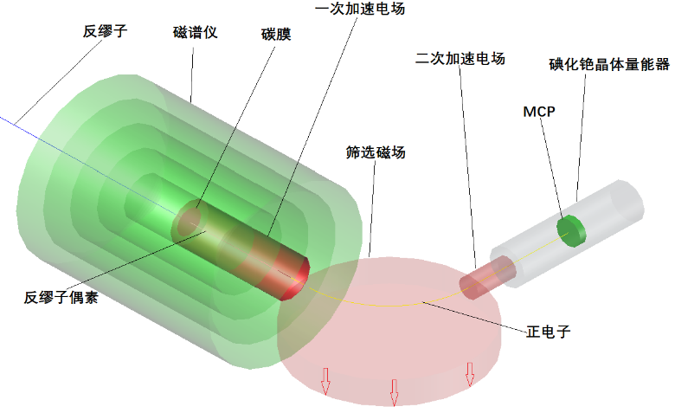
MC simulation to support MACE
New target with better efficiency?
Muonium to Antimuonium Conversion Experiment(MACE)
New ROI for better S/B?
New design with better resolutions?
New ideas…

Slide 25
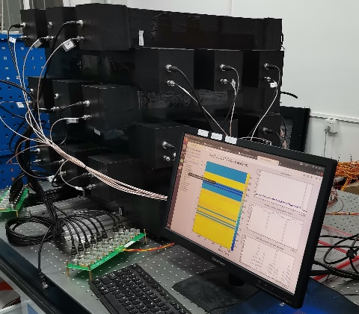
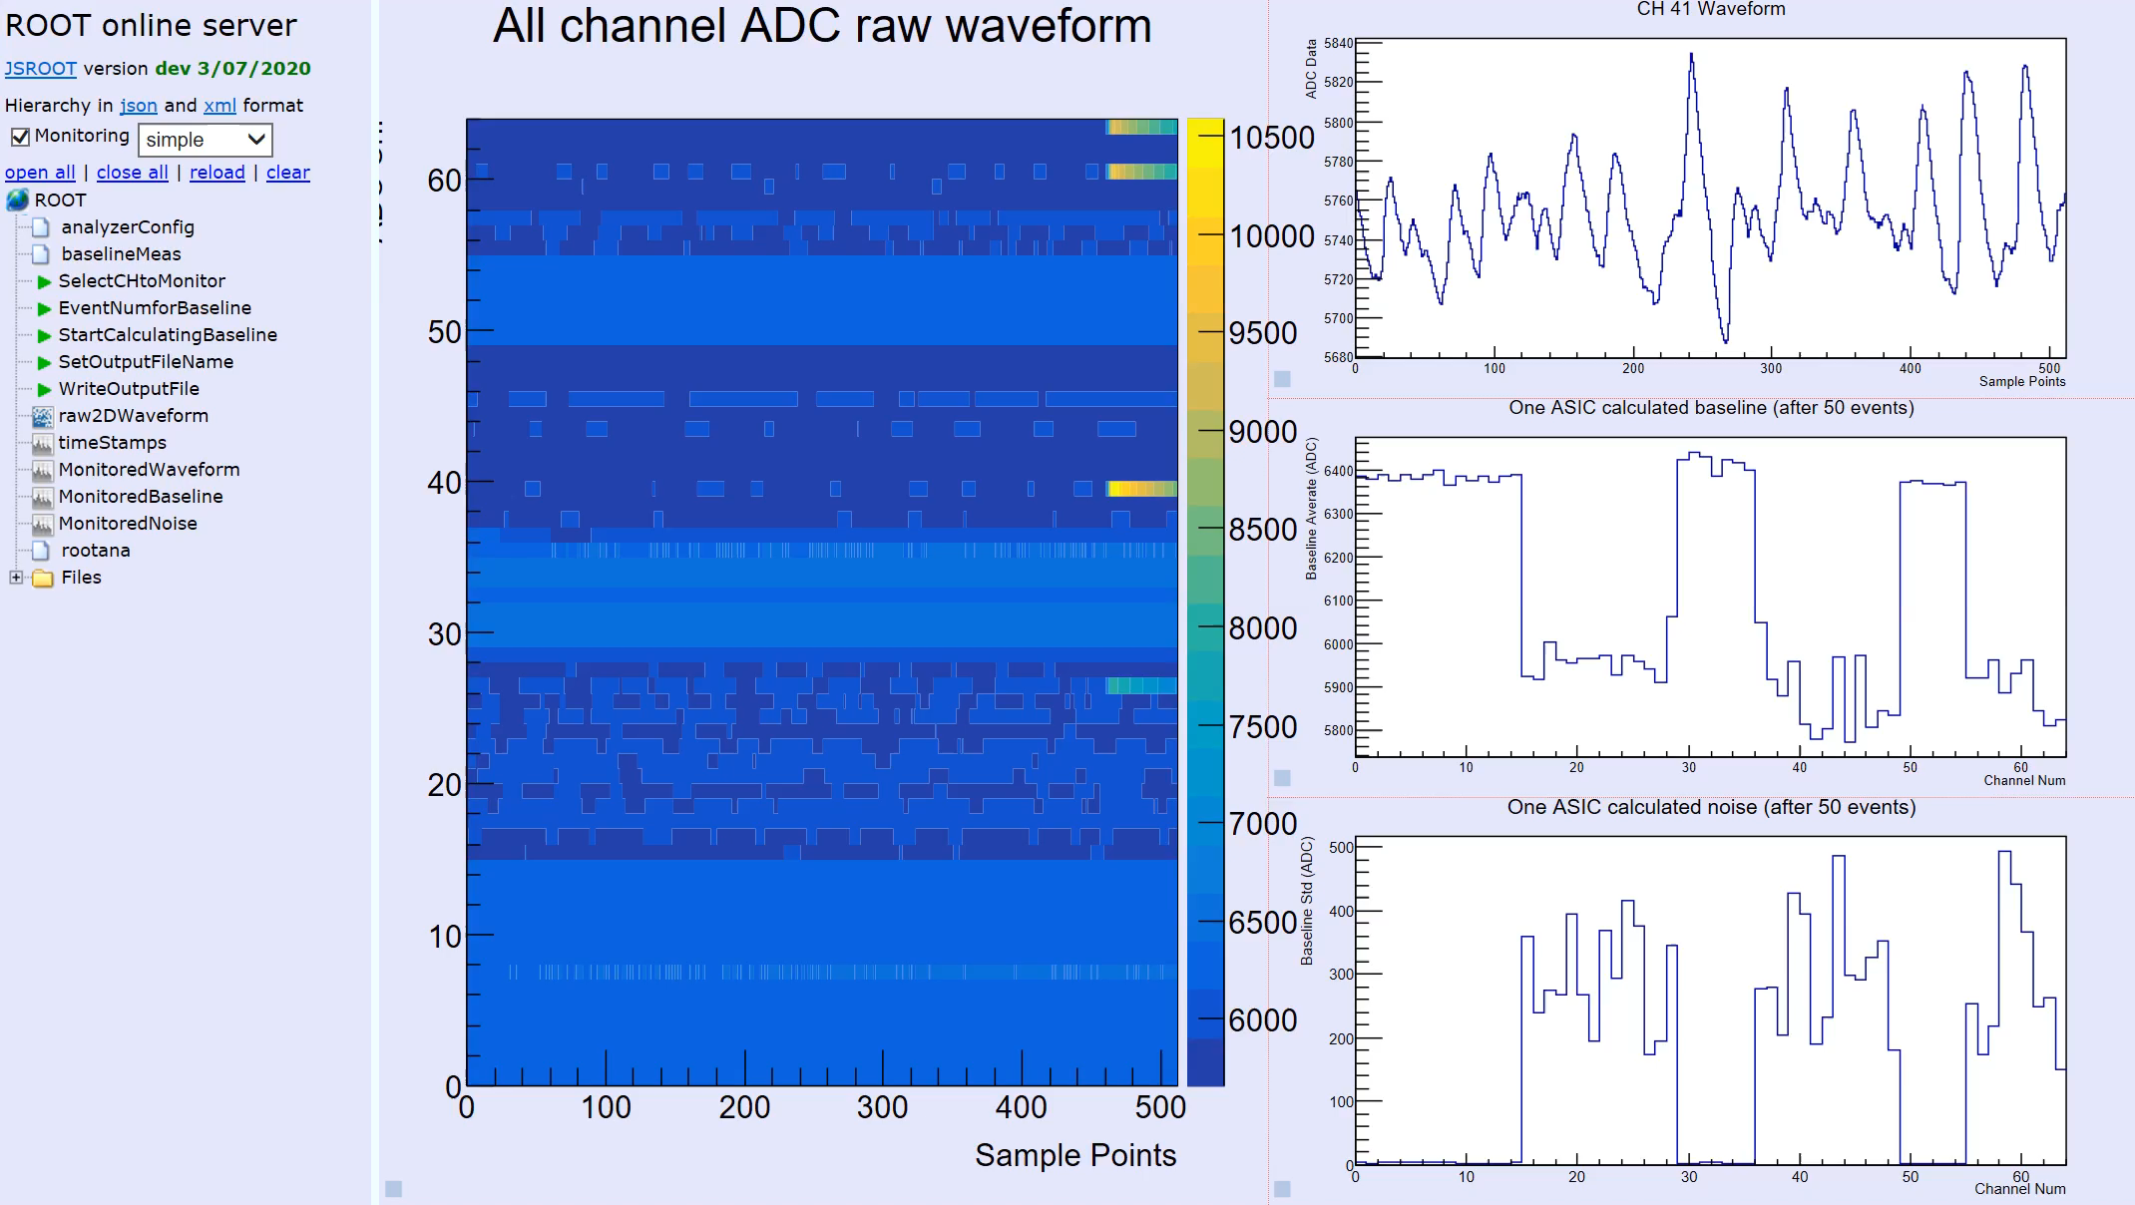

SMOOTH-MuGrid-v1.0: cosmic muon tracking
Online monitor by MIDAS
Offline reconstructions by a maximal likelihood method.
MuGrid-v1.0 is a prototype detector which can work as a cosmic muon veto.
A large lab space at ~60 m² reserved with an offered staff technician to be hired.
Improvement of time and energy information towards MuGrid-v2.0 on the way.

Slide 26
Table of contents
Motivations
Overview of the MOMENT project
Precision measurements and new physics searches
Summary

Slide 27
Summary
Push forward muon and neutrino physics based on the first accelerator muon beam in China.
Lots of physics to be done with accelerator muons/neutrinos: NSIs, neutrino decays, tests of flavor-symmetry models…
We naively proposed an experiment to search for muonium to antimuonium conversions: aim at the best sensitivity in the world, a potential breakthrough in the intensity frontier.
MACE will boost the innovative design in muon beamlines, muonium productions, high time and spatial resolution detectors. Aim at two orders of magnitude better than the latest limit.
Welcome all to pushing forward the Muonium to Antimuonium Conversion Experiment.
Welcome new ideas in muon and neutrino physics…
MACE

