Slide 1
LBNF Hadron Monitor
Jilei Sun, Anxin Wang, Ye Yuan, Jingyu Tang
2020 EMuS/MOMENT General Meeting
Dongguan, 11 December, 2020

Slide 2
Outline
Introduction
Progress on the SEM Hadron Monitor
Heat issues simulation
Vacuum requirement
Sag measurement
HM Prototype
Summary

Slide 3
Introduction
Hadron Monitor
Located downstream of a 200 m long decay pipe and just upstream of the beam absorber
Beam-based alignment of the target and focusing horns
Monitoring the neutrino beam during the normal operation by monitoring the residual protons that did not interact in target
Exposed to severe radiation without shielding
Radiation hardness is essential

Slide 4
Roles Played by the Hadron Monitor
Role 1: Beamline Alignment – Must Have
Low intensity, direct proton beam to the hadron monitor
Requires 70 microradians pointing resolution
Translates to 14 mm rms at hadron monitor
10^12 protons/pulse; 6 mm rms; 120 GeV or 60 GeV
Role 2: Target and Baffle Alignment – Must Have
Low intensity proton beam scanned across target/baffle to hadron monitor
Beam position determined by upstream BPMs
Beam absorption determined by total intensity at hadron monitor
Intensity measurement must be insensitive to beam movement from scan
10^10 → 10^12 protons/pulse; < 7.5 cm rms; 120 GeV
10^10 → 10^12 protons/pulse; < 15 cm rms; 60 GeV

Slide 5
Roles Played by the Hadron Monitor
Role 3: Alignment of Horns – Would be Nice
Low intensity proton beam scanned across horn alignment “fin”
Beam position determined by upstream BPMs
Beam absorption primarily determined by losses recorded in ionization chamber
Backup measurement by total intensity at hadron monitor
10^12 protons/pulse; 6 mm rms; 120 GeV or 60 GeV
Role 4: Monitoring during Operation – Would be Nice
Beam that makes it through the target hits the hadron monitor
Mostly protons
10^12 protons/pulse; 7.5 cm rms; 120 GeV
10^12 protons/pulse; 15 cm rms; 60 GeV

Slide 6
Parameters of Different Operation Mode
 | Protons Per Pulse @HM | Proton Beam Spot Size @HM (rms) | Beam Energy (GeV) | Pulse Duration (μs) | Cycle Time (s)
Role 1: Beamline Alignment | 1.00E+12 | 6 mm | 60/120 | 1.6 | 10
Role 2: Target and Baffle Alignment | 1E10 / 1E12 | 75 / 10 mm | 120 | 1.6 | 10
 | 1E10 / 1E12 | 150 / 10 mm | 60
Role 3: Alignment for Horns | 1.00E+12 | 6 mm | 60/120 | 1.6 | 10
Role 4: Monitoring during Operation | 1.00E+12 | 75 mm | 120 | 10 | 1.2
 | 1.00E+12 | 150 mm | 60

Slide 7
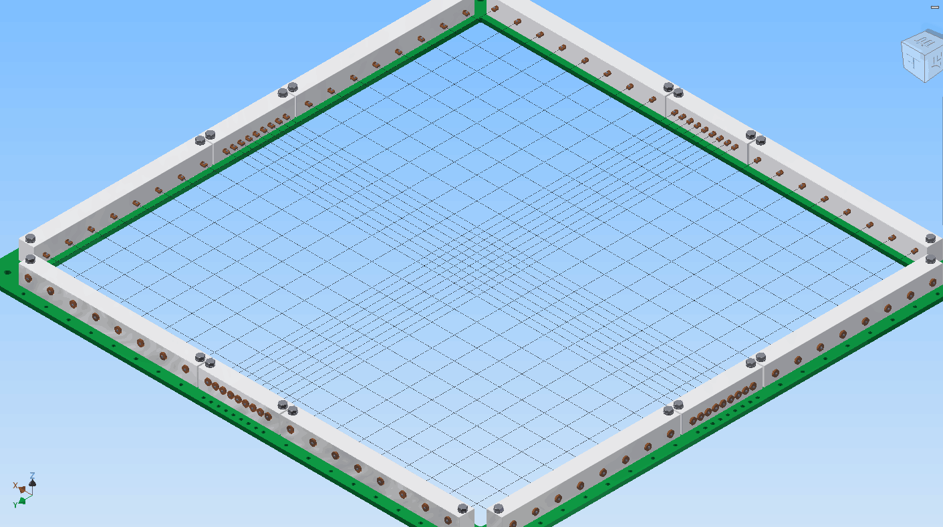
Progress on the SEM Hadron Monitor
Original idea was multi-wires
Signal was too weak when used for target and baffle alignment
 | Protons Per Pulse @HM | Proton Beam Spot Size @HM (rms) | Beam Energy (GeV) | Pulse Duration (μs) | Cycle Time (s) | Signal estimation 0~3σ (μA) Wire D=100μm
Role 1: Beamline Alignment | 1.00E+12 | 6 mm | 60/120 | 1.6 | 10 | 665~7.4
Role 2: Target and Baffle Alignment | 1E10 / 1E12 | 75 / 10 mm | 120 | 1.6 | 10 | 0.5~0.006 / 400~4.4
 | 1E10 / 1E12 | 150 / 10 mm | 60 |  |  | 0.3~0.003 / 400~4.4
Role 3: Alignment for Horns | 1.00E+12 | 6 mm | 60/120 | 1.6 | 10 | 665~7.4
Role 4: Monitoring during Operation | 1.00E+12 | 75 mm | 120 | 10 | 1.2 | 8.5~0.09
 | 1.00E+12 | 150 mm | 60 |  |  | 4~0.05

Slide 8
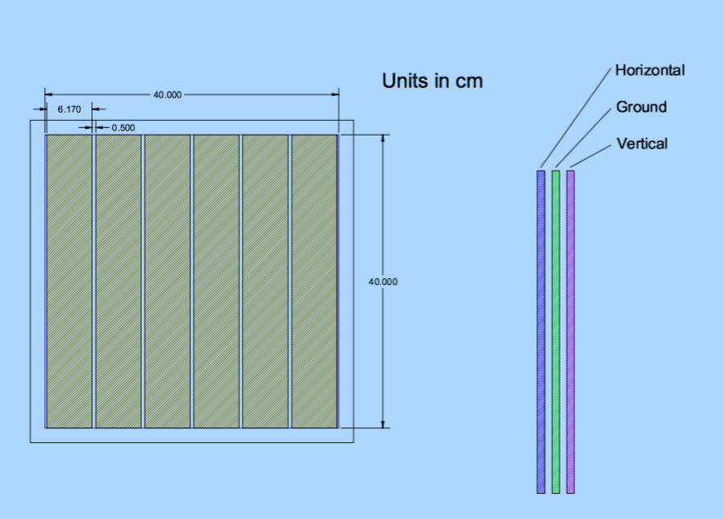
Multi-Strip Scheme
Have ~1000 times stronger signals than wires

Slide 9
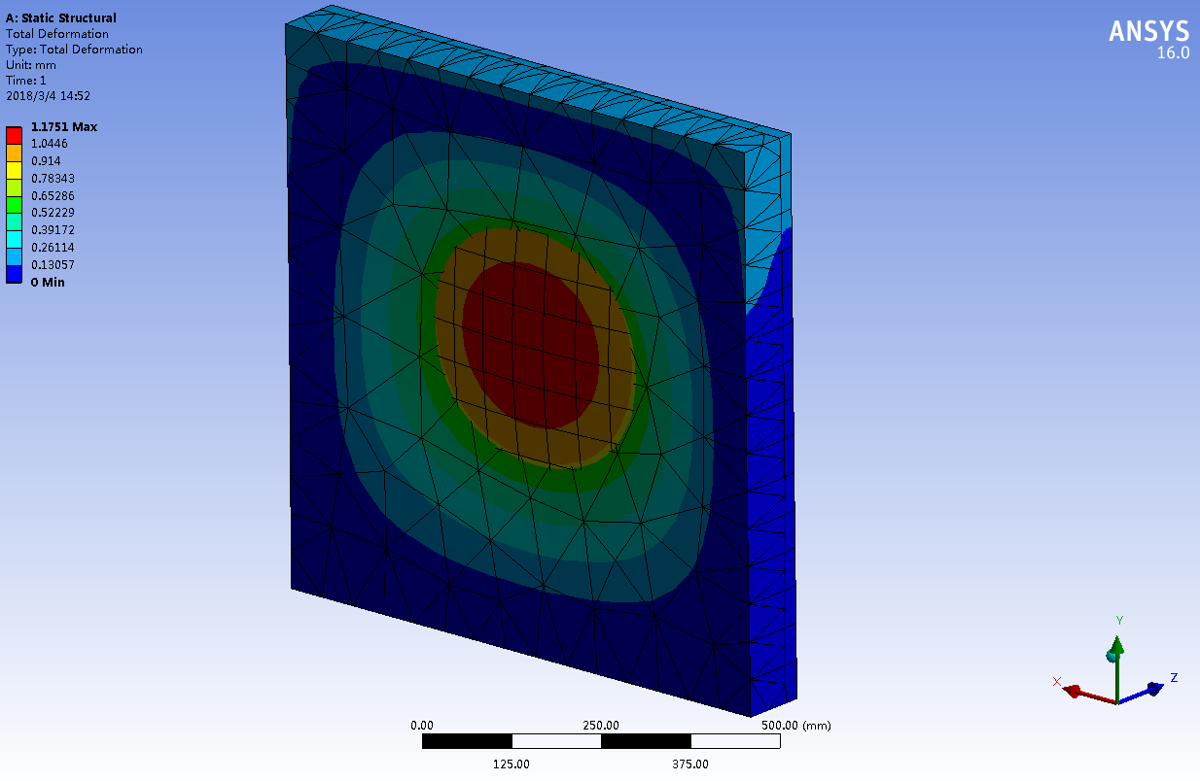
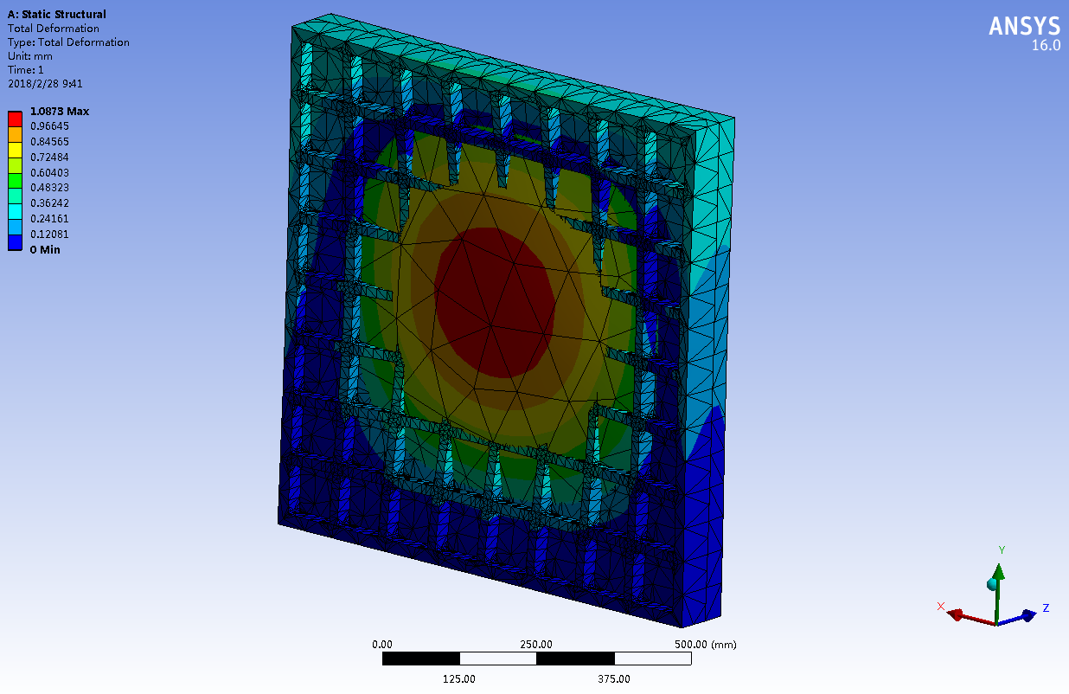
Mechanical consideration for the multi-strip
Vacuum chamber ( Material: Aluminum Alloy (LY12))
Uniform plate at the beam-in side: 24 mm thick
Rib plate at the beam-out side: plate thickness 10 mm; rib 30 mm
Minimize the influence of the electrons from chamber wall
Max. deformation: ~ 1 mm
Beam-in side, max. deformation 1.17 mm
Beam-out side, max. deformation 1.08 mm

Slide 10
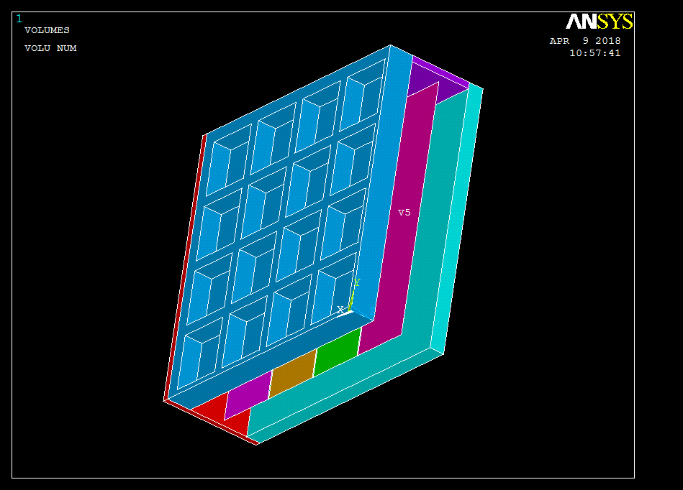
Heat Issues Simulation
Dimension of the vacuum chamber: 840 mm×840 mm×100 mm
Strip: Ti with 100μm thickness
Chamber outside surfaces convection coefficient: 5 W/(m^2∙K)
Titanium emissivity: 0.5

Slide 11
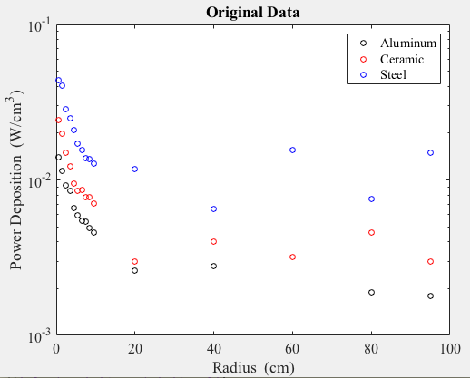
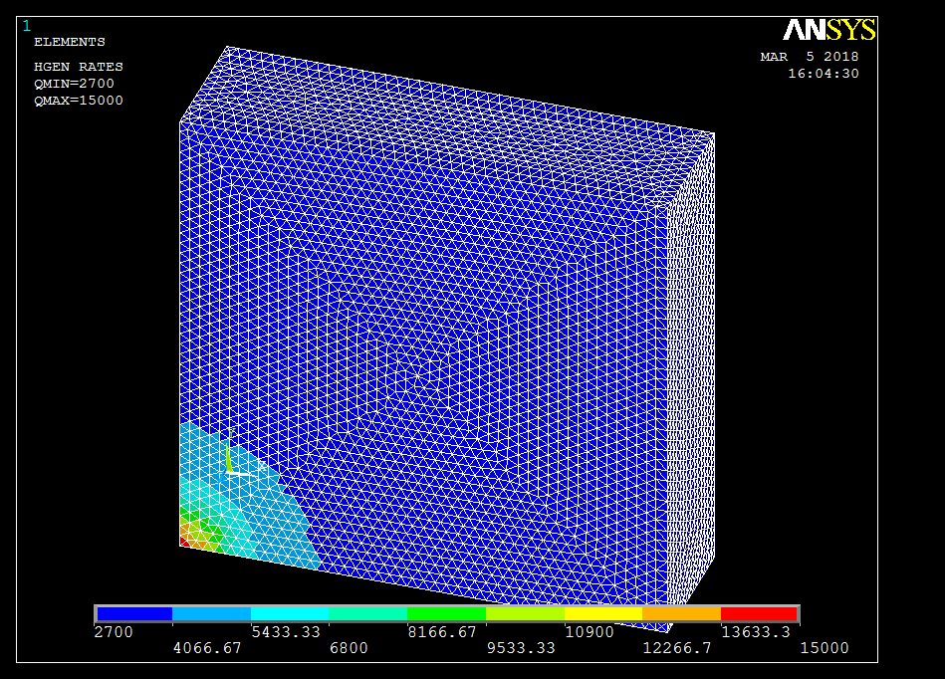
Heat Issues Simulation
Thermal load was from a MARS Monte Carlo with the following inputs (Done by FNAL)
Proton beam power: 2.4 MW
Proton beam momentum: 120 GeV
Target: 2 m long graphite (the water-cooled fin-type, not the RAL helium-cooled type)
At larger radius than the target core: 12 cm long “wings” (equivalent of the 12 cm long bafflette in the RAL design)
Power density as a function of radius at the HM location: Al, Ceramic, Steel
Model when thermal load applied

Slide 12
Maximum temperature 33.4 ℃, when initial temperature and ambient set to 20 ℃.
Heat Issues Simulation

Slide 13
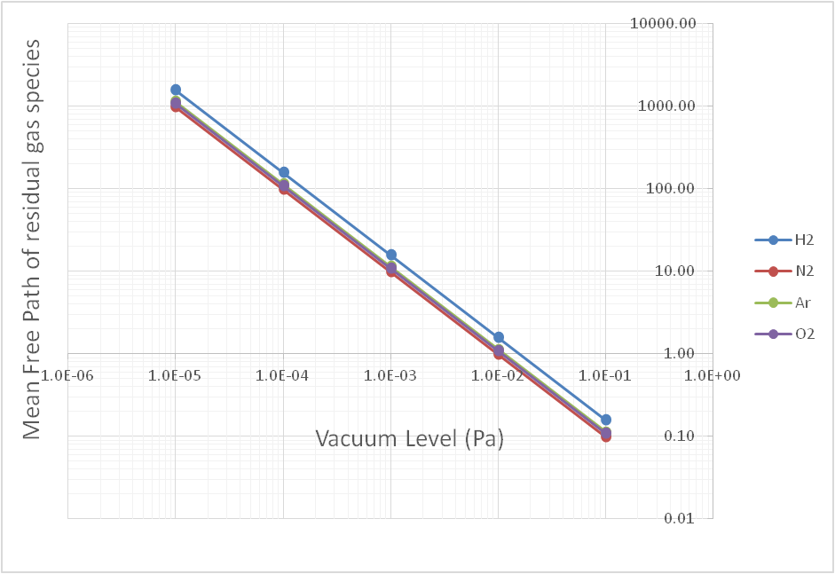
Vacuum Requirement
Mean Free Path calculation
If we take the secondary emission yield is 1%, and the distance between the planes of strips is D=1 cm, then the mean free path should be greater than D/0.01 = 1 m to prevent the influence of residual gas ionization.
At 10^-3 Pa (~10^-5 torr), the mean free path is approximately 10 m for most gasses.
𝜆=(K_{B} 𝑇)/(𝜋𝜎^2 𝑝)

Slide 14
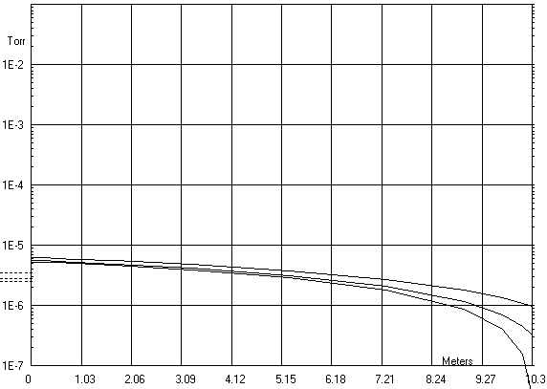
Vacuum Requirement
Pumping rate calculation
Chamber size: 1000 mm*1000m cm*100 mm, aluminum
Pipe size: 10 m length, 5 cm diameter, stainless steel
Leak rate: 7e-10 torr.L/(s.cm-2) for Al and 2e-10 torr.L/(s.cm-2) for SS
30 L/s will satisfy the requirement
10 L/s
5e-6 Torr
30 L/s
300 L/s

Slide 15
Sag measurement
Titanium strip
Expansion coefficiency ：（9.41~10.03）×10-6/℃（0-100℃）
Temperature rise: 20 ℃ ( 20 to 40℃)
Initial length: 1000 mm
Linear expansion: 0.2 mm
Tension is necessary
Sag of the horizontal strips need to be considered
If the measurement accuracy better than 1%
Gap size between strips: 1 mm
Sag should be less than 10 μm

Slide 16
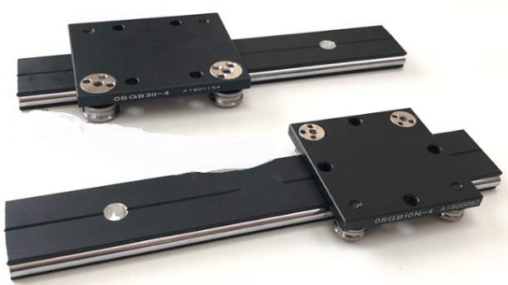
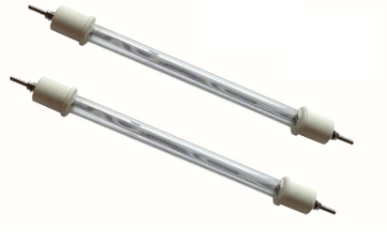
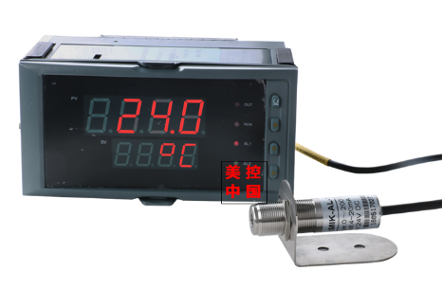
Test stand setup
Tension meter
Screw
Slider
Strip fixer
Heater
Ti strip
Slideway
Connecting board
Quartz heater
Tension meter:
2N ~ 500 N
Infrared thermal sensor

Slide 17
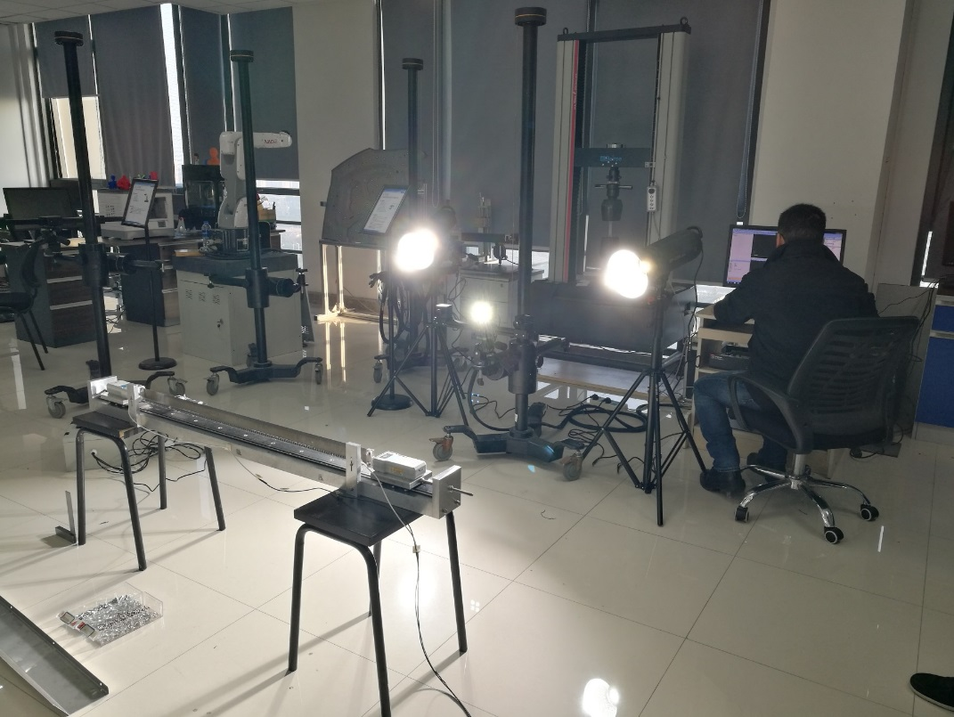
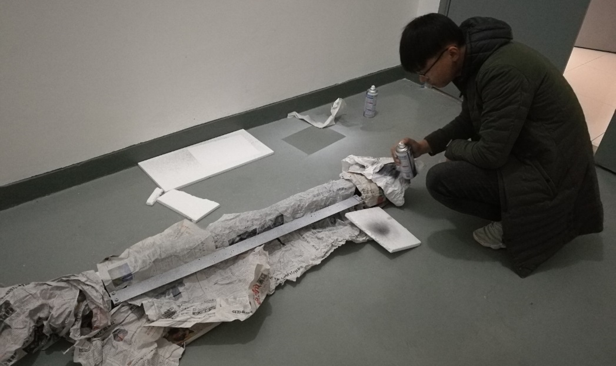
3D imaging system for sag measurement
Measuring the displacement by tracking the speckle images on the foil with 2 cameras.
Camera: 2.3 megapixel, pixel size 5.86μm*5.86μm
System measurement accuracy: 0.02 mm
Painting spray on the foil for tracking
System setup in Test 1

Slide 18
Test stand Improving
Drawbacks were found in Test 1&2
Strip fixer sag also
Stiffness factor of the tension meter is too high, which made the system very sensitive to the thermal expansion if there was no spring tensioning on the strip.
Strip fixer

Slide 19
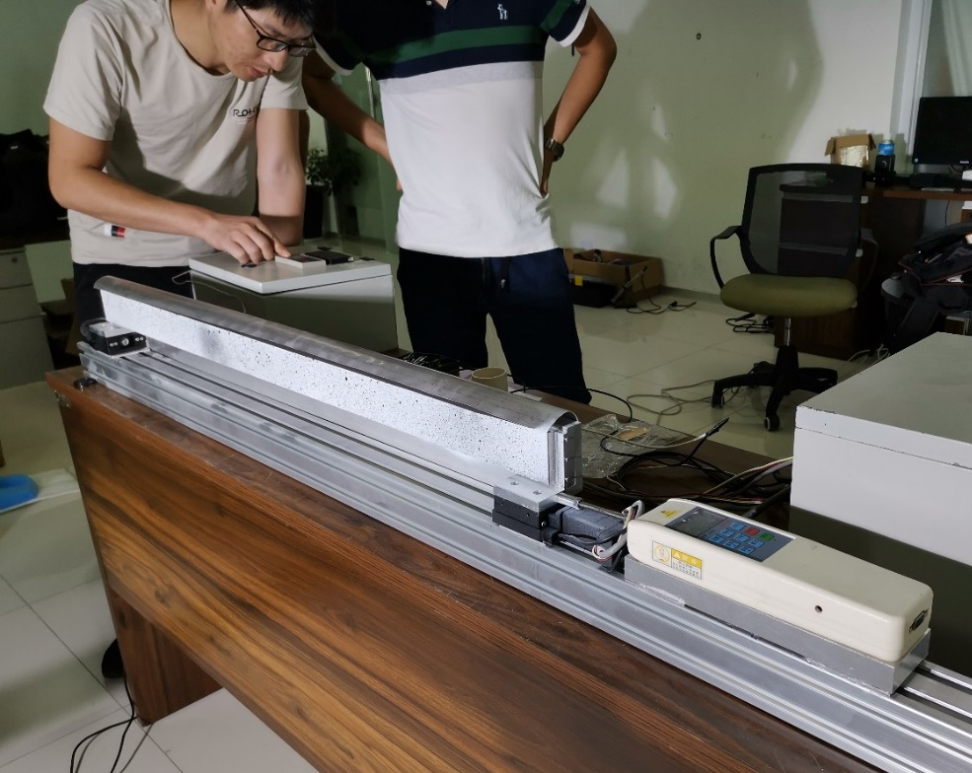
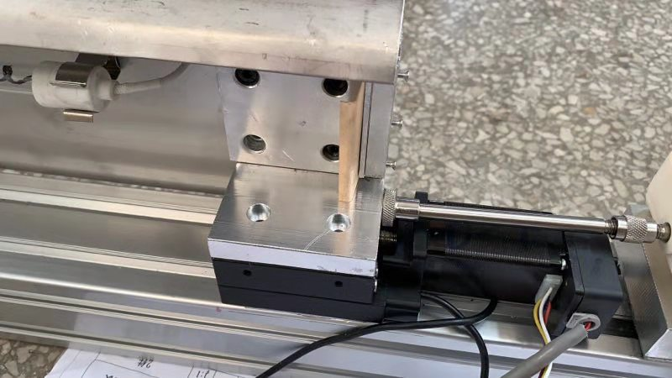
Test stand Improved
Leaf spring tensioning applied
Strip fixer sits on a slider, no more sag happens
Motor driven slider for accurate control
Leaf spring tensioning
Motor driven

Slide 20
Sag Measurement - Test 3
3 type of strips were tested
10 μm
50 μm
100 μm
Easily to be wrinkled

Slide 21
10 μm strip failed
Deformed because of the thermal stress
Initial position
Deformed position

Slide 22
Test result of the 50 μm strip
The sag of the horizontal strip can be controlled at 10 μm level while tension applied
Sag goes lower while increase the tension

Slide 23
Learned from Test 3
50 N tension (~11 pounds) looks like enough, sag should be less than 10 μm
Thinner is not better for the strip, thicker strip will have less deformation caused by the thermal stress, 50 ~ 100 μm would be a good choice
For the prototype manufacture, annealing to relieve the stress of the strip before cutting will be necessary

Slide 24
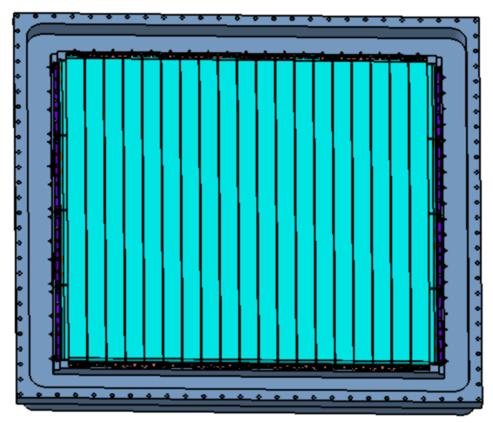
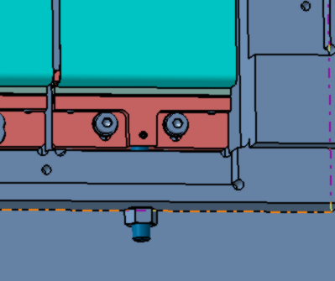
HM prototype
3D model
Leaf spring

Slide 25
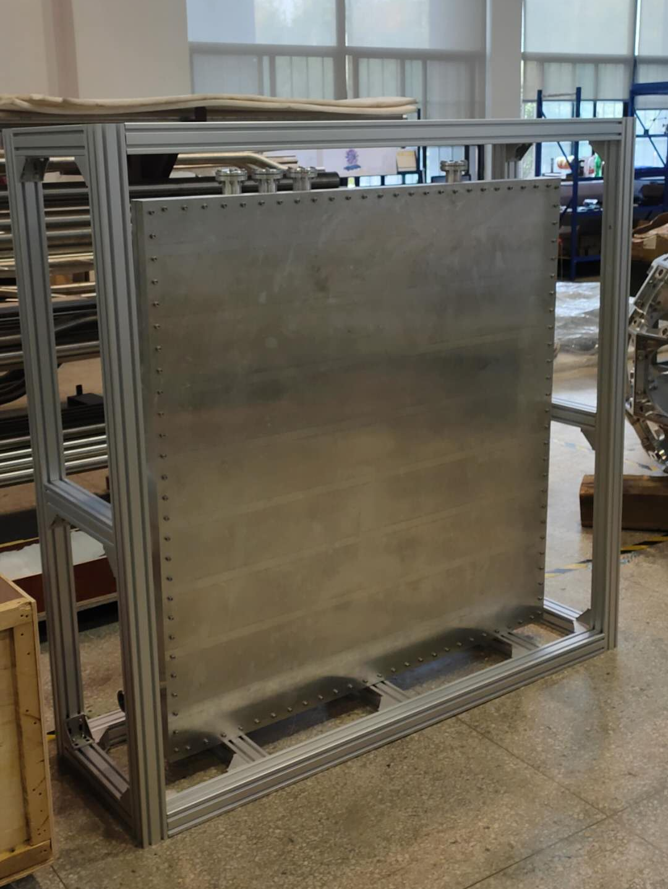
Vacuum maintenance with prototype
600 L pump + 10 m tube
< 1e-5 pa

Slide 26
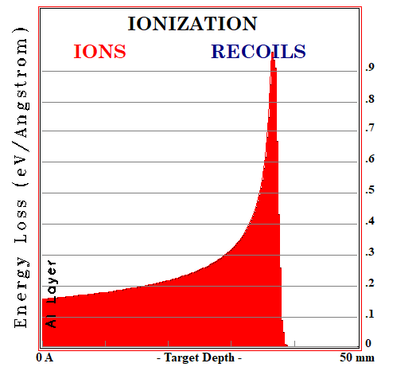
Prototype beam test
Proton beam parameters: 100 MeV, up to 500 μA, beam size 40 mm maximum
HM wall thickness 20 mm + 30 mm
Suitable test current is 1 μA considering the thermal issue

Slide 27
Summary
Multi-strip type hadron monitor was intensively studied to fulfill the LBNF requirements
Heat, Vacuum, Sag issues were considered, which are all at an acceptable level
A prototype is now finished manufacturing, further beam tests is in organization and will be done next month hopefully

Slide 28
Thanks for your attention!
谢谢！

