Slide 1
The muon beamlines for the simplified scheme
Luping Zhou
2020/12/12

Slide 2
Outline
EMuS
Surface muon beam for EMuS:
Simplified-scheme / Baby-scheme design
Vertical muon beamline

Slide 3
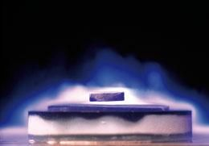
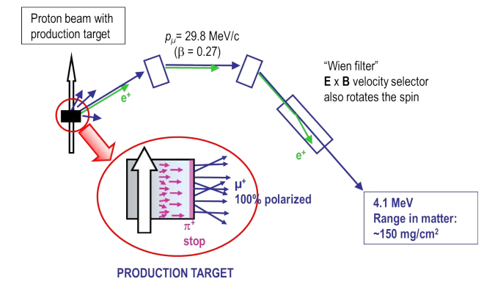
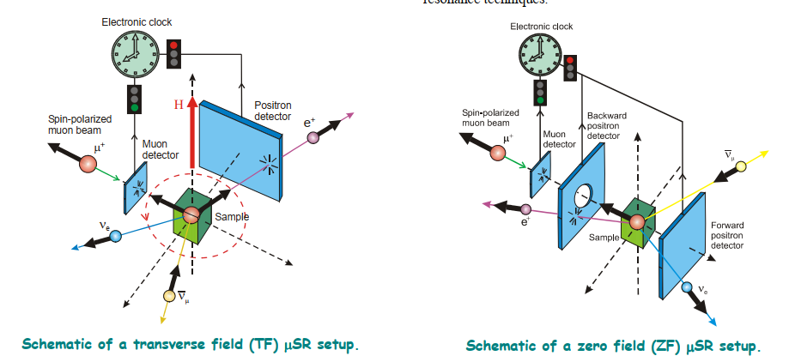

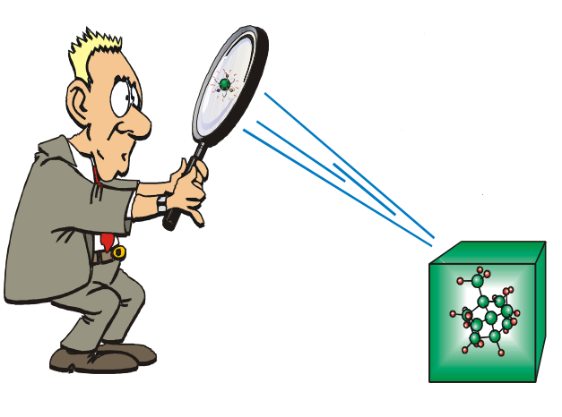
Development Trend of International Muon Source
EMuS
Muon from accelerator
The muSR (Muon Spin, Relaxation, Resonance...) technology based on the surface muon:
Injecting surface muons into materials
surface muon
various complex environments (high temperature, high pressure, strong magnetic field, etc.)
unique advantage in the research of neutron-absorbing materials
unique advantages in the research of external field-sensitive spin glass systems, heavy Fermi systems, and quasi-crystal systems (ZF-μSR).
It is widely used in local dynamic and static magnetic field measurement of magnetic materials, and it is a powerful supplement to neutron scattering technology.
ISIS
Pulsed type
J-PARC/MUSE
International muon sources
TRIUMF/CMMS
Continuous-wave type
PSI/SμS

Slide 4
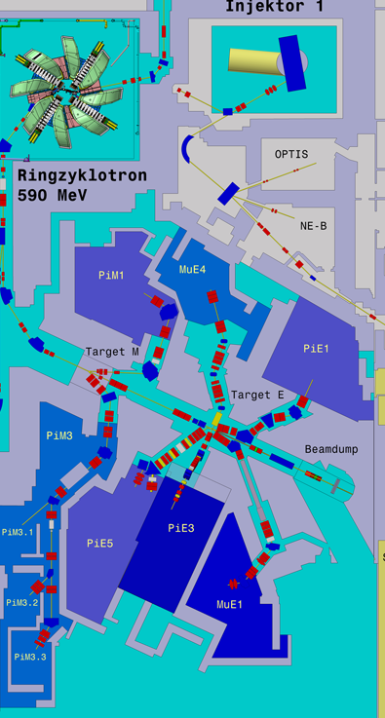
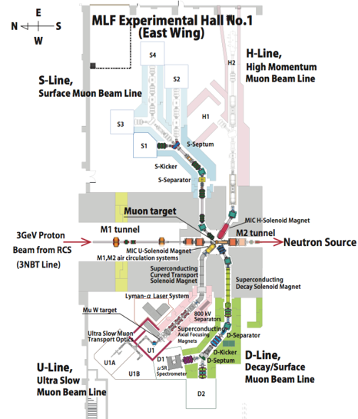
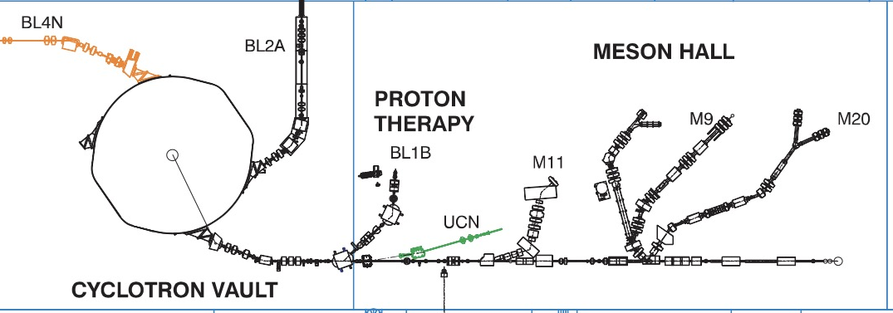
International Muon Sources
EMuS
Pulsed type
Continuous-wave type
ISIS
J-PARC/MUSE
PSI/SμS
TRIUMF

Slide 5
International surface muon beamlines
EMuS

Slide 6
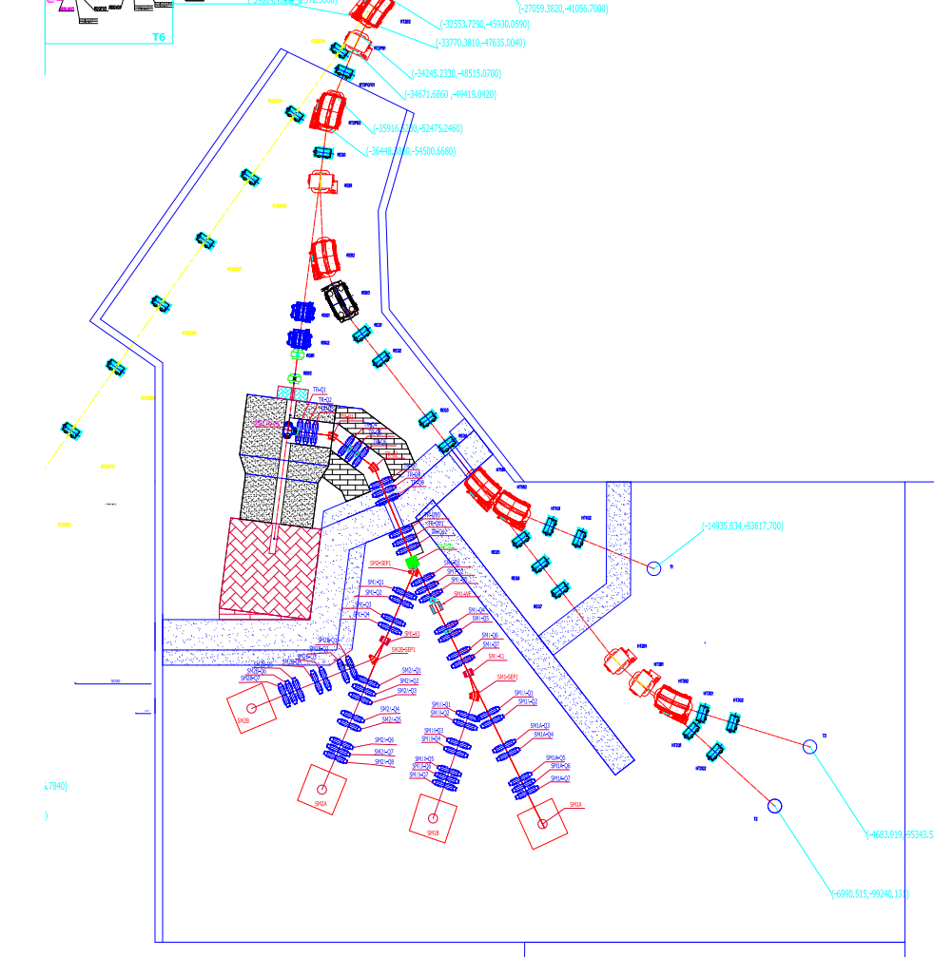
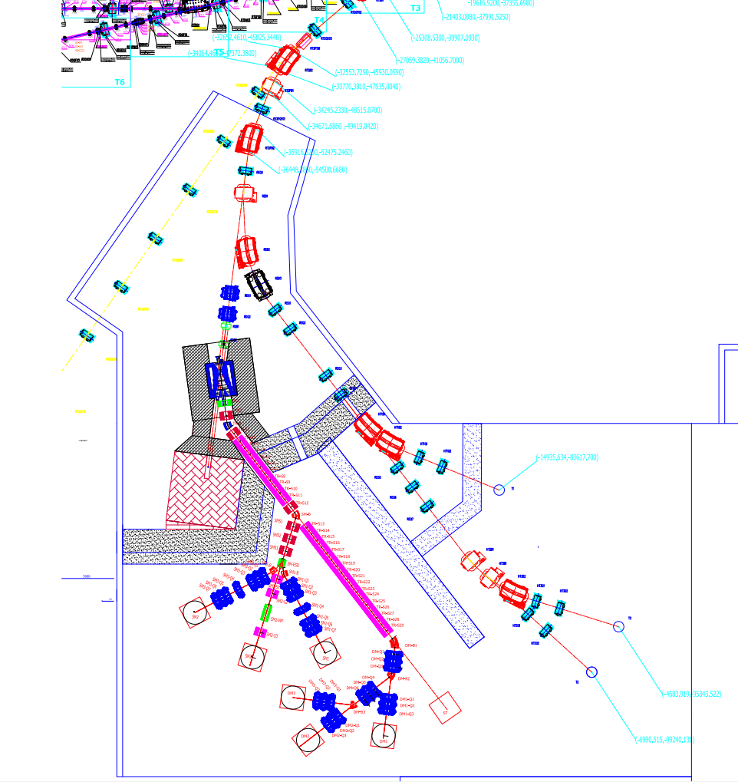
EMuS surface muon beamlines
EMuS
2 scenarios have been designed
Baby-scheme
Baseline-scheme

Slide 7
EMuS
I. Baby-scheme / Simplified-scheme

Slide 8
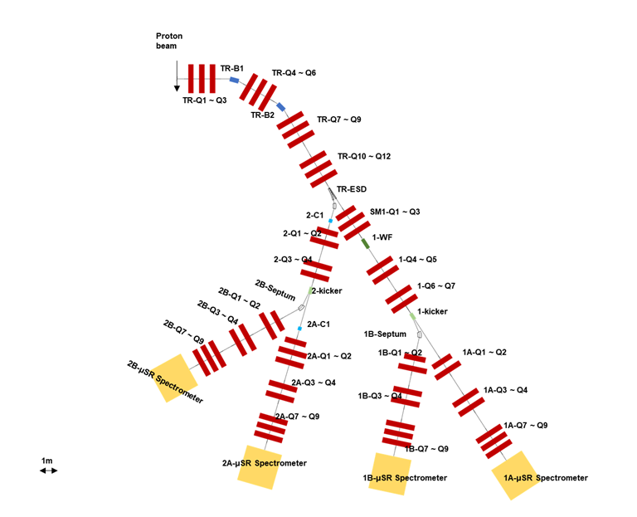
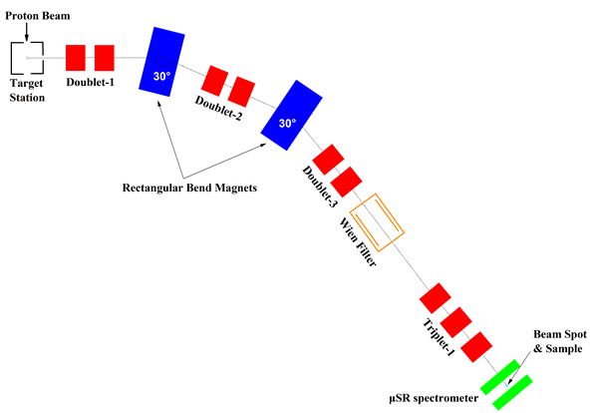
Development
EMuS
2017-2018
2019
2020

Slide 9
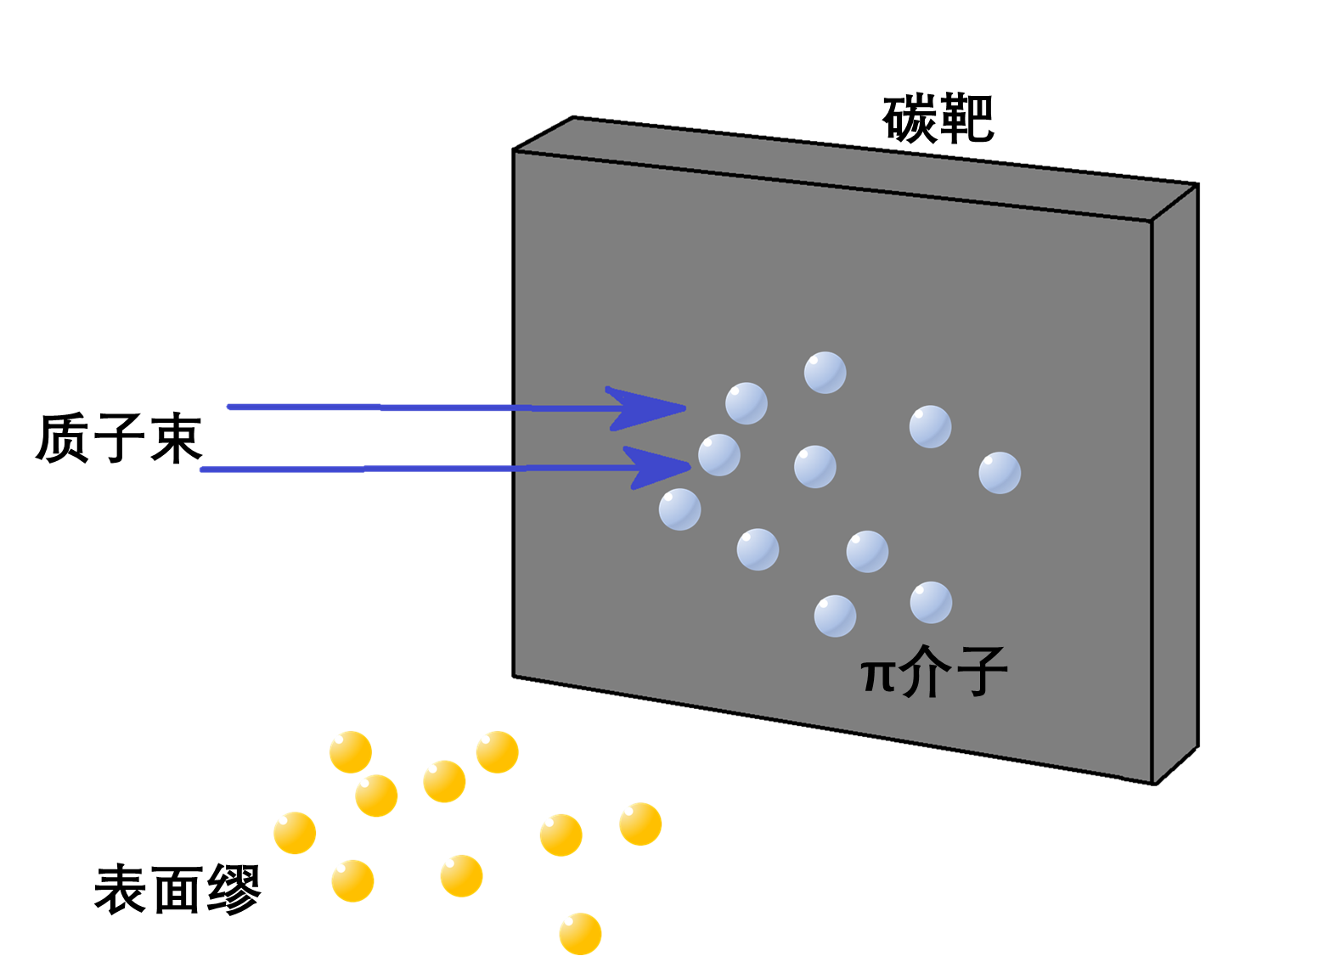
Introduction
EMuS
24*24*2 (rotated 10 degrees) graphite target (2g/cm^3) has been employed
The trunk beamline remain unchanged
SM1 has been changed to obtain better phase spaces for “time splitting” (2.5m drift)
Modular beamline is used as terminal line (doublet*2 for transmission and phase spaces + triplet*1 for focusing)
In SM2, the beam center deviates from the optical axis due to the “space splitting”, corrections are employed

Slide 10
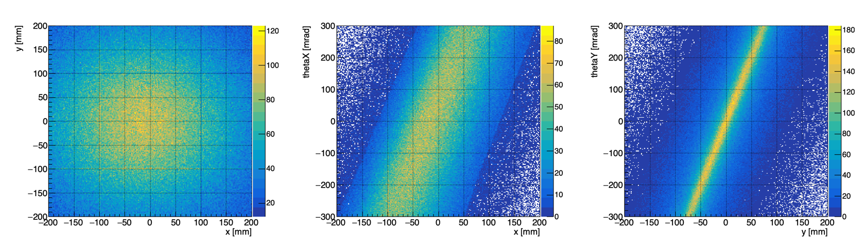
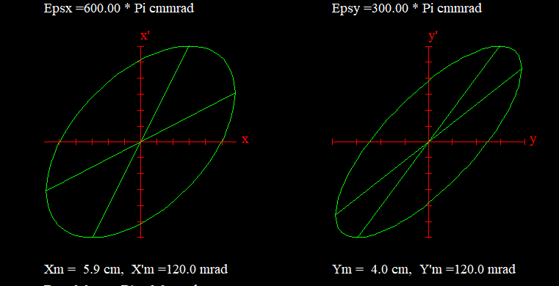
Acceptance / Phase spaces
EMuS
25cm from the surface of the target
25kW 1.6GeV proton beam: 9.766×10^13 /s
FLUKA4, Proton simulated: 1×10^11
Within the acceptance ellipses:
20<p<40: 6345
27.8<p<29.8 (Δp/p=7%): 1526 (equaling to 14.9×10^5 μ+/s)

Slide 11
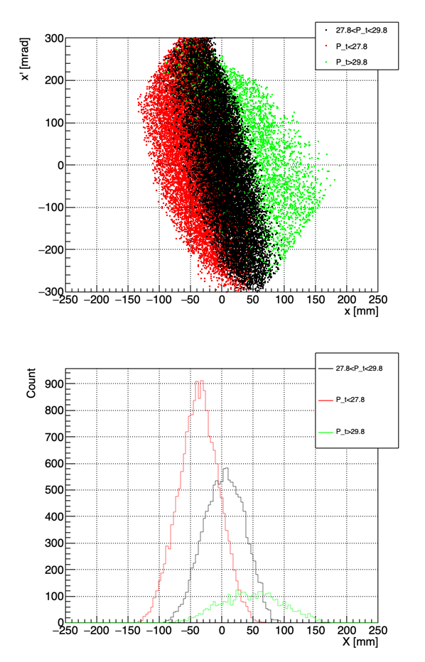
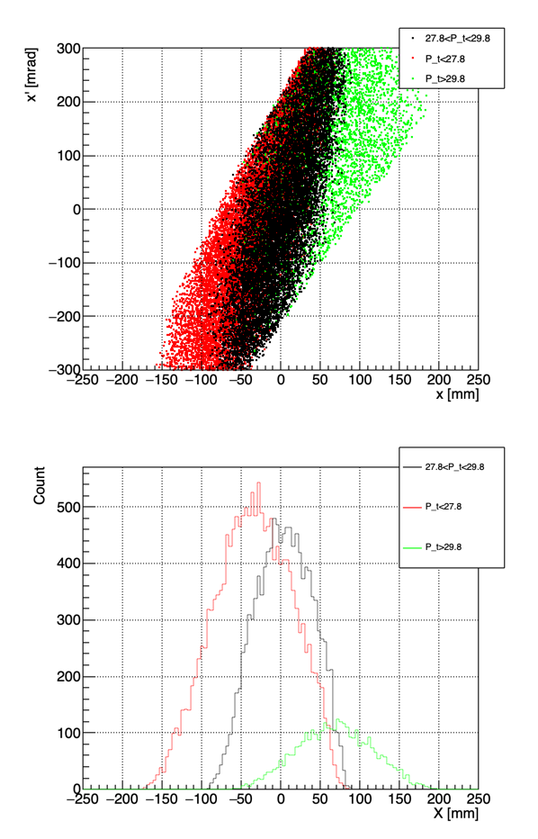
Trunk line
EMuS
The optical design of Trunk line remain unchanged since 2019
The momentum slits have been adjusted for the new target
Q5-entrance
Q5-exit

Slide 12
Momentum collimation
EMuS
Comparison of different slits settings for momentum collimation
 | momentum slits settings - X [mm] |  | SM1A Beam Spot
 |  |  | fitting [mm] |  | RMS [mm] |  | FWHM [mm] |  | emittance [pi.mm.mrad] |  | flux [E+05 mu+/s] |  | pol-z | momentum [MeV/c] |  | IP^2 [E+05 mu+/s]
 | Q5f | Q5e | sigmaX | sigmaY | x | y | x | y | x | y | sample | total |  | center | FWHM
nocoll | -- | -- | 11.86 | 13.63 | 12.26 | 13.43 | 30 | 34 | 367 | 660 | 3.23 | 6.98 | -0.89 | 28.55 | 2.2 | 2.56
coll1 | ±60 | ±65 | 11.99 | 13.58 | 11.85 | 13.28 | 31 | 32 | 353 | 662 | 3.05 | 6.54 | -0.92 | 28.55 | 2.2 | 2.58
coll2 | ±50 | ±50 | 11.74 | 13.64 | 11.54 | 13.32 | 32 | 29 | 344 | 670 | 3.05 | 6.34 | -0.93 | 28.55 | 2.2 | 2.64
coll3 | ±80 | ±80 | 11.91 | 13.55 | 12.03 | 13.36 | 31 | 32 | 354 | 661 | 3.25 | 6.86 | -0.90 | 28.55 | 2.2 | 2.63
Although the beam flux on the sample is 7% less compared with other collimation settings, the “coll2” has the highest polarization rate and IP^2

Slide 13
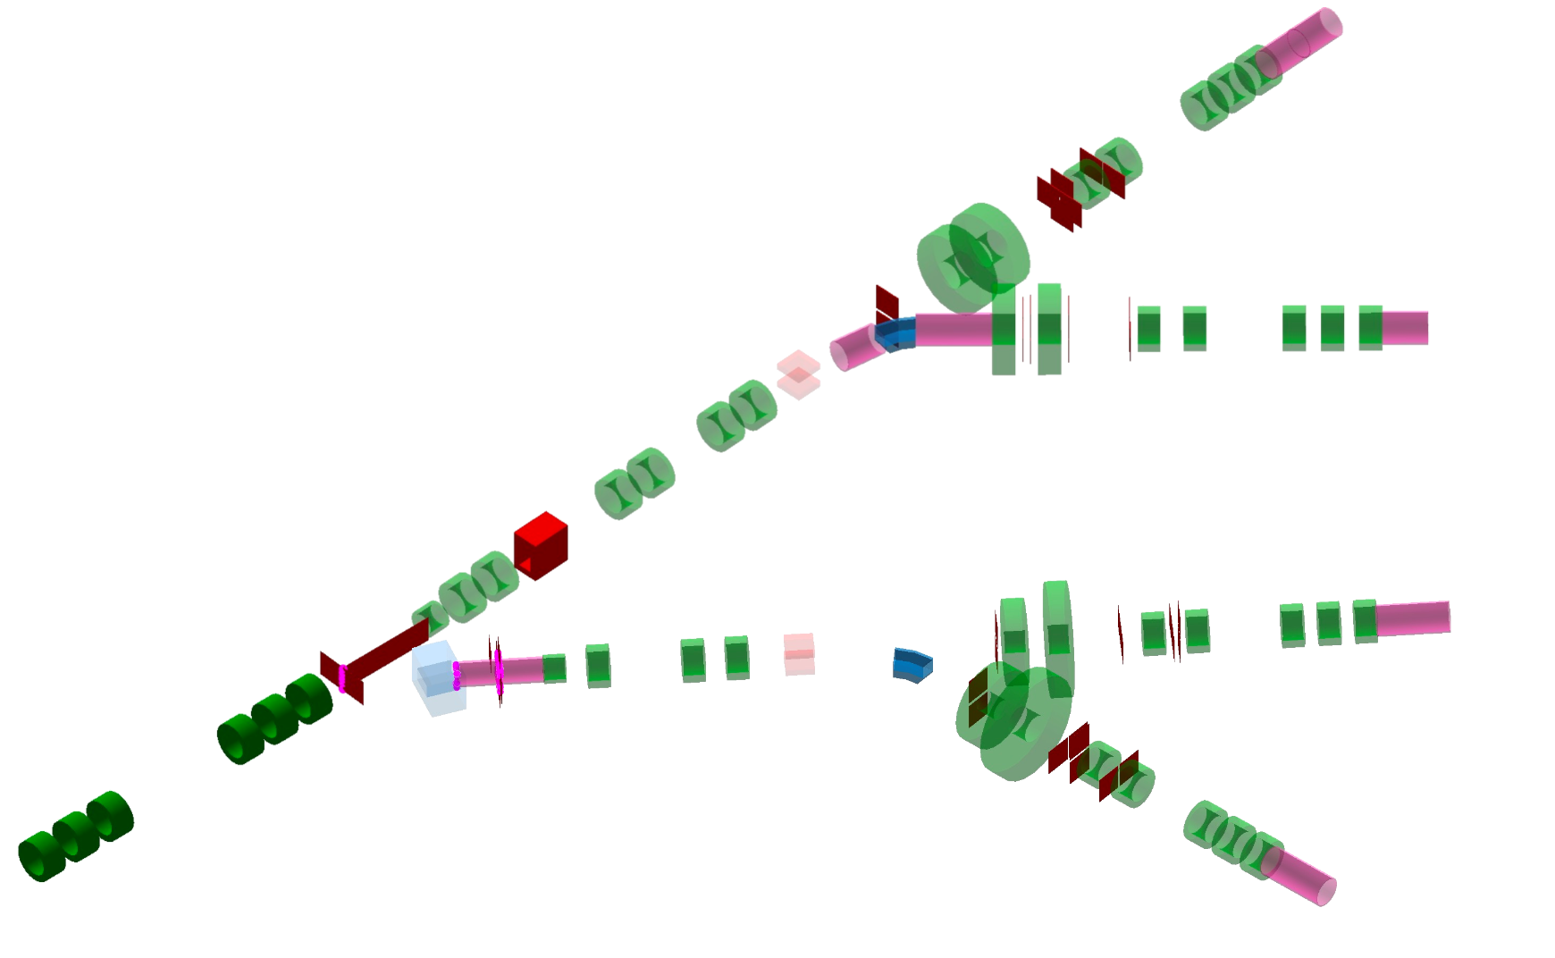
Optics
EMuS
SM1
SM1A
SM1B
SM1A
SM1B
SM1
SM2A
SM2
SM2A
SM2B
SM2B
SM2

Slide 14
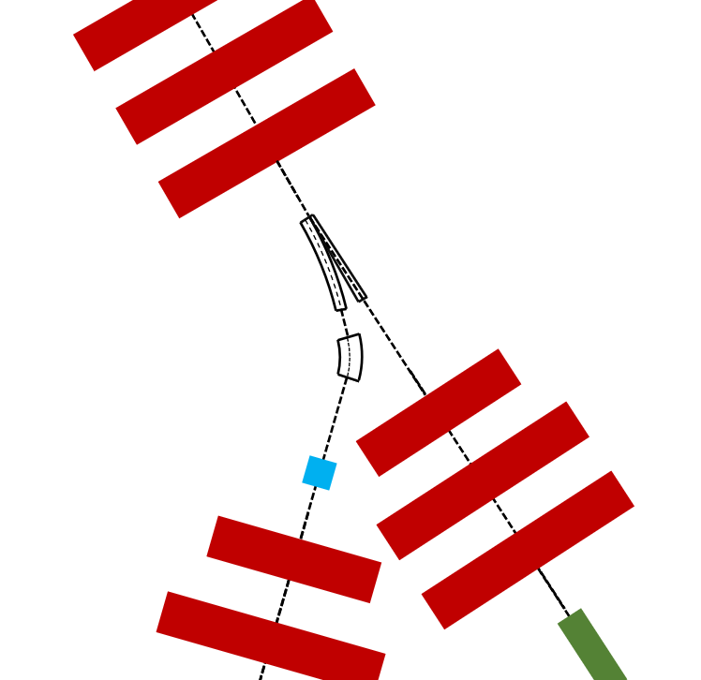
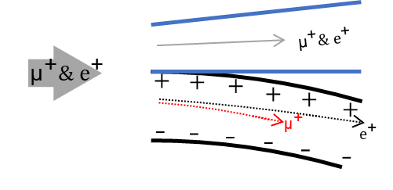
Space splitting
EMuS
Making full use of the long target
acceptance (H*V, pi.mm.mrad): 6000*3000
trunk line triplet-4
SM1
2000*4430 [π·mm·mrad]
SM2
3800*4354 [π·mm·mrad]

Slide 15
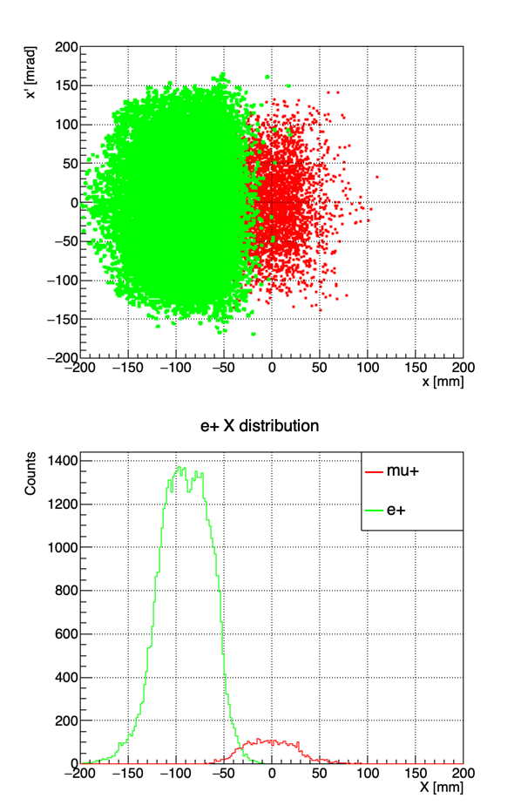
Positrons
EMuS
Positrons in SM1 beamlines will be deflected by the Wien Filter. The subsequent focusing structure and slits will scrape the remaining positrons, and no additional collimator is needed.

Slide 16
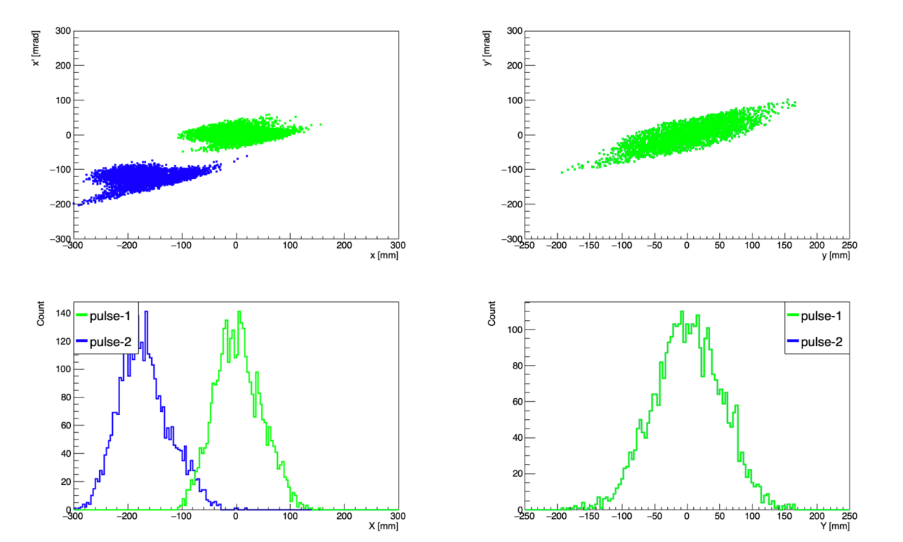
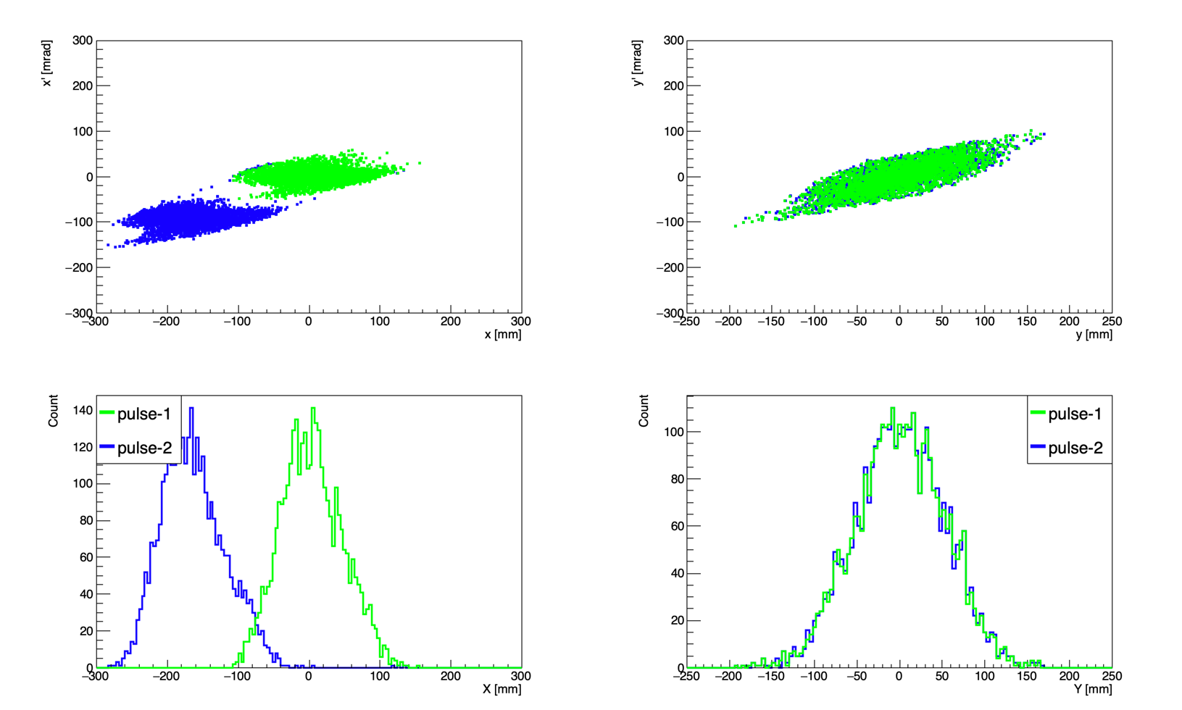
Time splitting
EMuS
In order to separate two pulses, both electric kicker and magnetic kicker have been tried.
Separation angles are same
Magnetic kicker magnet was chosen for the separation due to the large emittance.
Electric kicker, gap=20cm, E=1MV/m, $∆E=200kV$
Magnetic kicker, gap=20cm, B=0.088T

Slide 17
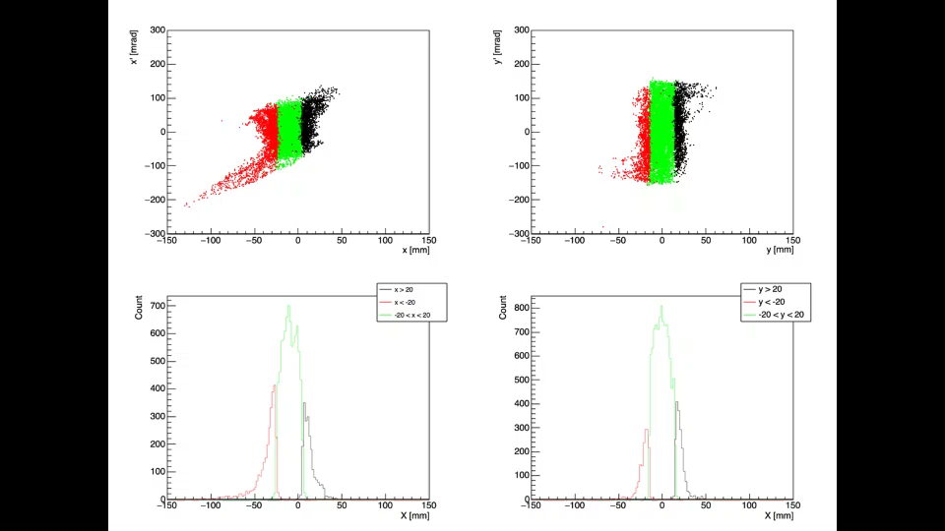
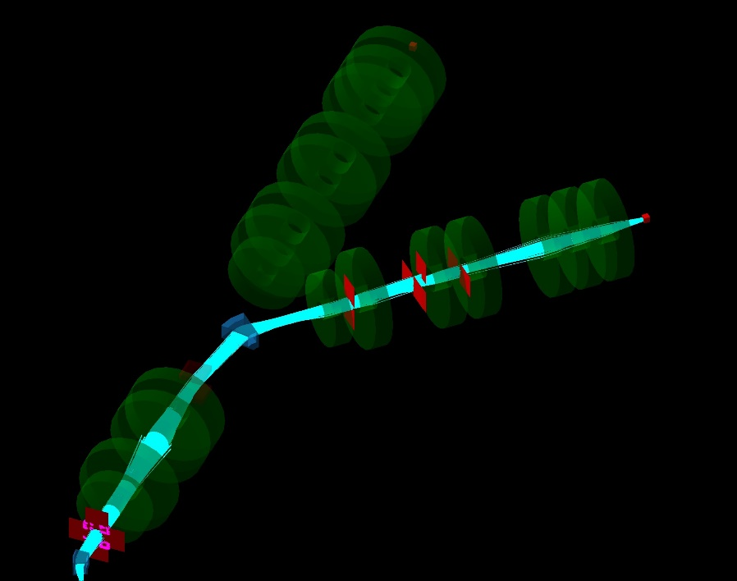
Beam spots controlling
EMuS
π phase shifts are employed for collimations
Four sets of slits are applied for SM1A/SM1B/SM2A/SM2B to ensure that each line can tune the beam spot without affecting other lines
optics
Monto-Carlo Simulation
SM2A
SM2B
Collimator-y
Collimator-x

Slide 18
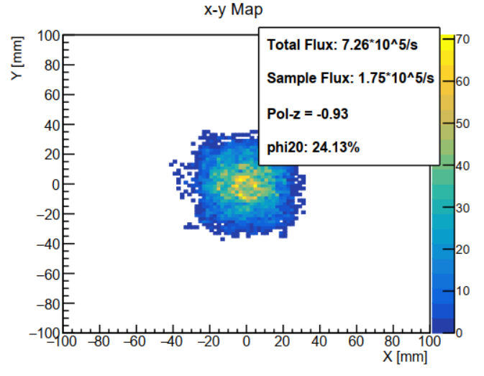
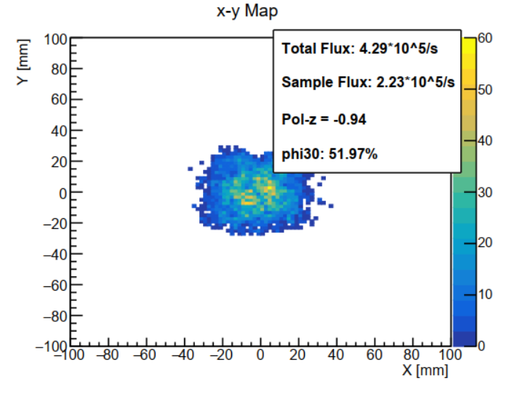
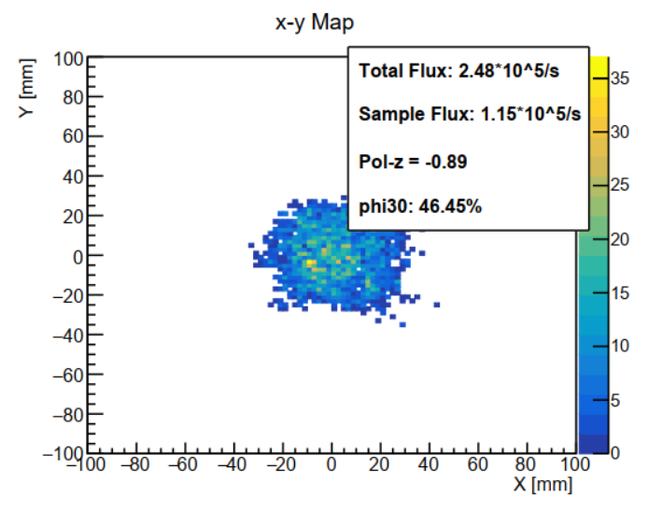
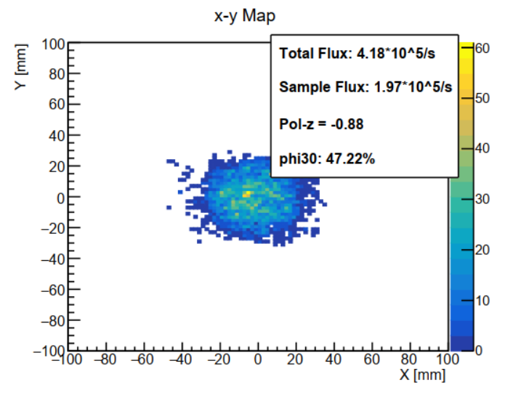
Beam spots (Ø30)
EMuS
SM1A
SM1B
SM2A
SM2B

Slide 19
Simplified scheme beam spots parameters
EMuS
For all end stations, 2E+05 mu+/s under 25kw proton beam could be expected (FLUKA 3)
 |  | rms emittance [pi.mm.mrad] |  | spot size [mm] |  | intensity [1E+05 /s] |  | polz
 |  | x | y | rms | fwhm | sample | total
SM1A | Ø30 | 397 | 593 | 12.49*11.26 | 33*32 | 2.83 | 5.74 | better than -0.9
 | Ø20 | 135 | 294 | 7.98*7.56 | 19*22 | 0.71 | 1.44
SM1B | Ø30 | 495 | 694 | 11.90*11.37 | 33*26 | 2.23 | 4.29
 | Ø20 | 360 | 475 | 9.08*8.37 | 23*21 | 0.89 | 1.99
SM2A | Ø30 | 514 | 432 | 12.33*12.33 | 30*34 | 1.15 | 2.48 | ~ -0.88
 | Ø20 | 228 | 201 | 8.60*8.30 | 26*24 | 0.28 | 0.67
SM2B | Ø30 | 348 | 817 | 12.48*11.67 | 34*30 | 2.09 | 4.3
 | Ø20 | 238 | 458 | 8.85*8.56 | 22*22 | 0.8 | 1.9

Slide 20
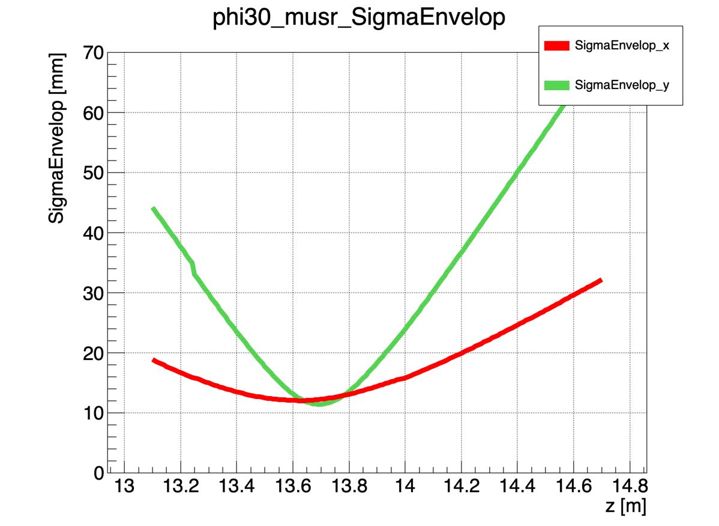
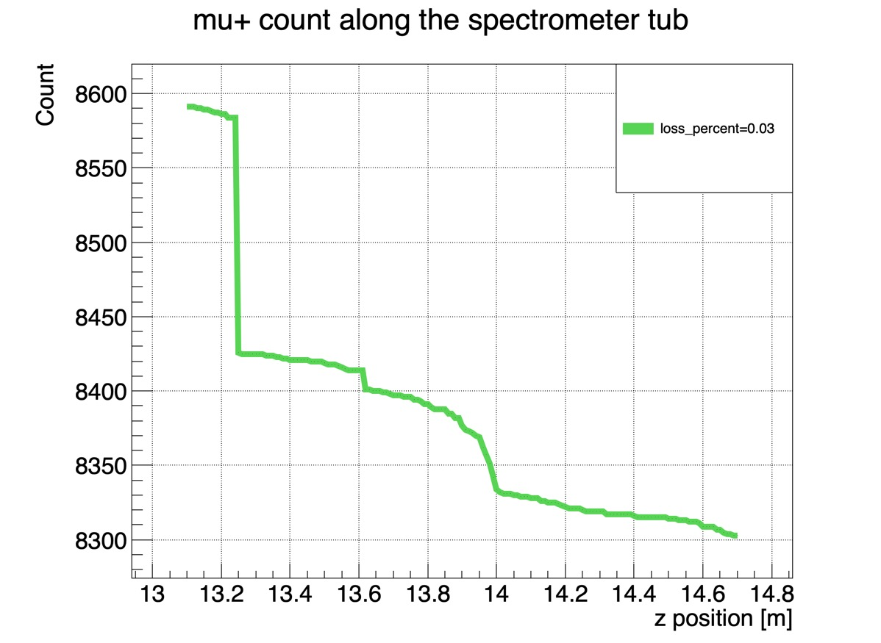
Beam info in μSR Spectrometer tube
EMuS
Example: SM2B
SM2B Ø30: the largest emittance
Most of the particles will be lost at the entrance of the spectrometer
2A-Q7 exit
2A-sample

Slide 21
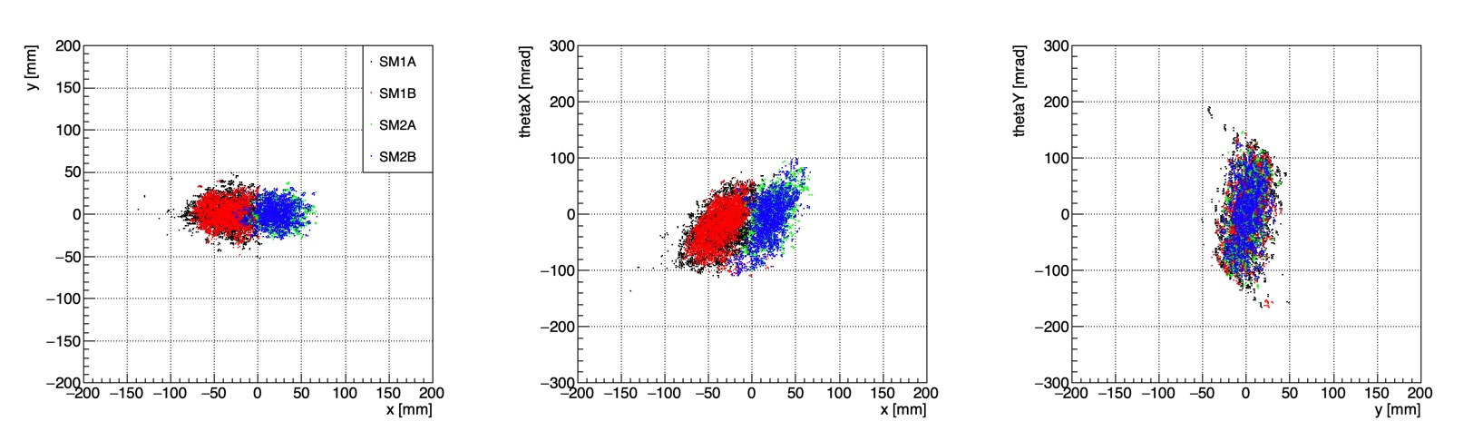
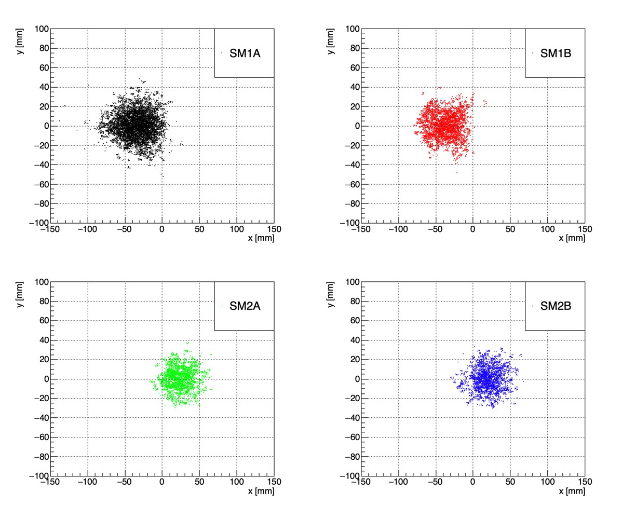
Ø30 on Target
EMuS

Slide 22
EMuS
II. Vertical beamline (Baseline-scheme)

Slide 23
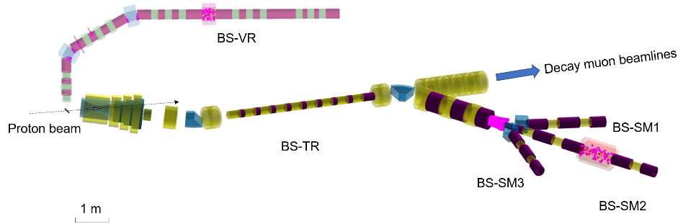
Introduction
EMuS
Baseline has four surface muon lines:
the vertical beam can operate independently and is not affected by other beamlines
three lines based on the main target cannot run simultaneously with decay muon beamlines

Slide 24


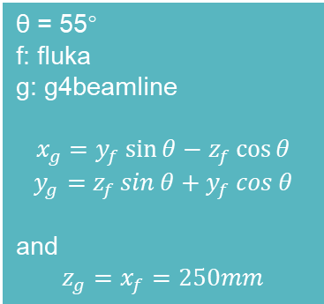


Phase spaces
EMuS
proton
θ = 55°
f: fluka
g: g4beamline
$$x_{g}=y_{f}\sin{θ}−z_{f}\cos{θ}$$
$$y_{g}=z_{f}\sin{θ}+y_{f}\cos{θ}$$
and
$$z_{g}=x_{f}=250mm$$
The phase space distributions in the two directions tends to be consistent
$$x_{g}$$
$$y_{f}$$
$$y_{g}$$
θ
Coordinate transformation
$$z_{f}$$
Vertical muon beam
dump

Slide 25
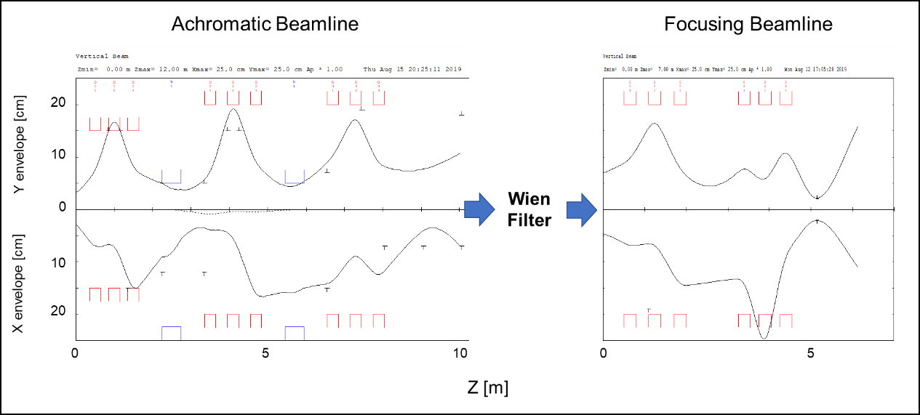
Optics
EMuS
Limitations:
The acceptance is limited by the capture solenoid ---- the apertures of first triplet are limited to 30cm
Symmetrical achromatic dispersion cannot be used. Due to space constraints, the bending angle is 60 degrees + 30 degrees

Slide 26
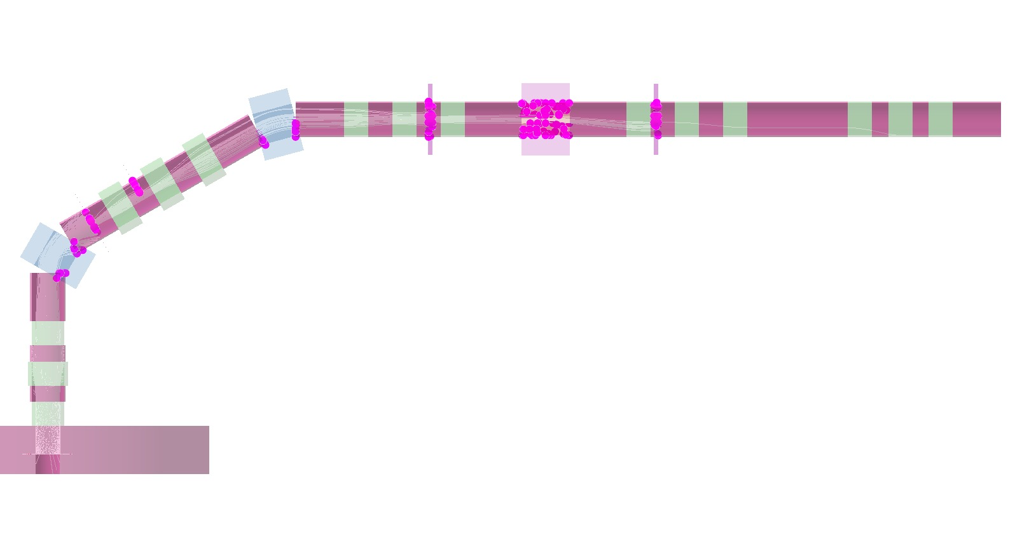
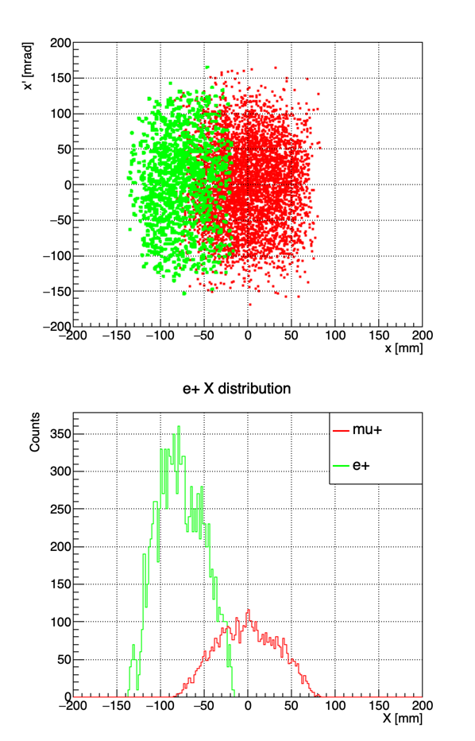
Positrons
EMuS
Vertical slits for beam spot
Most of the positrons will be scraped
Defocus, the rest of positrons will lost here

Slide 27
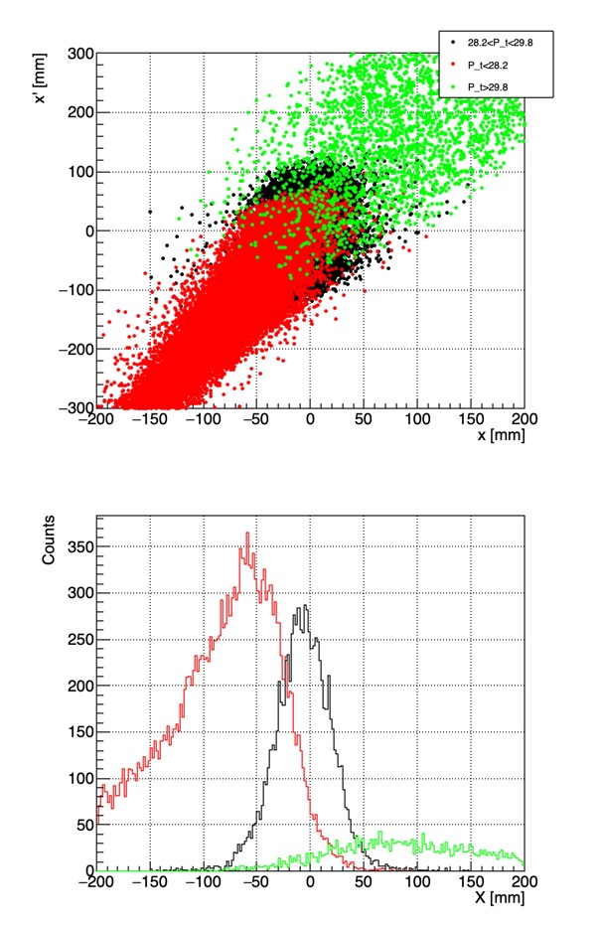
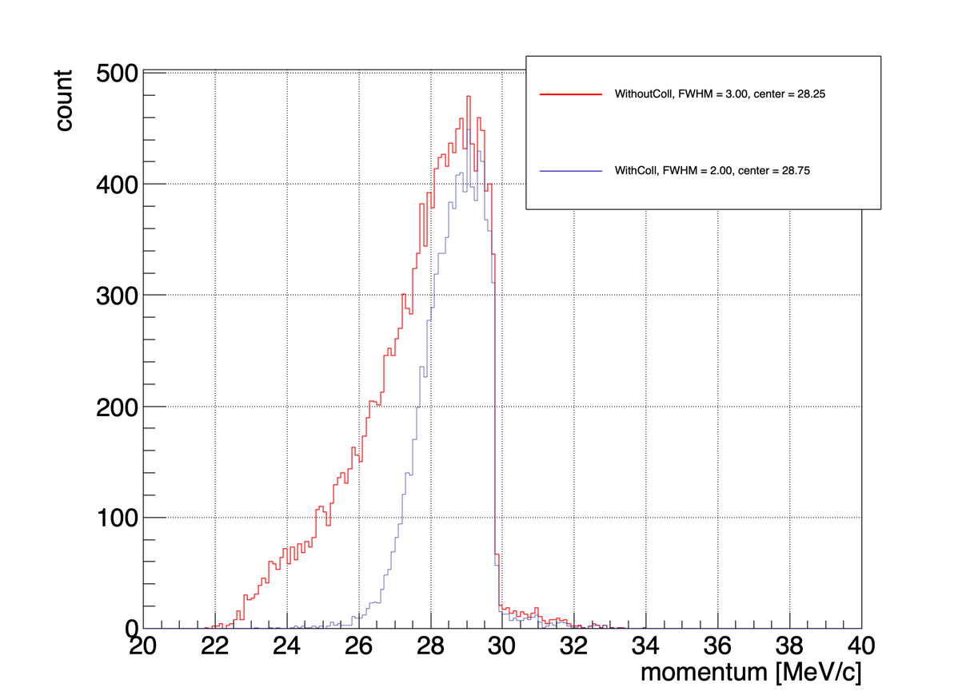
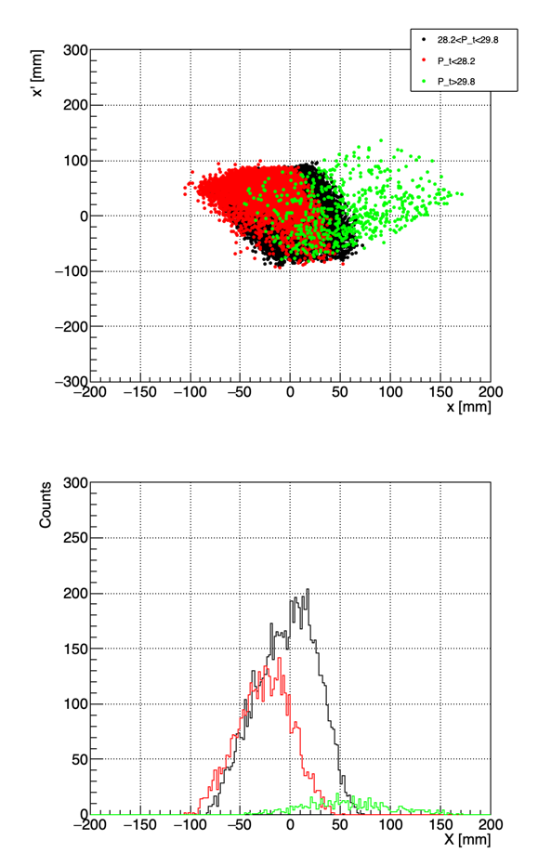
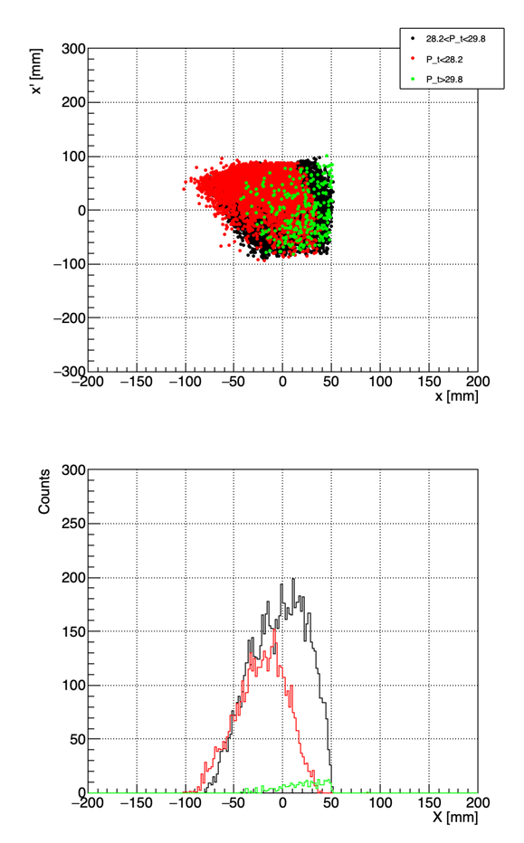
Momentum Collimation
EMuS

Slide 28
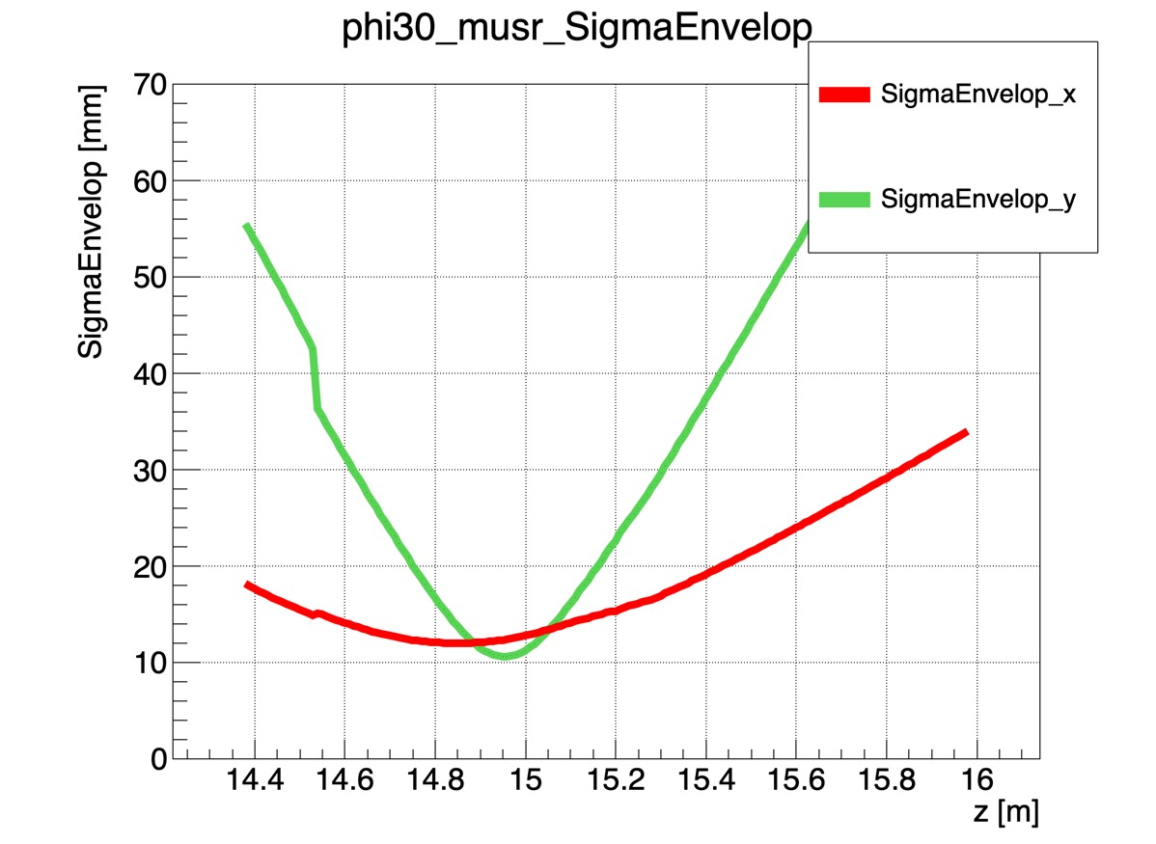
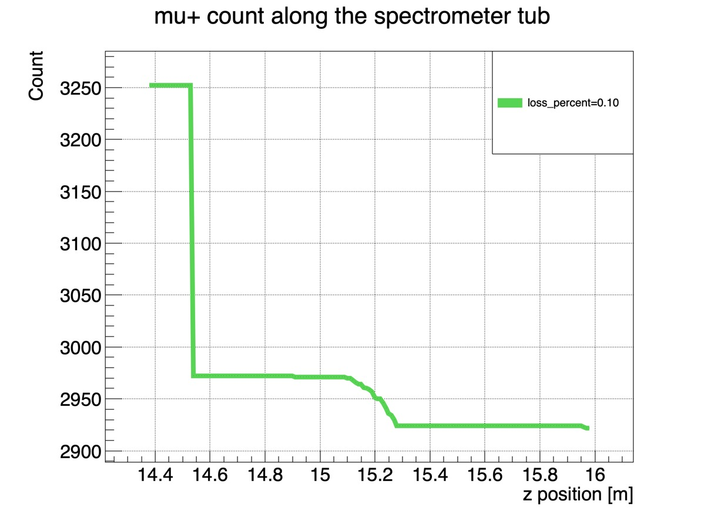
Vertical beamline beam spots & envelopes
EMuS
 | slits [mm] |  |  |  |  | spot size [mm] |  | flux [1E+05 /s, 25kW] |  | RMS emittance [pi.mm.mrad] | pol-z | p [MeV/c]
 | H-1 | H-2 | H-3 | V-1 | V-2 | RMS | FWHM | sample | total |  |  | center | FWHM
Ø30 |  |  |  | z=7900 width=±30 | z=10700 width=±30 | 10.49*11.42 | 26*29 | 1.42 | 2.57 | 282*987 | -0.94 | 28.62 | 1.88
Ø20 | z=12250 width=±35 | z=12400 width=±33 | z=12850 width=±35 | z=7900 width=±20 | z=10700 width=±20 | 7.75*8.07 | 17*19 | 0.42 | 0.92 | 143*540 | -0.96 | 28.62 | 1.88
sample

Slide 29
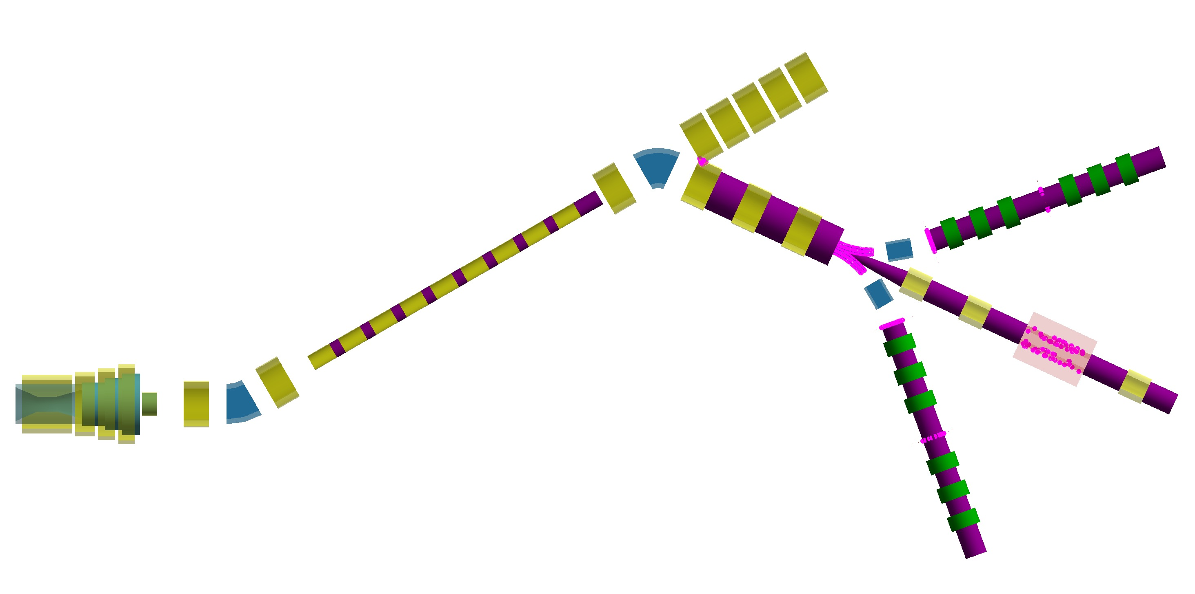
Baseline horizontal lines / end stations
EMuS
Presentation by Yang Hong
Decay muon beamlines
BS-SM1
BS-SM3
BS-SM2

Slide 30
Summary
EMuS
Simplified scheme:
Both space splitting and time splitting have been employed in order to make full use of long target as well as two pulses
Four end stations could supply surface muons with the intensity of 2E+05 /s (25kW, except sm2a). The polarization could reach -0.9
SM1A&SM2A will be constructed firstly
Baseline scheme:
Vertical muon beamline:
The intensity of vertical beamline could reach ~1.5E+05 under 25kW proton beam with a thin target
The polarization could reach -0.95

Slide 31
EMuS
Thank you

Slide 32
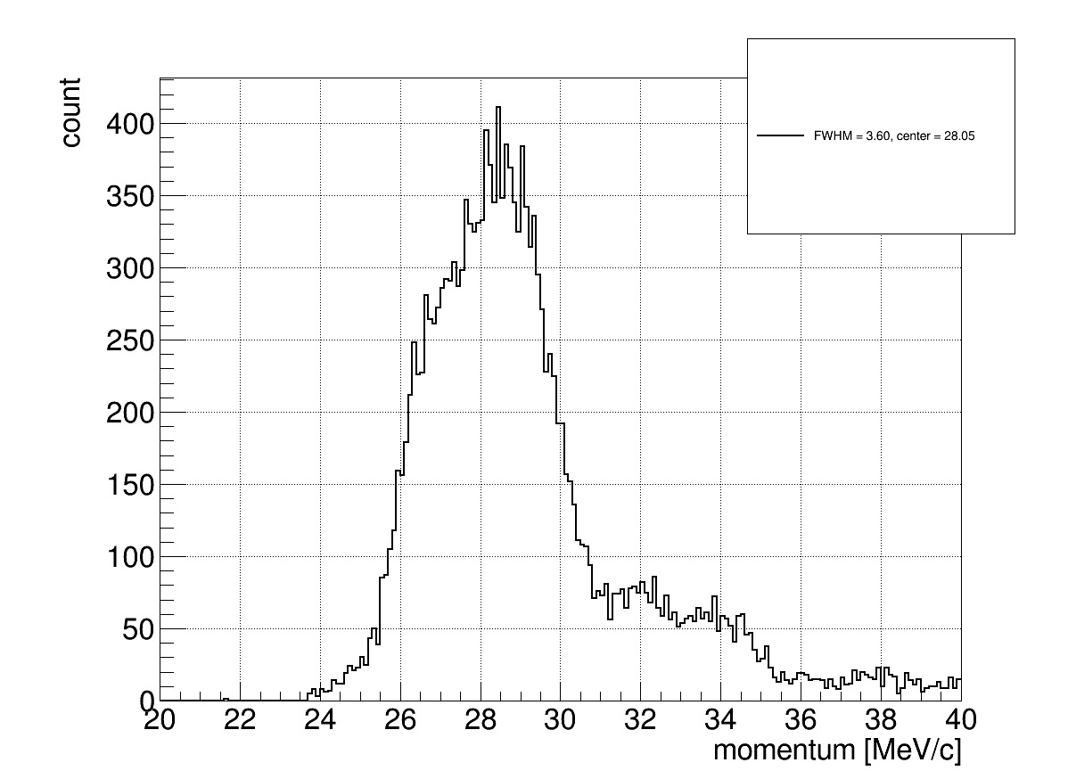
backup
EMuS
SM1-momentum
Large proportion cloud mu+
Wide range momentum spectrum
Cloud mu+
Momentum bite: 13%

Slide 33
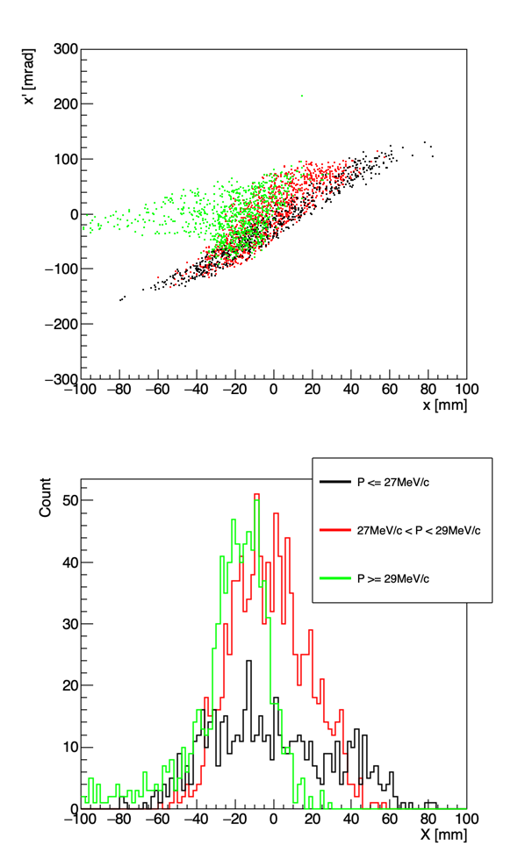
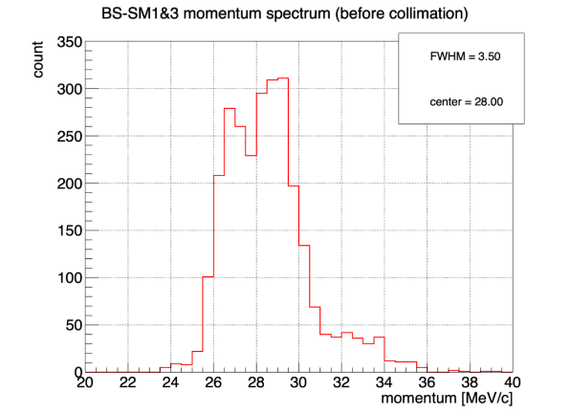
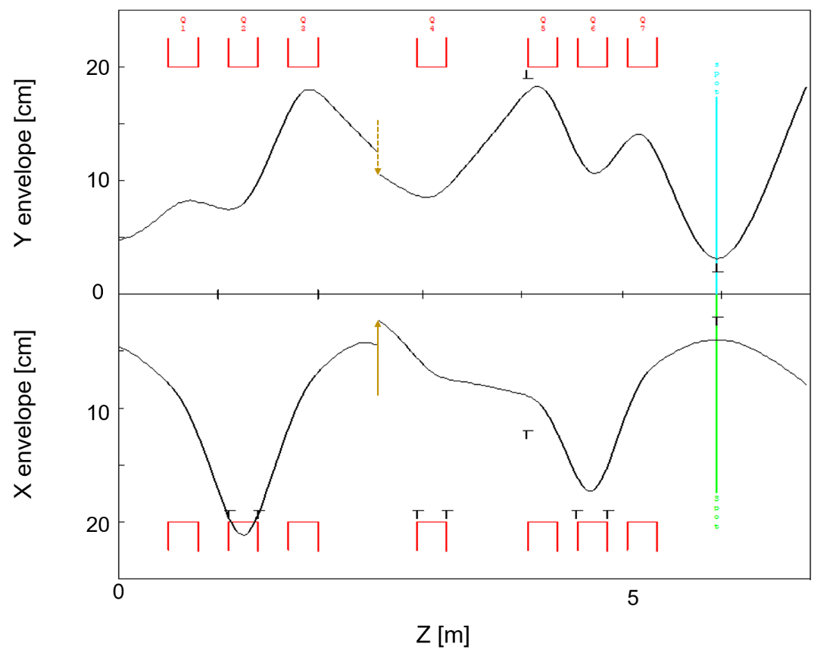
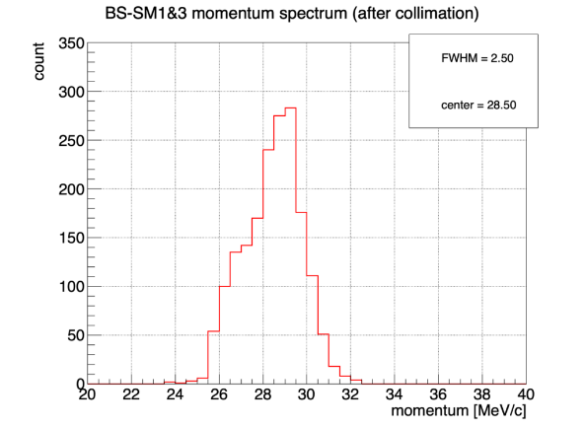
backup
EMuS
SM1-Chromatic aberration effect

Slide 34
backup
EMuS
束斑类型 | G4beamline中准直器位置与大小 [mm] |  |  | 束斑性质
 |  |  |  | 束斑大小[mm] |  | 流强 (10⁵ μ⁺/s) |  |  | 极化
 | X | Y | 固定准直器 | 束斑RMS | 束斑FWHM | 总流强 | 圆内流强 | 正方形内流强 | 极化度 | 纯净度
30*30 | z=3300 x=210; z=3100 x=-220; z=3800 x=-225 | z=3100 y=260 y=-290 | z=1002.55 x=±50; z=1002.55 y=32 y=-68; z=3402.55 x=220 x=-230； | 11.8*10.5 | 30*28 | 5.7 | 3.2 | 3.8 | -0.73 | 87%
20*20 | z=3300 x=205; z=3100 x=-212; z=3800 x=-225 | z=3100 y=240 y=-270 | z=1002.55 x=±50; z=1002.55 y=32 y=-68; z=3402.55 x=220 x=-230； | 8.72*8.84 | 22*22 | 2.6 | 1.1 | 1.4 | -0.74 | 86%
10*10 | z=3100 x=-210 x=200; z=3300 x=205; z=3800 x=-225 | z=3100 y=205 y=-241 | z=1002.55 x=±50; z=1002.55 y=32 y=-68; z=3402.55 x=220 x=-230 | 6.1*7.7 | 10*12 | 0.63 | 0.14 | 0.18 | -0.78 | 88%

Slide 35
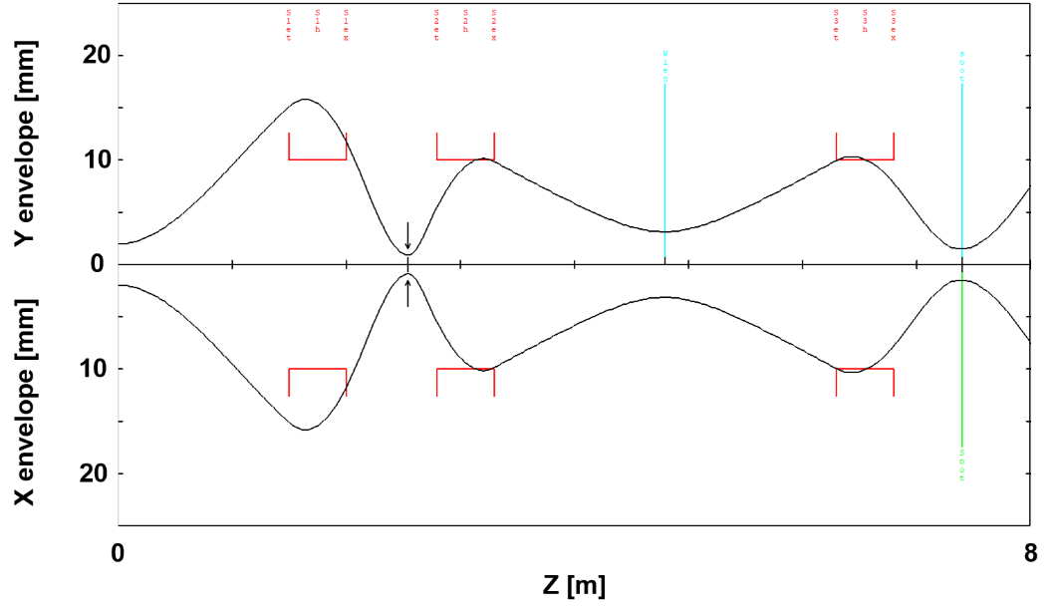

backup
EMuS

Slide 36
backup
EMuS
束斑类型 | 准直器位置及大小(mm) |  | 束斑性质
 |  |  | 束斑尺寸 (mm) |  | 流强 (10⁵ μ⁺/s) |  | RMS发射度x*y(π·mm·mrad) | 极化
 | X | Y | FWHM | RMS | 总流强 | 圆内流强 |  | 极化度 | 纯净度
phi25 |  |  | 26*22 | 12.75*12.60 | 7.6 | 3.1 | 890*888 | -0.76 | 86.6%
phi20 | z=2000, -50<x<50; z=6800, -50<x<50; z=2550, x>-10 | z=2000, -50<y<50; z=6800, -50<y<50; | 20*18 | 7.79*7.15 | 2.5 | 1.4 | 454*392 | -0.77 | 87.2%
Phi15 | z=2000, -30<x<30; z=6800, -40<x<40; z=2550, x>-10 | z=2000, -40<y<40; z=6800, -40<y<40; | 16*14 | 6.49*6.02 | 1.1 | 0.6 | 248*378 | -0.78 | 88.4%
phi10 | z=2000, -20<x<20; z=6800, -40<x<40; z=2550, x>-10 | z=2000, -30<y<30; z=6800, -40<y<40; | 10*10 | 6.50*4.78 | 0.6 | 0.2 | 209*171 | -0.79 | 89.5%

