Slide 1
Layout for the HEPEA
Speaker：Jing Hantao
Institute of High Energy Physics, Chinese Academy of Sciences (CAS)
Spallation Neutron Source Science Center
2020-12-12

Slide 2
Contents
Layout of High-energy Proton Experimental Area (HPEA)
Infrastructure and room allocation in HPEA
Radiation shielding for HPEA
Common facililties and conditions

Slide 3
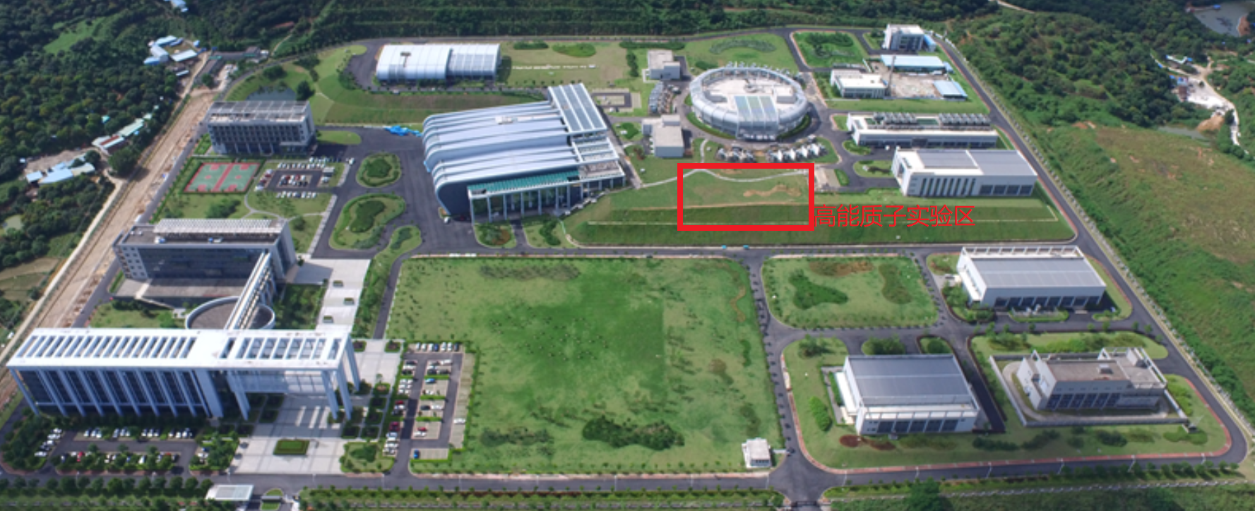
Bird’s view of CSNS
Office area
Facility area
Radiation protection building
Exhaust and air-condition centers
Support building
HPEA
Auxiliary area
2nd target station reserved
Test hall 1&2
Main substation

Slide 4
Layout of CSNS and High-energy Proton Experimental Area （HEPA）
Linac, 80 MeV@CSNS-I; 300 MeV@CSNS-II
RCS
1.6GeV, 25Hz
100 kW
1st target station
High-energy Proton
Experimental Area(HPEA)
Proton beam parameters for Experimental Muon Source (EMuS)
Proton energy：1.6 GeV
Beam power：20 kW
Bunch number per pulse: 2
Repetition：1 Hz
Proton number per bunch：7.8 E13 ppp (protons per pulse)
Notes:
Negative hydrogen ion

Slide 5
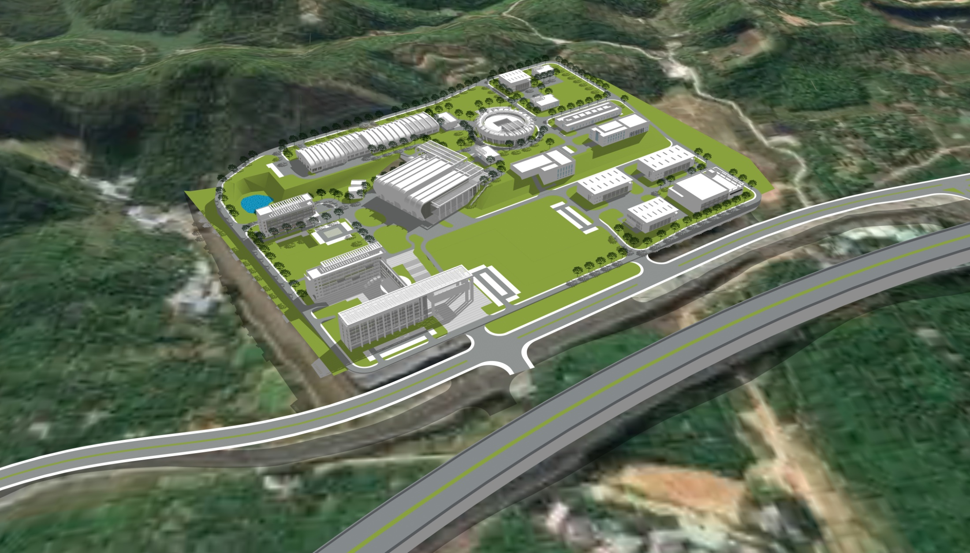
HEPEA Conceptual design rendering

Slide 6
HEPEA in CSNS facility campus

Slide 7
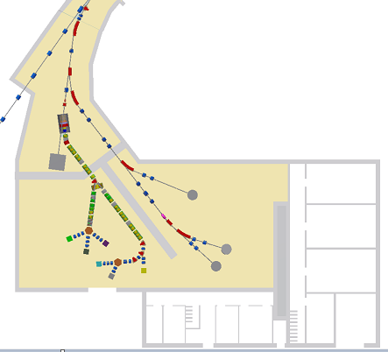
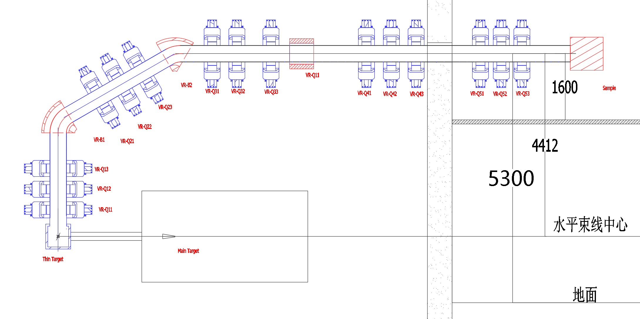
Infrastructure and room allocation in HEPEA
Exp. building (3 floors)：
User office
Labs
Preparation room
Detector and electronics room
Control room
Com. Equip. hall
ventilation
Supp. power
Water cool system
Extended tunnel：380 m²
PBW
Beam height：1.605 m
Common equipment
room: 715 m²
Exp. hall： 49mX30m=1470 m²
Exp. building：
3×25m×10.5m=788 m²

Slide 8
Supply power and ground wire
Common electric power （450 kW）
For Lights, cranes, air-condition and ventilation and so on；
Beamline equipment electric power（1500 kW）
For vacuum pumps, magnet and so on；
Clear electric power (Low noise) （100 kW）
For detector , electronics，DAQ server and control system et al.
Ground resistance（independent)：0.5-1.0 Ω

Slide 9
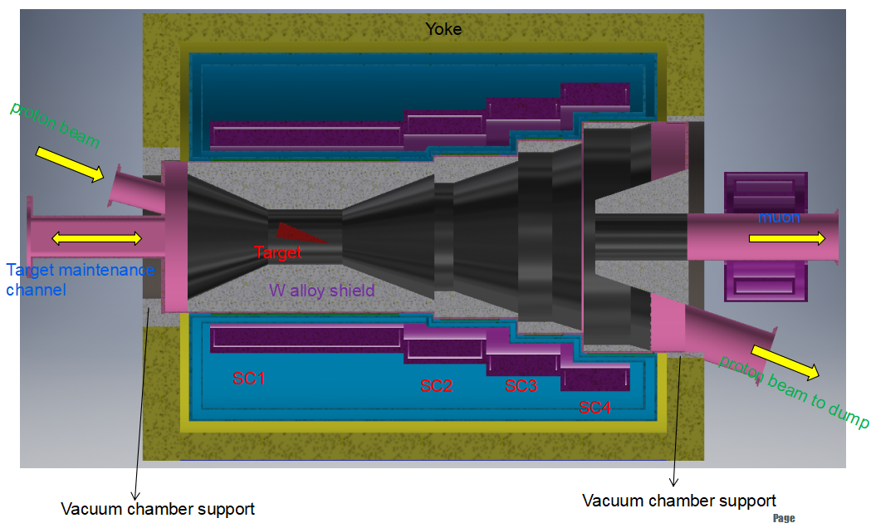
Cool water
For magnet and target shielding
Deionized water;
water-collecting well;
Water volume: 80m³/h;
Tap water；
Phase | Thickness of carbon target | Energy deposition | Max. tempture
Simplified-scheme | 100mm | 635.5W | 704deg.
Baseline scheme | 10mm | 63.55 W | 238deg.
 | 300mm | 1906.5 W | 880deg.

Slide 10
Ventilation
Extended tunnel
Same to operation mode of RTBT
Exp. hall
No activated air and loop with a period of 2 hour
Independent air condition
Extended tunnel
Common
Equipment
hall
Exp. hall
Exp. building
Parameter of ventilation:
Tunnel and experimental hall:
Environment temperature and humidity: 25±2 degree and 65±5%
Electronics and DAQ system:
Environment temperature and humidity: 23±2 degree and 65±5%

Slide 11
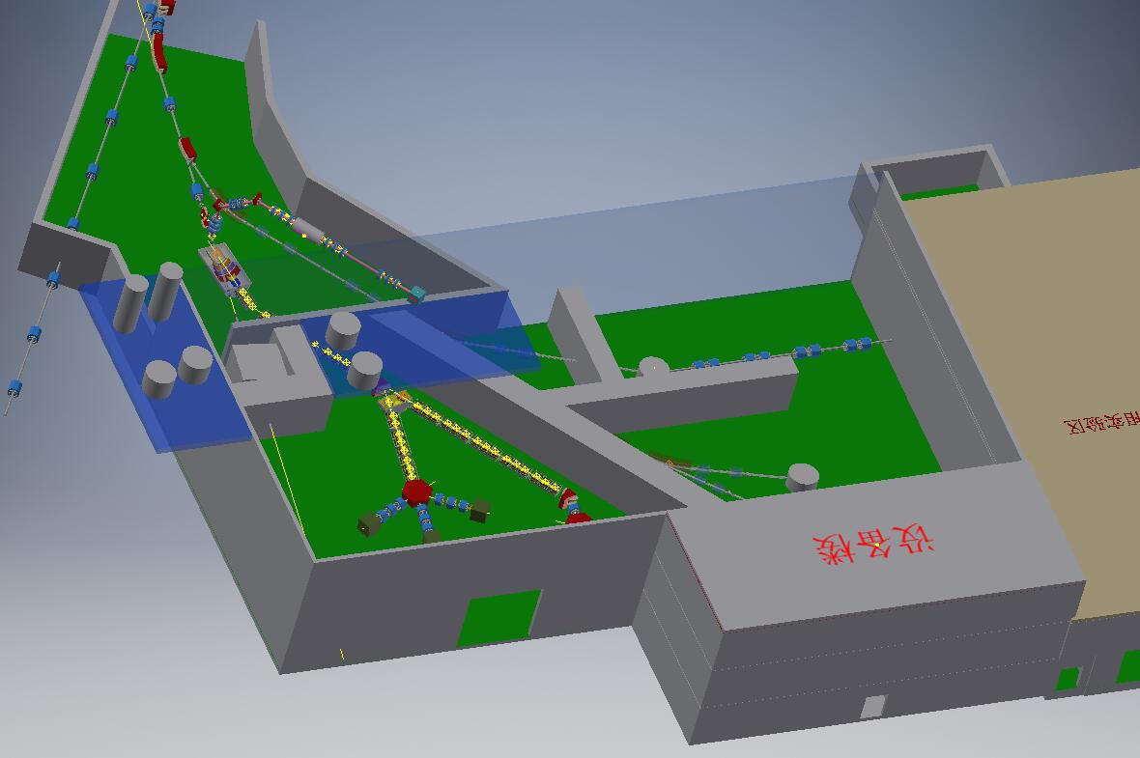
Cryogenic system
Cryogenic hall with area of 60 m²：high-pressure He gas tank, compressor, Oil removing device
A platform with 40m² for Cold box & He Dewar
Liquid He surrounding by 80 k He gas is sent to SC cryogenic box
Cryogenic boxes
Target station
Straight section 1
Straight section 2
Cold box & He Dewar
Cryogenic platform
High-pressure He gas tank
Compressor & Oil removing device
Cryogenic hall

Slide 12
Radiation shielding and protection

Slide 13
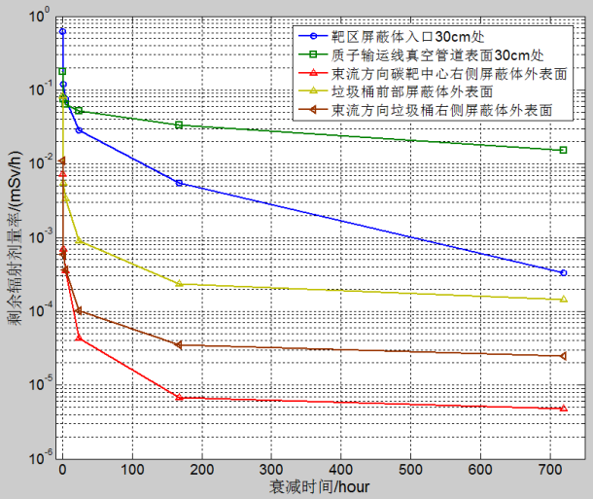
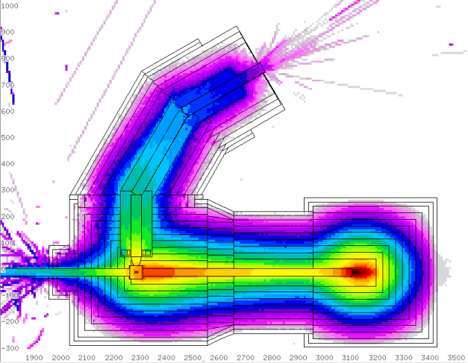
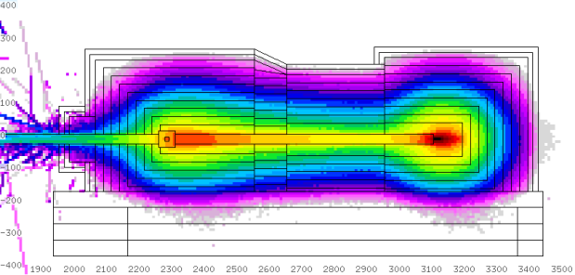
Target area and dump
Shielding limited value:
<1mSv/h (30cm from surface of equipment) after 4 hours with 100 days operation.
<2.5 μSv/h in experimental hall
mSv/h

Slide 14
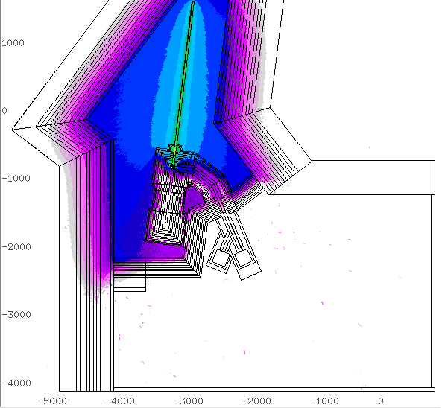
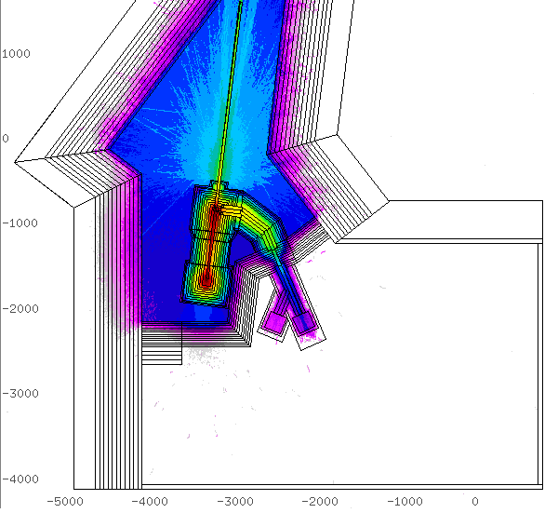
Radiation shielding for baby scheme
About 3m thickness for front shielding wall
mSv/h

Slide 15
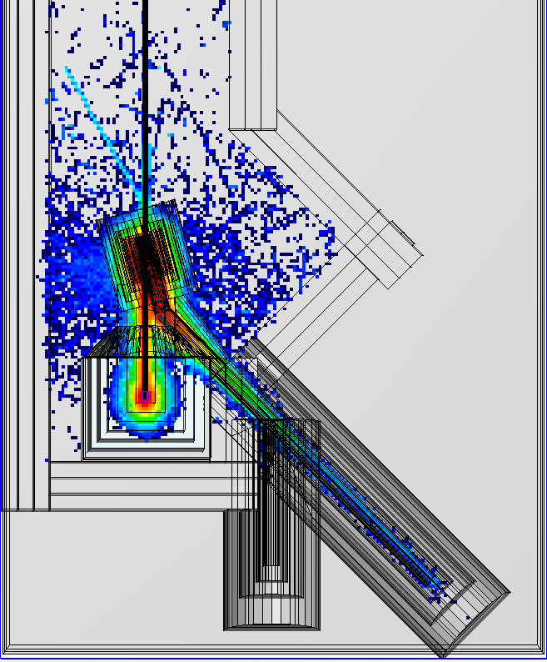
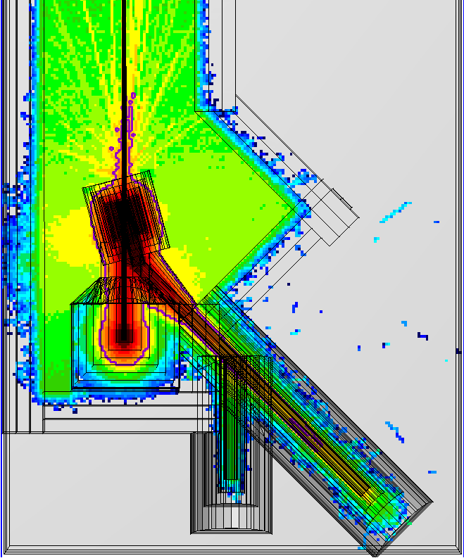
Shielding for baseline
About 1.6-m thickness of the divided wall on right side;
Dose-EQ after 4 hours with 100 days operation(mSv/h）
Prompt dose-EQ（mSv/h）

Slide 16
Thanks

