Slide 1


2020 EMuS & MOMENT General Meeting
The μSR spectrometer design
and prototyping
Ziwen PAN (潘子文), Jingyu DONG (董靖宇)
Hao LIANG (梁昊), Bangjiao YE* (叶邦角)
2020年12月12日
State Key Laboratory of Particle Detection and Electronics, USTC

Slide 2
Physical Basis of μSR spectroscopy
Design of Day-One spectrometer
CONTENT
Design of Super-μSR spectrometer
Prototype of a μSR spectrometer

Slide 3

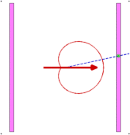
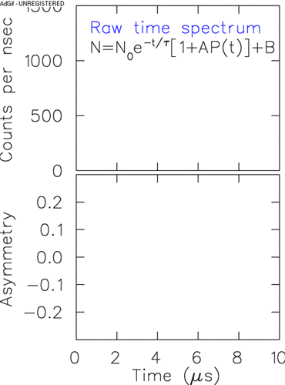
1
Physical Basis of μSR spectroscopy
μ⁺
Asymmetrical
Decay
μSR spectra
Sample
μSR spectrometer
Unfolding
Application
AP(t)
Processes of the technique
EMuS 2020

Slide 4
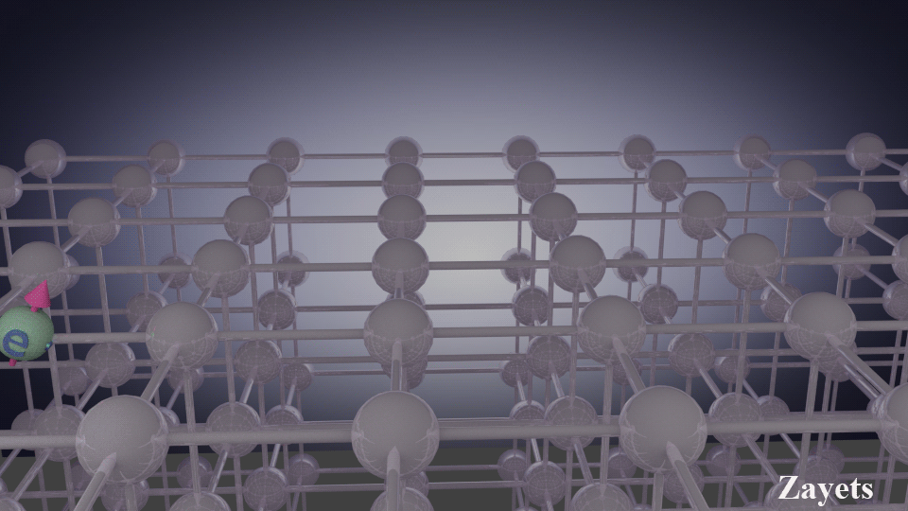
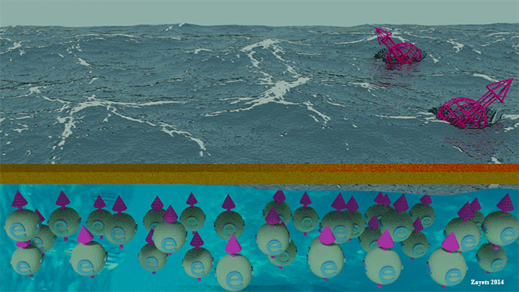
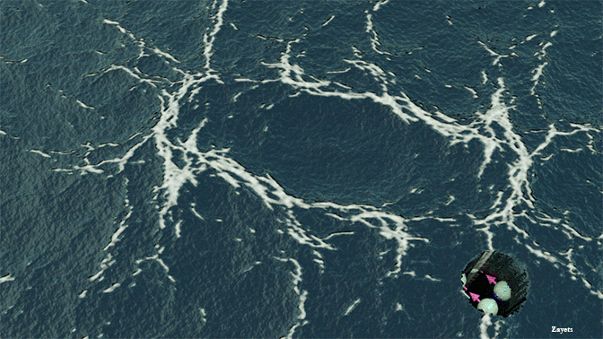
µSR: A quantum magnetism probe
Muon Spin Rotation/Relaxation/Resonance
Very weak effects (small moment magnetism ~ 10⁻³ µ_{B}/Atom)
Random magnetism (e.g. spin glasses).
Short range order (where neutron scattering is not sensitive).
Full polarization in zero field (independent of temperature, unique measurements without disturbance of the system)
Single particle detection (with extremely high sensitivity)
No restrictions (in choice of materials to be studied)
Advantages of the technique
EMuS 2020

Slide 5
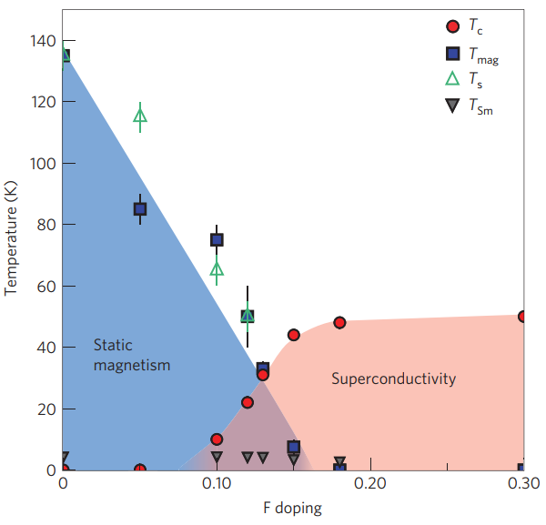
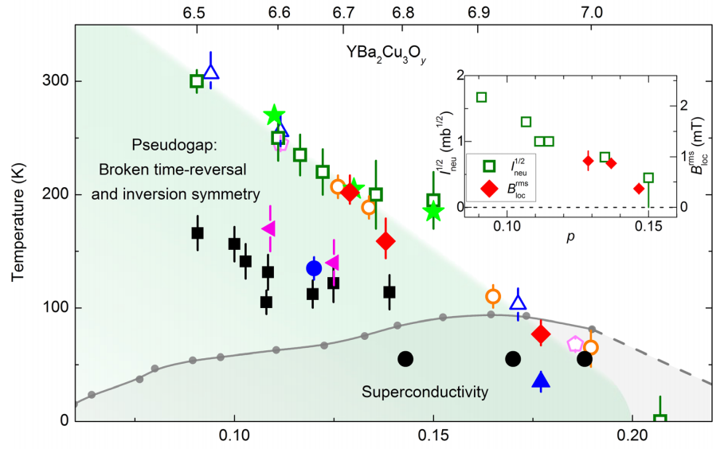
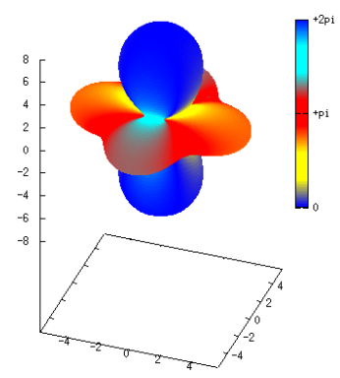
Highlights of Chinese μSR community
Prof. Xianhui Chen’s Group @ USTC
Coexistence of static magnetism and superconductivity in SmFeAsO_{1−x}F_{x} as revealed by muon spin rotation, Nature Materials 8, 310 – 314 (2009).
2013年国家自然科学奖一等奖成果内容 (物理所 / 中国科大)
Prof. Lei Shu’s Group @ FDU
Discovery of slow magnetic fluctuations and critical slowing down in the pseudogap phase of YBa₂Cu₃O_{y} , Science Advances 4, eaao5235 (2018).
高温超导体赝能隙研究取得突破
Prof. M. Smidman’s Group @ ZJU
Time-Reversal Symmetry Breaking in Re-Based Superconductors, Physical Review Letters 121, 257002 (2018).
铼基超导体时间反演对称性破缺(TRSB)起源
Highlights of Chinese users
EMuS 2020

Slide 6
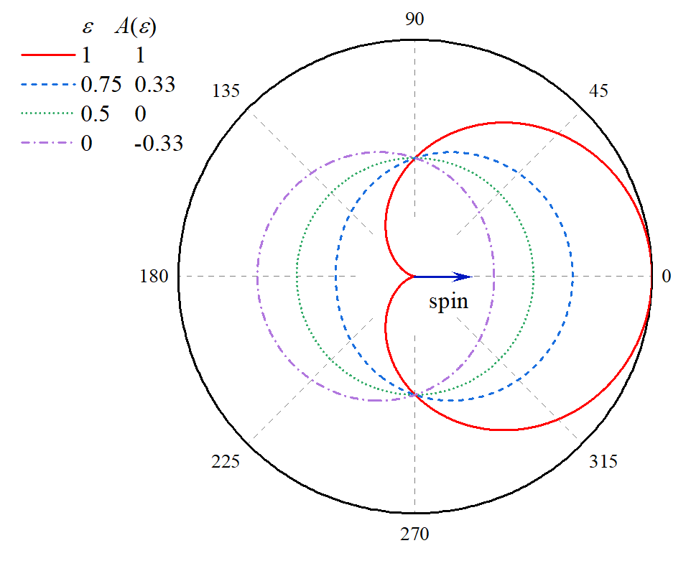
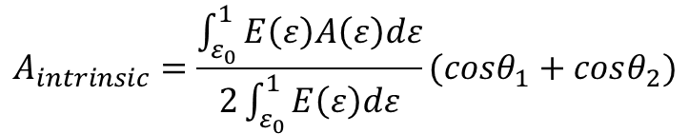
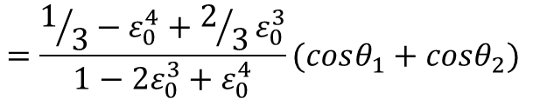
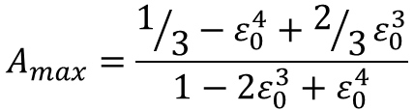
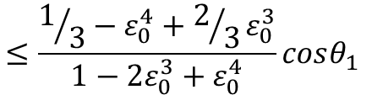
Intrinsic asymmetry：
$$A_{intrinsic}=\frac{\int_{ε_{0}}^{1}{E\left(ε\right)A\left(ε\right)dε}}{2\int_{ε_{0}}^{1}{E\left(ε\right)dε}}(cosθ_{1}+cosθ_{2})$$
$$=\frac{1/3−ε_{0}^{4}+2/3ε_{0}^{3}}{1−2ε_{0}^{3}+ε_{0}^{4}}(cosθ_{1}+cosθ_{2})$$
θ₂
θ₁
$$≤\frac{1/3−ε_{0}^{4}+2/3ε_{0}^{3}}{1−2ε_{0}^{3}+ε_{0}^{4}}cosθ_{1}$$
Maximum value：
$$A_{max}=\frac{1/3−ε_{0}^{4}+2/3ε_{0}^{3}}{1−2ε_{0}^{3}+ε_{0}^{4}}$$
ε is the normalized kinetic energy of positrons
ε₀ is the lower limit of primary kinetic energy of detected positrons
Nature of muon decay
EMuS 2020

Slide 7
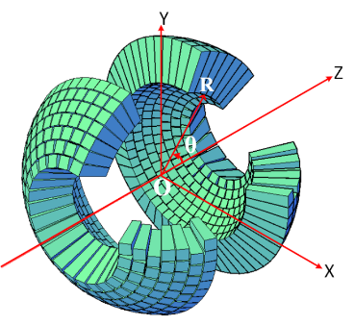
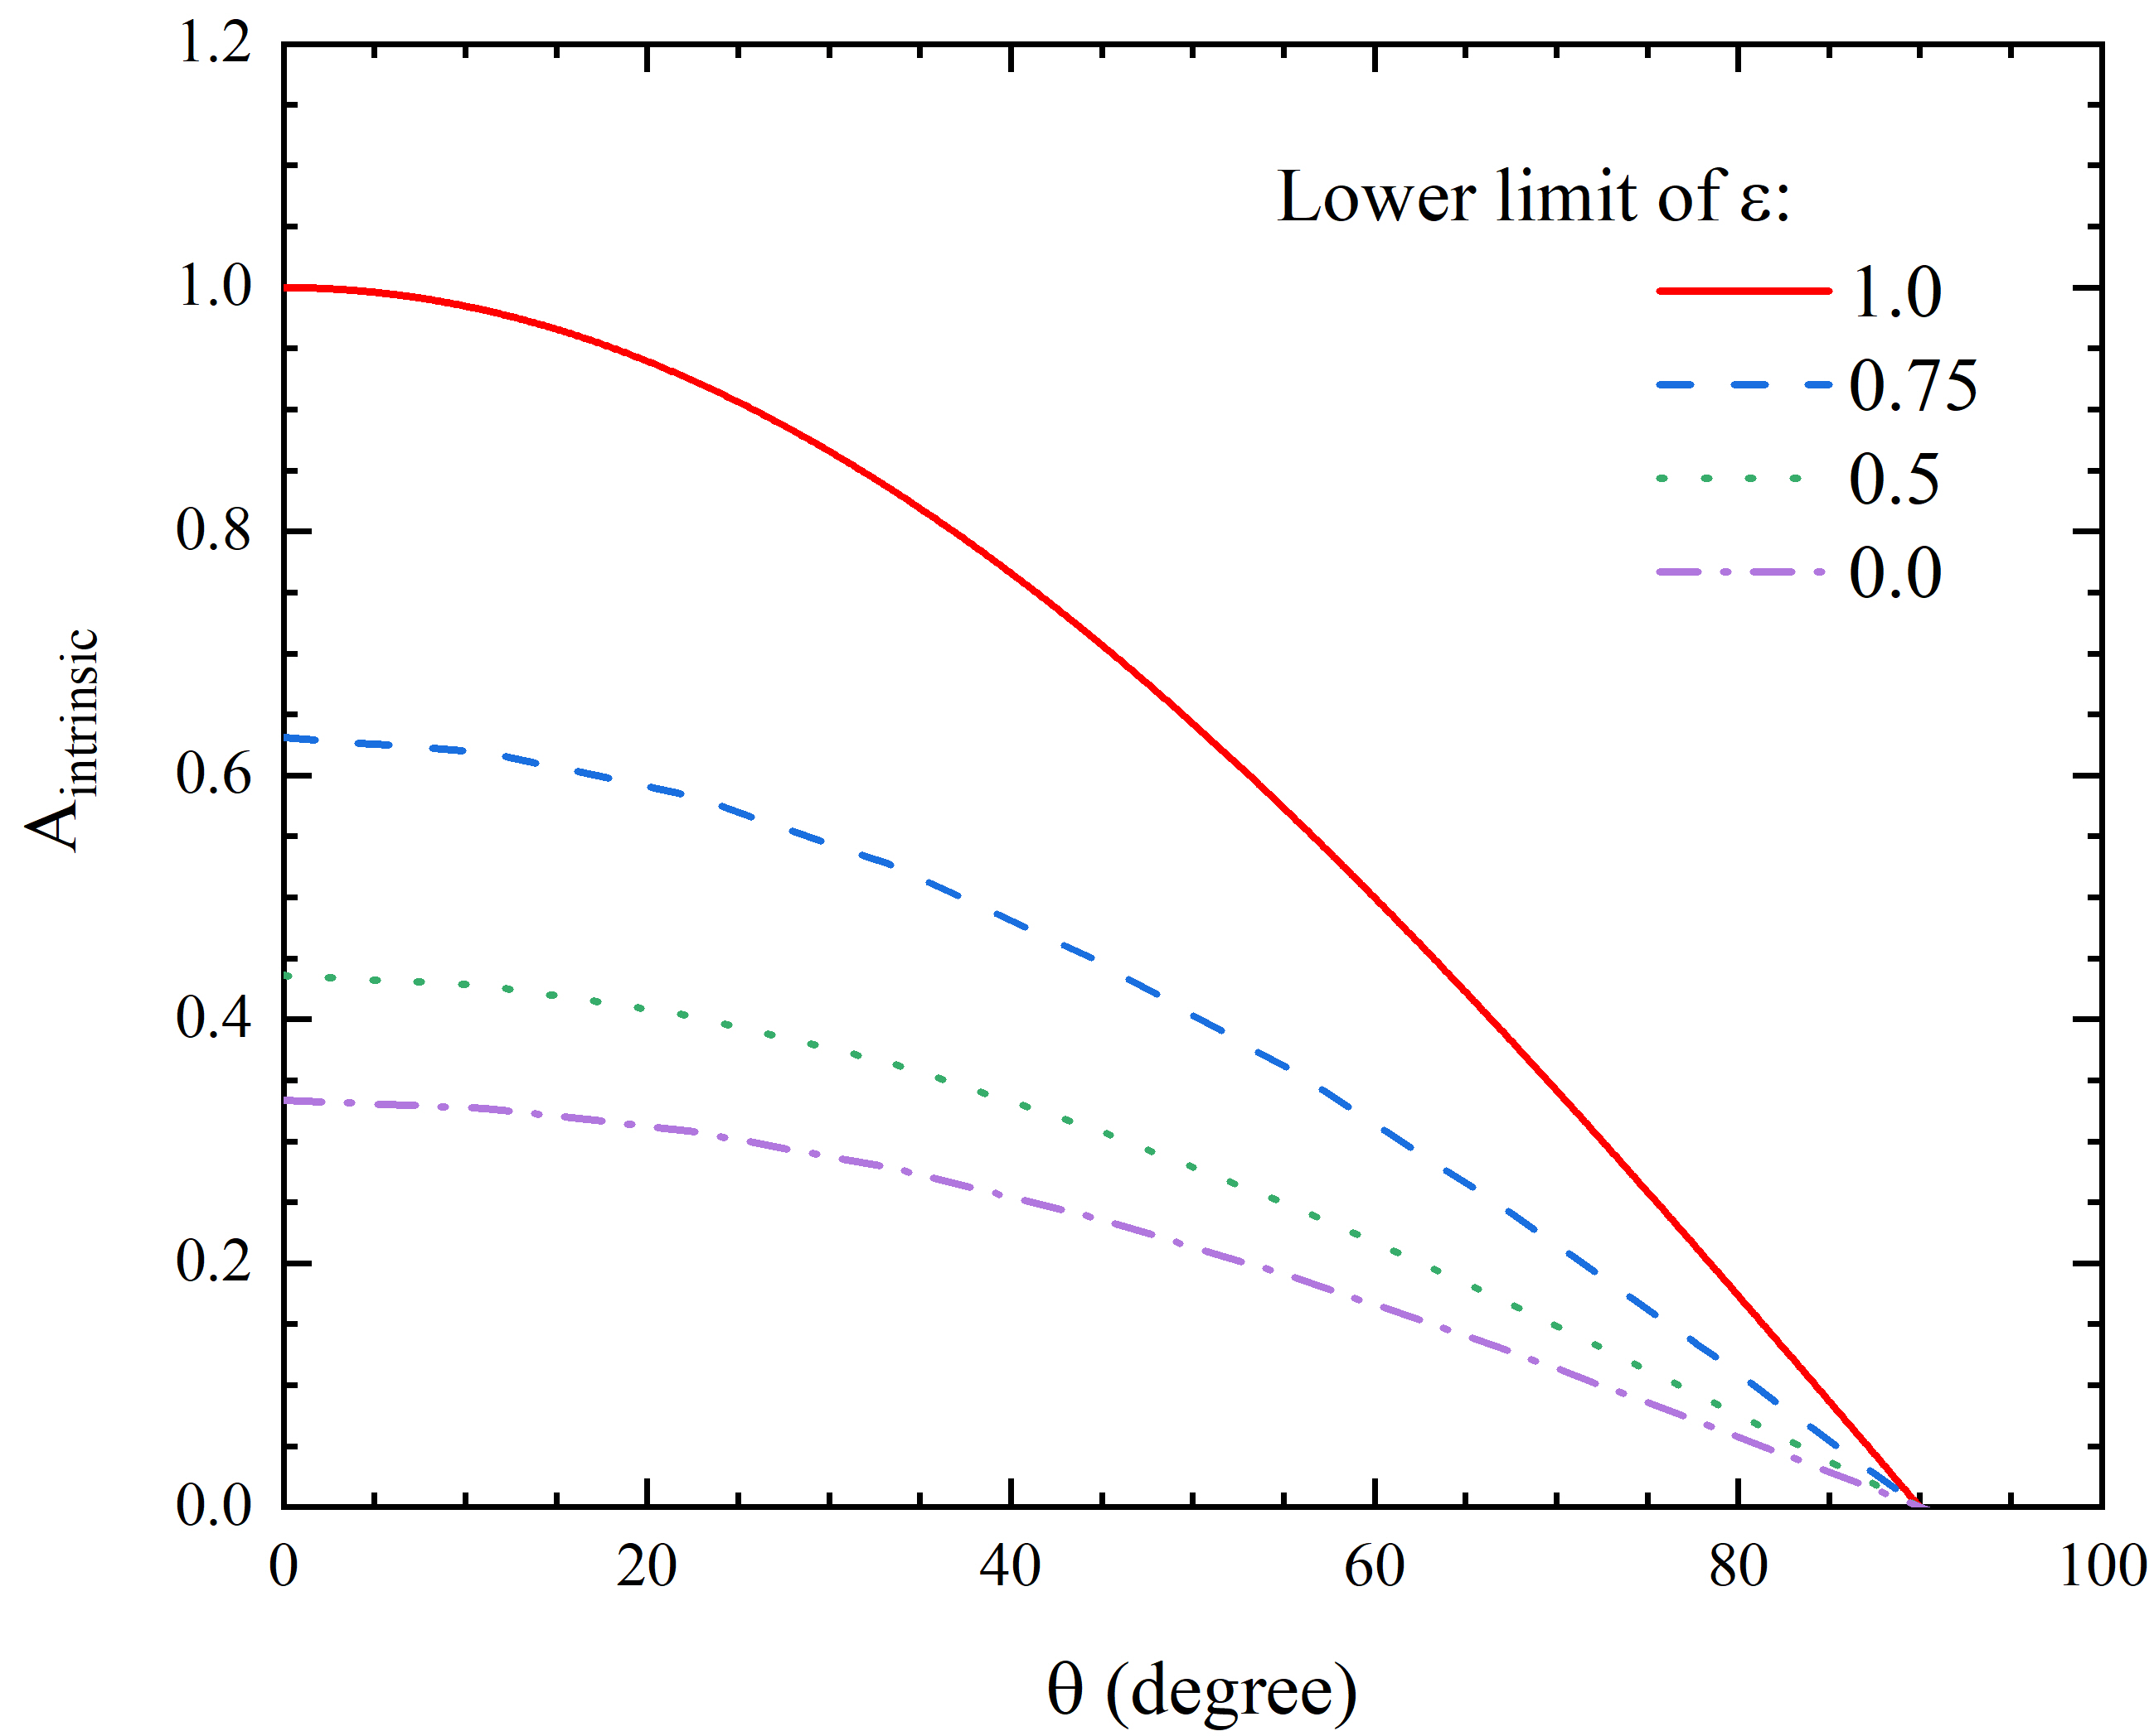
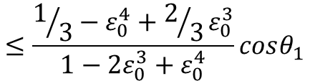
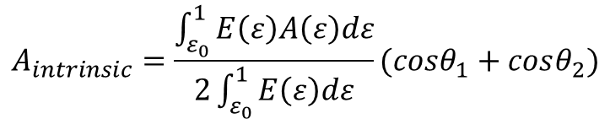
Intrinsic asymmetry：
$$A_{intrinsic}=\frac{\int_{ε_{0}}^{1}{E\left(ε\right)A\left(ε\right)dε}}{2\int_{ε_{0}}^{1}{E\left(ε\right)dε}}(cosθ_{1}+cosθ_{2})$$
A_{max}
$$≤\frac{1/3−ε_{0}^{4}+2/3ε_{0}^{3}}{1−2ε_{0}^{3}+ε_{0}^{4}}cosθ_{1}$$
Conclusions:
High energy positrons take high asymmetries
Detector rings with small theta values occupy high asymmetries
Selection of positron energy and emission angle is beneficial for the intrinsic asymmetry of a μSR spectrometer
Nature of muon decay
EMuS 2020

Slide 8
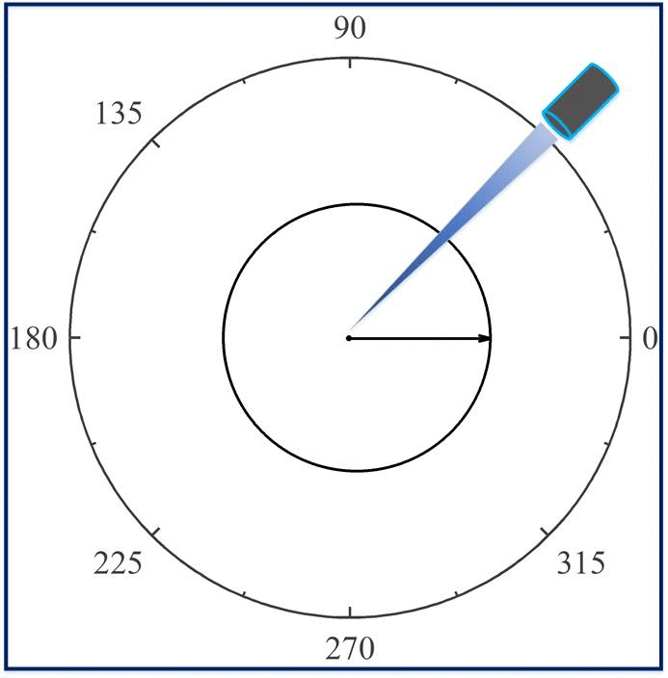
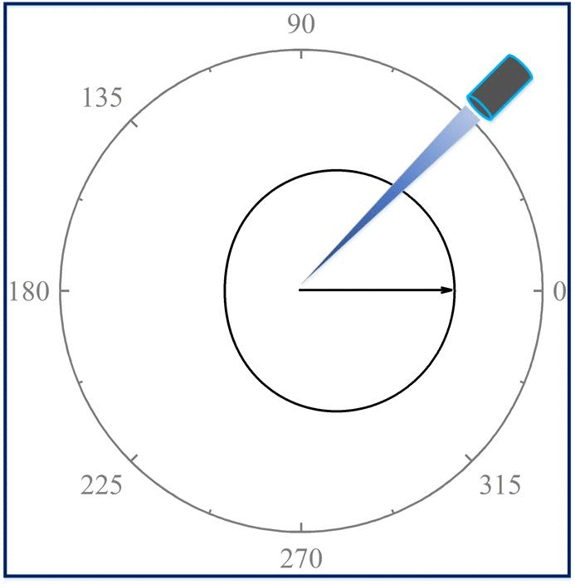
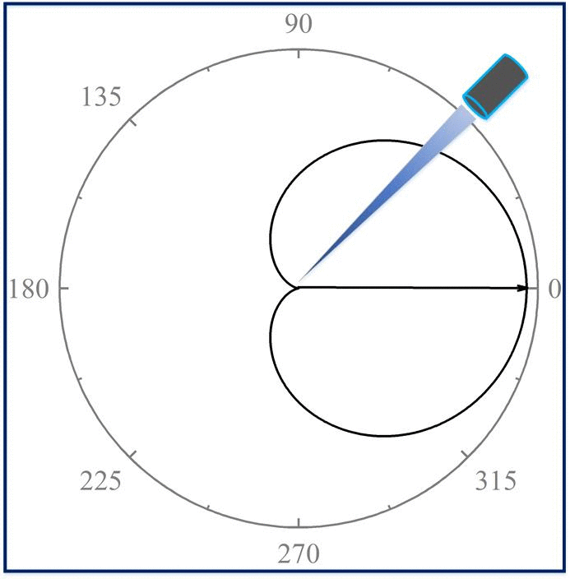
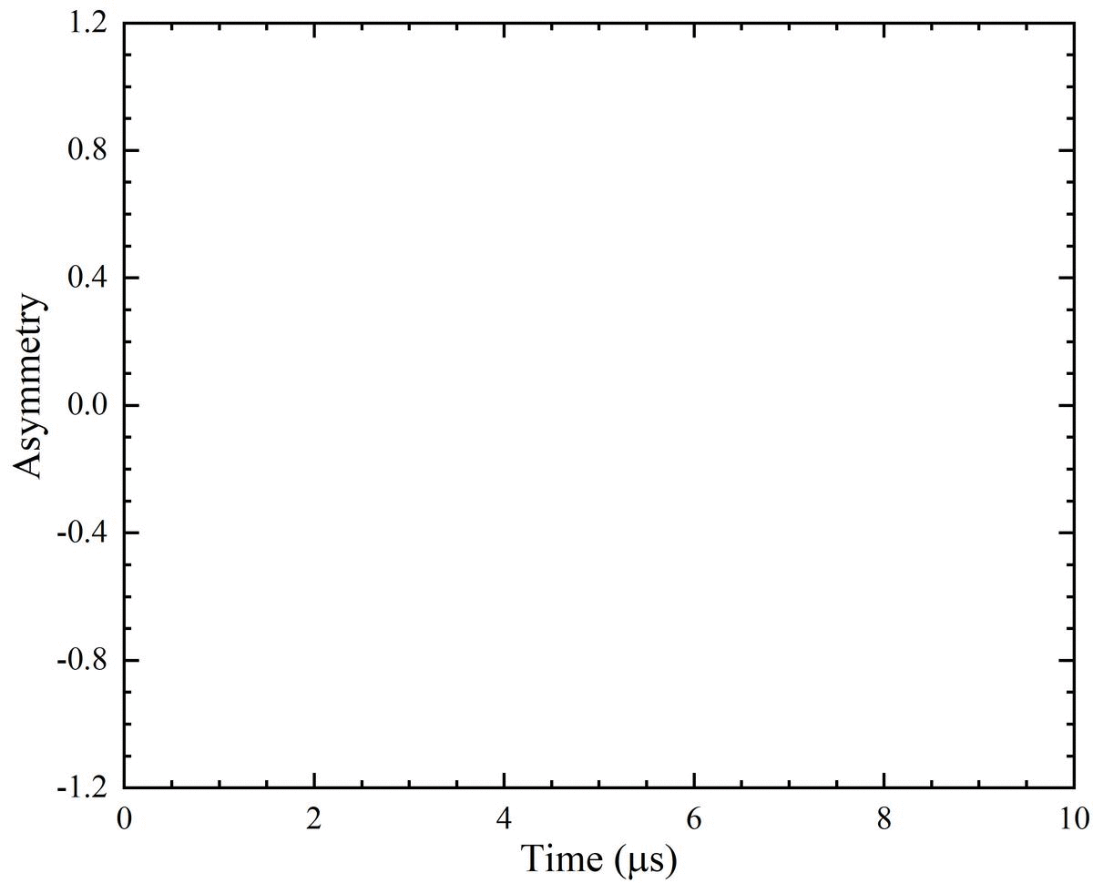
A_{intrinsic} = 0.05
A_{intrinsic} = 0.33
A_{intrinsic} = 1.0
Error analysis of μSR data
EMuS 2020

Slide 9
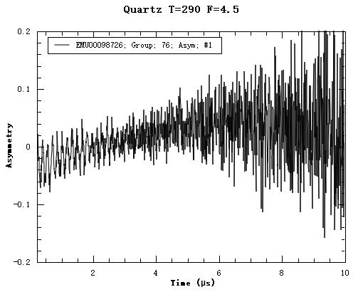
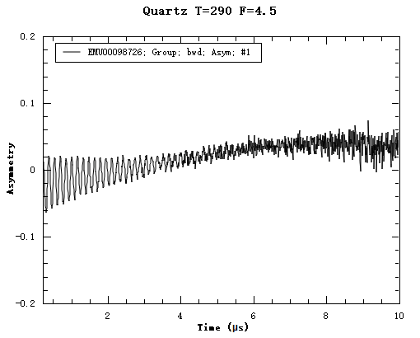
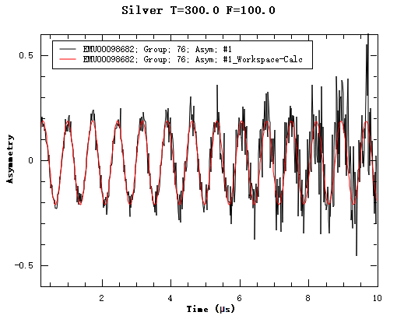
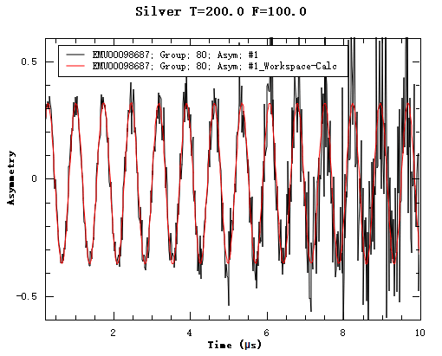






R
$$σ_{stat.}^{2}$$
$$σ^{2}$$
$FoM= A$²R
$$R↑$$
$$A↑$$
$$σ_{syst.}^{2}$$
A
Error analysis of μSR data
EMuS 2020

Slide 10




$$σ^{2}$$
R
A
$$RA2$$
$$σ_{stat.}^{2}$$
$$σ_{syst.}^{2}$$
I. Large solid angle coverage
I. Appropriate solid angle
II. Thin degrader – All counts
II. Thick degrader – E selection
III. Short deadtime - Rate loss
III. Short deadtime - Distortion
IV. Low background - Flypast
IV. Pulse width – ns scale
Requirements for spectrometer design
EMuS 2020

Slide 11
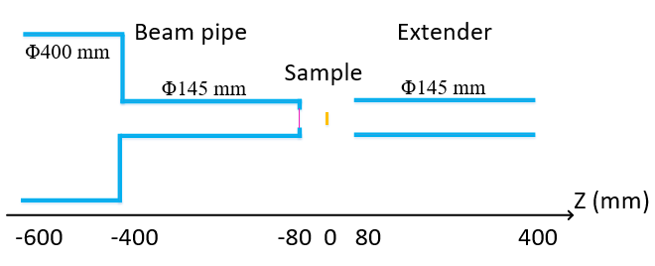
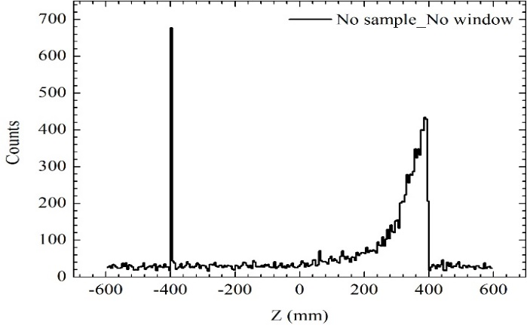
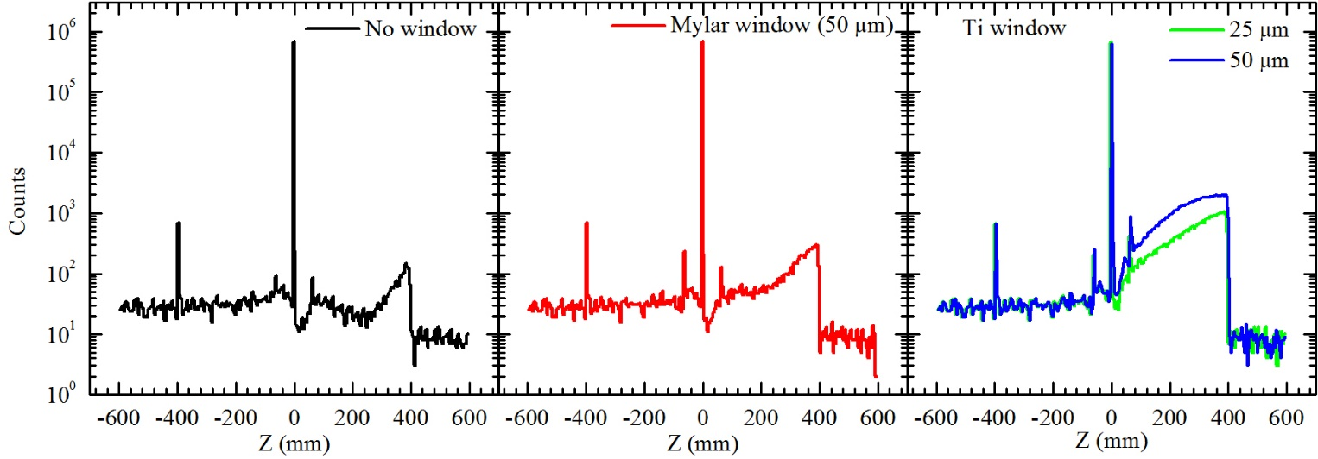
2
Design of Day-One spectrometer
Φ100 mm
Φ100 mm
Scattering is relatively insignificant with mylar window !
Background suppression
EMuS 2020

Slide 12
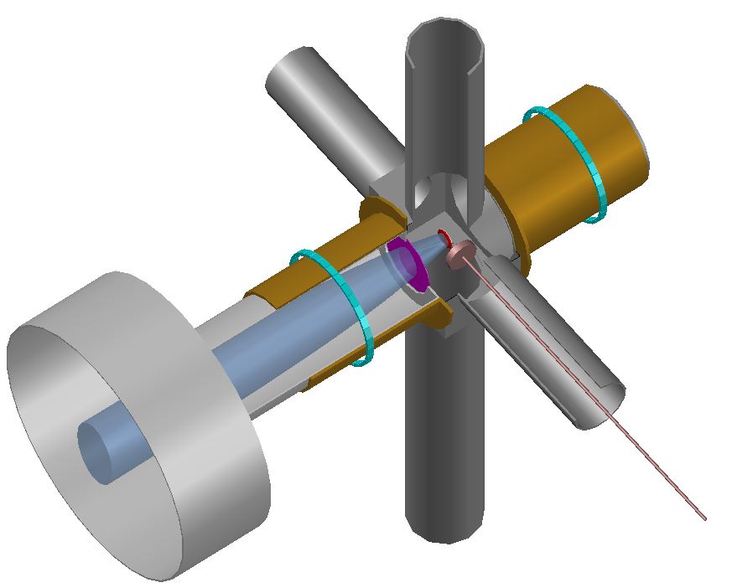
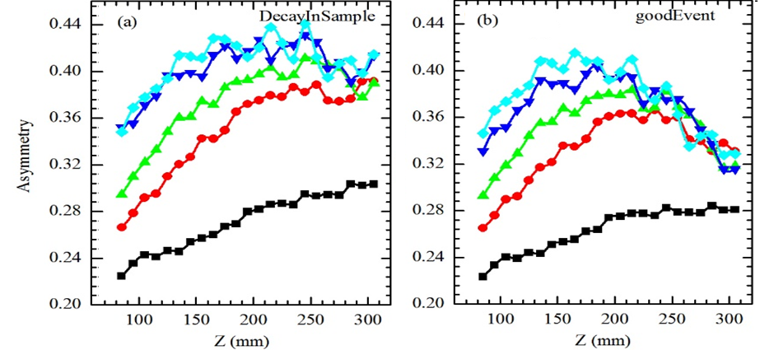
Search the high asymmetry area
Detector length: 10 mm
Ring radius: 90 mm
Degrader thickness: 0/3/5/8/10 mm
High asymmetries can be achieved with thicker degraders and smaller theta.
Asymmetry scanning
EMuS 2020

Slide 13
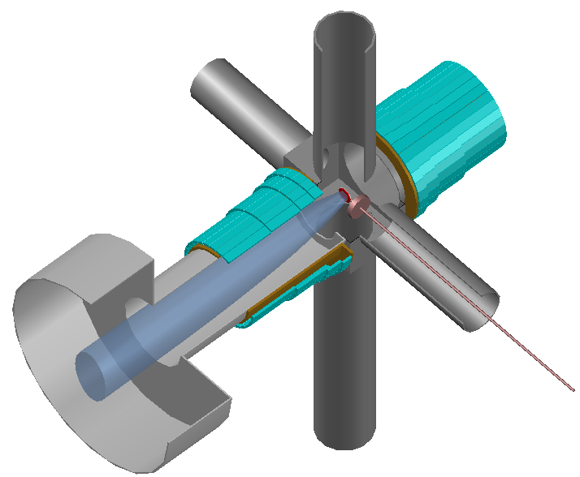
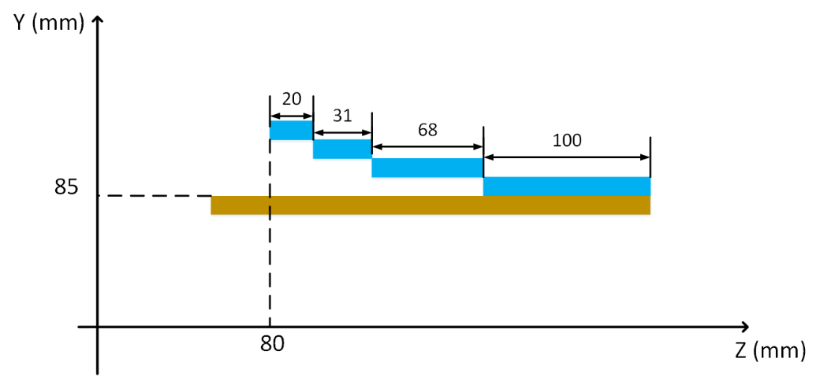
Placement of Day-One detectors
Spot size (mm) | Beam intensity (×10⁵ /s)
Φ10 | 0.58
Φ20 | 4.8
Φ30 | 10
1 2 3 4
32 detectors/ring
Solid angle coverage : 36.7%
Sample size： Φ30 mm
Detector arrangement
EMuS 2020

Slide 14
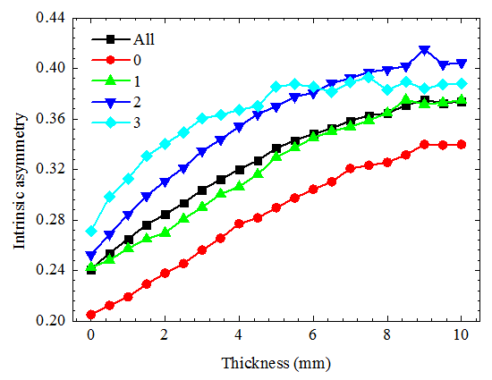
256 Channels
Degrader (mm) | Highest asymmetry | Average asymmetry | Event rate (Mevents/hr)
9 | 0.415 | 0.375 | 22.39
0.28 @ ISIS || 0.16 @ J-PARC
Detector arrangement
EMuS 2020

Slide 15
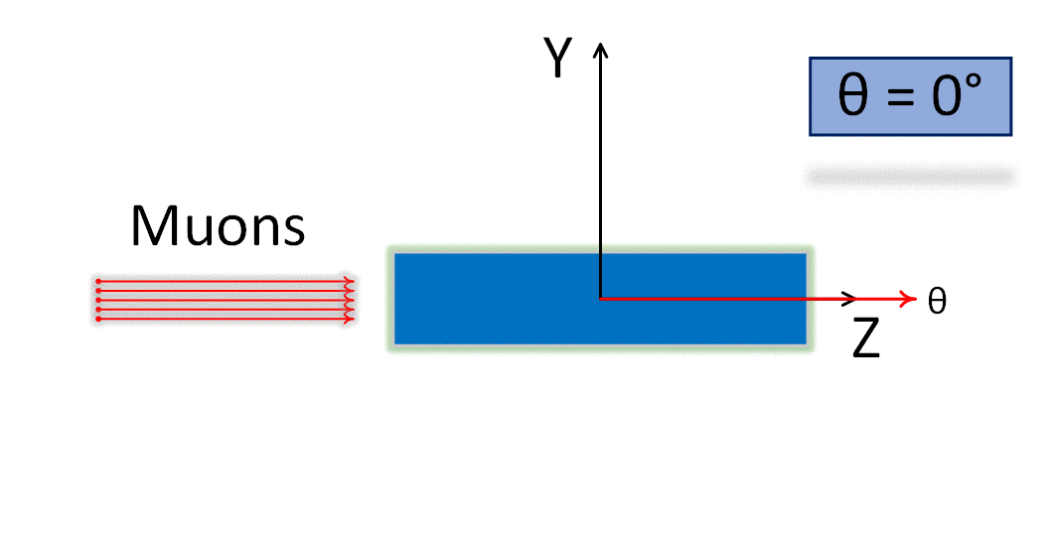
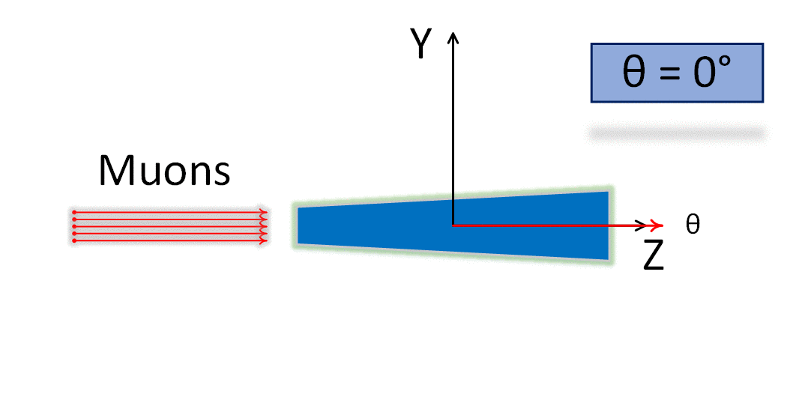
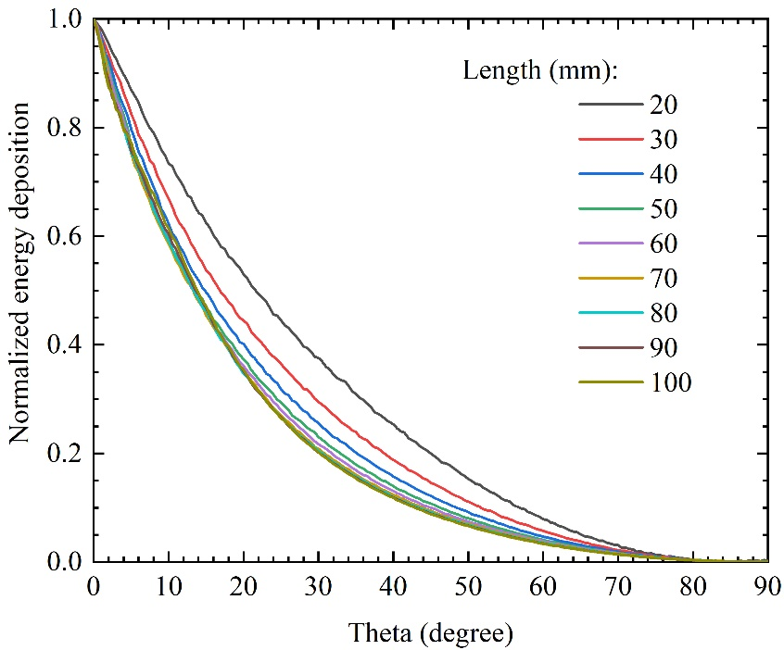
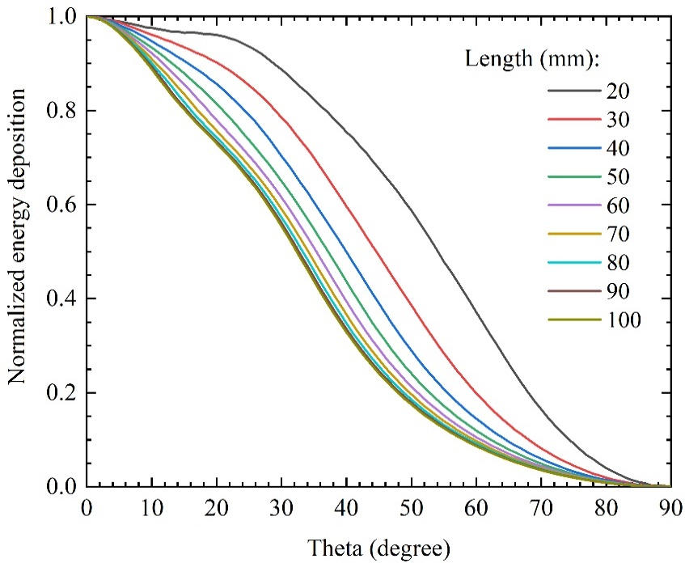
3
Design of Super-μSR spectrometer
Cuboid
Trapezoid
e+
e+
Angular discrimination
EMuS 2020

Slide 16
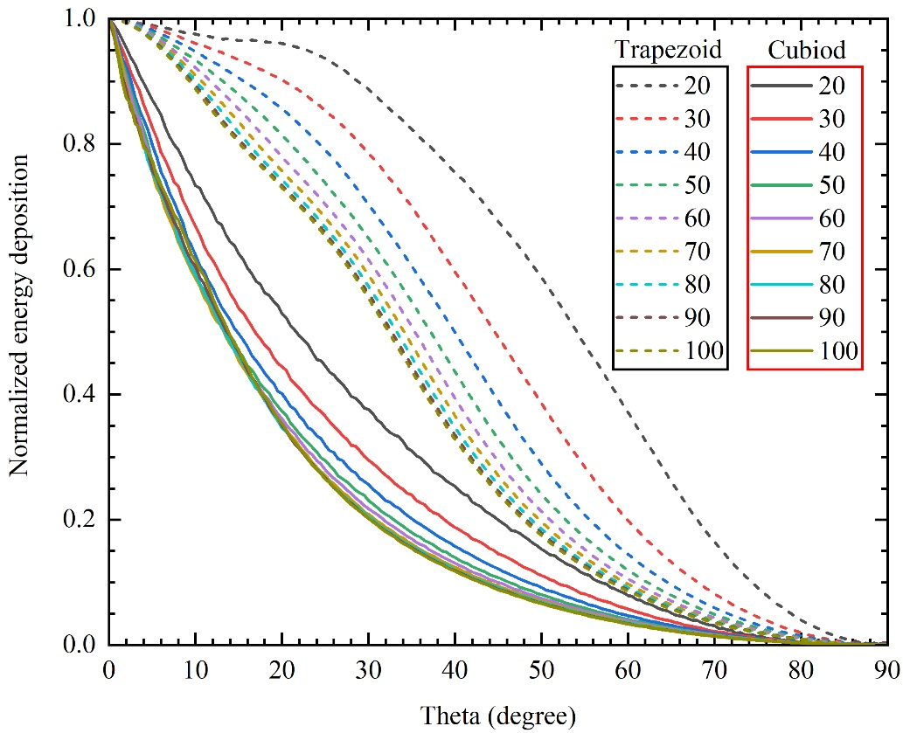
Comparison of two geometries
Cuboid
e+
Trapezoid
e+
The rectangular shape has significant advantages in angular discrimination!
Angular discrimination
EMuS 2020

Slide 17
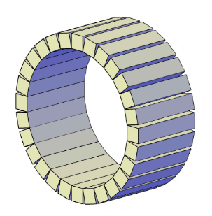
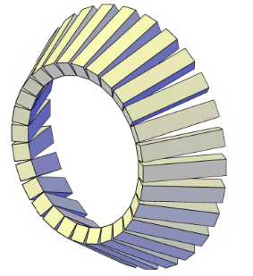
Comparison of two arrangements
Cylindrical
θ∈(θ_{min}, θ_{max})
θ
Range
Spherical
θ∈(0, θ_{max})
θ
Range
Angular discrimination
EMuS 2020

Slide 18
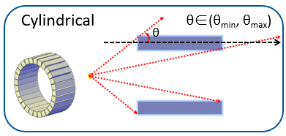
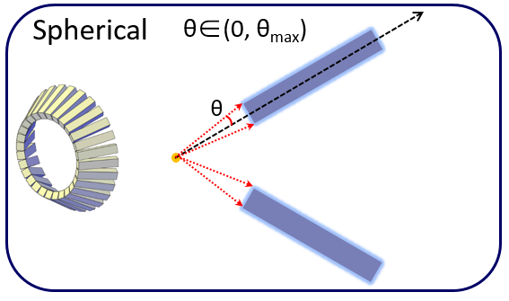
Comparison of two arrangements
The spherical arrangement has an narrow range of discrimination angle;
The cylindrical arrangement cannot distinguish scattering events with the same scattering angle;
Detectors should point to the sample center.
Angular discrimination
EMuS 2020

Slide 19
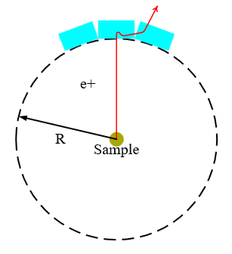
Suppression of double counts
I
II
I: Multiple scatterings of positrons or other secondary particles
II: Spiral motion of positrons in a strong longitudinal field
Types of double counts
EMuS 2020

Slide 20
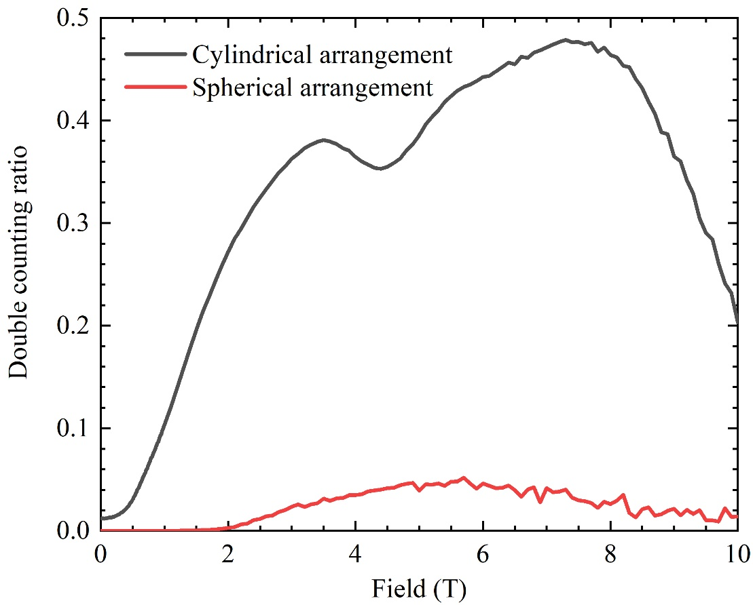
Suppression of double counts
Cylindrical
Spherical
The “point-to-sample” arrangement can suppress the double counting events significantly in LF up to 10 Tesla!
Double counting suppression
EMuS 2020

Slide 21
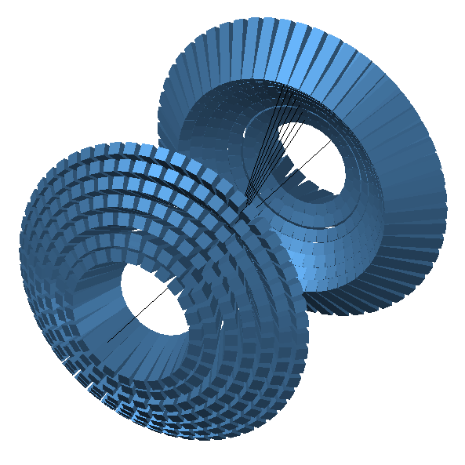
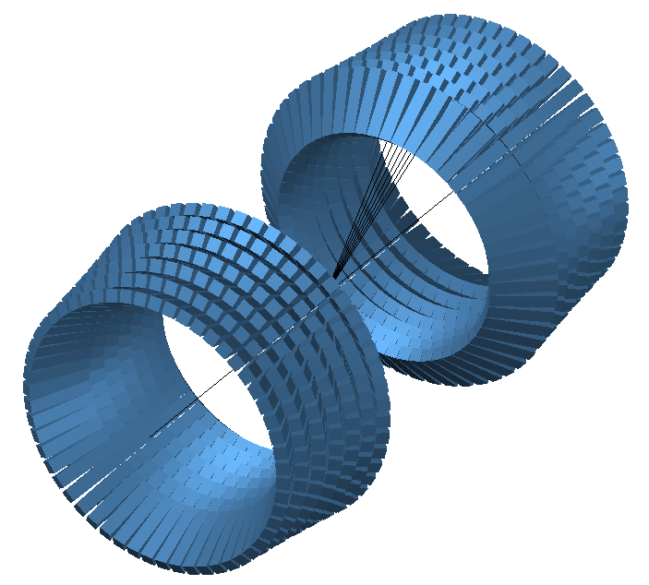
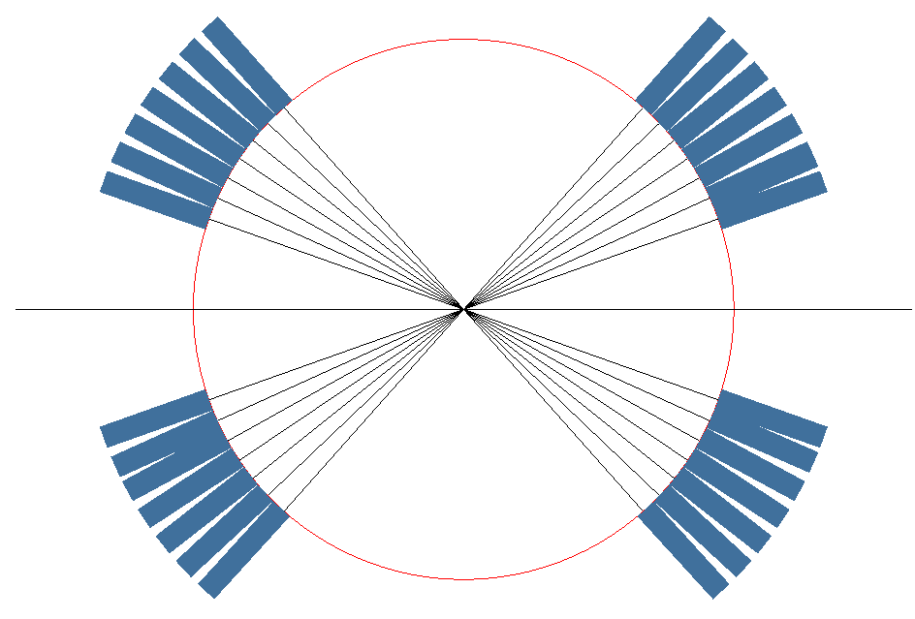
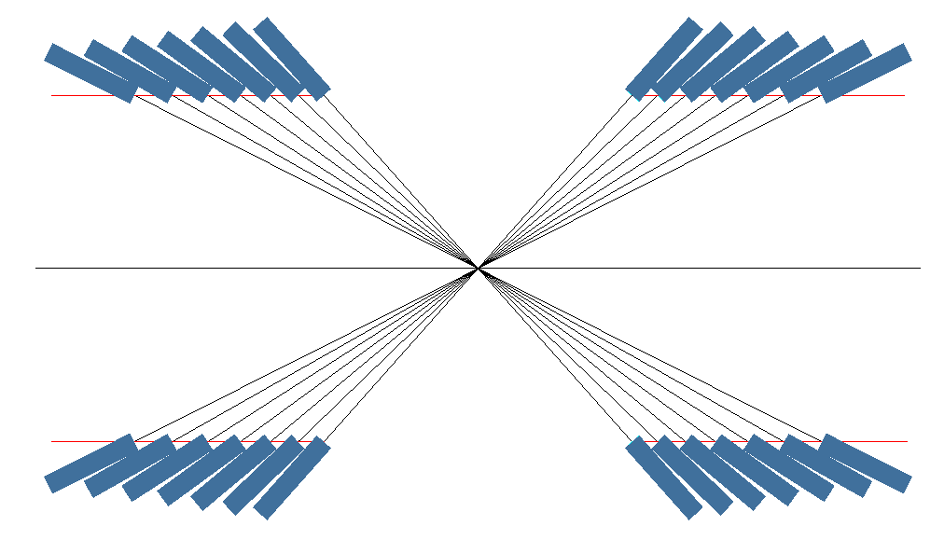
Possible Point-To-Sample models
Spherical model
Hybrid model
Point-To-Sample structures
EMuS 2020

Slide 22
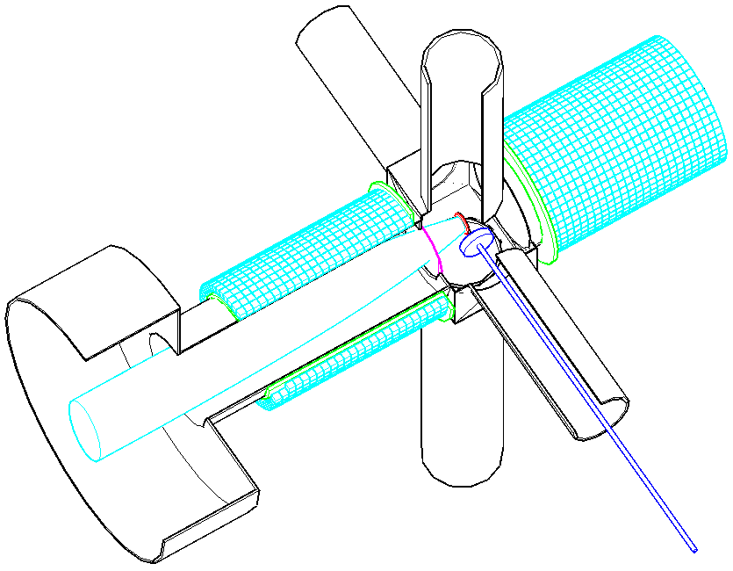


Arrangements of Super-μSR
Cylinder
Sphere
Hybrid
Size：10×10×10 mm³
Number：2560
Rings：25×2
Solid angle：30.6%
Size ：~ 5×5×50 mm³
Number ：2686
Rings：14×2
Solid angle ：42.5%
Size ：~ 10×10×50 mm³
Under development！
Arrangements of Super-μSR spectrometer
EMuS 2020

Slide 23

4
Prototype of a μSR spectrometer
Instruments:
128-channel
Scintillator + L-bent light guide + PMT;
Front-End Electronics + TDC;
QT-based DAQ software.
Main performance:
Deadtime: 7 ns
Acceptable counting rate:
12 Events/detector/pulse
Time resolution: 2 ns
Properties of the prototype
EMuS 2020

Slide 24

Update of scintillation detectors
S-bent
Beam test
L-bent
The output amplitude increases ~ 80%!
Improvements of detectors
EMuS 2020

Slide 25


Update of Front-End Electronics
CFD
LED
CFD: Constant fraction discrimination,
LED: Leading-edge discrimination
Details are in Prof. Liang’s talk!
Improvements of electronics
EMuS 2020

Slide 26

Main test I: deadtime measurement
Second test
Third test
Deadtime measurement
EMuS 2020

Slide 27

Main test I: deadtime measurement
Second test
Third test
The deadtime is improved from > 20 ns to ~ 7 ns after using PZCs;
The counting performance is the same (or better) as that of ISIS’s detection system!
Deadtime measurement
EMuS 2020

Slide 28

Main test II: frequency response
The performance of frequency response is the similar to that of ISIS’s detection system!
Frequency response measurement
EMuS 2020

Slide 29

Summary
Day-One spectrometer
Average asymmetry: 0.375
Counting rate: 2.2X10⁷ events/hour
Super-μSR spectrometer
Promising arrangement: hybrid structure
Under development
128-channel spectrometer prototype
Deadtime: 7 ns
Acceptable counting rate: 12 e⁺/detector/pulse
Satisfy the requirements for muSR applications
Summary
EMuS 2020

Slide 30


谢谢各位专家！恳请批评指正！
µSR: A quantum magnetism probe !

