Slide 1
Origin of >10 TeV gamma-ray emission for CTA ----Xi,shao-qiang
LHAASO Collaboration
高能所

Slide 2
OUTLINE
1. Observation and Model for CTA 1 Region from Radio to TeV.
2. Observation from LHAASO-KM2A and Fermi-LAT
3. Theory Model.

Slide 3
OUTLINE
1. Observation and Model for CTA 1 Region from Radio to TeV.
2. Observation from LHAASO-KM2A and Fermi-LAT
3. Theory Model.

Slide 4
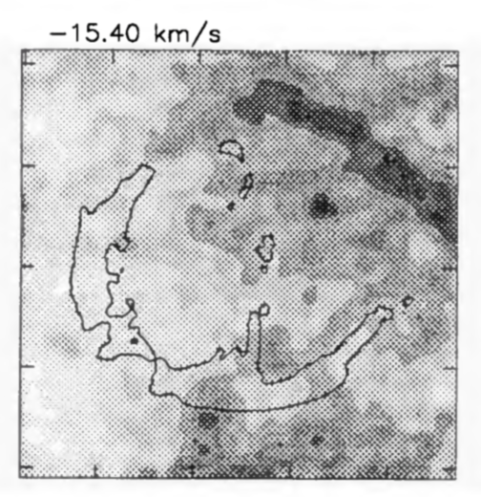
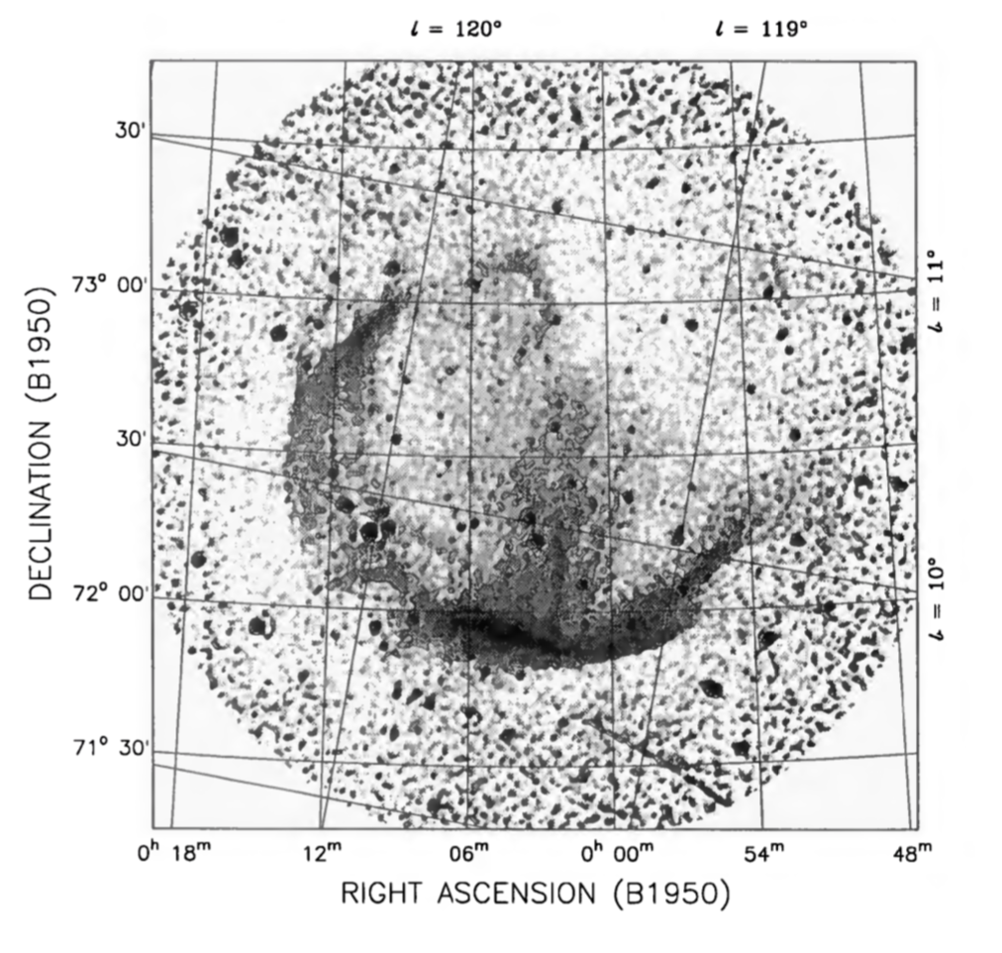
CTA 1
1.4 GHz Continued observation and H1
Pineault et al.1993

Slide 5
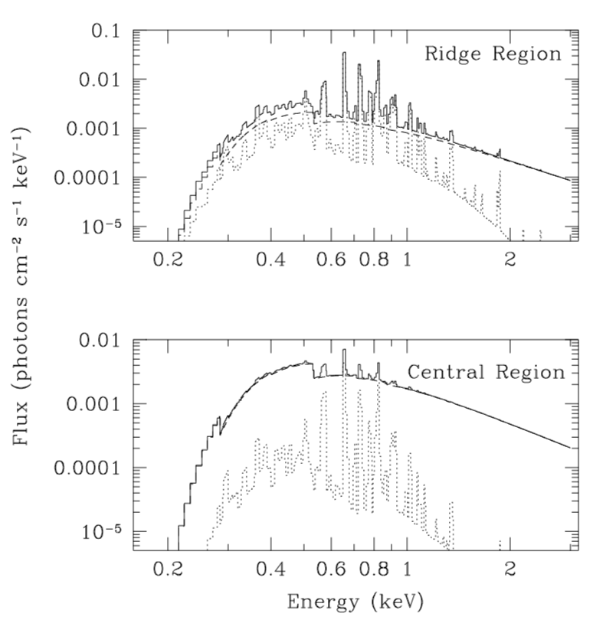
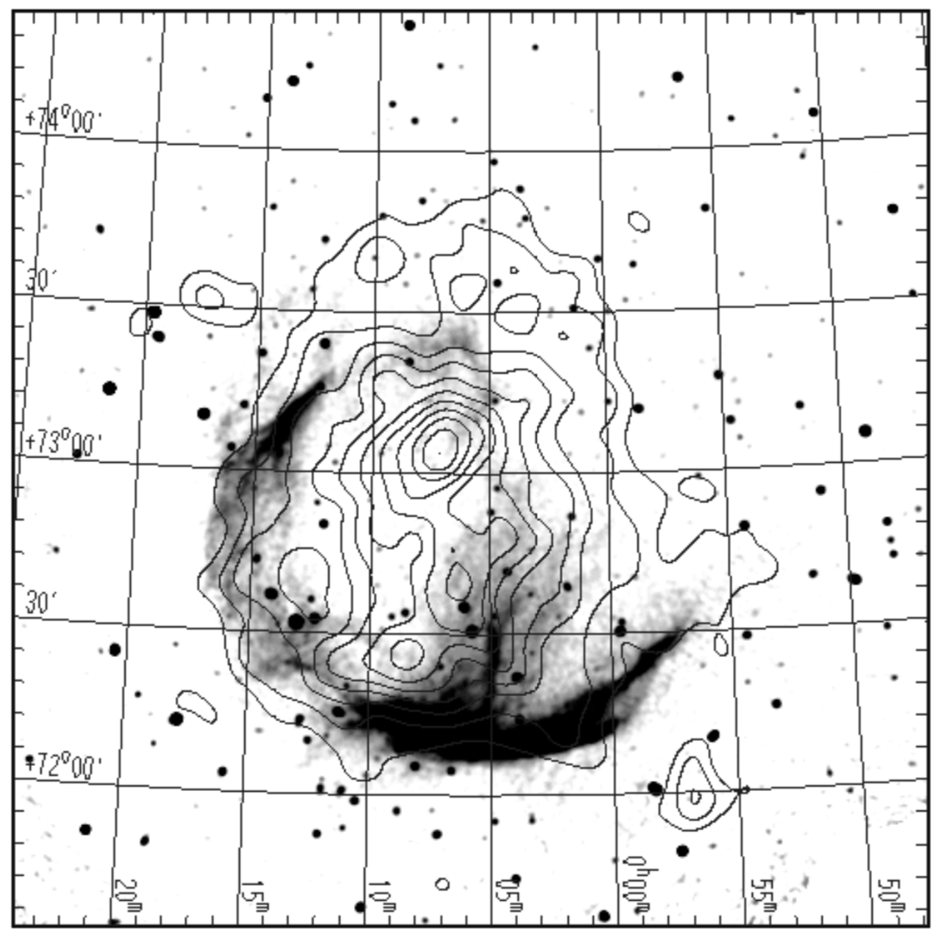
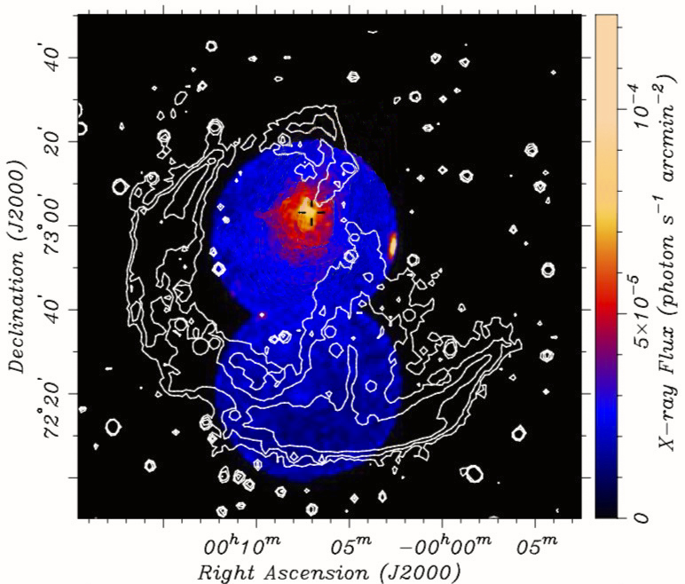
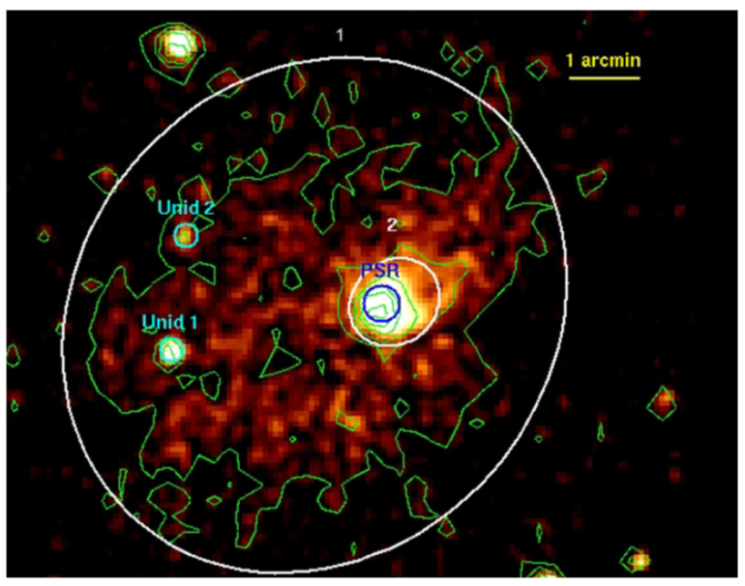
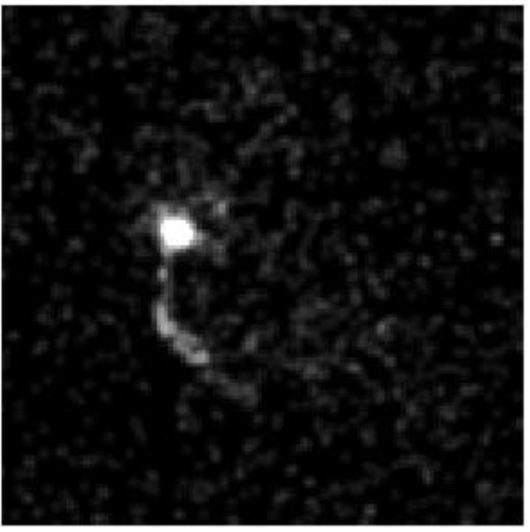
X-ray observation
X-ray Observational Conclution:
~ 10 arcmin Non-thermal from pwn
Thermal from
Center power
ASCA
XMM-Newton
Chandra
Slane,et al 1997,2004; Halpern,et al 2004; Blonding, et al. 2001; Caraveo, et al 2010;

Slide 6
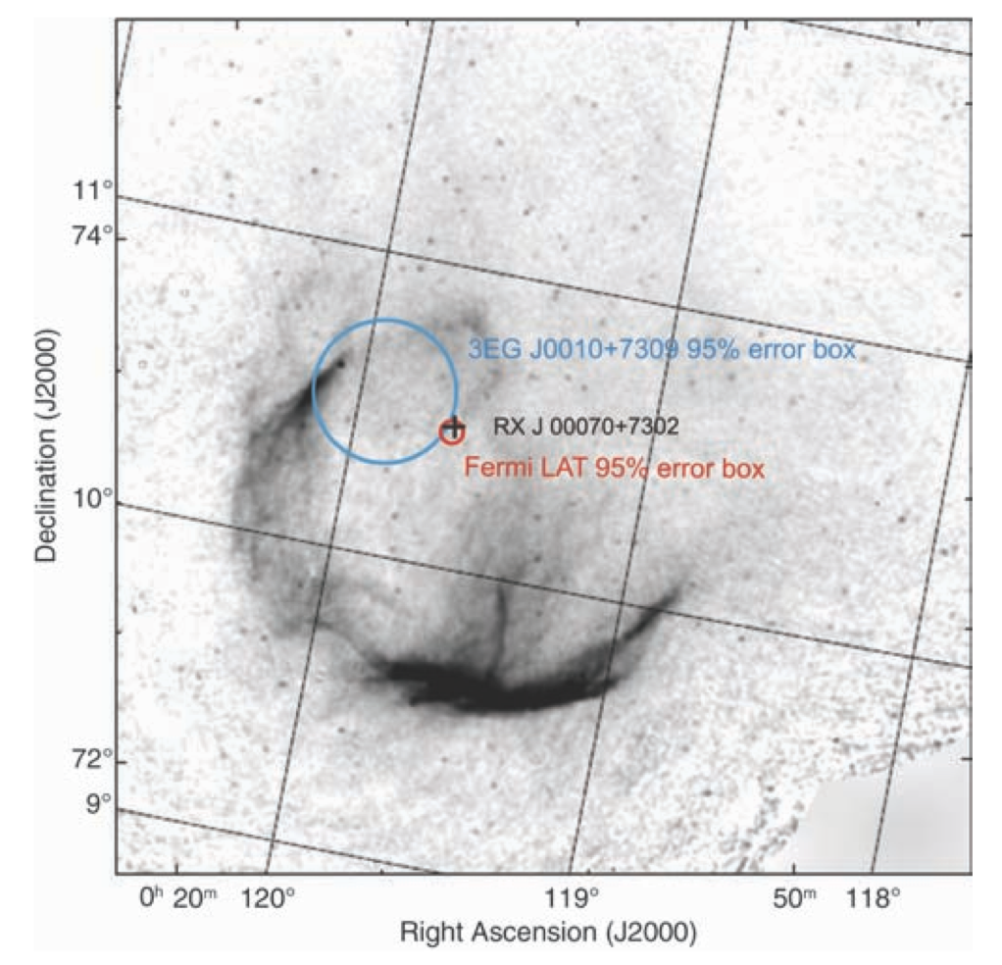
Pulsar discovery and Extended sources
Period | Frequency derivative | Characteristic age | Spin-down power
315.8 ms | -3.524e-12 | ~1.4e4 year | ~4.5e35 erg/s
Fermi-LAT collaboration2008,2012; Li et al.2016

Slide 7
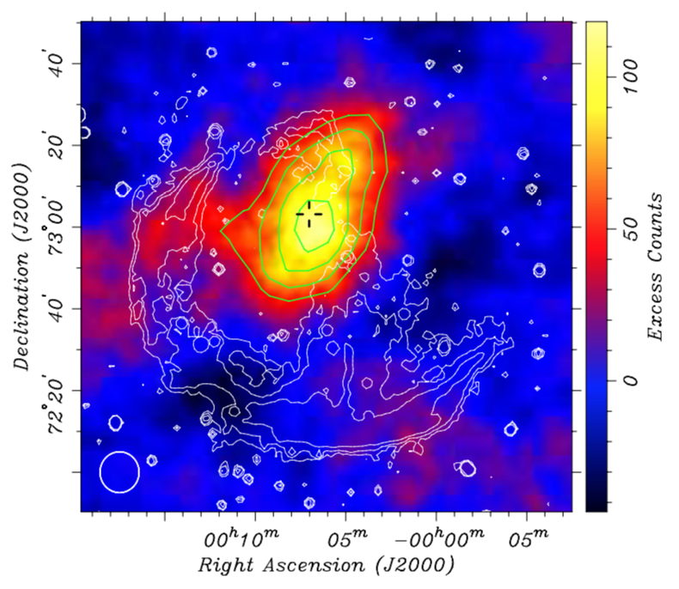
TeV Extended emission
VERITAS counts map
VERITAS Collaboration 2013;

Slide 8
OUTLINE
1. Observation and Model for CTA 1 Region from Radio to TeV.
2. Observation from LHAASO-KM2A and Fermi-LAT
3. Theory Model.
4. Uncertainty for Measure

Slide 9
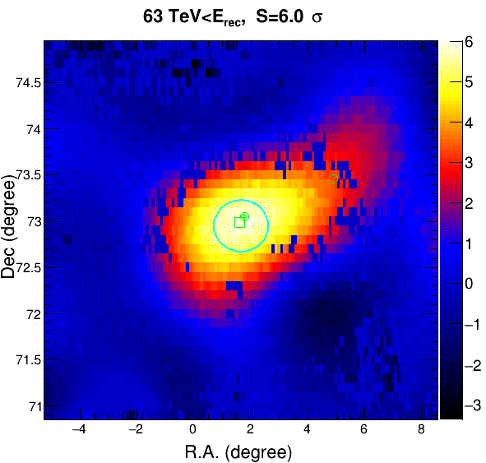
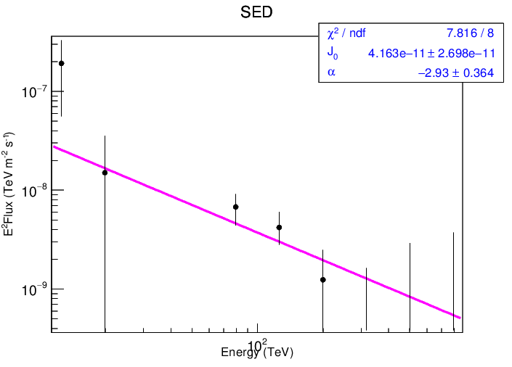
Results
Ra=1.65±0.46
Dec=72.95±0.10
Tentatively 扩展 sigma=0.29 ±0.11 deg(~2.6 sigma)

Slide 10
GeV Extended emission
Fermi-8-years off-pulsed data
Note that 0.5*disk model size approximate the 2D Gaussian model.
Fermi-LAT Collaboration 2018

Slide 11
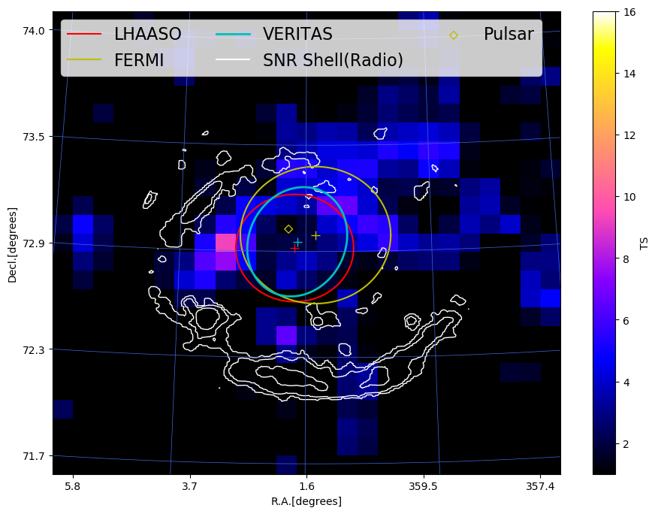
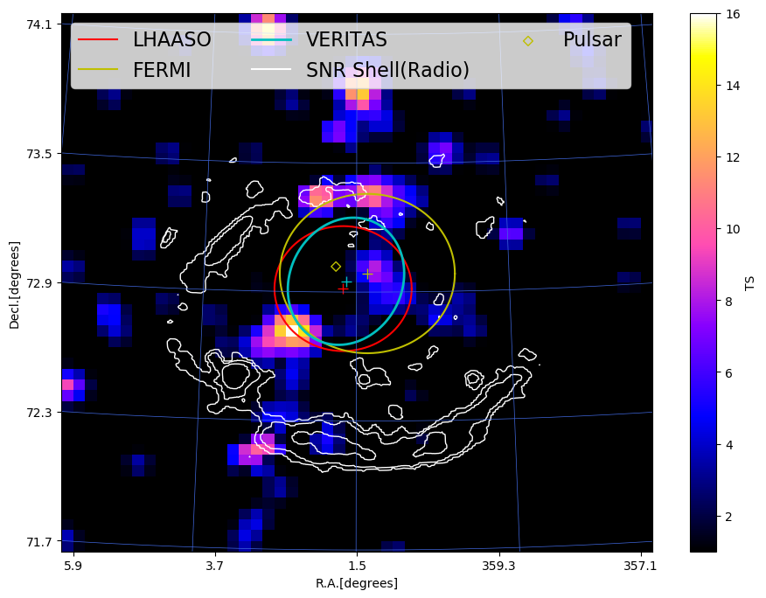
Subtracting the SNR emission
3-30 GeV analysis
30-500 GeV analysis
Martin.J et al.2016

Slide 12
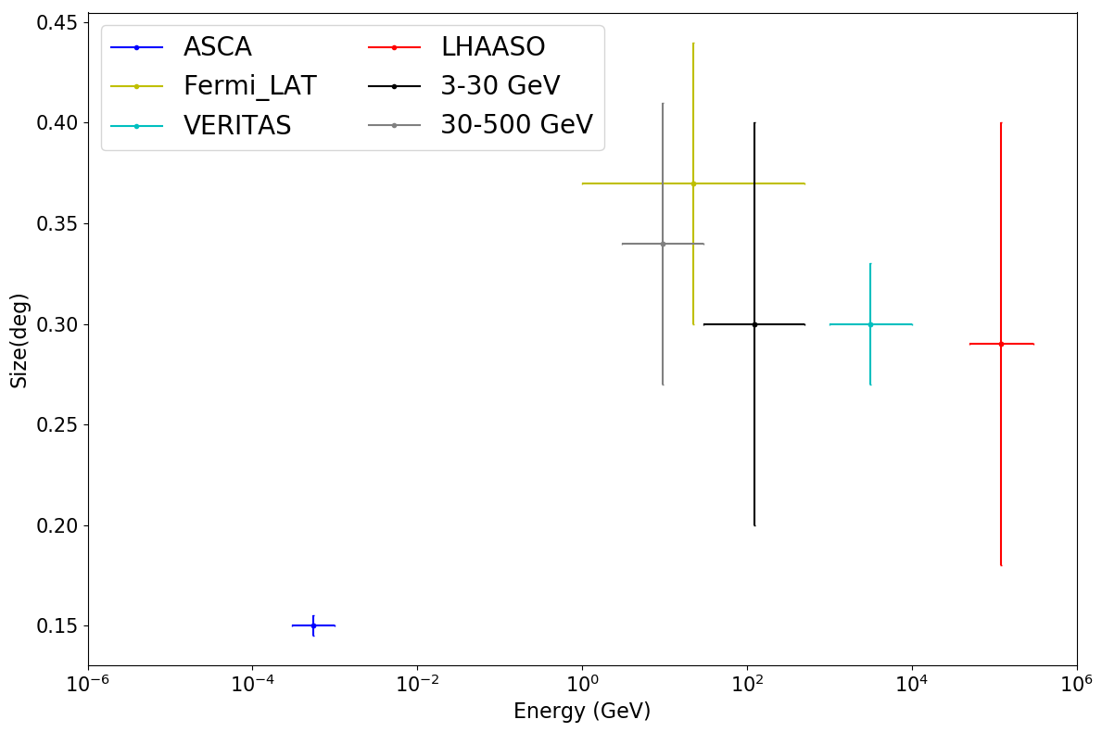
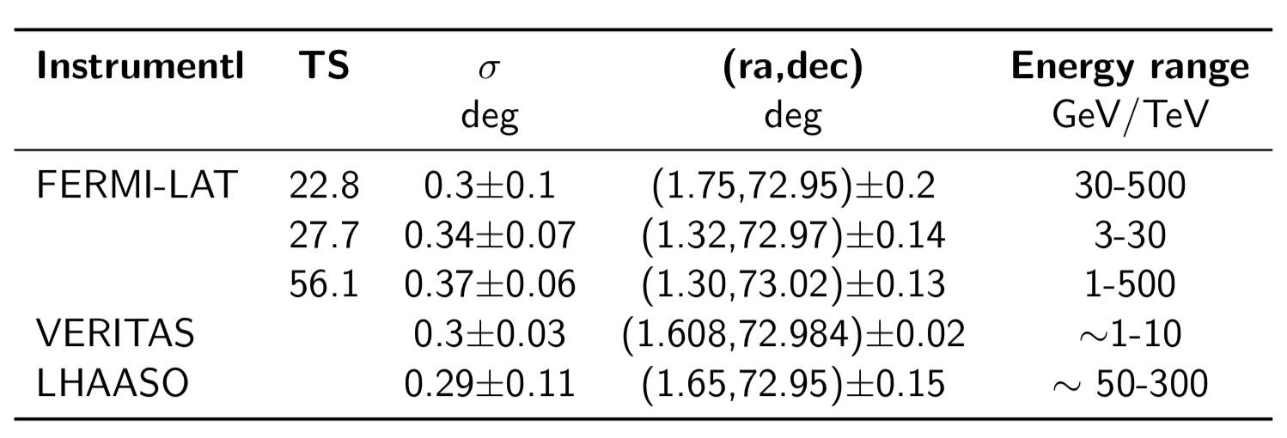
Summary Observation
?

Slide 13
SED

Slide 14
OUTLINE
1. Observation and Model for CTA 1 Region from Radio to TeV.
2. Observation from LHAASO-KM2A and Fermi-LAT
3. Theoretic Model

Slide 15
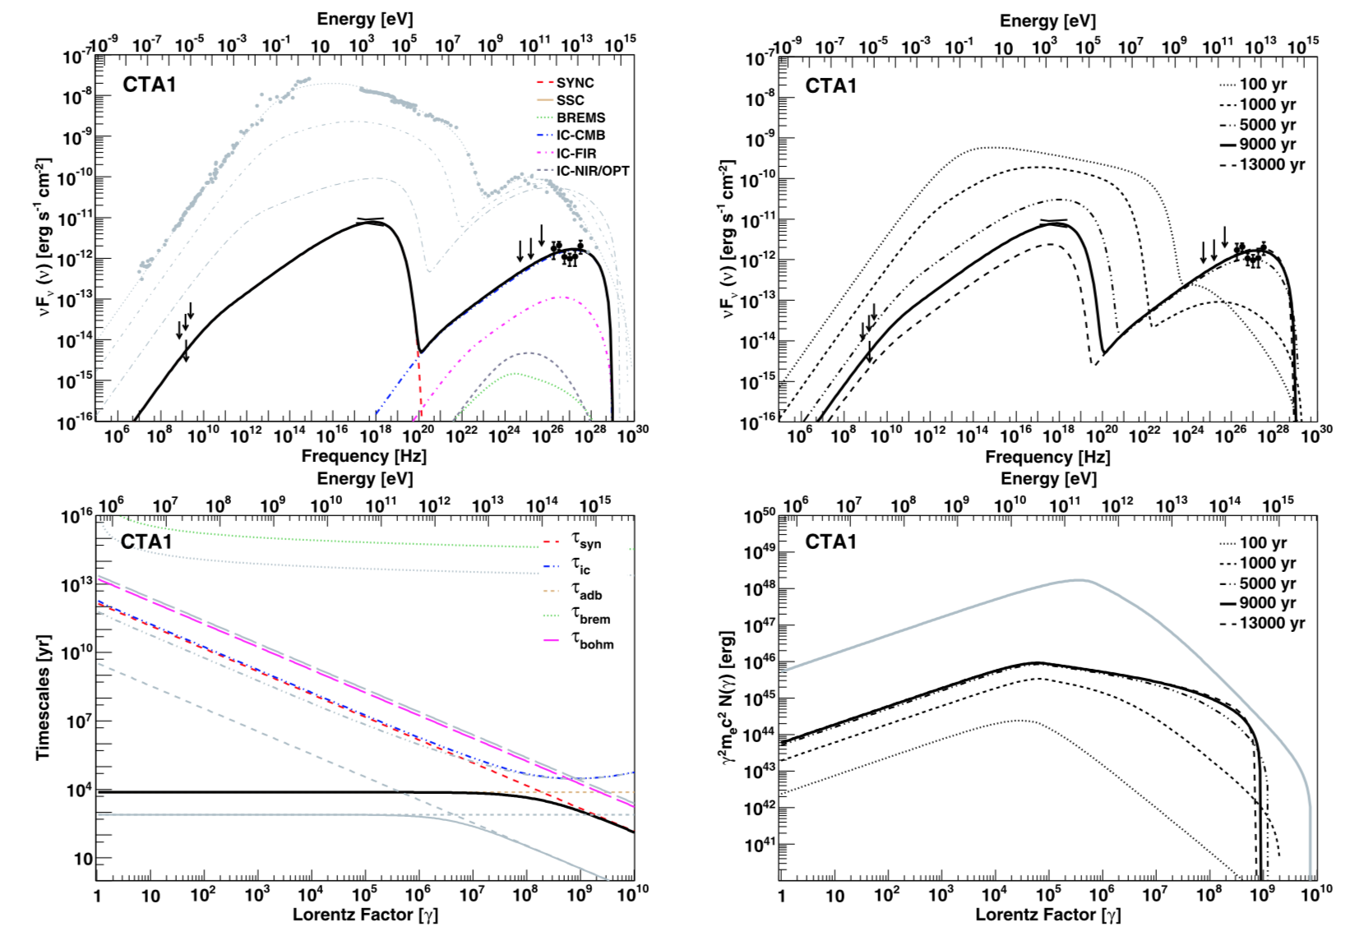
PWN model explain
DF Torres 2014

Slide 16
Comparing to pre-work

Slide 17
B=3 uG, E~30TeV-10PeV

Slide 18
B=5.5 muG, E~30 TeV-10PeV

Slide 19
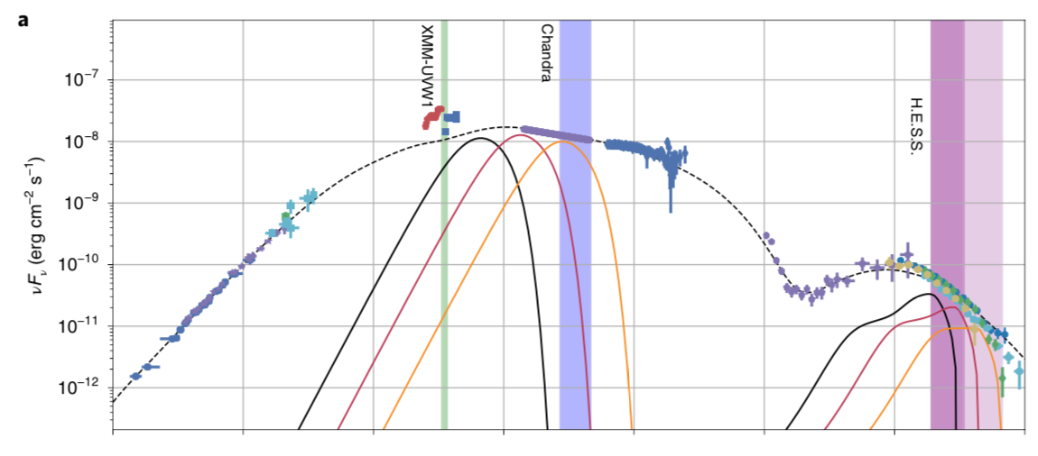
Crab SED

Slide 20
B=5.5 uG, E~20 TeV-200PeVWe= 2.5e45 erg

Slide 21
B=5.5 uG, E~8 TeV-200PeV We= 7e45 erg
$$τ_{sync}≈1.3×{10}^{7}{\left(\frac{E}{1 TeV}\right)}^{−1}{\left(\frac{B}{1 μG}\right)}^{−2} yr$$

Slide 22
CO(1-0) line brightness Temperature
Martin.J et al.2016

Slide 23
Summary
1. >200 TeV emission for CTA region , possible to be extended sources.
2. Extended size may be same from x-ray to UHE.
3. Favor a leptonic emission.
4. It is likely to crab, implication GeV emission is from Syn corresponding to ~200 PeV electron?

Slide 24
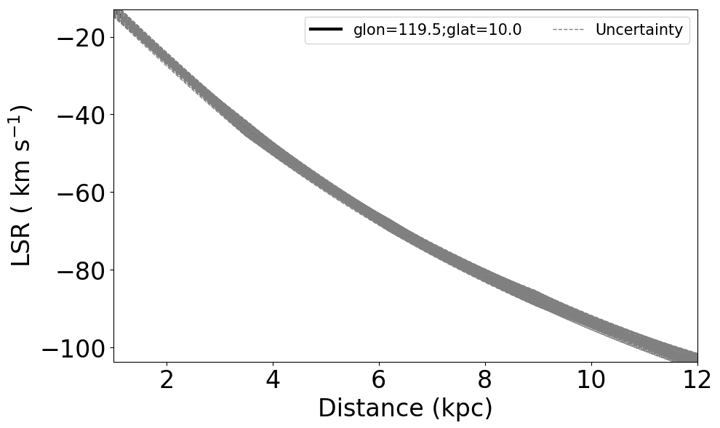
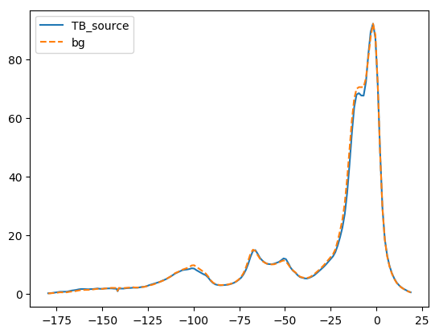
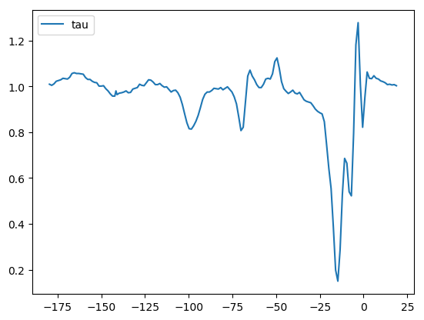
Distance

