Slide 1
Status of data and MC comparison in WCDA-1
Wu hanrong, Lin Sujie, LiuWei, Guo yiqing, Hu hongbo
2021-04-25 Guang Zhou

Slide 2
Outline
Data Sample
MC Sample
MC and data comparison
hits level
events level
4. Conclusions

Slide 3
MC Sample---CORSIKA
Shower MC Code： Corsika7.640
Energy range： 0.01TeV-0.1TeV, 0.1TeV-1TeV , 1TeV-10TeV, 10TeV-100TeV,
100TeV-1000TeV
Particle type： Proton, Helium, CNO, MgAlSi, Iron
index： -2.71, -2.64 , -2.68, -2.66, -2.59
direction： 0< zenith < 60， 0 < azi < 360
energy threshold of Secondary particle ： e+-,gamma: 0.3 MeV；强子,muon：50MeV
Sample statics：
TeV | 0.01-0.1 | 0.1-1 | 1-10 | 10-100 | 100-1000
Proton | 190000000 | 6.0x1e7 | 4.6x1e7 | 7.4x1.6 | 2.6x1e6
Helium |  | 5.7x1e7 | 2.6x1e6 | 1.9x1e6 | 9.6x1e5
CNO |  | 9.0x1e7 | 4.6x1e6 | 2.7x1e6 | 8x1e5
MgAlSi |  | 9.6x1e7 | 8.6x1e6 | 2.5x1e6 | 8.8x1e5
Iron |  |  | 6.2x1e6 | 2.5x1e6 | 1.0x1e6

Slide 4
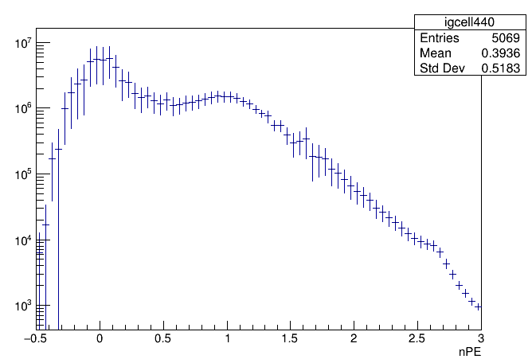
MC Sample---G4wcda && reconstruction
Detector MC： g4wcda4.1+4.2
Area： 2000m X 2000m
Usage times： 100次
Attenuation length： 15m
PMT collection efficiency： 0.8
Reconstruction version： Rb
Noise rate： ~20kHz
Charge resolution： 0.36
Noise spectrum：

Slide 5
Data and mc compasion
Basic hits compasion
noise------simulation reality
Hit signal------energy、position
Hit time-----direction
Events compasion

Slide 6
Date Selection
standard day:
20191122 && 20200630 (after uni-trigger)
2. Nfit>150
3. zenc<50
4. Core form Distance to center of pool < 50m

Slide 7
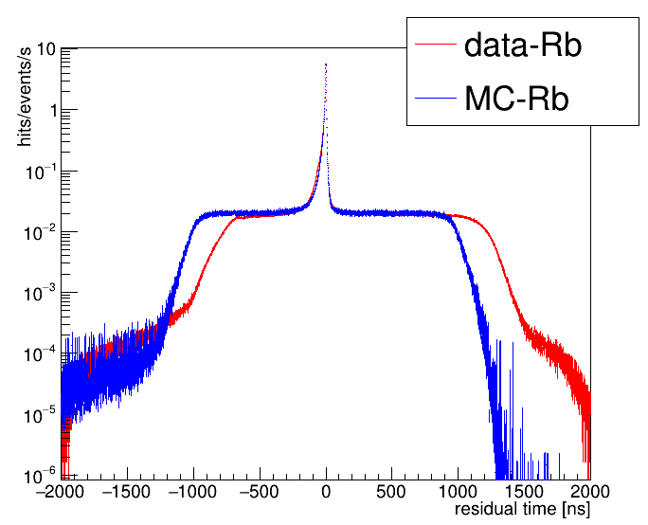
Noise check of data and MC
1. Data: 20191122，noise rate ~20kHz
MC noise rate 20kHz
Residual distribution: 1ns/bin, 20*1e3*900*1e-9=1.8e-2(/eve:nts/s) ➔ data is consistent with MC

Slide 8
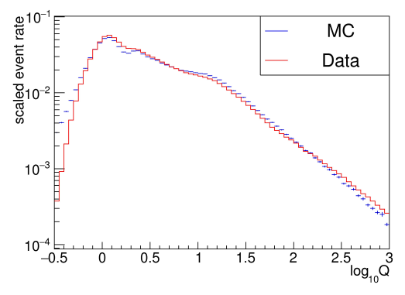
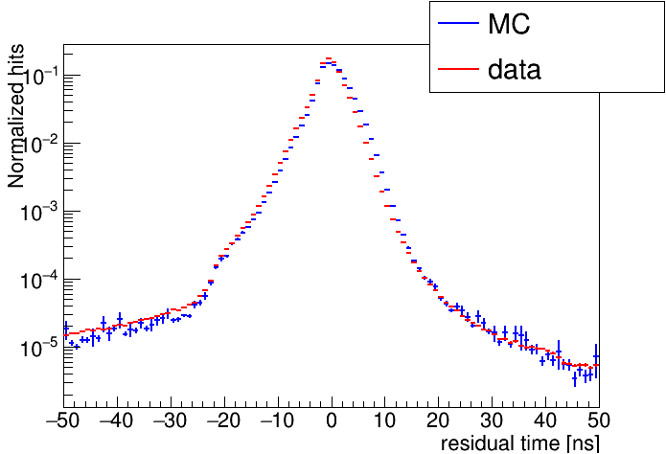
Hits comparison
-----Charge and Tchi from data and simulation
Mc and Data Inconsistensy with about ~20% (Npe>0.5)

Slide 9
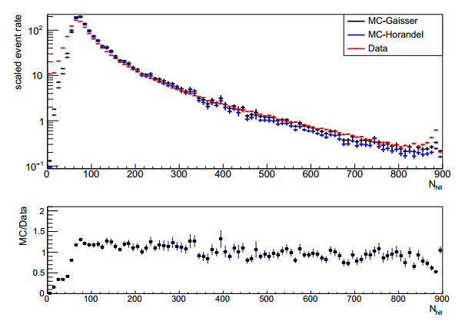
Events comparison
-----Nhit from data and simulation
Mc and Data Inconsistensy with about 10%~20% (Nhit>60)

Slide 10
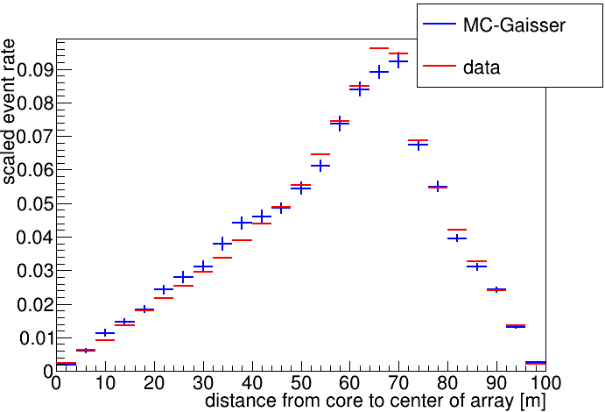
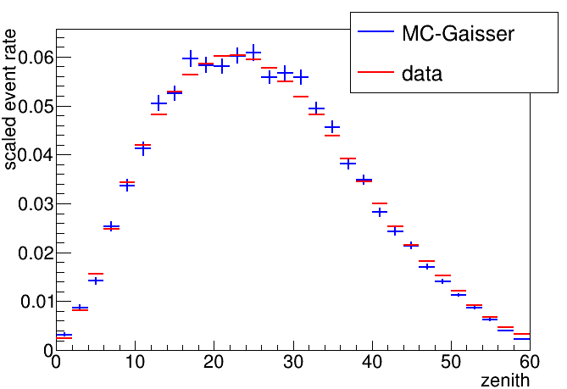
Events comparison
---direction and position from data and simulation

Slide 11
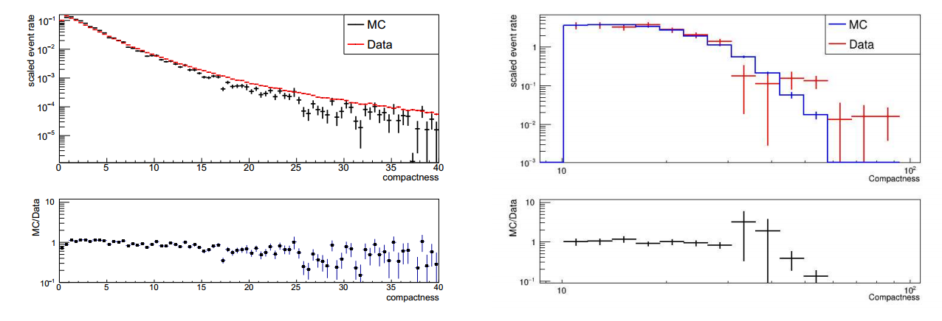
Events comparison
----Compactness of BKG and Gamma from data and simulation

Slide 12
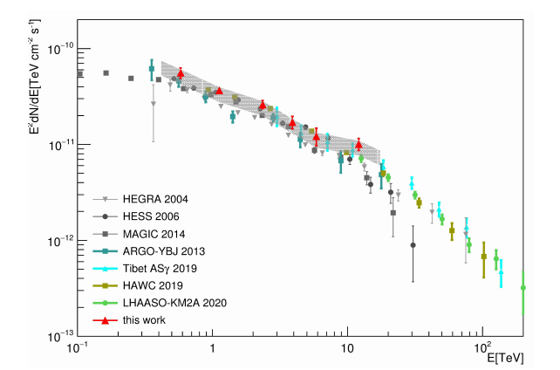
Energy spectrum from crab using WCDA-1 data
From WCDA-CPC paper

Slide 13
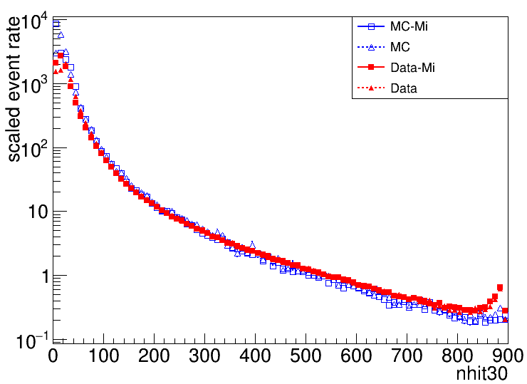
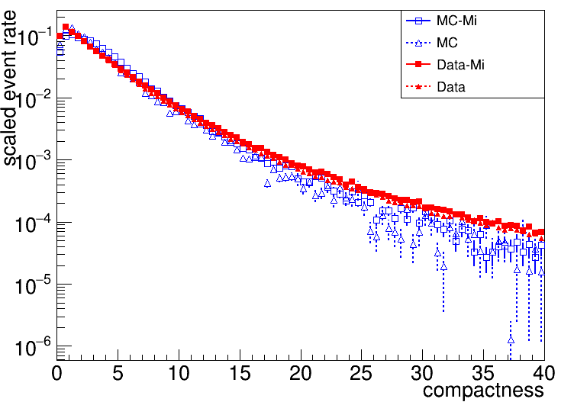
Events comparison
-----Nhit and compactness (uni-trigger)

Slide 14
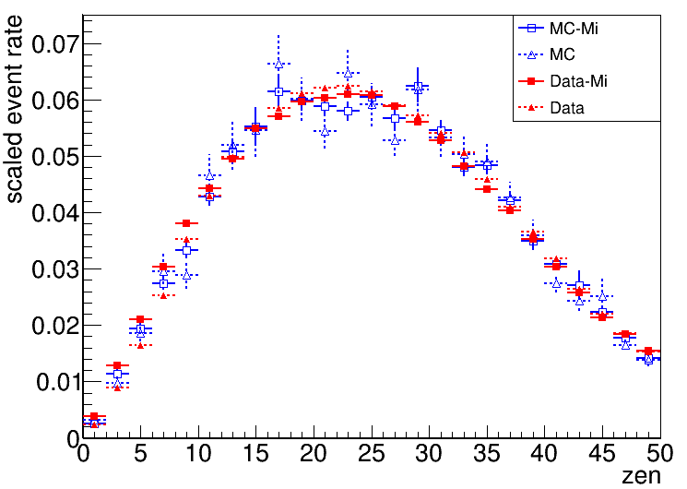
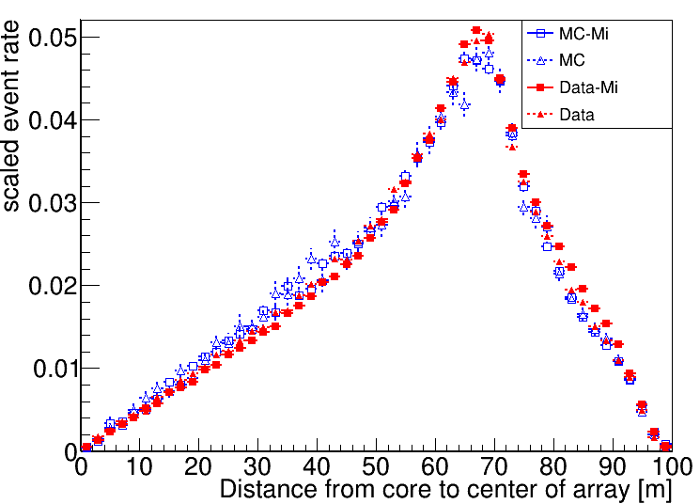
Events comparison
----- zen and position(uni-trigger)

Slide 15
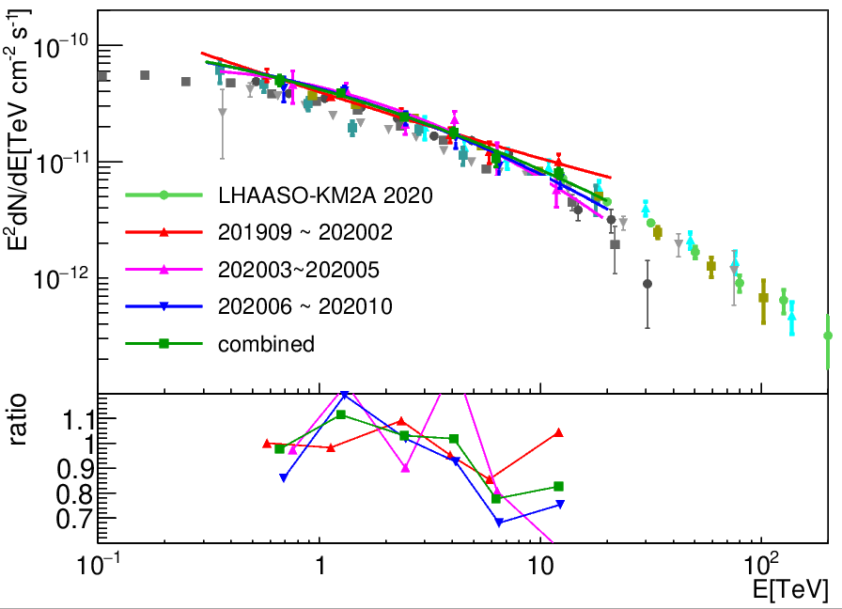
Energy spectrum from crab
(from Su-jie Lin’s PPT)

Slide 16
Full Simulation
g4wcda MC code is ready(4PMTs is merged)
Mass production is in progress

Slide 17
conclusions
The consistency of data and MC are checked from hits and events level, scaled event rate is well consistent
energy spectrum from Crab using WCDA-1 data consistent with other experiment
To do Full Simulation

Slide 18
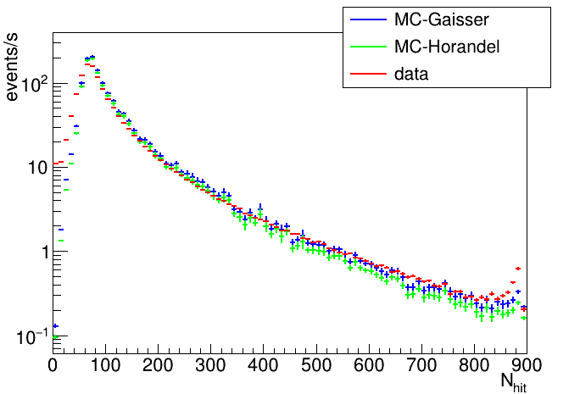
Cut: zenc<45 && 阵列中心<30m && nhit30 [500,800]
Rate_data = 7.4
Rate_mc = 4.5 (Gaisser)
Rate_mc = 3.8 (Horandel)
Data/MC(Gaisser) = 7.4/4.5 = 1.64
Data/MC(Horandel) = 7.4/3.8 = 1.95
画图cut:
Zenc < 45 && 阵列中心<50 m
MC整体抬高64%
Peak 处 MC比数据高约 ~30%
Scaling 前：
9.0cm光阴极时，rate比值（【60,800】）：
data/MC=1.39 （Gaisser），
data/MC=1.49（Horandel）.
Scaling 后：
Data/MC=0.84(Gaisser)
Data/MC=0.9 (Horandel)

Slide 19
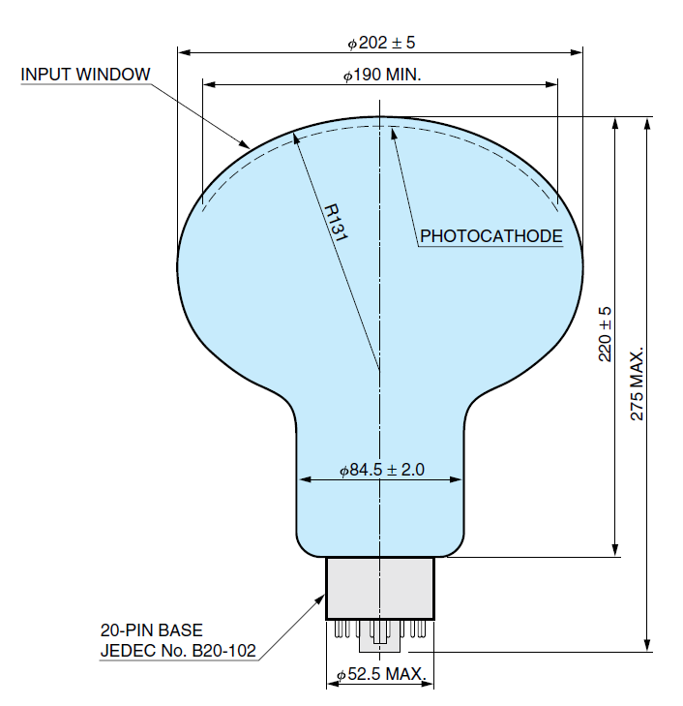
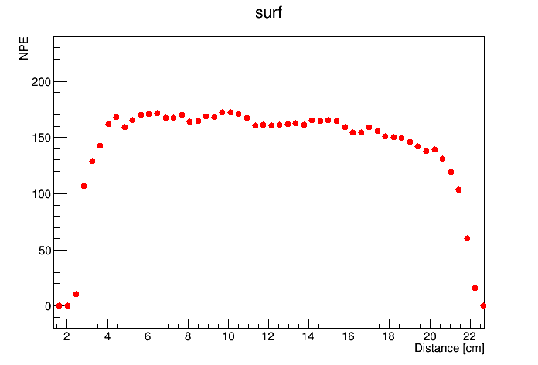
PMTR5912官方数据：
1. 赤道宽度202mm+-5
2. 光阴极不小于190mm；
3. 玻壳厚度3mm；
高博测量

Slide 20
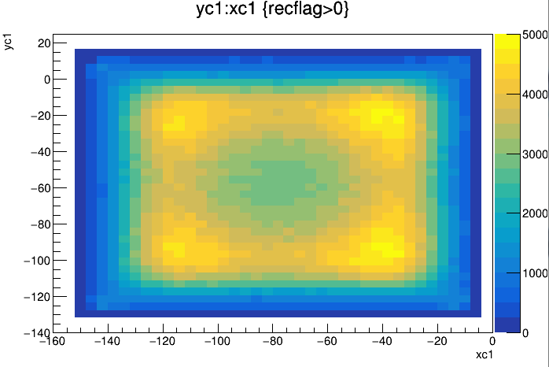
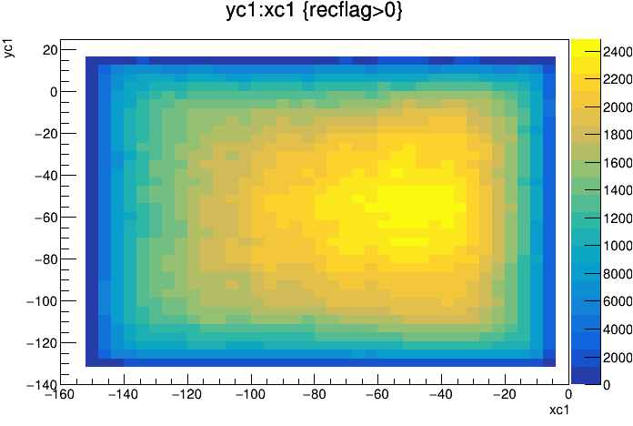
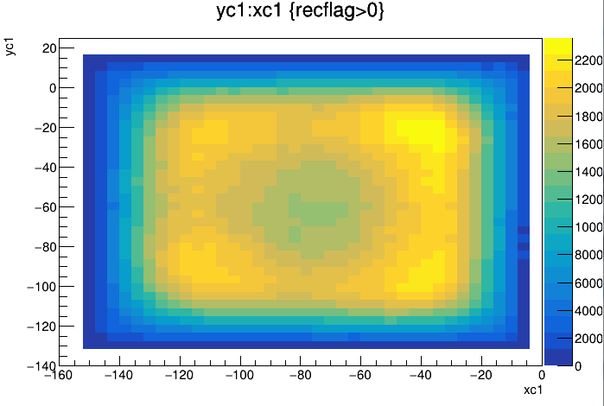
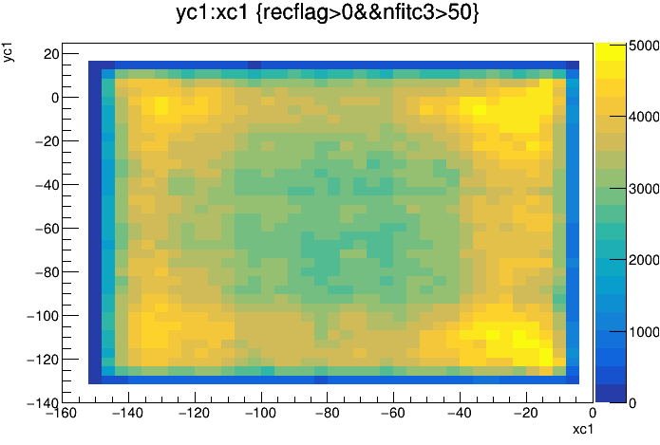
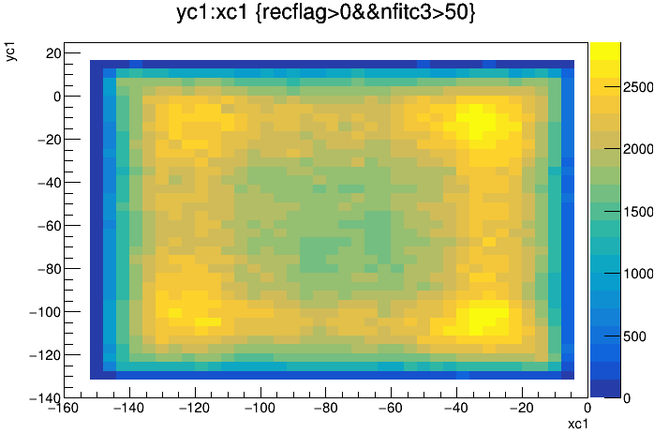
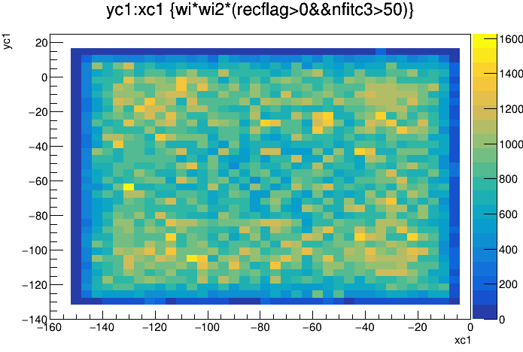
MC
reduce
dat

