Slide 1
LHAASO KM2A Reconstruction Software
based on LodeStar
Jia Kang, Zhu Chengguang , Li Zhe (IHEP)
Shandong University
2021.04

Slide 2
LodeStar: LHAASO Offline Data Processing Software Framework
New Version installed in cvmfs
sl7_x86_64_gcc6.5.0
Support the xrootd agreement
Update all DataIO services for xrootd
The whole software is based on Lodestar

Slide 3
The Software Structure
DetectorQuality_3quarter
Get detectors status
KM2Arec_3quarter
Main Reconstructed Program
Shell
bash file directory for run and sub jobs
RawData
DetectorQuality
Status.root
KM2Arec
RecData

Slide 4
DetectorQuality
Detector Quality Monitor
Noise rate, Occupancy, Time residual of each ED and MD
Two versions are provided
GeomertrySvc
EventRecIhepSvc
Two Output Type
Status.root
RawData
RawInputSvc
GetDetQuality
or
Status.txt
KM2ATimeSvc
KM2ACharSvc

Slide 5
The Main Program – KM2Arec
KM2ACharSvc
KM2ATimeSvc
GeomertrySvc
EventRecIhepSvc
RecData
RawData
Event Loop
RawInputSvc
DataCalibration
EventReconstruction
NtupleOutputSvc
RawEvent
LHCaliEvent
LHRecEvent

Slide 6
Shell
Shell package
Release package
LHStatus_V1.py
LHStatus_V2.py
Trans.py
LHRec.py
RecStand.sh
RecSub_job.sh
Status1_release
Status2_release
Rec_release

Slide 7
Test and Performance
We run some tests:
Run Time
Data Storage
Data save in
/eos/lhaaso/ (have copy file )
/eos/user/ (no copy file)
DetectorQuality ~ 5min
KM2Arec ~ 1h 50min
Both of them have no unsuccessful file

Slide 8
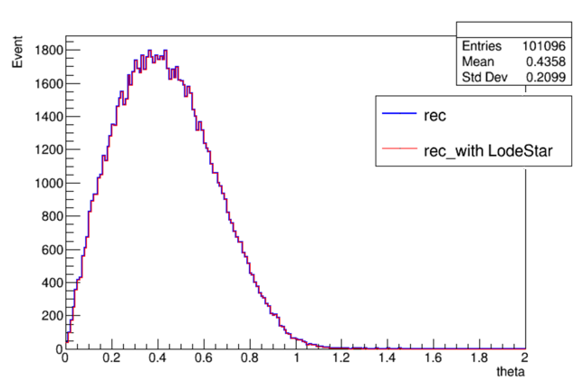
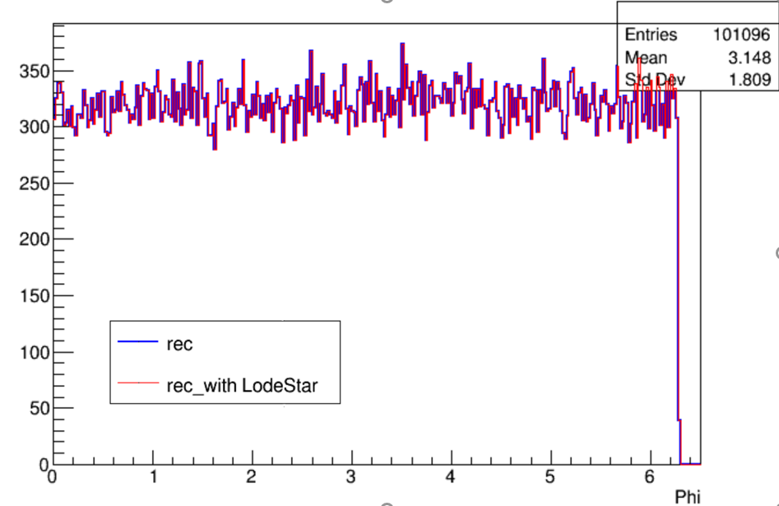
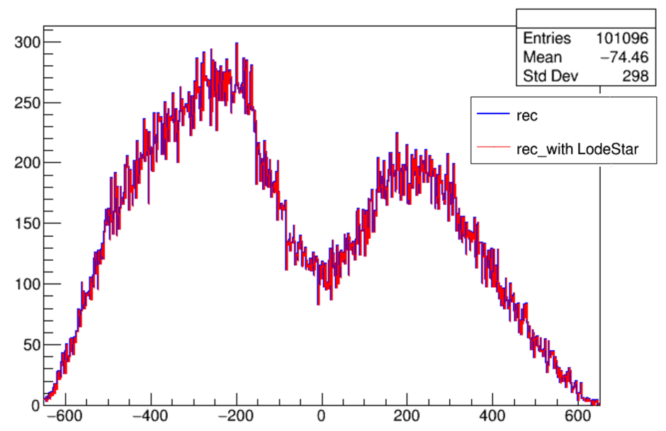
Test and Performance
Comparison of some key parameters :
r_Theta
r_Phi
r_Corex

Slide 9
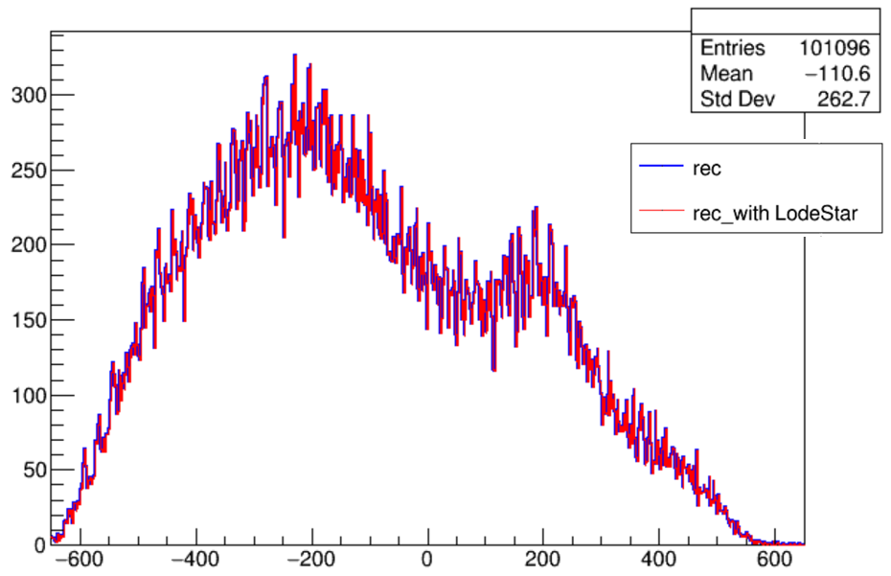
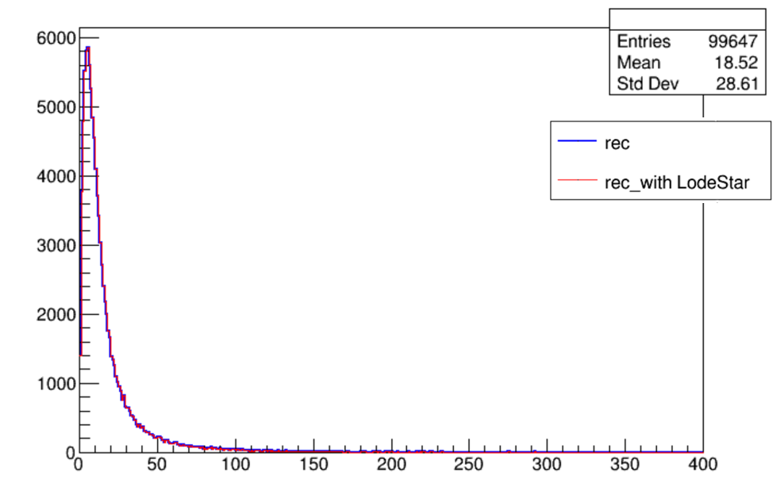
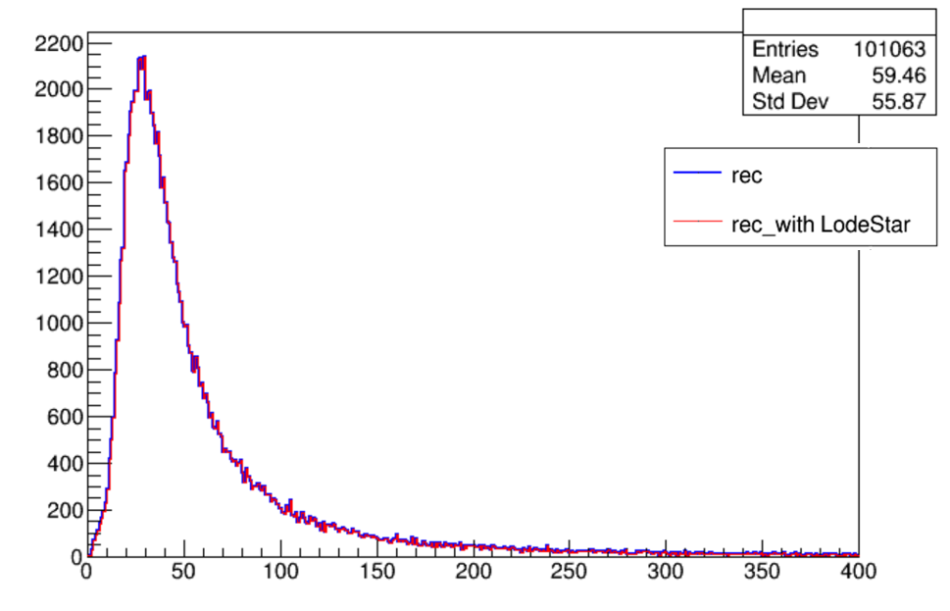
Test and Performance
Comparison of some key parameters :
r_Corey
NpE3
NuM4

Slide 10
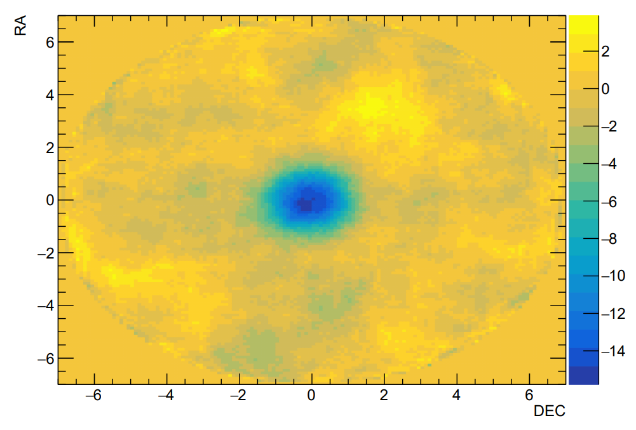
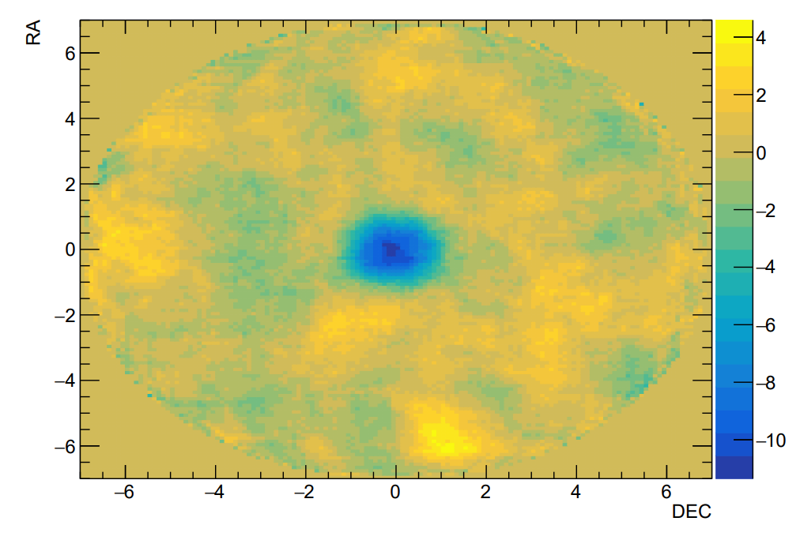
Test and Performance
We also used the 7days data to analysis moonshadow
Data : 20201227-20210102 7 days
NfiltE>=15&&NfiltE<42
NfiltE>=42&&NfiltE<120
MoonShadow

Slide 11
Summary
The program has been basically completed and realized its function.
More detailed tests are still under way ......
Based on Lodestar's features:
All algorithms and services are independent modules ,which reduced the bug rate.
common services and unified data interfaces
The event loop of LodeStar management can reduce the risk of memory leaks
The Twiki page can provide better application sharing
http://twiki.ihep.ac.cn/twiki/view/LHAASO/LhaasoSoftware

Slide 12
Thank you!

Slide 15
operation
Based on the encapsulation and modularity provided by the LodeStar framework , the user does not need to consider DataModel and DataIO
configuration environment
Download the need package
make install
execute

Slide 16
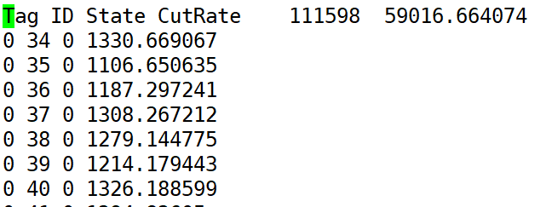
DetectorQuality
It also provides two types of
output file
It provides two algorithms for generating state files
Txt file Root file
GetDetQuality_V1
GetDetQuality_V2
Corresponding to
/eos/lhaaso/rec/km2a/software/Detector_Quality/
V1
V2

Slide 17
The Main Program – KM2Arec
GeomertrySvc
EventRecIhepSvc
GeometrySvc provides two data interfaces for DetectorState file
SetDetectorStatus() for Status.txt
SetDetectorStatusRoot() for Status.root

Slide 18
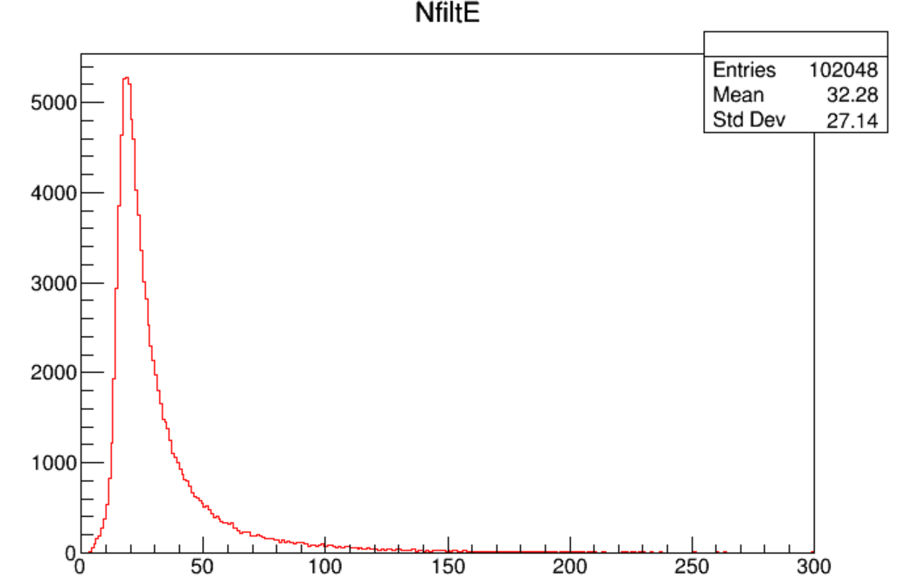
Test

