Slide 1
A unified model for orphan and multi-wavelength blazar flares
王泽睿
合作者：柳若愚，王祥玉，Maria Petropoulou，Foteini Oikonomou，薛瑞
2021年度LHAASO合作组第一次会议暨工程进展会
广东▪广州
2021/4/25

Slide 2
Outline
Introduction
Stochastic dissipation model
Results
Conclusion

Slide 3
Introduction
Blazar are the most extreme subclass of AGN with a relativistic jet closely aligned to the observer’s line of sight.
Blazar flares have been observed at different energy bands with different duration timescales ranging from several years to few minutes.
Different type of blazar flares: multi-wavelength flare, orphan flare.
Orphan flare: optical, GeV, TeV, neutrino (TXS 0506+056).
True orphan flare rates: 54.5% of optical and 20% of γ-ray flares are orphan events (178 blazars sample from Liodakis et al. 2019).

Slide 4
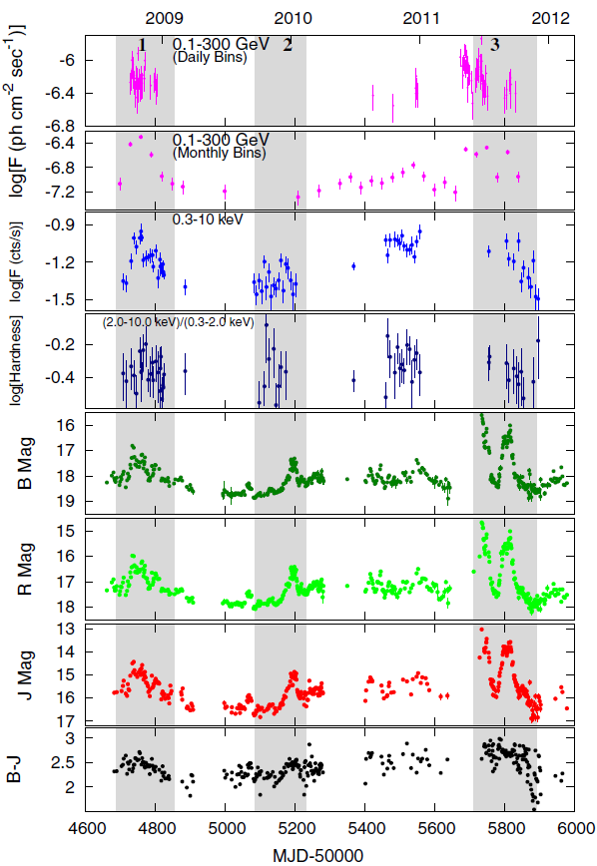
Introduction
Orphan optical flare
MWL light curve of PKS 0208-512
Chatterjee et al.(2013)
Orphan optical flare in 2010
FSRQ
Lasting for ≥3 months

Slide 5
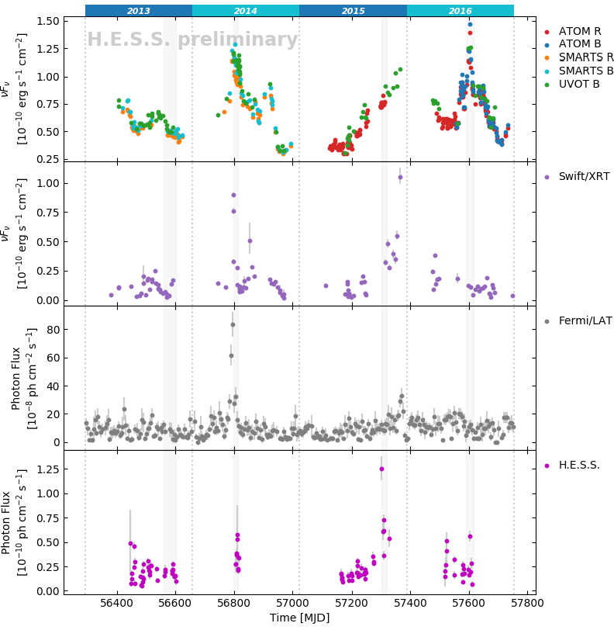
Introduction
Orphan optical flare
MWL light curve of PKS 2155-304
Wierzcholska et al.(2019)
Orphan optical flare in 2016
BL Lac
Lasting several months

Slide 6
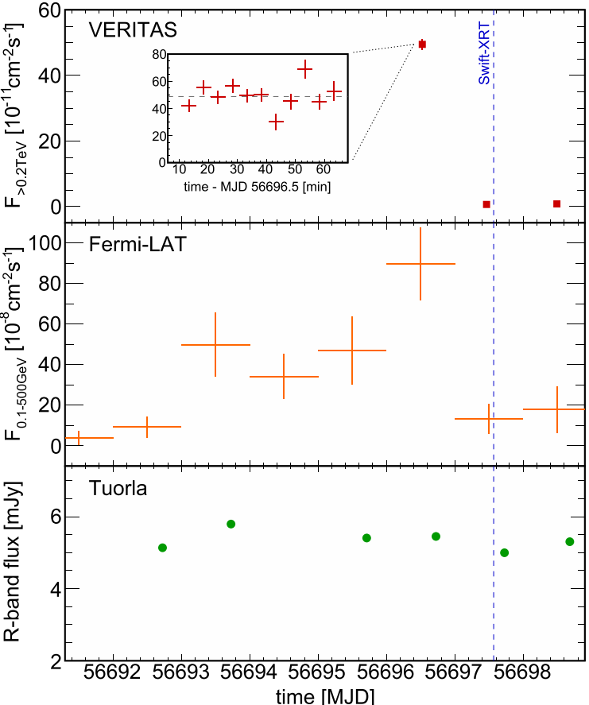
Introduction
Orphan γ-ray flare
MWL light curve of B2 1215+30
Abeysekara et al.(2017)
Orphan γ-ray flare in 2014
BL Lac
Lasting for about 5 days
And have a rapid decay (<8.9 hours)
The TeV flux reached 2.4 times the Crab Nebula flux with a variability timescale of < 3.6 h.

Slide 7
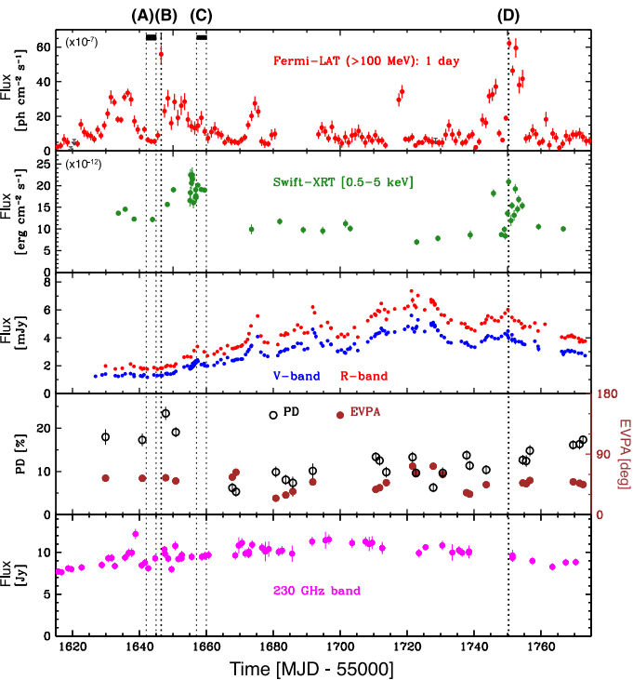
Introduction
Orphan γ-ray flare
MWL light curve of 3C 279
Hayashida et al.(2015)
Orphan γ-ray flare in interval B
FSRQ
Lasting for 12 hours

Slide 8
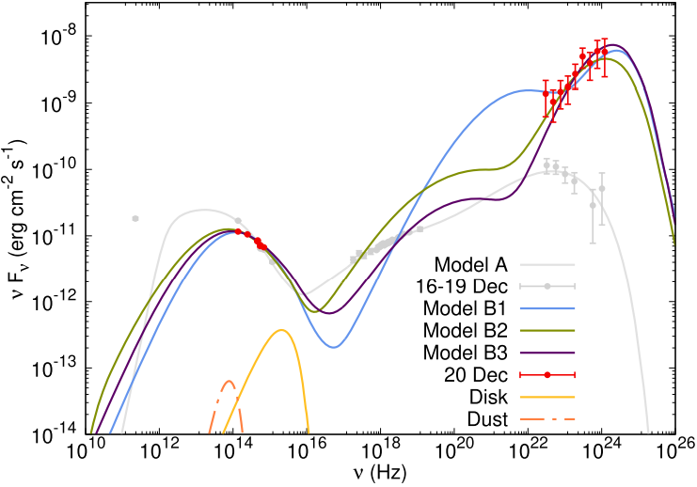
Orphan γ-ray flare from 3C 279
SED of 3C 279 (Lewis et al. 2019)
Red data represent the orphan γ-ray data which was observed during a 12 hr period on 2013 December 20.
Gray data represent the 3 day quiescent period immediately prior to the flare.

Slide 9
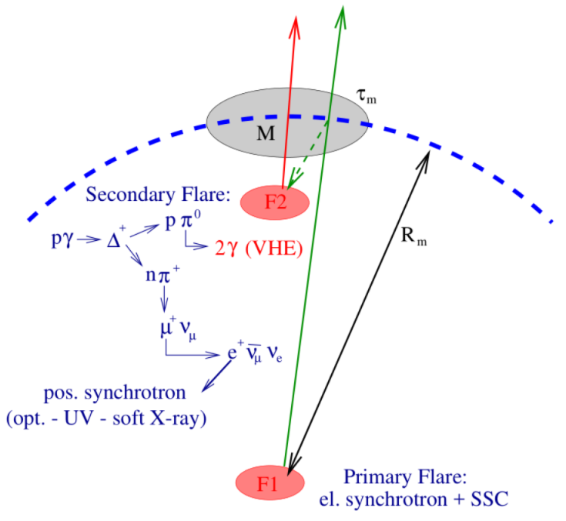
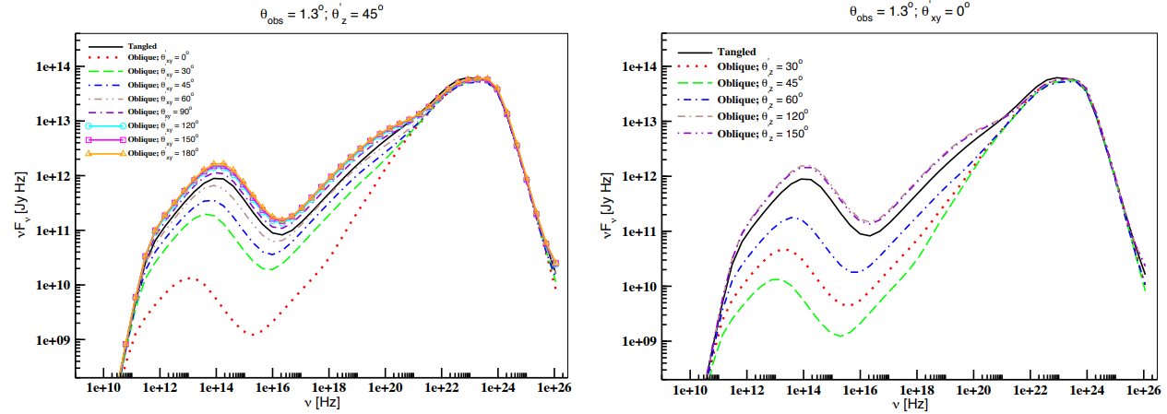
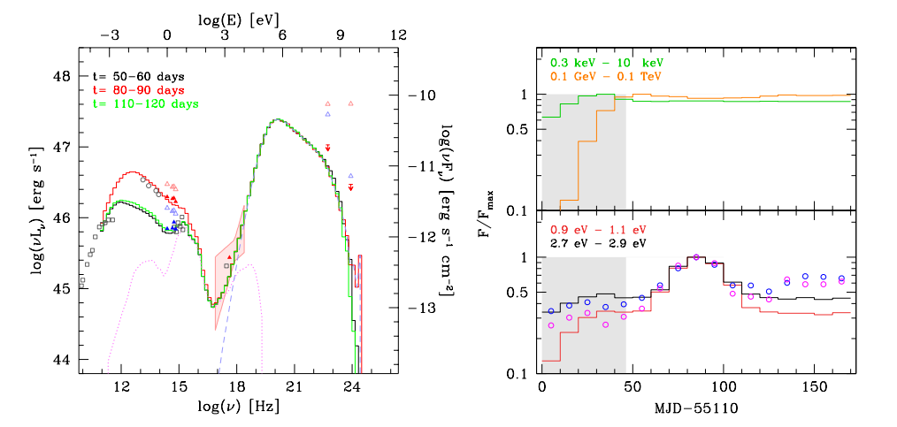
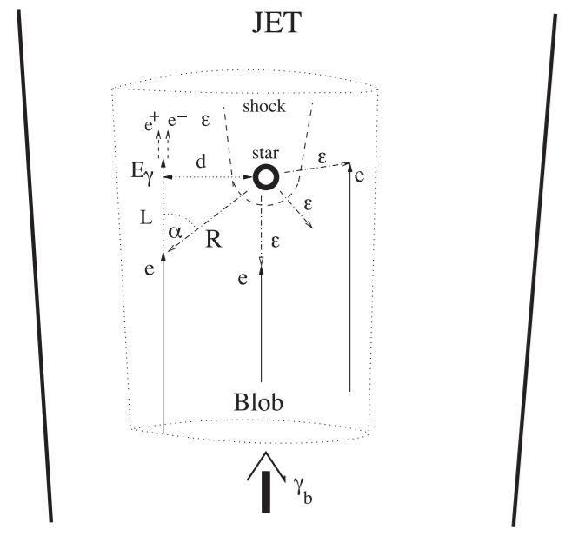
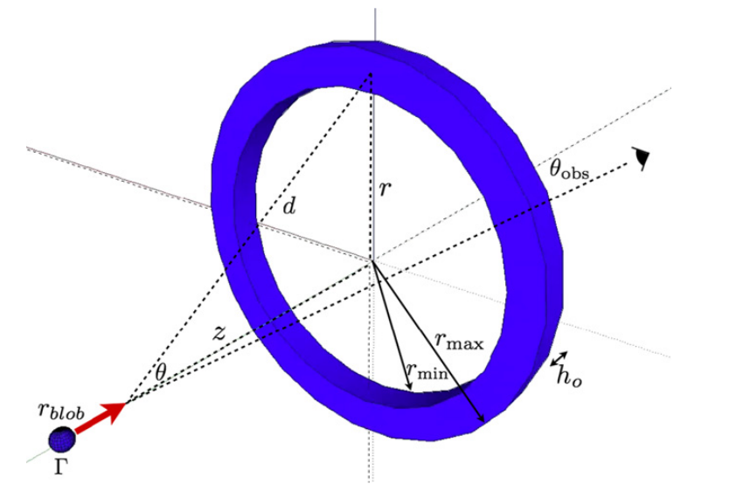
Different model for explaining orphan flare
The relativistic blobs encounter luminous stars (Banasinski, Bednarek & Sitarek 2016).
The ring of fire model (Macdonald et al. 2015).
Allocations of energy between the magnetization and particle acceleration (Chen et al. 2014).
The directionality of the magnetic field (Joshi, Marscher & Bottcher 2016).
Hadronic Synchrotron Mirror Model (Bottcher 2004).
7

Slide 10
Schematic view
Background emission + Flaring zone emission
$$R\left(r\right)=R_{0}\left(\frac{r}{0.1 pc}\right)$$
$$B\left(r\right)=B_{0}\left(\frac{R_{0}}{R\left(r\right)}\right)$$
$$δ_{D}\left(r\right)=δ_{D,0}−\frac{δ_{D,0}−2}{log\left(\frac{100 pc}{0.1 pc}\right)}log\left(\frac{r}{0.1 pc}\right)$$
$$u_{syn}\left(r\right)=\frac{L_{syn}}{4π{R(r)}^{2}Γ^{4}}$$
$$u_{BLR}\left(r\right)=\frac{ξ_{BLR}Γ^{2}L_{disk}}{3πr_{BLR}^{2}c\left[1+{\left(r/r_{BLR}\right)}^{β_{BLR}}\right]}$$
$$u_{DT}\left(r\right)=\frac{ξ_{DT}Γ^{2}L_{disk}}{3πr_{DT}^{2}c\left[1+{\left(r/r_{DT}\right)}^{β_{DT}}\right]}$$

Slide 11
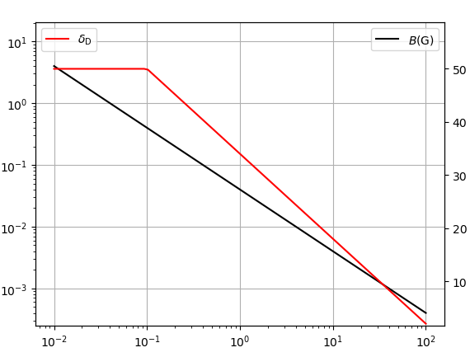
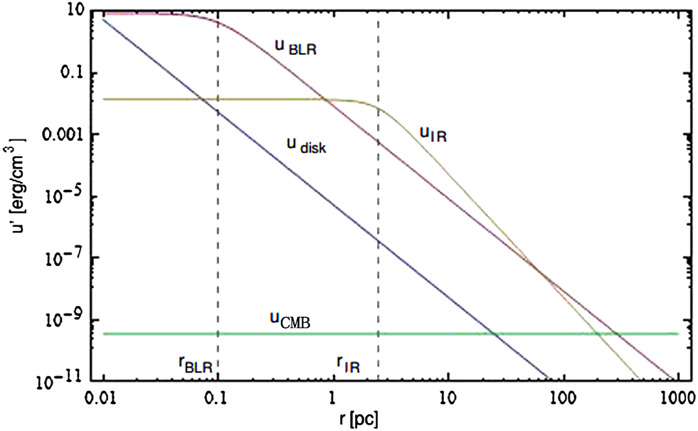
The physical environment changes along the jet

Slide 12
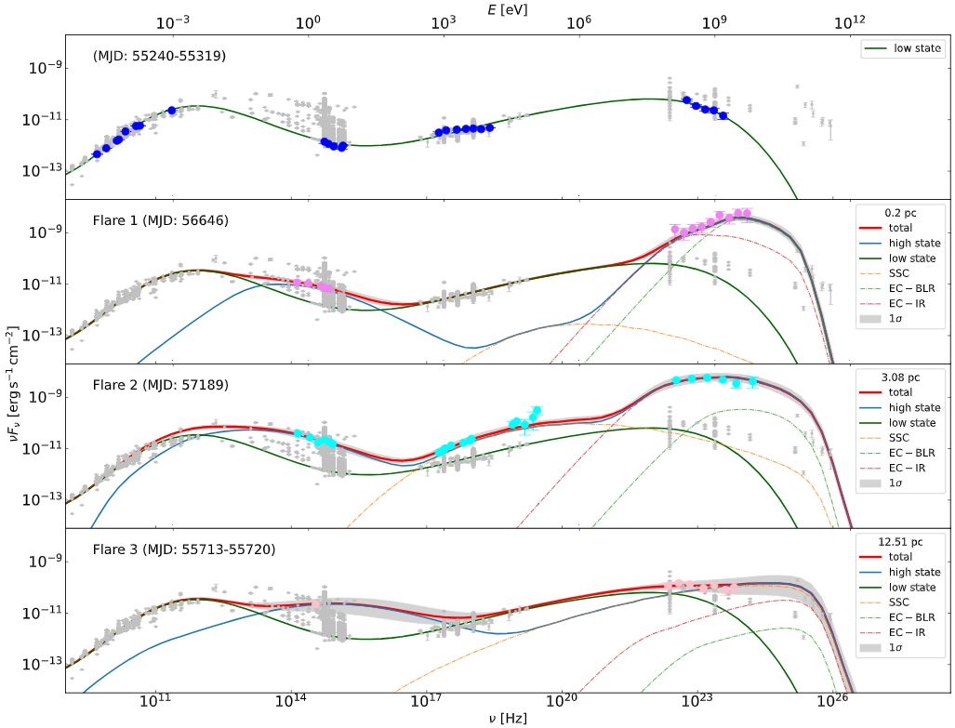
Fitting result for 3C 279
Low state
Orphan γ-ray flare
Multi-wavelength flare
Multi-wavelength flare

Slide 13
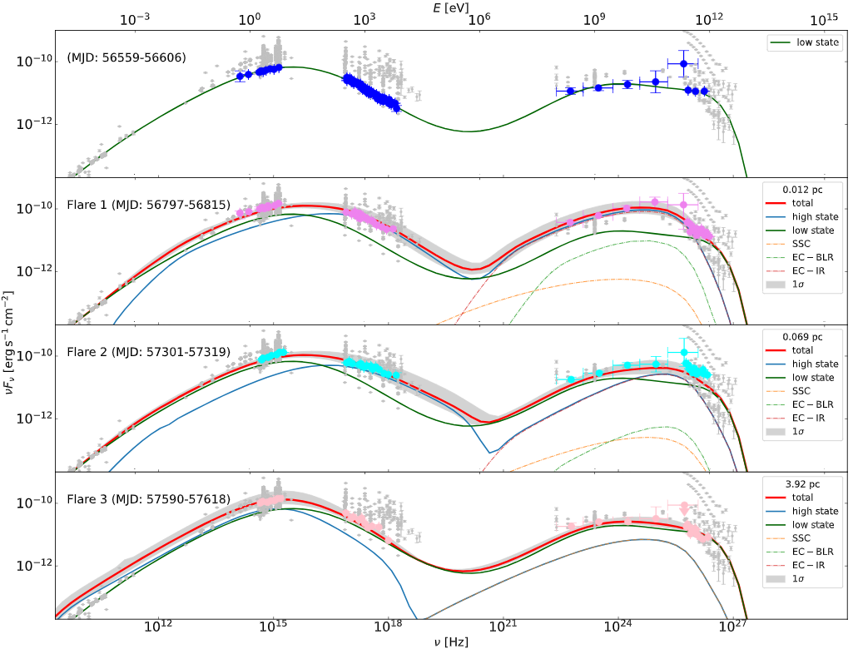
Fitting result for PKS 2155-304
Low state
Multi-wavelength flare
Multi-wavelength flare
Orphan optical flare

Slide 14
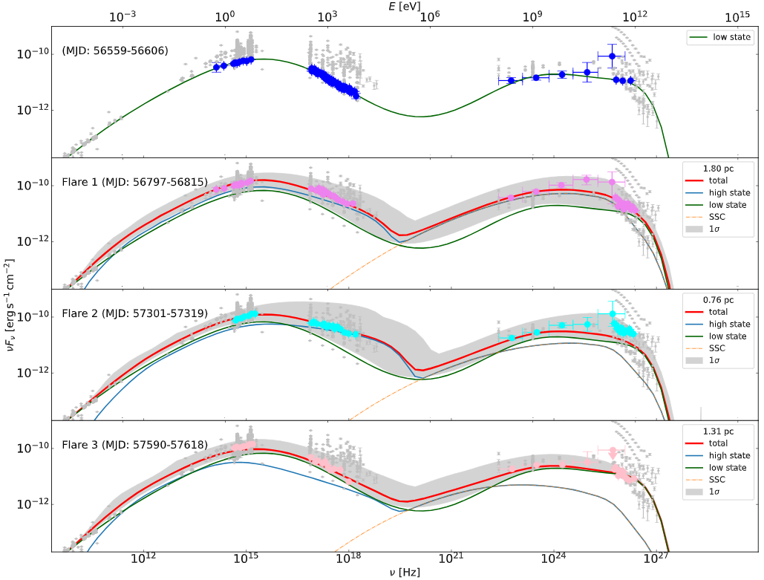
PKS 2155-304 without BLR&DT
Low state
Multi-wavelength flare
Multi-wavelength flare
Orphan optical flare

Slide 15
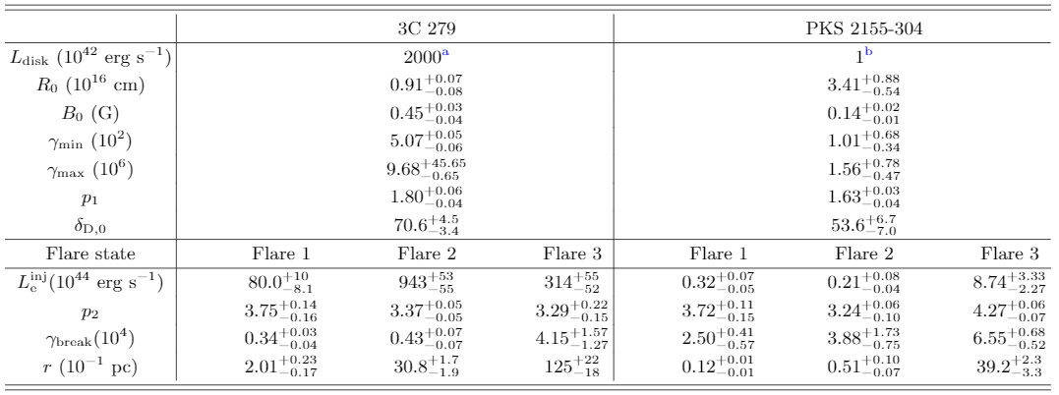
Fitting parameters

Slide 16
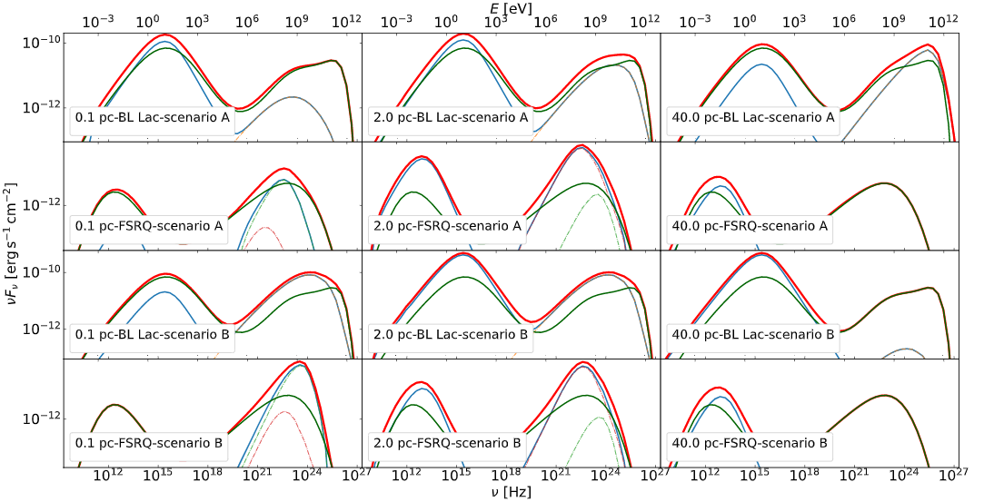
The general cases
Blazar type & scenario
scenario A
γ： far γ： near
opt： near opt： far
BL Lac FSRQ
γ： near γ： near
opt： far opt： far
scenario B
Scenario B: magnetic field strength B and Doppler factor $δ_{D}$ are assumed constant.
BL Lac case: without external radiation fields

Slide 17
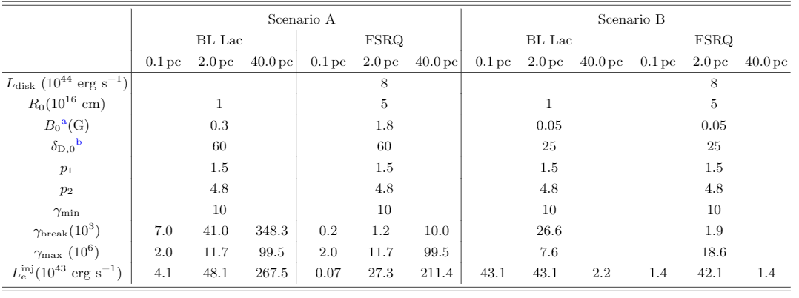
Parameters for general cases

Slide 18
Duration of blazar flares
The light-crossing times and observed duration of flaring states for 3C 279 and PKS 2155-304
$$t_{lc}=\left(1+z\right)R\left(r\right)/\left(cδ_{D}\right)$$
‘G’ denotes that this duration is estimated from the GeV band,
‘O’ from the optical, ‘X’ from the X-ray, and ‘T’ from the TeV band.

Slide 19
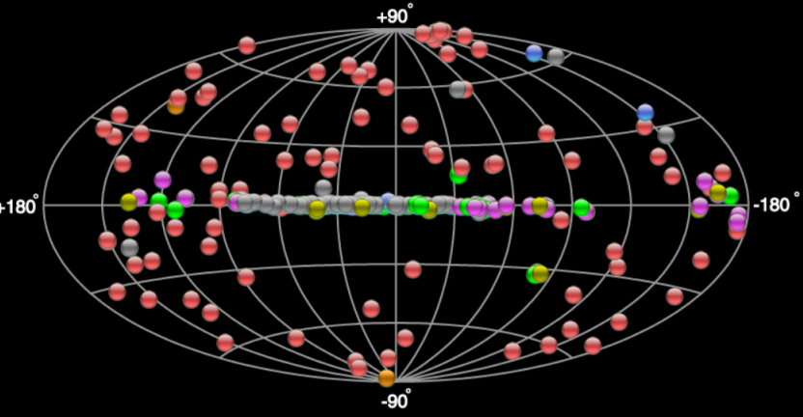
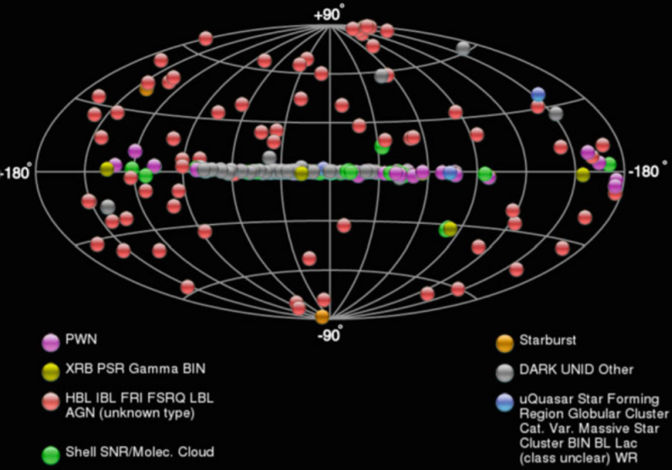
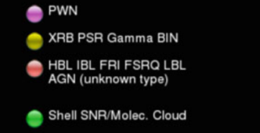
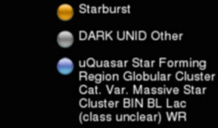
WCDA and Blazar flare
72 blazars, 2 possible blazars
5 flaring BL Lac type blazars have been detected to exceed the flux of the Crab Nebula.
Mrk 421: about 7 times
Mrk 501: 3 times
1ES 1959+650: 3 times
B2 1215+30: 2.4 times
BL Lacertae: 1.8 times
PKS 1510-089: 0.8 times
1ES 2344+514: 0.6 times
PKS 2155-304: 0.6 times
Notes:
Detection threshold better than 10% Crab units at Sub-TeV/TeV.

Slide 20
Conclusion
The stochastic dissipation model includes two emission components.
Background emission: the superposition of radiation from numerous but comparatively weak dissipation zones along the jet.
Flaring zone: stronger dissipation zone randomly appear at different positions along the jet.
The ratio between the Compton dominance of flaring zone and background emission determines the type of blazar flare.
FSRQ: orphan γ-ray flare tend to arise when the strong dissipation occurs close to the SMBH, while orphan optical flare arises when the strong dissipation occurs far away from the SMBH.
BL Lac: the situation is similar to that of FSRQs in scenario A, but the situation is more complex due to the KN effect in scenario B.
The flare duration and the orphan flare rates expected in the model are consistent with orphan flare observations made to date.
Thank you！

