Slide 1
On the energy-dependent diffusion coefficient around Geminga
Reporter：Yingying Guo^{1，2}
Collaborators：Y. Zhang^{2，1} Q.Yuan² , Y.L. Feng², S.P. Zhao³ R.Zhang² , X.Y. Huang², K.K. Duan², R.Y. Liu⁴ , E.S Chen¹ H.B. Hong¹ X.J.Bi¹
Institution：1. Institute of High Energy Physics, CAS 2. Purple Mountain Observatory, CAS 3. Shandong University 4 Nanjing Dong University.
2021 LHAASO 1th collaboration meeting

Slide 2
Contents
Background
Data selection
The significance map
The energy-dependent diffusion
The spectra of Geminga and Monogem
Systematic analysis

Slide 3
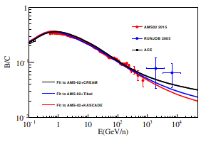
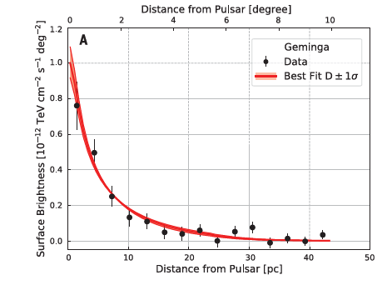
The propagation of CRs:diffusion
${ \sim {10}^{29}cm}^{2}/s$@100TeV
~${{10}^{27}cm}^{2}/s$
@100TeV
B/C ratio constrains diffusion coefficient, and extrapolates to higher energy
The measurement of diffusion coefficient
The Low diffusion zone is concentrated on the pulsars or property of ISM?
How does diffusion depend on energy?
Abeysekara et al., Science 358, 911–914 (2017) 17 November 2017
Notes:
低能限制→外推高能→直接测量
你这个题目，主要还是研究宇宙线的起源和传播。
a. 研究起源的办法， 就是源不同区域的能谱不同 （像银心的工作），
多信使分析其形态。
b.传播，就是研究扩撒系数。
所以你的研究背景和意义可以稍微再整理一下。
胡：左图的扩散系数是根据GeV-TeV的B/C比外推到100TeV的吗？这两个能标以及外推（间接）应该明确指出来

Slide 4
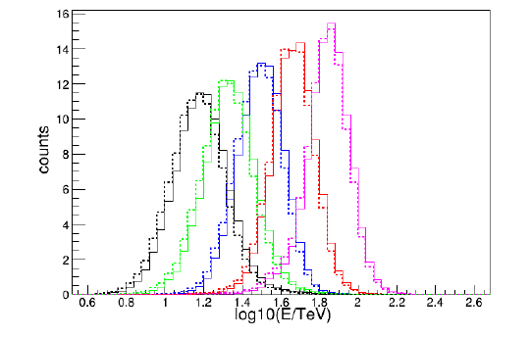
Data selection
One-year data form KM2A-Half array
The data criteria is the same as Crab.
Zenith angle (0-50deg)
Five energy bins below 100TeV
实线：Geminga
虚线：Monogem
The energy distribution of each bin

Slide 5
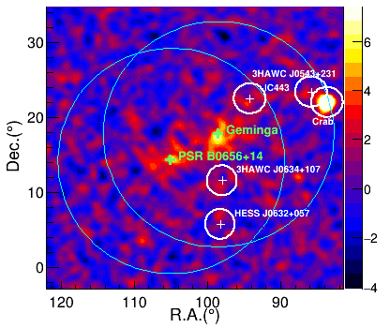
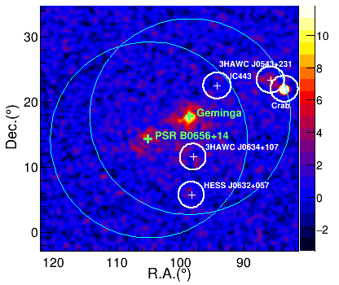
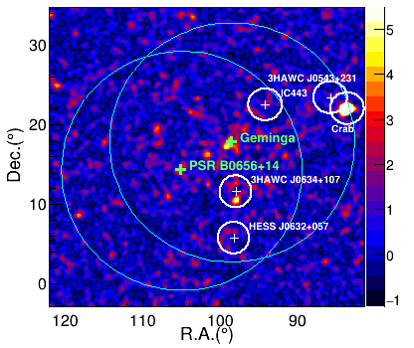
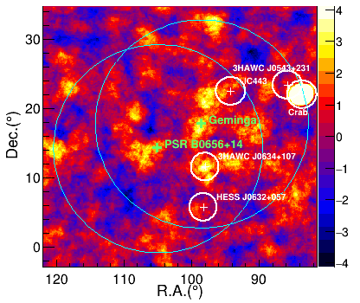
10-25TeV
25-60TeV
Significance map→
Region of interest：
Blue circles: 15deg
White circles: detected TeVsources，excluding region
>60TeV
>100TeV

Slide 6
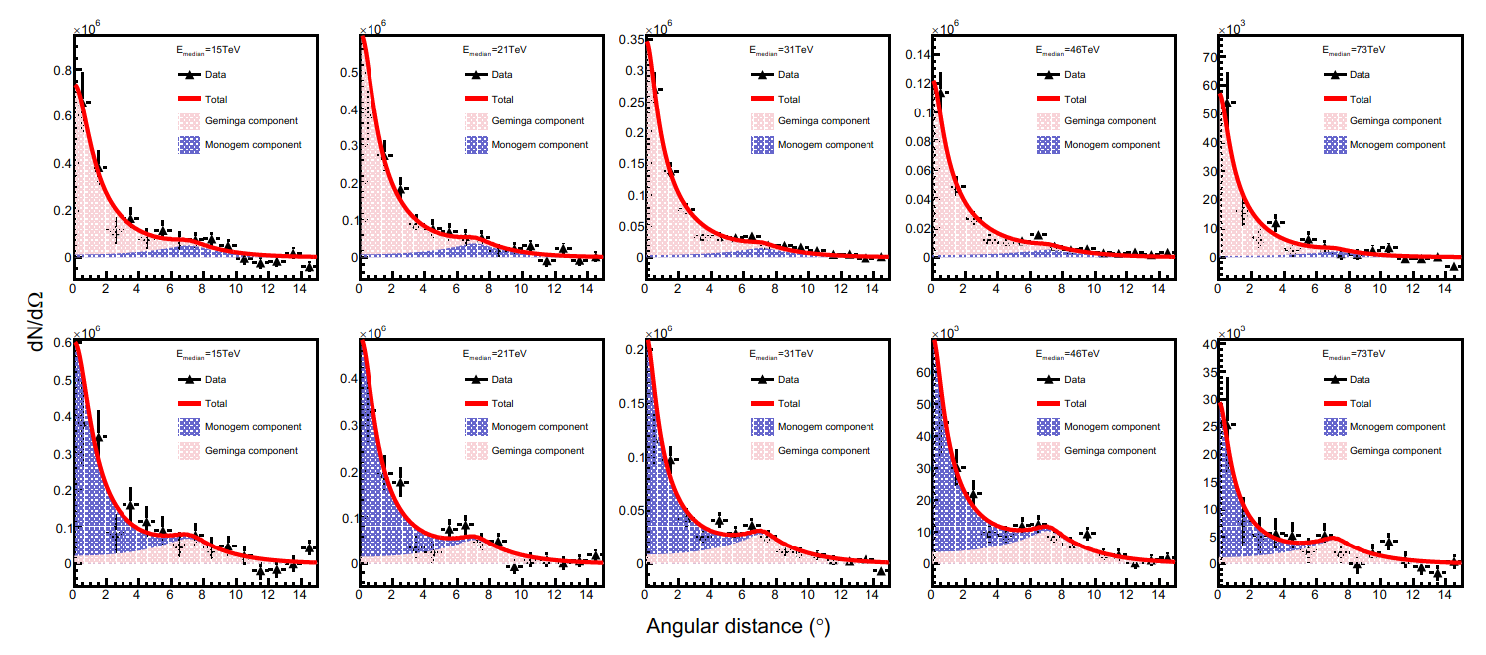
The best-fitting results
Diffusion model：
Notes:
180 350 320

Slide 7
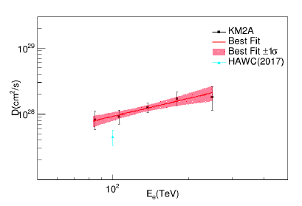
The energy-dependence of diffusion coefficient
The best-fitting diffusion angle
The energy-dependence of diffusion coefficient

Slide 8
Spectra
The spectra of Geminga and Monogem. Data points denote the statistic errors, shadow area denote systematic error.

Slide 9
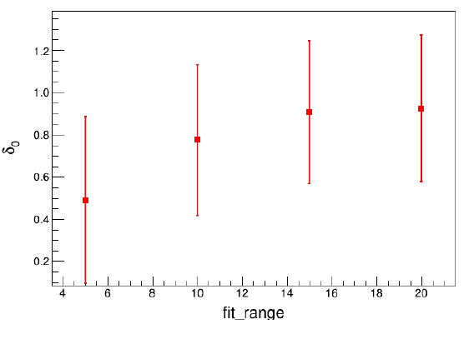
systematic error —Fitting area
The best-fitting diffusion angle along the circle radius
The variation of best-fitting δ along the circle radius
The variation of best-fitting δ is 0.12 when the radius change from 10⁰ to 20⁰.

Slide 10
Detection efficiency along declination
← Detection efficiency along declination
Two sets of simulated samples are used to verify that the influence of the detector efficiency change on the δ measurement is 0.05.

Slide 11
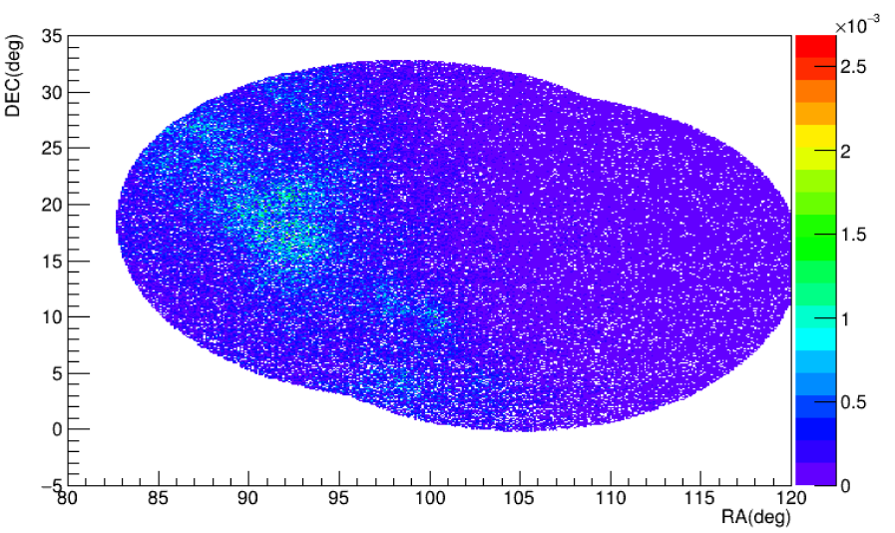
Diffusion γ ray influence
←The number of signals from theoretical expectation
The influence on the δ is 0.1 when the diffuse emission is less than ten times the theoretical expectation
46TeV

Slide 12
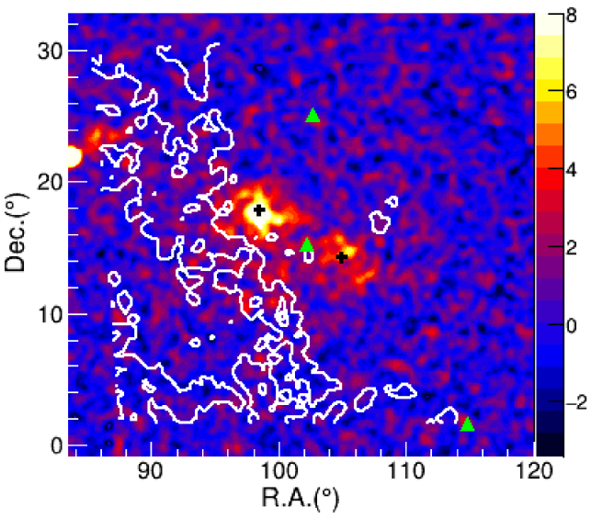
The gas distribution
The distribution of H₂
The distribution of CO

Slide 13
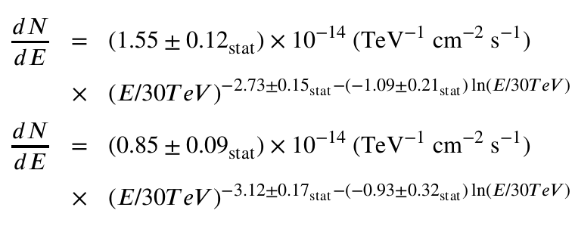
Conclusion
The first detection of energy-dependent diffusion coefficient
The spectra of Geminga and Monogem

Slide 14
Back up

Slide 15
HWAC profile 的对比
我们扩散系数高的原因
扩展角度在我们的模型下会大~10%
100TeV的冷却时间~8kyear/10kyear(HAWC)

Slide 16
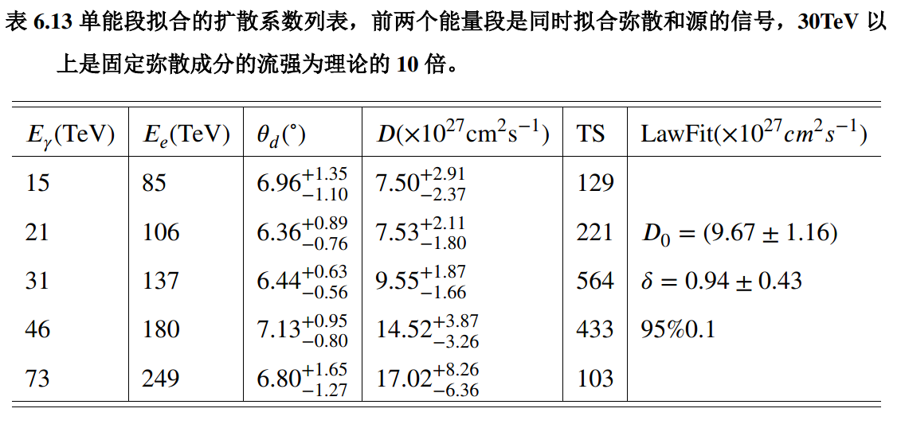

Slide 17
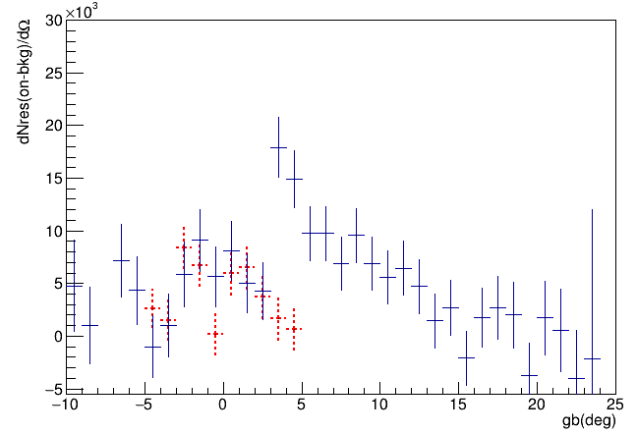
2.5度
红色是弥散辐射区域的超出（on-off）
蓝色是Gemigna拟合区域的超出

Slide 18
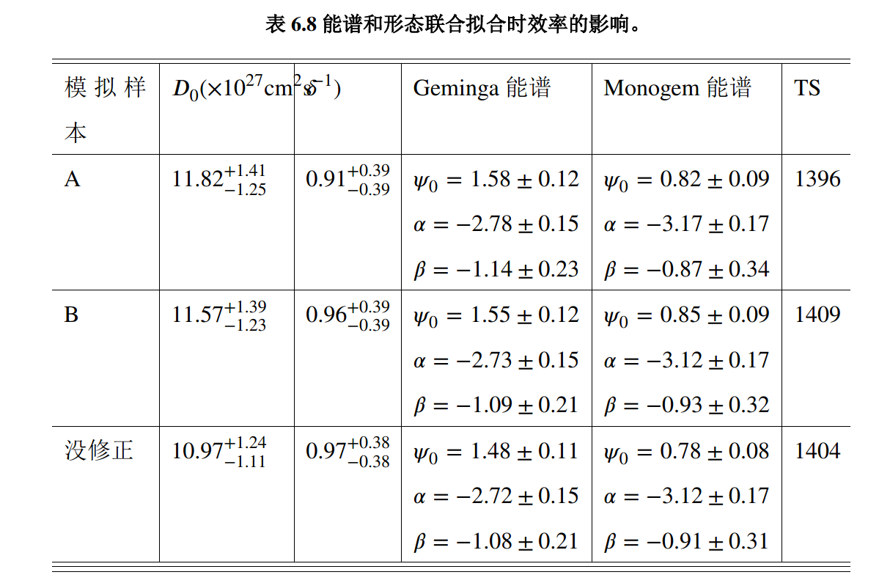

Slide 19
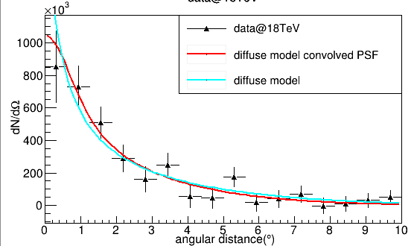
Geminga的PSF
$$ρ（θ）=αG1\left(θ\right)+α_{2}G2\left(θ\right)+α_{3}G3\left(θ\right)$$
用3个高斯描述
PSF
PSF
影响
模型（蓝）-------→探测结果（红）
Notes:
（根据模拟数据，位置和能谱都考虑了）

Slide 20
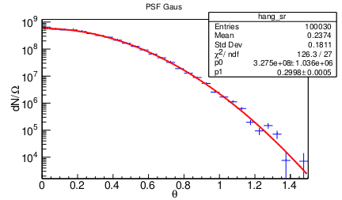
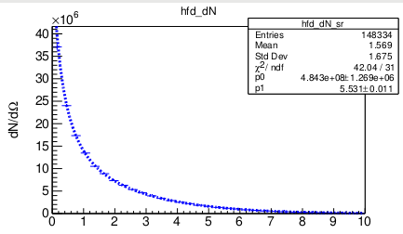
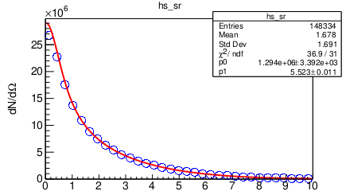
卷积的检查
放进去的模型：5.5
拟合结果在红框：5.53+-0..01
PSF: Gaus(0,0.3)
模型放入值： | PSF =0.3 theta=5.5
模型的撒点拟合： | 0.03+-0.01
模型卷积PSF后的拟合： | 0.02+-0.01
卷积后的拟合结果：5.52+-0.01
Binw=0.3度

Slide 21
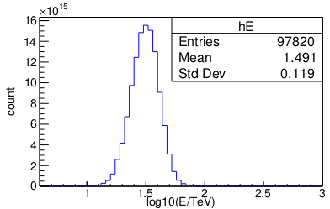
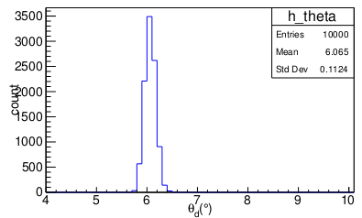
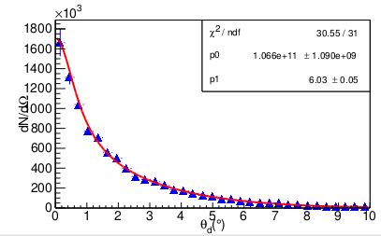
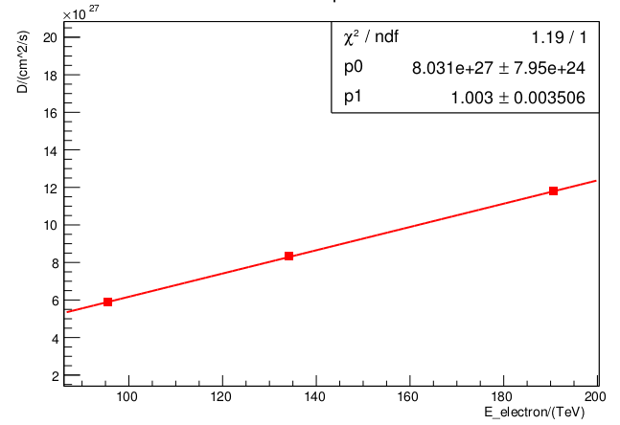
能量分辨的影响
抽取能量
抽取角度
测量扩散系数
单个粒子的模拟：
随能量变化的结果：
$$放入值：D=(8e27){(\frac{E}{130TeV})}^{1}$$

Slide 22
HAWC 误差theta_d->D误差传递
联合测量：
20 5.50 +- 0.70 --> 103 4.45e+27 +- 1.13e+27 cooling: 10kyear
20 5.50 +- 0.70 --> 103 5.48e+27 +- 1.40e+27 cooling:7.925kyear
扩展：8倍
扩散系数： 4倍
1015 的数据：
Geminga单独测量：D: 2倍 theta: 4倍
我的Geminga单独： D： 3倍 theta: 6 倍
0707的数据联合拟合的结果：
Pixel Minuit rst:size: 5.175e+06+-6.975e+05
size2: 2.726e+06+-4.424e+05
theta_d: 5.80+-0.70 8倍多
TS: 219.517306

Slide 23
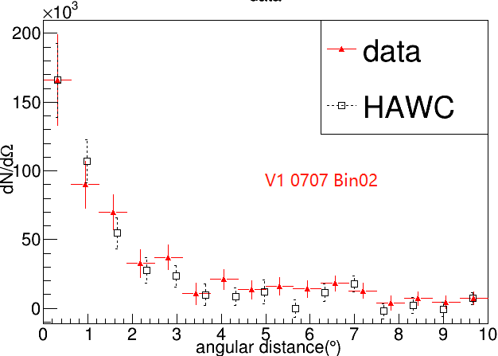
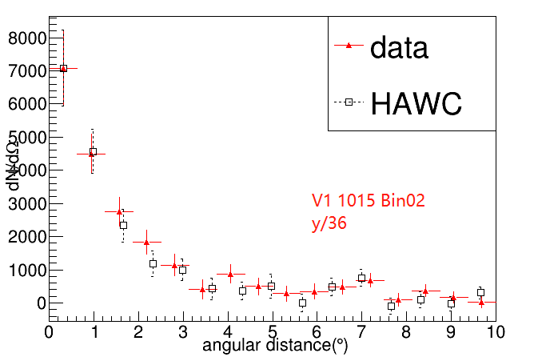
数据量比较

Slide 24
Geminga 的能谱

Slide 25
HAWC 二维图

