Slide 1
Measurement of the diffuse gamma-ray emission from Galactic plane with LHAASO-KM2A
S.P. Zhao¹, R. Zhang²
Y. Zhang², Q. Yuan², C.F. Feng¹, et al
On behalf of LHAASO Collaboration
[1] Institute of Frontier and Interdisciplinary Science, SDU
[2] Purple Mountain Observatory, CAS

Slide 2
Outline
Galactic CRs and Diffuse γ-Rays
Background Estimation
Data Analyzed
Estimation Method
Sky maps of gamma-rays
Energy Spectrum
Spectra Energy Distribution

Slide 3
Sky maps of Gamma-Rays
Sources
Different Origins of Gamma-Rays…
GDE
EGDE
Large-scale
extensive
sources

Slide 4
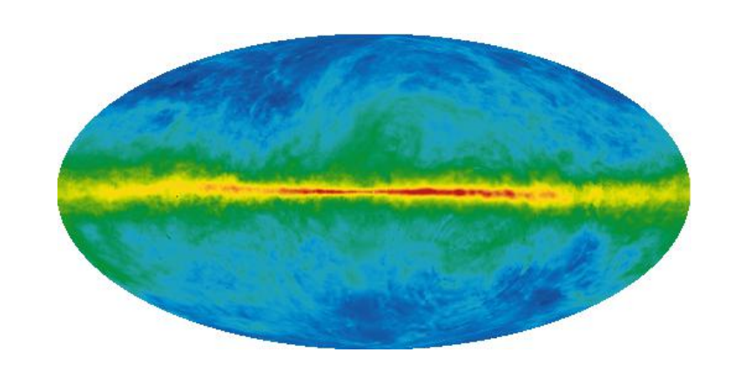
Galactic Diffuse Gamma Emission(GDE)
Dominant Processes to Produce GDE:
$e^{±}+ISM → γ$
$e^{±}+ISRF → γ$ (IC)
A indirect way to study CRs & DM
Propagating & Acceleration
Origin of “Knee”
Dark Matter(DM) annihilation signal
……
CRs(~PeV, ‘Knee’)
~100TeV
$$p, α+ISM → π^{0} → γ$$

Slide 5
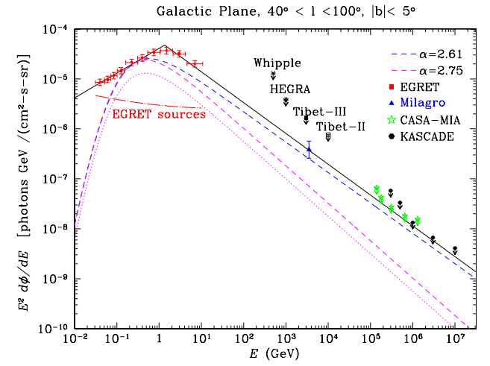
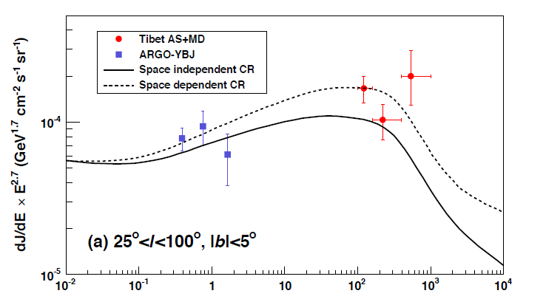
Observations of GDE
Ground-Based Experiments
No significant measurements over Energy ~100TeV
ASγ，2020

Slide 6
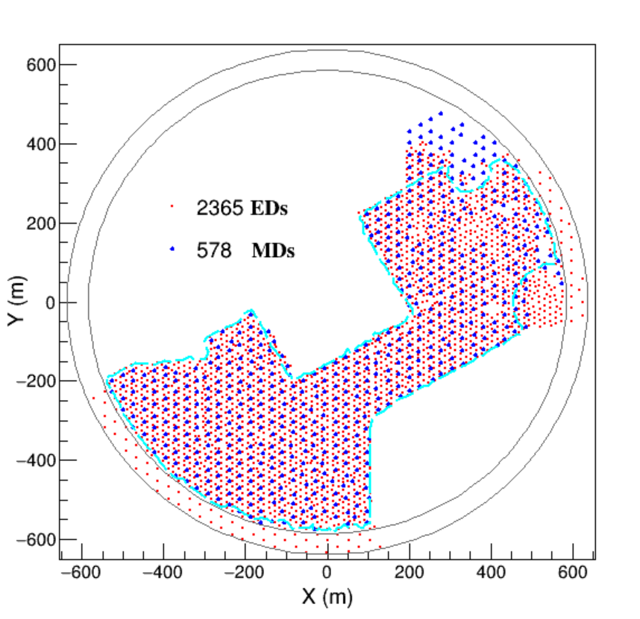
Data & γ-Proton Discrimination
KM2A(Half-Array) Data:
2019/12/27 ~ 2020/10/15
Events Selection：
Core located inside of the ‘RING’
NfiltE>10
NfiltM>10
NpE1(0~100m)>10
NpE1 /NpE2(40~100m) > 2
Age of EAS Shower: 0.6~2.4
Their EST < EST UP LIMIT (γ-Like events)
KM2A(1/2 Array) Detectors Distribution

Slide 7
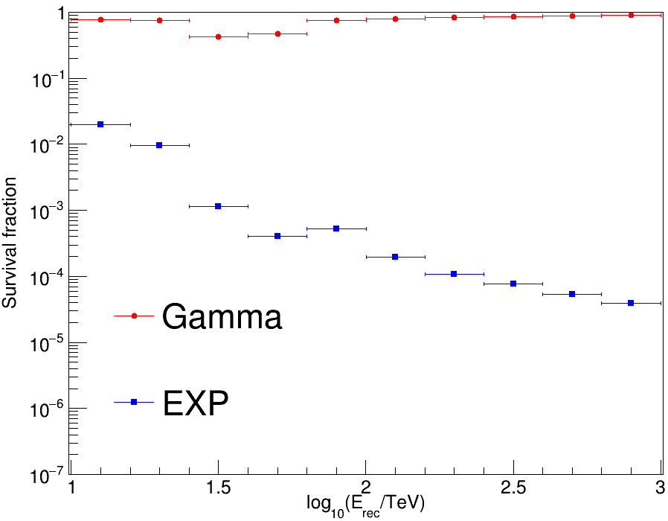
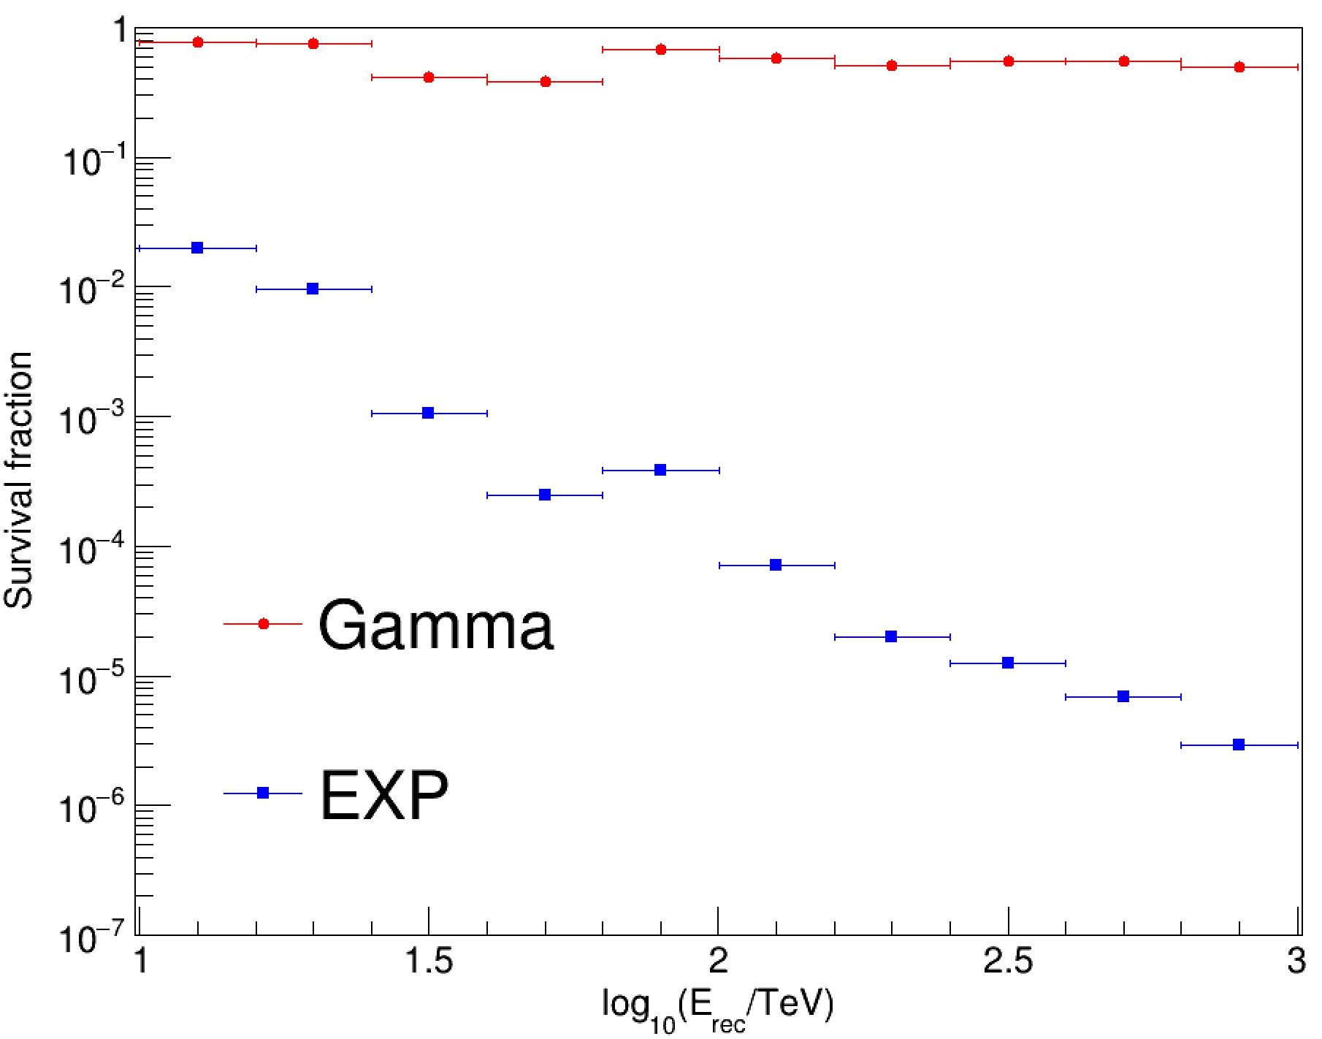
γ-Proton Discrimination
Event: est < EST UP LIMIT
More likely a gamma event
$est≔\log_{10}\frac{N_{μ}+0.0001}{N_{e}}$
log10(E/TeV)
1.0-1.2
1.2-1.4
1.4-1.6
1.6-1.8
1.8-2.0
2.0-2.2
2.2-2.4
2.4-2.6
2.6-2.8
2.8-3.0
old est(up limit)
-5.11
-5.24
-5.95
-6.08
-2.34
-2.35
-2.36
-2.36
-2.36
-2.36
new est(up limit)
-5.00
-3.20
-5.96
-6.17
-2.50
-2.69
-2.79
-2.74
-2.75
-2.79
old
new
More efficient

Slide 8
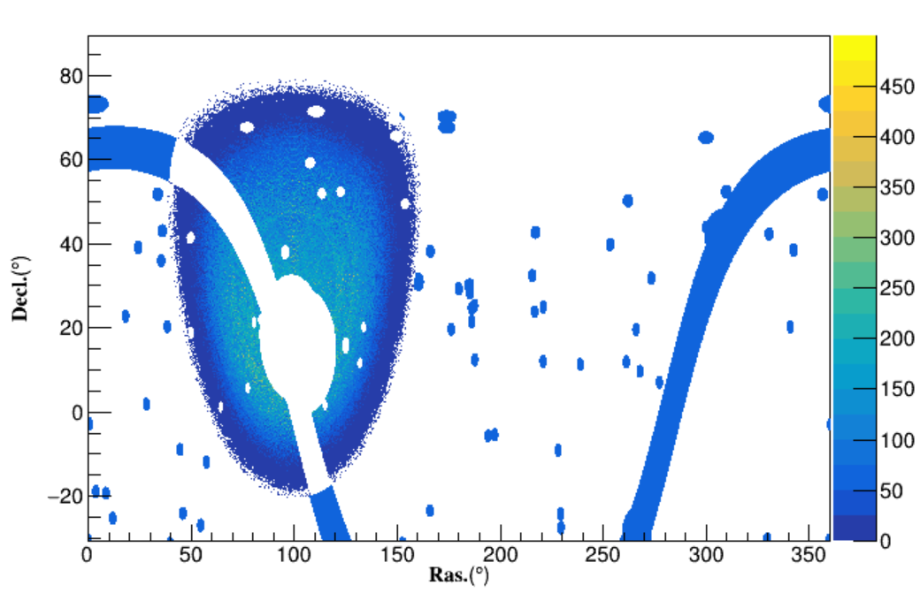
Background-Estimation: Method I,II
We’ve tried at least 3 different methods…
Local sidereal time(LST): Method I
MJD: Method II
CRs Distribution
Get distribution of CRs $f(t,θ,φ)$
Random sampling the backgrounds
—following $f(t,θ,φ)$
Unmasked Region
$$N_{sample}\left(unmasked\right) \sim N_{observed}(unmasked)$$
Areas Masked:
-5°<$b$<5°
TeV catlog sources（$r<R$）
Sources identified by LHAASO
Mask Region
$$R=3\sqrt{σ_{ext}^{2}+σ_{resol}^{2}}$$
CRs distribution & masked regions
$$t\left(LST\right)=100$$

Slide 9
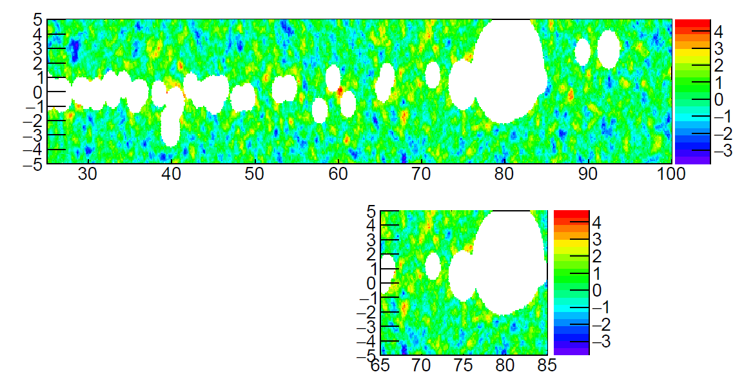
Measured Regions
Region I:
Inner Galactic Plane
(25°<$l$<100°)
Region II:
Cygnus Region
(65°<$l$<85°)
$$r<2\sqrt{{0.489}^{2}+σ_{ext}^{2}}$$
Masked radius

Slide 10
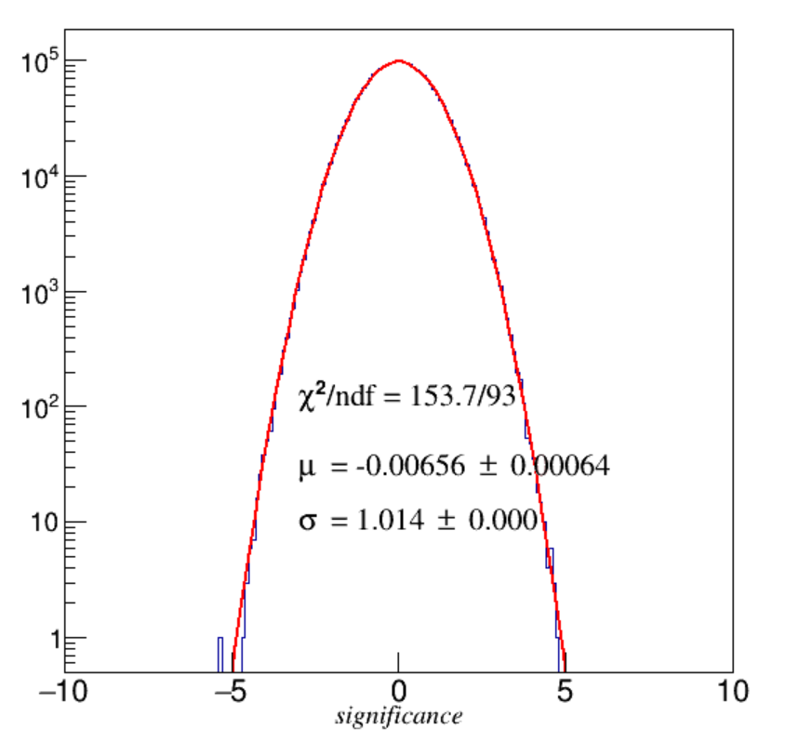
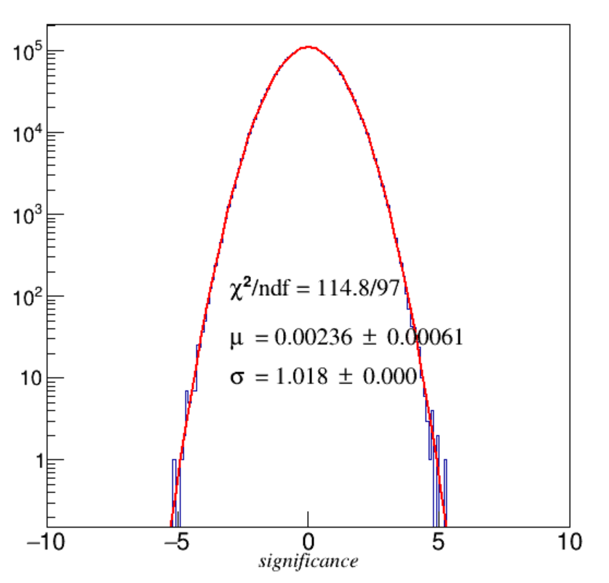
Results
$$s=\sqrt{TS}$$
Method I (performed on LST)
Method II (performed on MJD)
Energy: 16 ~ 25TeV, 0.491° top-hat smoothed, -15° < $δ$ < 65°, unmasked region

Slide 11
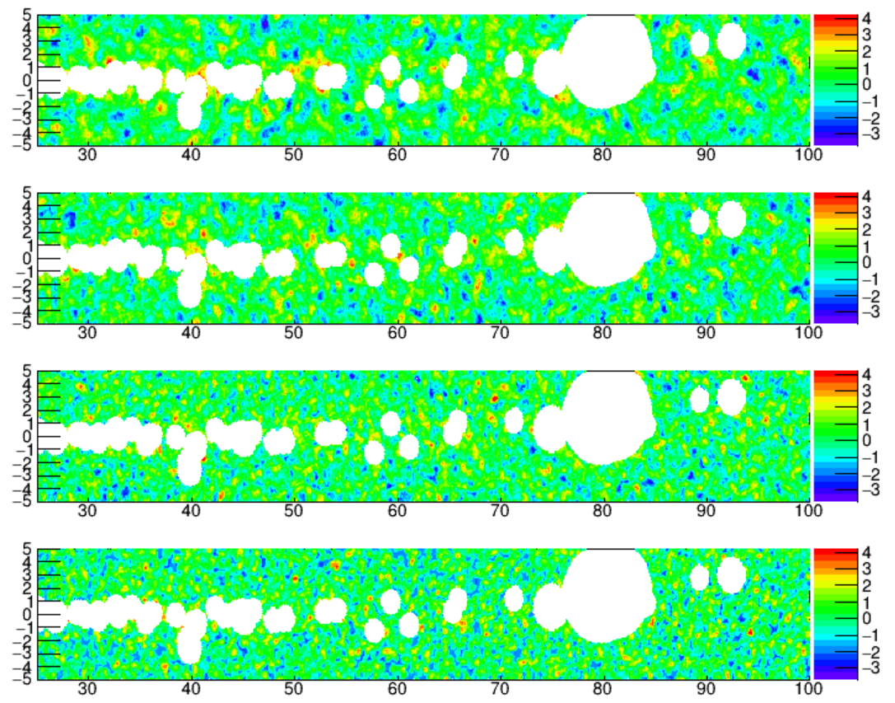
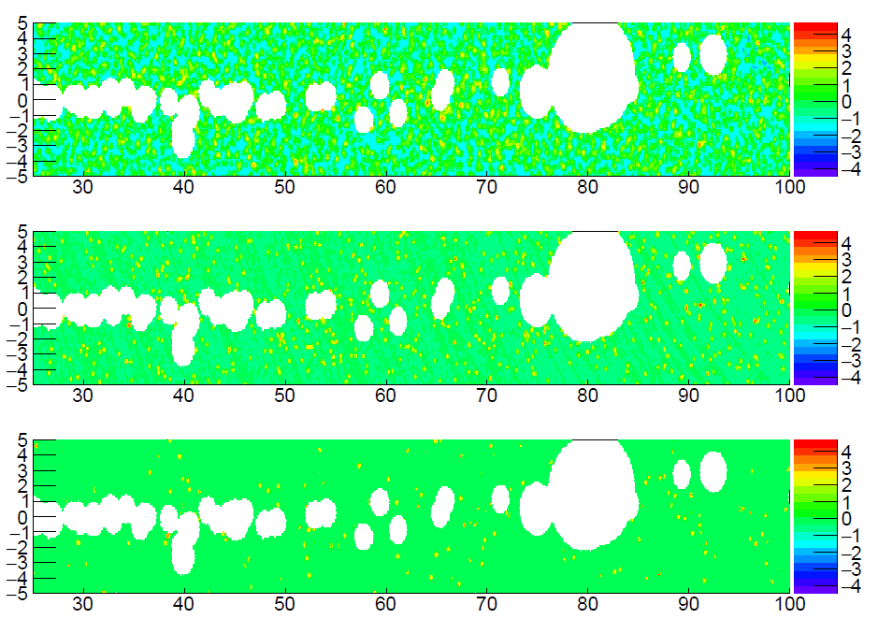
12.6TeV
79.4TeV
20.0TeV
126TeV
31.6TeV
200TeV
50.1TeV
Significance maps of different energy bins at inner
galactic plane (method I)

Slide 12
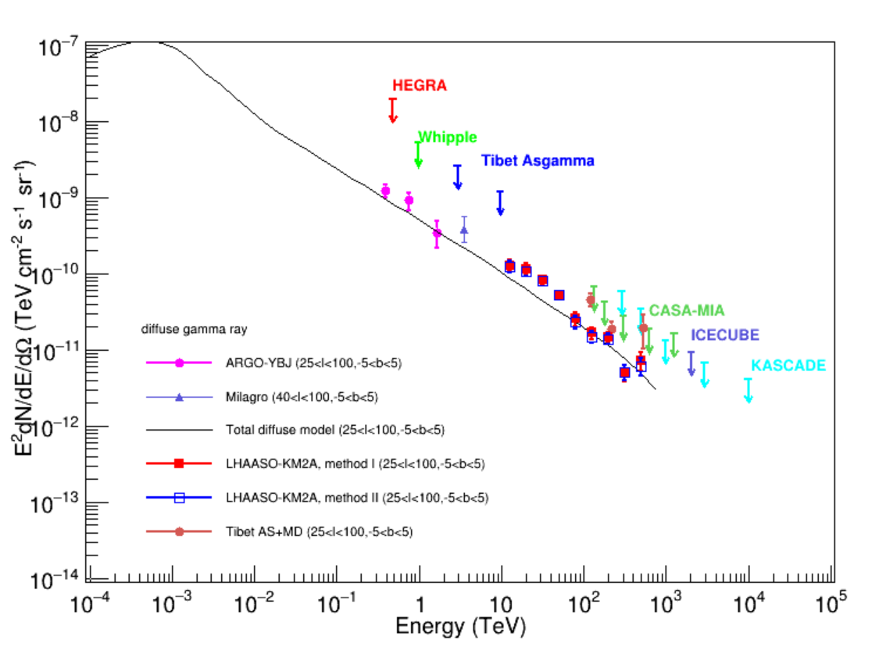
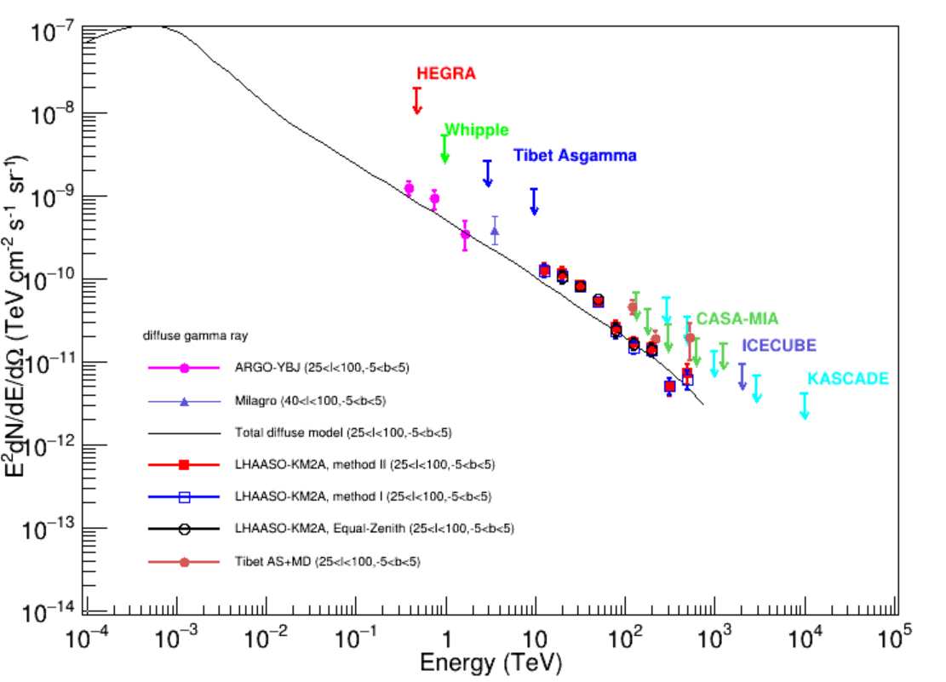
Spectra Energy Distribution —— 25°<$l$<100°
Equal-Zenith (LST)
Method I (LST)
Method II (MJD)
Energy(TeV) | Flux I(10⁻¹⁵) | Flux Il(10⁻¹⁵) | Flux EQZ(10⁻¹⁵)
12.59 | 784$±$132 | 814$±$148 | -
19.95 | 273$±$41.4 | 291$±$47.0 | 262$±$44.1
31.62 | 80.2$±$10.2 | 82.3$±$11.7 | 79.7$±$11.0
50.12 | 21.2$±$2.4 | 21.3$±$2.6 | 22.5$±$2.5
79.43 | 3.71$±$0.70 | 4.03$±$0.82 | 3.79$±$0.75
125.89 | 0.935$±$0.168 | 1.07$±$0.19 | 1.03$±$0.17
199.53 | 0.350$±$0.054 | 0.372$±$0.060 | 0.349$±$0.057
316.23 | 0.051$±$0.012 | 0.050$±$0.012 | -
501.19 | 0.024$±$0.006 | 0.029$±$0.008 | -

Slide 13
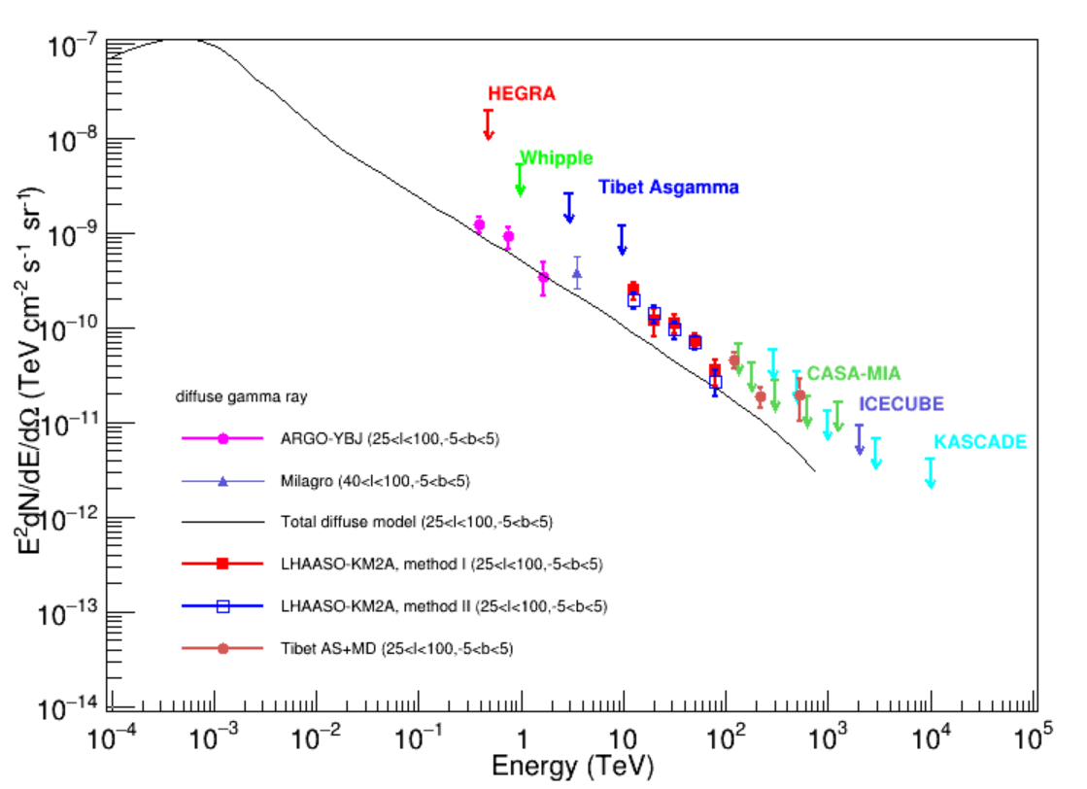
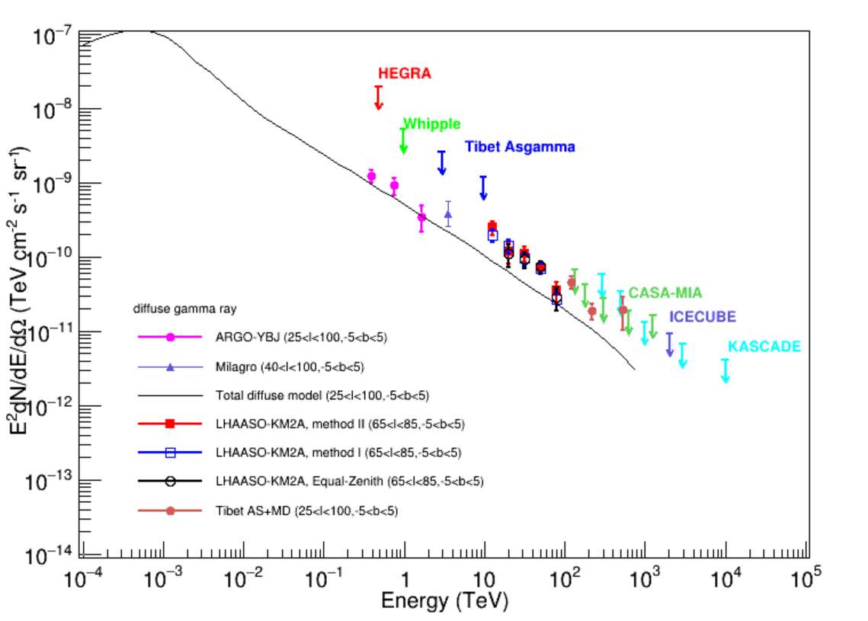
Spectra Energy Distribution —— Cygnus Region
Equal-Zenith (LST)
Method I (LST)
Method II (MJD)
Energy(TeV) | Flux I(10⁻¹⁵) | Flux Il(10⁻¹⁵) | Flux EQZ(10⁻¹⁵)
12.59 | 1238$±255$ | 1558$±320$ | -
19.95 | 353$±76.7$ | 299$±93.7$ | 274$±$89.6
31.62 | 94.5$±$18.2 | 111$±$24.5 | 91.2$±$21.7
50.12 | 27.6$±$4.35 | 29.1$±$5.32 | 29.7$±$5.13
79.43 | 4.29$±$1.33 | 5.56$±$1.75 | 4.50$±$1.57

Slide 14
Time For Q…

Slide 16
R=0.5（Asγ mask radius）
0 TS:129.2 sqrt(TS):11.4
1 TS:104.9 sqrt(TS):10.2
2 TS:35.4 sqrt(TS):6.0
3 TS:37.6 sqrt(TS):6.1
4 TS:307.1 sqrt(TS):17.5
Epoint: 50
alpha:2.98703e-14 (+-)7.11242e-15
beta:-3.05726 (+-)0.181534
beta2:0 (+-)0
Ecut:0 (+-)0
E:125.9 flux:2.88e-11 + 2.94e-12 - 2.94e-12
E:199.5 flux:1.71e-11 + 2.25e-12 - 2.25e-12
E:316.2 flux:8.70e-12 + 1.93e-12 - 1.93e-12
E:501.2 flux:8.60e-12 + 2.05e-12 - 1.90e-12

Slide 17
Spectra Energy Distribution —— 25°<$l$<100°
Energy(TeV) | Flux I(10⁻¹⁵) | Flux Il(10⁻¹⁵)
12.59 | 784$±$132 | 814$±$148
19.95 | 273$±$41.4 | 291$±$47.0
31.62 | 80.2$±$10.2 | 82.3$±$11.7
50.12 | 21.2$±$2.4 | 21.3$±$2.6
79.43 | 3.71$±$0.70 | 4.03$±$0.82
125.89 | 0.935$±$0.168 | 1.07$±$0.19
199.53 | 0.350$±$0.054 | 0.372$±$0.060
316.23 | 0.051$±$0.012 | 0.050$±$0.012
501.19 | 0.024$±$0.006 | 0.029$±$0.008
asgamma
Energy/TeV | flux | error
121.076 | 3.17E-15 | 6.08E-16
219.884 | 3.91E-16 | 9.94E-17
534.041 | 6.87E-17 | 3.33E-17

Slide 18
log₁₀E/TeV | Inner Galactic Plane (25°<l<100°, -5°<b<5°) solid angle:0.182906
 | Non | Noff | Ns | Sig
1.0-1.2 | 2080448 | 2071896.0 | 8552.0 | 5.9
1.2-1.4 | 734626 | 728979.2 | 5646.8 | 6.6
1.4-1.6 | 59053 | 57137.1 | 1915.9 | 8.0
1.6-1.8 | 7763 | 6973.4 | 789.6 | 9.3
1.8-2.0 | 4450 | 4097.3 | 352.7 | 5.4
2.0-2.2 | 503 | 378.0 | 125.0 | 6.1
2.2-2.4 | 121 | 49.9 | 71.1 | 8.5
2.4-2.6 | 36 | 18.5 | 17.5 | 3.6
2.6-2.8 | 18 | 4.0 | 14.0 | 5.1

Slide 19
log₁₀E/TeV | Cygnus区 (65°<l<85°, -5°<b<5°) solid angle:0.039895
 | Non | Noff | Ns | Sig
1.0-1.2 | 560672 | 557042.93 | 3629.07 | 4.86
1.2-1.4 | 169652 | 167755.1 | 1896.90 | 4.62
1.4-1.6 | 14427 | 13804.833 | 622.17 | 5.26
1.6-1.8 | 1950 | 1669.7 | 280.30 | 6.68
1.8-2.0 | 1028 | 924.87666 | 103.12 | 3.33
2.0-2.2 | 111 | 87.536666 | 23.46 | 2.41
2.2-2.4 | 30 | 11.343333 | 18.66 | 4.59
2.4-2.6 | 8 | 3.75 | 4.25 | 1.90
2.6-2.8 | 7 | 0.7686666 | 6.23 | 4.30

Slide 20
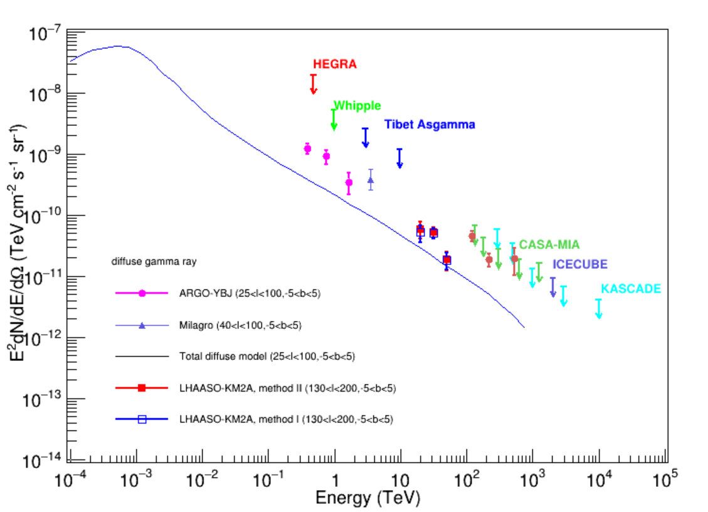
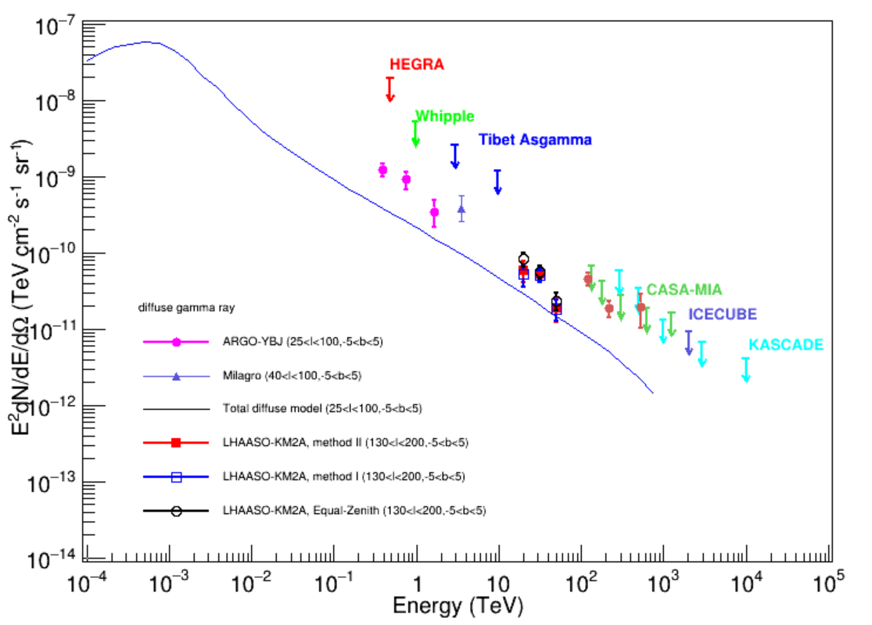
Equal-Zenith (LST)
Method I (LST)
Method II (MJD)
Energy(TeV) | Flux I(10⁻¹⁵) | Flux Il(10⁻¹⁵) | Flux EQZ(10⁻¹⁵)
12.59 | 131$±$40.3 | 149$±$45.9 | 206$±$42.0
19.95 | 51.6$±$9.9 | 52.3$±$11.1 | 55.7$±10.6$
31.62 | 7.28$±$2.22 | 7.34$±$2.46 | 9.35$±$2.37

Slide 21
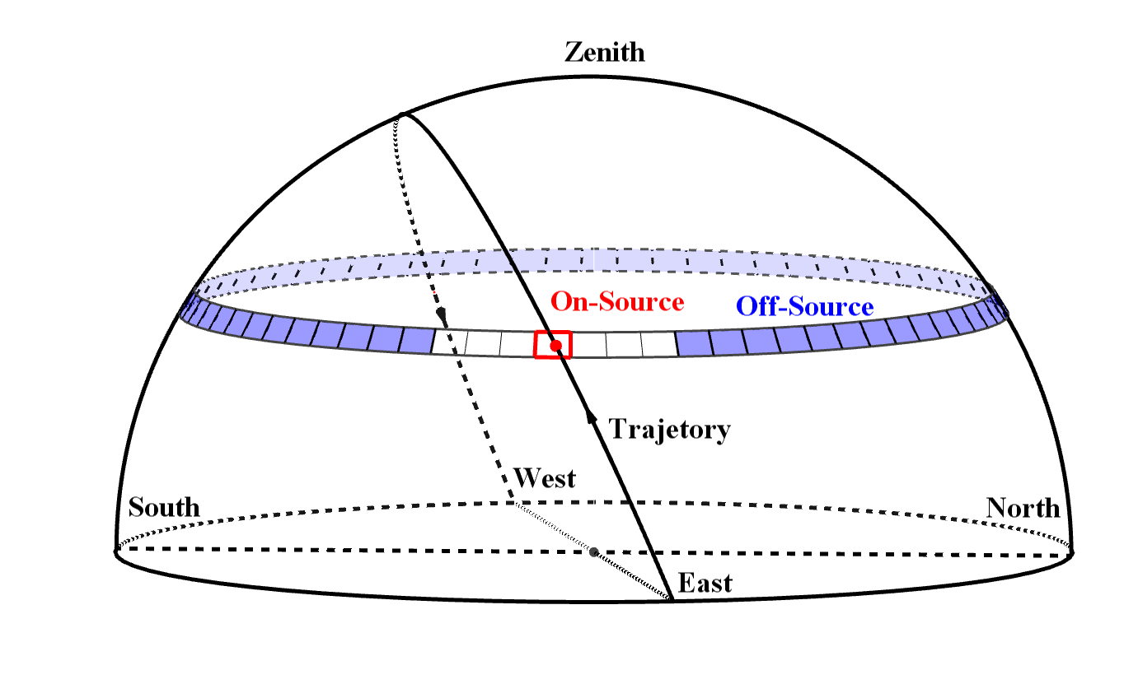
Background-Estimation: Method III
Equal-Zenith Method
Get distribution of CRs at belt $θ:$ $f_{t,θ}(φ)$
Calculate the backgrounds——following
$f_{t,θ}(φ)$
$$B_{t,θ,φ}=\frac{N_{t,θ,unmasked}}{\sum_{t,θ,unmasked}{f_{t,θ}(φ_{i}) }}∙f_{t,θ}(φ_{i})$$
Unmasked Bins
Masked Bins

