Slide 1
Long term observation of Crab spectrum with WCDA
& a likelihood analysis framework for WCDA
G.M.Xiang(SHAO)
Collaborator：M.Zha, Z.G.Yao, S.C.Hu (IHEP)
H.Zhou, Z.Wang, H.F.Zhang, R.Y.Tang(SJTU)
Z.X.Wang, J.N.Zhou, Y.Xing

Slide 2
Motivation
1.Crab spectrum help us understand the detector running status.
2.Choose a long term data set for analysis.
3. The framework can help us analyze the WCDA data efficiently

Slide 3
DATA Set
Phase 1 : 201909-202002 (CPC)
Phase 2 : 202003-202010 (WCDAU)
Phase 3 : 202011-202102 (PMT maintainance）

Slide 4
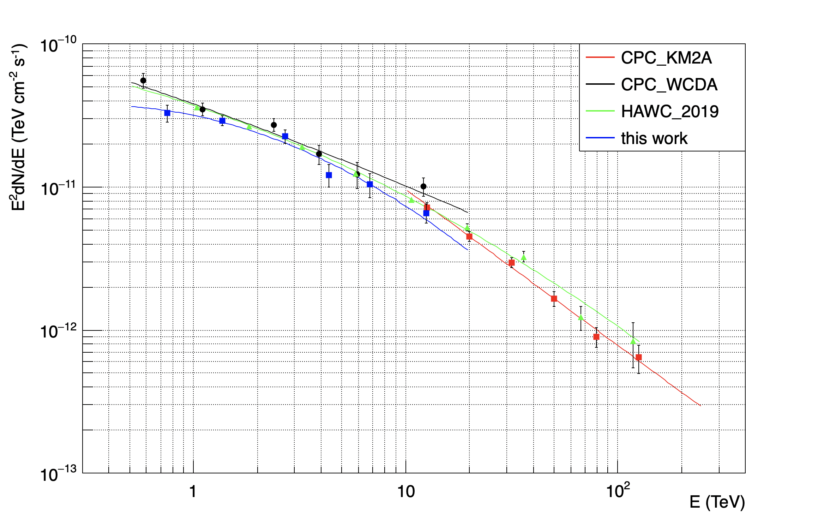
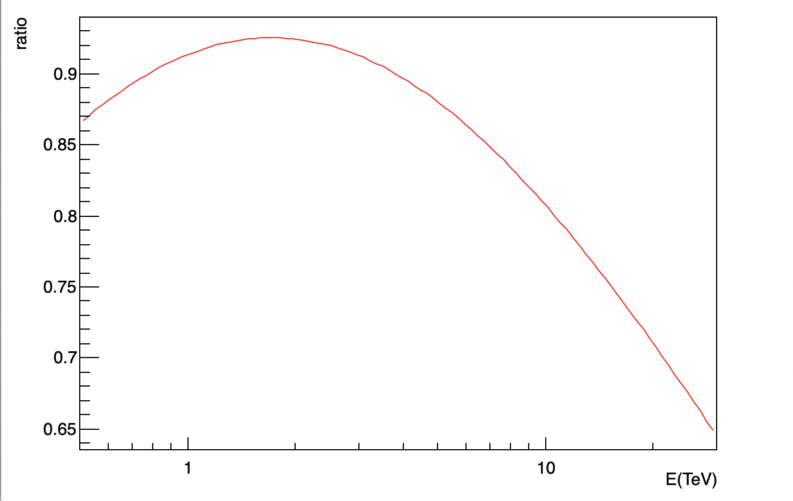
Crab Spectrum
Data Cut : same as CPC
Update： added 202007-202010
~232 transits

Slide 5
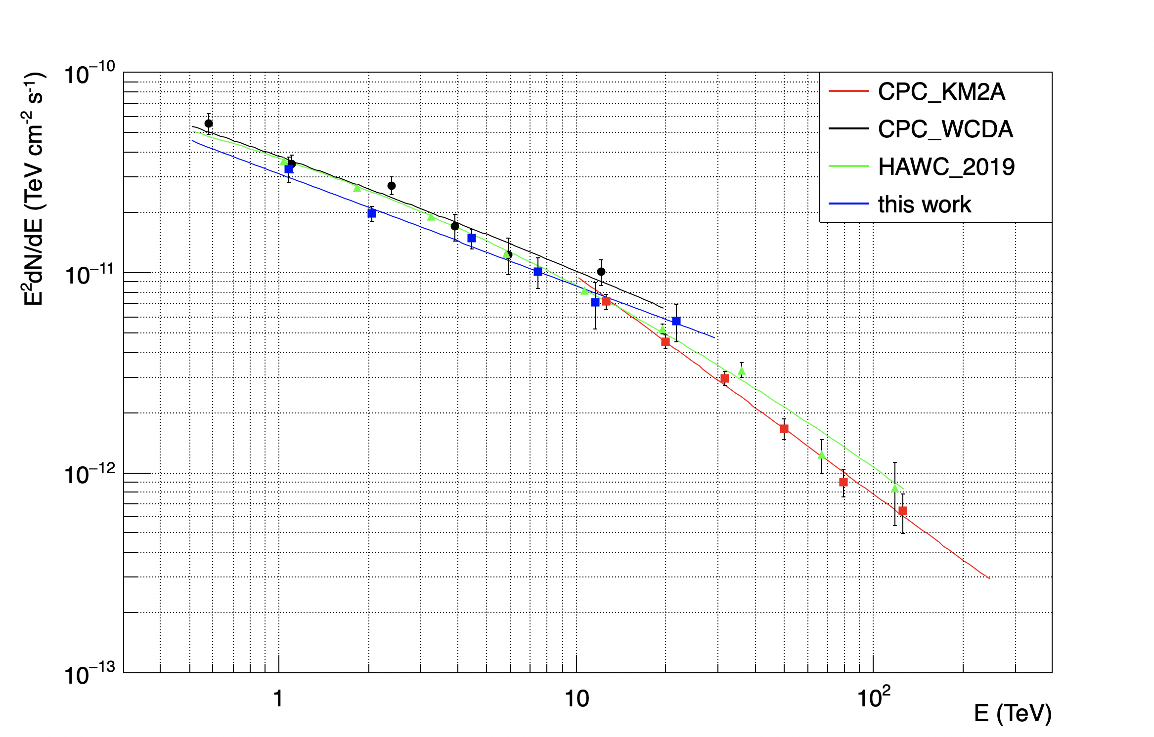
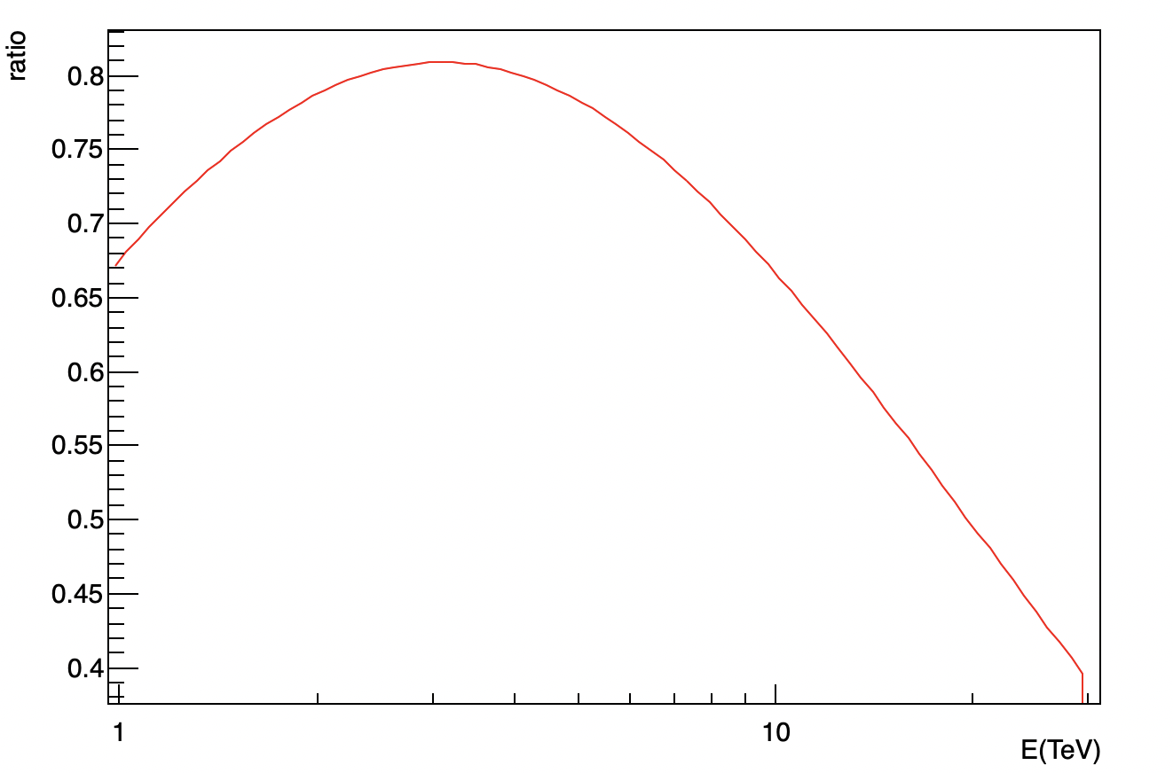
Crab Spectrum of New Reconstruction Version
Reconstruction Version:
Rc -> Me
Time calibration:
Hardware calibration-> offline calibration

Slide 6
A likelihood analysis framework for WCDA

Slide 7
Likelihood Analysis Framework
The framework was designed concurrently with the Multi-Mission Maximum Likelihood (3ML) architecture.
Binned Skymap
Provided by us
A little User code
Spectrum Morphology
TSmap
…
Detector Response
Minimizer Method
Choosed by user
Physics Model
Notes:
HAWC fermi veritas

Slide 8
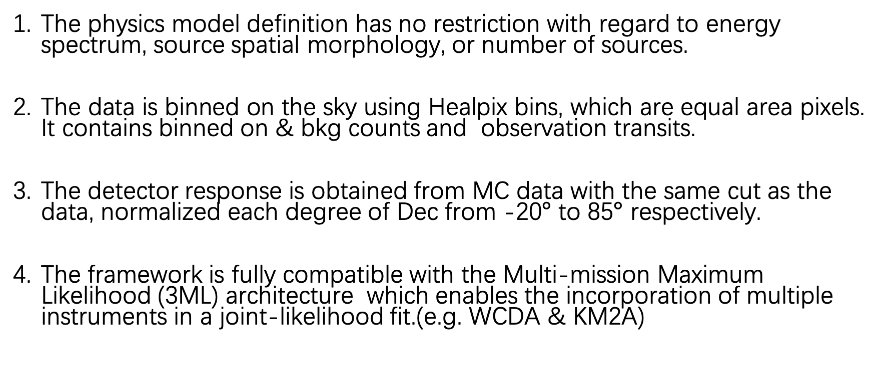
Features
The physics model definition has no restriction with regard to energy spectrum, source spatial morphology, or number of sources.
The data is binned on the sky using Healpix bins, which are equal area pixels. It contains binned on & bkg counts and observation transits.
The detector response is obtained from MC data with the same cut as the data, normalized each degree of Dec from -20$°$ to 85$°$ respectively.
The framework is fully compatible with the Multi-mission Maximum Likelihood (3ML) architecture which enables the incorporation of multiple instruments in a joint-likelihood fit.(e.g. WCDA & KM2A)

Slide 9
Binned Skymap
Event-level data is binned on the sky using HEALPix pixels, which are equal area pixels.
We currently use 10 Nhit bins, the events in a particular Nhit bin has a similar PSF and background rejection.
4 hours direct integration method is used in background estimation, the detected source and Galactic Plane are excluded.
Every Nhit bin has 2 HEALPix maps with on counts & bk counts，

Slide 10
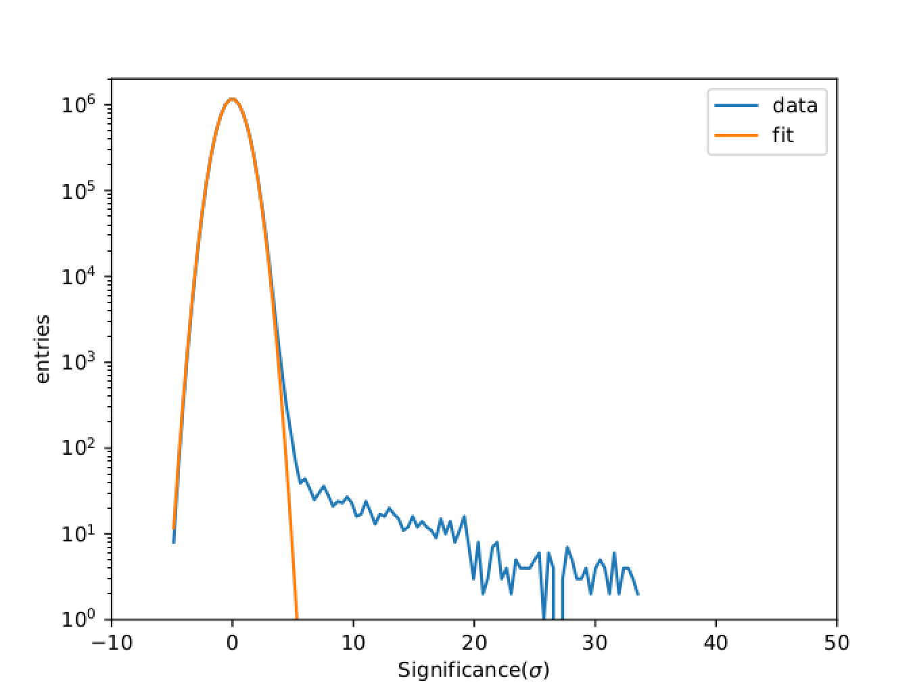
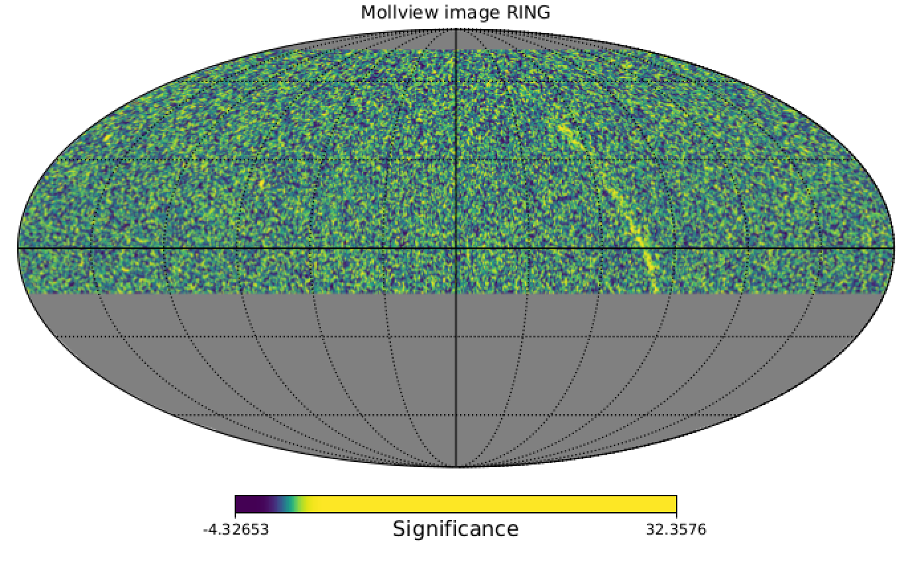
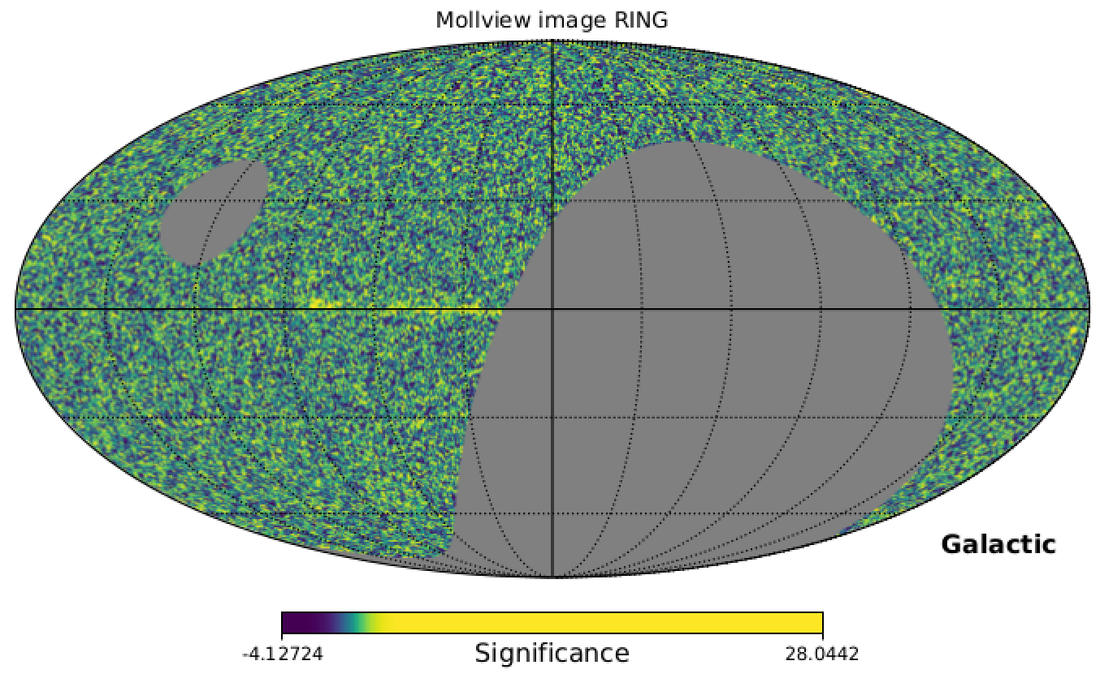
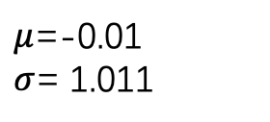
Significance Sky map
$μ$=-0.01
$σ$= 1.011
Mrk421
Galactic plane
Crab
Significance sky map in Equatorial & Galactic coordinate system

Slide 11
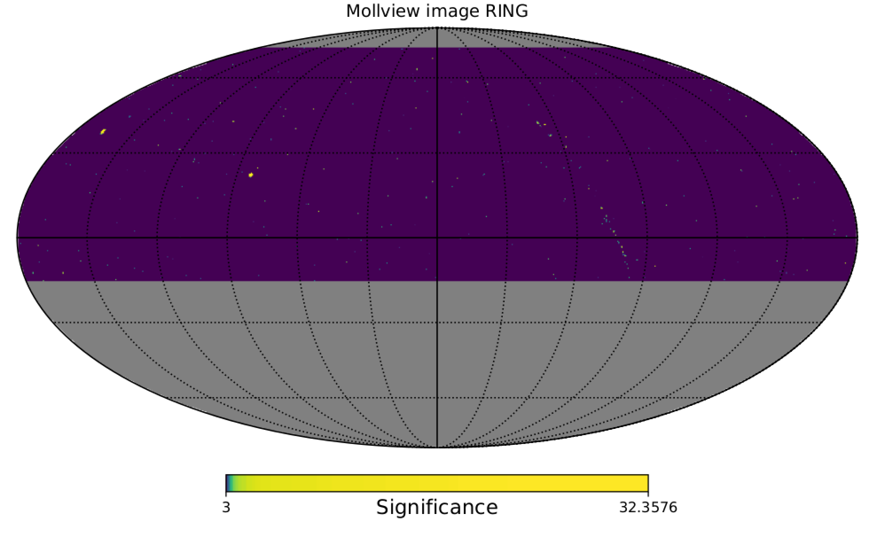
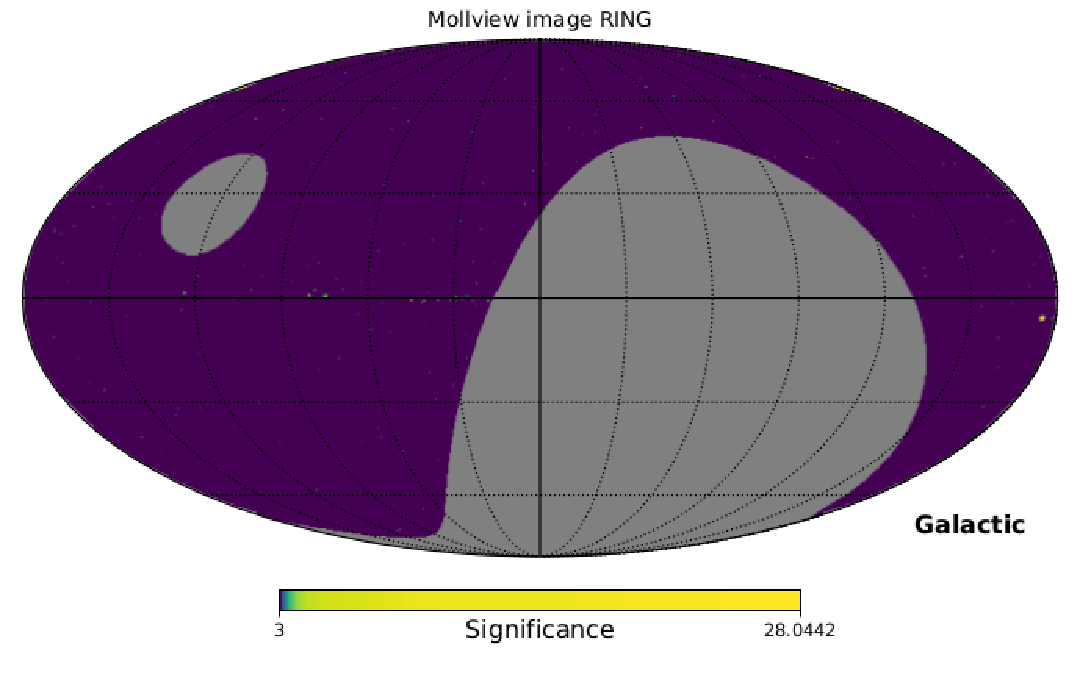
Significance Sky map（min=3. sigma）

Slide 12
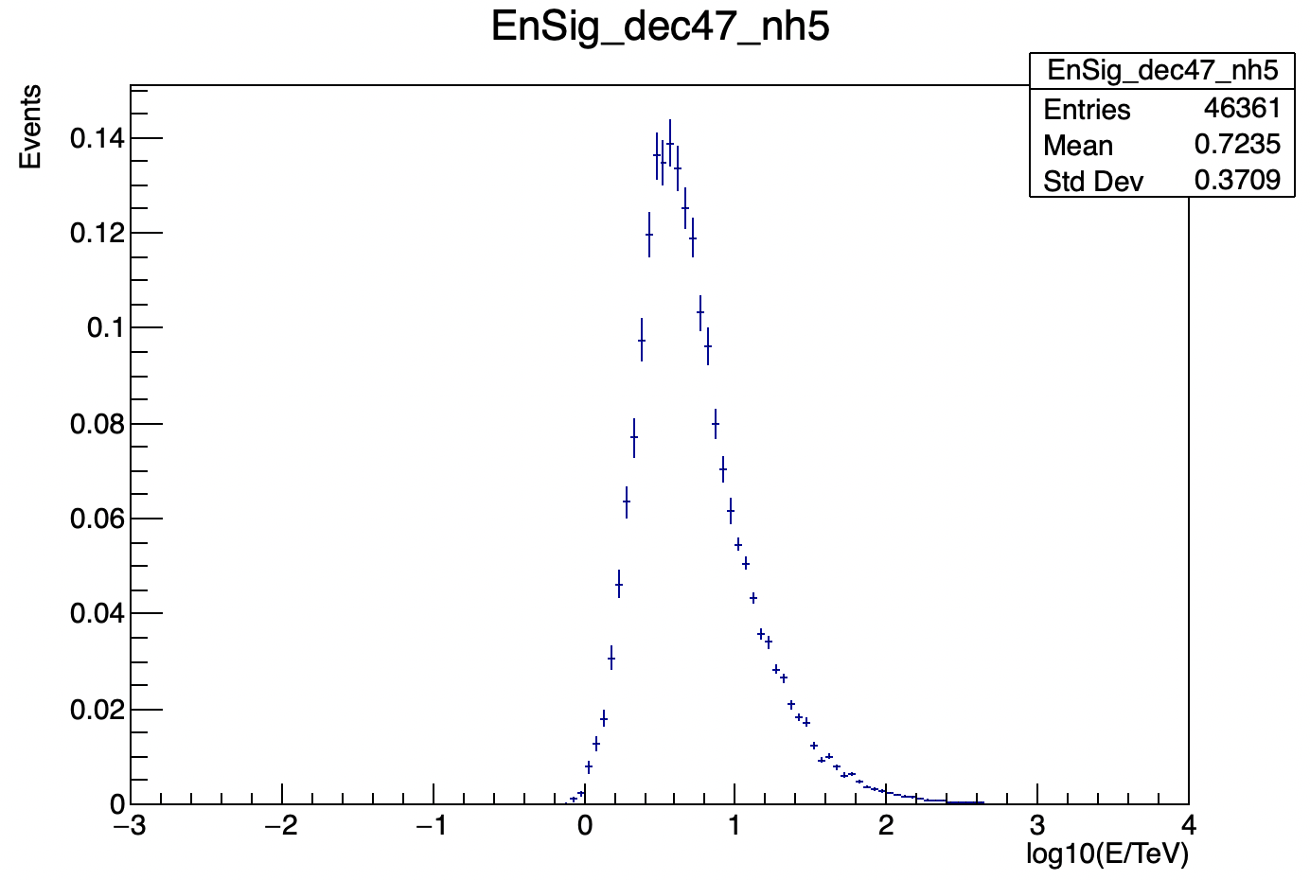
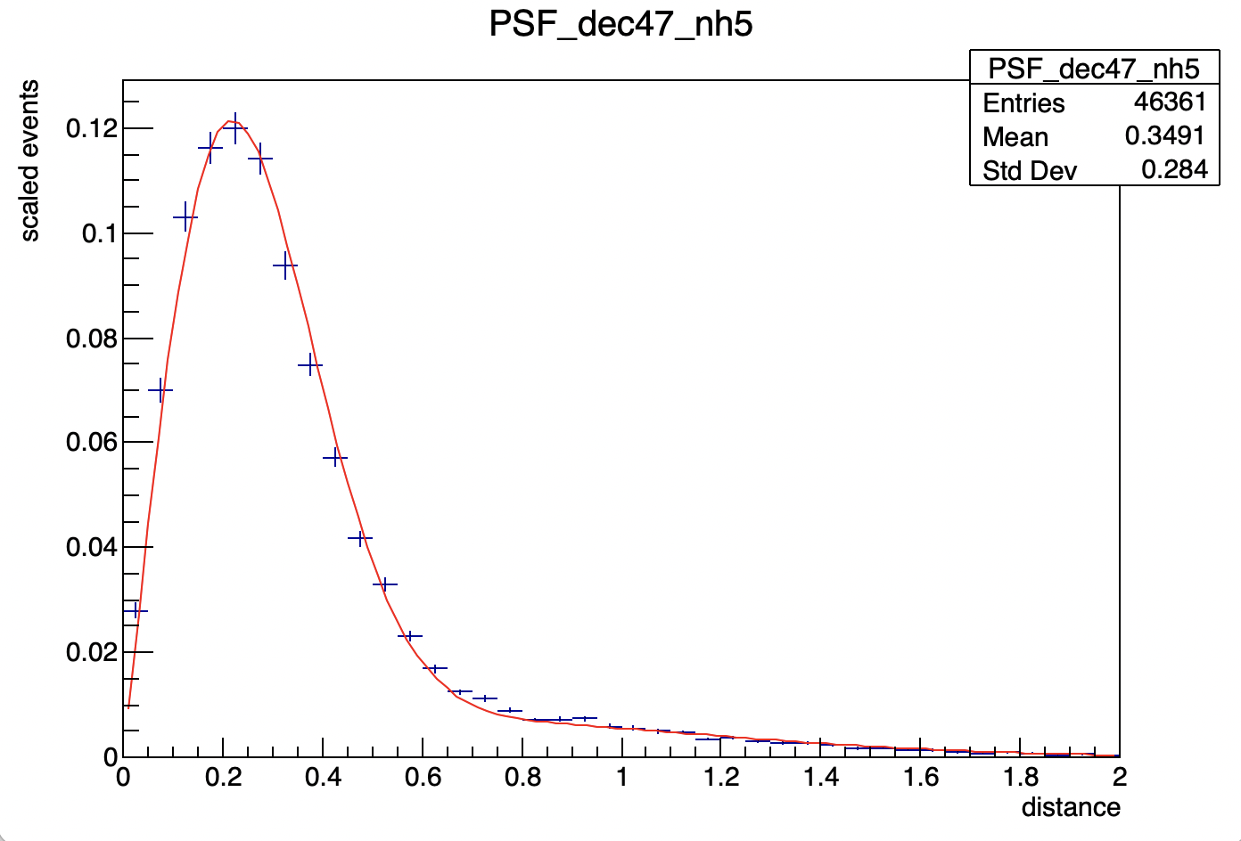
Detector Response
We define the detector response as a function of the declination and the source spectrum
If the spectrum is different from the spectrum used to generate the original detector response, the detector response is modified by re-weighting the energy distribution histograms for each bin.
Rayleigh Distribution

Slide 13
Physics Model
Define two types of sources:
1. Point Source:
1) spectrum 2) location
2. Extended Source:
1）spectrum 2) location 3) spatial morphology
Spectrum & spatial morphology are imported from astromodels，
or you can define your own model.
It supports Multi-Sources fitting

Slide 14
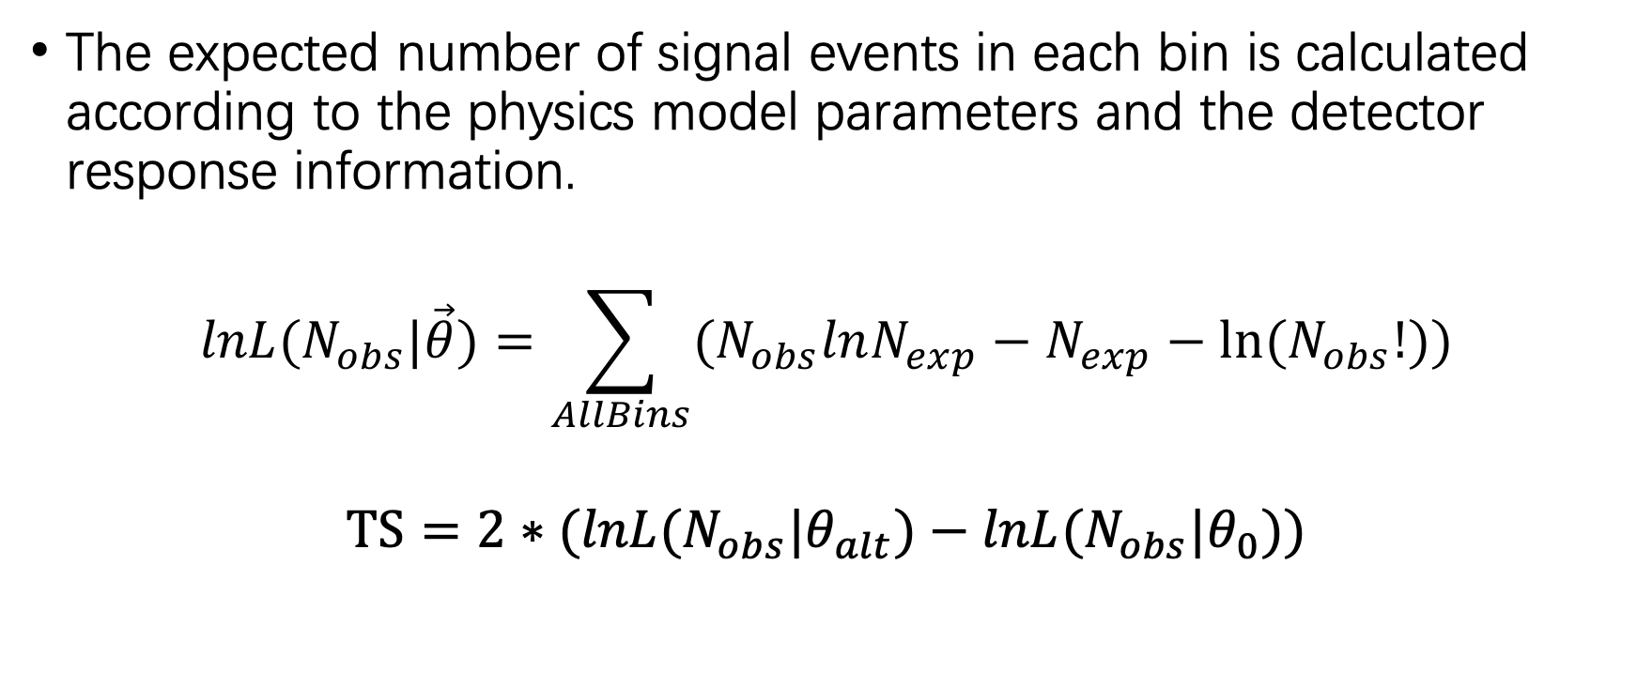
Likelihood Calculation
The expected number of signal events in each bin is calculated according to the physics model parameters and the detector response information.
$$lnL(N_{obs}|\vec{θ})=\sum_{AllBins}{(N_{obs}lnN_{exp}−N_{exp}−ln⁡(N_{obs}!))}$$
$$TS=2∗(lnL(N_{obs}|θ_{alt})−lnL(N_{obs}|θ_{0}))$$

Slide 15
Test running Result
Preliminary
H.F.Zhang , G.M.Xiang
Crab nebular spectrum using the same data of WCDA Crab paper
TSmap of Crab Nebulae

Slide 16
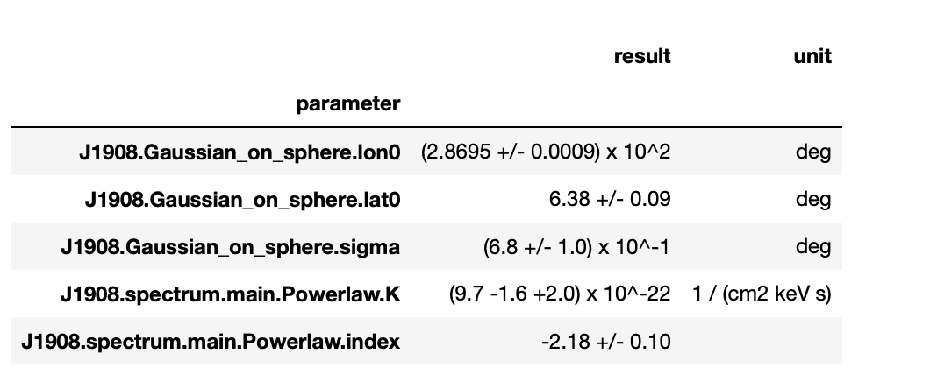
J1908+06
Preliminary
S.C.Hu’s Sigma=0.54
R.Y.Tang, S.C.Hu, G.M.Xiang
TS_J1908=175.79

Slide 17
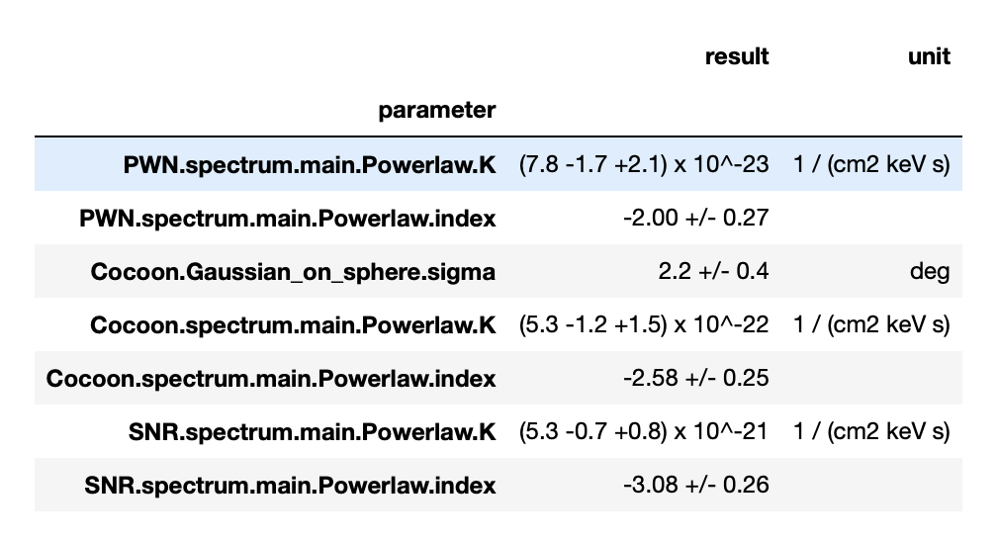
Cygnus Region
Preliminary
TS_Cocoon | 36.042525
TS_SNR | 49.750105
TS_PWN | 22.166927
R.Y.Tang , H.Zhou, G.M.Xiang
ROI:6 degree (masked 2HWC J2019+367 )

Slide 18
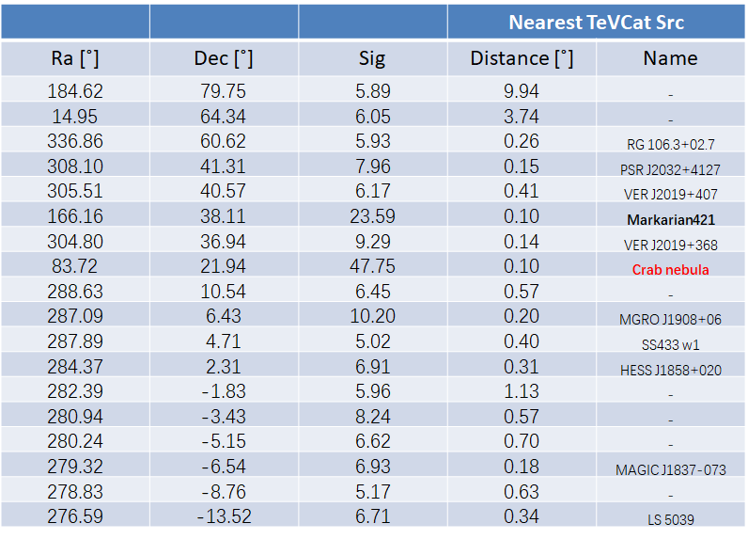
Catalog WCDA-1 201906-202002
Preliminary
S.C.Hu , G.M.Xiang

Slide 19
Summary
There is big discrepancy between Long time Crab Nebular spectrum and previous results.
We have a preliminary likelihood analysis framework for WCDA.
Outlook
Fix some bug in background estimation.
The difference of Crab spectrum.
Data format. root? fits?
In LHAASO summer school, we will provide a tutorial on how to use the framework for WCDA data analysis.

Slide 20
From S.C.Hu

Slide 21
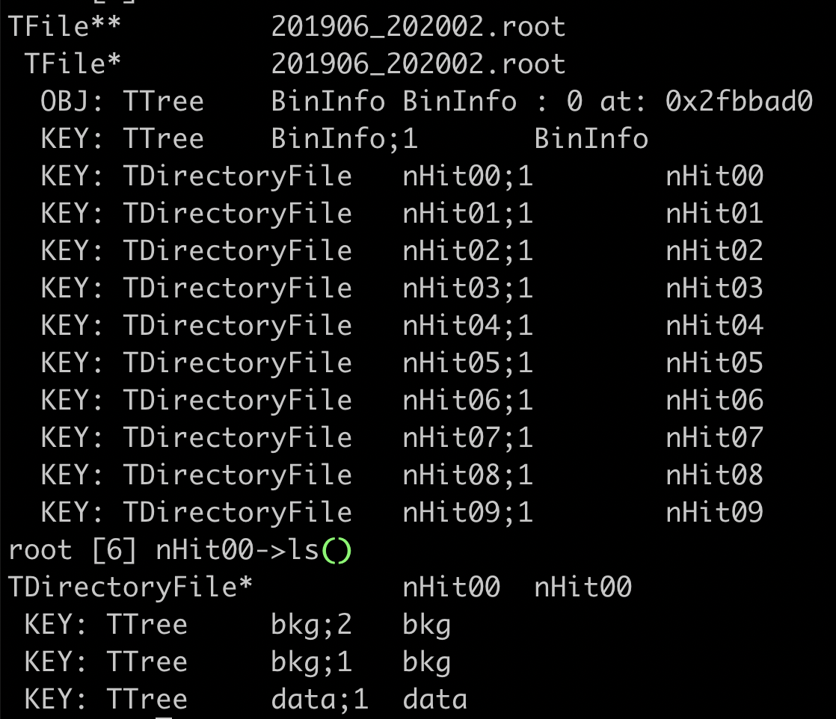
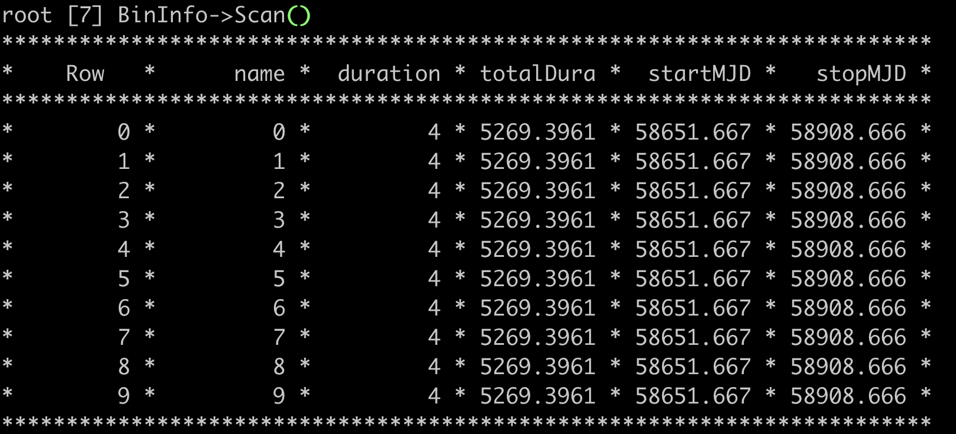
backup

Slide 22
HealPix skymap
on
bkg

Slide 23
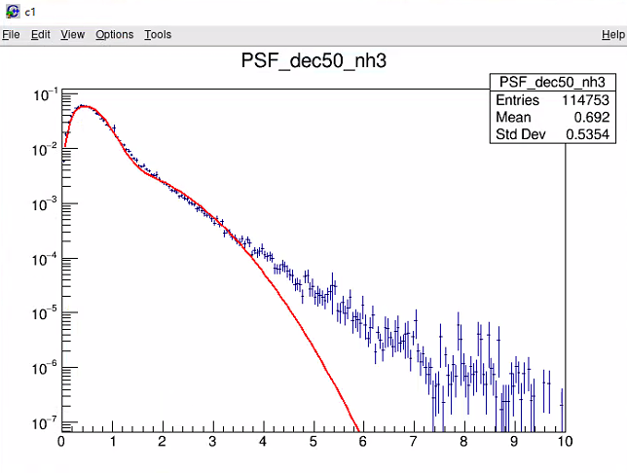
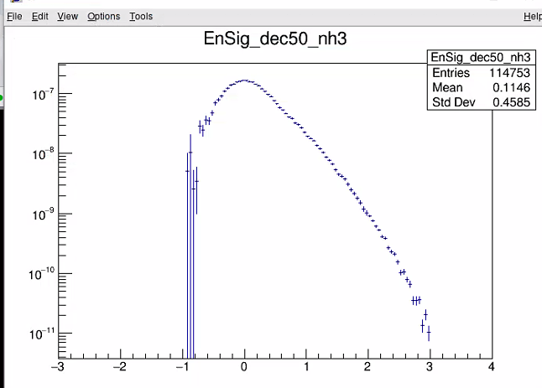
PSF & Sig

Slide 24
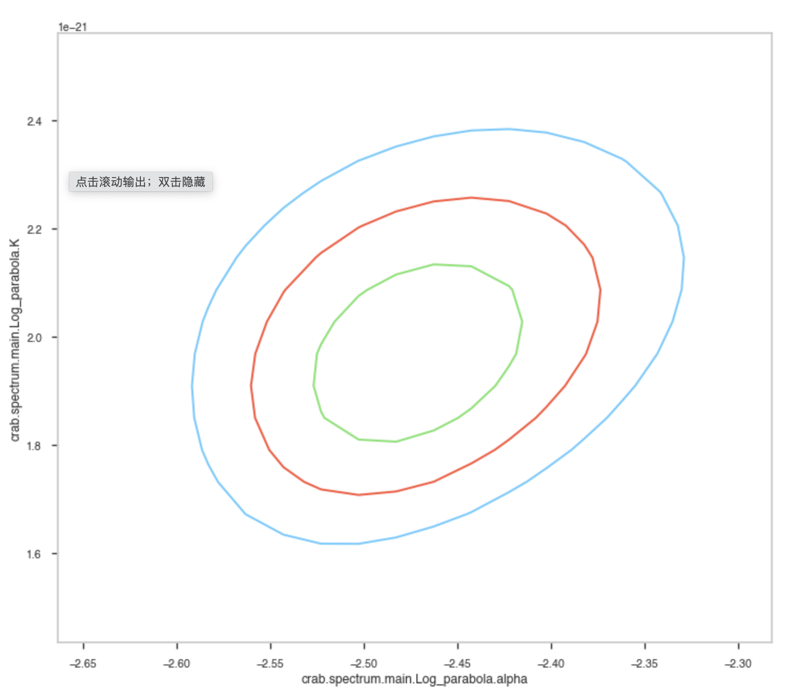
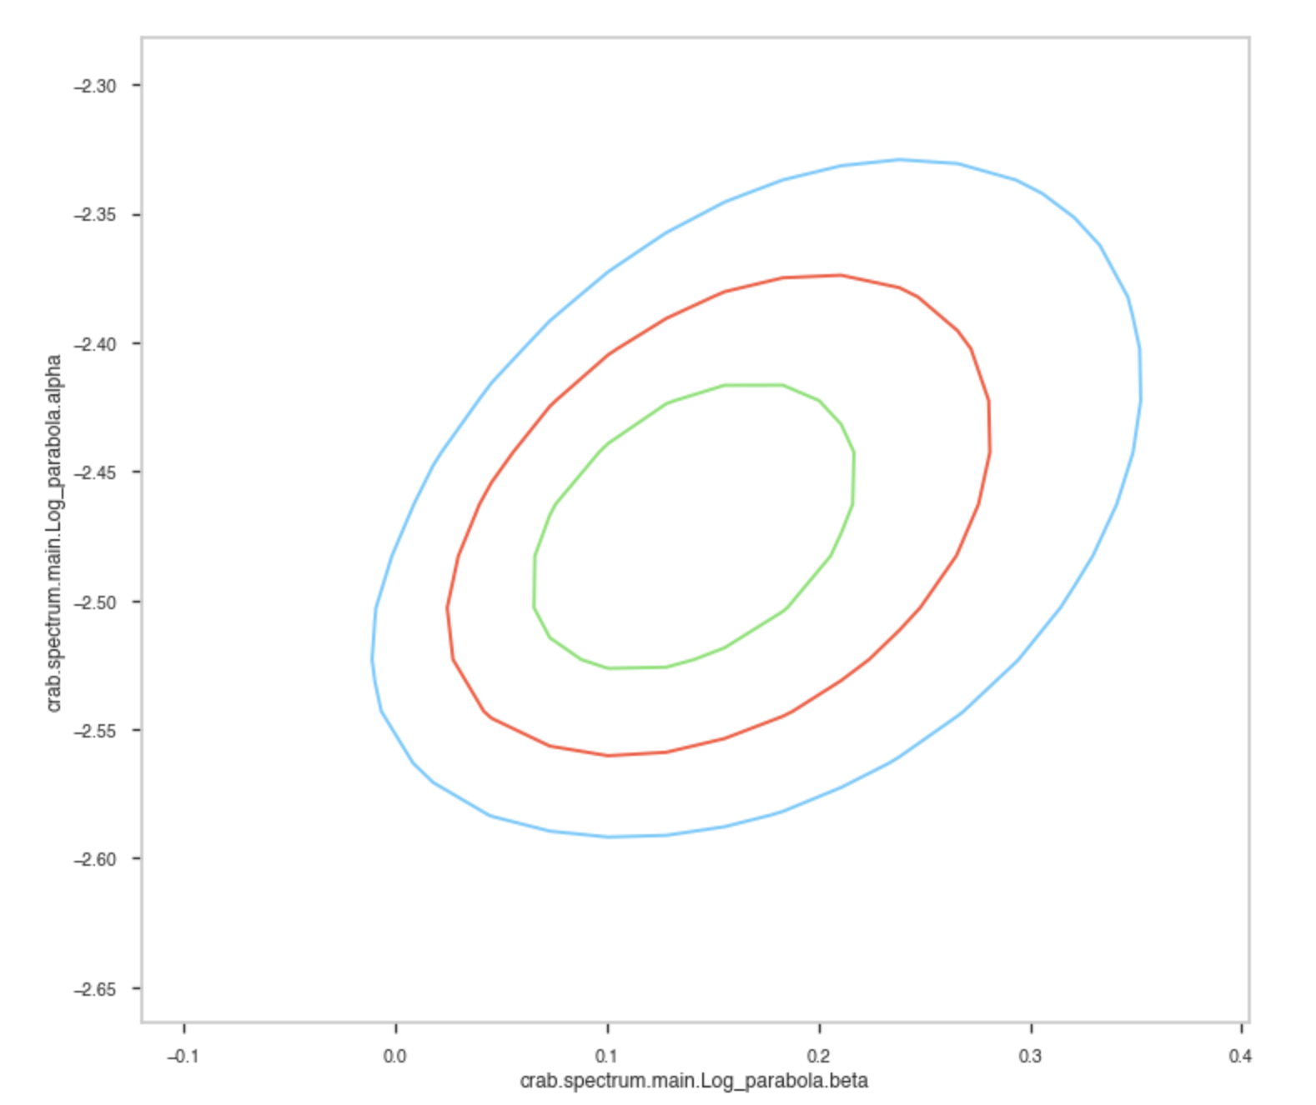
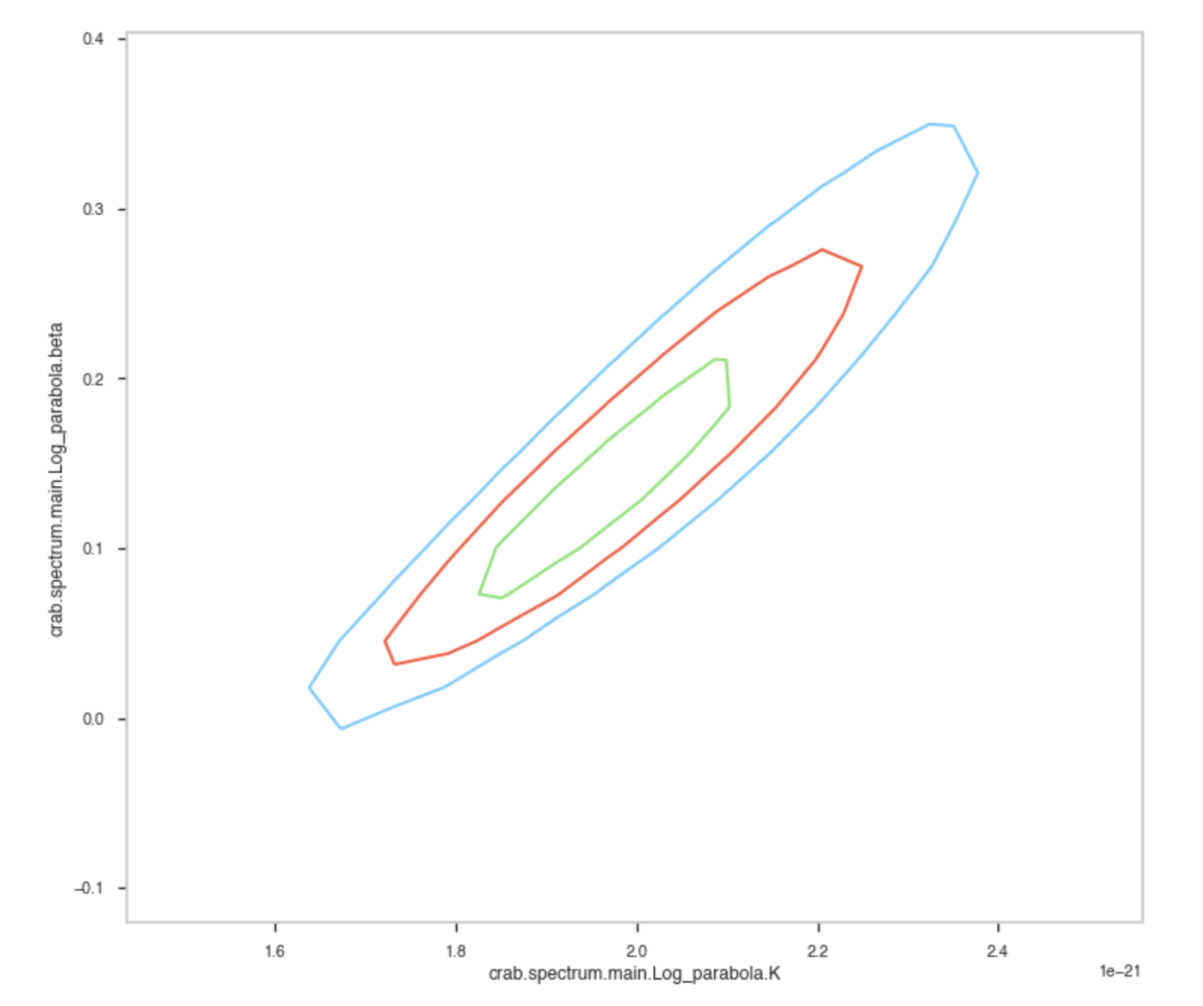
Parameter space

Slide 25
PSF

Slide 26
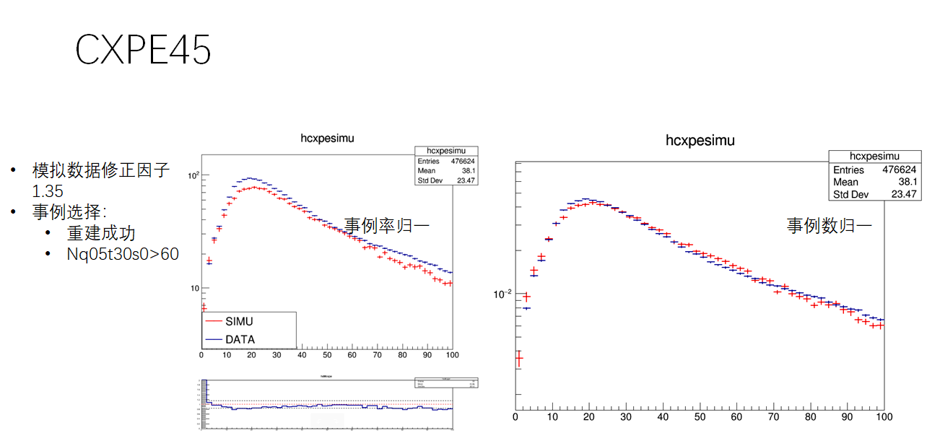

Slide 27
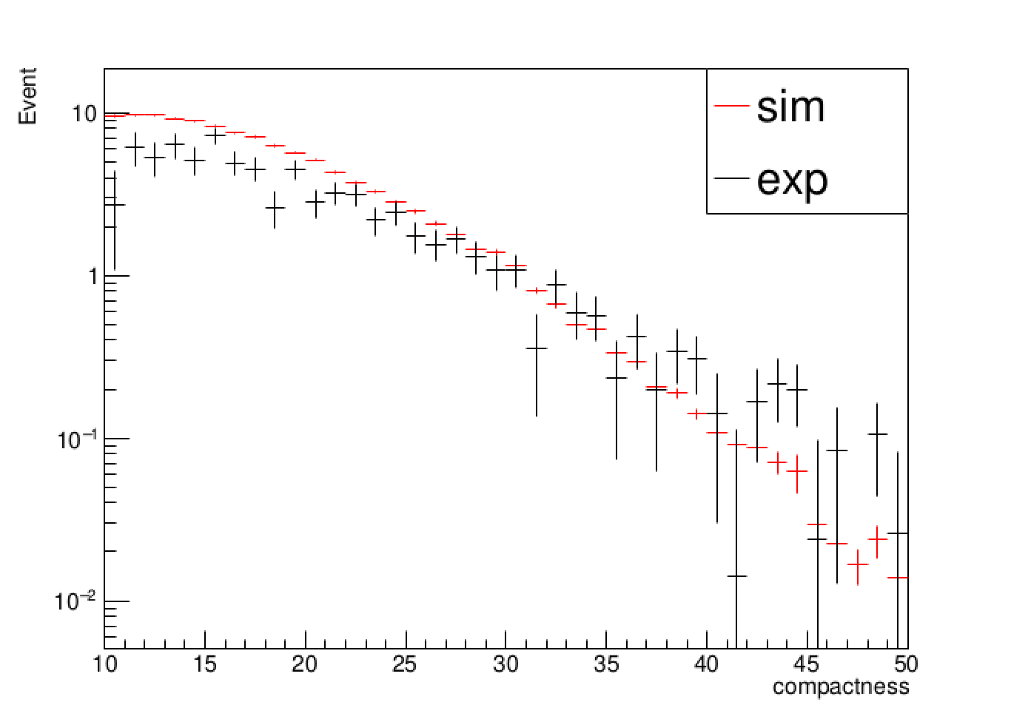
Gamma compactness (Scaled to per transit)

Slide 28
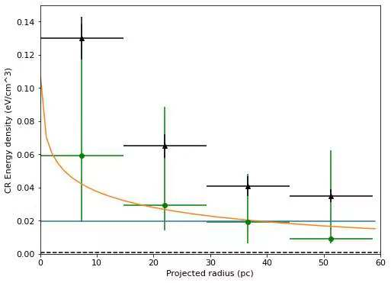
Preliminary
cosmic ray energy density profile calculated for four rings (0–15 pc, 15–29 pc, 29–44 pc and 44–55 pc) centred at the OB2 association

