Slide 1
Fast simulation of WCDA1 and the usages
Xiurong Li
2021/4/25
Institute of High energy Physics
LHAASO 2021 collaboration conference at Guangzhou

Slide 2
outline
Why need wcda1 fast simulation
The method of fast simulation
The reconstruction and comparisons
Simulate together with WFCTA and KM2A
Some big+small PMT information
Summary

Slide 3
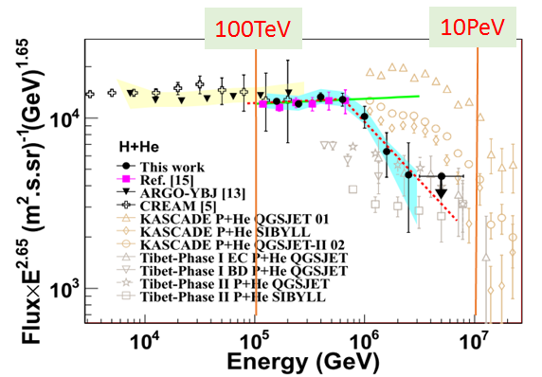
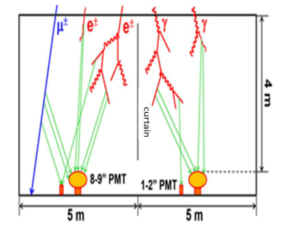
Why need fast simulation of WCDA1
WCDA1
WCDA++： 100TeV-10 PeV cosmic rays，
Supply information of core、direction and particle identification
300 photons/cm in water.
Huge of Cerenkov photons. fast simulation is impossible for so high energy and so much events

Slide 4
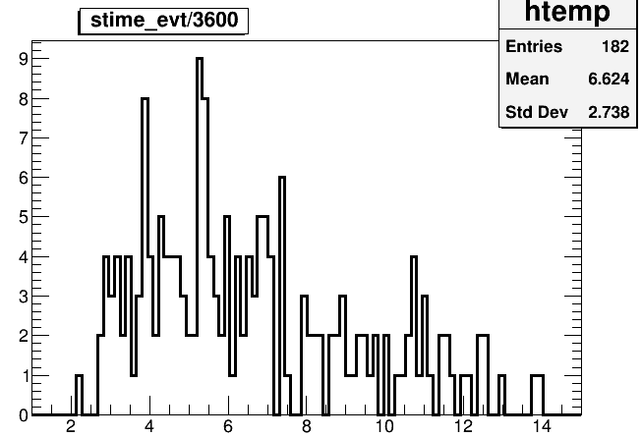
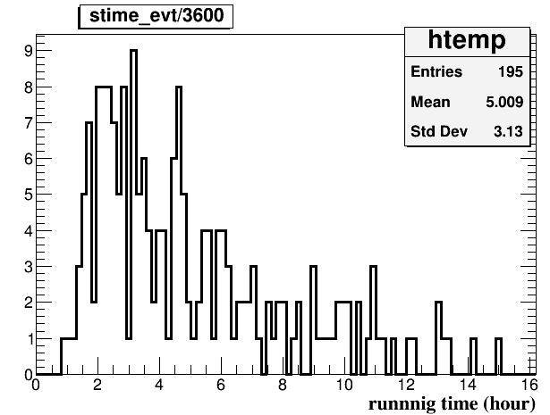
Need fast simulation to speed up
Running time (hour)
of 100 TeV Gamma
Running time (hour)
of 100 TeV Proton
 | 10Tev Gamma | 50 TeV Gamma | 100 TeV Gamma | 10 TeV Proton | 50 TeV Proton | 100 TeV Proton
Read secondaries | 2.36s | 2.4s | 3 s | 2.5 s | 2.68s | 2.658 s
No Cerenkov photons | 30 s 0.5 min | 251 s 4.2 min | 571.447 s 9.5 min | 22s 0.37 min | 157.889s 2.6 min | 363.2s 6.0 min
Full geant4 | 0.4 hour | 3.25 hours | 6.6 hours | 0.2 hours | 1.8 hours | 5 hours
Fast geant4 | 1.486 min | 0.23 hours | 0.52 hours | 1.437 min | 0.17 hours | 0.374 h

Slide 5
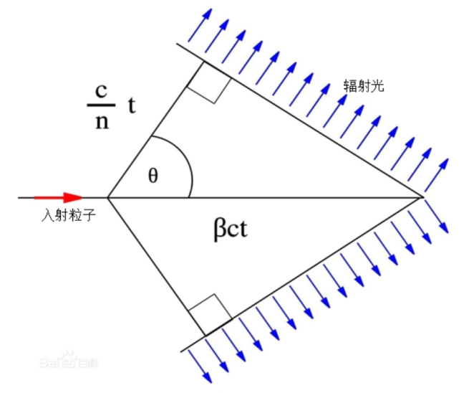
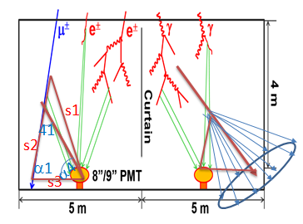
Fast simulation method developed from WCDA1 Geant4 full simulation
Each step of charged track is about 0.6cm
with about 200 photons generated.
Fast simulation method:
1. Juge each step of charged track:
Cerenkov circle hit PMTs(5*5) or not,
sheltered by curtains or not
2. Juge photons if 1:
photon hits any PMT or not
sheltered by curtains or not
Condition and suppose：
most photons hitting PMTs straightly

Slide 6
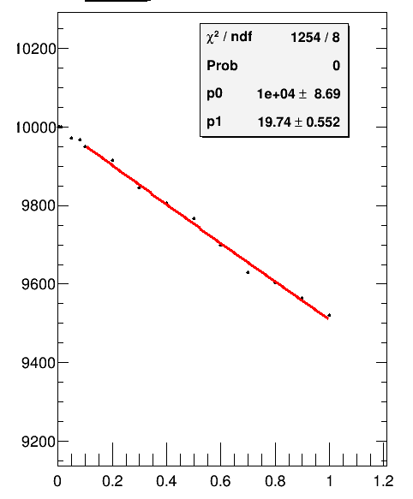
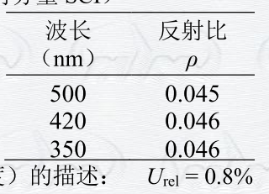
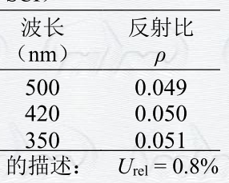
Why photons changing directions in the pool
Water scatter.
Only raylei scatter of water used in full sim,
with default scatter length about 148 m.
exp(-5/148.0)=0.967; exp(-3/148.0)=0.98
Less than 2% of photons changing directions because of water scatter
2. Reflection of curtains is about 4.6%
3. Reflection of ground is about 4.5%

Slide 7
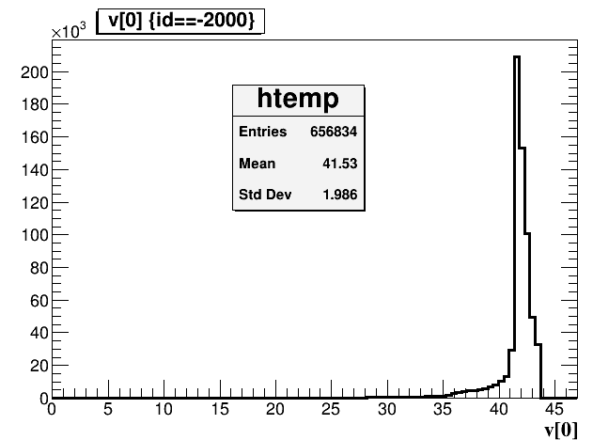
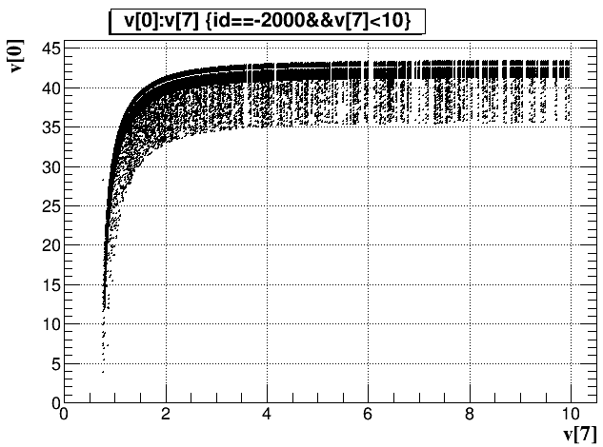
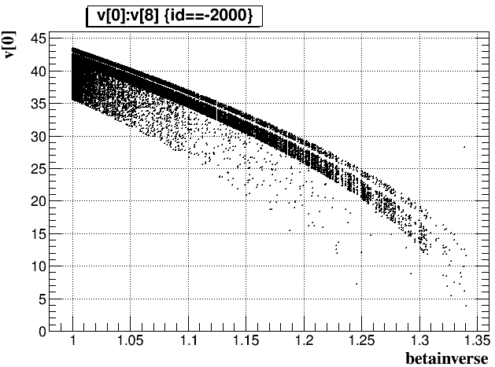
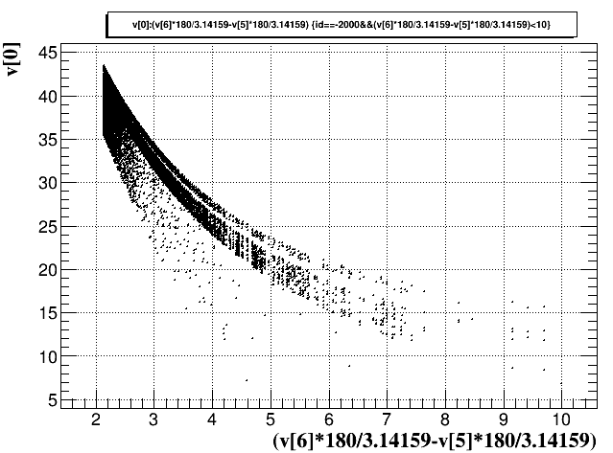
Angles of Cerenkov photons
9% with angle<40
5% with angle<38
2% with angle<35
About 3% with expected
maxAngle-minAngle>2.5
Angles of Cerenkov photons in Geant4 don’t strictly follow the formula and theory.

Slide 8
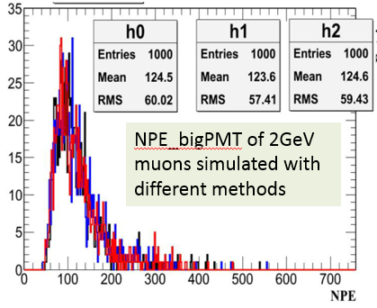
The samples and methods to compare fast simulation and full simulation
Samples：
1. single particles (less than 2%)
2. cosmic proton and Gamma
(big NPE about 5%, small NPE about 2%)
Methods:
1. tag each missing photons to see where from (most reflected)
2. Npe compare
3. reconstruction compare (core and direction)

Slide 9
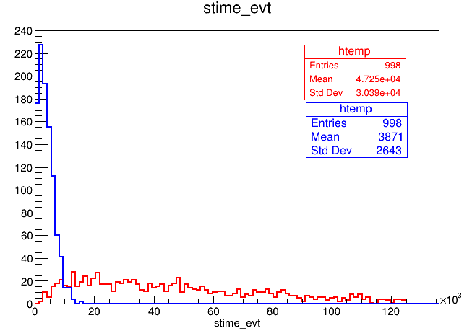
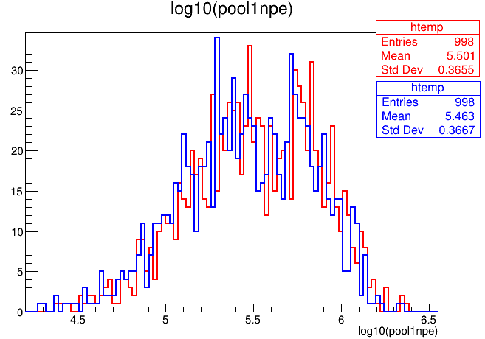
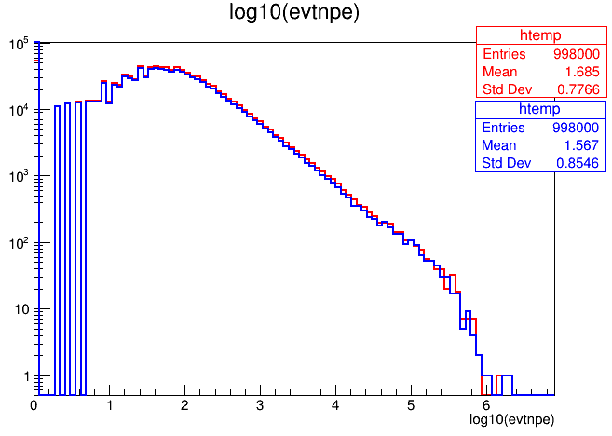
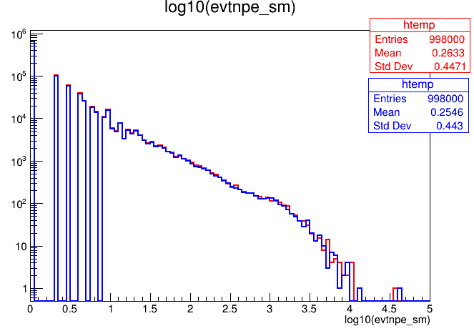
Compare fast simulation and full simulation with 100TeV-1PeV protons (core at the center of pool1)
Full simulation about 13.1 hour,
fast simulation about 1.1 hours

Slide 10
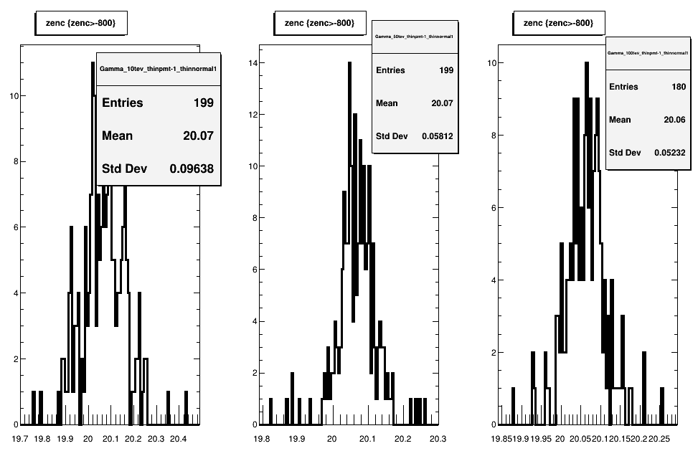
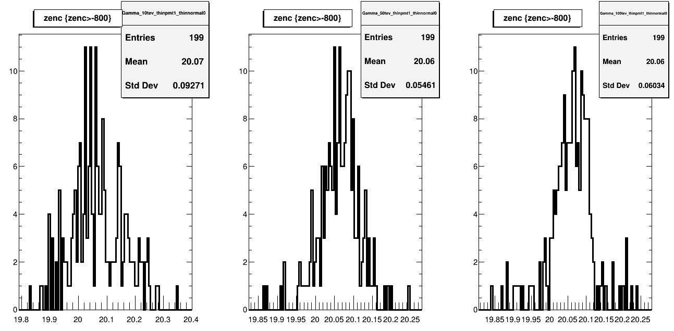
Reconstructed theta of full Simulation for Gamma(10T,50T,100T)
Reconstructed theta of fast Simulation for Gamma(10T,50T,100T)

Slide 11
The geant4 run shell job
-thinpmt: fast simulation or full simulation
-thinnormal: kill or randomly sim photons not hitting PMTs
-singlesim: corsika sim or single particle sim and how
-coreset: where to set the core. Read from corsika or randomly
evt_out.root: npe and time of each cell and fast core reconstruction
Hits_out.root: each hits saved for detail reconstruction
The reconstruction programs for two step simulation can be used for fast simulation.

Slide 12
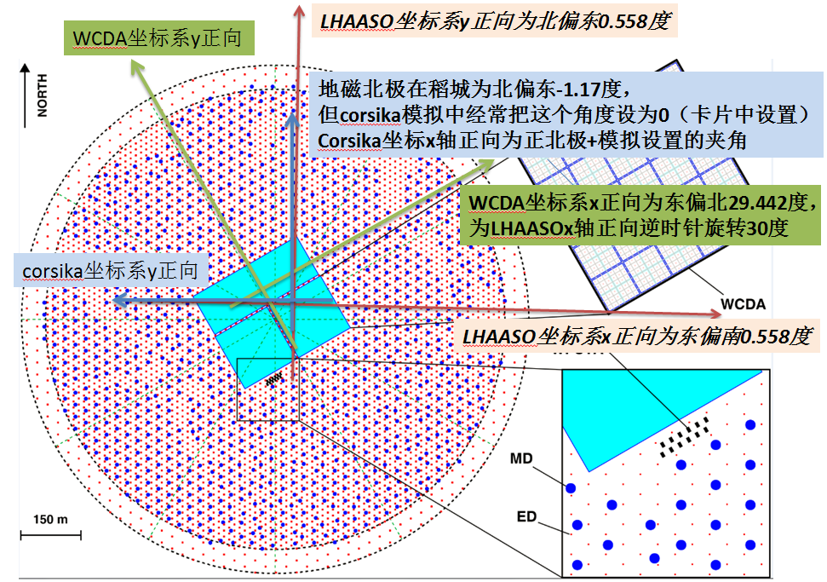
How to simulate WCDA+WFCTA+KM2A
In the WCDA fast geant4 code, automatically done:
1. direction roration; 2. core shift 3. height at 10 m
Set the direction、core、height of secondaries for the three arrays same;
merge the Geant4 outfiles.
Tested by WFCTA group

Slide 13
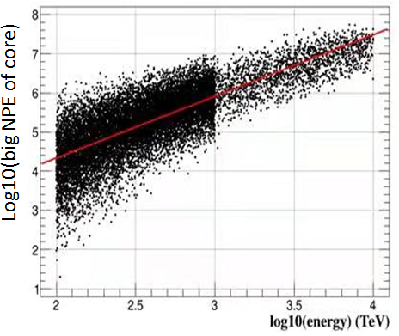
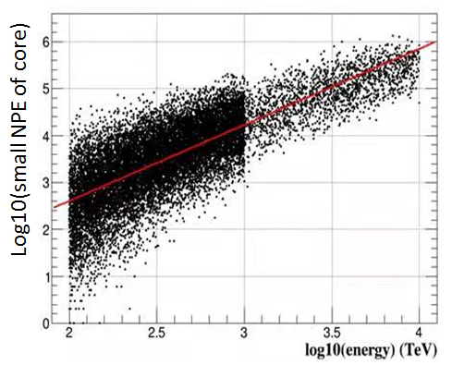
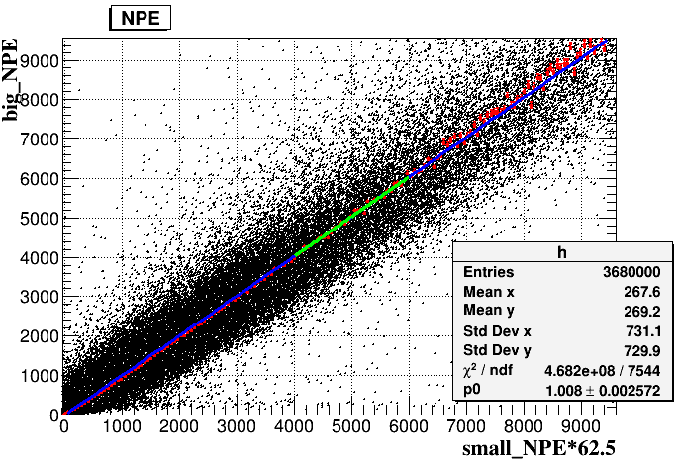
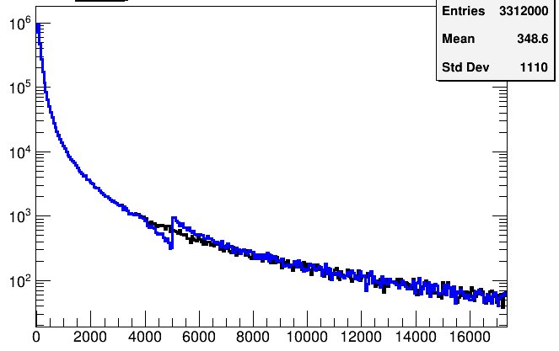
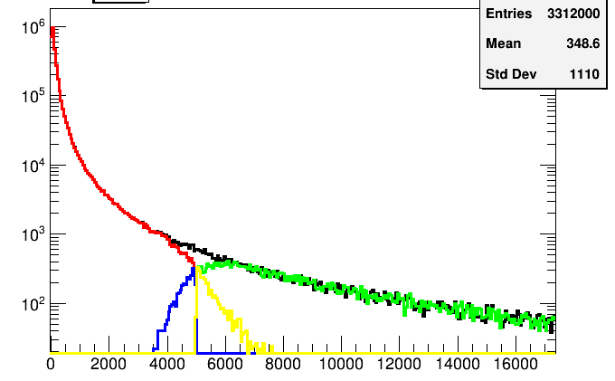
100TeV-10 PeV Protons simulated
Running speed ok
Big_Npe/small_NPE and the connection analyzed with fast and full simulation

Slide 14
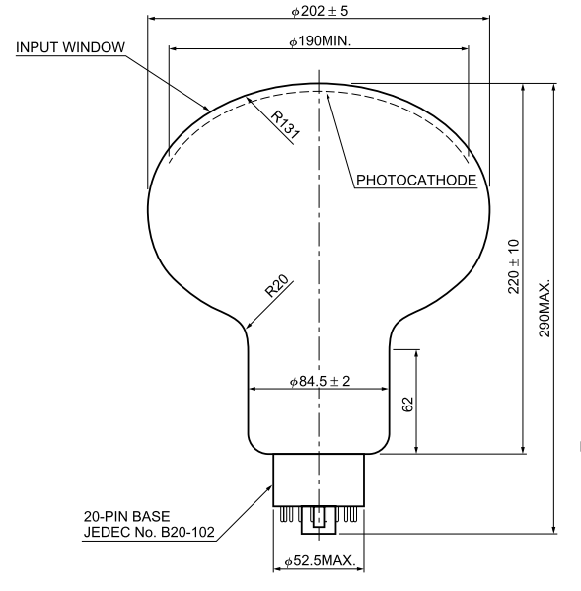
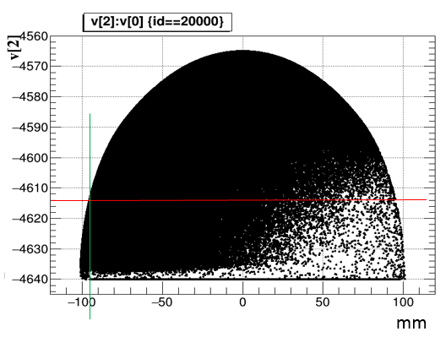
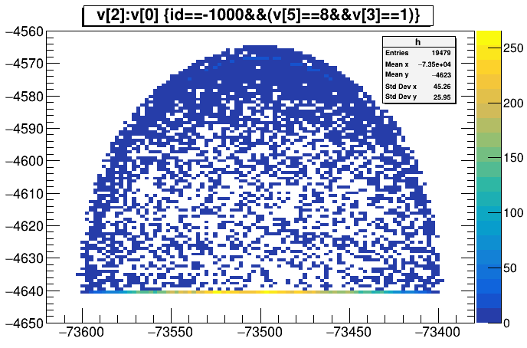
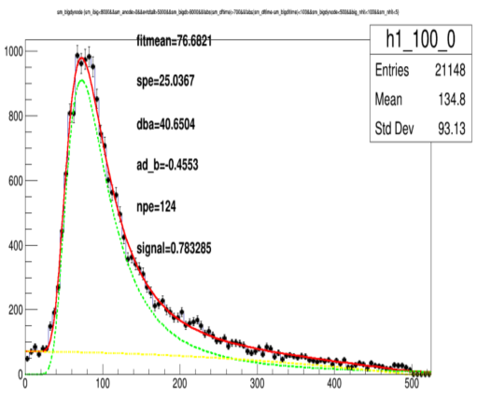
Corrected the photocathe area of 8 inch PMT by analyzing coincidence muons

Slide 15
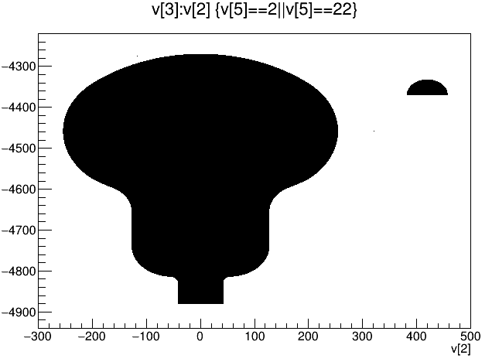
Summary
1. fast simulation of WCDA1 work and realized the requirement of comic ray energy measurement with WFCTA
2. Settled how to simulate with WFCTA and KM2A
3. Detailed comparison between fast and full simulation done
4. found and corrected some problems of simulation
5. Big_Npe/small_NPE (pool1) and the connection analyzed
Fast simulation of pool2 and pool3 with 20inch PMTs and 3inPMTs will be finished soon.
Measure energy spectrum of Gamma ray and enhance the sensitivity (WCDA+KM2A)

