Slide 1
Measurement of the attenuation length of muon in the air shower with MD of LHAASO-KM2A
Xiaoting Feng, Hengying Zhang, Cunfeng Feng
Shandong University

Slide 2
Outline
Motivation
Data selection
Constant Intensity Cut
Attenuation length varies with primary energy
The muon attenuation length
Conclusions

Slide 3
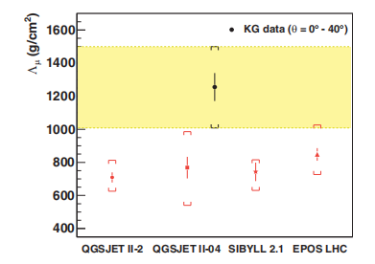
Motivation
the muon in extensive air showers (EAS) play an important role for understanding air shower physics.
Muon carry information about their parent particle, poins and kaons, production in hadronic interaction.
The attenuation of muon affect the evolution of the muon content of EAS in the atmosphere.
KASCADE-Grande find the deviation between data and MC.

Slide 4
Data selection
Table1：
Model | EPOS_Fluka_Proton | EPOS_Fluka_Fe | QGSII_Gheisha_Proton | QGSII_Gheisha_Fe | data （four days）
all | 2,003,984 | 961,064 | 1,954,409 | 929,124 | 279,649,602
after cut | 47,323 | 29,132 | 47,656 | 28,358 | 4,117,018
Cut: R_{p}<=100m, ($R_{p}$: distance from shower core to array center; r: distance to shower core)
NpE3>30, （ NpE3: number of e of ED with r=40-200）
NuM>10, （NuM: number of muons of MD with r=60-300）
NfiltE >=30, NtrigE >=30
NpE1/NpE3 >1, （NpE1:number of e of ED with r=0-100）
NfiltM >15,
Energy: 10TeV-10PeV

Slide 5
Constant Intensity Cut
The intensity of CR is isotropy
The same intensity corresponds to same CR primary energy.
The observed muon number at same flux varies as θ,
path increase as θ -> muon decay ->observed muon number decline
$$N_{μ}\left(θ\right)=N_{μ}^{0}e^{−X_{0}secθ/Λ_{μ}}$$

Slide 6
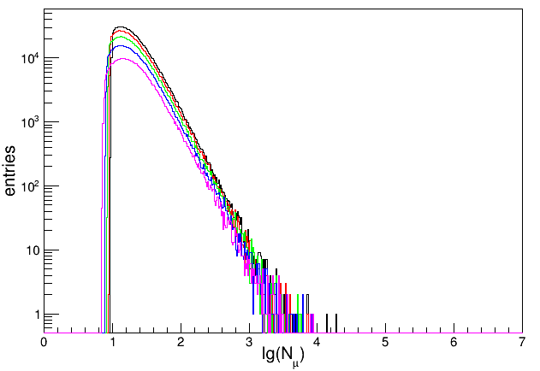
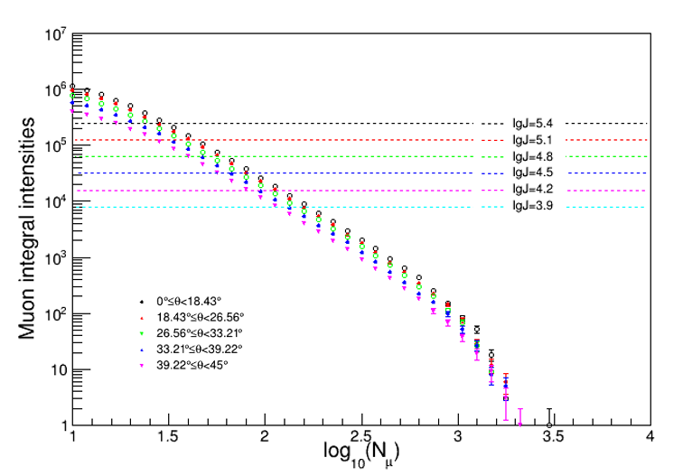
Constant Intensity Cut
muon spectrum
integral spectrum
five zenith-angle aperture： [0,18.43°],[18.43°,26.56°],[26.56°, 33.21°],[33.21°, 39.22°],[39.22°,45°].
$\log_{10}J≈[3.9,5.4]$ $∆$lgJ=0.3 of full efficiency and maximum statistics.

Slide 7
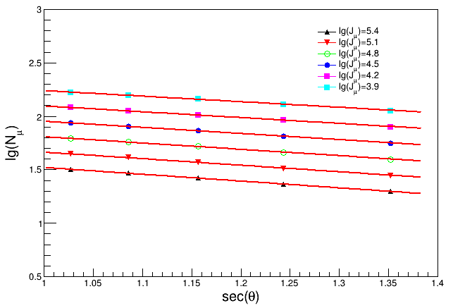
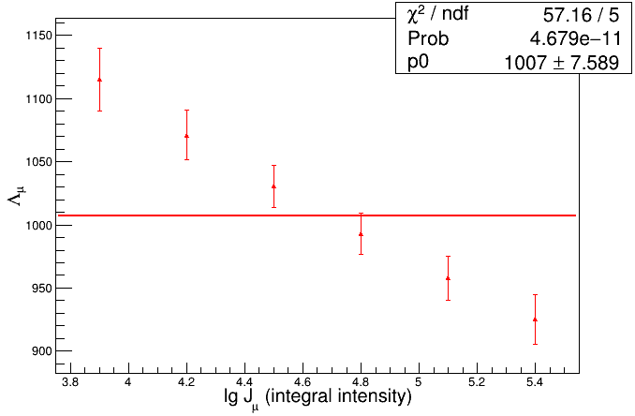
The muon attenuation length
muon attenuation curves
attenuation lengths distribution
attenuation curves using $N_{μ}\left(θ\right)=N_{μ}^{0}e^{−X_{0}secθ/Λ_{μ}}$, $Λ_{μ}$ as an appropriate physical quantity to study the evolution of the muon content of EAS in the atmosphere.

Slide 8
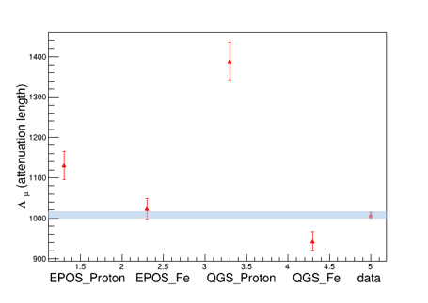
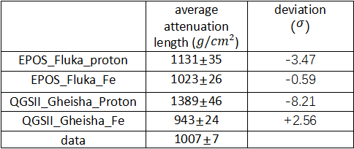
The muon attenuation length
Table2:
 | average attenuation length ($g/{cm}^{2}$) | deviation （$σ$）
EPOS_Fluka_proton | 1131±35 | -3.47
EPOS_Fluka_Fe | 1023±26 | -0.59
QGSII_Gheisha_Proton | 1389±46 | -8.21
QGSII_Gheisha_Fe | 943±24 | +2.56
data | 1007±7
table3
The same method can be used to obtain the attenuation length of the simulation data
Mc data $lgJ≈\left[2.2,3.7\right]$.

Slide 9
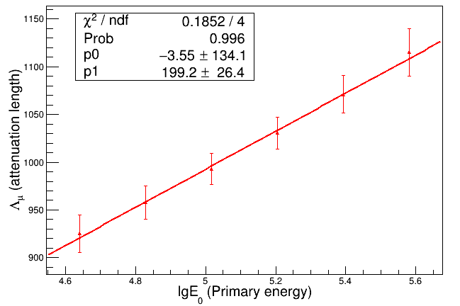
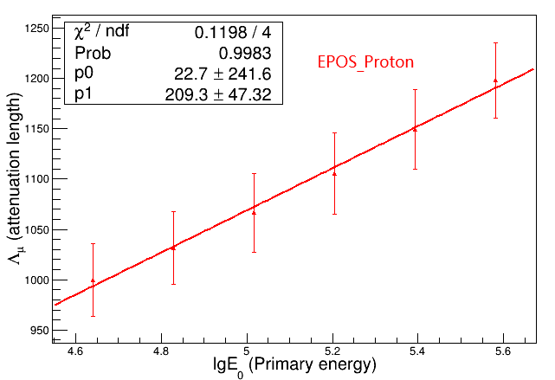
Attenuation length varies with primary energy
$Λ_{μ}$ varies with $E_{0}$ of experiment data
$Λ_{μ}$ varies with $E_{0}$ of MC
the greater energy of primary particle, the greater equivalent vertical muon size, and the greater attenuation length.

Slide 10
Conclusions
the average attenuation length of the experimental data is $1007±7(g/{cm}^{2}).$
No obvious deviation from MC
the attenuation length of experimental data decreases with the increase of flux.
$Λ_{μ}$ increasing with primary energy, it can be explained by the theory of relativity.
The tendency of $Λ_{μ}$ increasing with E also found in MC.

Slide 11
thanks

Slide 12
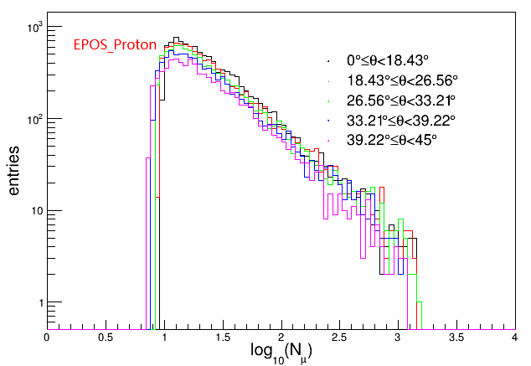
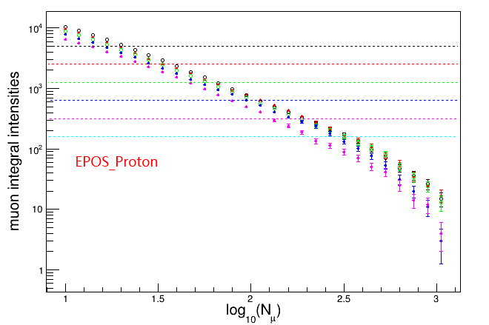
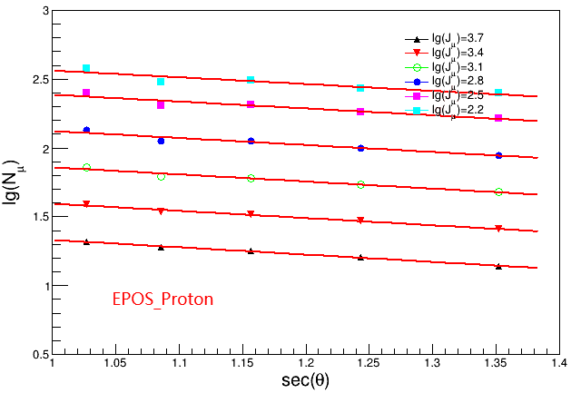
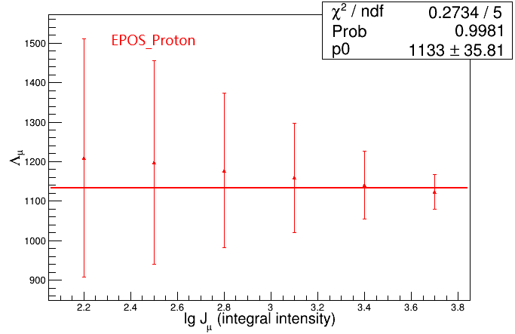
appendix
斜率：
0.531362,0.523193,0.515024,0.506854,0.498685,0.493238

Slide 13
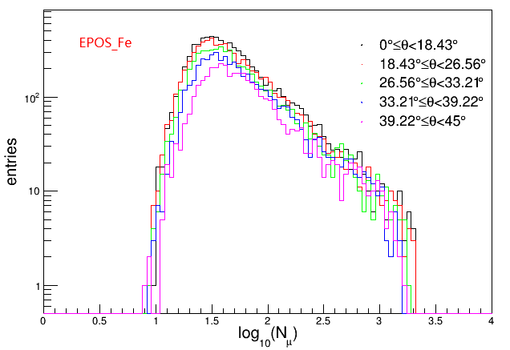
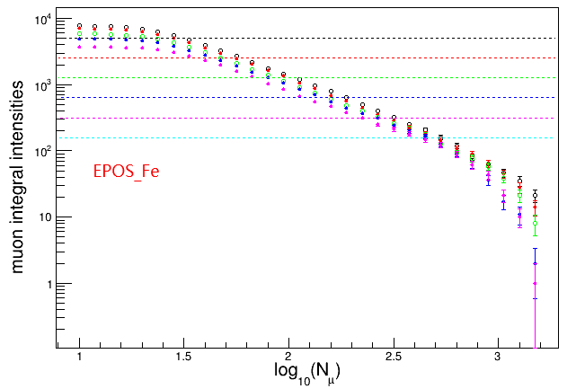
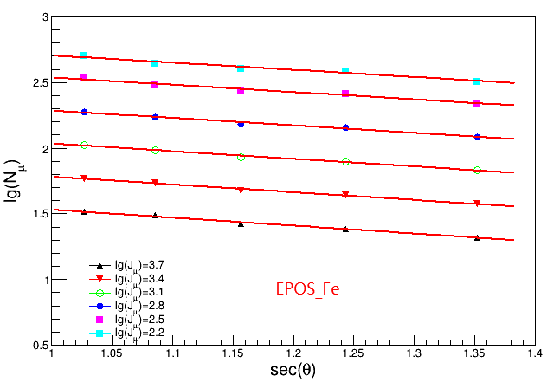
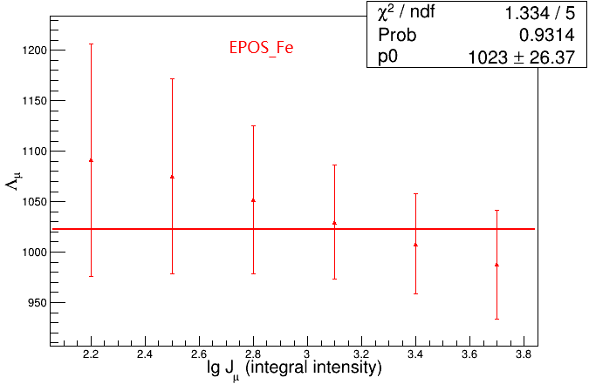
appendix
斜率：
0.604455,0.592154,0.579853,0.567551,0.55525,
0.547049

Slide 14
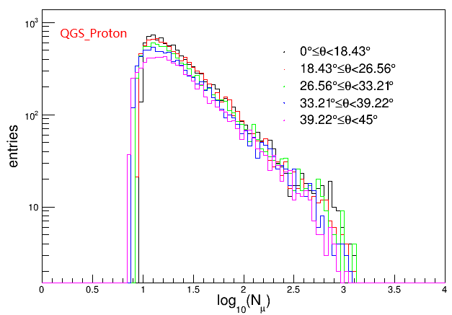
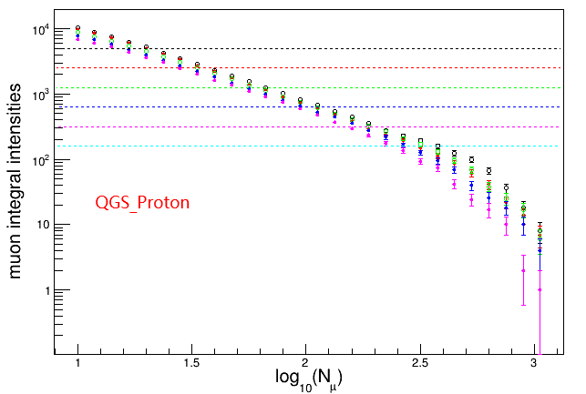
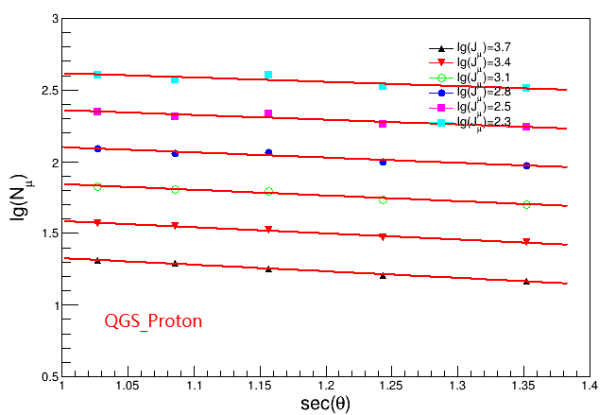
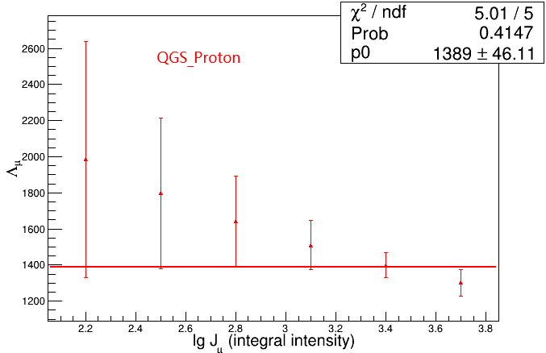
appendix
斜率：
0.458272,0.426743,0.395214,0.363686,0.332157,0.300628

Slide 15
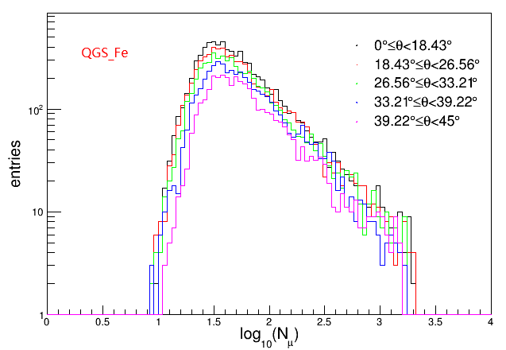
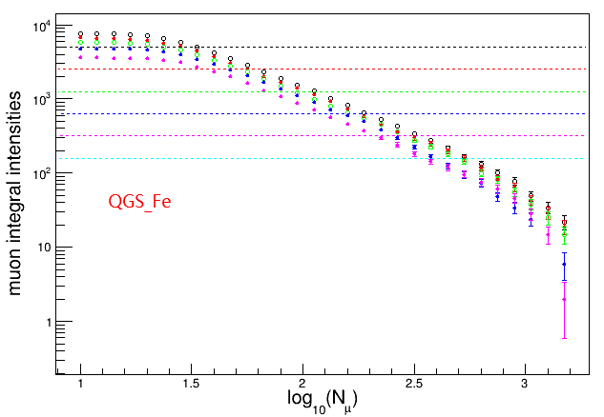
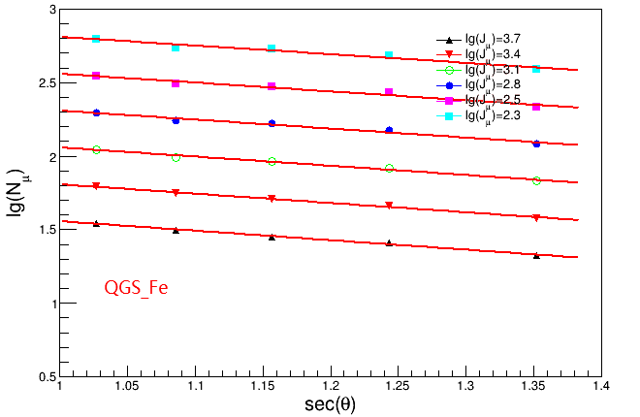
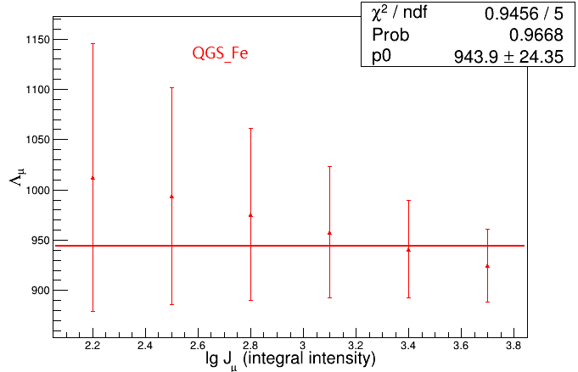
appendix
斜率：
0.645686,0.634443,0.623201,0.611958,0.600715,0.589472

Slide 16
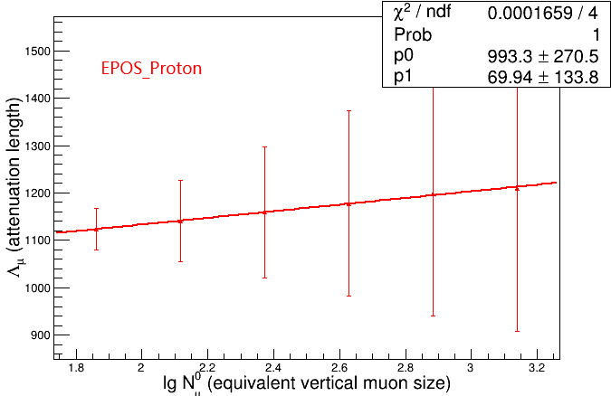
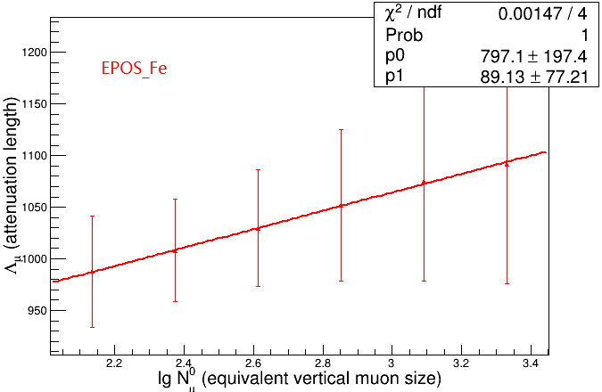
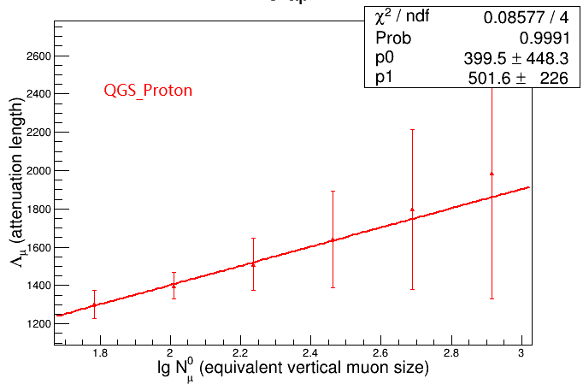
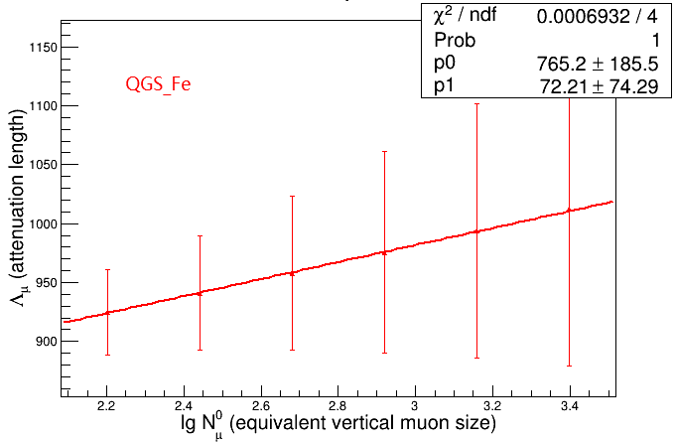
appendix

