Slide 1


Measurement of cosmic ray mean mass around the knee region by muon content in air showers with LHAASO-KM2A
Zhang Hengying(张恒英)，Feng Cunfeng (Shandong University)
He Huihai， Chen Songzhan and Li Cong (IHEP)
LHAASO-SDU

Slide 2
1
Motivation
2
MC vs. data
CONTENTS
3
Research methods and results
4
Summary

Slide 3
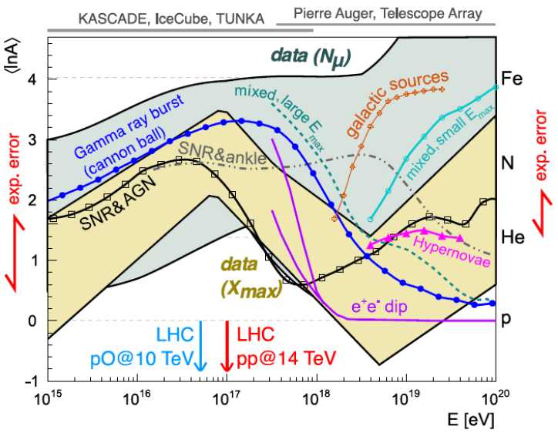
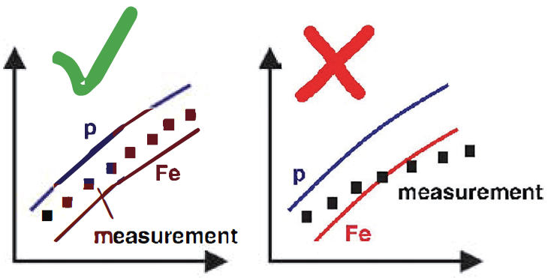

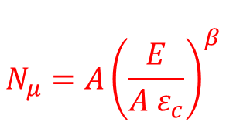
1. Motivation
$π^{±}→μ^{±}+ν_{μ}\left({\overline{ν}}_{μ}\right) and$ $K^{±}→μ^{±}+ν_{μ}\left({\overline{ν}}_{μ}\right)$
1) Hadronic interaction model
2) Cosmic ray composition
Matthews-Heitler model
$$N_{μ}=A{\left(\frac{E}{A ε_{c}}\right)}^{β}$$
H.P. Dembinski et al. EPJ Web Conf., 210:02004, 2019.

Slide 4
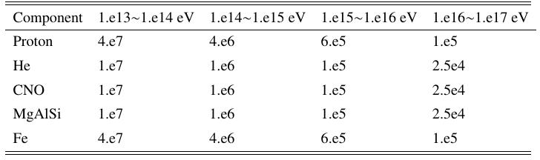
2. MC vs. Data
2. MC vs. Data
Simulation data：EPOS-Fluka and QGSJETII-04-Gheisha 10TeV-100PeV
simulation：
1000m
0-70degree
Five components{proton, helium, CNO, MgAlSi and iron}from 10 TeV to 100 PeV following an E^-2 energy spectrum
0<θ<70°，0<φ <360°
KM2A quarter-array trigger mode: time window 400ns，15 EDs fired
Experimental data：2020.07.19-2020.07.25 and 2020.08.01—2020.08.15
KM2A half-array trigger mode: time window 400ns，20 EDs fired
Using quarter-array configure retriggered： time window 400ns，15 EDs fired.

Slide 5
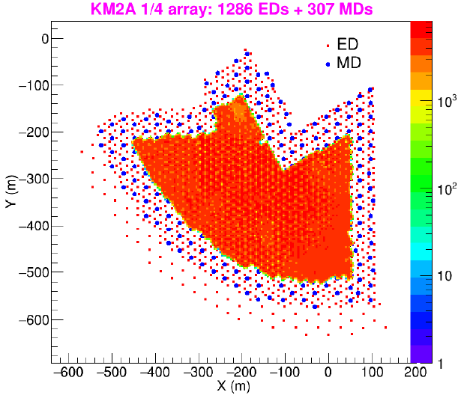
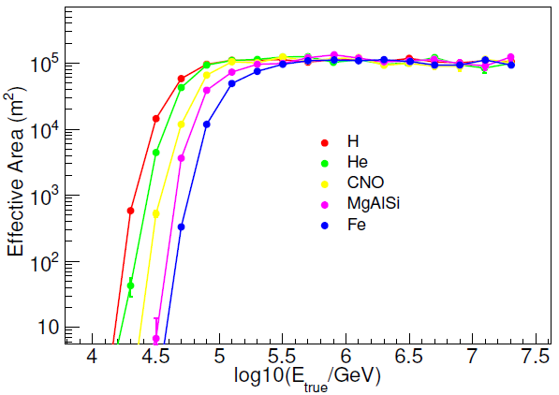
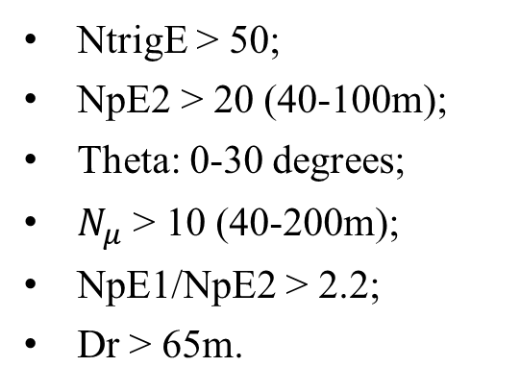
2. MC vs. Data
Event Selection
NtrigE > 50;
NpE2 > 20 (40-100m);
Theta: 0-30 degrees;
$N_{μ}$ > 10 (40-200m);
NpE1/NpE2 > 2.2;
Dr > 65m.

Slide 6
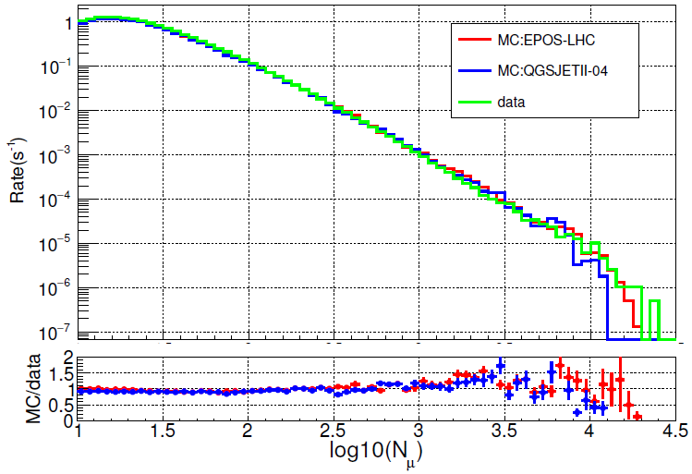
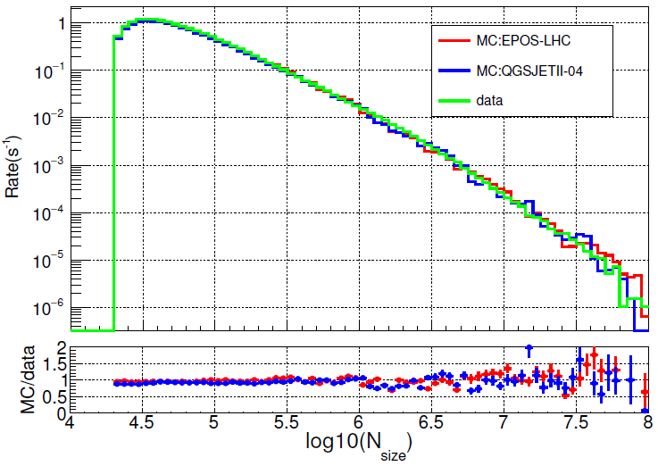
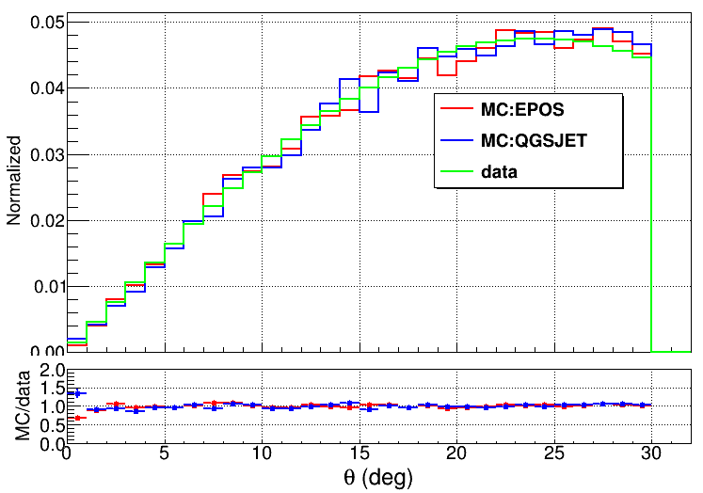
2. MC vs. Data
Different hadronic interaction model
data Rate: 15.5 Hz
EPOS Rate: 14.9 Hz
QGSJET Rate: 14.1 Hz

Slide 7
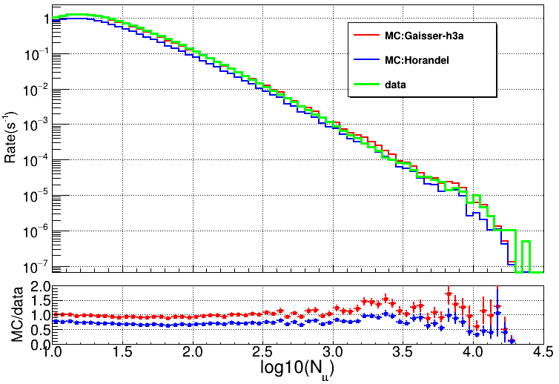
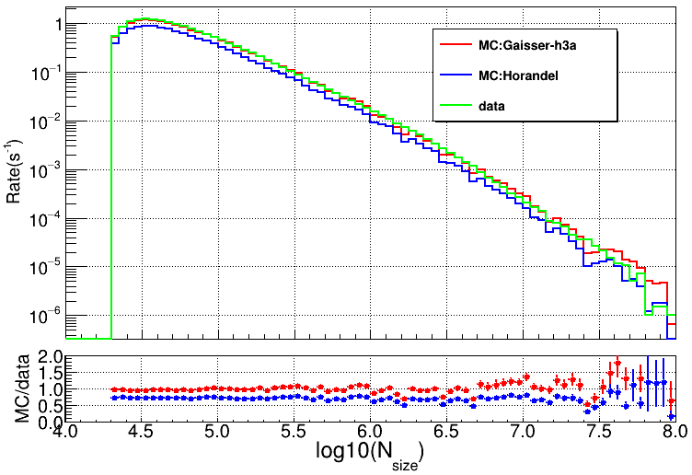
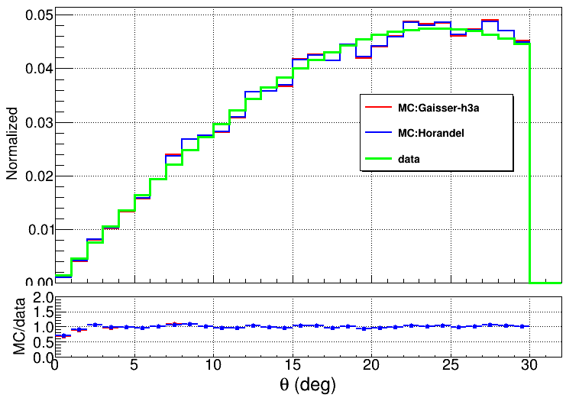
2. MC vs. Data
Different energy spectra model
data Rate: 15.5 Hz
H3a model Rate: 14.9 Hz
Horandel Rate: 11.1 Hz

Slide 8

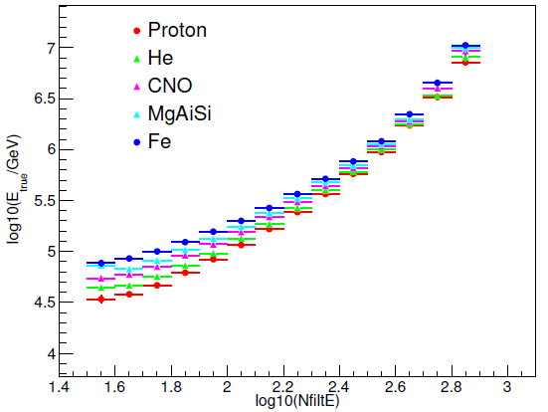
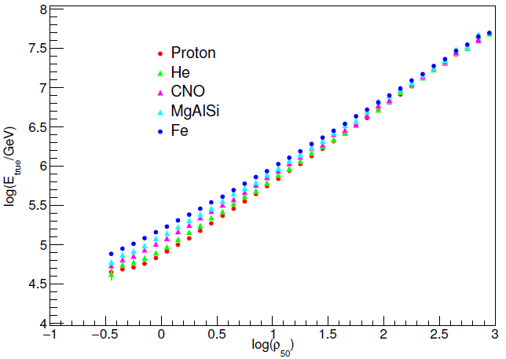
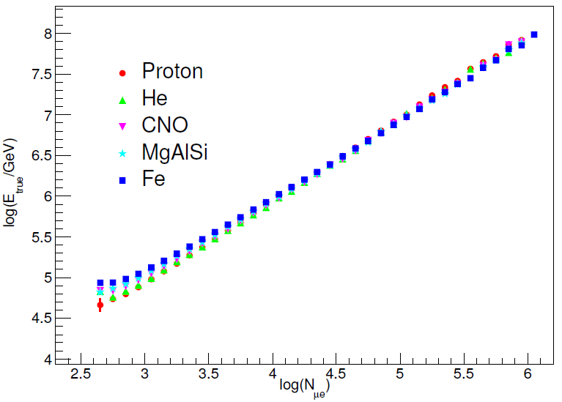
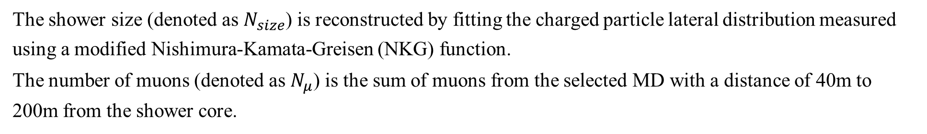
2. MC vs. Data
Energy reconstruction
The shower size (denoted as $N_{size}$) is reconstructed by fitting the charged particle lateral distribution measured using a modified Nishimura-Kamata-Greisen (NKG) function.
The number of muons (denoted as $N_{μ}$) is the sum of muons from the selected MD with a distance of 40m to 200m from the shower core.

Slide 9
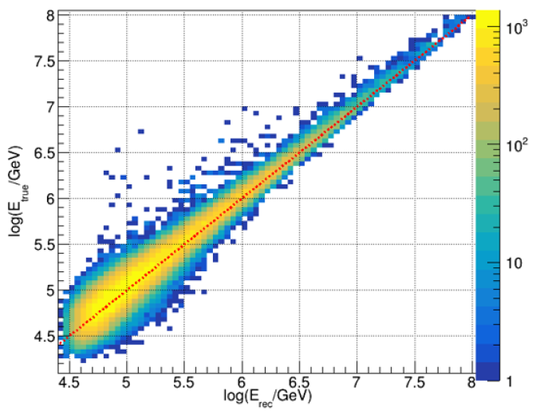
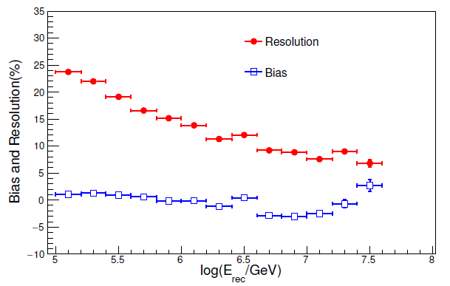
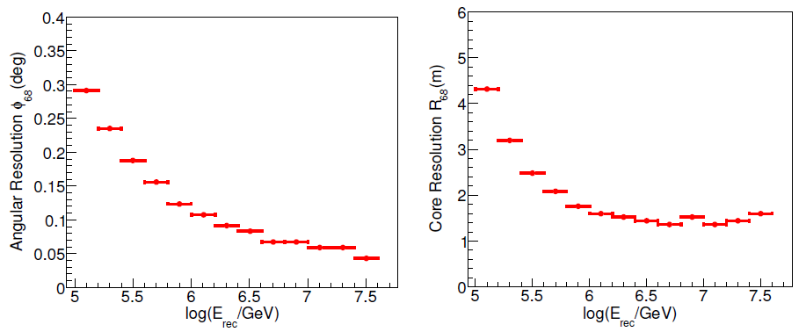
2. MC vs. Data
Energy reconstruction

Slide 10
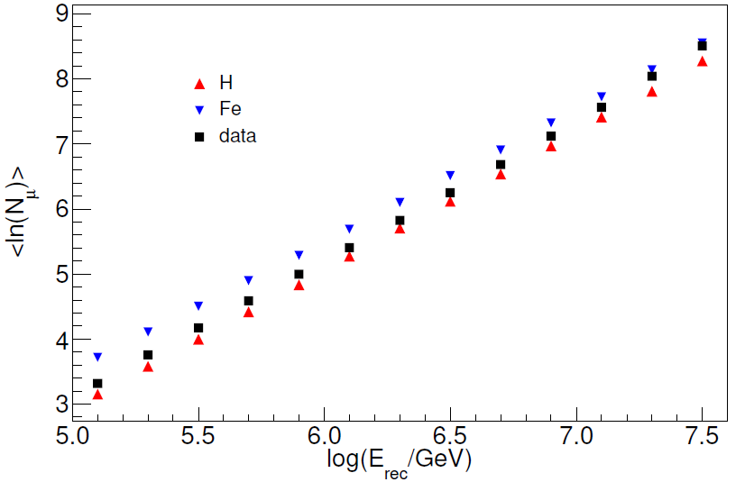
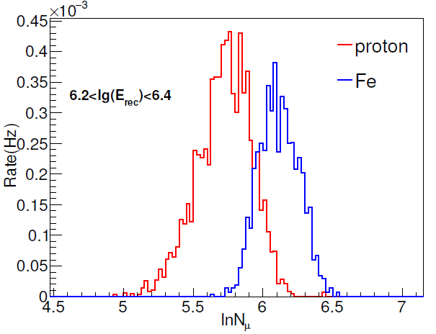
3. Research methods and results
Muon content measurement

Slide 11

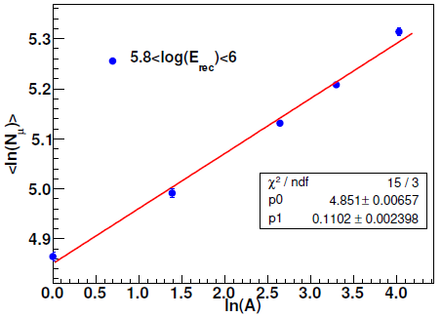
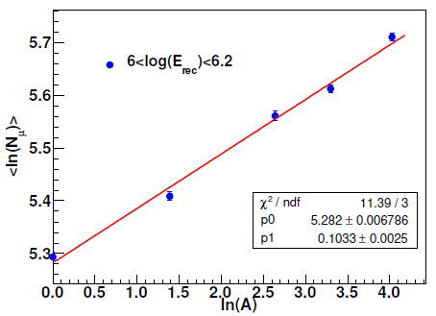

3. Research methods and results
Mean mass measurement
$$N_{μ}=A{\left(\frac{E}{A ε_{c}}\right)}^{β}$$
Nμ ∝ A for the same energy interval, the mean number of muons in air shower for each energy interval is measured by analyzing the signal of muon detectors, so the mean logarithmic mass of the cosmic ray derived from the mean number of muons.
11

Slide 12
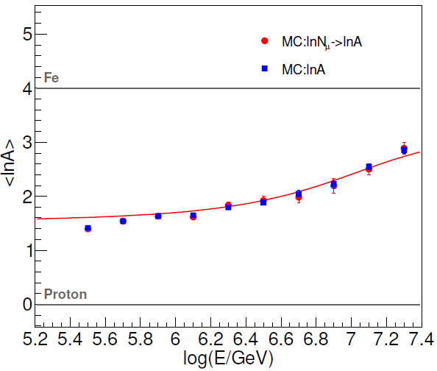
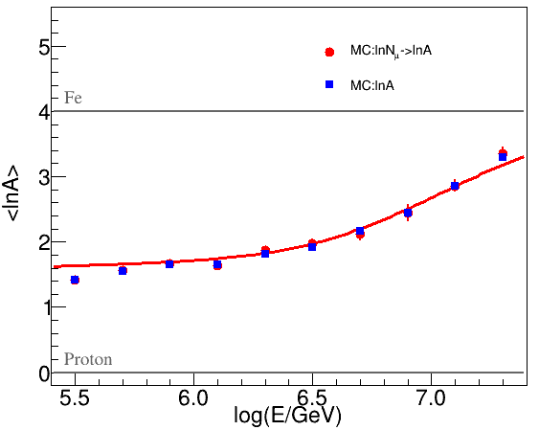
3. Research methods and results
Methods validation
Gaisser H3a model
Horandel model
The red point(mc:lnNμ->lnA) the lnA derived from the above function for five mass groups;
The bule square (mc:lnA) is the triggered mass of shower after event selection;

Slide 13
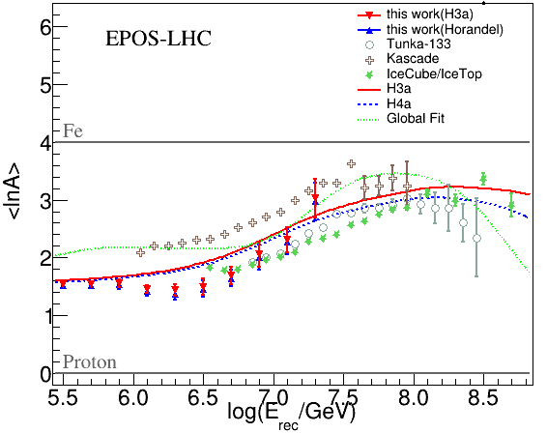
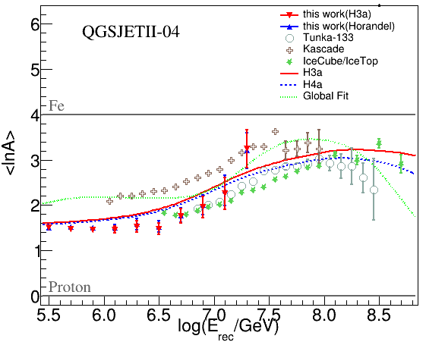
3. Research methods and results
Mean mass measurement

Slide 14
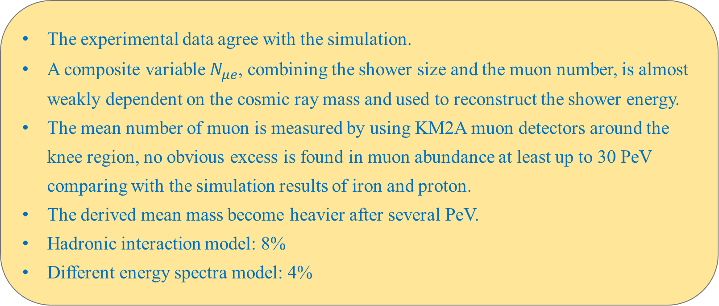
4. Summary
The experimental data agree with the simulation.
A composite variable $N_{μe}$, combining the shower size and the muon number, is almost weakly dependent on the cosmic ray mass and used to reconstruct the shower energy.
The mean number of muon is measured by using KM2A muon detectors around the knee region, no obvious excess is found in muon abundance at least up to 30 PeV comparing with the simulation results of iron and proton.
The derived mean mass become heavier after several PeV.
Hadronic interaction model: 8%
Different energy spectra model: 4%
Thanks

Slide 15
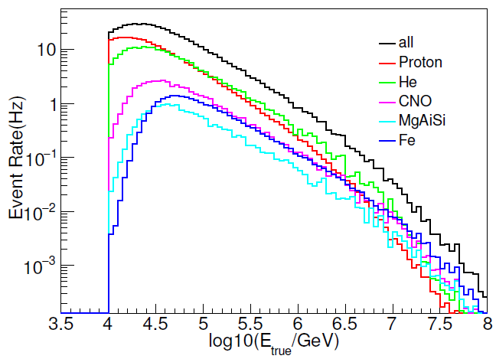
particle | Proton | He | CNO | MgAlSi | Fe | total | experiment
EPOS Trigger rate(Hz) | 256.75 | 201.17 | 47.91 | 16.79 | 24.95 | 547.57 | ~750

Slide 16
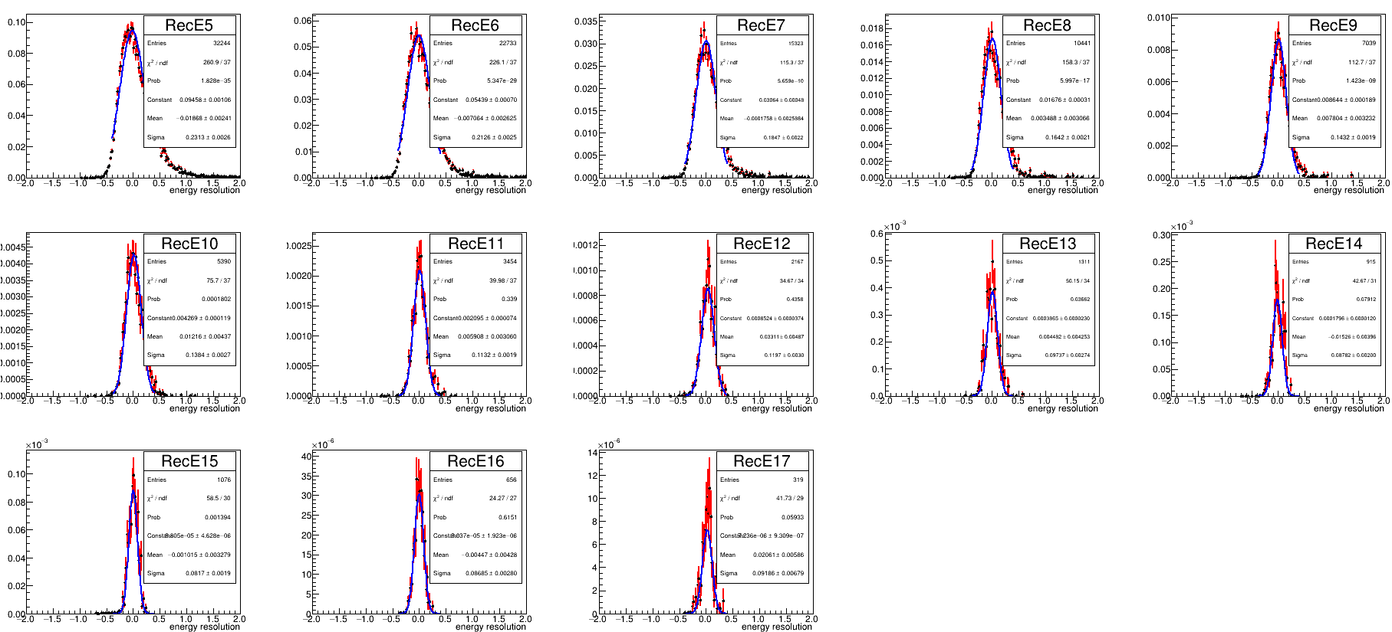

Slide 18

