Slide 1
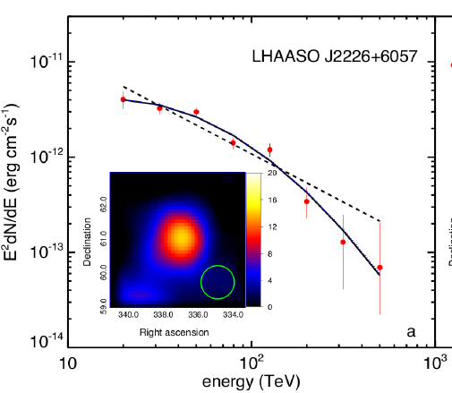
X-ray Analysis on the region of LHAASO J2226+6057
Ruo-Yu Liu (柳若愚)
Nanjing University (南京大学)
Collaborator: C. Ge (葛翀), S. Niu (牛书), Y. Chen (陈阳), X.-Y. Wang (王祥玉)
24.04.2021 – 27.04.2021，LHHASO Collaboration Meeting，Guangzhou

Slide 2
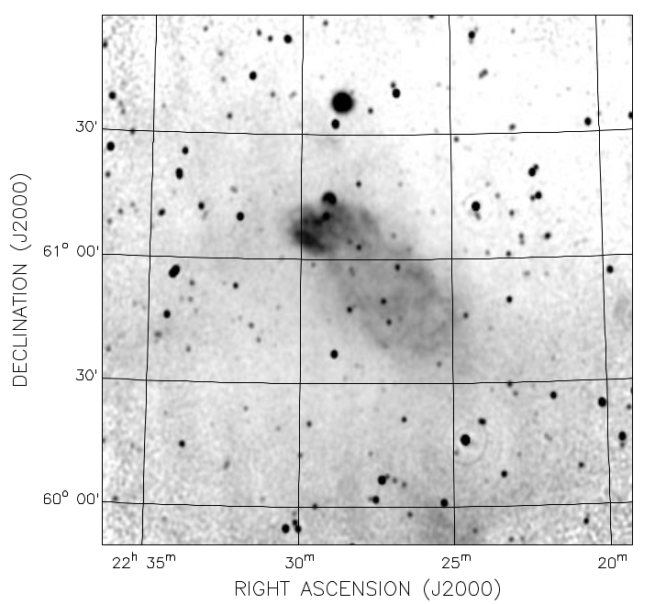
CGPS, 1.4GHz
Pineault & Joncase 2000
Radio Observation
Compact, bright Head
(including energetic pulsar PSR J2229+6114 of ~10kyr and its PWN Boomerang)
Diffusive, faint Tail
Effelsberg, Liu et al. 2020

Slide 3
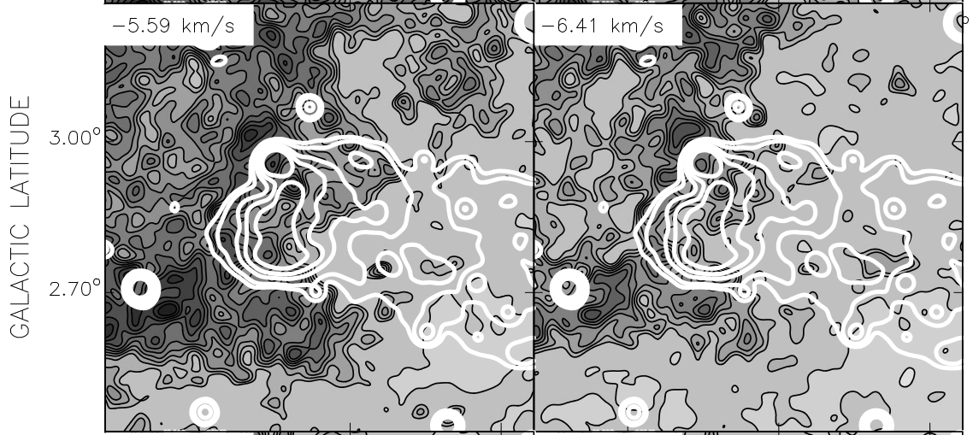
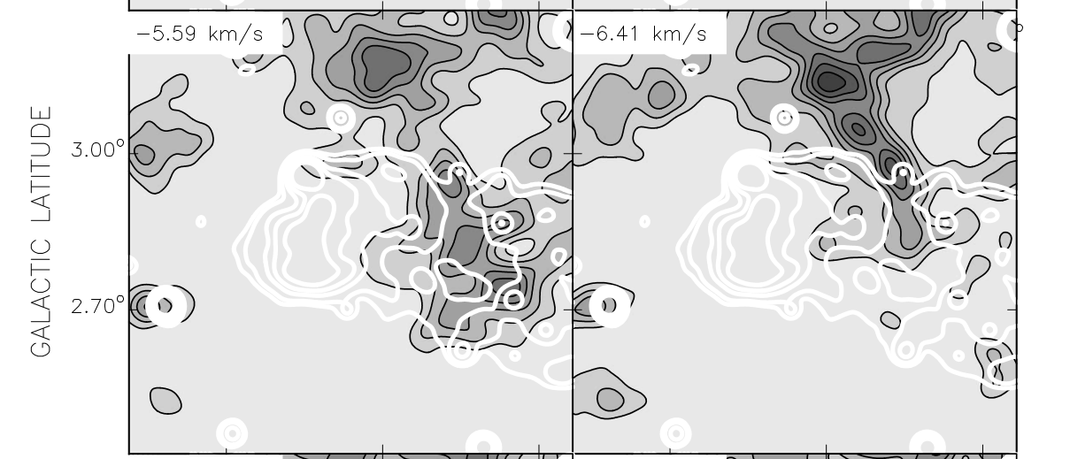
Distance ~800 pc
HI Cloud
Molecular Cloud (CO)

Slide 4
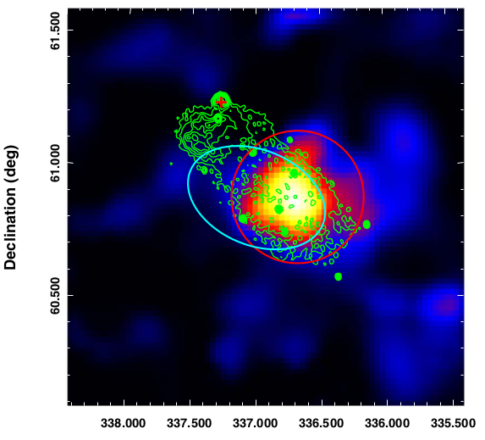
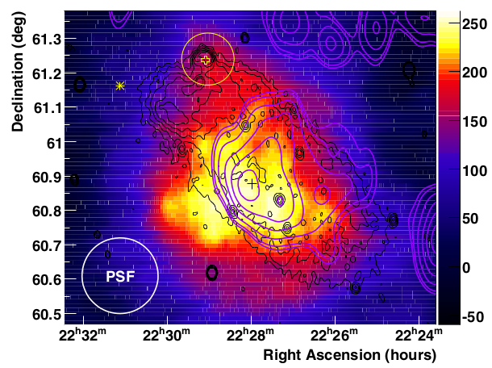
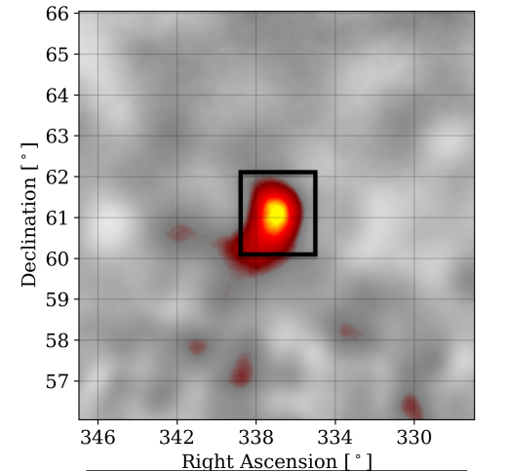
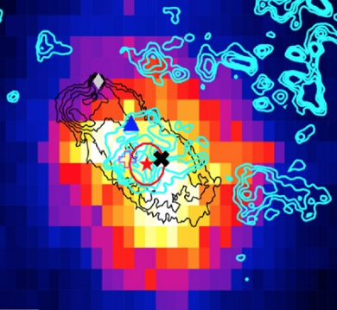
VERITAS 1-10TeV
VERITAS Collaboration 2009
Gamma-ray observation of SNR G106.3+2.7 region
Fermi-LAT 3-500GeV
Xin et al. 2019
Centroid of the gamma-ray emission coincident with Tail
HAWC 1-100TeV
HAWC Collaboration 2020
Tibet AS+MD, 10-100TeV
Asγ Collaboration 2021
Also seen by
MILAGRO

Slide 5
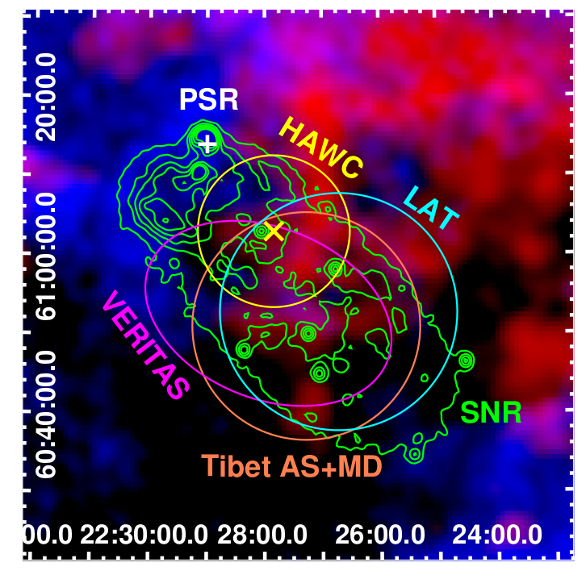
Blue: Atomic Cloud
Red: Molecular Cloud
Head: Interacting with HI Cloud
Tail: Expanding into a Cavity

Slide 6
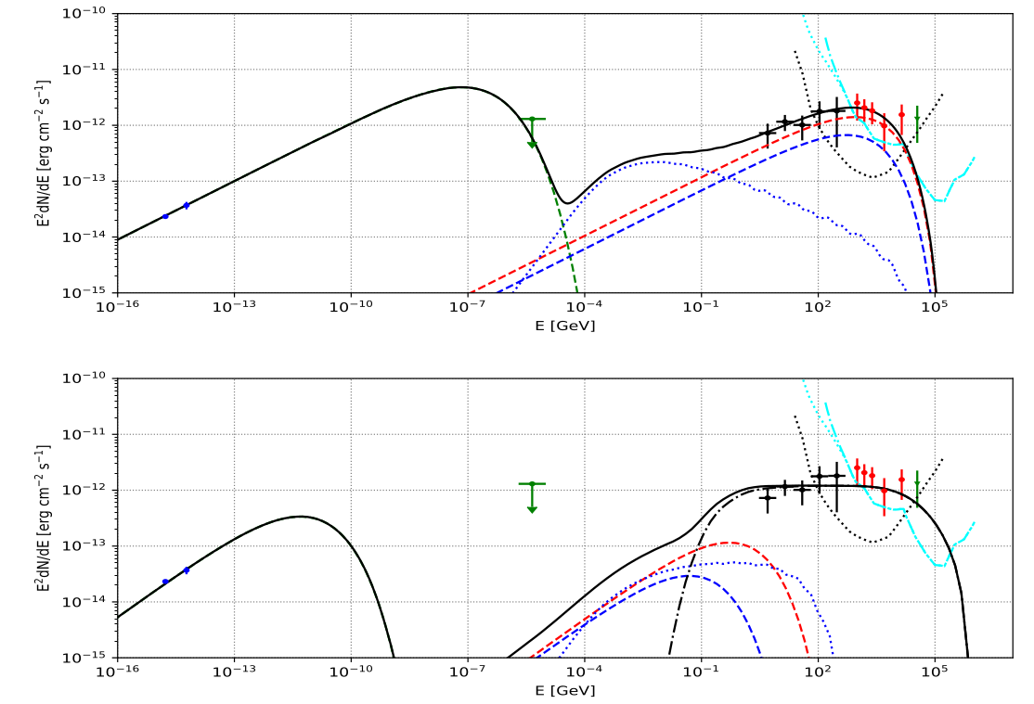
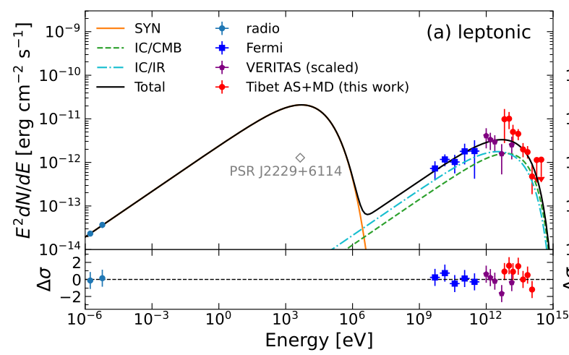
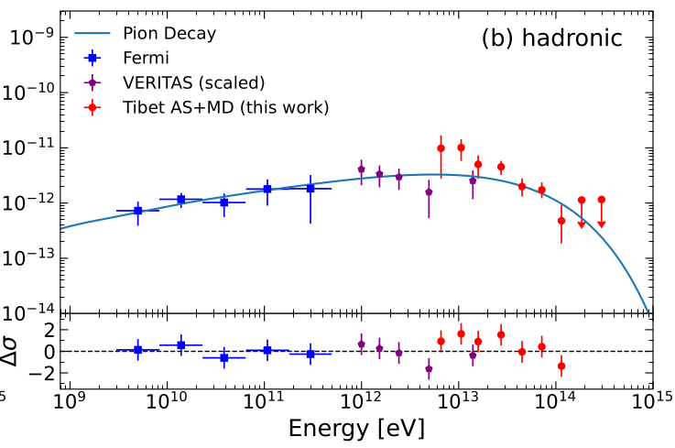
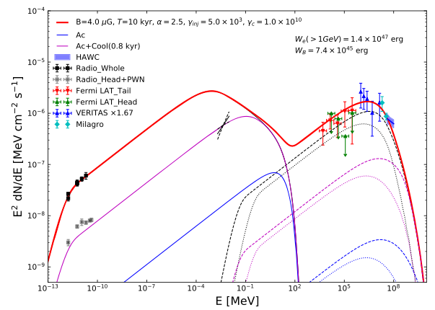
Both leptonic and hadronic scenario work
Xin et al. 2019
Asγ Collaboration 2021
Liu et al. 2020

Slide 7
X-ray observation is helpful!
IC
20TeV γ
100TeV e
Syn
5keV (10μG)
Better angular resolution & more statistics

Slide 8
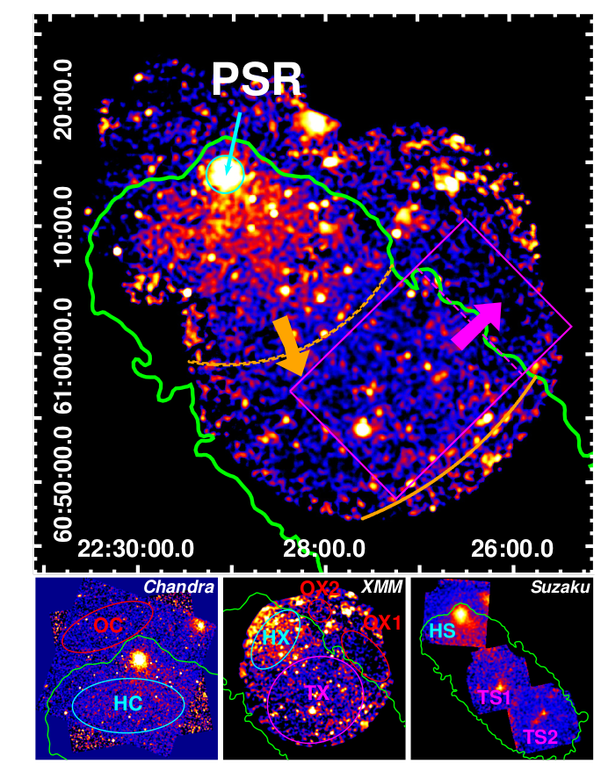
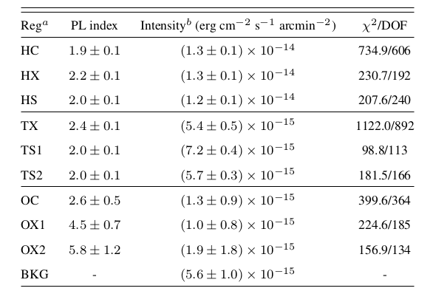
Nonthermal X-ray emission from SNR G106.3+2.7-Boomerang complex
H for Head (excluding Boomerang)
T for Tail
O for Outside
Significant contrast of X-ray surface brightness inside and outside the SNR
Ge, RYL, Niu, Chen & Wang 2020,
The Innovation, accepted

Slide 9
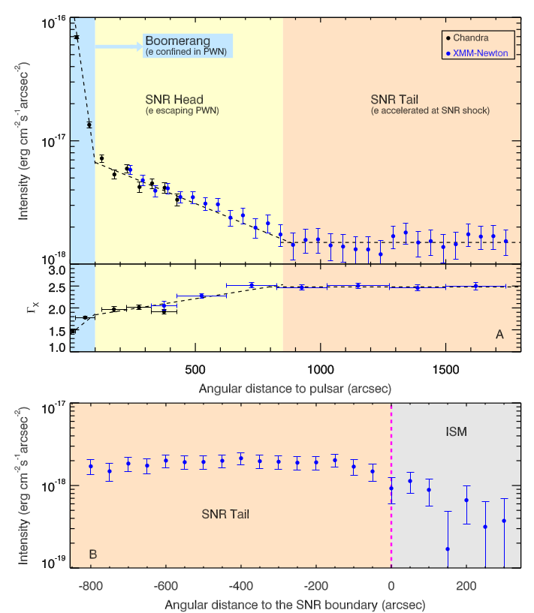
The surface brightness profile implies a different origin of the X-ray emission in the tail region from the head and Boomerang region
Locally accelerated by SNR shock
Nonthermal X-ray spectrum extending up to 7keV implies a shock velocity of 3km/s
The inferred high shock velocity empowers the shock to accelerate PeV protons!

Slide 10
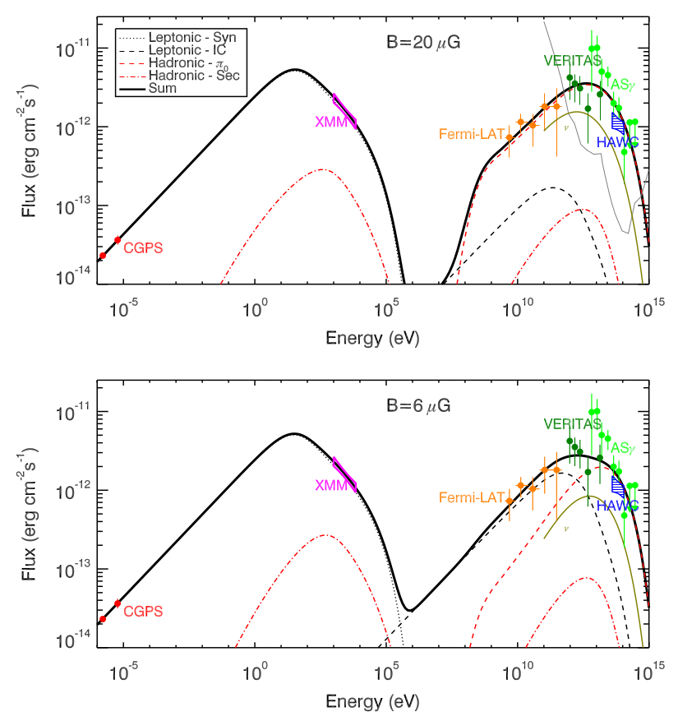
X-ray spectrum constrains IC contribution to gamma rays above 10TeV

Slide 11
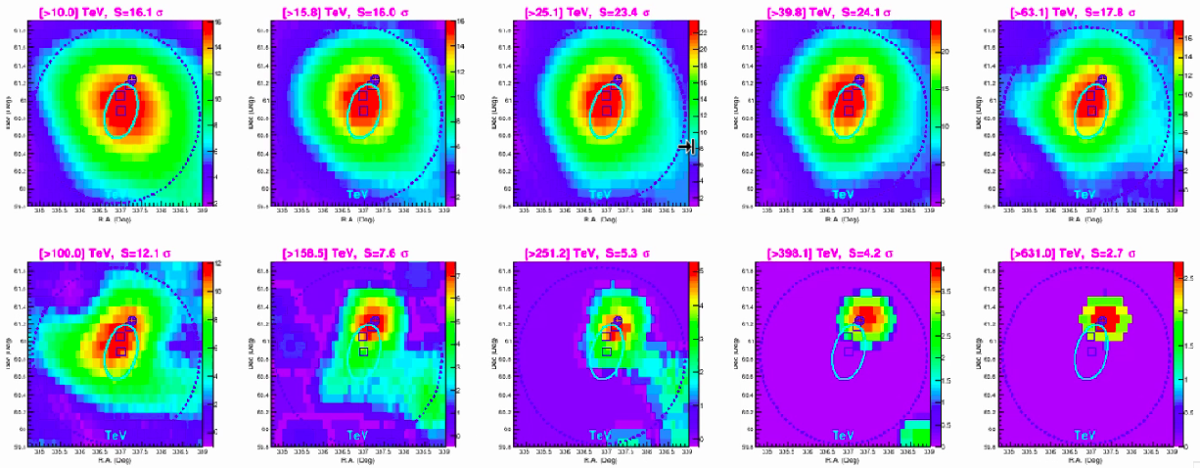
LHAASO observation
Two Components!
E_{γ}<100TeV, SNR, hadronic
E_{γ}>100TeV, Head, leptonic
SNR
PSR
Produced by S.-Z. Chen

Slide 12
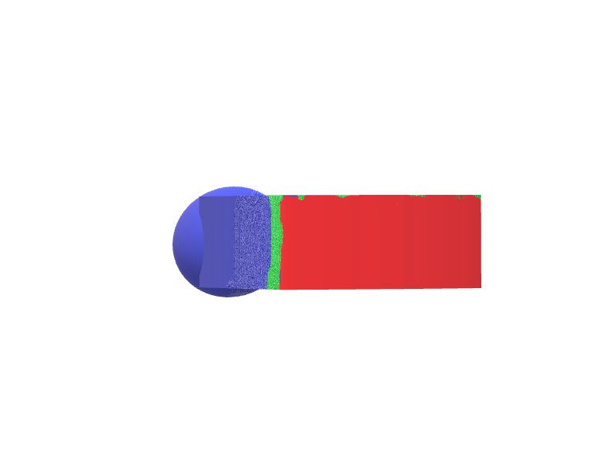
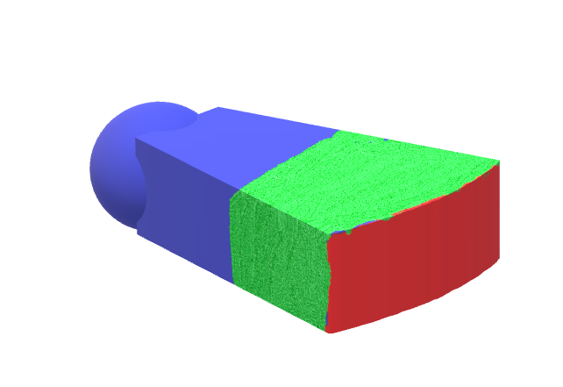
z
view in the xoy plane along LOS
HI Cloud
Head
(PWN)
Tail
(Shock front)
o
pulsar
v
PWN
Shock front
p
SN ejecta
y
x
H₂ Cloud
p
p
γ
LOS

Slide 13
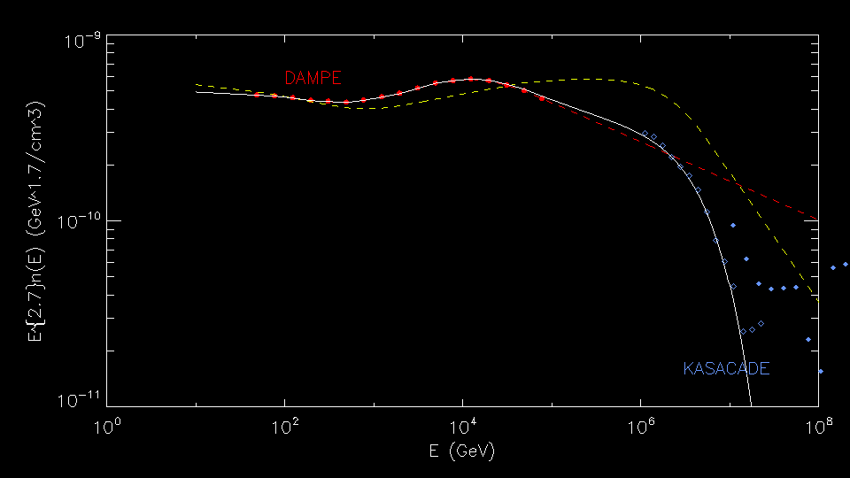
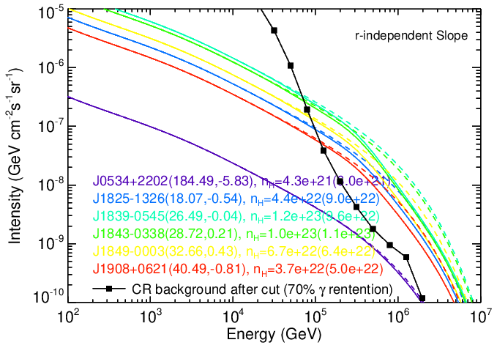
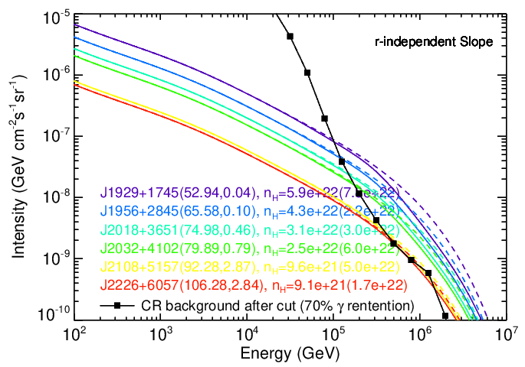
Possible contamination from diffuse gamma-ray produced by CR-ISM interaction in Galactic Plane
(with discussion with F. Aharonian and R.-Z. Yang)
Example: J2032+4102 (Cygnus)
I(600TeV) = 6e-9 GeV cm⁻²s⁻¹sr⁻¹
extension 3 degree →8e-14 erg cm⁻²s⁻¹

Slide 14
Back-up Slides

Slide 15
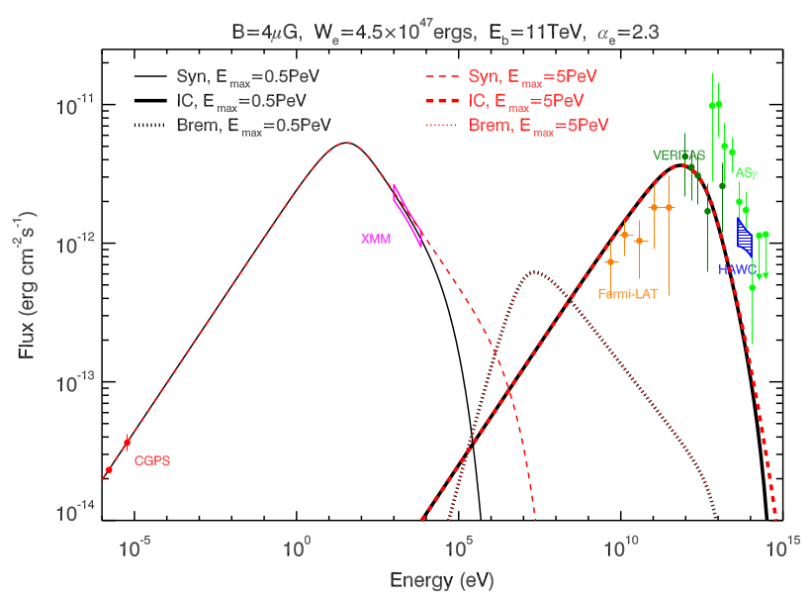

Slide 16
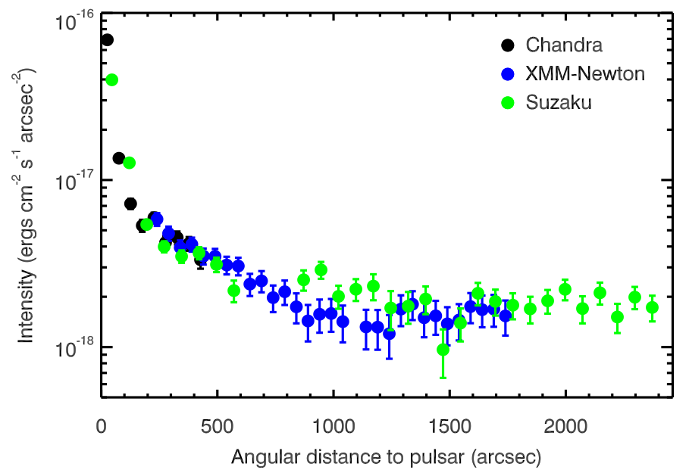

Slide 17
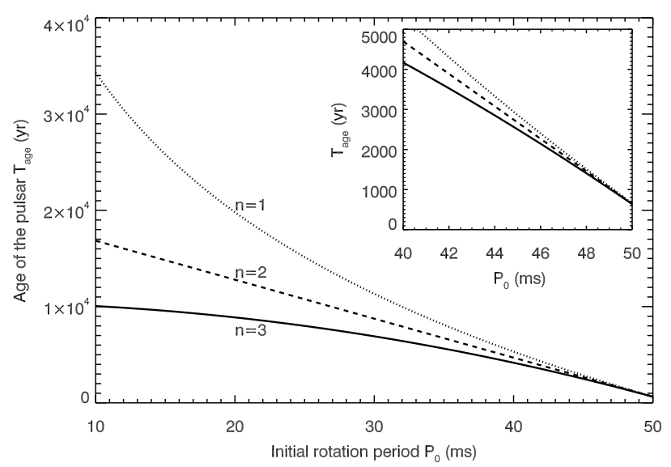

Slide 18
