Slide 1
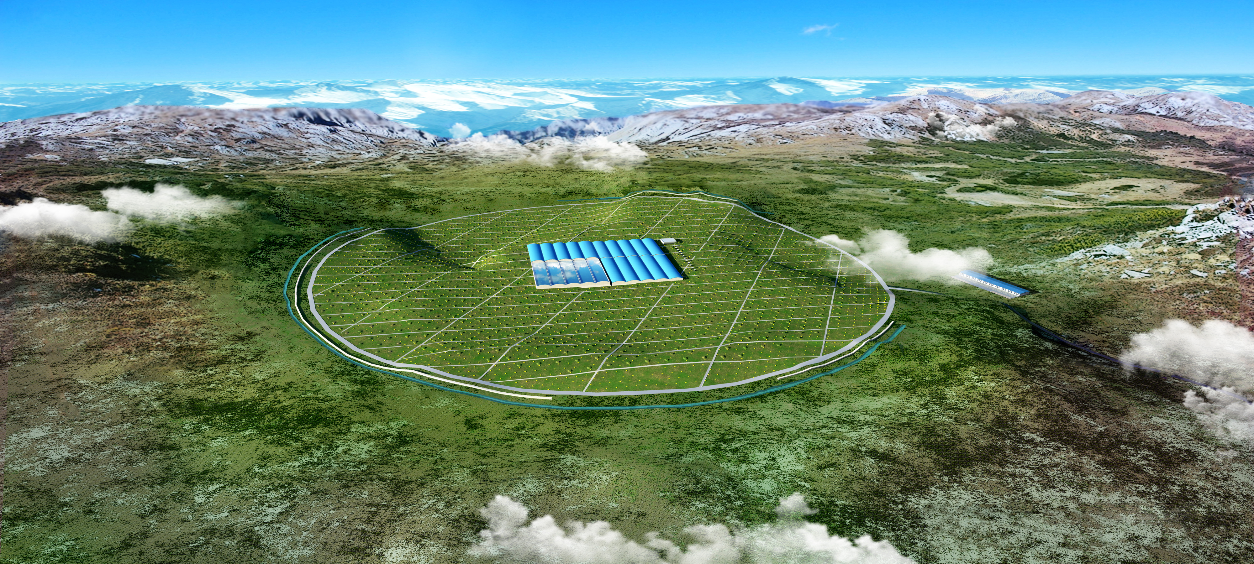
Search for VHE emissions from GRB 190829A with LHAASO-WCDA1
Yuhua Yao (姚玉华)
Sichuan University/IHEP
April 25, 2021
Notes:
大家上午好，我是姚玉华，今天给大家报告的题目是利用LHAASO-WCDA1无触发数据搜寻来自GRB190829A的甚高能辐射

Slide 2
Content
Gamma Ray Burst
GRB190829A
Method & Data analysis
Summary

Slide 3
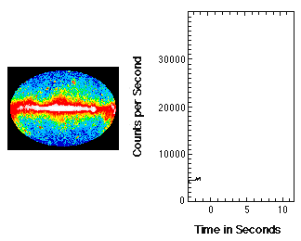
Gamma ray burst (GRB)
Notes:
伽玛暴是伽玛射线在时间上快速上升又急剧下降的现象，他是宇宙大爆炸外最剧烈的天体活动，持续时间一般在ms到千秒量级

Slide 4
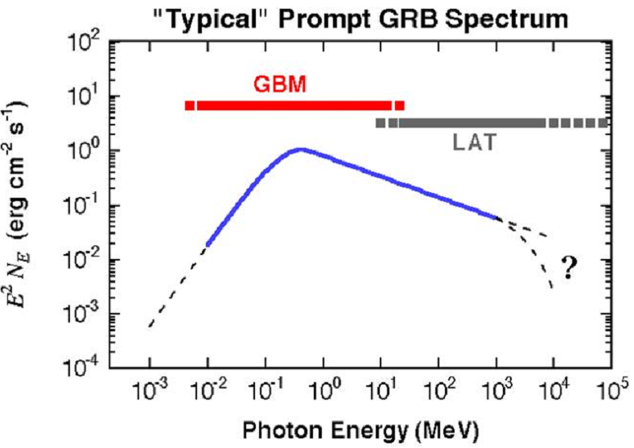
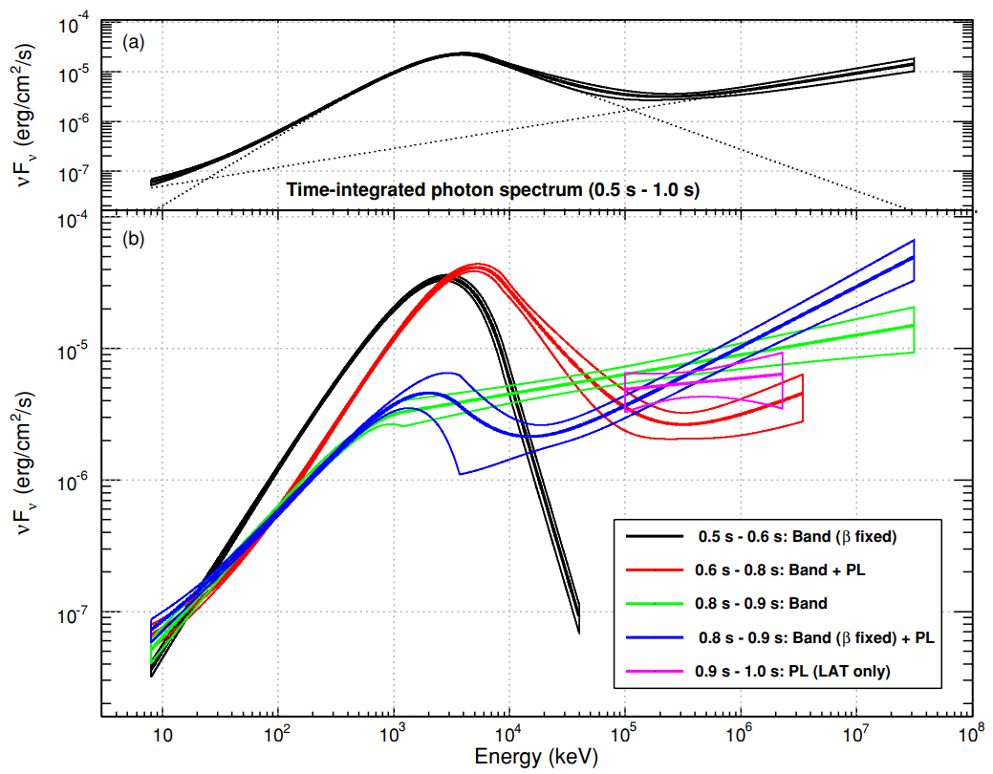
Limitted knowlege at VHE
GRB 090510A
Chance of Ground-based experiments
(HESS, MAGIC, HAWC, LHAASO-WCDA et. al)
Notes:
低能能谱一般可以用Band函数进行描述，在2019年以前从未有实验测到高能部分能谱

Slide 5
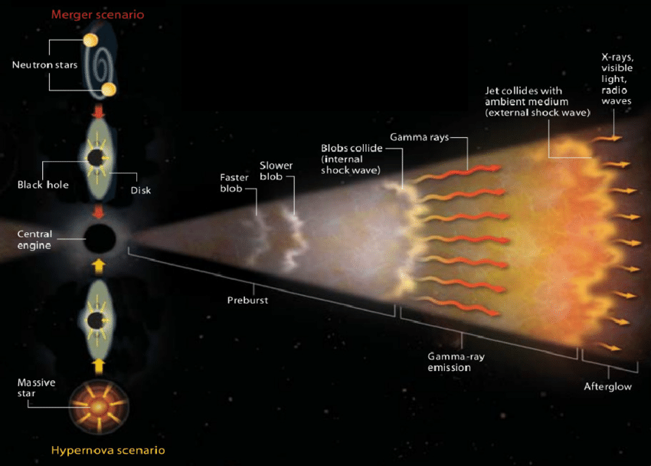
VHE emission from GRB
Large FOV (EAS array)
TeV emission is possible.
Radiation mechanism,
Lorentz Invariance Violation,
Mechanism of jet formation,
Relativistic bulk motion,
host-galaxies,
EBL, IGMF, ...
Prompt phase
prompt phase
Afterglow
phase
High sensitivity: (IACTs: Imaging Atmospheric Cherenkov Telescope)
Notes:
瞬时辐射，大视场，
余辉辐射，持续时间更长，低能辐射。
高能测量具有十分重要的意义

Slide 6
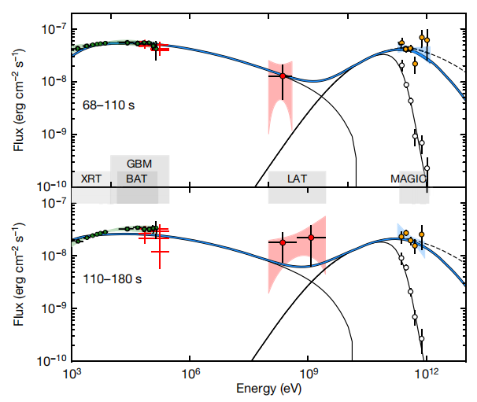
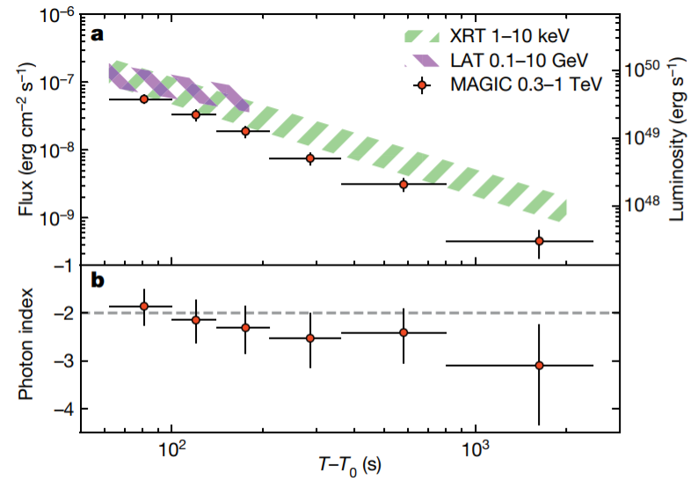
Sub-TeV Discovered @GRB190114C by MAGIC
SSC
0.3-1TeV: R_{ext}=10%, β_{ext}=-1.51
Notes:
MAGIC在2019年首次发现了这个暴的甚高能辐射，第一次在实验上正式了除了同步辐射之外另一种高能辐射成分的存在，能量10%， 能谱指数-1.51

Slide 7
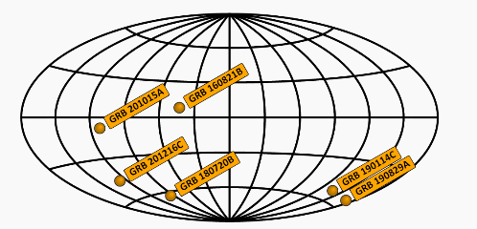
 | Sig [σ] | T_{obs} since trigger | Dist | Exp
GRB190114C | >50 | 57s | z=0.4245 | MAGIC
GRB180720B | >5 | 10.1 hr | z=0.654 | H.E.S.S.
GRB190829A | >5 | 4h 20m | z=0.0785 | H.E.S.S.
GRB201216C | >5 | ~57s | z=1.1 | MAGIC
GRB201015A | >3 | ~40s | z=0.43 | MAGIC
GRB160821B | >3 | ~24s | z=0.16 | MAGIC
Sub-TeV Observations
This picture is adopted from TeVCat
None is in prompt phase
It is difficult for IACTs.
Notes:
目前的现状，余辉辐射

Slide 8
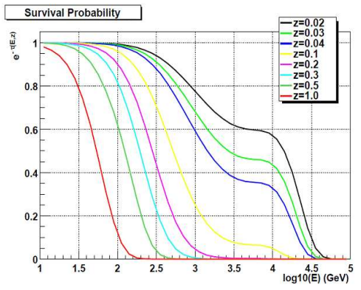
GRB 190829A
 | Sig [σ] | T_{obs} since trigger | Dist | Exp
GRB190114C | >50 | 57s | z=0.4245 | MAGIC
GRB180720B | >5 | 10.1 hr | z=0.654 | H.E.S.S.
GRB190829A | >5 | 4h 20m | z=0.0785 | H.E.S.S.
GRB201216C | >5 | ~57s | z=1.1 | MAGIC
GRB201015A | >3 | ~40s | z=0.43 | MAGIC
GRB160821B | >3 | ~24s | z=0.16 | MAGIC
Nearest (z= 0.0785)
H.E.S.S. sub-TeV obsrevation
in the afterglow
Notes:
在这些暴中GRB190829A十分特殊

Slide 9
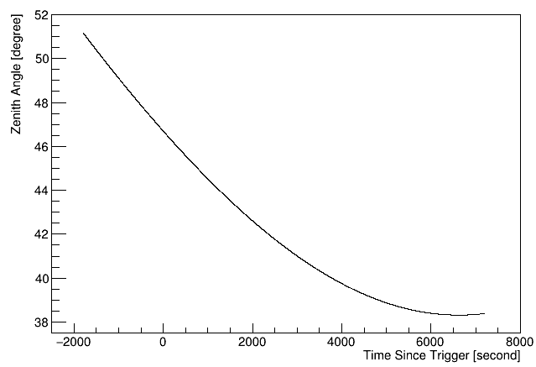
GRB190829A @ LHAASO-WCDA1
Notes:
GRB190829A在LHAASO视场范围内的情况，天顶角较大，但是由于LHAASO大视场的优势，我们有取数

Slide 10
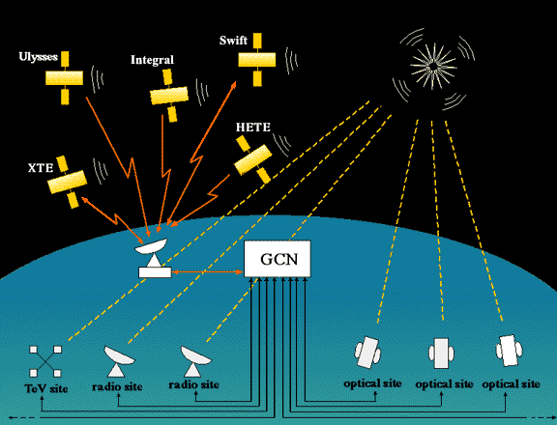
The LHAASO GRB follow-up program
Alert reception → Filter → Data storage
Typically exposure:
T0-0.5h → T0+2h per follow-up
> 100 GRB candidates 06/2019-03/2021
Triggerless data
Time coincidence search method？
Notes:
无触发GRB模式取数，目前为止已经有超过100个数据

Slide 12
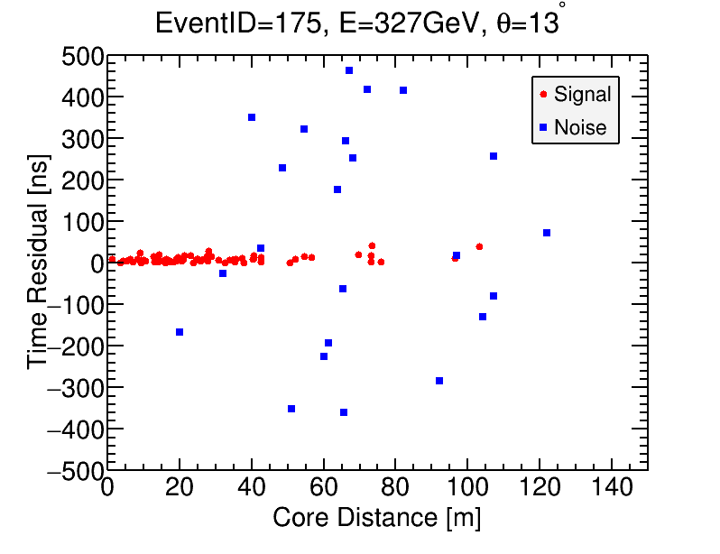
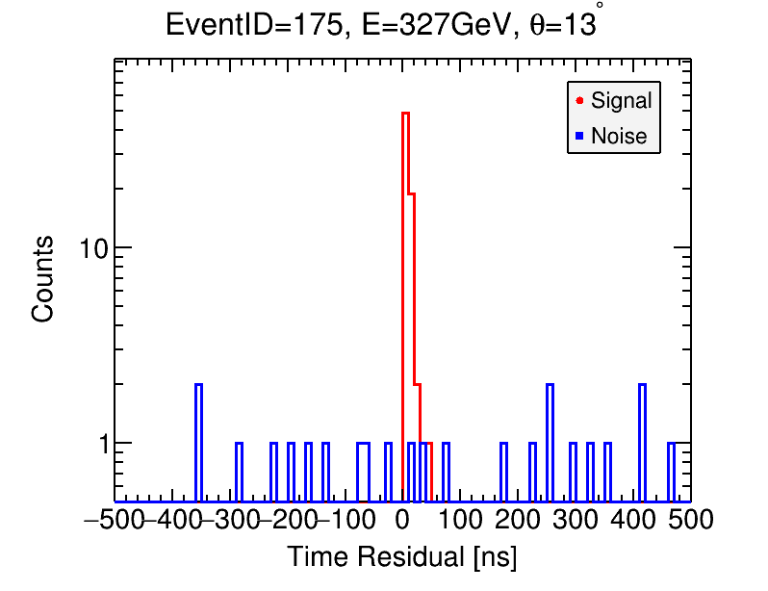
Method

Slide 13
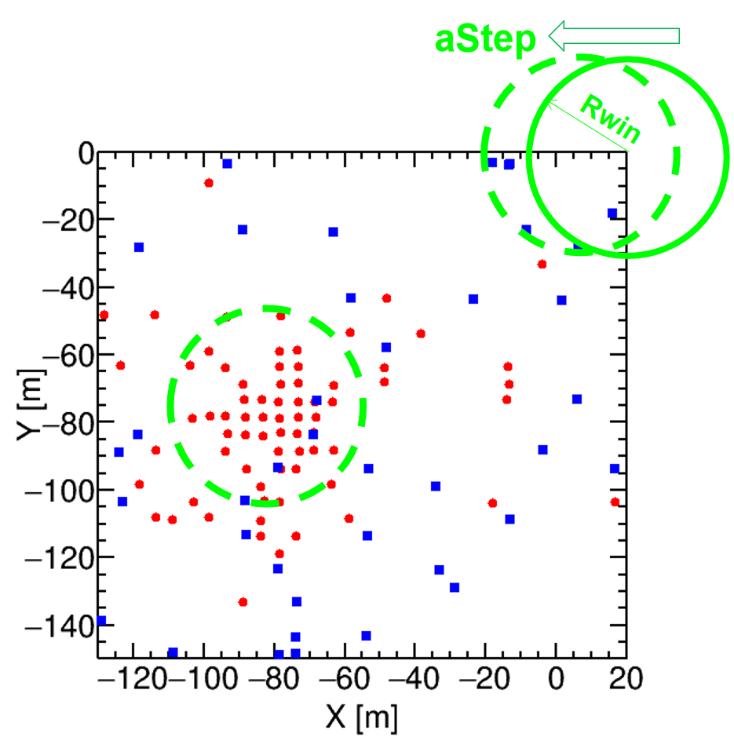
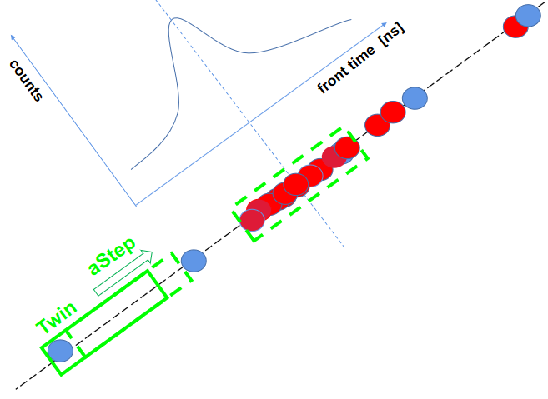
Method

Slide 14
MC Data Sample
Cut selection：
CR：
nfitc < 60 , zen<50°， recflag=ture
nfitc ≥ 60， zen<50°，recflag=ture
Gamma：
nfitc < 60 , zen<50°， recflag=ture
nfitc ≥ 60， zen<50°，recflag=ture，compactness>15
CR：
Component: p，He，CNO，
MgAlSi，Fe
Energy range: 1e10-1e15 eV
Gaisser CR spectrum
Gamma：
10GeV-100TeV
Cosmic Ray

Slide 15
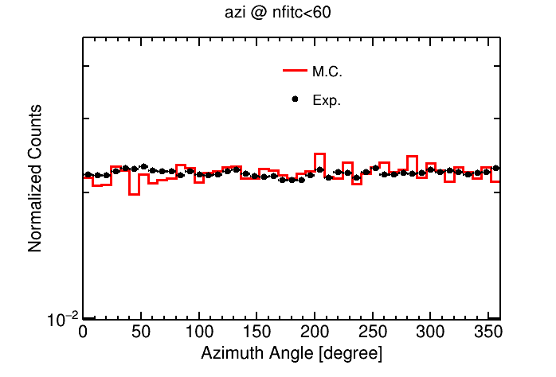
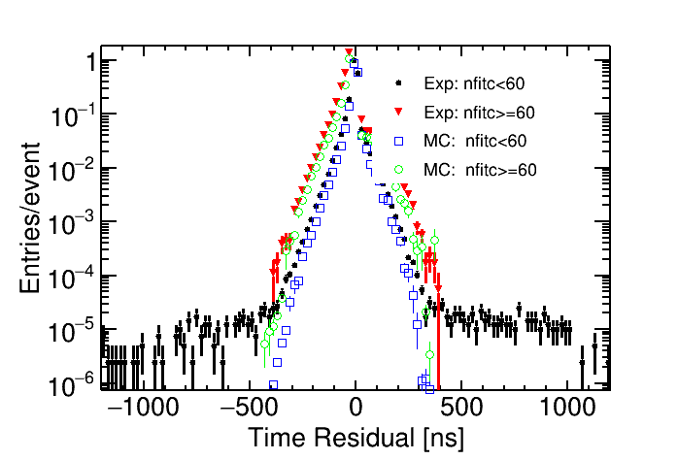
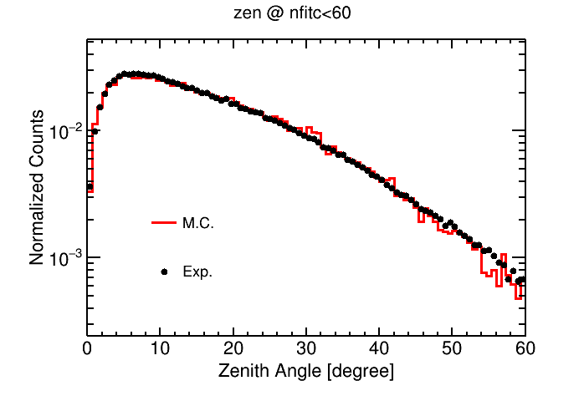
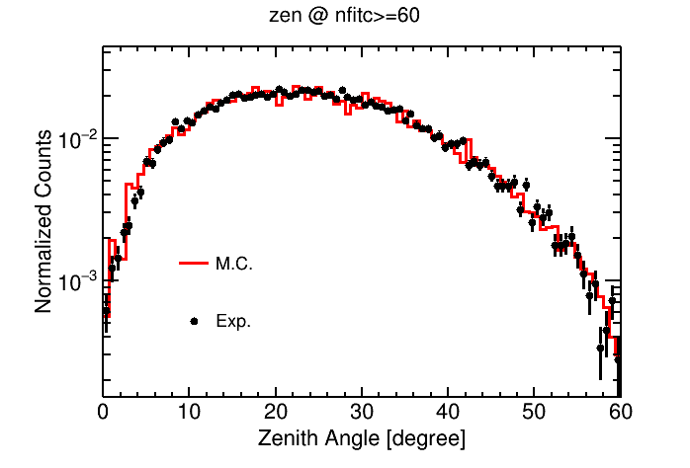
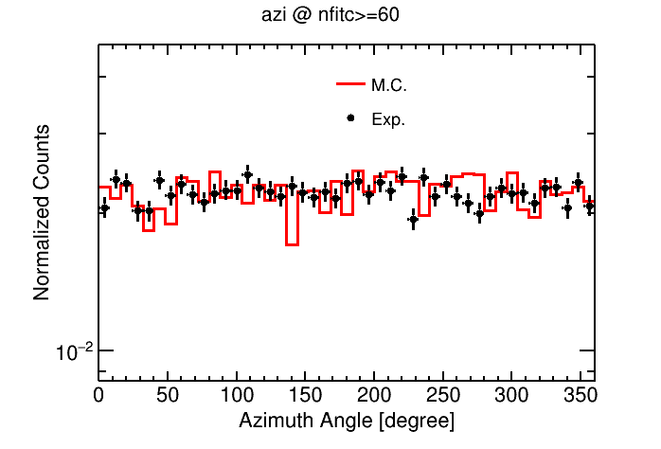
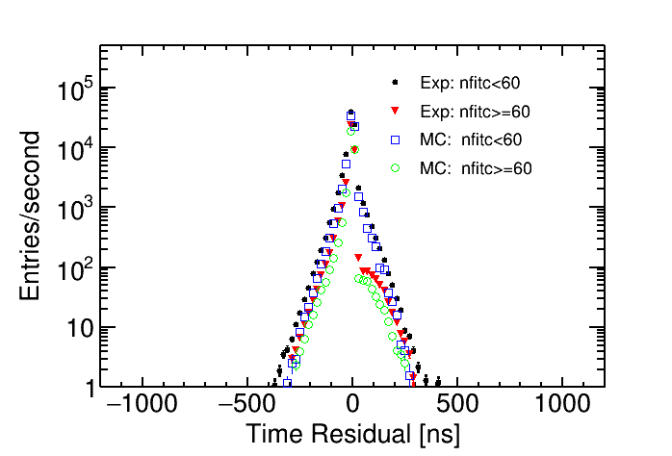
Cosmic Rays

Slide 16
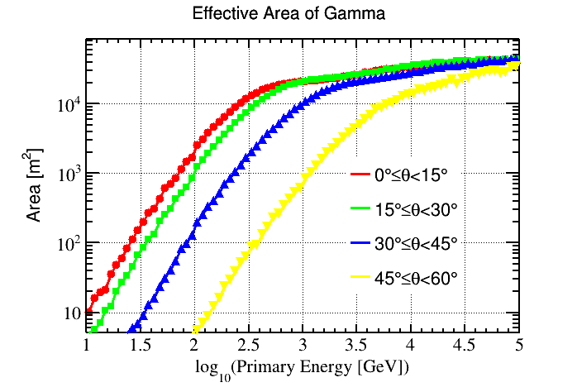
Effective area

Slide 17
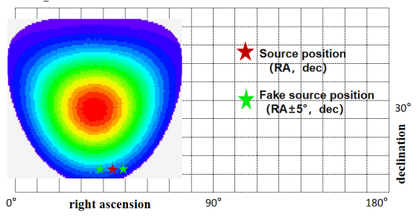
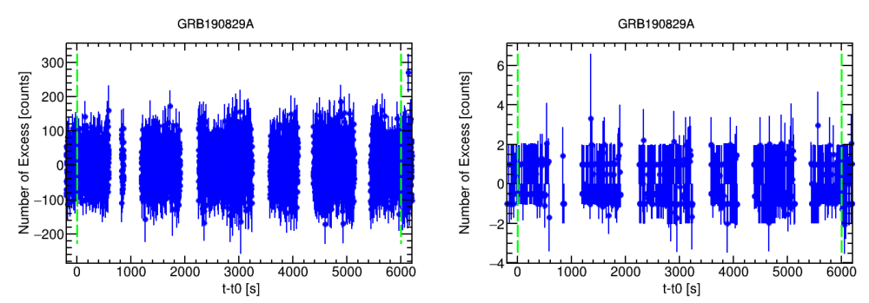
Lightcurve

Slide 18
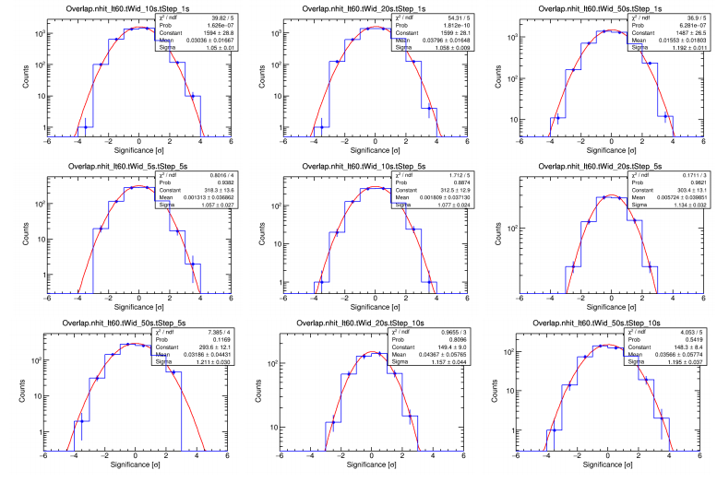

Slide 19
Upper Limits
Compared with afterglow emission in other wavelength, our upper limits seem to be little use might due to the low sensitivity of large zenith angle and sharply reduced flux.
The upper limits in the prompt phase are interesting
→ To constrain radiation mechnisms
Notes:
余辉辐射的上限看起来比多波段的要高很多，似乎没有用
而瞬时辐射的阶段的，比较有趣

Slide 20
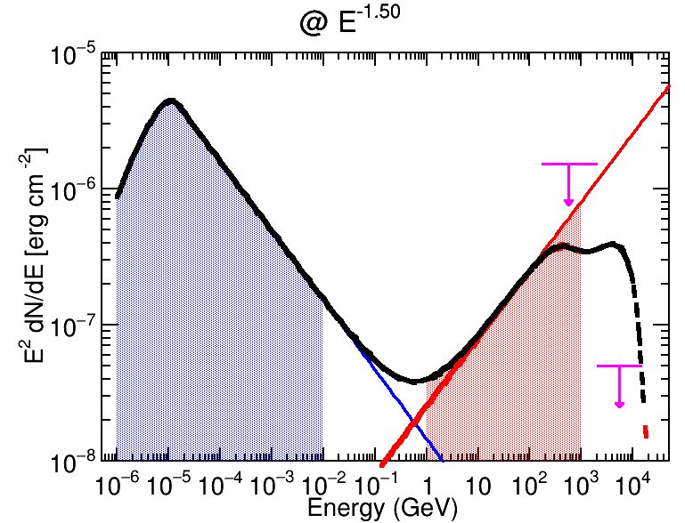
Upper Limits
Notes:
将瞬时辐射的能谱和GodEyes的高能模型能谱进行对比，当能谱也像余辉一样给-1.5， 比例用0.1，此时也可一看出。。高能TeV左右的这个上限，比预期的要低很多

Slide 21
VHE extra component
Upper limits of GRB 190829A:
Sub-TeV Afterglow emission of GRB190114C, GRB180720B
Intrinsic TeV emissions seem to be suppressed.
Compactness？ Lorentz Factor?
GRB 180720B
GRB 190114C

Slide 22
Summary
Compared with afterglow emission in other wavelength, our upper limits seem to be little use might due to the low sensitivity of large zenith angle and sharply reduced flux；
TeV prompt emission from GRB 190829A seems to be supressed;
Works about evolution of lightcurve and Lorentz factor are on going.
Thank you!

Slide 23
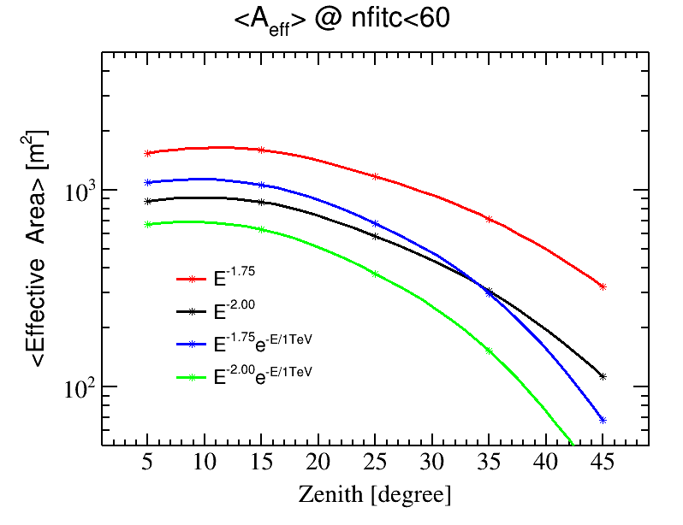
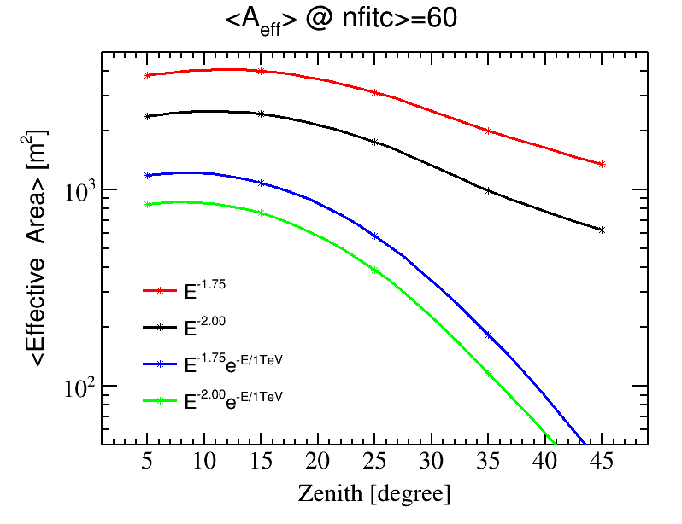

Slide 24
备份

Slide 27
