Slide 1
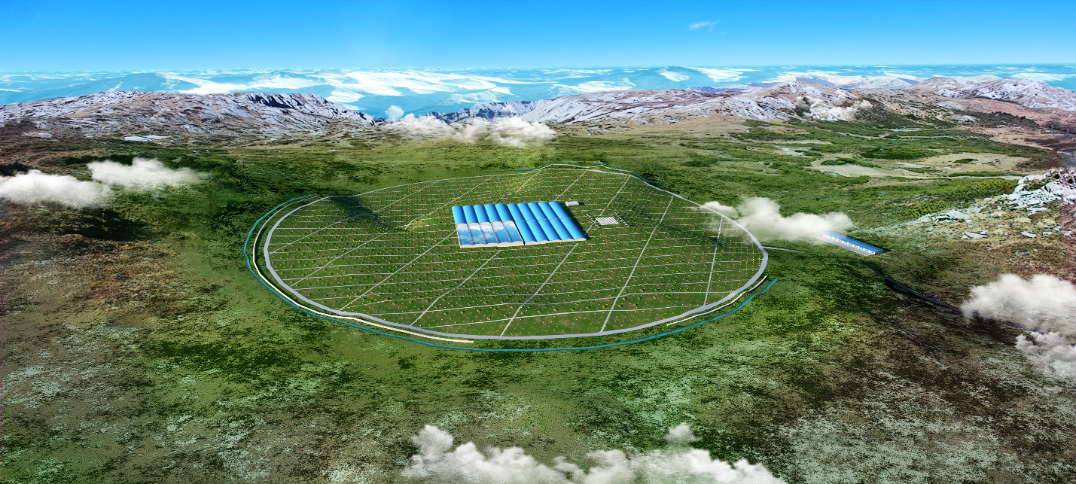
Status about WCDA data reconstruction and analysis
Min Zha, Zhiguo Yao, Bo Gao, Wei Liu, Jinyan Liu, ShiCong Hu, Guanman Xiang, Yanjing Wang, Chuandong Gao
Guangzhou 2021 LHAASO general meeting

Slide 2
outline
Data status
Reconstruction status
Some related results
Summary and outlook

Slide 3
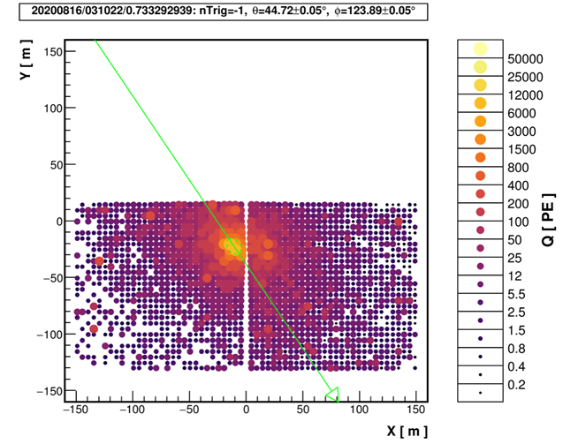
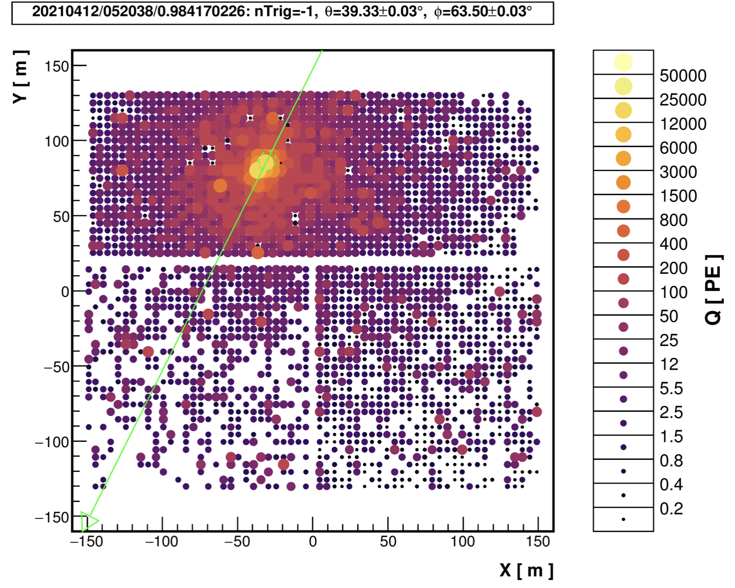
Timeline of WCDA
wcda-u = wcda-1+ wcda-2:
20200312-20210228
Phase 1: ~40 KHz
2020/03/12: nfee trigger
ES.*P110MN40*.dat;
Phase 2: ~45 KHz
2020/05/25: npmt trigger
ES.*P110MND45W*.dat;
Phase 3: ~65 KHz
2020/06/08/: pattern trigger
ES.*.P110MC15*.dat;
12X12 PMTs = 60 m X 60 m area trigger
Phase 4: ~ 90 KHz
2020/11/01 - 2021/02/28
wcda-1 cleaning + wcda-2 shielding
Raw data: 12 T /day
Phase 5: ~ 35kHz
2020/03/05 – now
WCDA full array running with 1PE @20inch + 0.3 pe@8inch

Slide 4
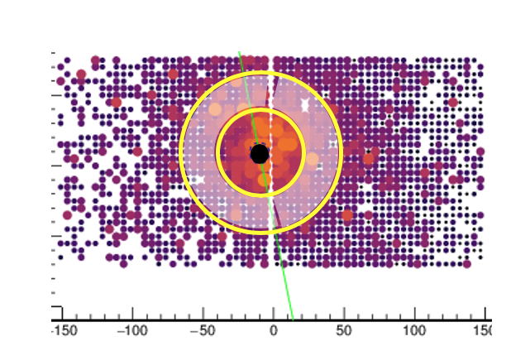
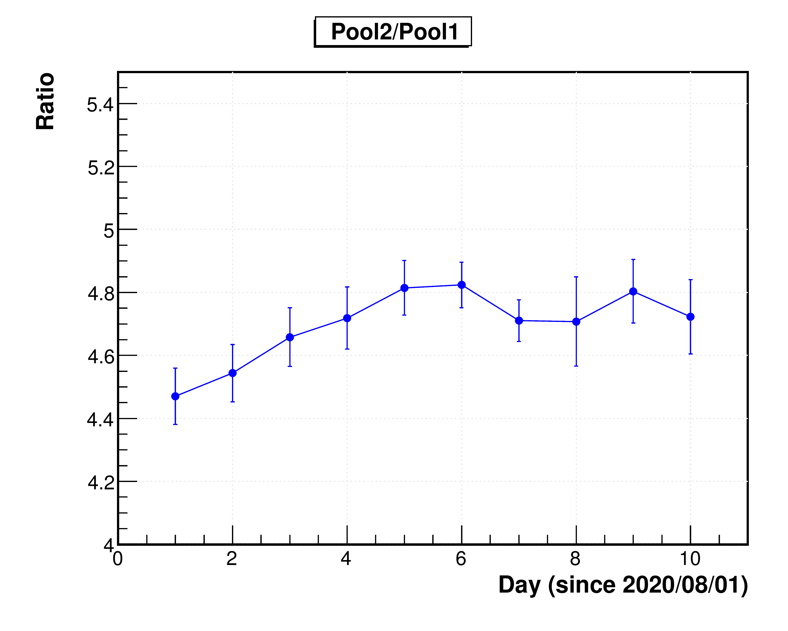
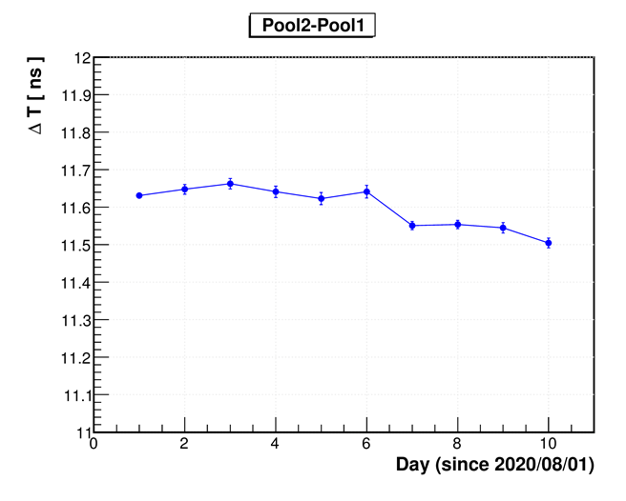
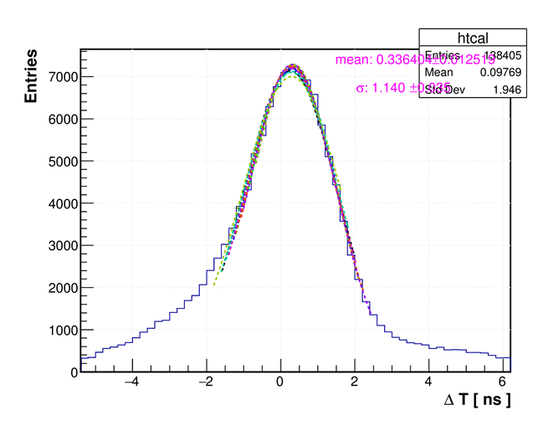
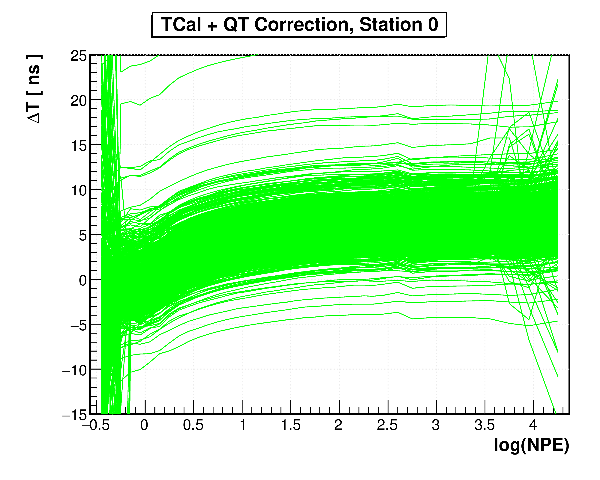
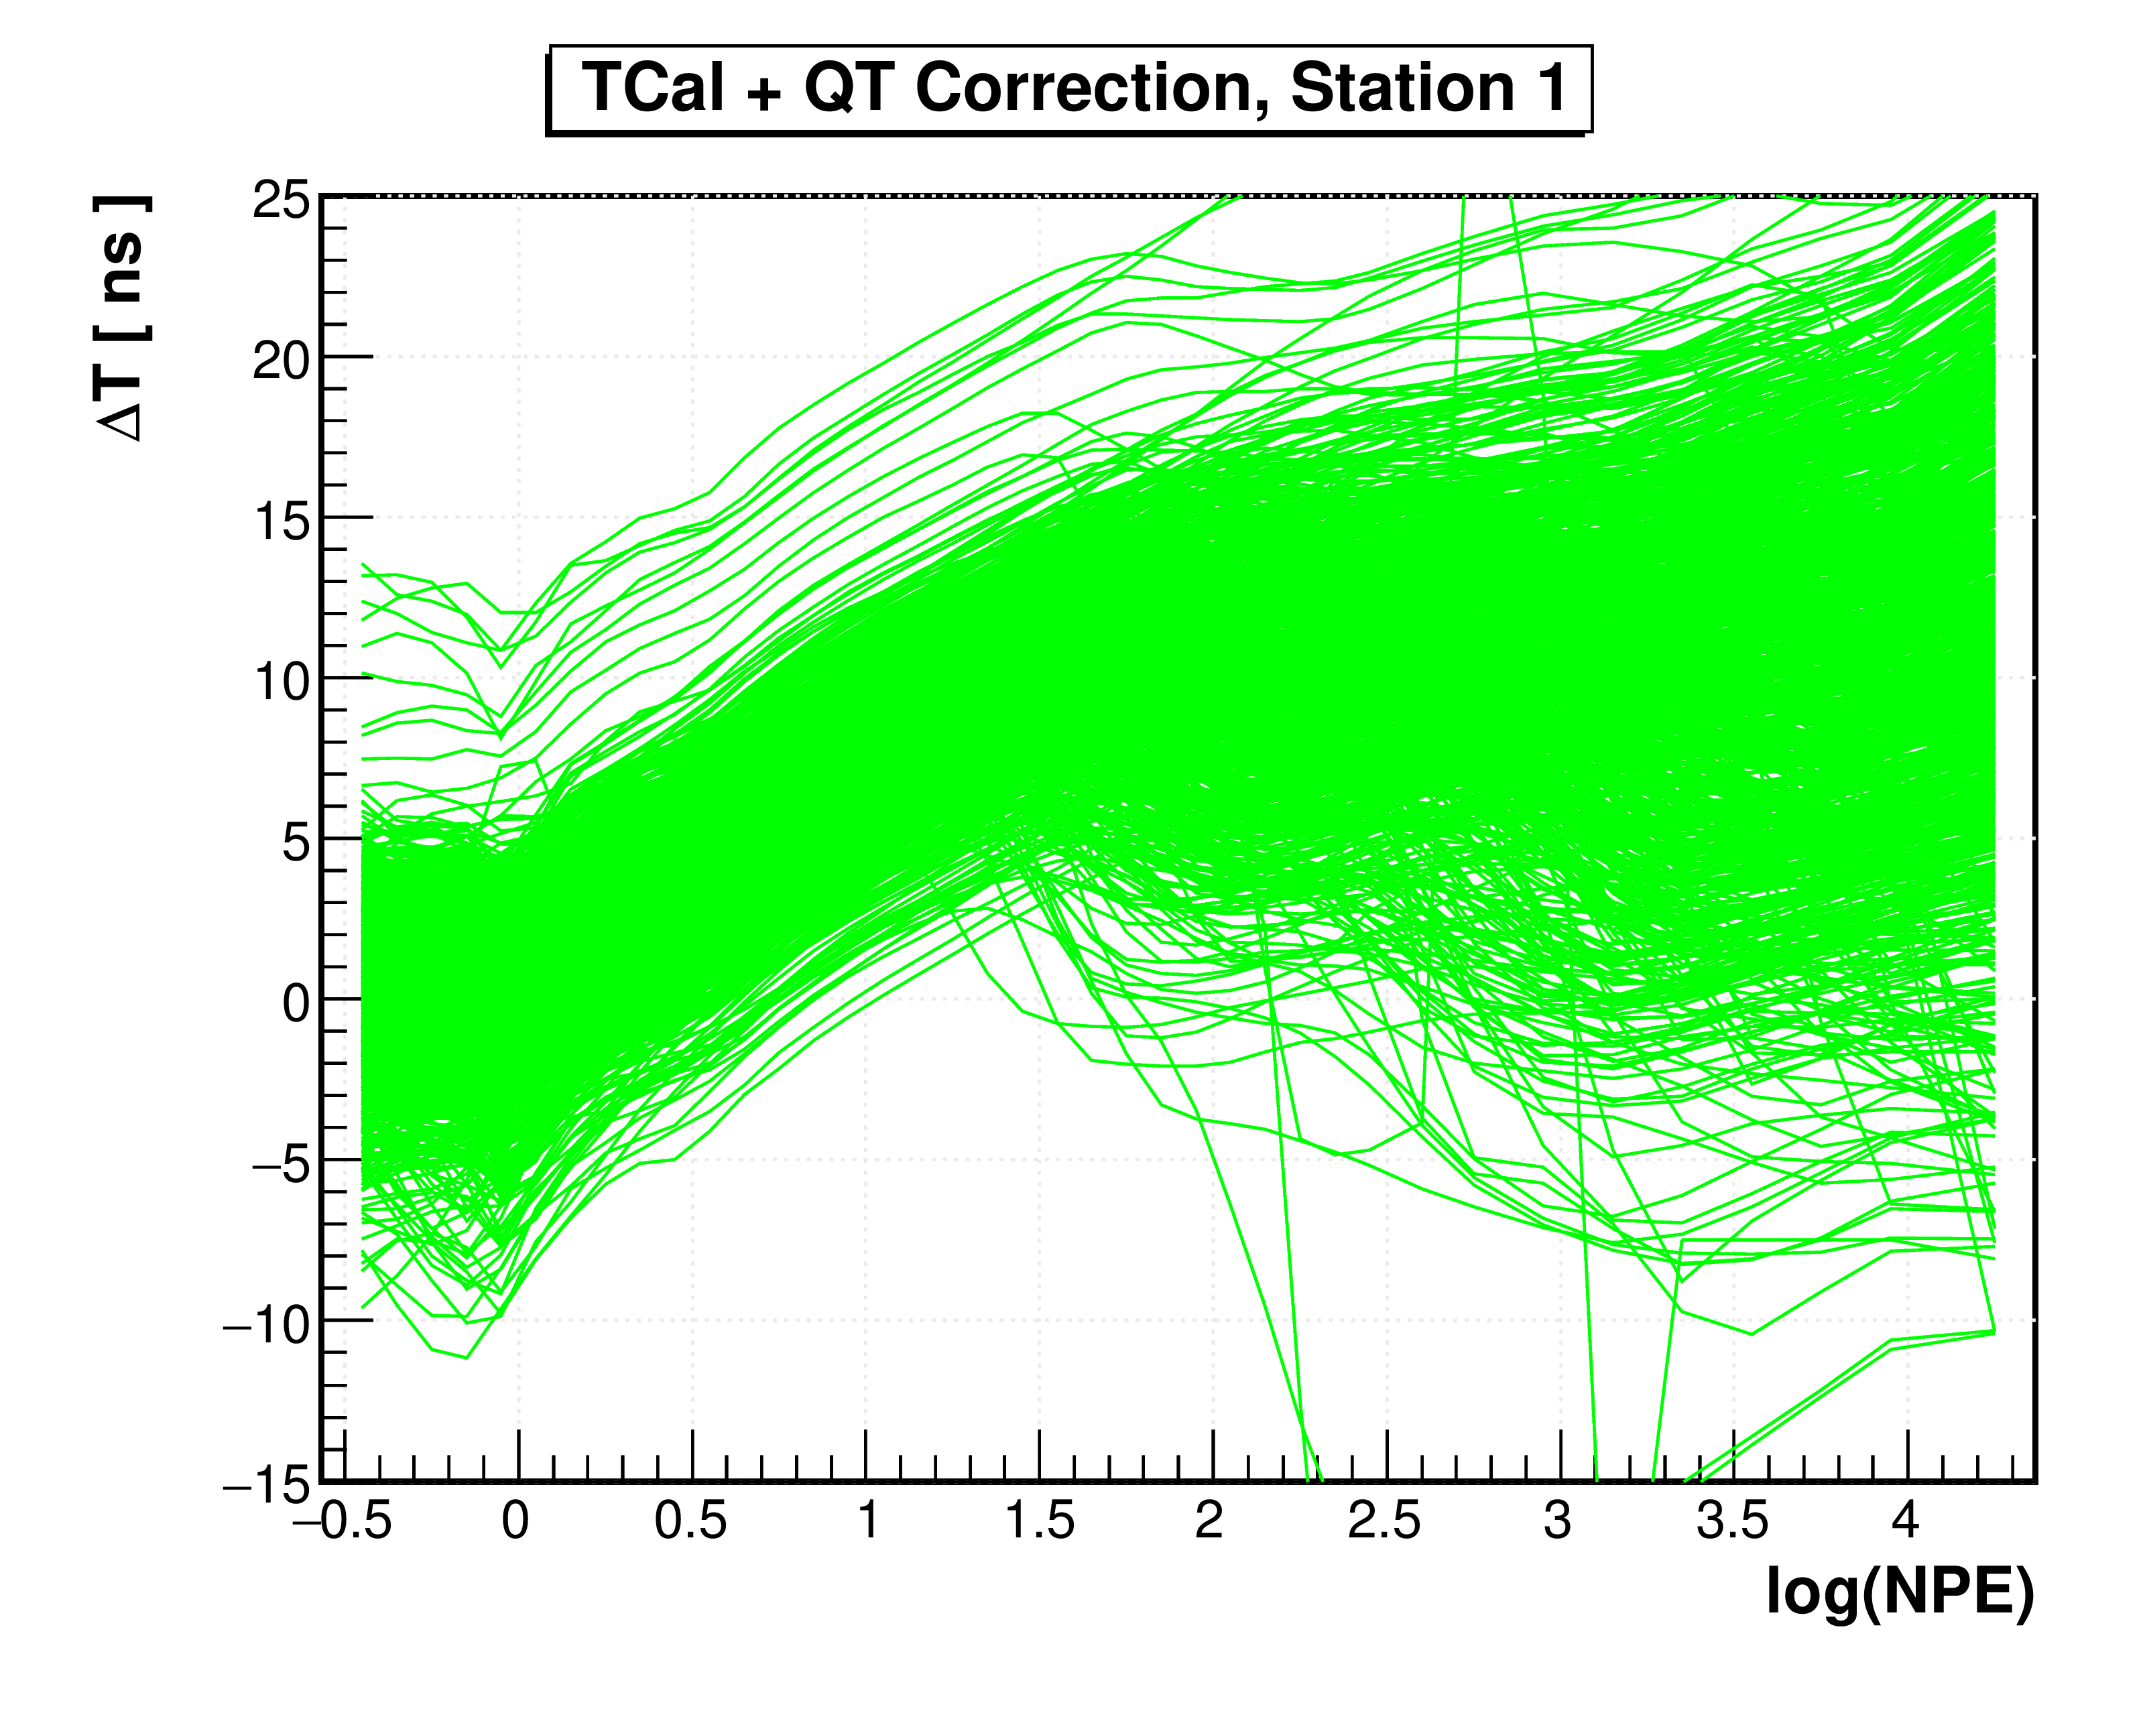
Reconstruction version From Mi to Me
Charge calibration data would be produced in period;
qcal_r20200528.root
8-inch and 20-inch PMT cross-calibration
Time calibration
Hardware time calibration
Offline time calibration
tcal_20200622v2f.root
Using CR showers to correct edge or local phenomena
Arrival time difference between pools
Water depth data
Wcal_latest.root
Reconstruction procedure:
noise filter;
The location of shower core was determined;
The arrival time of PMT was corrected for curvature and sampling effects;
Shower plane fitted in plane;

Slide 5
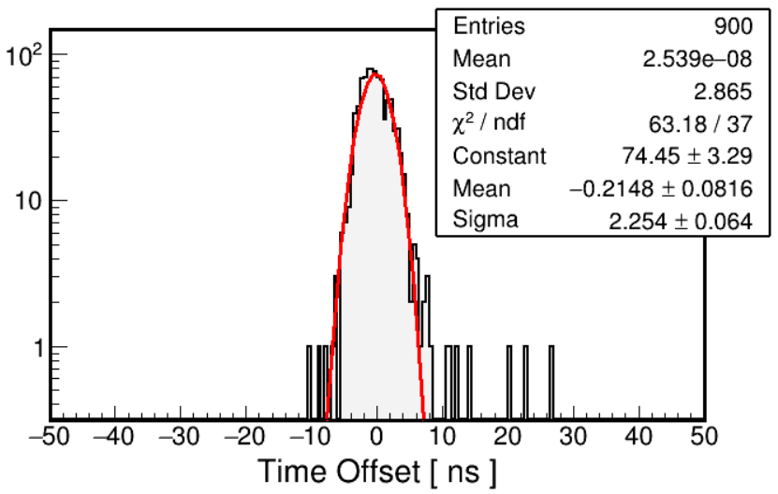
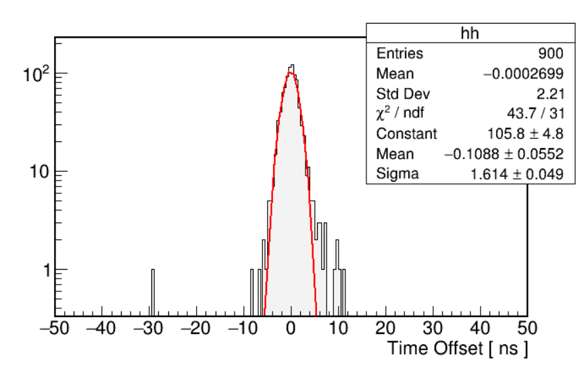
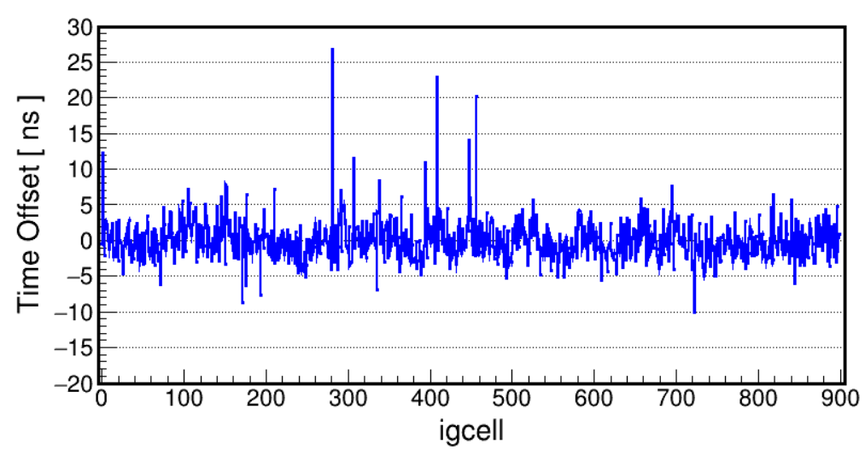
Time calibration from hardware
WCDA-1
WCDA-2
And relative QT curve measured from hardware
At this moment this group of parameters are used

Slide 6
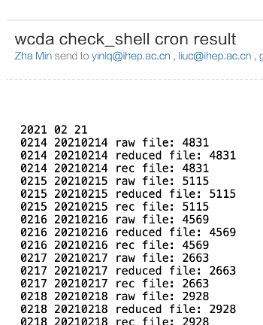
4 kinds of output data
reduced data: 180 ns time window
prelimary Q/P data: Nq25t30/cxpe >6 and density ratio in /out >1
Sampdata: < 7 deg
Original raw data
15T： 20210226 as example
Es*P110*.dat
Reducedata/
noise filter data 5.2 T/day
Es*P110*.reduced.root
Transfer to IHEP
Sampdata/
specific data sample around the sources(crab)
224 G/day
Es*P110*.samp.root
specific sources could be added, for example Mrk421
Recdata/
reconstruction data 940 G/day
2 trees: wcdaevent + wcdaeventheader
Es*P110*.rec.root
recgdata/
potential gamma events 1.4 G/day
Es*P110*.recg.root
Level 1: with very limited noise, these database could be re-reconstruced within very high speed such as 1 month data can be finished within 1 day with 2000 CPUs
Sampdata: < 7 deg, it is used to tune the new code and algorithm, 1-month crab data can be finished within 2 hours.

Slide 7
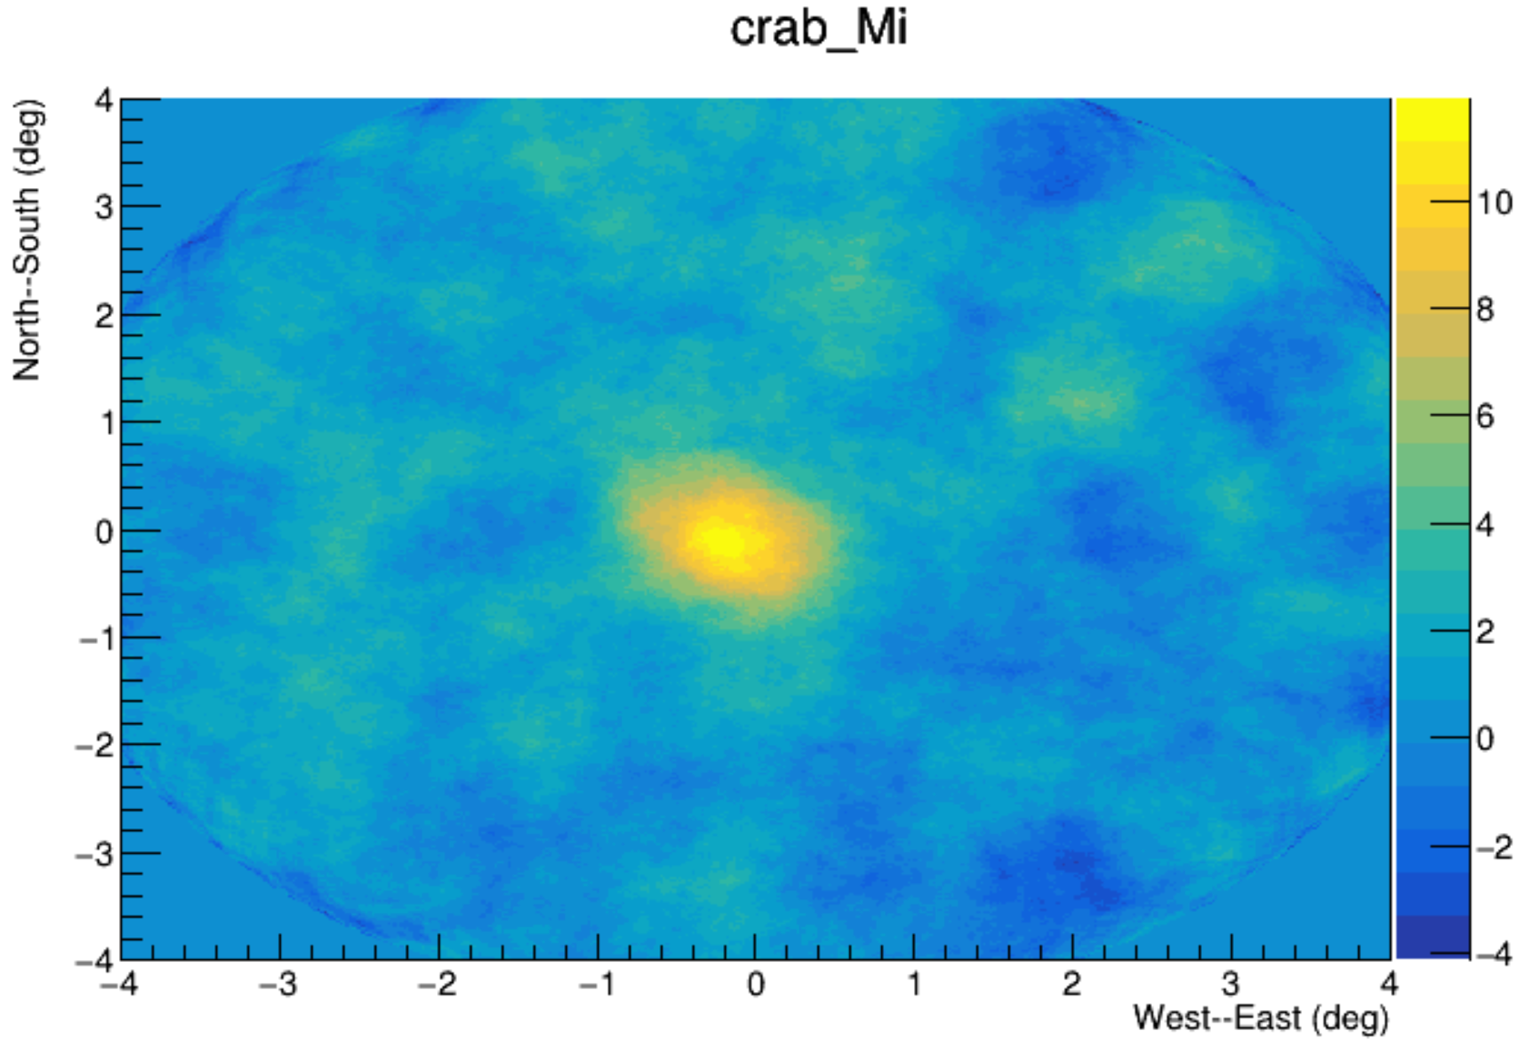
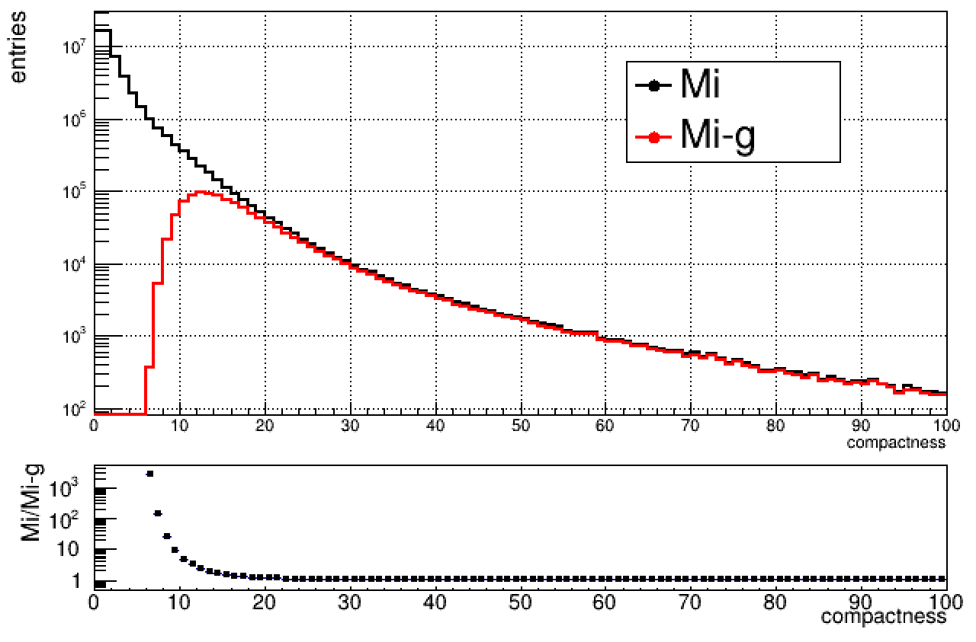
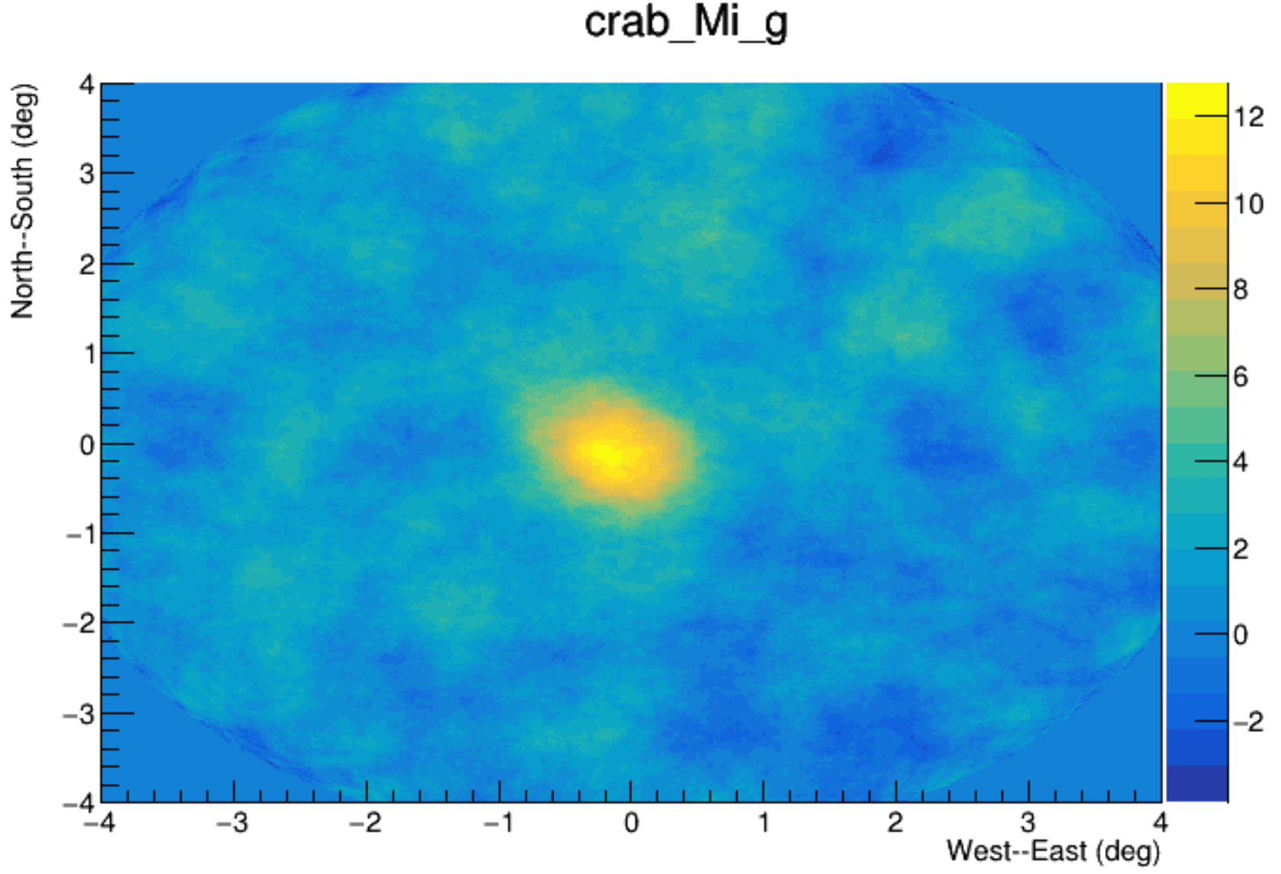
recdata .vs. recgdata 全部重建事例 .vs. 类伽马事例
Data
20200801-20200815
/eos/daocheng/user/w/wcdarec/prod/recdata/Mi/
/eos/daocheng/user/w/wcdarec/prod/recgdata/Mi/
Cut：ndet>100,compactness>15
$$compactness=\frac{nq05t30s0+nq05t30s1}{MAX(qmaxcxr45t30s0,..s1)}$$
gamma-like event database is very easy to be transferred to everyone and everywhere!
Notes:
Nq25t30/cxpe >6 && density ratio in /out >1 → recgdata

Slide 8
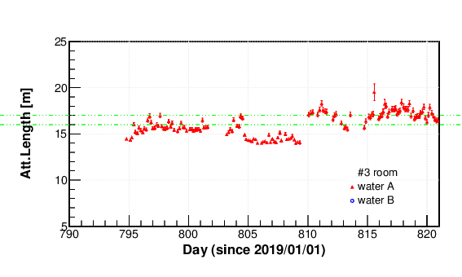
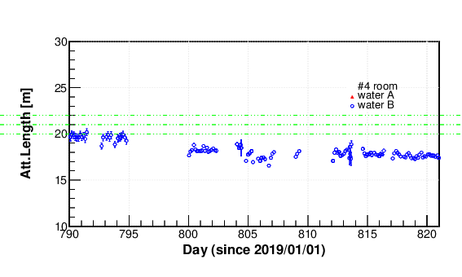
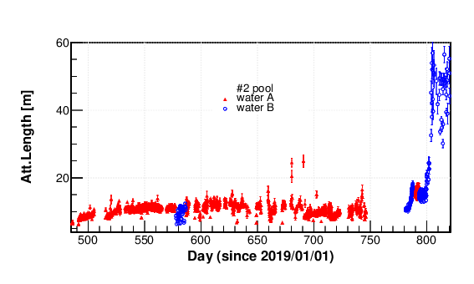
Full WCDA array water condition

Slide 9
PMT efficiency

Slide 10
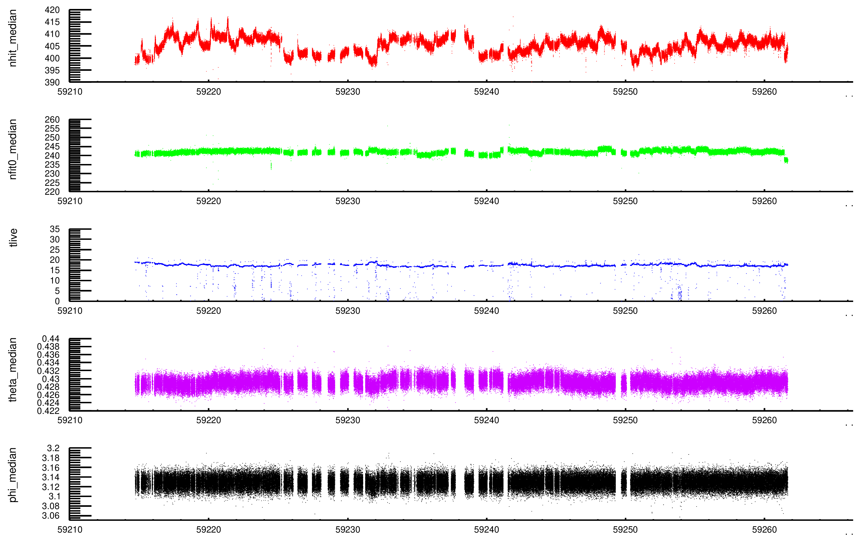
Reconstruction data quality check

Slide 11
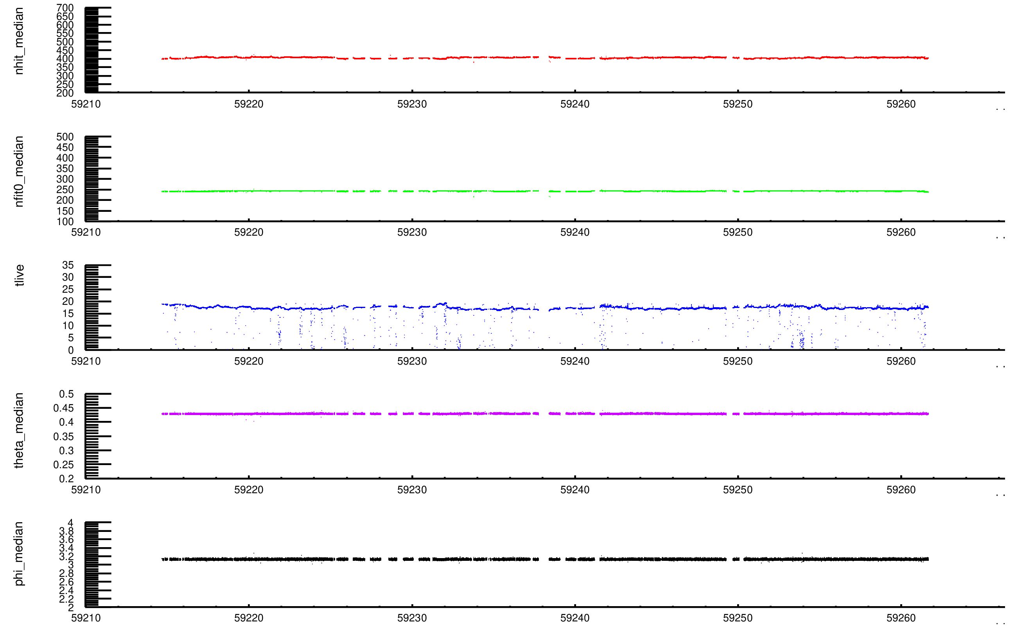
Passing leve-1 check
if(poolused_ != 3) continue;
if(ndetused_ < 1700) continue;
if(nhit_median_ < 350) continue;
if(nhit_median_ > 450) continue;
if(theta_median_ < 0.4) continue;
if(theta_median_ > 0.5) continue;
if(phi_median_ < 3.) continue;
if(phi_median_ > 3.3) continue;
if(tlive_ > 1e5) continue;
if(xc_median_ < 10.) continue;
if(xc_median_ > 40.) continue;
if(yc_median_ > -52.) continue;
if(yc_median_ < -65.) continue;

Slide 12
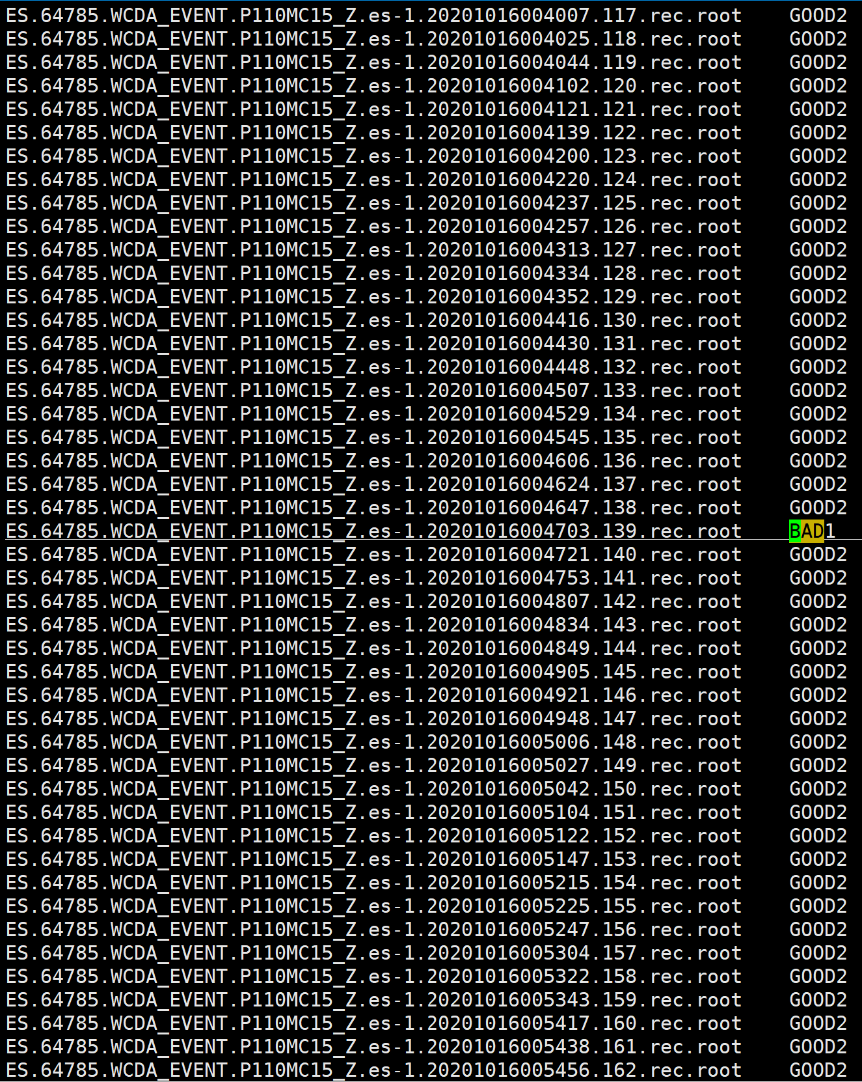
A daily Check-list in txt file
Each reconstruction file has a tag

Slide 13
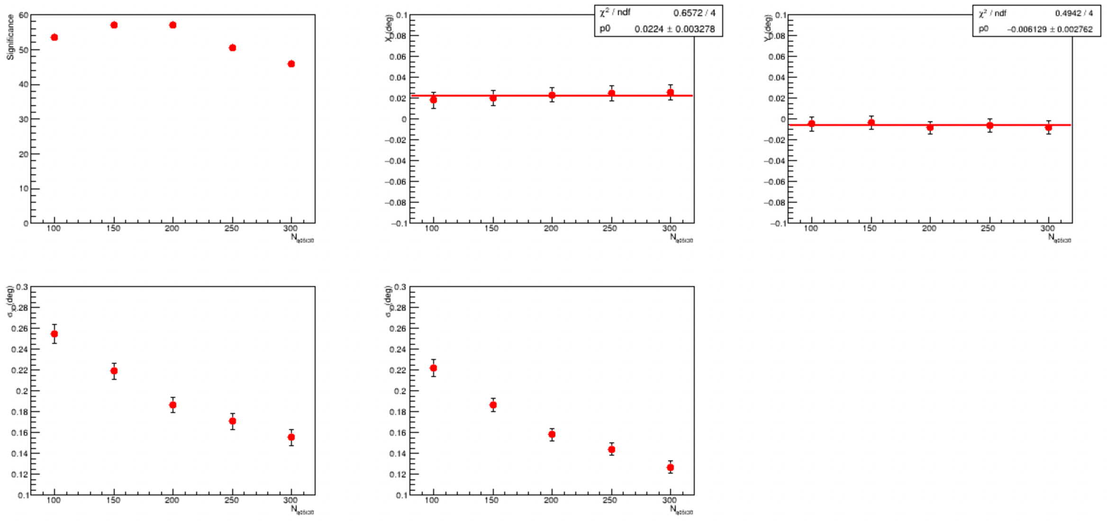
Some related results
Database: 20190401 – 20210228 @ WCDA-1 only
Version: Rb/Rc -> Me
Poinging error <0.1 deg;
Angular resolution consistent with CPC-CRAB result;
WCDA-1 crab @202006-202102

Slide 14
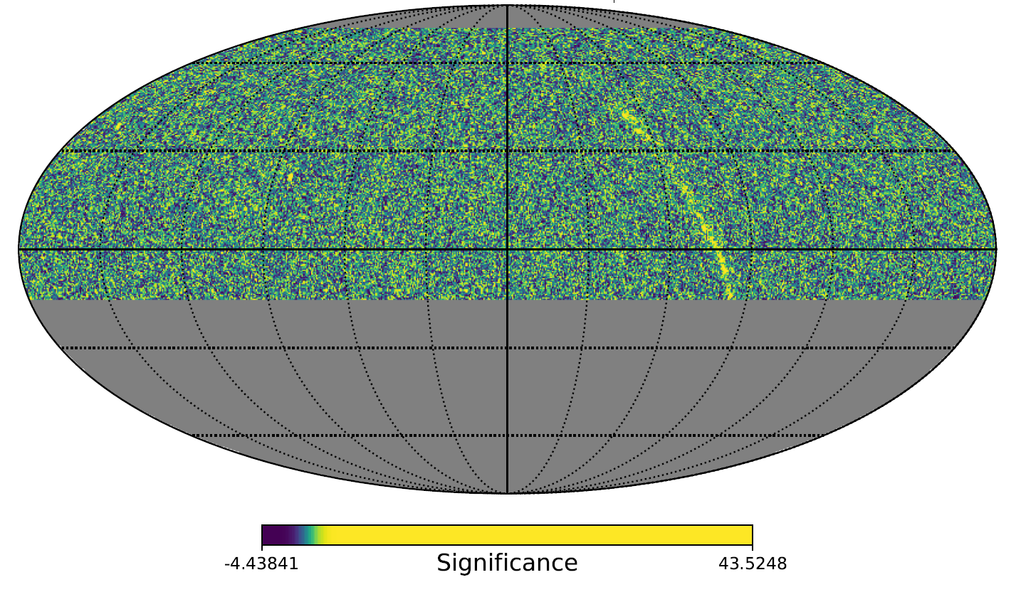
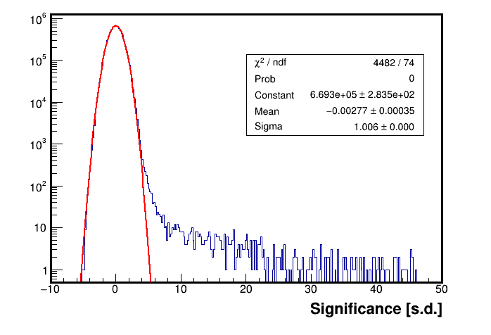
201906-202002 : Rc
Mrk421
Crab
Some sourcer results see the talk given by Chuandong Gao

Slide 15
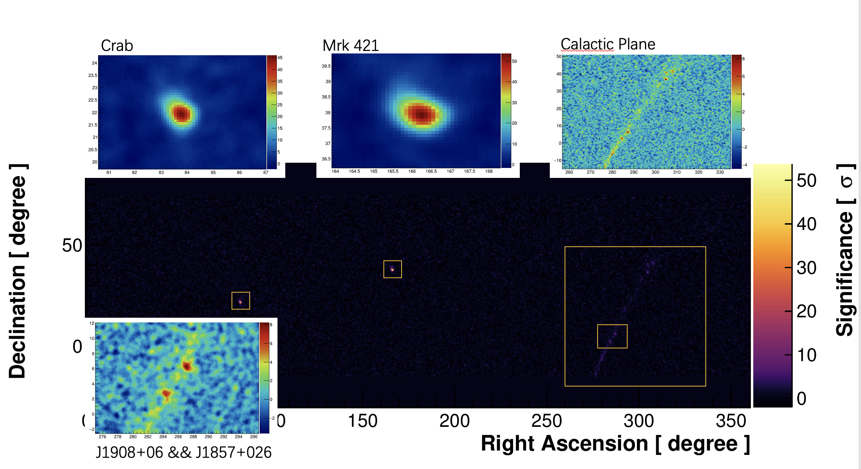
--continued
WCDA-U (WCDA-1 + WCDA-2) database
Before detector update
Version: Mi

Slide 16
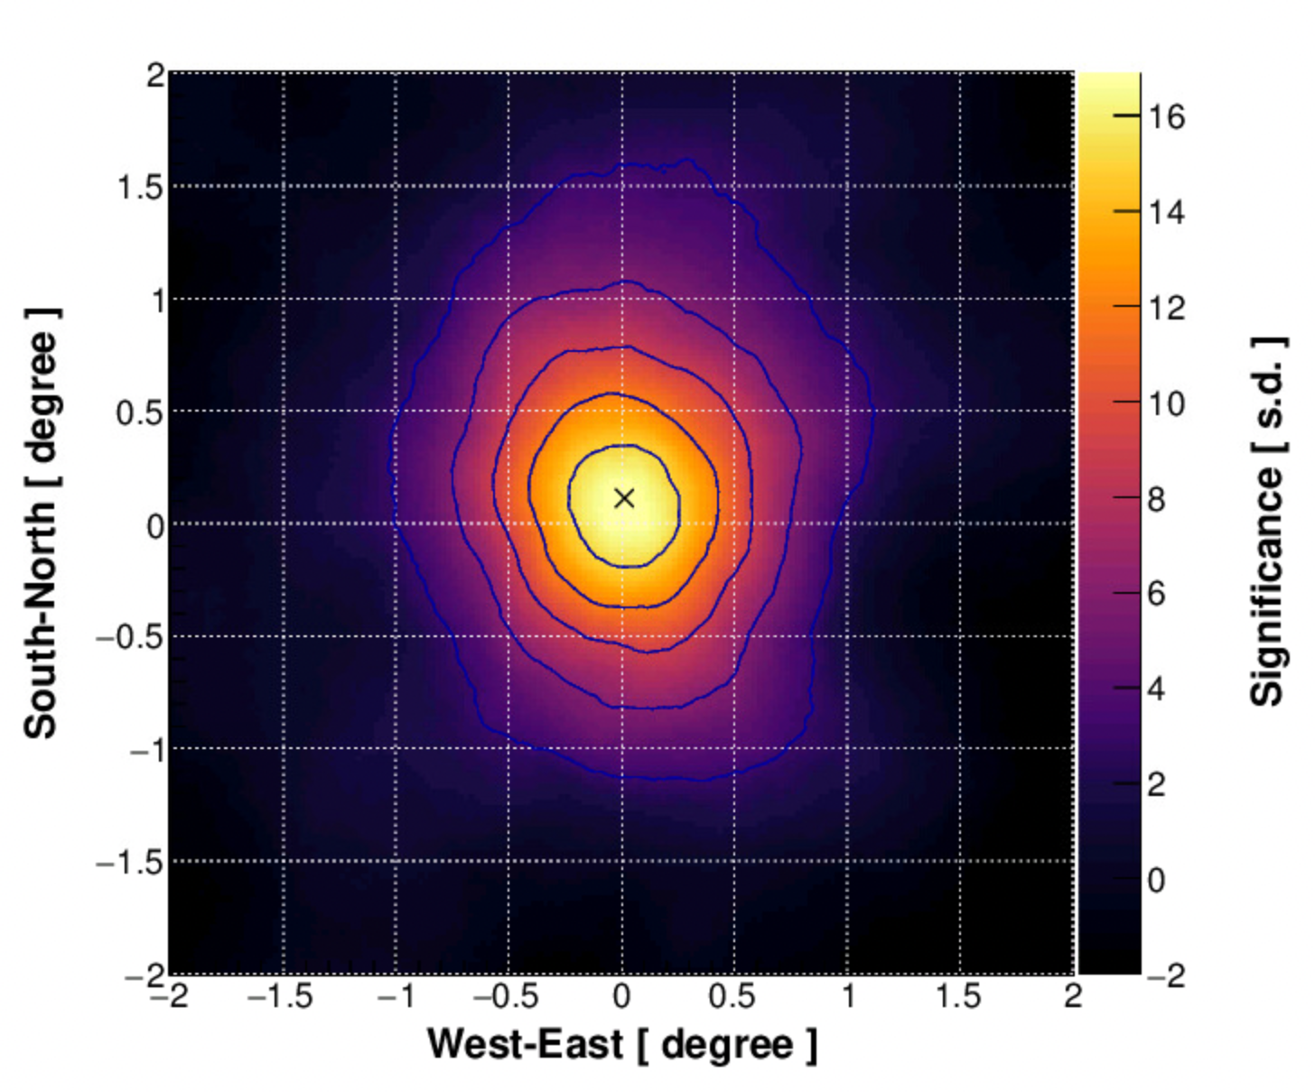
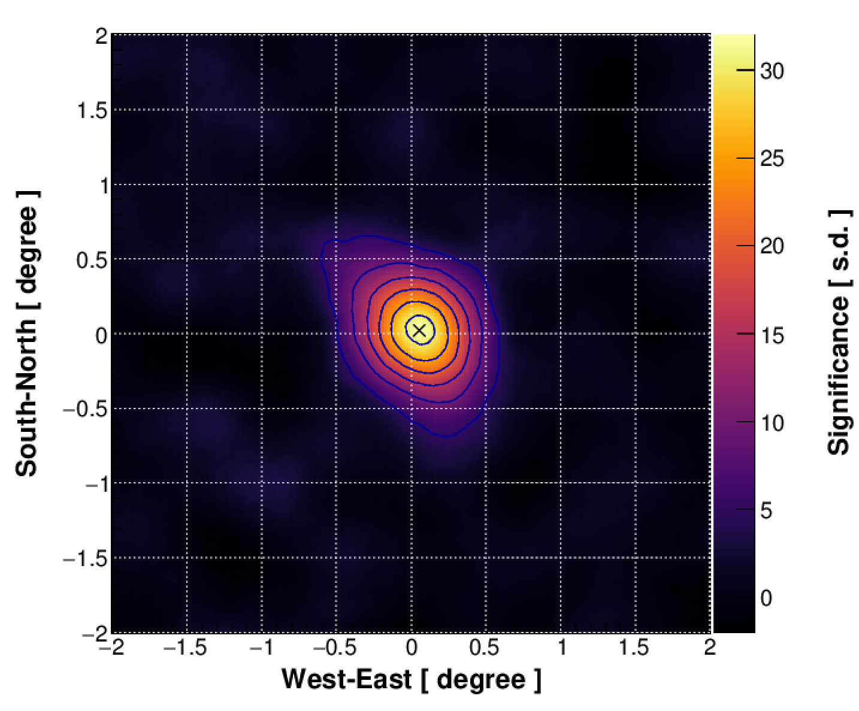
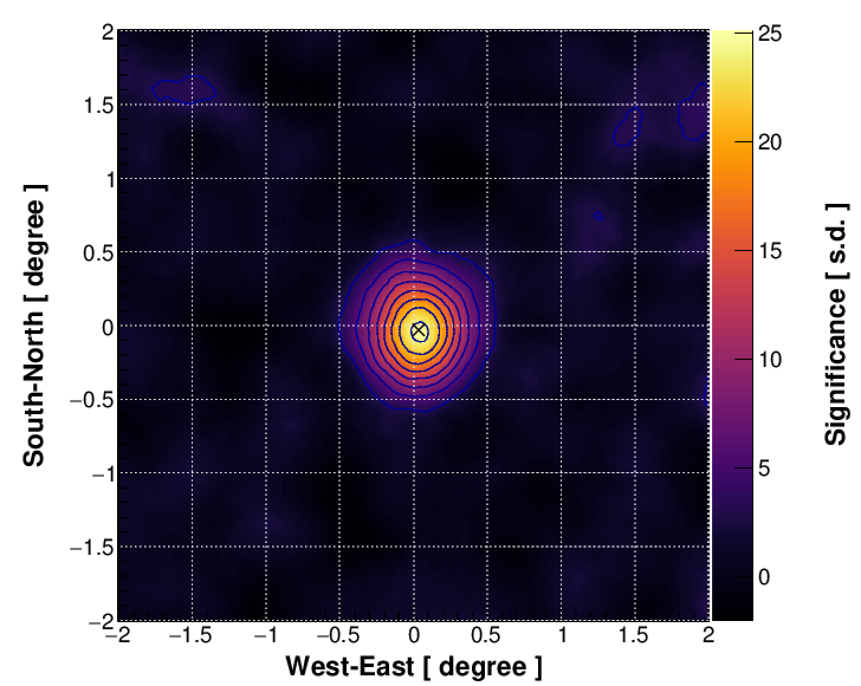
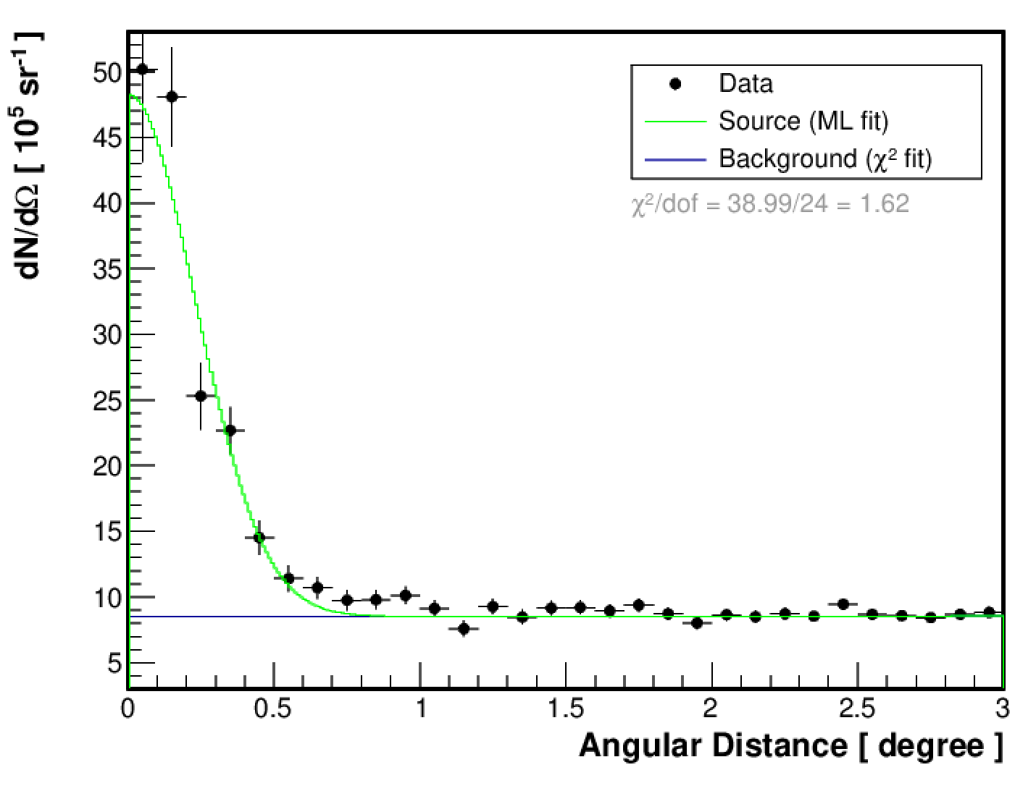
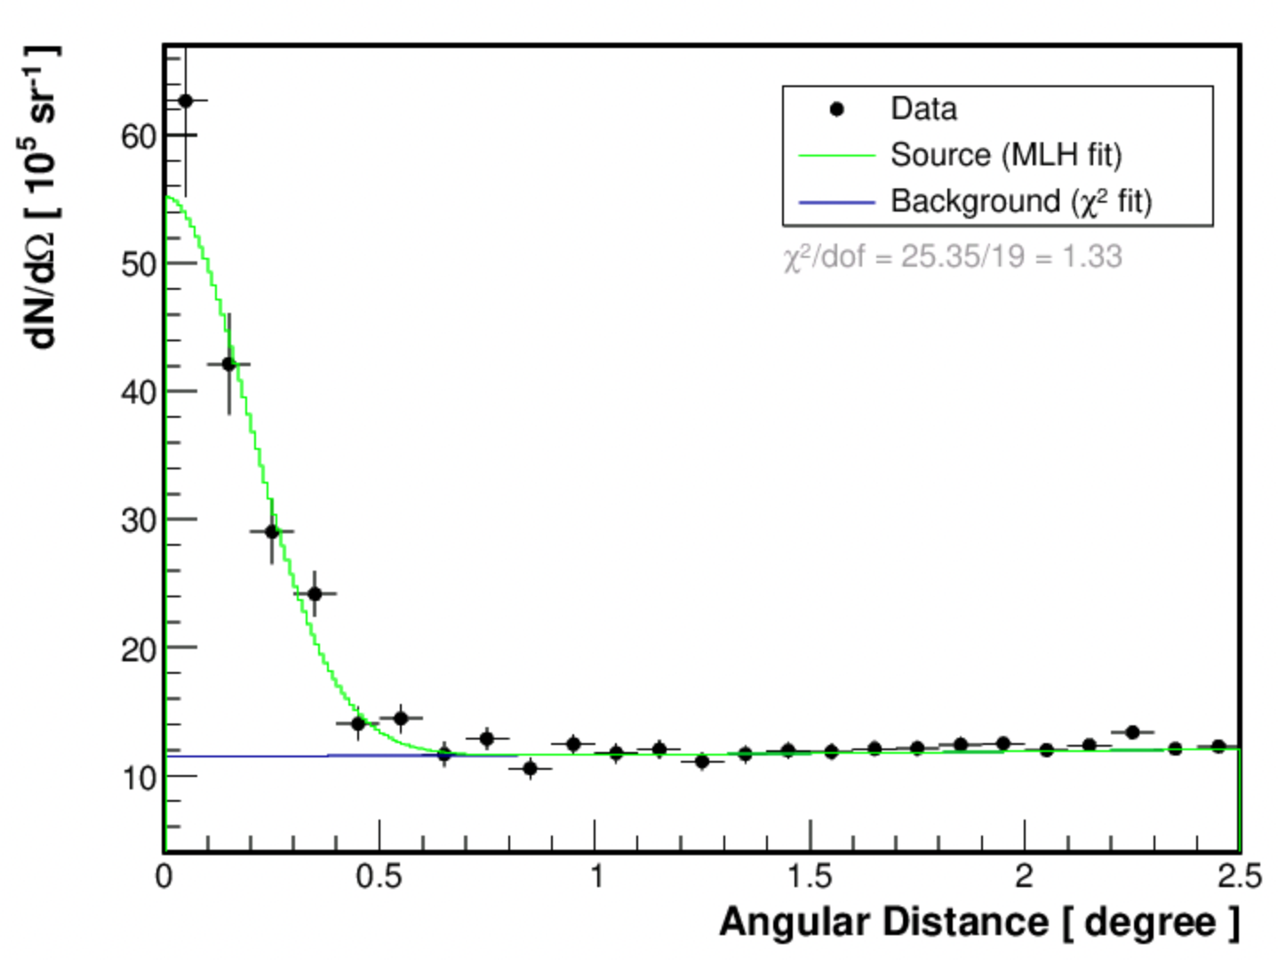
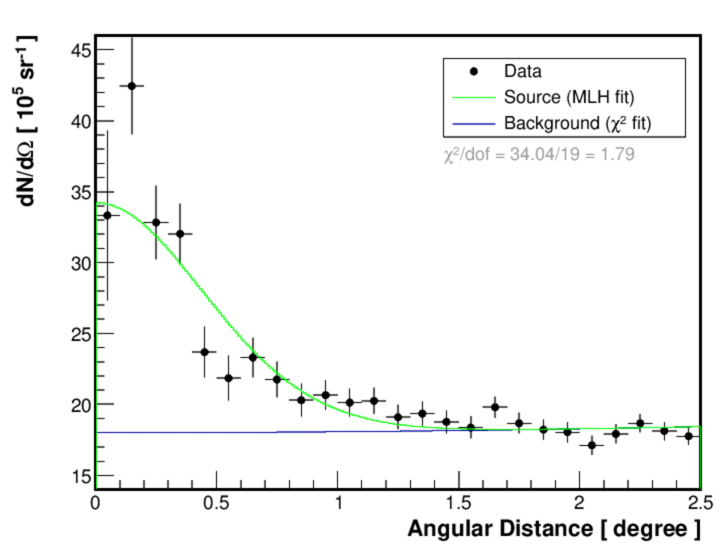
--continued
WCDA-U (WCDA-1 + WCDA-2) 20210101- 20210131
after detector update with WCDA-2 shielding
WCDA-1: 25 sigma
Nhit: >170 + C>17
Center: (0.02, -0.02)
psf: (0.17, 0.22)
WCDA-2: 18 sigma
Nhit: >170 + C>1.7
Center: (0.01, 0.11)
psf: (0.38, 0.54)
WCDA-u 32 sigma
Nhit: 230 + C>23.
Center: (0.05, 0.02)
psf: (0.22, 0.23)

Slide 17
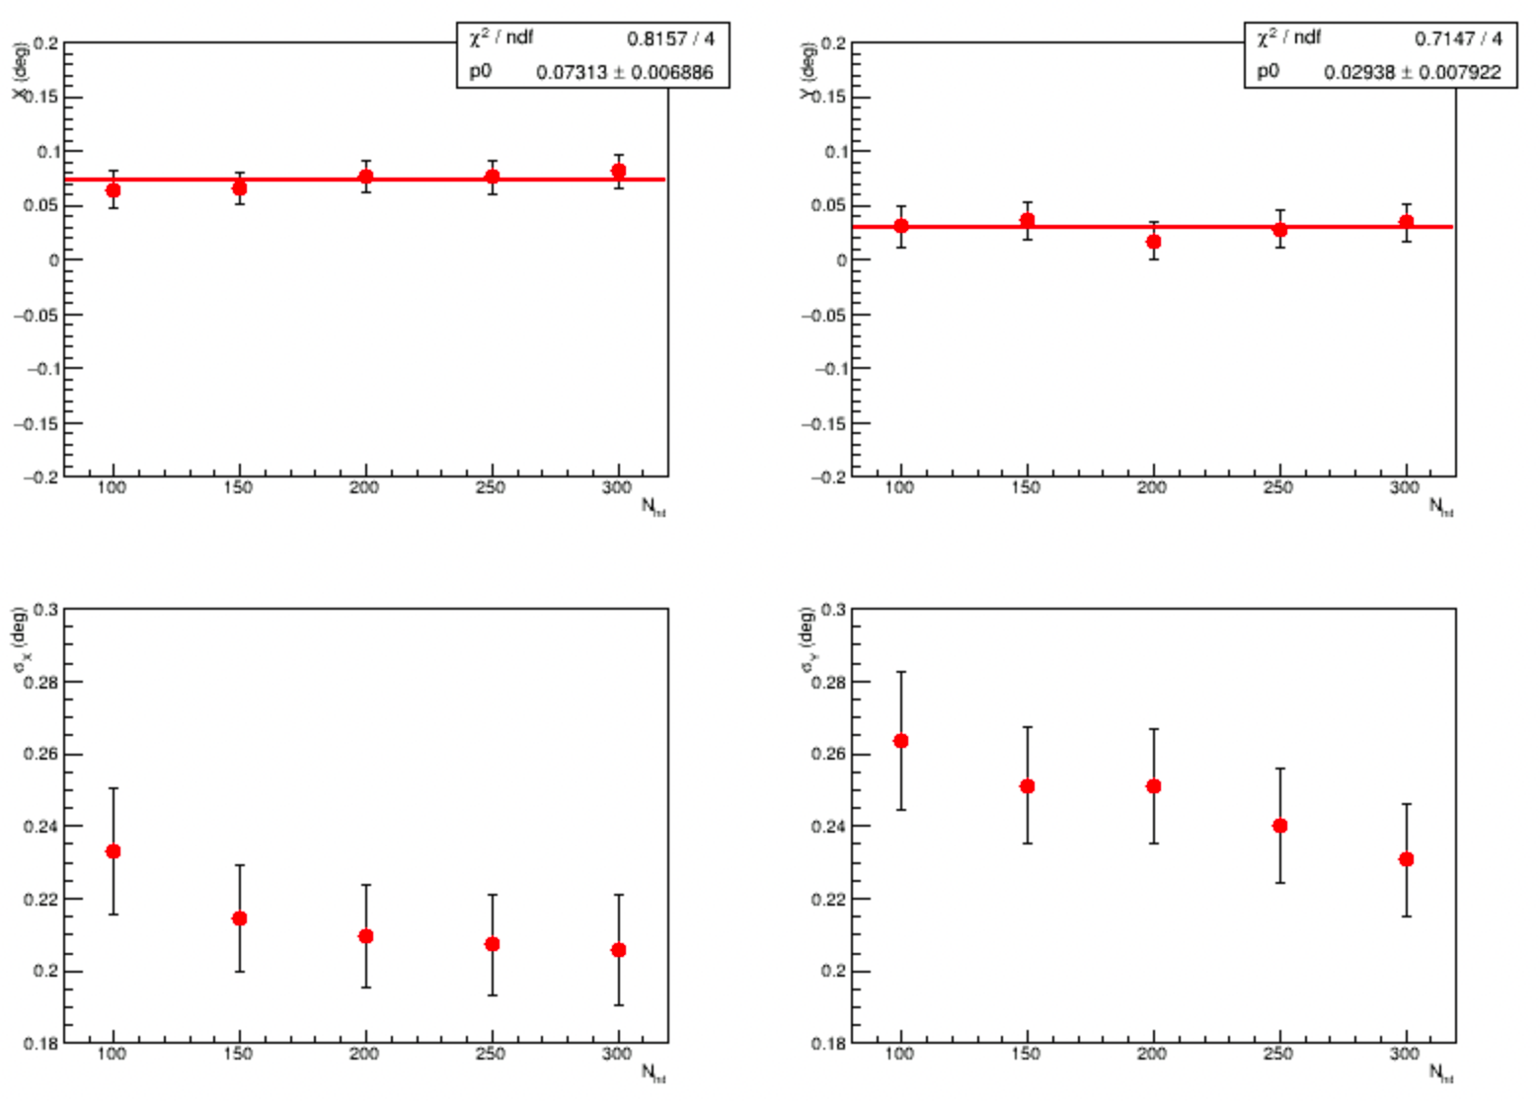
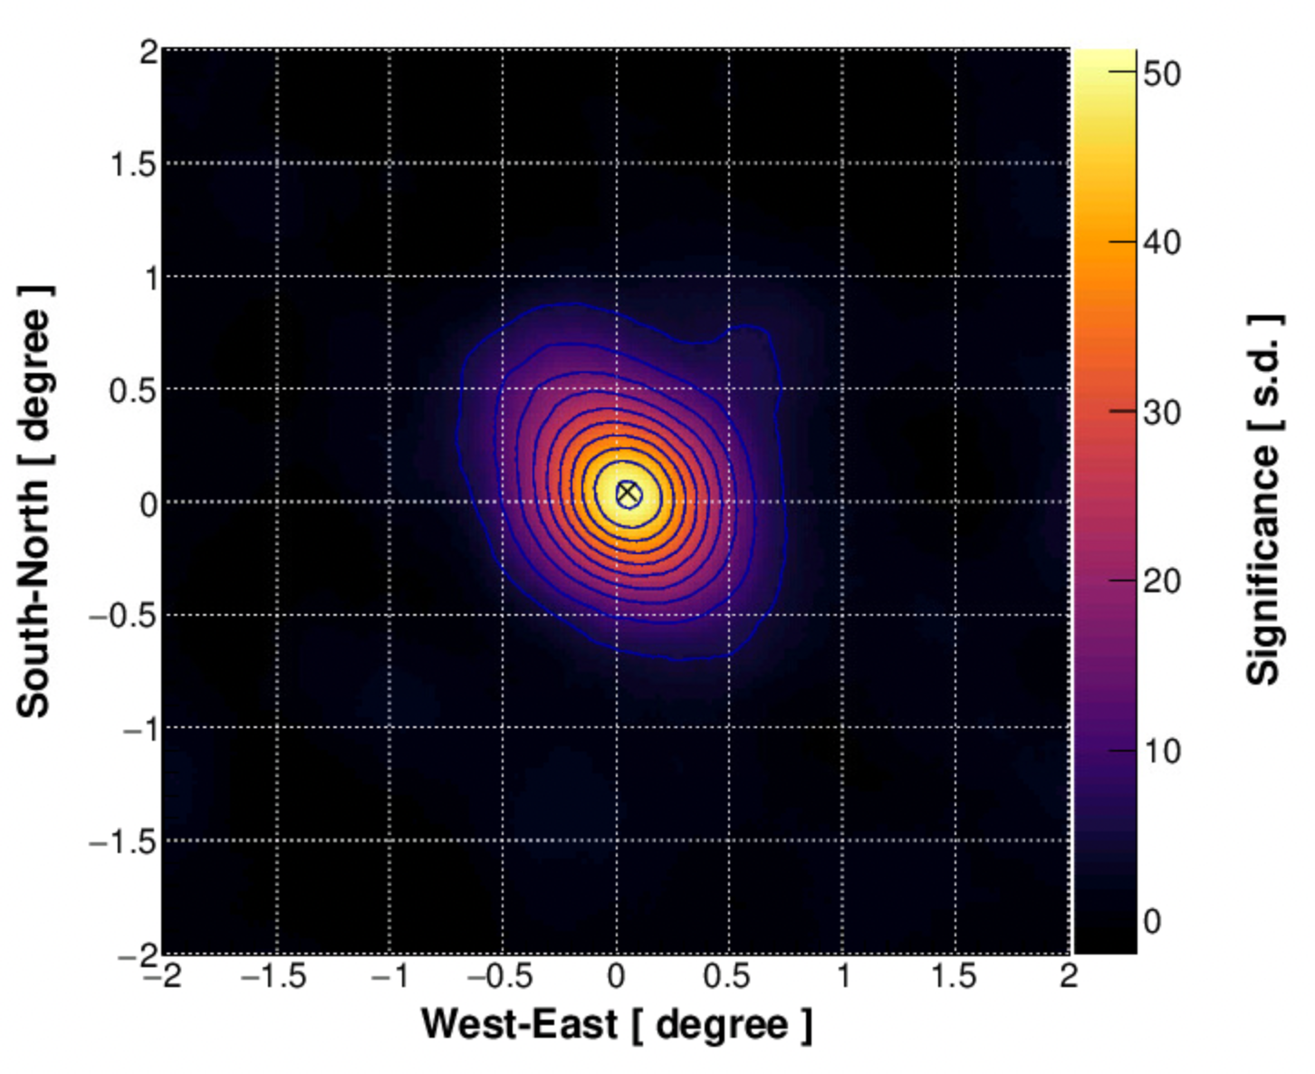
Pointing error and Angular resolution@ WCDA-U
4 month: 53 sigma

Slide 18
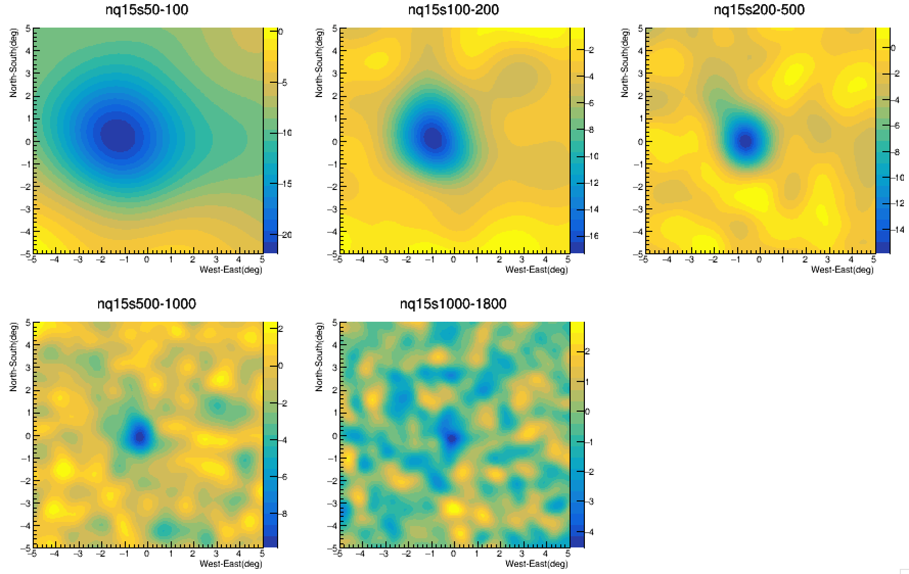
Moon shadow @ 202011

Slide 19
Summary and outlook
WCDA array is entering into full array stage, with reconstruction version update, the crab observation result from individual pools is reasonable;
3 different reconstruction databases are ready.
WCDA-1 only data from 20190401 – 20210228
WCDA-U data without shielding 20200314 – 20201031
WCDA-U data with shielding 20201101 – 20210304
It is under production and will be finished within one week;
Next step
WCDA full array data reconstructionstarting from 20210305
8-inch and 20-inch PMT cross-calibration at charge and arrival time?
Optimization on Angular resolution?
Optimization on Q/P separtion?
20 sigma /day --------------------------------→ No.1 target
Continue physics analysis on existed reconstruction database;
Full array MC studying;

Slide 20
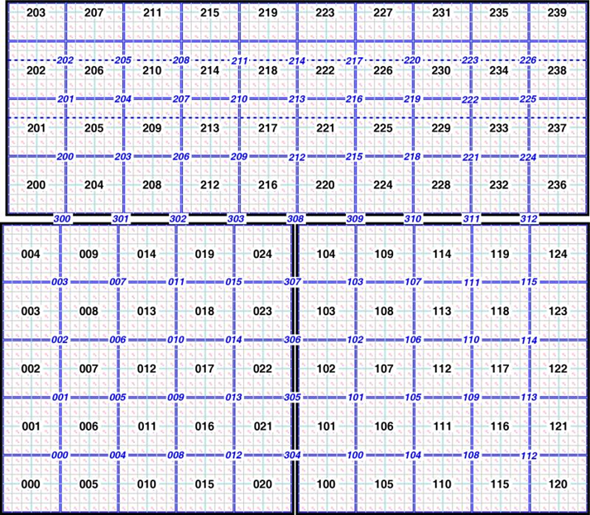
backup

Slide 21
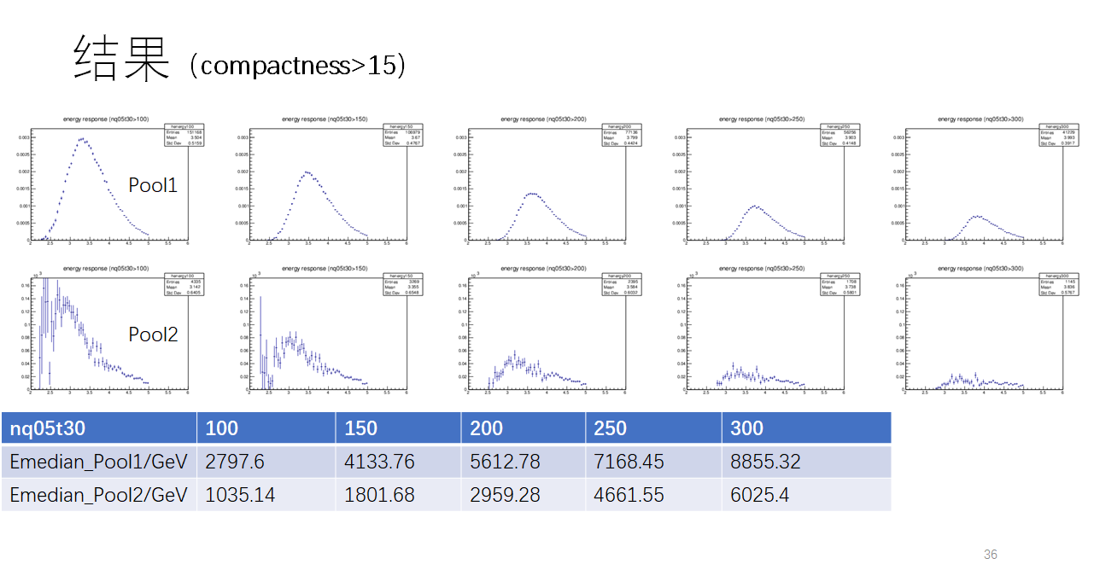
Gamma Response Energy
Looks like individual pool has best performance around 4 TeV
联合的median energy

Slide 22
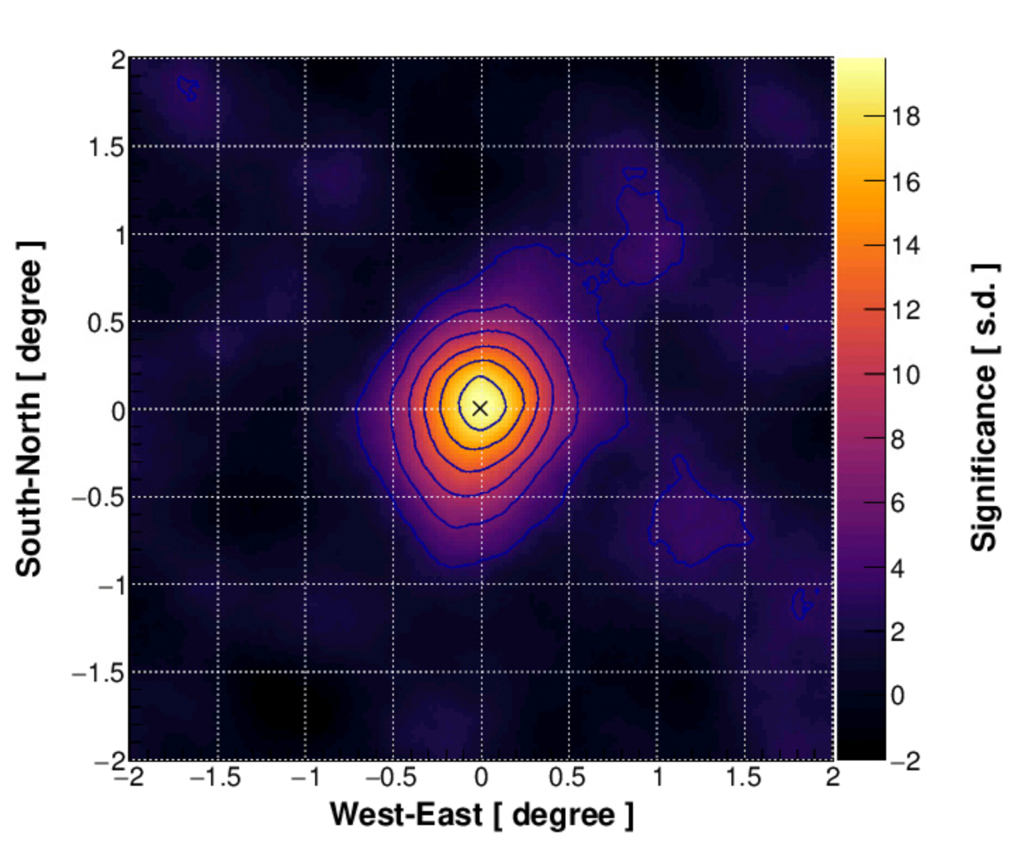
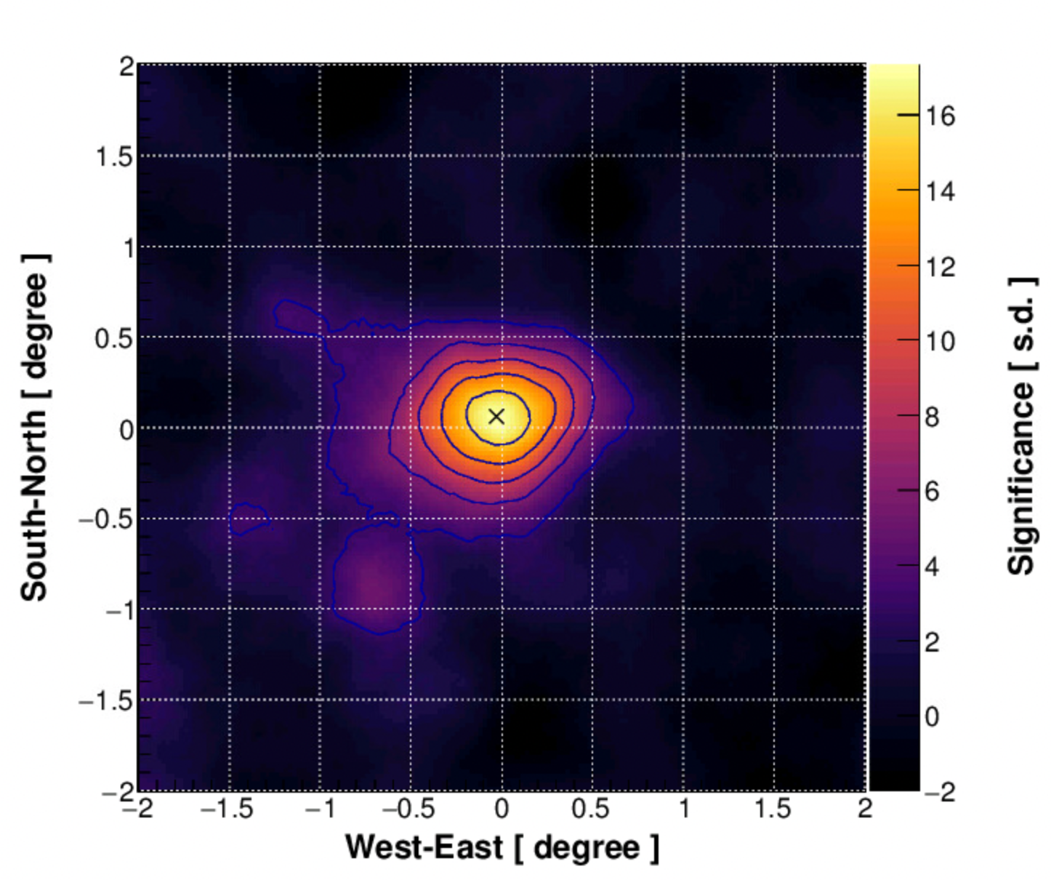
Result from offline calibration (20201101-20201130)
WCDA-1: 20 sigma
nq05t30: >100 + C>15
Center: (0.002, -0.002)
psf: (0.24, 0.31)
WCDA-2: 18 sigma
nq05t30: >250 + C>15
Center: (0.03, -0.06)
psf: (0.31, 0.21)

Slide 23
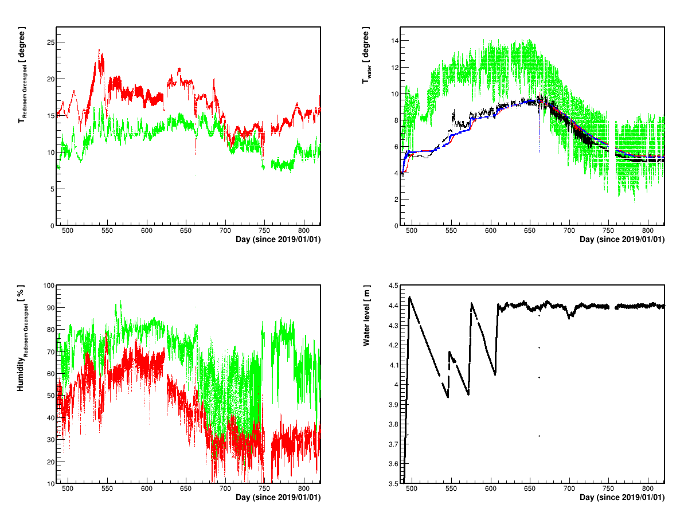
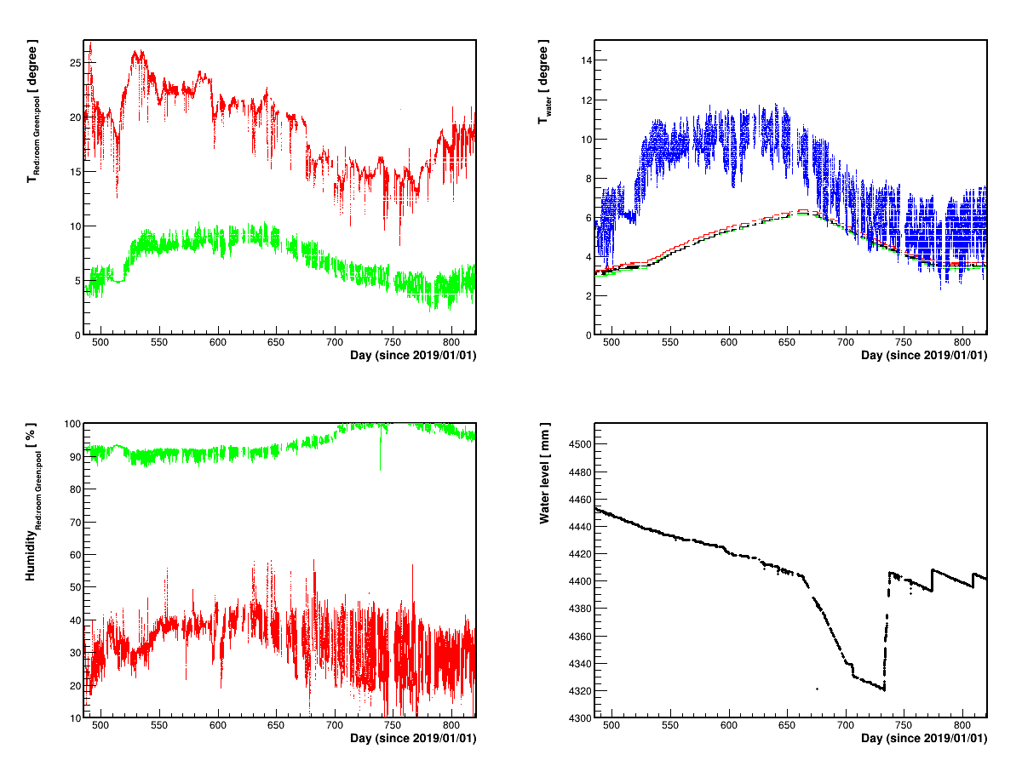
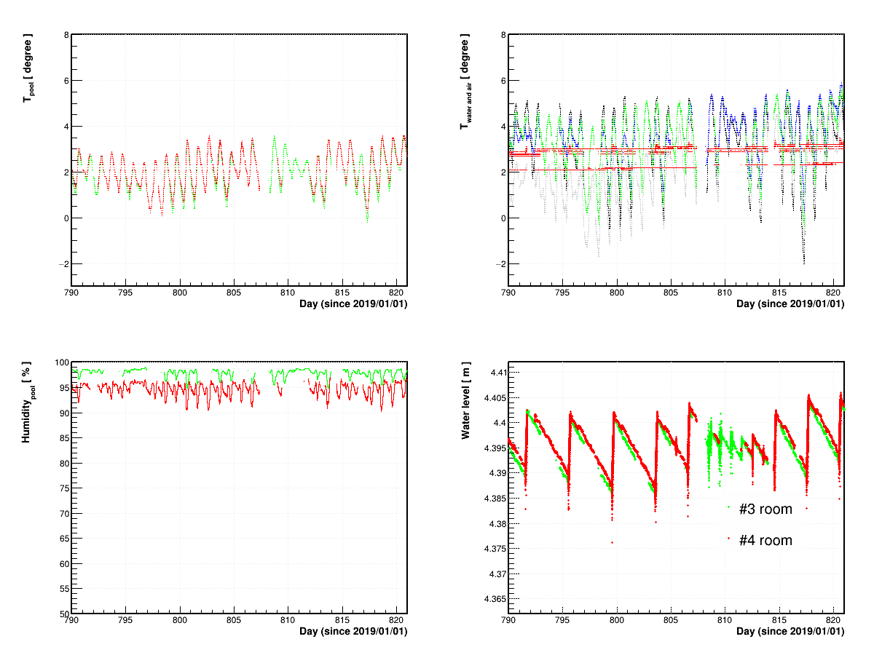
Pools enviormental parmaters
WCDA-1
WCDA-2
WCDA-3

Slide 24
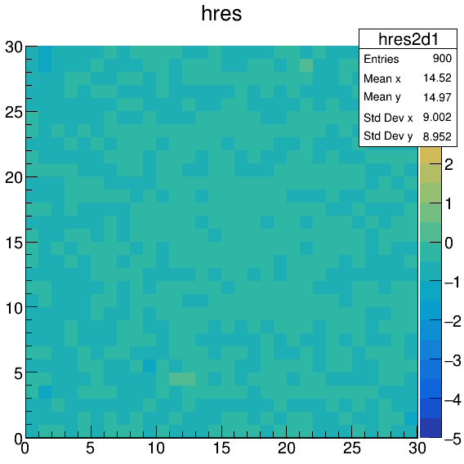
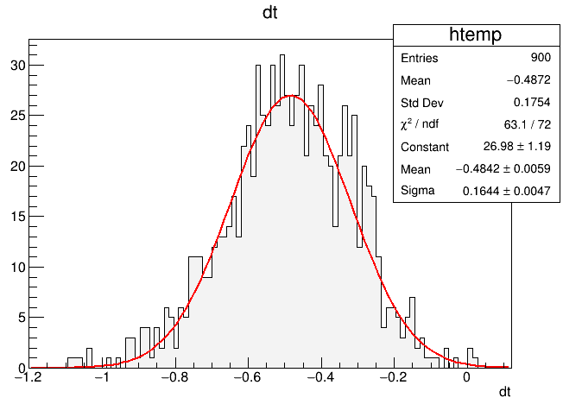
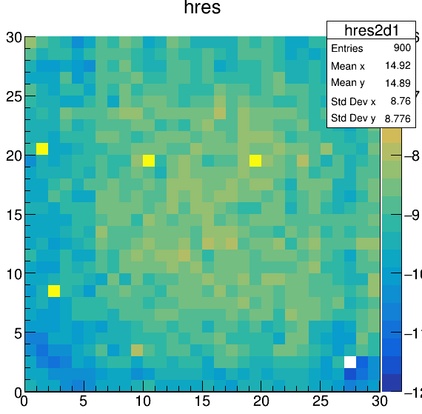
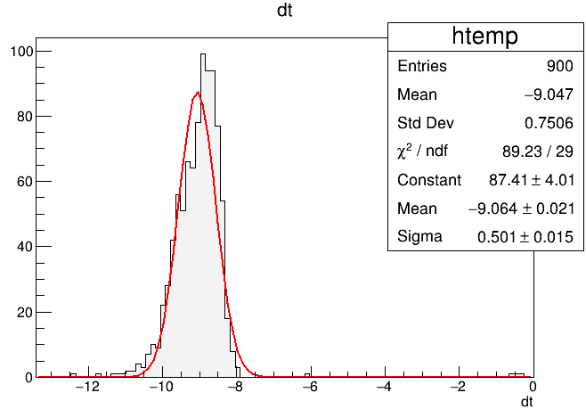
2nd Correction based CR showers
_{WCDA-1}
_{WCDA-2}

Slide 25
 |  |  | Nearest TeVCat Src
Ra [˚] | Dec [˚] | Sig | Distance [˚] | Name
184.62 | 79.75 | 5.89 | 9.94 | -
14.95 | 64.34 | 6.05 | 3.74 | -
336.86 | 60.62 | 5.93 | 0.26 | RG 106.3+02.7
308.10 | 41.31 | 7.96 | 0.15 | PSR J2032+4127
305.51 | 40.57 | 6.17 | 0.41 | VER J2019+407
166.16 | 38.11 | 23.59 | 0.10 | Markarian421
304.80 | 36.94 | 9.29 | 0.14 | VER J2019+368
83.72 | 21.94 | 47.75 | 0.10 | Crab nebula
288.63 | 10.54 | 6.45 | 0.57 | -
287.09 | 6.43 | 10.20 | 0.20 | MGRO J1908+06
287.89 | 4.71 | 5.02 | 0.40 | SS433 w1
284.37 | 2.31 | 6.91 | 0.31 | HESS J1858+020
282.39 | -1.83 | 5.96 | 1.13 | -
280.94 | -3.43 | 8.24 | 0.57 | -
280.24 | -5.15 | 6.62 | 0.70 | -
279.32 | -6.54 | 6.93 | 0.18 | MAGIC J1837-073
278.83 | -8.76 | 5.17 | 0.63 | -
276.59 | -13.52 | 6.71 | 0.34 | LS 5039

