Slide 1
A study of atmospheric changes at LHAASO
Xia J.J., Zhu F.R., Hu Liu
Southwest Jiaotong University
2021.4.26 @Guangzhou

Slide 2
Outline
Atmosphere Model at LHAASO site
Aerosol measurement with CE-318 at LHAASO site

Slide 3
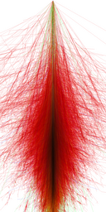
Atmosphere Model
The change of atmospheric depth will lead to the change of photon number in WFCTA
Explore whether the existing atmospheric model is applicable to LHAASO

Slide 4
Introduction
American Standard Atmospheric Model (it is an average model)
MSISE-90 model (the variation of atmospheric characteristics with time and latitude and longitude can be described)
Satellite measurement (SABER)
Pressure measurement at LHAASO (20 meters tower)

Slide 5
American Standard Atmospheric Model - MSISE-90 model
the MSISE model is greater than that of the American standard atmospheric model by 5-25g/cm^2 at altitude below 10km

Slide 6
Satellite measurements at LHAASO (SABER)
•The Publicly TIMED satellite data server downloads SABER observation data
•A total of 31 days of observations from 2013 to 2018（one measurement every 60 days）

Slide 7
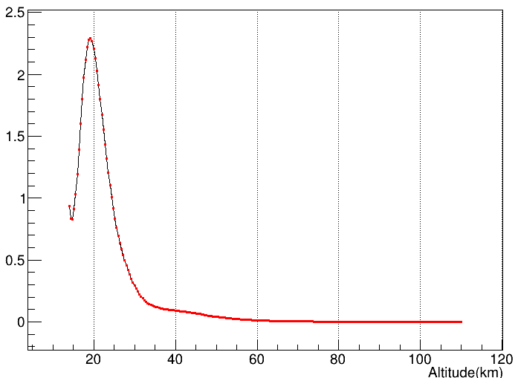
MSISE-90 model - SABER
•From the absolute difference of the mean value of the data, the difference between the two is very small
•the variation of atmospheric non-migratory tides and different bands of solar radiation, as well as the variation of the earth's magnetic field
msise-saber(g/cm²)

Slide 8
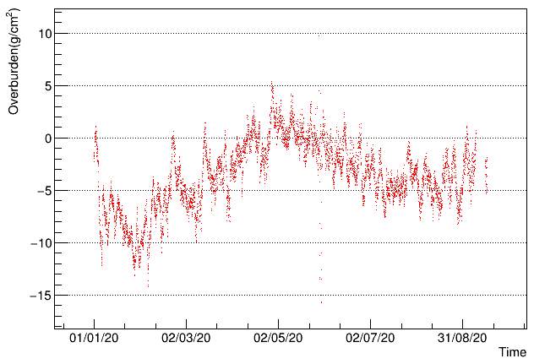
20 meters tower measurement at LHAASO site - MSISE-90 model
•The meteorological data from January to September, 2020 are compared with the model data of the same period.
The overburden was calculated from pressure
Each point represents the difference after averaging the data of the whole day
difference [g/cm²]

Slide 9
Summary on Atmosphere Model
MSISE model is greater than the American standard atmospheric model by 5-25g/cm^2(1.7%-8.9%) at altitude below 10km.
The difference between MSISE90 model and satellite observation data is small below 40km(<2.5g/cm^2).
The atmospheric depth observed by 20 meters tower at LHAASO‘s altitude is 1% to 2%(maximum ~12g/cm^2) less than that of the MSISE model.

Slide 10
Aerosol measurement with CE-318 at LHAASO
1
Principle：
lamda
Absolute calibration number ：
lamda
V is the measured voltage from CE-318, m is related to zenith angle of the sun at LHAASO site,
is the calibration number, 𝝉 is the measured optical depth of the total atmosphere.
optical depth of aerosol (AOD) can be estimated by subtracting the Rayleigh scattering component

Slide 11
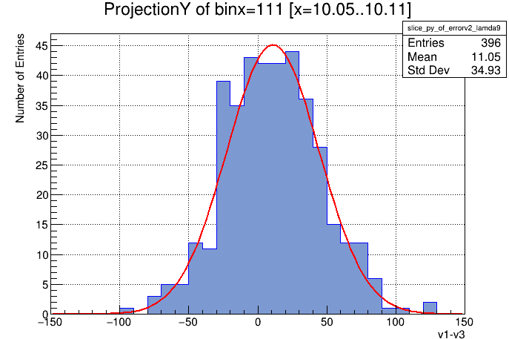
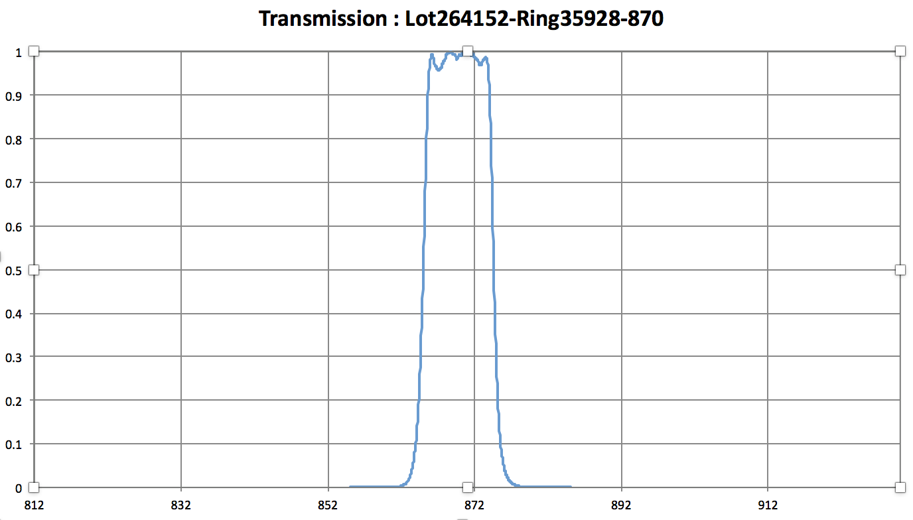
Error estimation
Error from voltage measurement
the voltage was measured three times, the error of voltage
is estimated from those difference
Error from Rayleigh scattering due to wave length
there is a filter inside CE-318, the band width is 2nm for 340nm, 4nm for 380nm, 25nm for 1640nm, and 10nm for other bands.

Slide 12
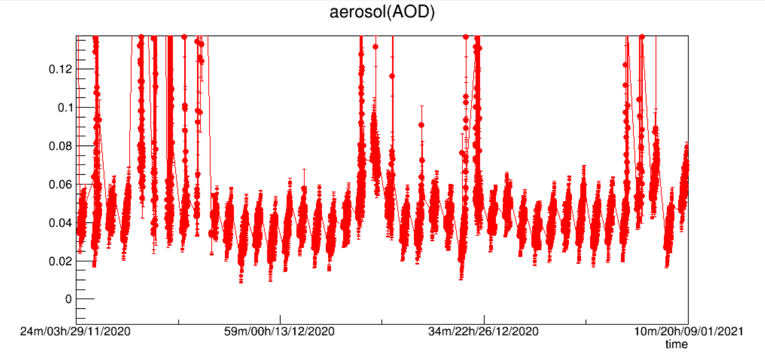
Non-Rayleigh Scattering
(only Rayleigh)
@380nm

Slide 13
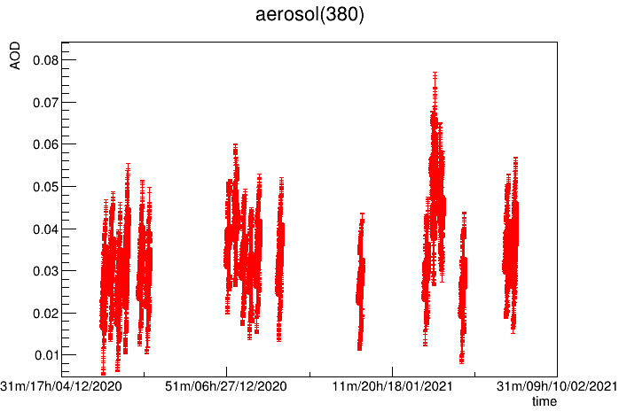
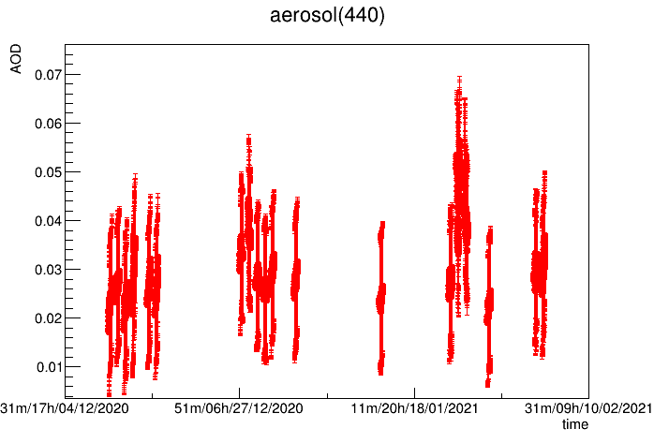
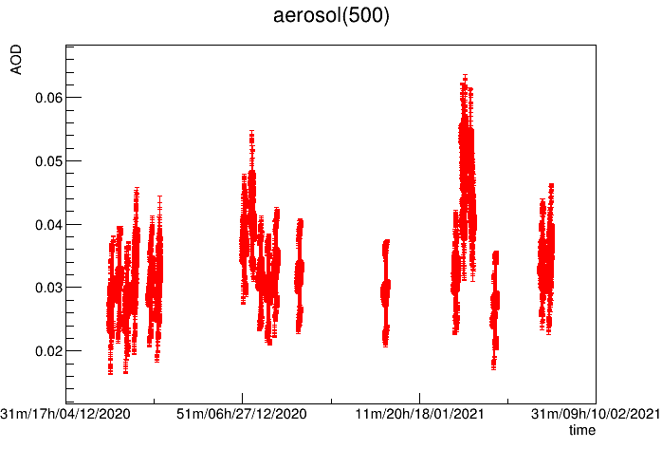
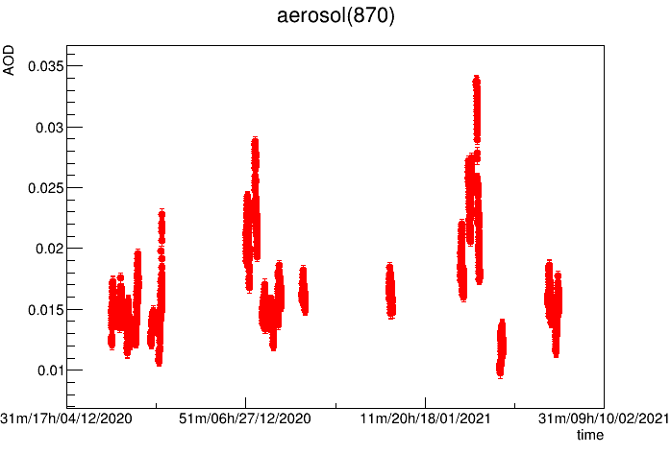
AOD VS time at different wavelength
380nm
440nm
AOD from 0.01 to ~ 0.07
500nm
870nm

Slide 14
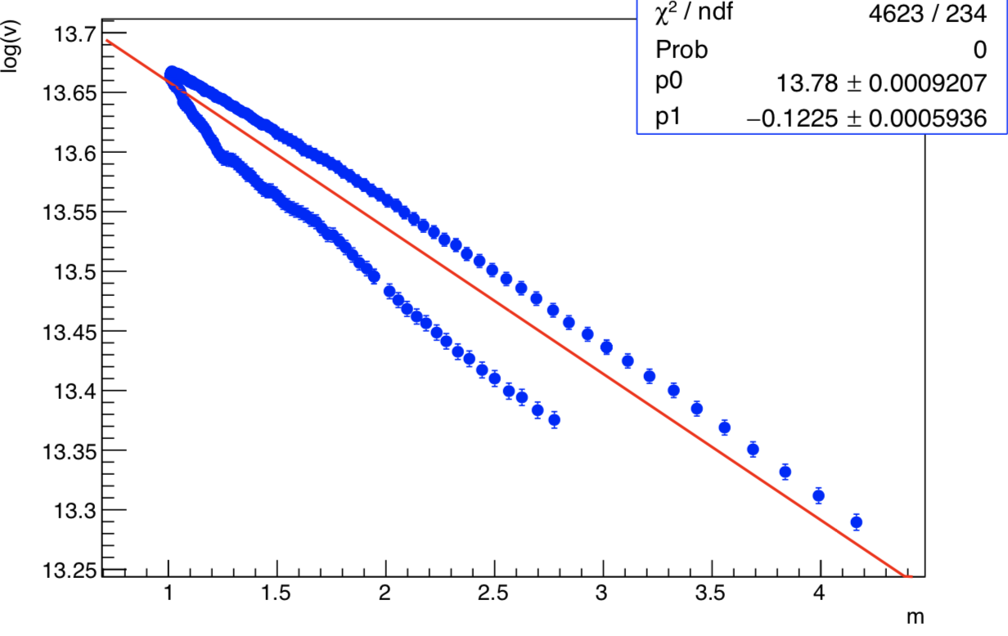
Moon data from CE-318
moon light is changing through one night

Slide 15
Summary on Aerosol measurement
Aerosol optical depth was measured with CE-318. It is about 0.01~0.07 in clear day
Next plan
correlate the AOD measurement with related variables (wind speed, IR temperature, …)
measure AOD in the night
compare AOD with laser data of WFCTA

