Slide 1
Search for Dark Matter with LHAASO
李文龙 贾康 祝成光
SHANDONG UNIVERSITY
2021-04-26

Slide 2
outline
Introduction
Analysis strategy
Summary

Slide 3
Introduction
A promising method for identifying Dark Matter (DM):
Gamma rays from the annihilation or decay of dark matter particles
Ideal observation target: Dwarf Spheroidal satellite galaxies (dSphs)
1. Large galactic DM substructures with high DM densities
2. Almost background-free
LHAASO Advantages:
1. Strong cosmic-ray rejection power
2. Large Field of view covering more than 19 dSphs
3. High sensitivity of gamma-ray detection and covering large Energy Range

Slide 4
Theoretical support
Estimating WCDA one year data
Combined 19 dSphs in Field of view
Select Five final decay states
Estimate sensitivities of DM Life && Annihilation cross section
References:
D.-Z. He, X.-J. Bi, S.-J. Lin, P.-F. Yin, and X. Zhang, “Prospect for dark matter signatures from dwarf galaxies by LHAASO,” Phys. Rev. D 100, (2019) 083003, arXiv:1903.11910 [astro-ph.HE].
Dong-Ze He, Xiao-Jun Bi, Su-Jie Lin, Peng-Fei Yin, Xin Zhang, “Expected LHAASO sensitivity to decaying dark matter signatures from dwarf galaxies gamma-ray emission,” Chinese Physics C Vol. 44, No. 8 (2020) 085001, arXiv:1910.05017

Slide 5
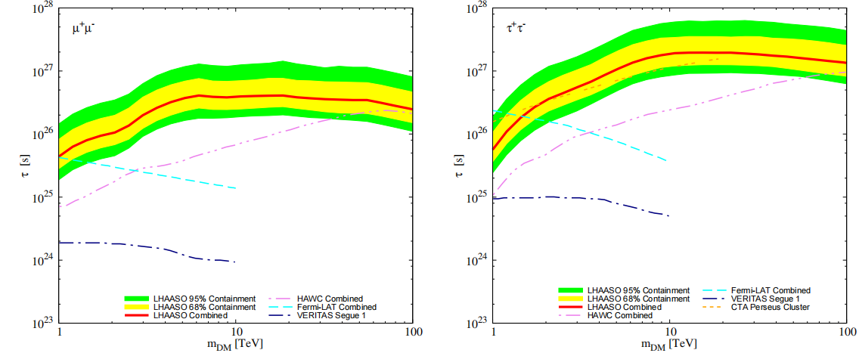
DM Life Estimation

Slide 6
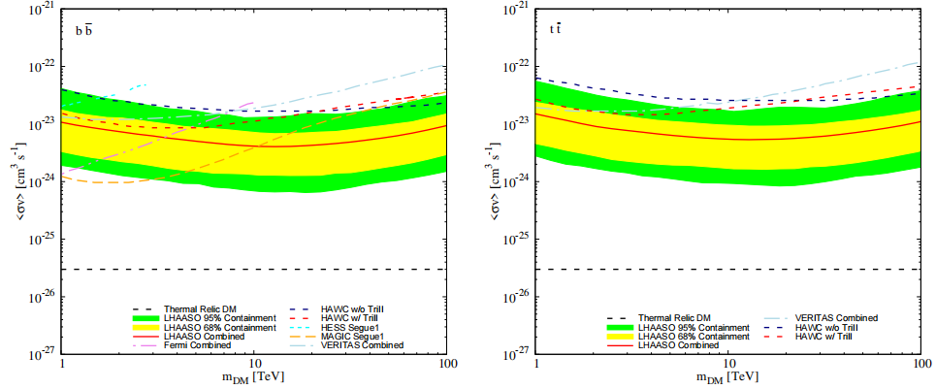
Annihilation Cross Section Estimation

Slide 7
Motivation
For almost all channels at the DM mass over 10TeV ，LHAASO sensitivities are better than other current experiments
μ⁺μ⁻ and $τ^{+}τ^{−}$ channels LHAASO shows excellent sensitivities for mass above 1TeV
LHAASO is more advantageous on observing high-latitude sources (major contribution to combined sensitivities)
LHAASO-KM2A
Expending the Energy Range
Increasing the statistics
More powerful on cosmic-ray rejection

Slide 8
Analysis strategy
Statistical method
On-Source Data
Off-Source Data to estimate Background Data
Signal Model

Slide 9
Statistical method: Profile likelihood-ratio tests
Construct likelihood function based on Poisson distribution for all energy bins
Profile likelihood ratio to test a hypothesized value of μ $0<λ(μ)<1$
Test statistic: discriminate the data over the hypothesis
To quantify the level of disagreement， define the p-value
For significance:
Calculate bkgd Rejection power
For sensitivity : 95% confidence $p_{μ}=0.05$
Calculate the signal upper limits μ

Slide 10
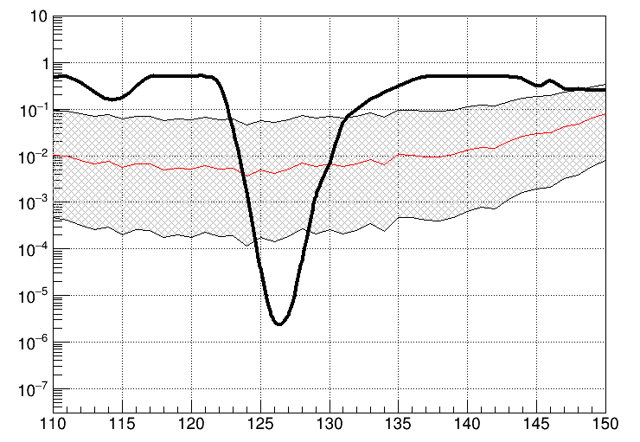
Method Validation
The Method realized in RooFit package
Validation with Higgs Search Data and the result is consistent
Reference：The ATLAS Collaboration,”Observation of a new particle in the search for the Standard Model Higgs boson with the ATLAS detector at the LHC”,Phys.Lett. B716 (2012) 1-29,arXiv:1207.7214

Slide 11
On-Source Data && Background Data
On-Source Data: gamma-rays from the On-Source Area.
Select the major contribution dwraf galaxies.
Based on the galaxy charactors to decide view angle
Off-Source Data: gamma-rays from surrounding the On-Source area.
method of Scaling Background Data and On-Source Area
Considering Cosmic rays are uniform in small scale
Scaling the Cosmic rays of Off-Source Area to On-Source area to obtain the Background Data

Slide 12
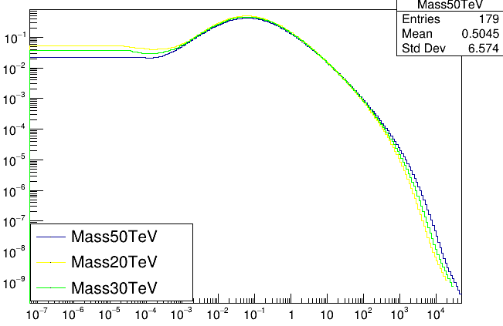
Theoretical Signal model
Theoretical Signal Data: Theoretical Signal Model && Effective observation time t_{effect}
Theoretical signal model can be got by PPPC4DM package
Getting the dNγ/dEγ distribution from PPPC4DM with final channel and Dark Matter mass
Signal Events emitted from Source galaxy
Decay:
Annihilation:
ttbar
$$Φ×teffect$$

Slide 13
Signal Model modification
Considering Energy Resolution of KM2A
Considering Detection efficiency over Energy and Zenith Angle

Slide 14
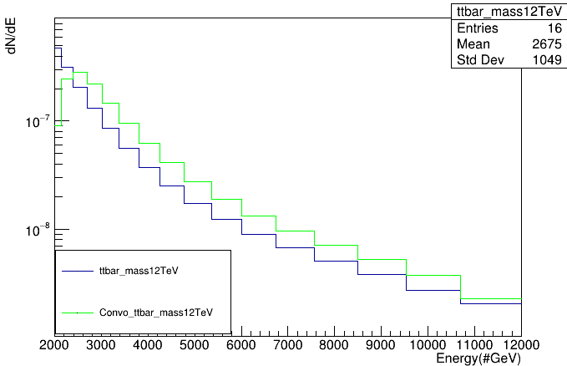
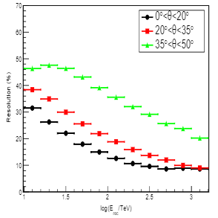
Signal Model smearing
Energy Resolution
Energy resolution depends on Energy and Zenith angle
Smearing the Theoretical Signal model with different Energy and Zenith angle
Method : Convolution different Gaussian distribution at different Energy

Slide 15
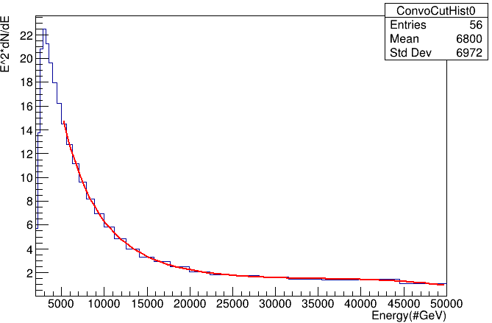
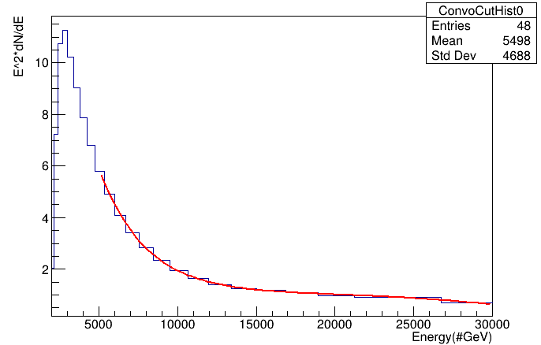
Signal Modelling
New Energy Spectrum Distribution constructed for convenient Fitting work
A Parameter of E² is multiplied into the formula
Fitting the new distribution with expo+pol3 function
DM mass 50TeV 0<Zen<20
DM mass 30TeV 0<Zen<20

Slide 16
Relative Detection Efficiency By Data
The Detection Efficiency depends on Energy and Zenith angle.
To Calculate the relative efficiency at different energy range and angle, We select the gamma-rays from Crab Nebula (Ras: 83.63, Dec: 22.02)
Calculate Method:
The flux from the crab are constant.
counting the Gamma Events from Crab at different Energy and Zenith Angle
scaled by the effective Observation time
scaled by the Effective Detection Area
efficiency at different energy and angle is proportional to the scaled number of event.
Data Selection situation
Data Zenith angle | 0-50°
Data Collection Time | Year 2020
Data Source | View Angle <1 degree

Slide 17
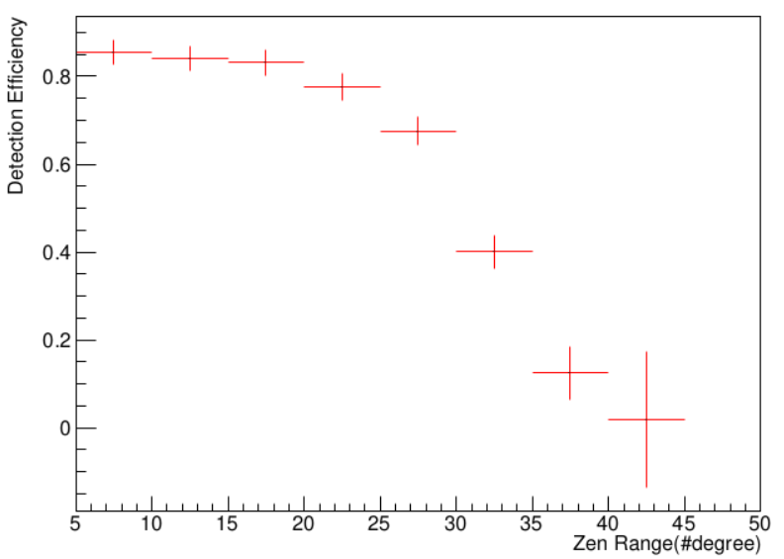
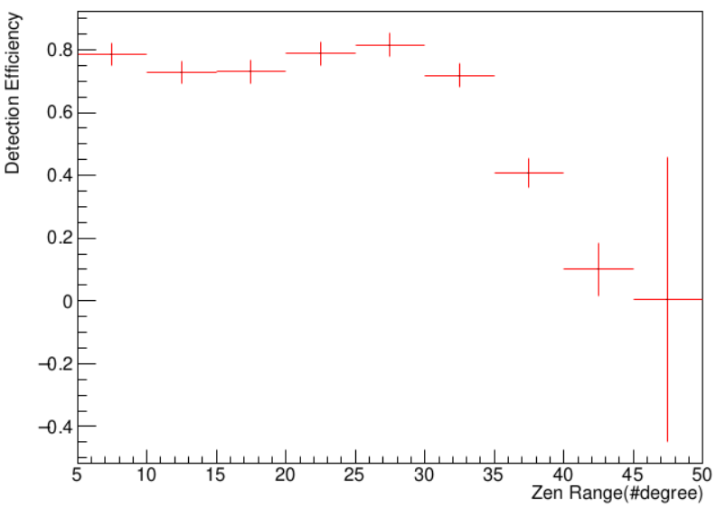
Scaling relative Efficiency by MC
Calculating the absolute Detection Efficiency by MC Data
Selecting zenith angle range
Scaling the relative Detection Efficiency
12.5-15.8TeV
10-12.5TeV

Slide 18
Summary
Further work on the signal model modification
Apply the results to analysis and plot the sensitivity distribution

Slide 19
THANKS

Slide 20
BackUp
Example:
On-Source Area is 1degree view angle of target galaxy
Off-Source Area is 1-3 degree view angle of target galaxy

Slide 21
BackUp

Slide 22
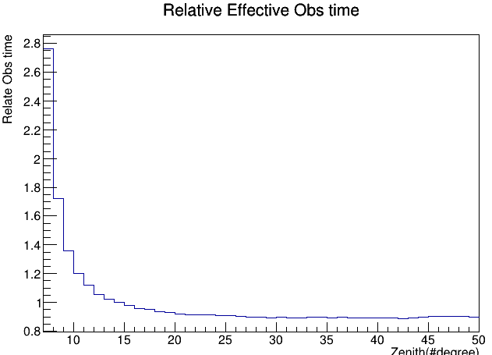
BackUp
Events | (7,10) | (10,15) | (15,20) | (20,25) | (25,30) | (30,35) | (35,40) | (40,45) | (45,50) | Zen range
1.0-1.1 | 519 | 454 | 410 | 357 | 339 | 163 | 50 | 12 | 0
1.1-1.2 | 257 | 197 | 178 | 192 | 186 | 169 | 94 | 29 | 1
1.2~ | 168 | 153 | 130 | 138 | 136 | 185 | 171 | 107 | 21
log(E/TeV)
Cut: age>0.6&&age<2.4&&r_Theta*57.29>0&&r_Theta*57.29<50&&Incut>0&&density>-1 &&NtrigE>19&&NfiltE>10&&NuM4>=0&&NpE3>=10&&NhitM>10&&chi<31.62&&NpE1>2.*NpE2

Slide 23
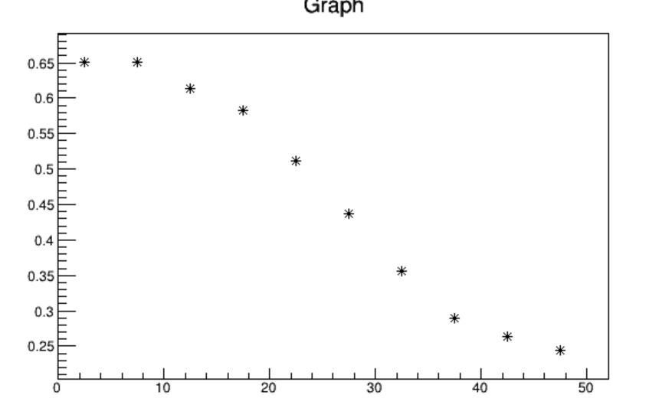
Scaling relative Efficiency by MC Data
The absolute Detection efficiency:
the figure shows successful Reconstruction with right Information
Effi
Energy range :10-12.5TeV
Zen angle(#degree)

Slide 24
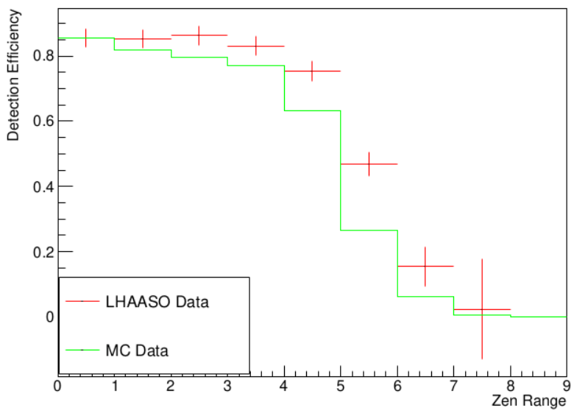
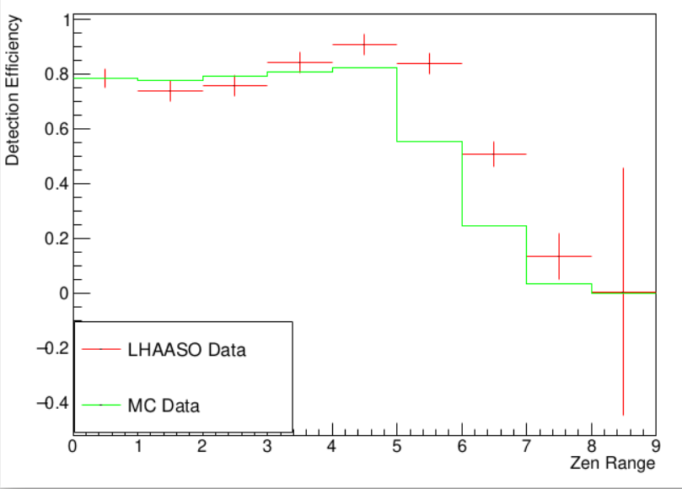
Scaling relative Efficiency by MC
1.0-1.1
1.1-1.2

