Slide 1
Conceptual design of HTS final focus quadrupole coils in CEPC Interaction Region
Yingshun Zhu, Chuang shen
Institute of High Energy Physics, Chinese Academy of Sciences
December 28, 2020
CEPC working day

Slide 2
Outline
Introduction of HTS quadrupole magnet
Conceptual design of HTS final focus quadrupole coils in CEPC IR
1) Cos2θ coil
2) CCT coil
3) Racetrack coil
Summary

Slide 3
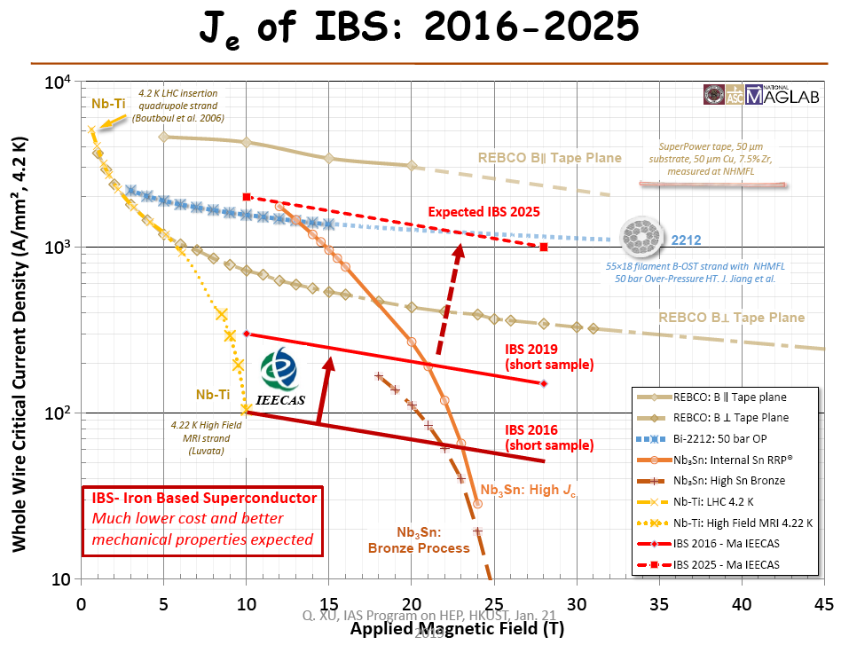
Introduction of HTS quadrupole magnet
HTS conductor: Bi-2212 (Tc 80K), Bi-2223, YBCO (Tc 92K), MgB2, IBS…

Slide 4
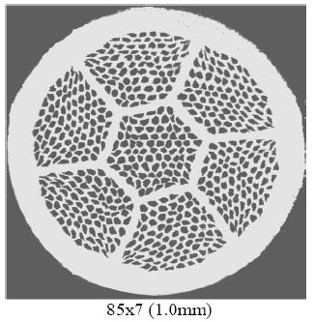
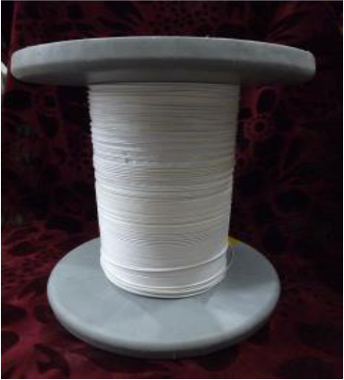
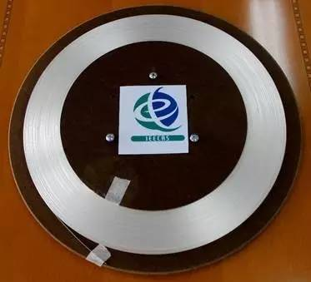
Introduction of HTS quadrupole magnet
Bi-2212
YBCO
IBS

Slide 5
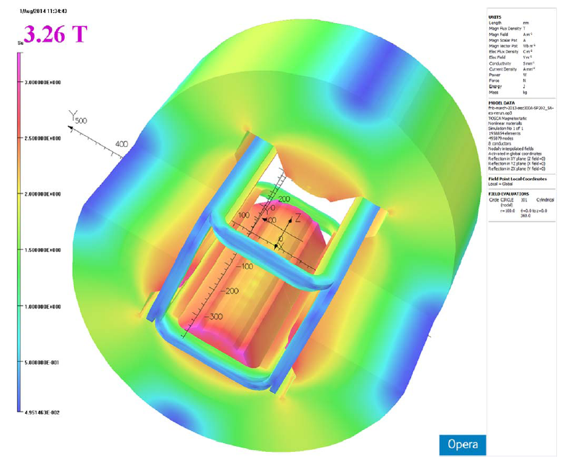
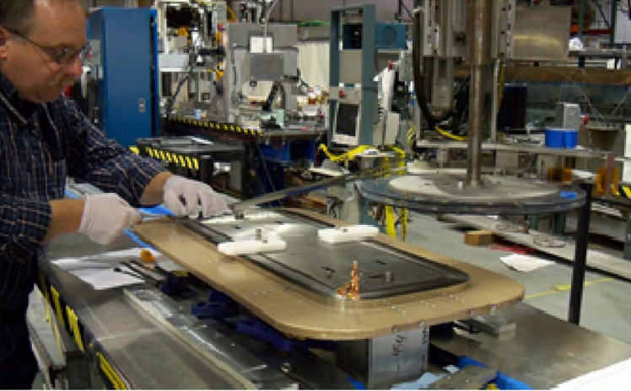
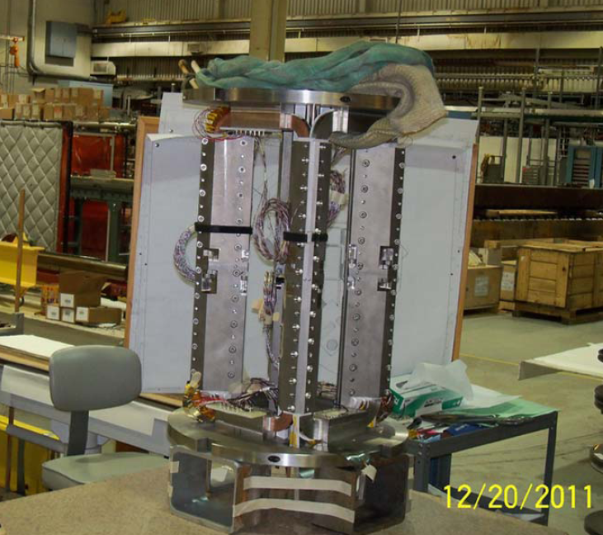
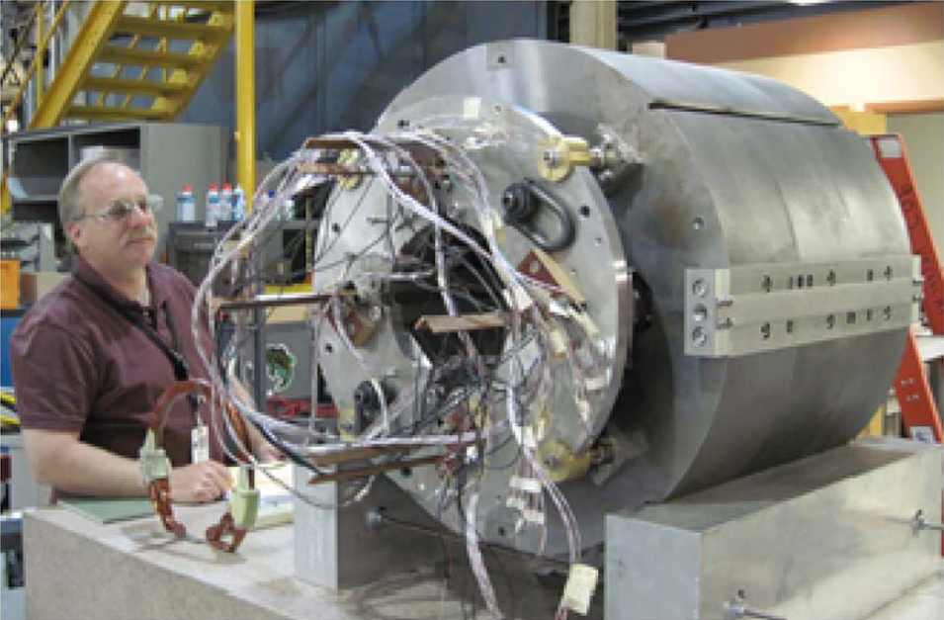
HTS quadrupole magnet R&D in the world
HTS Quadrupole for FRIB: Racetrack coil (BNL, 2015, ∅220mm, G:15T/m, 2G tape)

Slide 6
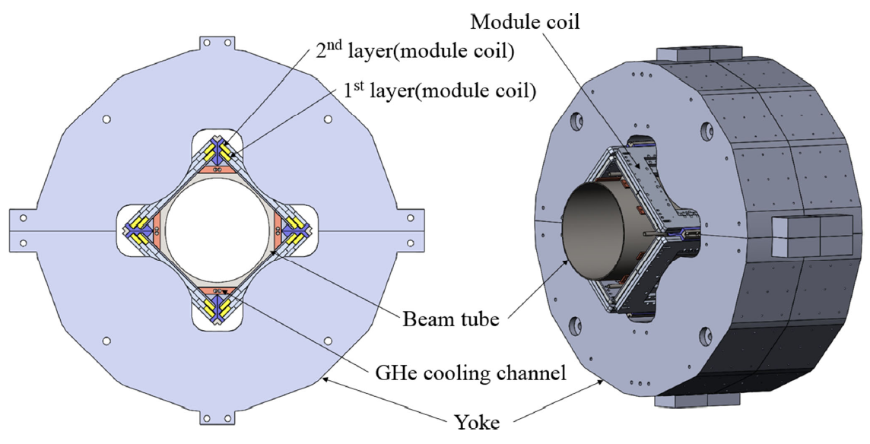
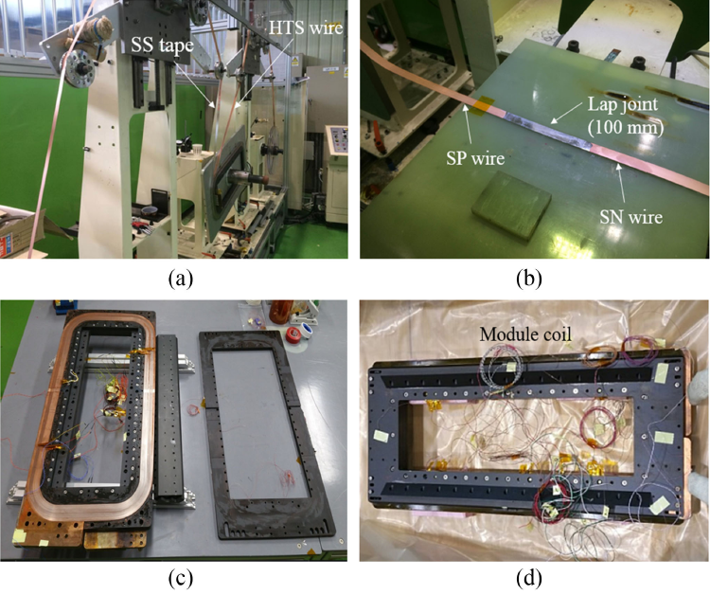
HTS quadrupole magnet R&D in the world
Prototype HTS Quadrupole of RISP：Racetrack coil (Korea, 2018, ∅300mm, G: 9T/m, 2G tape)

Slide 7
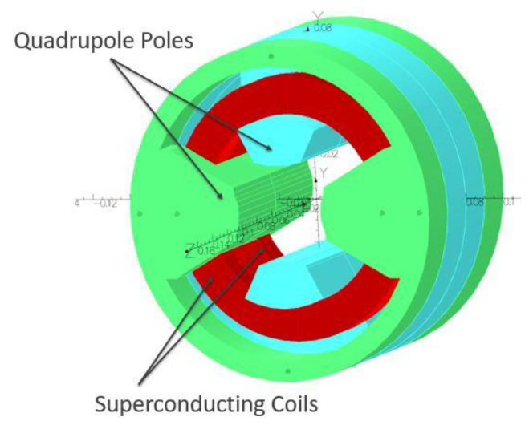
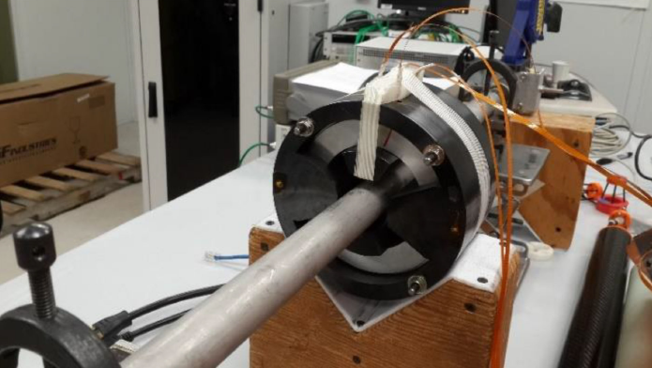
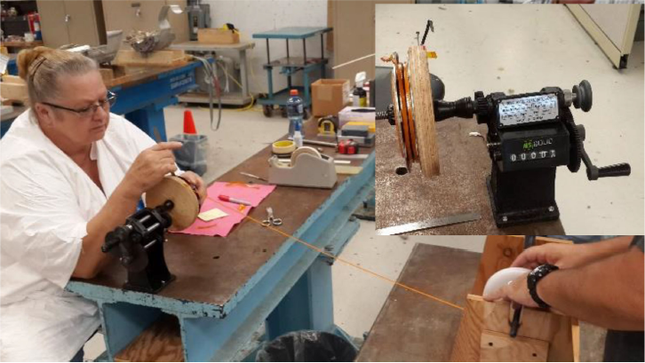
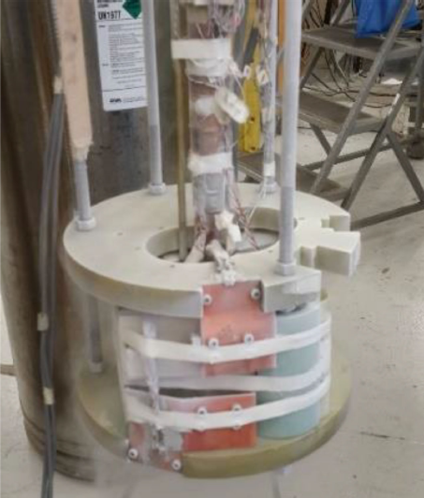
HTS quadrupole magnet R&D in the world
Prototype HTS Quadrupole With Circular Coils (Fermilab, 2019, coil ∅100mm, G: 8.7T/m, 2G tape)

Slide 8
Conceptual design of HTS final focus quadrupole coils in CEPC IR
The requirement of the CEPC double aperture Final Focus quadrupoles is recently updated for high luminosity with L*=1.9m.
Table 1: Updated Requirements of final focus quadrupole magnets for Higgs
Magnet | Central field gradient (T/m) | Magnetic length (m) | Width of GFR (mm) | Minimal distance between two aperture beam lines (mm)
Q1a | 141 | 1.21 | 15.21 | 62.71
Q1b | 84.7 | 1.21 | 17.92 | 105.28
Q2 | 94.8 | 1.5 | 24.14 | 155.11

Slide 9
Conceptual design of HTS final focus quadrupole coils in CEPC IR
Design considerations
The field gradient of quadrupoles is stronger compared to that in CDR, and the available bore space for the coil is smaller.
The development of Q1a is the most challenging.
Design of quadrupoles and anti-solenoid is similar to that in CDR.
Corrector coils will be inside the bore of Q1b and Q2 quadrupole coil.
Iron yoke is used to eliminate the field crosstalk between the two apertures.
Center Be pipe: diameter 28mm; Inside quadrupole, beam pipe diameter is around 17mm or 18 mm.

Slide 10
Conceptual design of HTS final focus quadrupole coils in CEPC IR
Feasibility of HTS superconducting magnet technology is being considered for CEPC IR superconducting magnets.
Both HTS round wire and tape are considered.
Advantage: Large critical current (expected), light weight of magnet
heat load resistant
High operating temperature.
Disadvantage: HTS conductor not mature now, expensive
Poor mechanical properties
HTS coil manufacture needs heat treatment
Large diameter of superconductor filament or layer.

Slide 11
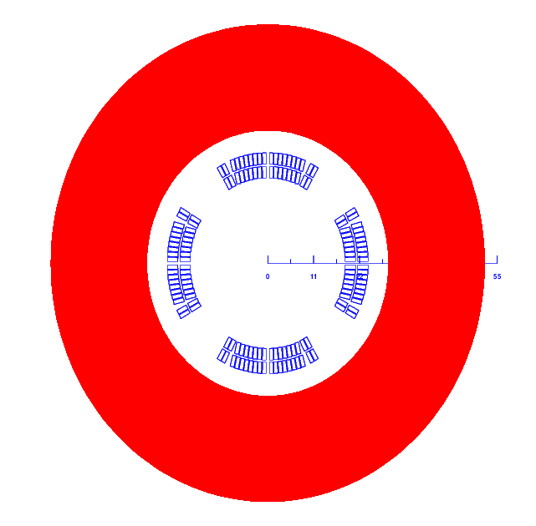
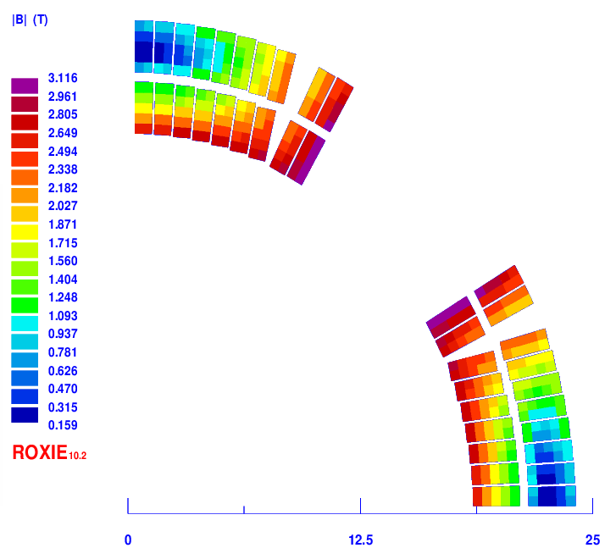
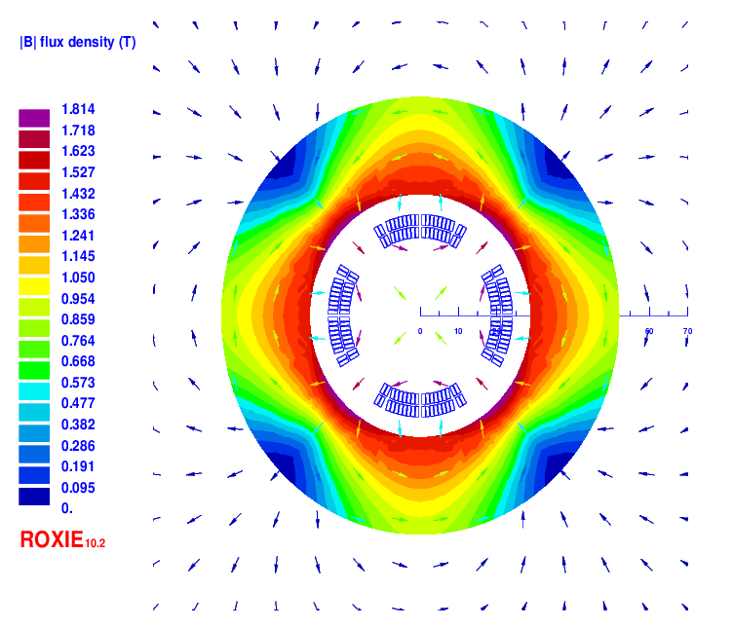
Conceptual design of Q1a for high luminosity with L*=1.9m
1) Cos2θ option of Q1a
HTS round wire is used. HTS Bi-2212 0.5mm wire or other conductor.
The design of Q1a is based on two layers cos2θ quadrupole coil using Rutherford cable with iron yoke. The inner diameter of the coil is 37mm.
Single aperture cross section is optimized with four coil blocks in two layers separated by wedges, using ROXIE.
The width of the cable is 2.5mm, and there are 19 turns in each pole.
The excitation current of Q1a is 1970A, and each multipole field in single aperture is smaller than 1×10⁻⁴.
2D model (single aperture)
Magnetic flux density distribution

Slide 12
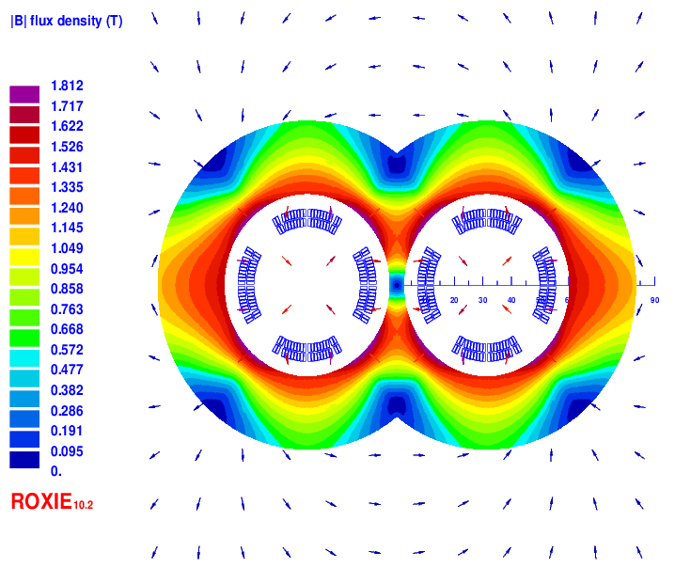
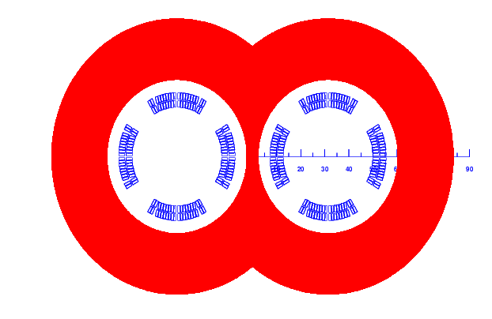
Cos2θ option of Q1a
Field cross talk of the two apertures
2D field cross talk of Q1a two apertures near the IP side, where the distance between two aperture centerlines is minimum.
Iron yoke width in the middle is very limited; the field harmonics as a result of field crosstalk is smaller than 0.5×10⁻⁴.
The dipole field in each single aperture as a result of field crosstalk is smaller than 5 Gs. Magnetic field cross talk between two apertures is negligible.
Double aperture model
2D Flux lines

Slide 13
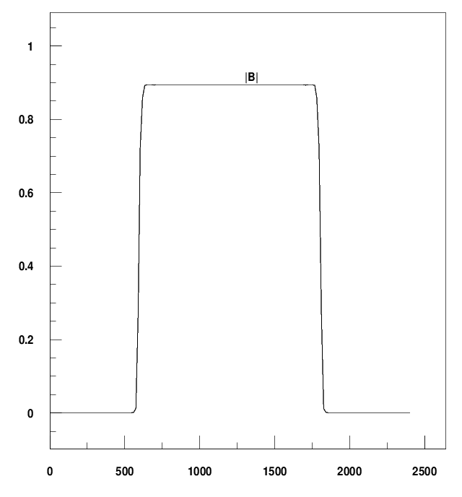
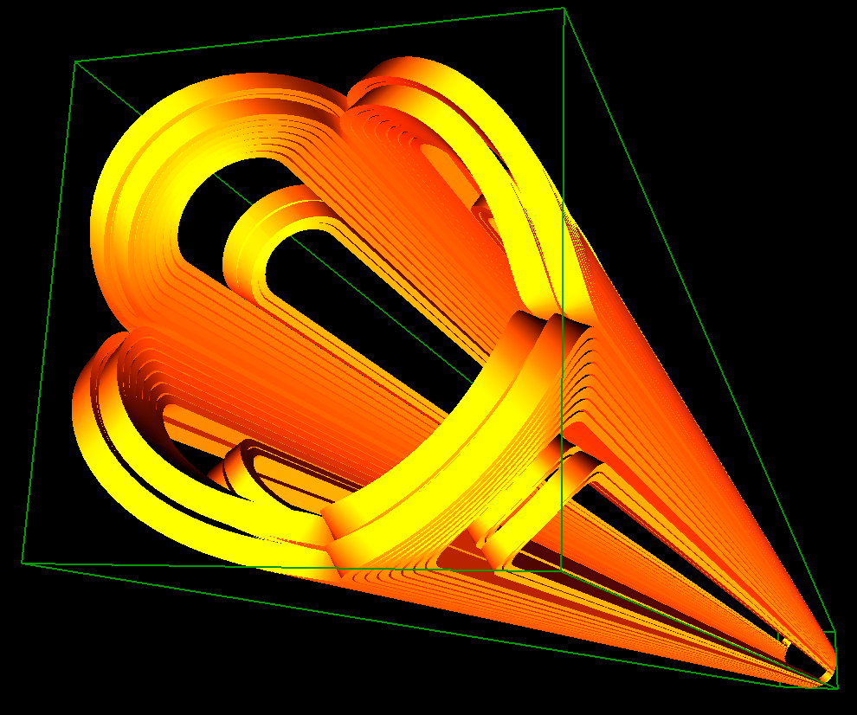
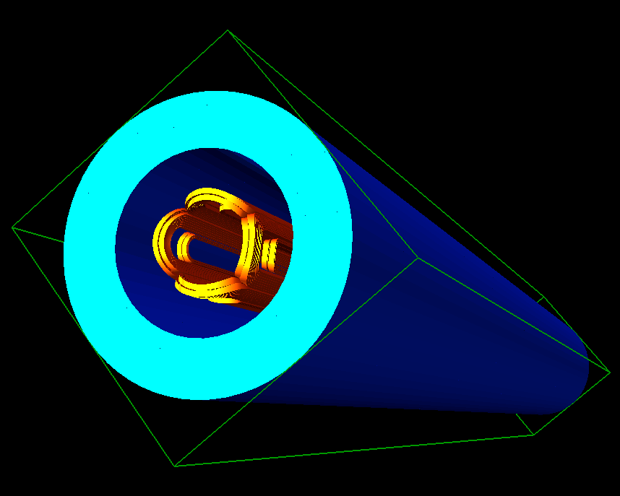
Cos2θ option of Q1a
3D design of Q1a
3D magnetic field is modeled and analysed using ROXIE.
Coil end detailed shaped is optimized and determined.
Field gradient 142T/m, each integrated field harmonics is smaller than 1×10⁻⁴.
The 3D magnetic field performance meets requirement.
Single aperture model in 3D

Slide 14
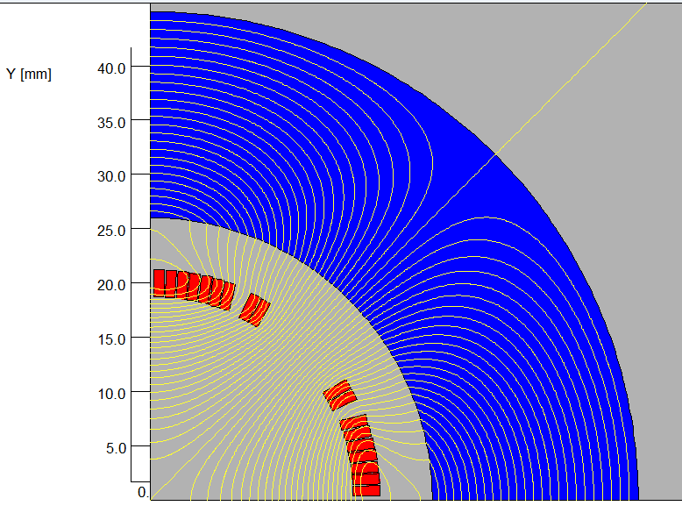
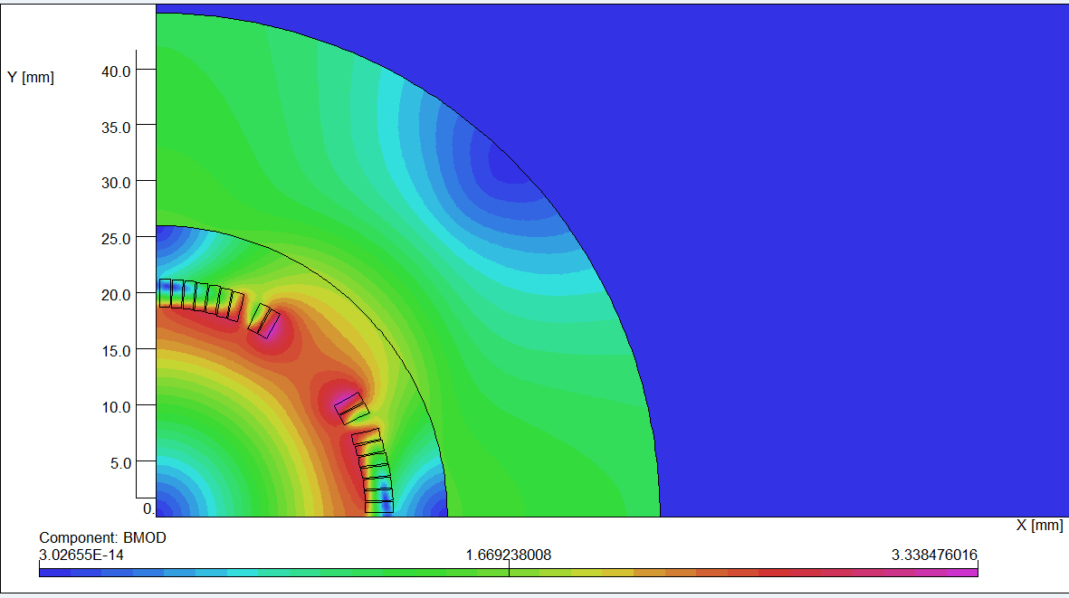
Cos2θ option of Q1a
One layer Cos2θ option of Q1a
One layer cos2θ quadrupole coil is used to reduce the magnet weight.
High current carrying capacity is assumed.
HTS round 0.5mm Bi-2212 or other conductor.
One layer, two coil blocks using Rutherford cable with iron yoke. The inner diameter of the coil is 37mm.
The width of the cable is 2.5mm, and there 9 turns in each pole.
The excitation current of Q1a is 3585A, and each multipole field in single aperture is smaller than 1×10⁻⁴.
2D model (single aperture)
Magnetic flux density distribution

Slide 15
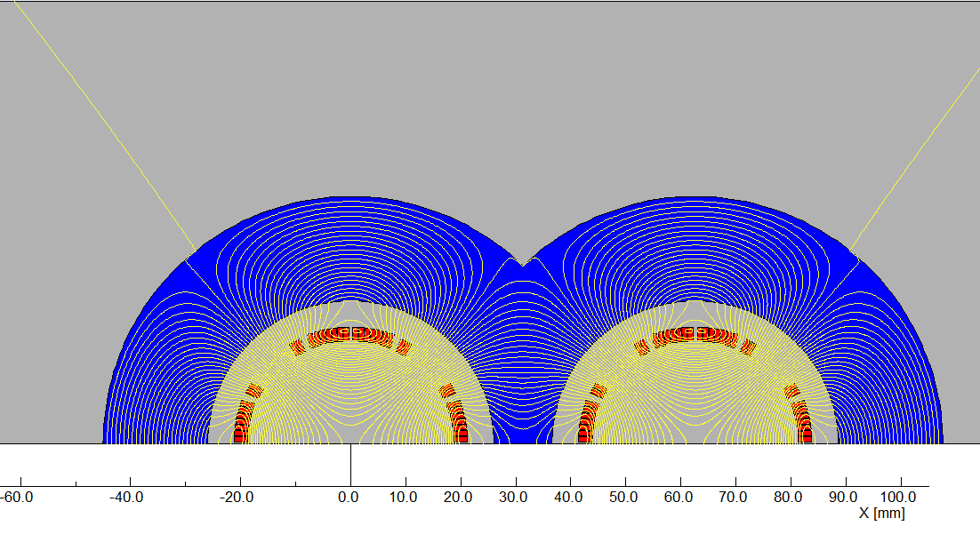
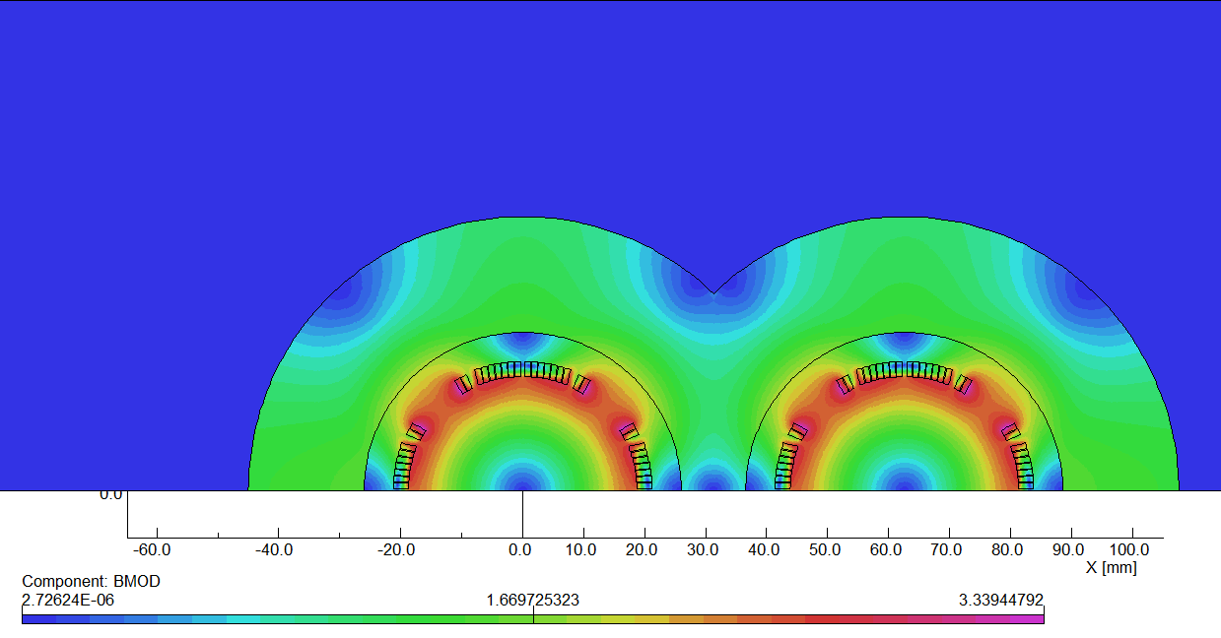
One layer Cos2θ option of Q1a
Field cross talk of the two apertures
2D field cross talk of Q1a two apertures near the IP side.
Iron yoke width in the middle can be larger; the field harmonics as a result of field crosstalk is smaller than 0.5×10⁻⁴.
The dipole field in each single aperture as a result of field crosstalk is smaller than 5 Gs. Magnetic field cross talk between two apertures is negligible.
Comparison of magnet weight: Using one layer coil, the Q1a magnet weight can be reduced by about 33% (120kg 80 kg) .
Double aperture model
2D Bmod

Slide 16
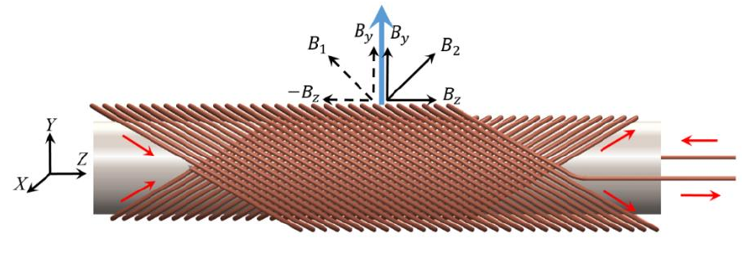
Conceptual design of Q1a for high luminosity with L*=1.9m
2) CCT option of Q1a
CCT : Canted cosine theta
The CCT design is based on a pair of conductors wound and powered such that their transverse field components sum up and their solenoid fields cancel.
In practice, the conductor is wound on a pre-cut groove in a supporting hollow cylinder or mandrel.
CCT dipole
CCT quadrupole

Slide 17
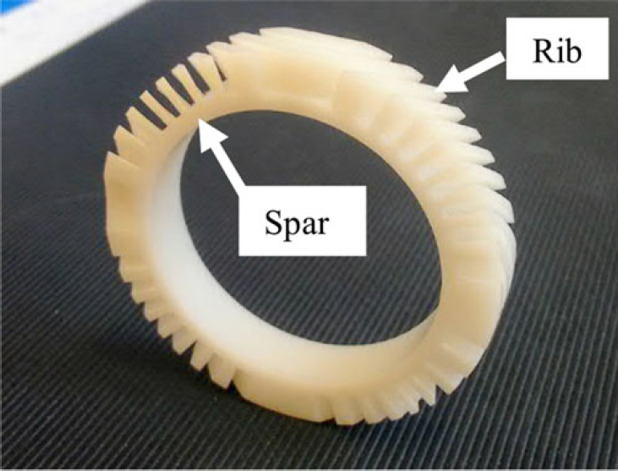
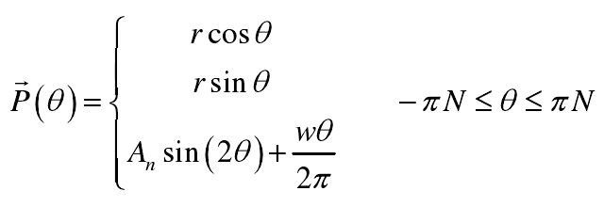
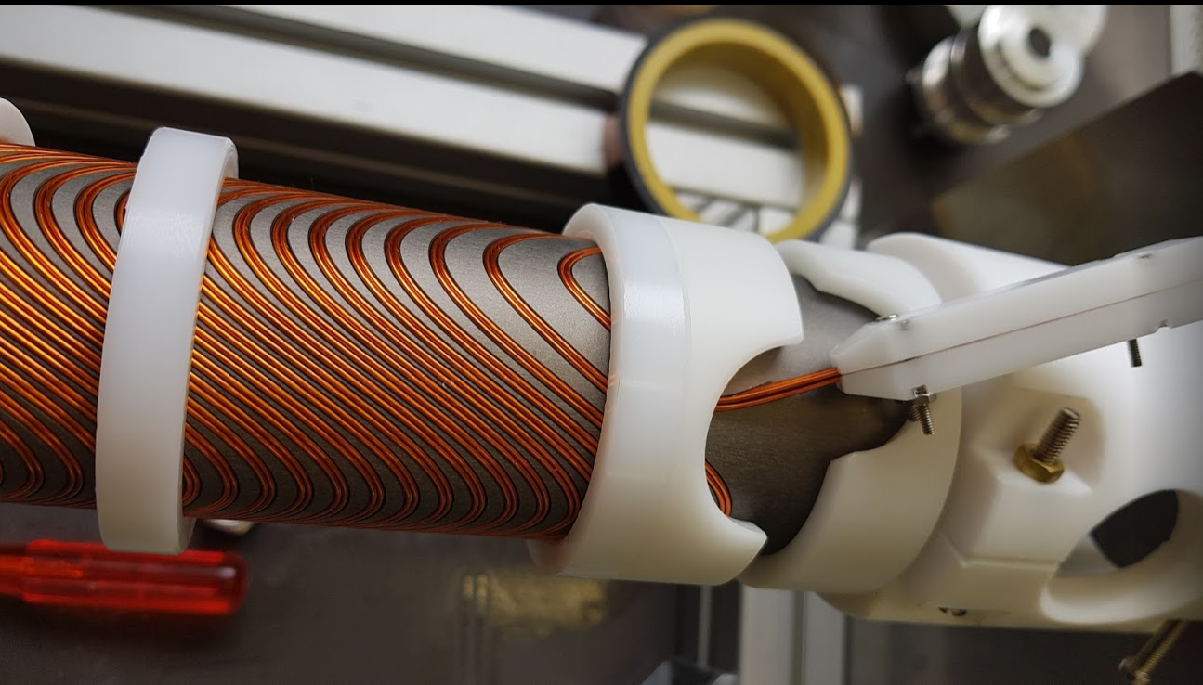
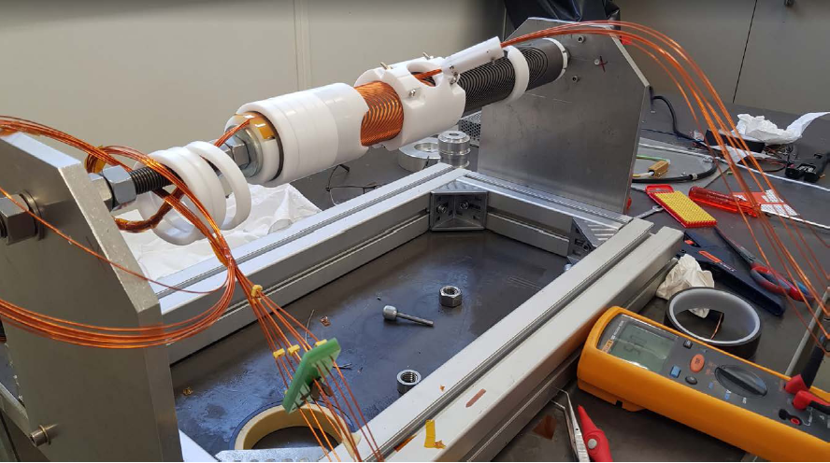
CCT option of Q1a
CCT quadrupole coil

Slide 18
CCT option of Q1a
CCT option of Q1a, conceptual design
HTS Bi-2212 0.8mm round wire or other conductor.
The design of Q1a is based on two layers CCT quadrupole coil. The inner radius of the spar is 18.5mm.
Outer radius of single aperture coil: 29mm.
Groove on the spar: 2×3mm; 6 wires in a groove.
Conductor canted angle: 30 deg
The excitation current of Q1a is 1342A,
Each integrated multipole field in single aperture is smaller than 1×10⁻⁴.

Slide 19
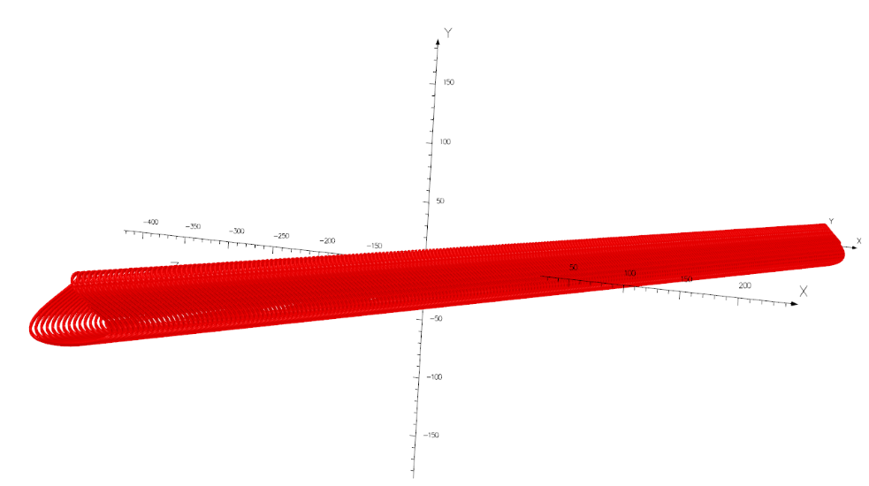
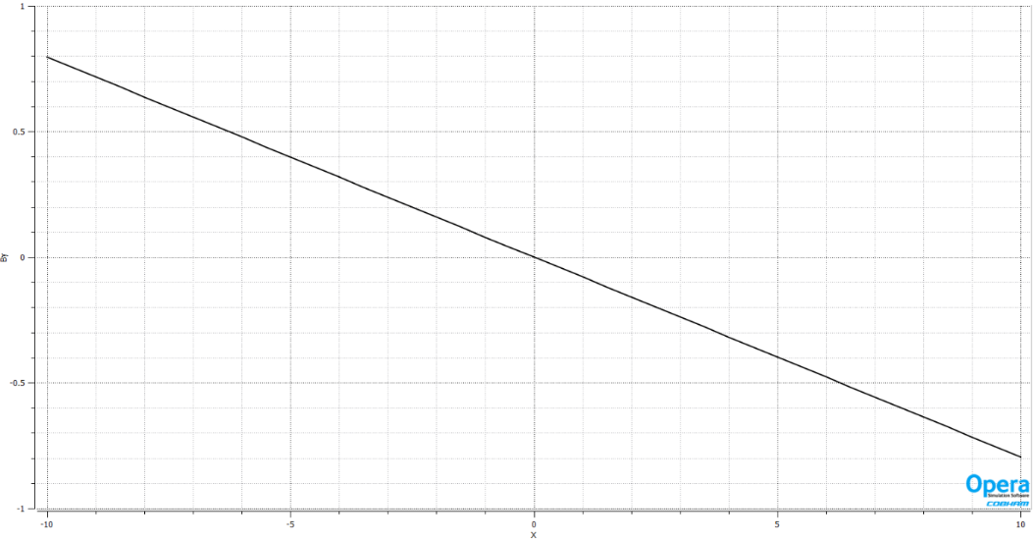
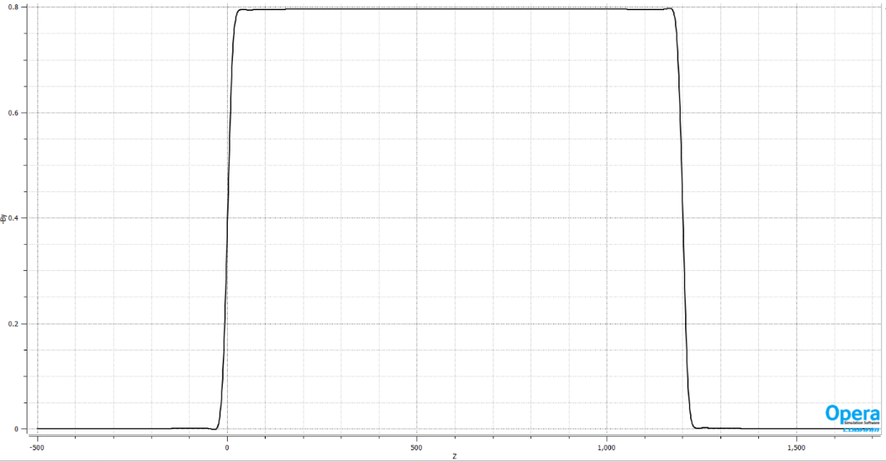
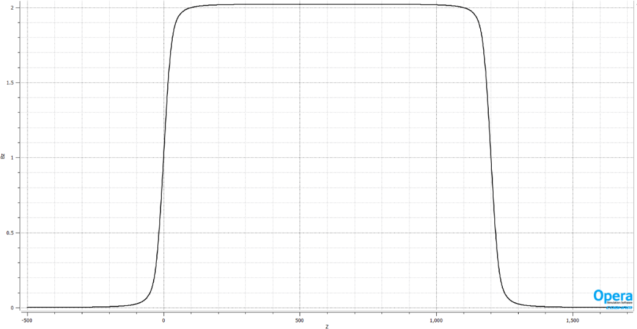
CCT option of Q1a
1st layer CCT coil of Q1a: consists of many small conductors
By along z
Solenoid field along z

Slide 20
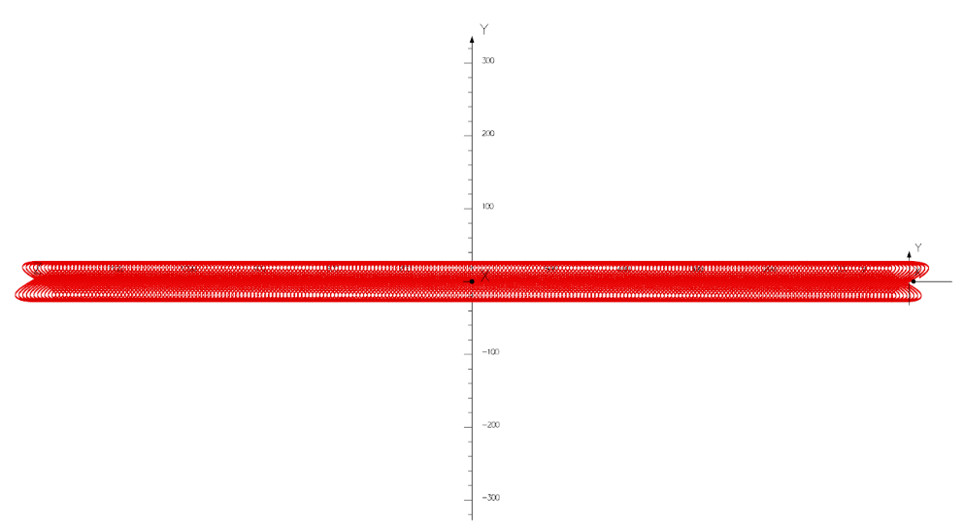
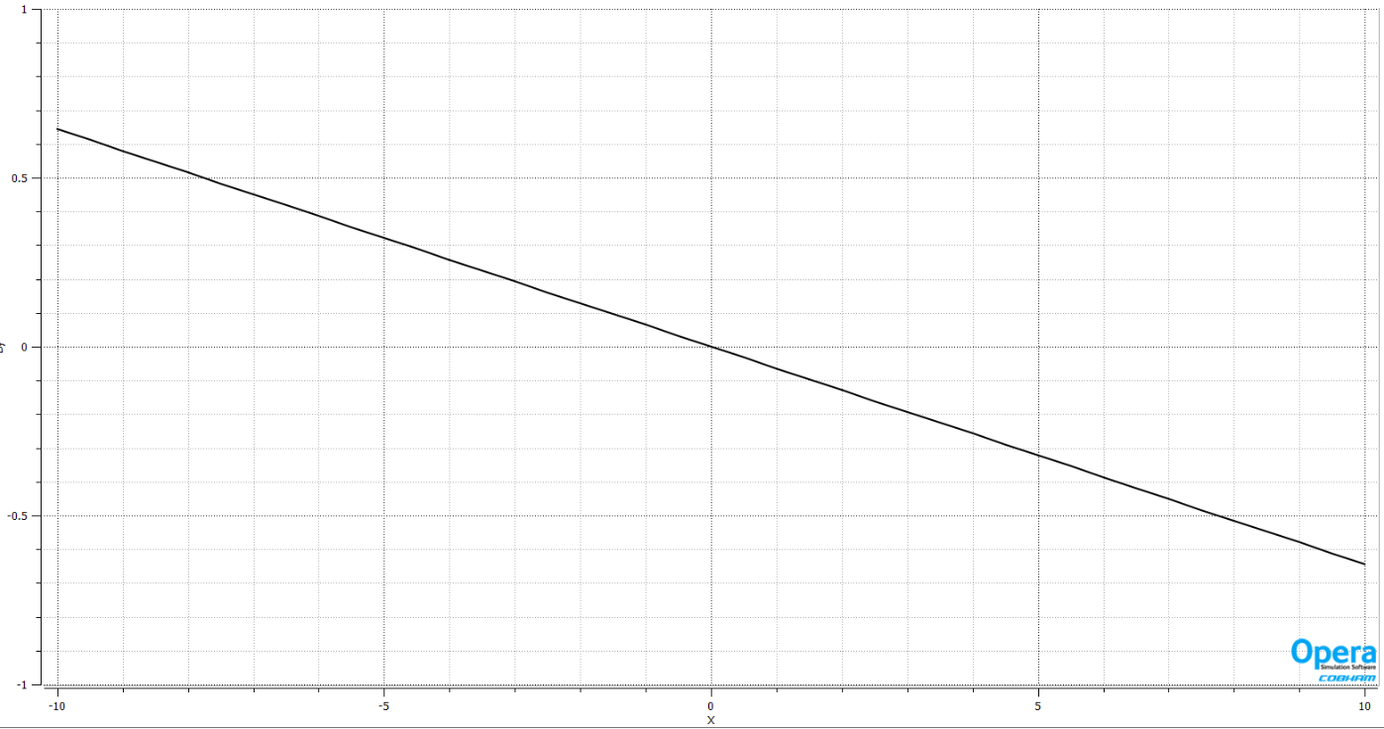
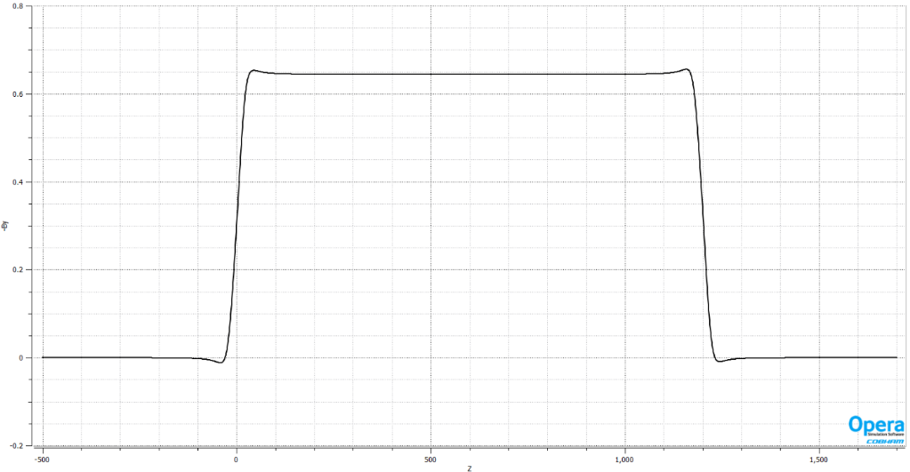
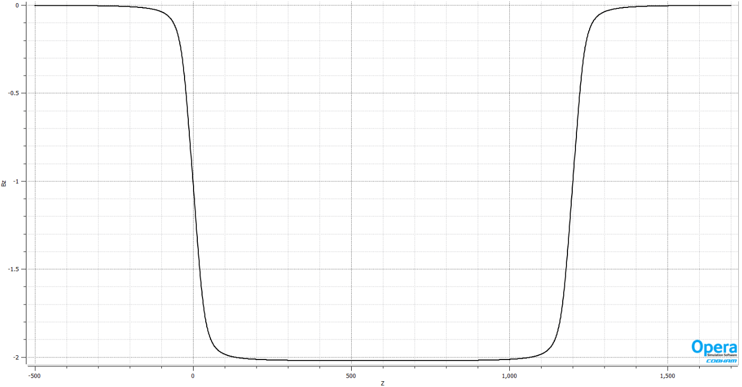
CCT option of Q1a
2nd layer CCT coil of Q1a
By along z
Solenoid field along z

Slide 21
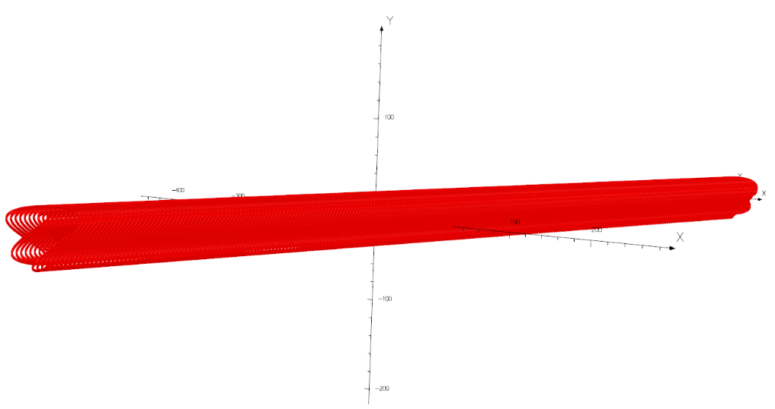
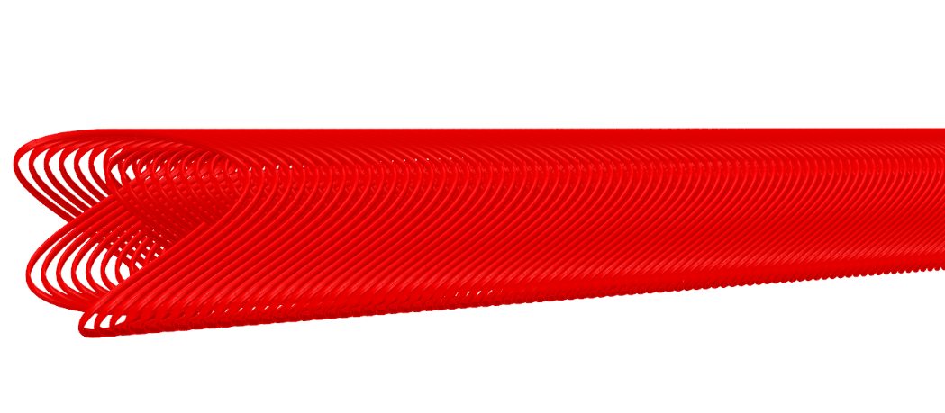
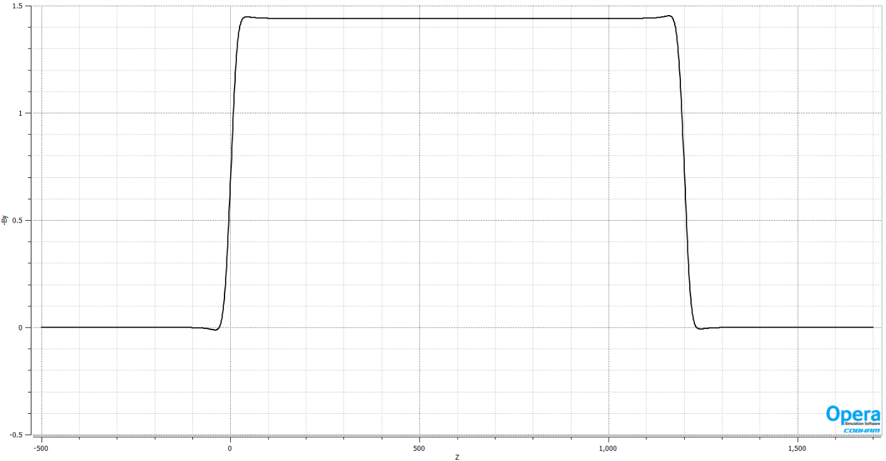
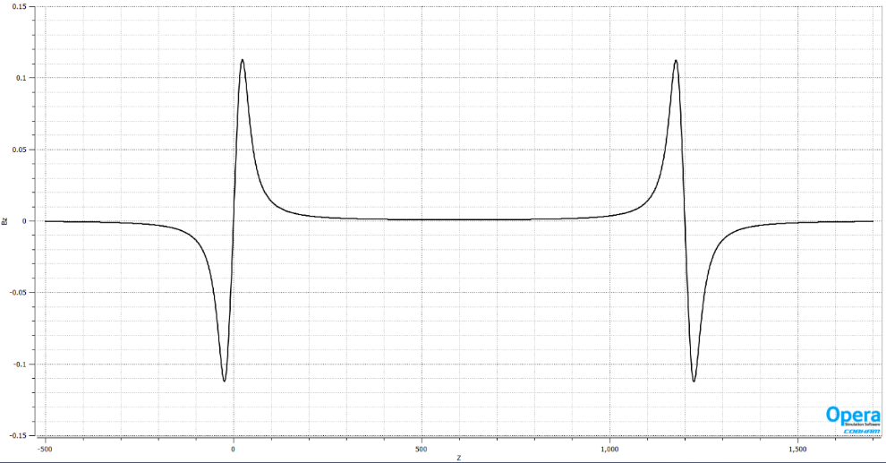
CCT option of Q1a
Double layer CCT coil of Q1a:
Most of the solenoid fields of two layers cancel out.
By along z
Solenoid field along z

Slide 22
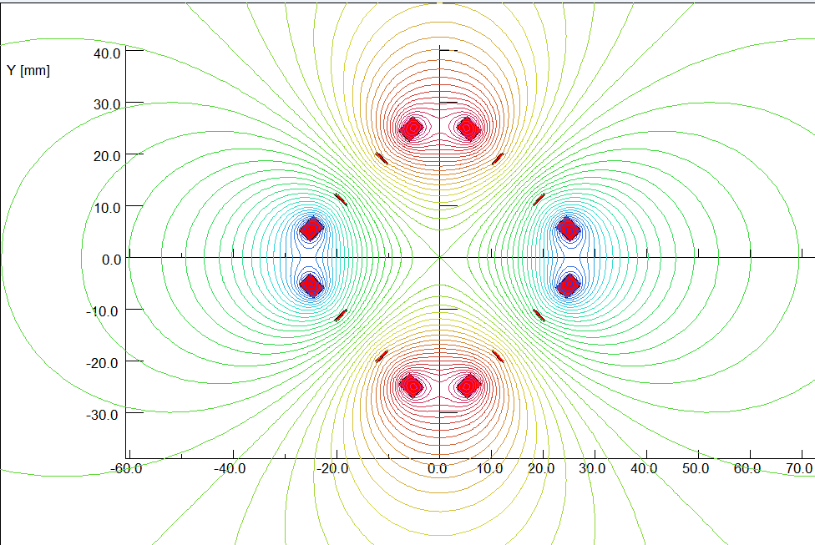
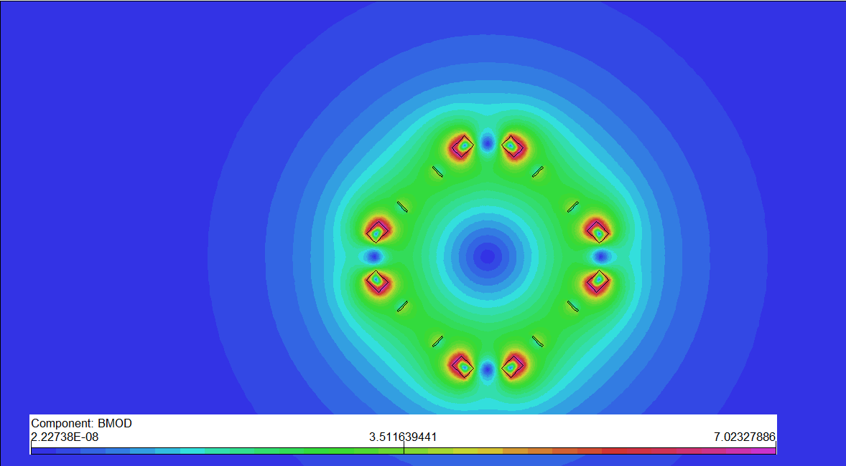
Conceptual design of Q1a for high luminosity with L*=1.9m
3) Racetrack coil option of Q1a
Iron-dominated HTS quadrupole magnet using racetrack coils has been studied and fabricated in the world.
Can coil-dominated HTS quadrupole magnet using racetrack coils work?
( field harmonics around 1×10⁻⁴ ).
Quadrupole coil using racetrack coils for Q1a is optimized. Each multipole field is smaller than 1×10⁻⁴ (b6: -0.5×10⁻⁴; b10: -0.2×10⁻⁴, Rref=7.6mm).
Quadrupole racetrack coils

Slide 23
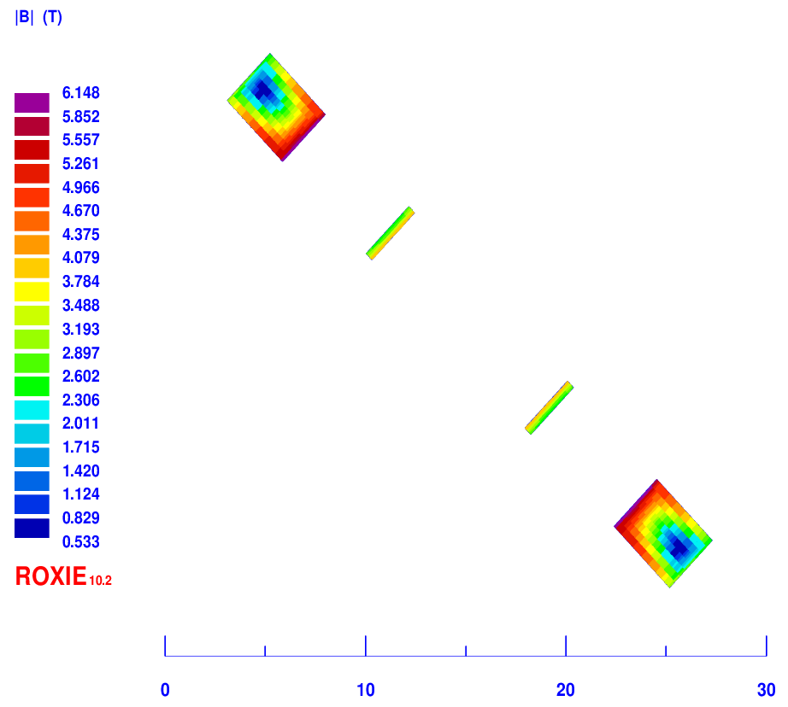
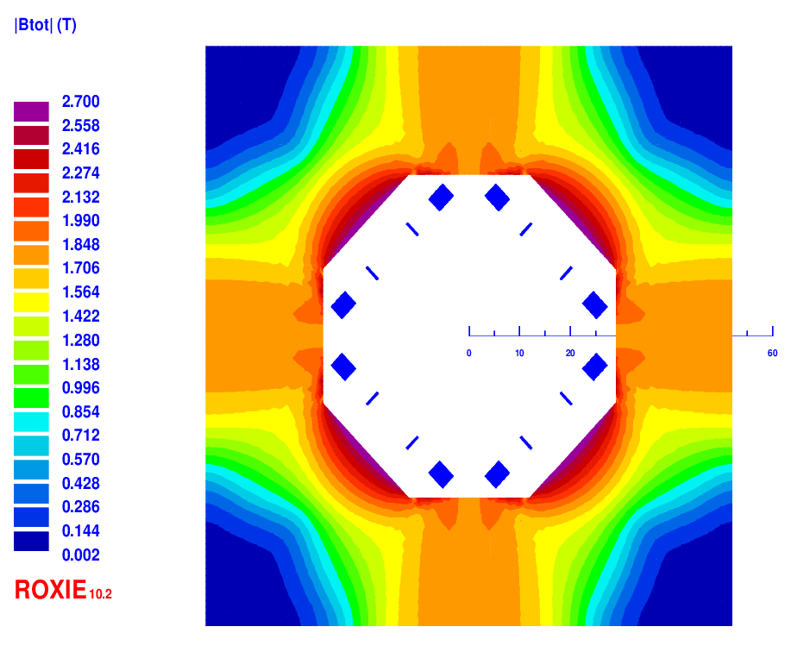
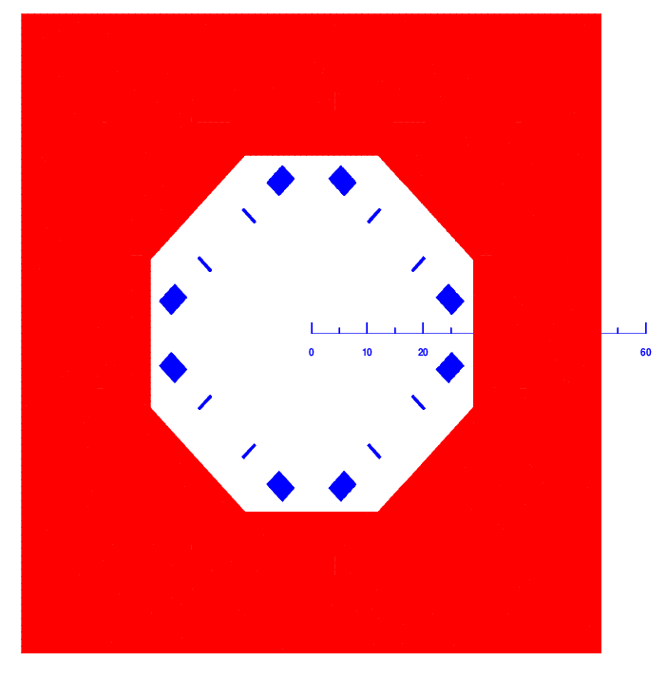
Racetrack coil option of Q1a
Racetrack coil option of Q1a, conceptual design
HTS YBCO tape (width 3 mm, thickness 0.1 mm) or other conductor.
Single aperture field calculation of Racetrack coils with iron
The excitation current of Q1a is 1020A; 43 turns for each pole
Each multipole field in single aperture is smaller than 1×10⁻⁴ (Rref=7.6mm).
Quadrupole racetrack coils 2D field calculation

Slide 24
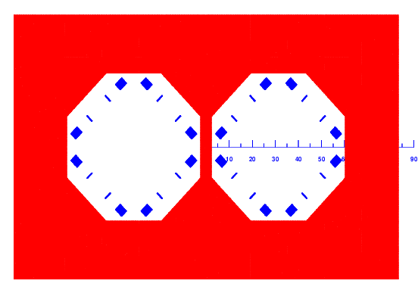
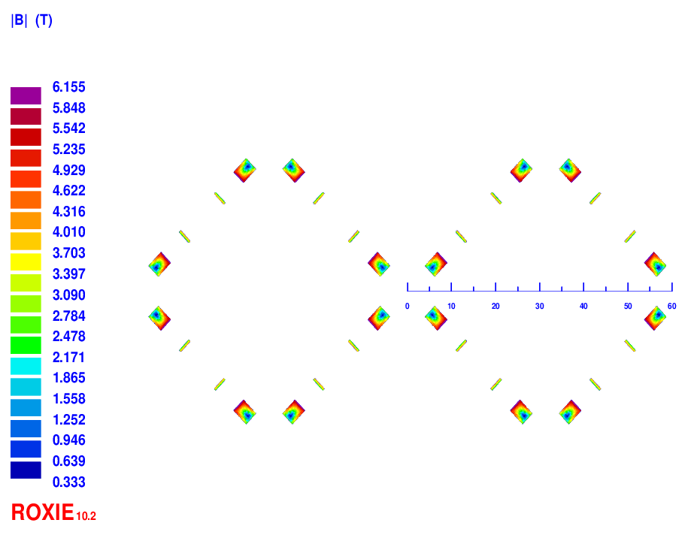
Racetrack coil option of Q1a
Field cross talk of the two apertures
2D field cross talk of Q1a two apertures near the IP side, where the distance between two aperture centerlines is minimum.
The field gradient in each aperture reaches 141 T/m.
Iron yoke width in the middle is very limited; the field harmonics as a result of field crosstalk is smaller than 2.0×10⁻⁴.
Magnetic field cross talk between two apertures is small.
Double aperture model
2D BMOD

Slide 25
Racetrack coil option of Q1a
3D design of Q1a with Racetrack coils
3D magnetic field is modeled and analysed using ROXIE.
Coil end detailed shaped is optimized and determined.
Field gradient 141T/m, each integrated field harmonics is smaller than 1×10⁻⁴.
The 3D magnetic field performance meets requirement.
Single aperture model in 3D

Slide 26
Conceptual design of Q1a for high luminosity with L*=1.9m
Comparison of three design HTS options of Q1a (141T/m)
Option | Excitation current (A) | Needed Engineering current density J_{E} on wire (A/mm2) | Bmax on coil (T)
Cos2θ (2 layers) | 1970 | 1004 | 3.2
CCT | 1342 (940 with iron) | 2670 (1870 with iron) | 3.8
Racetrack coil | 1020 | 3400 | 6.2

Slide 27
Current level of HTS superconductor in China
HTS Bi-2212
∅ 0.8-1.4mm
4.2K，3T, 4T short sample, Jc: 4400A/mm², 4000A/mm²，J_{E}:1100A/mm²,1000A/mm²
Bending radius ≥10mm
YBCO
Critical current/cm
Bending radius ≥5mm

Slide 28
Summary
Superconducting HTS quadrupole magnet R&D is in the early stage in the world.
Coil-dominated HTS quadrupole magnet using racetrack coils has been studied in the CEPC IR. Field quality of the coil layout < 1×10⁻⁴.
Three HTS options have been studied for the Q1a magnet using high luminosity parameters with L*=1.9m: Cos2θ coil, CCT coil, Racetrack coil.
The three design options are feasible in theory; Further detailed design is required.
As a first step, some test on HTS conductor is planned.

Slide 29
Thanks for your attention!
CEPC Working day

