Slide 1
PROGRESS OF LOW EMITTANCE BOOSTER DESIGN
Daheng Ji, Dou Wang
2020,12,28

Slide 2
Outline
Review of last report
Further error study based on TME 0
Update of lower emittance booster design
Error study based on FODO 1

Slide 3
Review of Last Report（2020.09.23）
Sawtooth effect @180GeV （ ✔ ）
Effect of earthfield @10GeV （ ✔ ）
Impacts/solution of Detector Stray Field （ ✔ ）
Dynamic simulation with errors during ramping and table ramping scheme （ ✔ ）
CDR design (FODO 0): error effect and correction of linear optics （ ✔ ）
Booster error study based on lower emittance lattice (TME 0) （ ✘）

Slide 4
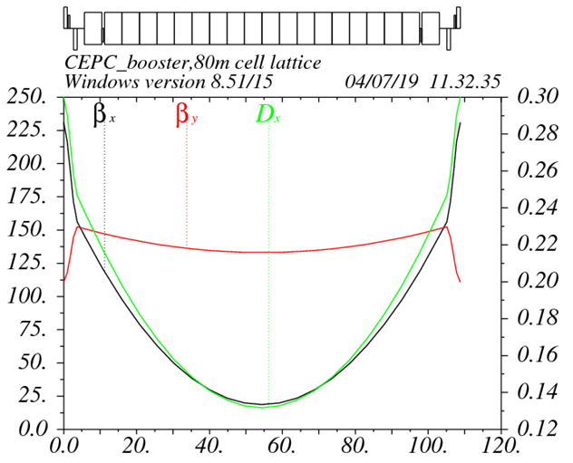
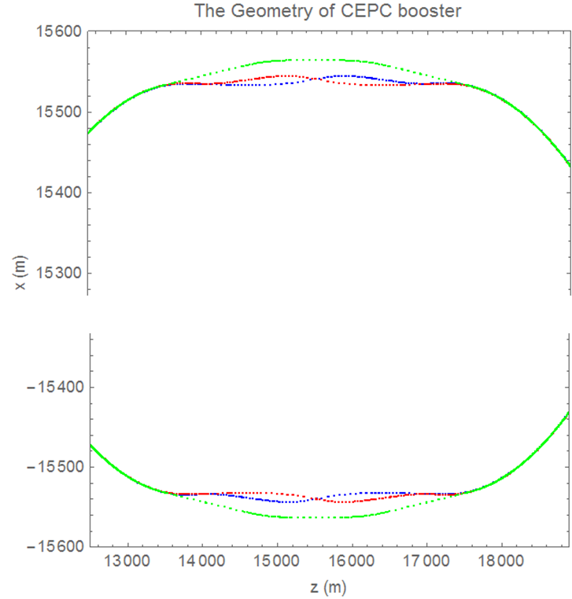
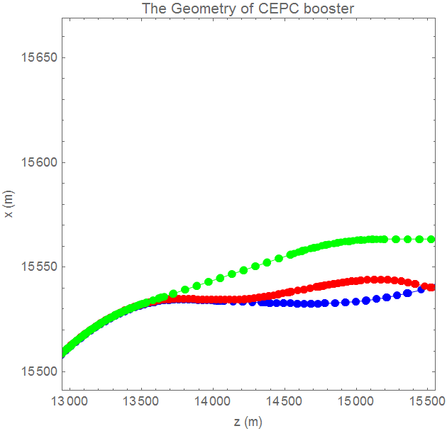
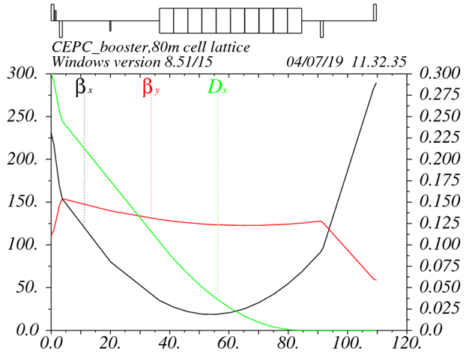
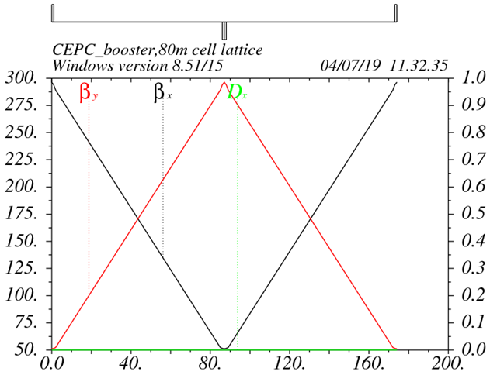
Review of last report Low emittance lattice design based on TME (0)
D. Wang, Y. M. Peng, C. H. Yu
Interleave sextupole scheme
Cell length: 110m
DA optimization
arc cell
Phase for arc cell
Phase for straight section
SD position
Phase for matching section
dis. supressor
Straight sec.
Exact geometry match for three rings
-- error=±0.17m

Slide 5
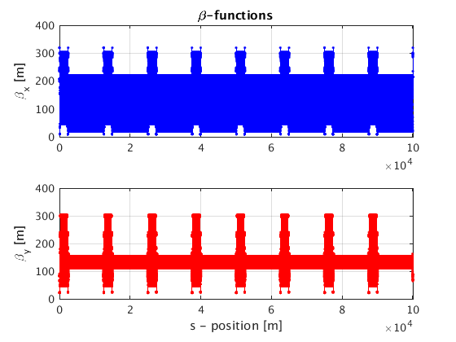
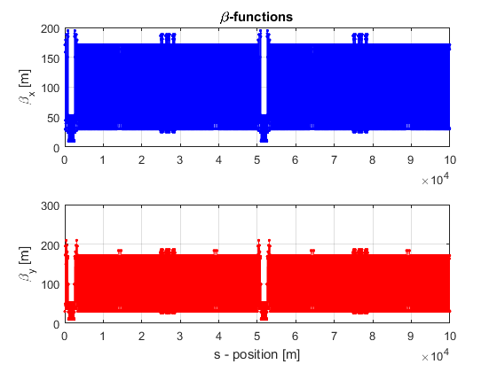
Review of last report Error effect and correction for linear optics (TME 0)
$$Error Effect ∝\sqrt{N}∗KL$$
TME 0
 | FODO 0 | TME 0
Emittance X (nm) | 3.57E-09 | 1.29E-9
Tunes | [263.2016/261.2193] | [319.2507/129.2806]
Quad amount | 2110 | 2528
Quad Strength (K1L rms） | 0.0383 | 0.0828
Sext amount | 512 | 2912
Sexts Strength (K2L rms) | 0.1795 | 0.1512
H Corrector | 1053 | 896
V Corrector | 1054 | 1632
BPM | 2108 | 2528
FODO 0 (CDR)

Slide 6
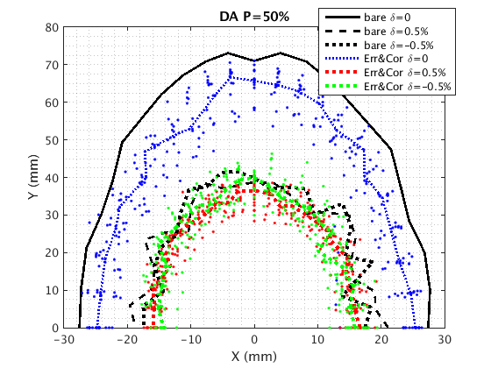
Review of last report Low emittance lattice design based on TME 0
RMS | FODO 0 (CDR) | TME 0
Orbit (mm) | 0.0575/0.0525 | 0.4065/0.2389
Beta Beating(%) | 0.294/0.353 | 3.940/5.439
Delta Dispersion(m) | 0.005/0.007 | 0.0156/0.0229
FODO 0 (CDR)
Error set and correction process is same as FODO Lattice
Beam parameter and DA recovery not good
Strong focusing?
1/4 resonance?
Correctors and BPMs arrangement?
…
TME 0

Slide 7
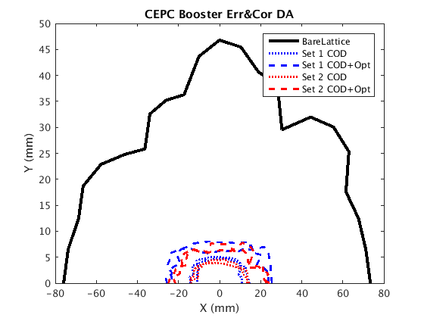
Further error study based on TME 0
FODO 0 (CDR)
RMS | FODO 0 | TME 0 | TME 0 opt.
Orbit (mm) | 0.0575/0.0525 | 0.4065/0.2389 | 0.2216/0.1784
Beta Beating(%) | 0.294/0.353 | 3.940/5.439 | 2.79/3.833
Delta Dispersion(m) | 0.005/0.007 | 0.0156/0.0229 | 0.0039/0.0052
TME 0
Correction optimization:
Tune change
Set H correctors on BEND
BPM position optimization
Dispersion function in orbit correction
Dispersion weight in correction
Singular value scan
…
TME 0 opt.

Slide 8
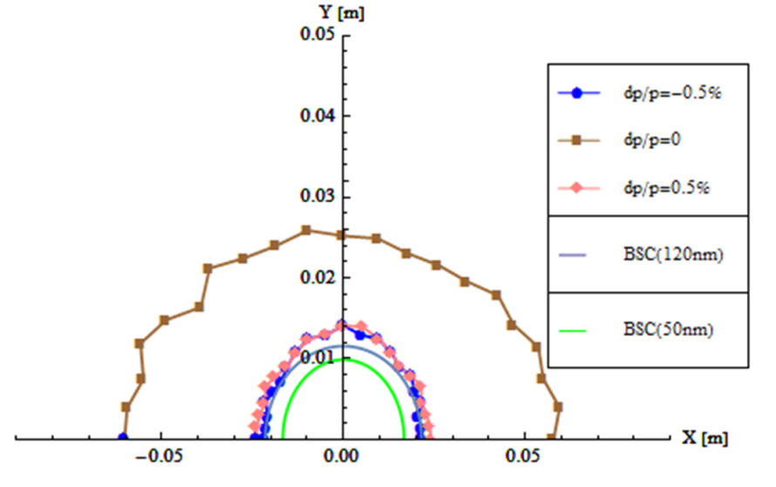
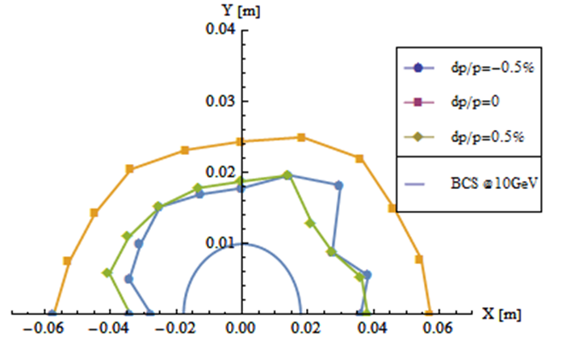
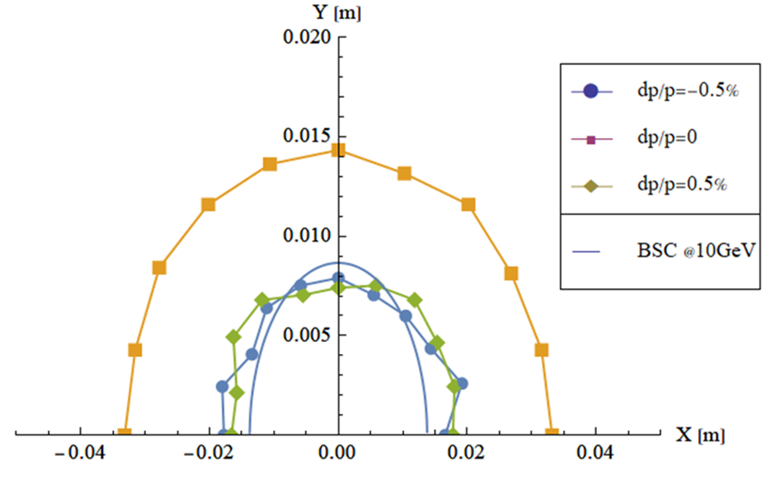
Lower emittance booster design update
D. Wang, Y. M. Peng, C. H. Yu
Emittance: 3.57nm → (1.29nm~1.9nm)
Coupling requirement: 0.5% → 1.4%
Injection for higher lum. H mode
Off-axis injection for CDR Higgs
Difficulty transfer from Collider to booster
Two kinds of low emittance lattice
TME (cell length=108m)
FODO (cell length=70m~80m)
CDR
New-TME
New-FODO

Slide 9
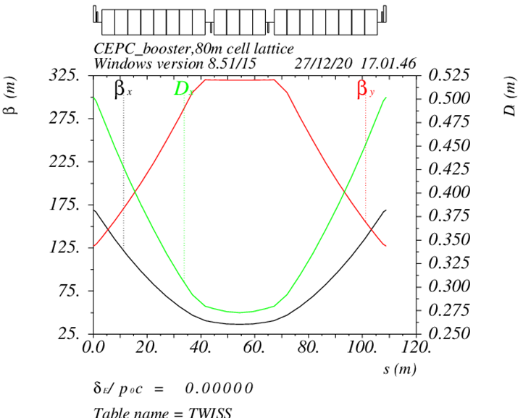
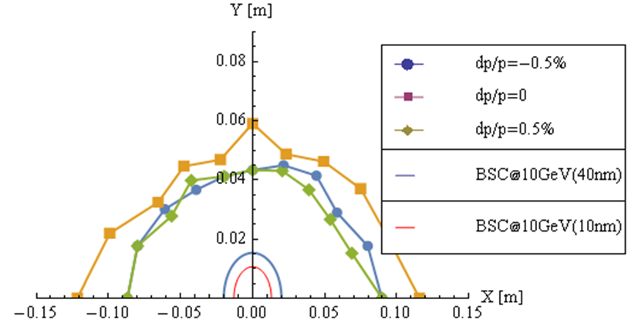
TME design update (TME 1)
D. Wang, C. H. Yu, Y. M. Peng…
Combined magnet: B+Q
Emittance = 1.45 nm@120GeV
Energy spread = .00168
fine tuning is going on…

Slide 10
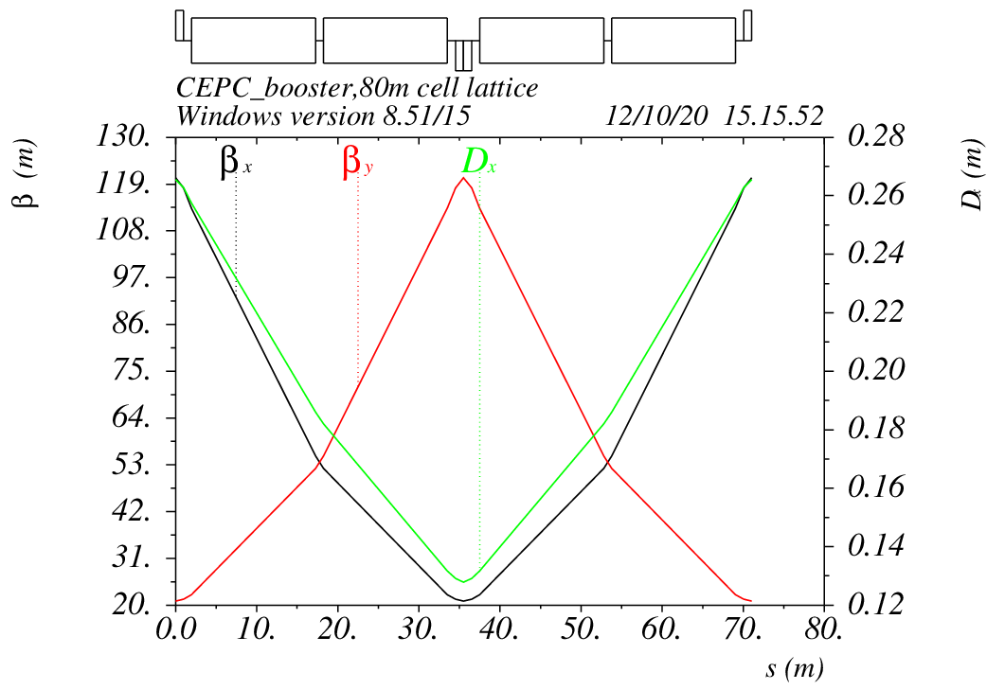
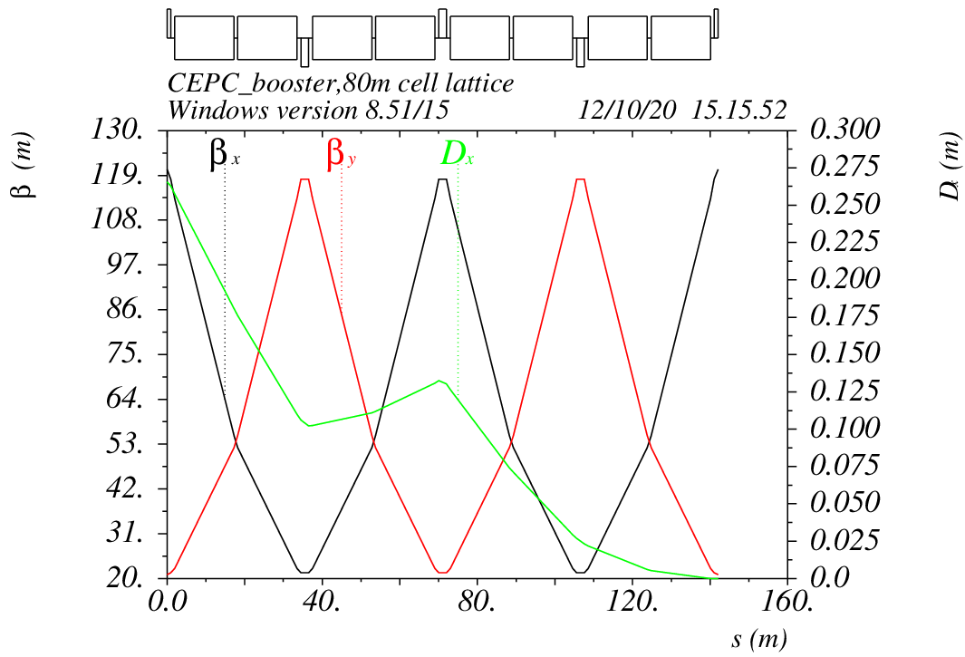
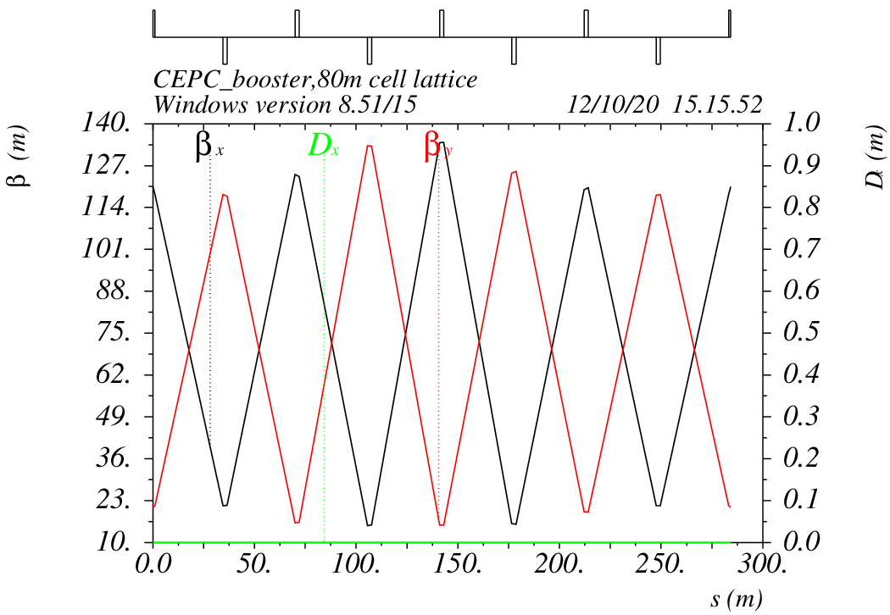
Alternative design based on FODO
90°/ 90° FODO cell
FODO length: 70m~80m
Noninterleave sextupole scheme
Similar structure as CDR
arc cell
dis. supressor
Straight sec.

Slide 11
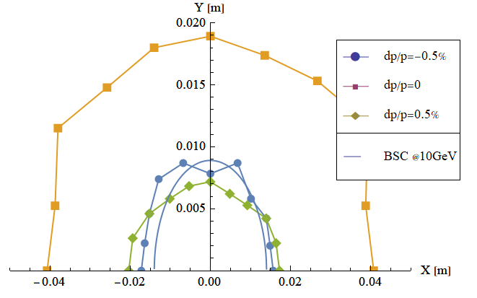
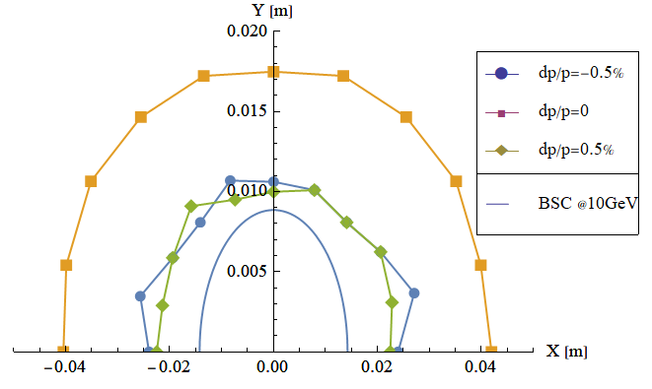
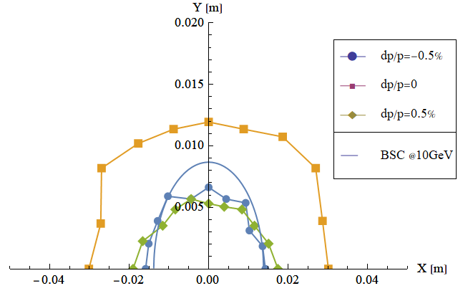
DA optimization for FODO lattice
Insert proper phase section to weaken/cancel some dispersive nonlinear term – enlarge off-momentum DA
80m FODO (emit=1.9nm)
Before opt
6*FODO5,
FODO,
6*FODO5,
FODO,
6*FODO5,
FODO,
6*FODO5
After opt
FODO 1.2
45° phase in short straight section
70m FODO (emit=1.29nm)
After opt
Before opt
FODO 1.1
7*FODO5,
7*FODO5,
7*FODO5,
7*FODO5
45° phase in short straight section

Slide 12
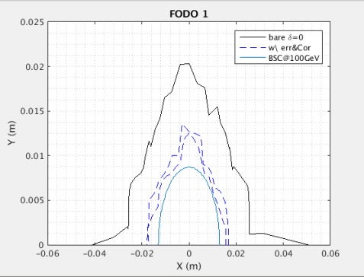
Error study based on FODO 1.1
$$Error Effect ∝\sqrt{N}∗KL$$
The sensitivity is between FODO 0 and TME0
The correction effect is consistent with the sensitivity
DA should be further optimized
Lattice | FODO 0 | TME 0 | FODO 1
Emittance X (nm) | 3.57E-09 | 1.29E-9 | 1.29E-9
Tunes | [263.201/261.219] | [319.250/129.280] | [353.180/353.280]
Quad amount | 2110 | 2528 | 2816
Quad Strength (K1L rms） | 0.0383 | 0.0828 | 0.0407
Sext amount | 512 | 2912 | 896
Sexts Strength (K2L rms) | 0.1795 | 0.1512 | 0.4091
H Corrector | 1053 | 896 | 1408
V Corrector | 1054 | 1632 | 1408
BPM | 2108 | 2528 | 2816
w/ Correction | FODO 0 | TME 0 | TME 0 opt. | FODO 1
Orbit (mm) | 0.0575/0.0525 | 0.4065/0.2389 | 0.2216/0.178 | 0.1693/0.1236
Beta Beating(%) | 0.294/0.353 | 3.940/5.439 | 2.79/3.833 | 1.52/2.50
Delta Dispersion(m) | 0.005/0.007 | 0.0156/0.0229 | 0.0039/0.0052 | 0.0045/0.0032

Slide 13
Key issue
Shortage of computing resources←→Accuracy/Iteration speed/Seeds
Memory
((1408(HC)+1408(VC))*2816(BPM)*2*2816(Q))*8/1024/1024/1024=332.75GB
((100(HC)+100(VC))*2816(BPM)*2*2816(Q))*8/1024/1024/1024=23.63GB
Matlab
1 loop: 2~3 weeks…

Slide 14
Summary
TME 0 was proved too sensitive and abandoned now
Lower emittance booster design updates two versions of the new design: TME 1 and FODO 1
TME 1 is in the process of design optimization
FODO 1 has started error simulation
Optics/DA result is acceptable, but not good enough
Shortage of computing resources limits the progress of iteration.

Slide 15
Thanks

Slide 16
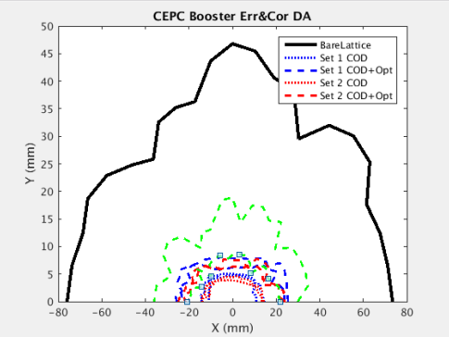

Slide 17
Low emittance lattice design based on TME （0）
D. Wang, Y. M. Peng, C. H. Yu
Interleave sextupole scheme
Cell length: 110m
DA optimization
arc cell
Phase for arc cell
Phase for straight section
SD position
Phase for matching section
dis. supressor
Straight sec.
Exact geometry match for three rings
-- error=±0.17m

