Slide 1
CEPC cavity high field & high Q performance increasing study status and plans
沙鹏，20201228 on behalf of SRF GROUP, Accelerator Division, IHEP

Slide 2
Outline
R&D of 1.3 GHz cavities
R&D of 650 MHz cavities
Nb3Sn
Others
Plans

Slide 3
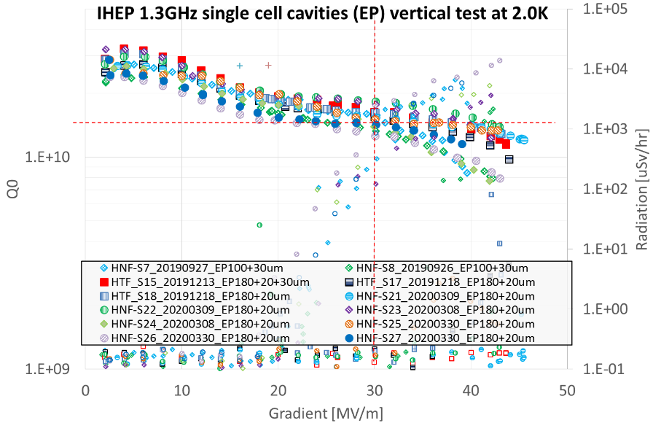
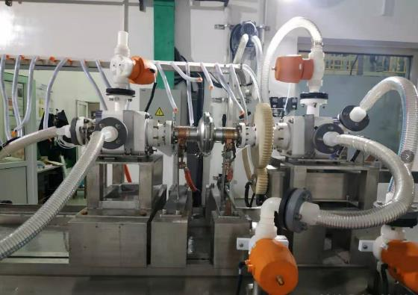
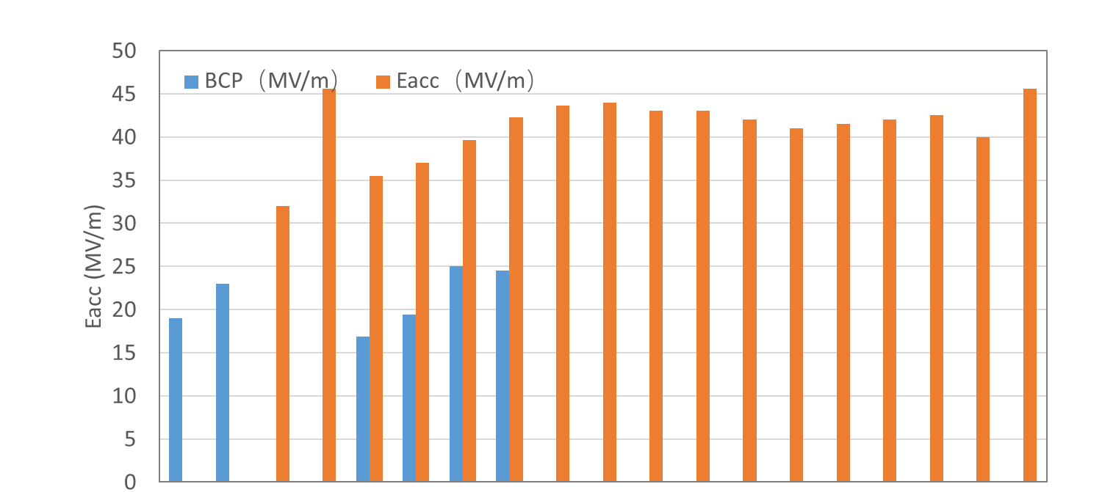
High Gradient 1.3 GHz 1-cell Cavity (EP)
Gradient increased rapidly (from BCP to EP, from initial EP to optimized EP).
All 12 single-cell cavities > 40 MV/m.

Slide 4
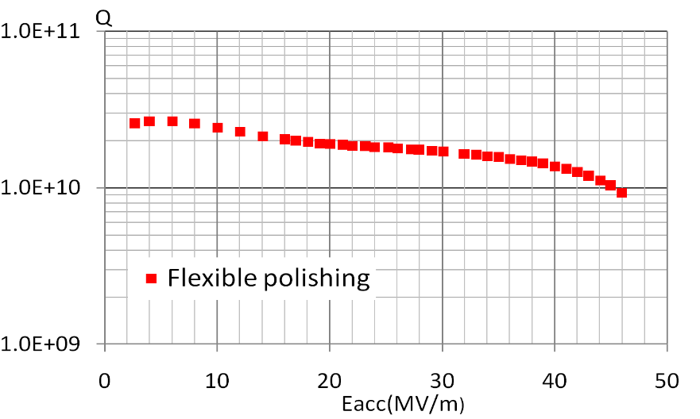
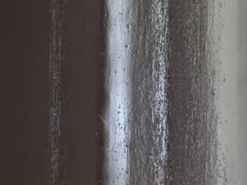

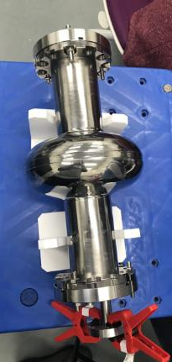
Flexible polishing of 1.3 GHz 1-cell cavity
Flexible polishing (FP) reached 46 MV/m for 1.3 GHz 1-cell cavity, which can be adopted instead of bulk EP.
Advantage of flexible polishing: high efficiency, environmental friendly, low cost
Conventional recipe
New recipe
Bulk EP (~150um)
FP (~150um)
46MV/m, record the highest Eacc in China!
At 2K
Initial
After flexible polishing
Inspection of equator of 1.3GHz 1-cell cavity
Vertical test result of 1.3 GHz 1-cell cavity
董超（主要完成人）获批一项自然科学基金青年项目（超导腔高精度流体辅助抛光技术，12005249）

Slide 5
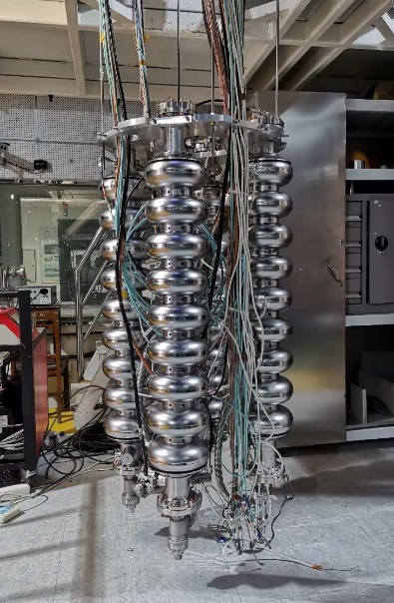
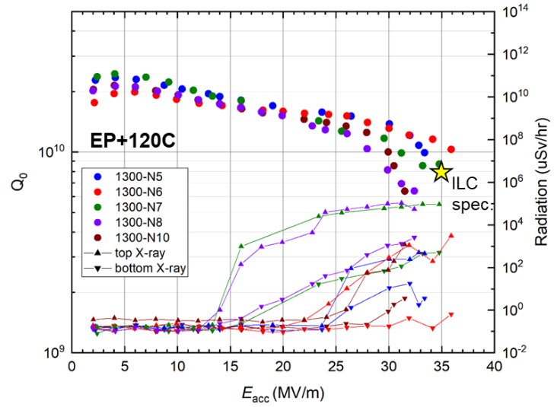
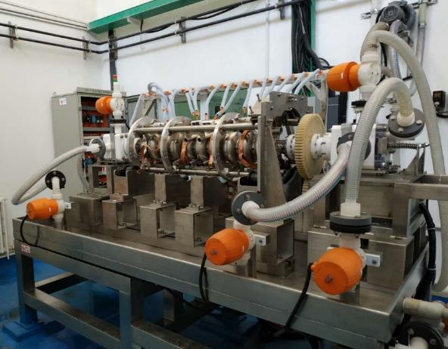
High Gradient 1.3 GHz 9-cell Cavity (EP)
High gradient is the basis for high Q because of large gradient degradation
With new EP tool, only 5 months to achieve 36 MV/m on 9-cell cavity
All of the five 9-cell cavities > 30 MV/m, cell gradient near or above 40 MV/m
Further push the gradient to 35~40 MV/m with 90% yield

Slide 6
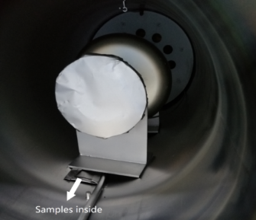
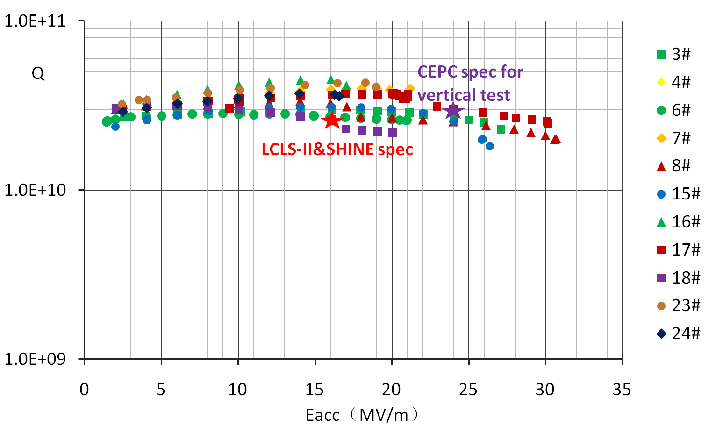
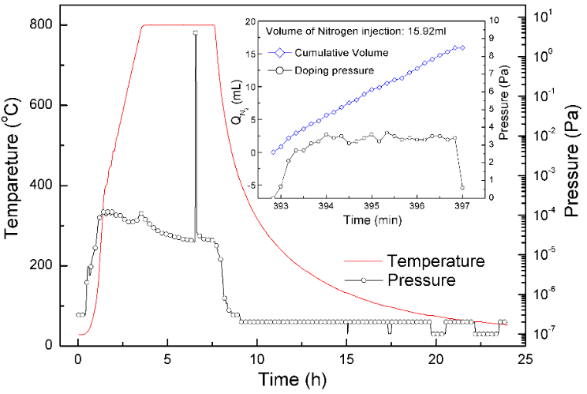
Nitrogen doping of 1.3 GHz 1-cell Cavity
The best result of N-doping reached 2.6E10@30MV/m——the best in China.
Two kinds of N-doping recipes is adopted: 800C 3h + 3/60@800C, 3/60@800C
2.6E10@30MV/m
Results of 1.3GHz 1-cell cavities N-doped
800C 3h + 3/60@800C

Slide 7
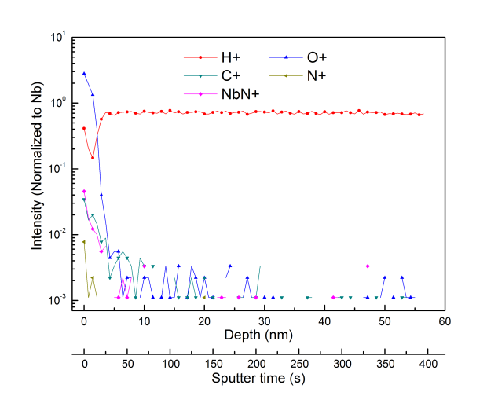
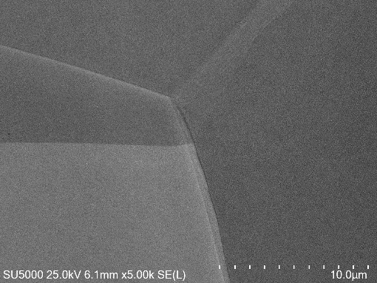
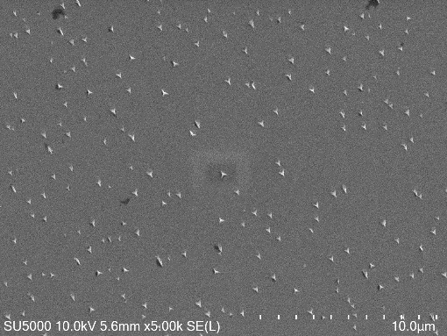
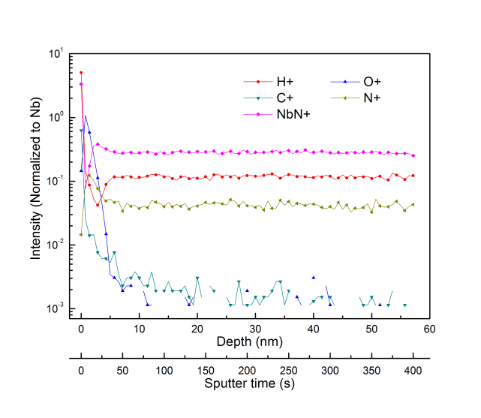
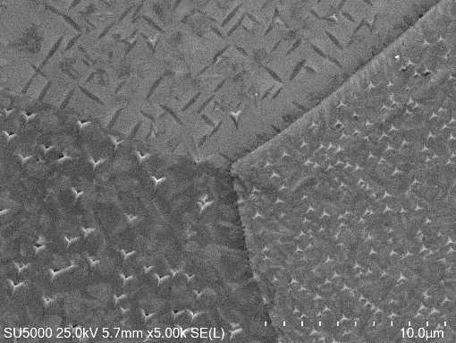
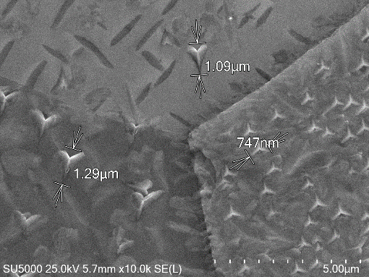
Microscopic measurements of N-doping
SIMS depth profile measurements of Nb samples
No doping
No doping
N-doping of large-grain Nb
N-doping of fine-grain Nb (right: different sizes of NbN for different crystalline orientation)
N-doping
SEM Measurements

Slide 8
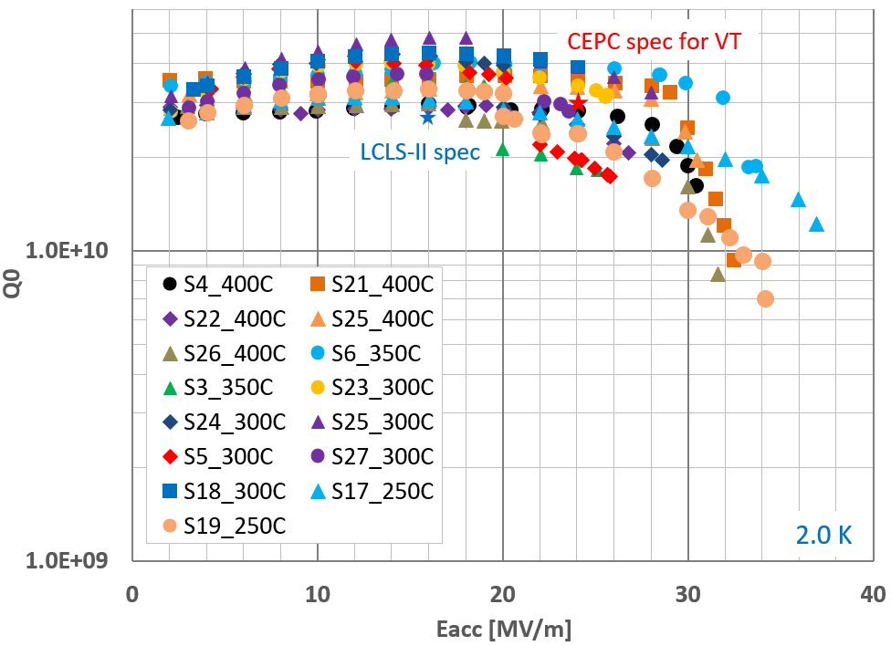
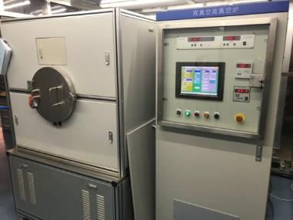
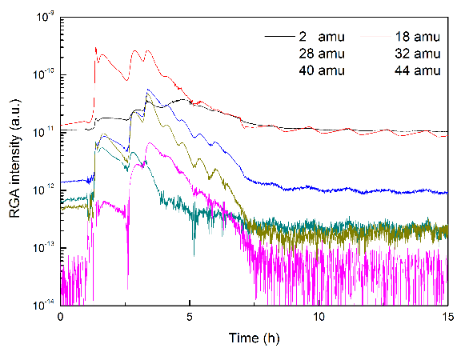
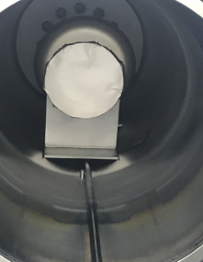
Mid-T furnace bake of 1.3 GHz 1-cell cavity
Different temperatures have been tried with 1.3 GHz 1-cell cavities at the same furnace for N-doping.
The average quality factor has reached 3.6E10 when the gradient is 16 MV/m，while the highest Q is 4.9E10@16MV/m (baking at 300C).
Vertical test results of 1.3 GHz 1-cell cavities after mid-T furnace bake
RGA data during bake
Mid-T Furnace bake at IHEP （Yuquan campus）

Slide 9
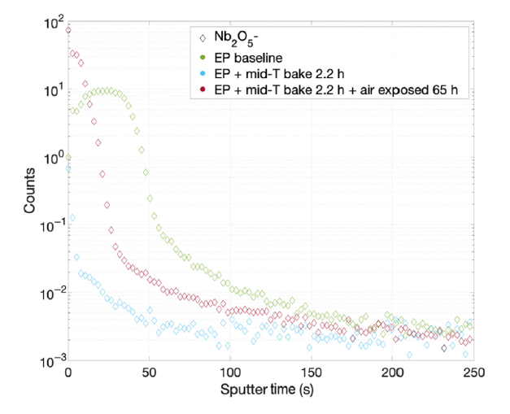
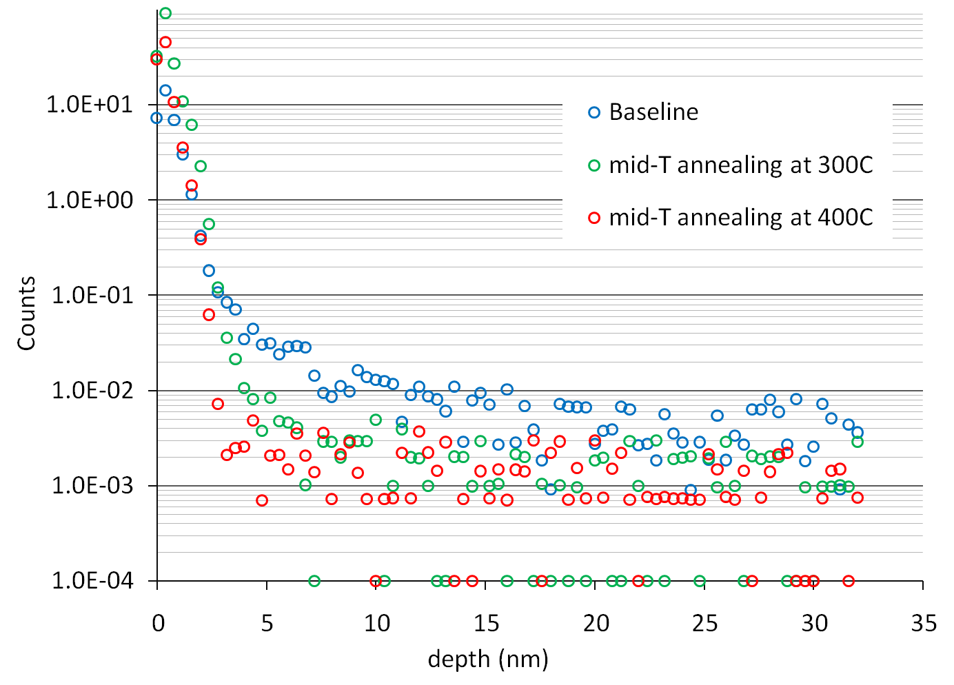
Microscopic measurements of Mid-T bake
Sputtering speed: 0.1nm/s
SIMS depth profile measurements of
Nb₂O₅ in niobium sample (FNAL)
SIMS depth profile measurements of
Nb₂O₅ in niobium sample at IHEP

Slide 10
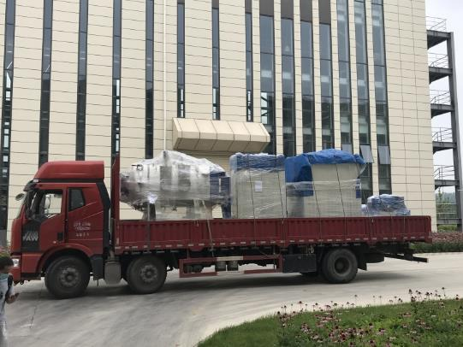
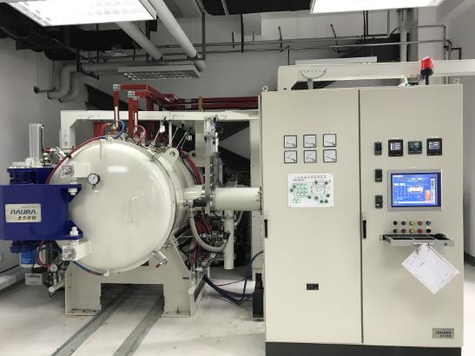
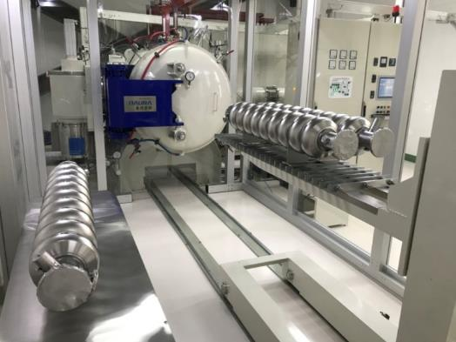
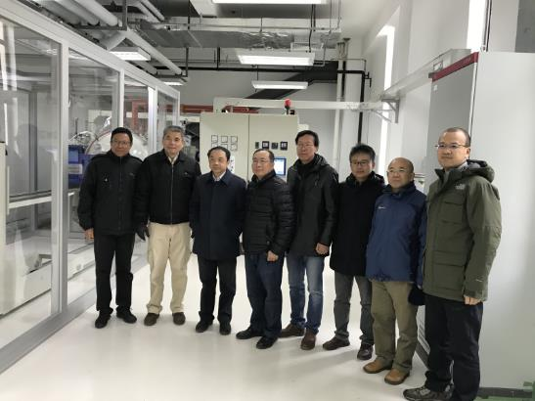
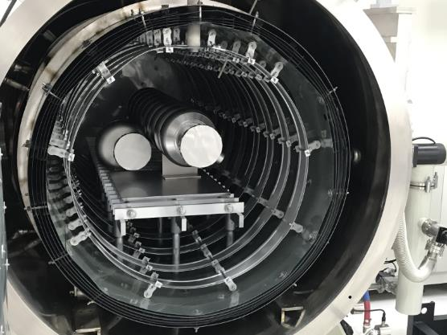
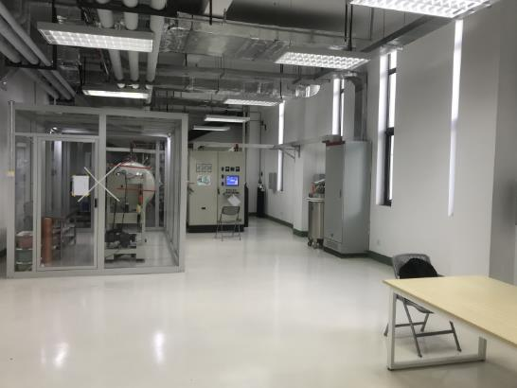
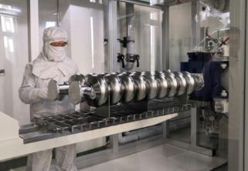
The furnace for 9-cell cavities at PAPS
Jul, 2020
Aug, 2020
Nov, 2020
Sep, 2020
Oct, 2020

Slide 11
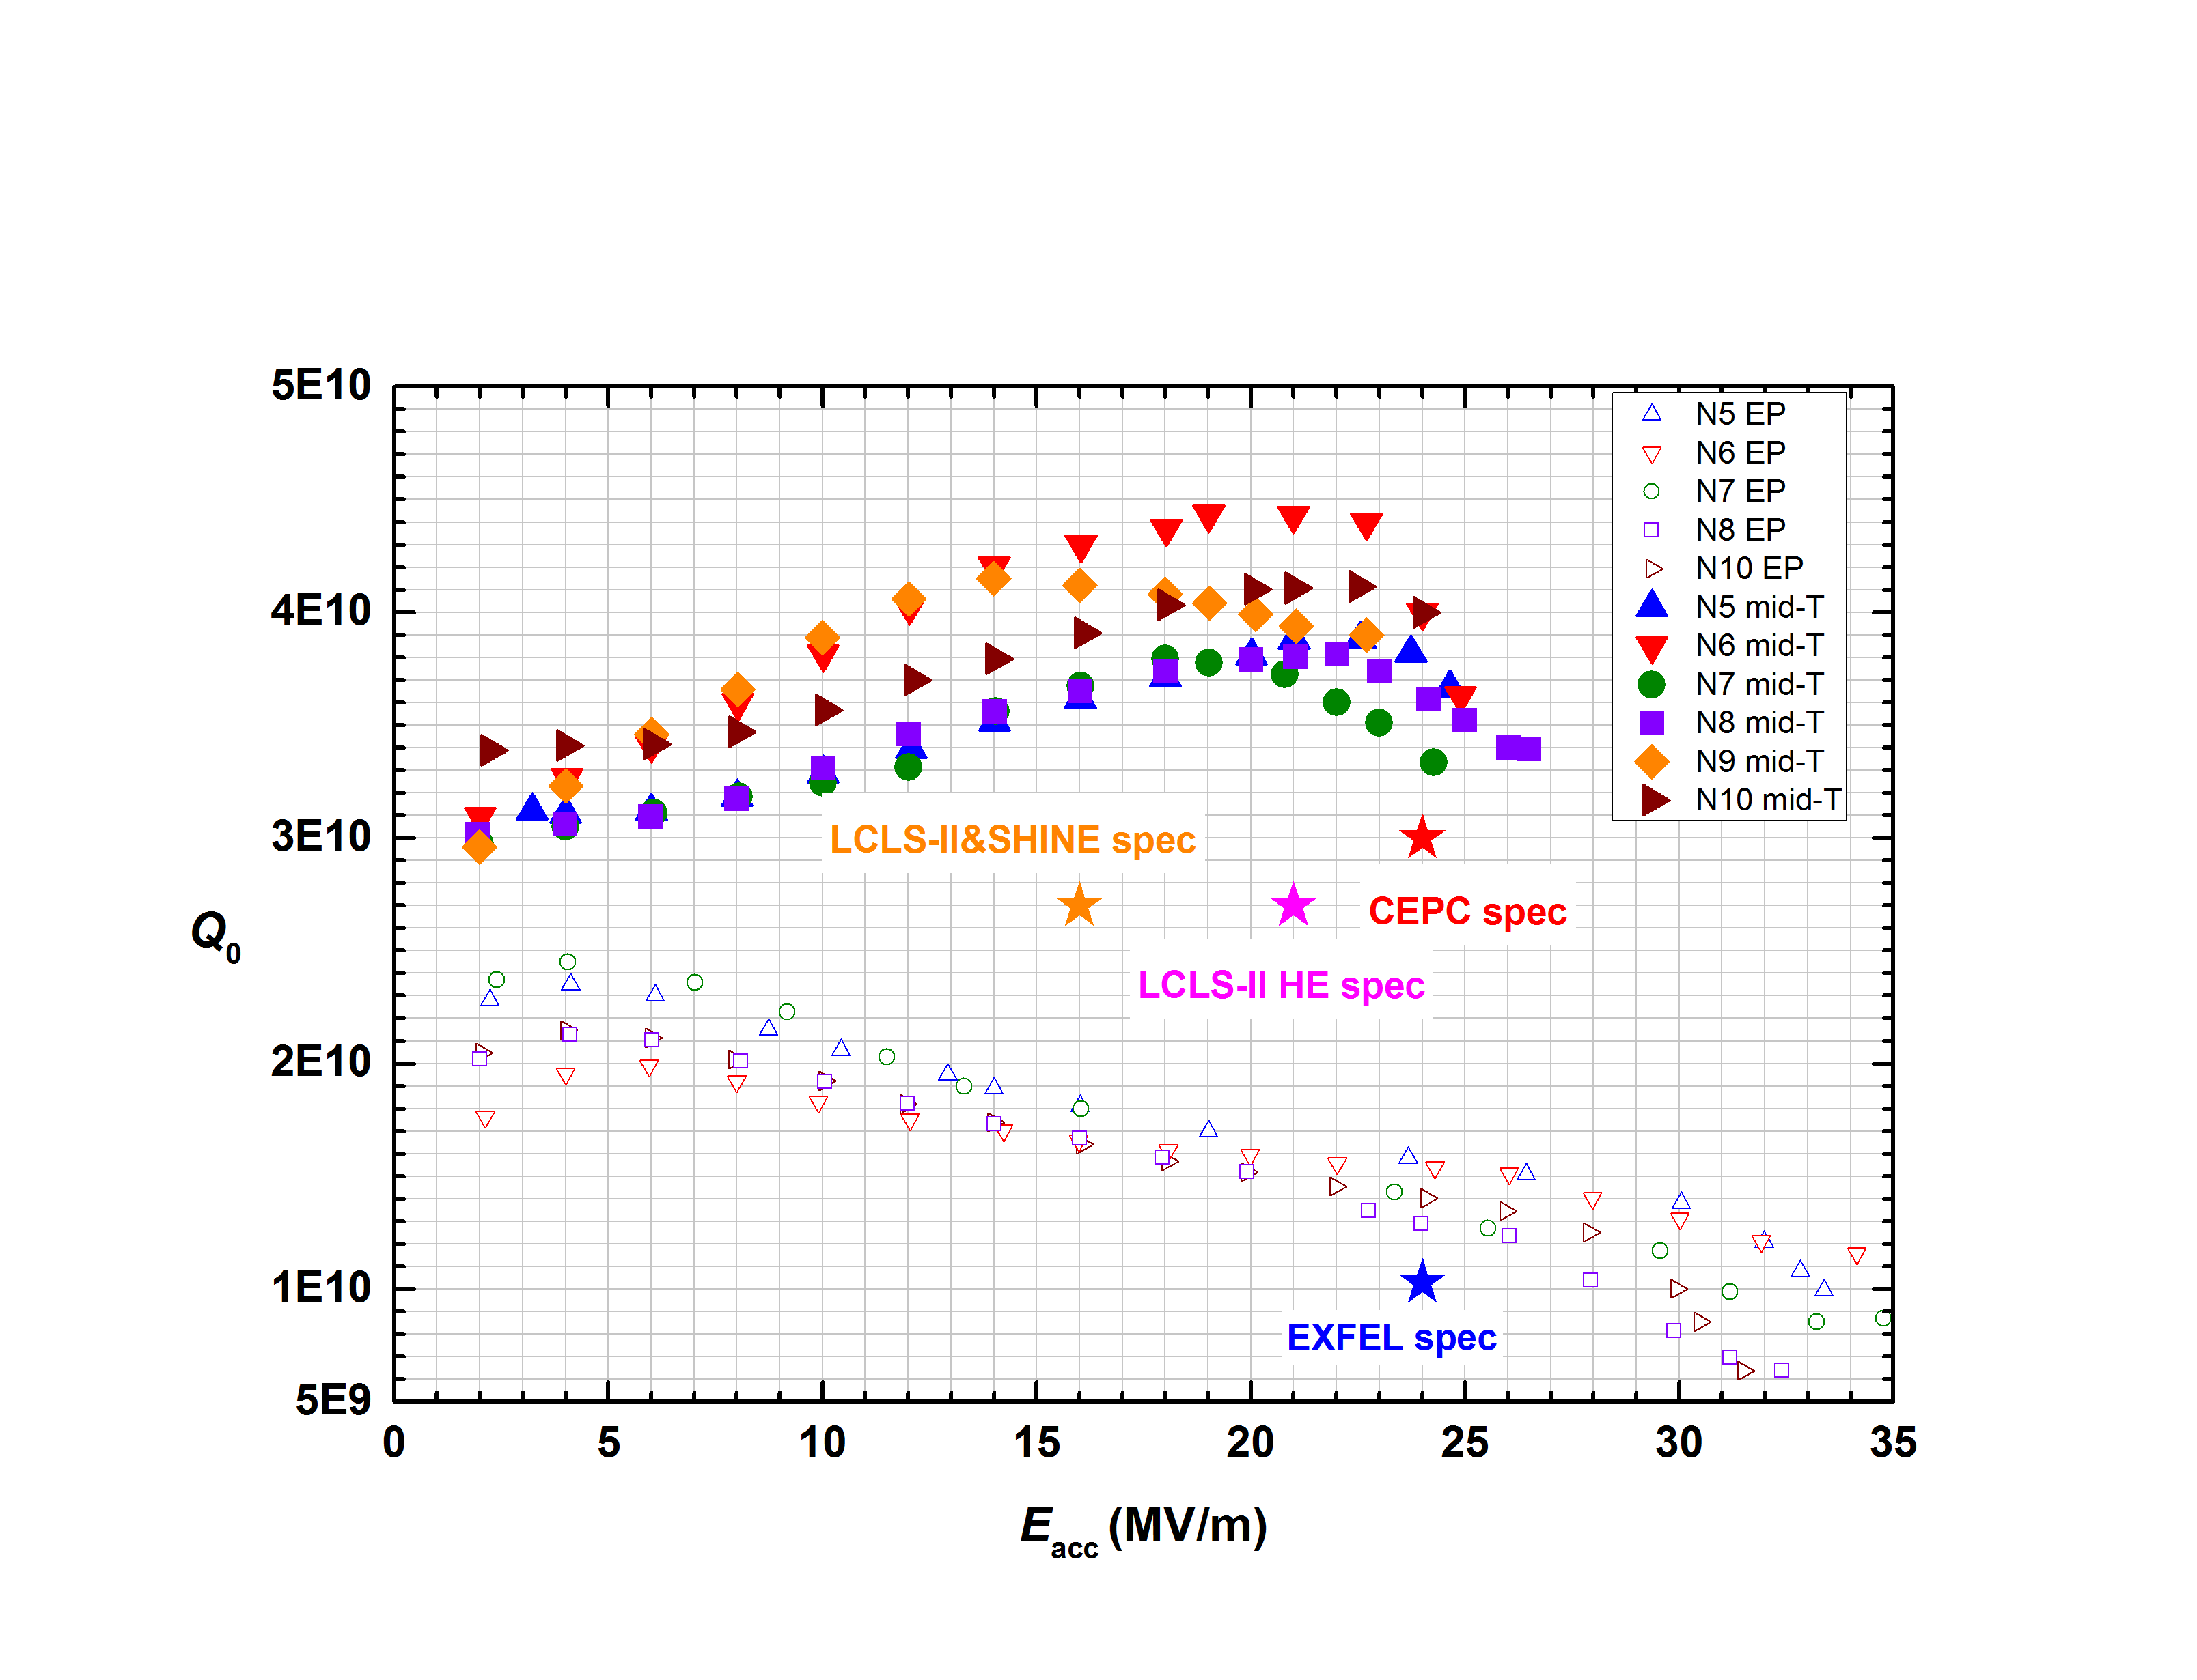
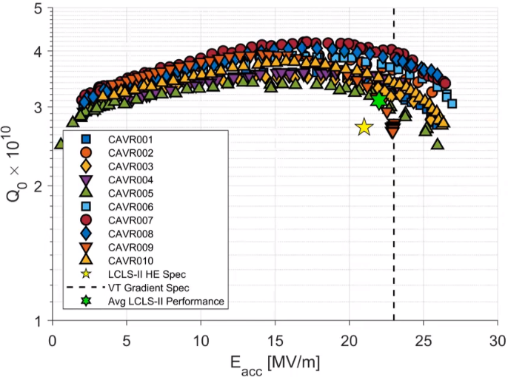
Mid-T furnace bake of 1.3 GHz 9-cell cavity
Six 1.3 GHz 9-cell cavities all received mid-T furnace bake of 300C at a new big furnace of PAPS. The average quality factor has reached 3.8E10 @16 MV/m , which is as good as LCLS-II HE.
Q increase by 100%~200%
Vertical test results of 1.3 GHz 9-cell cavities at IHEP
The latest results of 1.3 GHz 9-cell
cavities N-doped for LCLS-II HE

Slide 12
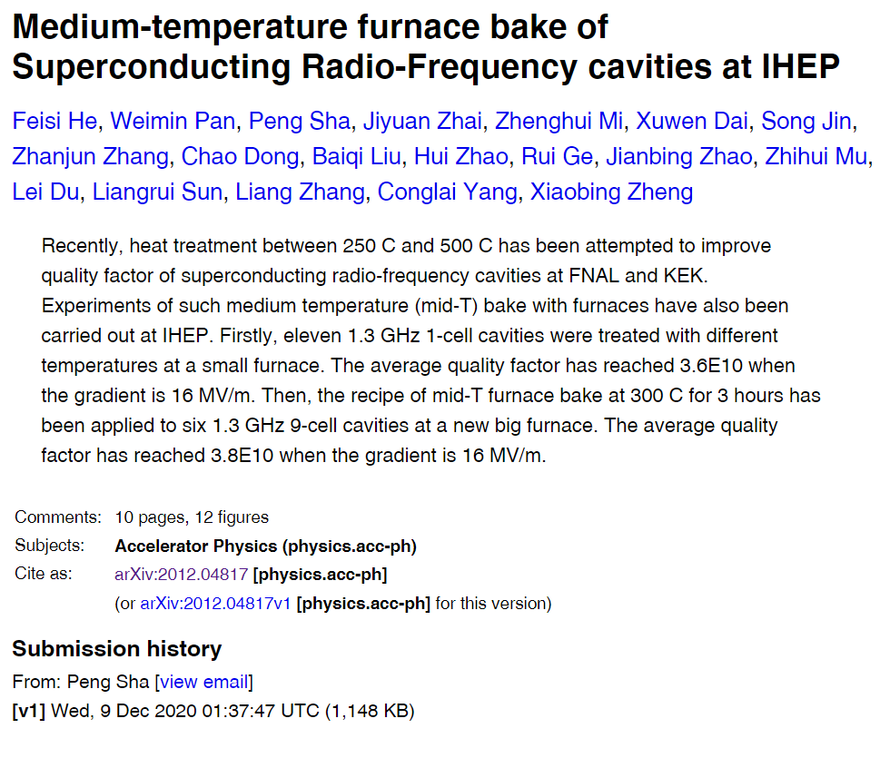
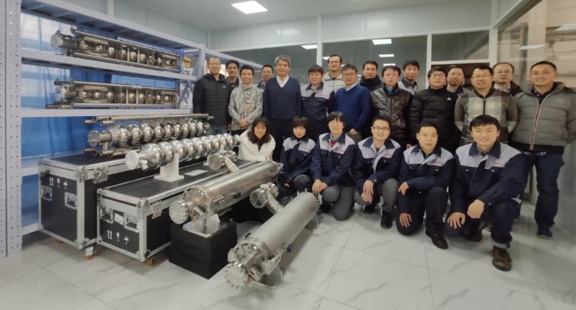
Mid-T furnace bake of 1.3 GHz 9-cell cavity
高能所1.3 GHz高性能超导腔团队
（项目负责人：潘卫民研究员；
技术负责人：贺斐思青年研究员）
https://arxiv.org/abs/2012.04817v1
期刊文章投稿中

Slide 13
Outline
R&D of 1.3 GHz cavities
R&D of 650 MHz cavities
Nb3Sn
Others
Plans

Slide 14
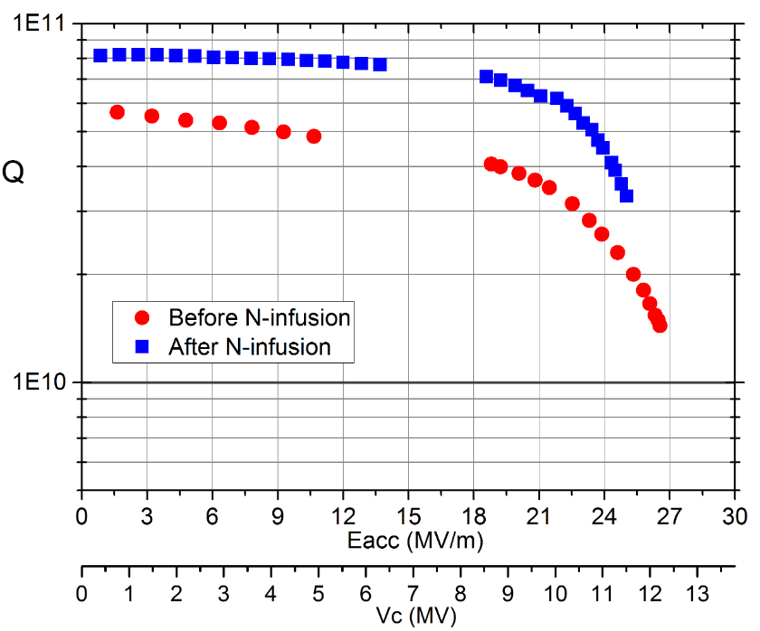
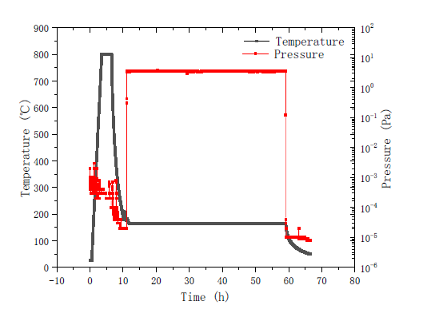
N-infusion of 650 MHz 2-cell Cavity
Nitrogen-infusion of the BCP cavity: 6E10@22MV/m, exceed CEPC spec (4E10@Eacc=22MV/m)
World record in BCP cavity. EP to further improve the gradient and Q.
Multipacting
CEPC Spec
N-infusion: 160C 48h

Slide 15
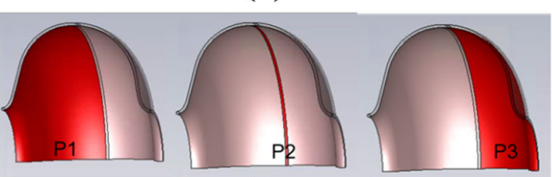
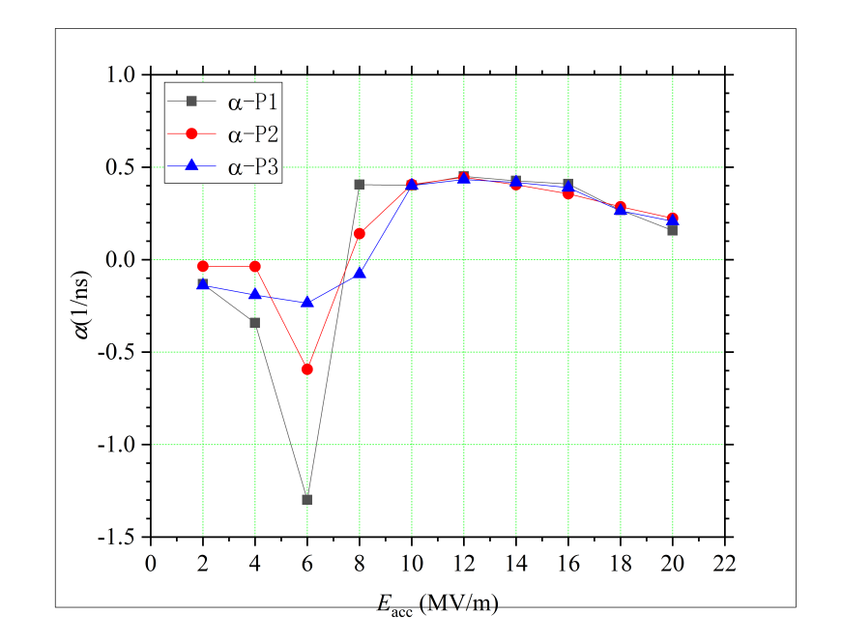
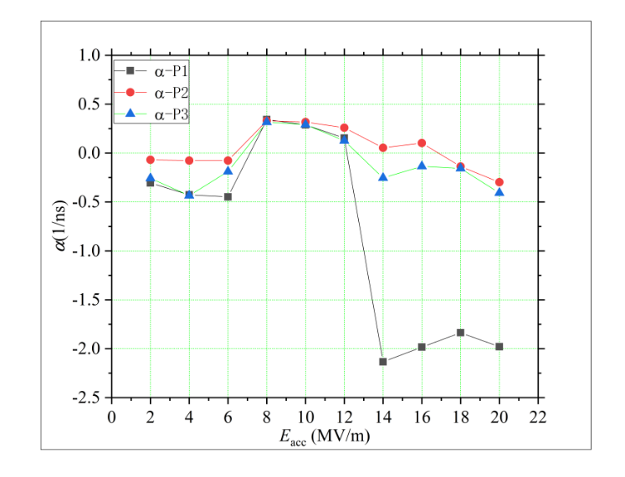
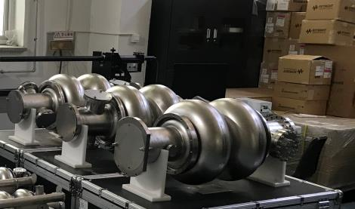
New 650 MHz 2-cell cavities for PAPS
3 new 650 MHz 2-cell cavities have been completed and received post process (BCP).
Cell shape (CEPC-V2) has been optimized to inhibit multipacting. The field propagation of the TE121 and TM012 modes also appears to be better than that of the old design (CEPC-V1).
CEPC-V1
CEPC-V2

Slide 16
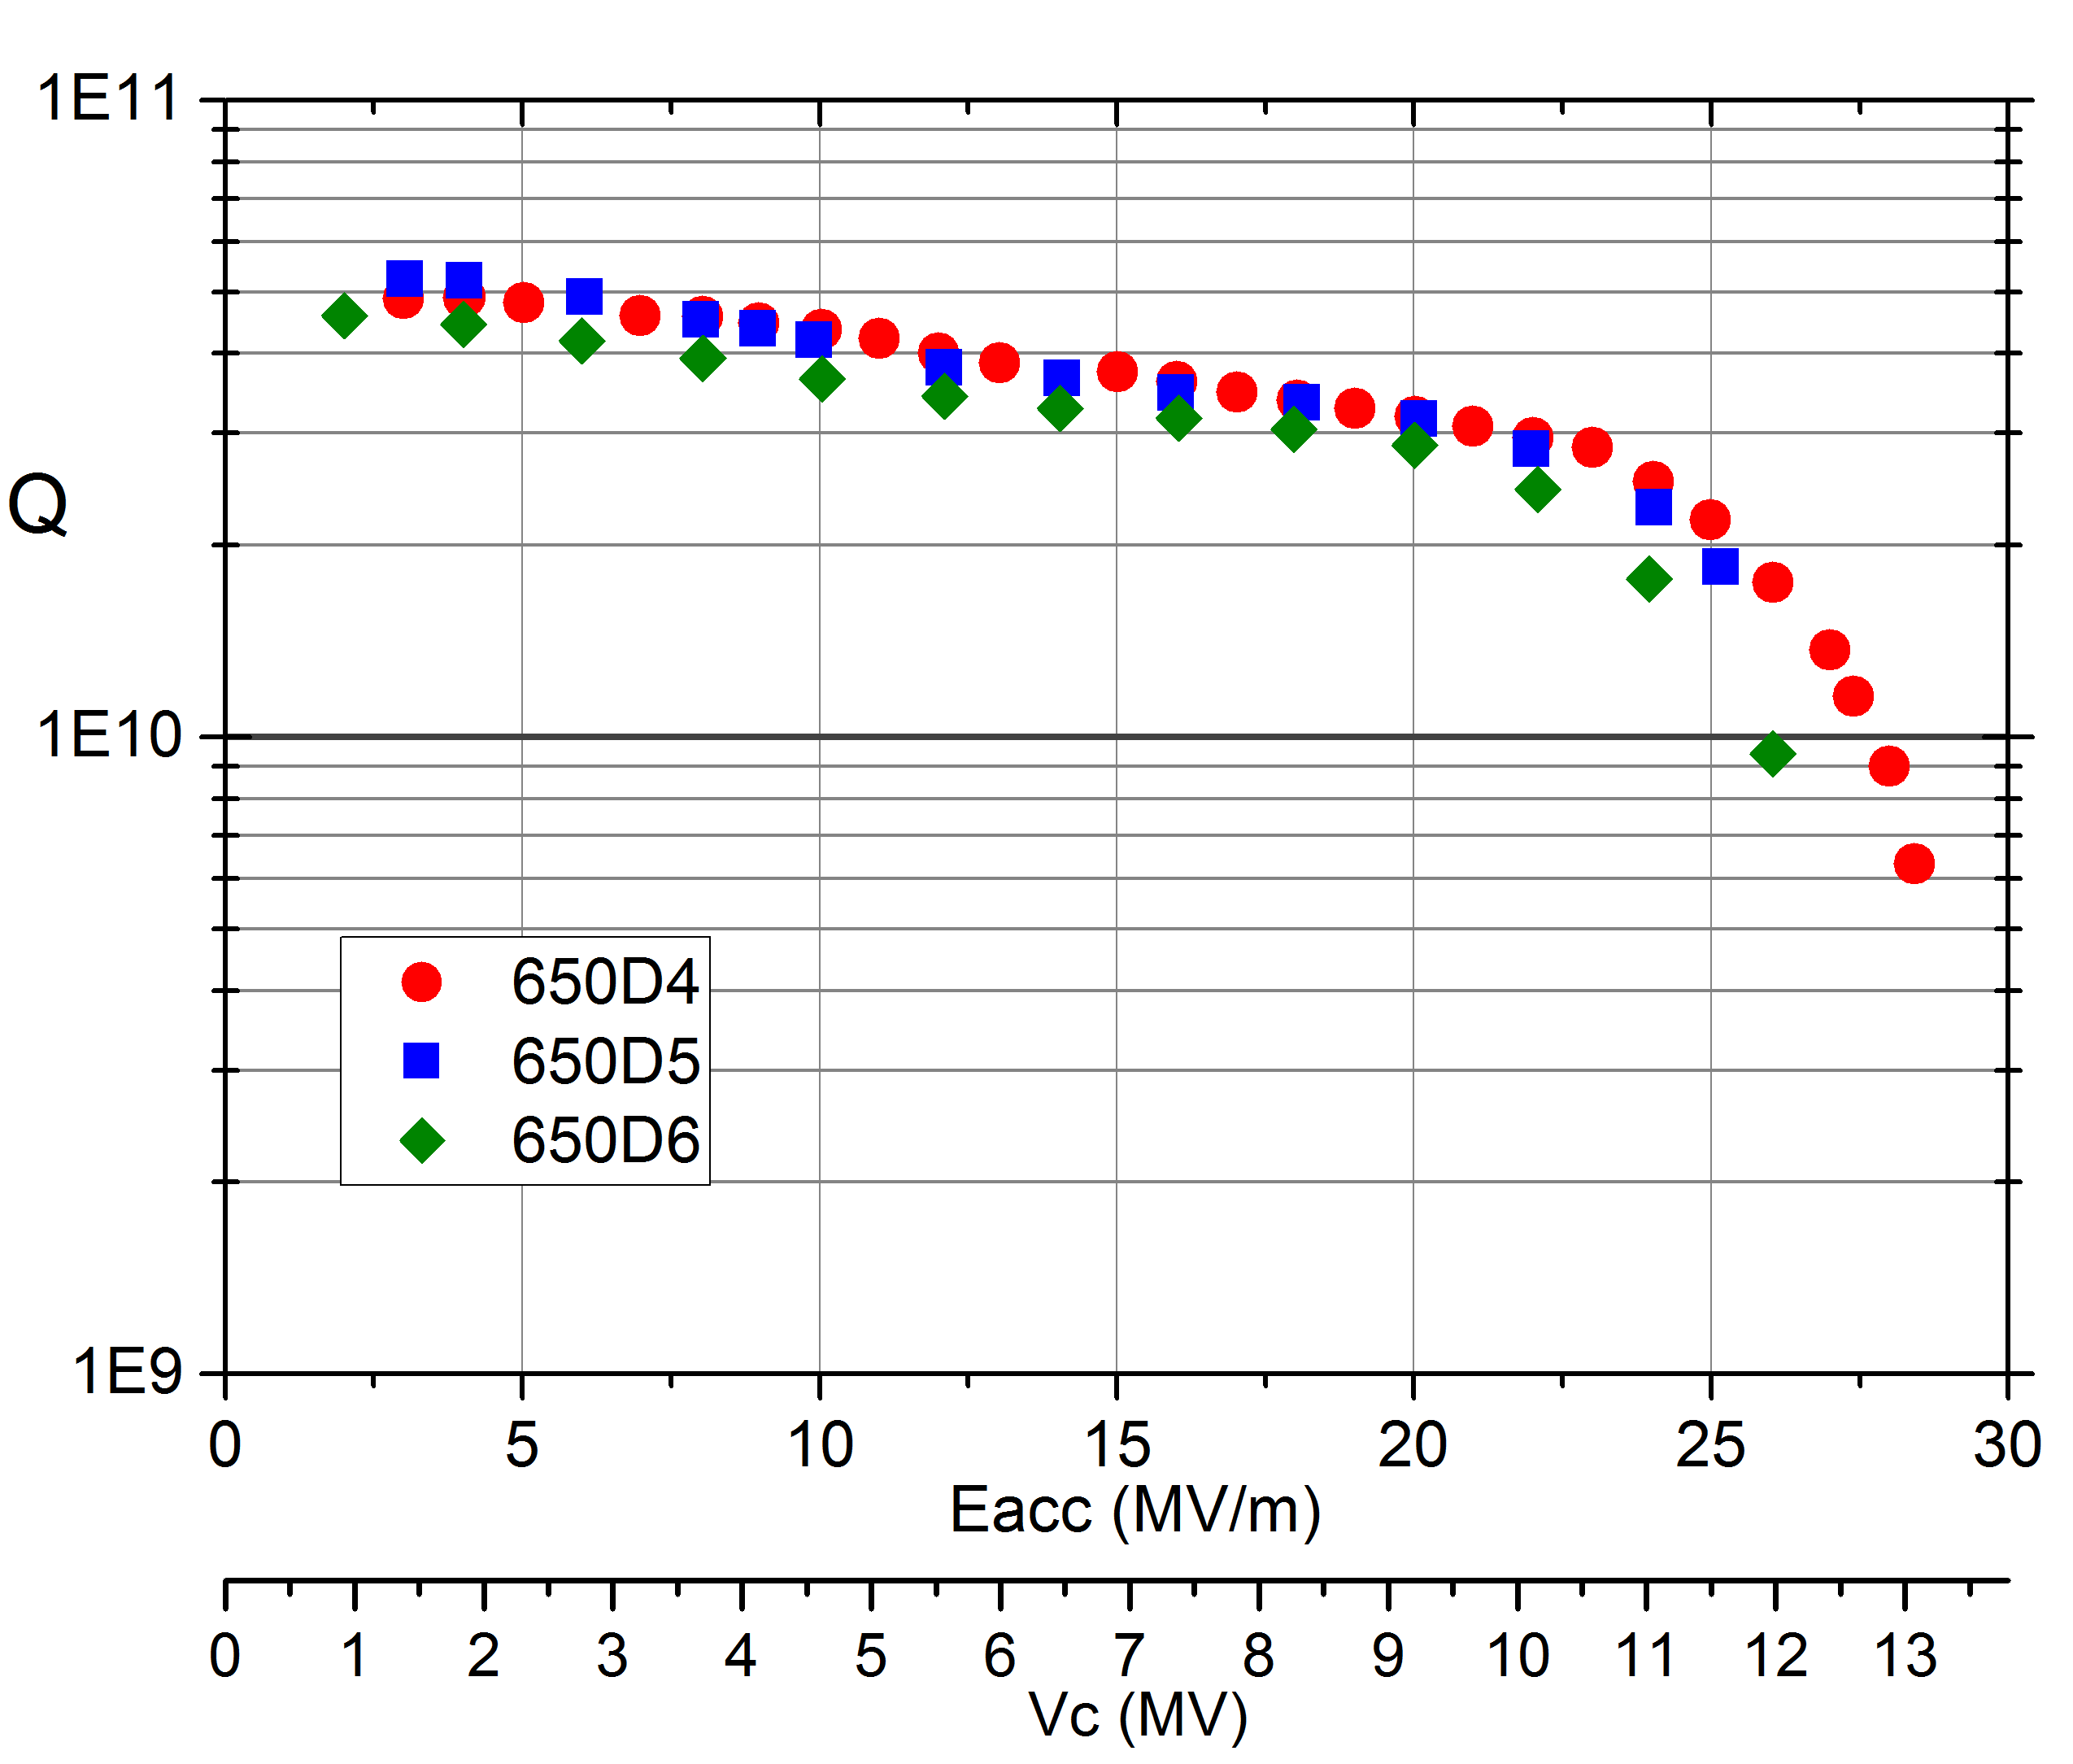
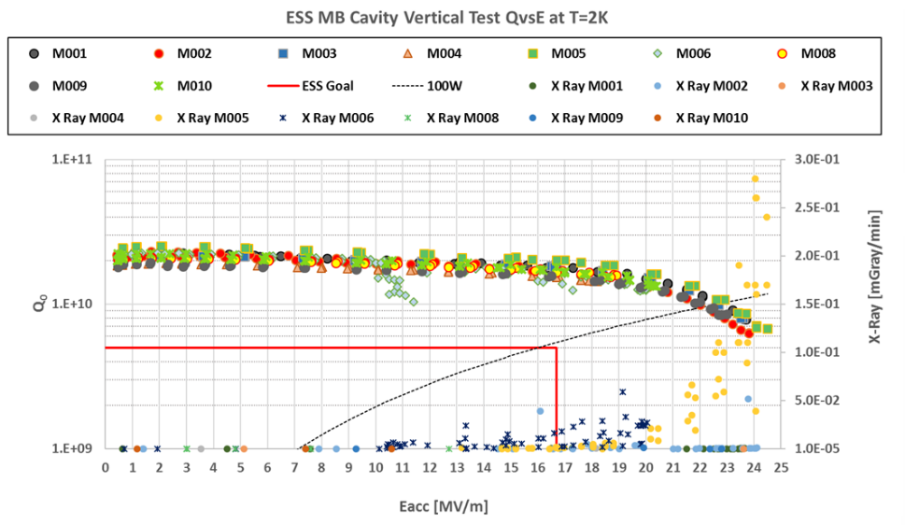
650 MHz 2-cell Cavity Vertical Test
The vertical test results of three 650 MHz 2-cell cavities (BCP process) all reached 3E10@20MV/m, which is similar as ESS 704 MHz β=0.67 6-cell cavities.
Scaling R/Q and frequency to 650 MHZ @ β=1 a Q₀ = 3-4E10 is expected @ 17 MV/m，Carlo Pagni, CEPC 2019 workshop.
Vertical test results of 650 MHz 2-cell cavities

Slide 17
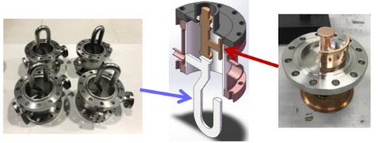
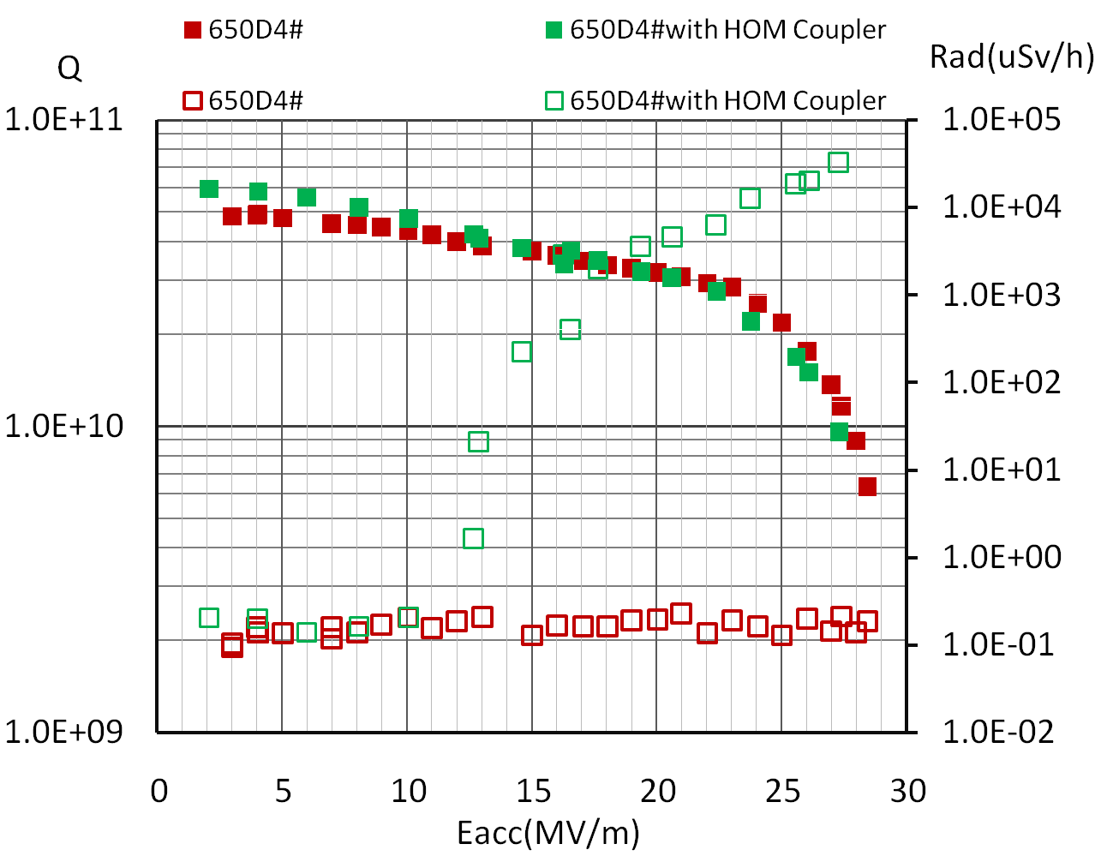
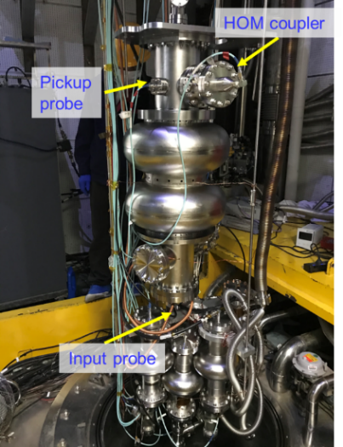
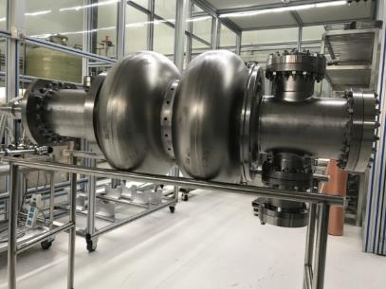
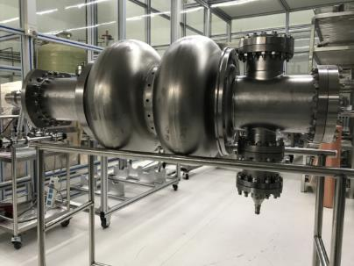
650 MHz 2-cell Cavity Vertical Test with HOM Couplers
Vertical test
The Q-Eacc curve remained the same after install HOM coupler. Field emission increased at low field, which may be resulted from the assemble with HOM coupler. The performance of HOM coupler was also verified at 2.0 K.

Slide 18
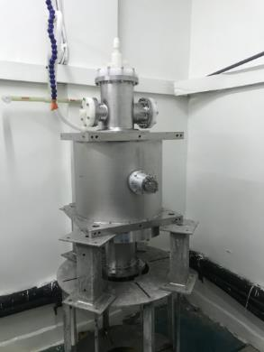
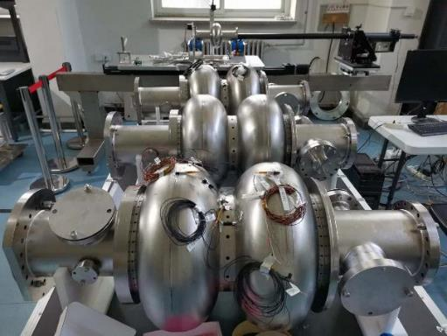






650 MHz 2-cell Cavity with Helium vessel
Cavity + 3 flux gates & 4 cernox
Measurement of magnetic shielding
BCP (inside/outside)
Assembly in Clean room
High pressure rinse
Vertical test (ongoing)

Slide 19







650 MHz 1-cell cavity (large grain)
BCP process and vertical test: 4.8E10@26MV/m
Cell after deep-drawing
Inspection
CEPC Spec
Cell after BCP of LG grain
Cell after BCP of fine grain (for comparison)

Slide 20

High gradient 650 MHz 1-cell cavity (large grain)
Two 1-cell LG cavities have completed Flexible polishing.
EP of 1-cell cavity is under commissioning, which began at 16 Nov 2020.
Abnormal EP current curves
  Wrong ratio of acids were found
  Flow meters were wrong
  Water found in gas source maybe lead some valve wrong.
The backflow rate abnormal for 2 times
  Pipes, pumps, components like flow meter were checked. A broken pipe was found
  The overflow hole on rotating sleeves are wrong.
Acid leaking for 2 times
  FKM(氟橡胶）seals are aged.
  A connector were not tighten in the upgrade
Pollution were found in acid for 3 times
  Once, it came from gear that the seal structure is not good.
  The other two times: because of cathode.
The two 1-cell LG cavities may receive EP process between Jan 4th and 10th, 2021.

Slide 21
Outline
R&D of 1.3 GHz cavities
R&D of 650 MHz cavities
Nb3Sn
Others
Plans

Slide 22



1.3 GHz Nb3Sn cavities
1E10@15MV/m
Sam Posen, Recent Nb3Sn Cavity Results from Fermilab, Nb3Sn SRF 20, 13 Nov 2020
1.3 GHz 9-cell cavity coating with Nb3Sn film at FNAL

Slide 23



650 MHz Nb3Sn cavities
At 4.2K
Schematic of a compact, meter-long e-beam SRF accelerator. The accelerator has a 4.5-cell 650 MHz cavity conductively coupled to the 4 K stage of four 2 W cryocoolers.
R C Dhuley et al 2020 Supercond. Sci. Technol. 33 06LT01
Vertical test result of 650 MHz 1-cell Nb3Sn cavity at FNAL

Slide 24






Nb cavity coating with Nb3Sn film at IHEP
3#: T_{C} ~18K
1#: T_{C} ~18K
XRD of Samples: nice polycrystalline Nb3Sn.

Slide 25






Cu cavity coating with Nb/Nb3Sn film at IHEP
Nb film coating
XRD showed the Nb film crystallized.
Nb3Sn film coating
Niobium plated cavity surface
Cu cavity coating with Nb/Nb3Sn by magnetron sputtering
张沛、戴劲、马永胜、杨馥羽、陈双凯……
XRD showed the Nb3Sn film crystallized.

Slide 26
Outline
R&D of 1.3 GHz cavities
R&D of 650 MHz cavities
Nb3Sn
Others
Plans

Slide 27



FeSe-Nb （S-S）结构的制备和表征
XRD、SEM、AFM
M-H 测试
国际上首次在Nb上生长出超导的FeSe。
FeSe-Nb结构的B_{c1}高于单层薄膜。
FeSe薄膜能生长在弯曲的Nb衬底，且结合力强。
Supercond. Sci. Technol. 34,015001 (2021)

Slide 28





Fe(Se,Te)-CeO2-Nb S-I-S 结构制备和表征
Nb film
Ra=2.83 nm
CeO₂-Nb
Ra=3.46 nm
XRD
AFM
AFM
Fe(Se,Te)成<00l>取向
绝缘层CeO2平整度与Nb层相当，厚度约50nm
初步制备出超导的Fe(Se,Te)，Tc约为4 K
下一步：提高Fe(Se,Te)薄膜质量
M-T测试
铁基超导腔模型（~200MV/m）

Slide 29




超导腔用于暗物质（轴子）探测
High Q
“0” gradient
Strong B field
Low temperature
经过调研，确定了技术方案：首选YBCO（H_{C2}最高），其次是铁基和Nb3Sn。
已经订购材料，准备采用加热和高压的方法，研制YBCO块材的谐振腔，频率~7GHz。
2020年，获批一项自然科学基金面上项目（超导材料用于轴子探测的前沿研究，12075270）。
韩国CAPP实验的超导腔（YBCO带材）（TM010: 6.89GHz; TM011: 7.23GHz）
超导腔工作在~20T的强磁场里，其高Q特性可以大幅提高轴子探测的灵敏度！

Slide 30
Outline
R&D of 1.3 GHz cavities
R&D of 650 MHz cavities
Nb3Sn
Others
Plans

Slide 31
CEPC超导高频系统五年规划（2021-2025）
TDR Phase 1: 2019-2020 (Components Prototyping)
SRF system TDR design and optimization
High Q, high gradient cavity, high power components and other key technology R&D
650 MHz high Q short cryomodule prototyping
PAPS SRF facility construction
TDR Phase 2: 2021-2022 (System TDR Design, Cryomodule Prototyping)
SRF system TDR design re-baseline and optimization
650 MHz high Q short cryomodule operation and improvement (to meet CEPC spec)
1.3 GHz high Q full cryomodule prototyping (to meet CEPC spec)
SRF facility (PAPS commissioning, operation and upgrade)
Industrialization (in synergy with other SRF projects in China)
Post-TDR: 2023-2025 (Cryomodule Prototyping, Mass-Production Preparation)
650 MHz full cryomodule prototyping?, engineering design, mass-production technology preparation
650 MHz Z-pole high current cryomodule design

Slide 32

十四五规划-重点培育（CEPC牵引）
2021年-2025年的发展目标：国际先进的高梯度、高品质因数超导腔及模组预研和产业化，批量用于国内大型超导加速器。同时，新材料超导腔研发取得突破。
2021年-2025年的预期成果
650 MHz大晶粒腔达到3E10@40 MV/m
650 MHz 2x2-cell模组达到CEPC指标
1.3 GHz高梯度9-cell腔批量超过ILC指标
1.3 GHz高Q 9-cell腔模组批量达标并运行
铌三锡超导腔达到1E10@20 MV/m@4.2K

Slide 33
十四五规划-重点培育（CEPC牵引）
高性能超导腔和超导模组研发及应用。在高品质因数、高加速梯度、高功率超导腔及相关技术前沿取得突破，部分实现国际领先。完成高性能超导腔模组的研制及产业化批量制造，满足五年内国内大型超导加速器建设的迫切需求，为CEPC和ILC建造做技术和人才储备。
射频超导新材料、新技术研发。包括铜腔镀铌、铌三锡镀膜、高温超导薄膜、柔性抛光等，并将其应用到加速器超导腔、暗物质探测等领域，用于CEPC超导腔或升级。
现有资源条件：高频组现有职工21人，研究生12人，共计33人。除高能光源外，主要依靠横向项目和自主申请的竞争性小项目。已建立玉泉路园区和怀柔平台两处超导高频实验设施。
国内外地位：因国内外大型先进超导加速器项目纷纷上马、竞争激烈，高能所处于项目劣势，需凝练研究方向、持续进行前沿技术攻关并深度参与国内项目建设，方可确保目前的国内领先地位，并进入世界前列。以铌三锡为代表的下一代超导腔技术发展迅速并可能实现民用，必须在这一领域有所突破，才能跟上国际发展。
所需保障措施：扩充支撑人员及培养企业人员，铌三锡超导腔有关设备，怀柔平台运行和升级费用。

Slide 34
1、高性能纯铌超导腔 | 电抛光、柔性抛光、大晶粒铌材、掺氮和中温退火、新工艺 | 650 MHz超导腔达到3E10@40MV/m 1.3 GHz超导腔达到2E10@45MV/m | CEPC以及其它射频超导加速器
2、铌三锡薄膜超导腔及超导腔镀膜技术研究 | 一、采用不同镀膜方法（高温蒸镀、高功率脉冲磁控溅射、直流磁控溅射）和基底（高纯铌、高纯无氧铜）制备不同频率的薄膜超导腔。液氦浸泡冷却下达到垂直测试指标。 二、搭建超导腔传导冷却垂直测试系统（无液氦），进行垂直测试。 三、设计和研制铌三锡超导腔模组（液氦浸泡或传导冷却），进行水平测试、争取进行束流实验。 | 一、掌握薄膜超导腔的关键技术。 二、4.2K温度下垂直测试，1.3 GHz铌三锡超导腔达到1E10@20MV/m，650 MHz铌三锡超导腔达到1.5E10@20MV/m。 三、完成一台铌三锡超导腔模组。 | 一、运行在4.2K的铌三锡超导腔将使CEPC的低温功耗相比铌降低3倍以上，大幅降低CEPC的建造和运行费用，尤其是ttbar升级。CEPC若使用铌三锡薄膜超导腔，将是对高能对撞机和加速器技术发展的重大贡献。铌三锡潜在的高梯度性能（两倍于铌）也将为未来高能超导加速器提供必需的技术。 二、因4.2K下Q值很高，铌三锡超导腔可采用脉管制冷机传导冷却，将使超导加速器首次摆脱庞大而昂贵的大型液氦制冷机系统，实现超导腔小型化，改变全球加速器产业格局。 | 因超导腔比常温腔具有能量效率高的显著优势（微波功率几乎全部被束流吸收，而不是大部分损耗在腔壁上），采用脉管制冷机的铌三锡超导加速器的造价和运行费用甚至低于常温加速器，有望取代相当一部分常温加速器，广泛应用于工业和医疗等领域，具有巨大的应用需求。

Slide 35
Thanks for your attention!

Slide 36


LCLS-II布局

