Slide 1
The Collaboration with CERN Control Group
Presented by Gang Li
CEPC Day, Dec.28, 2020

Slide 2
Collaboration has a future
CEPC: A super large scale project
Controlled device: Hundreds of thousands
EPICS PV: Tens of millions
Control system: All in control
The design of control system is iterative, with the development of technology

Slide 3
Collaboration has a future
Hardware Platform
COTS (commercial off-the-shelf): ATCA/uTCA, PLC, etc
Co-developed or self-developed products: WhiteRabbit, etc
Software Platform
EPICS
FESA
TANGO
Etc

Slide 4
Collaboration: Timing system-WR
Trigger
RF reference
Timestamp
定时系统：
产生一系列精确的时序信号，使加速器的特定设备在重复周期内按照一定的时序工作，确保束团注入到高频俘获区（bucket）内，使束流强度达到预设值。
向束流测量和谱仪亮度测量等设备发送触发信号和时钟参考信号，为数据获取，提供时间基准。

Slide 5
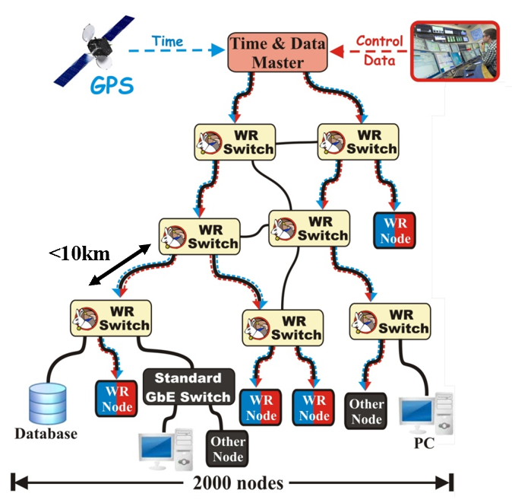
Timing system: White Rabbit Fieldbus
CERN and GSI initiative for control & timing
Fieldbus
Ethernet
Determinism & Reliability
Synchronization
Initial specs: links ≤10 km & ≤2000 nodes
Many applications worldwide
A prototype tested in operation: <10 ps jitter, ESRF
A prototype: <100 fs jitter and <10 ps reproducibility over reboots, CERN
White Rabbit materials from ：
https://indico.cern.ch/event/913576/
https://www.ohwr.org/projects/white-rabbit/wiki/overview
https://www.ohwr.org/projects/white-rabbit/wiki/jun2018meeting

Slide 6
Ethernet
Timing system: White Rabbit fieldbus
WR switch
WR switch
Up to 2000 nodes
WR switch
WR
node
Copper or fiber medium
WR switch
WR
node
WR
node
WR
node
Up to 10 Km fiber links
WR
node
WR
node
WR
node
WR
node
WR
node
Bandwidth: 1 Gbps
WR
node
WR
node
WR switch
WR
node
WR switch: 18 ports
WR
node
WR
node
Add/ Remove nodes dynamically
WR
node
WR
node
other GbE switch
other
node
Non WR devices
other
node
other
node
Ethernet Features (VLAN) & Protocols (SNMP)

Slide 7
Deterministic & Reliable
Timing system: White Rabbit fieldbus
Determinism is the guarantee that packet transmission delay between two stations will never exceed a certain boundary.
Reliability is the ability of a system to provide its services to clients under both routine and abnormal conditions.
Topology Redundancy
Data Resilience with Forward Error Correction schemes
WR switch
WR switch
FEC
WR switch

Slide 8
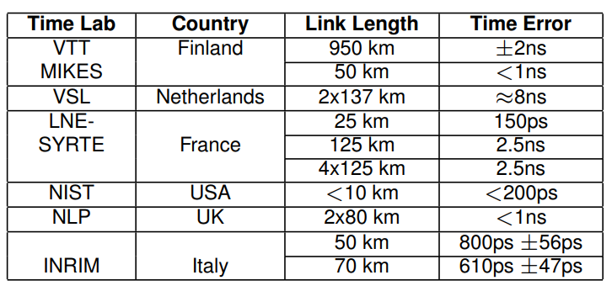
Synchronization Offset Adjustment with Enhanced Precision Time Protocol
Timing system: White Rabbit fieldbus
PTP synchronizes the local clocks with the master clock by measuring and compensating the delays introduced by the link.
System Timing Master
Timing Master
WR Switch
Timing Master
WR Switch
Common notion of time
WR switch
WR switch
WR switch
WR
node
WR
node
WR
node
WR
node
WR
node
WR
node
WR
node

Slide 9
White Rabbit: Trigger

Slide 10
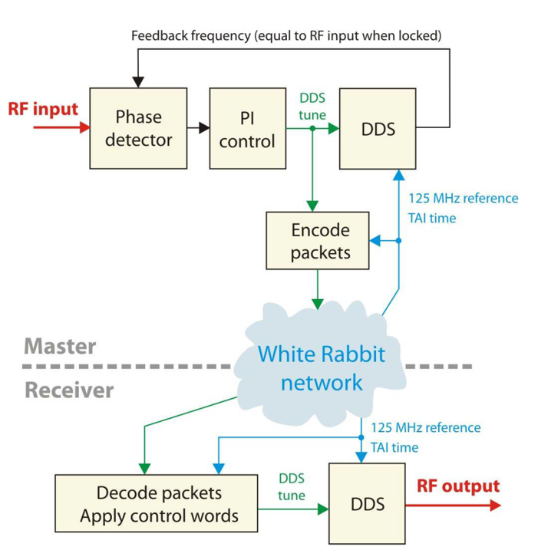
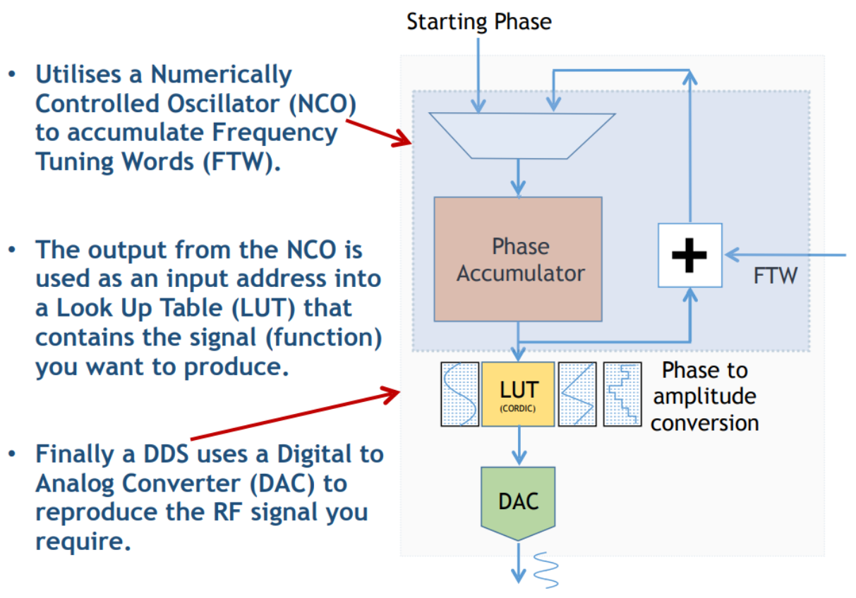
White Rabbit: RFoWR

Slide 11
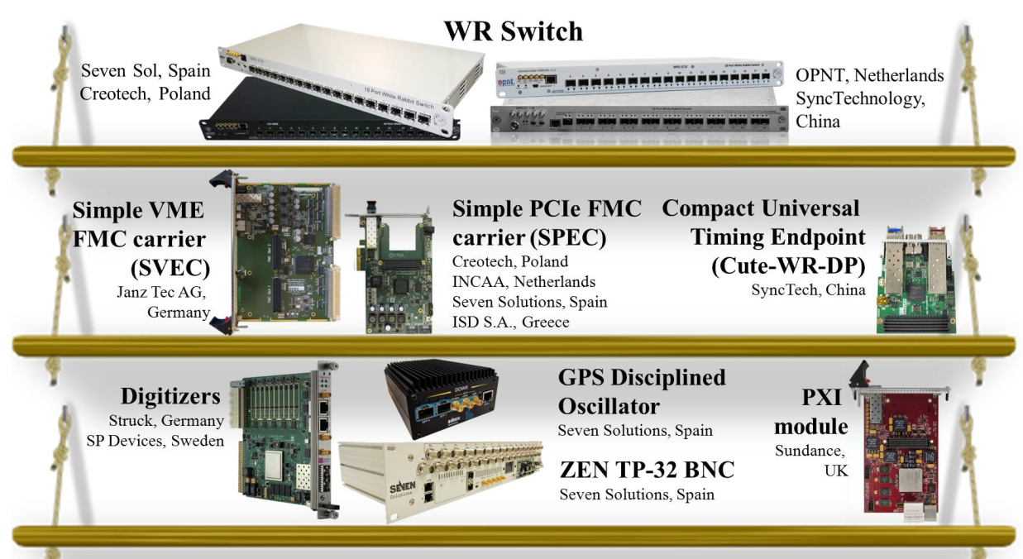
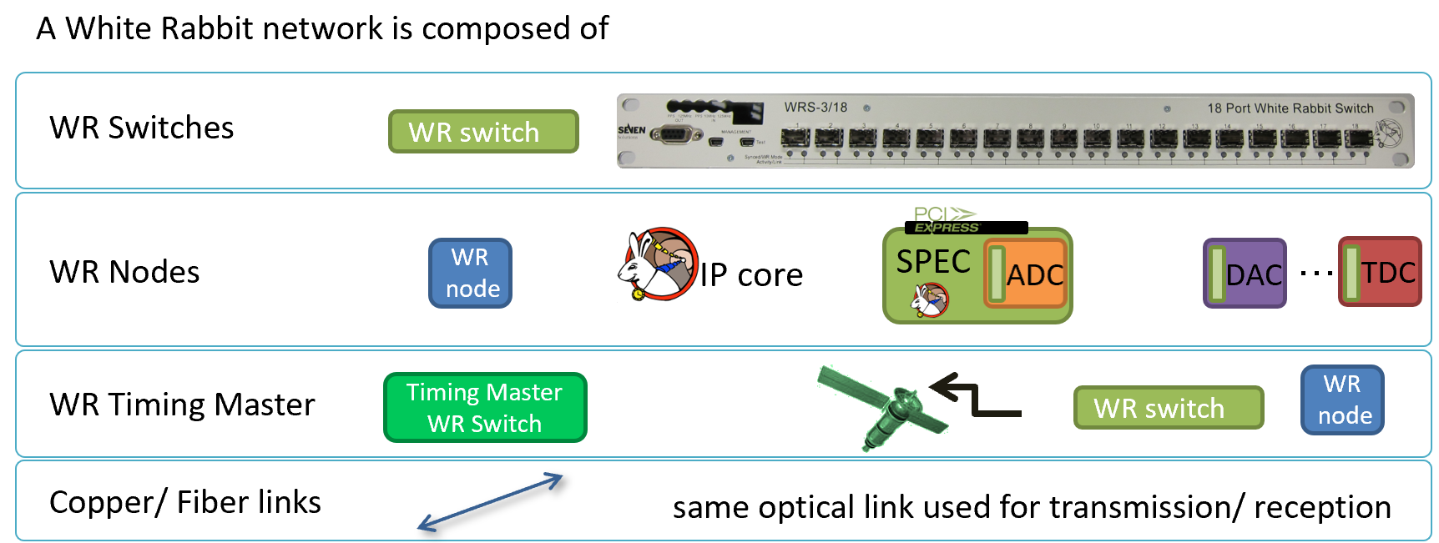
White Rabbit: Component

Slide 12
White Rabbit: Component costs

Slide 13
White Rabbit VS standard PTP

Slide 14
Collaboration: What and Who and How
WR Switch
COTS
WR Node
Some of COTS
Some of customized devices
更鼓，信科太
WR Switch
SHINE and IMP
Customized Node
CERN
all
CERN and Company
Send young people to CERN
Participate in workshop and international meeting
Prototype based on product from 更鼓 or 信科太
Apply for fund

Slide 15
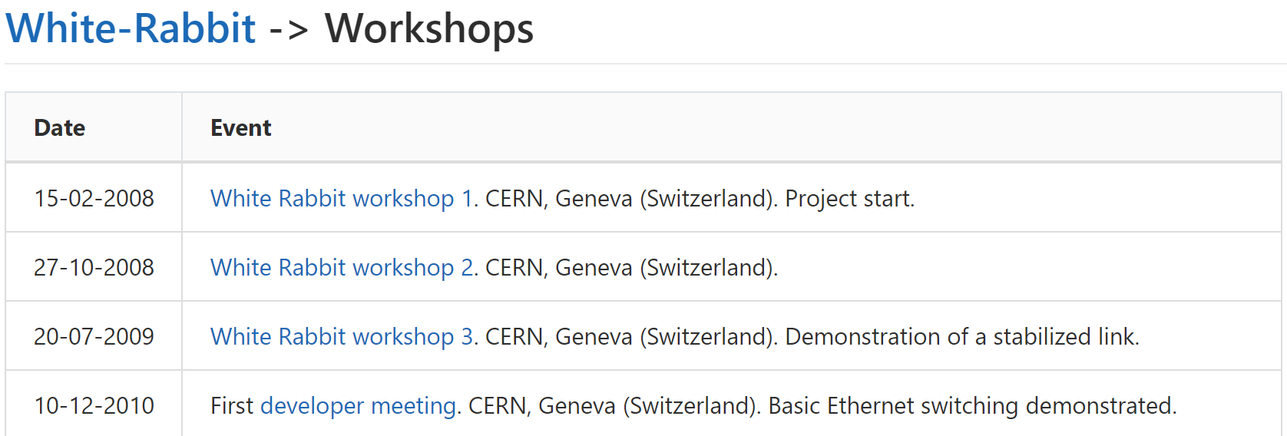
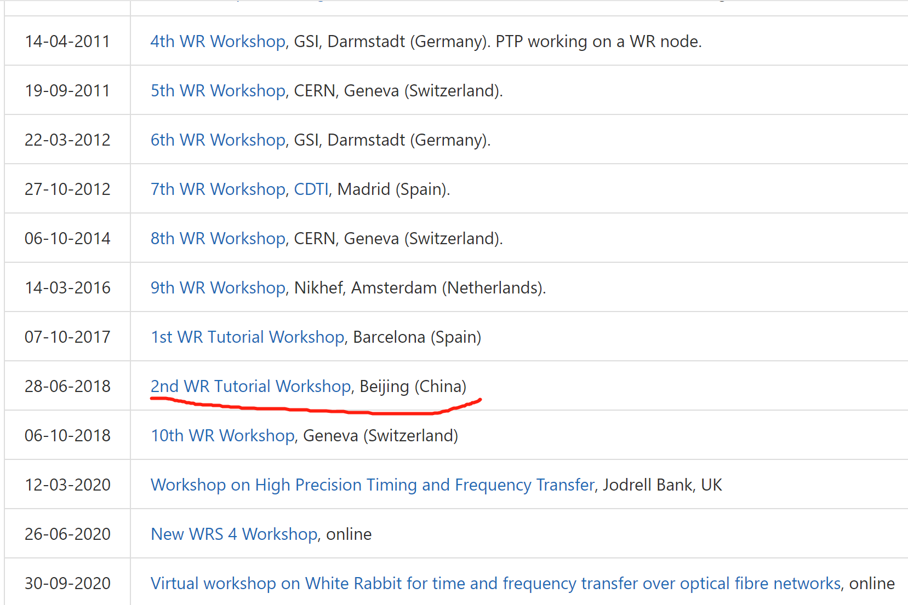
Collaboration: Conference and workshop
International conference and workshop
https://icalepcs.org/conferences.html
https://ohwr.org/project/white-rabbit/wikis/Workshops

Slide 16
Reference
https://ohwr.org/project/white-rabbit/wikis/WRpresentations
https://www.ohwr.org/projects/white-rabbit/wiki/jun2018meeting
https://indico.cern.ch/event/913576/

Slide 17
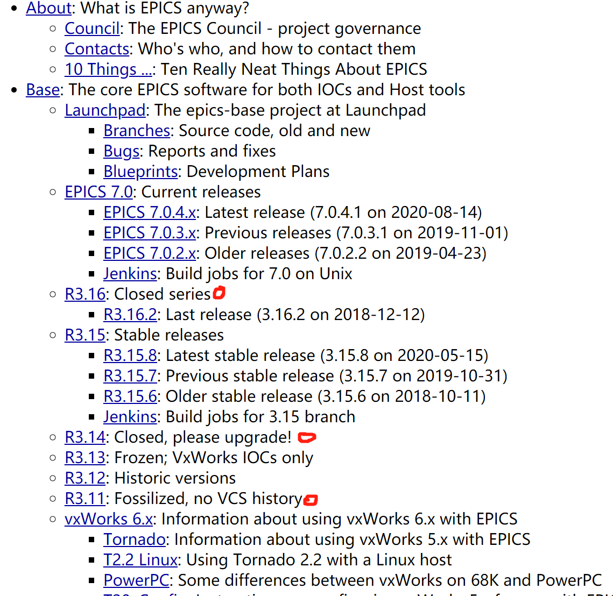
Summary
WR: CERN and others
EPICS：Cooperate with EPICS community
Thanks a lot!

