Slide 1
Recent Progress on CPI
e+ Acc. & Experiments
Dr. Dazhang LI from AC, IHEP
on behalf of THU-IHEP AAC group

Slide 2
Outlines
e+ acc.: key issues and our method
Experiments results and timetable
Brief introduction to e- acc. progress
Summary & 2021 plan

Slide 3
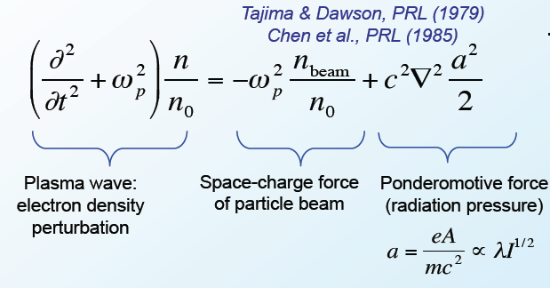
Plasma-based wakefield acceleration
Drive Beam:
laser pulse
e- bunch
proton beam
…………
A “proper” wakefield means:
Longitudinal wakefield is similar for each particle
Transverse wakefield can provide strong focusing force
Plasma wave excitation, 1~100GeV/m gradient
3

Slide 4
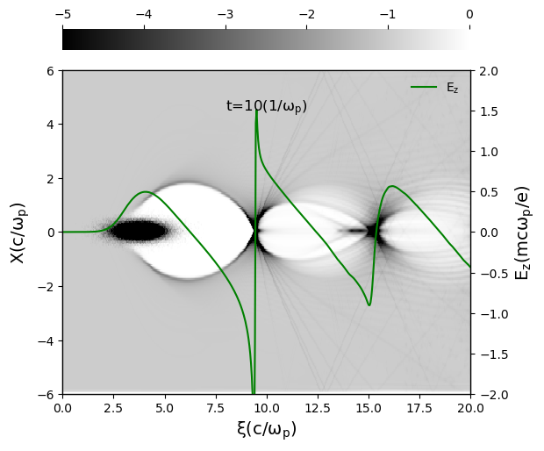
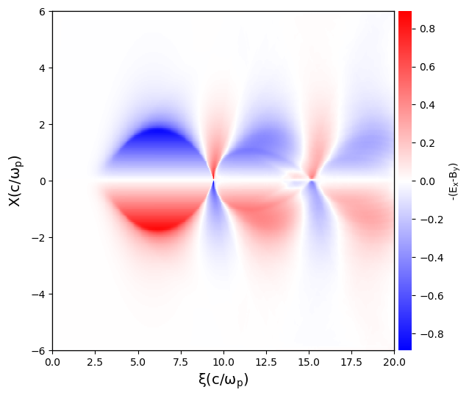
Blowout regime for plasma acc.
e+ beam loading
e- beam loading
Perfect for e- acc., poor for e+ acc.
4

Slide 5
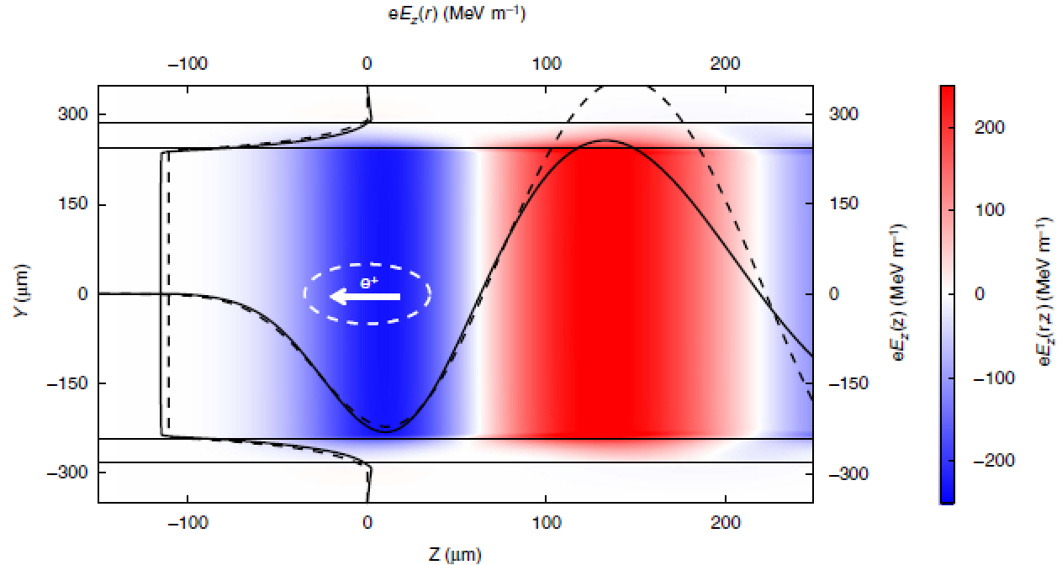
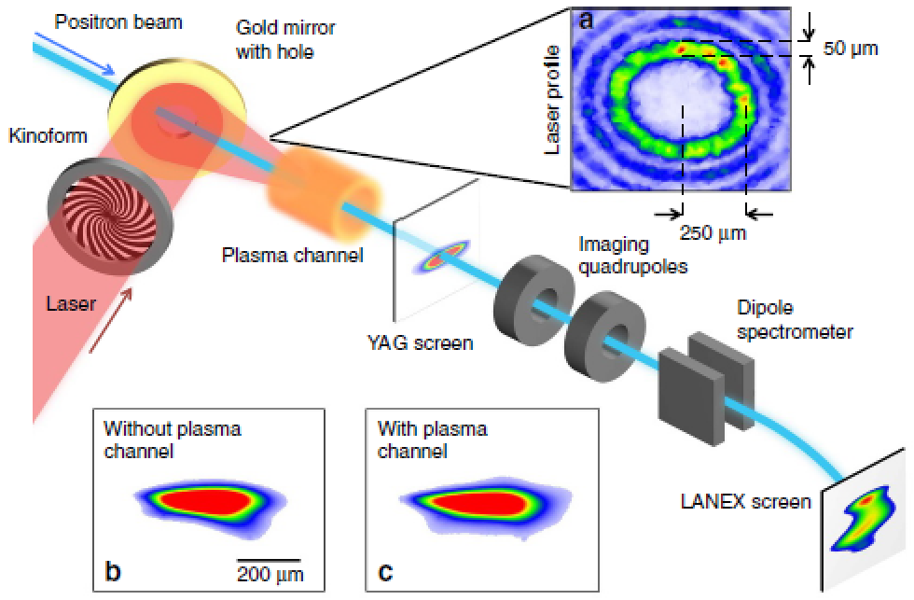
Methods for plasma based e+ acc.
Hollow channel: very sensitive to the misalignment
5

Slide 6
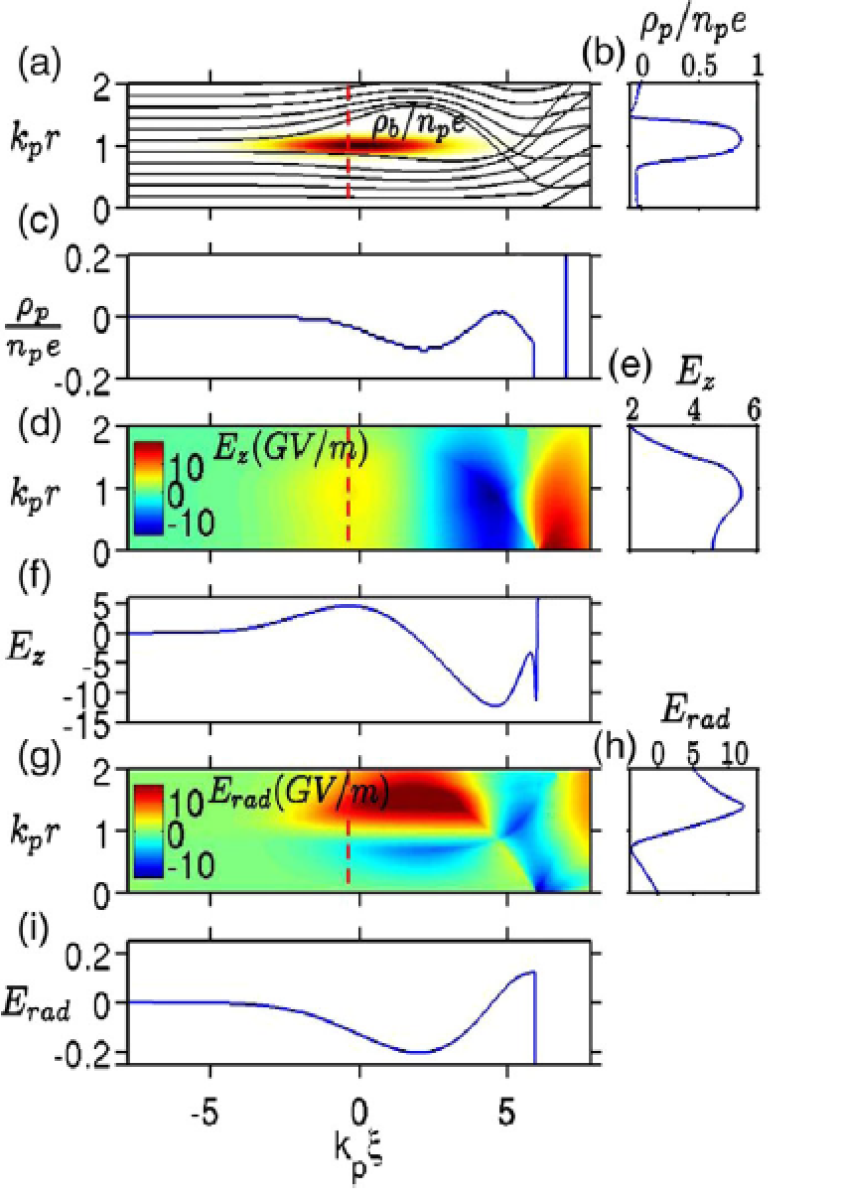
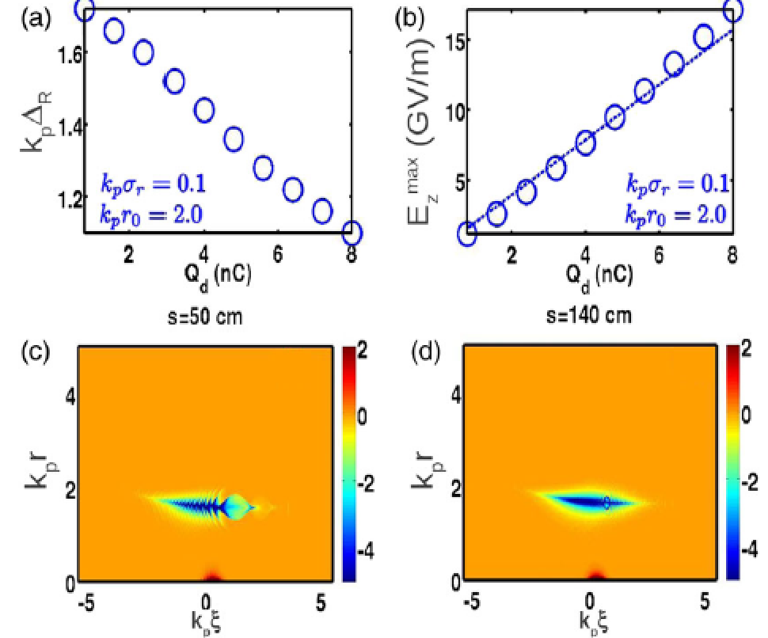
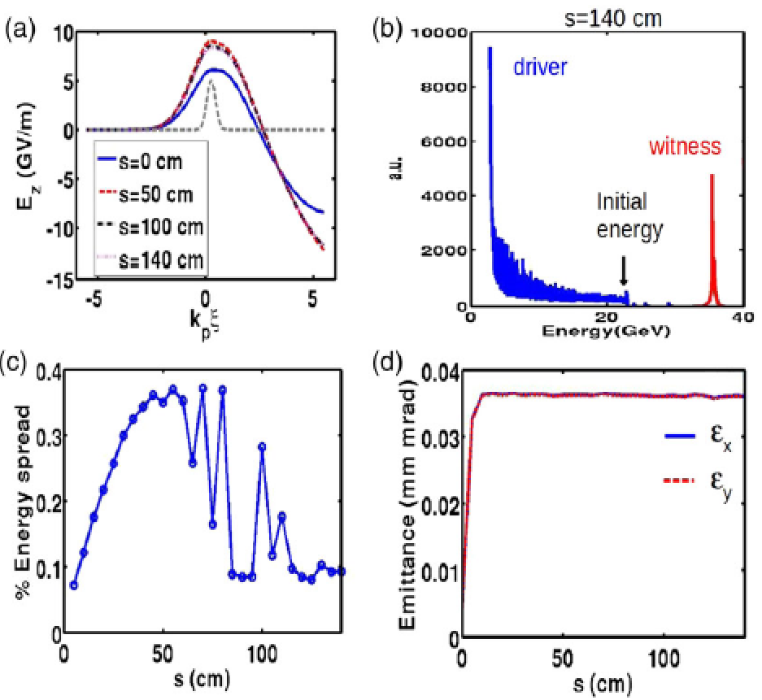
Methods for plasma based e+ acc.
Hollow e- driver: very low energy transfer ratio
6

Slide 7
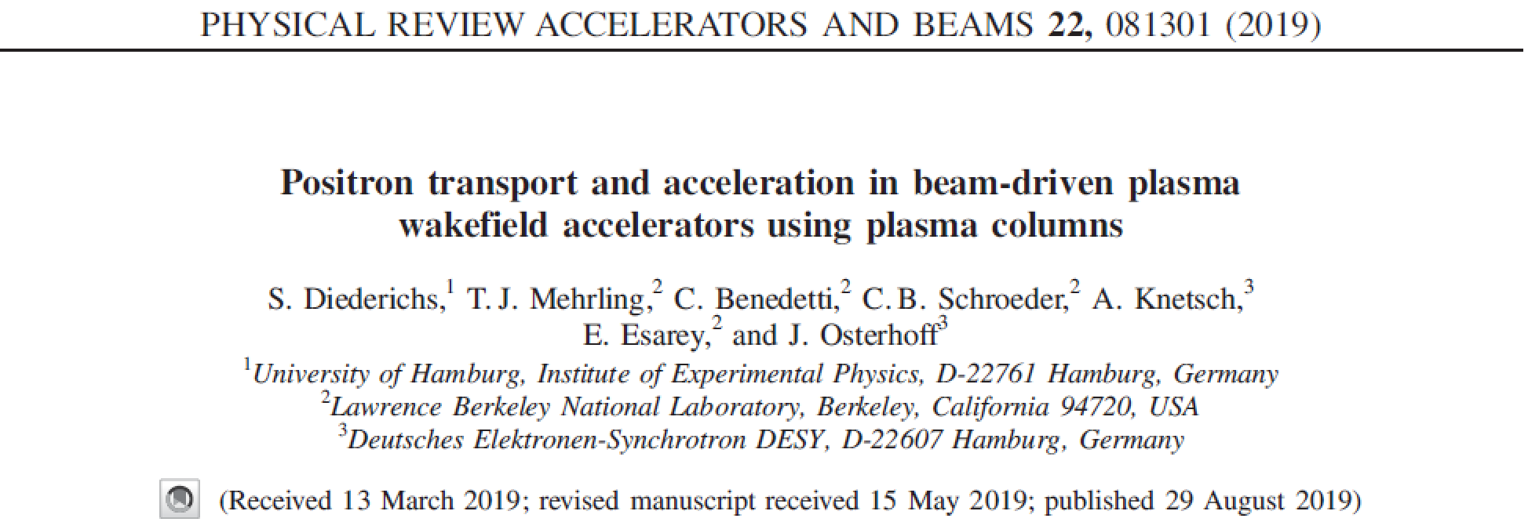
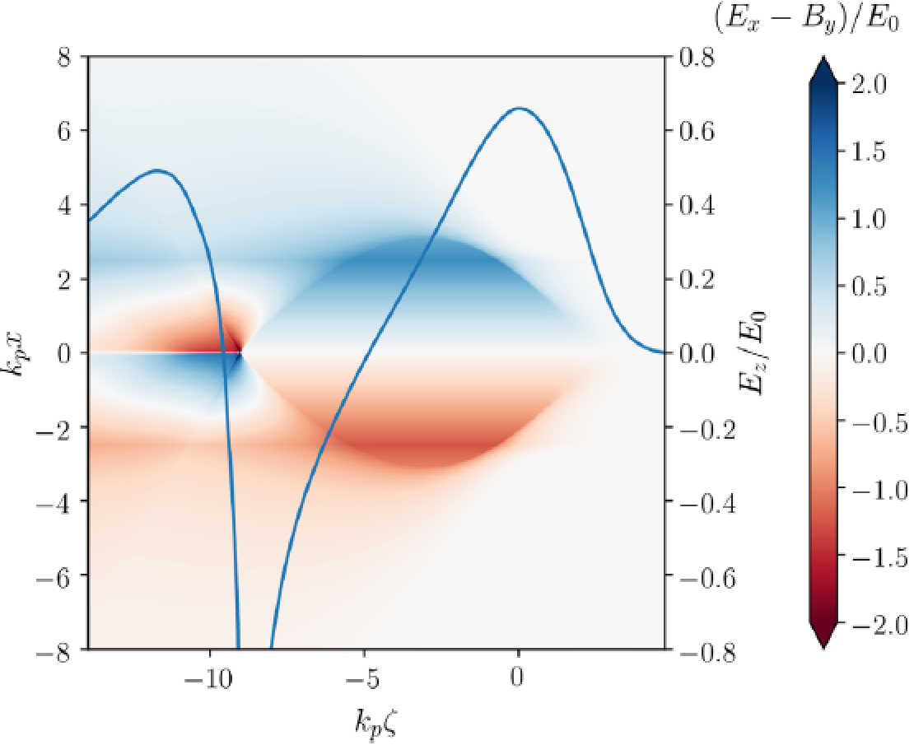
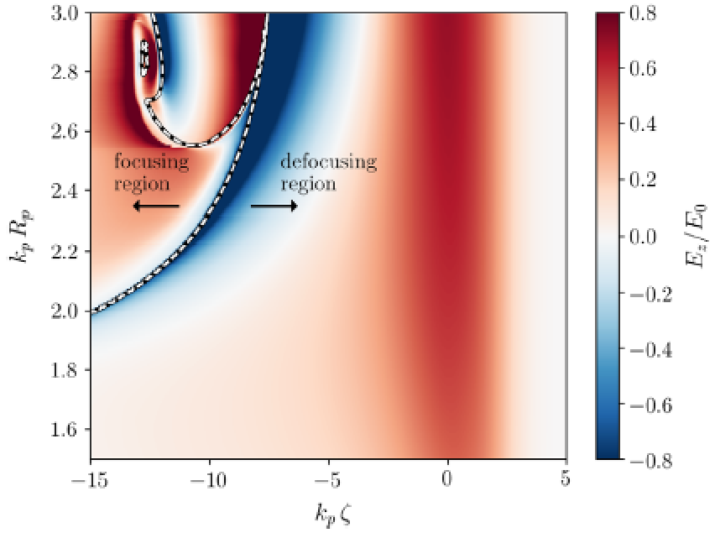
Methods for plasma based e+ acc.
Finite-radius plasmas: nonlinear Ez in transverse plane
7

Slide 8
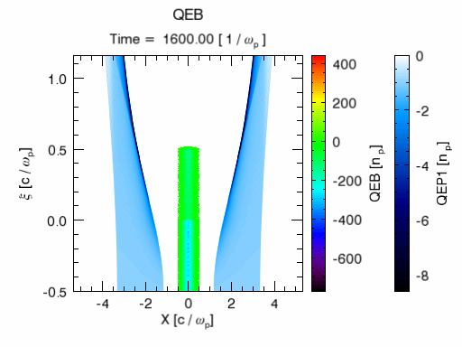
e+ acc. V1.0 → hollow channel (CDR)
High efficiency 60%
Low energy spread ~0.5%
Small emittance growth
Need e- driver, e+ trailer and plasma channel coaxial, not very practical
Simulation performed by Dr. S. Y. Zhou and Prof. W. Lu (2018)
8

Slide 9
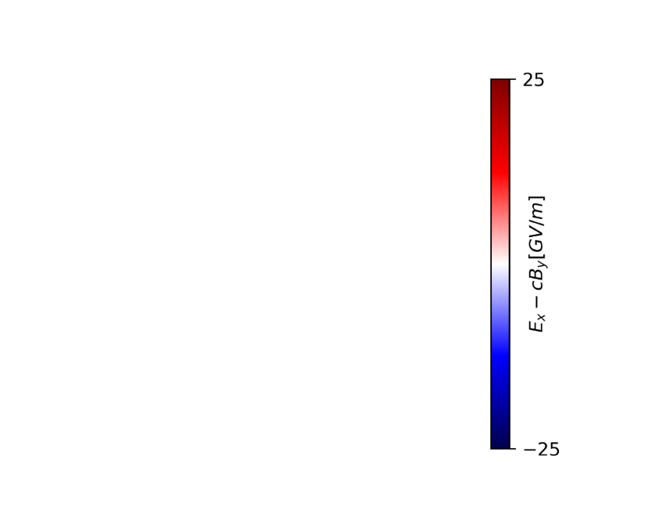
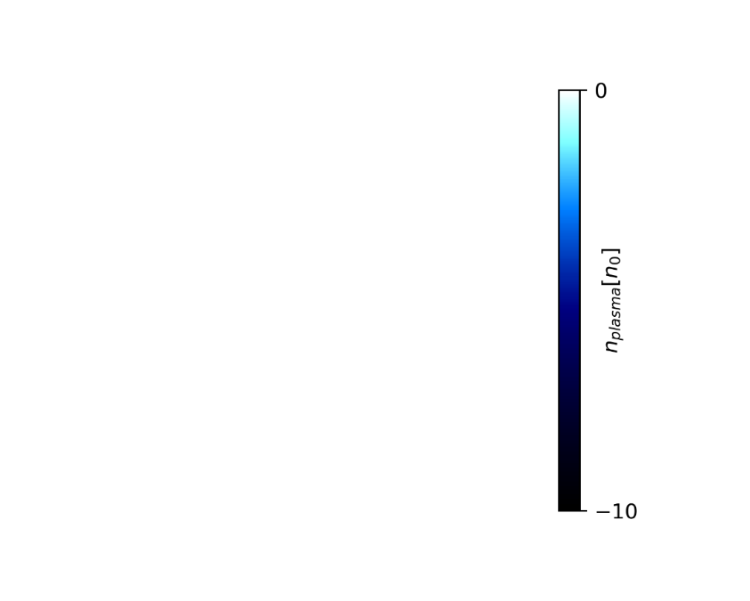
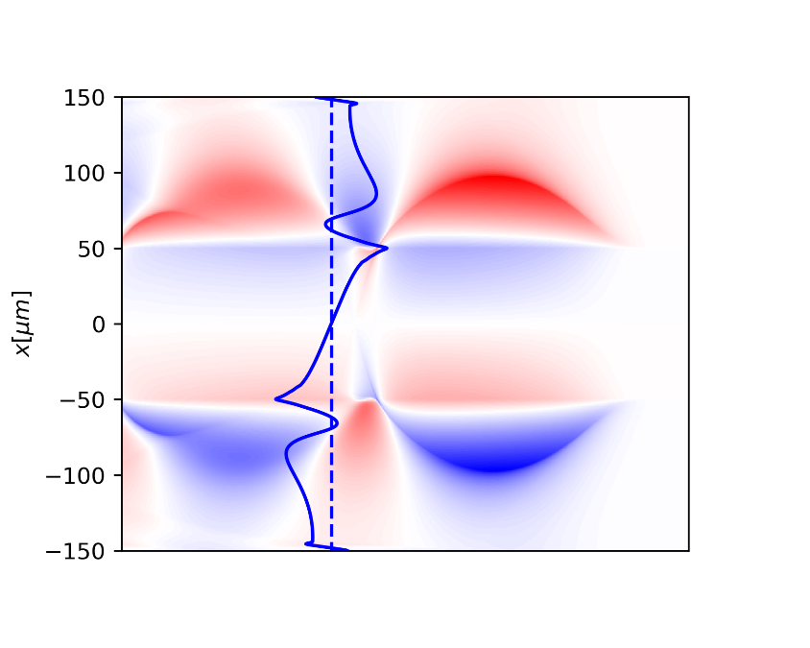
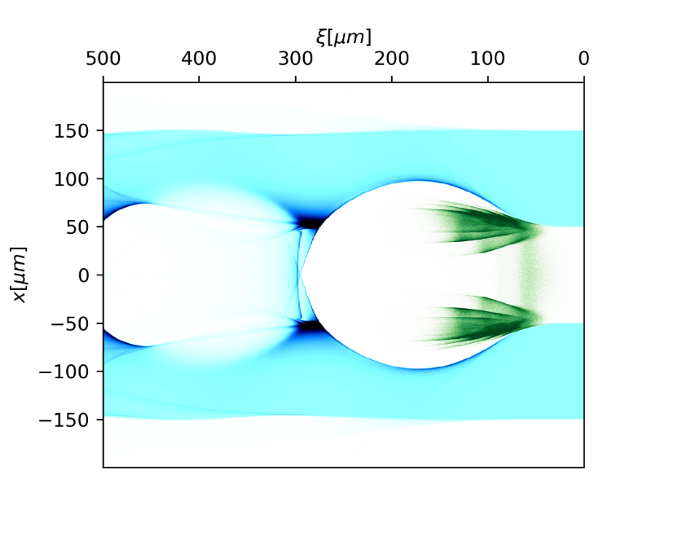
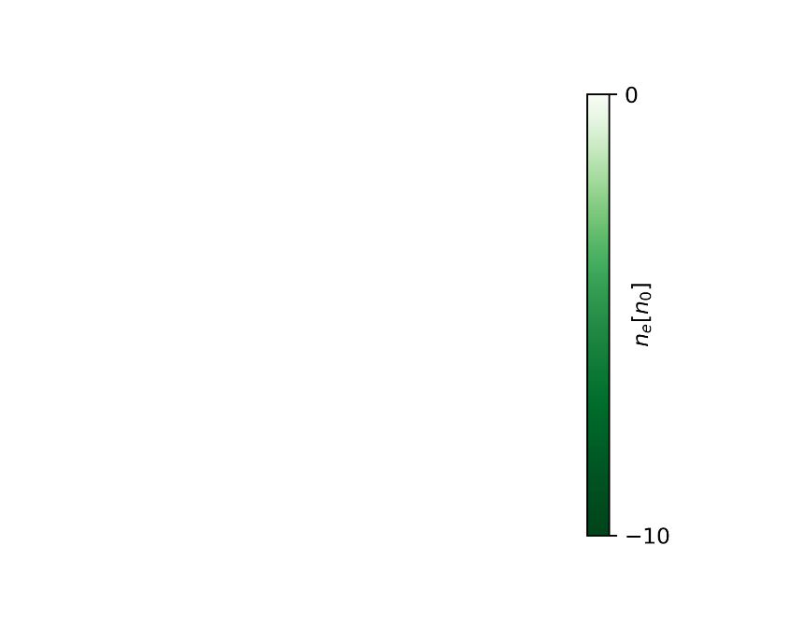
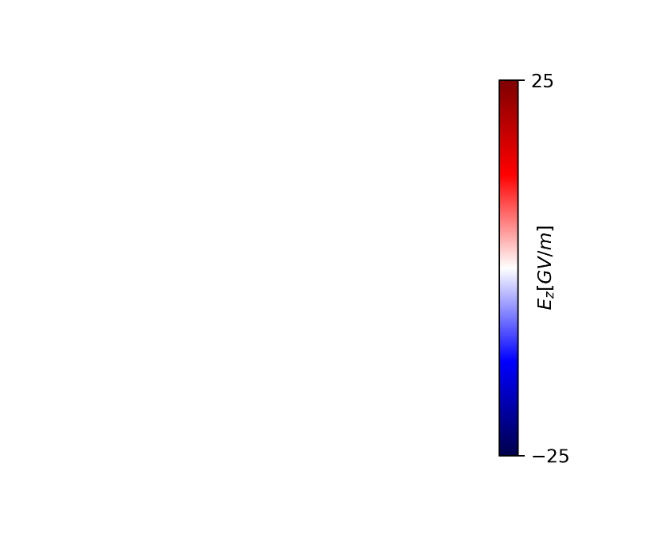
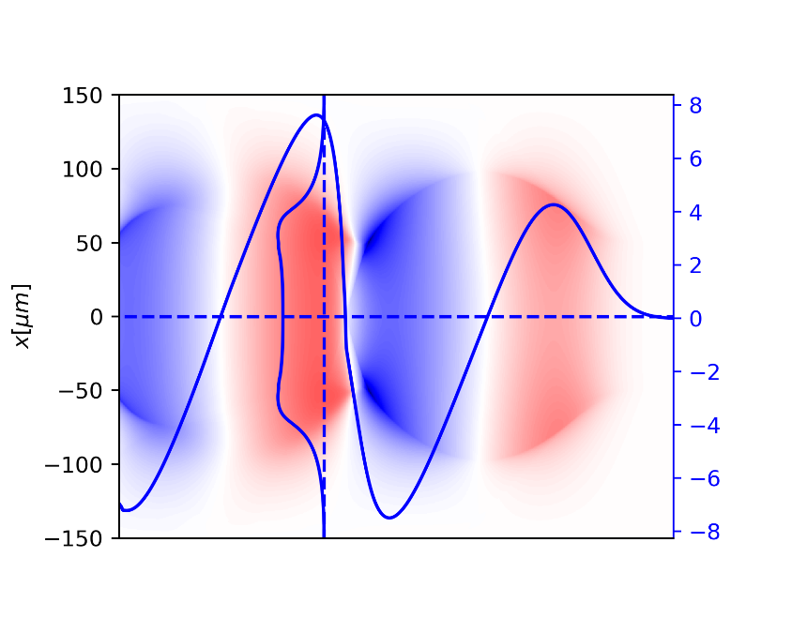
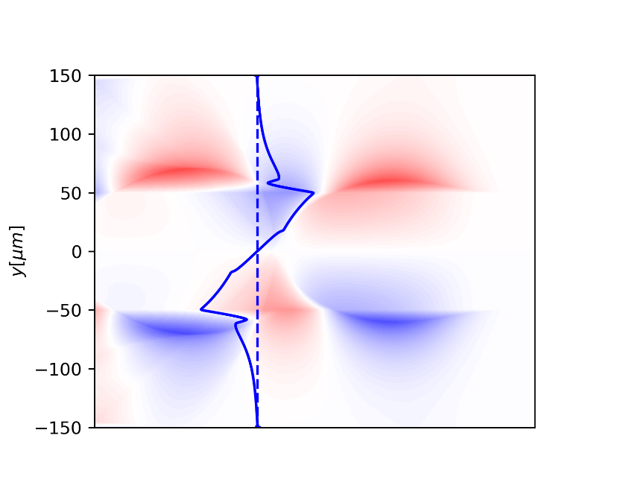
e+ acc. V2.0 → asymmetric e- in h.c.
9

Slide 10
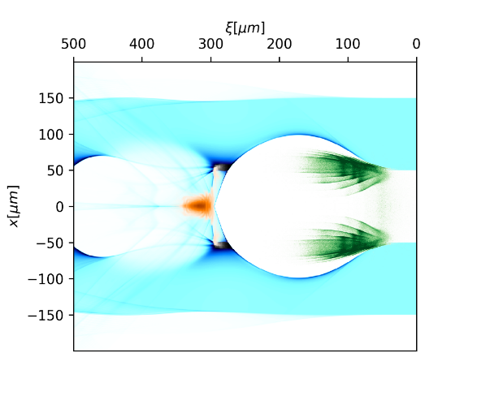
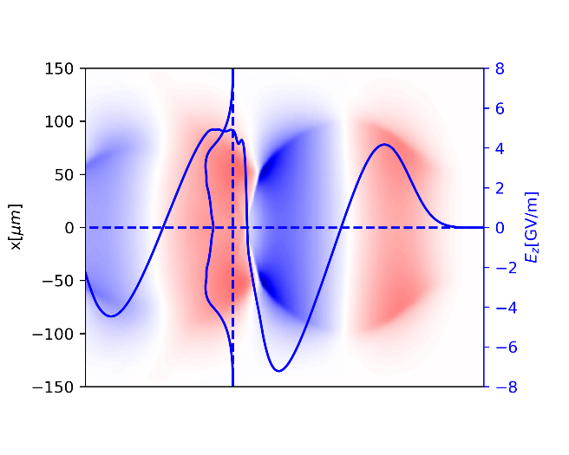
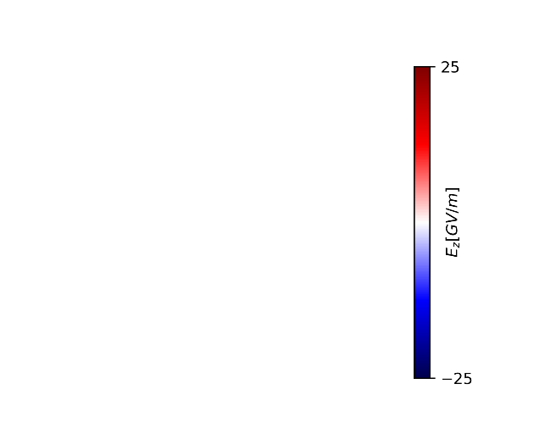
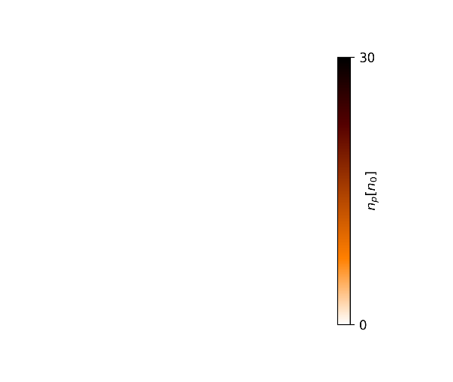
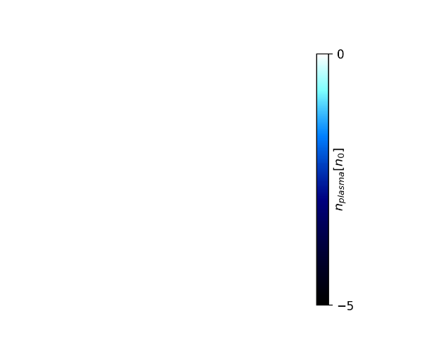
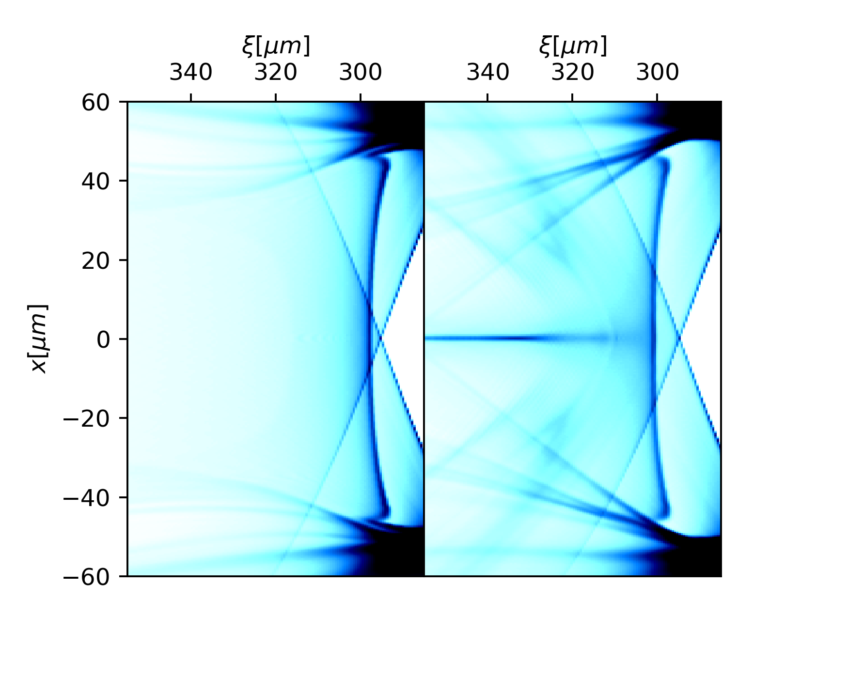
e+ acc. V2.0 → e+ beam loading
10

Slide 11
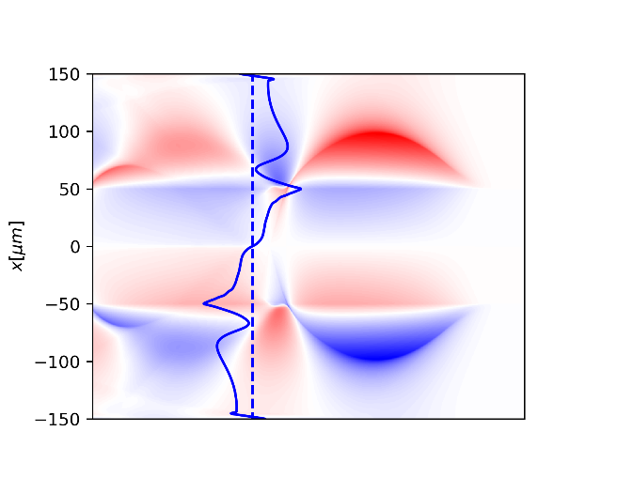
e+ acc. V2.0 → e+ beam loading
11

Slide 12
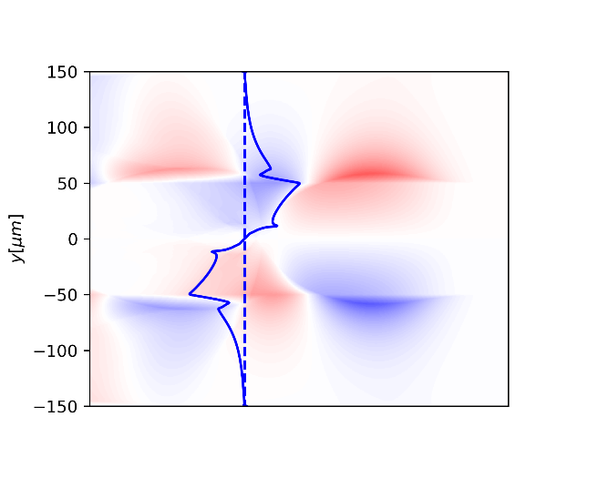
e+ acc. V2.0 → e+ beam loading
12

Slide 13
High efficiency uniform e+ acc.
Gradient~5GV/m，Efficiency >30%, Energy Spread~1.5%
S. Y. Zhou, W. Lu, et al., arXiv: 2012.06095v1, Submitted to PRL (2020.12)
13

Slide 14
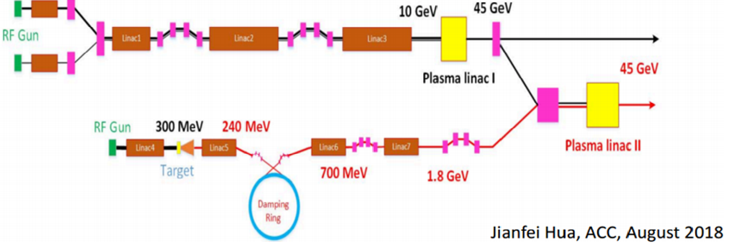
CPI conceptual Design V1.0 → V2.0
CEPC Plasma Injector V1.0
2nC
Jianfei Hua, AAC, August 2018
e1
e2
e3
e3
e4
CEPC Plasma Injector V2.0
e4
p1
p1 1.2nC, 2.4 GeV
p1
Dazhang Li, CPS, September 2019
14

Slide 15
Proposals on FACET-II facility
Beam Evolution in Hollow Plasma Channel for Stable Positron Acceleration
Demonstration of stable transport mode for asymmetric electron beam in hollow plasma channel
Exploring the robustness of asymmetric electron beam in hollow plasma channel and identifying tolerances for different beam parameters
Mapping the wakefield structure of this stable mode and demonstrating its capability of positron acceleration and focusing
Also available on SXFEL facility
15

Slide 16
New method under consideration
Plasma electron filament may help e+ focusing
16

Slide 17
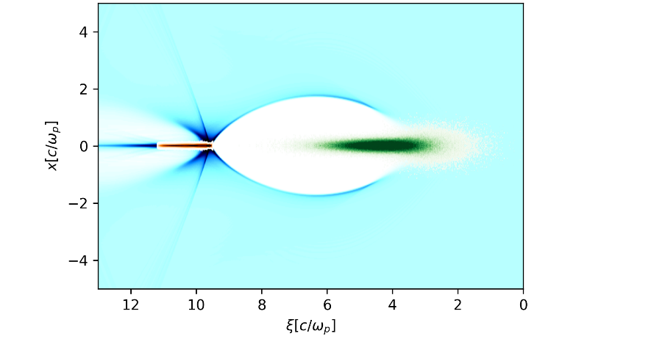
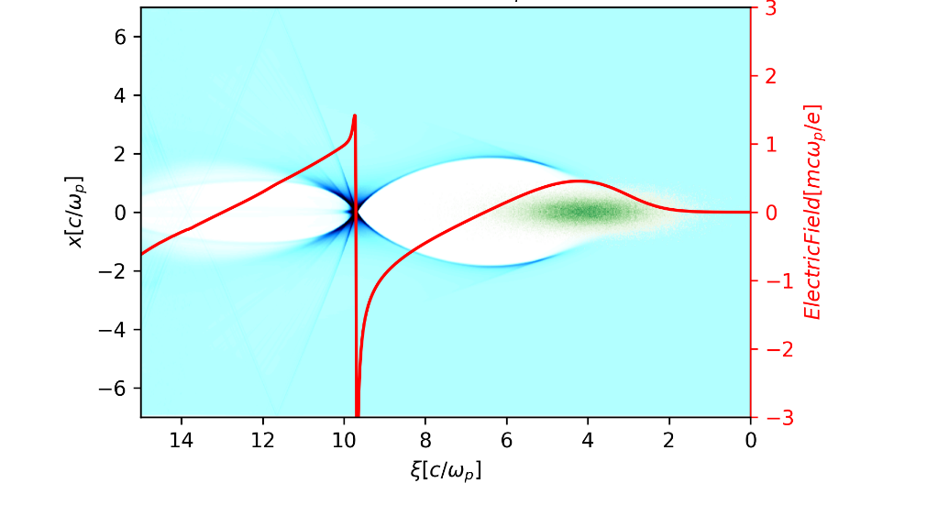
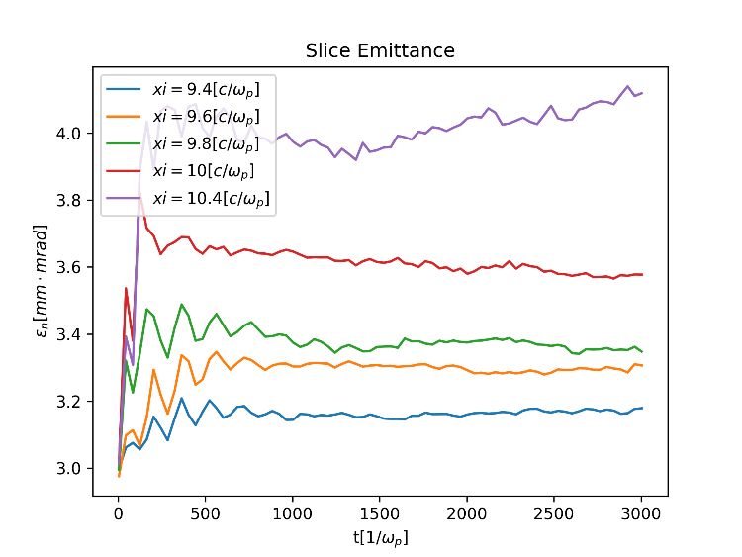
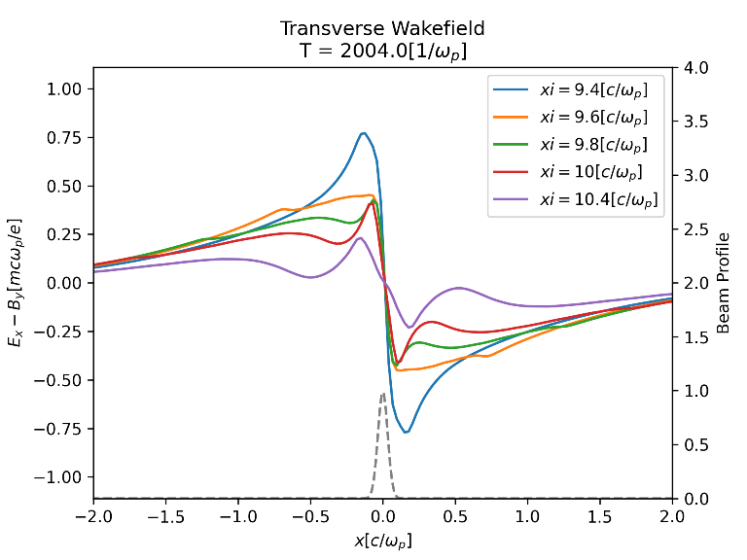
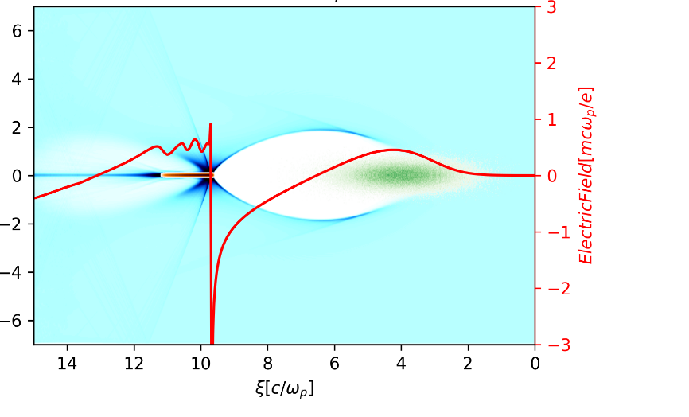
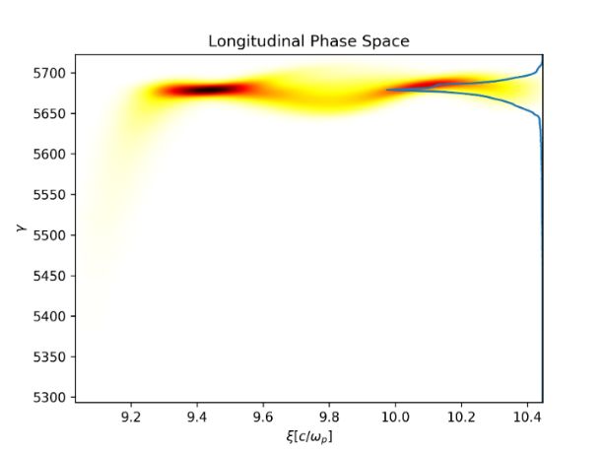
New method under consideration
17

Slide 18
Outlines
e+ acc.: key issues and our method
Experiments results and timetable
Brief introduction to e- acc. progress
Summary & 2021 plan

Slide 19
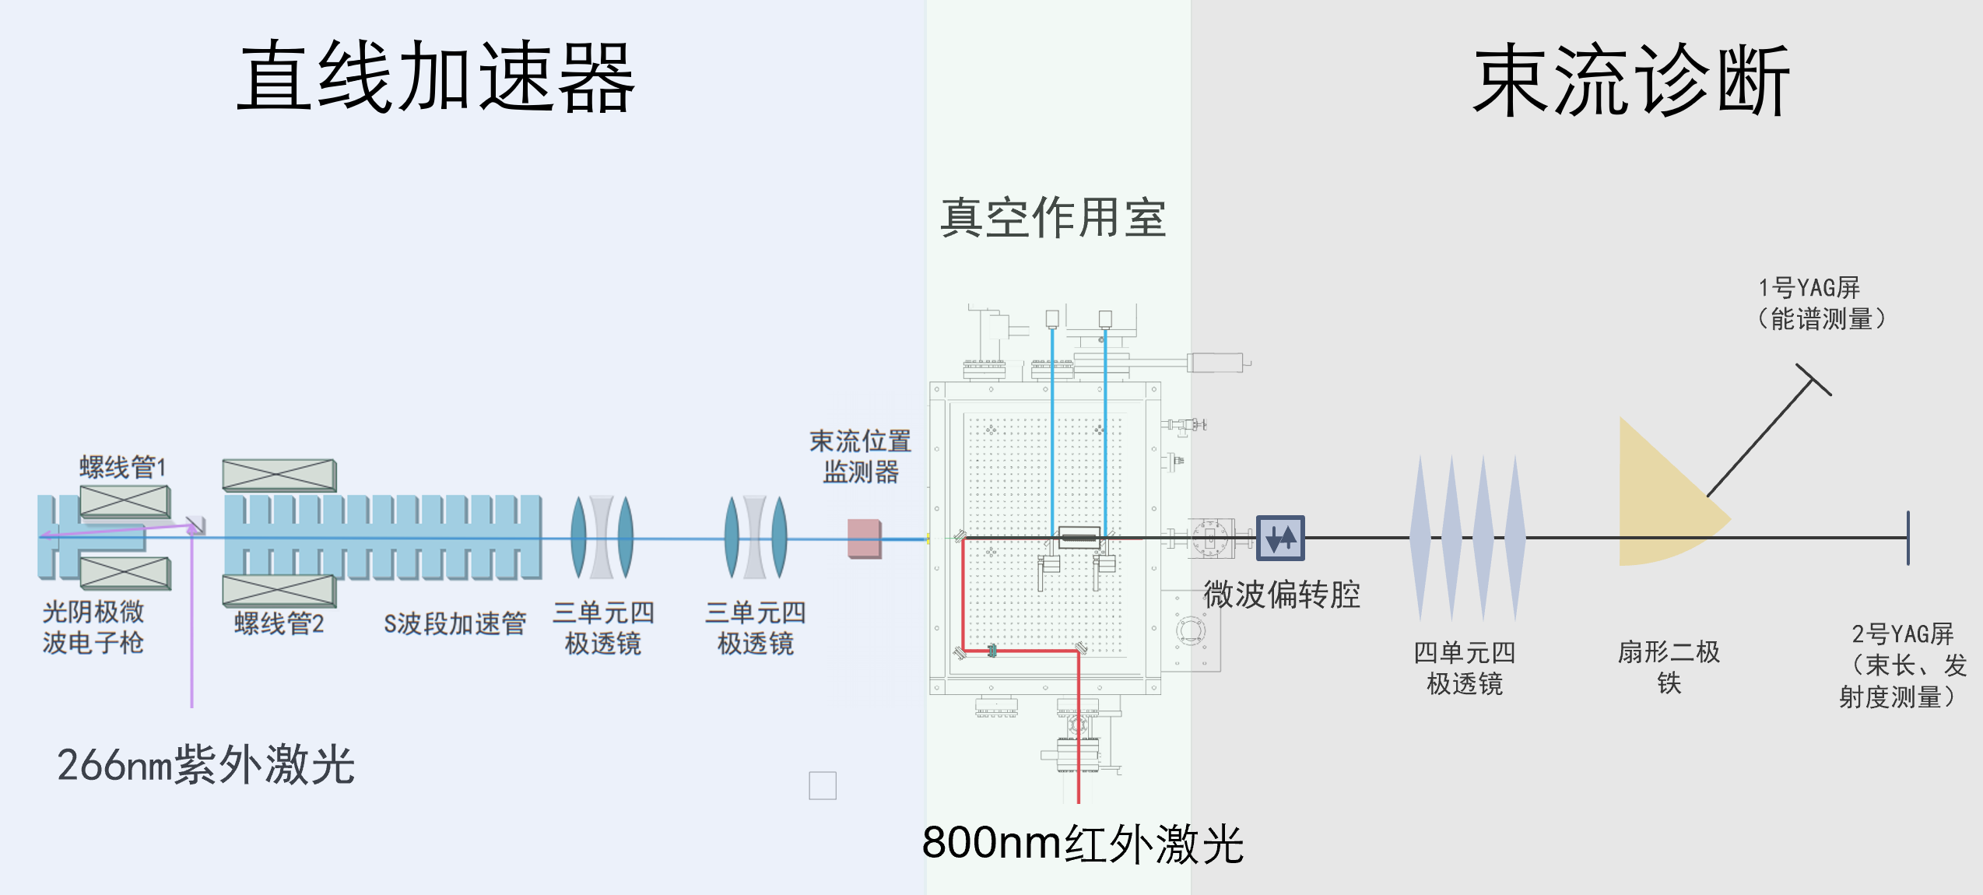
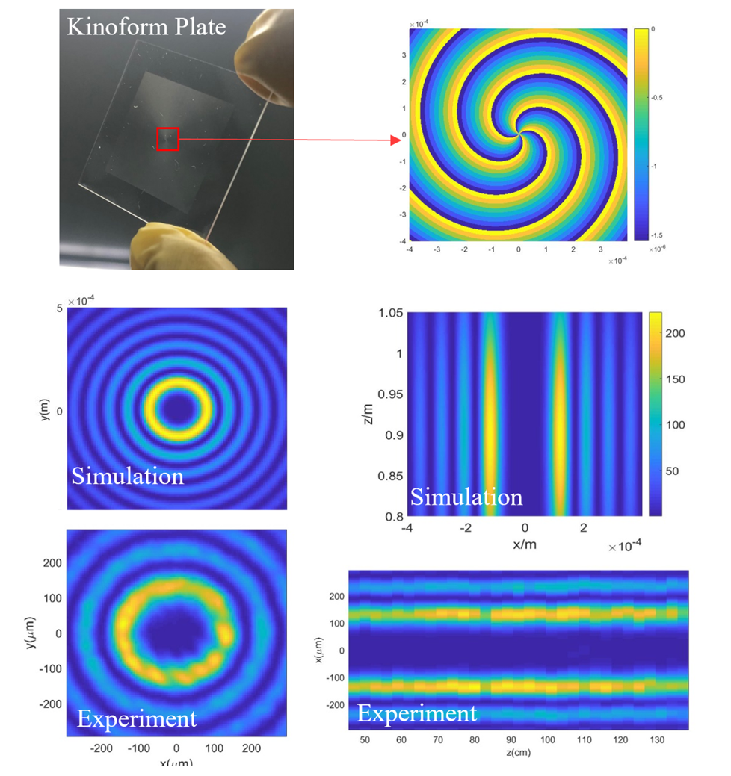
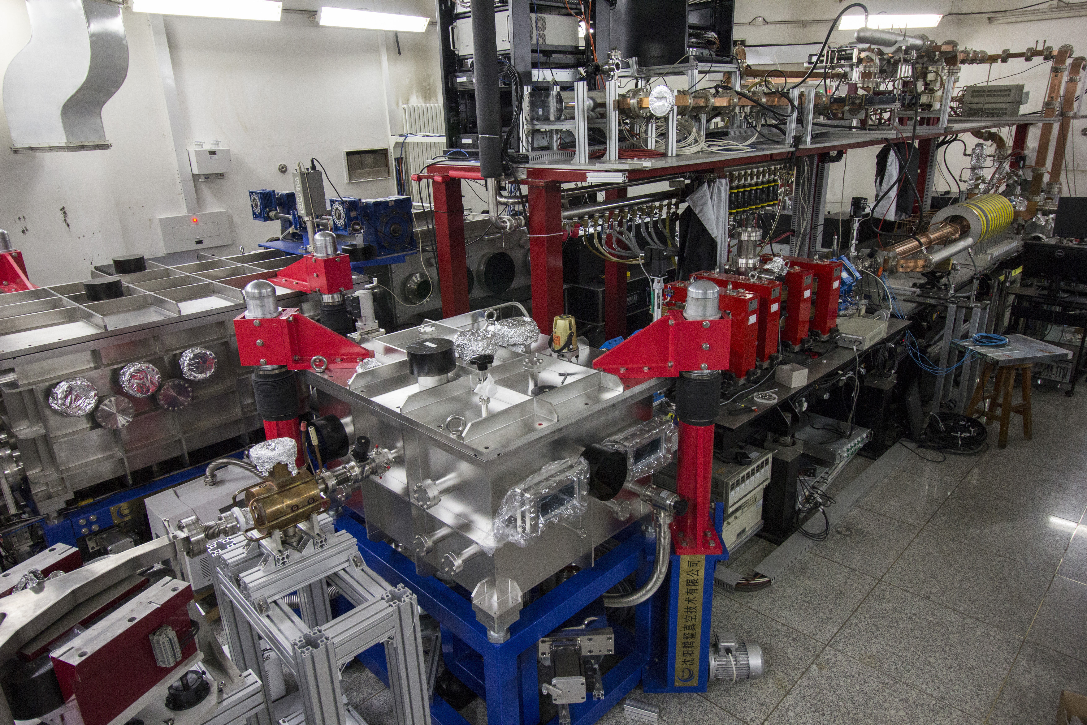
Dechirper experiment @ THU lab
RF gun
Chicane
S-band
linac
Compressor
beam
Interaction
chamber
Planned to finish it before Feb. but delayed by Covid-19. Finally finished it this month.
Deflecting
cavity
Dipole
19

Slide 20
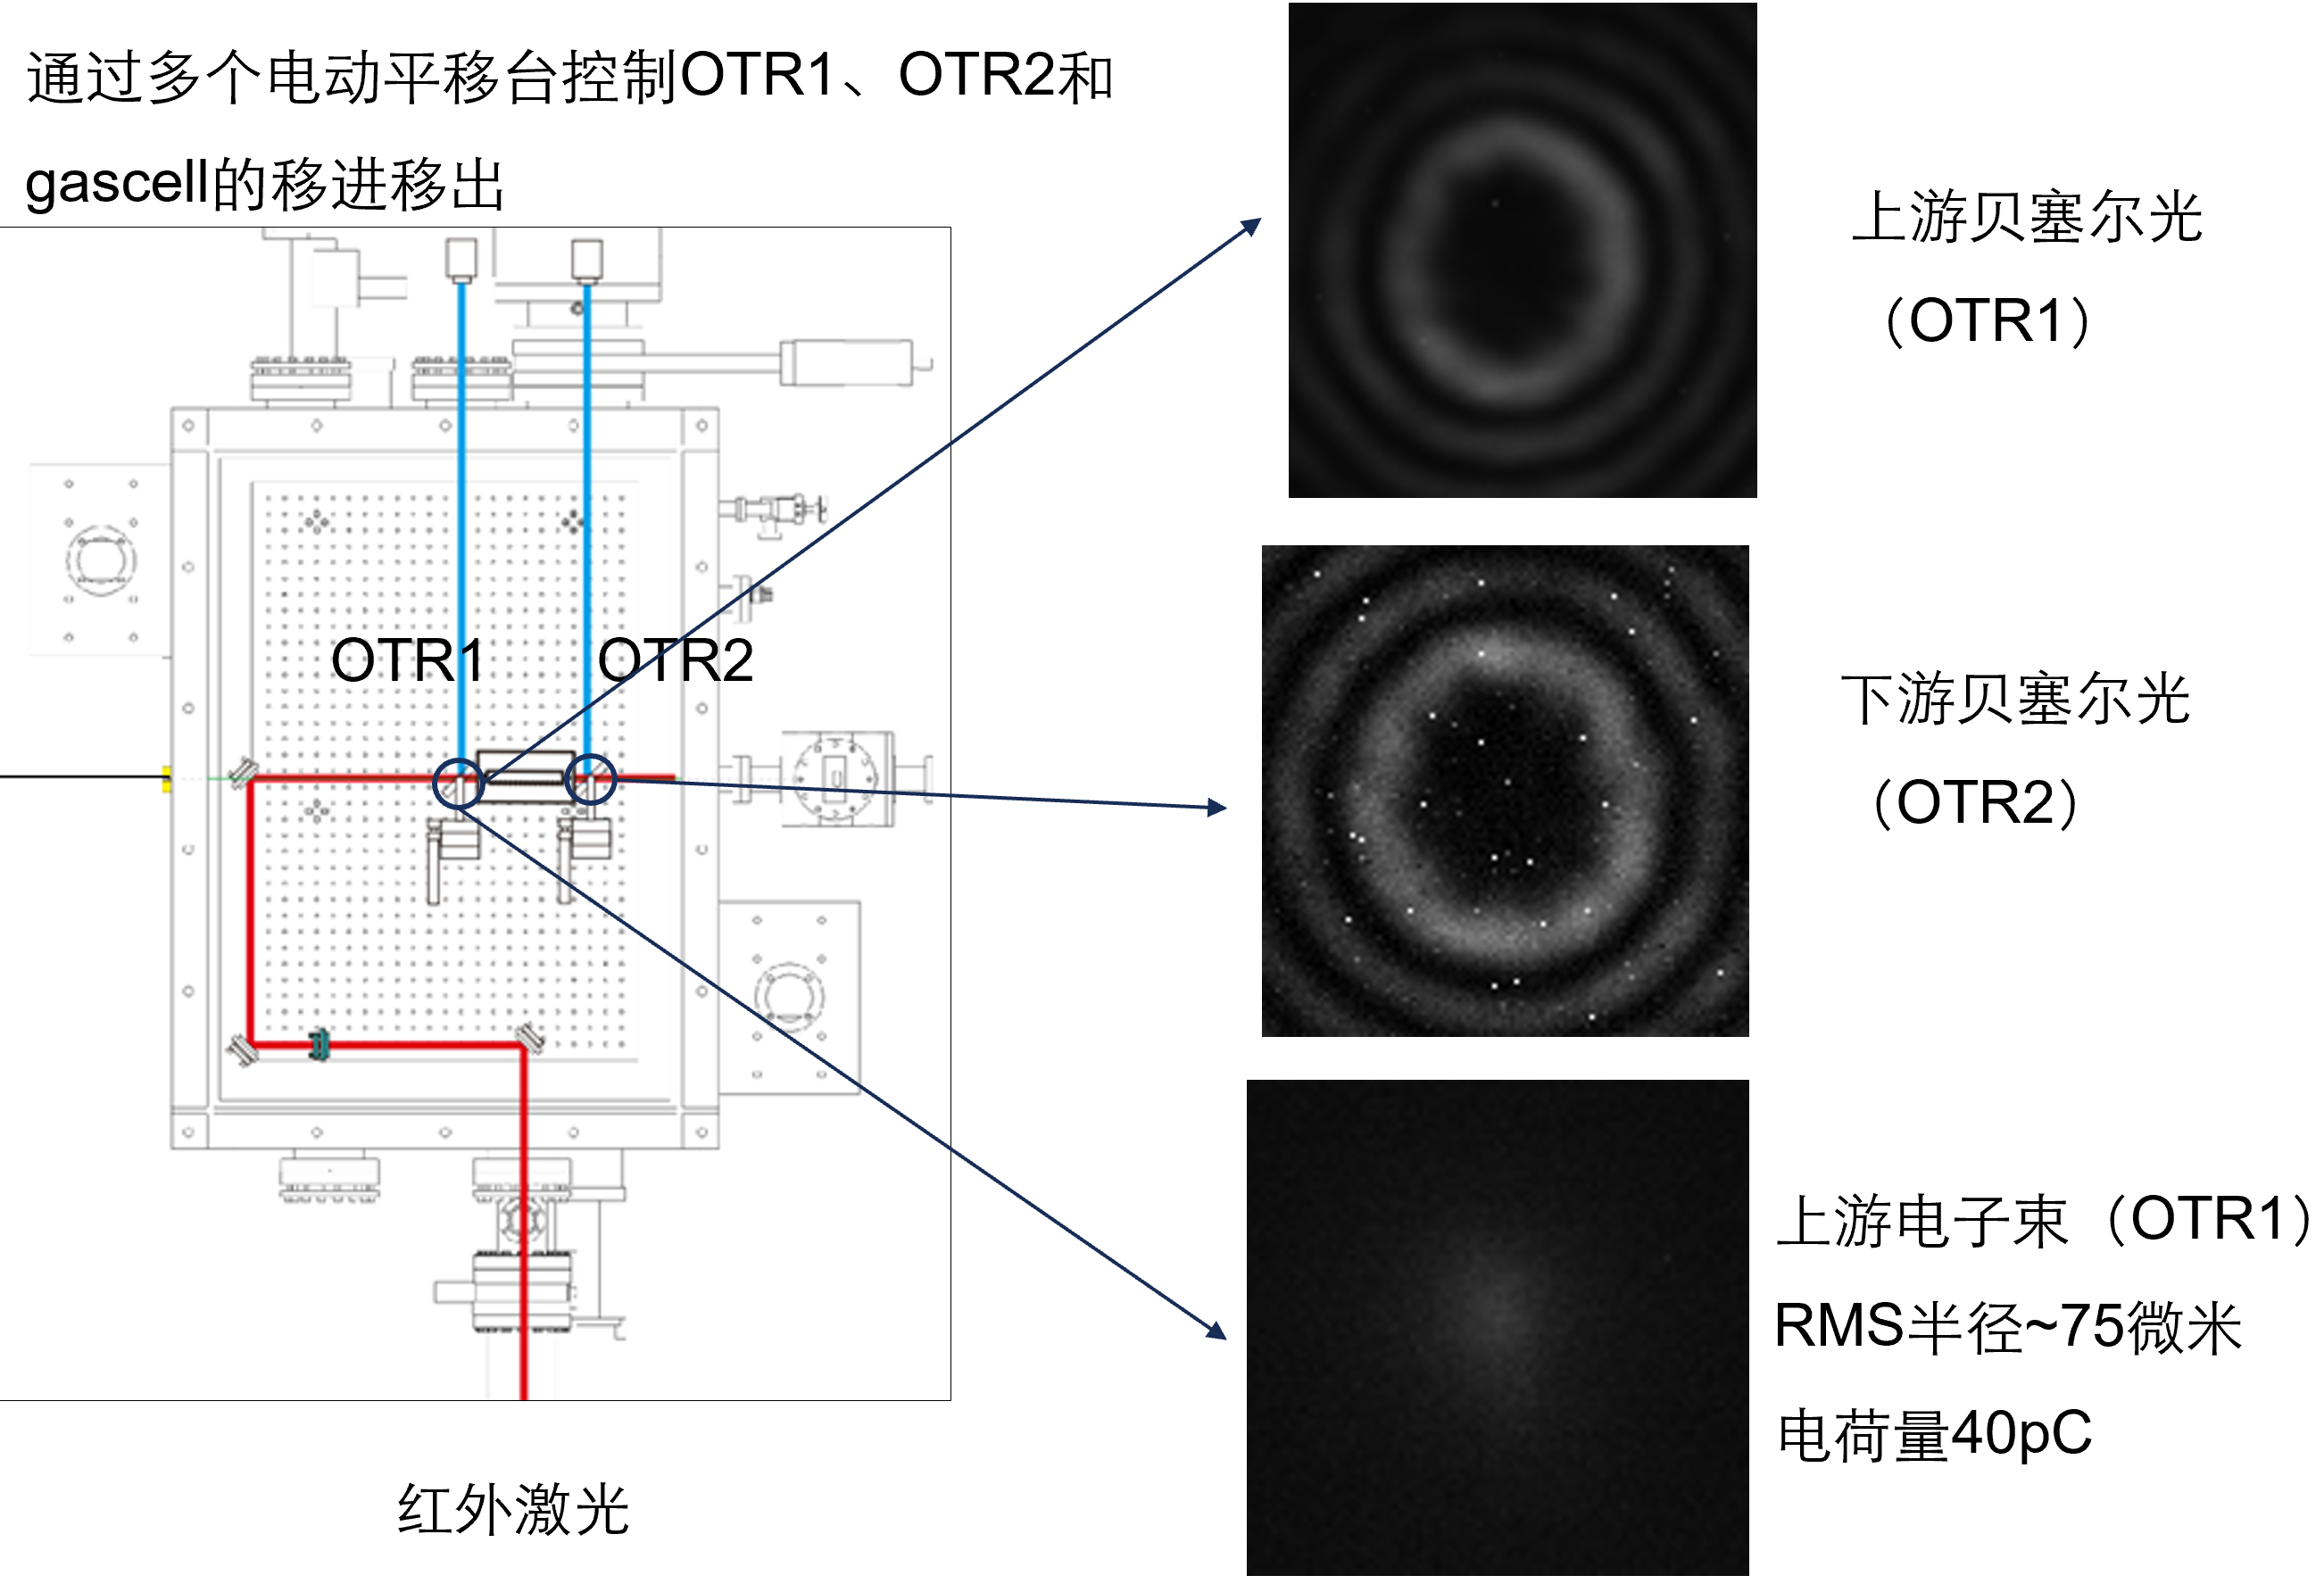
Dechirper experiment @ THU lab
20

Slide 21
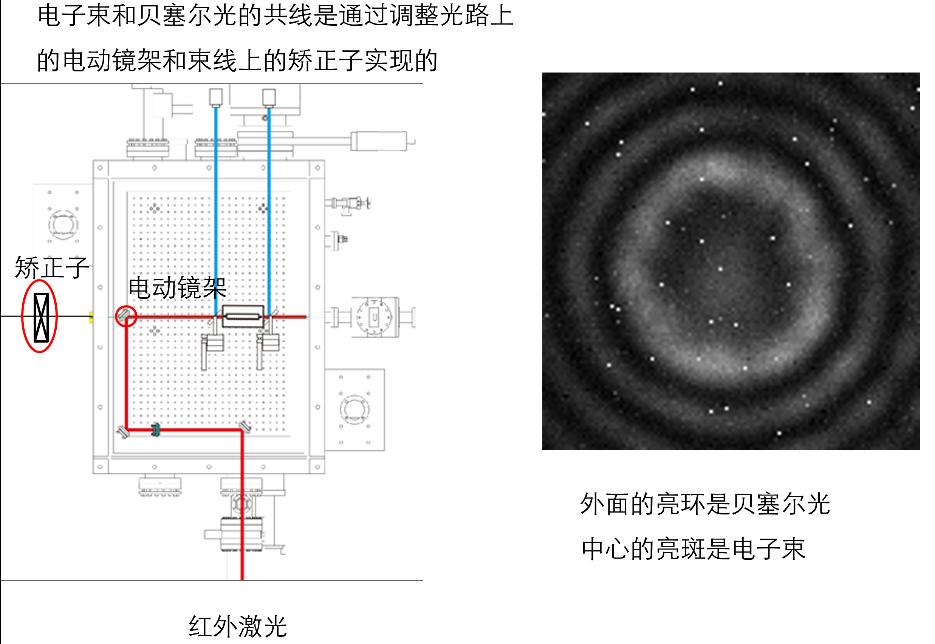
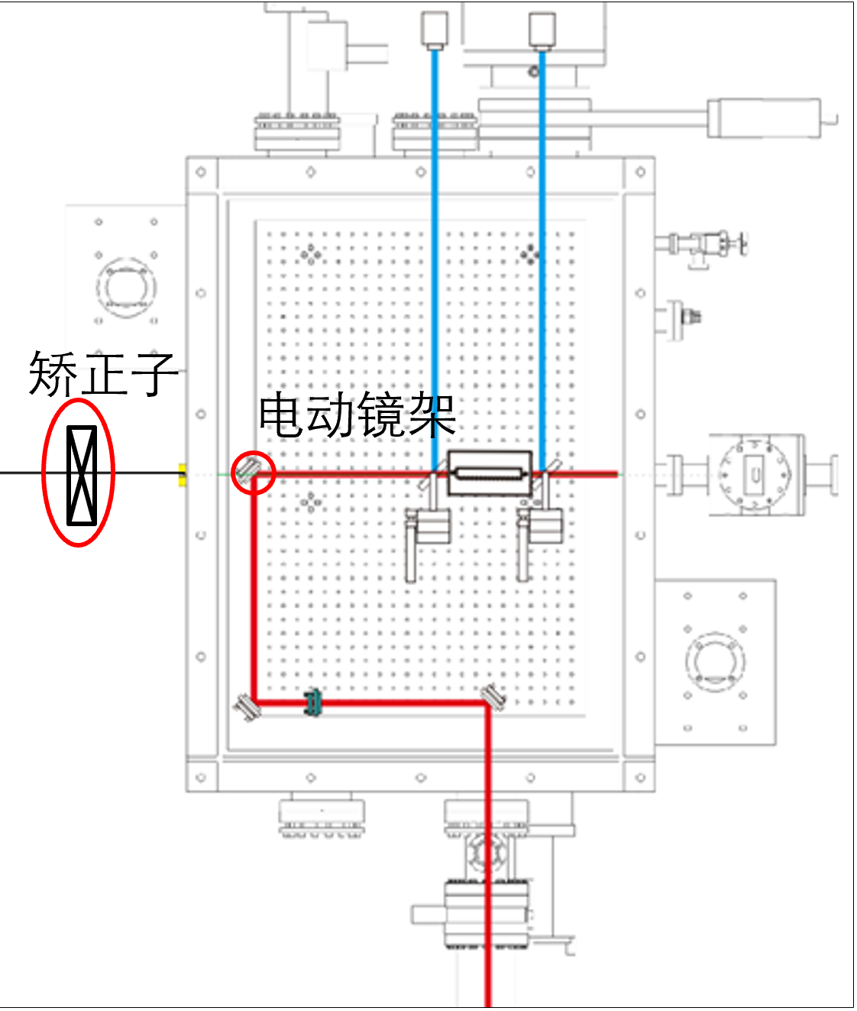
Dechirper experiment @ THU lab
21

Slide 22
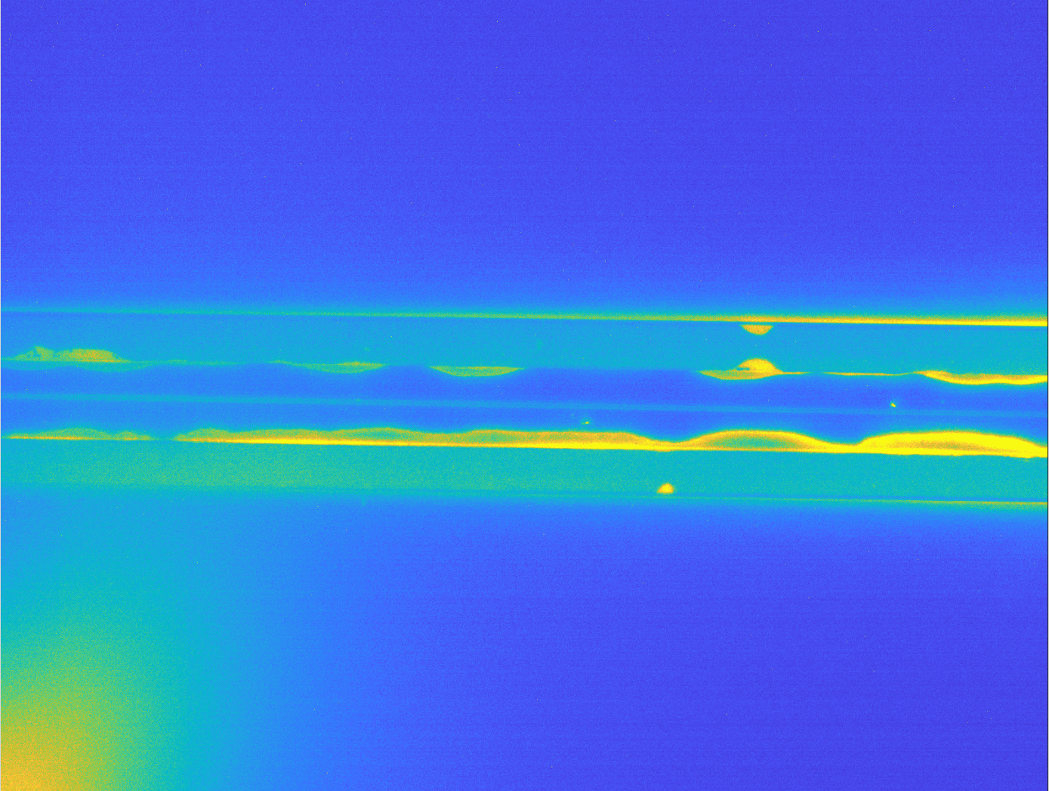
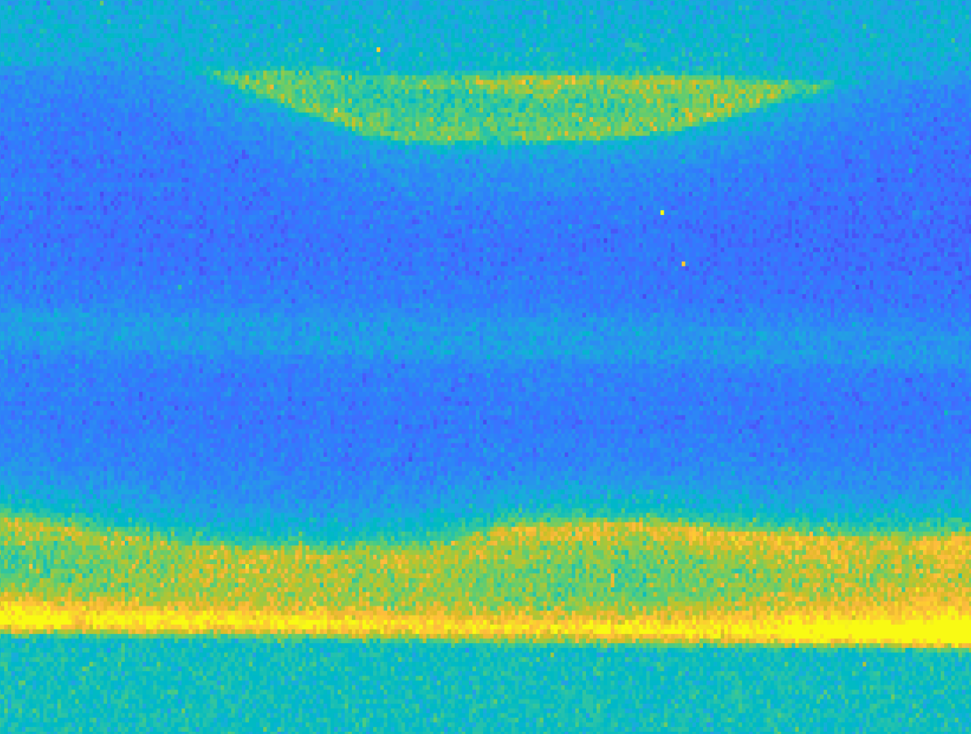
Dechirper experiment @ THU lab
电离线(N2)：
可以看清楚hollow channel的两个边沿
First generation of plasma hollow channel by using inert gases
First observation of the plasma hollow channel with clear edges
22

Slide 23
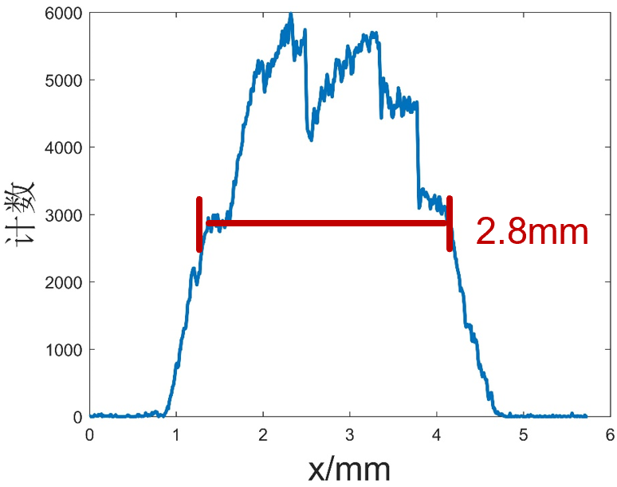
Bunch length measurement ~ 2ps
23

Slide 24
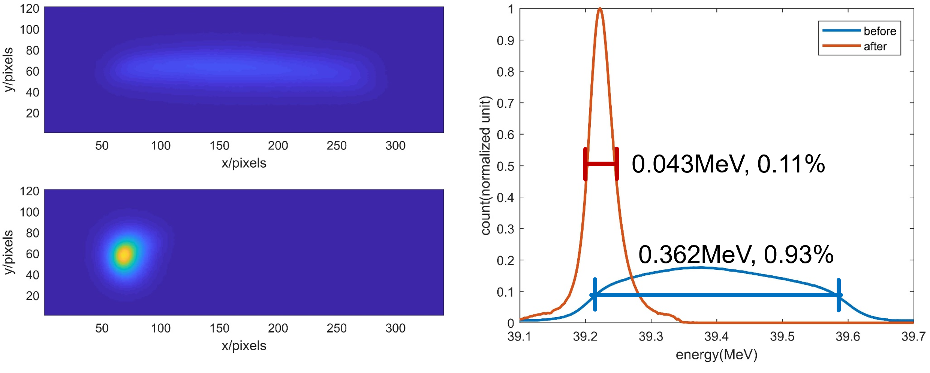
Energy spread measure: 1%→0.1%
24

Slide 25
Dechirper experiment @ THU lab
Experiment goals
Decrease the energy spread from 1% to 0.1% (√)
Hollow channel impact on beam quality (√, not affect emittance)
What to do next
Asymmetric electrons evolving in hollow channel
2-bunch e- PWFA exp. with hollow channel (one from LWFA?)
2-bunch e- HTR (use triangle e- bunch) PWFA experiments
25

Slide 26
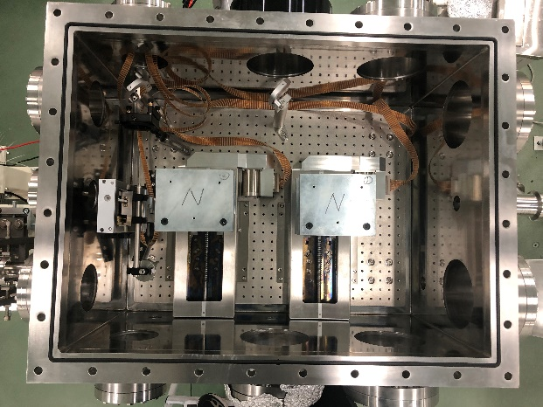
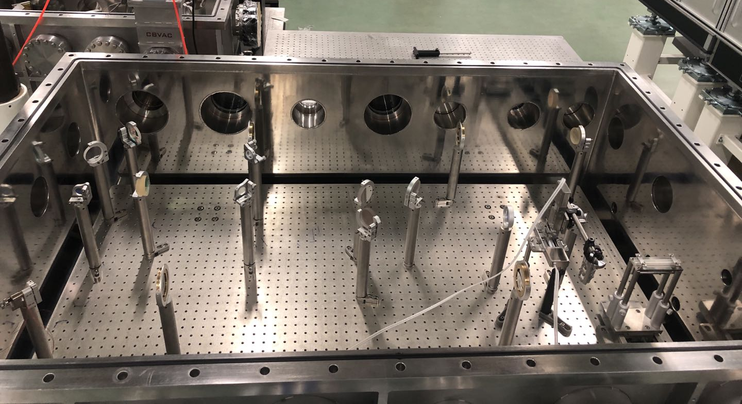
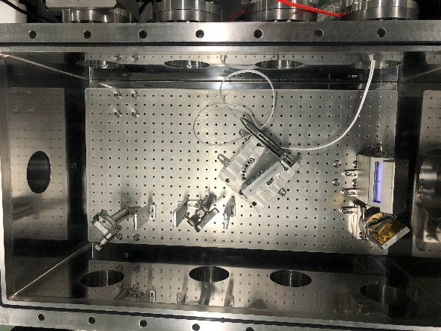
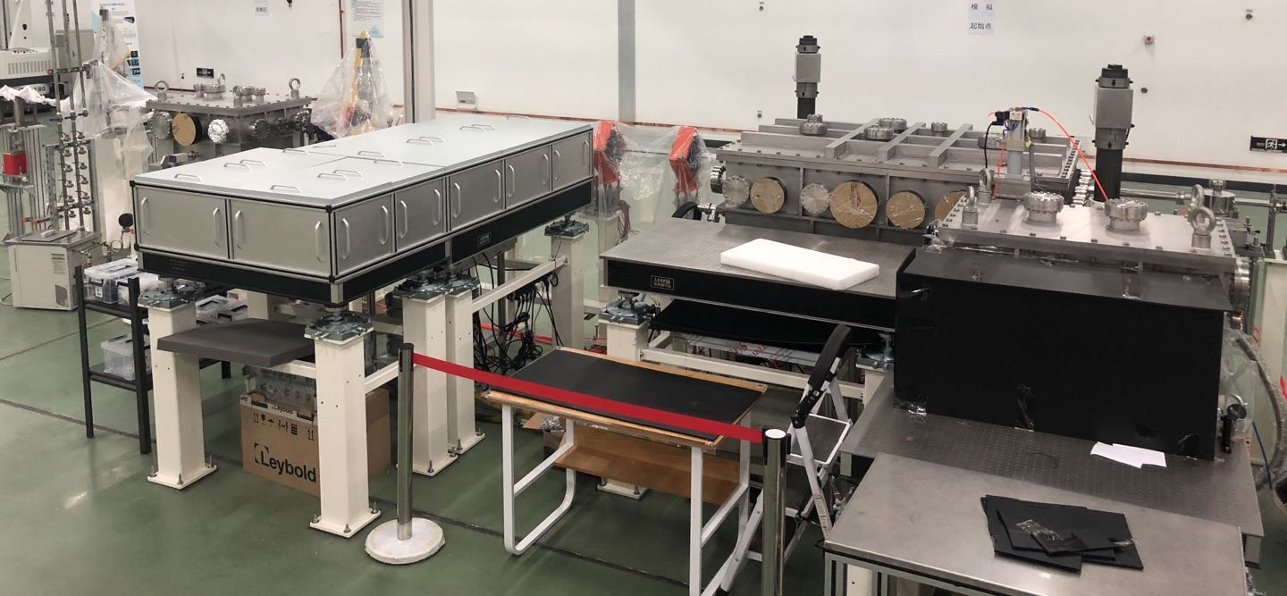
Experiment preparation @ SXFEL
束测室
主作用室
压缩池
束测室
主作用室
压缩池
Slides from Dr. Bo Peng (2020)
26

Slide 27
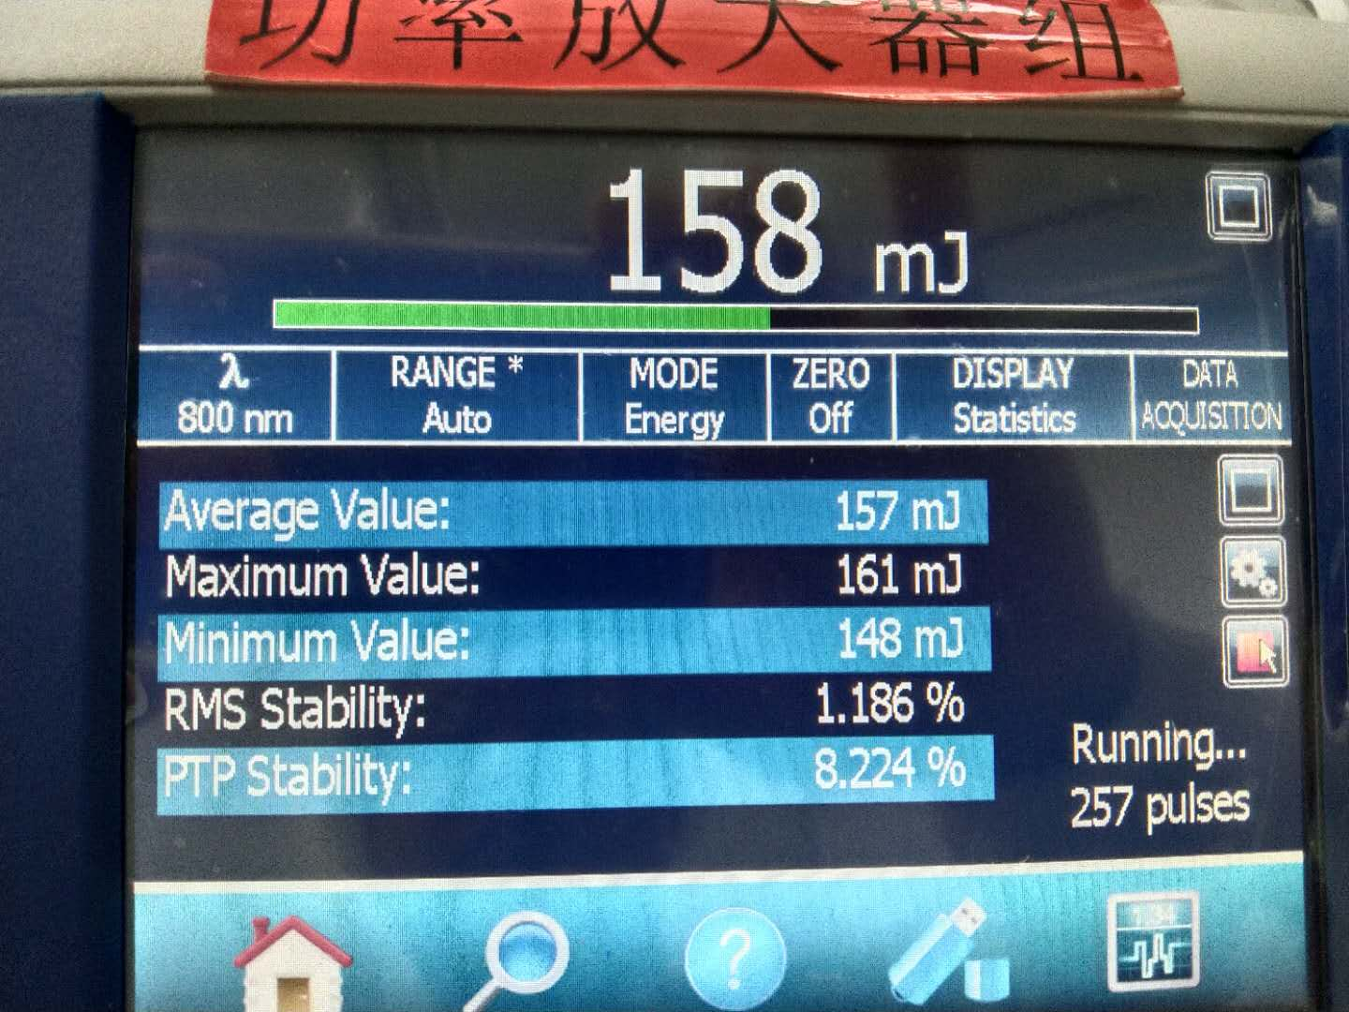
Experiment preparation → laser system
Amplifier energy performance
Amplifier output profile before expander
Pulse compressor efficiency: 72%
Pulse duration
Slides from Dr. Bo Peng (2020)
27

Slide 28
Experiment preparation → gas loop
Requirement：
200 ~ 10⁵ pa (Negative pressure)
28

Slide 29
Tentative schedule for SXFEL exp.
2021.2:
Overall control system installation, connect the laser, beamline and plasma source systems
2021.3:
Plasma density (inside the gascell) measurement with the resolution of 2×10¹⁵ cm⁻³, as shown in https://arxiv.org/abs/2010.02567v1
2021.4-2021.5:
Beamtime
29

Slide 30
Outlines
e+ acc.: key issues and our method
Experiments results and timetable
Brief introduction to e- acc. progress
Summary & 2021 plan

Slide 31
Error analysis for HTR e- acc.
31

Slide 32
Error analysis for HTR e- acc.
MUST DOUBLE CHECK!!
32

Slide 33
Error analysis for HTR e- acc.
33

Slide 34
What to do next?
Short term (right now)
Double check the simulation results
Choose lower transformer ratio to avoid hosing instability
Re-optimize baseline design, increase the trailer’s charge
Mid term (in 2021)
Try to suppressing hosing instability by using (BNS damping, phase mixing, plasma lens……)
Long term (in 2-3 years)
Machine learning + MOGA for further optimization
34

Slide 35
Linac optimization for ideal beams
$$Assuming no coupilng between x−y direction$$
$$β_{∗}=156mm \left(V1.0\right)→14.6 mm (V2.0)$$
L-band photocathode rf gun under design.
Finished the preliminary linac design and the end-to-end simulation (e- gun → FFS). Beam distribution improved but can not meet the requirements yet.
NEED MORE OPTIMIZATIONS
Optimized by Dr. Cai Meng (2020)
35

Slide 36
Outlines
e+ acc.: key issues and our method
Experiments results and timetable
Brief introduction to e- acc. progress
Summary & 2021 plan

Slide 37
Summary and prospects
e+ acceleration
Fixed the baseline design and prepare for peer review
Start the error analysis in 2021 (IHEP)
Continue to explore new method(s) (THU)
e- acceleration
1st Stage error analysis finished, not 100% work, results under re-check
Lower transformer ratio and/or increase trailer’s charge
Further optimization with machine learning and GA
Experiments
World-class-level results for THU experiment
Hope to get enough beamtime and good results @ SXFEL
Continue to push FACET-II proposals
37

Slide 38
Thanks！

