Slide 1
CEPC CDR collider ring and booster magnets power consumptions compared with FCC-ee
Wen Kang, Mei Yang
CEPC Day
Nov. 28, 2020

Slide 2
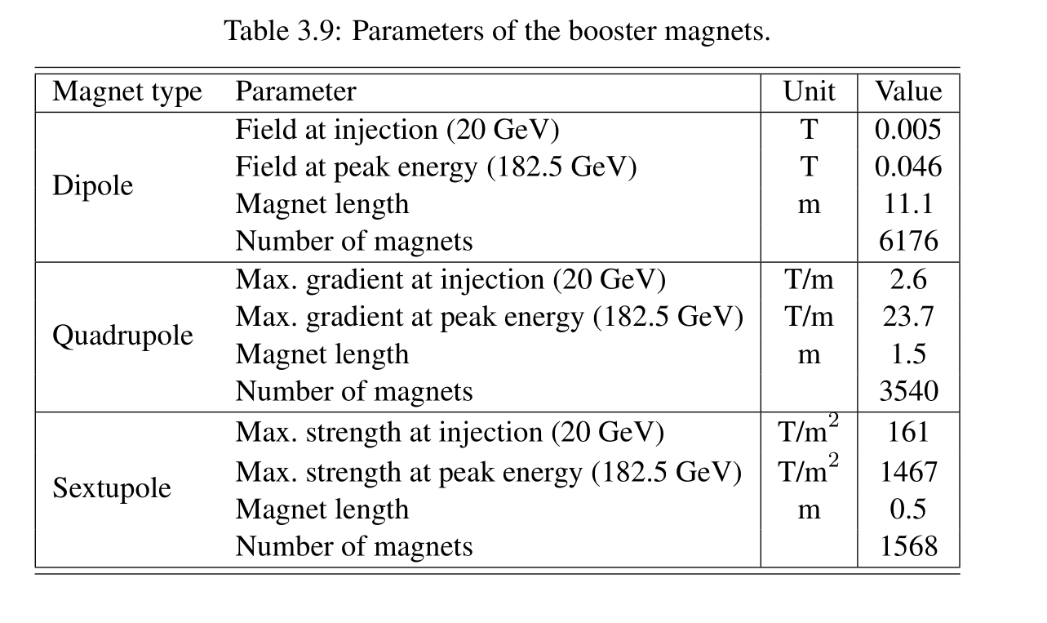
The CDR of FCC-ee did not present the designed power consumption of the booster magnets, so we have to design the magnets for the FCC-ee booster and calculate the power consumption according to the parameters of the FCC-ee booster magnets listed in below table.

Slide 3
Evaluated power consumption of the CEPCB dipoles and FCCB dipoles

Slide 4
Evaluated power consumption of the CEPCB quadrupoles and FCCB quadrupoles

Slide 5
Evaluated power consumption of the CEPCB sextupoles and FCCB sextupoles

Slide 6
The total max. power consumption of the FCCB magnets: 60.1MW
The total avg. power consumption of the FCCB magnets: 24.0MW
The total max. power consumption of the CEPCB magnets: 37.6MW
The total avg. power consumption of the CEPCB magnets: 15.0MW

Slide 7
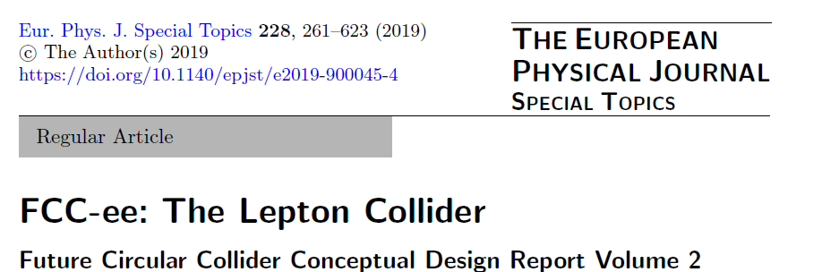
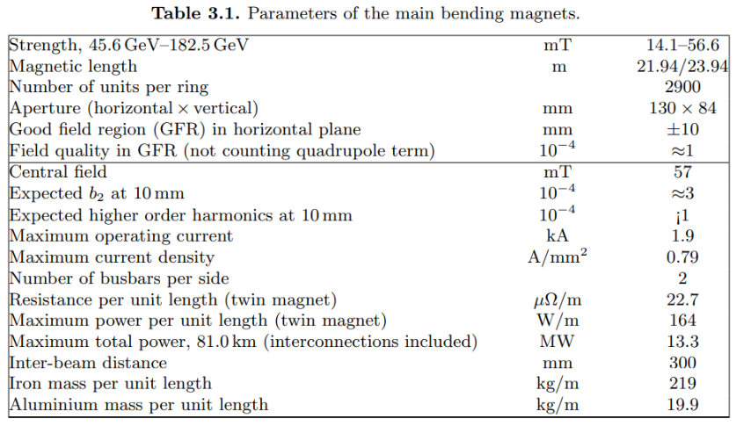
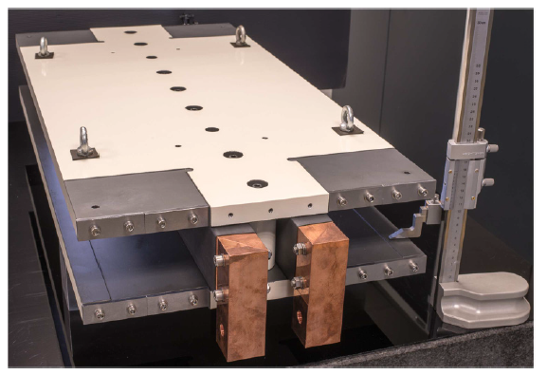
FCC-ee CDR-2019
FCC-ee Main dipoles

Slide 8
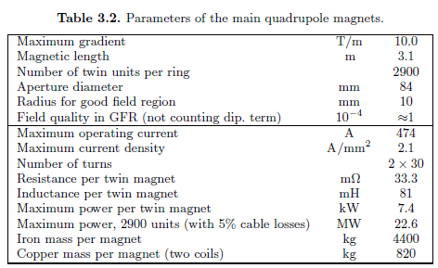
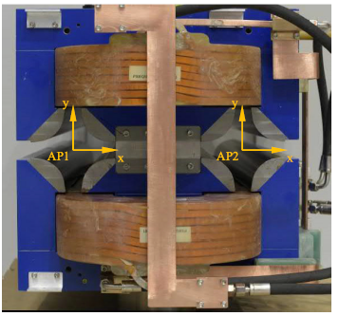
FCC-ee CDR-2019
Main twin aperture quadrupoles

Slide 9
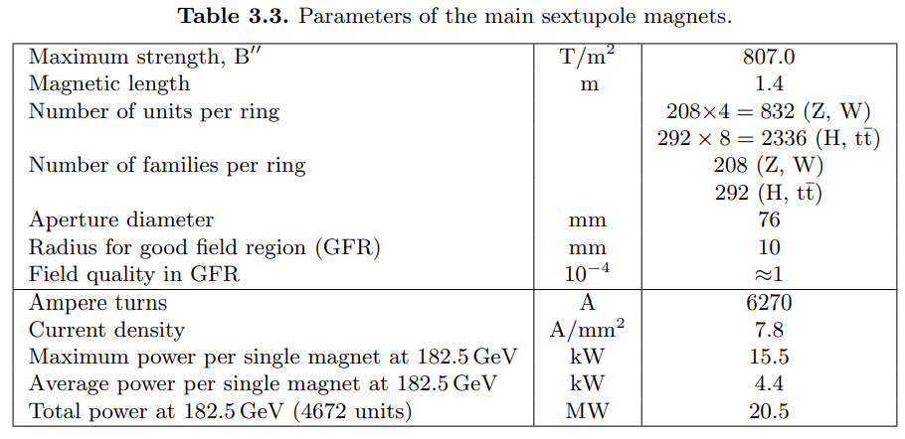
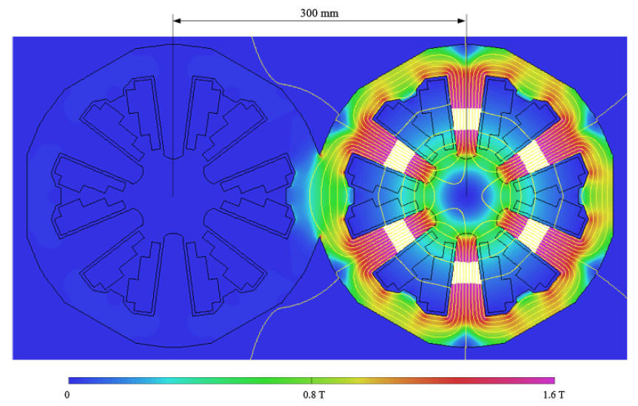
FCC-ee CDR-2019
Main sextupoles

Slide 10
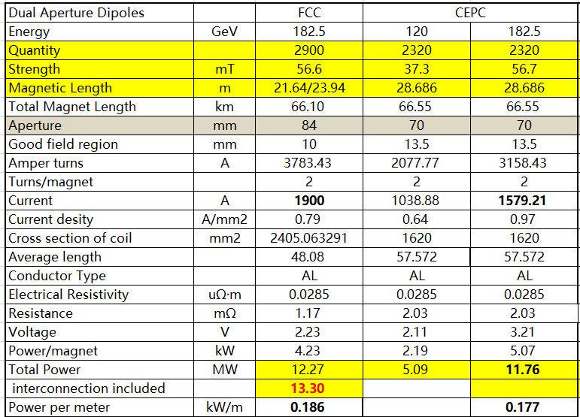

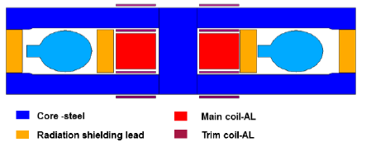
CEPC Collider Ring—dual aperture dipole magnets
CDR-2018
The power per meter normalized by current density,
aperture, and magnet length is consistent.

Slide 11
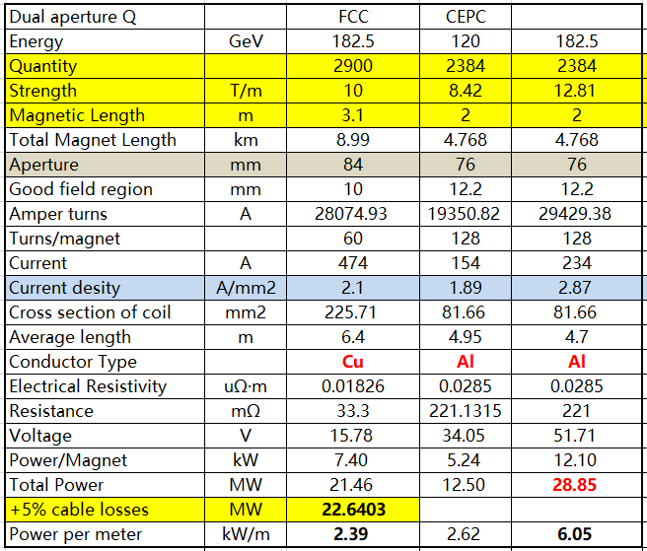
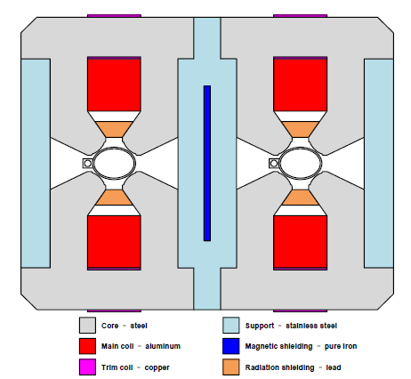

CEPC Collider Ring—Dual aperture quadrupole magnets
The difference in power per meter normalized by current density, aperture, magnet length and gradient is less than 1%.
CDR-2018

Slide 12
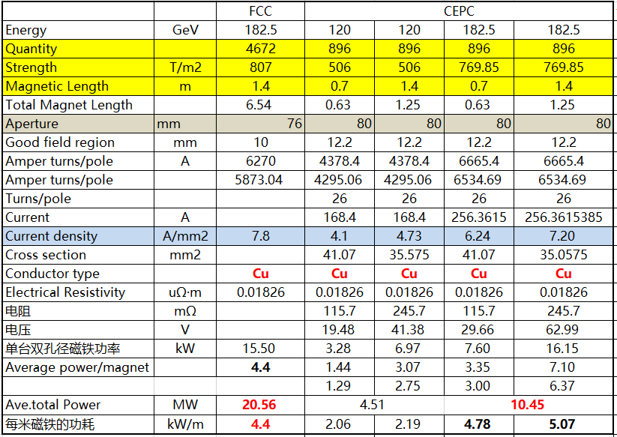

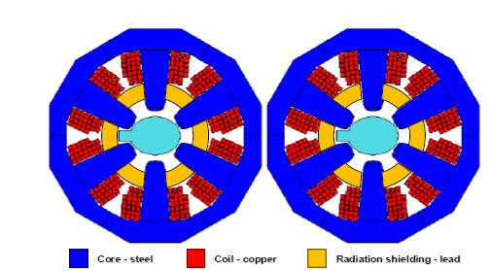
CEPC Collider Ring—Single sextupole magnets
CDR-2018
The average power is about 44% of the sextupoles’ power in CEPC, while 28% in FCC-ee.

Slide 13
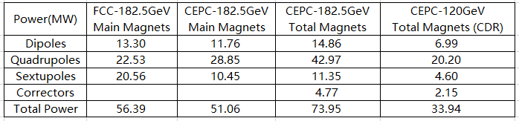
Total Power Consumption of Collider Ring
Total Power Consumption of Collider Ring
  Total Magnets including the single aperture dipole/quadrupole magnets and the correctors.

