Slide 1
Test Beam opportunity on
Beijing Synchrotron Radiation Facility (BSRF)
YongSheng Huang (黄永盛）, Zhijun Liang (梁志均）, MengZhao Li (李梦朝）,Bo Liu(刘波)
IHEP, Chinese Academy of Sciences

Slide 2
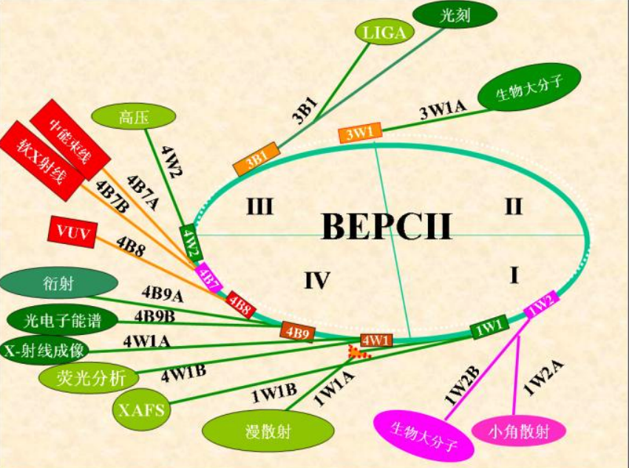
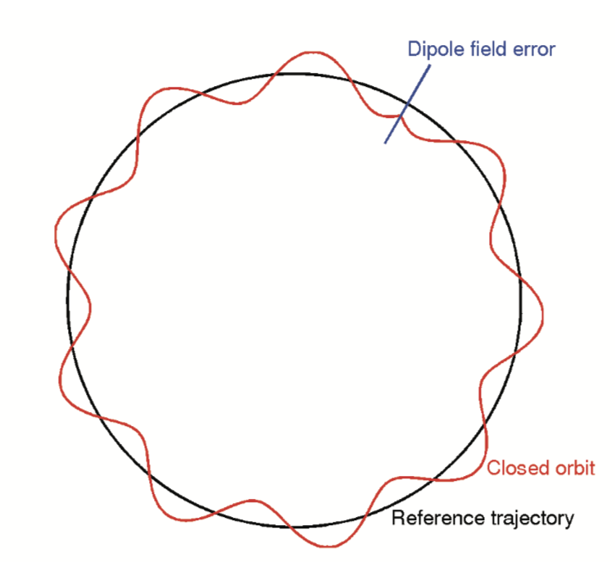
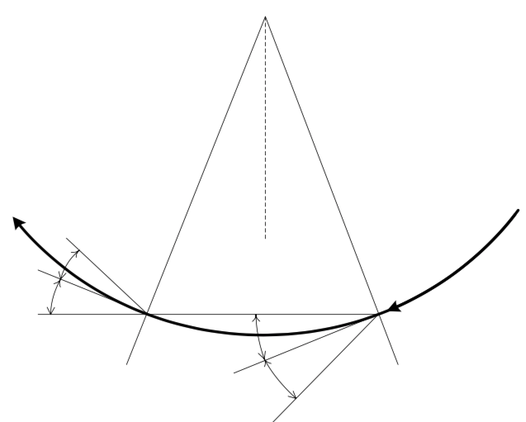
Motivation
Due to pandemic, many CEPC testbeams scheduled at DESY were cancelled
Test beam facility in IHEP Hall 10 can be alternative option
However Limited by event rate, and operation time (~2 months per year)
Beijing Synchrotron Radiation Facility (BSRF) stations can be alternative
Out-of-phase electrons may go through BSRF station
Advantage of BSRF:
Long operation period (~10 months per year)
Potential to have high event rate and high energy electrons
Electron orbit

Slide 3
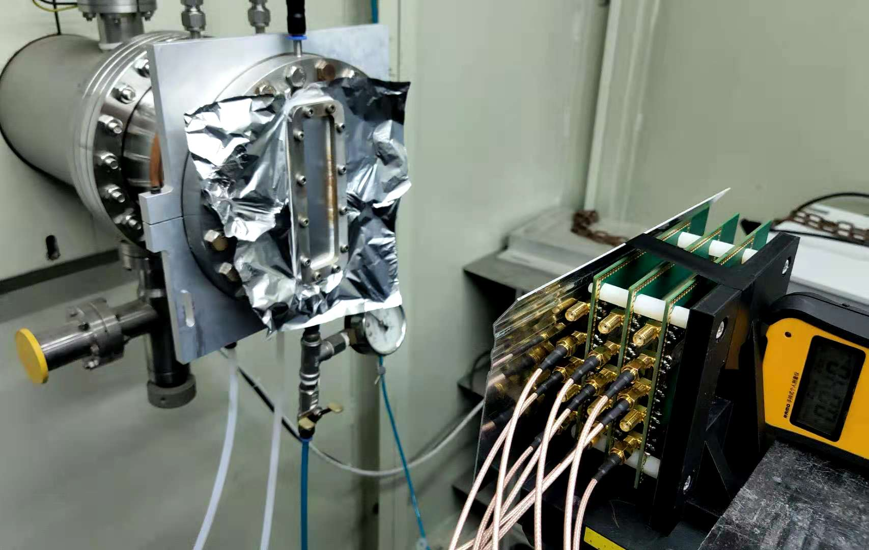
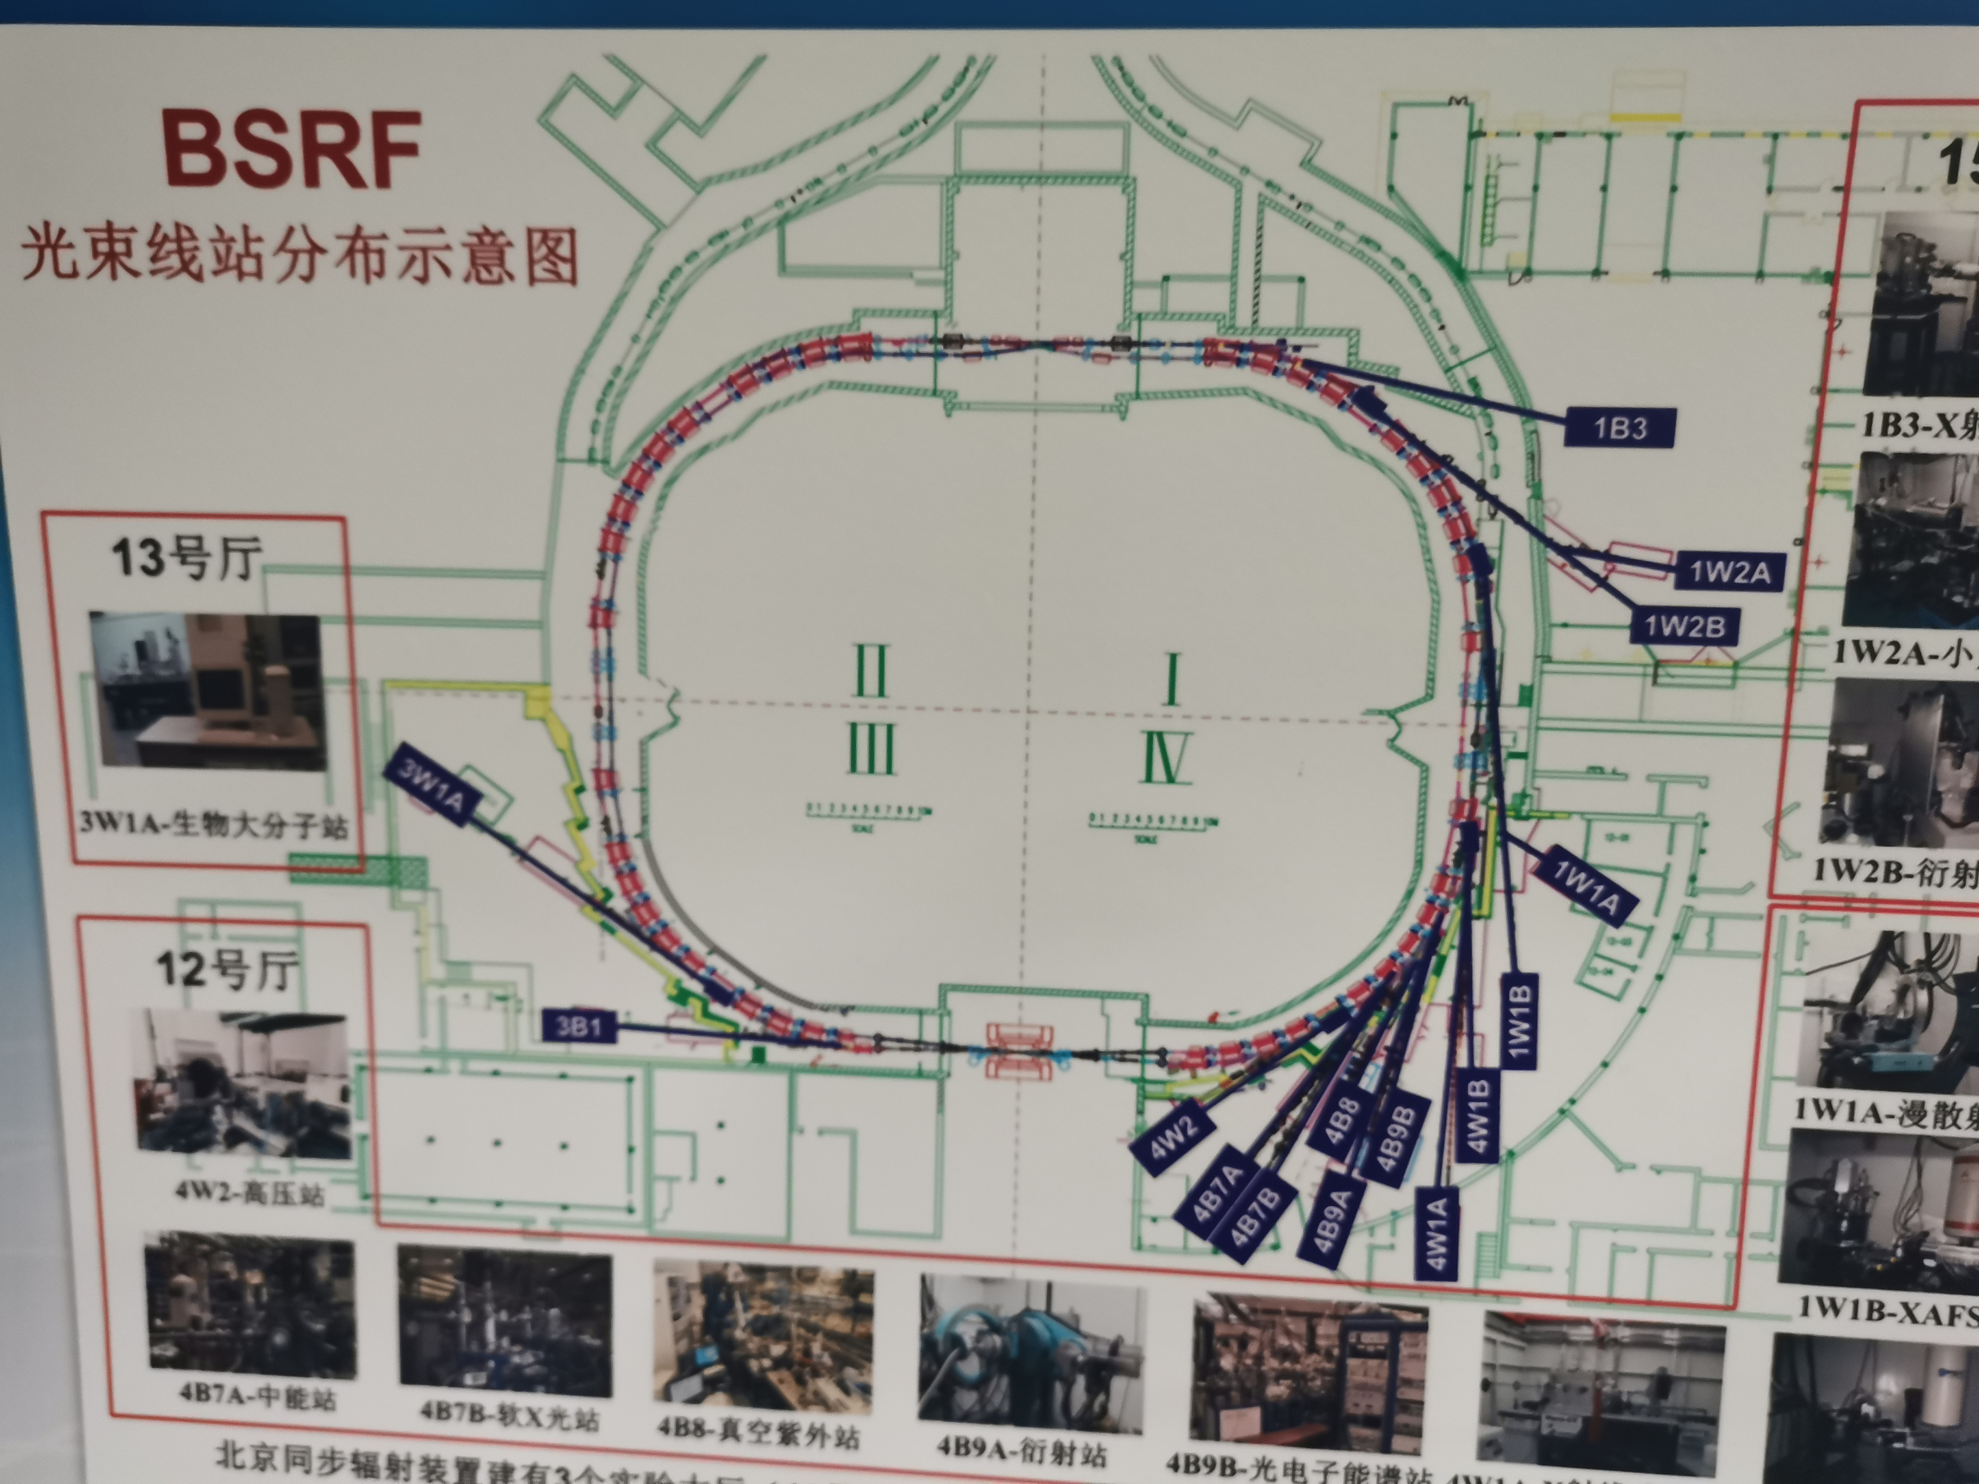
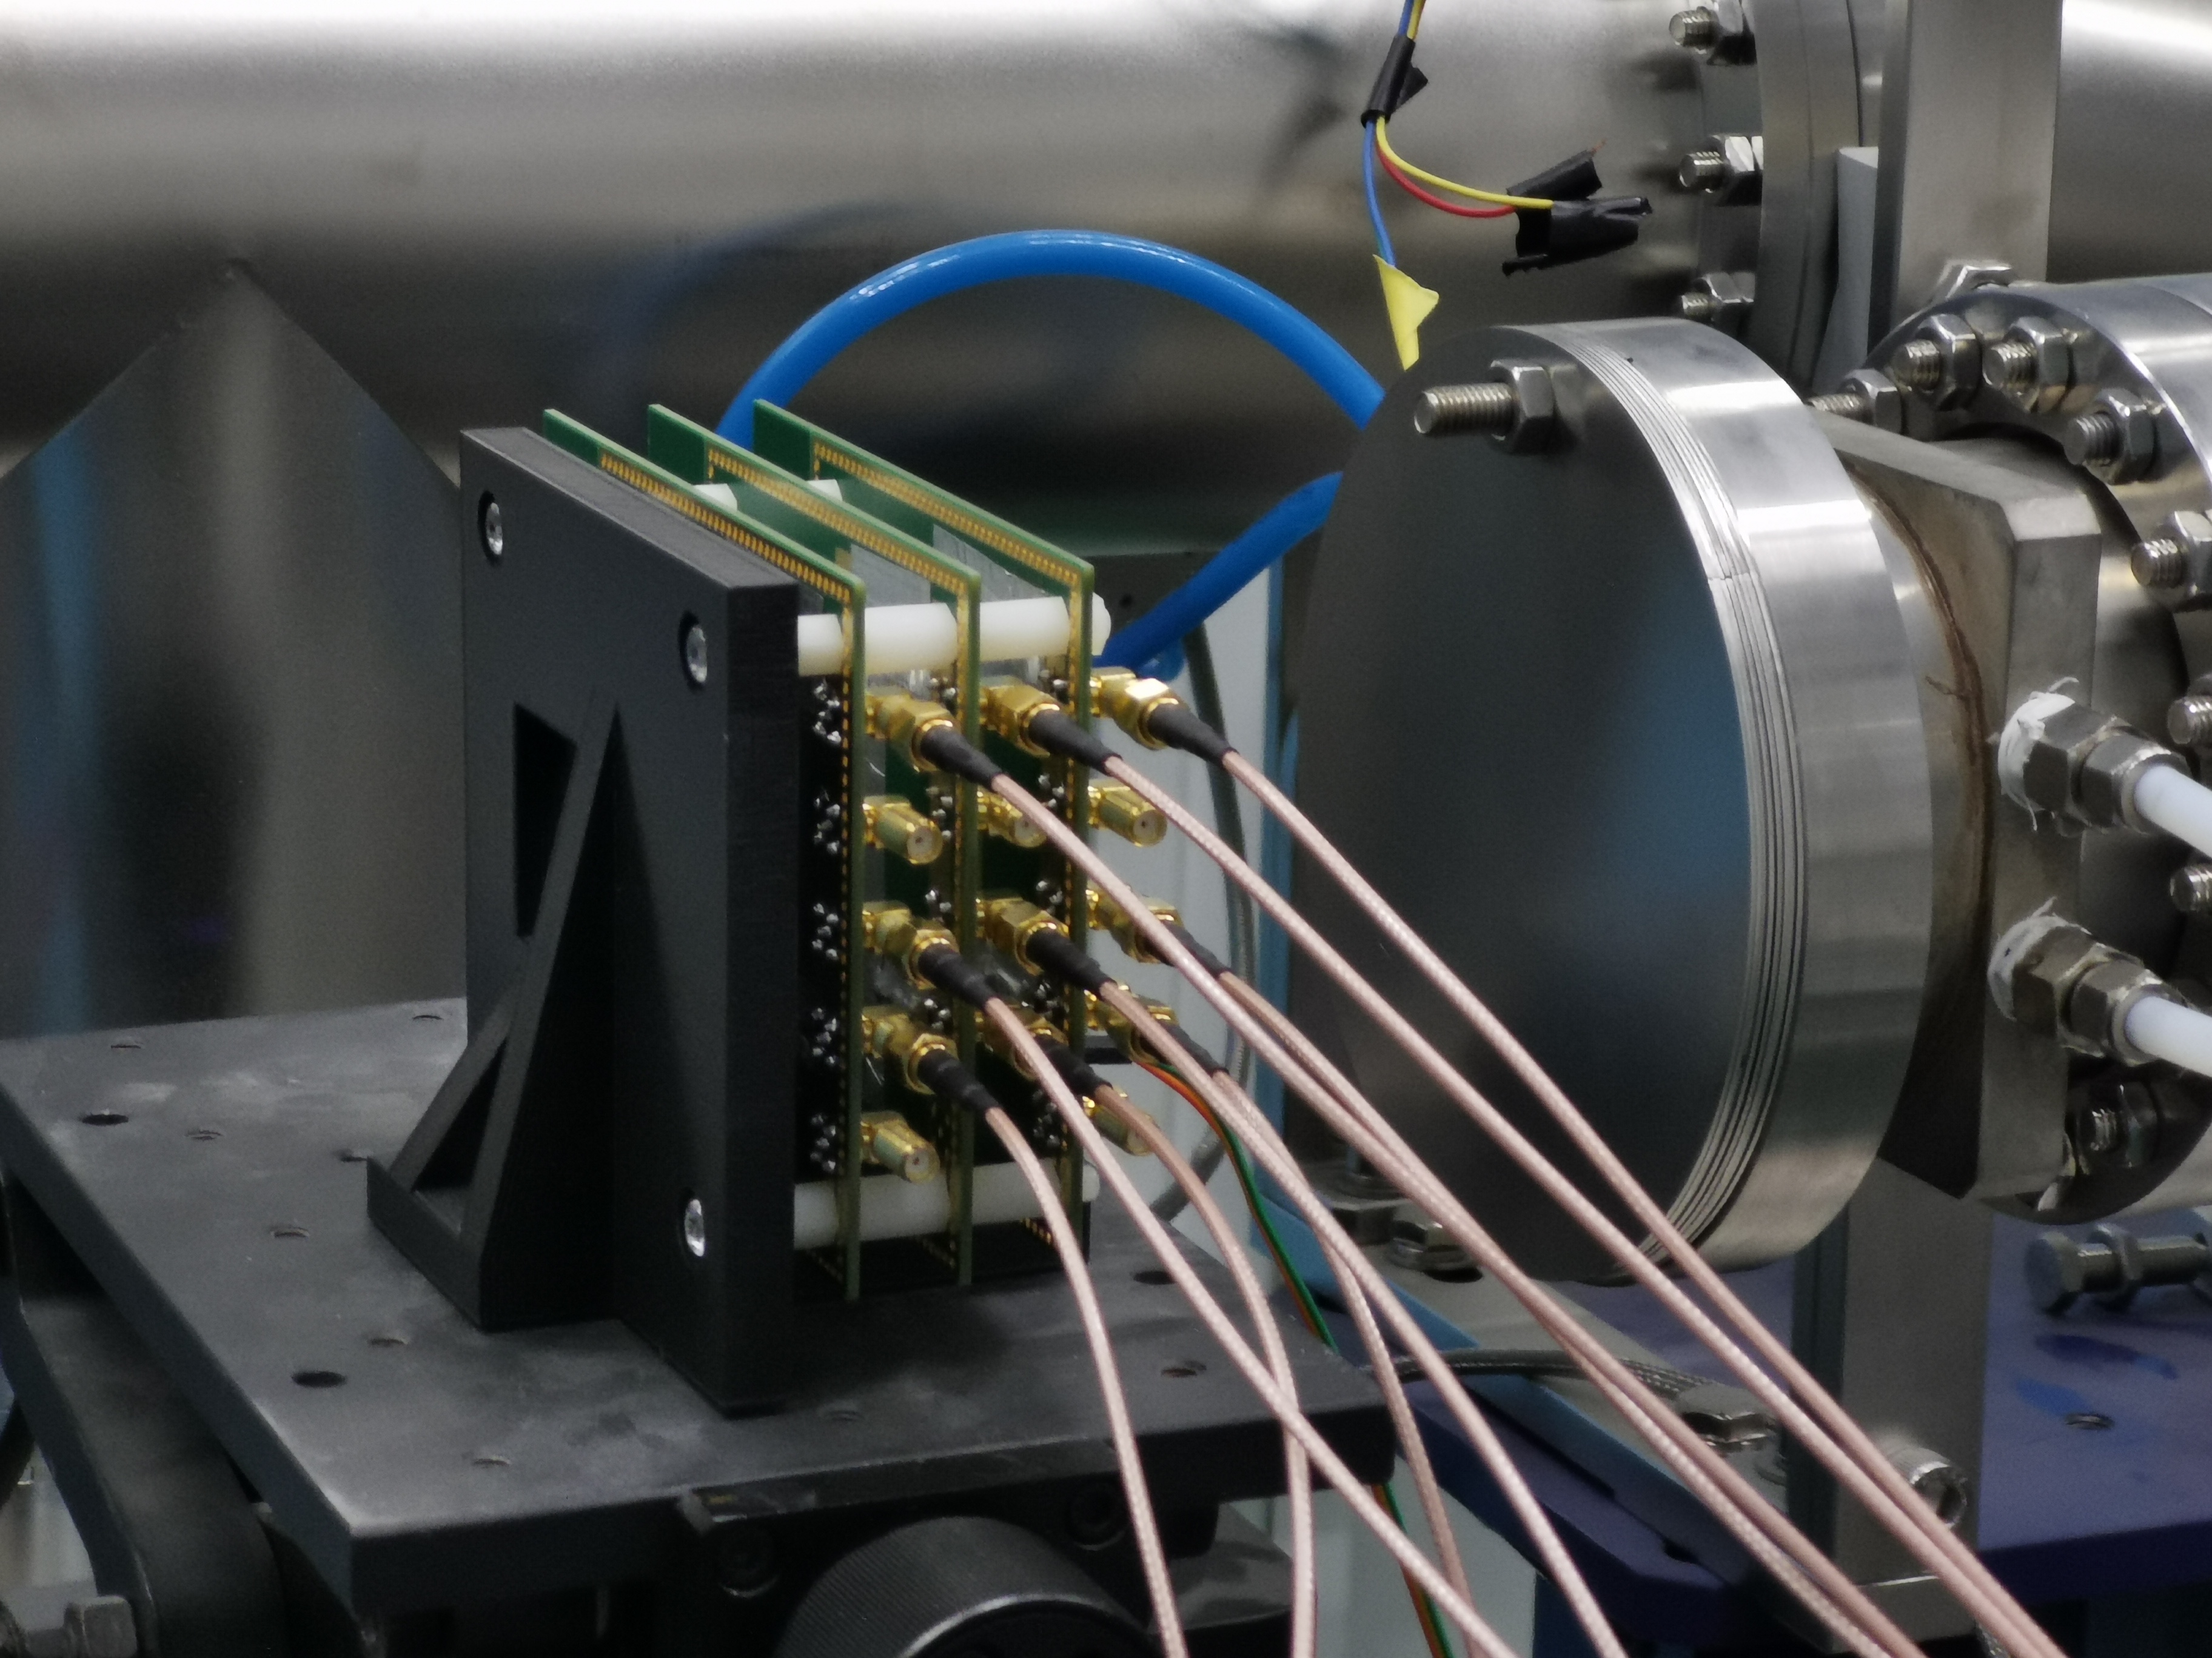
Setup at BSRF Station
1B3 station (18m away from BEPC ring)
1W2B station(~30m away from BEPC ring)
4W1A station (40m+ away from BEPC ring)
Setup at 4W1A station
Setup at 1B3 station

Slide 4
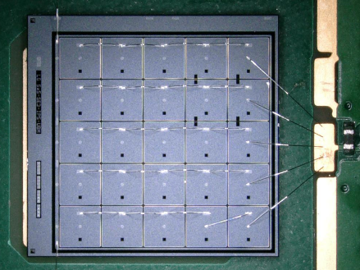
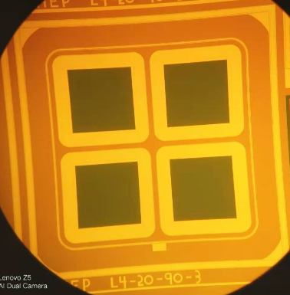
Detector at BSFC testbeam
Three detectors are used, data taking with Oscilloscope
→ One IHEP-IME 2×2 LGAD. Area: 3mm×3mm, time resolution: 39ps
Two HPK 5×5 LGAD. Area: 6.5mm×6.5mm, time resolution: 60-70ps
One HPK 15×15 LGAD. Area: 20 mm ×20 mm, low signal level
HPK 5×5 LGAD
Single channel readout
IHEP-IME
2×2 LGAD
IHEP-IME
2*2 LGAD
17mm
17mm
Beam
(X ray
/electrons?)
HPK 5*5
HPK 5*5

Slide 5
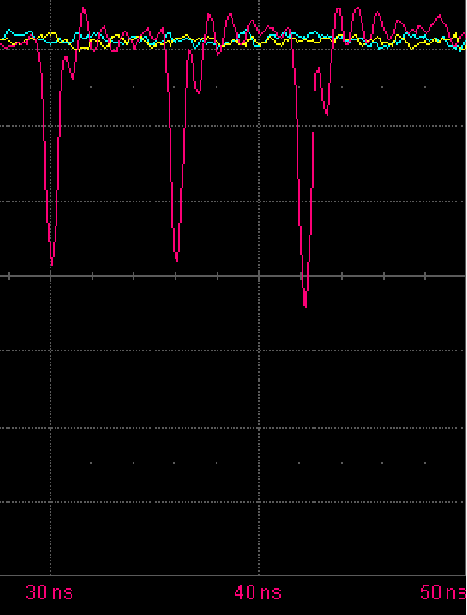
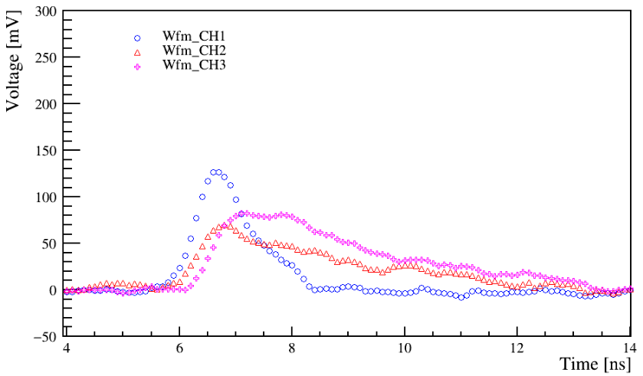
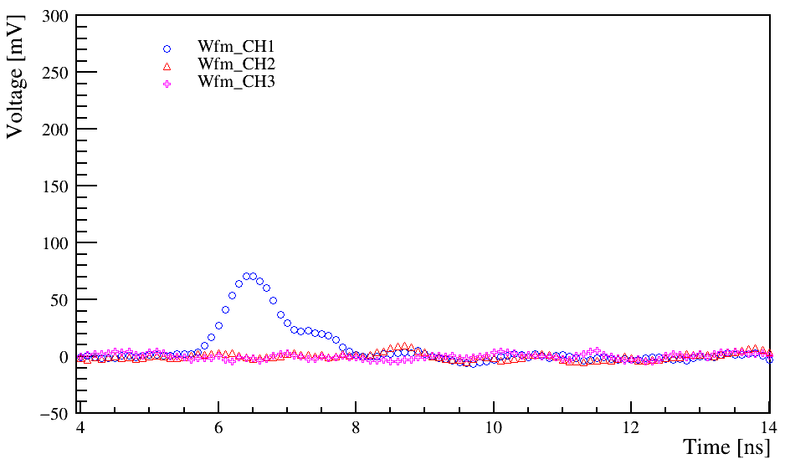
Detector signal at BSFC testbeam
Two type of signal: Coincidence and non-coincidence events
Typical non-coincidence events
(signal only in 1 LGAD
no signals for others LGADs )
Typical Coincidence events
(Coincidence signal
in 2~3 LGAD detectors)
6ns
high rate , Period: ~6ns
Consistent with BEPC cycle
IHEP-IME 2×2 LGAD
HPK 5×5 LGAD
HPK 5×5 LGAD
IHEP-IME 2×2 LGAD
HPK 5×5 LGAD
HPK 5×5 LGAD

Slide 6
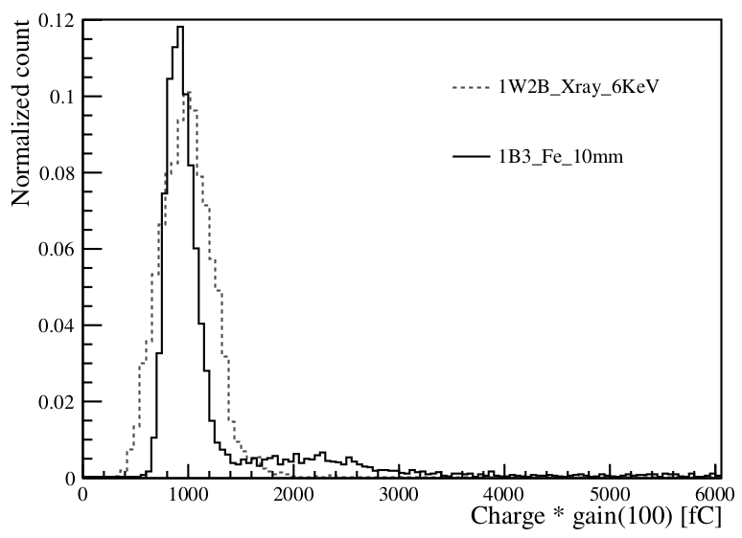
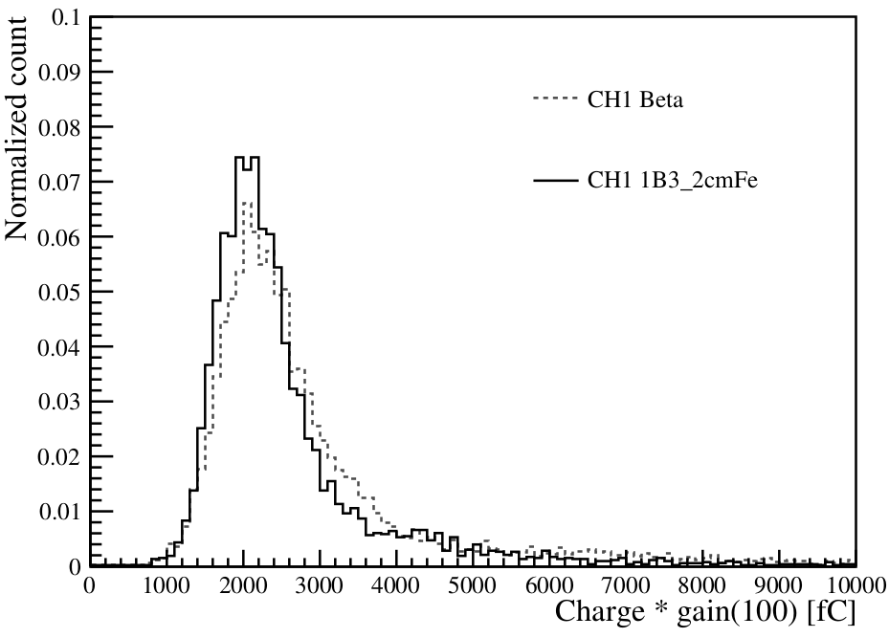
Detector signal at BSFC testbeam
Collected charge of non-Coincidence
Similar to 6keV X ray
Collected charge of Coincidence signal
consistent with MIP signal in beta test
6keV X ray
Beta test
BSRF
BSRF
Beta tests
2 MIP
IHEP-IME LGAD
IHEP-IME LGAD

Slide 7
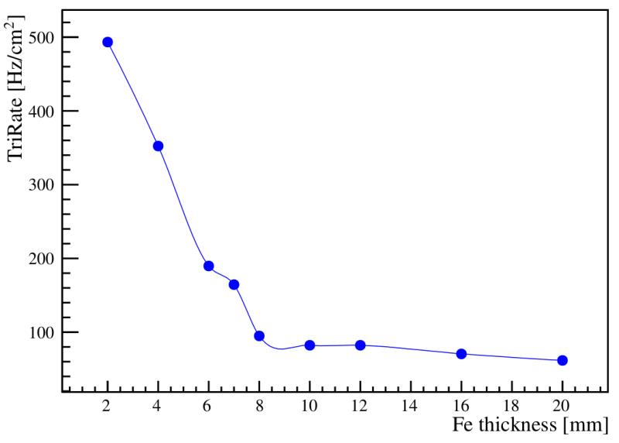
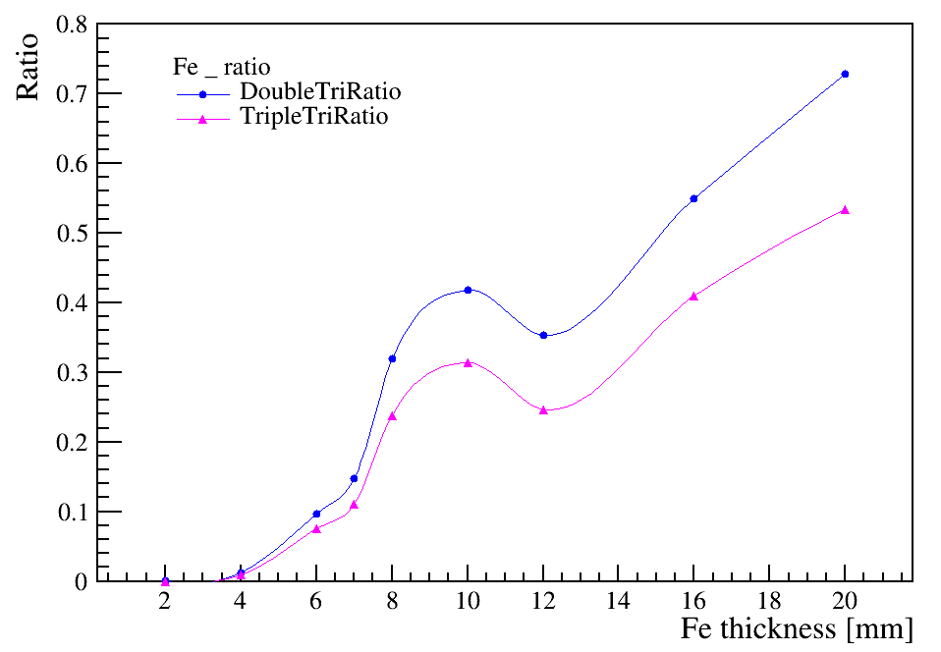
Trigger rate
IHEP-IME LGAD
17mm
17mm
Triggering on IHEP-IME LGAD (upstream detector)
Adding more layers of steel to absorb X ray
Trigger rate decrease, and then became stable at ~50Hz/cm²
Coincidence events ratio increased
Steel
Beam
(X ray
/electrons?)
HPK
HPK
Trigger on IHEP-IME LGAD
2 LGAD coincidence ratio
3 LGADs coincidence ratio
Steel thickness(mm)
Steel thickness(mm)

Slide 8
Event rates
Coincidence events rate (MIP-like event rate) is higher in station closer to BEPC ring
BSRF Station | 1B3 | 4W1A
Coincidence events rate （Hz/cm²） | ~50 | ~1.5 Hz/cm²
Distance to BEPC ring (meter) | 18 | ~43

Slide 9
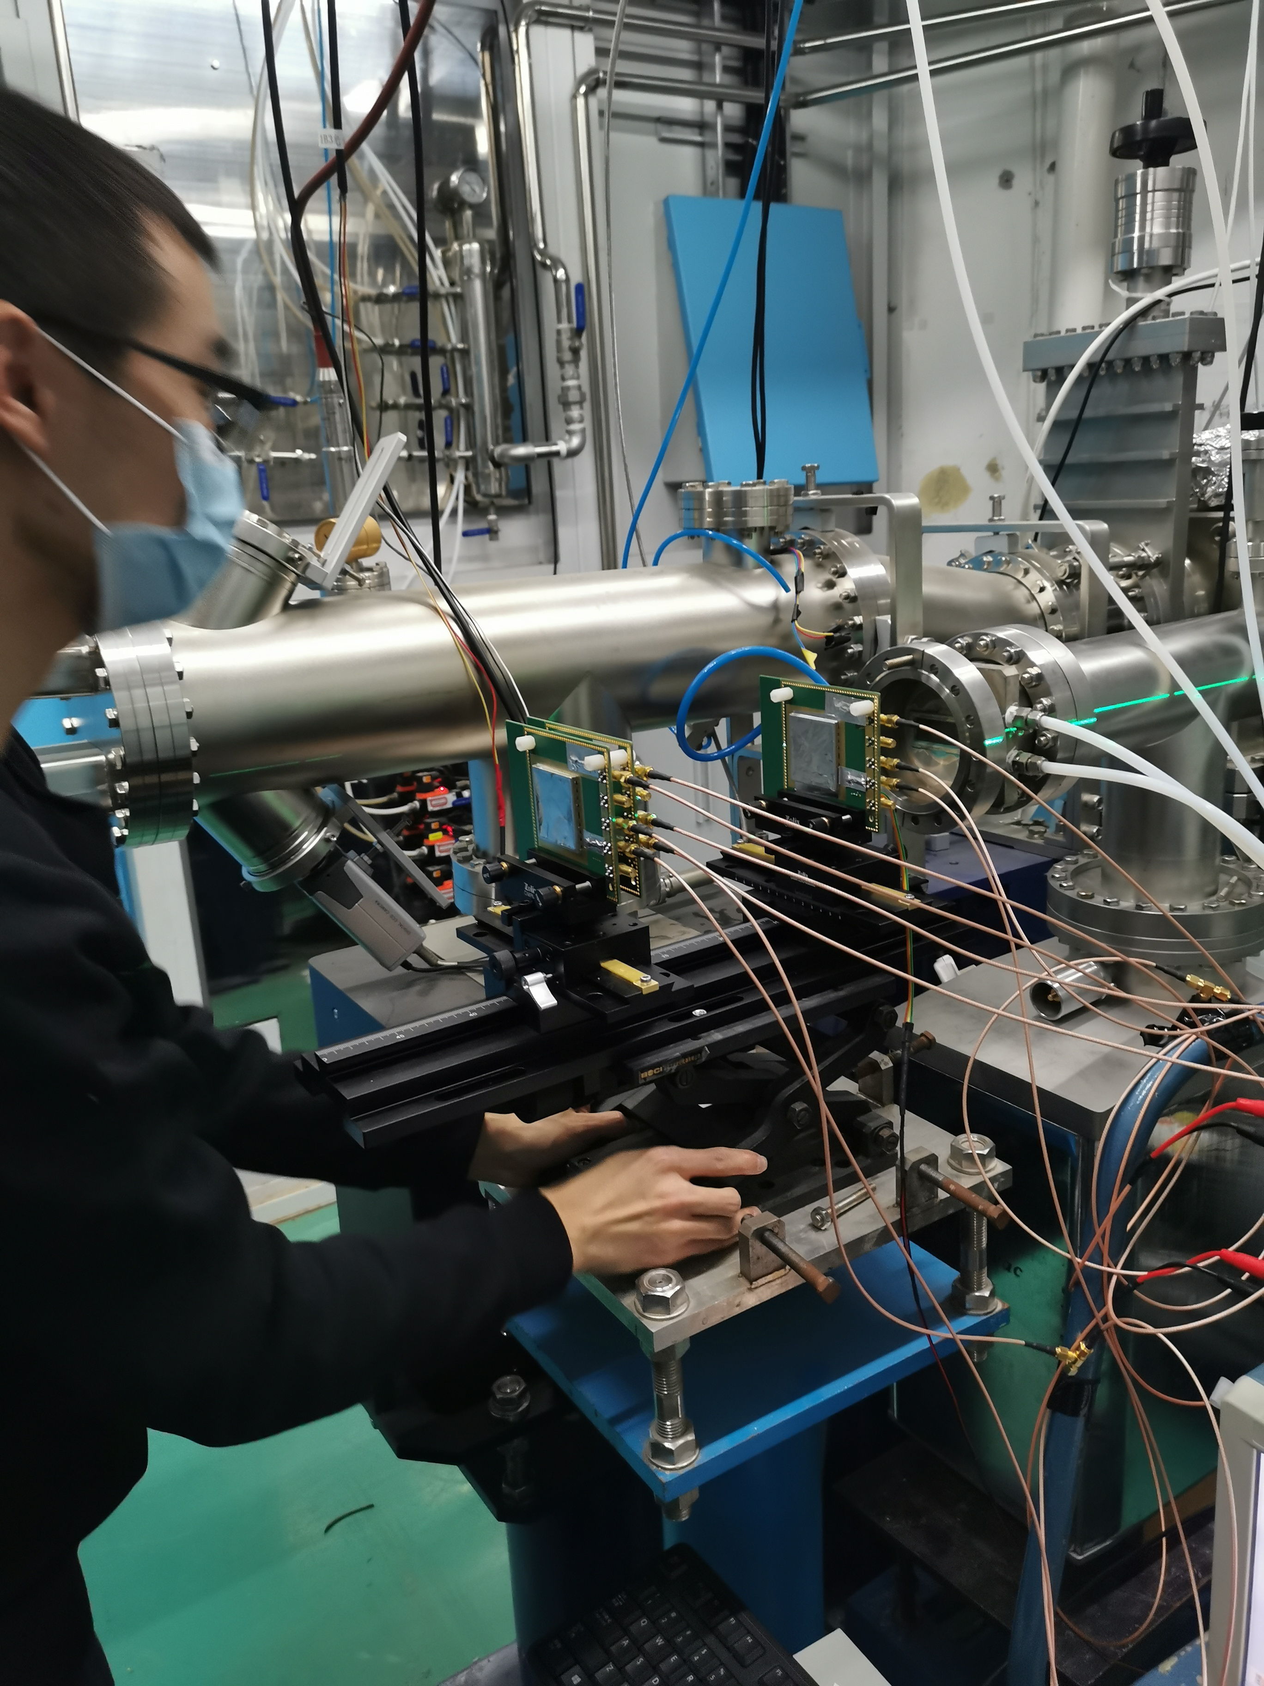
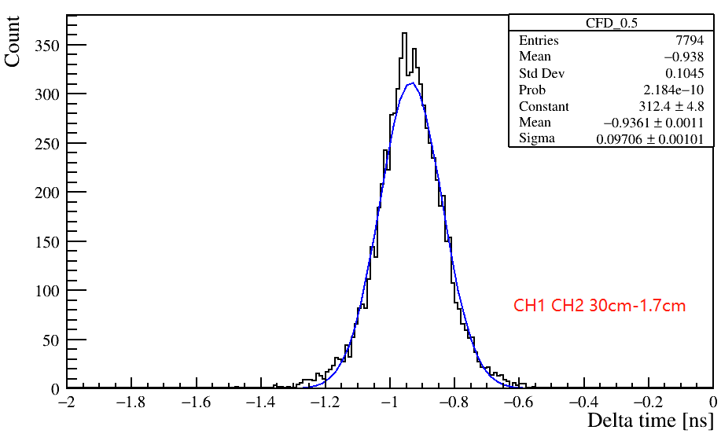
Time of flight– identifying MIP-like particle
In coincidence events, what is MIP-like particle ?
Is that low momentum proton or pion (secondary particles) ?
Or high energy electrons ?
Measured flight time=936 ps, σ_{t}=97ps
Expected flight time = 943 ps
Consistence with speed of light （electron like)
Exclude proton below 1GeV
Exclude pion below 0.2 GeV
IHEP-IME
2*2 LGAD
28.3cm
beam
Distance
=28.3cm
HPK 5*5
Steel

Slide 10
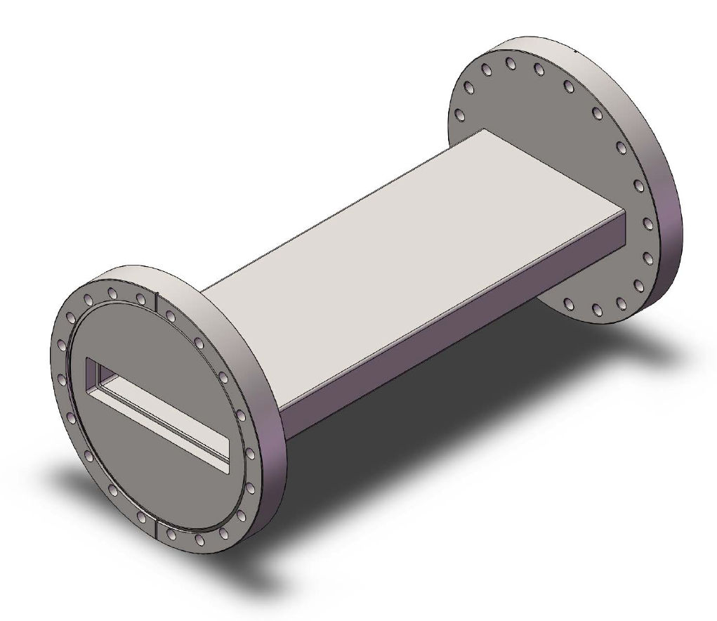
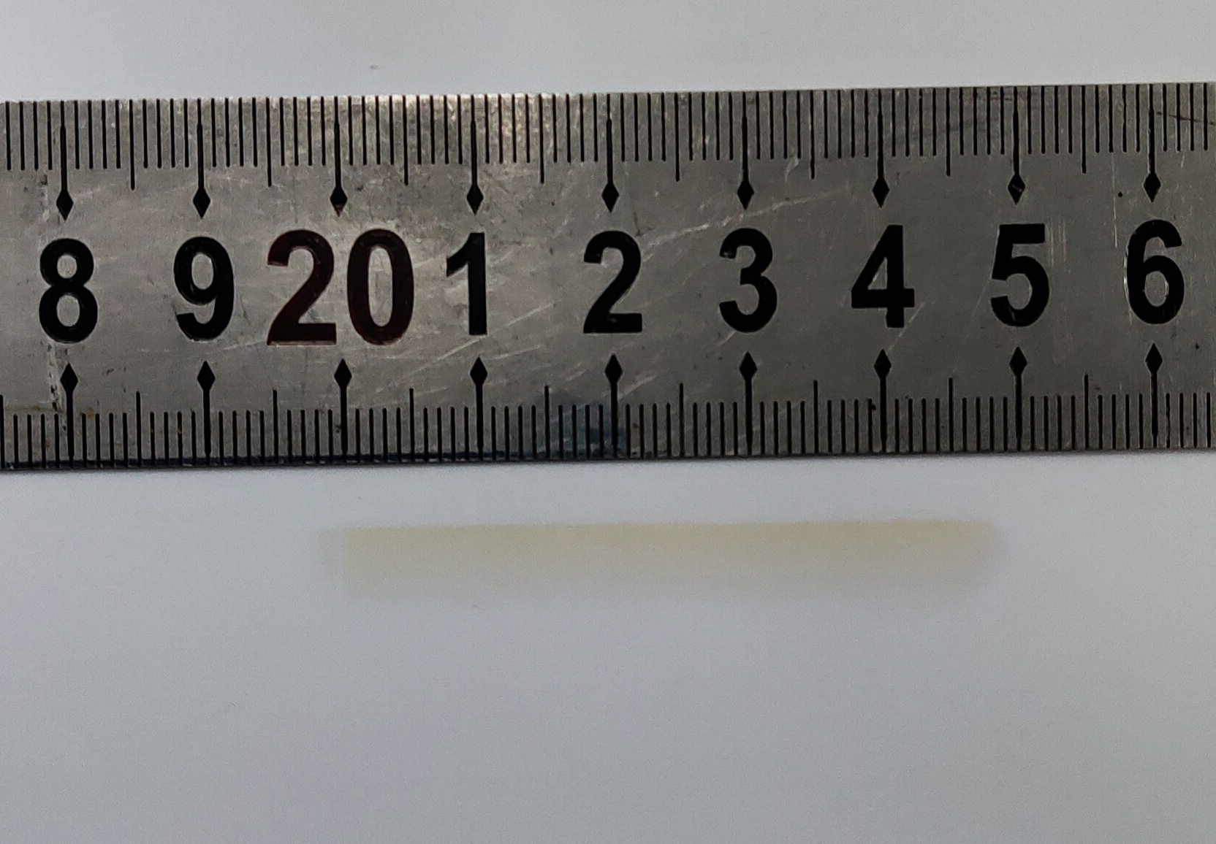
Beam profile
Beam spot size:~0.5cm * 5cm (estimated from burn mark )
Beam spot size is consistent with of the shutter shape
Shutter in 1B3 station
Burn mark in 1B3 station

Slide 11
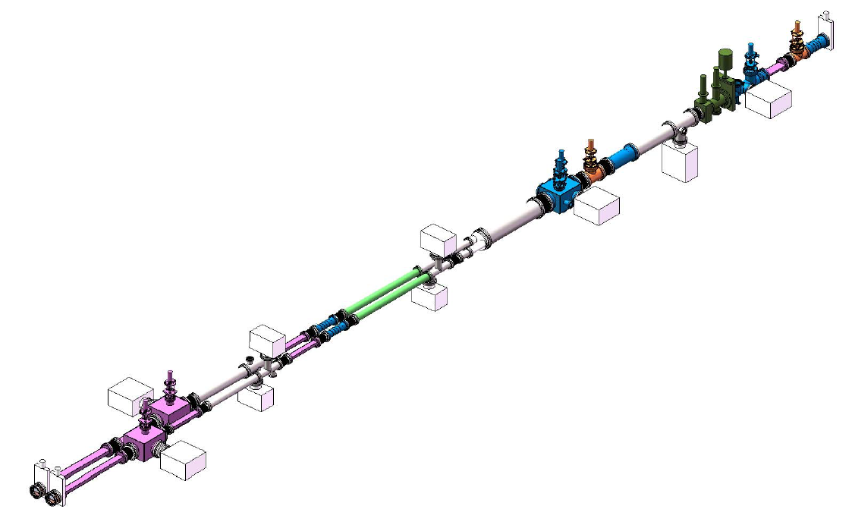
Potential of using 1B3b station for detector test beam
1B3a was used for XRD spectrum (material structure study)
1B3b is now borrowed temporarily
Test beam potential study (last week)
Accelerator colleague will use 1B3b for next 1~2 months for vacuum study （插入件在X辐照下放气实验）
Has potential to build test beam facility for longer term at 1B3b
Use CEPC vertex detector chips to build beam telescope
Build a magnetic to sperate X ray from electron beams, also measure the momentum of electrons
1B3b
1B3a
1B3a
1B3b

Slide 12
Summary
Found MIP-like particles in three BSRF stations (likely to be high energy electrons)
The largest MIP-like event rate is about 50Hz/cm²
BSRF stations has potential to become a good test beam facility

Slide 13
Comparisons
 | DESY | IHEP Hall 10 E3 beam line | BSRF
Momentum | 1-6 GeV | <1 GeV secondary beam | 1~2.5 GeV (to be measured)
Particles | electrons | Protons/ Pions/ /Electrons | Electrons ? (to be confirmed)
Trigger rate | 250Hz/cm² ⁻⁻4000 Hz/cm² | 0.6 Hz/cm² (design) <0.1 Hz/cm² (measured) | ~50 Hz/cm²
Operation period | ~10 months/ year | ~2 months/ year | ~10 months/ year
Beam spot Size | 4cm² | ~80cm² | ~2.5cm² Depending on shutter shape

Slide 14
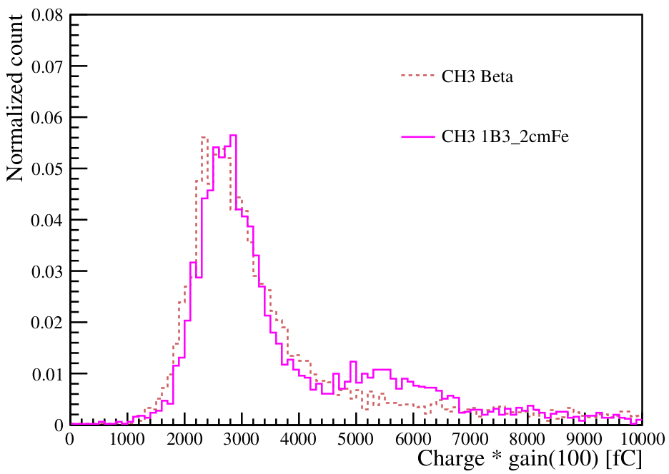
Coincidence signal at BSFC test beam
IHEP-IME LGAD
Collected charge of Coincidence signal
consistent with MIP signal in beta test
2MIP like signal in large area LGAD
17mm
17mm
Steel
Beam
HPK
HPK
Beta test
Beta test
BSRF
BSRF
IHEP-IME 2*2 LGAD
HPK 5*5 LGAD
2 MIP ?

Slide 15
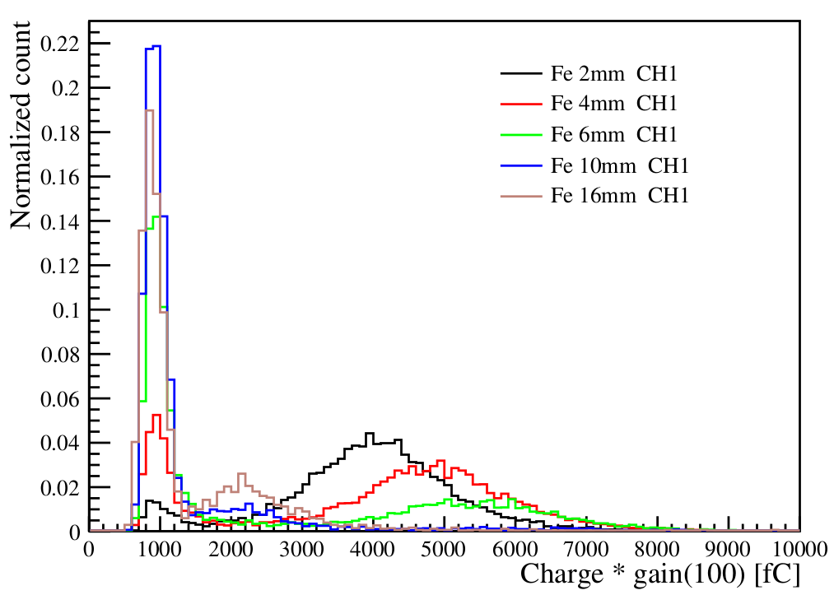
Non-Coincidence signal at BSFC test beam
Collected charge of non-Coincidence
First peak is similar to 6keV X ray
The origin of the second peak is unknow, it disappeared after putting more Steel
IHEP-IME LGAD
Similar to
6keV X ray
17mm
17mm
Steel
Beam
HPK
HPK
IHEP-IME 2*2 LGAD

Slide 16
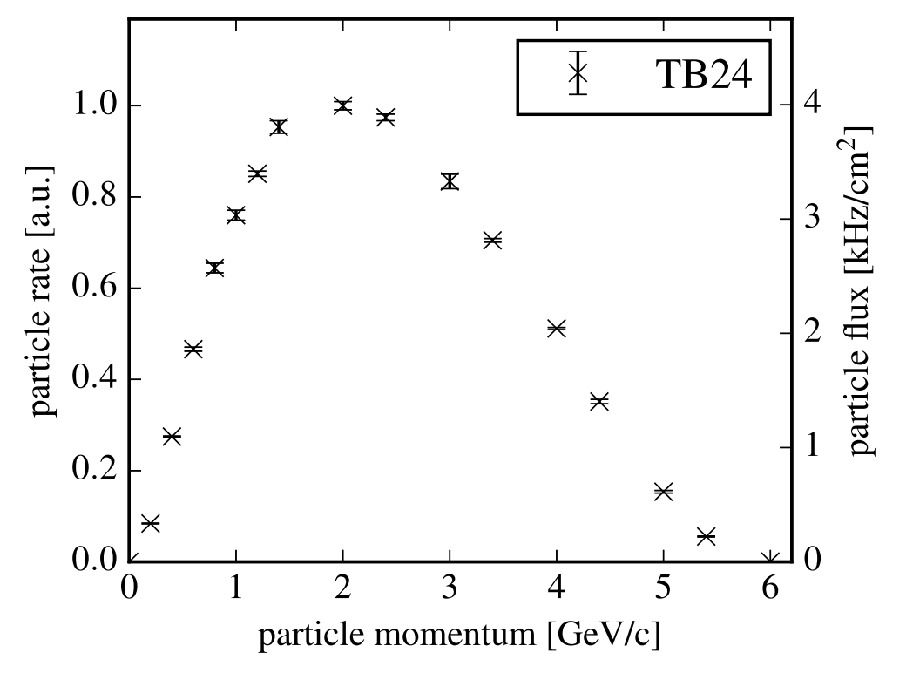
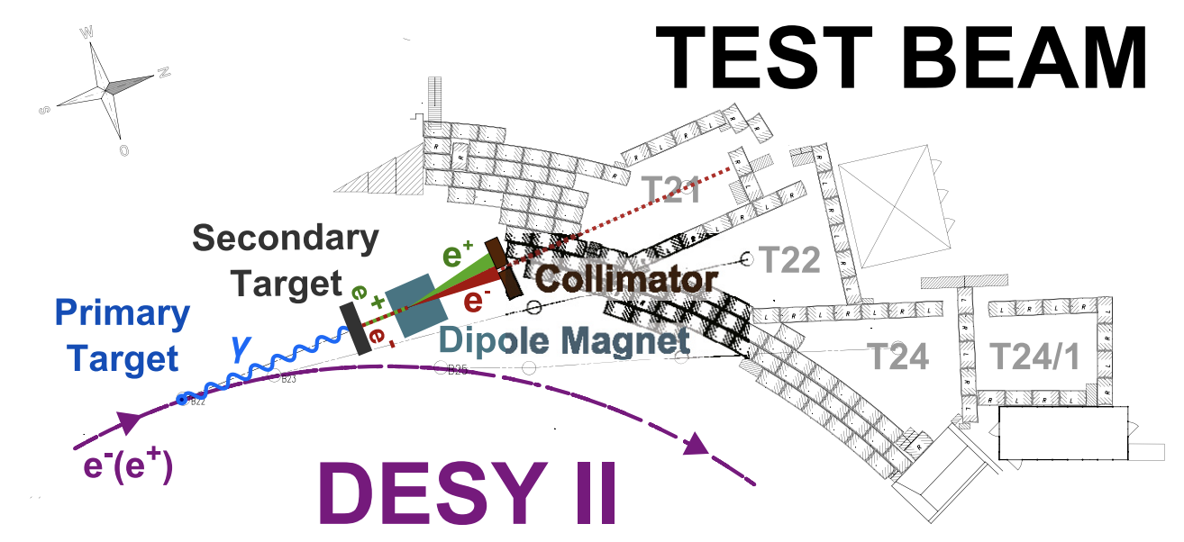
DESY test beam facility

Slide 17
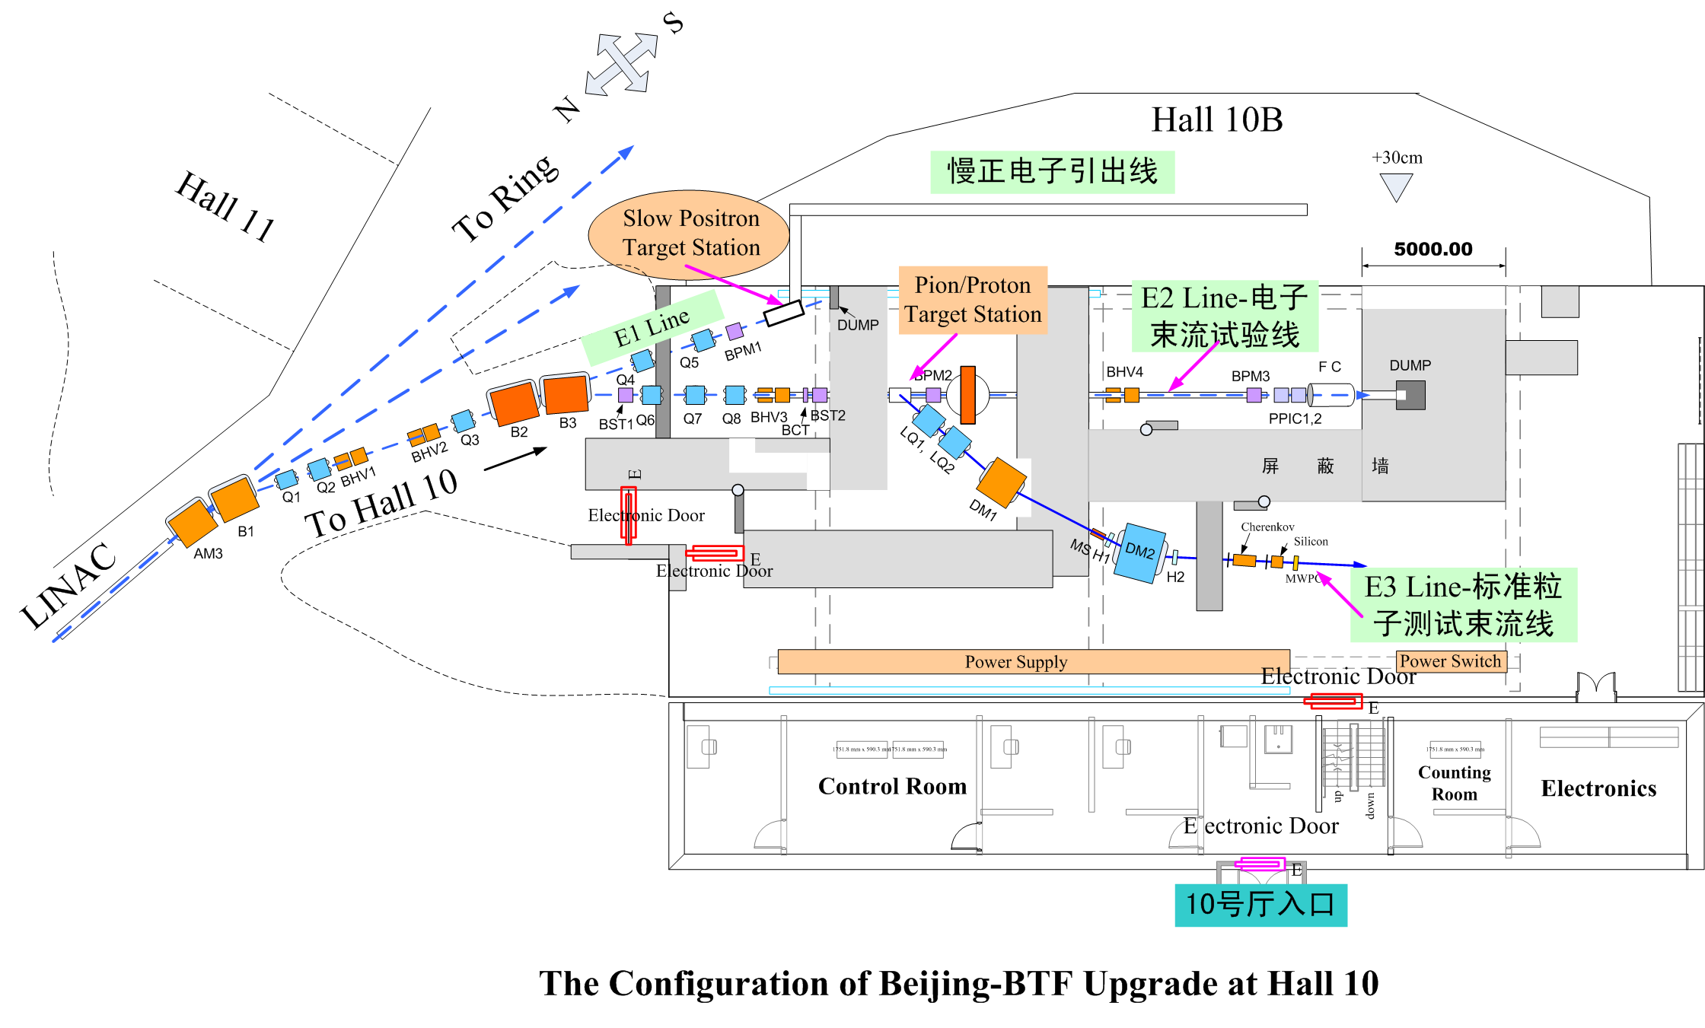
IHEP Hall 10

Slide 18
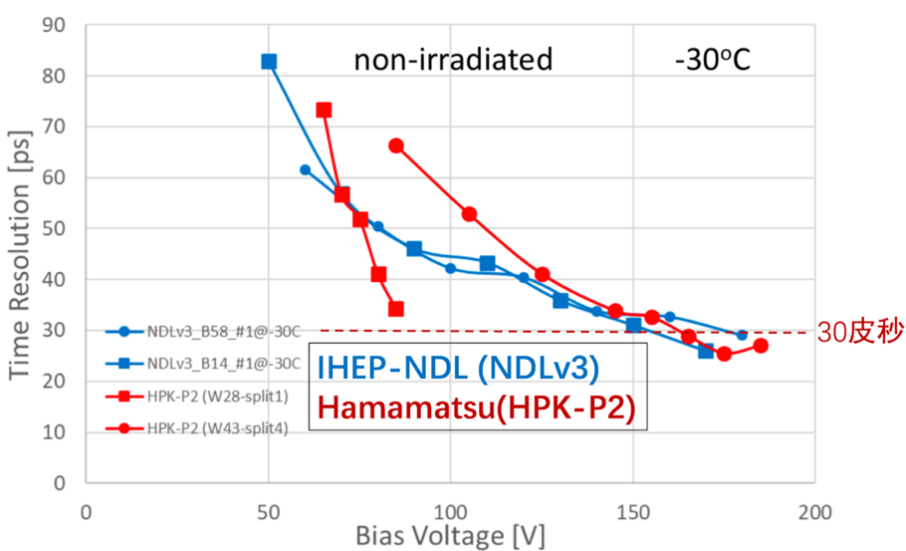
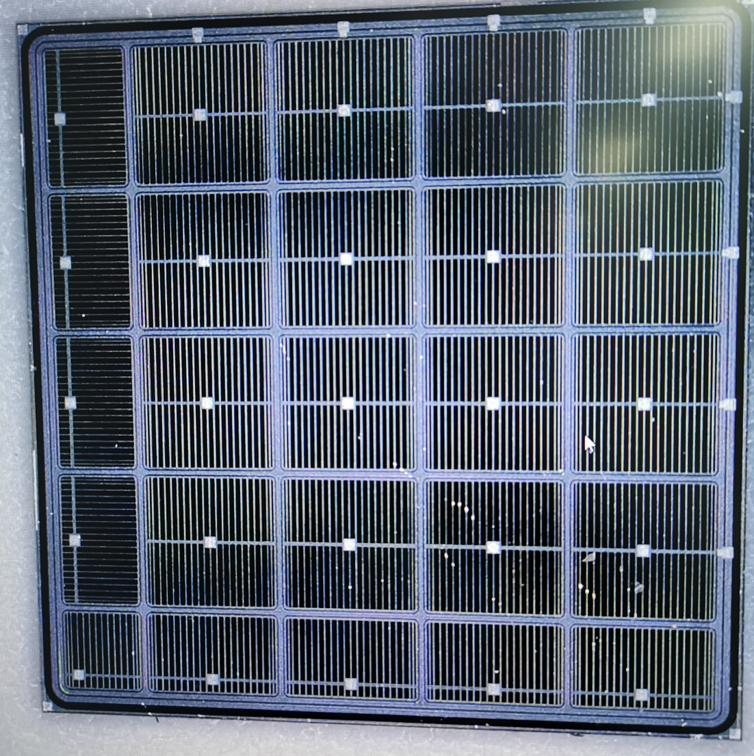
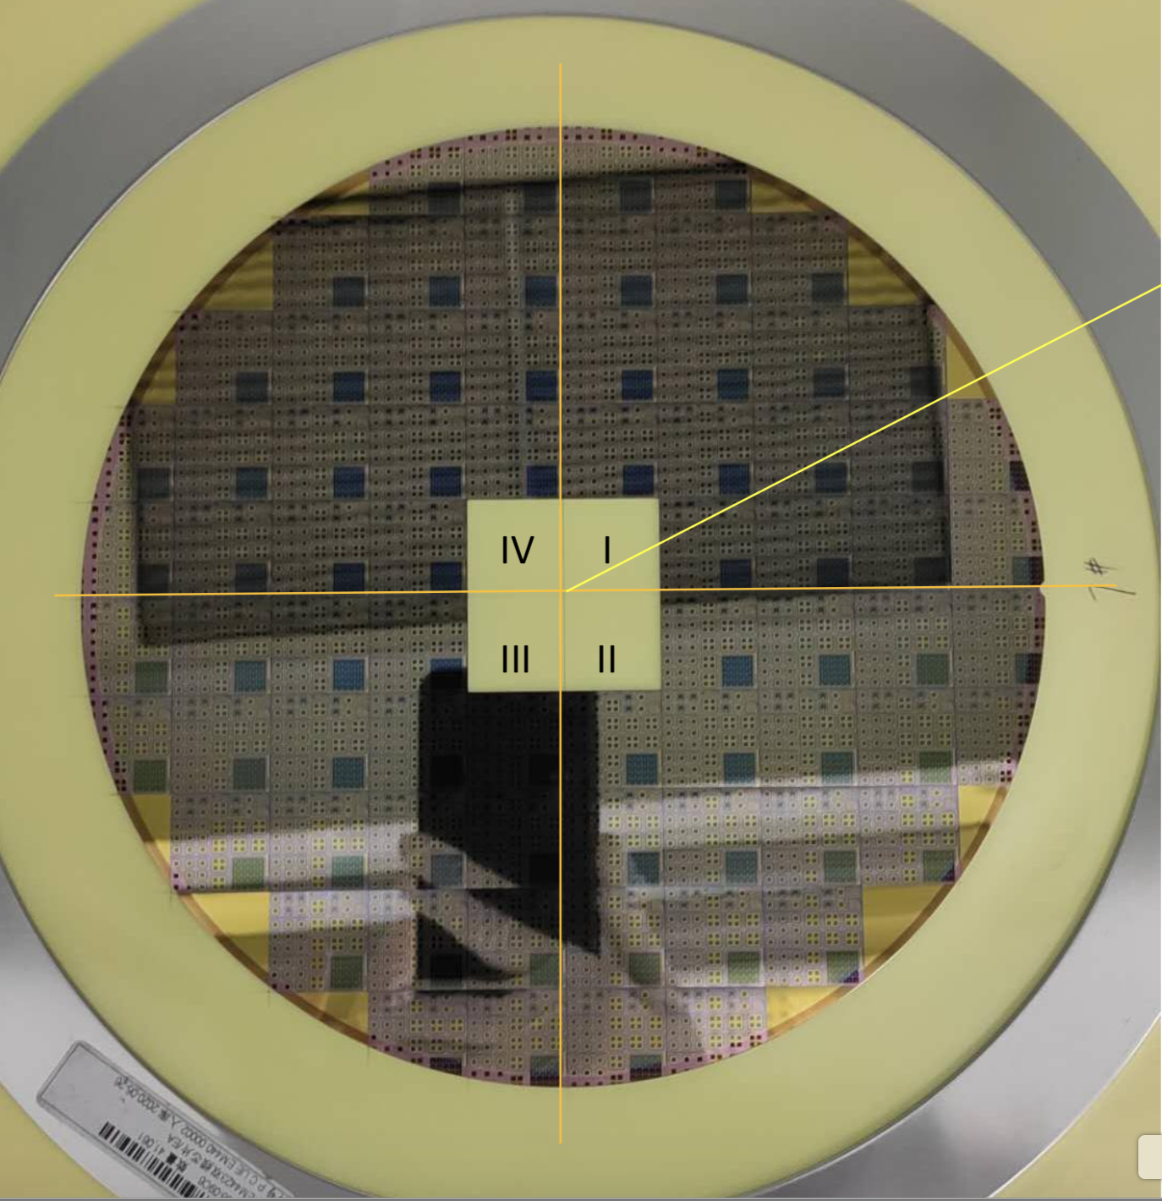
CEPC timing detector : R & D status
IHEP and Beijing Normal U. developed IHEP-NDL LGAD sensors
→ Can reach 25 pico-second(ps) , similar performance compared to HPK sensors
IHEP and Institute of micro-electronics (IME) developed IHEP-IME sensors
→ IHEP team (Mei Zhao …) designed, IME fabricated
Timing resolution in beta test
IHEP-IME sensors
8 inch wafer
IHEP-NDL sensor

Slide 19
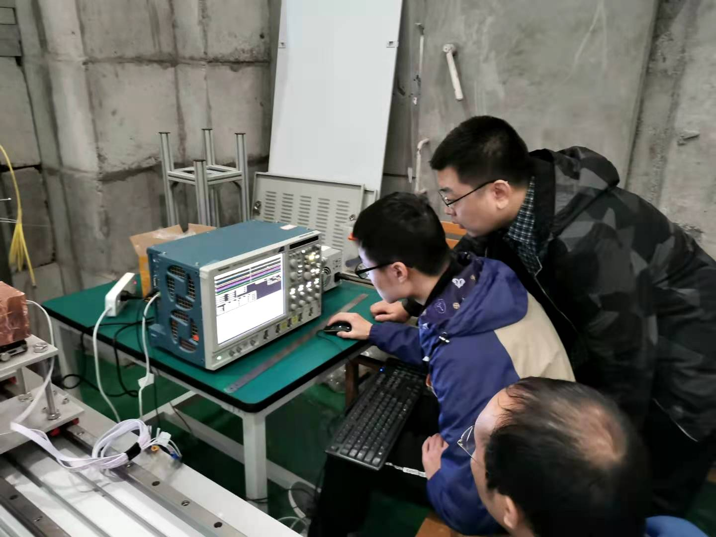
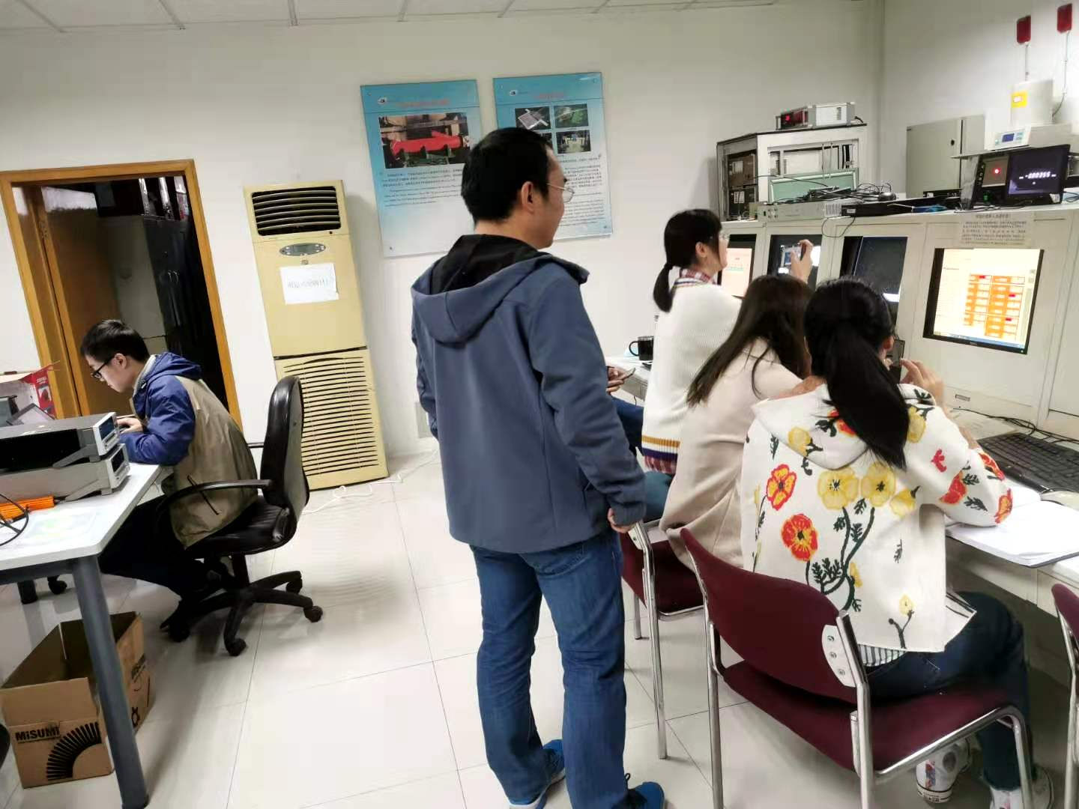
CEPC timing detector :IHEP Test beam 2020
Timing detector team (3 postdocs and 4 students) participate IHEP test beam
→ Tuning the beam, taking shifts, commissioning the detectors
Postdoc: Bo Liu, Yunyun Fan, Xuan Yang
Students: Mengzhao Li, Shuqi Li, Han Cui, Chengjun Yu

Slide 20
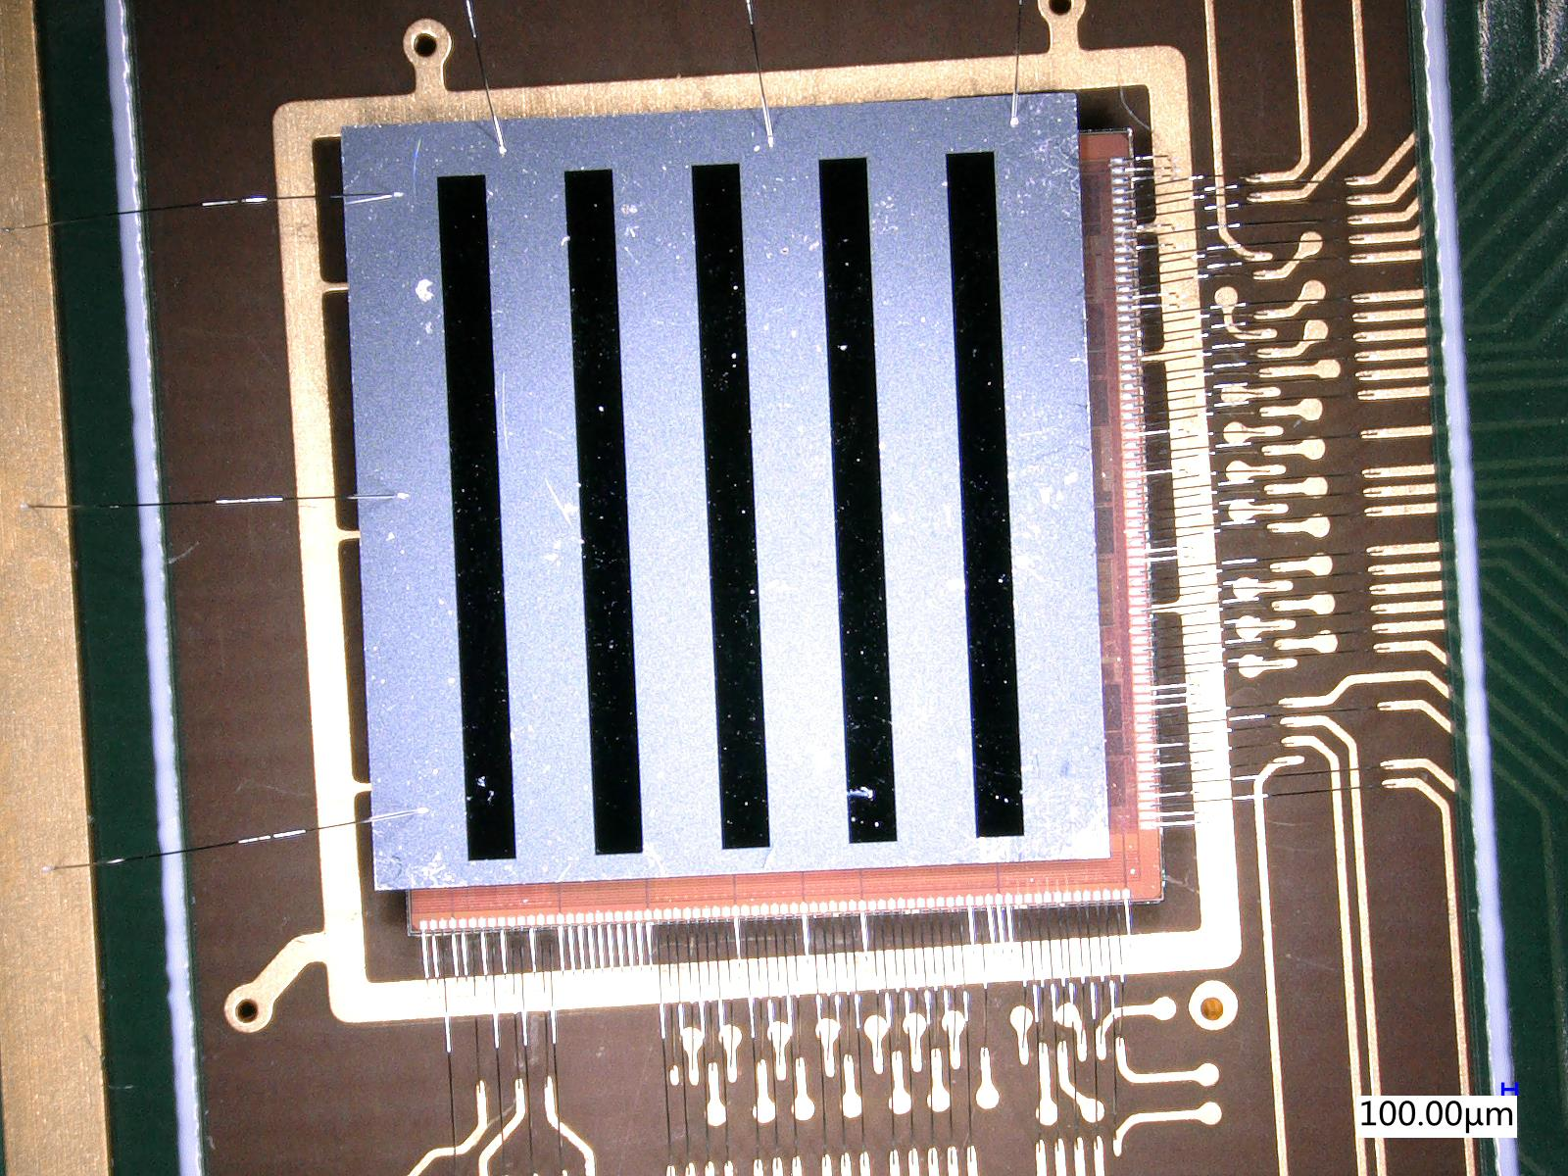
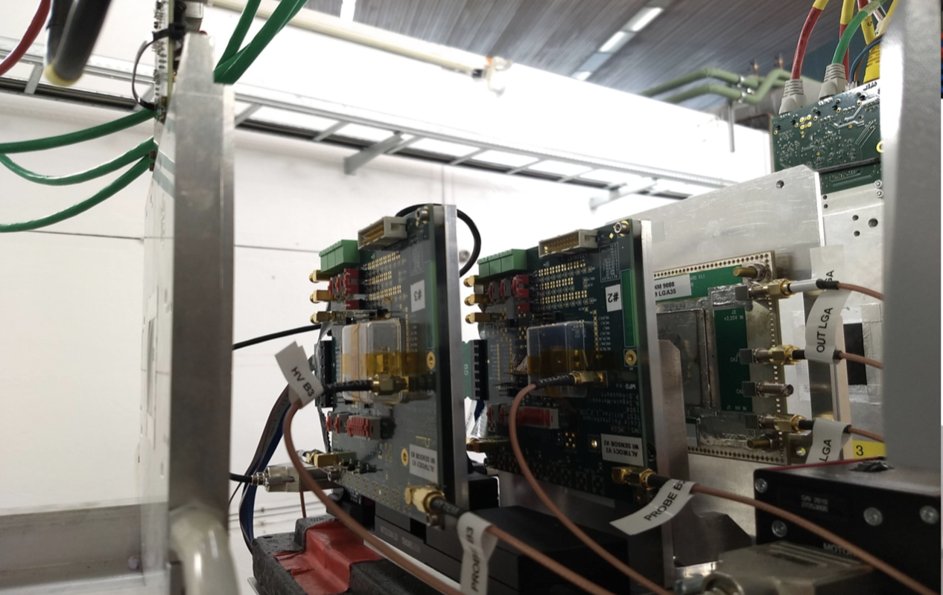
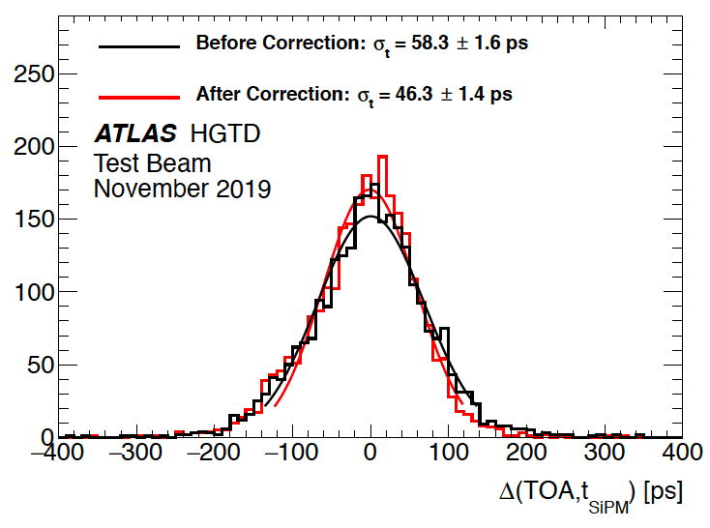
Outlook: Testbeam with ATLAS HGTD module
Time resolution: 45ps
Position resolution: ~1mm
Area : 6.5mm*6.5mm --> (2cm*4cm)

Slide 21
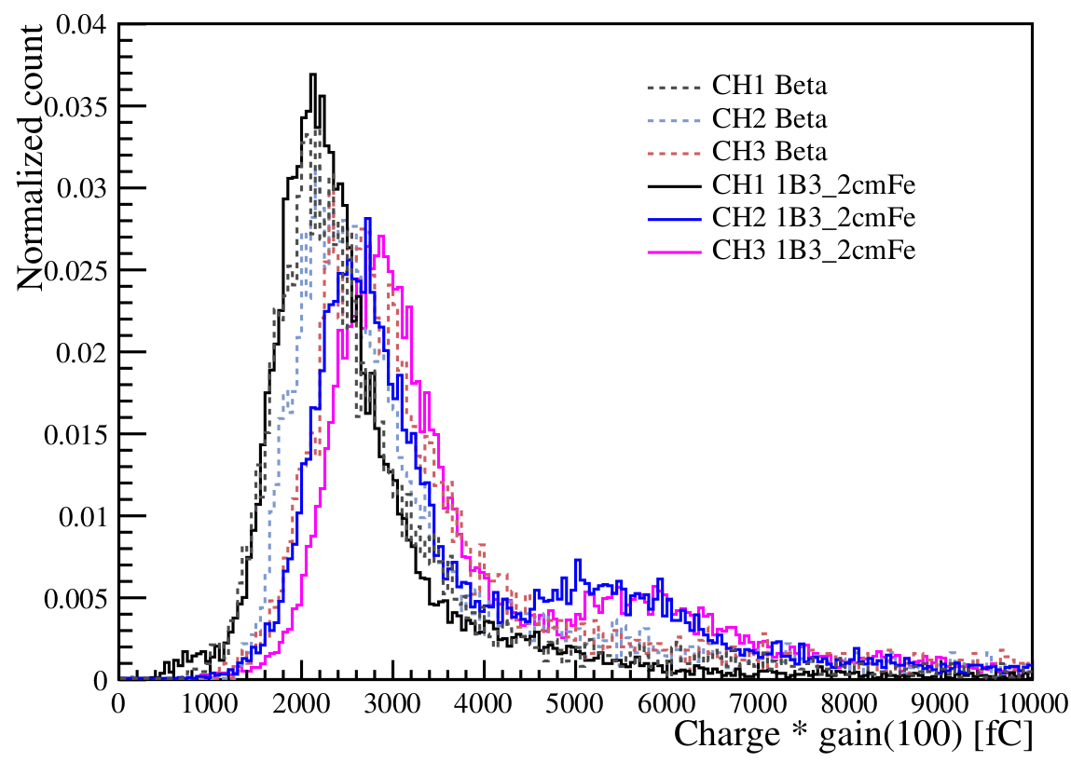
Detector signal at BSFC testbeam
Collected charge in non-coincidence signal is consistent with ~10keV X ray signals
Collected charge in coincidence signal events is consistent with MIP signal in beta test
Found two-MIP like signal in HPK LGAD in BSRF beam tests
Two MIP particles hitting one LGAD detector at the same time ?
Beta
tests
BSRF
tests
2 MIP

