Slide 1
charmonium spectroscopy
Dian-Yong Chen
Southeast University
PRD100, 074016;93,034028;91,094023; EPJC 76, 671;74,3208
Collaboration With Xiang Liu, Jun he, Cheng-qun Pang et al

Slide 2
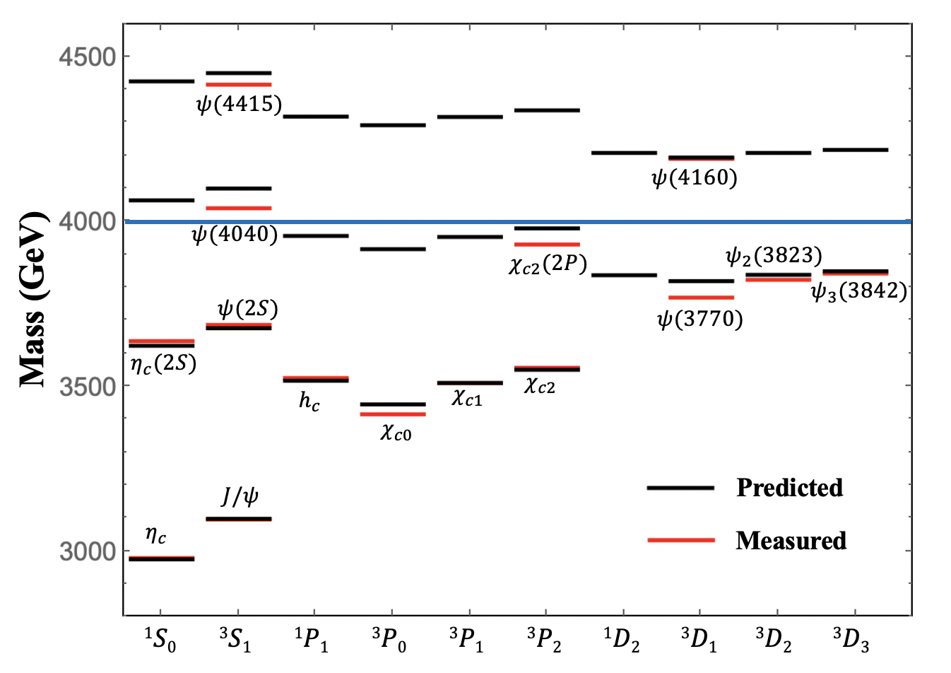
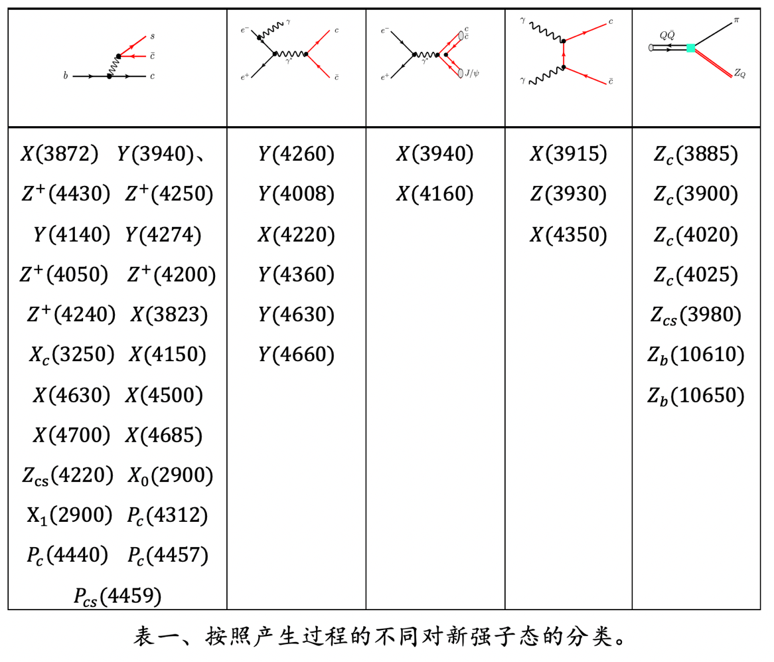
charmonium Spectroscopy
Newly observed states
Only 3 Charmonia above 4 GeV are established!
A good opportunity to enrich the charmonium spectroscopy

Slide 3
Outline
1. Y(4220) as $ψ(4S)$
2. D wave Charmonia
2. Y(4140) as $χ_{c1}(3P)$
3. Summary

Slide 4
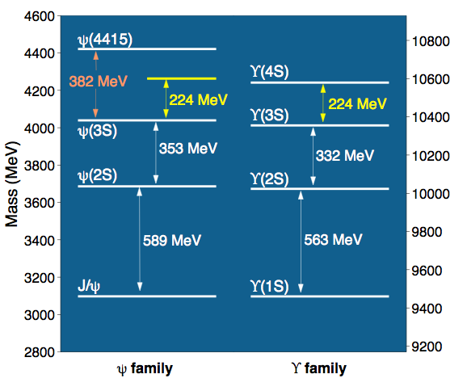
Prediction of $ψ(4S)$
The similarity between $J/ψ$ and $Υ$ families
The mass spectrum analysis
Compared with the $ψ$ family, the $Υ$ family with radial quantum number n=1,2,3,4 were well established both experimentally and theoretically.
Thus, the study of the $ψ$ family, can be borrowed from $Υ$ family.
If the law of the mass gap relation still holds for n=3,4 in the $ψ$ and $Υ$ families, we find that the mass of $ψ(4S)$ should be located at 4263MeV.
comparison of the $ψ$ family with the $Υ$ family:
Similarity:
Mass gap: 2S-1S: 589 MeV Vs 563 MeV
3S-2S: 353 MeV Vs 332 MeV
Violation:
If $ψ\left(4415\right)$ is $ψ\left(4S\right)$, the similarity between charmonium and bottomonium is violated.
Mass gap: 4S-3S: 382 MeV Vs 224 MeV
Anomalous:
bottomonium mass gaps:
2S-1S>3S-2S>4S-3S
charmonium mass gaps:
2S-1S>3S-2S<4S-3S
Li-Ping He, Dian-Yong Chen, Xiang Liu, Matsuki, Eur. Phys. J. C 74, 3208
The screening potential prediction of ψ(4S) mass:
4273 MeV Li&Chao PRD79, 094004 (2009)
4247 MeV Dong et al., PRD49, 1642 (1994)
Consistent!!

Slide 5
Questions:
If this predicted state exists in the $J/ψ$ family, we must reveal its underlying properties to answer why there does not have any evidence in the present experiment
Can Y(4260) or Y(4360) be as the candidate of predicted charmonium with mass around 4.26 GeV?
Charmonium-like state around 4.26 GeV

Slide 6
The decay behavior of the predicted charmonium around 4.26 GeV
We adopt the QPC model to study the decay behavior of the discussed charmonia
Test the reliability of the QPC model via $ψ\left(3S\right)\left(ψ\left(4040\right)\right)$ decays;
Well reproduce the experimental data of the $ψ\left(3S\right);$
Enable us to apply this model to safely study the decays of the $ψ\left(4S\right).$
L. Micu, NPB 10, 521 (1969)

Slide 7
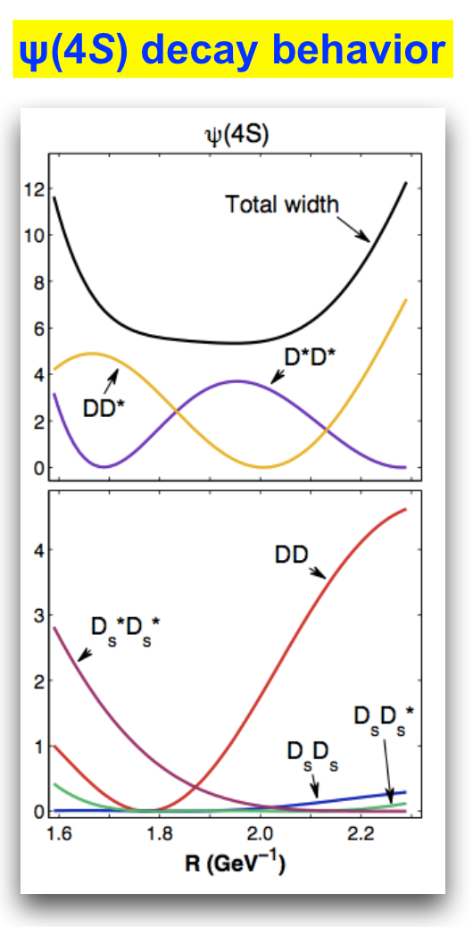
A very interesting result of the decay behavior of ψ(4S) can be found:
• The total decay width of ψ(4S) is stable corresponding to the R range adopted, while its partial decay widths strongly depend on the R value
• Due to node effect! • The predicted charmonium ψ(4S) has very narrow width around 10 MeV
• For the higher charmonia above the DD threshold, this phenomenon of ψ(4S) presented here is unusual
ψ(4040), ψ(4160) and ψ(4415) have widths 80 ± 10 MeV, 103 ± 8 MeV and 62 ± 20 MeV, respectively, all of which are large. Even ψ(3770) which is just 43 MeV above the DD threshold has the width 27.2 MeV
Exclude Y(4260)/Y(4360) as the candidate of ψ(4S)

Slide 9
$ψ(4S)$in $e^{+}e^{−}→χ_{c0}ω$
BESIII, arXiv:1410.6538
If taking the mass of ψ(4S) to be 4230 MeV (Expt.), we find:
ψ(4S)→χc0ω is allowed
ψ(4S)→χc1ω and ψ(4S) →χc2ω are forbidden kinematically
e⁺e⁻→χc0ω
Explain why only e⁺e⁻→χc0ω was reported by BESIII
e⁺e⁻→χc1ω and e⁺e⁻→χc2ω are not significant

Slide 10
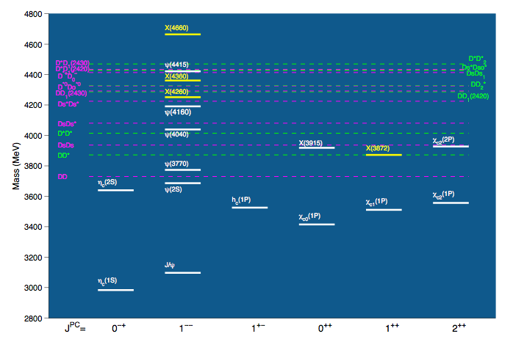
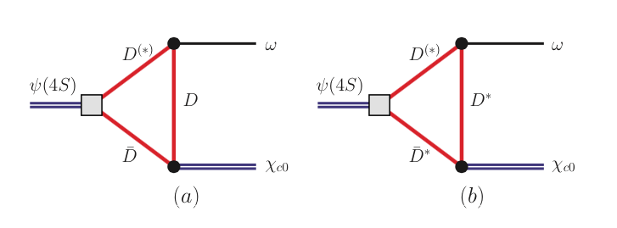
The study of the transition ψ(4S ) → ωχc0
For higher charmonia and bottomonia, the unquenched effect becomes more and more important since more channels are open
Coupled-channel effect
Non-perturbative properties of QCD
Hadronic loop is an effective description for this effect

Slide 11
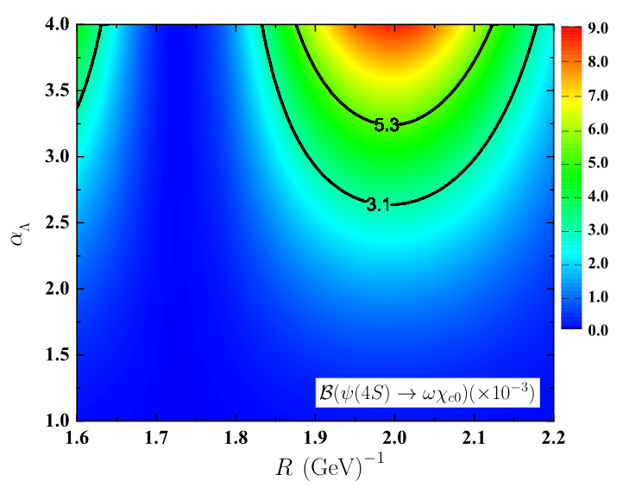
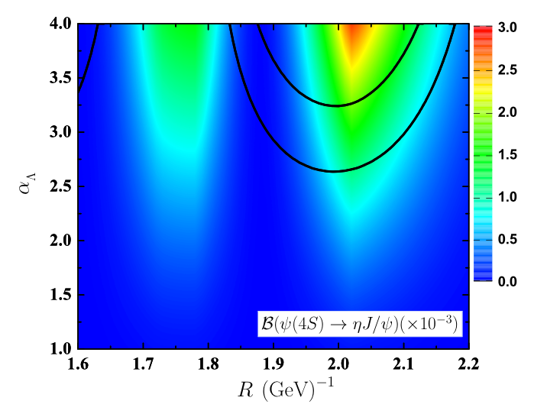
BESIII result (assuming the enhancement from ψ(4S)):
Li&Chao PRD79, 094004
Dong et al., PRD49, 1642
$$ψ\left(4S\right)→ηJ/ψ$$
$$<1.9×10^{−3}$$
$$ψ\left(4S\right)→χ_{c0}ω$$
Dian-Yong Chen, Xiang Liu and Matsuki,Phys.Rev.D91,094023

Slide 12
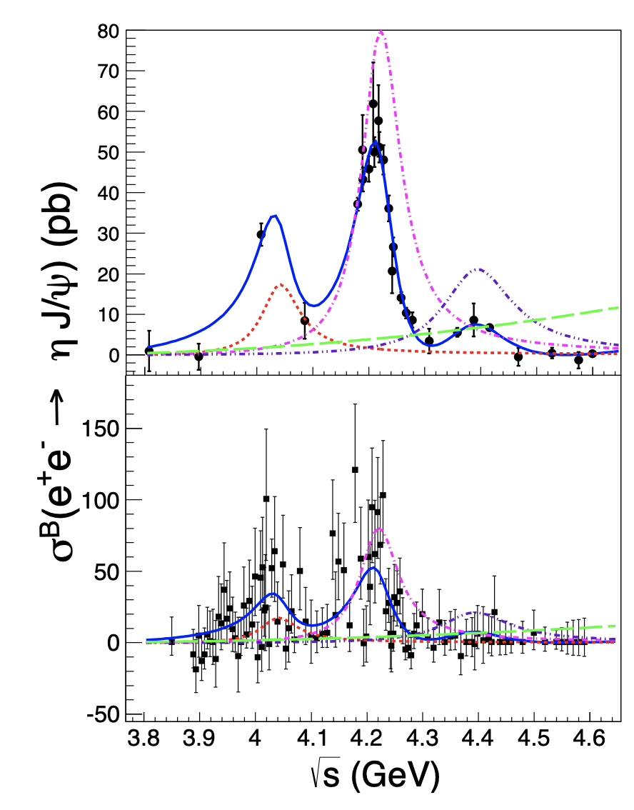
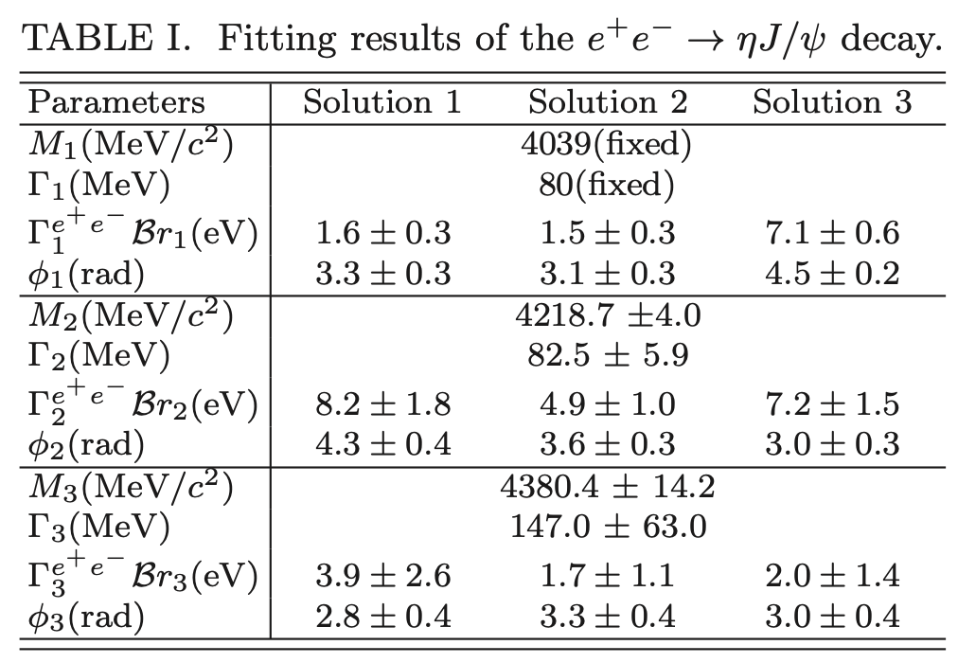
BESIII PRD102, 031101 (2020)
Compare with $χ_{c0}ω$ channel
Width are different,
Need a combined fit to both channels!

Slide 13
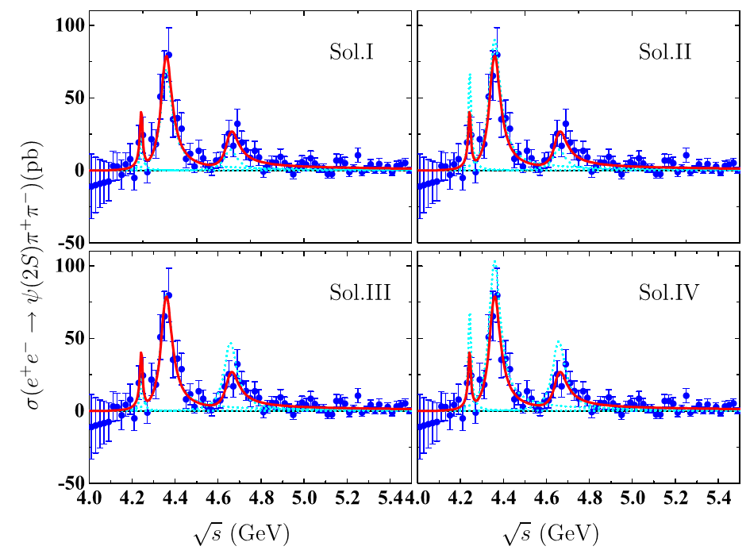
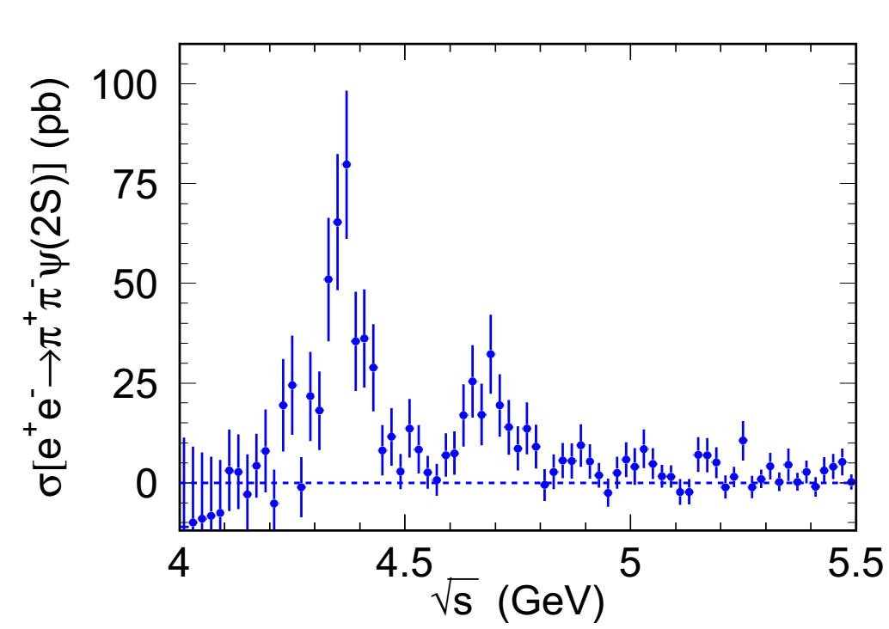
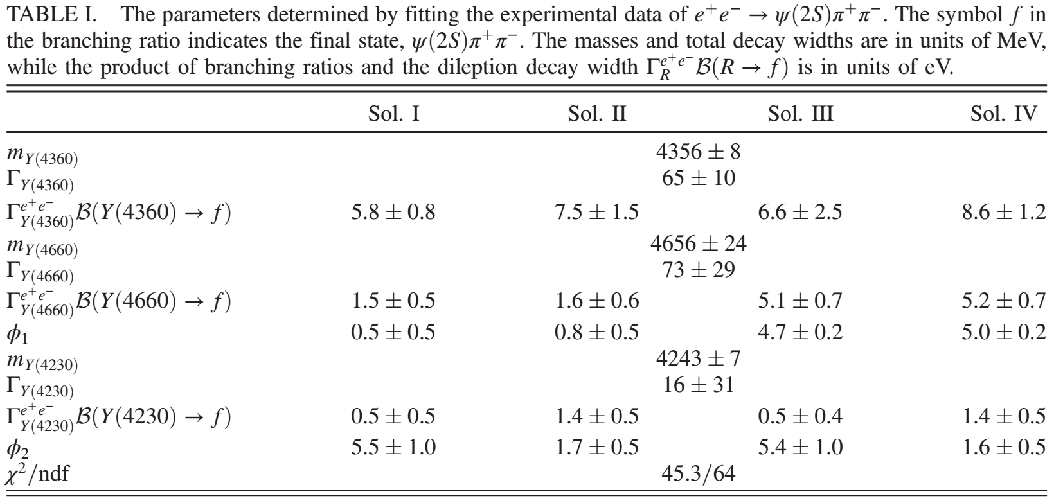
𝝍(𝟒𝑺) in $e^{+}e^{−}→π^{+}π^{−}ψ\left(2S\right)$
Fit the cross section with 𝜓(4𝑆)
Belle, PRD91,112007 (2015)
Y(4360)
New?
Y(4660)
Phys.Rev.D93,034028
Two confirmed structrue Y(4360) and Y(4660)
A new narrow structure around 4.2 GeV
The new structure may correspond to 𝜓(4𝑆)?

Slide 14
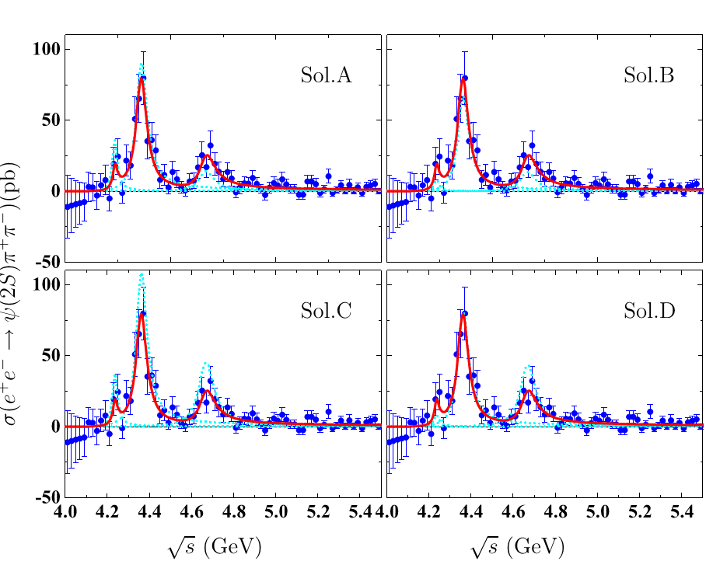
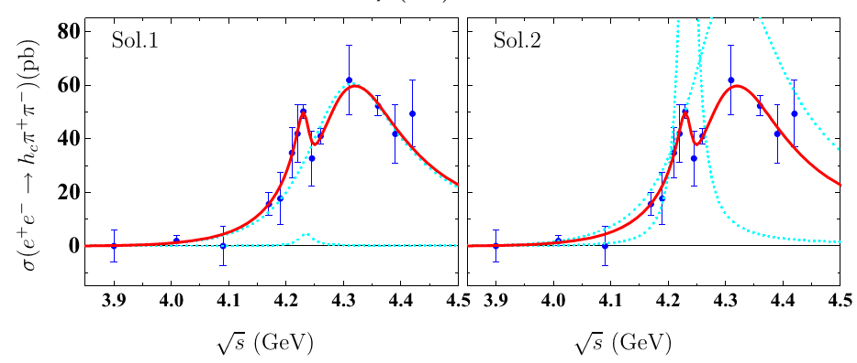
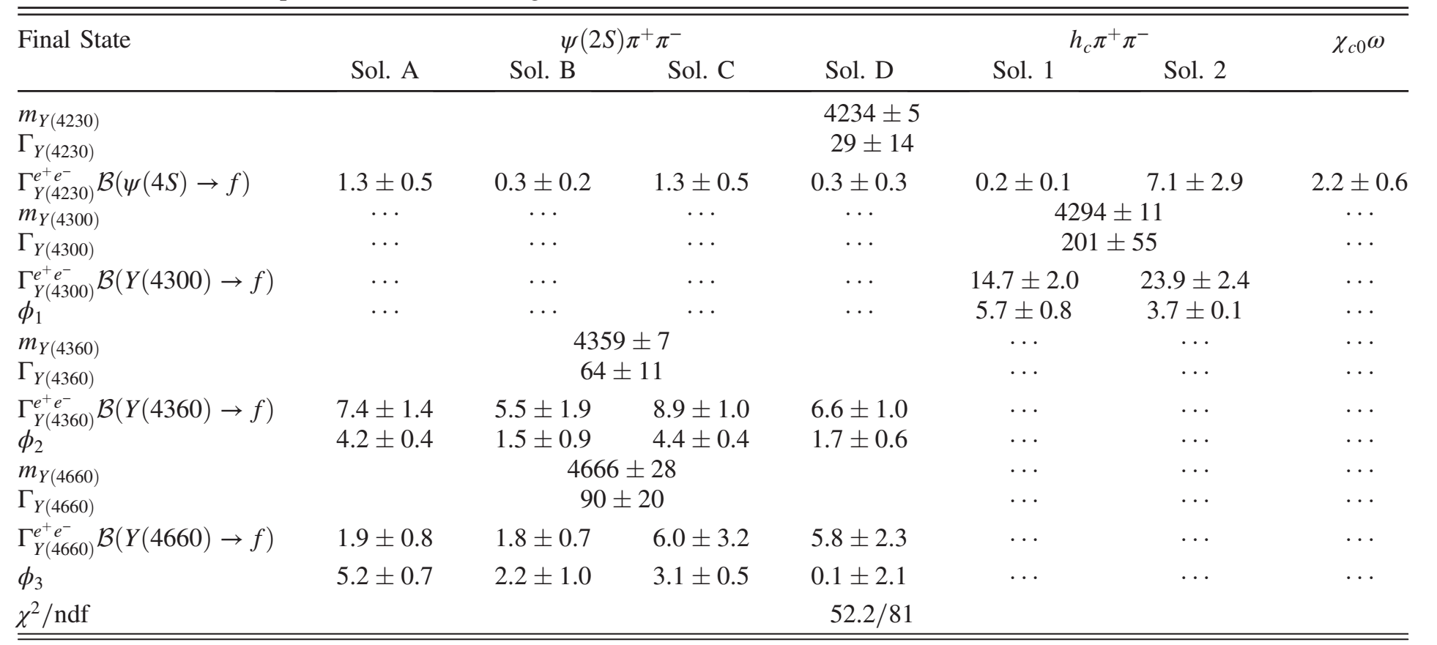
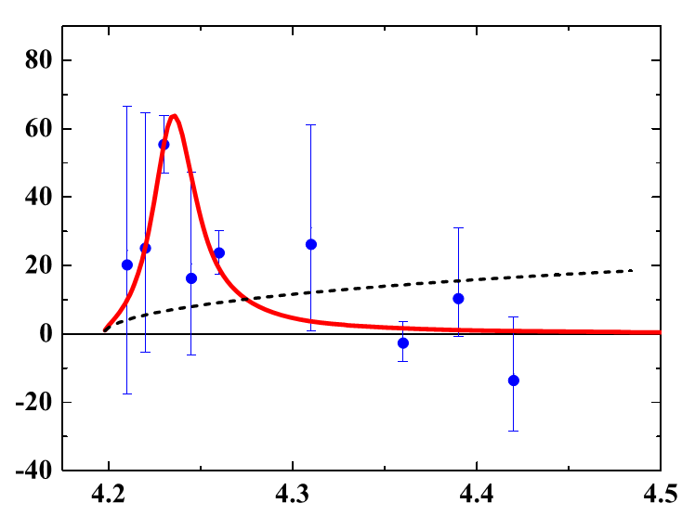
Combined fit to $e^{+}e^{−}→χ_{c0}ω, π^{+}π^{−}h_{c}$ and $π^{+}π^{−}ψ(2S)$ Scheme-I
$${e^{+}e^{−}→π}^{+}π^{−}ψ(2S)$$
$${e^{+}e^{−}→π}^{+}π^{−}h_{c}$$
Narrow structure
$${e^{+}e^{−}→χ}_{c0}ω$$

Slide 15
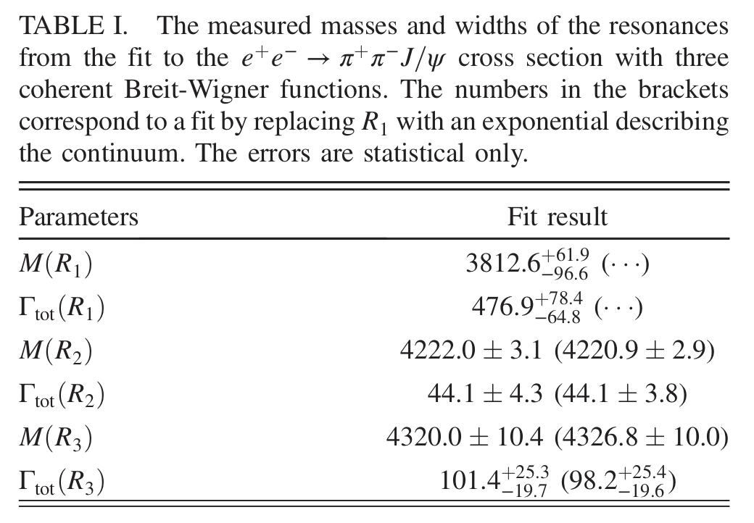
Precise measurement of $e^{+}e^{−}→{ π }^{+}π^{−} J/ψ$ from BESIII
Y(4260) = Y(4220)+Y(4320)
Y(4220): resonance parameters are consistent with our fit to $e^{+}e^{−}→{ π }^{+}π^{−} ψ(2s)$
A new resonance Y(4320) was observed for the first time

Slide 16
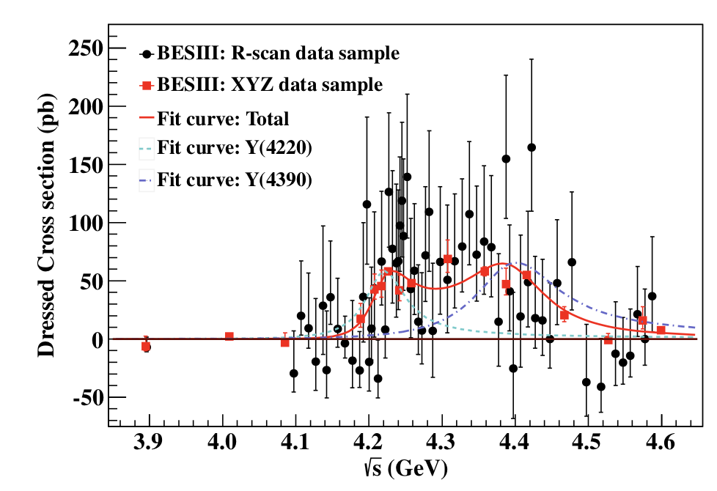
Precise measurement of $e^{+}e^{−}→{ π }^{+}π^{−} h_{c}$ from BESIII
Y(4220)
$$M_{1}=\left({4218.4}_{−4.5}^{+5.5}\right)MeV Γ_{1}=\left({66.0}_{−8.3}^{+12.3}\right) MeV$$
$M_{1}=\left({4391.5}_{−6.8}^{+6.3}\right)MeV Γ_{1}=\left({139.5}_{−20.6}^{+16.2}\right) MeV$
Y(4390): new resonance

Slide 17
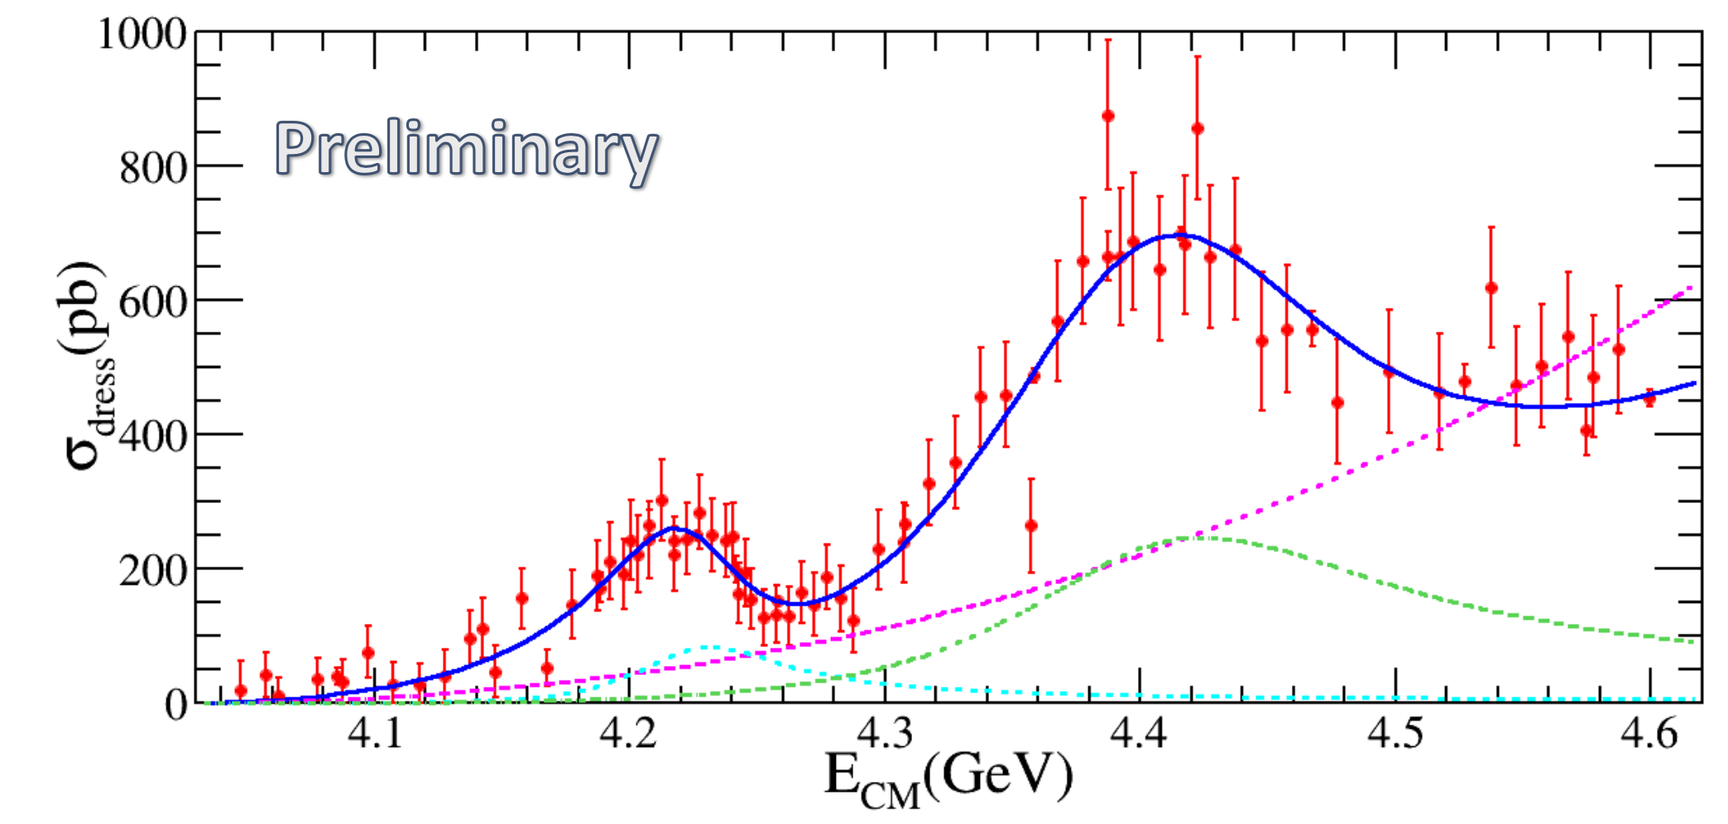
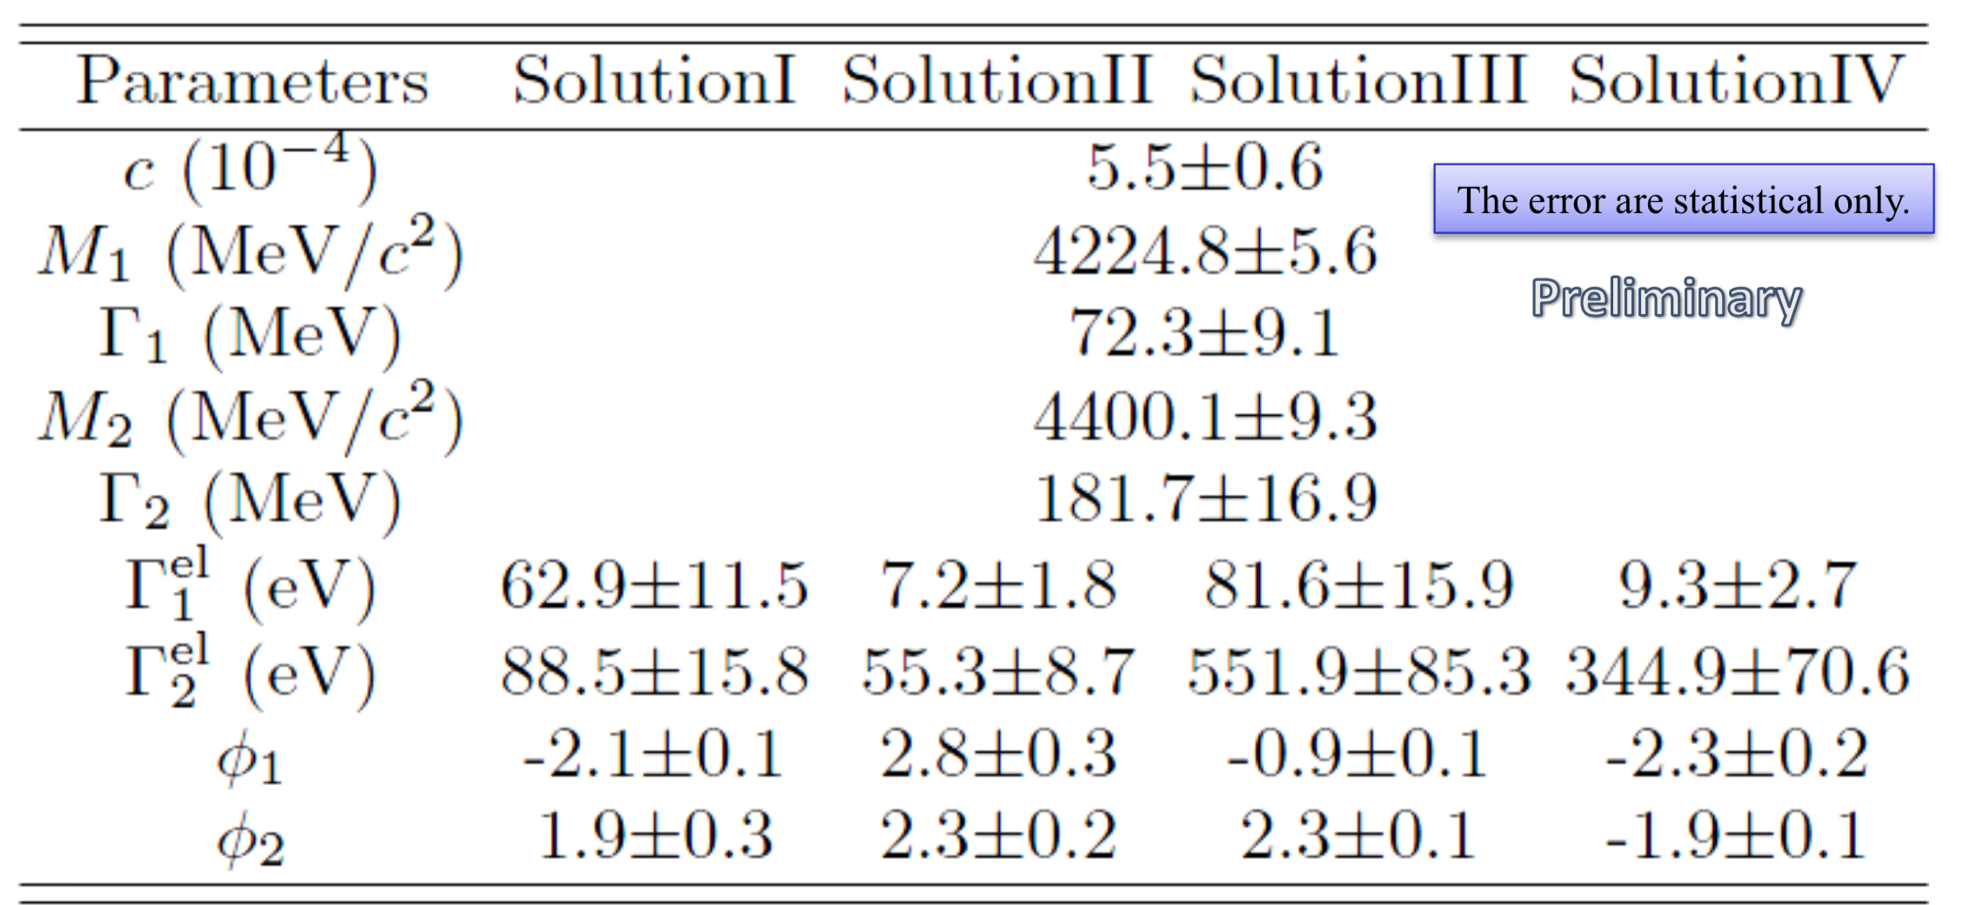
$e^{+}e^{−}→{ π }^{+}D^{0}D^{∗−}$ from BESIII
Y(4220)
Y(4390)

Slide 18
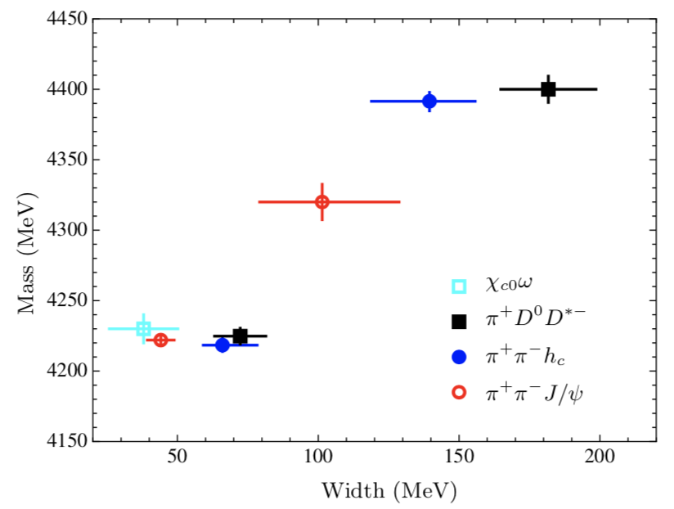
Y(4320)
Y(4390)
Y(4220)
Y(4220)
a). consistent with our predictions
b). observed in several hidden charm decay channels and one open charm channel
Y(4320) and Y(4390) ?

Slide 19
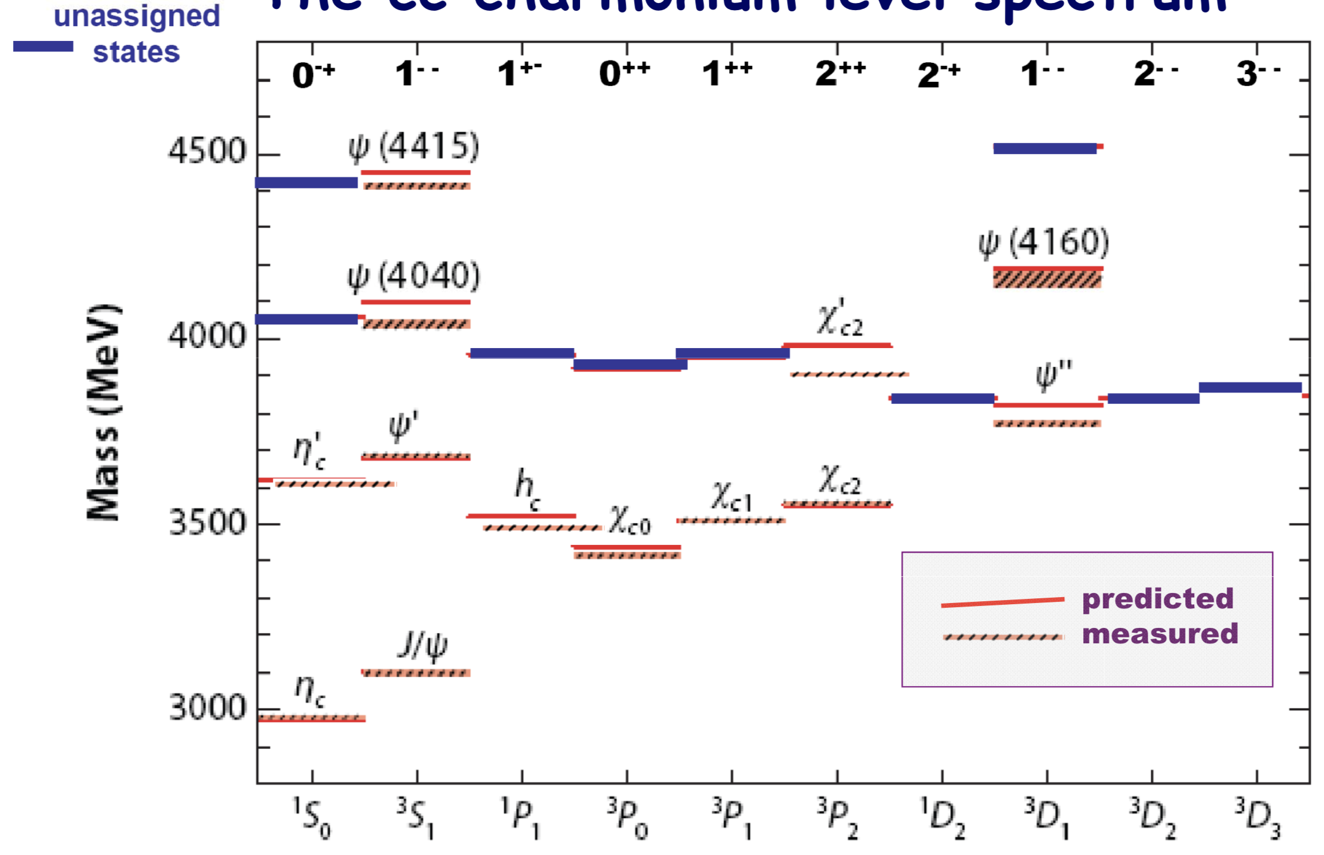
Y(4390)
Y(4220)
Y(4320)
a). no room for these two states in S wave vector charmonium;
b). Y(4320): possible candidate of $ψ(3^{3}D_{1})$?

Slide 20
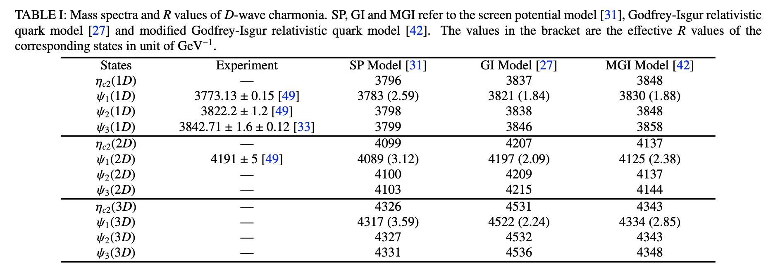
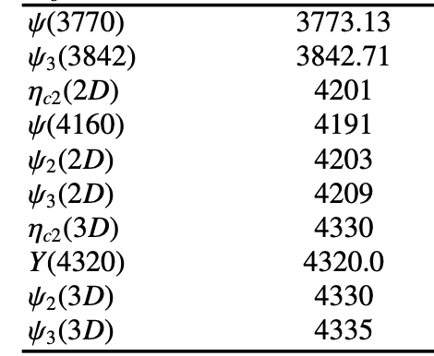
D wave charmonia
1. The predicted mass are model dependent.
2. Mass splittings Caused by spin-spin interactions are similar

Slide 21
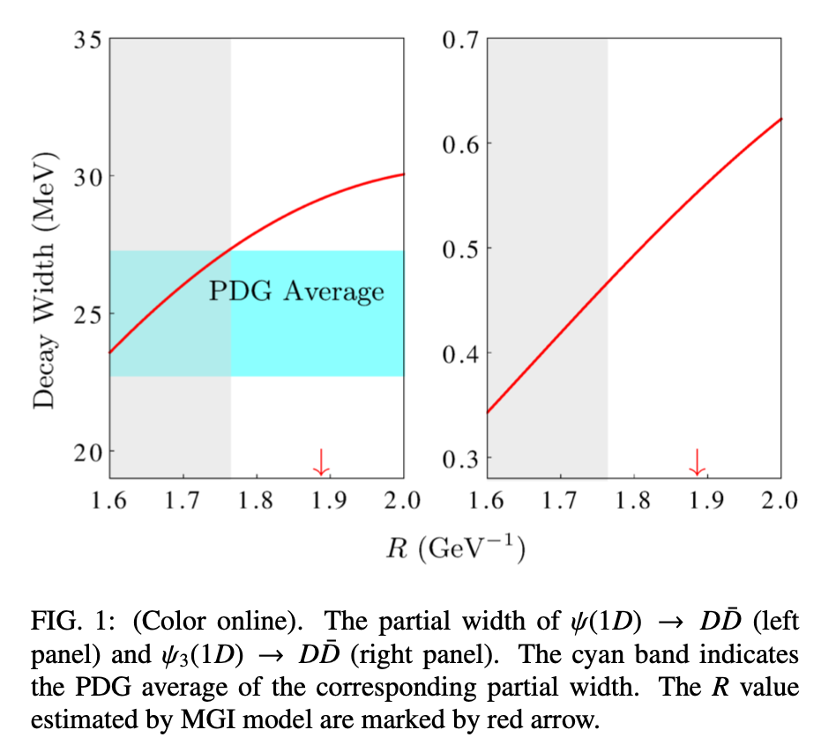
1D States
$$ψ_{3}(3842)$$
$$ψ(3770)$$
Open charm channel: $D\overline{D}$
Branching ratio: ${(93}_{−9}^{+8})\%$
Determined R range: 1.56~1.76 GeV⁻¹
$$ψ_{3}(3842)$$
$Γ_{ψ3}=2.79±0.51±0.35$ MeV;
$D\overline{D}$ channel: 0.34~0.46 MeV;
F wave suppression.
$$ψ(3770)$$

Slide 22
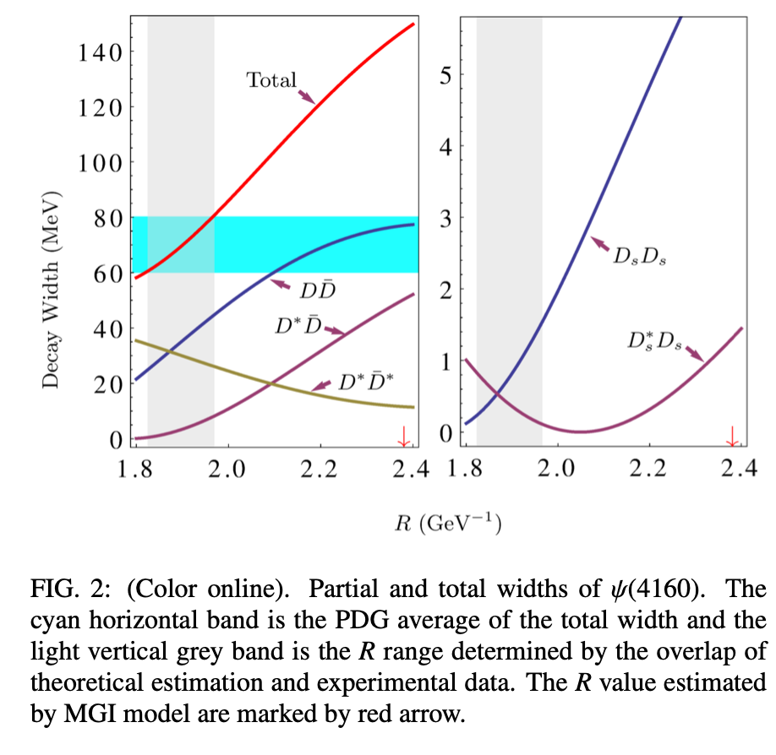
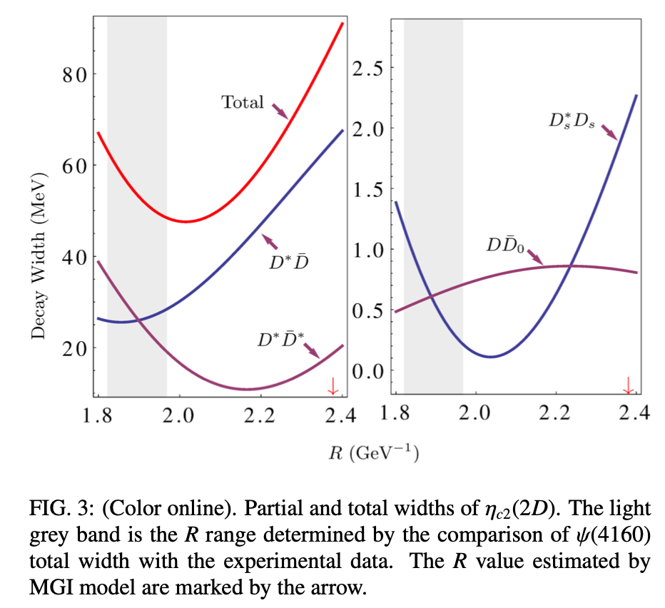
2D States: $ψ\left(4160\right)$ and $η_{c2}\left(2D\right)$
Dominant channel: $ψ\left(4160\right)→D\overline{D}/D^{∗}{\overline{D}}^{∗}$, $η_{c2}\left(2D\right)→D^{∗}\overline{D}/D^{∗}{\overline{D}}^{∗}$
Total width of $η_{c2}$: 48~64 MeV

Slide 23
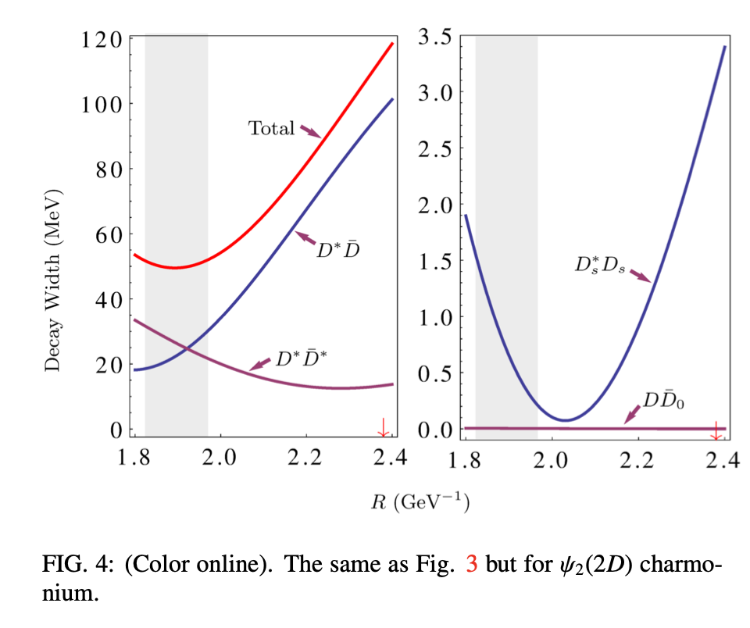
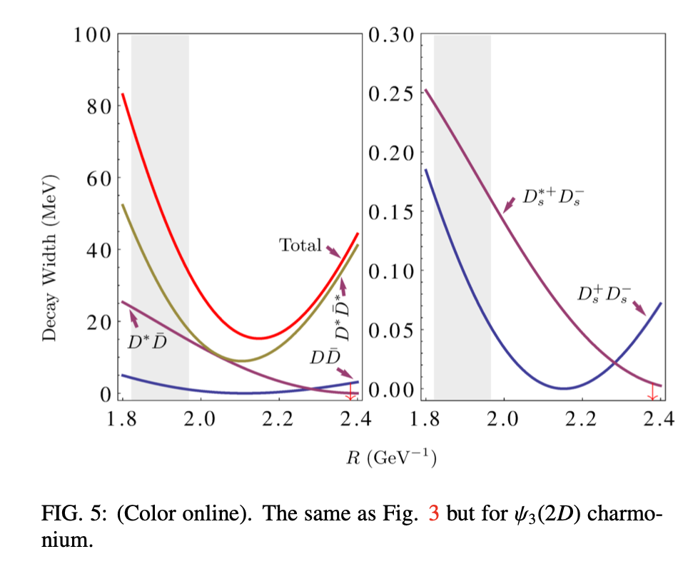
2D States: $ψ_{2}\left(2D\right)$ and $ψ_{3}\left(2D\right)$
Dominant channel: $ψ_{2}\left(2D\right)→D^{∗}\overline{D}/D^{∗}{\overline{D}}^{∗}$, $ψ_{3}\left(2D\right)→D^{∗}\overline{D}/D^{∗}{\overline{D}}^{∗}$
Total width:
$ψ_{2}(2D)$: 50~52 MeV
$ψ_{3}(2D)$: 52~76 MeV

Slide 24
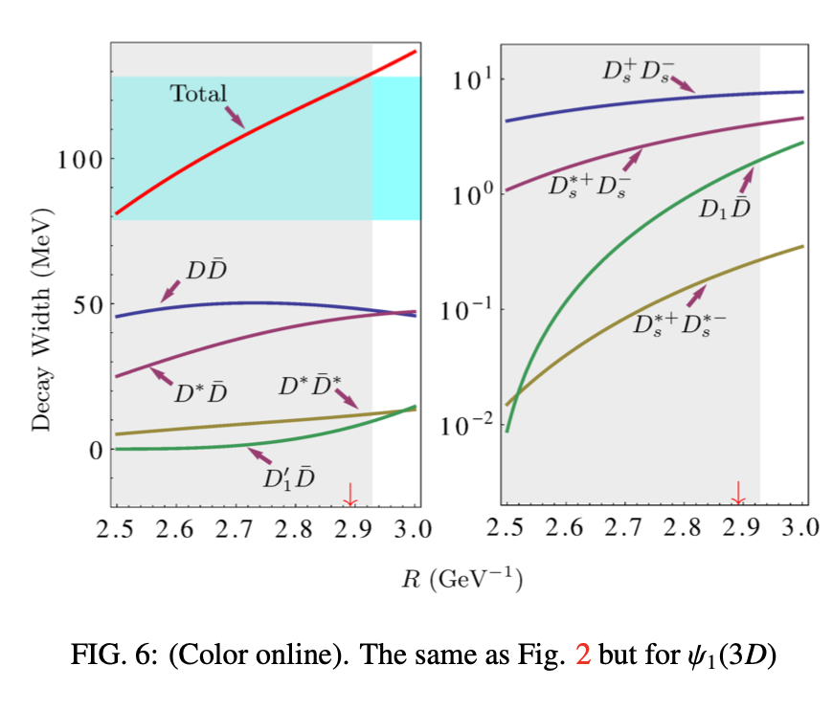
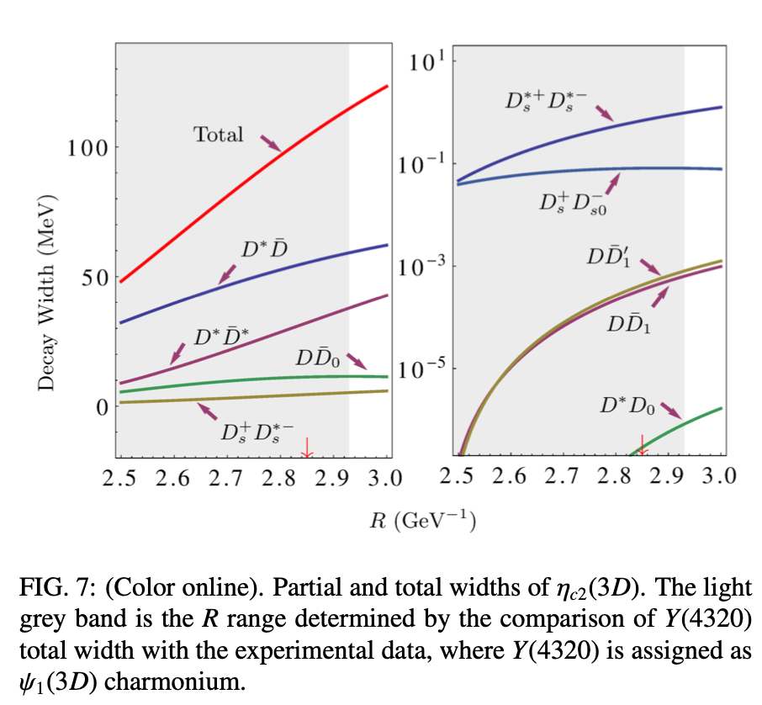
3D States: $ψ\left(4320\right)$ and $η_{c2}\left(3D\right)$
Dominant channel: $ψ\left(4320\right)→D\overline{D}/D{\overline{D}}^{∗}$, $η_{c2}\left(3D\right)→D^{∗}\overline{D}/D^{∗}{\overline{D}}^{∗}$
Total width of $η_{c2}(3D)$: 47~114 MeV

Slide 25
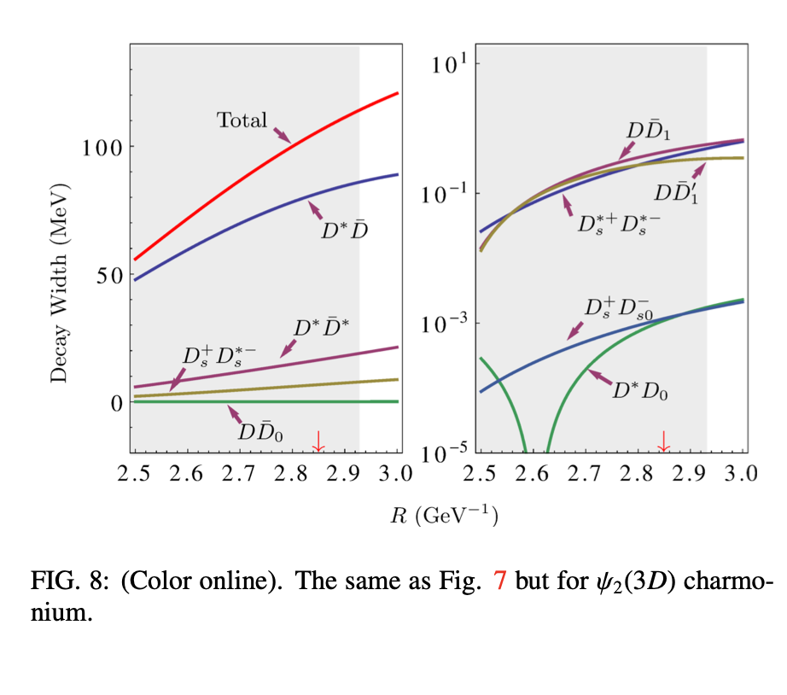
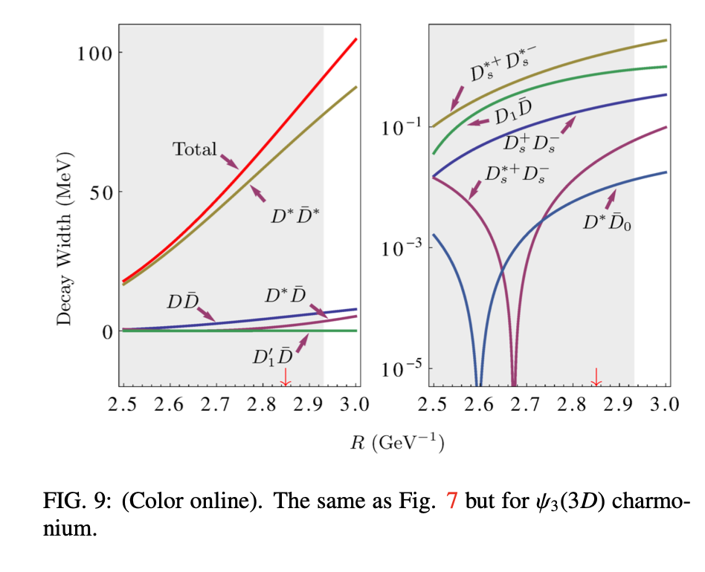
3D States: $ψ_{2}\left(3D\right)$ and $ψ_{3}\left(3D\right)$
Dominant channel: $ψ_{2}\left(3D\right)→D^{∗}\overline{D}$, $ψ_{3}\left(3D\right)→D^{∗}{\overline{D}}^{∗}$
Total width:
$ψ_{2}(3D)$: 54~113 MeV
$ψ_{3}(3D)$: 17~89 MeV

Slide 26
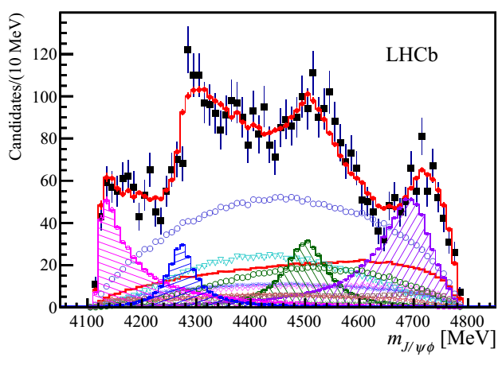
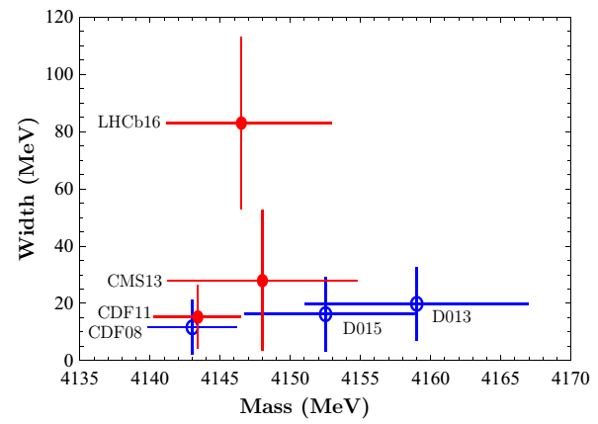
Where are $χ_{cJ}(3P)$?
arXiv:1606.07895
4300 MeV
370 MeV
$$X(3915)$$
$$χ_{c2}(3930)$$
$$X(3872)$$
370 MeV
$$χ_{c1}(3510)$$
$$χ_{c2}(3556)$$
$$χ_{c0}(3414)$$
Comparison with other measurements
Four P wave triplet have been well established,
The mass gap for $χ_{c2}(1P)$ and $χ_{c2}(2P)$ is 370 MeV,
3P states should below 4300 MeV.
Large width?

Slide 27
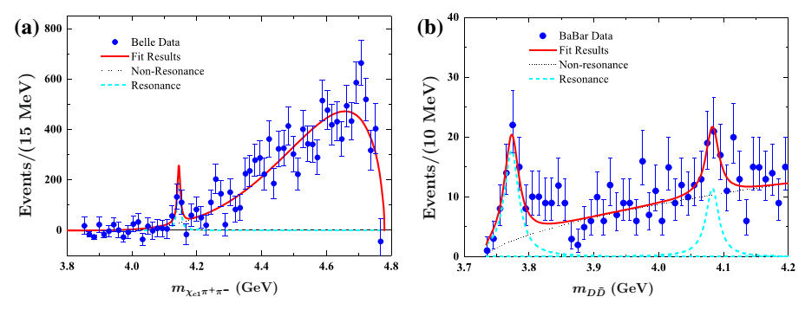
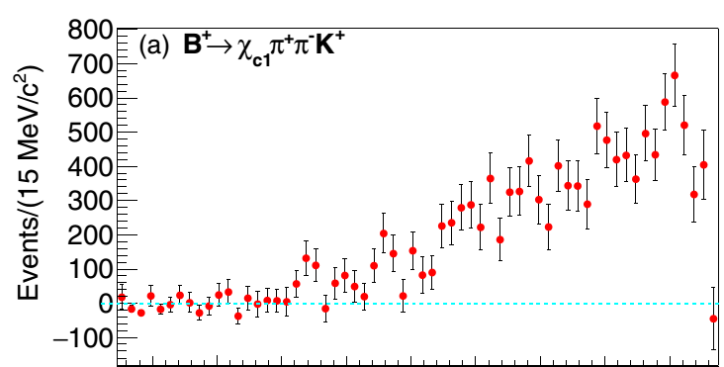
$$B^{+}→{π^{+}π^{−}χ}_{c1} K^{+}$$
Dian-Yong Chen,Eur.Phys.J.C76,671
Belle, PRD93, 052016(2016)
Y(4140)?
Parameters
Fit the data
Nonresonance
Consistent with Y(4140)
Favor small width
Y(4140)= $χ_{c1}(3P)$?
Resonance

Slide 28
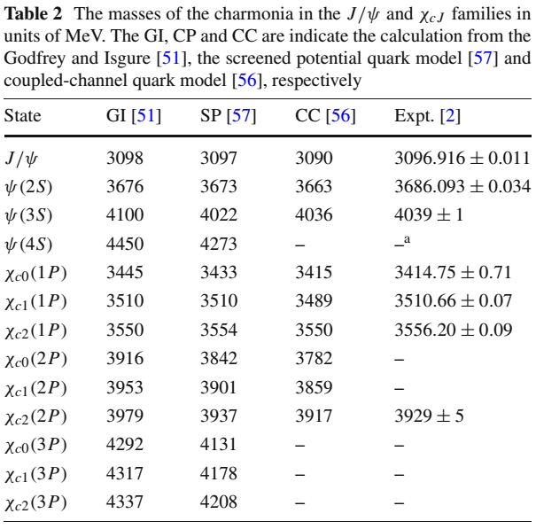
spectrum
Assuming Y(4140)= $χ_{c1}\left(3P\right)$,
then $χ_{c0}\left(3P\right)<4140$MeV
Evidence of structure in $B→K D\overline{D}$
BaBar, PRD 77, 011102 (2008)
Mass gaps: 1) 370 MeV Vs 218 MeV
2) 100 MeV Vs 60 MeV
Consistent with Screened potential model (both $ψ(4S)$ and $χ_{cJ}(3P)$ )
Are Y(4140) and Y(4083) $χ_{c1}\left(3P\right)$ and $χ_{c0}\left(3P\right)$?

Slide 29
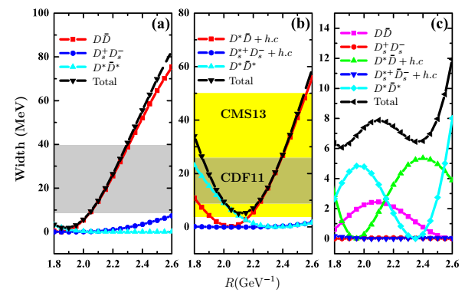
Decay behavior
Open charm decays of $χ_{c1}\left(3P\right)$ (3P0 model)
R values: 2P:1.8 GeV⁻¹, 3P: >1.8 GeV⁻¹
Overlapped range: 3P0:2.08~2.30 GeV⁻¹
3P1: the width is consistent with our fit and the data from CDF and CMS (favor small width)
3P2: very narrow due nods effects

Slide 30
Summary
Y(4220) as 4S charmonium
Spectrum, hidden charm decay
D wave charmonia
$ψ\left(3770\right)，ψ\left(4160\right)$ and $Y\left(4320\right)$as a scale of 1D, 2D and 3D vector charmonia
Predicted decay behaviors of 2D and 3D charmonia
3P charmonia
Evidence of Y(4140) in the $B^{+}→{π^{+}π^{−}χ}_{c1} K^{+}$
interpreted Y(4140) as $χ_{c1}(3P)$
Find possible evidence of $χ_{c0}(3P)$ in the $B→D\overline{D} K$

Slide 31
Thank you for your attention!

