Slide 1


Heavy Meson Structure on the Light-front
Jiatong Wu(吴家同)
with Xingbo Zhao, Hengfei Zhao, Kaiyu Fu
Jiangshan Lan, Chandan Mondal, Siqi Xu,
Yang Li, Pieter Maris, James P. Vary
Institute of Modern Physics, CAS, Lanzhou, China
‡University of Chinese Academy of Sciences, China
Iowa State University, Ames, US
第二届强子与重味物理理论与实验联合研讨会
2021年3月28日

Slide 2
Outline
Basis Light-front Quantization approach
Application to heavy mesons
  Gluon content
Summary

Slide 3
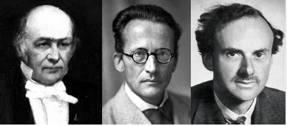



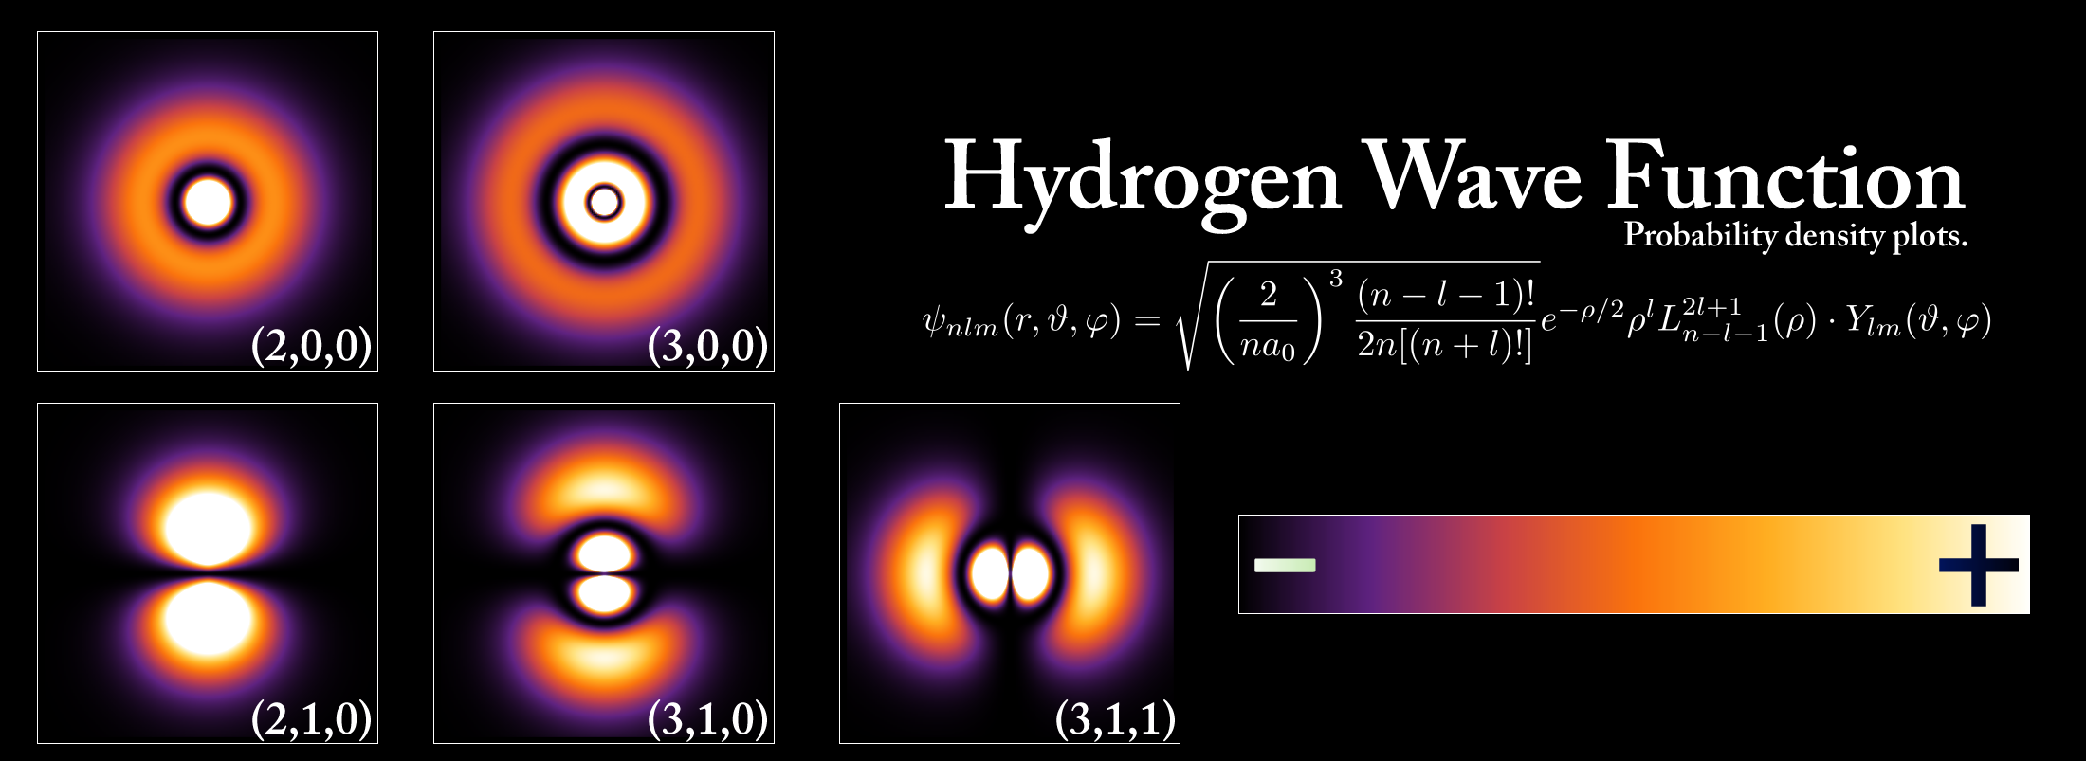

Hamiltonian Formalism
Schrödinger equation universally describes different physics：
$$H|ψ〉=E|ψ〉$$
atom
nucleus
hadron
Nonrelativistic, few-body
Nonrelativistic, many-body
Relativistic, many-body
Wave functions encode full information of the system
3

Slide 4
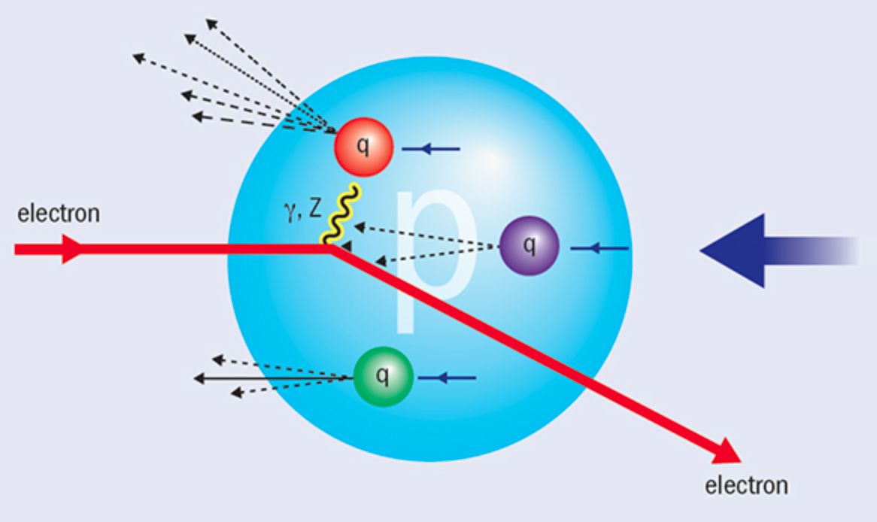

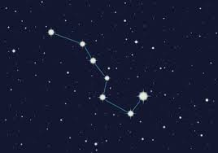

Light-front Time
Hadron structure is measured by (virtual) photon
We "see” the world at fixed light-front time ($t=x^{0}$ + $x^{3}$)

Slide 5



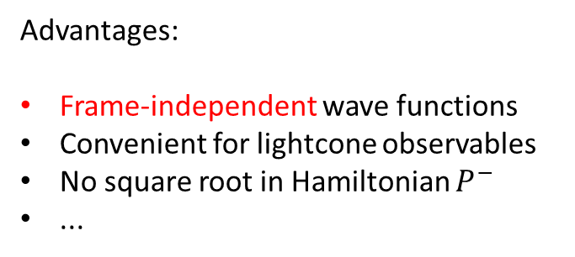

Light-front Quantization
[Dirac, 1949]
Equal time quantization
Light-front quantization
Not just a coordinate transformation
Different quantization surface
Profound consequences?
$$x^{1},x^{2},x^{3}$$
$${x^{−}=x}^{0}−x^{3},$$
$$x^{⊥}=x^{1,2}$$
Advantages:
Frame-independent wave functions
Convenient for lightcone observables
No square root in Hamiltonian $P^{−}$
...
$$P^{0},\overset{⃑}{P}$$
$${P^{−}=P}^{0}−P^{3},$$
${P^{+}=P}^{0}+P^{3}$,$P^{⊥}=P^{1,2}$
Notes:
Light front was first proposed by Dirac, at 1949.
1. First, what is light-front. Different from equal time theory. We define light-front time as a linear combination of the regular time and one of the spatial coordinate, usually we choose z direction.
So our field quantized at this equal light-front time plane. Where in equal time quantization, they quantized at this equal time plane.
X minus is longitudinal coordinate. P minus is light front Hamiltonian. P plus is longitudinal momentum.
This is light front version of schordinger equation.
Please note that it is not just a coodernate transformation, it is a new theory in a different quantization.
Why go to light front? For we can get Frame Independent wavefunction. Which encods all the information of the bound state structure. It has simple vacuum structure. The theory is boost invariant. And there is no square root in Hamiltonian p minus.

Slide 6
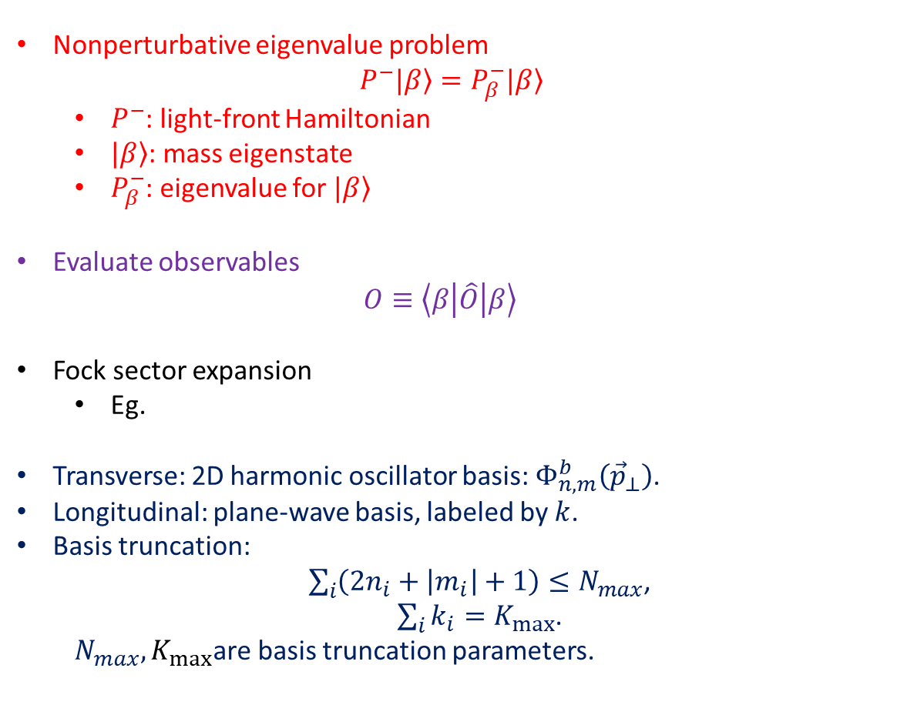

Basis Light-front Quantization
[Vary et al, 2008]
Nonperturbative eigenvalue problem
$$P^{−}|\left.β\right\rangle =P_{β}^{−}|\left.β\right\rangle$$
  $P^{−}$: light-front Hamiltonian
  $|\left.β\right\rangle$: mass eigenstate
  $P_{β}^{−}$: eigenvalue for $|\left.β\right\rangle$
Evaluate observables
            $$O≡\left\langle β | \hat{O} | β\right\rangle$$
Fock sector expansion
  Eg.
Transverse: 2D harmonic oscillator basis:${ Φ}_{n,m}^{b}\left({\vec{p}}_{⊥}\right)$.
Longitudinal: plane-wave basis, labeled by $k$.
Basis truncation:
  $\sum_{i}{\left(2n_{i}+\left|m_{i}\right|+1\right)}≤N_{max}$,
  $\sum_{i}{k_{i}}=K_{max}$.
  $N_{max},K_{max}$are basis truncation parameters.
  $$\left|Meson\right\rangle =a\left|q\overline{q}\right\rangle +b\left|q\overline{q}g\right\rangle +c\left|q\overline{q}q\overline{q}\right\rangle +…$$
Large $N_{max}$ and $K_{max}$: High UV cutoff & low IR cutoff
Notes:
1.

Slide 7

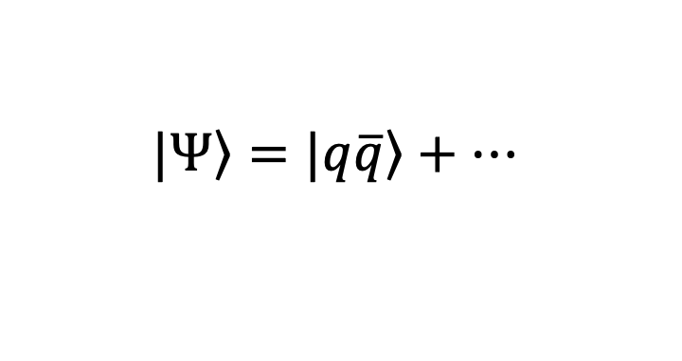
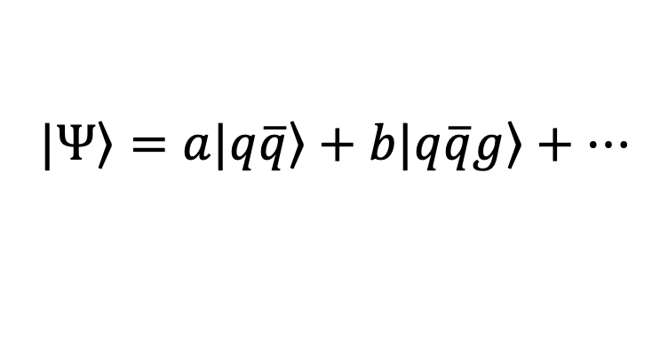
Progress in Heavy Meson: Including One Dynamical Gluon
$$\left.|Ψ\right\rangle =\left.|q\overline{q}\right\rangle +…$$
[Yang Li, et al, 2017]
$$\left.|Ψ\right\rangle =a\left.|q\overline{q}\right\rangle +b\left.|q\overline{q}g\right\rangle +…$$
[in preparation]

Slide 8
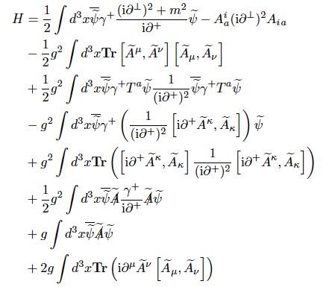

Light-front QCD Hamiltonian
$$P_{LFQCD}^{−}$$

Slide 9
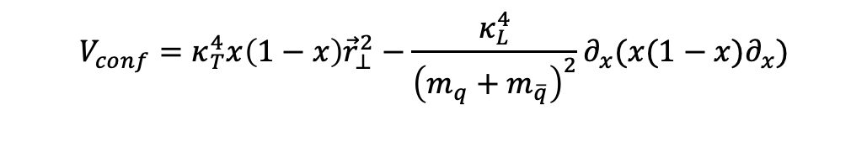
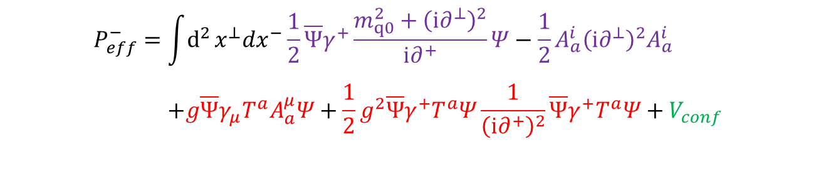
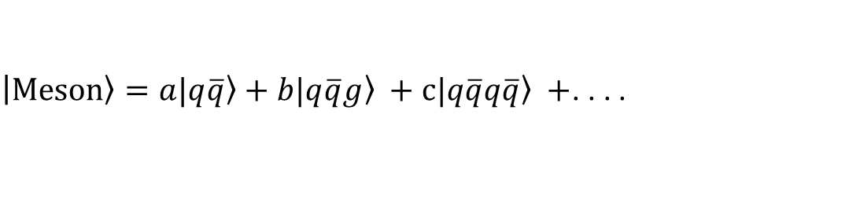
Heavy Quarkonium
Heavy meson in progress
$\left|Meson\right\rangle =a\left.|q\overline{q}\right\rangle +b\left.|q\overline{q}g\right\rangle +c\left.|q\overline{q}q\overline{q}\right\rangle +$. . . .
Light-front QCD Hamiltonian + effective confining potential:
$$\begin{aligned}P_{eff}^{−}=&\int{d^{2}}x^{⊥}dx^{−}\frac{1}{2}\overline{Ψ}γ^{+}\frac{m_{q0}^{2}+{\left(i∂^{⊥}\right)}^{2}}{i∂^{+}}Ψ−\frac{1}{2}A_{a}^{i}{\left(i∂^{⊥}\right)}^{2}A_{a}^{i} \\ & \\ &+g\overline{Ψ}γ_{μ}T^{a}A_{a}^{μ}Ψ+\frac{1}{2}g^{2}\overline{Ψ}γ^{+}T^{a}Ψ\frac{1}{{\left(i∂^{+}\right)}^{2}}\overline{Ψ}γ^{+}T^{a}Ψ+V_{conf}\end{aligned}$$
Confining potential:
Long-distance
$$V_{conf}=κ_{T}^{4}x\left(1−x\right){\vec{r}}_{⊥}^{2}−\frac{κ_{L}^{4}}{{\left(m_{q}+m_{\overline{q}}\right)}^{2}}∂_{x}(x(1−x)∂_{x})$$
Inspired by light-front holographic QCD
Longitudinal confinement
[Brodsky, et al, 2015]
[Yang Li, et al, 2017]

Slide 10
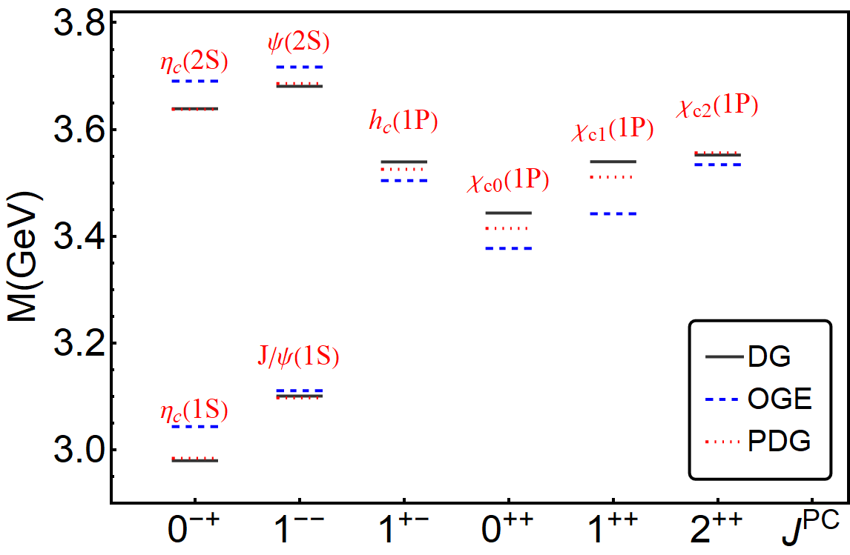
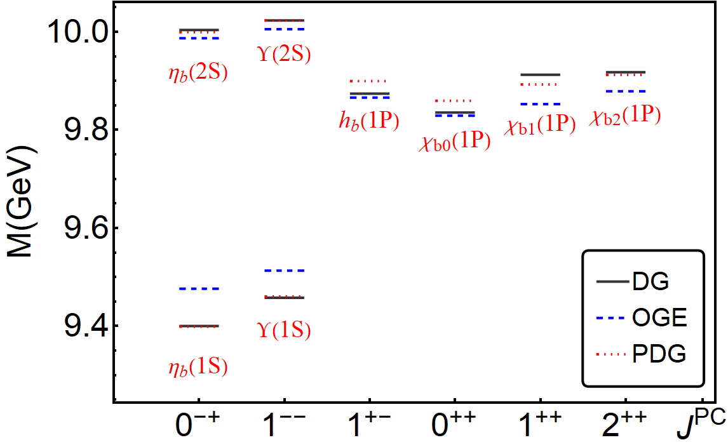
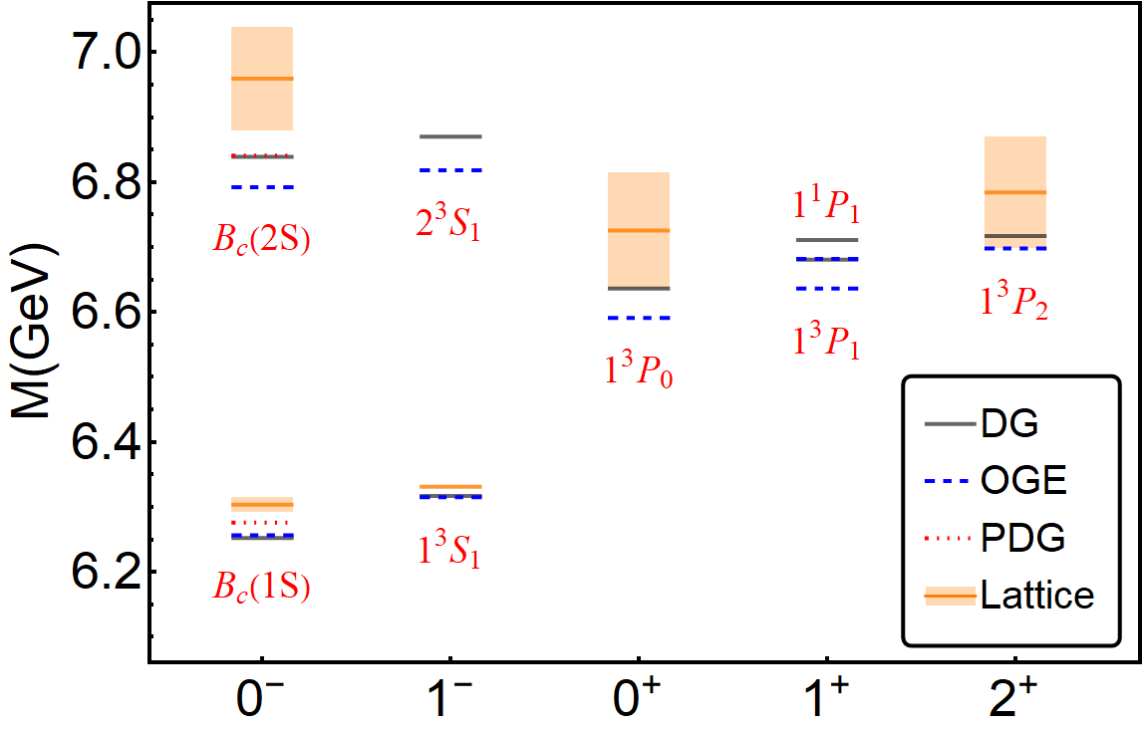



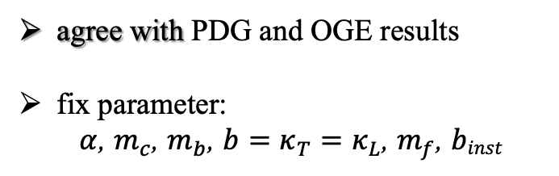

Heavy meson in progress
Mass spectrum
Charmonium
Bottomonium
$B_{c}$meson
agree with PDG and OGE results
fix parameter:
$α$, $m_{c}$, $m_{b}$, $b=κ_{T}=κ_{L}$, $m_{f}$, $binst$
OGE($c\overline{c} and b\overline{b}$) : [Yang Li, et al, 2017]
OGE($b\overline{c}$) : [Shuo Tang, et al, 2018]
[in preparation]
This Work: $N_{max}=10,K_{max}=11,M_{J}=0$

Slide 11
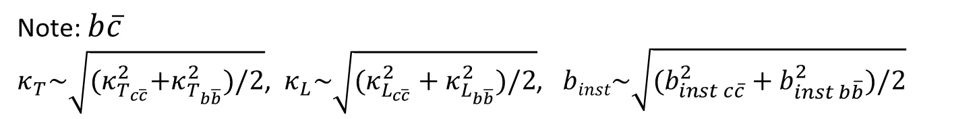
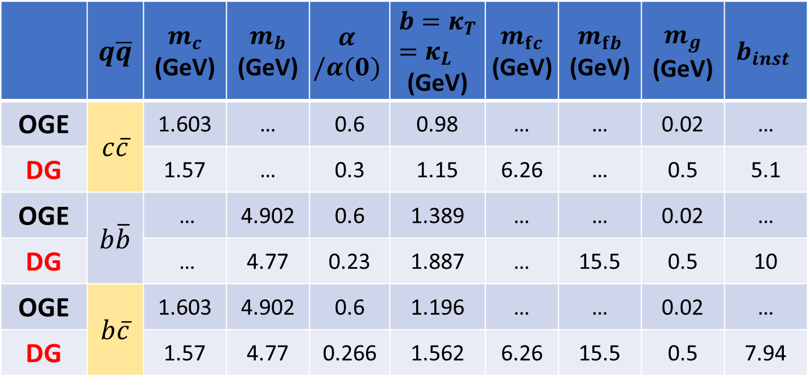

Heavy meson in progress
Parameters
 | $$q\overline{q}$$ | $$m_{c}$$ (GeV) | $$m_{b}$$ (GeV) | $$α$$ $$/α(0)$$ | $${b=κ}_{T}=κ_{L}$$ (GeV) | $$m_{fc}$$ (GeV) | $$m_{fb}$$ (GeV) | $$m_{g}$$ (GeV) | $$b_{inst}$$
OGE | $$c\overline{c}$$ | 1.603 | … | 0.6 | 0.98 | … | … | 0.02 | …
DG |  | 1.57 | … | 0.3 | 1.15 | 6.26 | … | 0.5 | 5.1
OGE | $$b\overline{b}$$ | … | 4.902 | 0.6 | 1.389 | … | … | 0.02 | …
DG |  | … | 4.77 | 0.23 | 1.887 | … | 15.5 | 0.5 | 10
OGE | $$b\overline{c}$$ | 1.603 | 4.902 | 0.6 | 1.196 | … | … | 0.02 | …
DG |  | 1.57 | 4.77 | 0.266 | 1.562 | 6.26 | 15.5 | 0.5 | 7.94
Note: $b\overline{c}$
$κ_{T}\sim \sqrt{{(κ}_{T_{c\overline{c}}}^{2}+κ_{T_{b\overline{b}}}^{2})/2}$, $κ_{L}\sim \sqrt{(κ_{L_{c\overline{c}}}^{2}+κ_{L_{b\overline{b}}}^{2})/2}$, $binst\sim \sqrt{(b_{inst c\overline{c}}^{2}+b_{inst b\overline{b}}^{2})/2}$
This Work: $N_{max}=10,K_{max}=11,M_{J}=0$
[in preparation]

Slide 12
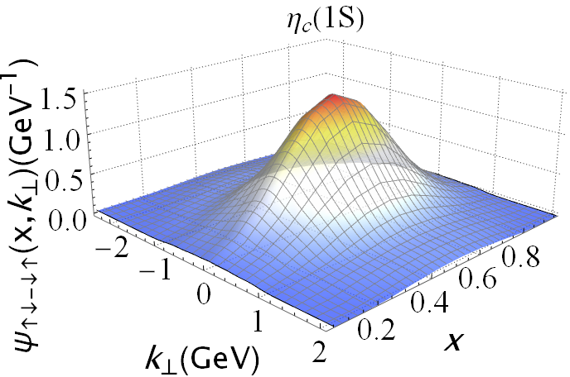

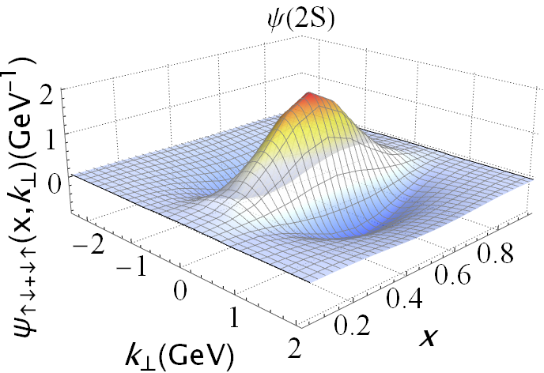
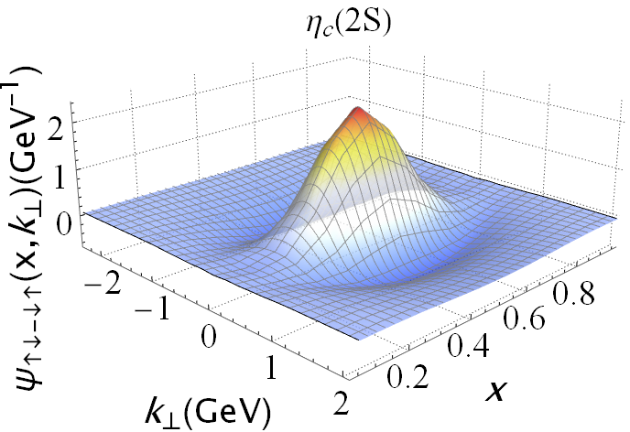
Heavy meson in progress
Wave function
Charmonium S-wave

Slide 13
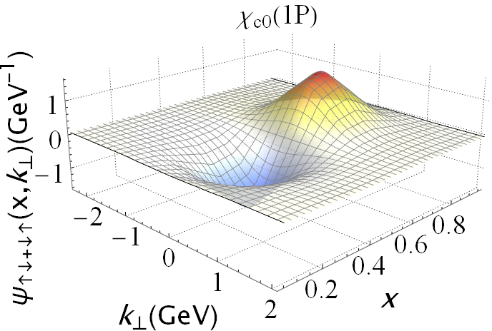
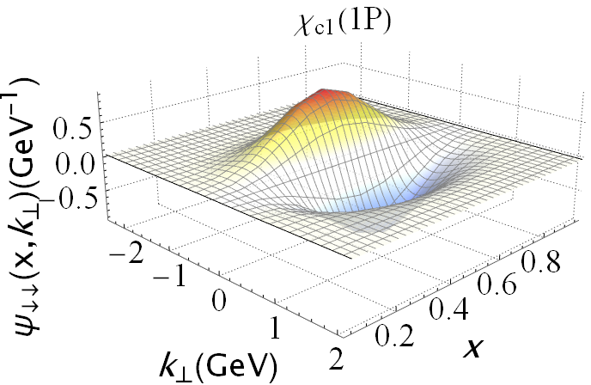
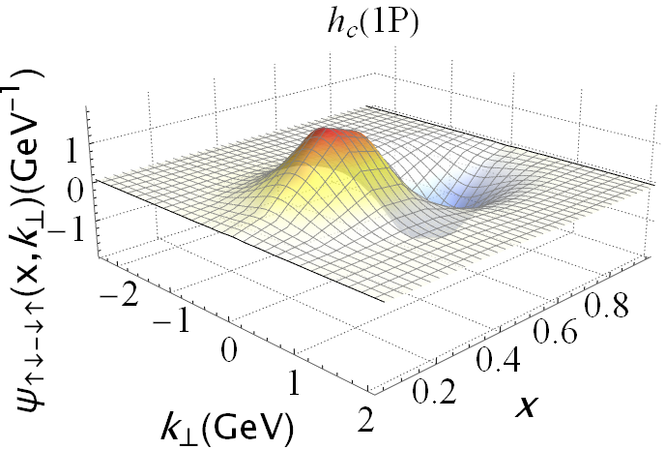

Heavy meson in progress
Wave function
Charmonium P-wave

Slide 14
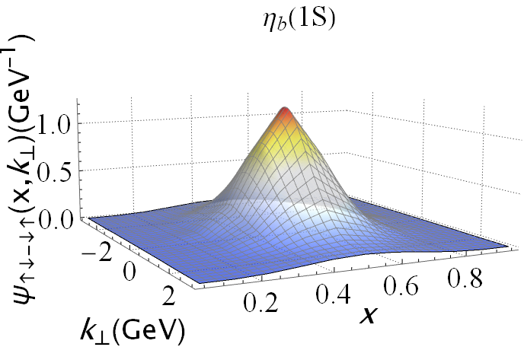
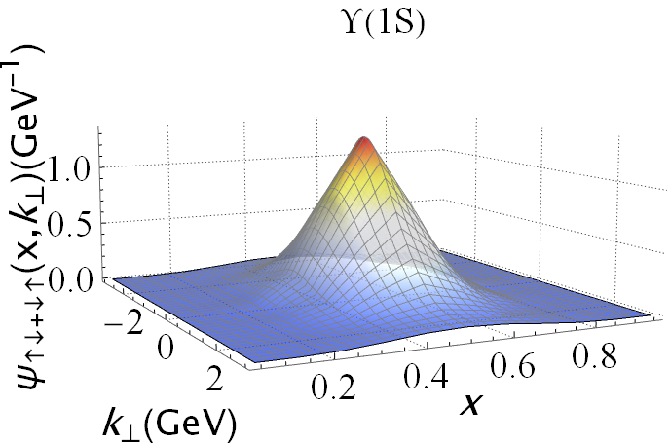
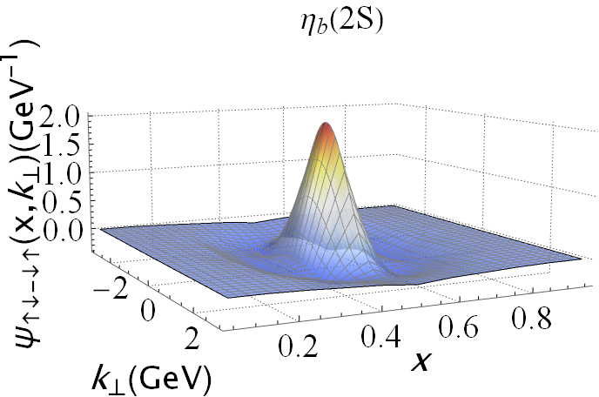
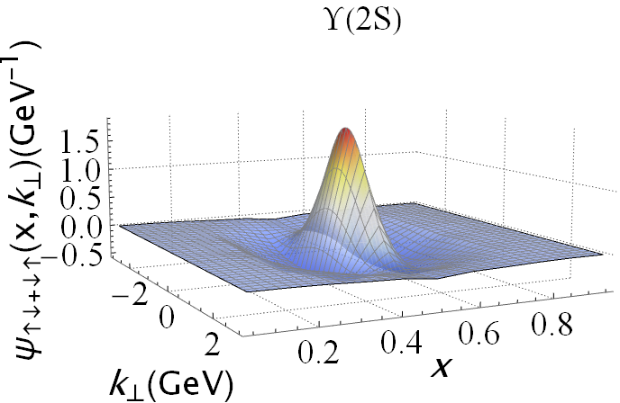
Heavy meson in progress
Wave function
Bottomonium S-wave

Slide 15
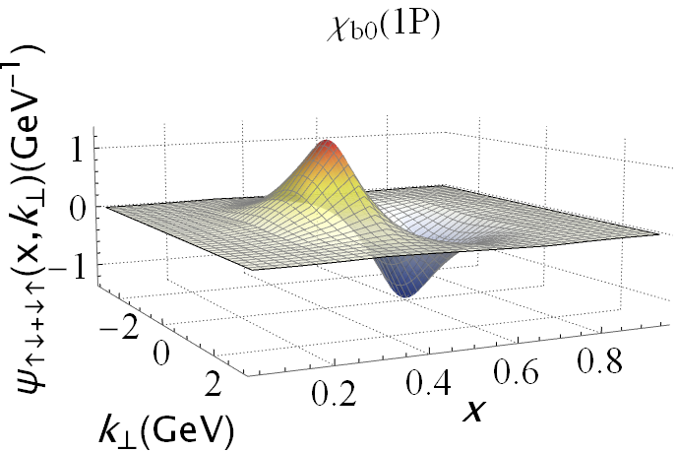
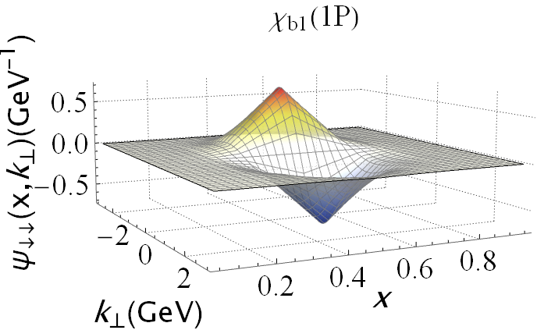
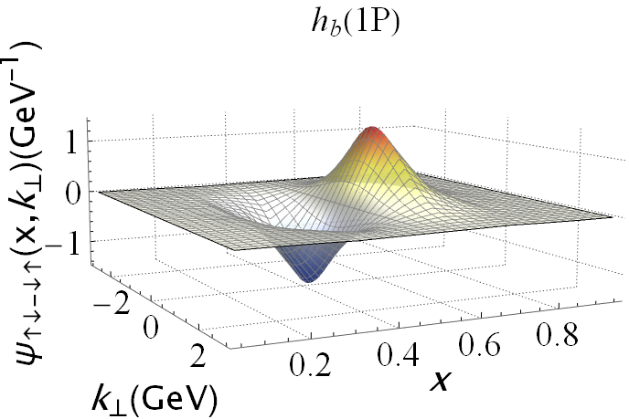
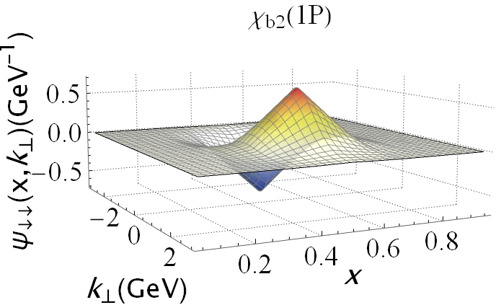
Heavy meson in progress
Wave function
Bottomonium P-wave
[Yang Li, et al, 2017]

Slide 16
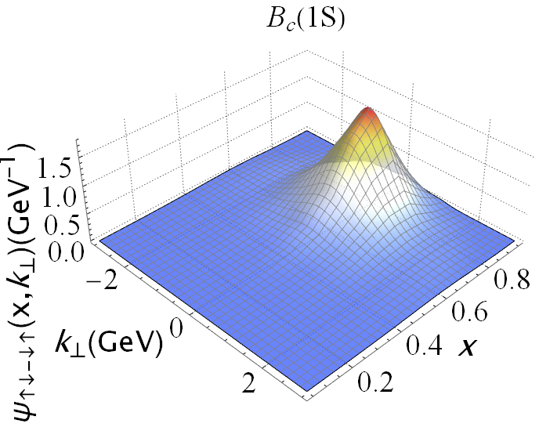
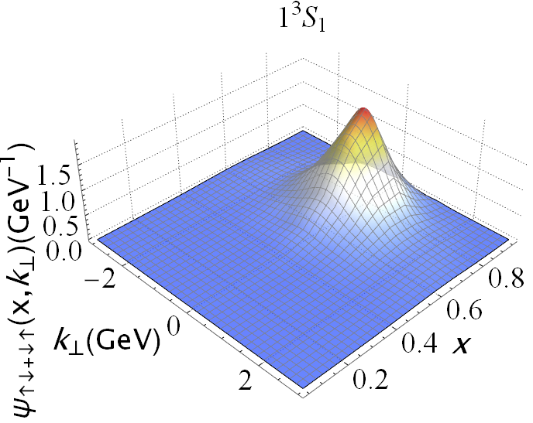
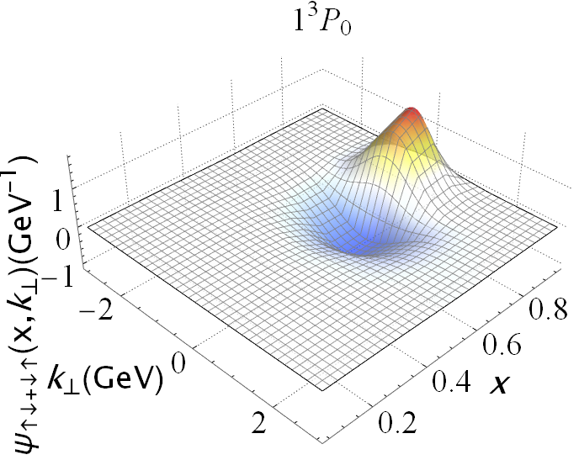
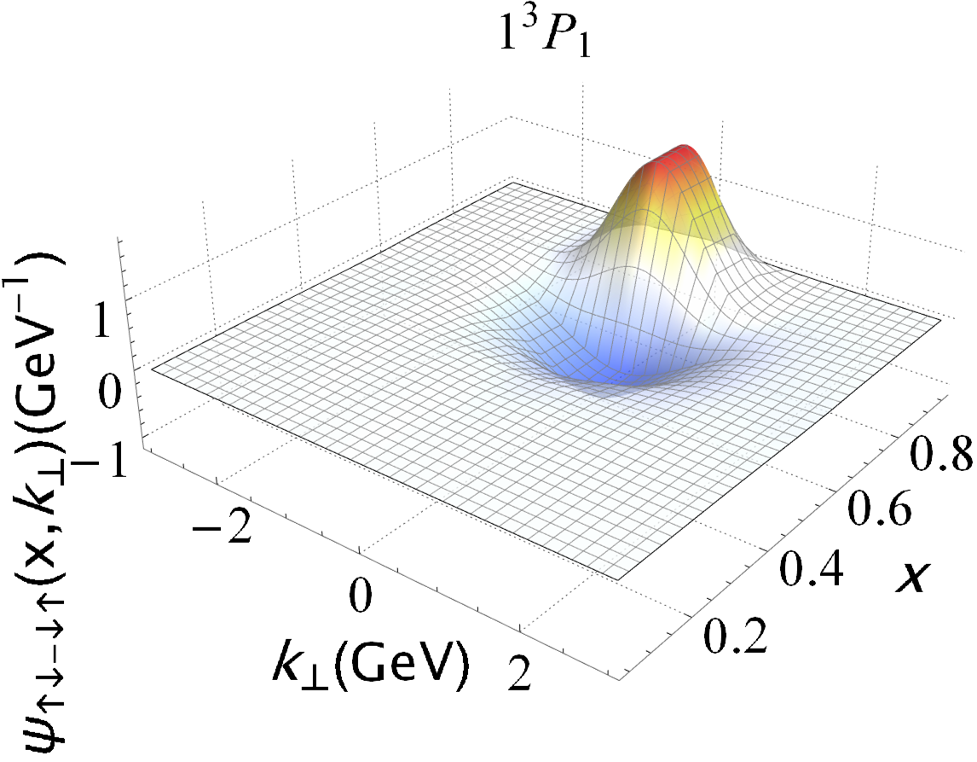
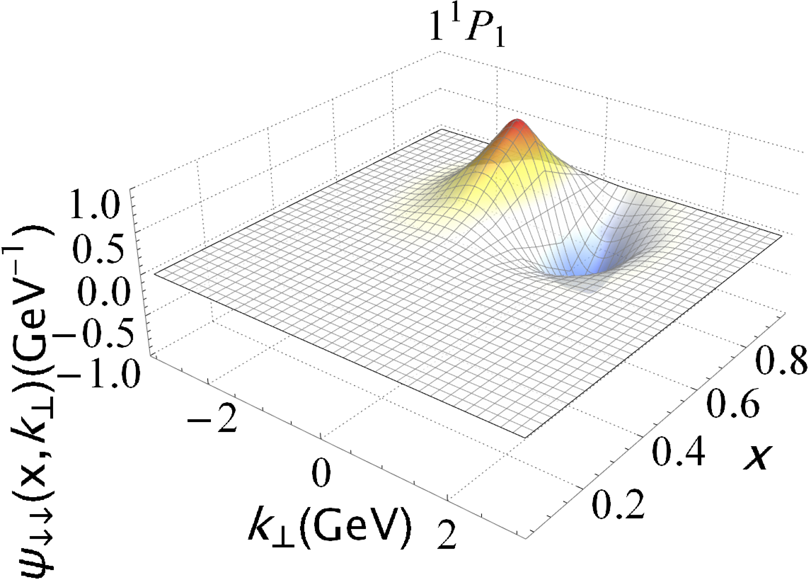
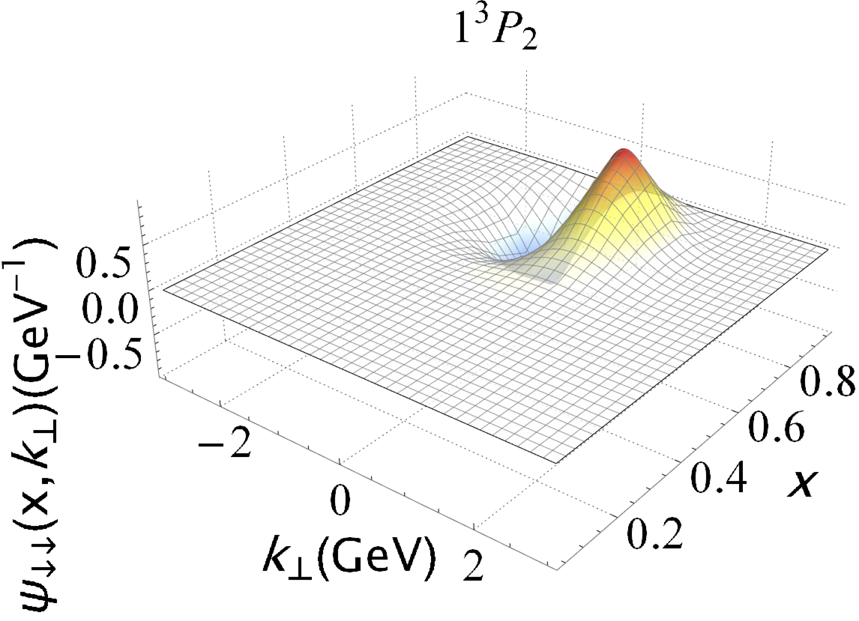

Heavy meson in progress
Wave function
Preliminary
$B_{c}$meson
Nodal structure in radial direction

Slide 17
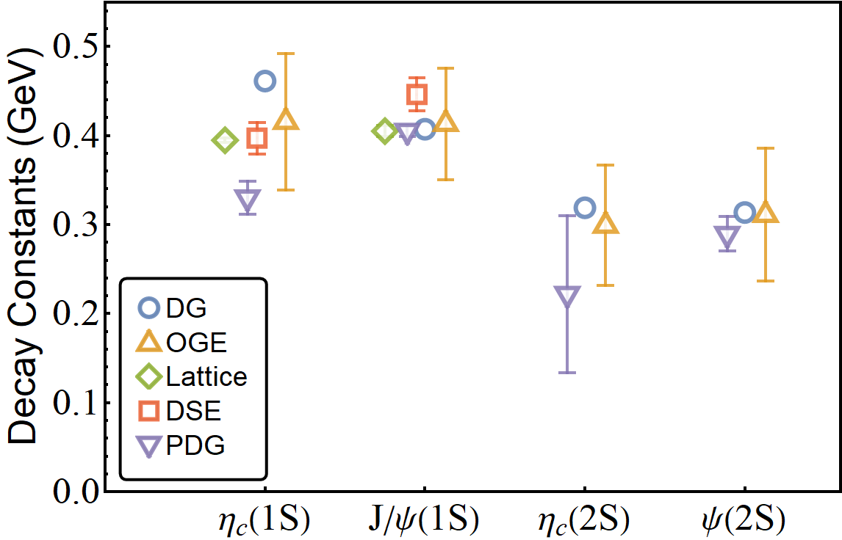
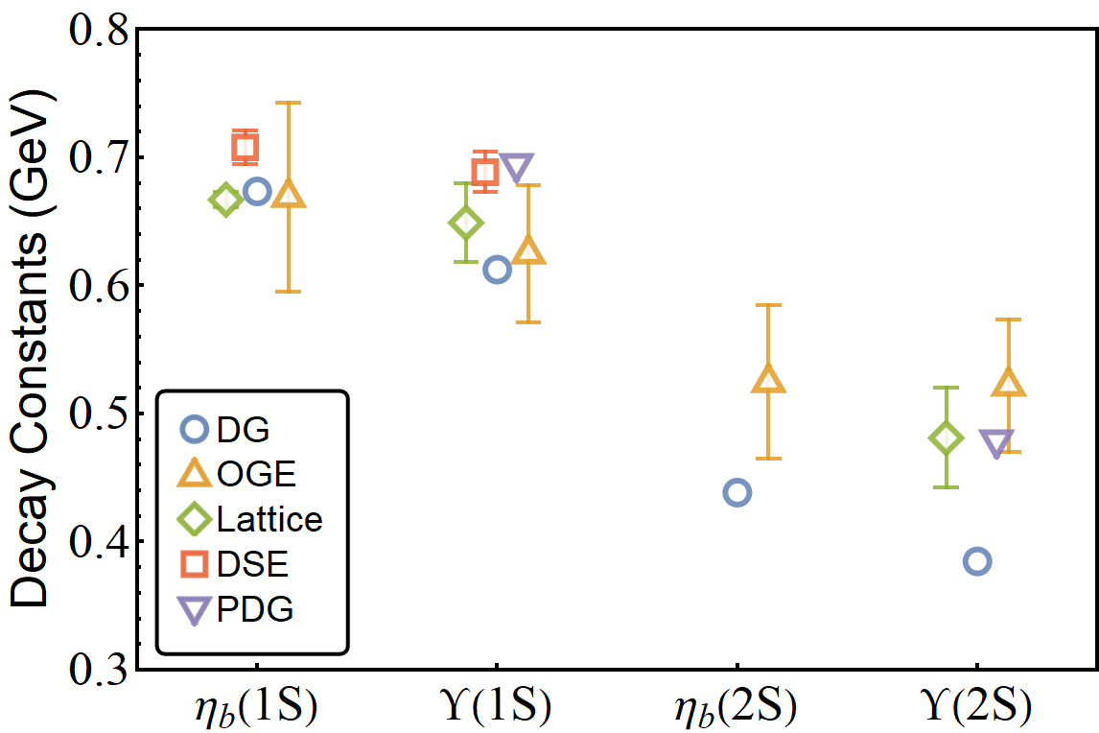
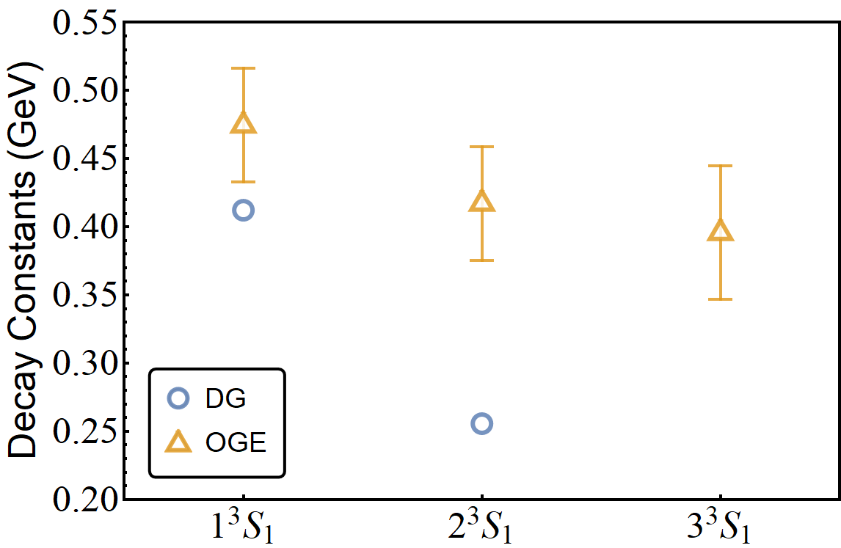


Heavy meson in progress
Decay constants
$\frac{f_{P,V}}{2\sqrt{2N_{c}}}=$ $\int_{0}^{1}{\frac{dx}{\sqrt{x(1−x)}}\int{\frac{d^{2}k_{⊥}}{2{\left(2π\right)}^{3}}Ψ_{↑↓∓↓↑}^{λ=0}(x,{\vec{k}}_{⊥})}}$
Charmonium
Bottomonium
$B_{c}$meson
agree with PDG and OGE for Charmonium
OGE : [Yang Li, et al, 2017 and Shuo Tang, et al, 2018]
Lattice : [C. McNeile et al, 2012]
Dyson-Schwinger equations : [M. Blank, et al, 2011]
This Work: $N_{max}=10,K_{max}=11,M_{J}=0$

Slide 18
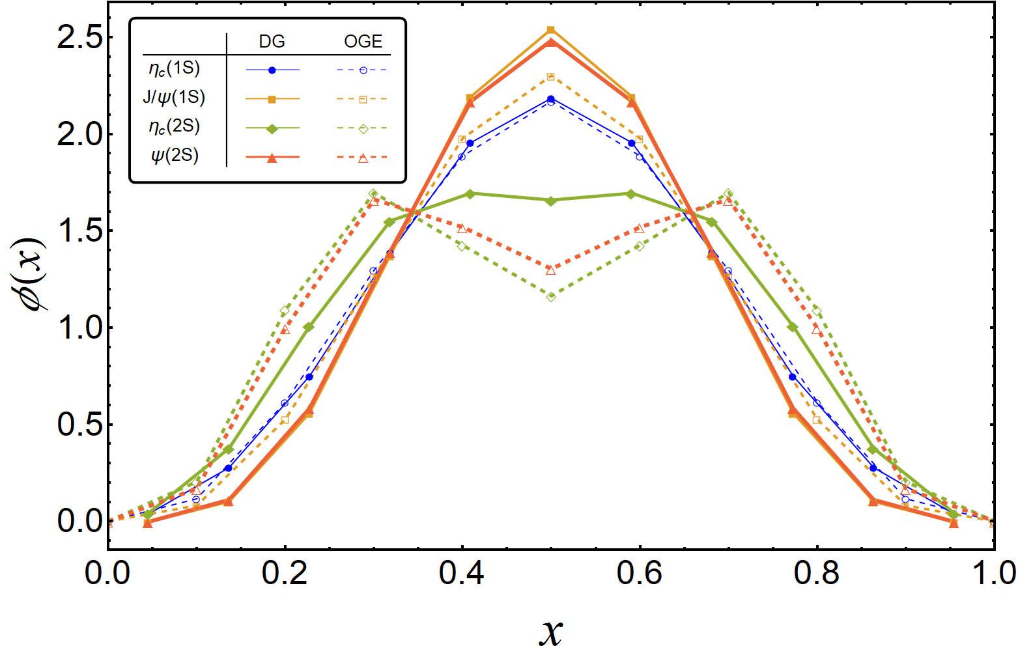
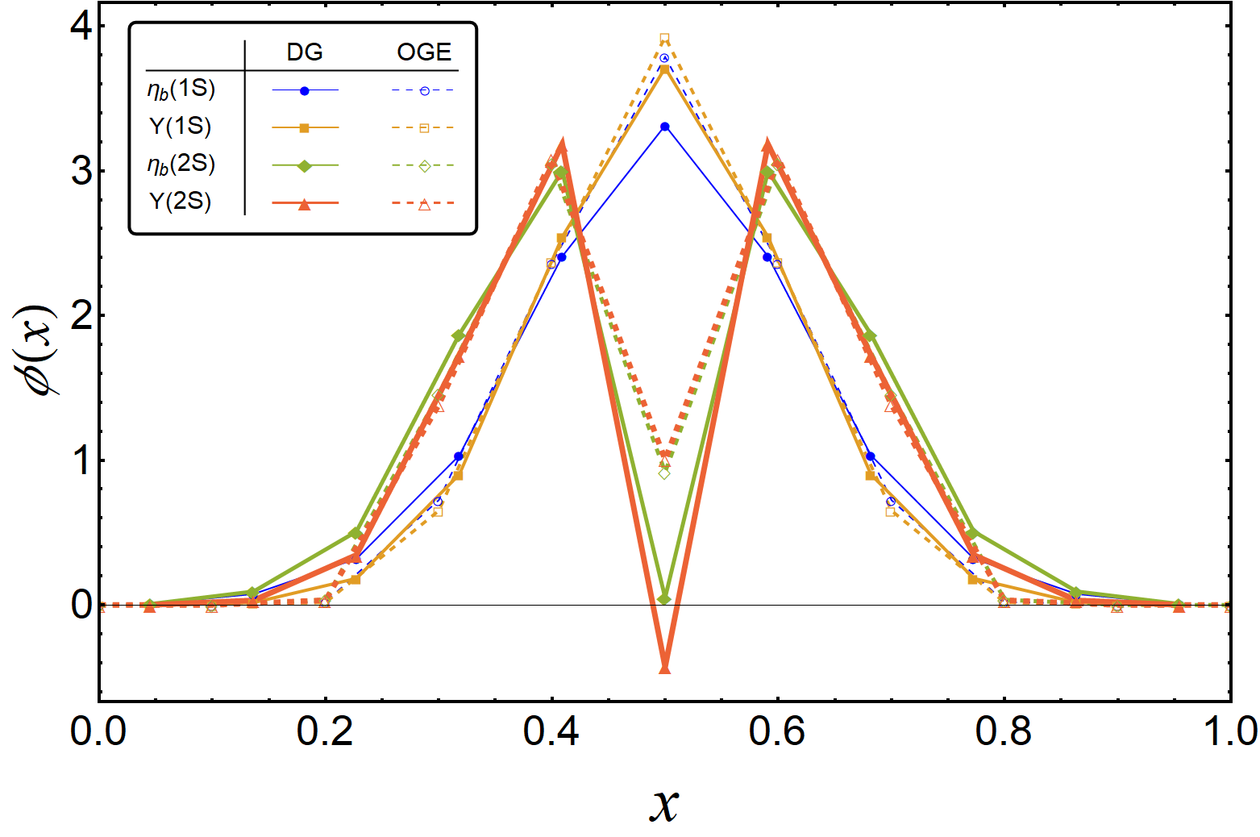
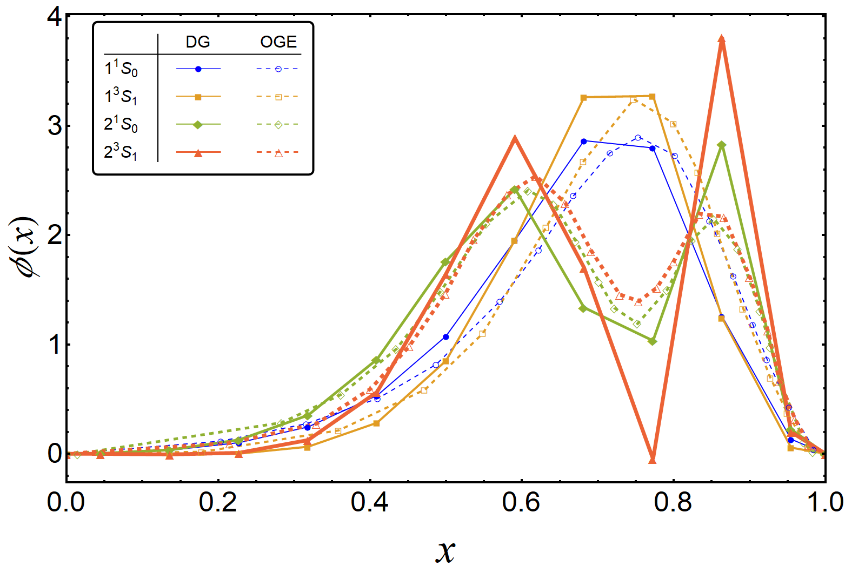
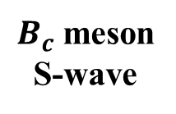

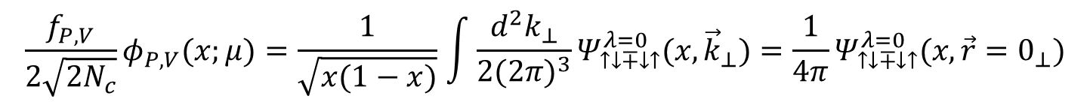
Heavy meson in progress
Distribution amplitudes
[Lepage ’80]
$$\frac{f_{P,V}}{2\sqrt{2N_{c}}}φ_{P,V}(x;μ)=\frac{1}{\sqrt{x(1−x)}}\int{\frac{d^{2}k_{⊥}}{2{(2π)}^{3}}Ψ_{↑↓∓↓↑}^{λ=0}(x,{\vec{k}}_{⊥})={\frac{1}{4π}Ψ}_{↑↓∓↓↑}^{λ=0}(x,{\vec{r}=0}_{⊥})}$$
Bottomonium S-wave
Charmonium S-wave
agree with OGE results
$B_{c}$meson
S-wave
OGE : [Yang Li, et al, 2017 and Shuo Tang, et al, 2018]
This Work: $N_{max}=10,K_{max}=11,M_{J}=0$

Slide 19
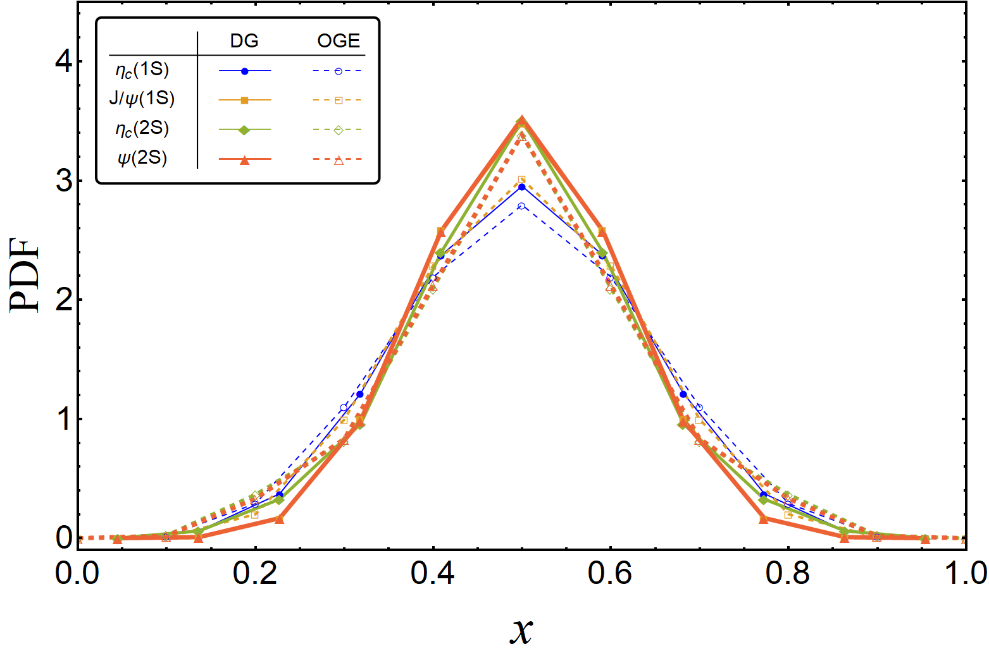
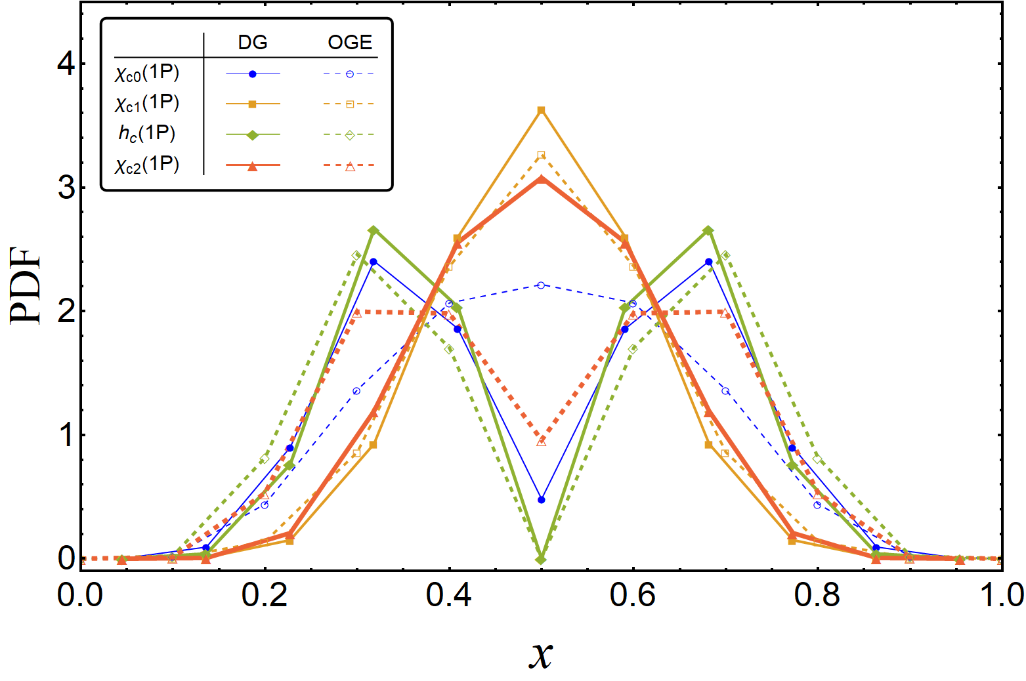
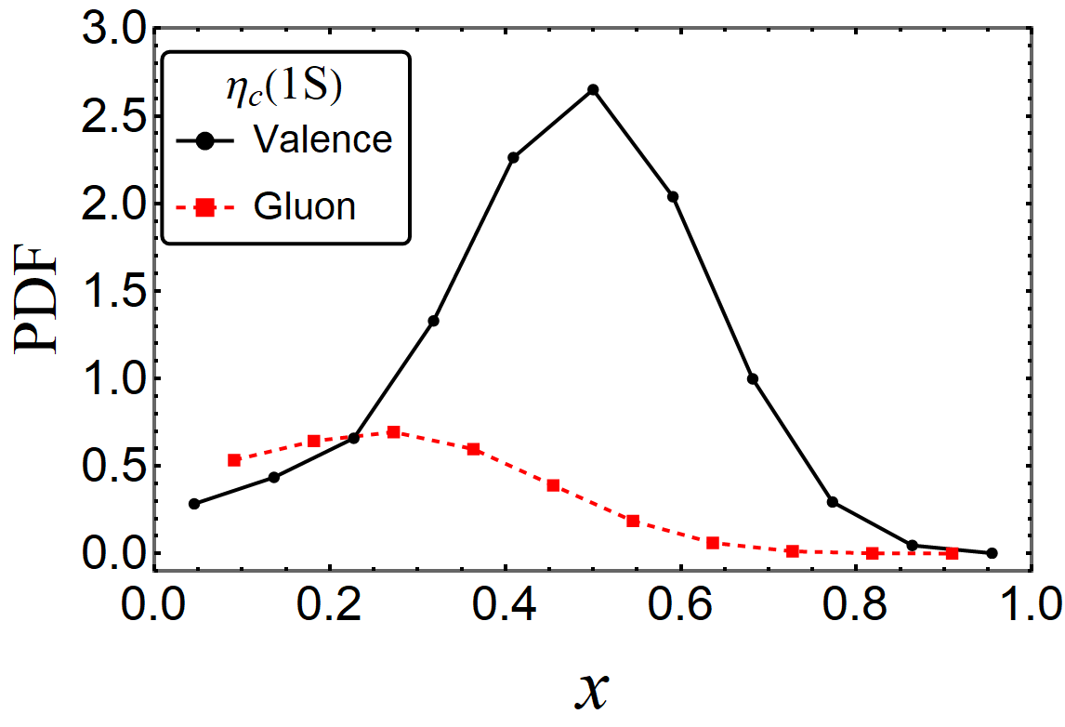


Heavy meson in progress
PDF
PDF in the first Fock sector
PDF in the both Fock sectors
Charmonium
Preliminary

Slide 20





Heavy meson in progress
PDF
PDF in the first Fock sector
PDF in the both Fock sectors
Bottomonium
Preliminary

Slide 21






Heavy meson in progress
Form Factor and Radii
Lattice : [Dudek ‘06]
[Yang Li, FBS ‘17]
[ Brodsky ’06]
Dyson-Schwinger equations : [Mari ‘07]
$$F\left(Q^{2}\right)=∫dx_{i}H(x_{i},0,Q^{2})$$
$$<r_{c}^{2}> =−6\frac{∂}{∂Q^{2}}F_{ch} (Q^{2})$$
Charmonium FF
Charmonium
Bottomonium FF
Bottomonium

Slide 22




Heavy meson in progress
GPD
[ physical review D 89]
$$H\left(x_{i},ξ=0,t=−{{\vec{Δ}}^{2}}_{⊥}\right)∼∫dk_{⊥}ψ_{n}^{↑∗}\left(x_{i},k_{⊥_{i}}^{′},λ_{i}\right)ψ_{n}^{↑}(x_{i},k_{⊥_{i}},λ_{i})$$
Bottomonium
Charmonium

Slide 23
Conclusions
Hamiltonian approach to relativistic bound states
Many-body wave functions available (momentum, spin, color...)
Straightforward to calculate lightcone observables
  Contains gluon structure
Consistency between mass spectrum and hadron structure
Systematically expandable by including higher Fock sectors
Thank you!

