Slide 1
FPGA Helix Tracking Algorithm with STT
Wolfgang Kühn, Yutie Liang, Zhen’an Liu
Jingzhou Zhao
IHEP Beijing, IMP Lanzhou, Uni-Giessen
29.12.2020

Slide 2
Outline
1. Introduction
2. Tracking Algorithm
T0 extraction from tracking
Tracking at FPGA
5. Summary and Outlook

Slide 3
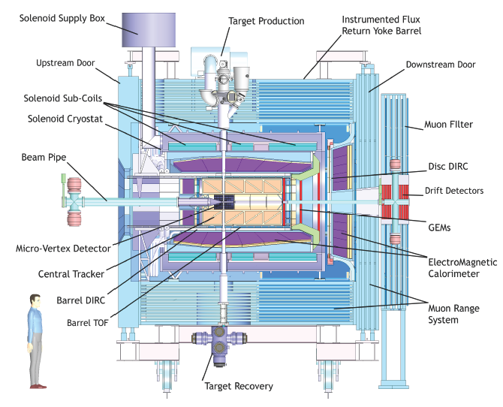
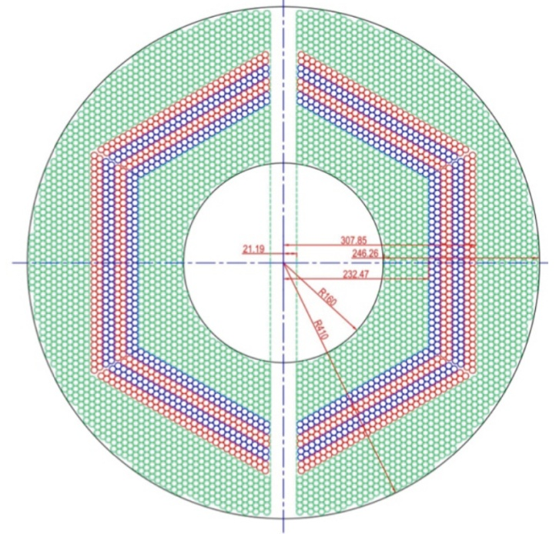
Introduction to the PANDA STT
4636 Straw tubes
23-27 planar layers
15-19 axial layers (green) in beam direction
4 stereo double-layers for 3D reconstruction,
with ±2.89 skew angle (blue/red)
From STT : Wire position + drift time

Slide 4
Tracking Algorithm -- Road Finding
Layer_ID
Hit
Hit
Hit
Hit
Hit
Hit
Hit
Hit
Hit
Hit
Hit
Tube_ID
Hit: Seg_ID (3 bits) + LayerID (5 bits) + Tube_ID (6 bits) + Arrival time
1: Start from inner layer
2: Attach neighbour hit to tracklet layer by layer
Boundary between two segments.
Number of neighbor:
4 in axial layer; 6 in stereo layer

Slide 5
Tracking Algorithm -- helix parameters calculation
Known : x_{i} , y_{i} , d_{i}
Question: To determine a circle,
x² + y² + ax + by + c = 0
Method: Minimize the equation
E² = ∑(x_{i}² + y_{i}² + a x_{i}+ b y_{i} + c)² (1/d_{i})²
y
x_{c}, y_{c}, R
x
S_{x} = ∑x_{i} …
S_{xx} = ∑x_{i}x_{i} …
S_{xxx} = ∑x_{i}x_{i}x_{i} …
1) Circle para.
2) Track quality.

Slide 6
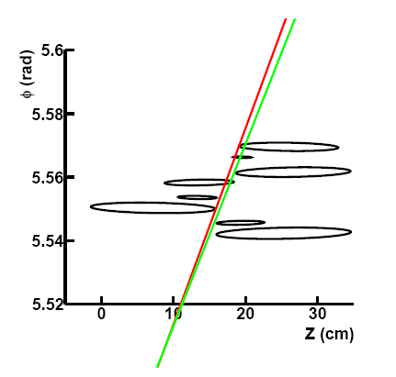
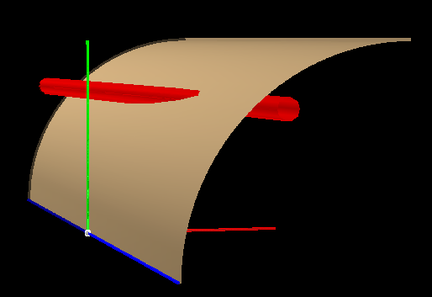
Pz reconstruction
1: The radius, the position of the helix center in the XY plane are determined.
2: Φ = kZ + Φ₀
One cylinder the helix lies in.
Based on Pt determined before
y
Crossing points
(ellipse)
One straw tube
x
z
Track need to be tangent to the crossing ellipse.
Gianluigi Boca and Panda Collaboration, Panda STT TDR, 2012

Slide 7
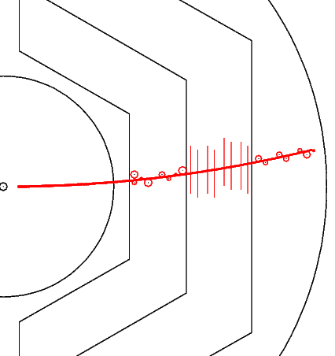
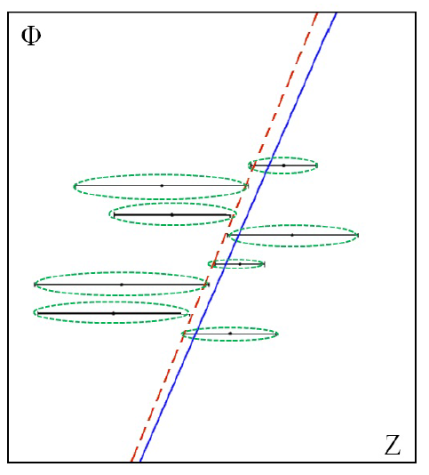
Pz reconstruction
Known : z_{i} , Φ _{i} , d_{i}
Question: To determine a line,
Φ + kz + Φ₀= 0
Method: Minimize E² = ∑(Φ_{i} + kz_{i} + Φ₀)² (1/d_{i})²

Slide 8
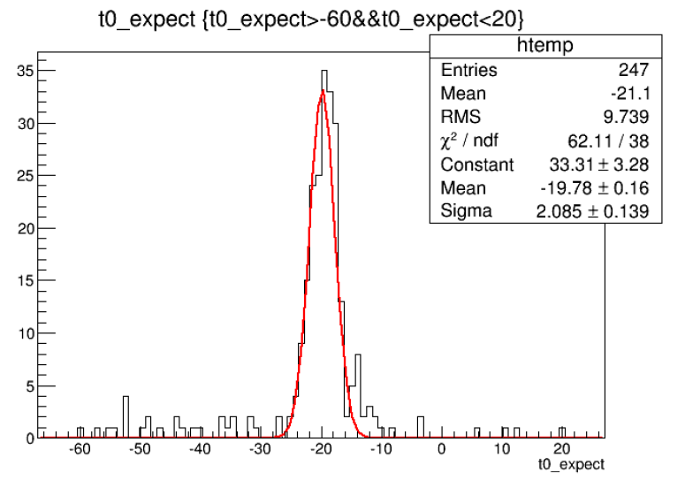
Extract T₀ from Tracking
T0 shift = Ʃdi /N / const (N: number of hits
di: signed distance of circle to track)
T0 shifted by:
-50 ns:
-20 ns:
10 ns:
20 ns:
Extracted T0:
-47.0±4.0 ns
-19.8±2.1 ns
9.4±2.5 ns
19.0±2.3 ns

Slide 9
Tracking Strategy with experimental data -- 20 MHz
Hits are sorted according to their arrival time.
In case of T₀ provided:
Start from T₀ → Collect hits in 220 ns window →
Run tracking algorithm → Assign track to right event
In case of T₀ not provided:
Do tracking and T₀ extraction at the same time

Slide 10
Tracking Strategy with experimental data -- Phase I
Hits are sorted according to their arrival time.
In case of T₀ provided:
Start from T₀ → Collect hits in 220 ns window →
Run tracking algorithm → Assign track to right event
In case of T₀ not provided:
Take the earliest time of a segment of hit as T₀ . → do one more iteration to optimize.

Slide 11
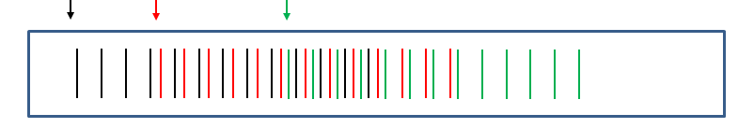
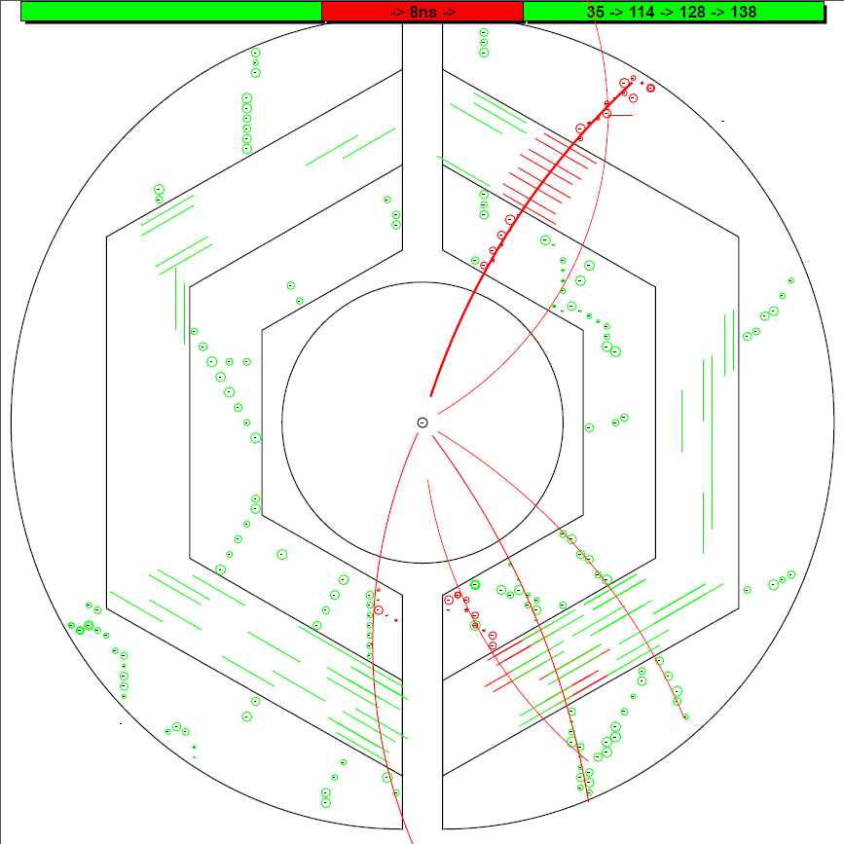
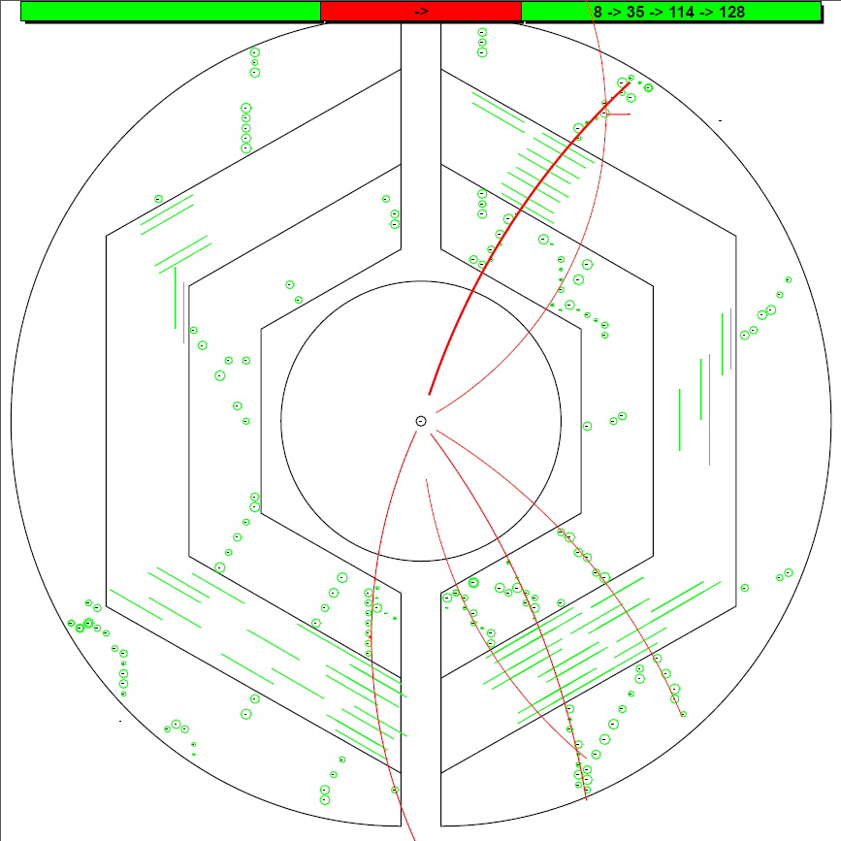
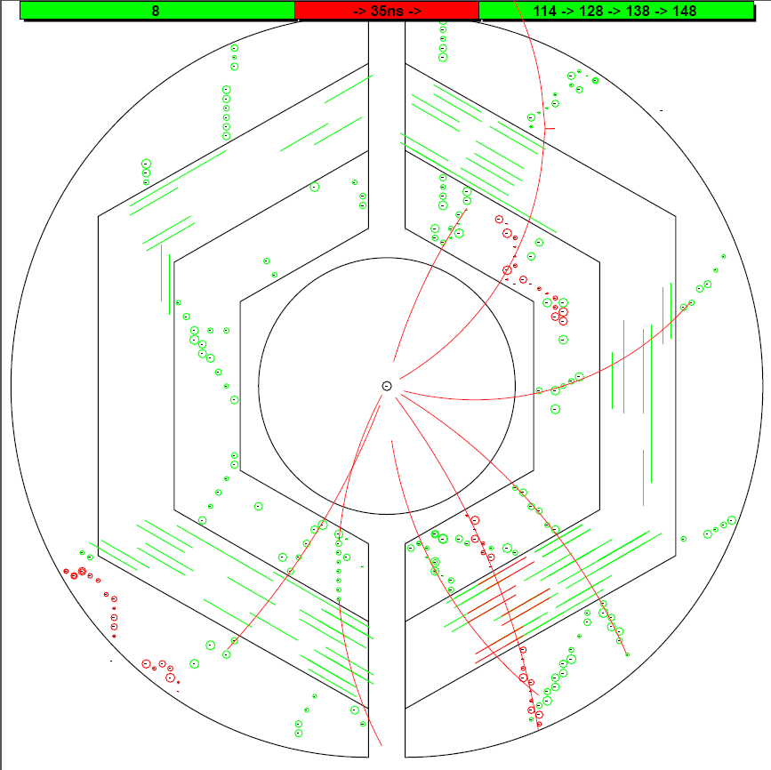
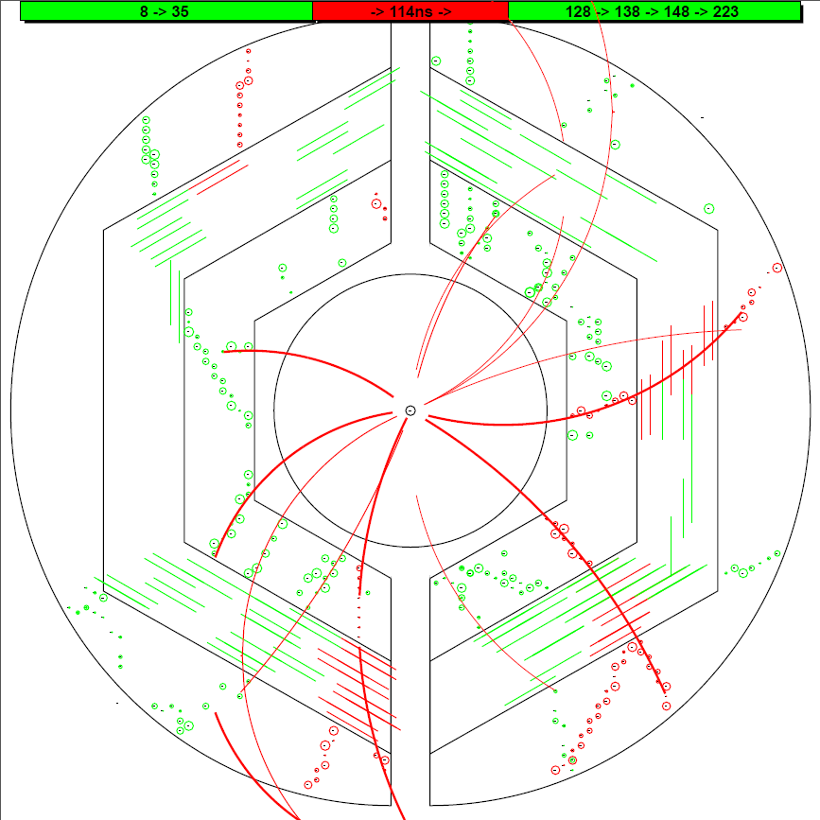
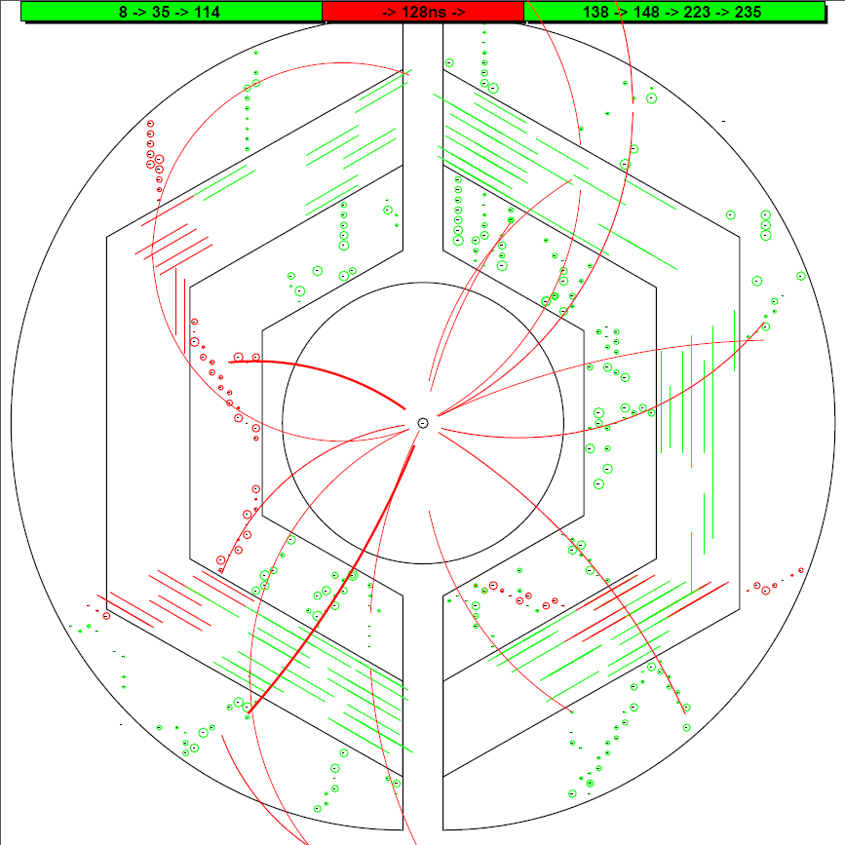
8.4
35.9
114.1
T0 (ns) : MC Input Iter_2
T0 (ns) : MC Input Iter_2
T0 (ns) : MC Input Iter_2
T0 (ns) : MC Input Iter_2
T0 (ns) : MC Input Iter_2
#1 T0 = 140.9 ns
0.0
0.0
0.0
0.0
0.0
8.4
8.4
8.4
8.4
8.4
9.0
9.0
9.0
9.0
9.0
9.4
9.4
9.4
9.4
#1 T0 = 9.4 ns
#0 T0 = 9.0 ns
37.2
37.2
37.2
37.2
38.2
38.2
35.9
38.2
35.9
35.9
35.9
35.9
#1 T0 = 115.3 ns
#1 T0 = 116.8 ns
114.1
114.1
114.1
114.1
114.1
114.5
114.5
114.5
116.6
115.3
#1 T0 = 98.3 ns
#1 T0 = 95.3 ns
#1 T0 = 114.5 ns
#1 T0 = 116.6 ns
128.2
128.2
128.2
128.2
128.2
140.9
139.0
140.9
141.1
139.0
139.0
139.0
139.0
148.3
150.9
148.3
148.3
148.3
148.3
#1 T0 = 128.0 ns
#1 T0 = 119.0 ns
#1 T0 = 35.7 ns
#0 T0 = 37.2 ns
#0 T0 = 38.2 ns
11

Slide 12
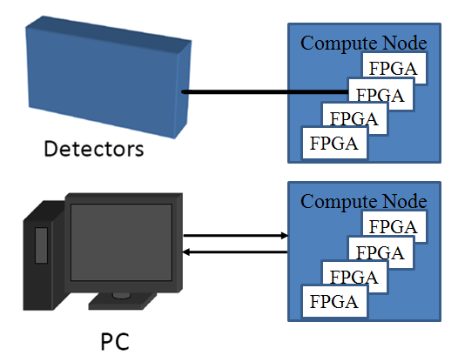
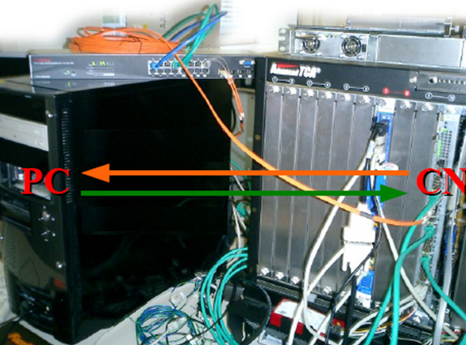
Setup and Test
PC as data source and receiver.
Ethernet.
Optical link
Ethernet via
Optical Link
FPGA
FIFO
Tracking algorithm
FIFO

Slide 13
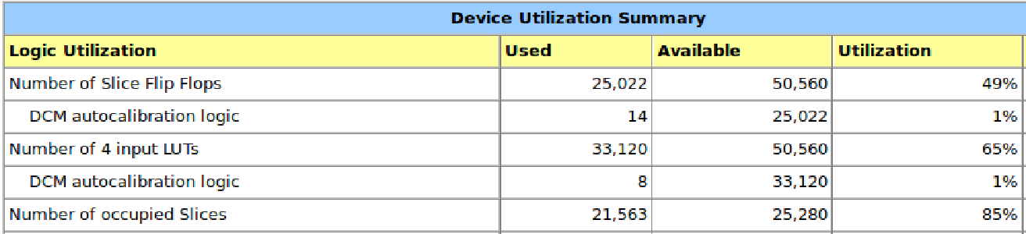
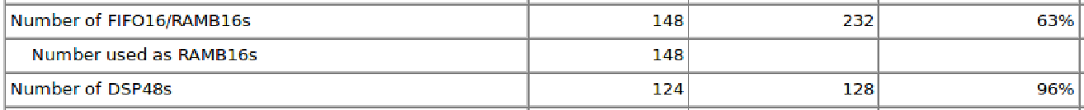
Performance at FPGA
For one event with 100 hits (6 tracks): 7 μs
Hit reading
Road finder
Pt extraction
Pz extraction
(100 cc)
(50 cc X 6)
(120 cc X 2 X 6)
(60 cc X 2 X 6)

Slide 14
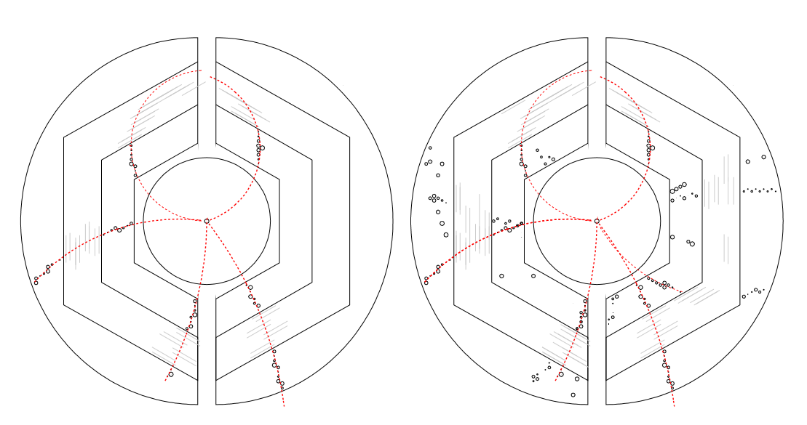
Tracking at FPGA
Data flow: Hit information at PC → FPGA, extract helix para. → PC
PC is used to draw hits and helix in the plot. The helix parameters come from FPGA.

Slide 15
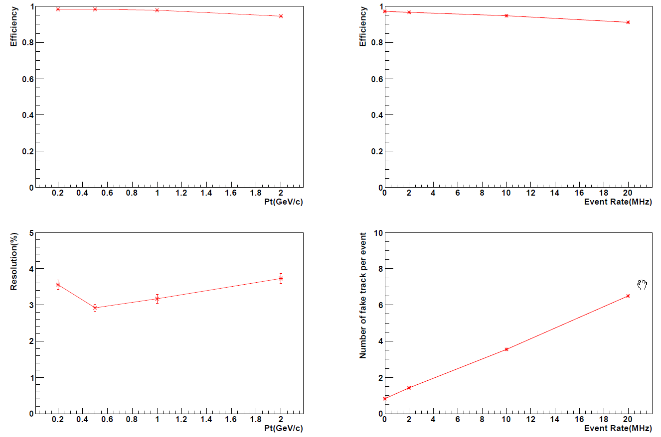
Performance test

Slide 16
Summary and Outlook
σ_pt : ~ 3.2% σ_pz : ~ 4.2% .
7 μs/event (6 tracks)
Tracking strategy in case of W/O T0.
From Virtex 4 to Kintex 7 in future.

Slide 17
Thank you

Slide 18
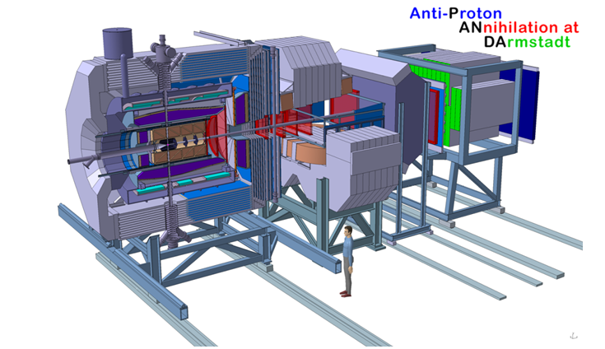
项目研究内容—无硬件触发数据获取系统
自触发前端电子学及数据推动结构
时钟分配系统 – 全局时间戳对齐事例
Level 1 (L1) 网络层–由高性能计算节点组成，运行丰富的特征提取算法。提取径迹级别物理信息，如动量、能量、粒子类别。
Level 2 (L2) 网络层– 利用L1网络层输出进行高层次信息提取，抽取事例级别的物理信息，如母粒子的质量，用以压低本底。
梁羽铁

Slide 19
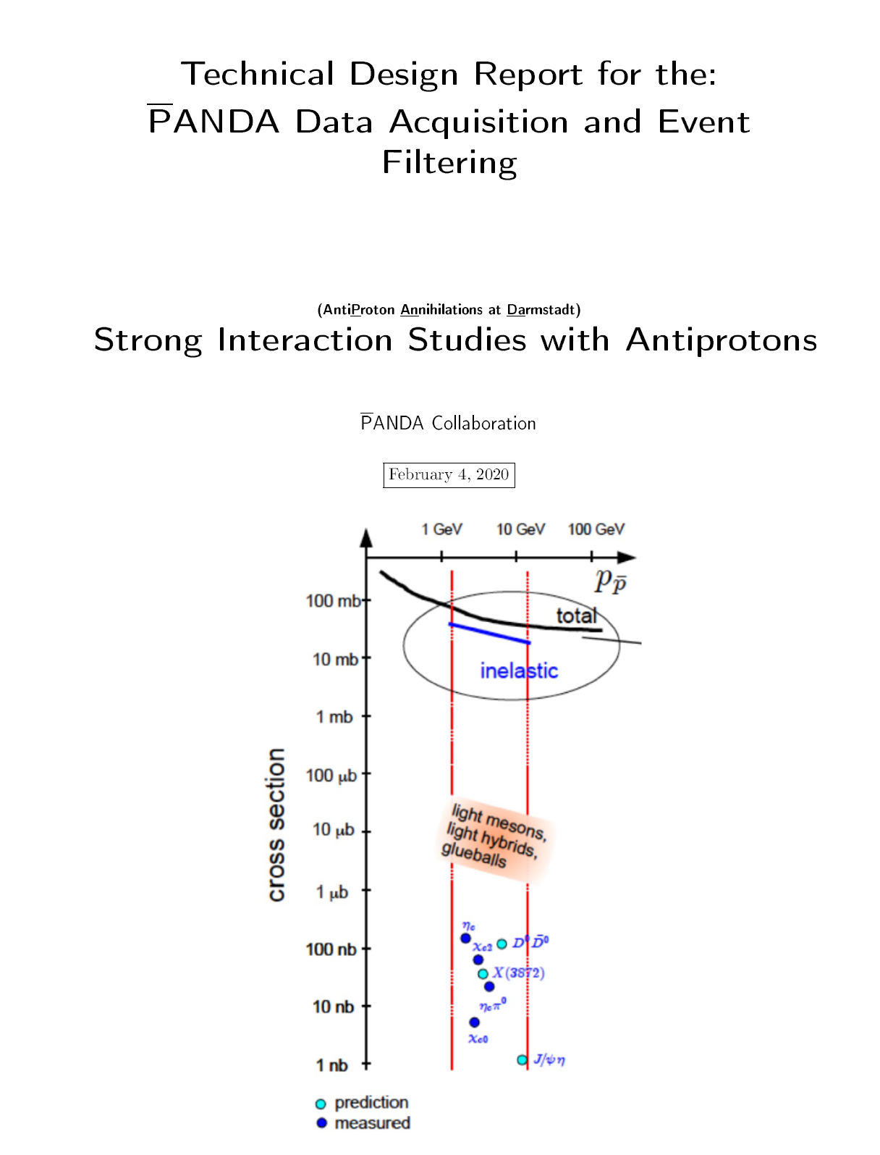
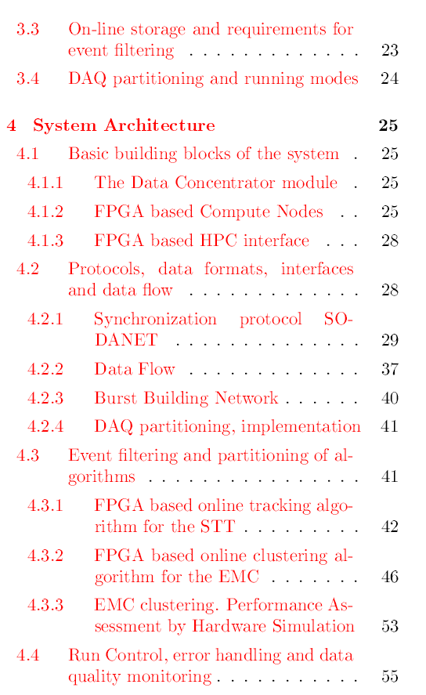

Slide 20
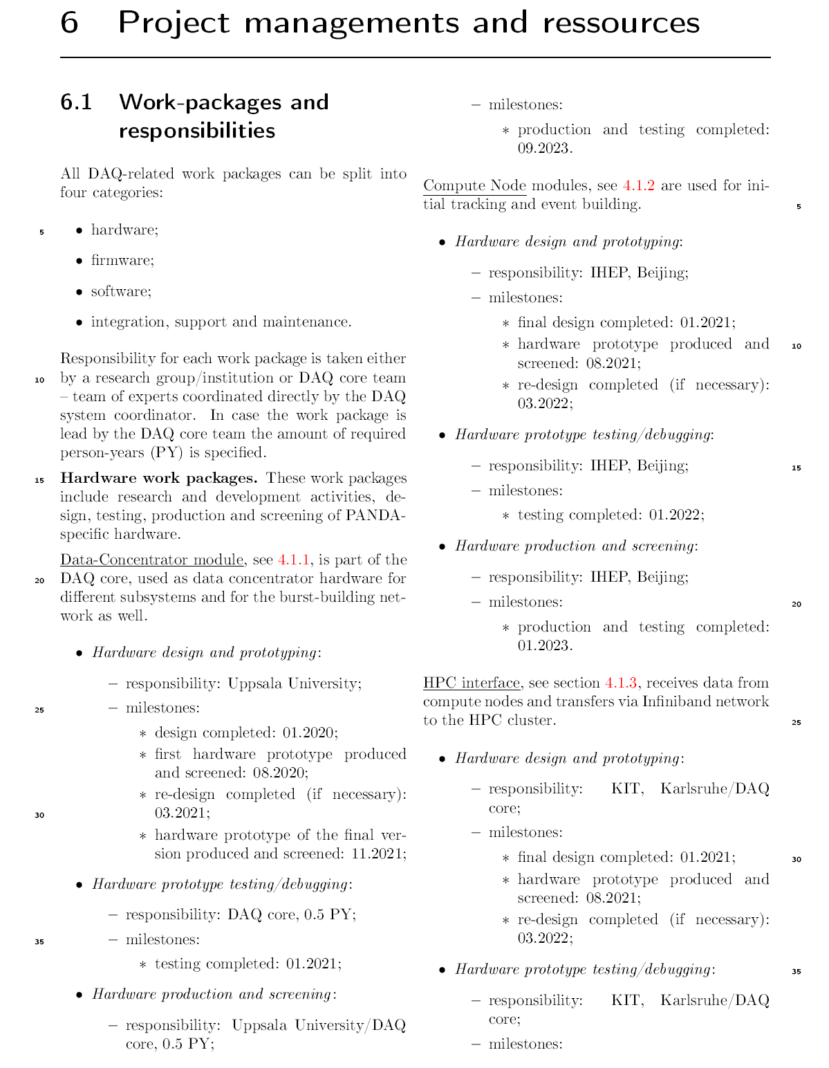
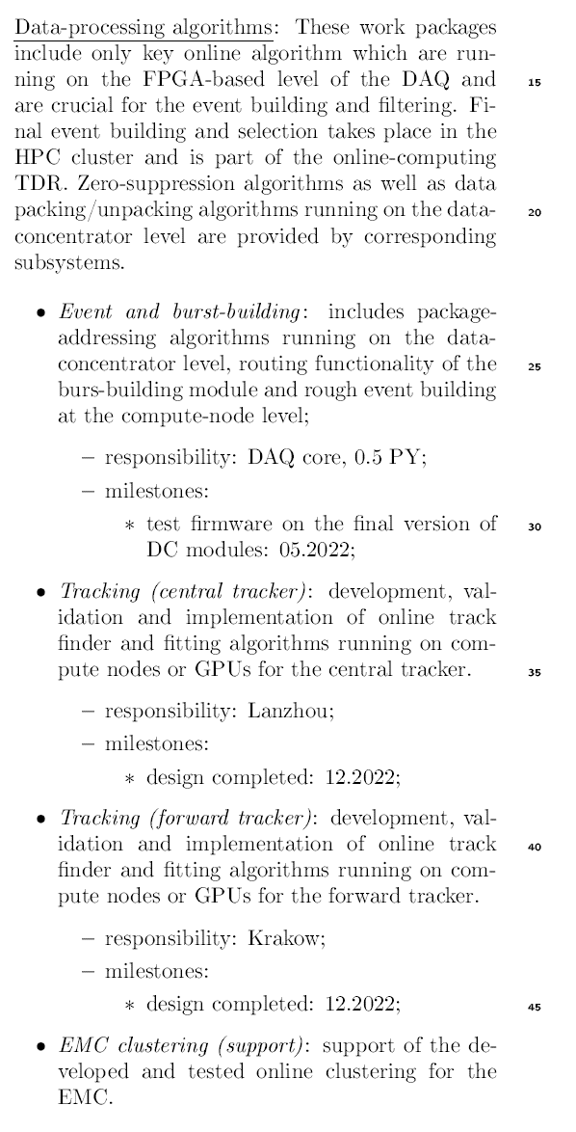

Slide 21
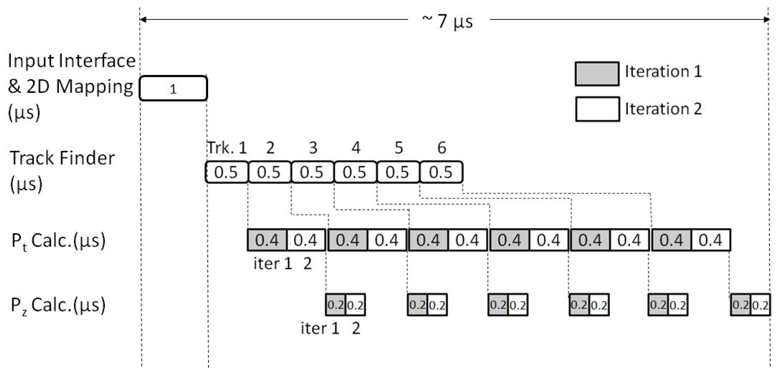
The Latency

Slide 22
Event Structure -- pile-up
20 MHz
1600 ns revolution time
400 ns gap
T_{Mean} between 2 events: 50 ns
Drift time: ~200 ns
Event pile-up

Slide 23
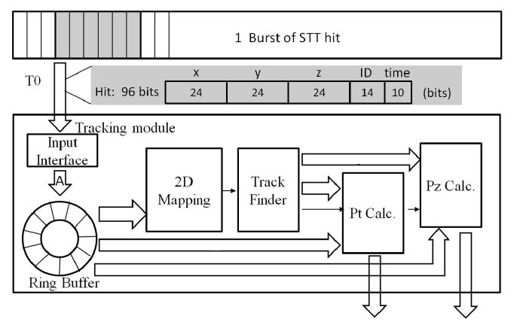
Block diagram of algorithm in VHDL

Slide 24
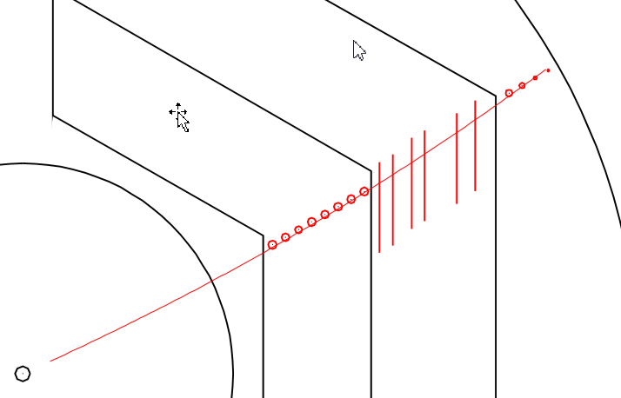

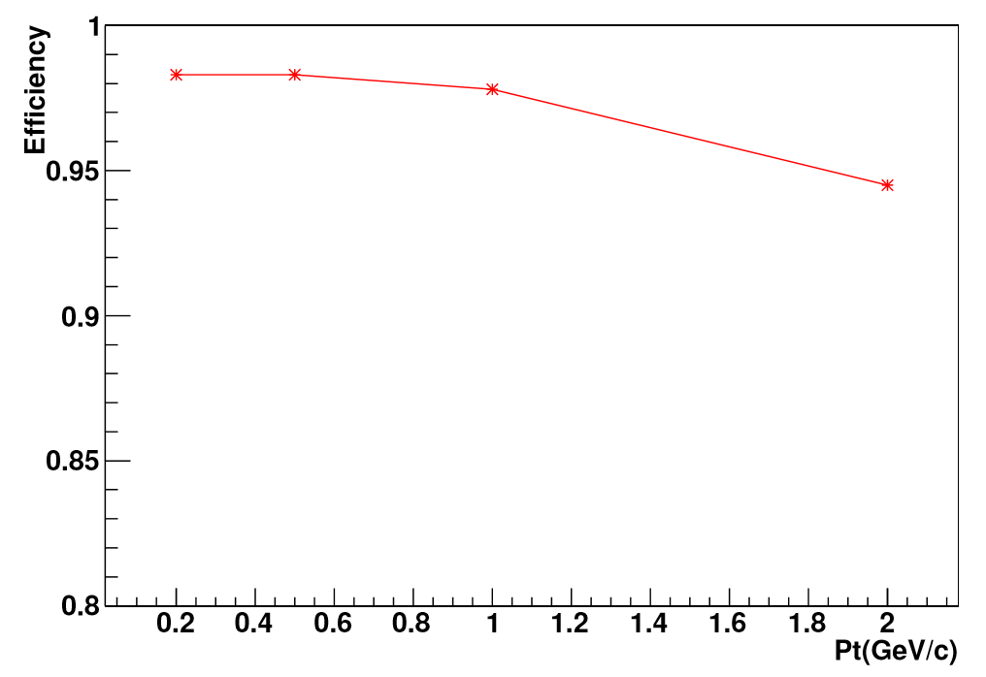
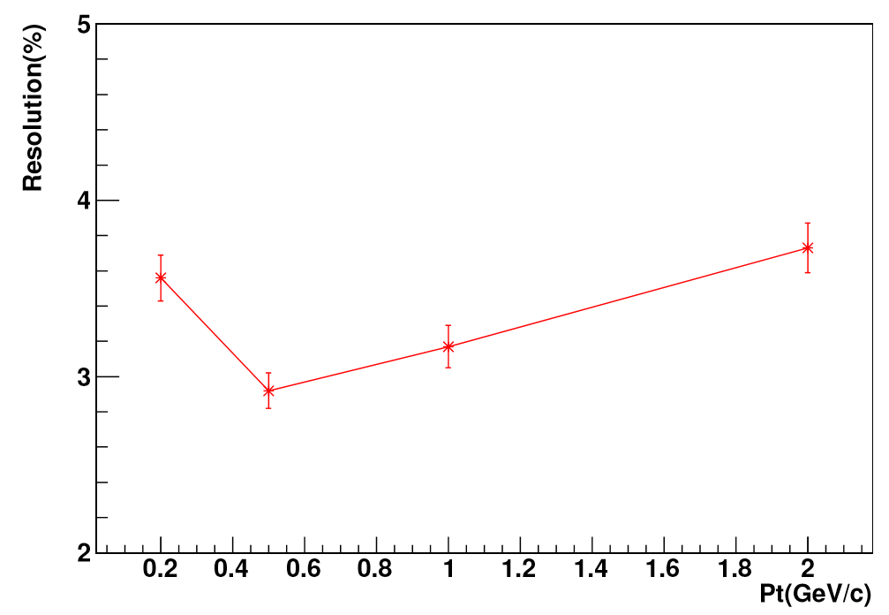
Performance test
N_gen: number of generated tracks
with at least 3 hits in STT
|P_rec - P_gen| < 6 sigma
24

Slide 25
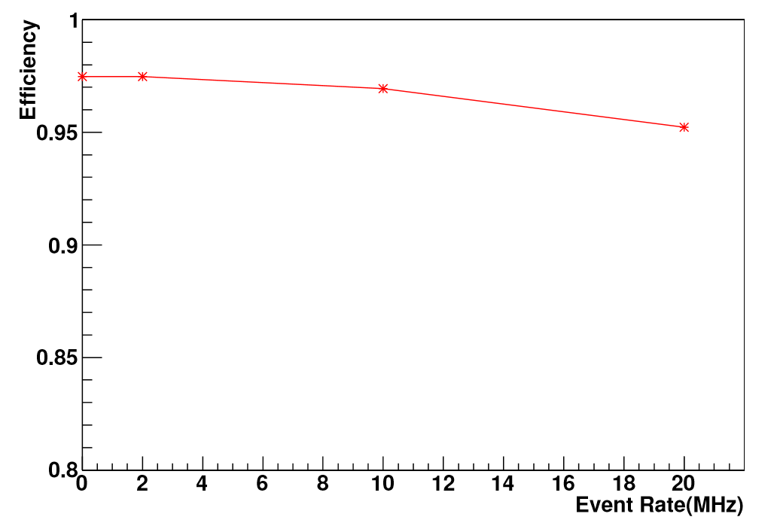
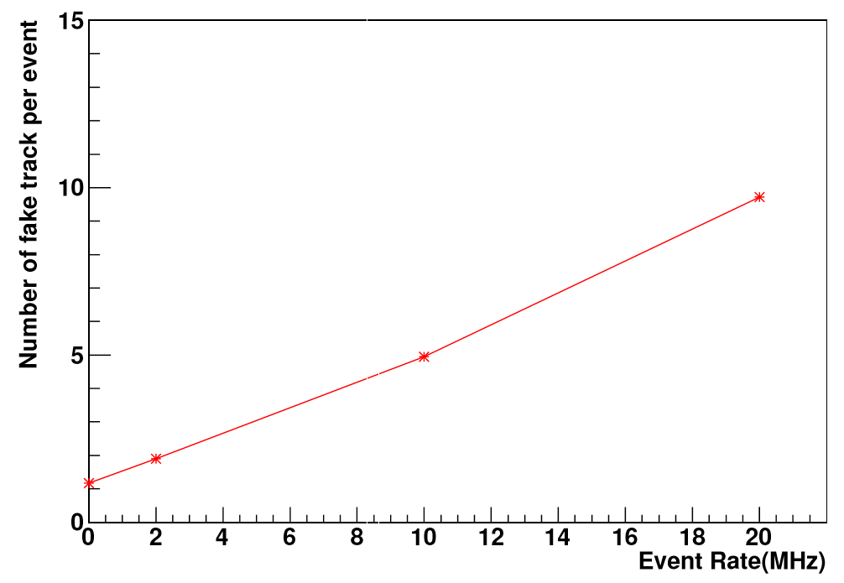
Performance at different event rate
Number of fake tracks per event increases at high event rate.
25

Slide 26
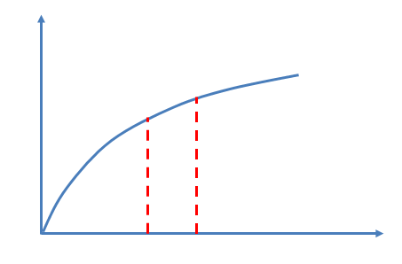
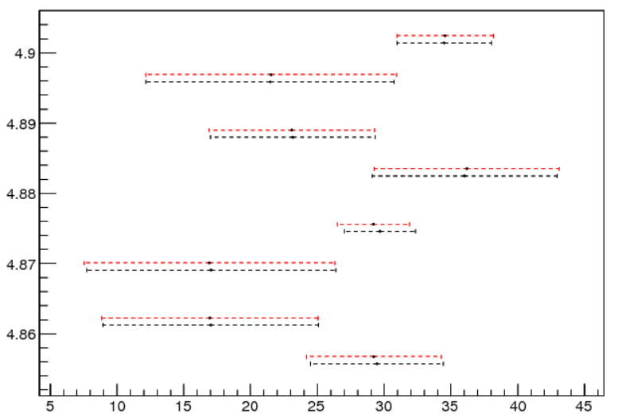
Square Root Operation
384 bins in the range of 1 ~ 4, error ~ 0.4%
Linear extrapolation, precision improves
C++ VHDL
Xc: 0.7286 0.7278
Yc: 161.153 161.138
R: 161.155 161.167 (0.01%)
Φ
Zi:
C++ VHDL
29.4 ±5.0 29.23 ±5.1
17.0 ±8.1 16.93 ±8.1
z(cm)

Slide 27
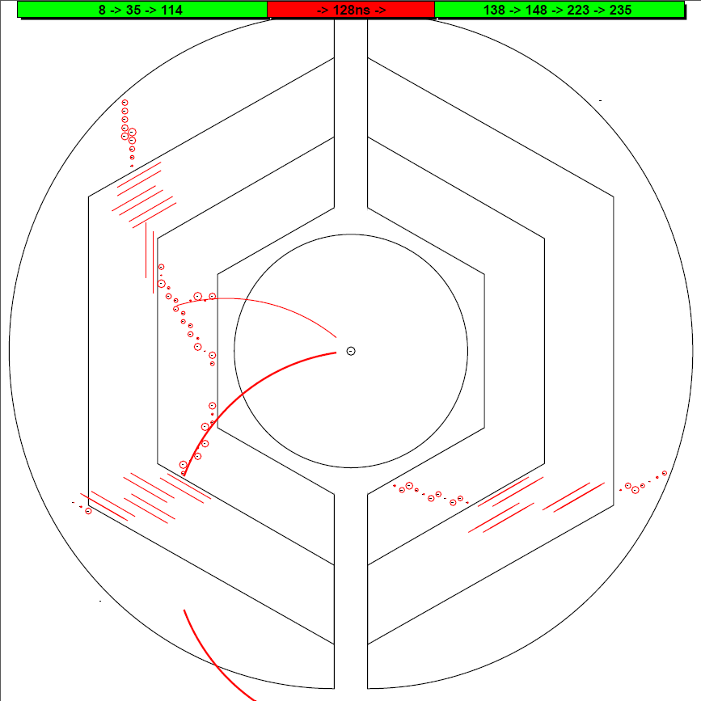
The Missing Event at Event-based simulation
Tracks in this event are not well reconstructed.
In this case, it is hard to extract a T₀.
27

Slide 28
Tracking at FPGA -- 20 MHz
Data flow: Hit information at PC → FPGA, extract helix para. → PC
PC is used to draw hits and helix in the plot. The helix parameters come from FPGA.

Slide 29
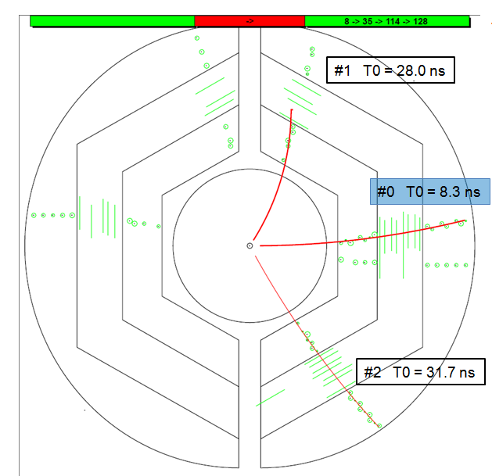
HK 22.7
Tracking Strategy
8.4
35.9
114.1
1) Start from 0
2) hits in 220 ns window
3) run tracking algorithm
4) extract T₀ of next event
5) go back to 2)
Two time-based simulations:
1 GeV single muon
DPM

Slide 30
HK 22.7
Performance at FPGA
For one event with 100 hits (6 tracks): 7 μs
Hit reading
Road finder
Pt extraction
Pz extraction
(100 cc)
(50 cc X 6)
(120 cc X 2 X 6)
(60 cc X 2 X 6)

Slide 31
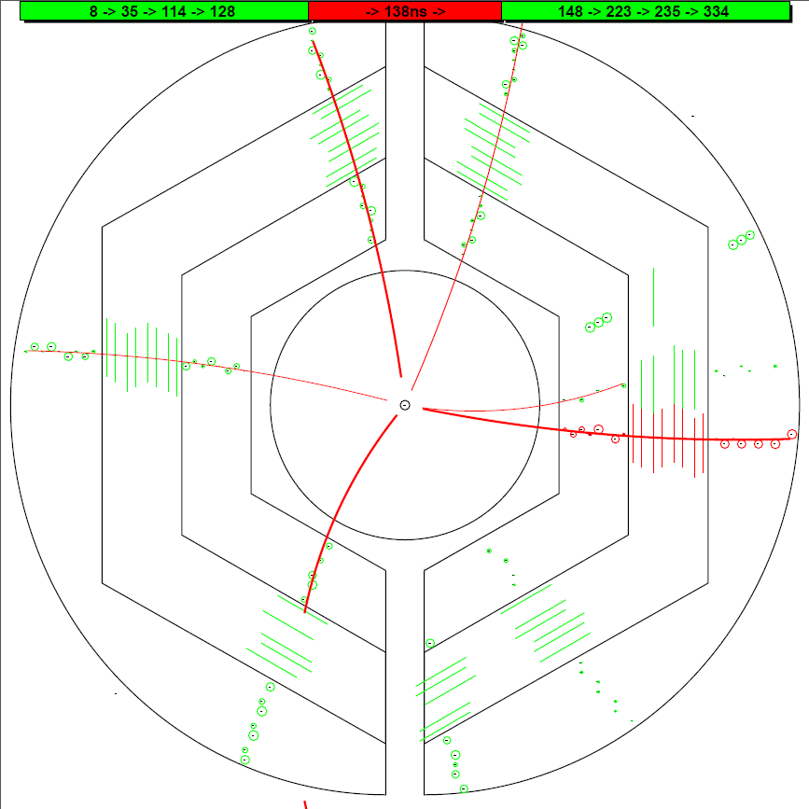
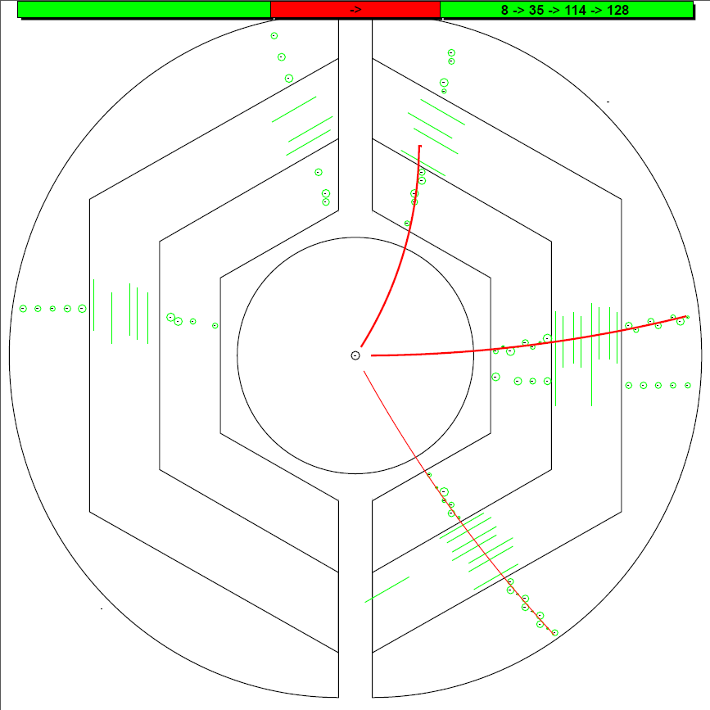
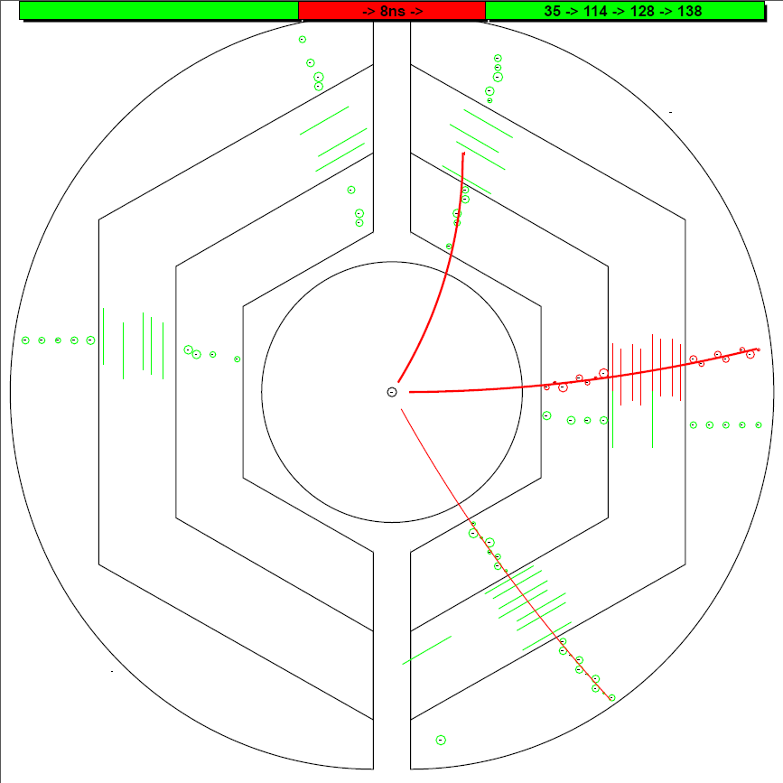
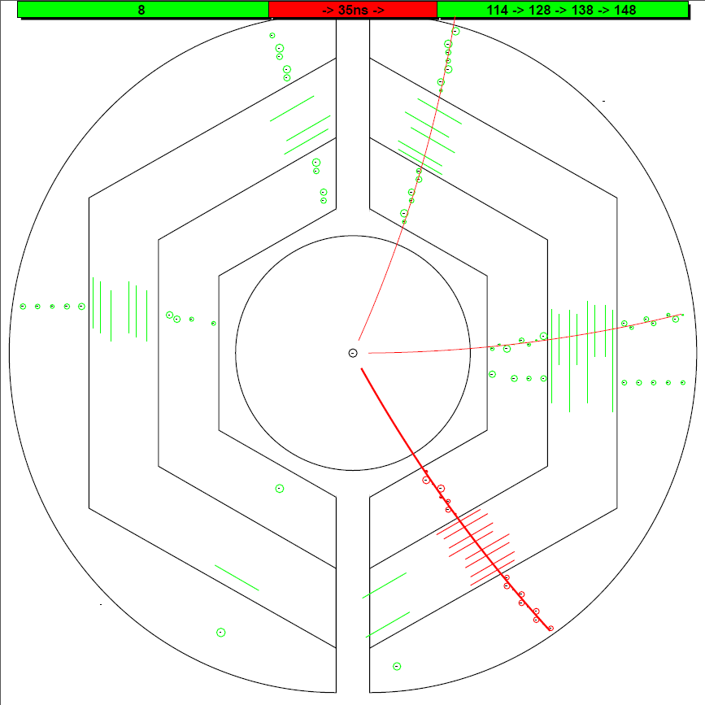
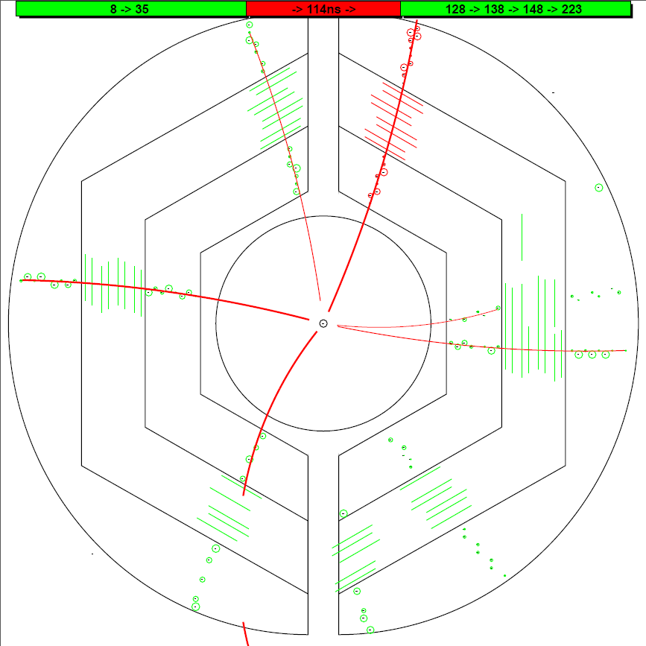
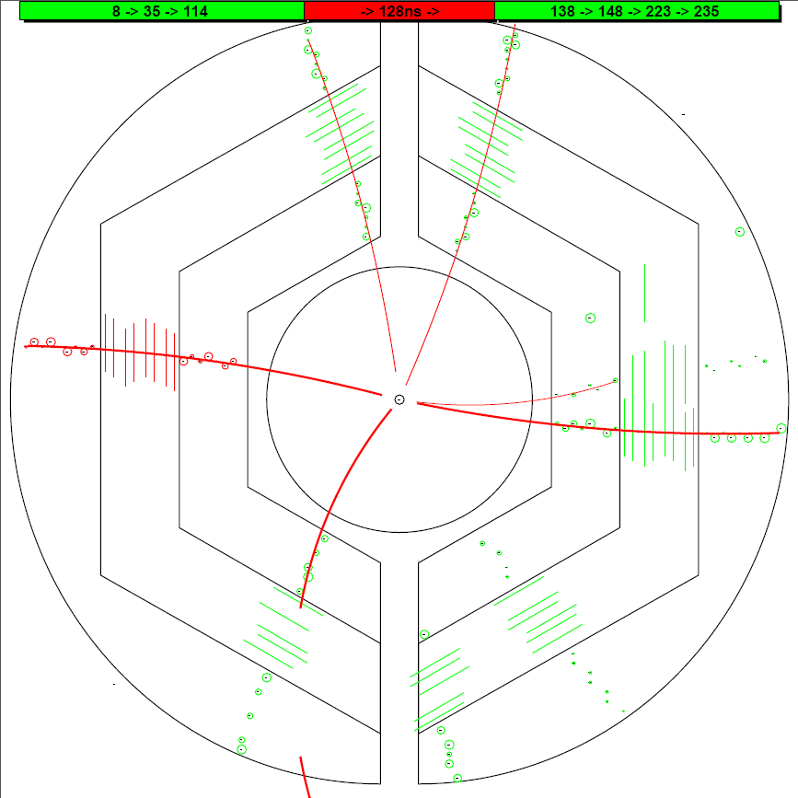
HK 22.7
T0 (ns) : MC Input Iter_2
T0 (ns) : MC Input Iter_2
T0 (ns) : MC Input Iter_2
T0 (ns) : MC Input Iter_2
T0 (ns) : MC Input Iter_2
T0 (ns) : MC Input Iter_2
0.0
0.0
0.0
0.0
0.0
0.0
#1 T0 = 146.1 ns
#1 T0 = 147.4 ns
#1 T0 = 147.4 ns
#1 T0 = 28.0 ns
#1 T0 = 36.3 ns
#1 T0 = 112.4 ns
#1 T0 = 116.0 ns
#1 T0 = 116.6 ns
#1 T0 = 117.1 ns
8.4
8.4
8.4
8.4
8.4
8.4
8.3
8.3
8.3
8.3
8.3
8.3
8.5
8.5
8.5
8.5
8.5
34.6
34.6
34.6
34.6
34.6
35.9
35.9
35.9
35.9
35.9
35.9
35.9
35.9
35.9
35.9
#1 T0 = 128.0 ns
#1 T0 = 128.0 ns
#1 T0 = 128.1 ns
#0 T0 = 8.3 ns
#0 T0 = 8.5 ns
#0 T0 = 9.7 ns
#0 T0 = 65.7 ns
#0 T0 = 67.8 ns
#0 T0 = 97.0 ns
114.1
114.1
114.1
114.1
114.1
114.1
112.4
112.4
112.4
112.4
116.0
116.0
#1 T0 = 137.2 ns
116.0
#1 T0 = 138.4 ns
#1 T0 = 139.2 ns
128.0
128.0
128.0
128.0
128.2
128.0
128.2
128.2
128.2
128.2
#1 T0 = 127.2 ns
128.2
#1 T0 = 158.1 ns
#1 T0 = 167.0 ns
#2 T0 = 34.6 ns
#2 T0 = 35.9 ns
#2 T0 = 31.7 ns
138.4
139.0
138.4
139.2
139.0
139.0
139.0
139.0
139.0
148.3
147.4
148.3
148.3
148.3
148.3
148.3

Slide 32
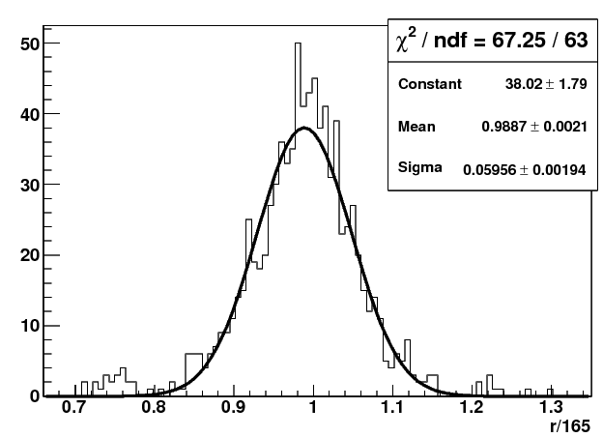
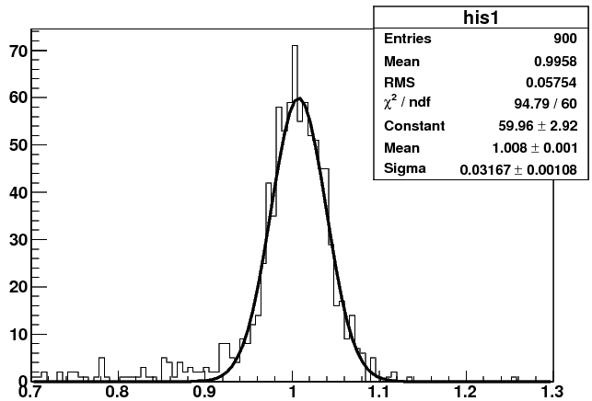
To Improve the Momentum Resolution -- using a 2nd iteration
y
Pt(input) 1st iteration 2nd iteration
0.2GeV/c : 0.195 ±0.0068 0.195±0.0068
0.5GeV/c : 0.5 ±0.0212 0.5 ± 0.0164
1.0GeV/c : 0.99 ±0.0595 1.0 ± 0.0317
2.0GeV/c : 1.85 ±0.213 2.0 ± 0.073
x_{c}, y_{c}, R
x
1st iteration
2nd iteration
Pt(GeV/c)
Pt(GeV/c)

Slide 33
..
..
9
..
8
7
5
6
4
3
1
2

Slide 34
PZ reconstruction

Slide 35
Pz reconstruction
1: The radius, the position of the helix center in the XY plane are determined.
2: Φ = kZ + Φ₀
One cylinder the helix lies in.
Based on Pt determined before
y
Crossing points
(ellipse)
One straw tube
x
z
Track need to be tangent to the crossing ellipse.
Gianluigi Boca and Panda Collaboration, Panda STT TDR, 2012

Slide 36
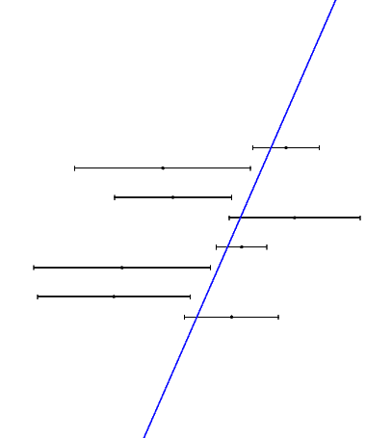
Pz reconstruction
Known : z_{i} , Φ _{i} , d_{i}
Question: To determine a line,
Φ + kz + Φ₀= 0
Method: Minimize E² = ∑(Φ_{i} + kz_{i} + Φ₀)² (1/d_{i})²

Slide 37
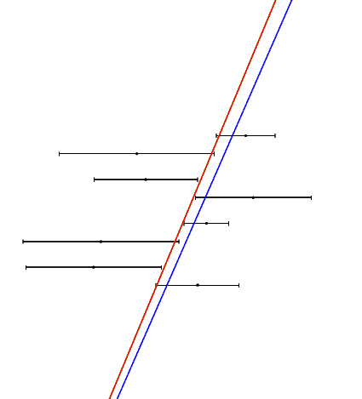
Pz reconstruction
Pt = 0.5 GeV/c
Pz(input)
0.25 GeV/c : 3.7 %
0.50 GeV/c : 4.0 %
1.00 GeV/c : 4.3 %
Pt = 1.0 GeV/c
Pz(input)
0.5 GeV/c : 3.1 %
1.0 GeV/c : 3.8 %
2.0 GeV/c : 4.2 %
Pt = 2.0 GeV/c
Pz(input)
1.0 GeV/c : 3.7 %
2.0 GeV/c : 4.8 %
4.0 GeV/c : 5.2 %

Slide 38
