Slide 1
Stage report
TAURUS Optimization

Slide 2
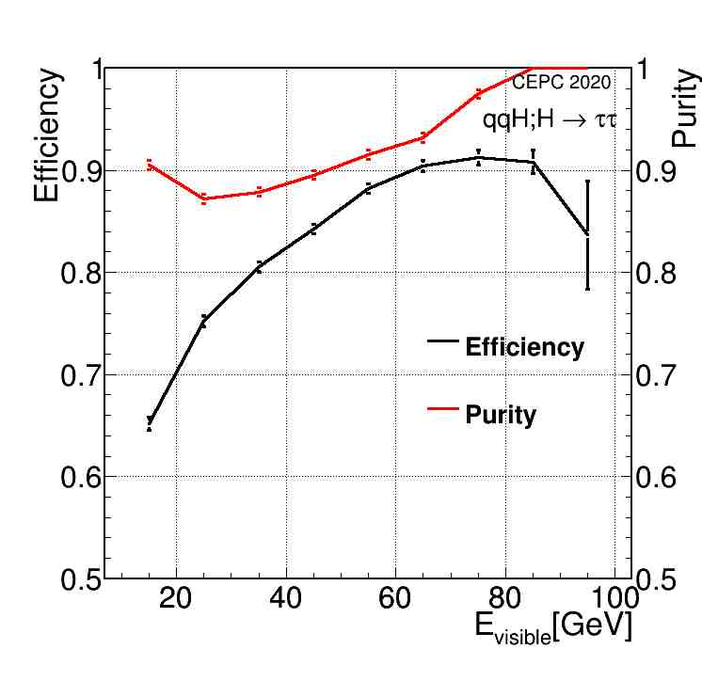
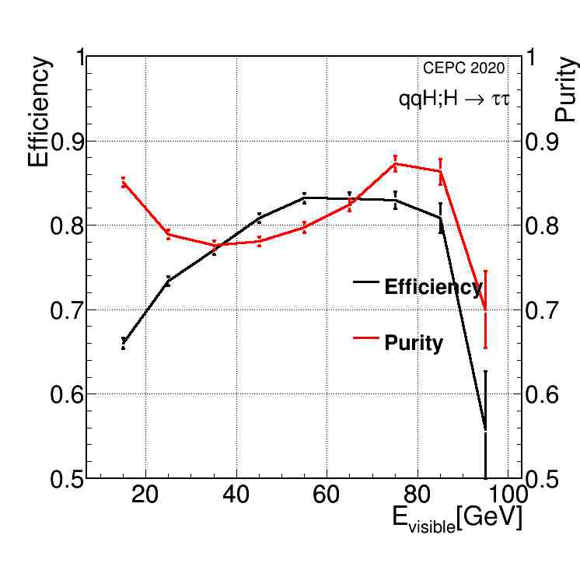
Performance MinDR<0.1, MinER<0.1
Pure Generator
Full Simulation

Slide 3
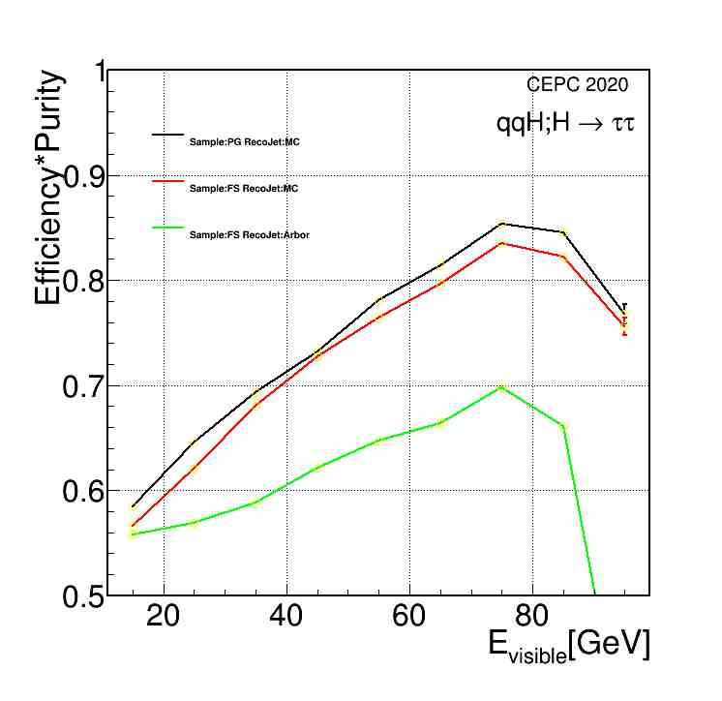
Performance MinDR<0.1, MinER<0.1

Slide 4
Matching Condition
 | Pure Generator | Full Simulation
DE<0.1 && DR<0.1 | 25907(0.880) | 24226(0.784)
DE<0.8 && DR<0.5 | 26394(0.897) | 26700(0.864)
Total | 29431 | 30888
cut | 487(0.017) | 2474(0.080)

Slide 5
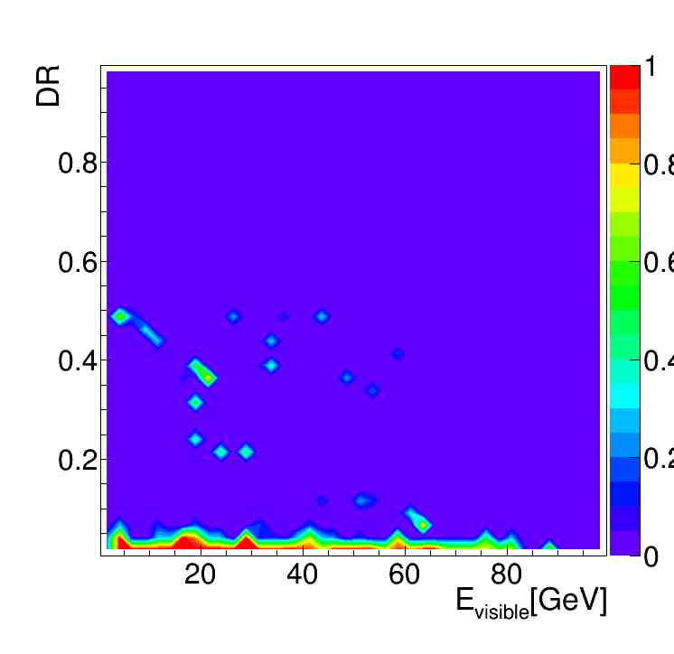
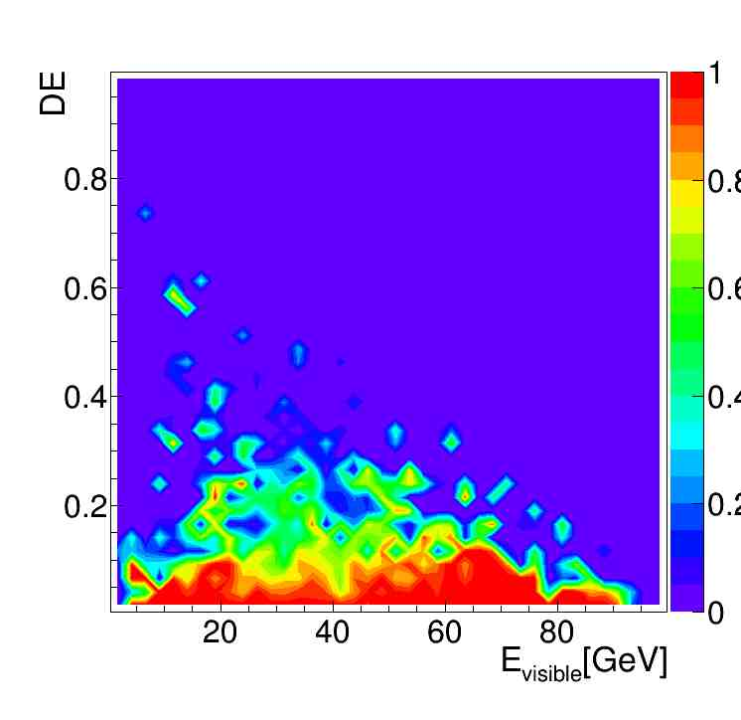
DR/DE:E:Performance
DR
DE

Slide 6
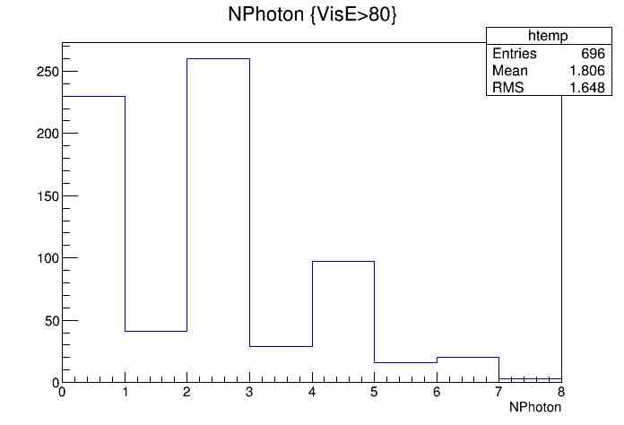
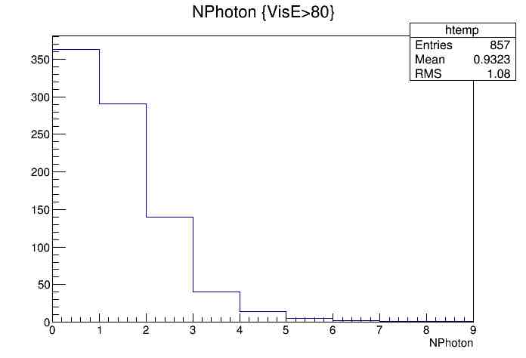
NPhoton Distribution
Pure Generator
Full Simulation

Slide 7
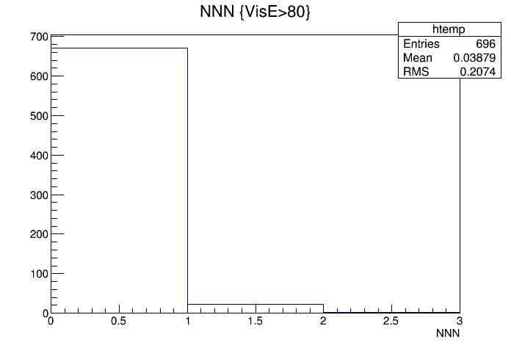
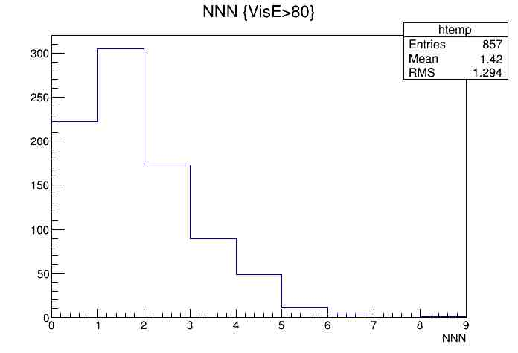
NNN Distribution
Pure Generator
Full Simulation

Slide 8
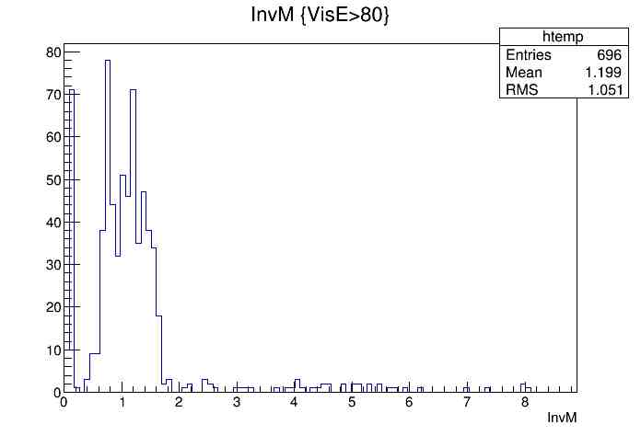
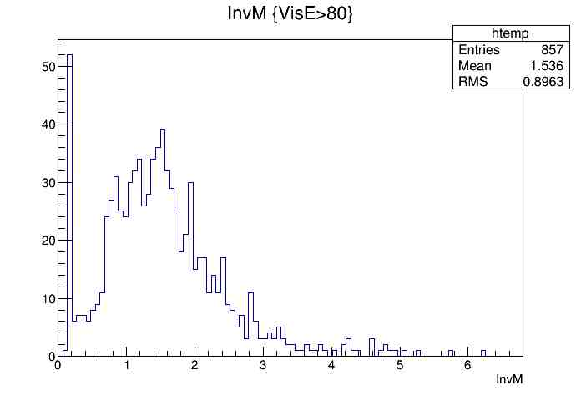
InvM Distribution
Pure Generator
Full Simulation

Slide 9
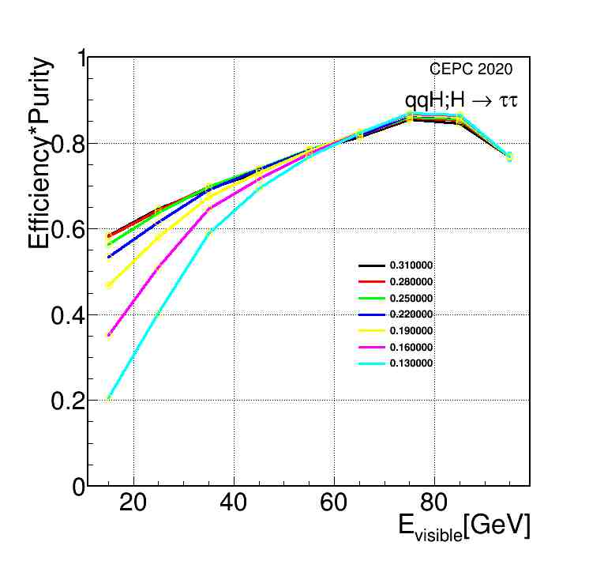
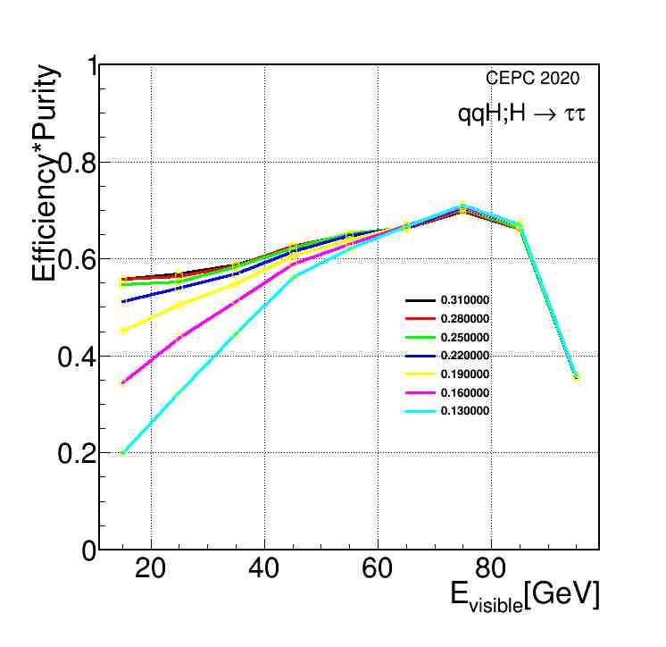
Performance Scan
Pure Generator
Full Simulation

Slide 10
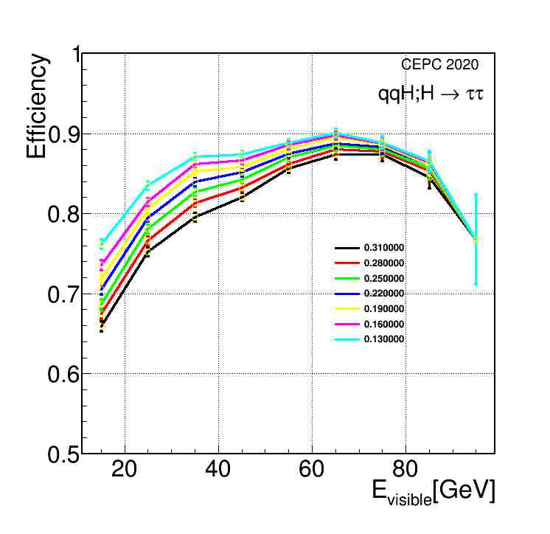
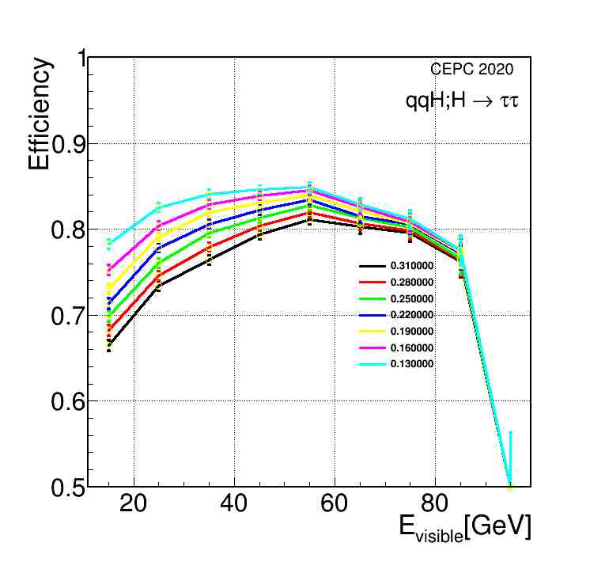
Efficiency Scan
Pure Generator
Full Simulation

Slide 11
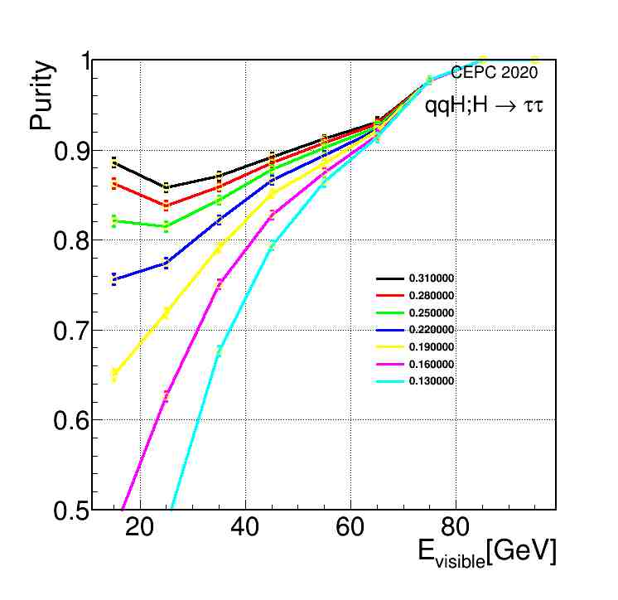
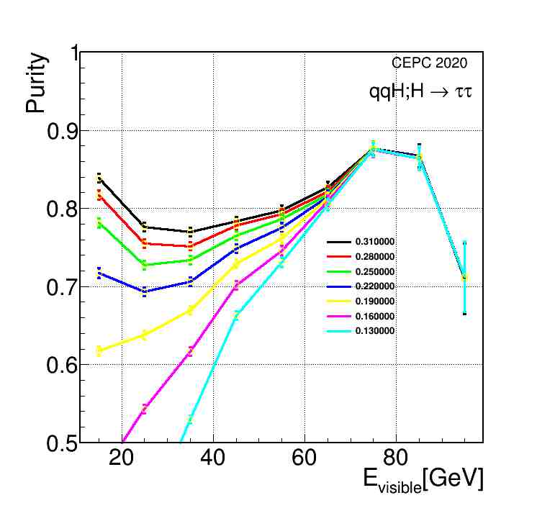
Purity Scan
Pure Generator
Full Simulation

Slide 12
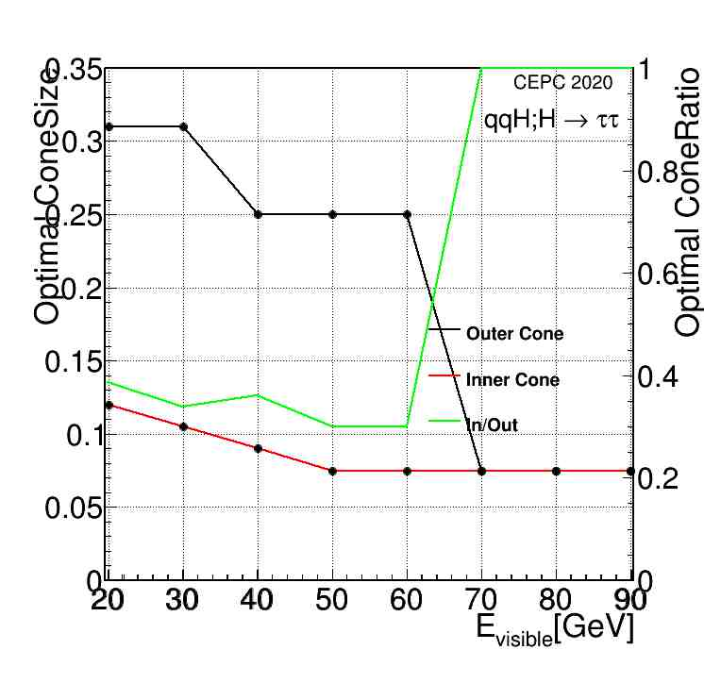
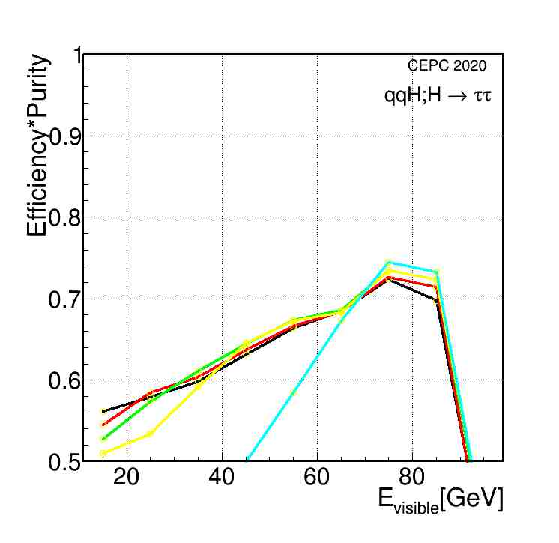
Full Simulation Optimization(Cone Size)
Cone tuned per energy
Improved performance
Outer Cone | Inner Cone
0.31 | 0.12
0.31 | 0.105
0.25 | 0.09
0.25 | 0.075
0.075 | 0.075

Slide 13
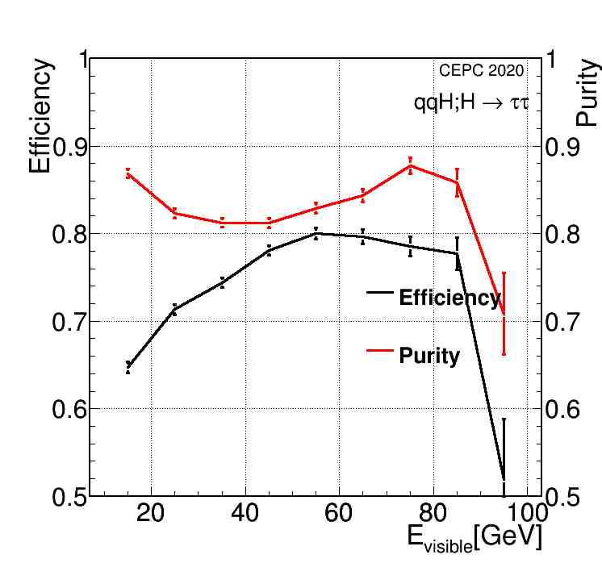
Impact Parameter
IP>0.1
Default

Slide 14
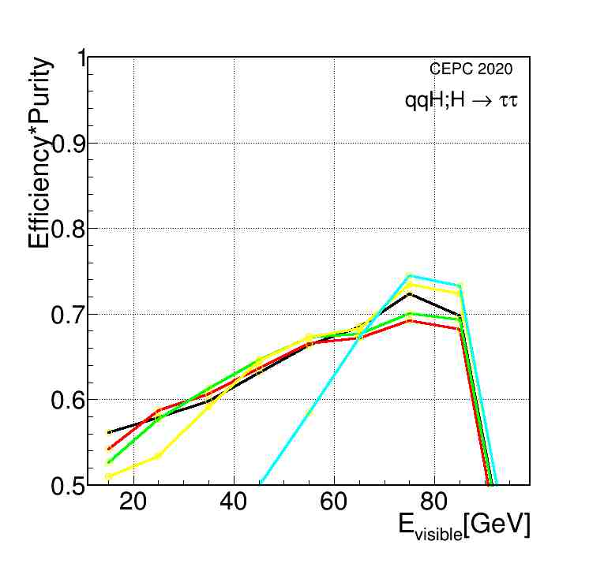
Performance
IP+ConeSize
ConeSize

Slide 15
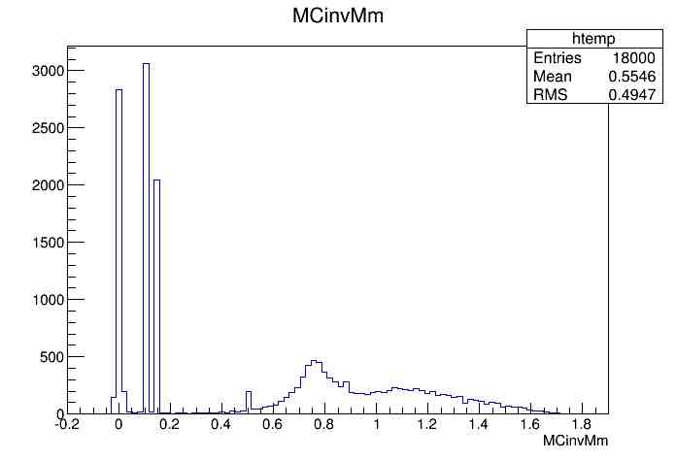
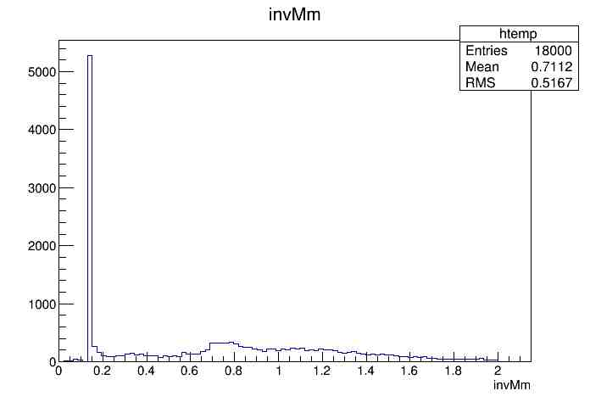
InvM Distribution
MC level
Reconstructed level

Slide 16
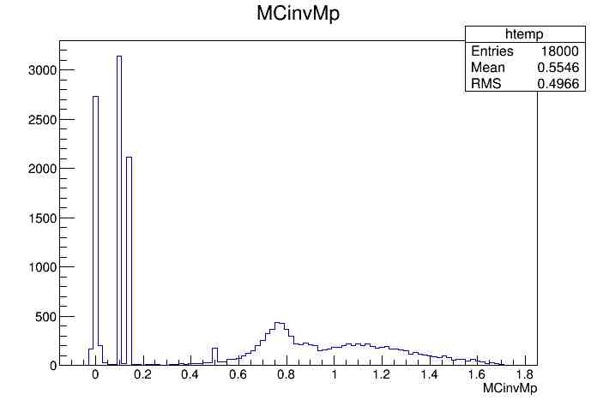
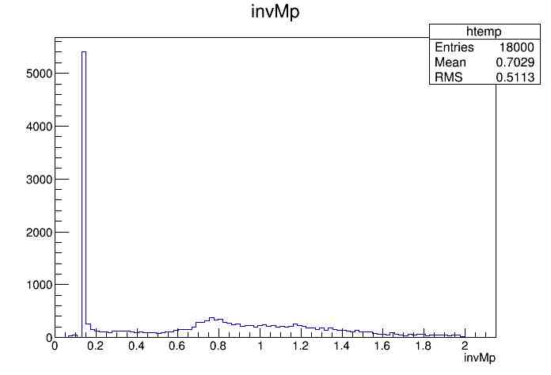
InvM Distribution
MC level
Reconstructed level

