Slide 1
Introduction of new TME booster lattice
Ji Daheng, Wang Dou
On behalf of CEPC AP group
CEPC day, IHEP, Jan. 22th, 2021

Slide 2
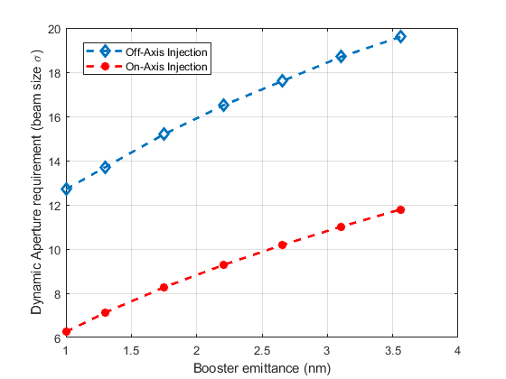
CEPC high lum. Higgs parameters
 | Higgs (CDR) | Higgs
Number of IPs | 2 | 2
Energy (GeV) | 120 | 120
Circumference (km) | 100 | 100
SR loss/turn (GeV) | 1.73 | 1.8
Half crossing angle (mrad) | 16.5
Piwinski angle | 3.48 | 4.87
N_{e}/bunch (10¹⁰) | 15.0 | 16.3
Bunch number | 242 | 214
Beam current (mA) | 17.4 | 16.8
SR power /beam (MW) | 30 | 30
Bending radius (km) | 10.7 | 10.2
Momentum compaction (10⁻⁶) | 11.1 | 7.34
β_{IP} x/y (m) | 0.36/0.0015 | 0.33/0.001
Emittance x/y (nm) | 1.21/0.0024 | 0.68/0.0013
Transverse σ_{IP} (um) | 20.9/0.06 | 15.0/0.037
ξ_{x}/ξ_{y}/IP | 0.018/0.109 | 0.018/0.115
V_{RF} (GV) | 2.17 | 2.27
f _{RF} (MHz) (harmonic) | 650 (217500)
Nature bunch length σ_{z} (mm) | 2.72 | 2.25
Bunch length σ_{z} (mm) | 4.4 | 4.42
Energy spread (%) (SR/BS) | 0.1/0.134 | 0.1/0.19
Energy acceptance requirement (%) | 1.35 | 1.7
Energy acceptance by RF (%) | 2.06 | 2.5
Lifetime due to beamstrahlung (min) | 80 | 41
Lifetime (min) | 25 | 21
F (hour glass) | 0.89 | 0.88
L_{max}/IP (10³⁴cm⁻²s⁻¹) | 2.93 | 5.0
Horizontal DA requirement of collider ring due to injection
X. H. Cui

Slide 3
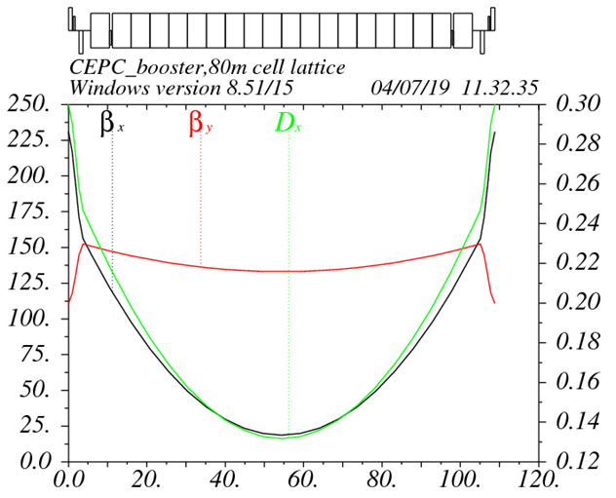
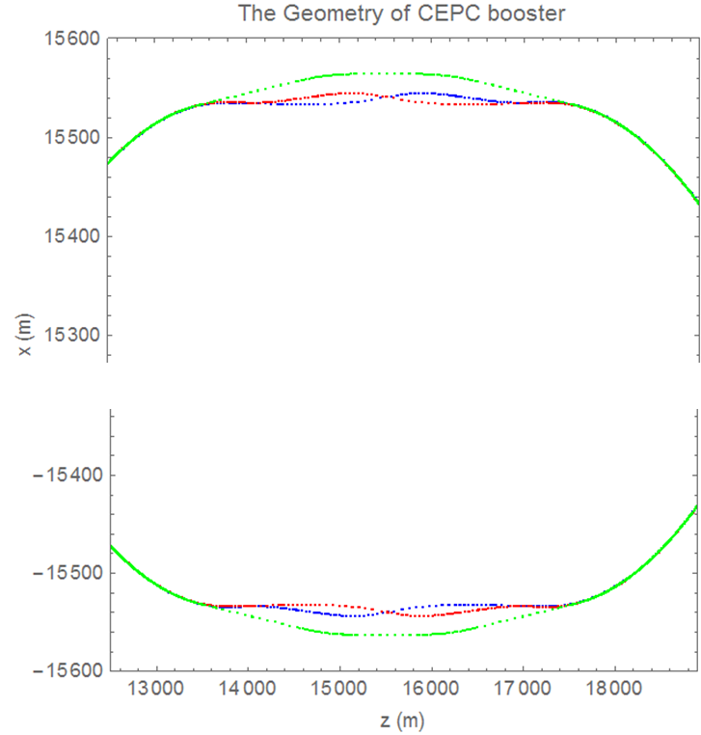
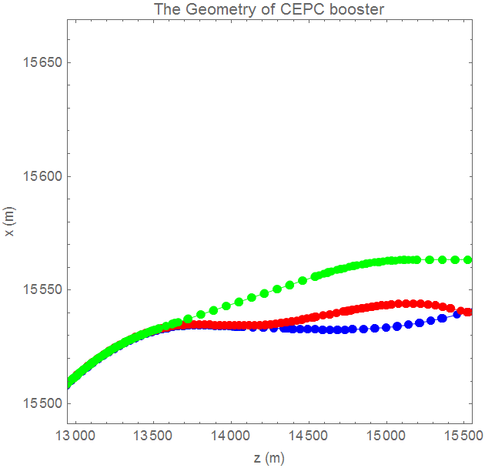
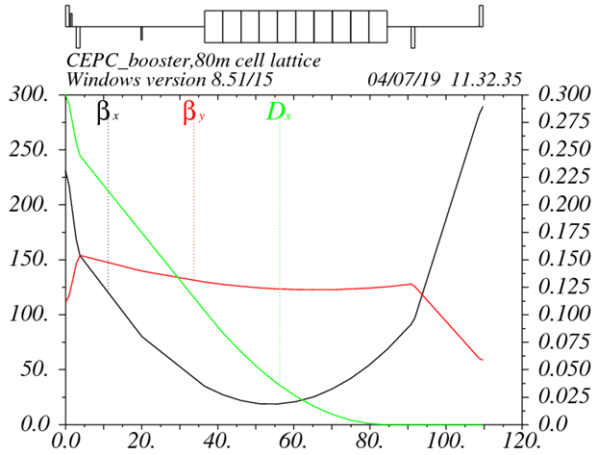
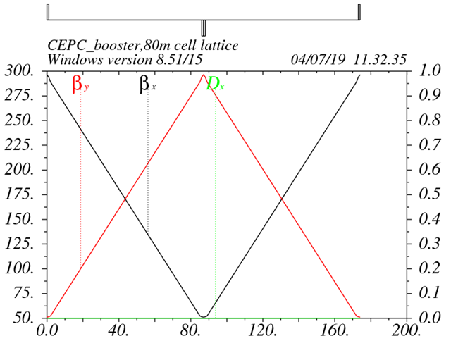
Booster lattice design based on TME （TME0）
D. Wang, Y. M. Peng, C. H. Yu
Interleave sextupole scheme
Cell length: 110m
DA optimization
arc cell
Phase for arc cell
Phase for straight section
SD position
Phase for matching section
dis. supressor
Straight sec.
Exact geometry match for three rings
-- error=±0.17m

Slide 4
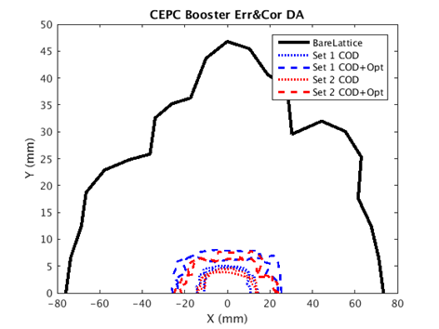
Error effect and correction (TME 0)
 | Dipole | Quadrupole | Sextupole
Transverse shift X/Y (μm) | 100 | 100 | 100
Longitudinal shift Z (μm) | 100 | 150 | 100
Tilt about X/Y (mrad) | 0.2 | 0.2 | 0.2
Tilt about Z (mrad) | 0.1 | 0.2 | 0.2
Nominal field | 1e-3 | 2e-4 | 3e-4
 | Accuracy (m) | Tilt (mrad) | Gain | Offset w/ BBA(mm)
BPM(10Hz) | 1e-7 | 10 | 5% | 30e-3
$$Error Effect ∝\sqrt{N}∗KL$$
Error correction process is almost same as CDR
 | FODO 0 (CDR) | TME 0
Emittance X (nm) | 3.57E-09 | 1.29E-9
Tunes | [263.2016/261.2193] | [319.2507/129.2806]
Quad amount | 2110 | 2528
Quad Strength (K1L rms） | 0.0383 | 0.0828
Sext amount | 512 | 2912
Sexts Strength (K2L rms) | 0.1795 | 0.1512
H Corrector | 1053 | 896
V Corrector | 1054 | 1632
BPM | 2108 | 2528
Orbit correction
Optics correction with dispersion control
RMS | FODO 0 | TME 0 | TME 0 opt.
Orbit (mm) | 0.0575/0.0525 | 0.4065/0.2389 | 0.2216/0.1784
Beta Beating(%) | 0.294/0.353 | 3.940/5.439 | 2.79/3.833
Delta Dispersion(m) | 0.005/0.007 | 0.0156/0.0229 | 0.0039/0.0052

Slide 5
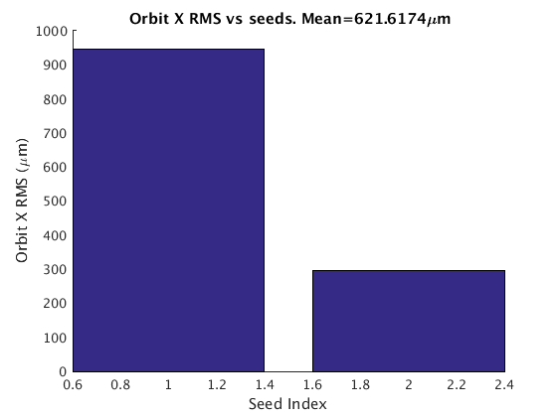
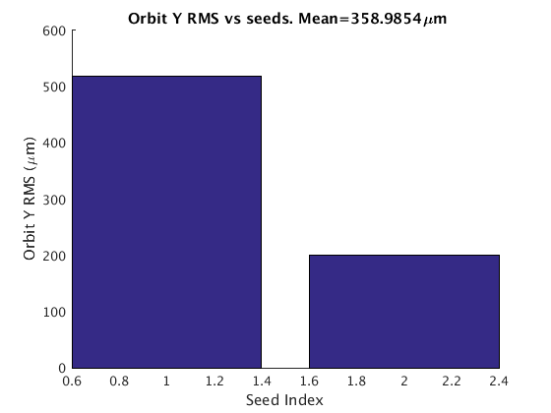
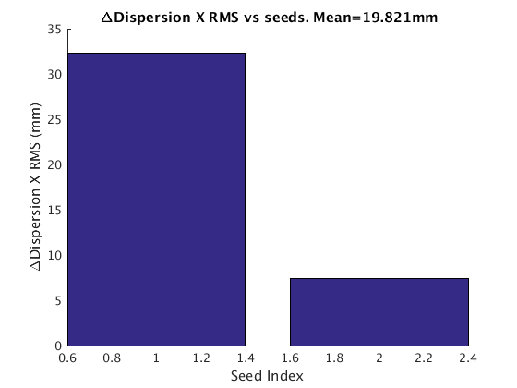
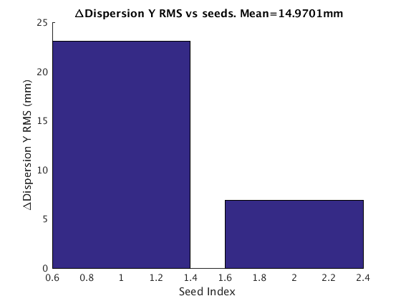
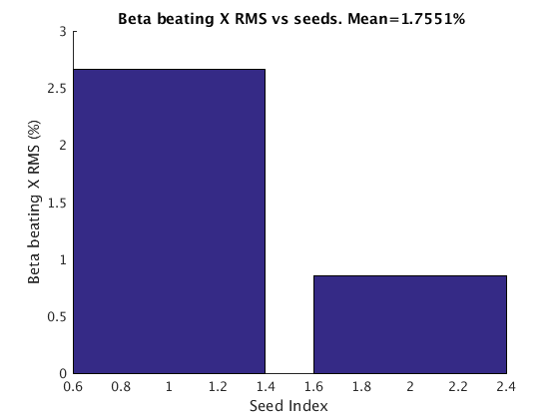
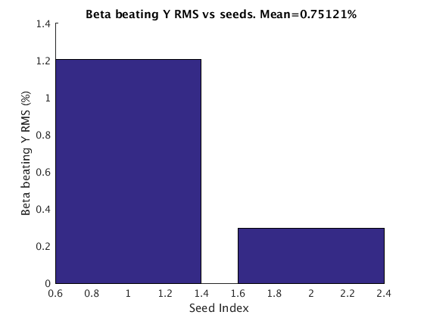
Error sensitivity- Bare Lattice+Q Shift 3um &1um

Slide 6
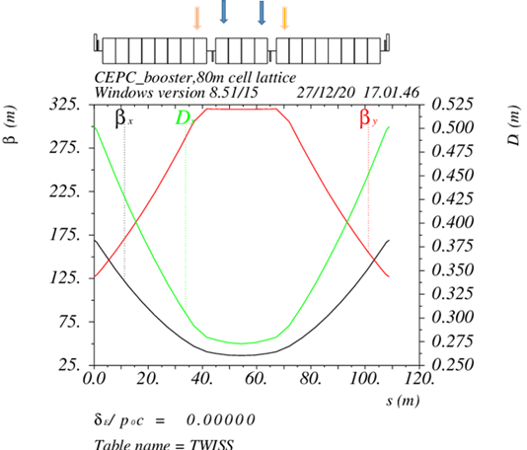
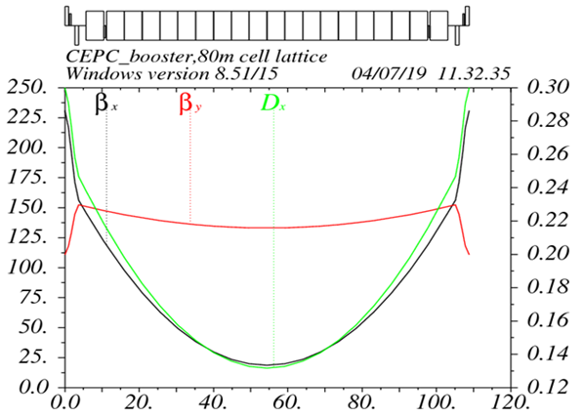
TME design update (TME 1)
D. Wang, C. H. Yu, Y. M. Peng…
Overall idea: uniform distribution for the Q
Combined magnet: B+Q, B+S
Emittance = 1.45 nm@120GeV
Energy spread = .00168
αp = 2.21×10⁻⁵
Interleave sextupole scheme
Phase advance/cell: 100°/28°
B+S
TME 0
TME 1

Slide 7
Booster parameter update based on TME
Extraction
Injection
Consistent with new CEPC high lum. parameter at 4 energy modes.

Slide 8
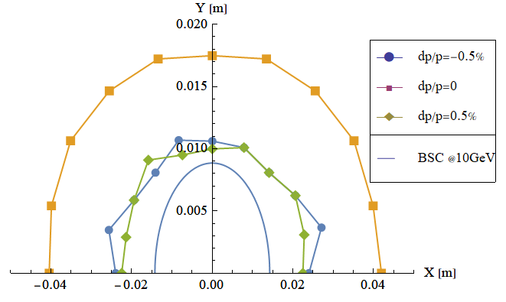
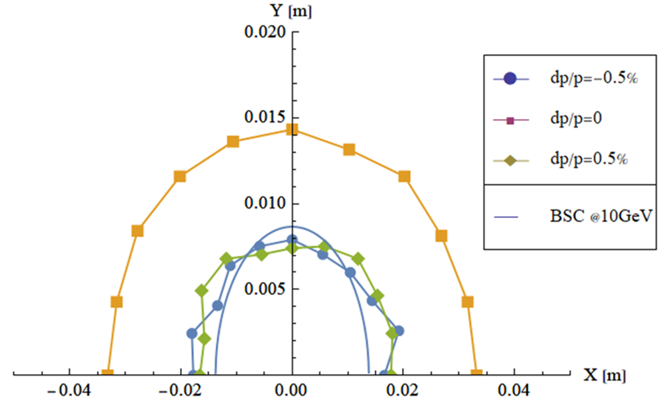
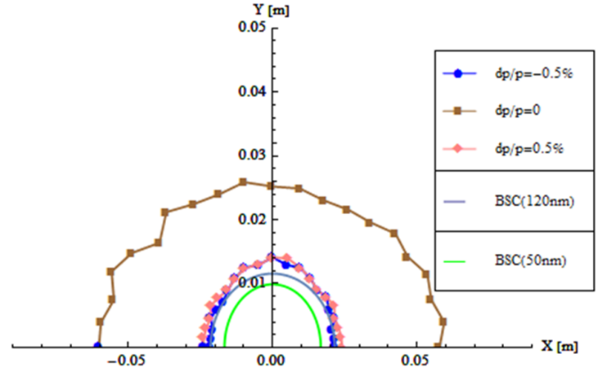
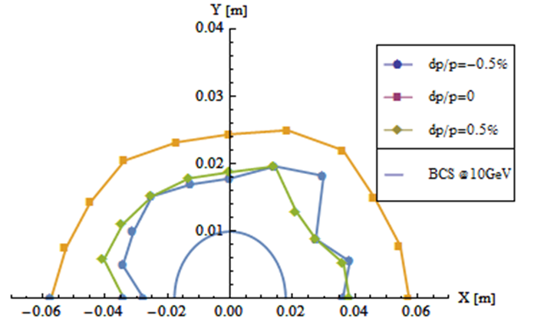
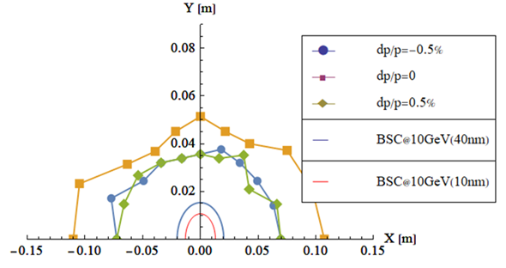
DA comparison
DA tracking by SAD.
FODO 1.1
FODO 1.2
1.9nm
1.29nm
FODO0 (CDR)
3.56nm
TME 0
TME 1
1.3nm
1.45nm

Slide 9
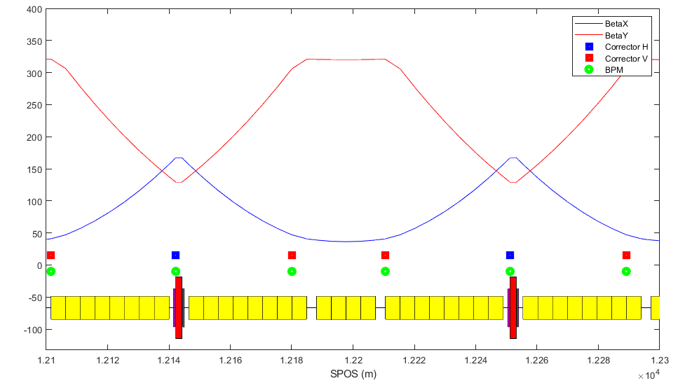
Error effect and correction (TME1)
Lattice | FODO 0 （CDR） | FODO 1 | TME 0 | TME1
Emittance X (nm) | 3.57 | 1.29 | 1.29 | 1.44
Tunes | [263.201/261.219] | [353.180/353.280] | [319.250/129.280] | 230.231/87.181
Quad amount | 2110 | 2816 | 2528 | 1090+1440(B+Q)
Quad Strength (K1L rms） | 0.0383 | 0.0407 | 0.0828 | 0.0190
Sext amount | 512 | 896 | 2912 | 1440+1440(B+S)
Sexts Strength (K2L rms) | 0.179 | 0.4091 | 0.1512 | 0.02
H Corrector | 1053 | 1408 | 896 | 898
V Corrector | 1054 | 1408 | 1632 | 1632
BPM | 2108 | 2816 | 2528 | 2530
Less Q and S
Lower power consumption for Q and S
Lower error sensitivity

Slide 10
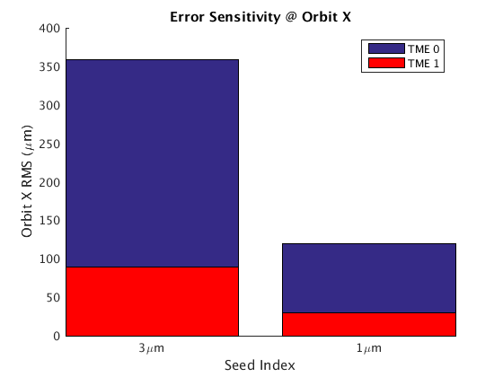
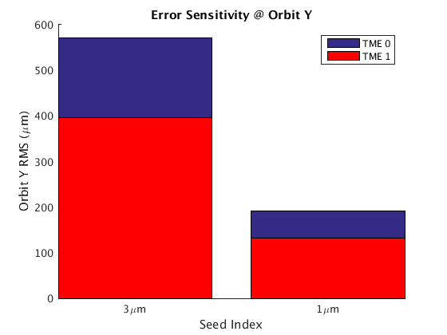
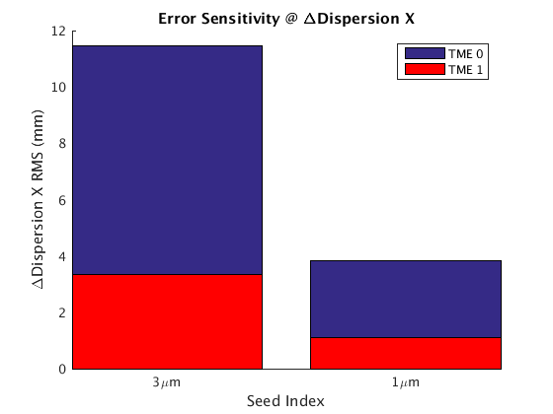
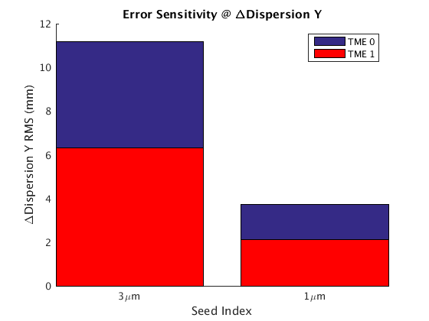
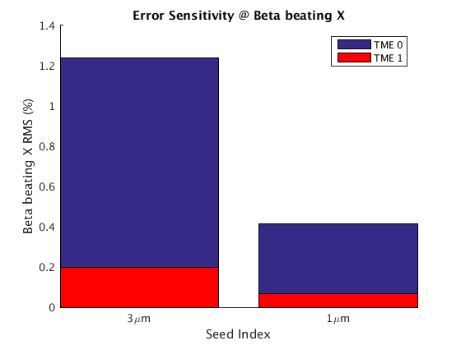
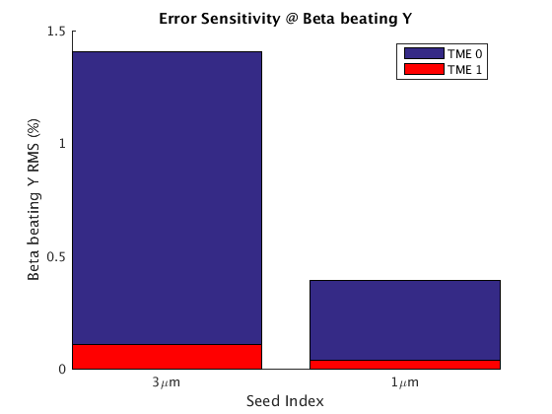
Error sensitivity- Bare Lattice+Q Shift 3um &1um TME 0 vs TME 1
TME 1 error sensitivity much better than TME 0

Slide 11
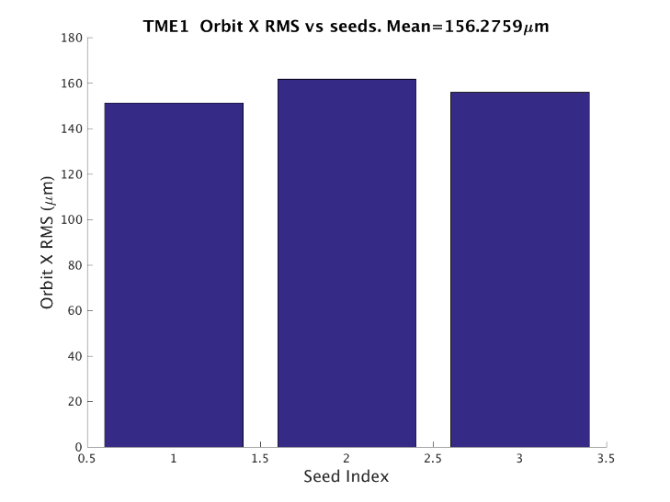
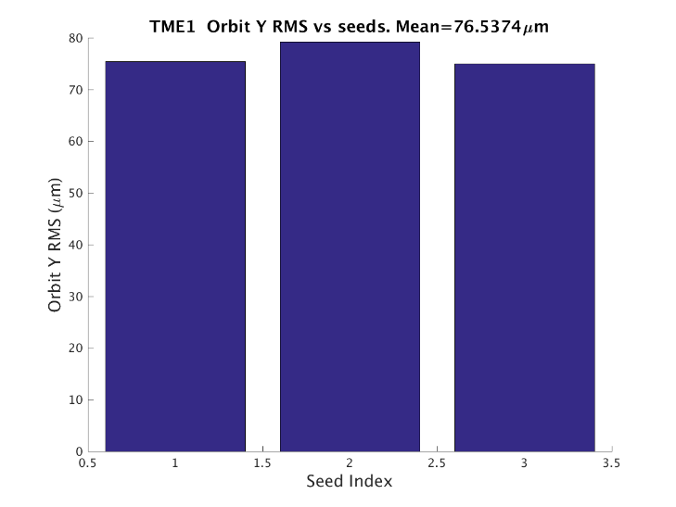
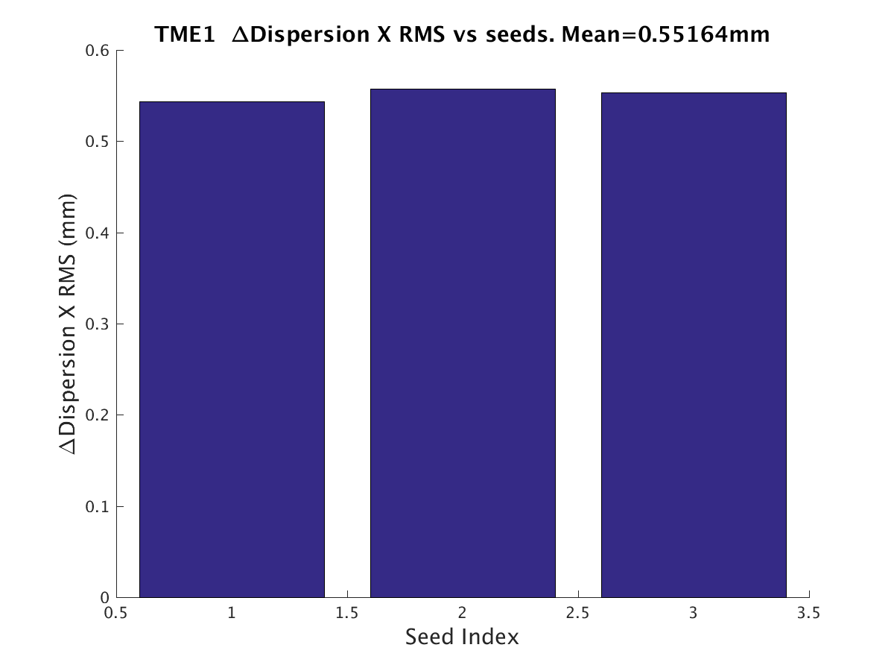
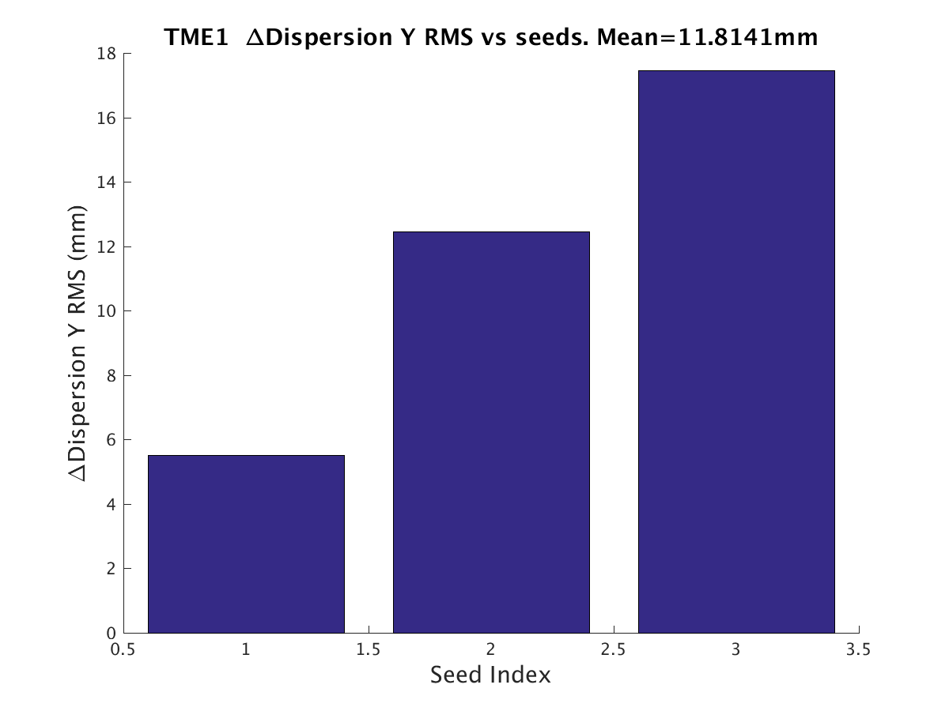
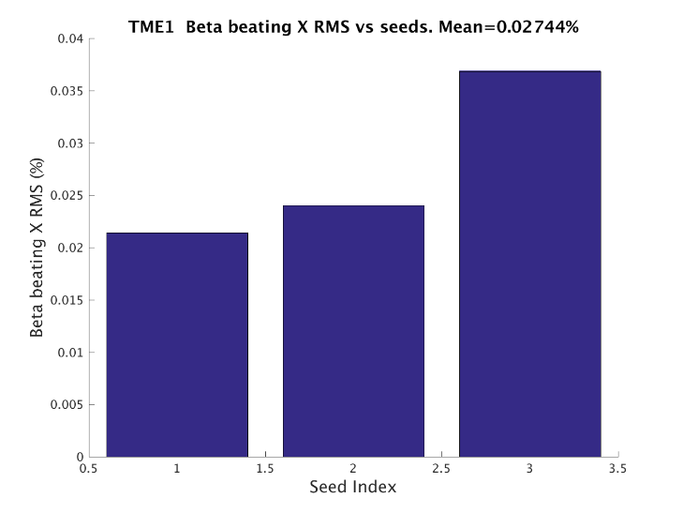
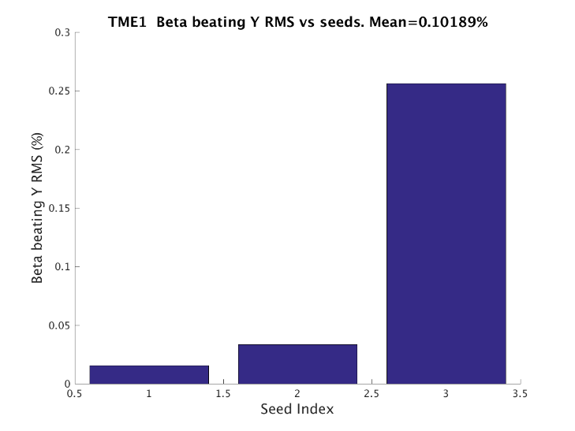
Error effect and correction (TME1)
RMS | FODO 0 (CDR) | FODO 1 | TME 0 opt. | TME1
Orbit (mm) | 0.0575/0.0525 | 0.1693/0.1236 | 0.2216/0.178 | 0.156/0.077
Beta Beating(%) | 0.294/0.353 | 1.52/2.50 | 2.79/3.833 | 0.0274/0.102
Δ Dispersion(m) | 0.005/0.007 | 0.0045/0.0032 | 0.0039/0.0052 | 0.00055/0.011
Most of Orbit/Optics correction effect is very good
The correction result of vertical dispersion is not good, which can be solved by parameter optimization
DA tracking is still in progress,

Slide 12
Summary
New TME design (TME 1) booster reduces the number of independent magnets by using combined magnets.
Improves the uniformity of component distribution and reduces the strength of Q&S
Error sensitivity and simulated correction analysis show excellent robustness
The results of more seeds and DA Tracking are still in the calculation, and we hope to further determine the advantages of TME structure
The results of further design optimization are still in progress

