Slide 1
Introduction of HTS final focus quadrupole coils in CEPC Interaction Region
Yingshun Zhu
Institute of High Energy Physics, Chinese Academy of Sciences
January 22, 2021
CEPC working day

Slide 2
Outline
Introduction
Considerations on related issues in Conceptual design of HTS final
focus quadrupole coils in CEPC IR
1) Design requirement
2) Which HTS material is suitable
3) Working temperature
4) Can the field gradient increased
5) Can the magnet diameter and weight reduced
6) Impact on cryogenic system and mechanical system
Summary

Slide 3
Introduction
HTS conductor: Bi-2212 (Tc 80K), Bi-2223, REBCO (Tc 92K),
IBS (Tc <56K)…
1G HTS: Bi-2212, Bi-2223
2G HTS: REBCO
New HTS: IBS
Important characteristics of HTS conductor:
Current carrying performance
Size of superconducting filament
Mechanical properties

Slide 4
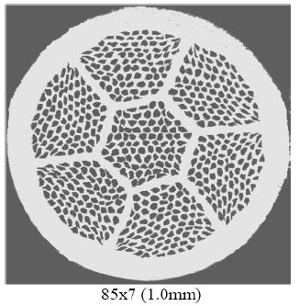
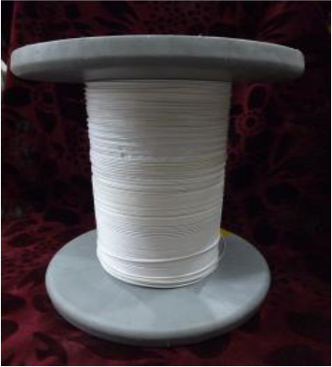
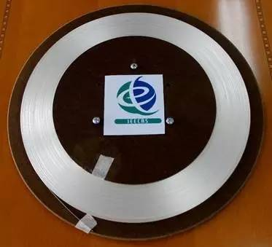
Introduction
Bi-2212
YBCO
IBS

Slide 5
Considerations on related issues in Conceptual design of HTS final focus quadrupole coils in CEPC IR
The requirement of the CEPC double aperture Final Focus quadrupoles is recently updated for high luminosity with L*=1.9m.
Table 1: Updated Requirements of final focus quadrupole magnets for Higgs
Magnet | Central field gradient (T/m) | Magnetic length (m) | Width of GFR (mm) | Minimal distance between two aperture beam lines (mm)
Q1a | 141 | 1.21 | 15.21 | 62.71
Q1b | 84.7 | 1.21 | 17.92 | 105.28
Q2 | 94.8 | 1.5 | 24.14 | 155.11

Slide 6
Conceptual design of HTS final focus quadrupole coils in CEPC IR
Design considerations
The field gradient of quadrupoles is stronger compared to that in CDR, and the available bore space for the coil is smaller.
The development of Q1a is the most challenging.
Design of quadrupoles and anti-solenoid is similar to that in CDR.
Corrector coils will be inside the bore of Q1b and Q2 quadrupole coil.
Iron yoke is used to eliminate the field crosstalk between the two apertures.
Center Be pipe: diameter 28mm; Inside quadrupole, beam pipe diameter is around 17mm or 18 mm.

Slide 7
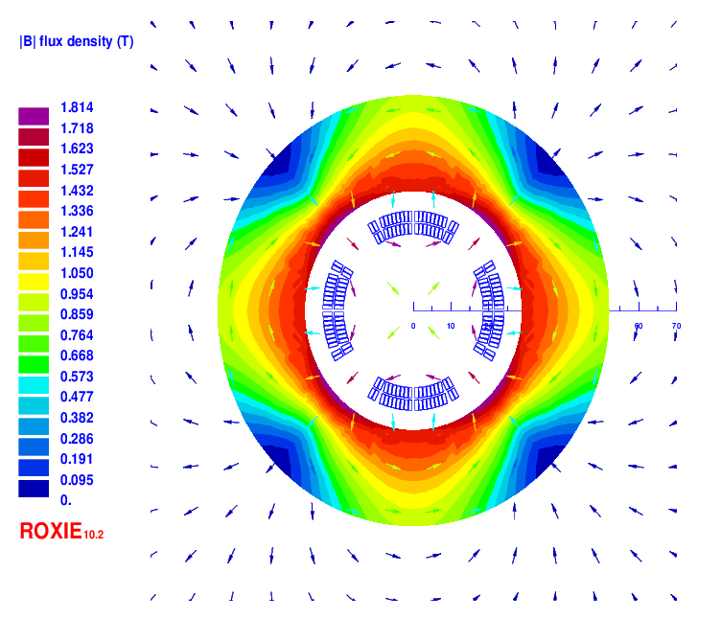
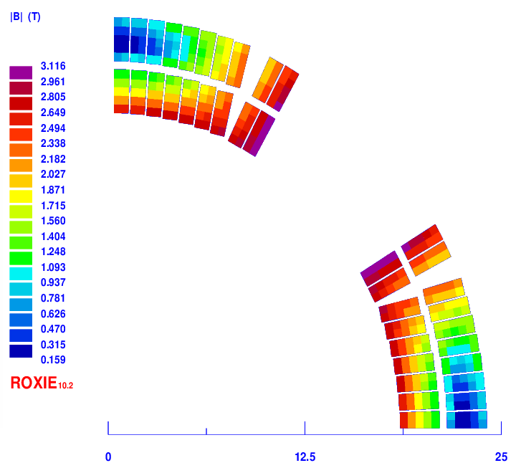
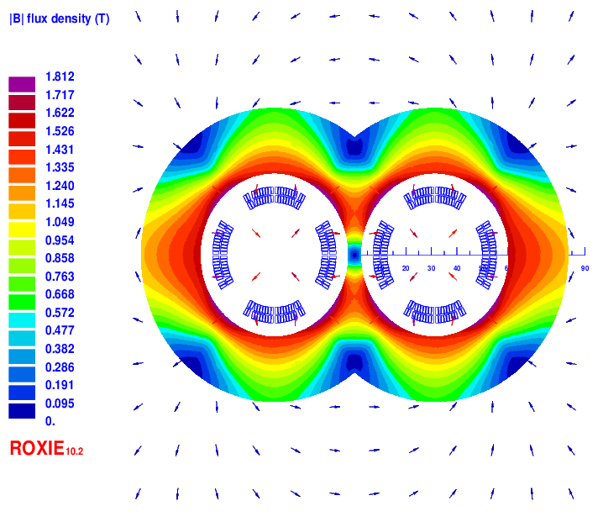
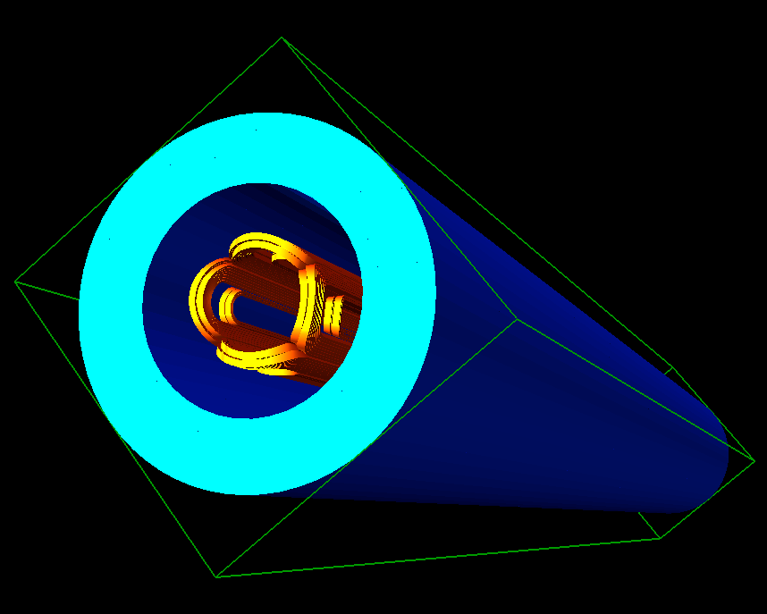
(1) Cos2θ option of Q1a
HTS Bi-2212 0.5mm wire or other conductor. Q1a: on two layers cos2θ quadrupole coil using Rutherford cable with iron yoke. Inner diameter: 37mm.
The width of the cable is 2.5mm, and there are 19 turns in each pole. Magnetic field cross talk between two apertures is negligible.

Slide 8
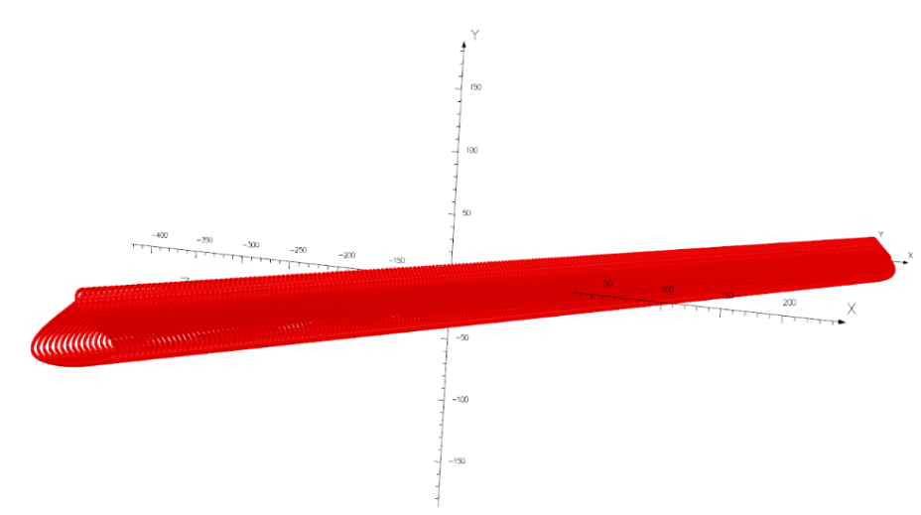
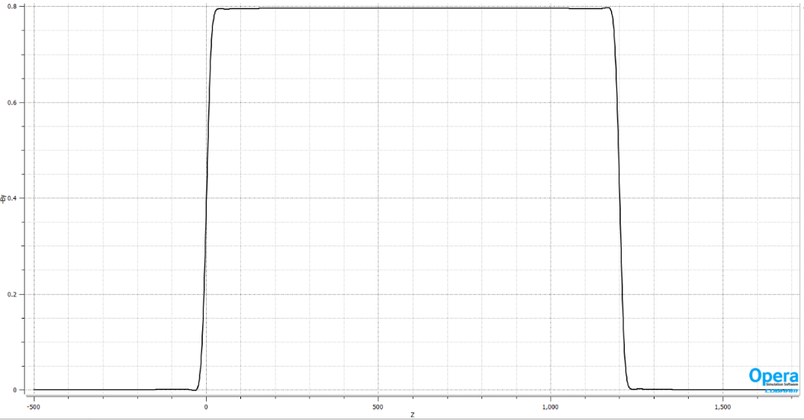
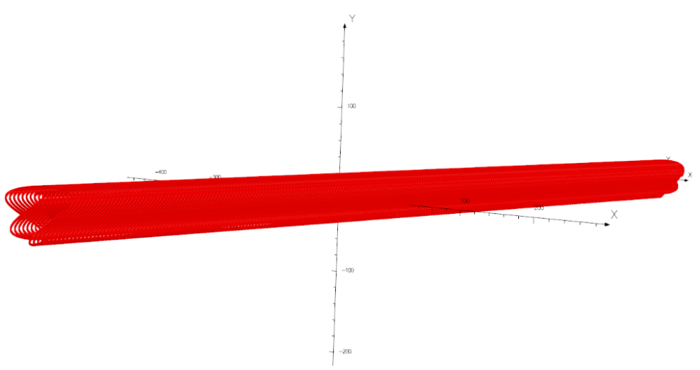
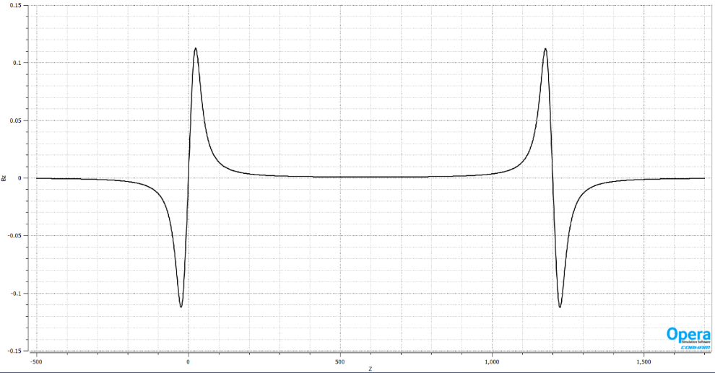
(2) CCT option of Q1a
HTS Bi-2212 0.8mm round wire or other conductor.
Q1a: on two layers CCT quadrupole coil. Inner radius of the spar: 18.5mm.
Outer radius of single aperture coil: 29mm.Groove: 2×3mm; 6 wires in a groove. Conductor canted angle: 30 deg.

Slide 9
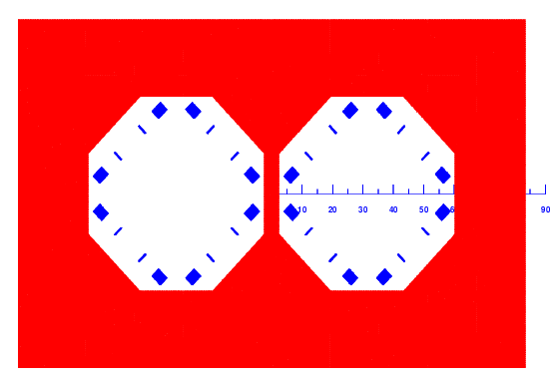
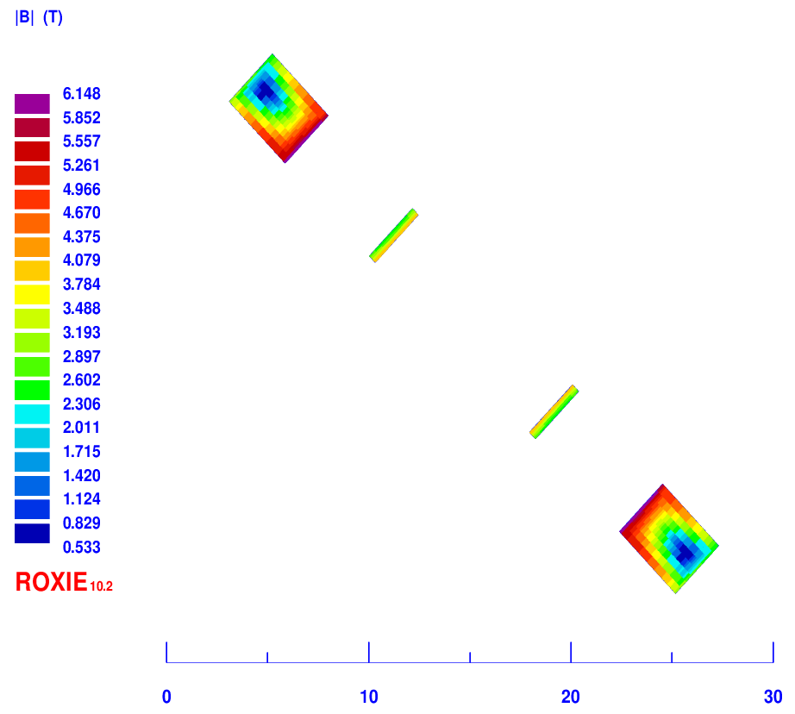
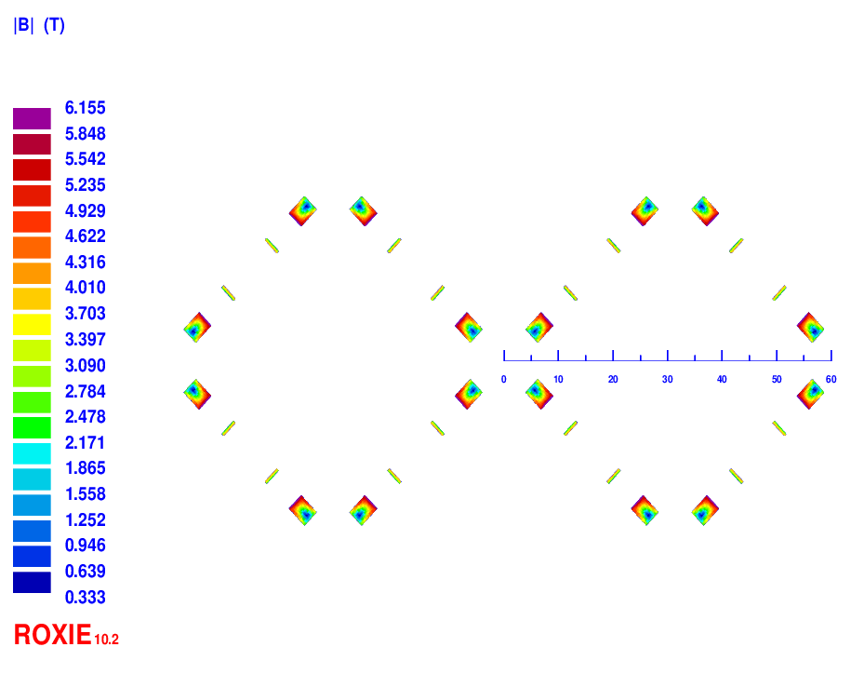
(3) Racetrack coil option of Q1a
HTS YBCO tape (width 3 mm, thickness 0.1 mm) or other conductor.
The excitation current of Q1a is 1020A; 43 turns for each pole
Each multipole field in single aperture is smaller than 2×10⁻⁴ (Rref=7.6mm).

Slide 10
Conceptual design of Q1a for high luminosity with L*=1.9m
Comparison of three design HTS options of Q1a (141T/m)
From the comparison, Cos2θ coil has the highest magnetic efficiency, lowest needed Engineering current density.
Option | Excitation current (A) | Needed Engineering current density J_{E} on wire (A/mm2) | Bmax on coil (T) | Possible Conductor
Cos2θ | 1970 | 1004 | 3.2 | Bi-2212
CCT | 1342 (940 with iron) | 2670 (1870 with iron) | 3.8 | Bi-2212
Racetrack coil | 1020 | 3400 | 6.2 | YBCO

Slide 11
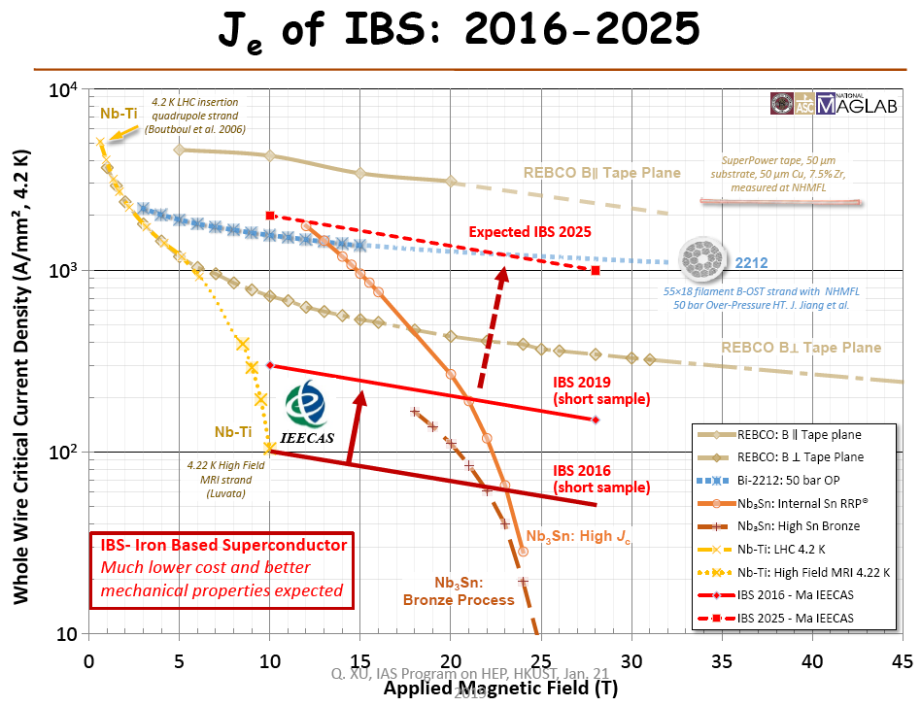
2) Which HTS material is suitable
HTS conductor: Bi-2212 (Tc 80K), Bi-2223, YBCO (Tc 92K), MgB2, IBS…
From Q.J.Xu

Slide 12
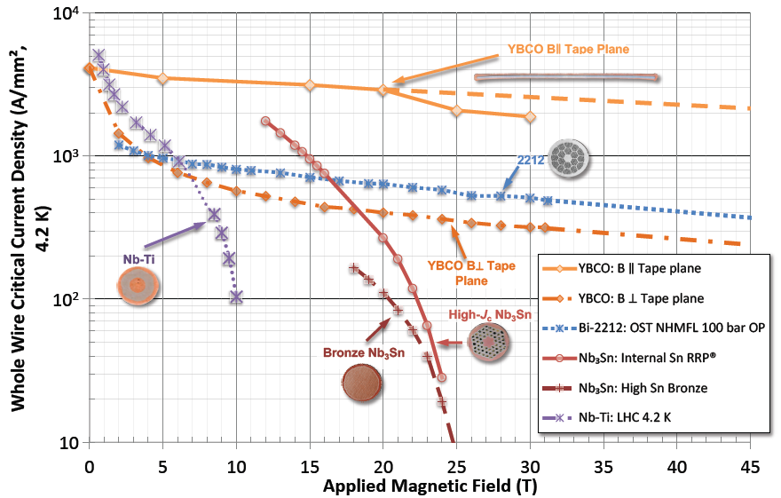
Another diagram of current density versus magnetic field
From USPAS 2018

Slide 13
Current level of HTS superconductor in China
HTS Bi-2212
∅ 0.8-1.4mm
4.2K，3T, 4T short sample, J_{E}:1100A/mm²,1000A/mm²
Bending radius ≥10mm
YBCO
Critical current/cm
Current level of NbTi superconductor in China
4.2K，3T, 4T short sample, J_{E}:1600A/mm²,1400A/mm²

Slide 14
2) Which HTS material is suitable
The magnetic field gradient is proportional to the current carrying capacity of superconducting materials.
For Q1a,The maximum field in the coil is below 3.2T.
Around this magnetic field value, among all kinds of HTS materials, Bi-2212 has the highest current carrying capacity, and can meet the required engineering current density in the Cos2θ option. (Current technical level)
The current carrying capacity of Bi2212 is almost equal to that of NbTi.
So at the Current technical level, Bi-2212 is suitable to be used in the conceptual design.
In the future, with the improved performance of HTS material, the IBS conductor is promising for application in CEPC IR.

Slide 15
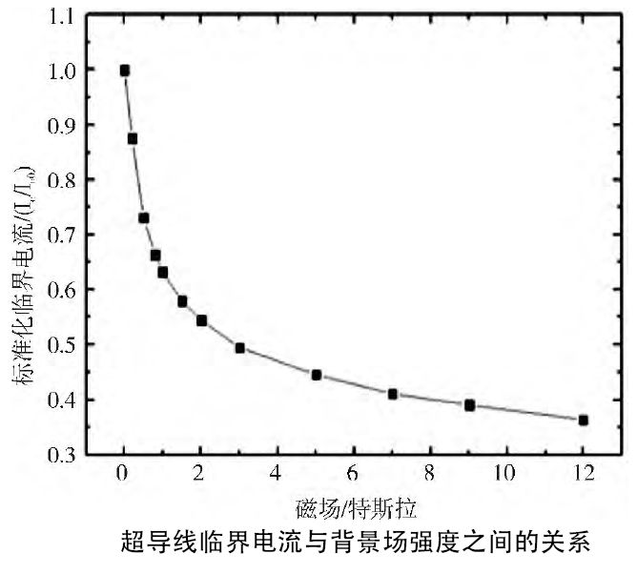
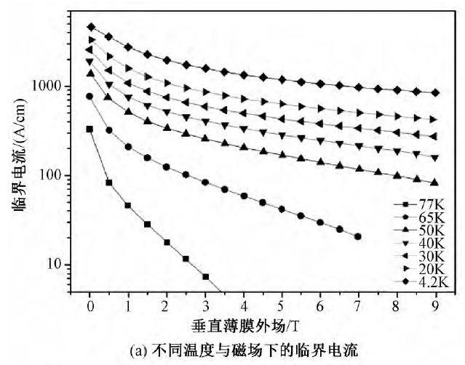
3) Working temperature
The current carrying capacity of HTS superconductor decreases with the increase of temperature.
Using high temperature materials Bi-2212, the working temperature of the magnet is around 4.2K, can be at 6 to 7K, maybe at 10K in the future.
Bi-2212 YBCO

Slide 16
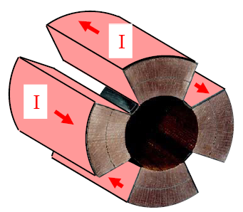
4) Can the field gradient increased
The magnetic field gradient is proportional to the current carrying capacity of superconducting materials.
Around and below 3.2T, at current technical level, the current carrying capacity of Bi-2212 is almost equal to that of NbTi.
So using Bi-2212, the field gradient remain almost unchanged. (Compared with NbTi with same layout)
In the future, with the improved performance of HTS material, the field gradient can be increased.

Slide 17
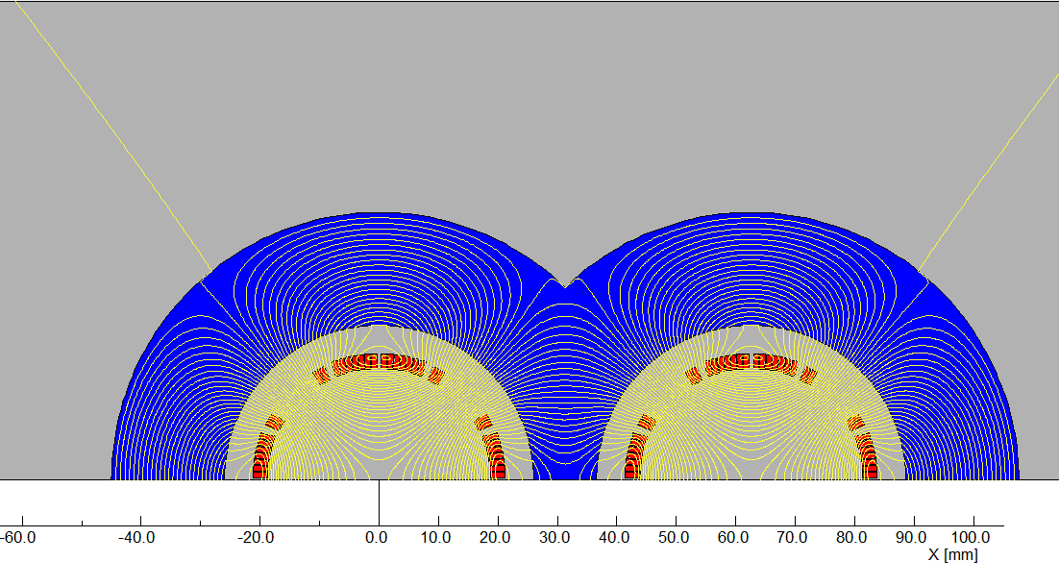
5) Can the magnet diameter and weight reduced
Around and below 3.2T, at current technical level, the current carrying capacity of Bi-2212 is almost equal to that of NbTi.
So using Bi-2212, the magnet diameter remains almost unchanged.
The mass density of Bi-2212 is close to NbTi (Nb 8.57g/cm3,Bi 9.8 g/cm3, Cu 8.9g/cm3), so magnet weight almost unchanged. (Compared with NbTi)
In the future, with the improved performance of HTS material, the magnet diameter and weight can be reduced.
If current carrying capacity doubled, using one layer coil, the Q1a magnet weight can be reduced by about 33% (120kg 80 kg) .

Slide 18
6) Impact on cryogenic system and mechanical system
At current technical level
Around and below 3.2T, the current carrying capacity of Bi-2212 is almost equal to that of NbTi.
Using Bi-2212, the working temperature of the magnet can be at 6 to 7K. It is slightly beneficial to the design and operation of cryogenic system.
Since the magnet weight remains almost unchanged, using HTS conductor, the influence on mechanical system can be ignored.
In the future
With the improved performance of HTS material, the magnet diameter and weight can be reduced.
Using HTS conductor, it is very beneficial on cryogenic system and mechanical system.

Slide 19
Summary
Three HTS options have been studied for the Q1a magnet using high luminosity parameters with L*=1.9m: Cos2θ coil, CCT coil, Racetrack coil.
Cos2θ coil has the highest magnetic efficiency, and the smallest requirement on the current carrying capacity of HTS conductor.
The field of CEPC magnet is low. Present current carrying capacity of Bi-2212 conductor is close to the requirements.
At present technical level, the current carrying capacity of Bi-2212 is almost equal to that of NbTi. Using Bi-2212, the field gradient and magnet weight remain almost unchanged. It is slightly beneficial to the cryogenic system.
In the future: With the improved performance of HTS material, the field gradient can be increased, and the magnet diameter and weight can be reduced. It is very beneficial on cryogenic system and mechanical system.

Slide 20
Thanks for your attention!
CEPC Working day

