Slide 1
Machine protection for the beam loss failure
Haijing Wang, Peng Zhang, Yiwei Wang, Chenghui Yu
CEPC DAY, 2021/1/22

Slide 2
Outline
Status for the beam loss failure
  Investigation of machine protection
  Beam loss failure of CEPC
Simulation status of the movable collimator
  Normal operation
  Beam loss failure
Discussion

Slide 3
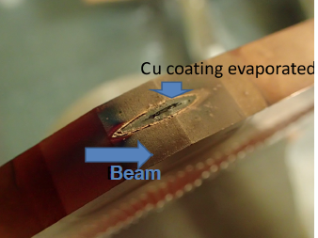
Status for the beam loss failure
Necessity of machine protection
  2466 dipoles, 3052 quadrupoles, 948 sextupoles and 2904 correctors, and their power supplies.
  240 RF cavities.
  520 metal gate valves.
  Other devices like BPMs, kickers, detector, and the operational ‘mistakes’…
Beam loss failure for other facilities
The abrupt halt of LHC in 2008
The accelerator was damaged over 700 m;
53 magnets had to be replaced or repaired;
The beam vacuum was polluted over 2 km;
Repair and re-commissioning lasted over 1 year.
Beam loss failure should be avoided as much as possible and machine protection should be designed.
Broken collimator of Super KEKB

Slide 4
Status for the beam loss failure
Investigation of machine protection—KEKB
  Beam abort system, to avoid direct hit on movable collimators.
  Triggers for the abort: beam loss monitor abort, beam phase abort, Belle abort.
  Response time: ~100 us (~10 turns).
Investigation of machine protection —Super KEKB
  Can deliver the stored beam into a beam dump and prevent spewing beam everywhere in the ring.
  Response time: less than 20 us. (~2 turns)
Abe, Tetsuo, et al. "Achievements of KEKB." Progress of Theoretical and Experimental Physics 2013.3 (2013).
Akai, Kazunori, Kazuro Furukawa, and Haruyo Koiso. "SuperKEKB collider." Nuclear Instruments and Methods in Physics Research Section A: Accelerators, Spectrometers, Detectors and Associated Equipment 907 (2018): 188-199.
Mimashi, Toshihiro, et al. "SuperKEKB beam abort system." Proc. IPAC 14 (2014): 116.

Slide 5
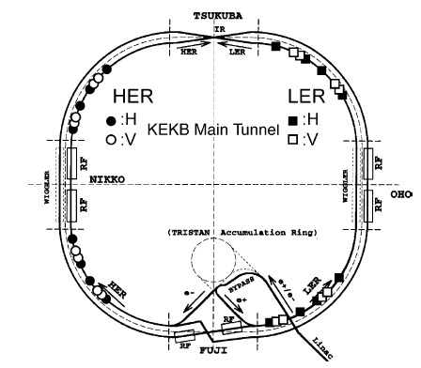
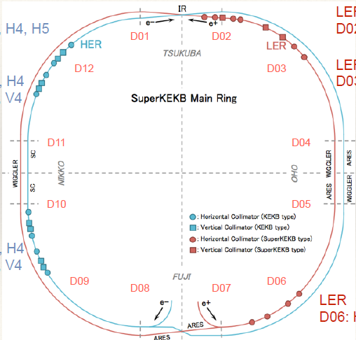
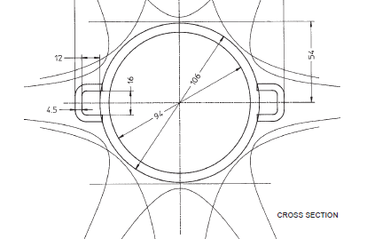
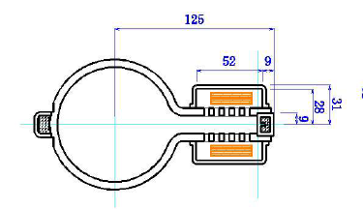
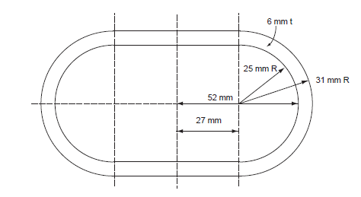
Status for the beam loss failure
Investigation of machine protection—KEKB/ Super KEKB
  Big quantity of collimators. 32 for KEKB, 35 for Super KEKB.
  Big vacuum chamber aperture in X direction. Radii: 47 and 52mm for KEKB, 125 mm for SuperKEKB.
In case of beam loss failure, it seems to hit the collimator or be extracted by aborting system. The vacuum chambers and the magnets are safe.
Y.Suetsugu, et.al. Latest movable mask system for KEKB, Nuclear Instruments and Methods in Physics Research A 513 (2003) 465–472.
Takuya Ishibashi, et.al. Design of Beam Collimators for SuperKEKB, OLAV IV, April 3rd, 2014.
KEKB Design Report.
Letter of Intent for KEK Super B Factory

Slide 6
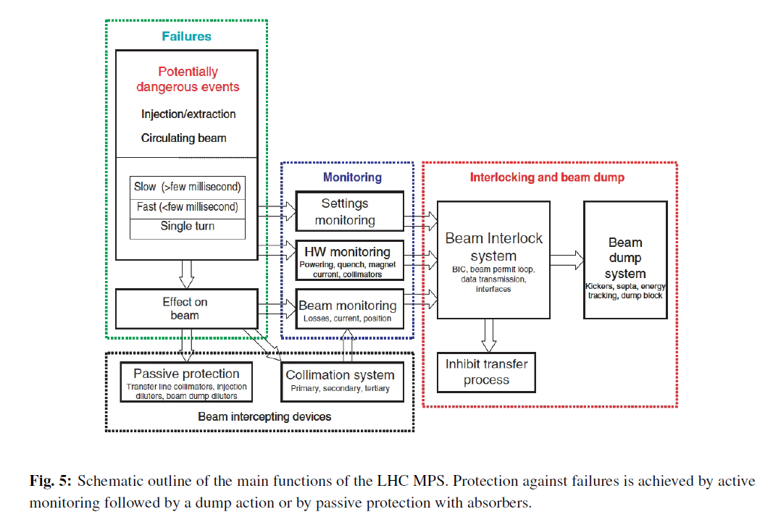
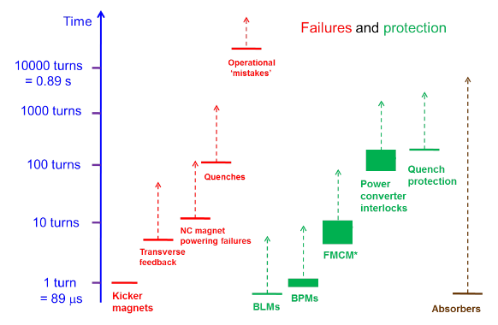
Status for the beam loss failure
Investigation of machine protection—LHC
  16 connected systems.
  Collimators are used for passive protection. 99.99% of the lost protons were intercepted. 100 collimators.
  Dump delay: 270 us (3 turns)
Time scales for failures and protection of LHC
Wenninger, Jörg. "Machine protection and operation for LHC." arXiv preprint arXiv:1608.03113 (2016).

Slide 7
Status for the beam loss failure
Beam loss failure of CEPC
  The dipole powering failure is mainly considered.
  If all the bunches hit on one location→ Any material will be melted.
  The time of magnet failure:~ms level. From W. Kang, B. Chen, and LHC
  Bunch distance: 207 m or 0.7 us (242 bunches in 50 km), much faster then the magnet failure.
  The beam may be separated bunch by bunch.
  The problem becomes: one bunch may hit on the vacuum chamber and then the magnets.
Here needs more detailed calculation.
Wenninger, Jörg. "Machine protection and operation for LHC." arXiv preprint arXiv:1608.03113 (2016).

Slide 8
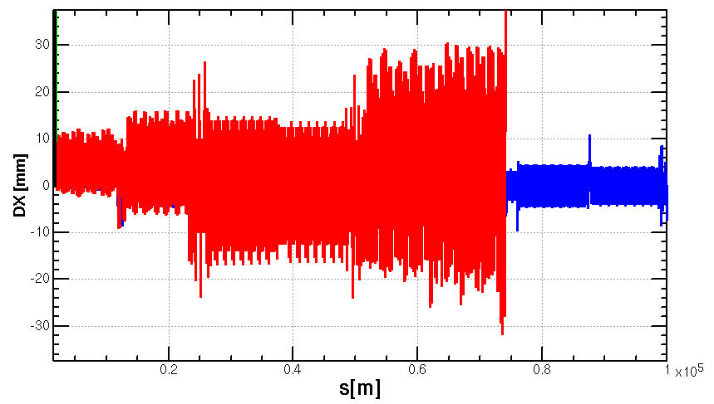
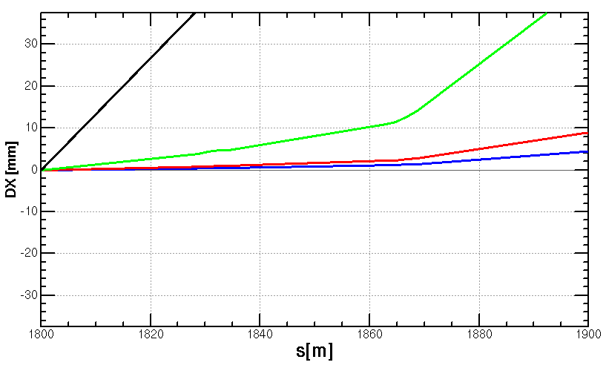
Status for the beam loss failure
Beam loss failure of CEPC
  The beam will not hit the vacuum chamber in 1 turn if the dipole field descends 1%.
  Supposing the magnet field loss is linear, and all the dipoles have powering failure. Total time is 1ms (about 3 turns). Then 1% descend equals to 3km.→The beam will be lost in 1 turn, on collimators (4 collimators each ring) or on vacuum chamber.
-B=99% B0
-B=98% B0
-B=90% B0
-B=0
  w/o strength difference of the bends
    more perturbation if included
  w/o synchrotron radiation effect which is corrected with tapering in the normal status

Slide 9
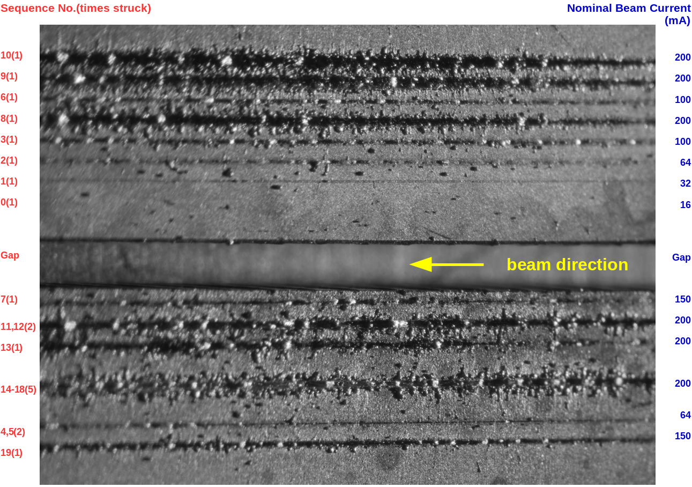
Status for the beam loss failure
May the collimators be broken by the lost beam?
  Yes, very possible. Happened in KEKB, Super KEKB, APS.
  Potential threats for APS-U, HEPS.
May the lost beam shoot the vacuum tube or the magnets?
  Rarely reported.
Broken collimator of KEKB
Broken collimator of Super KEKB
Experiments of APS-U
Experiments of LHC

Slide 10
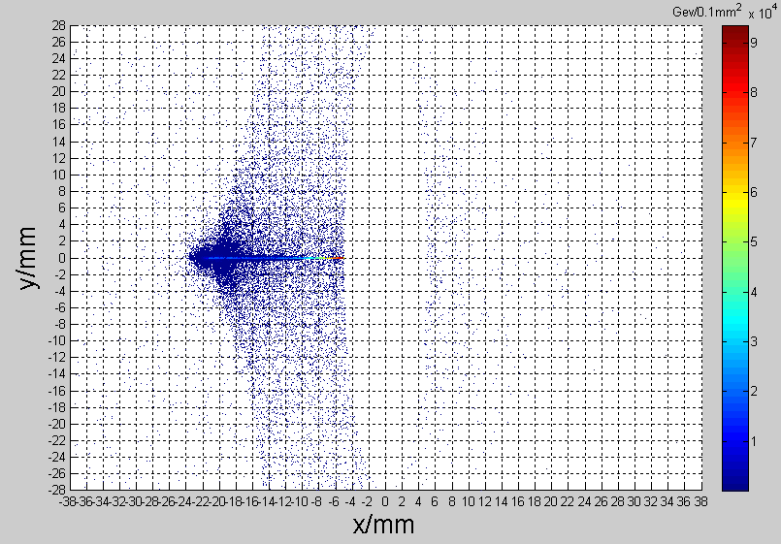
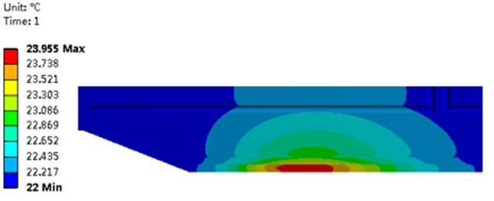
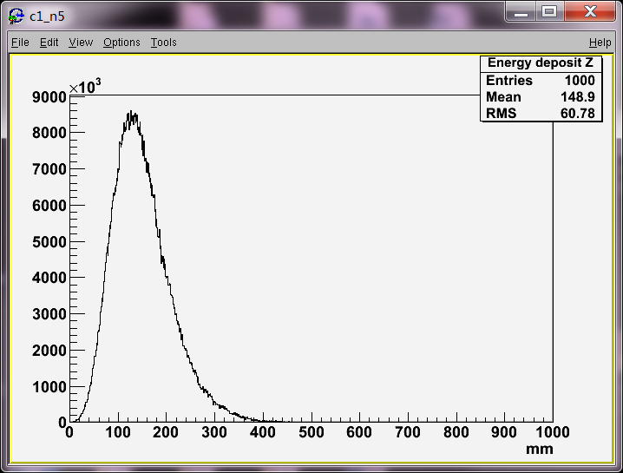
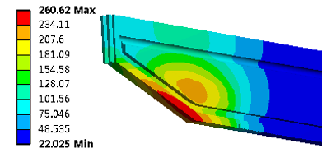
Simulation status of the movable collimator-Normal operation
Material：Cu
Particle distribution from S. Bai
Maximum heat generation: 1.07e8 W/m³
Total heat generation: 91.6 W
Maximum temperature raise by particle-material reaction: 2℃
Normal operation when the tip length is 400mm:
The main thermal load is the SR load: 9.3 kW@30 MW, Higgs
Heat flux:~ 1.3e7 W/m²
Maximum temperature: ~261℃
400 mm for Copper to absorb the 120 GeV electrons.

Slide 11
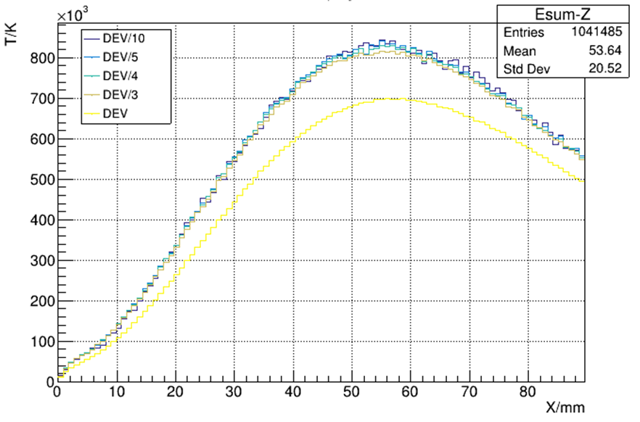
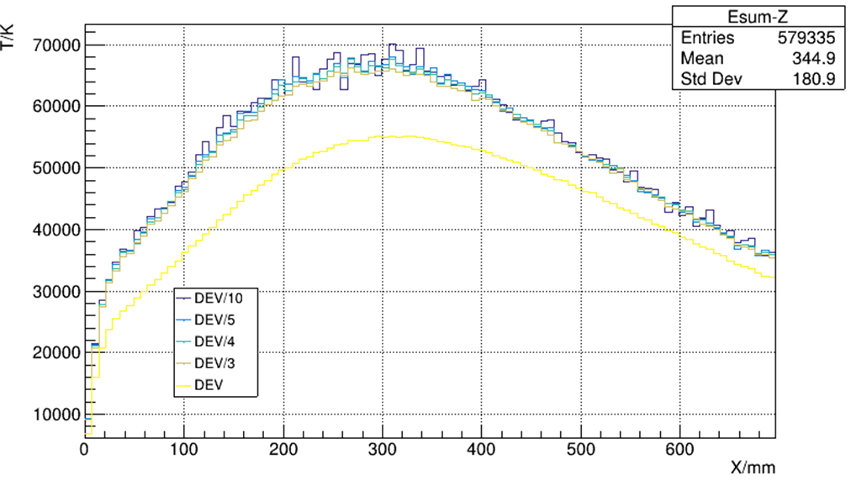
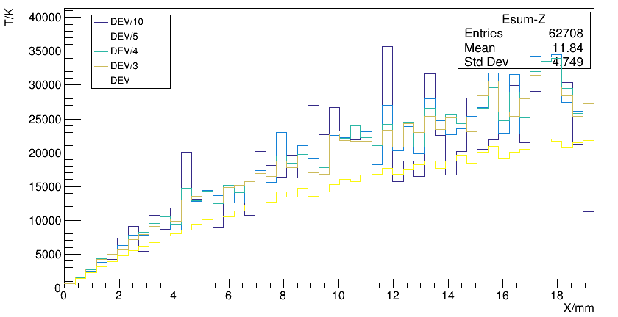
Simulation status of the movable collimator-Beam loss failure
If the beam loss happens:
  Several times per day. From C. Yu.
  Supposing all the particles shoot on the collimator.
Crazy beam
Crazy temperature
Material: Cu
Material: C
Maximum temperature
Cu: ~840e3 ℃ in at 55 mm
C：~70e3 ℃ in at 300 mm
Phase transitions are neglected.

Slide 12
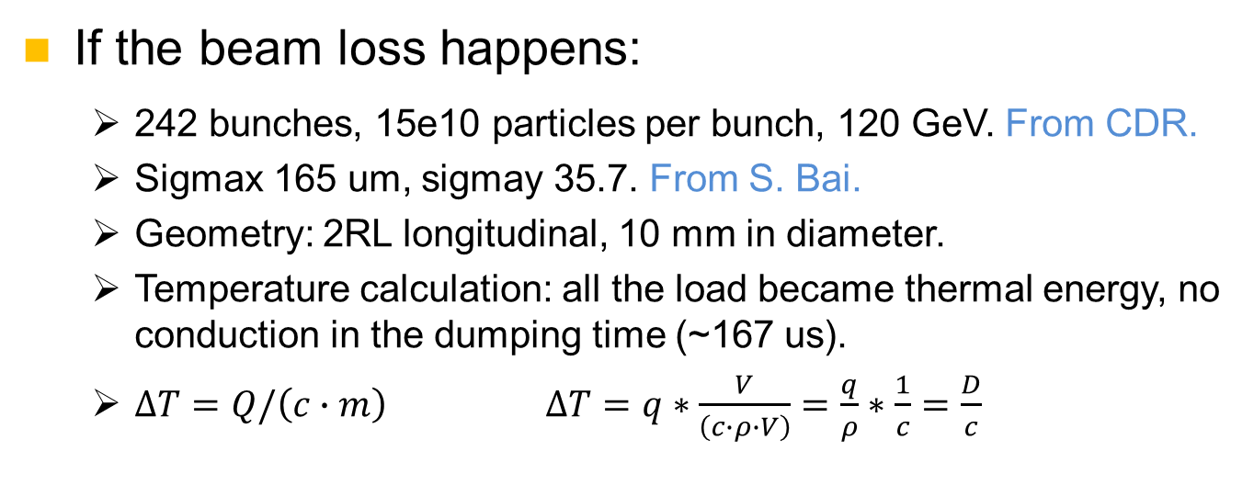
Simulation status of the movable collimator-Beam loss failure
If the beam loss happens:
  242 bunches, 15e10 particles per bunch, 120 GeV. From CDR.
  Sigmax 165 um, sigmay 35.7. From S. Bai.
  Geometry: 2RL longitudinal, 10 mm in diameter.
  Temperature calculation: all the load became thermal energy, no conduction in the dumping time (~167 us).
  $∆T=Q/\left(c∙m\right)$ $∆T=q∗\frac{V}{\left(c∙ρ∙V\right)}=\frac{q}{ρ}∗\frac{1}{c}=\frac{D}{c}$
RL：
1.46 cm for copper,
19.32 cm for carbon
How much heat in the crazy beam?
  242*15e10*1.602e-19*120e9 =697.831kJ
  Equals to ~2kg water from 20℃ to 100℃
  Equal to ~1.7kg copper from 20 ℃ to melting point or ~131g copper to gasification point.
  4.6 m long copper of the cross section (165, 35.7) um will be gasified.
Beam
Target

Slide 13
Simulation status of the movable collimator-Beam loss failure
Comparison with the simulation of Super KEKB:
  The collimator of Super KEKB has broken.
  Their simulation corresponded to the broken appearance.

Slide 14
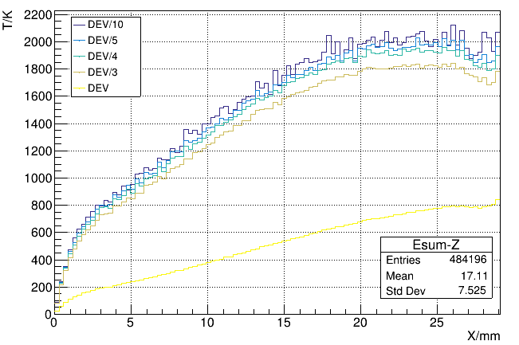
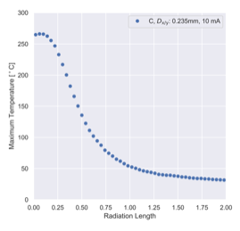
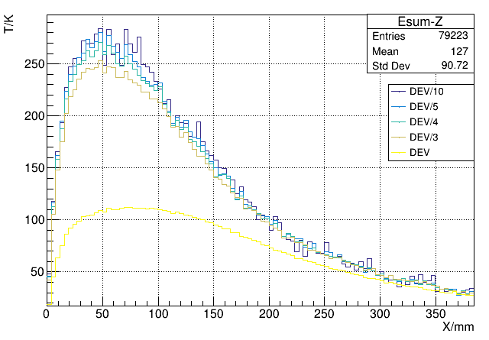
Simulation status of the movable collimator-Beam loss failure
Comparison with the simulation of Super KEKB:
  Gaussian beam profile, FWHM Dx and Dy are 0.5 mm.
  Beam current in simulation: 50 mA. Positron beam energy: 4GeV.
Max. ~250 ℃
Material: Cu
Max. ~250 ℃
Maximum temperatures within 1 RL and melting points for Super KEKB
Material: C
Super KEKB simulation of C.
The simulation is roughly correct.
Our simulation of Super KEKB case

Slide 15
Discussion
If the lost beam hit on collimators
  The lost beam will hit on the same longitudinal location.
  Can endure ~12 bunches without broken for carbon.
  Or ~0.3 bunches for copper.

Slide 16
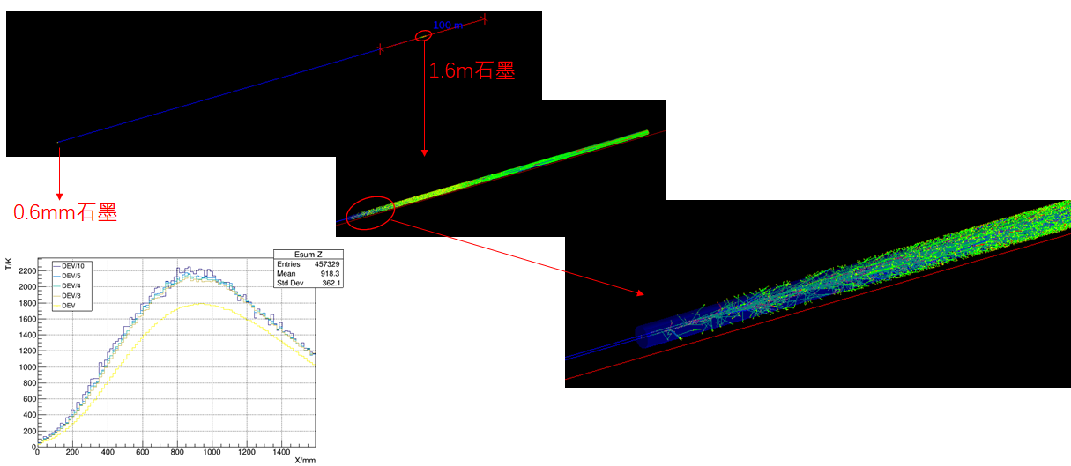
Discussion
If the lost beam hit on collimators
  Pre-scraper of 0.6 mm carbon, 350 m before collimator. Carbon collimator can endure all the bunches.
  HOM load?

Slide 17
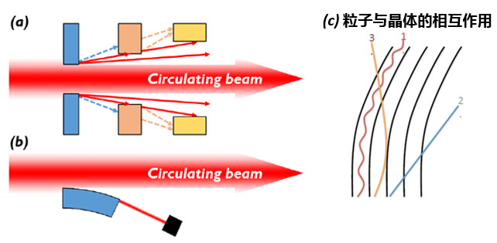
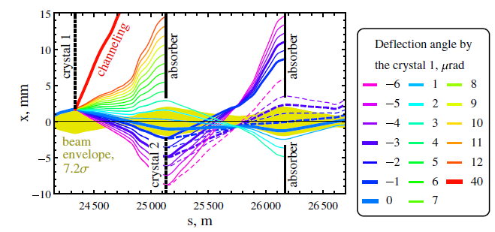
Discussion
Bent crystal collimator
  Being studied by CERN, FCC-hh.
  Thermal load? Technique flexibility?
Solid Xenon collimator
  Proposed by APS as a beam dump, the beam can vaporize sufficient xenon to rapidly diffuse the beam and render it harmless.
  Concept designed. Needs cryogenic system.
  Technique flexibility?
Double crystal-based collimation system of FCC-hh

Slide 18
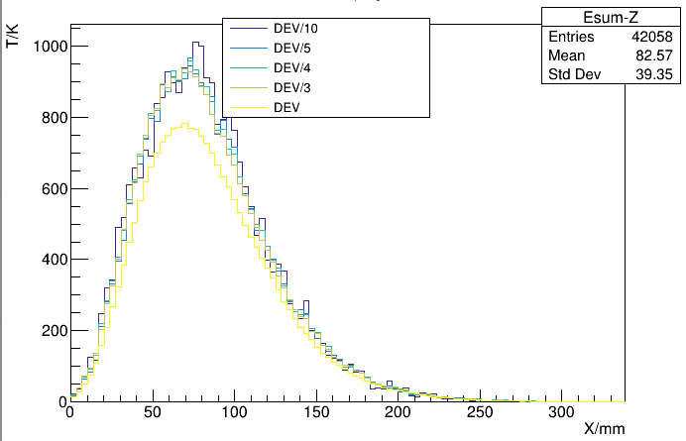
Discussion
If the lost beam hit on vacuum chambers
  The lost beam will hit on different longitudinal locations.
  Scale up the beam size of (165, 35.7)um three times to (495, 107) um, the copper chamber will not melt.
  The aluminum chamber is safer than copper, according to the calculation of HEPS.
Material: Cu

Slide 19
Discussion
Additional solenoids on the vacuum chamber with a reverse switching may be used to dilute each bunch.
  Response time?
Other beam loss failures:
  Electro-static separator
  Quench of superconducting systems
  Vacuum valve
  …

Slide 20
Thanks

