Slide 1
CEPC同步辐射光源在材料工业领域的应用
黄永盛
2021-04-24 东莞 IHEP

Slide 2
Outline
1、CEPC SR system design
2、applications on the

Slide 3
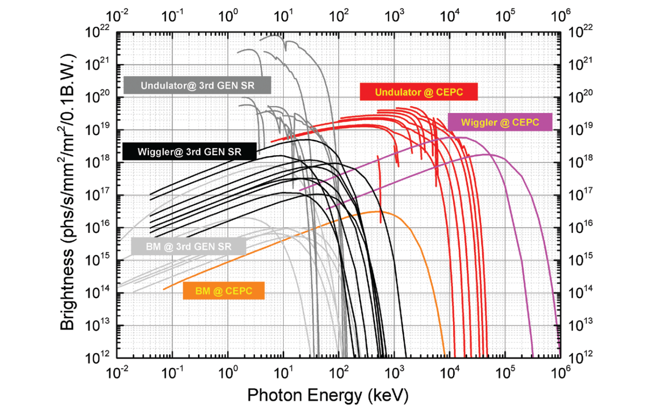
Brightness of the SR from bent iron, torsion, oscillator and low-K undulators in future high-energy particle colliders(CEPC-CDR)
The torsion pendulum has a characteristic gamma energy of 19.2 MeV and a high flux radiant energy of 300 MeV. The gamma light energy produced by the undulator can reach 20 MeV at high flux. Moreover, in the energy region greater than 100 keV, the brightness and flux of the future high energy particle collider synchrotron source are higher than those of the third generation synchrotron radiation source.

Slide 4
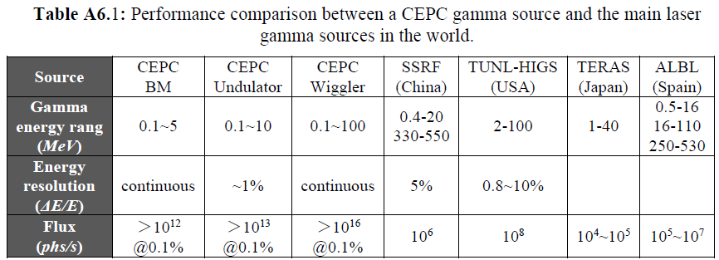
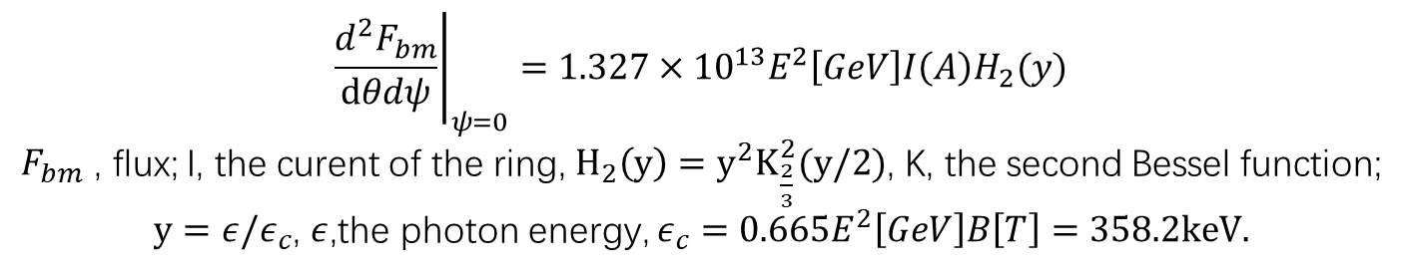
Central intensity of Synchrotron radiation,[photon/s/mrad2/0.1%b.w.]
$${\left.\frac{d^{2}F_{bm}}{dθdψ}\right|}_{ψ=0}=1.327×{10}^{13}E^{2}\left[GeV\right]I\left(A\right)H_{2}(y)$$
$F_{bm}$ , flux; I, the curent of the ring, $H_{2}\left(y\right)=y^{2}K_{\frac{2}{3}}^{2}(y/2)$, K, the second Bessel function;
$y=ε/ε_{c}$, $ε$,the photon energy, $ε_{c}=0.665E^{2}\left[GeV\right]B\left[T\right]=358.2keV.$
Notes:
IN these calculations, the Increment of the radiation power is not considered. It is a big problem. Another problem: do we need undulator and wiggler together? Maybe, just wiggler Is Ok. The gamma energy from the wiggler can cover that from undulator. Also the spectrum from undulator is not monoenergetic too. The another problem is: there are no so many users of the high energy gamma-ray.

Slide 5
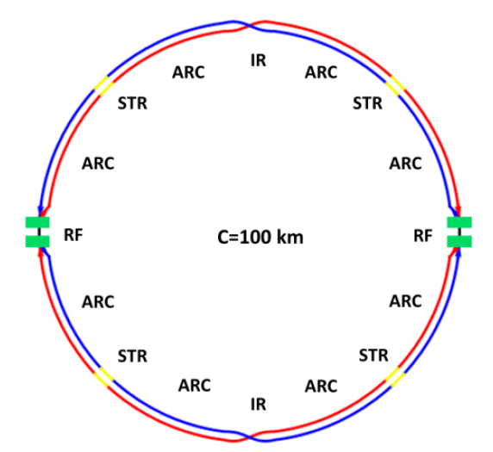
Total design of the SR stations
Four beamlines：
S1+S2
bending magnetic field line：0.1-5MeV, >10^12@0.1%,
High energy X-ray diffraction/scattering/transmission beam line
Hard X-ray micro/nano probe beamline
High voltage extreme condition beam line
wiggler beamline：0.1-100MeV,>10^14@0.1%
Photon-nuclear physics science
Others high energy gamma-ray station, GRB simulations
S1+S2:wiggler+MWCS energy calibration+ Bend

Slide 6
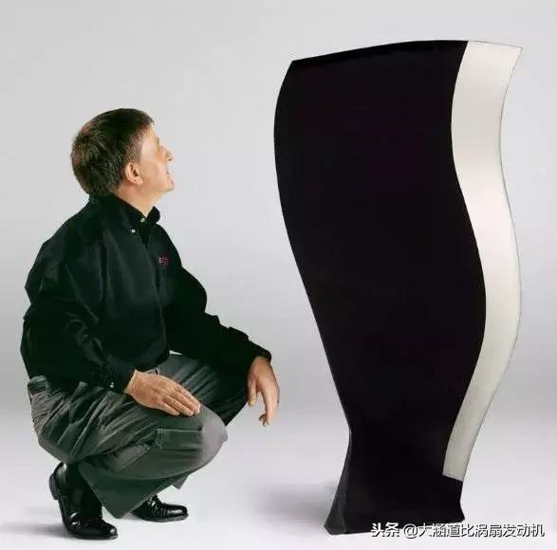
S1 SR from bending magnetic field：0.1-5MeV, >10^12@0.1%
High energy X-ray diffraction/scattering/transmission beam line
In-situ observation and structural analysis of aircraft engine blade growth process
Structural changes of special steel
Observation of special welds
Hard X-ray micro/nano probe beamline
High voltage extreme condition beam line
Structural changes of special materials under dynamic and high pressure conditions of 1000GPa
Study on the equation of state of special materials under static high pressure and high temperature/low temperature

Slide 7
S2: SR from wiggle magnetic field：0.1-100MeV, >10^14@0.1%
Photon-nuclear physics science
Gamma assisted transmutation
Giant resonance,
Nuclear resonance fluorescence
a “mini” giant dipole resonance it is often called pygmy dipole resonance (PDR).
¹²C(α,γ)¹⁶O reaction: the "Holy Grail" of nuclear astrophysics.
Others high energy gamma-ray station, GRB simulations
radio-pharmaceuticals production

Slide 8
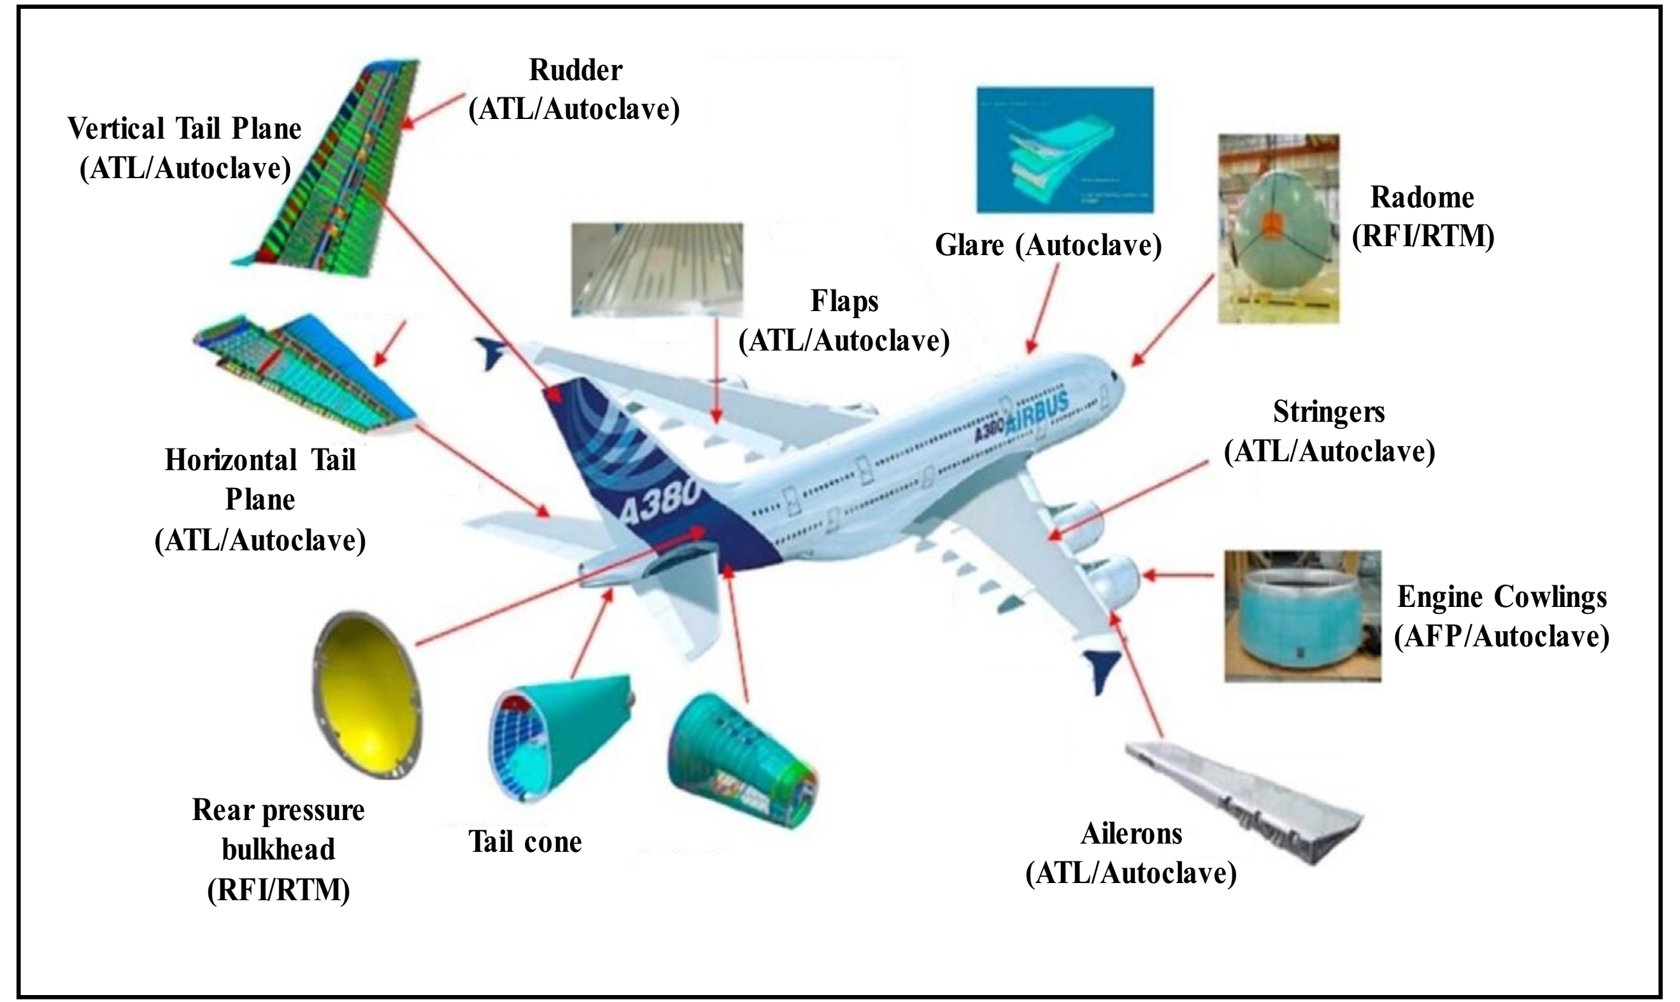
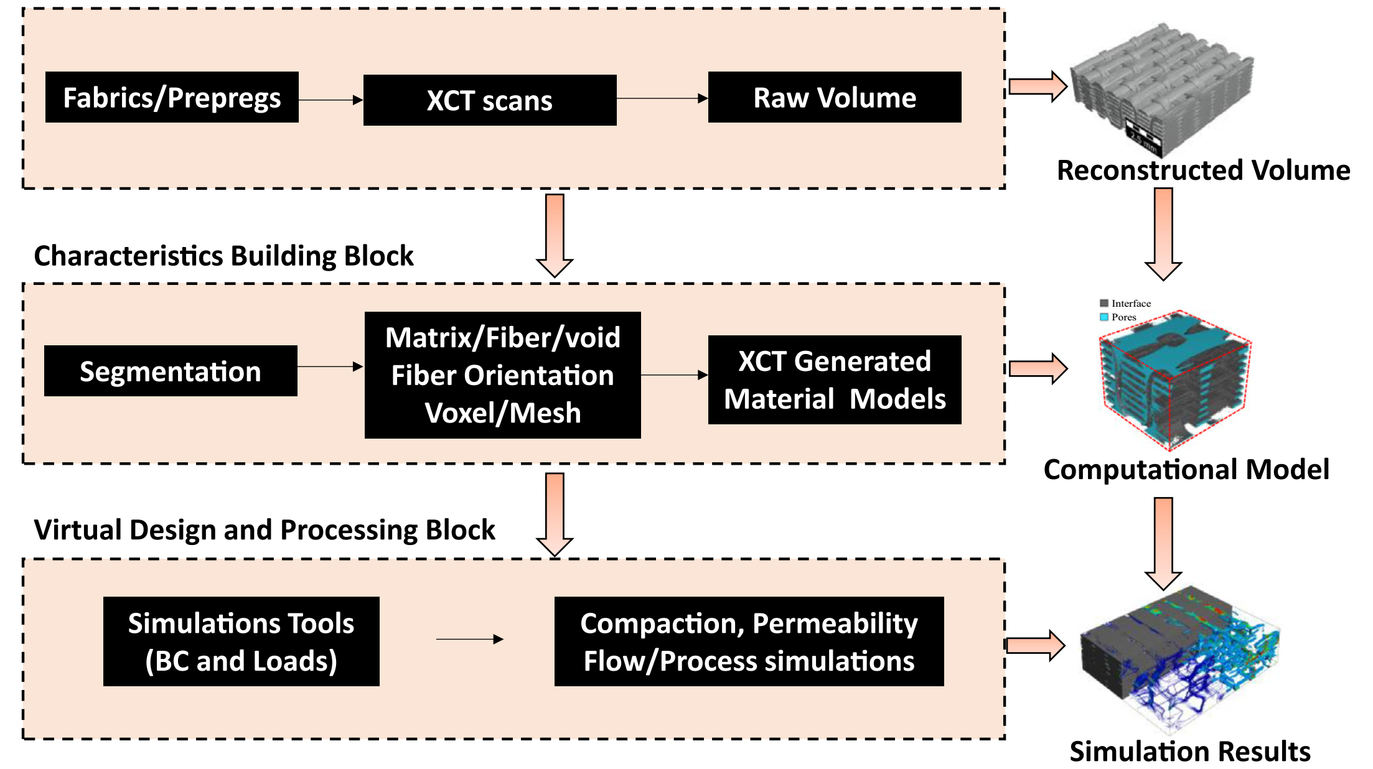
线站科学目标
原位环境下重金属材料的加工过程研究
工件铸造、锻压和服役状态下的内部结构无损表征
材料内部焊接问题、缺陷演化、晶粒排布以及残余应力分析
筑建材料工艺—结构—性能一体化

Slide 9
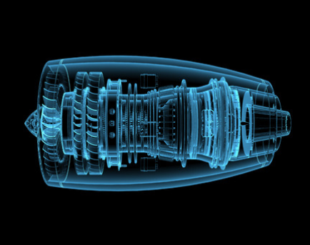
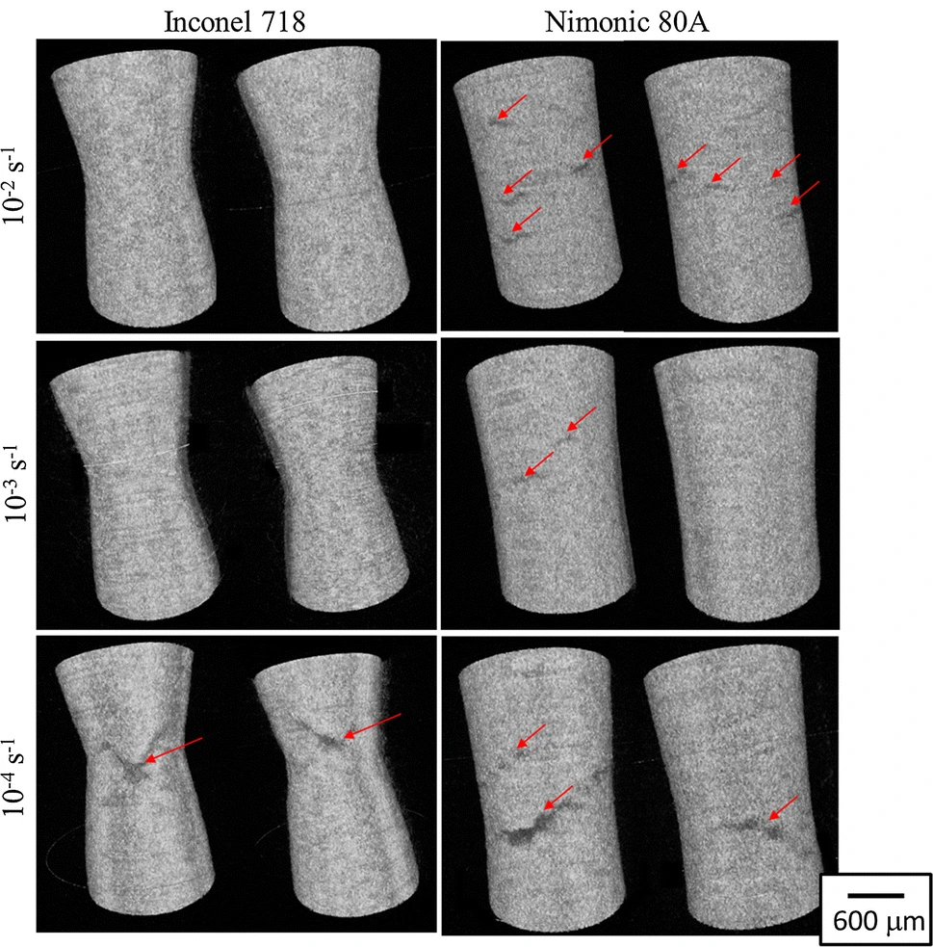





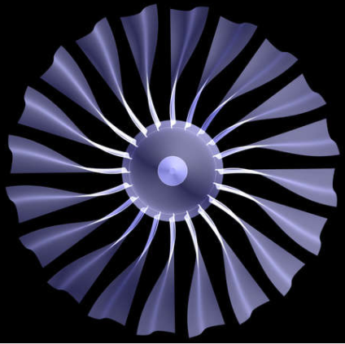
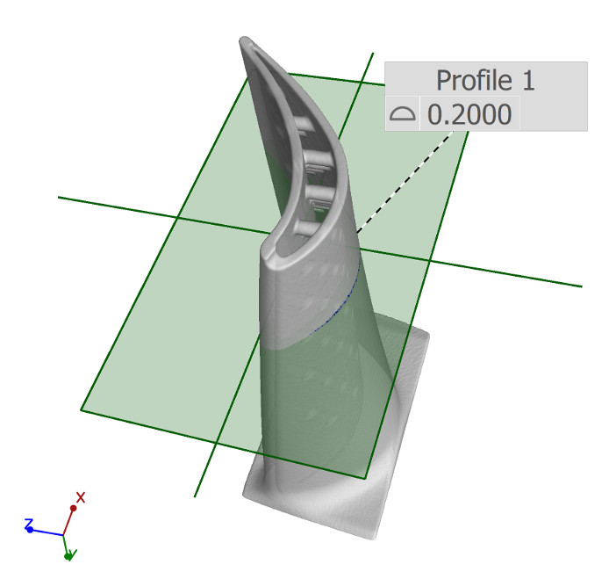





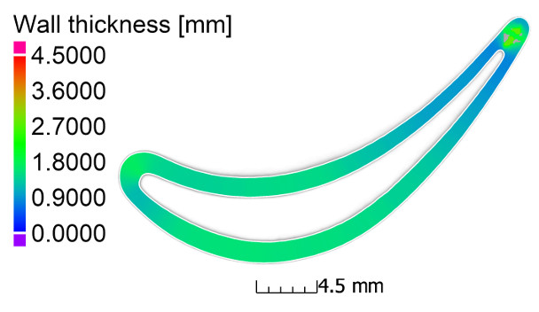
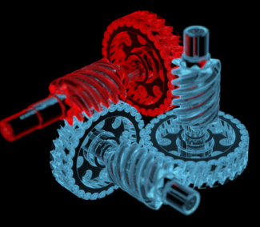
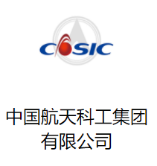

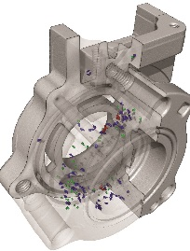



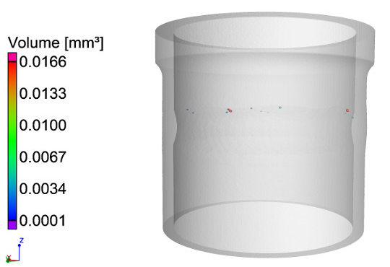



产业需求
发动机
叶片
齿轮
承压容器

Slide 10
需求分析—以航空发动机和燃气轮机（“两机” ）为例
产业链
对象
主要公司
高温硬质合金
钛合金、镍合金
钢材
复合硬质材料
炼石有色 中钢天源
韶关钢铁 章源钨业
光威复材 宝钛股份
火炬电子 西部材料
高穿透
上游
原材料
高通量
铸造件
涡轮叶片
机匣
锻造件
压气机叶片
盘、轴
齿轮
燃烧室、喷管
轴承
中航重机 江苏永翰
中国二重 爱乐达
三角防务 成发科技
应流股份 图南股份
新研股份 万泽股份
大视场
中游
零部件
高分辨
下游
整机制造
航空发动机
燃气轮机
航发动力 中国动力
炼石航空 上海电气

Slide 11
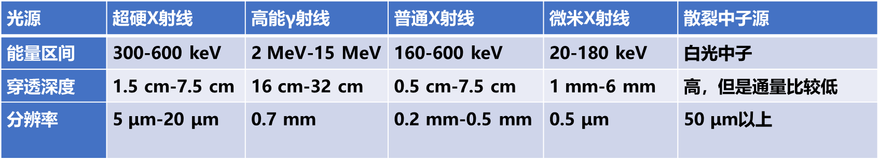
国内外发展现状
与国内外同步辐射线站对比
光束线 | CEPC-SR光源 | HEPS | ESRF | PETRA III
 | 超硬x射线 | 高能x射线衍射 | ID15A | P07
光源 | SR | Undulator | Undulator-CPMU18 | Undulator
能量范围(keV) | 360 | 60-120，可扩展至300 | 20-500 | 50-200
光子通量(phs/s) | 1 × 10¹²@360 keV | 1×10¹²@100 keV | 5×10¹³@50 keV | 7×10¹¹@100 keV
光斑尺寸H×V (μm²) | 20000和5000 | 1000 | 0.3-8000 | 1000
状态 | 设计 | 运行 | 运行 | 运行
典型工件探伤光源横向对比

Slide 12
CEPC high-flux γ beamlines
Complementary with the third generations of synchrotron sources, spallation neutron sources, industrial CT, and LCS gamma sources:
7.5cm steel penetration, several micron resolution, high flux fast imagination
Static imaging - engine blade inspection: 6cm thick steel, 1-5 micron resolution
Dynamic imaging---metal phase change process-droplet solidification/seawater corrosion mechanism: us, 6cm thick steel, 1-5 micron resolution
Image reso.
Spallation neutron source
mm
Third generations
Synchrotron radiation source
High energy CT
10um
CEPC-SR γ
（static & dynamic）
LCS γ
um
Micro-nano CT
mm/keV-10keV
cm/100keV
10cm/MeV
penetration/energy

Slide 13
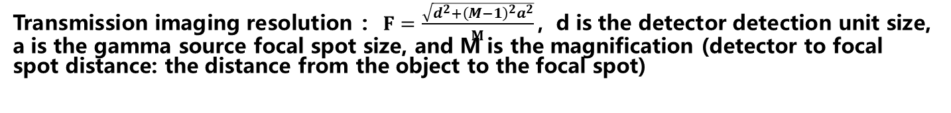
Gamma imaging system design
Detector 50μm one detection unit, 10cm size, magnification 10, light source focus 10μm, object measuring 1cm diameter disc each time, one hour scanning range 1 square meter, resolution can reach 6μm
1m:Objective dis.
10m:det. Dis.
10cm CEPC-SR γ Spot
10 um CEPC-SR-γ radius
Moving Objection
Transmission imaging resolution ：$F=\frac{\sqrt{d^{2}+{\left(M−1\right)}^{2}a^{2}}}{M}$，d is the detector detection unit size, a is the gamma source focal spot size, and M is the magnification (detector to focal spot distance: the distance from the object to the focal spot)

Slide 14
Example：from Mayue， MRE

Slide 15
实验站设计
实验站主要实验方法和实验能力
实验站 | 实验方法 | 实验能力
实验站1 | X射线显微成像 X射线显微断层成像 快速成像 扫描成像 | 大型原位加载设备 ROI区域时间分辨 > 20ms 大视场，覆盖范围20 × 20 mm²-47.5 × 47.5 mm² 扫描实现超大视场 空间分辨率：10-20 μm
实验站2 | X射线显微成像 X射线显微断层成像 快速成像 | 小型原位环境设备 ROI区域时间分辨 > 20ms 厘米级高分辨成像，3-7 μm

Slide 16
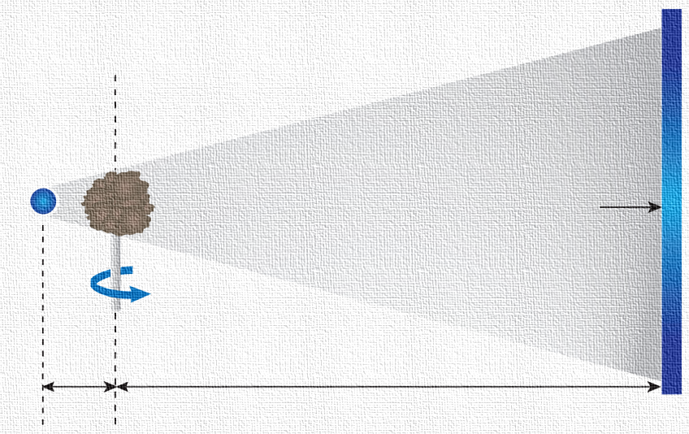
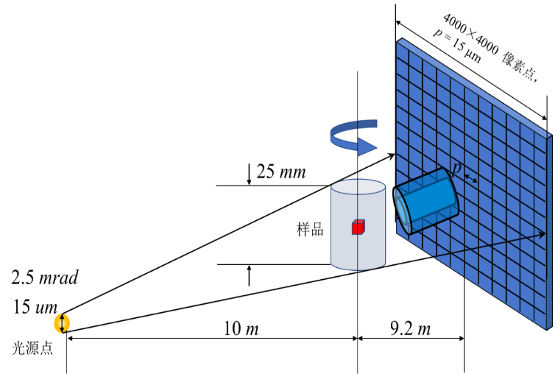
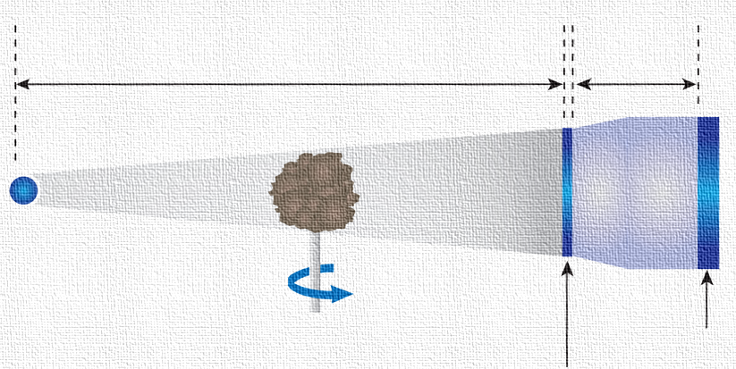

实验站1：侧重大视场
探测器
实验站1设计参数
几何放大M₁
实验站2：侧重高分辨
几何放大M₁
光学放大M₂
$$σ=\frac{\sqrt{{\left(\frac{p}{M_{2}}\right)}^{2}+{\left[s\left(M_{1}−1\right)\right]}^{2}}}{M_{1}}$$
空间分辨率：
探测器
闪烁体

Slide 17
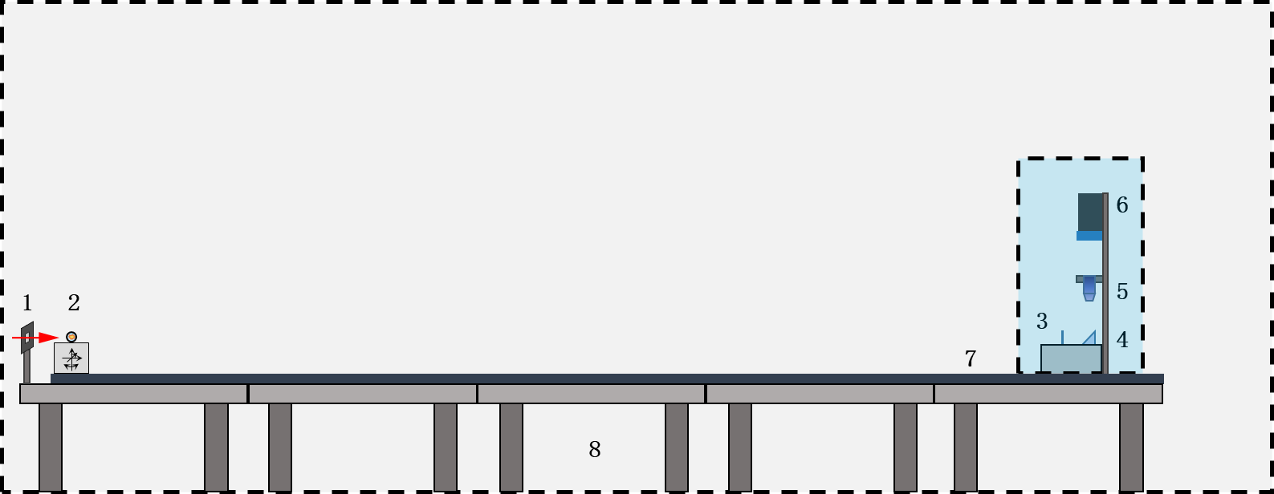
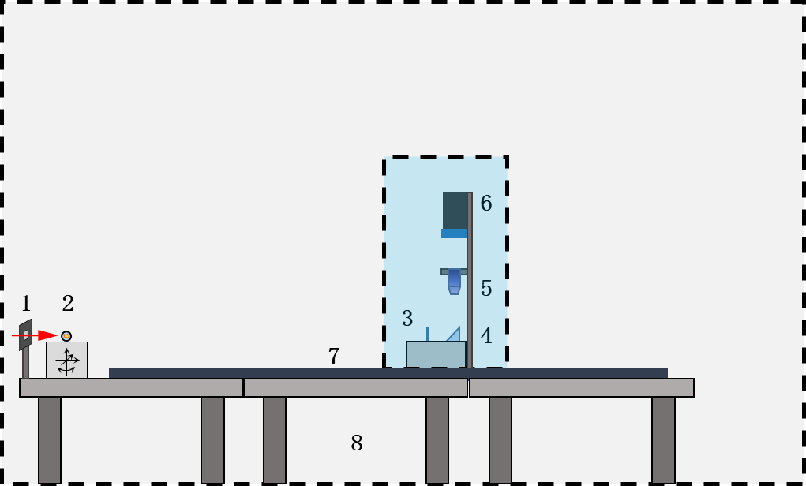
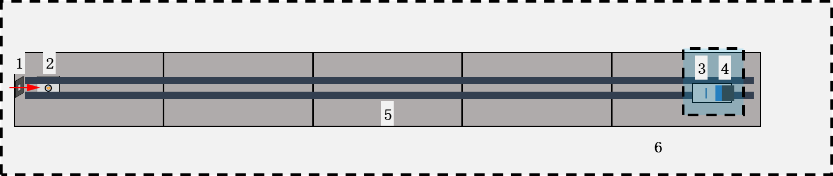
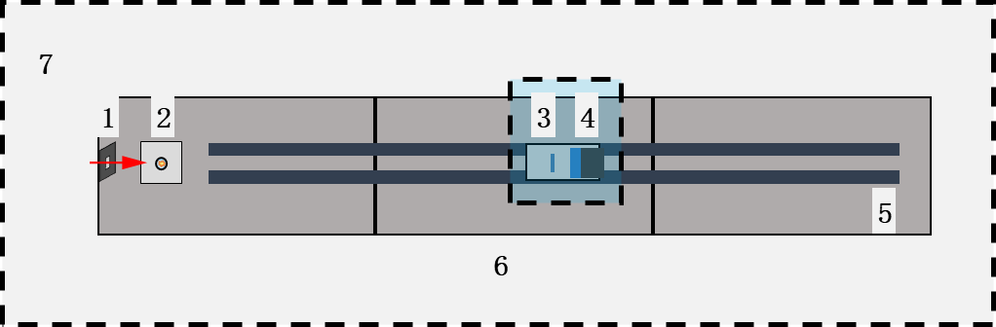
实验站布局
实验站1侧视图
实验站2侧视图
实验站1俯视图
实验站2俯视图

Slide 18
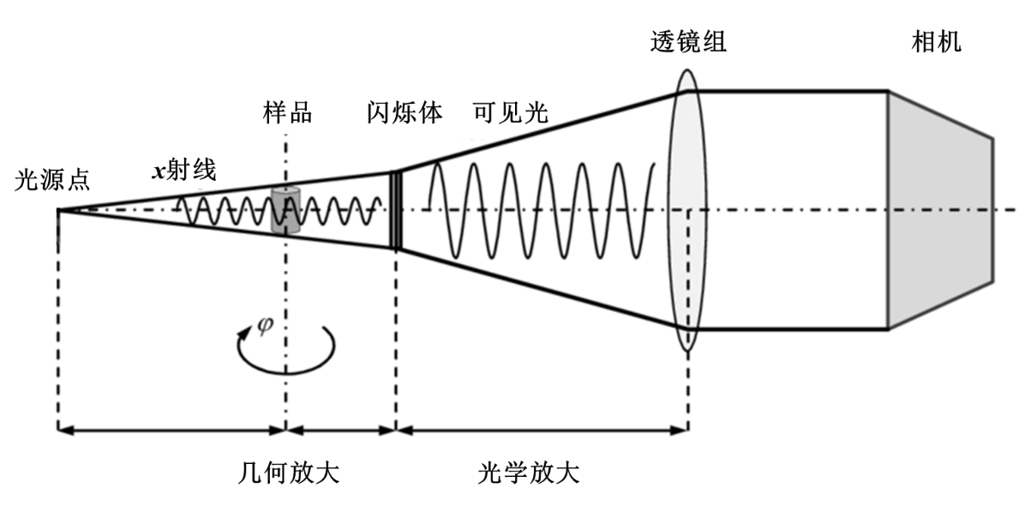
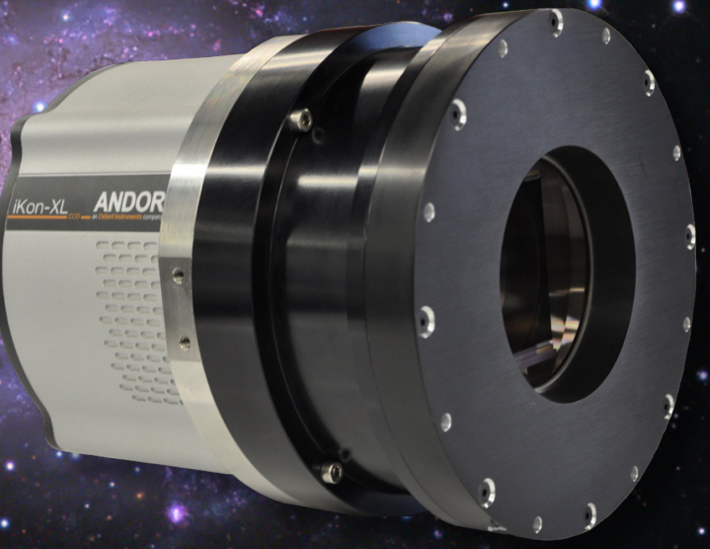
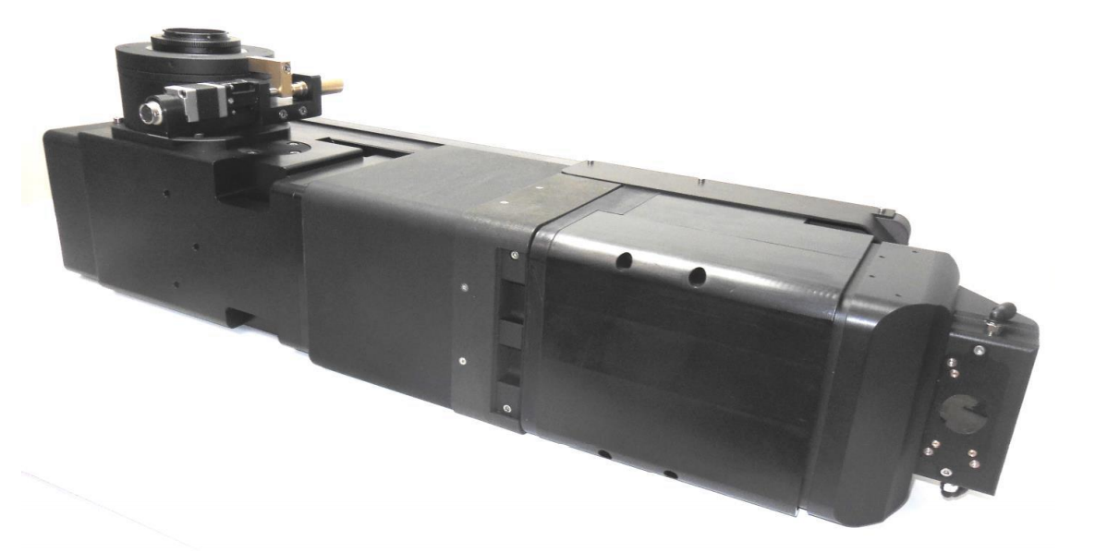
实验站关键设备参数
GAGG+EMCCD探测器
像素点：> 6000×6000
像元尺寸：15×15 μm
芯片尺寸： > 90×90 mm
暗电流：< 0.001e-@-90℃
量子效率：> 90%@400nm-700nm
光学耦合系统
放大倍率：1×，1.25×，2×，4×，5×，10×或20×
最大对角线视场： > 130 mm

