Slide 1
Report from Computing Status Review

Slide 2
Charge letter
Review the status of JUNO Computing System mainly focusing on the actions subsequent to the PDR in Nanning and on the distributed computing infrastructure.
Discussion on the status of the following items:
1.DAQ: data throughput and network capability
2.RAW data workflow-architecture: data environment, data format-primary storage (performance, site, framework)-custodial storage (environment)-resources (HS06, PBn, manpower)
4.RECO data workflow:-performance-data flow-data distribution
5.Simulation: needed resources
6.User cases: status
7.Networking: status
8.Testing the readiness for data taking: a Data Challenge (management and transfer)
9.Operation-central services-role of the sites-support
Time and Place: January, 22nd, 2021; Remote Meeting
Review Committee
Simon Blyth, Luca Dell’Agnello, Li Fei, Chen Gang, Stefano Mari (chair), Deng ZiyanEx ‐ officio: Yifang Wang, Jun Cao, Gioacchino Ranucci

Slide 3
Comments
Because a status review, we were aspected to report on progress about the various items
Review was covering JUNO computing:
Kaiping
IHEP
Distributed Computing Infrastructure (DCI)
The agenda was based on the items with a status to show

Slide 4
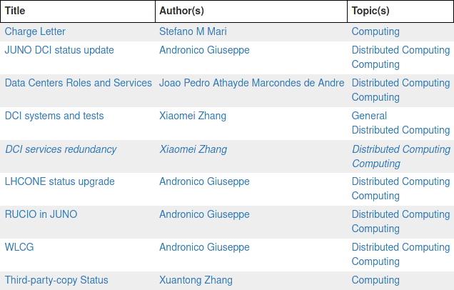
Agenda
https://juno.ihep.ac.cn/cgi-bin/Dev_DocDB/DisplayMeeting?sessionid=1337

Slide 5
Unofficial preliminary news
No critical comments
No sensible reccomendations
Schedule massive data transfer challenge
Close MoU as soon as possible
Pay attention to time we have

Slide 6
Thank you

