Slide 1
Introduction and progress of XCache
Teng Li, Yifan Yang
Shandong University, IHEP
2021.1

Slide 2
Outline
Introduction to XRootD and XCache
General XCache use cases
Current progress of application in JUNO
Outlooking future work

Slide 3
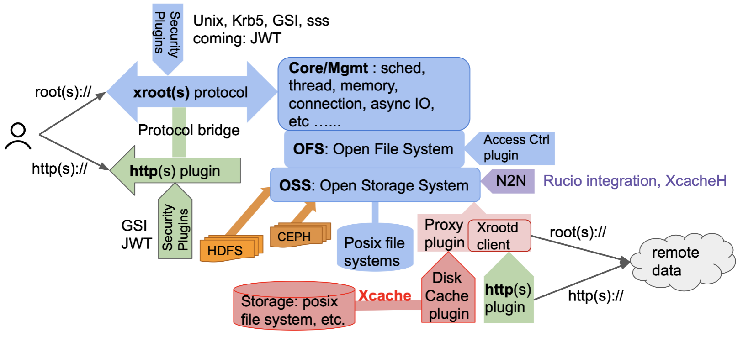
Introduction to XRootD
Open source storage developed by SLAC
Plugin arcitecture, very widely used in HEP
Slide from Andrew Hanushevsky, XRootD developer

Slide 4
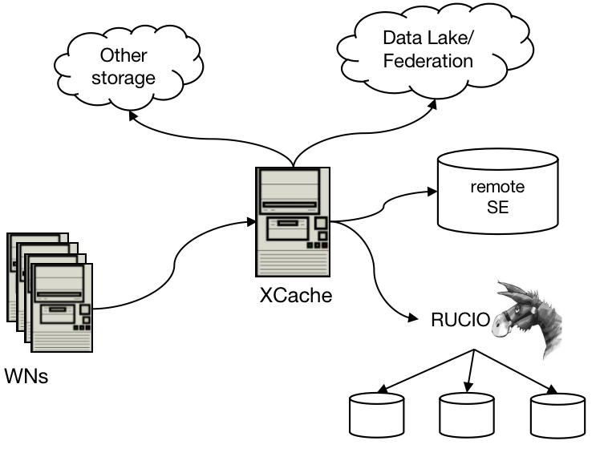
XCache
XRootD Proxy Cache
XRootD running in proxy mode with disk cache (libXrdFileCache.so)
Squid like cache that talks root protocol
XCache has became popular
There is a push towards storage model with more remote data access
Data caching helps to:
Hide latency
Reduce WAN traffic

Slide 5
XCache features
Plugin-based design:
Caching S3-type objects
Name2Name to integrate with high level data management system
Flush cache if source is updated: XCacheH
Support http(s) and xroot protocol
Standard HEP data access protocols
Support whole file/sub-file cache
Sub-file cache: TFile::Open('root:[xcache_server]//[xroot_path].root')
Support async fetching and multi-threading
Capable of handling large data files

Slide 6
XCache features
Customise-able caching behaviour
Disk cleanup policy
Name plugin to filter out unpopular files
Support rich monitoring
XRootD internal metrics
Caching-specific information in .cinfo files
Cluster-able: easy to scale up
Multiple level of cache could be setup
Use proxy-manager for load-balance
cmsd
Proxy Mgr
cmsd
cmsd
XCache
XCache

Slide 7
XCache use cases
Remote data access optimization for diskless sites
For sites without enough manpower to manage decent storage elements
Diskless sites are attached to one endpoint, or 'data lake'
Used in ATLAS and CMS
Integrated with central data management system (Rucio)
Volatile Rucio storage element: report cached content back
Rucio name to name plugin: work with rucio metalink to cache file from any where
More advanced use case: virtual placement for higher cache hit rate
Worker Node
XCache
high
latency
external
storage
Worker Node
Worker Node

Slide 8
XCache use cases
Optimization of local data storage
XCache with SSD/fast NIC to cache frequently used files
For slow data storage, e. g. storage with erasure coding (CEPH, EOS), tape
Other use cases:
Optimization for data access for HPC
As alternative of Squid for CVMFS
Worker Node x800
CEPH
Cluster
Job container
XCache
user job
xrootd client
XRootD Server
rados plugin
echo system @ RAL
See latest talks at WLCG doma-access WG

Slide 9
Work progress
XCache instances were setup at IHEP and SDU
Using personal cert for X509 based authentication
Xroot and https protocol supported
xrdcp xroot://xcache//xroot://filepath.root
xrdcp xroot://xcache//https://filepath.root
wget https://xcache//xroot://filepath.root
wget https://xcache//https://filapath.root
Functionality tests done
Ready for other small sites
JINR
XCache
IHEP
Worker Nodes
IN2P3
XCache
SDU
Worker Nodes

Slide 10
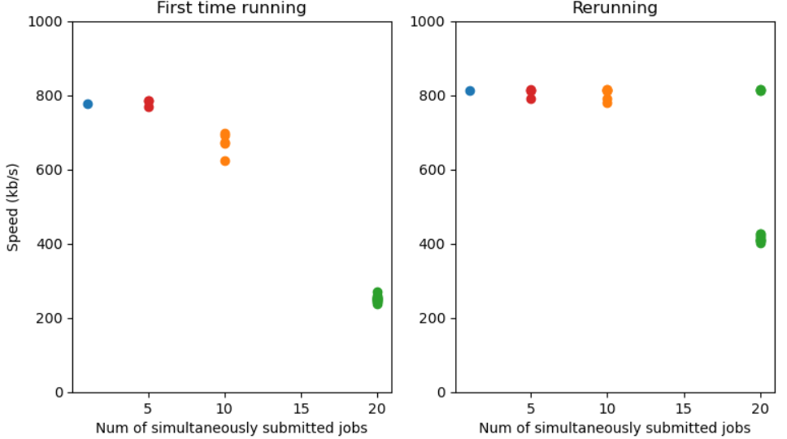
Work progress
Integrated with jsub and DIRAC
XCache server config read from DIRAC
Jsub to incorporate XCache when downloading input data
Tested with JUNO jobs at SDU
results from Yifan Yang
XCache works, but currently limited by internal bandwith at SDU
Needs to look into this

Slide 11
Future work on XCache
Enable using XCache at diskless sites
Unify the authentication method: bot cert
Find out recommended configurations according to site size
Analytics based on XCache monitoring
Intergrate XCache into the workflow
Needs further improvement of jsub
More complex development: see next slide
Find a way to write out output data
Transfer output data back is one of the major failure reasons

Slide 12
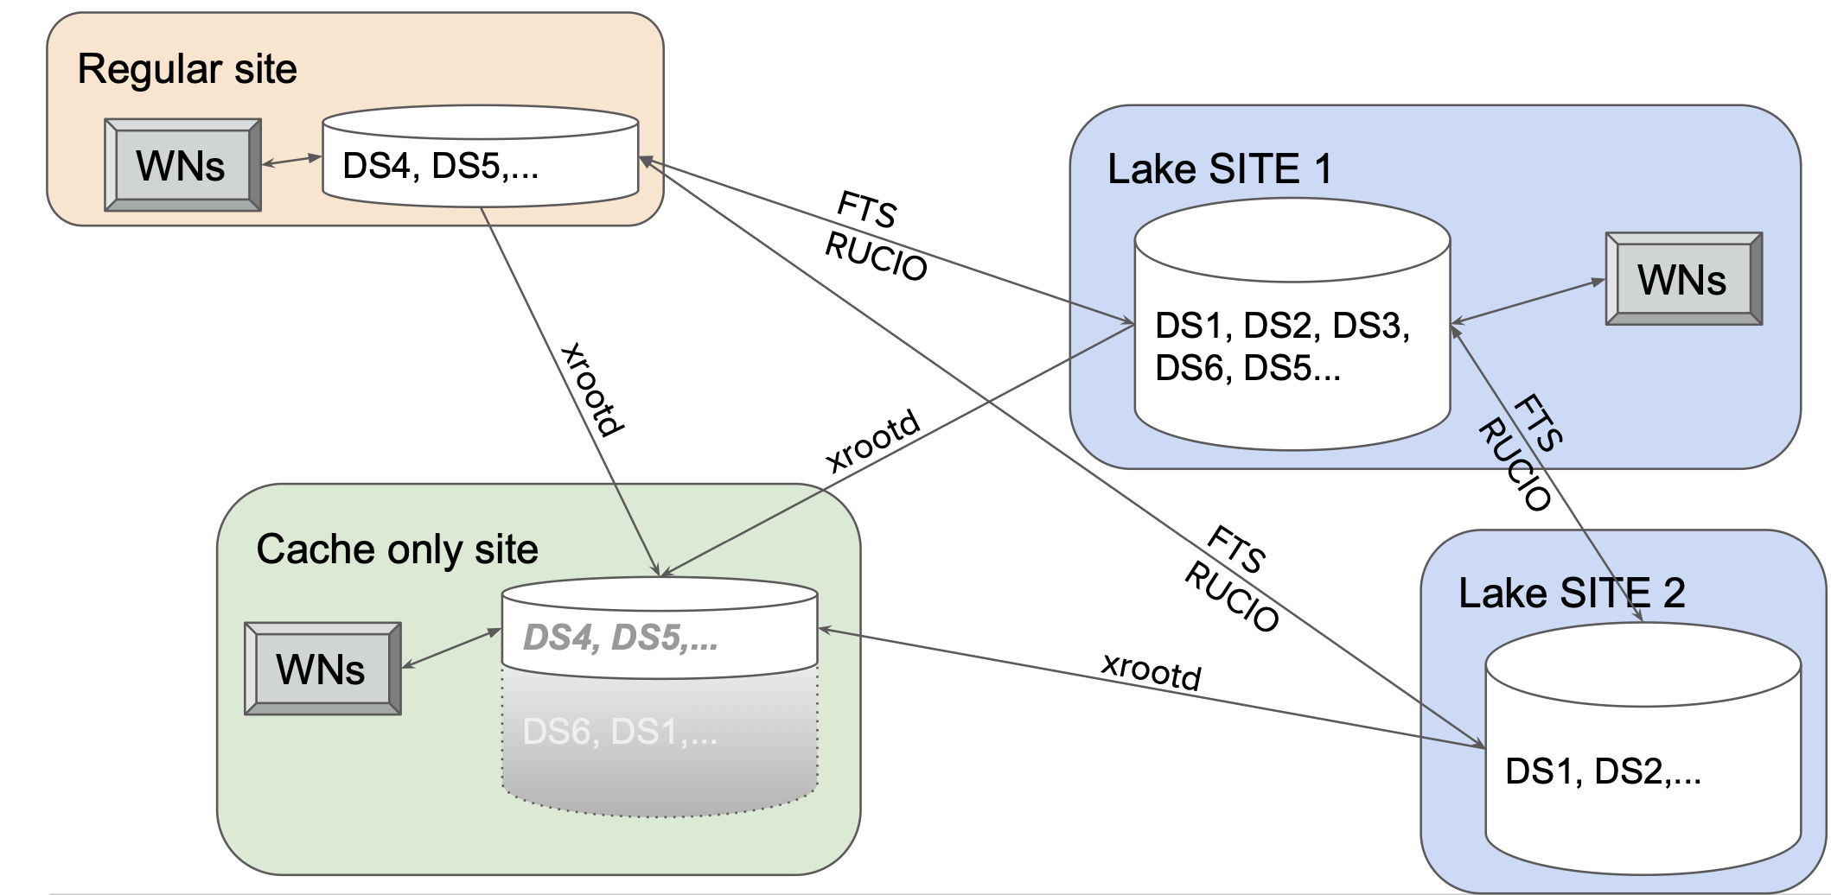
Future work on XCache
Intergration with Rucio/DIRAC
Set up XCache as a volatile Rucio Storage Element
XCache to report cached data back to Rucio, WMS to schedule jobs accordingly
Use 'virtual placement' to optimise XCache performance
In Rucio, place data virtually in diskless sites to 'fool' WMS
Cache hit rate will be high as job shedular works
slide from Ilija Vukotic

Slide 13
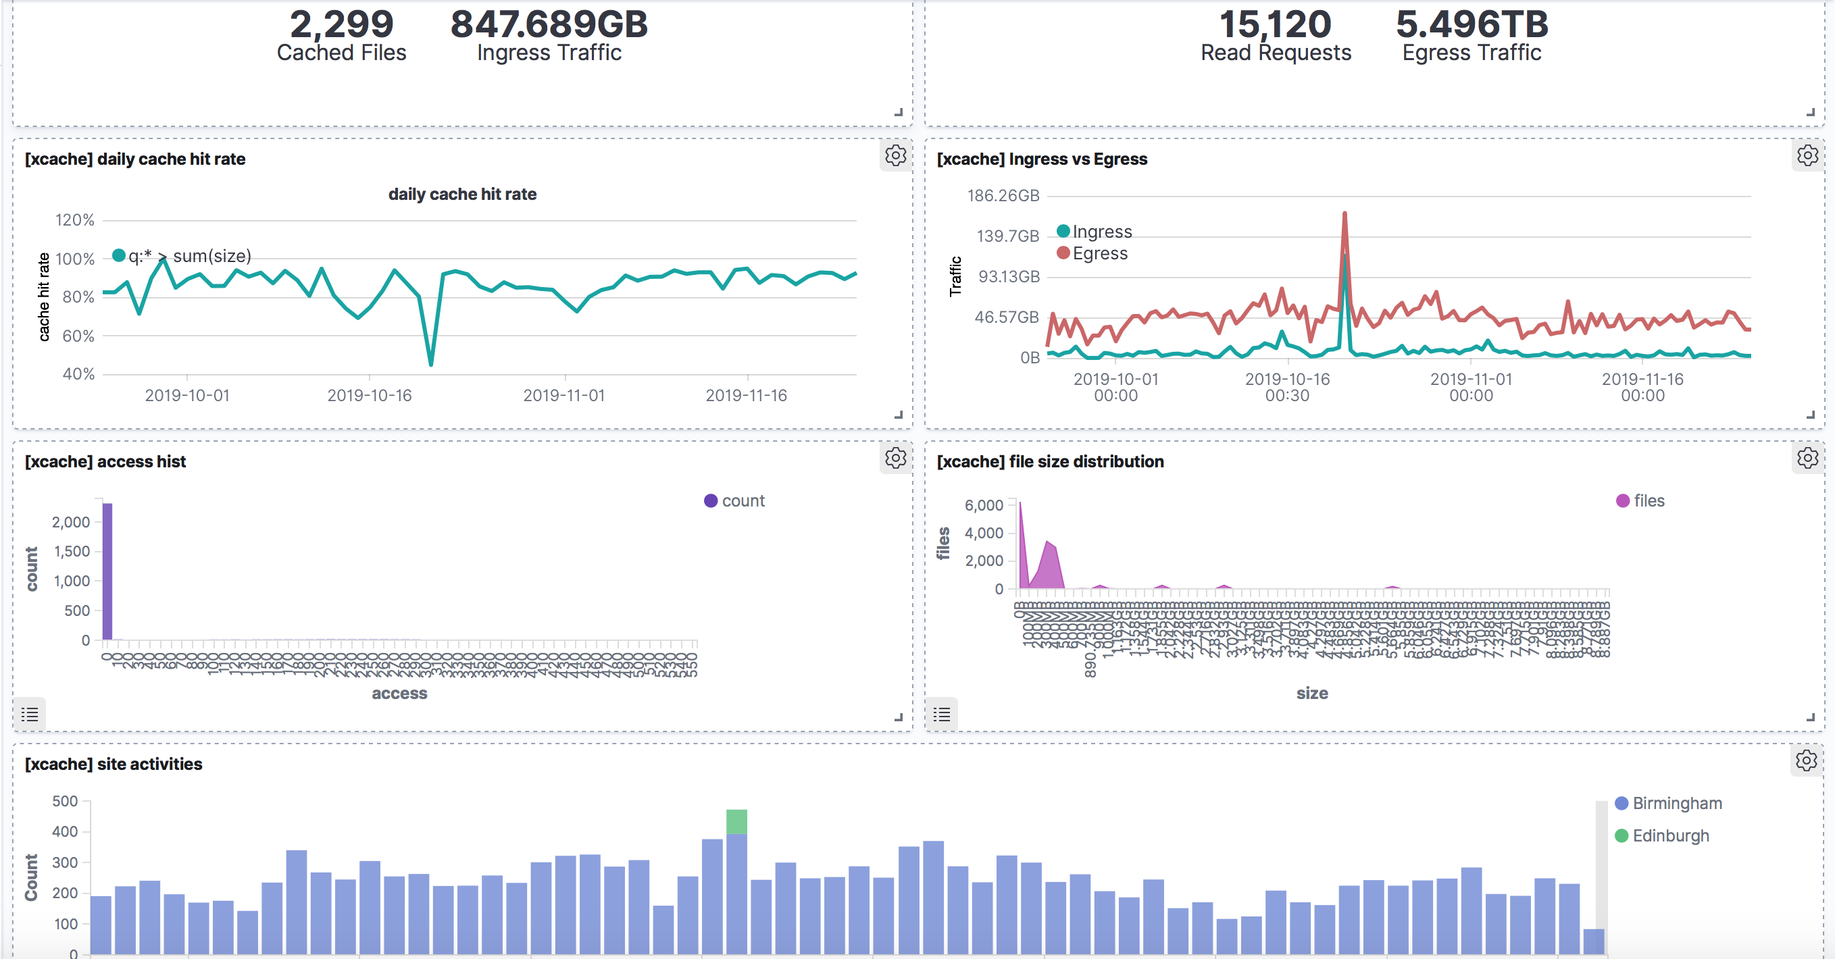
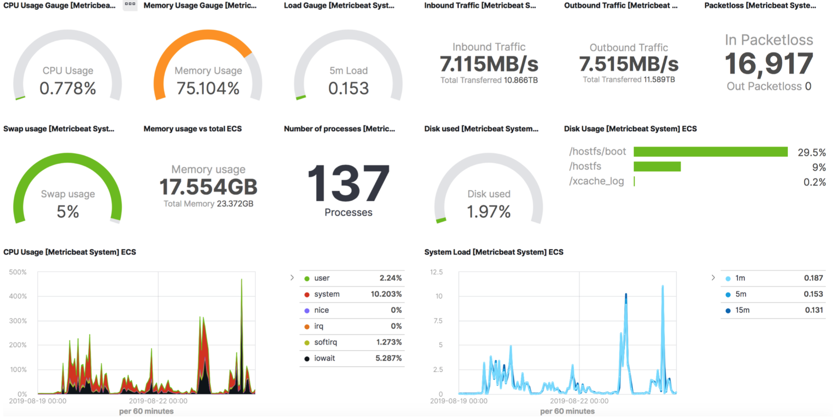
Future work on XCache
Setup monitoring
Read cache info files to calculate data access, cache hit/miss
Use ELK to collect for data analytics
To optimize cache behevior if nesessary

Slide 14
Future work on XCache
Deployment method
The Slate project was developed at University of Chicago
Use k8s for service deployment
The central site acts like k8s controller
Containerised services are sent to and monitored at slave sites
XCache and also other services
Could solve manpower issue at small sites
XCache could fully deployed and monitored at the central site
JINR
IHEP
INFN
XCache
XCache
SDU
padova
Notes:
图

Slide 15
Future work on XCache
XCache as an alternative of Squid for CVMFS
CVMFS as a global r/o FS, usually needs multiple layers of cache
stratum-0: publish data
stratum-1: replicate data
clients: read data
Squid doesn't prefer very large files
Petotential problem when JUNO calibration data comes into CVMFS
Use XCache to free Squid from CVMFS
XCache designed for both large/small files
Ongong study of XCacheH

Slide 16
Thanks for listening

