Slide 1
Fully-heavy Charmonium Interactions Via The Pomeron Exchange
2021/05/17
第7届XYZ粒子研讨会(龚畅)
Speaker：Chang Gong
Cooperators: Mengchuan Du, Qiang Zhao, Xian-hui Zhong, Bin Zhou

Slide 2
Outline
Background
The Introduction To Pomeron
The Photonproduction Of In Elastic Scattering Processes
- Interaction via The Pomeron Exchange
$η_{c}$- $η_{c}$ Interaction via The Pomeron Exchange
Summary

Slide 3
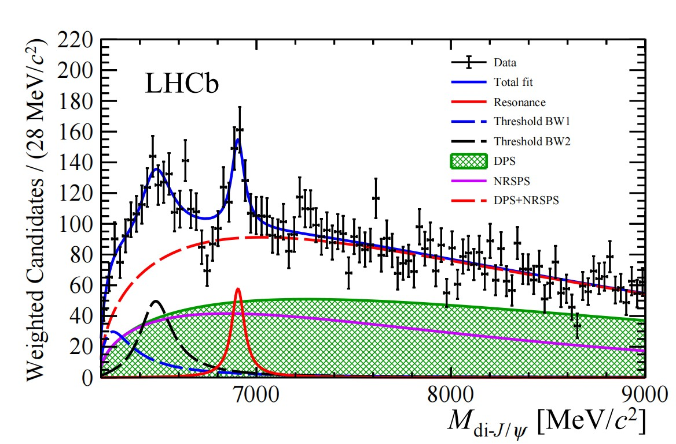
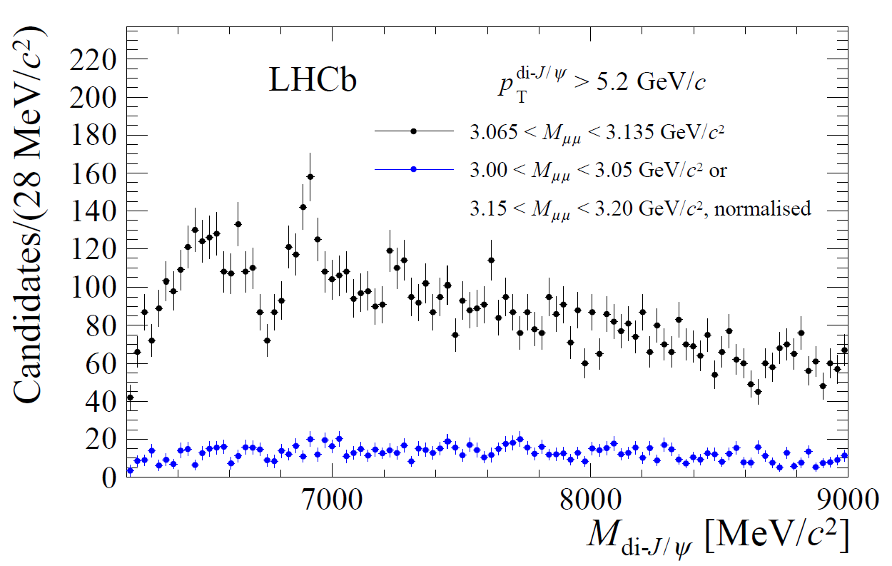
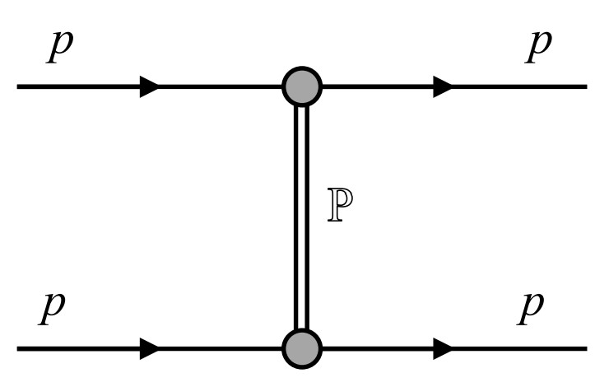
Background
For fully-heavy charmonium system, the long-distance light meson exchanges do not contribute in LO
Charmonium meson exchange is supreesed for large mass and high scale of creation
Tetraquark models predict that there are many s-wave and p-wave states can decay into the di- energy spectrum
What is the underlying mechanism to bind the fully-heavy system?
V. R. Debastiani and F. S. Navarra Chin.Phys.C 43,013105(2018)
M. N. Anwar, J. Ferretti, F. K. Guo, E. Santopinto, and B. S. Zou, Eur. Phys. J. C 78, 647 (2018)
M. S. liu, F. X. Liu, X. H. Zhong and Q. Zhao, [arXiv:2006.11952]
LHCb arXiv:2006.16957v1
short-distance interaction
soft gluons
g
g
+
g
g
Notes:
The spectrum shows a broad structure above twice the jpsi mass threshold ranging from 6.2-6.8GeV/$c^{2}$ and a narrow structure at about 6.9GeV/$c^{2}$, here named as X(6900).
In the transversed momentum binned analyses, the X(6900) structure becomes more pronounced in higher $P_{T}$ region.
The high $P_{T}$ region is exploited to select the data sample with enhanced SPS production, which includes contributions from $T_{cc\overline{c}\overline{c}}$ states.
X(6900): tetraquark states consisting of four charm quarks; molecular state(the rescatterng of two charmonium states produced close to their mass thresholds).

Slide 4
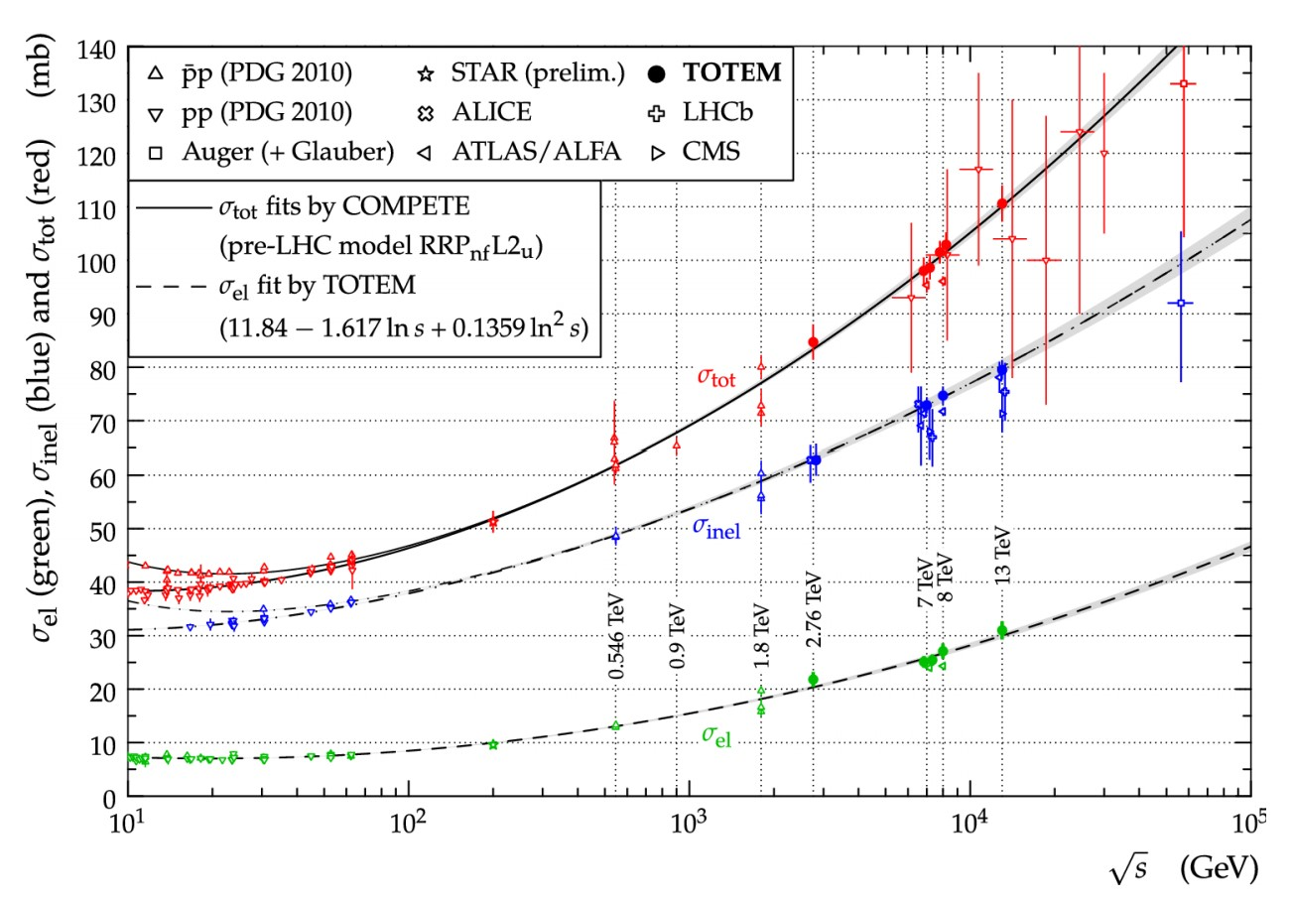
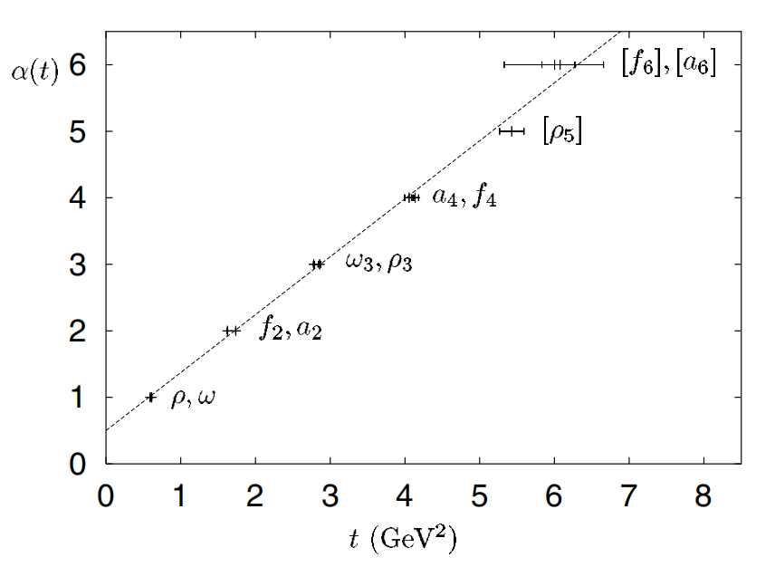
The Introduction To Pomeron
Diffractive processes provide a good ground for the dynamics of soft hadron-hadron interactions. High-energy total cross sections have a constant asymptopic behavior
Optical theorem:
In Regge theorem, at large s regionthe pp elastic amplitude reads:
Pomeron trajectory:
P.A. Zyla et al. (Particle Data Group), Prog. Theor. Exp. Phys. 2020, 083C01 (2020)
P. D. B. Collins, An Introduction to Regge Theory and High-Energy Physics
A. Donnachie and P. V. Landshoff, Nucl. Phys. B231, 189 (1984)
Notes:
1.Definition of Diffractive:
There is no universally agreed definition of diffractive processes.
Theoretically, diffraction is the effect caused by the absorption of the incoming plane-wave in some region of impact parameter,b. After a decomposition of the distorted plane-wave over the outgoing momentum, q, due to absorption we arrive at some set of plane-waves with non-zero transverse momentum, qt does not equal to 0.
Experimentally, we call diffractive the events with large rapidity gaps (LRG) in the distribution of the final state particles.
2. the pomeron interaction behavior is photonlike.

Slide 5
The Introduction To Pomeron
Donnachie-Landshoff parameterized the elastic pp-scattering amplitude in the Regge form:
the parameterized pomeron Reggeon trajectory is:
is the Dirac electromagnetic form factor of the proton
is the pomeron-quark interaction coupling
Donnachie and Landshoff had demonstrated the relationship between the phenomenological Pomeron exchange and non-perturbative QCD behavior
It is generally agreed that the pomeron exchange can be phenomenologically described as the exchange of a pair of non-perturbative gluons
A. Donnachie and P. V. Landshoff, Nucl. Phys. B311, 509 (1988)
M. Diehl, Z. Phys. C 66, 181 193 (1995)
A. Donnachie, J. Gravelis, and G. Shaw, Phys. Rev. D. 63, 114013(2001)

Slide 6
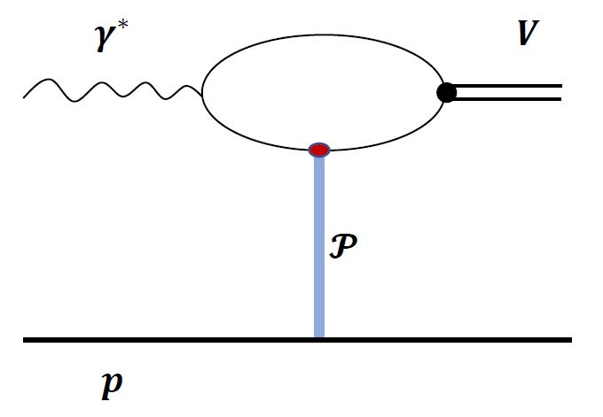
The Photonproduction Of In Elastic Scattering Process
Phenomenological Pomeron exchange gives a good description in high-energy hadronic processes for small t elastic scattering and for diffractive dissociation.
From the analyses of small-x limit behavior, the coupling of the pomeron to quarks is not quite pointlike. The form factor involves a mass scale of the order of 1 GeV
The pomeron coupling form factor is 1 for an on-shell quark.
A. Donnachie and P. V. Landshoff, Nucl. Phys. B311, 509 (1988)
pomeron coupling form factor for each off-shell leg :
The lower part of this graph is the exchange of the pomeron between a quark and a nucleon:
The cross section for vector-meson photonproduction takes the form:
J.-M. Laget, R. Mendez-Galain / Nuclear Physics A581 (1995) 397-428
Notes:
1.In the photonproduction process, one quark that couples to the upper end of the Pomeron is constrained to be near-shell by the wave function of the vector meson. The other is off-shell in an amount of the virtualities of the initial photon.
2. the pomeron form factor is 1 for an on-shell quark.

Slide 7
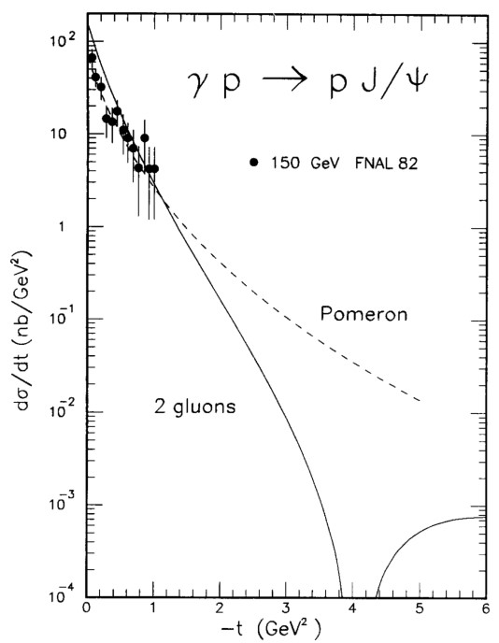
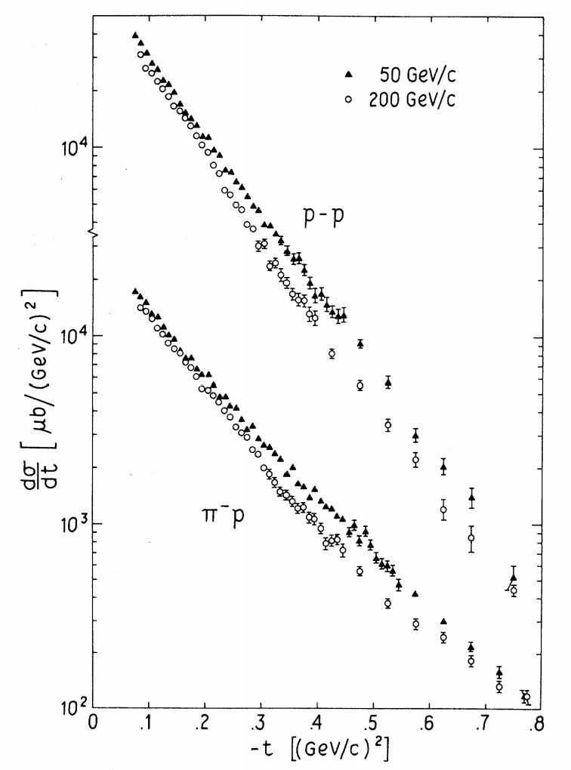
The Photonproduction Of In Elastic Scattering Process
The quark pomeron interaction coupling is only flavor dependent. From the elastic photonproduction process of , we can determine the coupling
Purely hadronic elastic reactions do not involve a pomeron form factor cause the hadronic wave functions constrain the participating quarks to be near mass shell
In analagy with the proton-proton elastic scattering case, we can derive the dynamics of meson-meson interaction through the exchange of the pomeron
The pp elastic scattering amplitude is:
The pomeron-exchange contribution to the differential cross section for elastic scattering is:
is the elastic form factor of the pion. The data fit well to:
G. A. Jaroszkiewicz and P. V. Landshoff, Phys. Rev. D10, 170 (1974)
C.W. Akerlof et. Phys.Rev.D 14 (1976) 2864

Slide 8
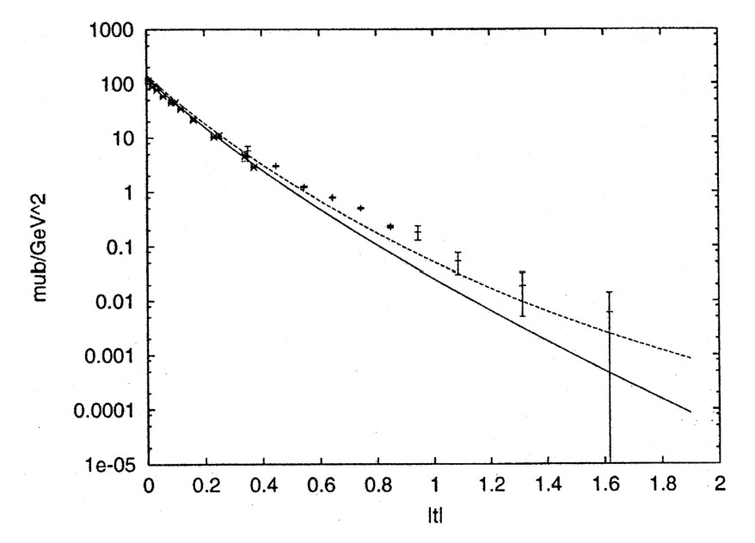
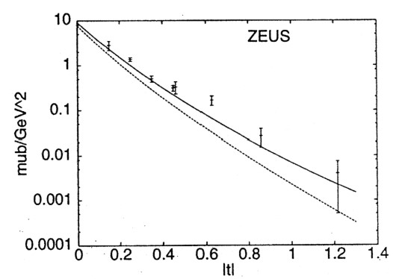
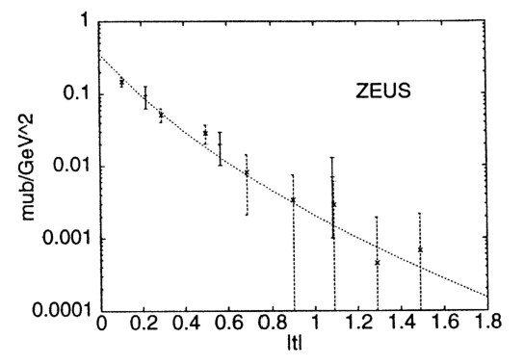
The Photonproduction Of In Elastic Scattering Process
A. Donnachie, P.V. Landshoff, Phys. Lett. B. 478, (2000) 146–150
The coupling to the vertex is rather flatter, and they treat it as a constant

Slide 9
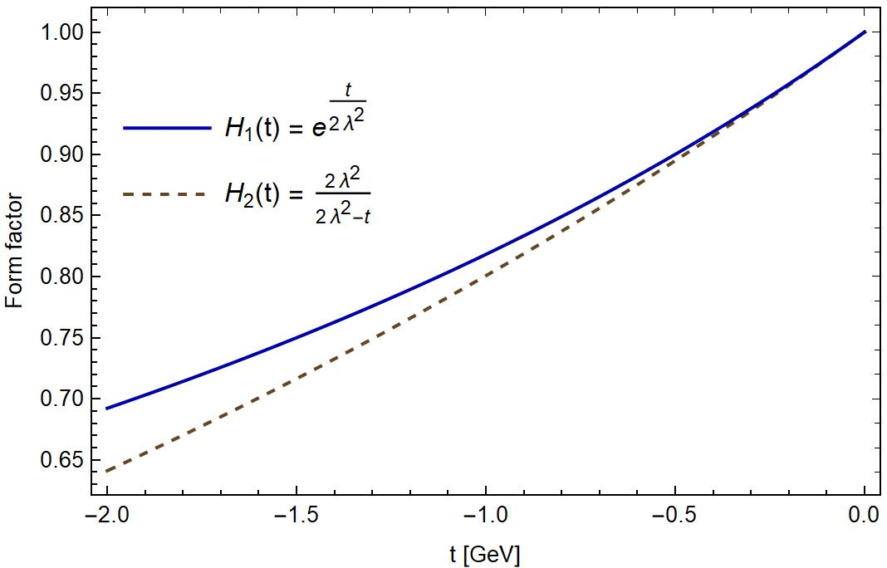
- Interaction via The Pomeron Exchange
Q. Zhao, J. P. Didelez, M. Guidal, and B. Saghai, Nucl. Phys. A660, 323 (1996)
Alexander I. Titov, Yong-seok Oh, Shin Nan Yang, Tosiyuki Morii, Phys.Rev.C 58 (1998) 2429-2449
The t channel and u channel amplitudes are expressed as:

Slide 10
- Interaction via The Pomeron Exchange
The S-wave couplings between two vector charmonia:
Notice that explicit t-dependence appears in the Pomeron exchange potential.As we only focus on the S-wave amplitude behavior in the vector charmonium scatterings, we integrate the angular part of the amplitude
We apply the following projection operators for these three quantum numbers
It is hard to deal with the tensor structure for the resummation of bubble graphic. However, the large mass of charmonium meson offers an advantage of that the three momentum are small compared to its mass in the energy region of interest.
R.Molina, D. Nicmorus, and E. Oset Phys. Rev. D. 78, 114018 (2008)
Notes:
1.The zero component of the polarization vector for outline meson can be assumed to be zero

Slide 11
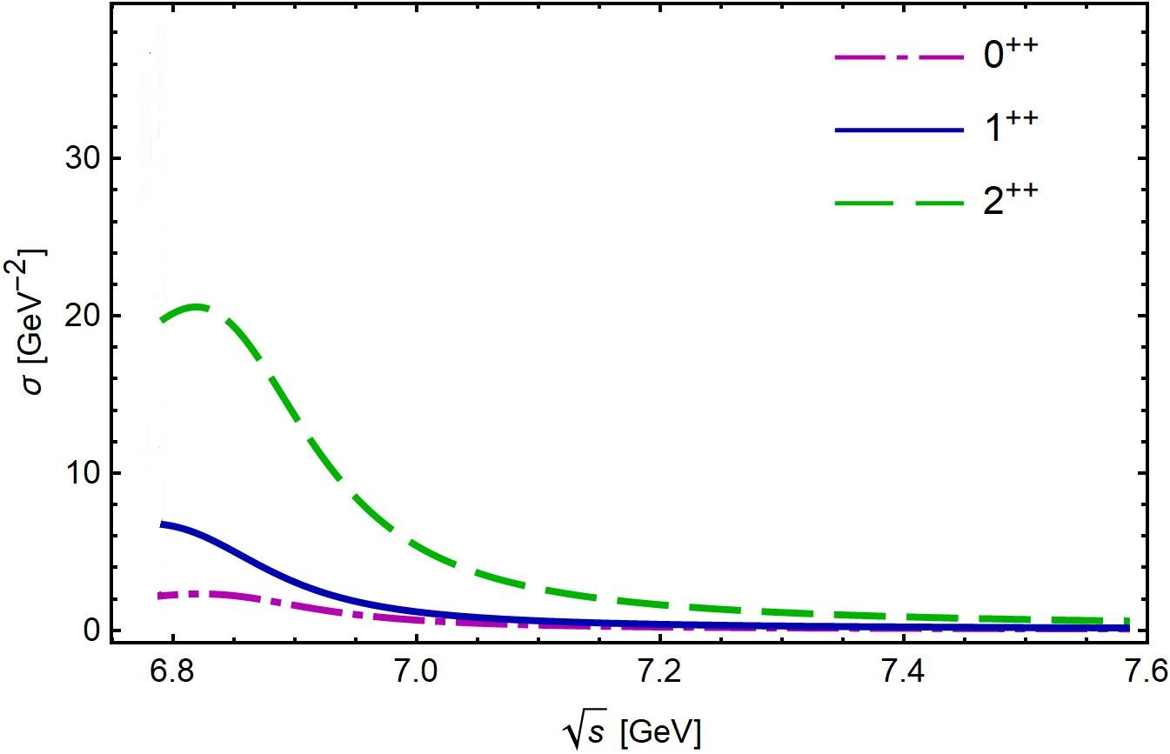
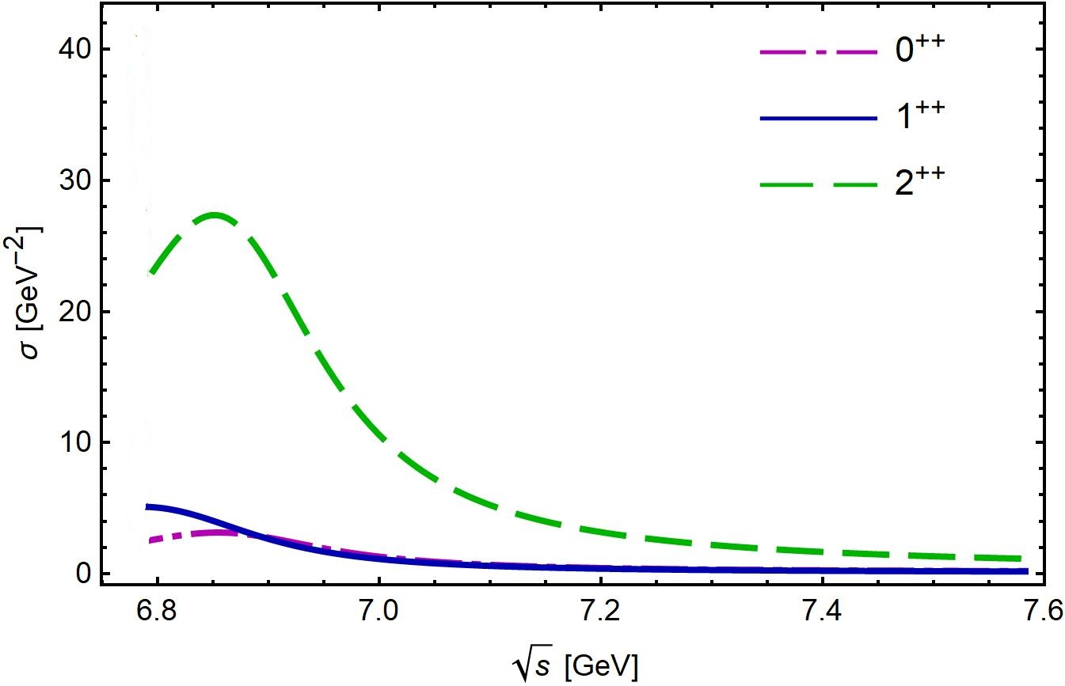
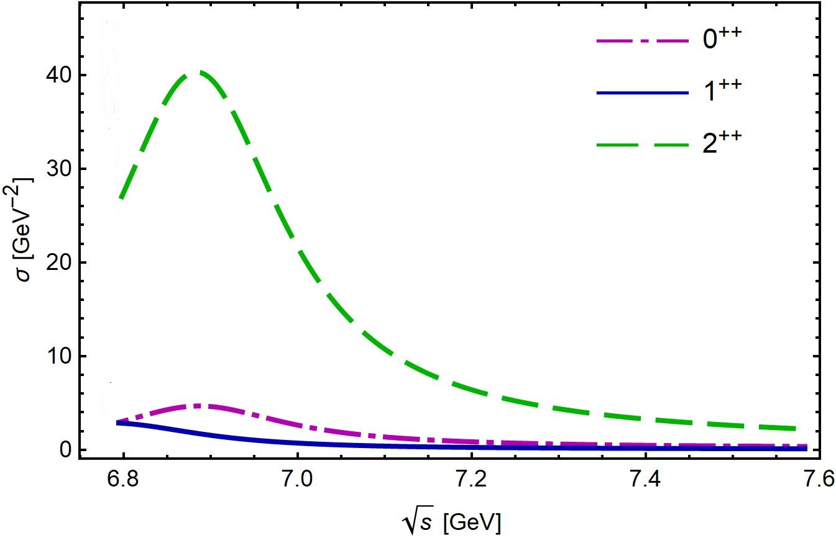
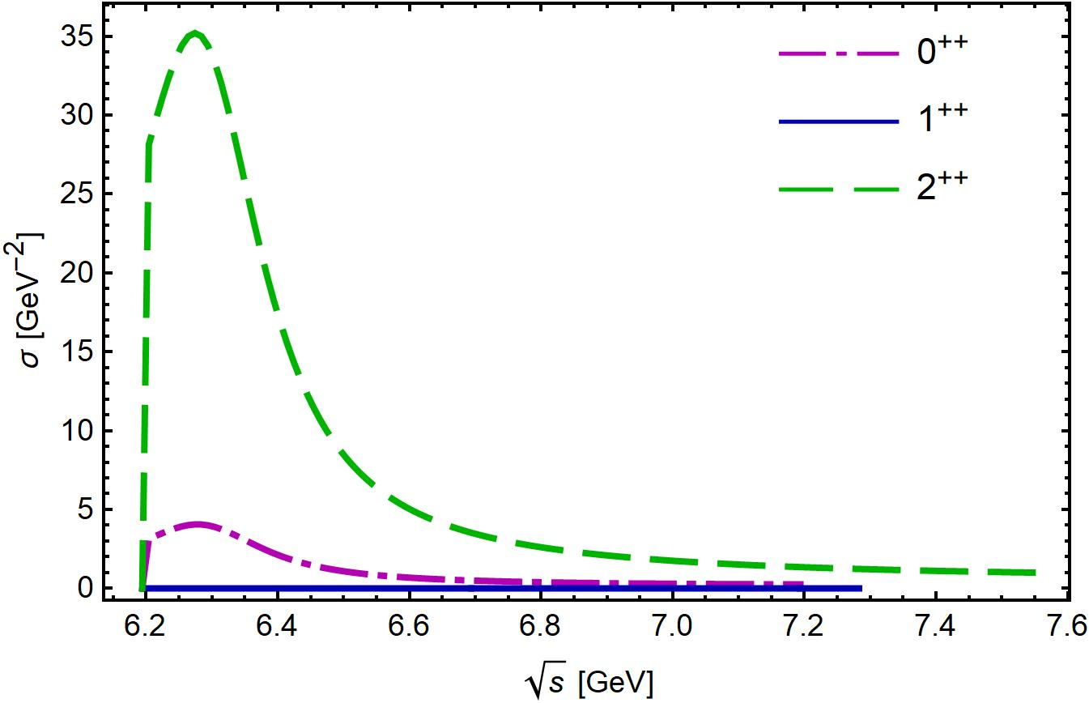
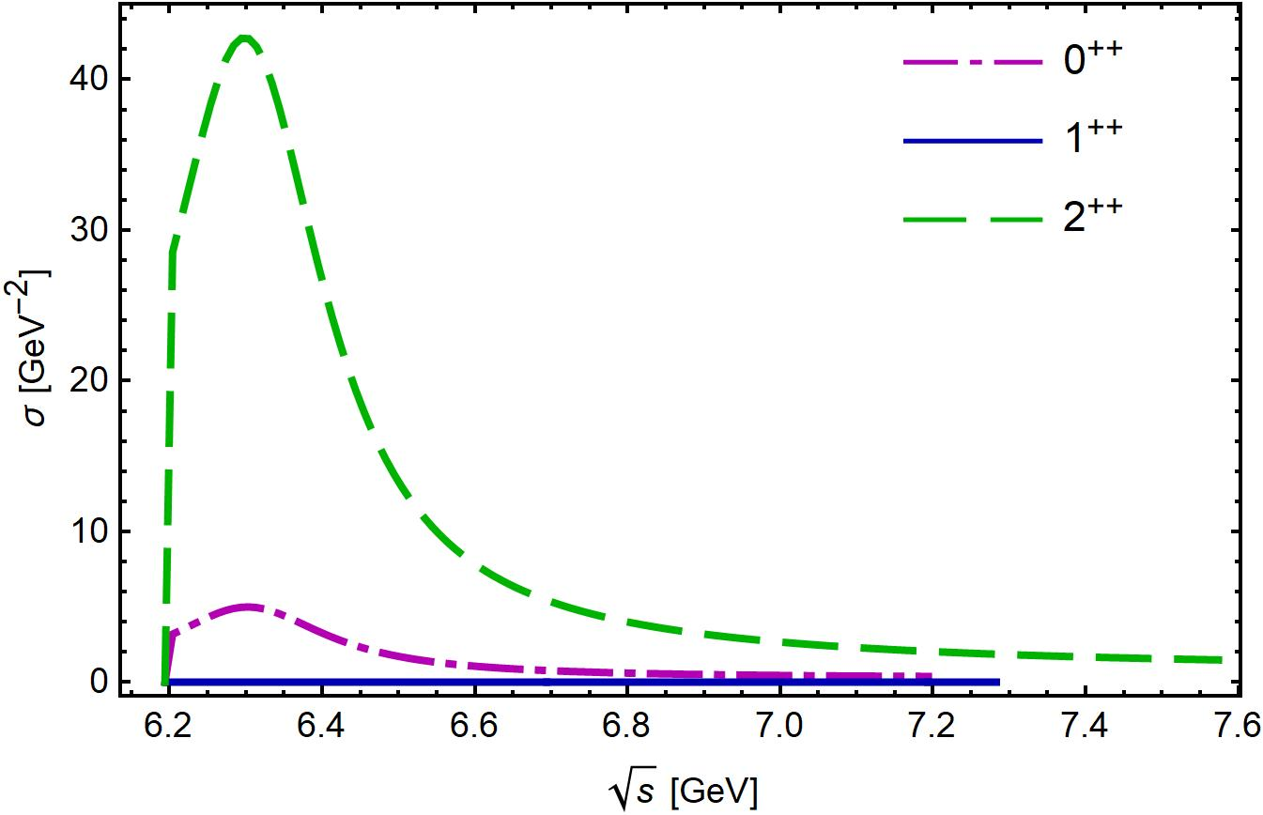
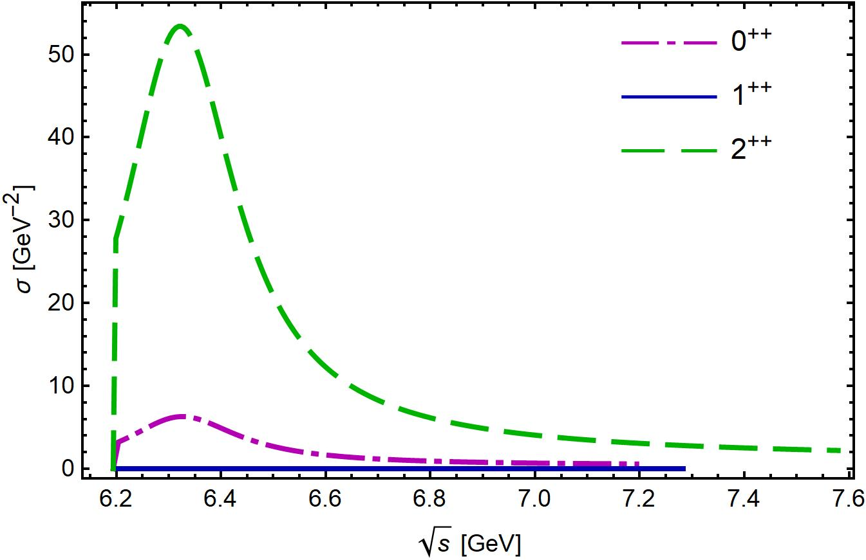
- Interaction via The Pomeron Exchange
Chang Gong, Meng-Chuan Du, Bin Zhou, Qiang Zhao, Xian-Hui Zhong[arXiv:2011.11374[hep-ph]]

Slide 12
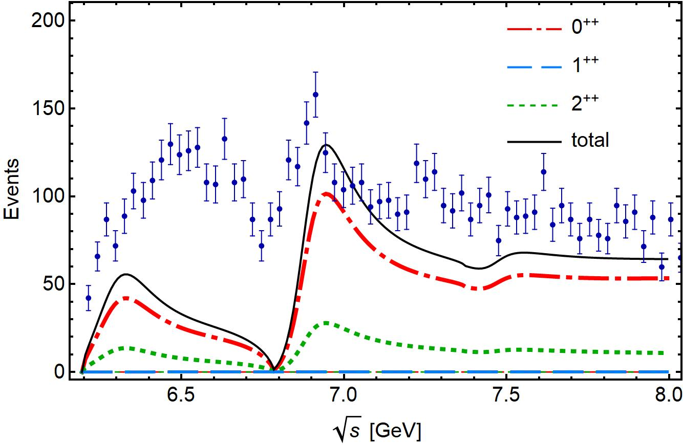
The coupled-channel model for reproducing the di-J/𝜓 energy spectrum at LHCb
We consider three coupled channel J/𝜓 -J/𝜓, J/𝜓-𝜓(2S) and 𝜓(2S)-𝜓(2S)
M. L. Du, V. Baru, F. K. Guo, C. Hanhart, U. G. Meißner, A. Nefediev and I. Strakovsky, Phys.Rev.Lett. 126, (2021) 132001
Chang Gong, Meng-Chuan Du, Bin Zhou, Qiang Zhao, Xian-Hui Zhong[arXiv:2011.11374[hep-ph]]

Slide 13
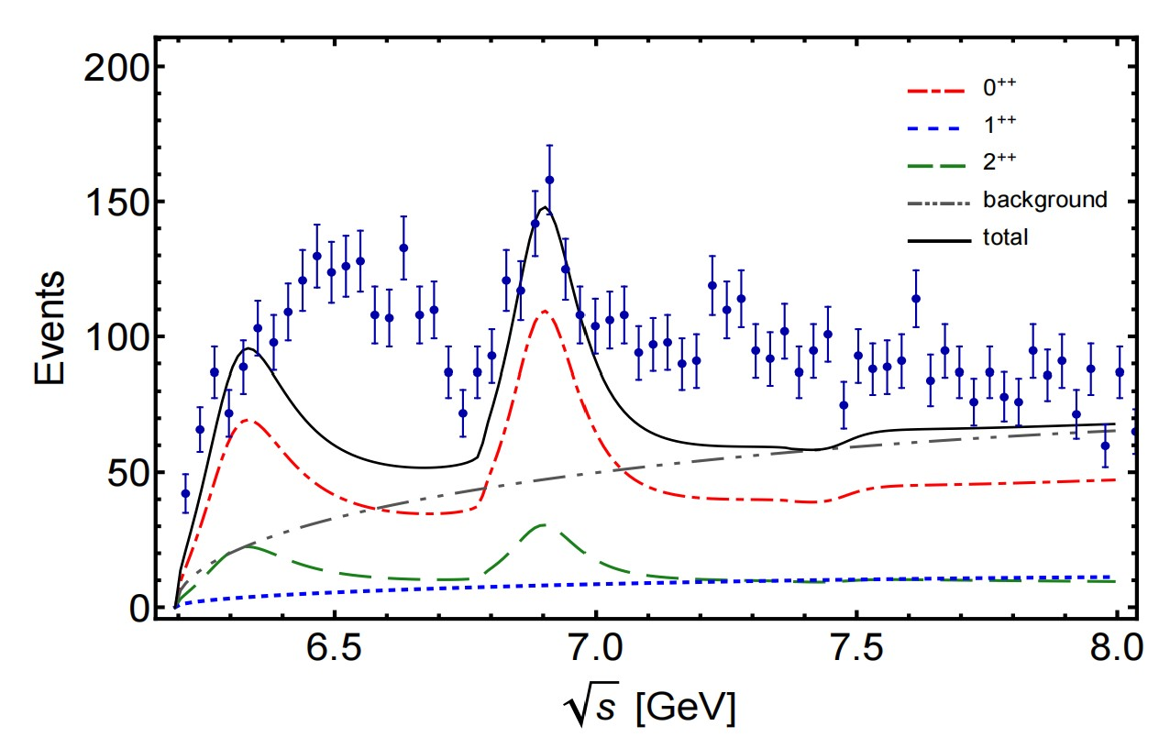
The coupled-channel model for reproducing the di-J/𝜓 energy spectrum at LHCb
$$r_{1}:r_{2}:r_{3}=1: 2e^{−iπ/2}:1$$
The phase difference between different channel.
Considering the DPS background.
The X(6900) state favors

Slide 14
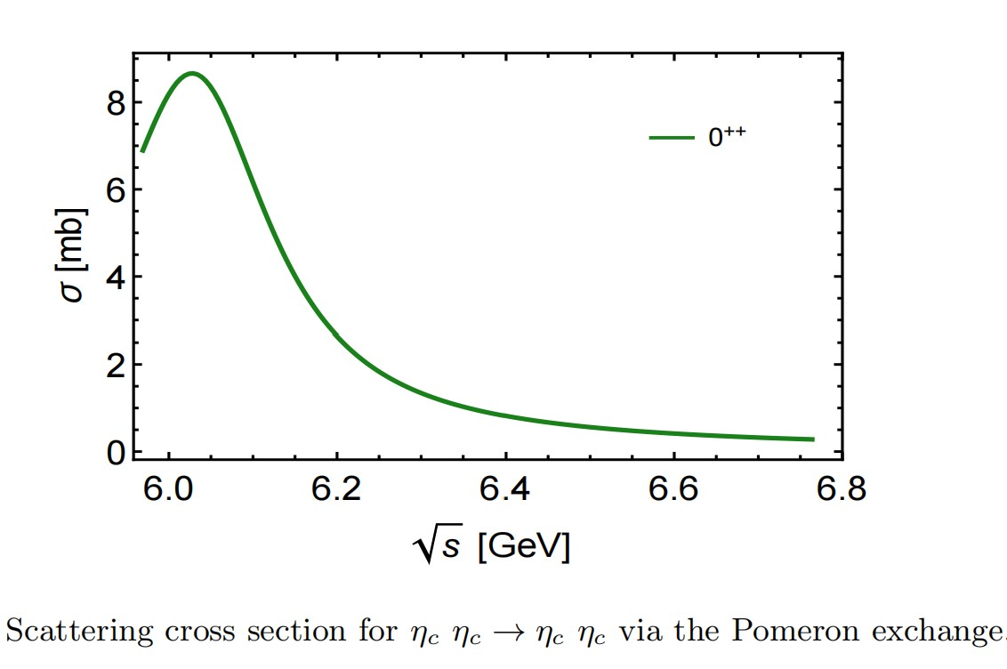
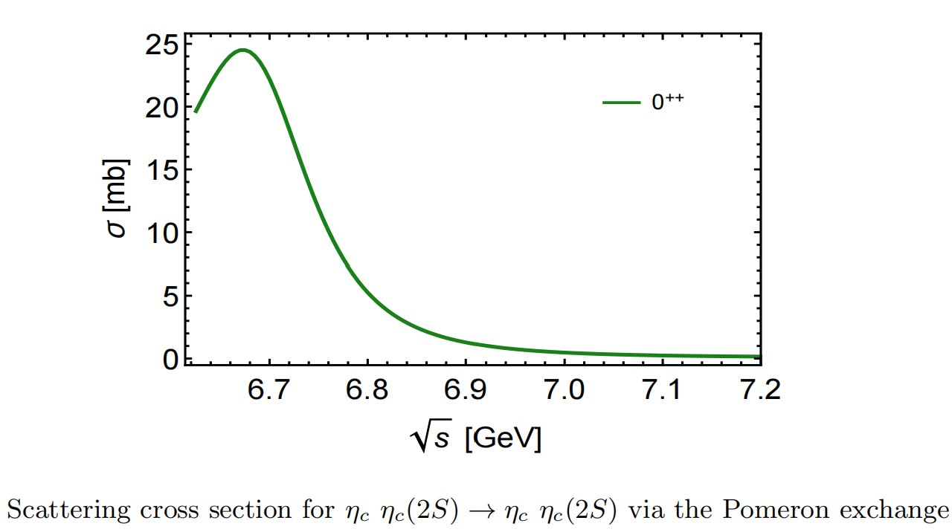
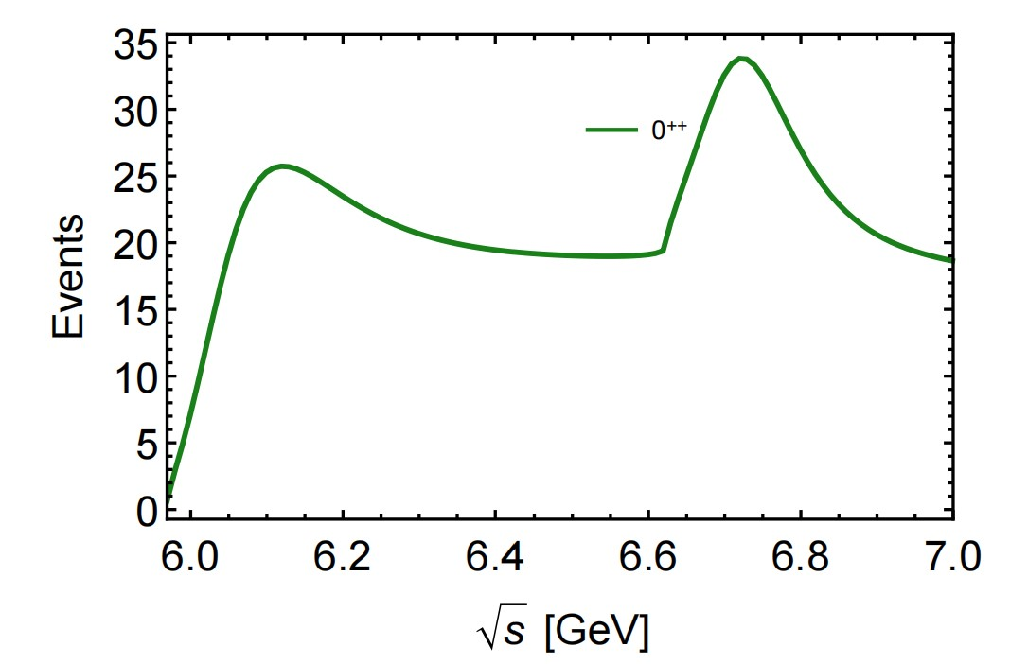
$η_{c}$- $η_{c}$ Interaction via The Pomeron Exchange
The S-wave couplings between two pseudo-scalar charmonia:
In the case that the X(6900) being an tetra-quark state with quantum number , the X(6900) can also be observed in the $η_{c}$- $η_{c}$ spectrum.
However, the Pomeron exchange mechanism for the fully-heavy quark system gives different pole positions for different channel.

Slide 15
Summary
For fully heavy charmonium system, the pomeron exchange potential offers a short-distance interaction mechanism
The S-wave - interaction via the Pomeron exchange can reproduce the X(6900) state.
The di-pseudoscalar charmonia spectrum is a good tool to reveal the underlying dynamics in the fully heavy charmonium system.
Thanks For Your Attention.

