Slide 1
第七届XYZ粒子学术研讨会
7th workshop on the XYZ particles
沈成平、张黎明、朱世琳、苑长征
2021年5月18日 青岛

Slide 2
提 纲
会议总结
XYZ研讨会回顾
致谢

Slide 3
42 plenary talks
1 overview
12 experimental talks
  BESIII, LHCb, Belle, Belle II, CMS
29 theoretical talks
  New tools
  2-, 3-, 4-, 5-, 6-, 7-, 8-quarks
  Meson, baryon, compact multiquark states, atom, molecule, kinematic effect
  Spectroscopy, properties, nature, production, decay
感谢报告人提供精彩的报告！

Slide 4

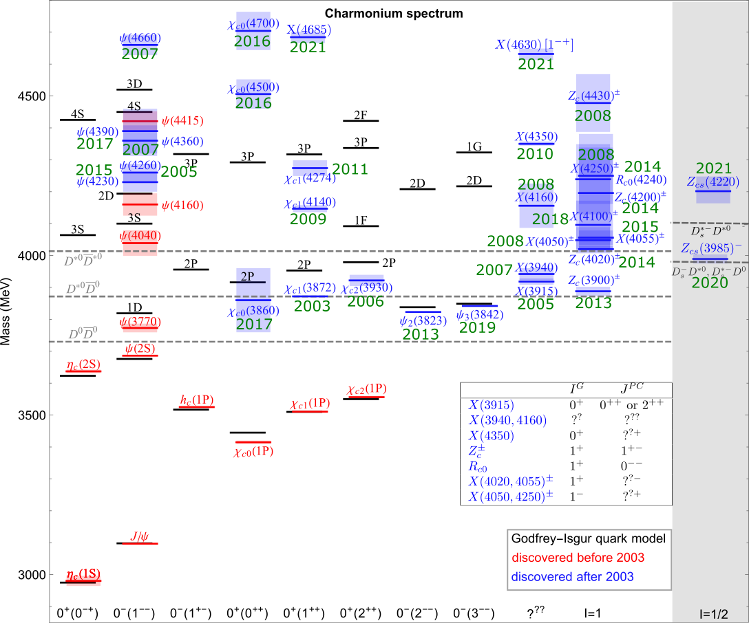









Charmonium(-like) structures
From
FKGuo
+ Pentaquarks
+ Hexaquarks
+ ……

Slide 5
Theoretical methods
From
FKGuo
Hadronic level: nonrelativistic EFT
  nonrelativistic expansion + heavy quark symmetry, with and w/o pion exchange
  poles correspond to hadronic molecules (purely molecules with only constant contact terms in single channel)
  mixing with charmonia can change the pole positions
  Low-energy constants unknown
Hadronic level: meson exchange model
  unknown/poorly known couplings
  cutoff dependence and ambiguous treatment of the short-distance potential
Quark level: quark model
  models based on chromomagnetic interactions
  diquark model
  unquenched quark model
  screened potential B.-Q. Li, K.-T. Chao (2009); …
Quark level: QCD sum rules
Kinematical triangle singularities
  Talks by 蒋军、张振华、杨智、吴天伟
E. Cincioglu, J. Nieves et al. (2016); Friedrichs model: Z.-Y. Zhou, Z.-G. Xiao (2016-2000); …
  Talks by 朱俊韬、王福来、陈锐
  Talks by 陈晓云、谭悦、刘风萧、王国利、吴雨衡
  Talk by 安洪涛
  Talk by 罗肆强
Y. Lu, N. Anwar, B.-S. Zou (2017); P. Ortega, J. Segovia, D. Entem, F. Fernandez (2018); …
  Talks by 陈伟、王志刚
  Talks by 景豪杰、刘晓海、杜蒙川

Slide 6
A few issues of interest
Width of the X(3872)
Width of the D*_{s0}(2317)
Γ_{ee} of the Y(4230) and other charmonium(like) states
Spin-parity of the pentaquark states
Production/decay rate of any predicted states
Criteria to discriminate different theoretical models
What measurements can BESIII, LHCb, Belle II do to understand any of these (exotic) states
Expectation for states in bottom sector

Slide 7
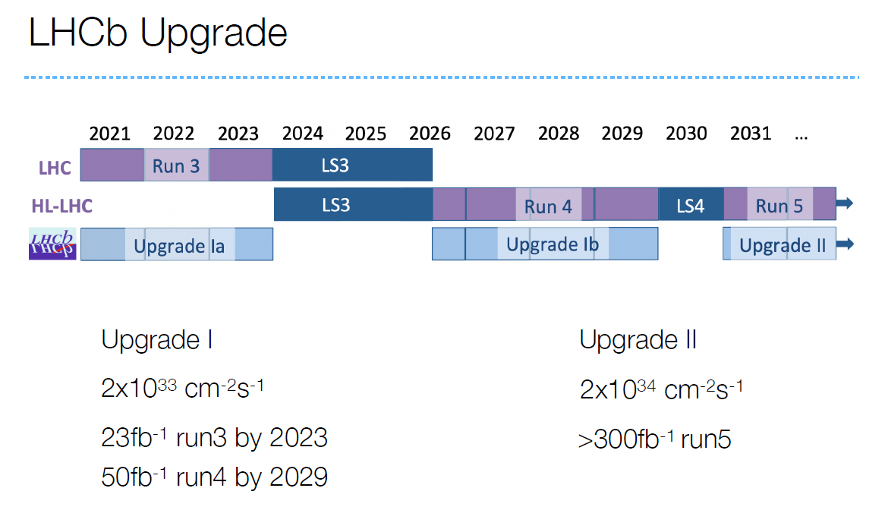
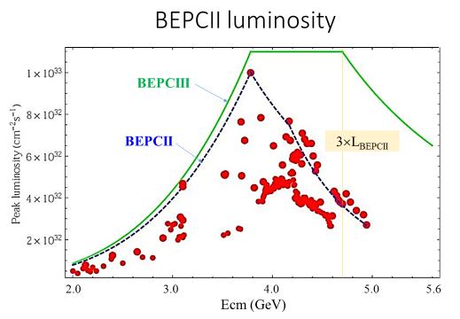
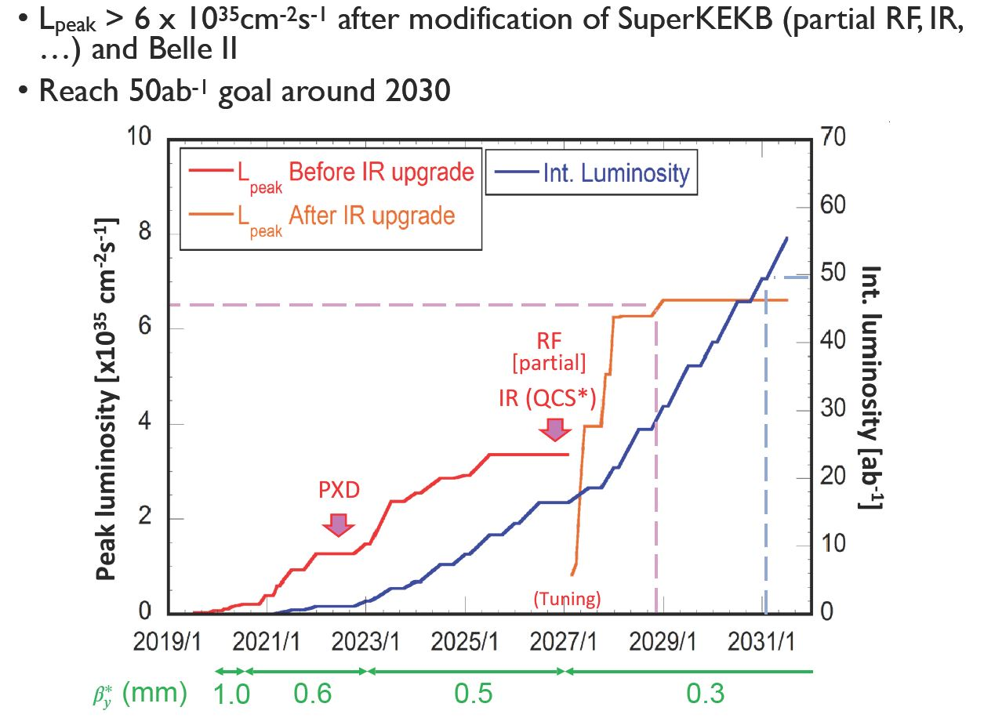
Future
Lots of data at ATLAS, CMS, ALICE experiments
+

Slide 8
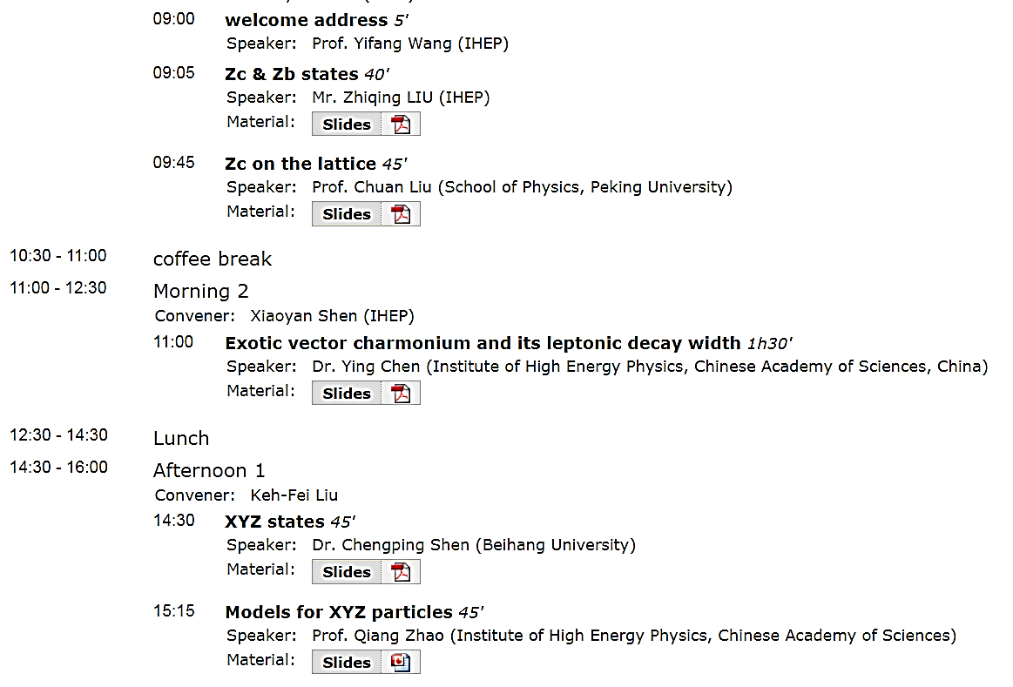
1st workshop on the XYZ particles
（2013年5月10-11日，北京四季御园）
25人参会

Slide 9
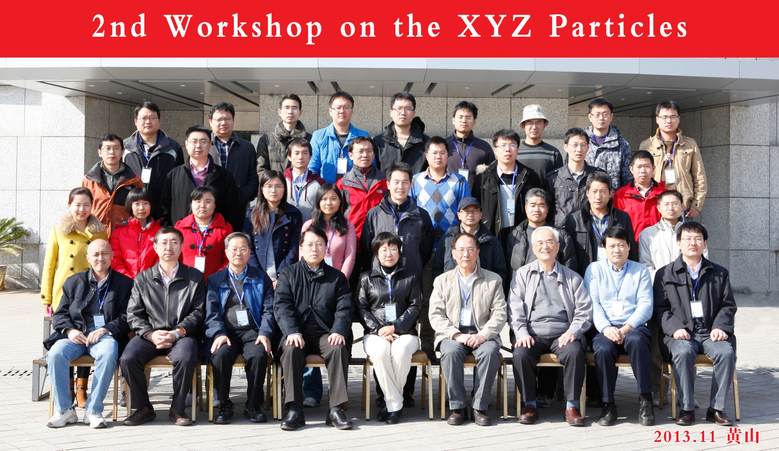
2nd workshop on the XYZ particles
（2013年11月20-22日，黄山）

Slide 10
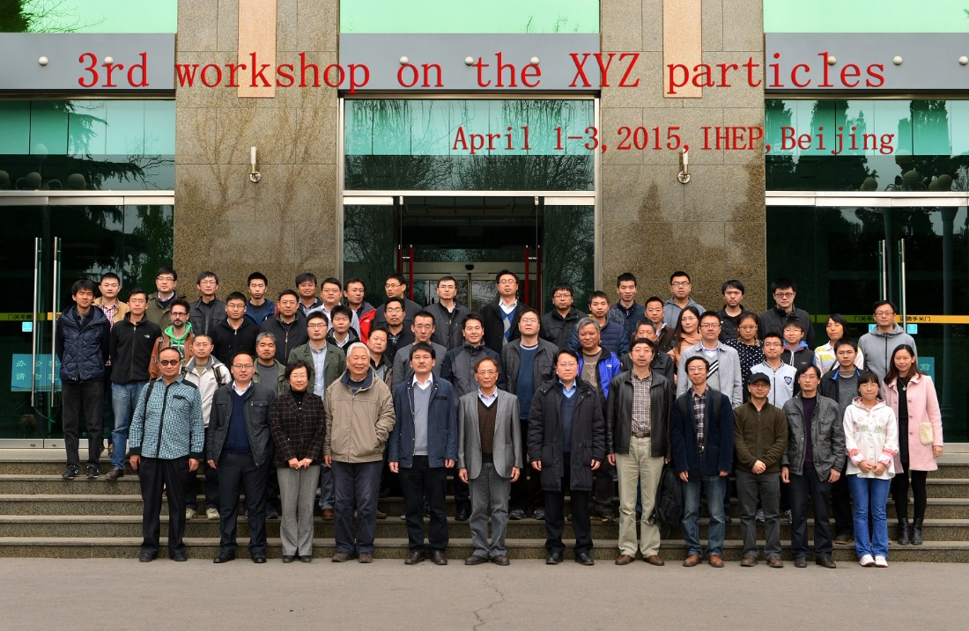
3rd workshop on the XYZ particles

Slide 11
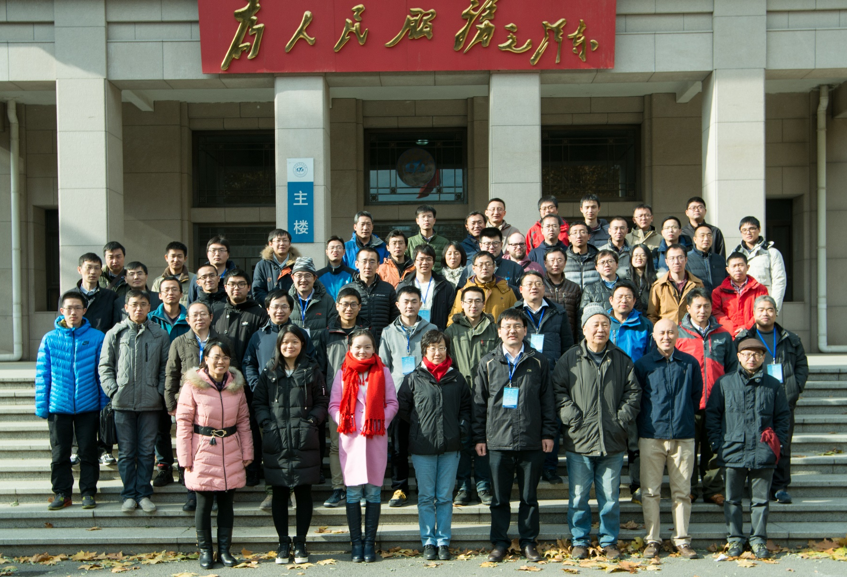
4th workshop on the XYZ particles
（2016年11月23-25日，北京航空航天大学）

Slide 12
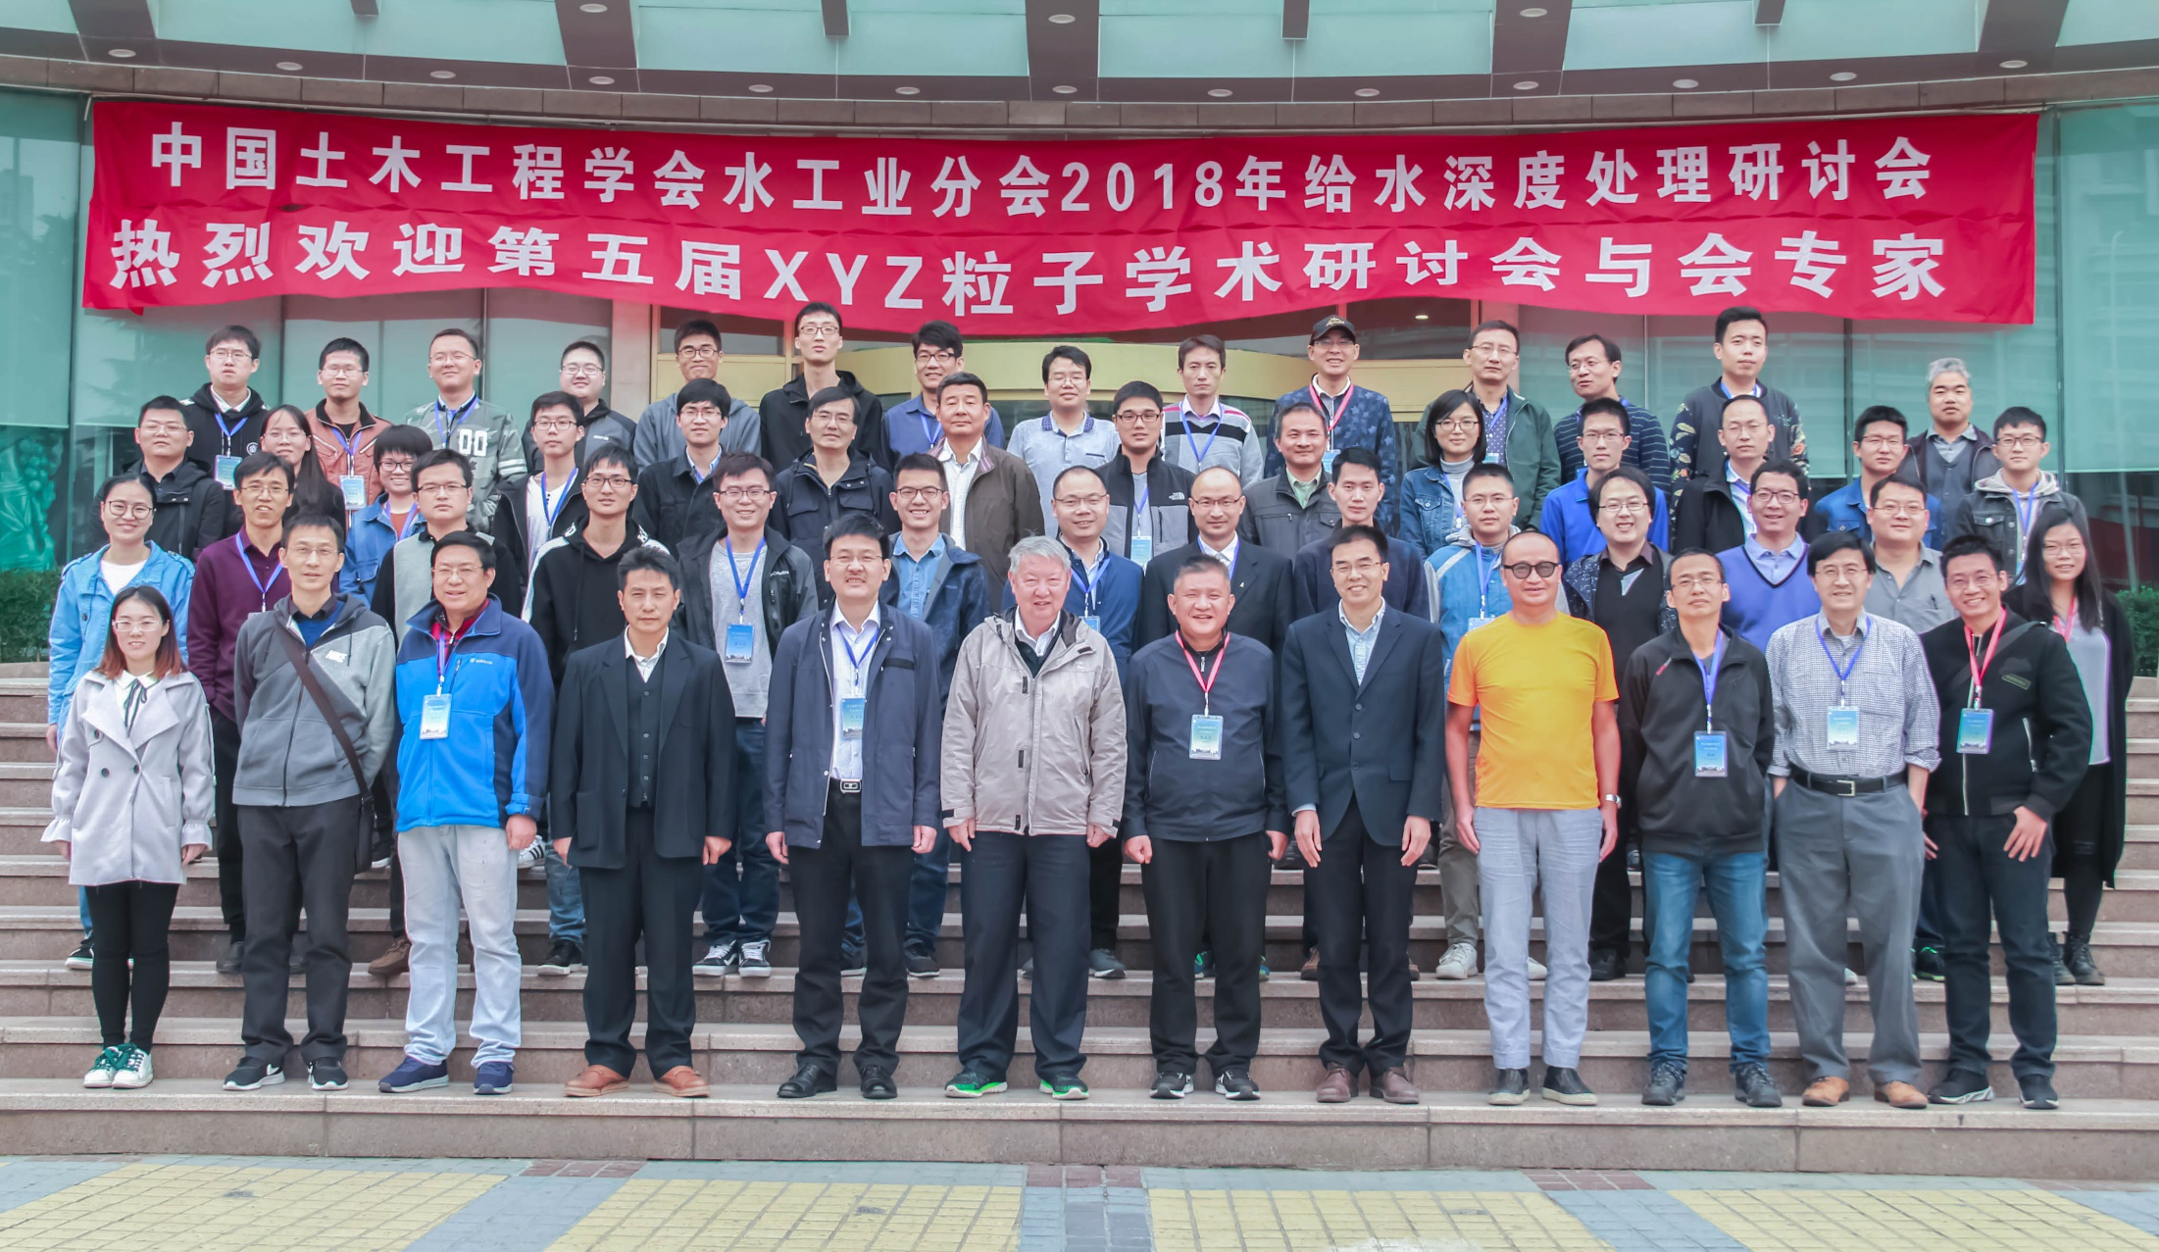
5th workshop on the XYZ particles
（2018年10月19-23日，郑州大学）

Slide 13
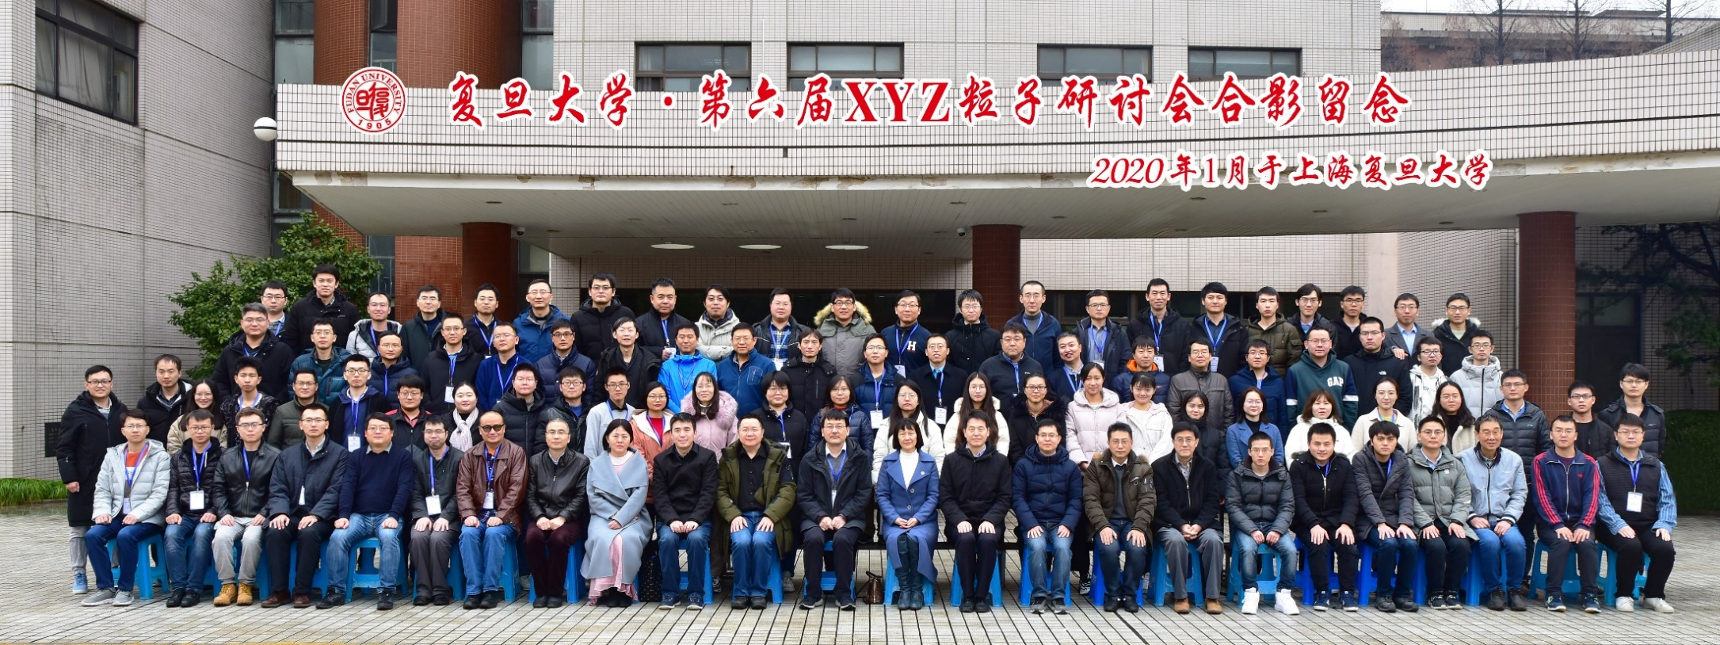
6th workshop on the XYZ particles
（2020年1月11-13日，复旦大学）
首次放开注册，注册人数136人！
【前疫情时代】

Slide 14
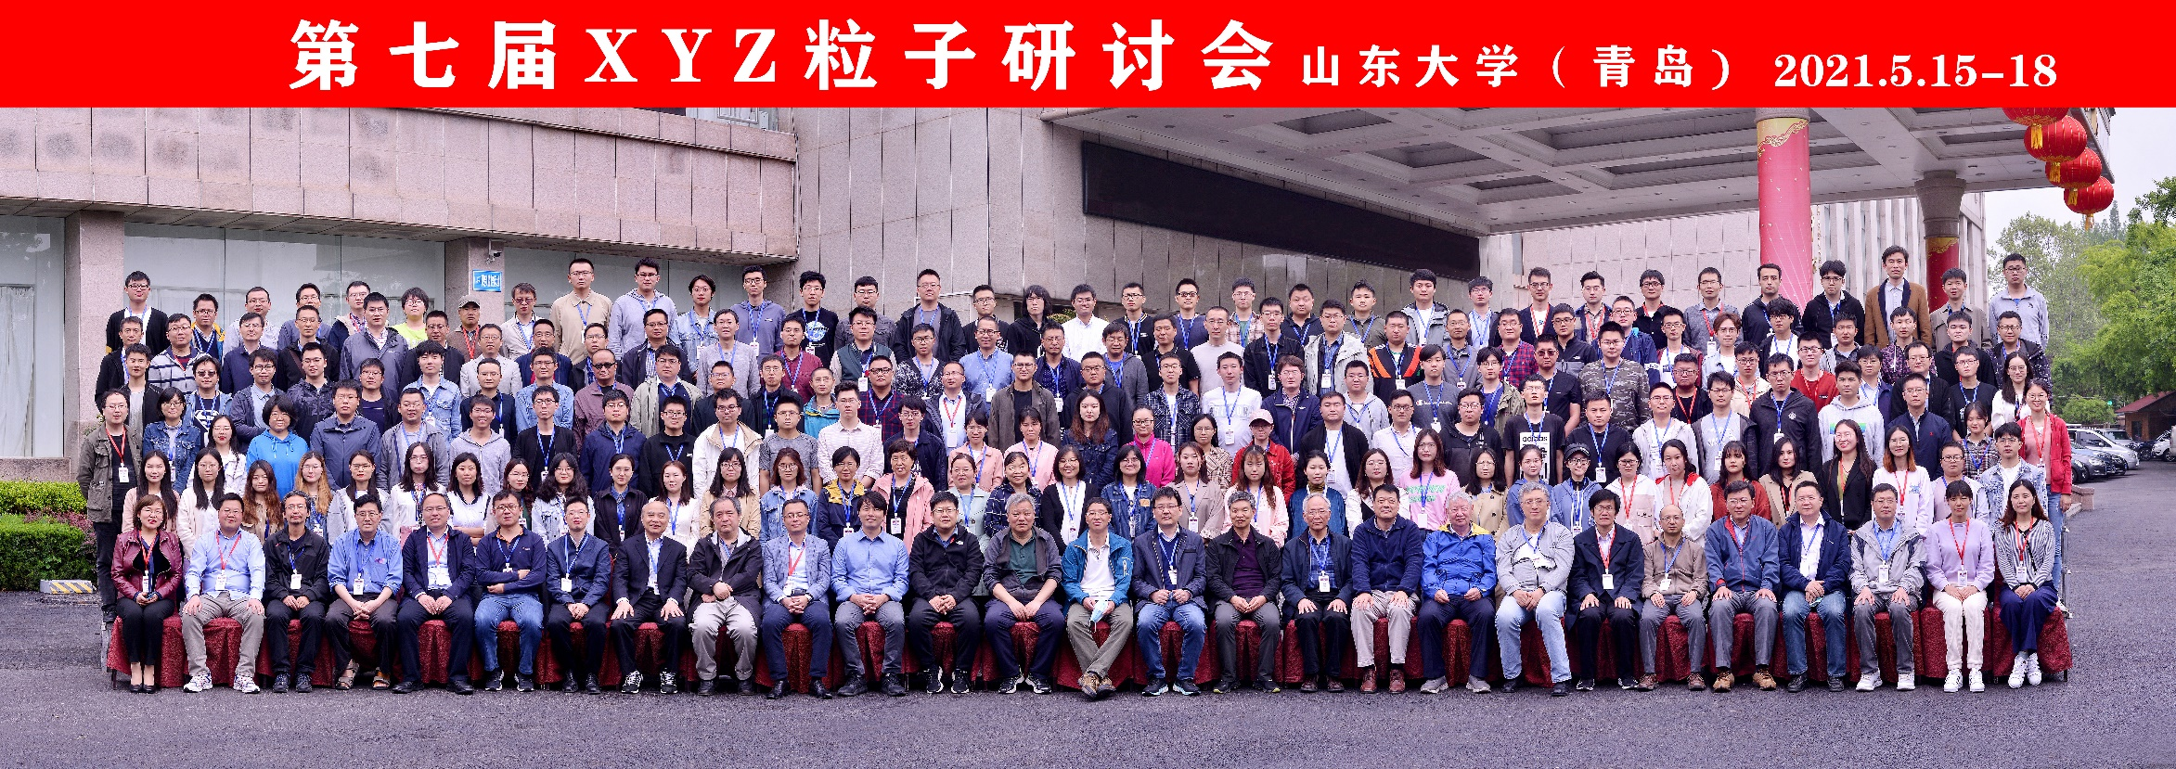
7th workshop on the XYZ particles
（2021年5月15-18日，山东大学）
后疫情时代，注册人数271人！
感谢大家参加、提交报告、参与讨论！
XYZ = 奇特强子态相关研究

Slide 15
感谢组织第七届XYZ粒子研讨会
山东大学前沿交叉科学青岛研究院粒子科学技术研究中心
  梁作堂、黄性涛、张学尧、……
刘智青等老师及团队
  老师：刘智青（主席），焦健斌，李晓玲，秦小帅，孙振田
  秘书：尹娜，张兰，孙默瑶，周梦丽
  学生与博士后
    李起鑫，吉钰瑶，国梦娇，崔佳佳，谢 勇
    曾凡蕊，王吉鹏，王玉林，韩婷婷，李井文
    牛 艳，周 航，姜侯兵，廖龙洲

Slide 16
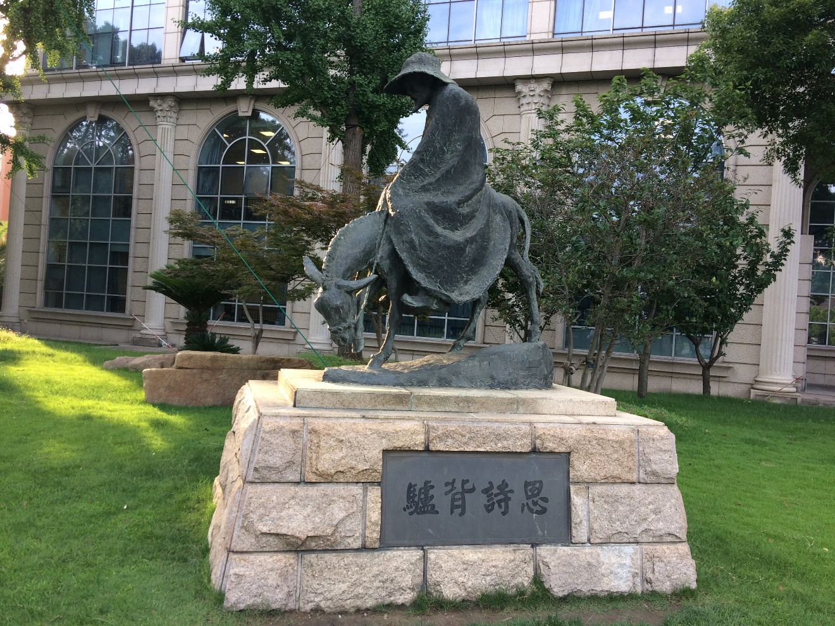
2020年1月，上海：
带着你的最新成果，明年青岛见！

Slide 17
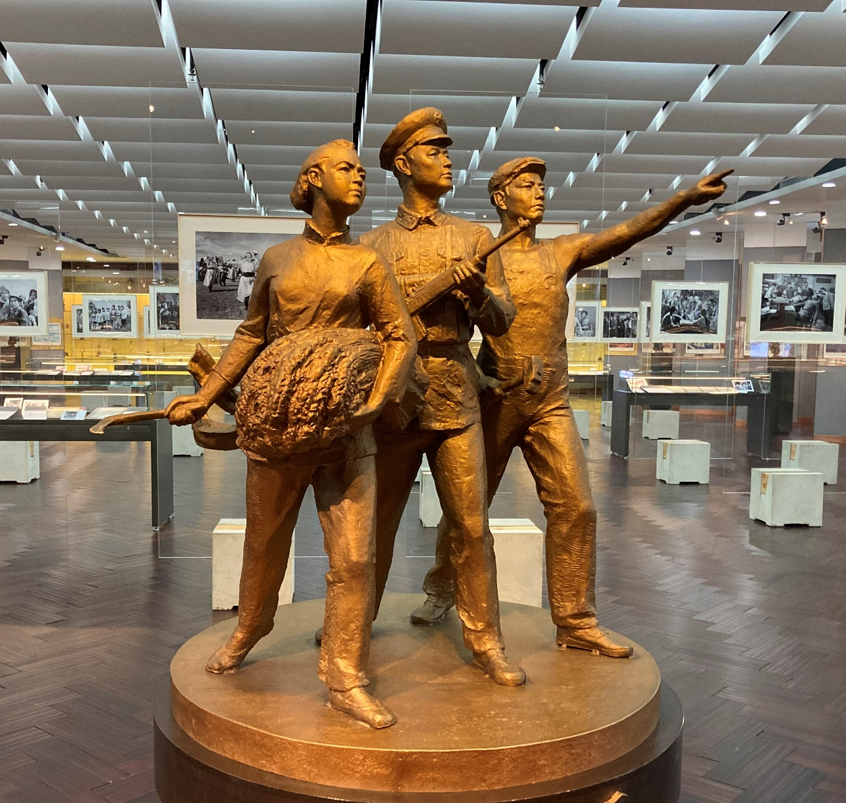
2021年5月，青岛：
带着你的最新成果，明年奔向长春！

Slide 18
backup

Slide 19
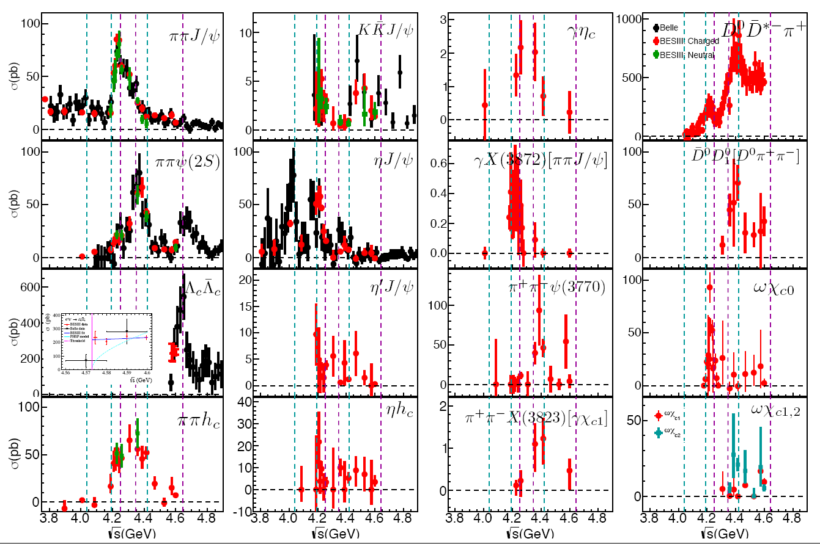
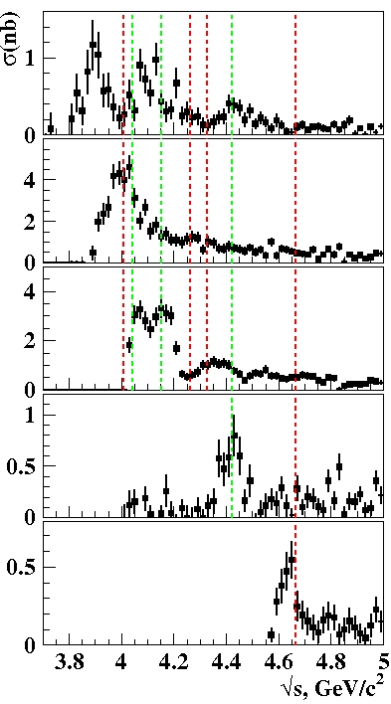
After we have measured all the e⁺e⁻ annihilation cross sections, what do we do to get the resonant parameters of the vector charmonium(-like) states?
PRD77,011103(2008)
DD
ψ(4160)
DD*
Y(4350)
PRL98, 092001 (2007)
Y(4008)
Y(4260)
D*D*
ψ(4415)
ψ(4040)
PRL100,062001(2008)
Y(4660)
DDπ
PRL101, 172001(2008)
Λ_{c}⁺Λ_{c}–
From Yuping Guo, talk @ Hadron2019, Guilin
From Galina Pakhlova

Slide 20
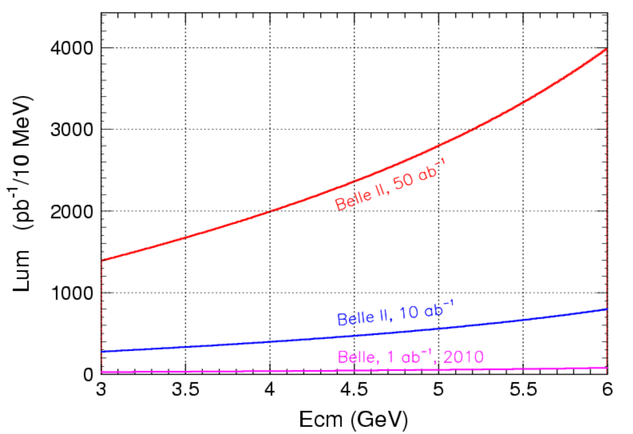
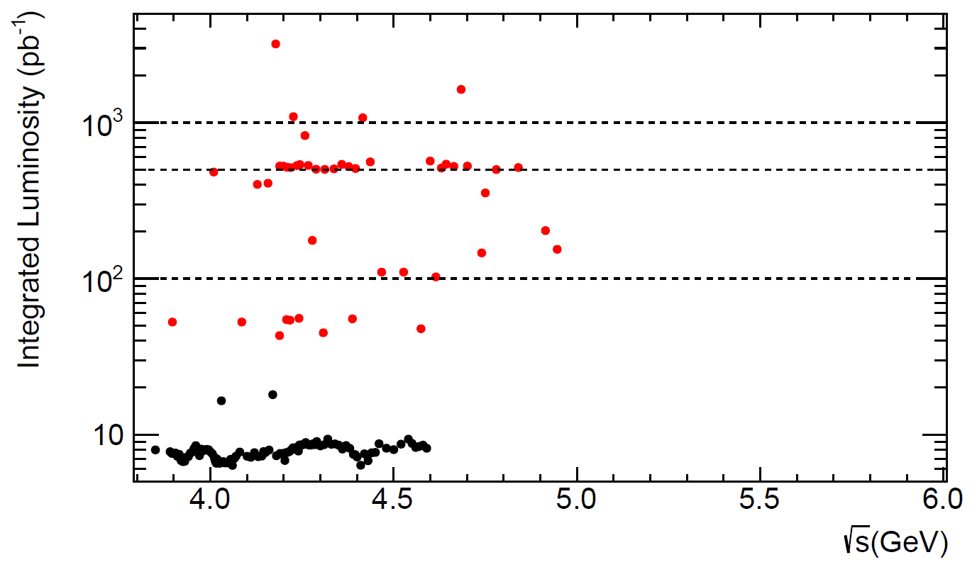


Comparison between Belle II ISR & BESIII
ISR effective luminosity
@ 10.58 GeV
2030
2025

Slide 21
Belle II vs. BESIII in XYZ study
Full Belle II data sample (50 ab⁻¹ at 10.58 GeV, ISR events in 10 MeV) compared with 0.5 fb⁻¹ at BESIII/BEPCII [or BEPCIII ]
ISR mode | L_{BESIII}/L_{Belle II} | ε_{BESIII}/ε_{Belle II} | N_{BESIII}/N_{Belle II}
π⁺π⁻J/ψ @ 4.26 GeV | 0.5 fb⁻¹ / 2.2 fb⁻¹ | 46% / 15% | 0.70
π⁺π⁻ψ’ @ 4.36 GeV | 0.5 fb⁻¹ / 2.3 fb⁻¹ | 41% / 5% | 1.82
@ 4.66 GeV | 0.5 fb⁻¹ / 2.5 fb⁻¹ | 35% / 6% | 1.19
π⁺π⁻h_{c} @ 4.26 GeV @ 4.36 GeV | 0.5 fb⁻¹ / 2.2 fb⁻¹ | 2.7% / — | > 5
K⁺K⁻J/ψ @ 4.6 GeV | 0.5 fb⁻¹ / 2.4 fb⁻¹ | 40% / 7.5% | 1.11
@ 4.9 GeV | 0.5 fb⁻¹ / 2.7 fb⁻¹ | ~40% / 10% | 0.74
Λ⁺_{c}Λ⁻_{c} @ 4.6 GeV | 0.5 fb⁻¹ / 2.4 fb⁻¹ | 51% / 7.5% | 1.42
@ 4.9 GeV | 0.5 fb⁻¹ / 2.7 fb⁻¹ | 39% / 7.5% | 0.96
Data taking strategy at BESIII is crucial! A few round of scans?

