Slide 1
Comprehensive study of light axial vector mesons with the presence of triangle singularity
arXiv:2103.16861
Meng-chuan Du (杜蒙川)
In collaboration with Prof. Qiang Zhao (赵强)
2021年5月18日，青岛

Slide 2
Content
Introduction
Decay with the presence of TS
Numerical results
Conclusion

Slide 3
Introduction

Slide 4
$q\overline{q}$ mesons
In quark model, the axial vector mesons (AVM) are states with $^{2s+1}P_{J}= ^{3}P_{1}$ and$^{1}P_{1}$
$$J^{PC}=1^{+−}$$
$$J^{PC}=1^{++}$$
In PDG, the assignments and masses are
States | Mass [MeV]
$$a_{1}(1260)$$ | $$1230±40$$
$$f_{1}(1285)$$ | $$1281.9±0.5$$
$$f_{1}(1420)$$ | $$1426.3±0.9$$
$$b_{1}(1235)$$ | $$1229.5±3.2$$
States | Mass [MeV]
$$h_{1}(1170)$$ | $$1166±8$$
$$h_{1}(1415)$$ | $$1416±8$$
$$K_{1}(1270)$$ | $$1253±7$$
$$K_{1}(1400)$$ | $$1403±7$$

Slide 5
Open $K^{∗}\overline{K}$ threshold and TS
Abnormal isospin breaking in $J/ψ→γη\left(1405/1475\right)→γ+3π$
M. Ablikim et al. [BESIII], PRL 108,182001(2012)
TS mechanism is the key
J. J. Wu, X. H. Liu, Q. Zhao and B. S. Zou, PRL 108,081803(2012)
F. Aceti, W. H. Liang, E. Oset, J. J. Wu and B. S. Zou, PRD 86,114007(2012)
N. N. Achasov, A. A. Kozhevnikov and G. N. Shestakov, PRD 92, 036003(2015)
M. C. Du and Q. Zhao, PRD 100,036005(2019)
TS mechanism for $J/ψ→γf_{1}(1420)→γ+3π$
X. G. Wu, J. J. Wu, Q. Zhao and B. S. Zou, Phys. Rev. D 87, 014023 (2013)
$a_{1}(1420)$ observed in $π^{−}p→p+f_{0}π^{−}→p+π^{+}π^{−}π^{−}$
C. Adolph et al. [COMPASS], PRL 115,082001(2015)
H. X. Cheng, E. L. Cui, W. Chen, T. G. Steele, X. Liu and S. L. Zhu, PRD 91,094022 (2015)
Qiang Zhao, Hadron-2013, Nara, Japan
M. Mikhasenko, B. Ketzer and A. Sarantsev, PRD 91,094015 (2015)
F. Aceti, L.R.Dai and E. Oset, PRD 94,096015(2016)
M. G. Alexeev et al. [COMPASS], arXiv:2006.05342(2020)

Slide 6
Hadronic molecules
$f_{1}(1420)$ could be a $K^{∗}\overline{K}$molecule.
R.S.Longacre, PRD 42,874(1990)
S-wave $K^{∗}\overline{K}$ interaction can dynamically generate $f_{1}\left(1285\right), a_{1}\left(1260\right) ,h_{1}\left(1170\right),h_{1}\left(1415\right)$ and $b_{1}(1235)$ states. It is found that $f_{1}(1420)$ could be accommodated by the molecule framework.
L.Roca, E.Oset and J.Singh PRD 72,014002(2005)
$f_{1}(1420)$ is a kinematic effect induced by the TS of $f_{1}(1285)$
V. R. Debastiani, F. Aceti, W. H. Liang and E. Oset, PRD 95,034015(2017)
$J/ψ→πb_{1},h_{1}\left(1170\right)η^{\left(′\right)},h_{1}\left(1415\right)η^{(′)}$ are studied treating these mesons as dynamically generated states by the pseudoscalar and vector S-wave couplings
W. H. Liang, S. Sakai and E. Oset, PRD 99,094020(2019)

Slide 7
Our scheme
The calculation based on the molecular-state picture is not fully consistent with experiment results.
In our study we simply take these states as quark model states. The mixing angles are introduced and the production and decay channels are constrained by SU(3) flavor symmetry.
We will then give a brief introduction to the mixing angle and the production mechanism. After that we will discuss the decay mechanism with the presence of TS.

Slide 8
State mixing and production

Slide 9
Mixing angles
$h_{1},h_{1}^{′},f_{1},f_{1}^{′},K_{1A},K_{1B}$ are mixing objects of physical states.
$$\left(\begin{matrix}K_{1}(1270) \\ K_{1}(1400)\end{matrix}\right)=\left(\begin{matrix}\cos{θ_{K_{1}}} & \sin{θ_{K_{1}}} \\ −sin{θ_{K_{1}}} & \cos{θ_{K_{1}}}\end{matrix}\right)\left(\begin{matrix}K_{1B} \\ K_{1A}\end{matrix}\right)$$
$$\left(\begin{matrix}f_{1}^{′} \\ f_{1}\end{matrix}\right)=\left(\begin{matrix}\cos{θ_{f}} & −\sin{θ_{f}} \\ \sin{θ_{f}} & \cos{θ_{f}}\end{matrix}\right)\left(\begin{matrix}{\tilde{f}}_{8} \\ {\tilde{f}}_{1}\end{matrix}\right)=\left(\begin{matrix}\cos{α_{f}} & −\sin{α_{f}} \\ \sin{α_{f}} & \cos{α_{f}}\end{matrix}\right)\left(\begin{matrix}f_{n} \\ f_{s}\end{matrix}\right)$$
$$\left(\begin{matrix}h_{1}^{′} \\ h_{1}\end{matrix}\right)=\left(\begin{matrix}\cos{θ_{h}} & −\sin{θ_{h}} \\ \sin{θ_{h}} & \cos{θ_{h}}\end{matrix}\right)\left(\begin{matrix}{\tilde{h}}_{8} \\ {\tilde{h}}_{1}\end{matrix}\right)=\left(\begin{matrix}\cos{α_{h}} & −\sin{α_{h}} \\ \sin{α_{h}} & \cos{α_{h}}\end{matrix}\right)\left(\begin{matrix}h_{n} \\ h_{s}\end{matrix}\right)$$
$$α=θ+\arctan{\sqrt{2}}$$
$${\tilde{f}}_{8},{\tilde{h}}_{8}=\frac{u\overline{u}+d\overline{d}−2s\overline{s}}{\sqrt{6}};{\tilde{f}}_{1},{\tilde{h}}_{1}=\frac{u\overline{u}+d\overline{d}+s\overline{s}}{\sqrt{3}}; f_{n}, h_{n}=\frac{u\overline{u}+d\overline{d}}{\sqrt{2}}; f_{s},h_{s}=s\overline{s}$$
Gell-Mann-Okubo relation
$$θ_{f}, α_{f}$$
${|θ}_{K_{1}}|∼{34}^{∘} or {57}^{∘}$,
$\left|θ_{K_{1}}\right|<{45}^{∘}$is favored ,
$$α_{f}≃{84.5}^{∘}, α_{h}≃{91.8}^{∘}$$
$$|θ_{K_{1}}|$$
$$θ_{h}, α_{h}$$
H. Y. Cheng, PLB 707,116

Slide 10
Production in $e^{+}e^{−}$ annihilation
$f_{1}(f_{1}^{′})$ can be produced in $J/ψ→γf_{1}(f_{1}^{′})$
$$\frac{g_{f^{′}}}{g_{f}}=\frac{⟨f_{1}^{′}γ|\hat{H}|J/ψ⟩}{⟨f_{1}γ|\hat{H}|J/ψ⟩}=\frac{\sqrt{2}\cos{α_{f}}−\sin{α_{f}}}{\sqrt{2}\sin{α_{f}}+\cos{α_{f}}}$$
$$\left\langle {\left(s\overline{s}\right)}_{1^{++}}γ\left|\hat{H}\right|J/ψ\right\rangle ≃\left\langle {\left(u\overline{u}\right)}_{1^{++}}γ\left|\hat{H}\right|J/ψ\right\rangle =\left\langle {\left(d\overline{d}\right)}_{1^{++}}γ\left|\hat{H}\right|J/ψ\right\rangle$$
$J/ψ→γa_{1}$ is suppressed$. a_{1}$ can be searched in $ψ\left(3686\right)→γχ_{c1}→γπa_{1}→γ+4π$
$$B.R\left(ψ(2S\right)→γχ_{c1})=\left(9.79±0.2\right)\%$$
$b_{1}$ and $h_{1}(h_{1}^{′})$ can be searched in $J/ψ→πb_{1}$, and $J/ψ→η^{(′)}h_{1}^{(′)}$. They are constrained by SU(3) symmetry, i.e.
$$L_{ψBP}=g_{ψBP}ψ^{μ}⟨B_{μ}P⟩$$
$B.R\left(J/ψ→π^{±}b_{1}^{∓}\right)=\left(3±0.5\right)×{10}^{−3}$,
$B.R. \left(J/ψ→η^{′}h_{1}^{′}→η^{′}K^{∗}\overline{K}+c.c.\right)=\left(2.16±0.31\right)×{10}^{−4}$.
Double-OZI suppressed process is possible for $J/ψ→η^{(′)}h_{1}^{(′)}$

Slide 11
Decay with the presence of TS

Slide 12
TS enhanced decay channels
There could be strong impact of TS in the following channels
$f_{1}\left(f_{1}^{′}\right)→a_{0}π→ηππ$,
$f_{1}\left(f_{1}^{′}\right)→a_{0}π→K\overline{K}π$,
$f_{1}\left(f_{1}^{′}\right)→f_{0}π→3π$,
$a_{1}→f_{0}π→3π$,
$b_{1}→φπ→K\overline{K}π$,
$h_{1}\left(h_{1}^{′}\right)→φπ→K\overline{K}π$,
$$K^{∗}({\overline{K}}^{∗})$$
$$π$$
$$A$$
$$K(\overline{K})$$
$$\overline{K}(K)$$
$$X$$
$I=0$ $K\overline{K}$ can couple to $f_{0}$ in S-wave, $φ$ and $ω$ in P-wave,
$I=1 K\overline{K}$ can couple to $a_{0}$ in S-wave, $ρ$ in P-wave.
There are other resonant contributions to some of these channels.
Effective couplings of axial vector mesons are constrained by experiments and symmetry.

Slide 13
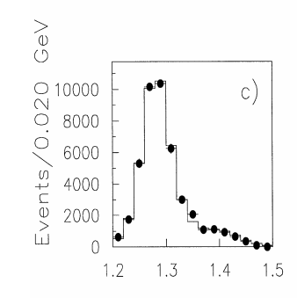
$$f_{1}\left(f_{1}^{′}\right)→a_{0}π→ηππ$$
$a_{0}π$ is one of the dominant decay channels of $f_{1}$
$$B.R.\left(f_{1}→a_{0}π→ηππ\right)=\left(38±4\right)\%$$
In PDG, $f_{1}^{′}→a_{0}π$ is “possibly seen”. The branching ratio of $f_{1}^{′}→a_{0}π$ is small.
There is weak signal of $f_{1}^{′}$ in $ηπ^{+}π^{−}$ final state in $pp$ scattering by WA102 collaboration [1].
Fig.1 $J^{PC}=1^{++}$ $a_{0}π$ wave of the $ηπ^{+}π^{−}$ spectrum in $pp→p_{f}\left(ηπ^{+}π^{−}\right)p_{s}$. The $0^{− +}$ wave is suppressed in central production.[1]
[1] D. Baberis et al. [WA102], PLB 440,252

Slide 14
$$f_{1}\left(f_{1}^{′}\right)→a_{0}π→ηππ$$
The interactions are given by
$L_{AVP}={ig}_{AVP}〈A^{μ}\left[V_{μ},P\right]〉$ $L_{VPP}=ig_{VPP}〈V^{μ}\left[P,∂_{μ}P\right]〉$
Matric elements of $A,V,P$ are fields of axial vector mesons $(J^{PC}=1^{++})$, vector mesons and psedoscalar mesons multiplets.
P-wave bare vertices of $f_{1}\left(f_{1}^{′}\right)→a_{0}π$ are given by the $|n\overline{n}〉$ component of $f_{1}(f_{1}^{′})$
$$L_{f_{1}a_{0}π}=g_{ASP}\sin{α_{f}} f_{1}^{μ}(π∂_{μ}a_{0}−a_{0}∂_{μ}π)$$
$$L_{f_{1}^{′}a_{0}π}=g_{ASP}\cos{α_{f}} f_{1}^{μ}(π∂_{μ}a_{0}−a_{0}∂_{μ}π)$$
$g_{ASP}$ and $g_{AVP}$ are pending determined

Slide 15
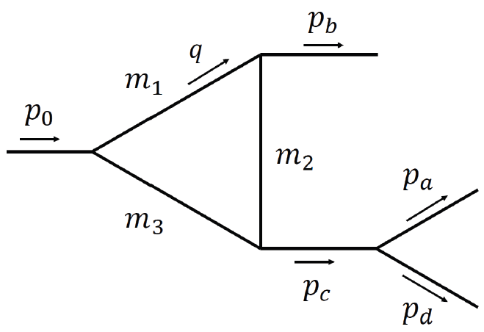
Loop integral for $A→SP$
P
For $A→SP$, the typical loop integral takes the following form
A
S
$$I^{μ}=\int{\frac{d^{4}q}{{\left(2π\right)}^{4}}\frac{\left(−g^{μν}+\frac{q^{μ}q^{ν}}{q^{2}}\right){\left(q−2p_{b}\right)}_{ν}F(q^{2})}{\left(q^{2}−m_{1}^{2}+im_{1}Γ_{1}\right)\left[{\left(q−p_{b}\right)}^{2}−m_{2}^{2}\right][{\left(p_{0}−q\right)}^{2}−m_{3}^{2}]}}$$
Monopole form factor is applied to cut the UV divergence of triangle diagrams,
$$F\left(q^{2}\right)=\prod{\frac{m_{i}^{2}−Λ_{i}^{2}}{p_{i}^{2}−Λ_{i}^{2}}}, Λ_{i}=m_{i}+βΛ_{QCD}$$
Unitarized propagator for $a_{0}$ and $f_{0}$ [1,2]
$$\frac{i}{D_{a_{0}}(k^{2})}=\frac{i}{k^{2}−m_{a_{0}}^{2}−i\sum_{ab}{g_{a_{0}ab}^{2}Π_{ab}(k^{2})}}$$
$$ab=\left\{ηπ, K^{0}{\overline{K}}^{0},K^{+}K^{−}\right\}$$
$$\frac{i}{D_{f_{0}}(k^{2})}=\frac{i}{k^{2}−m_{f_{0}}^{2}−i\sum_{ab}{g_{f_{0}ab}^{2}Π_{ab}(k^{2})}}$$
$$ab=\left\{π^{+}π^{−},π^{0}π^{0}, K^{0}{\overline{K}}^{0},K^{+}K^{−}\right\}$$
[1] N.N. Achasov, A.V. Kiselev, PRD 70, 111901(2004)
[2] N.N. Achasov, A.A. Kozhevnikov, G.N. Shestakov , PRD 92,036003

Slide 16
$$f_{1}\left(f_{1}^{′}\right)→K\overline{K}π$$
We know from experiments that
$f_{1}→K\overline{K}π$ is dominated by P-wave $f_{1}→a_{0}π$ channel
$f_{1}^{′}→K\overline{K}π$ is dominated by S-wave $f_{1}^{′}→K^{∗}\overline{K}$ channel
$$L_{f_{1}a_{0}π}=g_{ASP}\sin{α_{f}} f_{1}^{μ}(π∂_{μ}a_{0}−a_{0}∂_{μ}π)$$
In our scheme
$f_{1}→K^{∗}\overline{K}$ is suppressed by the phase space
The tree-level $f_{1}^{′}→a_{0}π$ is suppressed by mixing angle
For $f_{1}^{′}$ decay, the interference may lead to non-trivial structure in the low-mass region of $K\overline{K}$ spectrum
$$L_{f_{1}^{′}a_{0}π}=g_{ASP}\cos{α_{f}} f_{1}^{μ}(π∂_{μ}a_{0}−a_{0}∂_{μ}π)$$
To determine the couplings
$g_{AVP}$ can be estimated from $f_{1}^{′}→K\overline{K}π$
Given $g_{AVP}$, $g_{ASP}$ can be determined from $f_{1}→a_{0}π→ηππ$
The phase between $g_{AVP}$ and $g_{ASP}$ can be fixed by $f_{1}→K\overline{K}π$

Slide 17
$$f_{1}\left(f_{1}^{′}\right)→f_{0}π→3π$$
$$∼B_{n}−B_{c}$$
$$∼ε_{μ}(I_{n}^{μ}−I_{c}^{μ})$$
$$∼ε_{μ}(I_{n}^{μ}+I_{c}^{μ})(B_{n}−B_{c})$$
Similar mechanism has been applied to $η(1405/1475)$ decays [1]
The isospin violation is produced by
Direct $f_{0}$ production through triangle diagrams
$a_{0}−f_{0}$ mixing, which is enhanced by triangle mechanism
Model dependence is suppressed for
The dispersive parts cancel in the on-shell kinematic region.
The masses of $a_{0}$ and $f_{0}$ are very close to $K\overline{K}$ threshold.
[1]M. C. Du and Q. Zhao, PRD 100,036005(2019)

Slide 18
$$a_{1}→3π$$
The TS mechanism in $a_{1}(1260)$ decay has been studied in Ref[1,2]
The interaction of $a_{1}→ρπ, K^{∗}\overline{K}$ is related with $f_{1}^{′}→K^{∗}\overline{K}$ by SU(3) symmetry.
The tree level $a_{1}\left(1260\right)→f_{0}π$ is allowed, which serves as a probe to detect the structure of $f_{0}(980)$. If it is treated as a scalar quark model state, the coupling of $a_{1}→f_{0}π$ can be correlated with $f_{1}→a_{0}π$.
[1] M. Mikhasenko, B. Ketzer and A. Sarantsev, PRD 91, 094015 (2015)
[2] F. Aceti, L. R. Dai and E. Oset, PRD 94, 096015 (2016)

Slide 19
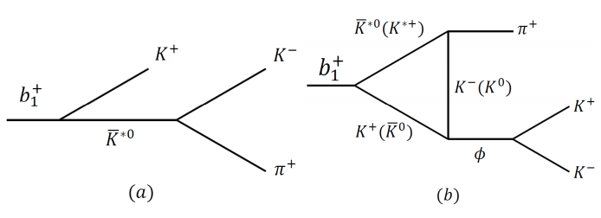
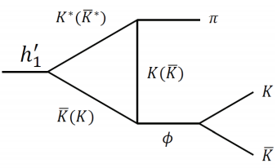
$$b_{1},h_{1}^{′}→φπ$$
OZI suppressed for $b_{1}→φπ$.
$B(1^{+ −})→VP$ is constrained by symmetry
$$L_{BVP}=g_{BVP}⟨B^{μ}\left\{V_{μ},P\right\}⟩$$
$g_{BVP}$ can be determined by $h_{1}→ρπ→3π$ ($α_{h}$ dep.) and $b_{1}→ωπ$ (S-wave, $α_{h}$ indep.).
$J/ψ→πK^{∗}\overline{K}+c.c. →φππ$ and $J/ψ→ηK^{∗}\overline{K}→ηφπ$ are studied in Ref. [1].
[1] H. J. Jing, F. K. Guo, B. S. Zou, PRD 100,114010(2019)
G parity is violated for $h_{1}(h_{1}^{′})→φπ$
The branching ratios of $J/ψ→π^{−}b_{1}^{+}+c.c. →φπ^{+}π^{−}$ and $J/ψ→ηh_{1}^{′}→ηφπ$ can be calculated.

Slide 20
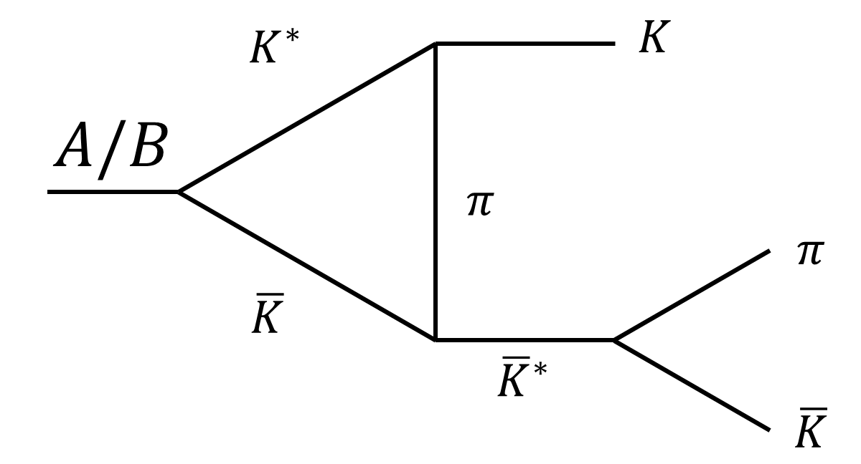
Loop integral for $B→VP$
P
$$M^{loop}∼ε_{μ}I^{μα}∗\frac{\left(−g_{αβ}+\frac{p_{cα}p_{cβ}}{p_{c}^{2}}\right)}{p_{c}^{2}−m_{φ}^{2}+im_{φ}Γ_{φ}}{\left(p_{a}−p_{d}\right)}_{β}$$
B
V
$$I^{μα}=\int{\frac{d^{4}q}{{\left(2π\right)}^{4}}∗\frac{\left(−g^{μν}+\frac{q^{μ}q^{ν}}{q^{2}}\right){\left(q−2p_{b}\right)}_{ν}{\left(p_{c}+2p_{b}−2q\right)}_{α}F(q^{2})}{\left(q^{2}−m_{1}^{2}+im_{1}Γ_{1}\right)\left[{\left(q−p_{b}\right)}^{2}−m_{2}^{2}\right]\left[{\left(p_{0}−q\right)}^{2}−m_{3}^{2}\right]}}$$
The same loop contributes to the vertex correction of $A/B→K^{∗}\overline{K}+c.c.$
In NR limit
Num.$∼4p_{b}^{μ}p_{b}^{α}−4p_{b}^{μ}q^{α}−2q^{α}p_{b}^{α}+2q^{μ}q^{α}$
Vertex correction to $A/B→K^{∗}\overline{K}+c.c.$ is weak due to insufficient phases space

Slide 21
Numerical Results

Slide 22
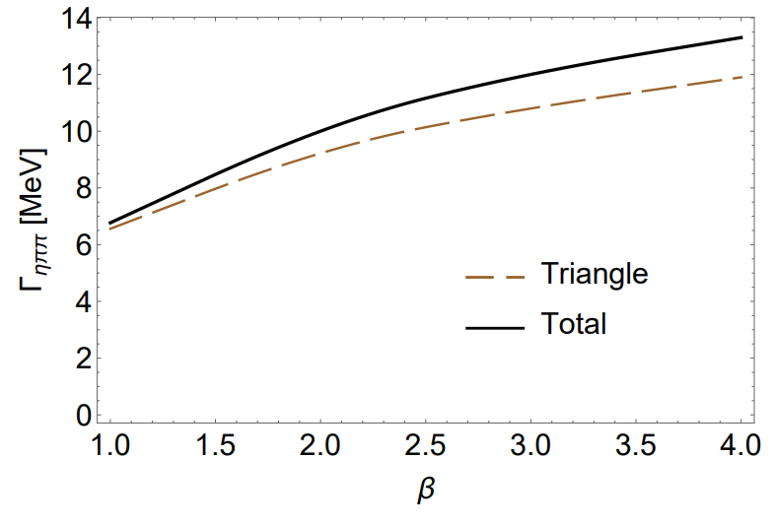
Partial widths of $f_{1}$ and $f_{1}^{′}$
Channels | $$f_{1}(1285)$$ | $$f_{1}(1420)$$
$a_{0}π→ηππ$ tree | $$7.5±1.7$$ | $$\left(1.7±0.4\right)×{10}^{−1}$$
$a_{0}π→ηππ$ tri. | $$\left(2.0±0.6\right)×{10}^{−1}$$ | $$9.2±3.0$$
$a_{0}π→ηππ$ total | $$9.7±2.4 (8.6±1.3)$$ | $$10±3.5$$
$a_{0}π→K\overline{K}π$ tree | $$\left(3.7±0.4\right)×{10}^{−1}$$ | $$\left(1.7±0.2\right)×{10}^{−2}$$
$a_{0}π→K\overline{K}π$ tri. | $$\left(2.4±0.5\right)×{10}^{−2}$$ | $$1.2±0.2$$
$a_{0}π→K\overline{K}π$ total | $$\left(5.0±0.5\right)×{10}^{−1}$$ | $$1.0±0.1$$
$$K^{∗}\overline{K}→K\overline{K}π$$ | $$\left(3.0±0.1\right)×{10}^{−1}$$ | $$49±1$$
$K\overline{K}π$ total | $$1.5±0.2(2.1±0.2)$$ | $$52±3$$
$f_{0}π→3π$ mixing | $$\left(3.6±1.2\right)×{10}^{−3}$$ | $$\left(9.0±2.9\right)×{10}^{−5}$$
$f_{0}π→3π$ tri. | $$\left(1.0±0.1\right)×{10}^{−3}$$ | $$\left(1.1±0.1\right)×{10}^{−1}$$
$f_{0}π→3π$ mixing via tri. | $$\left(1.4±0.4\right)×{10}^{−4}$$ | $$\left(8.0±2.6\right)×{10}^{−3}$$
$f_{0}π→3π$ total | $$\left(1.0±0.3\right)×{10}^{−2}$$ | $$\left(1.6±0.3\right)×{10}^{−1}$$
Couplings | Value
$$g_{f_{0}K^{+}K^{−}}$$ | $5.96±0.13$ GeV
$$g_{f_{0}π^{+}π^{−}}$$ | $2.96±0.12$ GeV
$$g_{a_{0}K^{+}K^{−}}$$ | $2.24±0.11$ GeV
$$g_{a_{0}ηπ}$$ | $3.02±0.35$ GeV
$$g_{AVP}$$ | $2.04$ GeV
$$g_{f_{1}a_{0}π}$$ | $$2.93$$
$$g_{f_{1}^{′}a_{0}π}$$ | $$0.282$$
$$g_{f_{1}K^{∗}\overline{K}}$$ | $1.24$ GeV
$$g_{f_{1}^{′}K^{∗}\overline{K}}$$ | $2.17$ GeV
$$g_{a_{1}K^{∗}\overline{K}}$$ | $2.04$ GeV
$$g_{a_{1}f_{0}π}$$ | $$2.93$$
Tab.1 Partial width in MeV, at $g_{AVP}=2.0$4 GeV , $β=2$. Only the uncertainties of $g_{VPP}$ and $g_{SPP}$ couplings are considered. The PDG averaged value are in round brackets.
Tab.2 Coupling constants in $1^{++}$ sector, where the $SPP$ couplings are adopted from Ref. [1,2].
Couplings | Value
$$g_{BVP}$$ | $3.03$ GeV
$$g_{h_{1}ρπ}$$ | $4.28$ GeV
$$g_{h_{1}^{′}ρπ}$$ | $0.13$ GeV
$$g_{h_{1}^{′}K^{∗}\overline{K}}$$ | $3.09$ GeV
$$g_{b_{1}K^{∗}\overline{K}}$$ | $3.03$ GeV
$$g_{b_{1}ωπ}$$ | $4.28$ GeV
$$g_{ψBP}$$ | $4.35×{10}^{−3}$ GeV
Tab.3 Coupling constants in $1^{+ −}$ sector
Fig.2 $β$ dependence of $Γ(f_{1}^{′}→a_{0}π→ηππ)$
[1] A.Aloisio et al. [KLOE], PLB537,21 (2002);
[2] A.Aloisio et al. [KLOE], PLB536,209(2002)

Slide 23
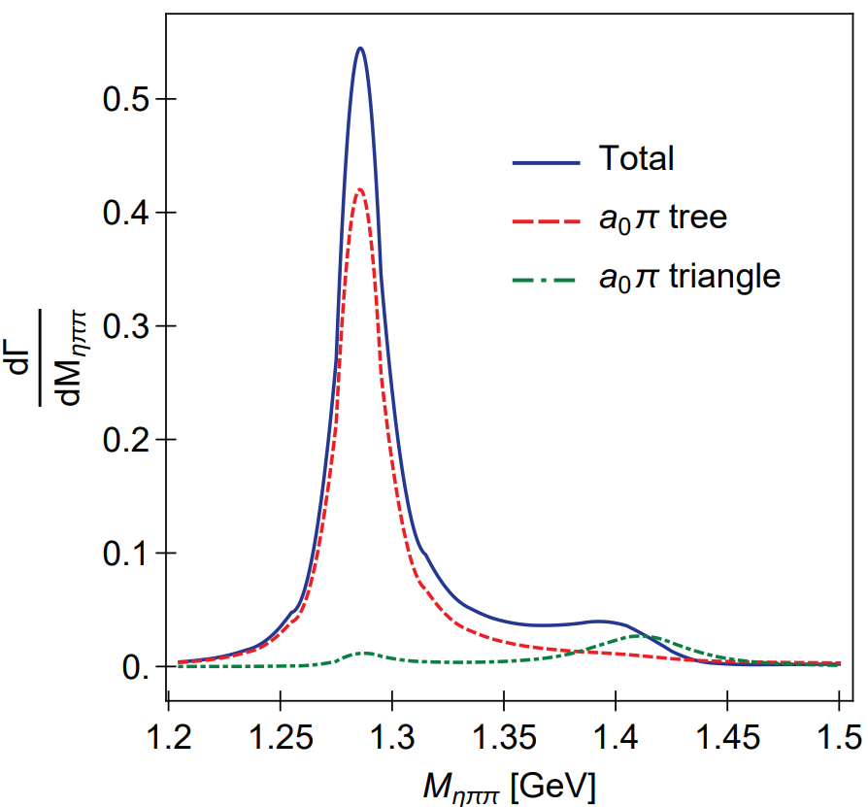
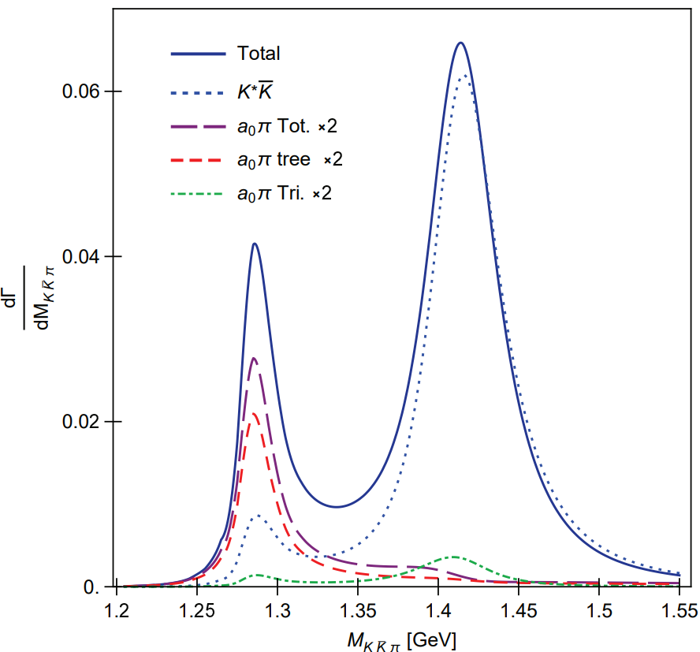
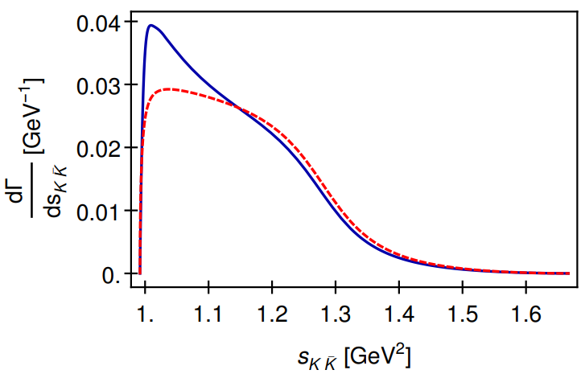
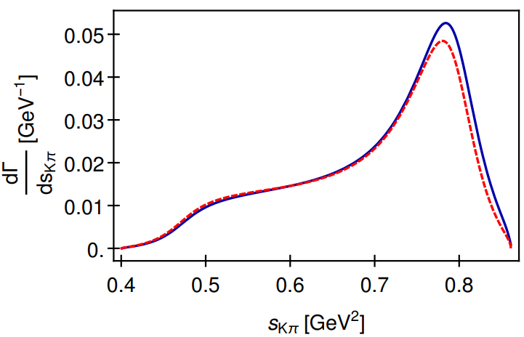
Spectra in $J/ψ$ decay
Fig.3 $ηππ$ (left) and $K\overline{K}π$ spectra of $J/ψ→γ\left(f_{1}+f_{1}^{′}\right)→γηππ,γK\overline{K}π$.
Fig.4 $K\overline{K}$ (left) and $Kπ$ (right) spectra of $f_{1}^{′}→K\overline{K}π$

Slide 24
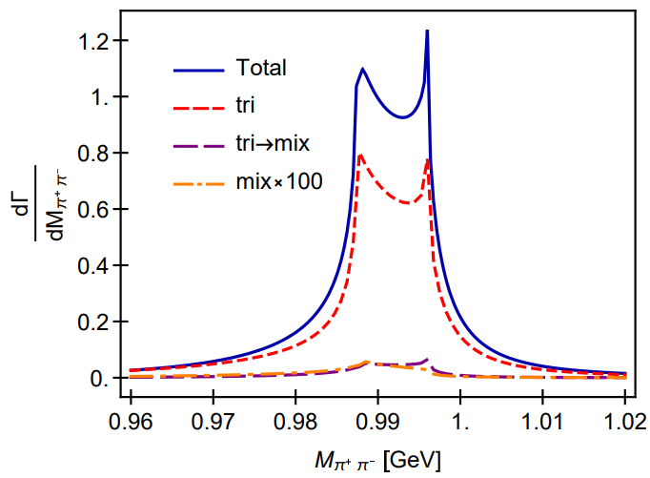
$$f_{1}(f_{1}^{′})→3π$$
$$R_{f_{1}→3π}^{total}=\frac{B.R.(f_{1}→f_{0}π→π^{+}π^{−}π^{0})}{B.R.(f_{1}→a_{0}π→ηπ^{0}π^{0})}∼0.3\%$$
$$R_{f_{1}→3π}^{mix}=\frac{B.R.(f_{1}→f_{0}π→π^{+}π^{−}π^{0})}{B.R.(f_{1}→a_{0}π→ηπ^{0}π^{0})}∼0.1\%$$
Our result is consistent with BESIII measurement [1]
$$R_{χ_{c1}→3π}=\frac{B.R.(χ_{c1}→a_{0}π→f_{0}π→π^{+}π^{−}π^{0})}{B.R.\left(χ_{c1}→a_{0}π→ηπ^{0}π^{0}\right)}$$
$$=\left(0.31±0.16\left(stat.\right)±0.14\left(sys.\right)±0.03\left(para.\right)\right)\%$$
The large isospin violation from Ref.[2] requires
$$R_{f_{1}→3π}=\frac{B.R.(f_{1}→π^{+}π^{−}π^{0})}{B.R.(f_{1}→a_{0}π→ηπ^{0}π^{0})}=\left(2.5±0.9\right)\%$$
Fig.5 $π^{+}π^{−}$ spectrum in $f_{1}^{′}→π^{+}π^{−}π^{0}$.
$R_{f_{1}^{′}→3π}=\frac{B.R.(f_{1}^{′}→f_{0}π→π^{+}π^{−}π^{0})}{B.R.(f_{1}^{′}→a_{0}π→ηπ^{0}π^{0})}∼5\%$.
Single specific mechanism ($a_{0}−f_{0}$ mixing, $κ\overline{K}$, $K^{∗}\overline{K}$ rescattering) cannot explain the large isospin violation of $f_{1}$ [3].
[1] M. Ablikim et al., PRD 83, 032003 (2011). [2] V. Dorofeev et al., EPJ A47,68(2011)
[3] N.N. Achasov, G.N.Shestakov, Nucl.Part.Phys.Proc.287,89(2017)

Slide 25
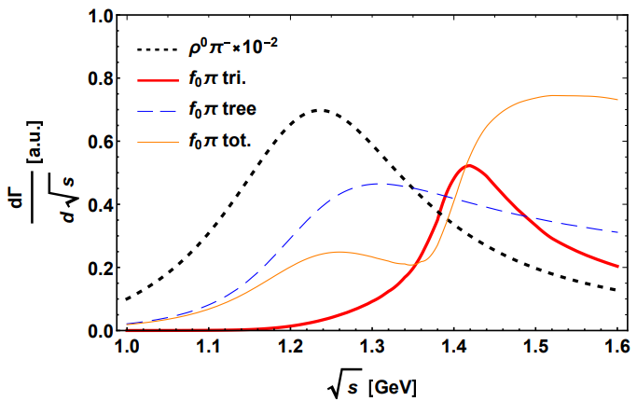
$$a_{1}→3π$$
Fig.6 $a_{1}$ spectrum of $χ_{c1}→πa_{1}$
$χ_{c1}→πa_{1}→4π$ can be factorized for the large momentum of the pion recoiling against $a_{1}$. The intensity and width of $a_{1}→f_{0}π$ through triangle mechanism are consistent with Ref. [1][2]
$$\frac{a_{1}→f_{0}π}{a_{1}→ρπ}≃0.6\%$$
$Γ≃150$ MeV
[1] M. Mikhasenko, B. Ketzer and A. Sarantsev, PRD 91,094015 (2015)
[2] F. Aceti, L.R.Dai and E. Oset, PRD 94,096015(2016)

Slide 26
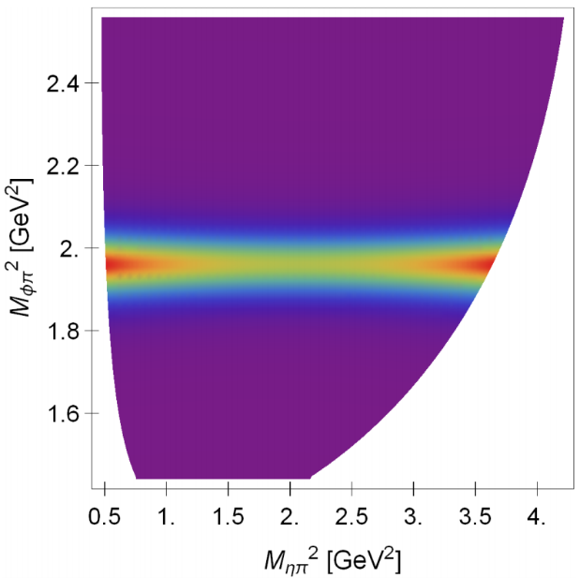
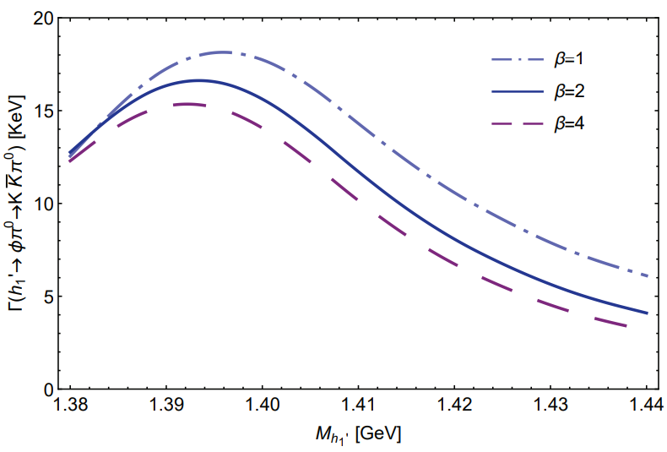
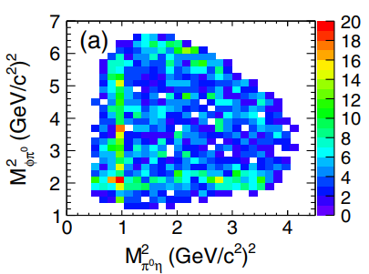
$$h_{1}^{′}→φπ$$
$$B.R.\left(J/ψ→h_{1}^{′}η→ηφπ\right)=6.3×{10}^{−8}$$
Fig.8 Dalitz plot of $J/ψ→ηh_{1}^{′}→ηφπ$ with the resonance of $h_{1}^{′}$
Fig.7 Partial width of $h_{1}^{′}→φπ^{0}→K\overline{K}π^{0}$ in unit of KeV
[1] M. Ablikim, et al. PRL,121,022001(2018)
[2] H. J. Jing, F. K. Guo, B. S. Zou, PRD 100,114010(2019)
Fig.9 Dalitz plot of $J/ψ→ηφπ$ from Ref.[1]

Slide 27
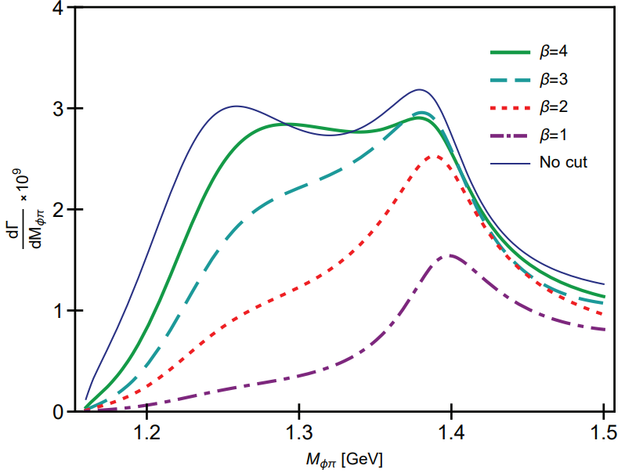
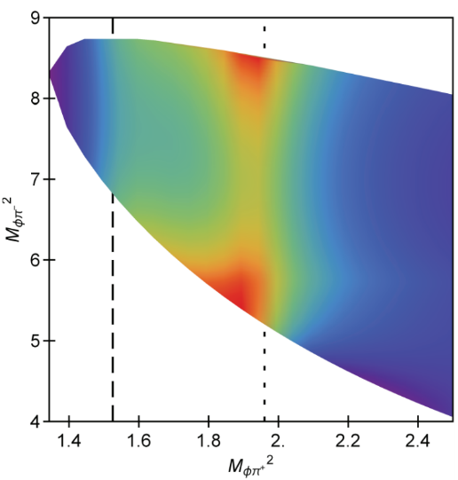
$$b_{1}→φπ$$
$$\sqrt{s}=m_{b_{1}}$$
$\sqrt{s}=1.4$ GeV
Fig.10 $K^{+}K^{−}$ spectra of $b_{1}^{+}→K^{+}K^{−}π^{+}$ evaluated at $\sqrt{s}=m_{b_{1}}$ (left) and $\sqrt{s}=1.4$ GeV (right). The $φπ^{+}$ signal is produced by OZI evading triangle mechanism.
On-shell branching ratio (at $β=2$)
$$\frac{B.R.(b_{1}^{+}→φπ^{+}→K\overline{K}π^{+})}{B.R.\left(b_{1}^{+}→ωπ^{+}\right)(S−wave)}=1.8×{10}^{−4}$$
Estimation without TS:
$$B.R.^{est.}\left(J/ψ→π^{±}b_{1}^{∓}→φπ^{+}π^{−}\right)≃1×{10}^{−6}$$
Actual branching ratio:
$$B.R.\left(J/ψ→π^{±}b_{1}^{∓}→φπ^{+}π^{−}\right)≃1×{10}^{−5}$$
Fig.11 $φπ^{+}$ spectrum (left) and the Dalitz plot (right) of $J/ψ→π^{±}b_{1}^{∓}→φπ^{+}π^{−}$

Slide 28
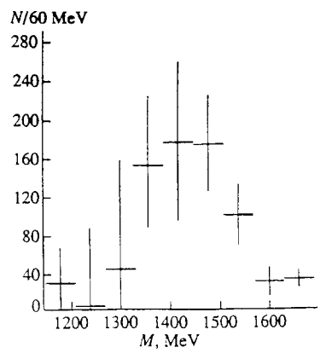
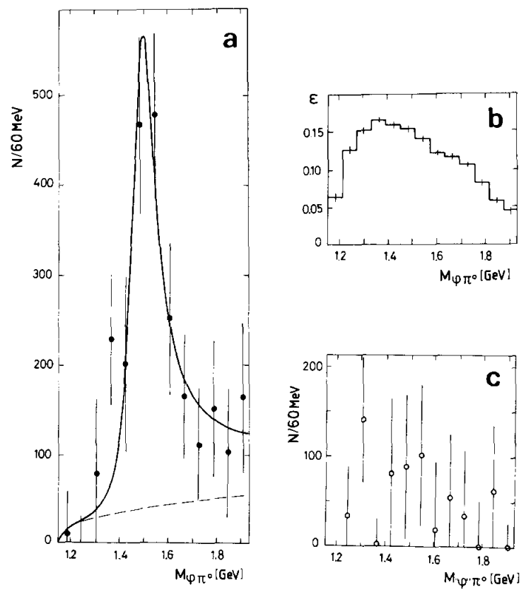
$$b_{1}→φπ$$
Fig.13 Effective mass spectrum of the $φπ^{0}$ system in the reaction $π^{−}p→φπ^{0}n$ (the results are weighted with detector efficiency) [2,3]. The “anti-OPE” selection $\left|t^{′}\right|>0.1 {GeV}^{2}$ is applied, which affects only slightly the efficiency for $π^{−}p→b_{1}n$ (not proceeding via OPE exchange), but which reduces the background from the OPE-mediated reaction $π^{−}p→C\left(1480\right)n$ by a factor of 5 [2,3].
Fig.12 (a) The acceptance-corrected $φπ^{0}$ mass spectrum in $π^{−}p→φπ^{0}n$. (b) The acceptance of the Lepton-F spectrometer for $φπ^{0}$ events. (c) The false “$φ$”$π^{0}$ mass spectrum [1].
“C(1480)” is reported with $I=1$ $J^{PC}=1^{−−}$, by OPE.
$M=1480±40$ MeV, $Γ=130±60$ MeV [1]
[1] Bityukov S.I. et al. Phys. Lett. B 118,383 (1987)
[2] V. A. Viktorov et al. Phys. Atom. Nucl. 59,1184 (1996)
[3] S.V. Golovkin et al. Z. Phys. A 359,435 (1997)

Slide 29
Conclusions

Slide 30
Thank you for your attention
Conclusion
Our combined study taken into account the TSM is consistent with taking the axial vector mesons as quark model states
Particularly, in our study, only TSM of $f_{1}(1285)$ cannot account for $f_{1}(1420)$, but the TSM of $a_{1}(1260)$ can produce $a_{1}\left(1420\right)$.
TSM produces non-trivial features in the spectra of $J/ψ→γ\left(f_{1}+f_{1}^{′}\right)→γηππ$ and $γK\overline{K}π$, in both the three-body and the two-body distributions.
TSM also plays a role in $C=−1$ sector, i.e. $b_{1}$ and $h_{1}$, where we predicted the branching ratio of OZI suppressed $J/ψ→b_{1}π→φππ$ and Isospin violated $J/ψ→h_{1}\left(1425\right)η→φπη$ induced by TSM.

